Slide 2
LIU – related 2015 Injectors MDs
- draft list -
S. Gilardoni
Contributions from:
H. Bartosik, G. Bellodi E. Benedetto, M. Bodendorfer, V. Forte,
A. Huschauer, G. Iadarola, Y. Papaphilippou G. Rumolo, G. Sterbini, R. Wasef

Slide 3
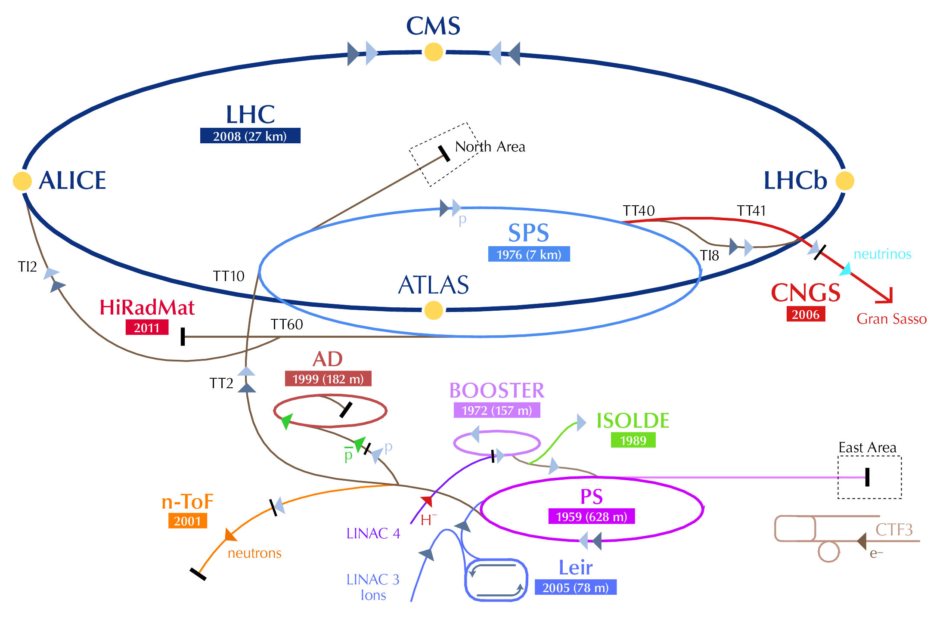
LHC p-beam production
Present
LIU (2019)
Proton flux / Beam power
50 MeV
Linac2
Linac4
160 MeV
1.4 GeV
PSB
2.0 GeV
PSB
26 GeV
Output energy
PS
PS
450 GeV
SPS
LHC /
HL-LHC
7 TeV
Transverse emittance produced in the PSB by the multi-turn Linac injection
Longitudinal bunch spacing (25-50 ns) produced in PS as trains (batch) structure
Final adjustments of beam properties done in the SPS:
  Scraping of the beam tails
  Adjustment of the bunch length

Slide 4
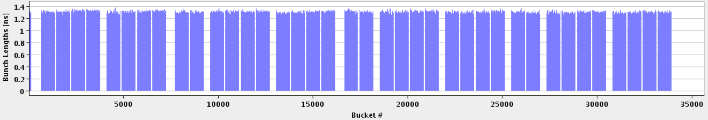
LHC and Injectors – 50 ns
1 PS batch
(36 bunches)
1 SPS batch
(144 bunches)
Abort gap
2012-2013 LHC - 26.7 km - 1380 bunches – 50 ns
To LHC
= Field in main magnets
450 GeV
= Proton beam intensity (current)
= Beam transfer
SPS
26 GeV
PS
1.4 GeV
PSB
1.2 seconds
Time

Slide 5
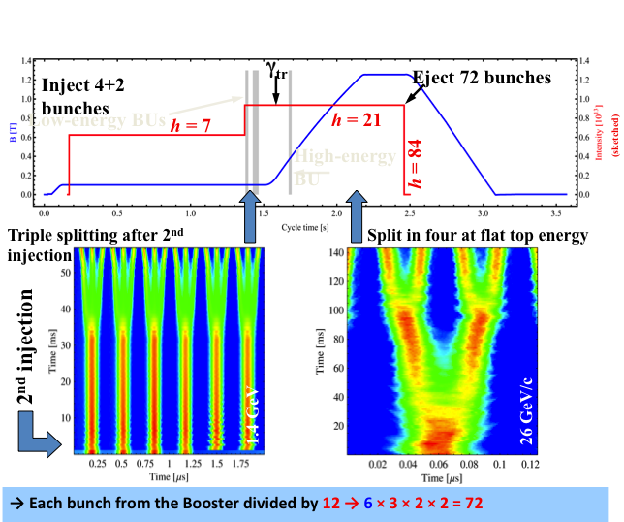
LHC25(50)ns Production Scheme as today
Production scheme:
a) Double batch injection from PSB (4 + 2 bunches, 6 bunches for PS at h=7)
b) Up to 4 batches of 72 bunches each transferred to the SPS (288 bunches)
Transverse emittance produced in the PSB, longitudinal in the PS
Multiturn proton injection in PSB
RF gymnastics in PS:
  Triple splitting
  Acceleration
  2 x Double splittings
    (1 Double splitting for 50 ns)
  Bunch rotation
3 RF systems in PSB
5 RF systems in PS
2 RF systems in SPS

Slide 6
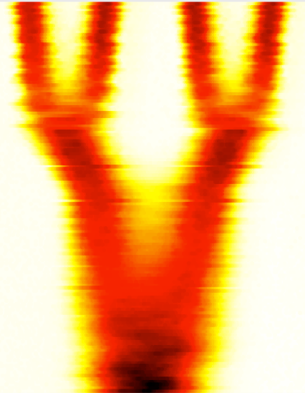
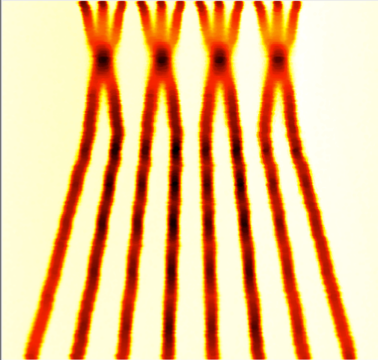
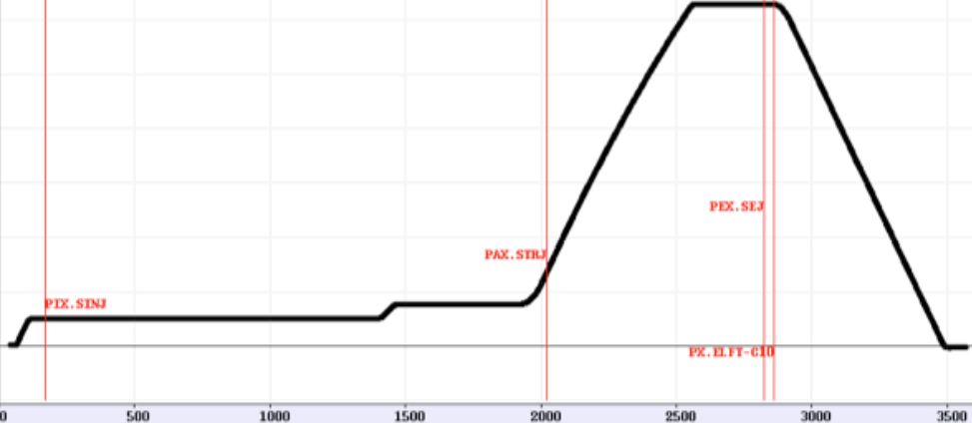
LHC 25(50)ns alternative Production (BCMS)
Production scheme:
a) Double batch injection from PSB (4 + 4 bunches, 8 bunches for PS at h=9)
b) Up to 5 batches of 48 bunches each transferred to the SPS (240 bunches)
Transverse emittance produced in the PSB, longitudinal in the PS
- Multiturn proton injection in PSB with shaving
RF gymnastics in PS:
  Batch compression
  Bunch merging
  Triple splitting
Acceleration
2 x Double splittings
  (1 Double splitting for 50 ns)
Bunch rotation
BCMS “Batch Compression, Merging and Splitting in PS”
h = 9 →10 → 11→12 → 13 → 14 → 7 → 21
h = 21 → 42 → 84
4 bunches
+4 bunches
h = 9
h = 21

Slide 7
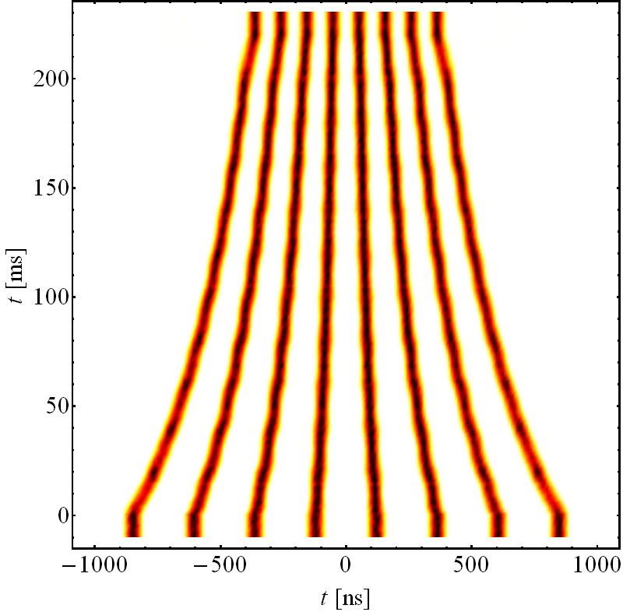
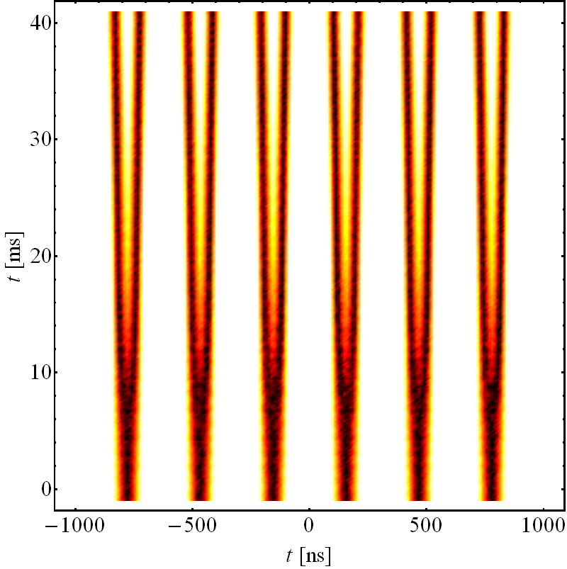
Catalogue of Possible production schemes - 25 ns
Schemes 25 ns | PSB – PS bunches | RF gym. in PS | RF gym. at injection | RF gym. at extraction | b/Train to SPS | SPS injections
3-spitting (standard scheme) | 4 + 2 | /3 ↗ /2 /2 |  |  | 72 | 4
BCMS | 4 + 4 | +2C/3↗/2 /2
 |  |  |  |  | 48 | 5
BCS | 4 + 4 | C ↗ /2 /2
 |  |  |  |  | 32 | 5
8b+4e | 4 + 2 | /2 ↗ /2 /2
 |  |  |  |  | 48 | 5
/ Splitting C Batch Compression + Merging ↗Acceleration to 26 GeV/c

Slide 8
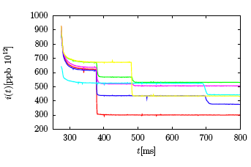
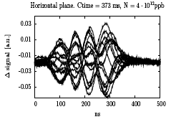
PSB intensity limitations
Space charge
β
Extraction@805
Transverse instabilities
(if damper not active)
Injection@275
N_{b} (x 10¹⁰ ppb)
Losses during injection process:
  Conventional multi-turn injection (40-50% losses)
  Losses at injection septum and longitudinal capture
Space charge (losses, emittance blow up)
Instabilities along the cycle (efficiency of the transverse feedback)
Brightness from PSB limited for LHC beams but no issue with intensity

Slide 9
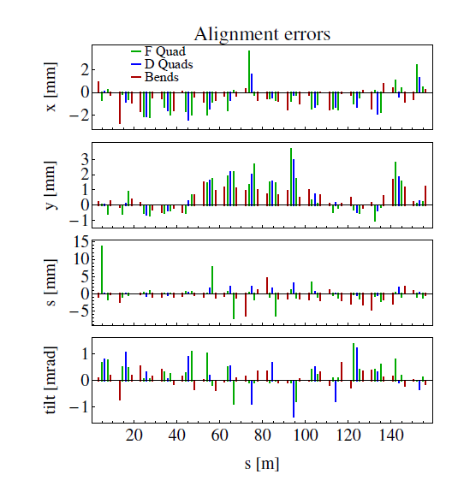
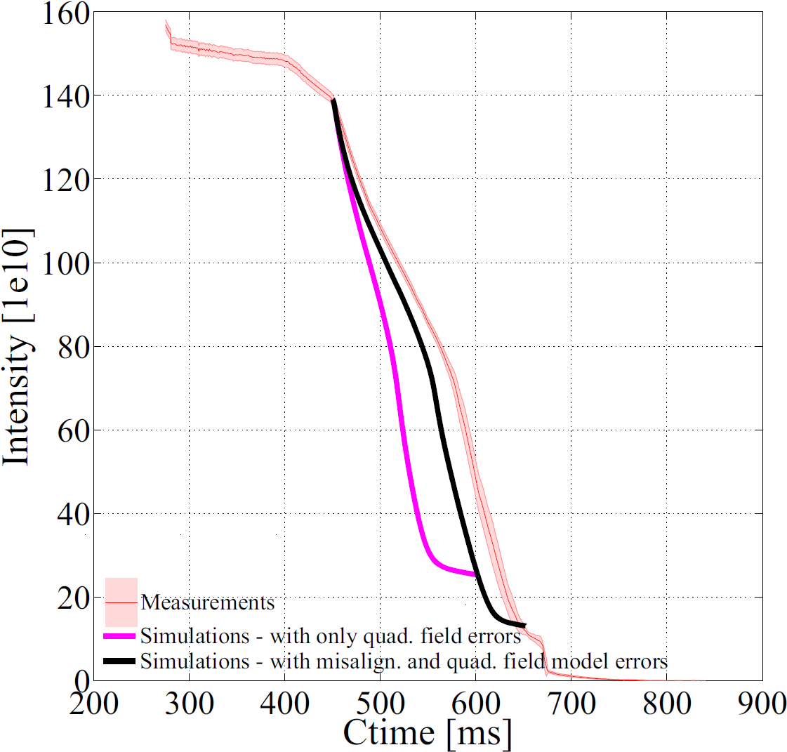
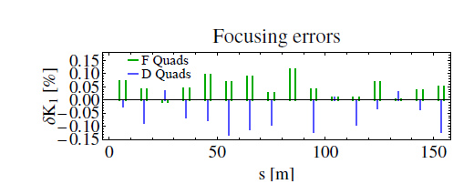
PSB R2 long term losses by space charge
Big effort to evaluate losses due to space charge (main bottleneck in the machine)
and resonance lines interactions (like the 2Qy=9 half-integer).
Optimization of the optics model through beam-based measurements.
Reference:
V. Forte et al., “CERN PS Booster Space Charge Simulations with
a Realistic Model for Alignment and Field Errors”, IPAC’14, Dresden, Germany, TUPRI029

Slide 10
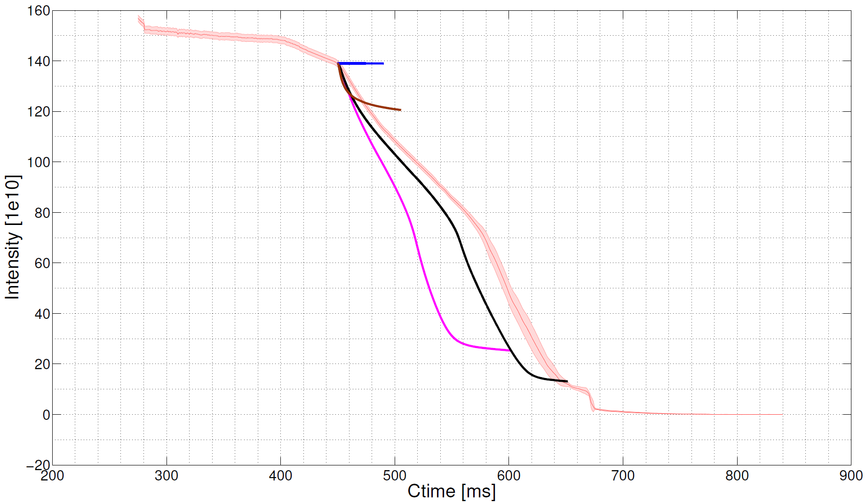
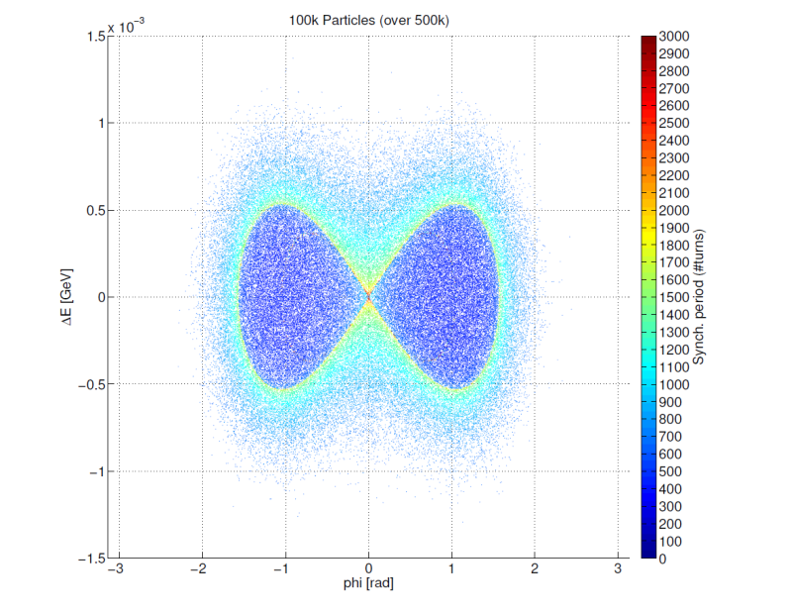


Simulations: losses behavior for long bunch
No errors – With s.c. (4.285, 4.517)
Quad field errors - No s.c. (4.285, 4.517)
Change of losses regime
Quad field errors - With s.c. (4.285, 4.517)
Quad field errors – Misalign. errors – With s.c. (4.284 4.513)
Very good agreement in shape and for initial-final value!
The complete model of the machine is FUNDAMENTAL !!
PSB Experiments, 6D Tune evolution with SC
Vincenzo Forte – Space charge meeting – CERN - 20/05/2014

Slide 11
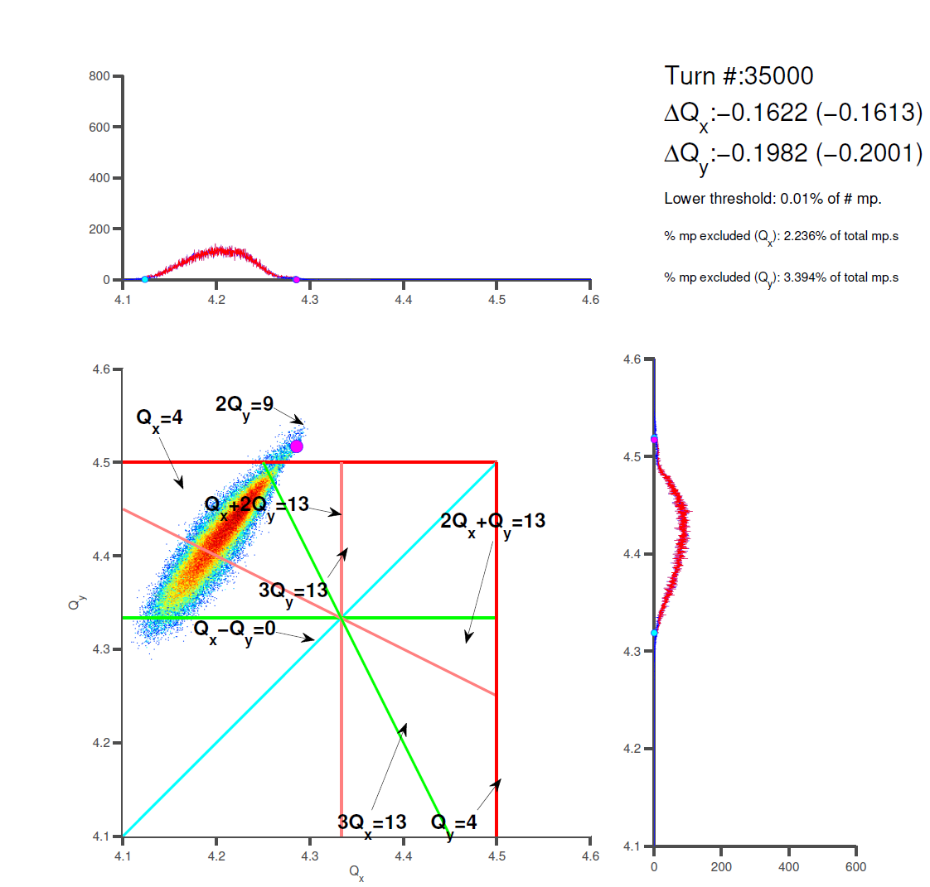
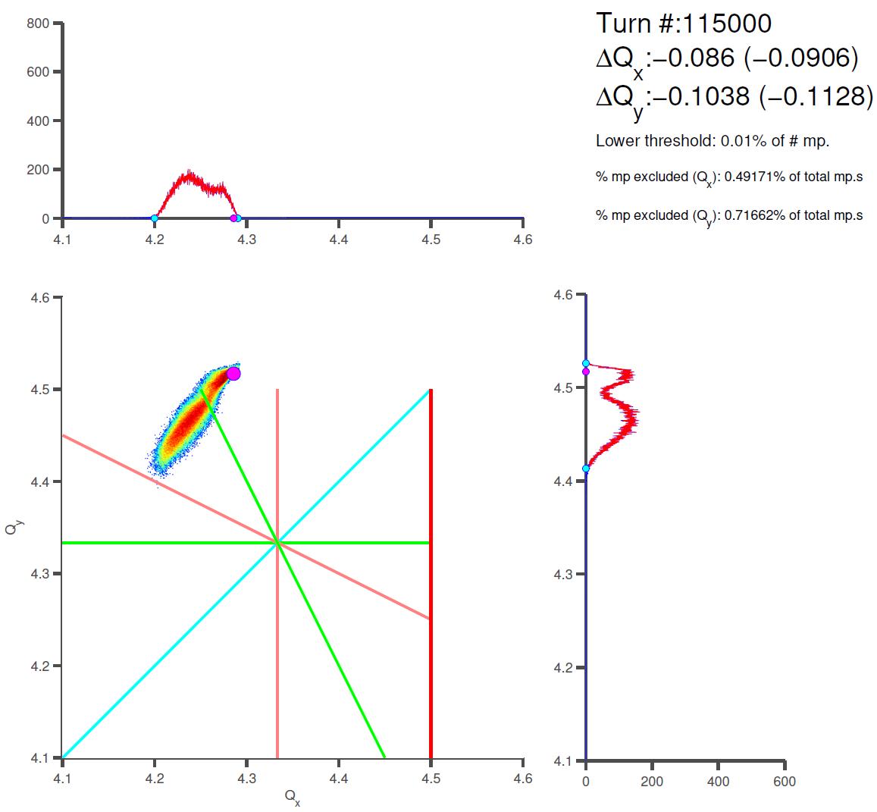
Tunes Simulations (with quad field errors)
C485 on the magenta curve
C565 on the magenta curve
There is a valley on the resonance…
Tunes computation (phase advance per turn)
PSB Experiments, 6D Tune evolution with SC
Vincenzo Forte – Space charge meeting – CERN - 20/05/2014

Slide 12
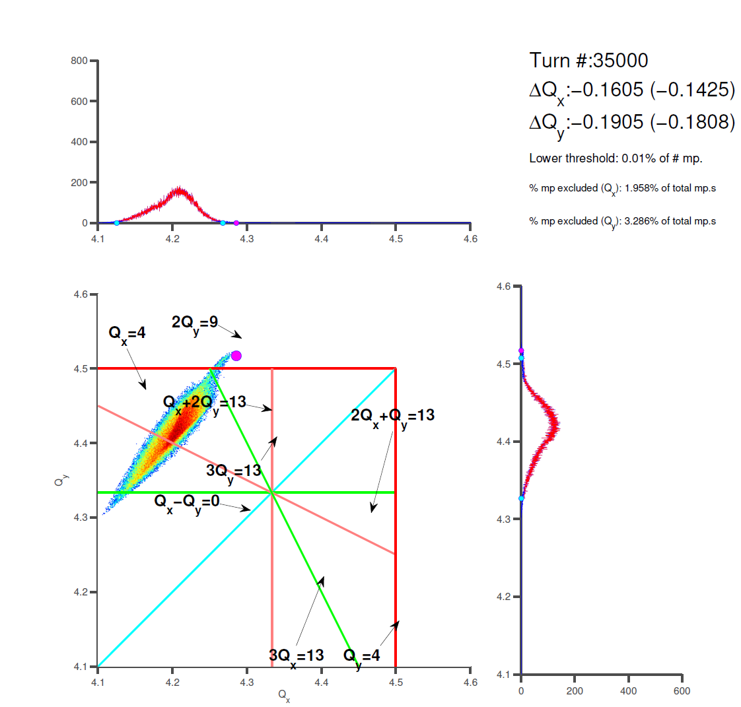
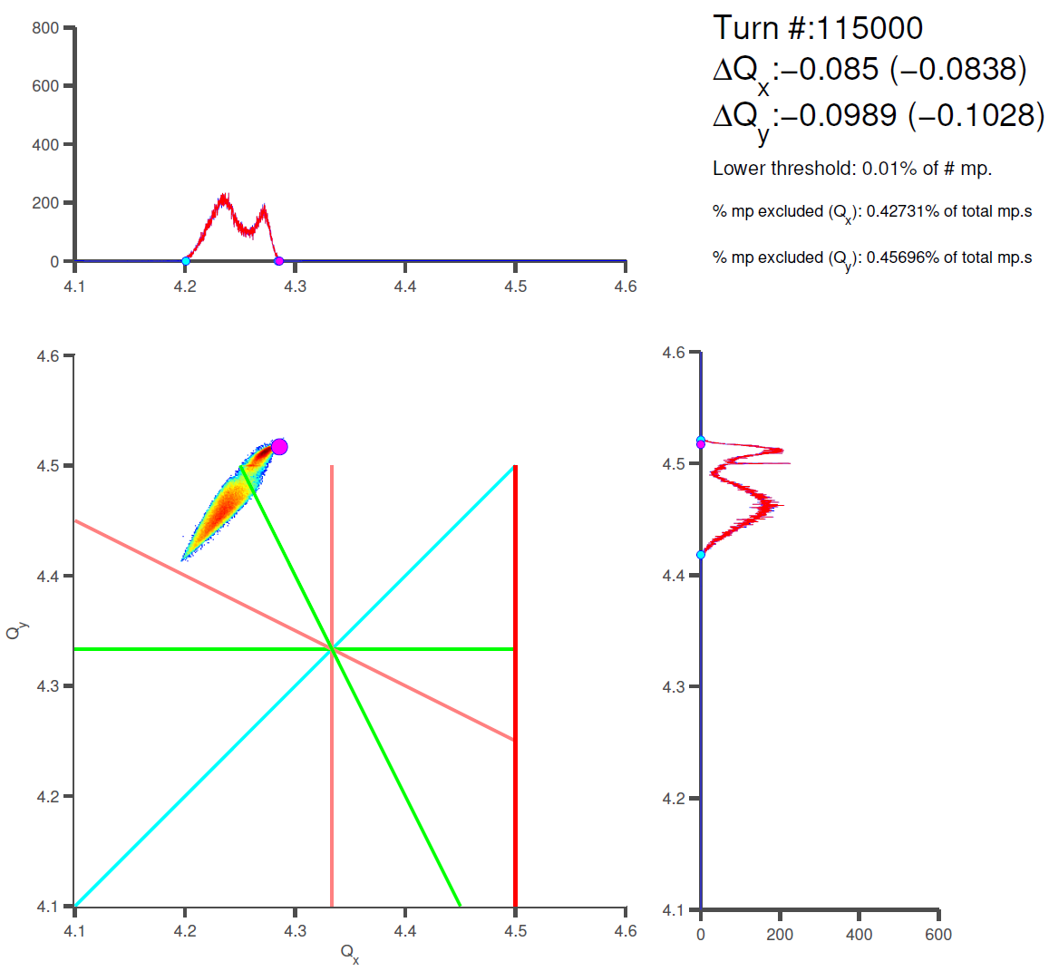
Tunes Simulations (with quad fields)
C485 on the magenta curve
C565 on the magenta curve
A peak comes out at the resonance location
Tunes (avg. over 1500 turns)
PSB Experiments, 6D Tune evolution with SC
Vincenzo Forte – Space charge meeting – CERN - 20/05/2014

Slide 13
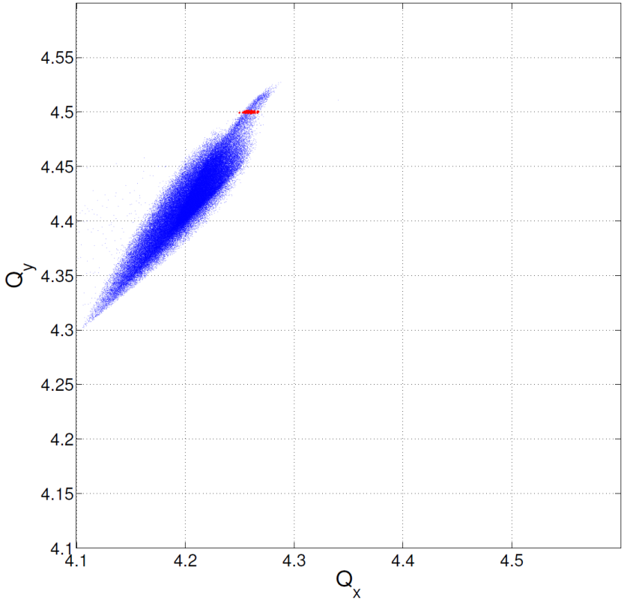
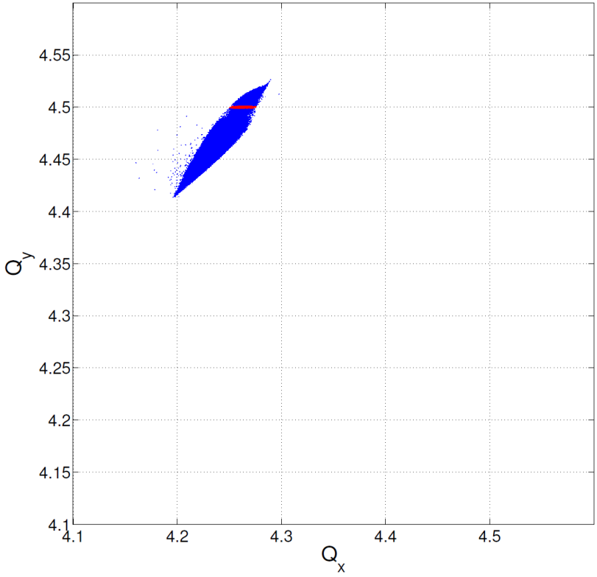
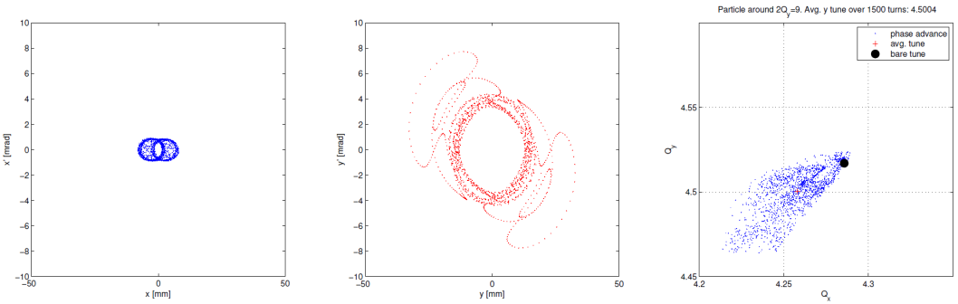
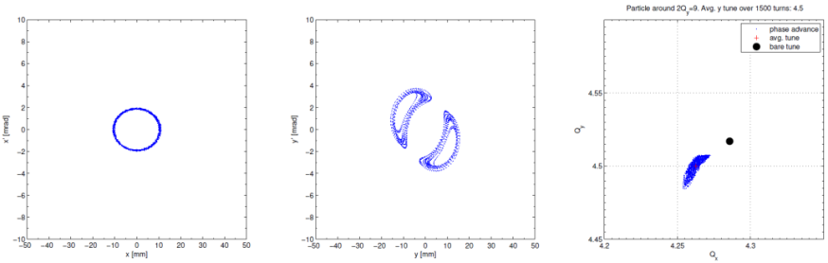
Tunes Simulations (with quad field errors)
C485 on the magenta curve
C565 on the magenta curve
Selecting particles inside Qy=4.5 +/− 0.001…
Particles with smaller spread sit on vertical transverse islands!
Red because it gets lost

Slide 14
PSB – full list
effects on the beam (blow-up /losses) of the large tune footprint from space-charge and chromaticity
losses identification along the cycle
impedance model
optics model -> turn-by-turn measurements with AC dipole excitation
  Strongly depending on new turn-by-turn system precision

Slide 15
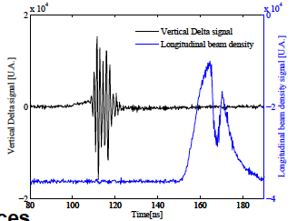
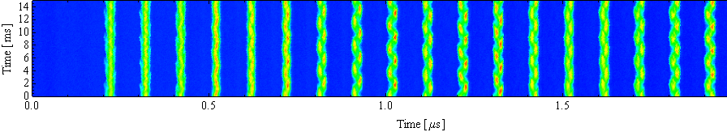
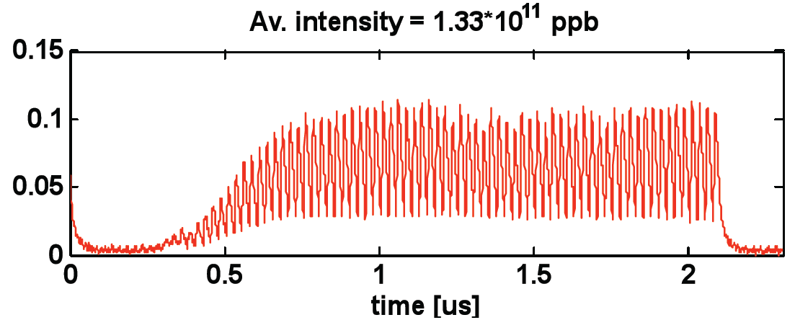
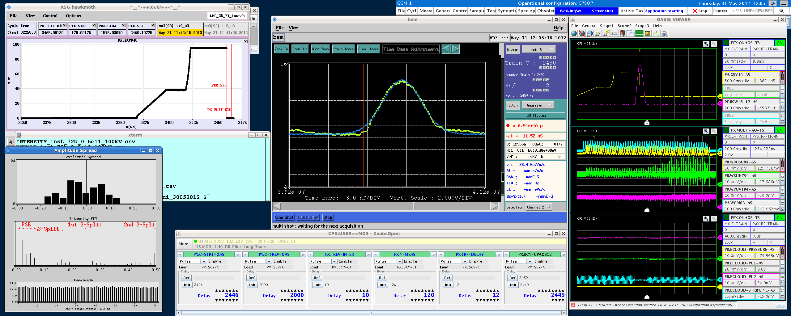
PS brightness limitations overview
Acceleration/Bunch splittings
Longitudinal CBI → New damper
Transient beam loading → 1 turn delay FB
Transition crossing → No limitation expected
Flat top:
Longitudinal CBI → New damper
Electron cloud → Transverse FB
Transverse instabilities → Transverse FB
Injection flat bottom:
Space charge → Injection @2GeV
Headtail instability → Transverse FB

Slide 16
PS brightness limitations overview
Acceleration/Bunch splittings
Longitudinal CBI → New damper
Transient beam loading → 1 turn delay FB
Transition crossing → No limitation expected
Flat top:
Longitudinal CBI → New damper
Electron cloud → Transverse FB
Transverse instabilities → Transverse FB
Maximum SC tune spread @injection
ΔQ_{y} = 0.31 → 2 GeV will allow for more brightness
Maximum intensity per bunch @extraction due to CBI
N_{b}= 2 x 10¹¹ ppb → 3 x 10¹¹ ppb with new feedback
Injection flat bottom:
Space charge → Injection @2GeV
Headtail instability → Transverse FB

Slide 17
PS MD – complete list (1/3)
Transverse Plane
RDT (Kick response measurements, LOCO, DC dipole)
New injection studies (injection elements precision)I
njection error with quadrupolar pickup
- Tune vs kick strenght at different dp/p for modelling chromo-geom. terms
- Compensation of integer with sextupoles/quadrupoles

Slide 18
Space-charge: current limitations
Halo particles
Core of the beam
The beam tune-spread is trapped between the 4Qy=25 and the integer.
If one increases the vertical tune to avoid emittance growth due to the integer, the beam loss increases because of the 4th order resonance
Choice of working point is a compromise between beam loss and emittance blow-up

Slide 19
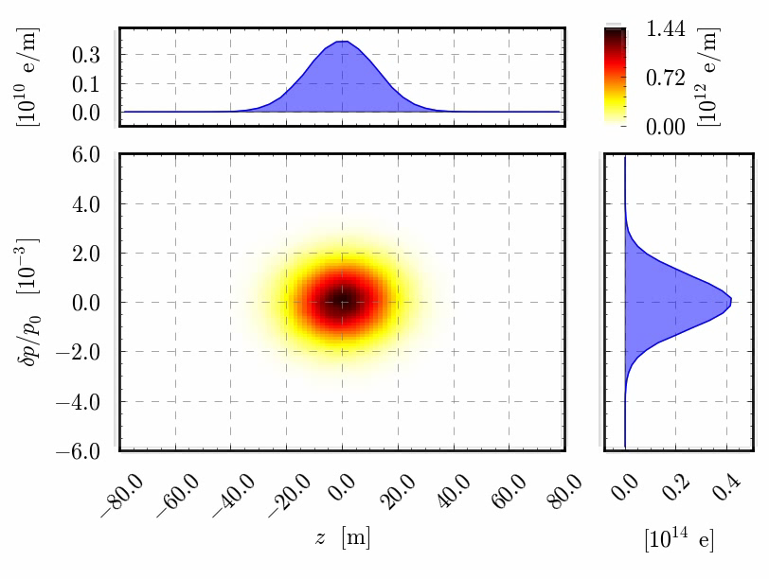
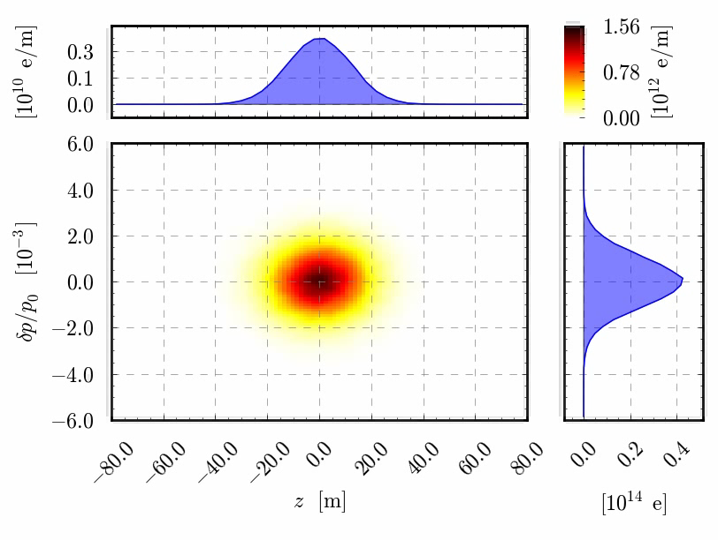
PS MD – complete list (2/4)
Space charge and emittance blow-up mitigation techniques
Integer resonance scan
Intrabunch oscillations
Special large H dispersion optics
Space charge with Quadrupolar PU
Hollow bunches
Fully coupled optics at injection
Different Interger tune or
tune split of one/two units

Slide 20
Fully coupled optics solution example
Regular optics
  Betas <23m, D_{x}<3.5m (rms , D_{y}=0m)
  (Q_{x},Q_{y}) = (6.31,6.28)
  Transition gamma = 6.17
  Chromaticities (uncorrected) = (-5.9, -7.7)
Distorted optics
  Betas <28m, D_{x}<6.5m, |D_{y}|<6.5m
  (Q_{x},Q_{y}) = (6.31,6.28)
  Transition gamma = 5.9
  Chromaticities (uncorrected) = (-8, -9.7)

Slide 21
Beta functions
Slight beta variation between regular and distorted optics
  RMS beta beating of 10%
  Beta functions at injection septum (SMH42) decreased by 7% (no injection bump included)

Slide 22
Dispersion functions in H-V plane
Important dispersion variation between regular and distorted optics
  RMS horizontal dispersion beating of 60%
  Horizontal dispersion at injection septum (SMH42) increased by 30% and vertical dispersion equal to -4.4m (no injection bump included)
  This needs further optimisation (local correction of optics at injection point)

Slide 23
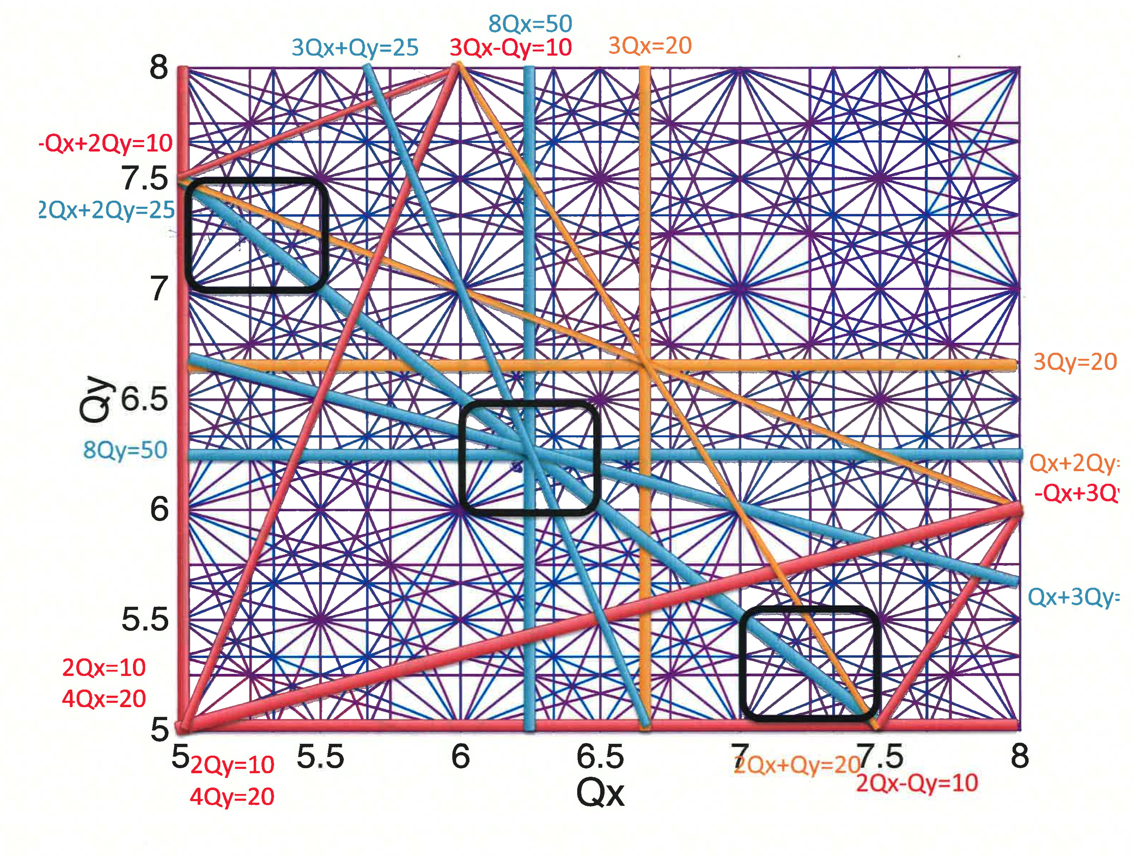
Resonances and space charge

Slide 24
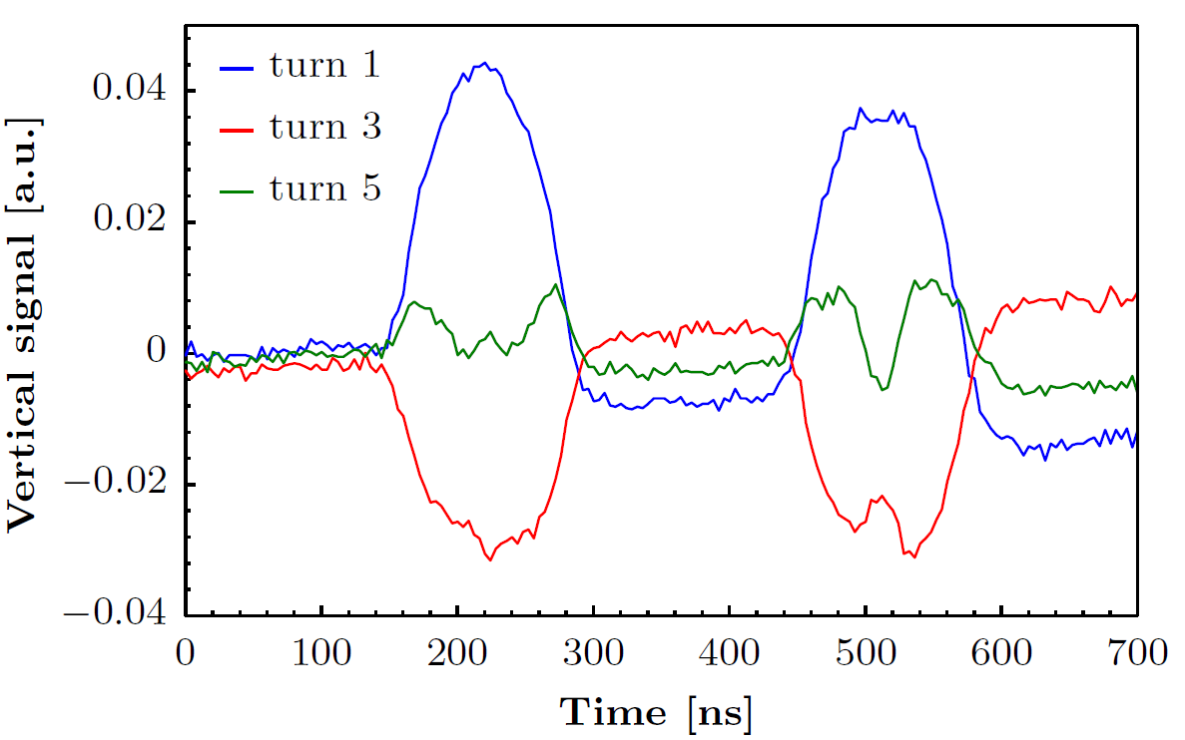
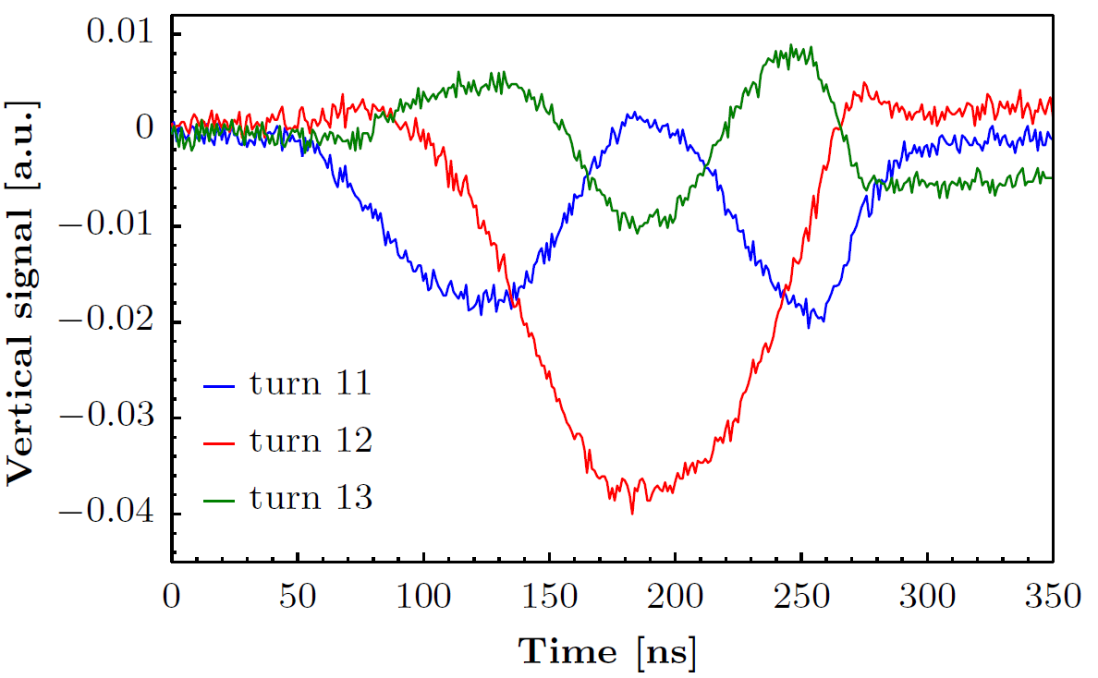
Injection oscillations at PS injection
PSB
Fast buildup of intra-bunch oscillations
(few turns after injection)
Oscillations primarily observed in vertical plane
  PSB recombination is in the vertical plane
Oscillations contribute to beam loss at injection
Visible each time the beam is injected
Effect due to image charges/currents (indirect space charge) associated to an injection error
PS
I_{p} = 375 ∙10¹⁰ ppb (Meas.)
I_{p} = 700 ∙10¹⁰ ppb (Meas.)
Simulations
CNGS
TOF

Slide 25
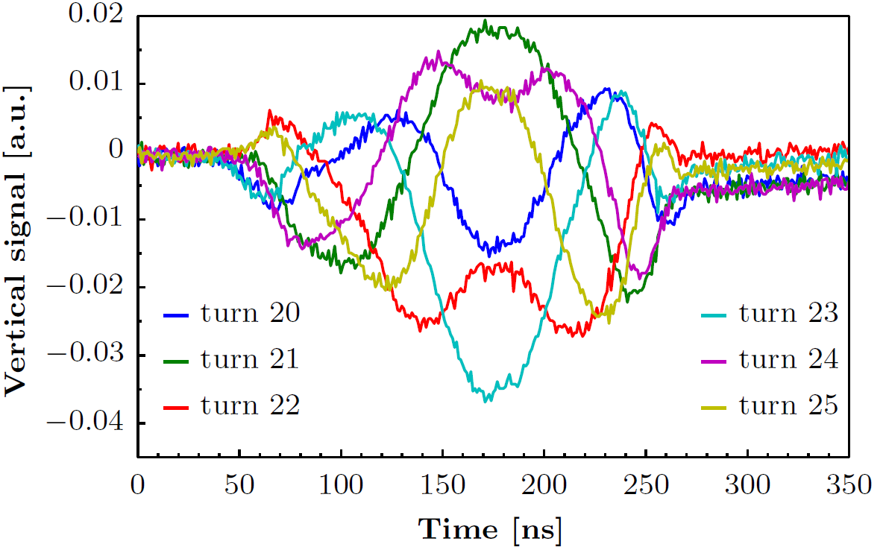
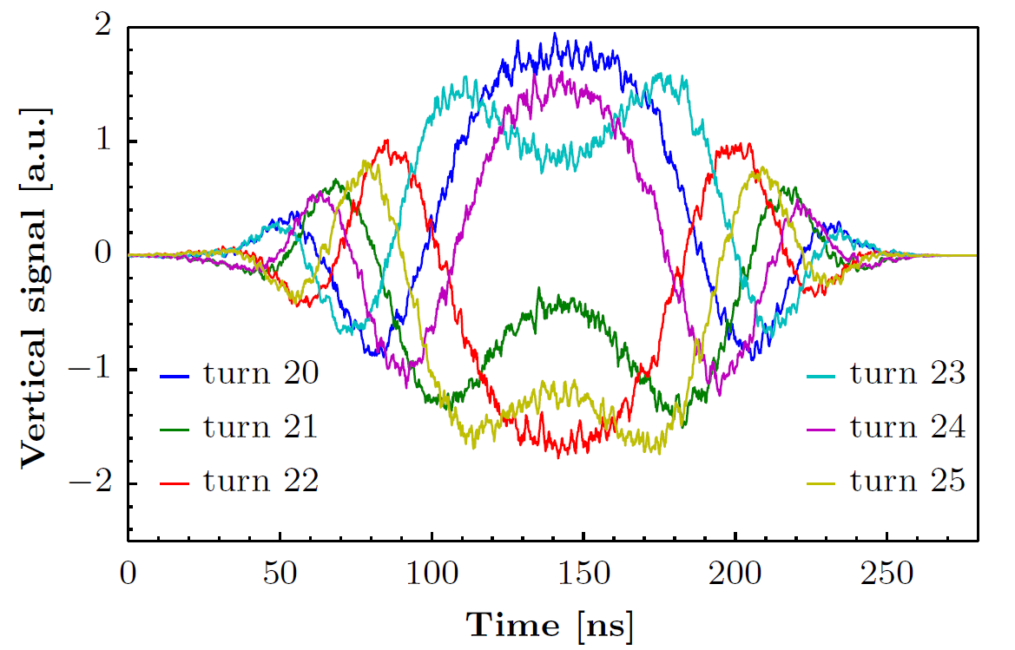
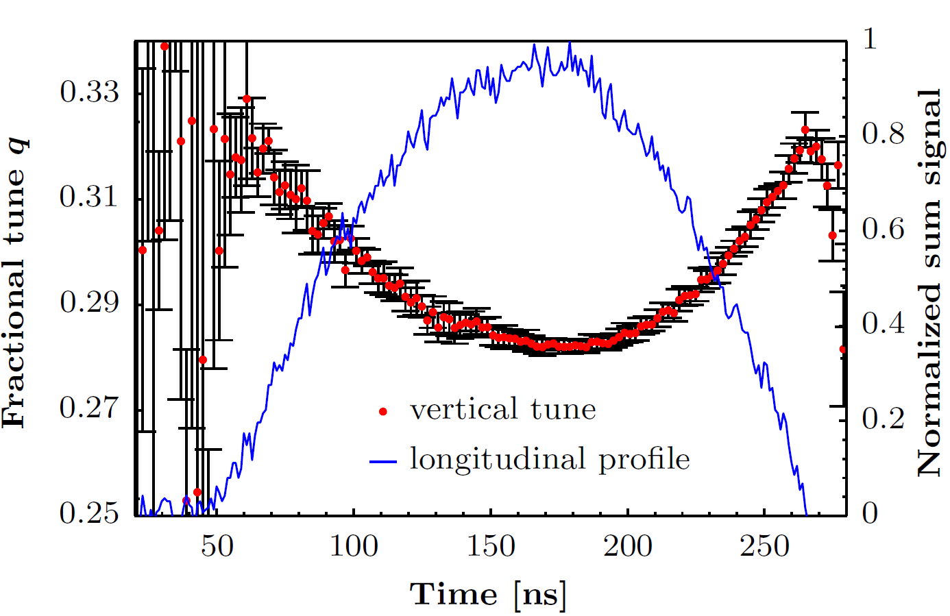
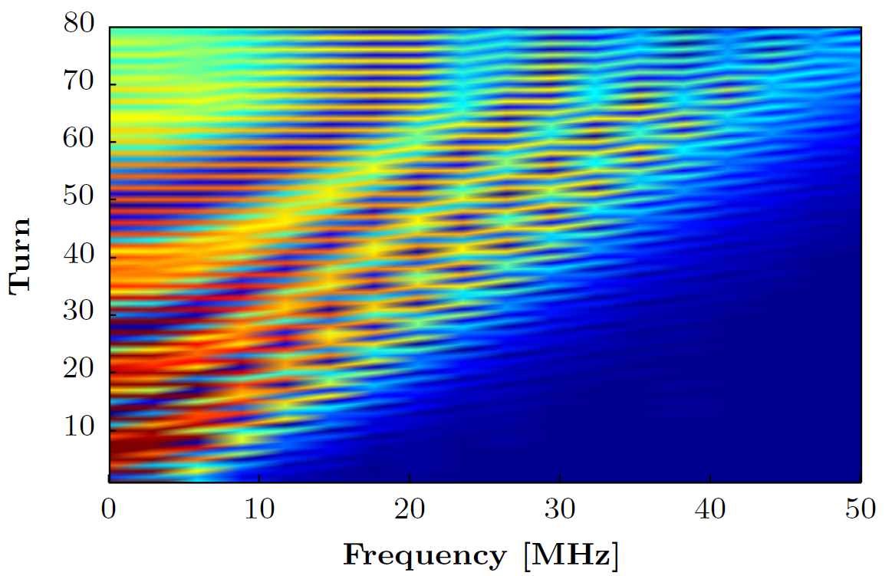
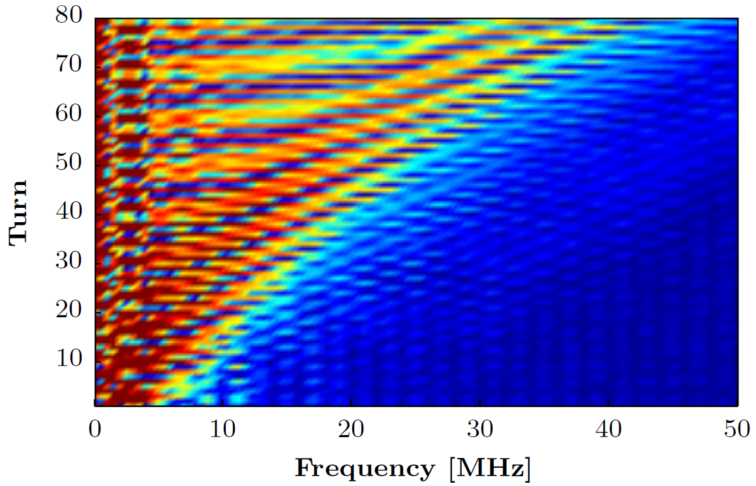
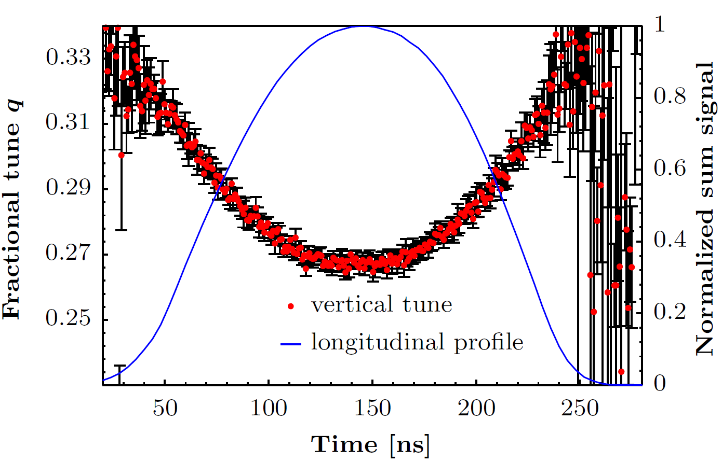
Injection oscillations: comparison
measurement
simulation

Slide 26
PS MD – complete list (3/4)
Collective effects
TMCI at transition vs longit emttances (< 1eVs) and chromaticity jump and ODEs
Flat top (e-cloud?) instability
Transverse instab. @injection Vs. inj. Error/chromaticity/tune
e-cloud
New detectors e-cloud meas.
e cloud general studies
ecloud from energy loss/phase error
Impedance
Impedance identification
Transverse impedance via Tune shift
Longitudinal broadband impedance (quadrupolar transfer function)

Slide 27
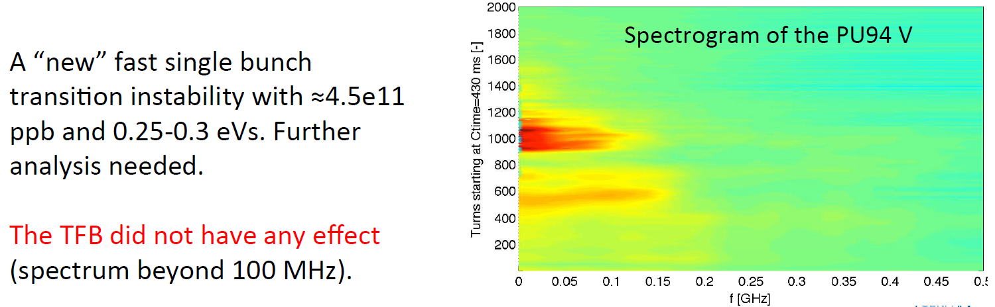
Transition crossing
TOF-like single bunch beam
Future Studies with small longitudinal emittances
Minor influence of initial transverse emittance

Slide 28
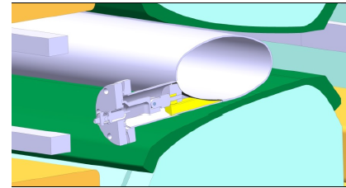
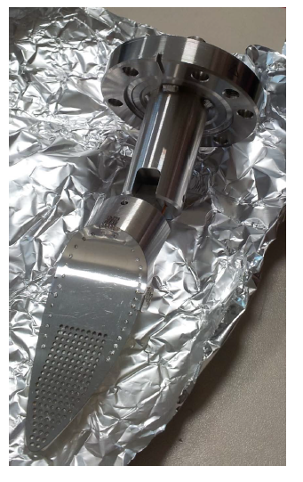
Pick up MU98 for e-cloud: setup
The pick-up has a complex shape due to aperture contraints, space hindrance of the yoke and limited access to the electrons from the cloud
insulating
electrode
support
Expected currents:
-16 nA with centered beam
-3uA with beam 30 mm offset
grid

Slide 29
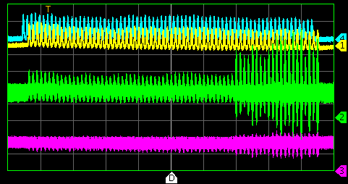
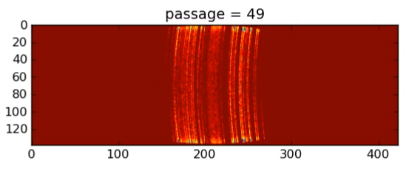
e-cloud instabilities: simulations and T-damper
-- Wall current monitor -- Sum -- Horizontal -- Vertical
e-cloud observed for 25 ns beam production but no influence on beam quality
Transverse instability observed together with
e-cloud if bunches shorter than nominal or kept
in the machine for time longer than needed.
Shorter batches a la BCMS suffering less
Damper/TFB tests proved that
instability can be efficiently delayed
Pycloud simulations for combined function magnets established to predict future operation
10 ms

Slide 30
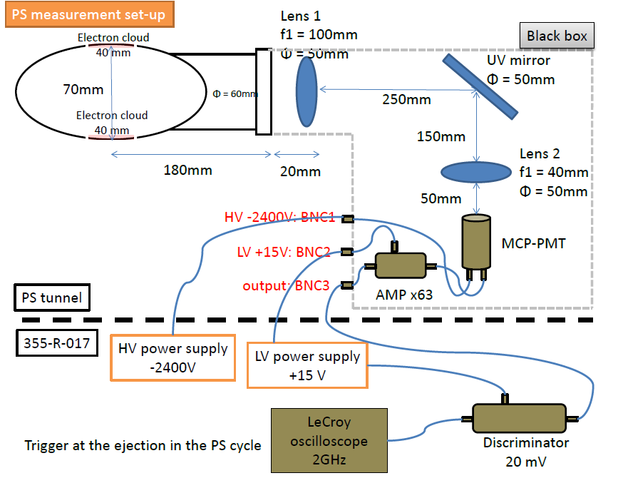
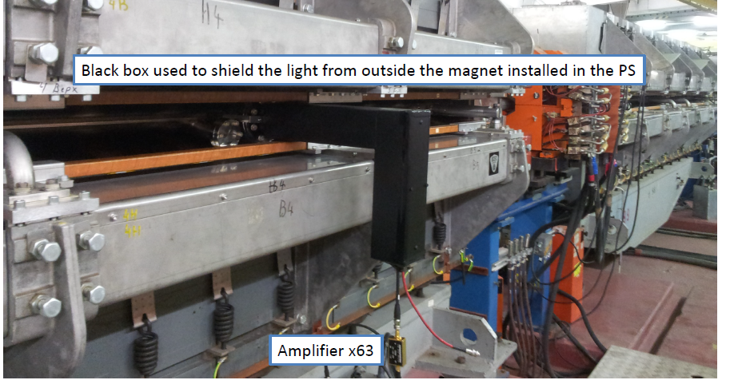
PS (e-cloud produced) photon detector: setup
Detect cathodo-luminescence induced
by the e-cloud electrons impining on the
beampipe surface

Slide 31
PS MD – complete list (4/4)
Longitudinal
Coupled bunch instabilities - Tests longitudinal damper
Higher voltage from 40 MHz cavities
PS-SPS Transmission with two 40 MHz cavities
PSB-PS transfer h = 1+2 to h = 7/9
Effect of sub-harmonic RF voltage on coupled-bunch instabilities
Effect of wide-band feedback on beam induced voltage in 10 MHz cavities
Merging of flat bunches at 2.5 GeV and possibly deceleration to 1.4/2 GeV
Tests with new White-Rabbit B-train
Study on longitudinal losses at transition (1 eVs limit for longit. Emittance)
Acceleration with programmed frequency (no B-train)

Slide 32
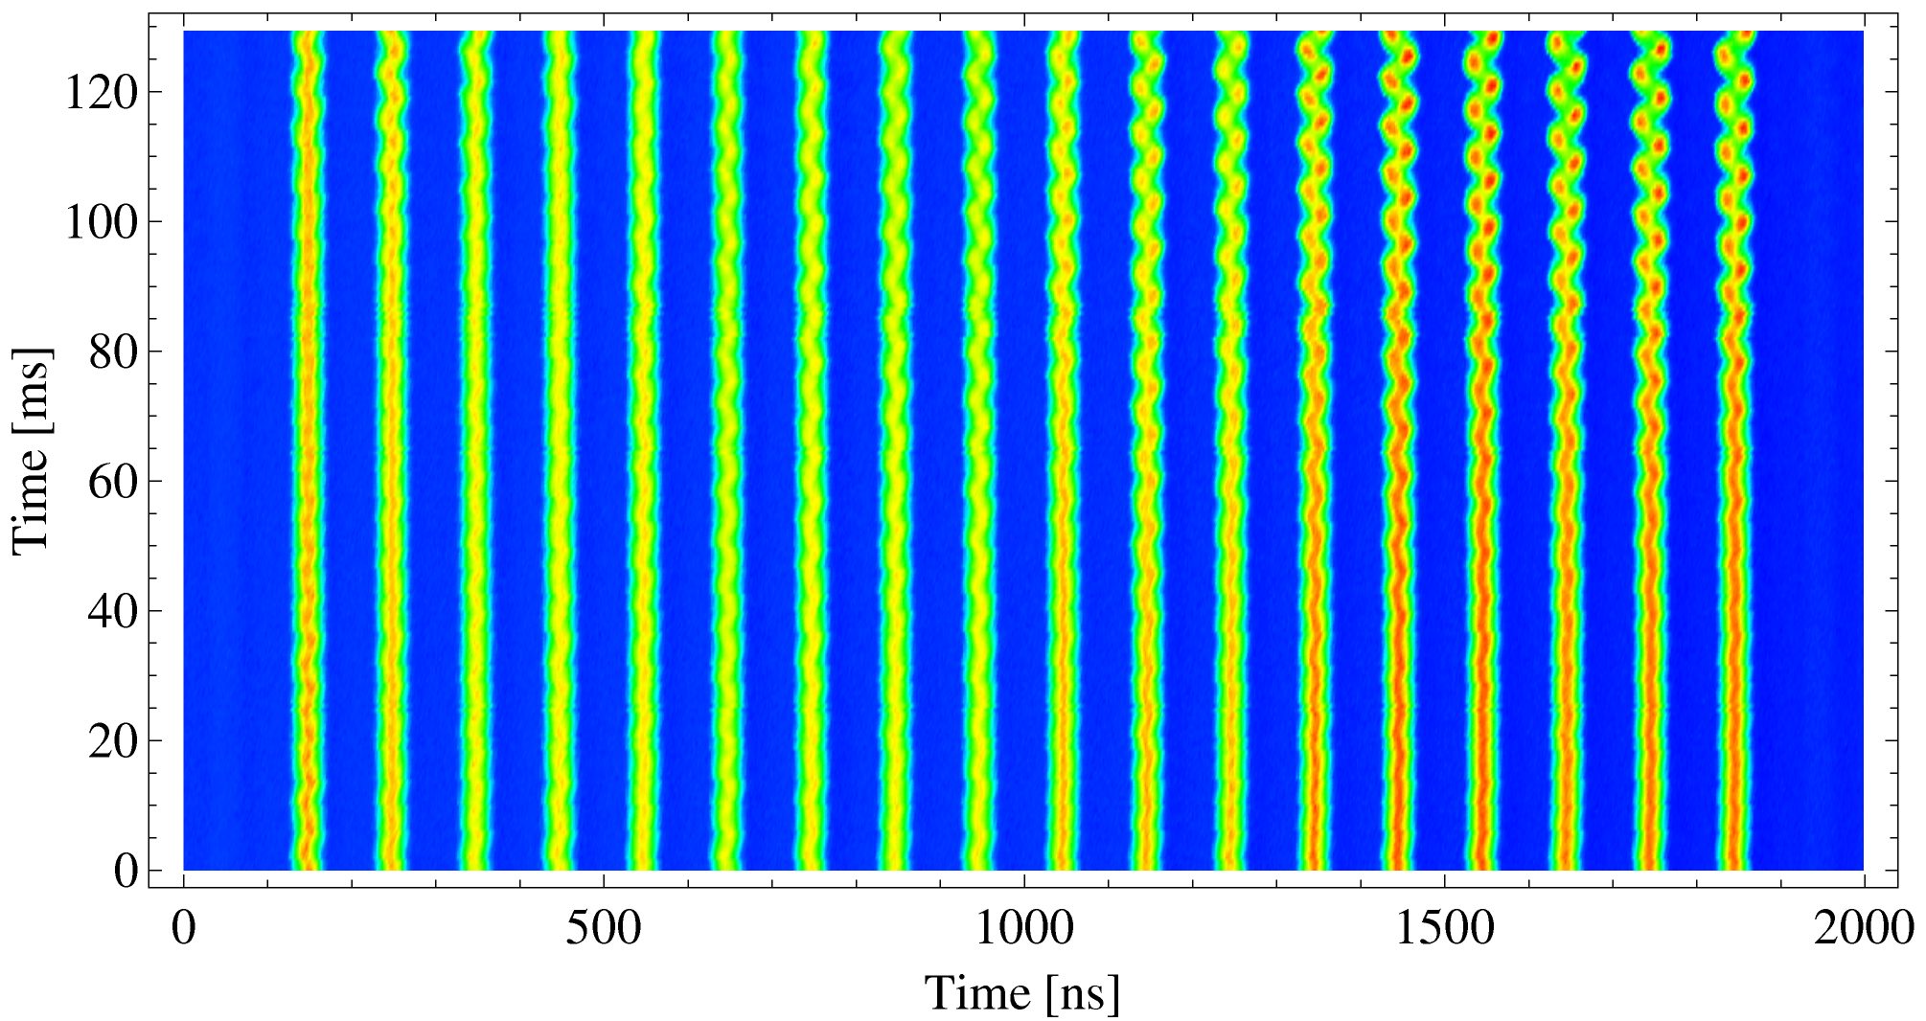
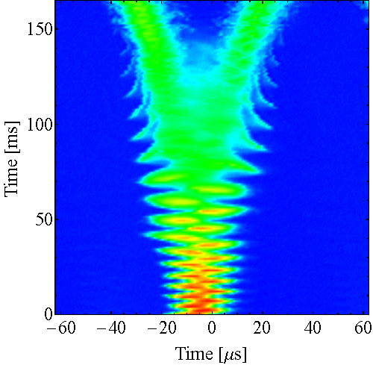
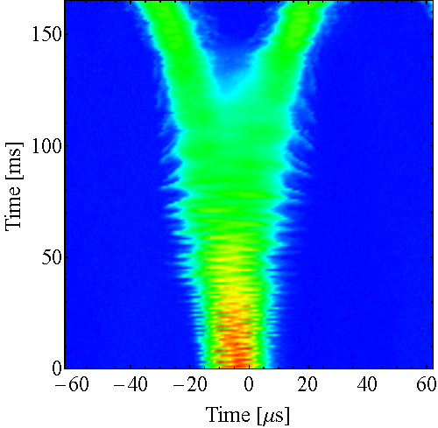
Longitudinal Coupled bunch instabilities
Longitudinal CB instabilities
appear after transition
With new dedicated longitudinal damper
possible to reach more than 2.5e11 p/b at extraction.
Finemet cavity installed during LS1
Extrapolated to 0.35 eVs
With FB
Reachable without FB
FB test with C11 (2009), acceleration only
FB OFF
FB ON

Slide 33
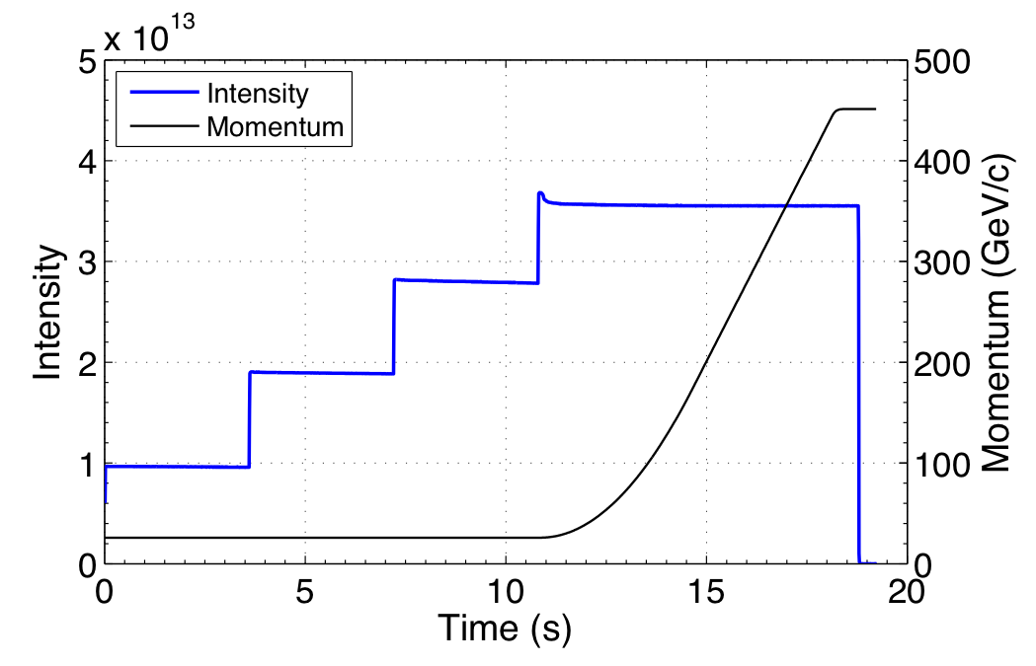
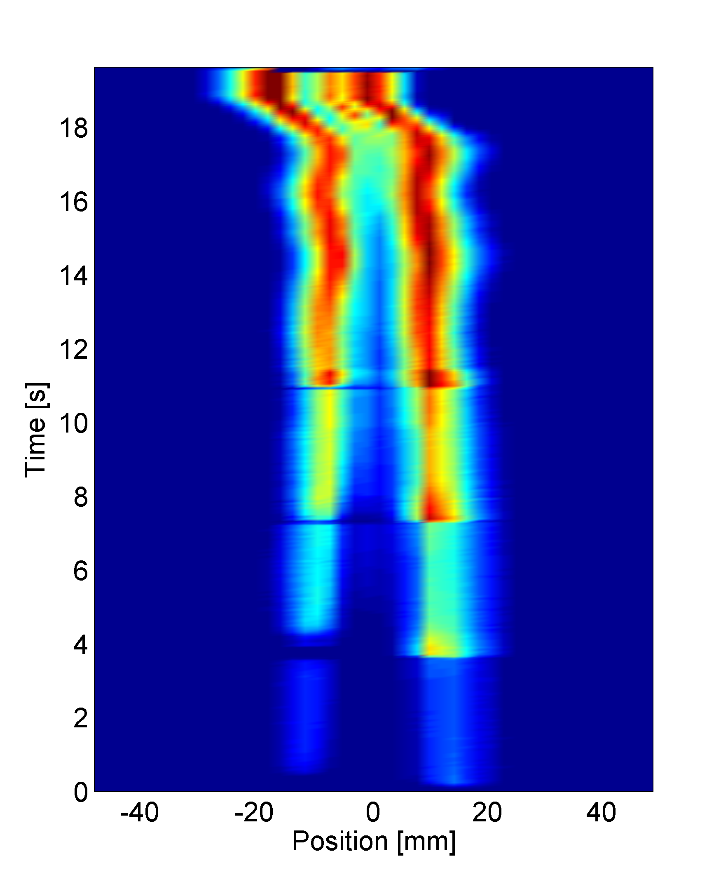
SPS limitations overview – LHC beams
Ramp and flat top:
Longitudinal instability
Beam loading
RF power
Maximum SC tune spread @injection
ΔQ_{y} = 0.21 → still margin for 25 ns beams
Maximum intensity per bunch @extraction due to RF power and longitudinal instabilities
N_{b}= 1.3 x 10¹¹ ppb → 2 x 10¹¹ ppb with RF upgrade and a-C coating
Along the whole cycle:
Electron cloud for 25 ns
Injection flat bottom:
Capture losses, incoherent losses
Space charge
TMCI

Slide 34
SPS MD – complete list (1/3)
Mainly ABP
- Transverse impedance studies
- impedance measurements (tune shift vs intensity, growth rates for negative chromaticity, impedance localisation)
- TMCI and negative chroma instabilities with new transverse damper
- coupled bunch instability for compar. low frequency part of the existing impedance model
- intermediate optics (Q22) preparation
- Electron cloud MDs in addition to scrubbing and doublet beam preparation
- Check of electron cloud instability (25 ns beam performance in general) on Q26
- Space charge
- study maximum acceptable space charge tune spread + tune diagram above Qy = 20.25
- emittance growth close to integer resonance with BGI
- measurement of fixed lines close to Qx+2Qy resonance
- measurements with quadruplar pickup (if BBQ can be recabled)
- Split optics (20, 26)
- SPS machine modeling
- improvement of linear and non-linear machine model (non-linear chromaticity, amplitude detuning, possibly resonance driving terms, …)
- Qualification of new LIU beam types
- 80 bunch scheme
- 8b+4e

Slide 35
SPS MD – complete list (2/3)
MD studies (mainly other MD users)
Longitudinal instabilities studies (impedance identification ,understanding of int. limitations)
- instability thresholds
- impedance measurements (quadruple synchrotron frequency shift, debunching of long bunches at injection without RF, …)
- Bunch rotation at 450 GeV for high intensity 25 ns beams
- Transverse damper commissioning
- for LHC and fixed target beams
- special studies for doublet beam
- 800 MHz LL RF
- Beam Instrumentation
- calibration and commissioning of various instruments
- Collimation studies
- COLDEX (request of 5 dedicated blocks)
- Coasting beam studies
- emittance growth in view of crab cavities experiments and collimator studies

Slide 36
SPS MD – complete list (3/3)
Operational setup and scrubbing runs
- Performance optimization and performance reach of 25 ns operational LHC beam
- Electron cloud
(in view of LIU scrubbing vs. coating decision, including instabilities and beam quality)
- scrubbing runs
- optimisation of doublet scrubbing beam for LHC including the optimisation of the magnetic cycle length and ramp speed
- possible intensity and beam quality limitations due to electron cloud after high intensity scrubbing
- impact of transverse emittance on losses, emittance growth and beam stability

Slide 37
Space charge tune shift – SPS
  Expect (Q20)
  ΔQ_{x} ~ 0.11
  ΔQ_{y} ~ 0.20
50 ns BCMS beam on LHC filling cycle
  Single batch with N ~ 2x10¹¹ p/b @inj. and ε_{n}~ 1.1 μm
  Measurements for different tunes
  Average of 5 measurements at the end of flat bottom
  No (vertical) blow-up for Q_{y} ≥ 0.21 → consistent with expected tune shift
No vert.
blow-up

Slide 38
80 bunches from PS
Remove 1 bunch with transverse feedback:
21 => 20 bunches
2 double
splittings
20 => 40 =>
80 bunches instead of 72
triple splitting
7 => 21 bunches
PS extr. kicker rise time
89 ns (1-99%) => O.K.
26 GeV
4 bunches
+3 (instead of 2) bunches
Inj. kicker rise time O.K.
1.4 GeV
2.5 GeV
h=7
h=21
h=42
h=84

Slide 39

80 bunches from PS
Very promising first experimental tests on single bunch beam @2.5GeV
  Excitation with the transverse damper (with low and corrected chromaticity)
intensity
bunch eliminated

Slide 40
80 bunches from PS
Very promising first experimental tests on single bunch beam @2.5GeV
  Excitation with the transverse damper (with low and corrected chromaticity)
Remarks
  Beam losses at low energy ➔ possibility to localize losses with orbit bump (controlled aperture restriction)?
  Compatible with the present T-damper power amplifiers (0.8 kW CW, BW=23 MHz@-3dB)
  For eliminating selected bunch of a full train need
    new firmware for the digital card controlling the feedback
    bunch synchronous trigger to gate the damper gain which requires RF-LL development. Technical solution exists but to be developed.
  Possible impact on e-cloud and longitudinal stability in PS and SPS
  Level of ghost bunches in LHC to be checked

Slide 41
LHC filling schemes
Nominal 25 ns filling scheme: 2736 colliding bunches in IP1 and IP5
4x80 bunches per LHC injection
  Up to 2892 colliding bunches in IP1 and IP5 => +5.7%
  Should be O.K. for MKI and MKE (t.b.c.)
  Implication on protection devices (TDI, …), LHC and SPS beam dump load, e-cloud, …
  Possible impact on e-cloud in LHC
3x80 bunches per LHC injection
  Up to 2732 colliding bunches in IP1 and IP5 => almost like nominal filling scheme
  Back-up in case of limitations of total intensity per SPS-to-LHC transfer (e.g. LHC protection devices, SPS beam dump, …)
  Required average SPS RF power reduced
  Very interesting option to alleviate other limits in SPS (e.g. intensity (3x80)/(4x72) = 0.83)

Slide 42
80 bunches from PS: conclusions & MD plans
80 bunches per PS batch is very interesting
  LHC luminosity increase by up to more than 5% for same pile-up limit
  In case of limitations of intensity per SPS-to-LHC transfer => ~ almost the same number of bunches in LHC when transferring 3 PS batches per LHC injection
  For selected bunch within train: need new firmware for digital card and bunch synchronous trigger
Plans for MD studies in 2014/2015
  Validate elimination of single bunch out of a train if new LLRF and tagging firmware ready
  Losses localization (e.g. dummy septum)
  Check for ghost bunches in the SPS and in the LHC
  Impact on e-cloud and longitudinal stability in PS and SPS

Slide 43


e-cloud: Doublet beam, a possible boost to scrubbing
Injection of long bunches into SPS (with 25 ns spacing)
Capturing each bunch in 2 neighboring 200 MHz buckets
Successfully used during last scrubbing run
Clear enhancement on e-cloud detectors compared to standard 25 ns beam measured
1.6x10¹¹ p/doublet
MBA
1.6x10¹¹ p/b
25 ns
5 ns
1.6x10¹¹ p/doublet
MBB
1.6x10¹¹ p/b

Slide 44
LHC Pb-beam production

Slide 45
Post-LS2 Scheme
Scheme in 2011
(2013 performance)
LEIR
max. 7 injections
max. 13 injections
Twice 5.5x10⁸ ions/bunch
Twice 8x10⁸ ions/bunch
200ns
5.6x10⁸ ions before splitting
200ns
3.8x10⁸ ions
PS
100ns
2.8x10⁸ ions
100ns
2.2x10⁸ ions
200ns
SPS
~2μs
50ns spacing
1.6x10⁸ ions
200ns
1.2 10⁸ ions in collision
LHC
1.4x10⁸ ions
200ns
max. 358
50ns spacing
max. 1248

Slide 46
How to increase Luminosity after LS2?
Linac3 & Source:
  Intensity x 2.5: Low energy beam transport (LEBT) Source -> RFQ
  Injection spacing: 200ms -> 100ms
  Upgrade of Linac3-Booster-Spectrometer (LBS)
LEIR (without LEBT upgrade):
  Injected int. x 2: Injection rate in LEIR -> from 5Hz to 10Hz
  Extracted int. x 1.45: LEIR low energy beam loss mitigation
  Dedicated ion beam dump
PS:
  Numb. of bunches x 2: bunch splitting -> 4 bunches out of PS with 100ns bunch spacing
SPS:
  New SPS injection system: 100ns batch spacing
  SPS slip-stacking -> 50ns bunch spacing into LHC

Slide 47


Details of the Post-LS2 scheme
Linac3
  Same intensity as 2013: 20μA for 200μs. Try to understand bottle-necks to establish design report intensity: 50μA of Pb54+ for 200μs.
  100ms spacing between pulses towards LEIR (vs. 200ms in 2013).
New source & LEBT simulation is very different from the “old model”
100ms spacing
β=2.3x10⁻³
D. Kuchler & R. Scrivens

Slide 48

Linac3 MDs – increasing performances

Slide 49

Details of the Post-LS2 scheme
LEIR
  Max. 13 inj. @ 100ms, 3.6 s cycle, extr. of 2 bunches at 72MeV/n.
  Increase cooling rate for 100ms injection spacing
  Mitigation of intensity limitation: reduce loss from 35% to 20%
  Increase extr. int. from 5.5x10⁸ Pb⁵⁴⁺/bunch to 8x10⁸ Pb⁵⁴⁺/bunch
(Coasting beam)
RF capture
Extraction
@ 2880ms
BHN current [100A]
35% loss at max. extracted intensity (5.5x10⁸ Pb⁵⁴⁺/bunch)
B-field

Slide 50
Details of the Post-LS2 scheme
LEIR low energy beam loss – conclusions from the LEIR internal review, Aug. 20th 2014:
No experimental evidence nor theoretical basis for thinking that the intensity limitation is a hard limit.
Study effect of the transverse damper.
Extensive effort needed for better machine modelling.
Lots of LEIR MD time (not parasitic) for bare-machine studies.
1.) Chromaticity measurement with LEIR in bare machine mode. No Ecooler field + compensators to disturb the optics.
2.) Everything which envolves a “flat” cycle, i.e. no magnetic ramp.
2.1) RF capture study without ramp
2.2) Long term cooling observation
2.3) Transverse feedback behaviour in stationary but
bunched beam scenario.

Slide 51

LEIR chromaticity

Slide 52
LEIR planning
Sep | Q4
Oct
Nov
Dec
Jan | Q1
Feb
  Interaction with transverse damper & instability
  Interaction of e-cooling and RF-capture
  Other tune areas: >1.82 (H), >2.72 (V)
  Chromaticity for new tunes, neg. (H), neg. (V)
  Vacuum pressure during beam loss
  RF capture in H2/H4 (rather than H1)
2014
Ar
March
2015
GTS ion source: Ar -> Pb
July
2015
Jul- Sep | Q3
Oct- Dec | Q4
Jan- Mar | Q1
Apr- Jun | Q2
Jul- Sep | Q3
Oct- Dec | Q4
  Re-establish 2013 beam intensity and loss phenomenon
  Compare Ar findings with re-established Pb beam
  Run LEIR with neg. chromaticity and design tune
  Run LEIR with newly found tune from Argon
  Test higher intensity e-cooler beam
  Testing & refuting
    Space charge
    Transverse damper
    Impedance
    Other type of instability?
    New working hypotheses?
  If necessary: Order new hardware
  (commisioning would take place after LS2)
  Re-iterate testing & refuting
Pb
Minimum set
Dec
2016

