Slide 1
RF Dipole Cavity HOM Coupler Fabrication
JLAB, February 25, 2015

Slide 2
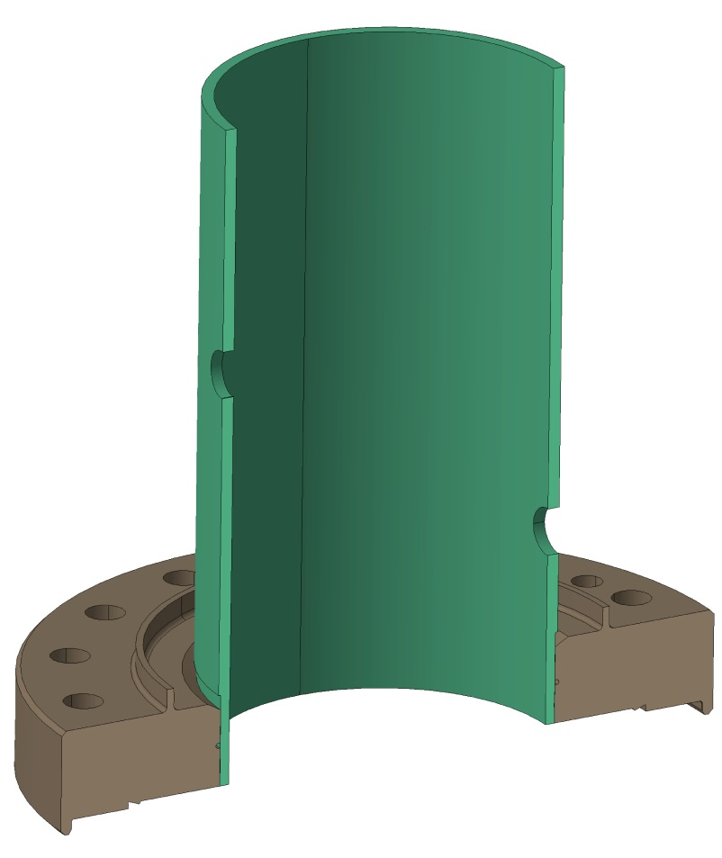
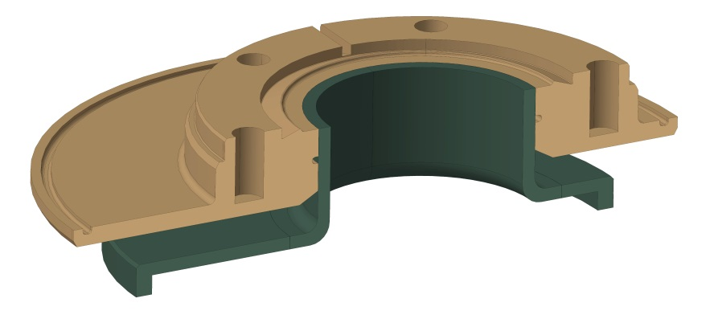
Fabrication Step 1 – Brazing
Brazing
Machined Nb top
Nb coupler body + SS flange (316 LN)
QC after brazing
Leak check
Concentricity
Rolled/formed Nb can
Courtesy of Teddy Capelli

Slide 3
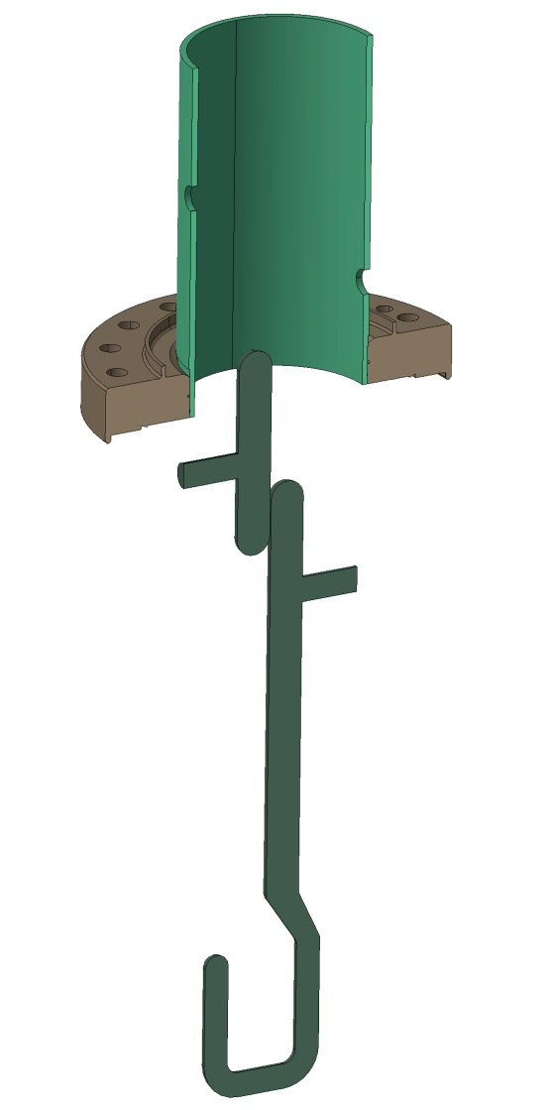
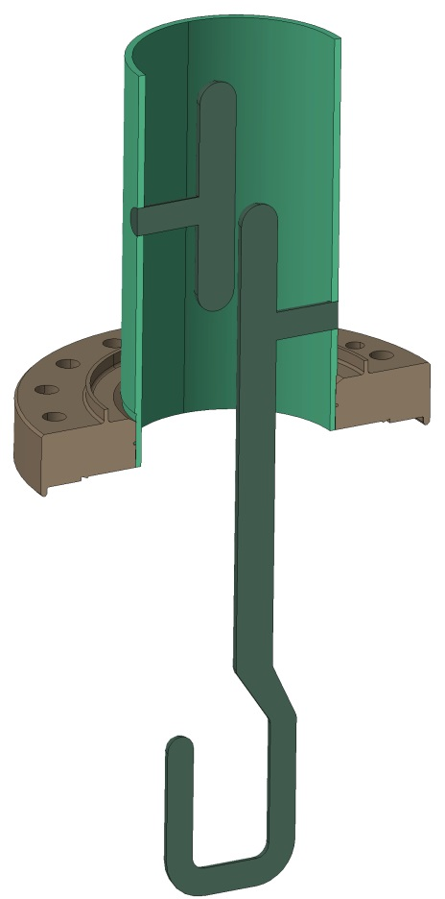
Fabrication Step 2 – EBW
Use fixture to control the gap
QC after welding
Measure gap, perpendicularity
Courtesy of Teddy Capelli

Slide 4
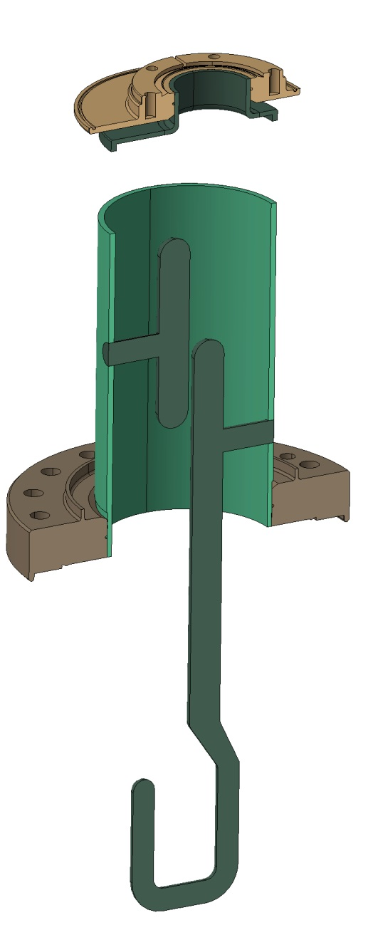
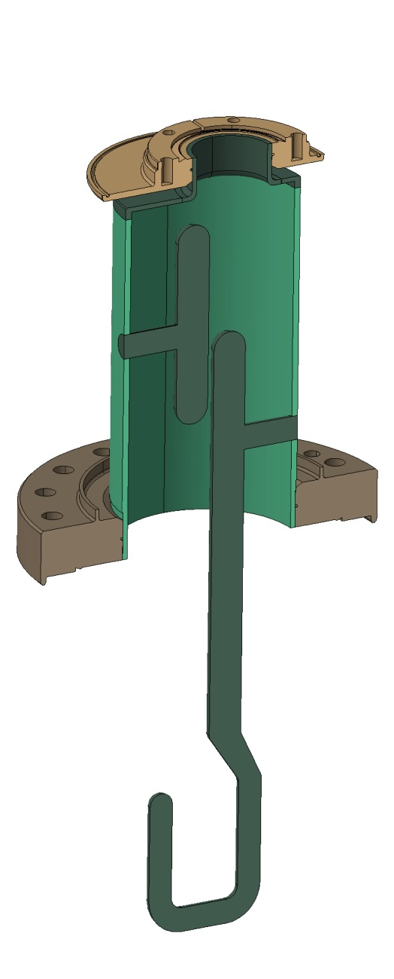
Fabrication Step 3 – EBW
Courtesy of Teddy Capelli

Slide 5
Fabrication Step 4 – BCP
BCP with active thickness monitoring
150 μm removal
After BCP/Rinse the spool piece will be mounted to protect hook
Spool piece to enclose the hook during BCP
Courtesy of Teddy Capelli

Slide 6
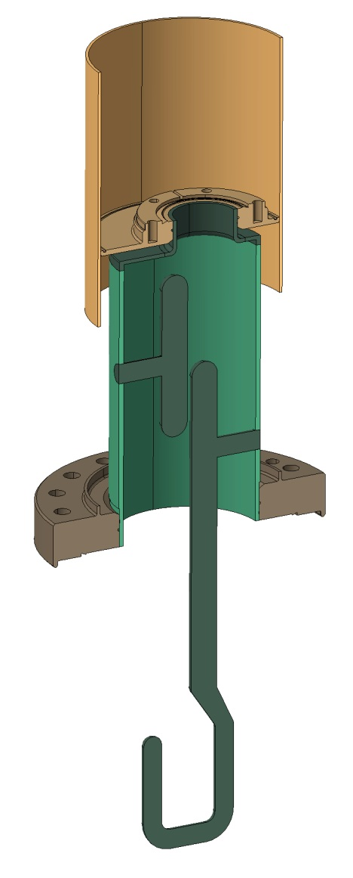
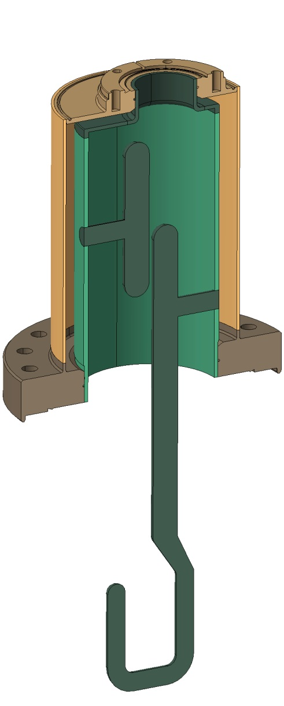
Fabrication Step 5 – He Jacket Weld
EBW or TIG
Standard SS tubing
Courtesy of Teddy Capelli

Slide 7
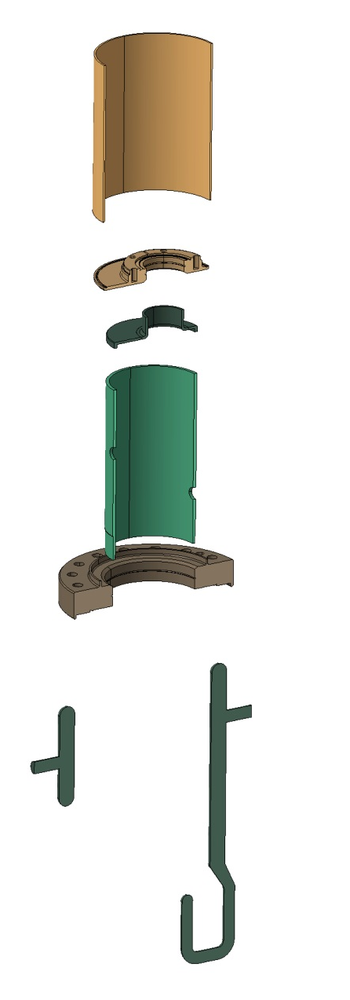



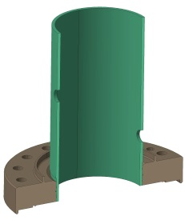
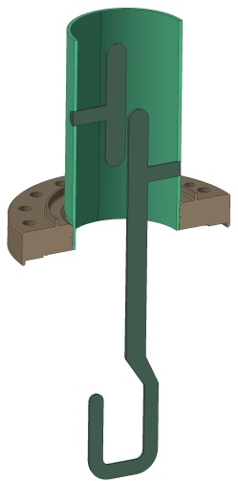
Summary
Courtesy of Teddy Capelli

Slide 8
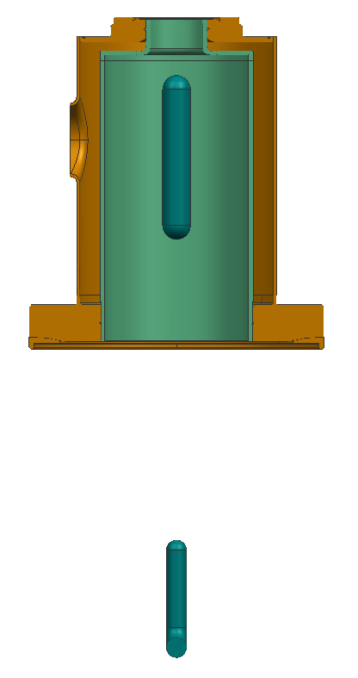

High Pressure Rinse
Stationary nozzle
Nozzle inserted below the hook
Coupler assembly attached to the rotating turn table
Water pressure adjusted not to bend the hook

Slide 9
Fabrication Traveler
Nb Sheet
316 LN Bulk
Nb Bulk
Nb Bulk
316 LN Bulk
316 LN Tube
Roll / Form
Machine bottom flange
Machine Hook & T
Machine can top
Machine top flange
Cut to the length
Dimensions Roundness
Dimensions
Dimensions
Dimensions
Dimensions
Dimensions
Machine Braze OD
Braze
Braze
Leak check
Cold shock / cycle
Leak check
Leak check
Cold shock / cycle
Leak check
EBW
Perpendicularity
Gap dimension
Tune
EBW
Dimensions
Parallelism top & bottom flanges
BCP / Rinse
Install Spool
EBW or TIG
Leak check / Survey / Cleaning

Slide 10
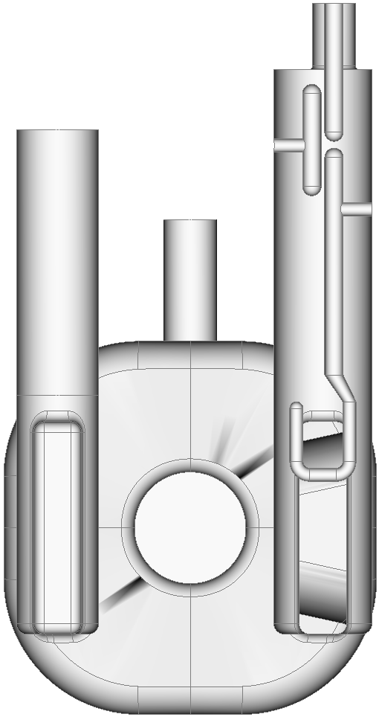
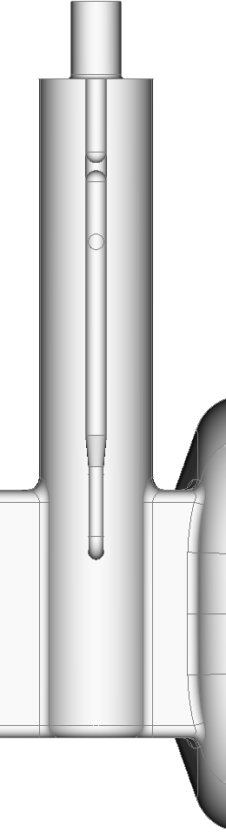
Manufacturing Tolerance
Deviations introduced during manufacturing and also the most crucial GD&T for performance
gap_bar
rot_about_z
Introduced during manufacturing, easily controlled or large allowable tolerance
tank_radius
bar_radius
gap_top
rot_about_x
Introduced during assembly but with large tolerance
y_tip
gap_probe
gap_top
gap_bar
gap_probe
rot_about_x
(+)
rot_about_z
(+)
bar_radius
ytip
tank_radius

Slide 11
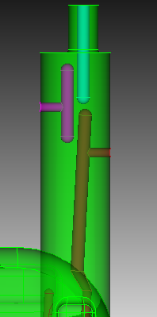
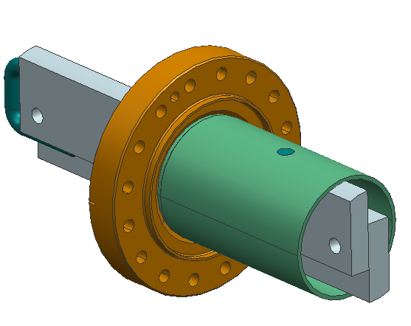
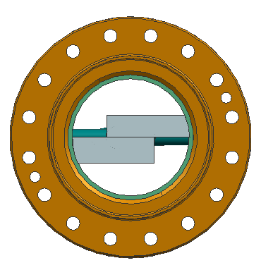
Tolerance Control
Precision machined fixture will be used during welding to control the hook and T alignment.
Weld joint will be optimized to reduce the deformation.

Slide 12
H-HOM Error analysis and tolerances

Slide 13
H-HOM Error analysis and tolerances

Slide 14
H-HOM Error analysis and tolerances

Slide 15
H-HOM Error analysis and tolerances

Slide 16
H-HOM Error analysis and tolerances

Slide 17
H-HOM Error analysis and tolerances

Slide 18
H-HOM Error analysis and tolerances

Slide 19
H-HOM Error analysis and tolerances

Slide 20
H-HOM Error analysis and tolerances

Slide 21
H-HOM Error analysis and tolerances

Slide 22
Fabrication Readiness
All conventional proven fabrication technique
Braze : same as cavity beam pipe
EBW : hook welding to cylindrical surface used for other HOM couplers
Coupler design provides necessary access for controls
Inspection and correction possible between each step

Slide 23
Acknowledgement
Design and engineering – CERN EN, STFC/UK, Fermilab
Fabrication guidance – JLAB Machine shop, JLAB SRF Engineering

