Slide 1
HOM:
Assessment of
Thermo-Mechanical Performance
M. Garlaschè
on behalf of CRAB Collaboration

Slide 2
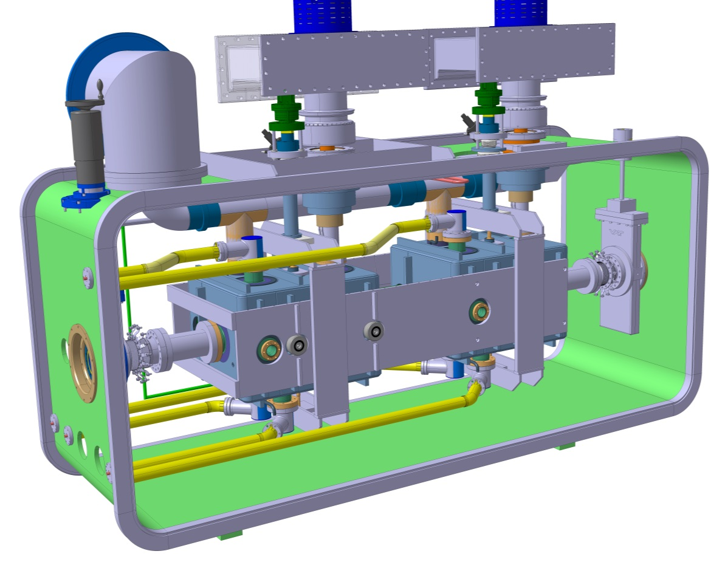
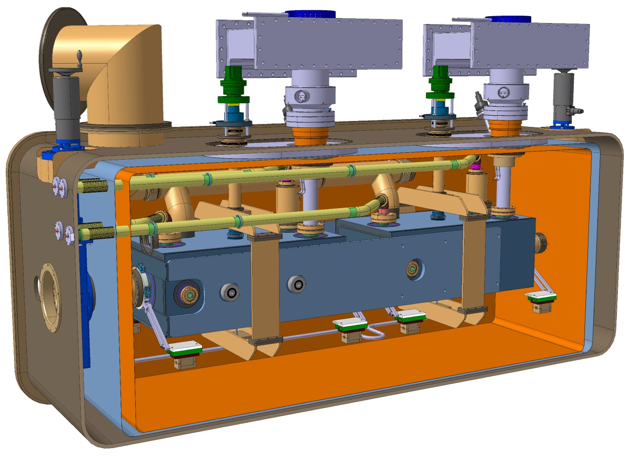
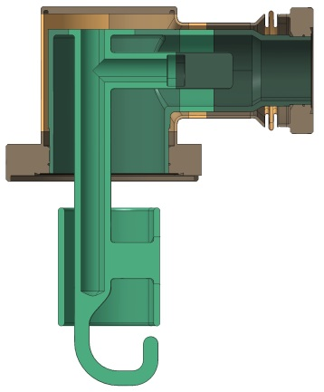
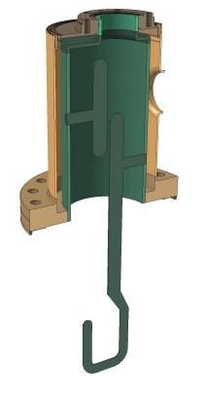
HOM Calculations
Thermal:
Coax Cable Heat Losses
Quench Power Limits
Thermo-Structural:
Resistance to loads & maximum deformation in cool-down & working condition
Modal performance

Slide 3
Thermal Calcs: Coaxial Line

Slide 4
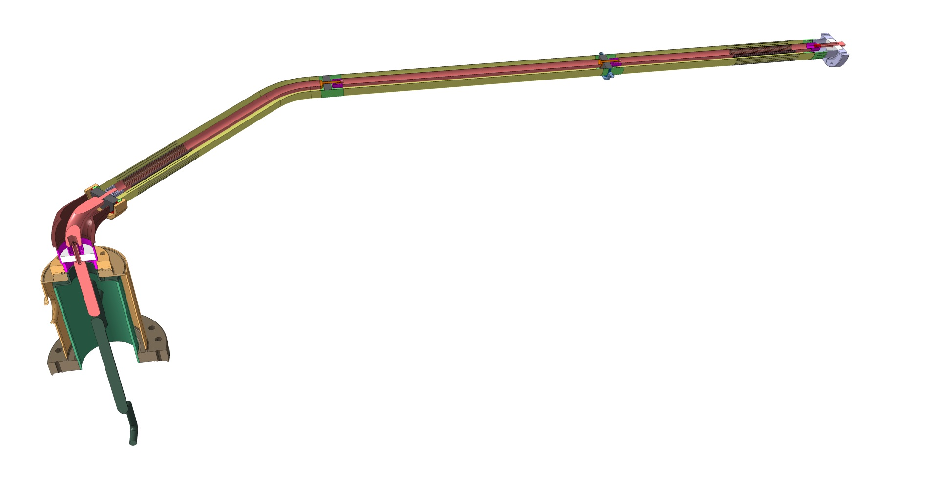

Thermal Calcs: Coaxial Line
A (=300K)
DQW & RFD: common configuration
Inner tube ∅_E | 17.4 mm
Outer tube ∅_E | 40 mm
Tube thickness | 0.3 mm
Copper coating | 5 μm
Length_coax | ~1600mm
B (=2K)
Semi-analitical evaluation:
Heat Losses to He Bath (Static & Dynamic)
T distribution
$$Q_{Conduction}={Q_{I}^{}}^{A→Bath}+{Q_{coat_I}^{}}^{A→Bath}+{Q_{E}^{}}^{Int→Bath}+{Q_{coat_E}^{}}^{Int→Bath}$$
$$Q_{RF}=f(R(T),{I(x)}^{2})$$
Hp: P_{RF}=1kW @ 1GHz

Slide 5
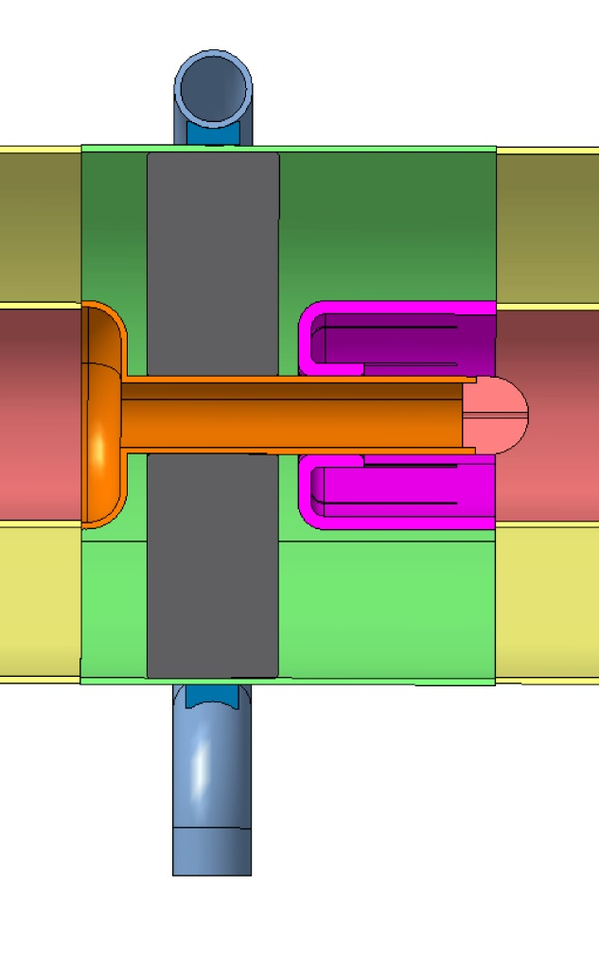
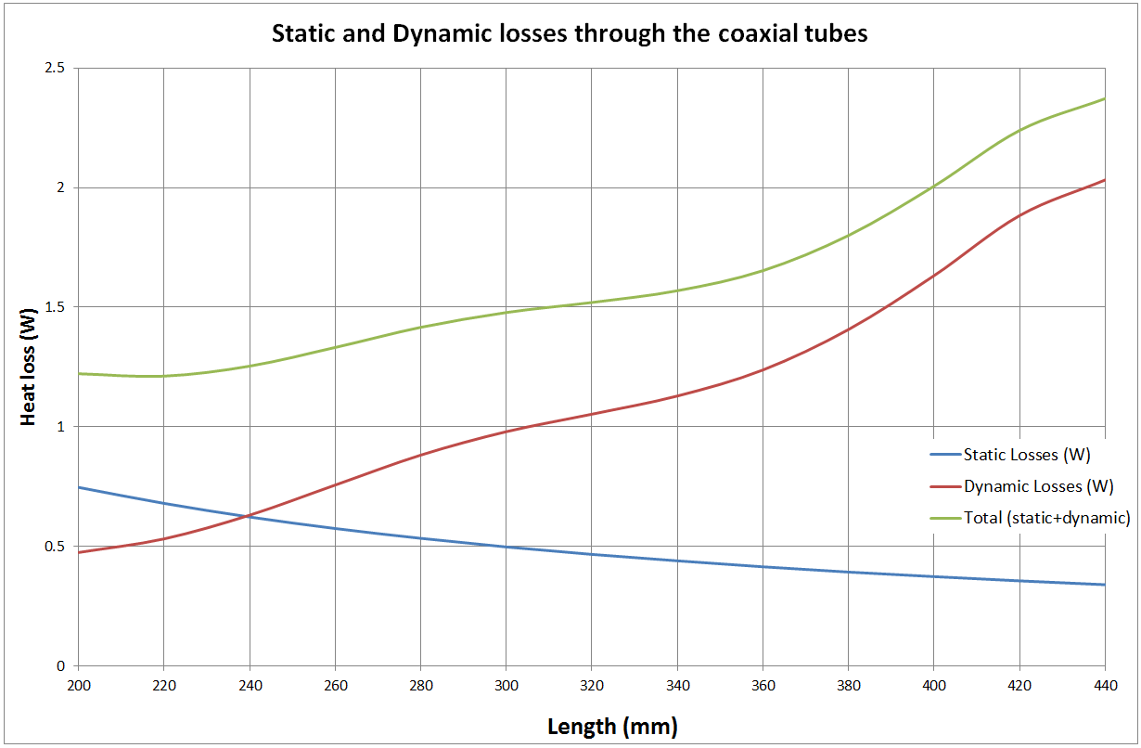
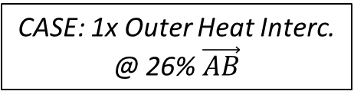
Thermal Calcs: Coaxial Line
Different Cases studied:
No Cooling
Outer H.Intercept
Inn. & Out. H.Intercept
Outer Intercept
Inner Intercept (e.g. Al2O3)
CASE: 1x Outer Heat Interc.
@ 26% $\vec{AB}$
!!!
2.5
For lengths 1600mm...
TOTAL
Heat Loss [W]
Thermal Intercepts (1x÷2x)
DYN.
Total losses (@ 2K):
Static ~ 0.2 W
Dynamic ~ 1.9 W
STAT.
~2W / line
0
200
Cable Length [mm]
440

Slide 6
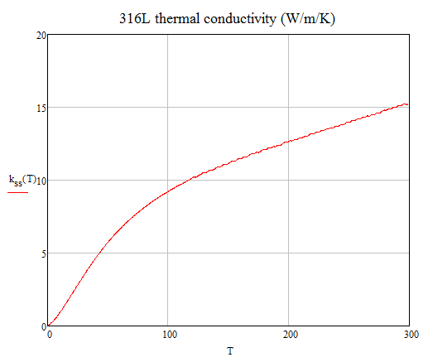
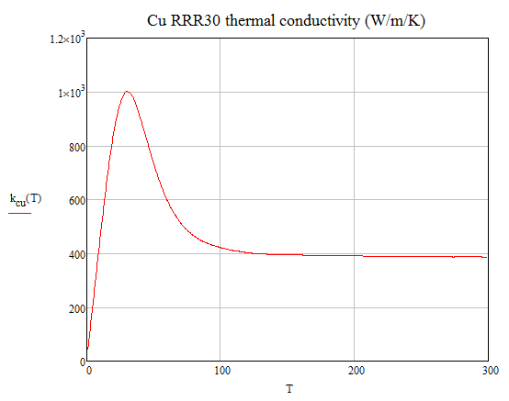
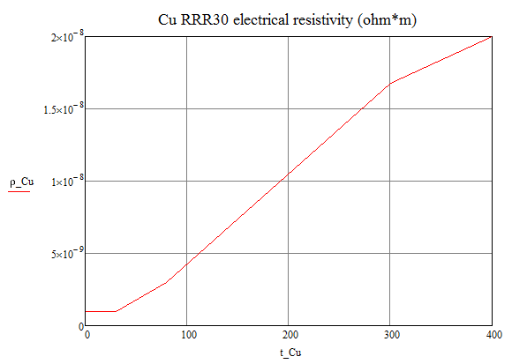
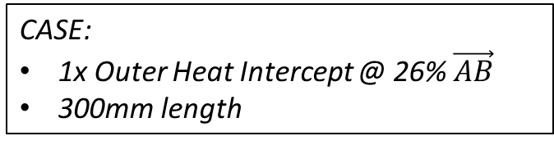
Properties for Coax Line Calc.
Temperature values along Inner tube [K]
400
CASE:
1x Outer Heat Intercept @ 26% $\vec{AB}$
300mm length
0
0.3 m

Slide 7
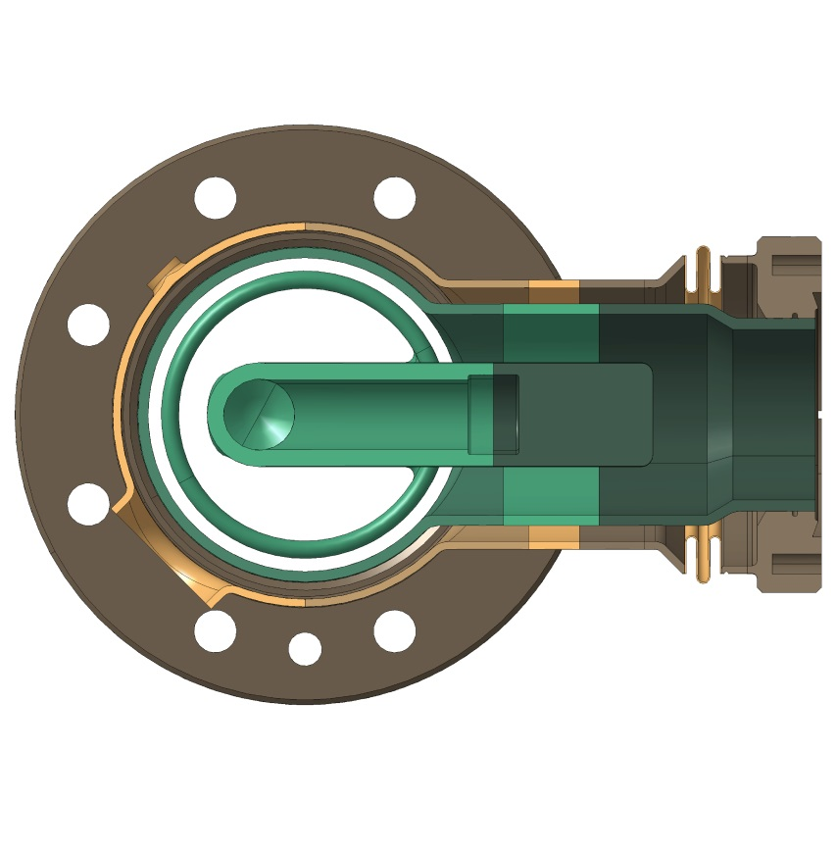

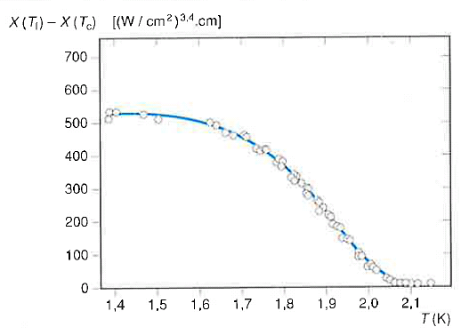
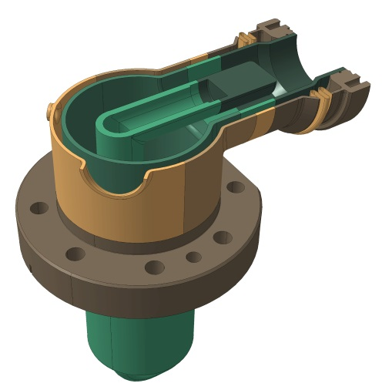


Helium Heat Evacuation
Aim: determine minimum cross section for heat evacuation via HOM He cooling line
Hp: all coax line heat (~2W) goes to HOM line
~2W
[1]
$$s_{min}=2.5 {cm}^{2}$$
$$s_{design\left(∅20 mm\right)} \sim 3.1 {cm}^{2}$$

Slide 8
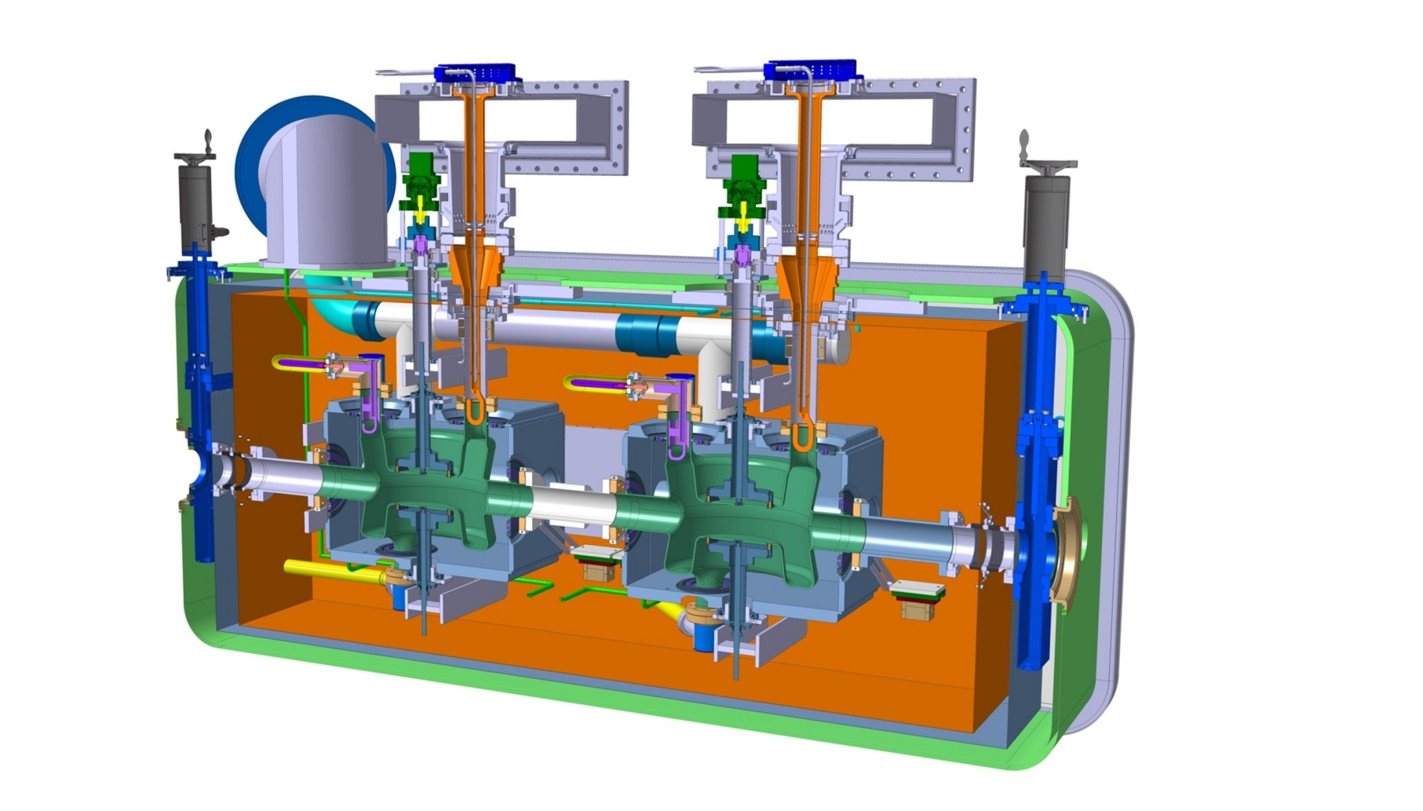
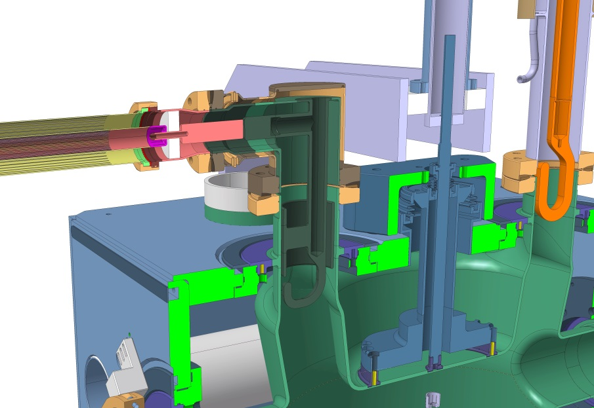
Thermal Calcs: HOM
P_{HOM}
  Aim: determine HOM thermal performance w.r.t. quench

Slide 9
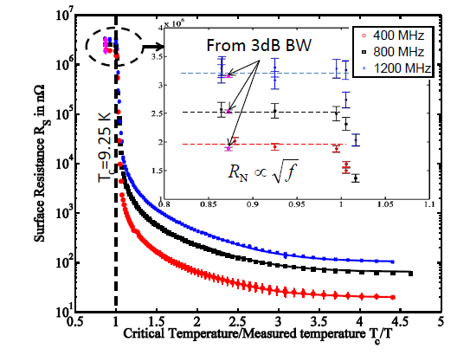
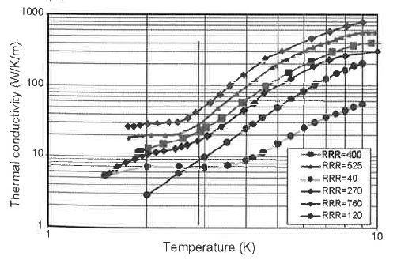
Thermal Calcs: DQW HOM
Nb properties as function of Temperature

Slide 10
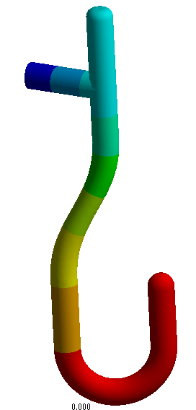
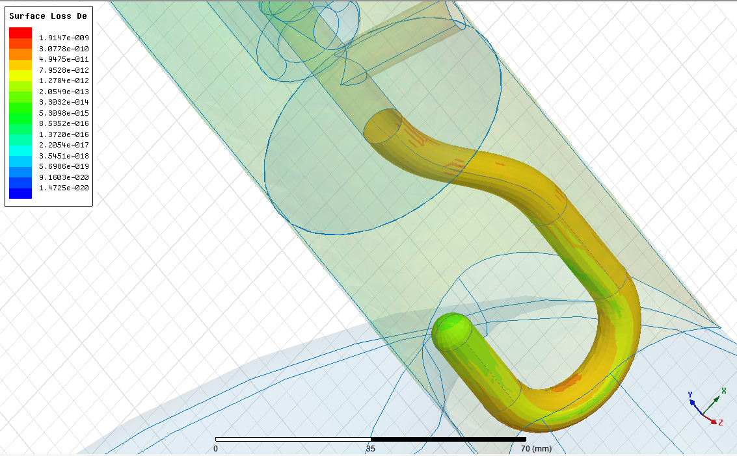
Thermal Calcs: DQW HOM
  Iterative lumped calculation HFSS/ANSYS, to assess HOM temperature distribution
  Rs_{Nb} = f(T) ; λ_{Nb} = f(T)
  Initial DQW geometry
    No active cooling inside stem
T₀
Temp. Gradient
T_{MAX}
Courtesy S.Verdu Andres

Slide 11
Thermal Calcs: DQW HOM
Few configurations studied
T₀ [K] | R_{S} , λ_{Nb} | RRR | TMAX [K] | P_RF [mW]
2 | Const | - | 3.1 | 5
2 | f(T) | 380 | 3.4 | 9
2 | f(T) | 40 | X
4 | f(T) | 300 | 4.8 |  | 35
T₀
Temp. Gradient
T_{MAX}
Cu option not viable
RRR > ~250, for acceptable λ_{Nb}
NEXT... Current Design:
Q_{RF}= 17mW
Active He cooling @ 2K, 100 mm distance from tip
Courtesy S.Verdu Andres

Slide 12
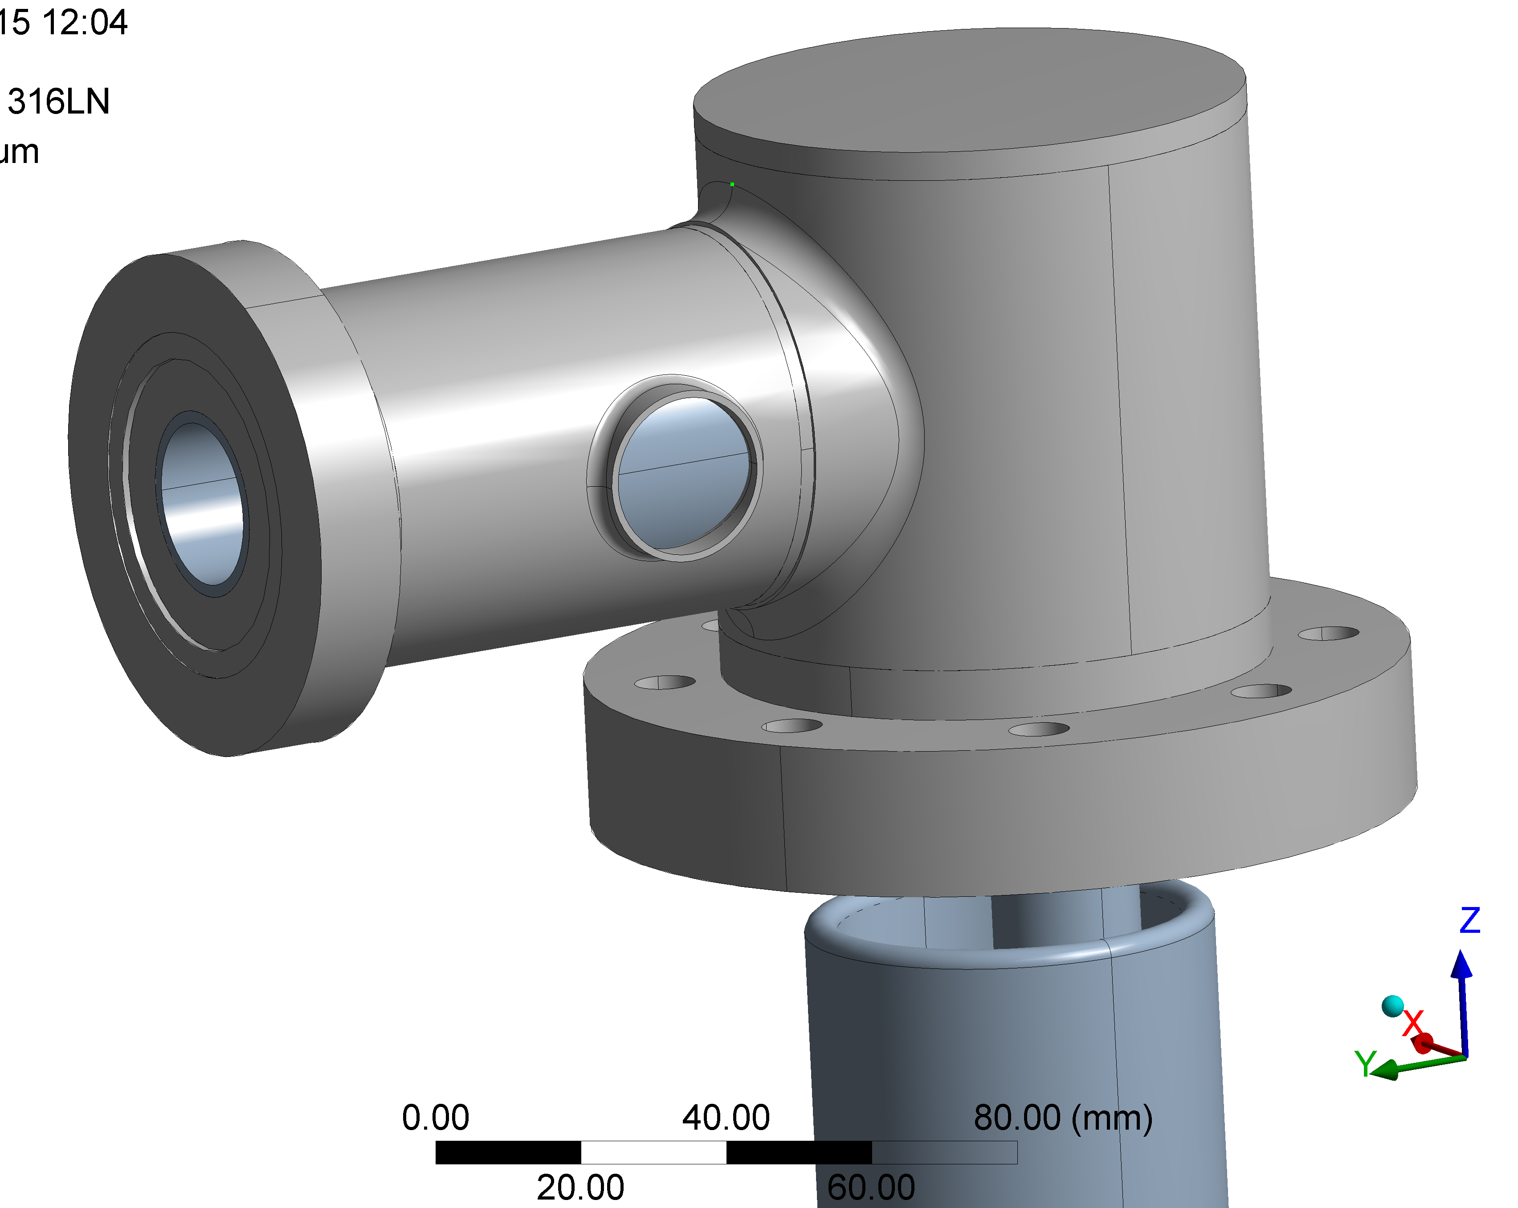
Thermostruct. Calcs: HOM
Two Geometries: w. & w/o Bellow

Slide 13
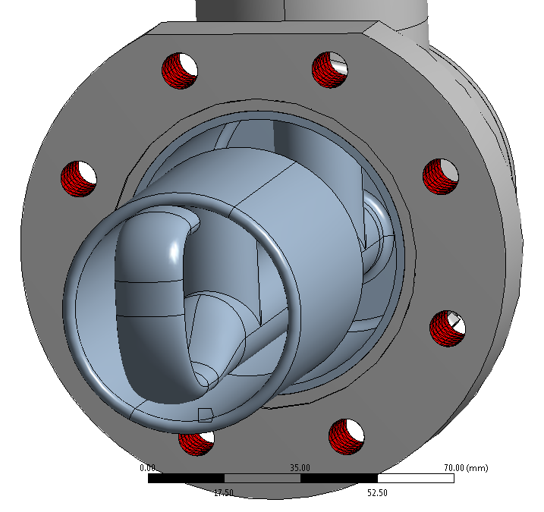
Thermostruct. Calc: Load Cases
 | Load Value | Verification criteria
Normal Operation (Load Case #1) | No pressure Thermal Contraction: 300K → 2K Coax Line: 20 N | Displacement of the hook (wrt the flange). Total budget 0.5 mm
Maximum Stress (Load Case #2) | Internal pressure: 0.18 MPa Thermal Contraction: 300K → 2K Coax Line (w/ margin): 50 N | Yield strength at 2K
Maximum Stress (Load Case #3) | Internal pressure: 0.18 MPa Coax Line (w/ margin): 50 N | Yield strength at 300K
Further Assumptions:
Nb-316LN welds not modeled (bonded contact in the flange internal cylinder).
Uniform temperature.
Neglected temperature dependence of Elastic modulus and Poisson’s ratio.
Constrained Displacement in the bolt holes of the horizontal flange.
Deformable option activated
(allows thermal contraction)
No constraint on the vertical flange.

Slide 14
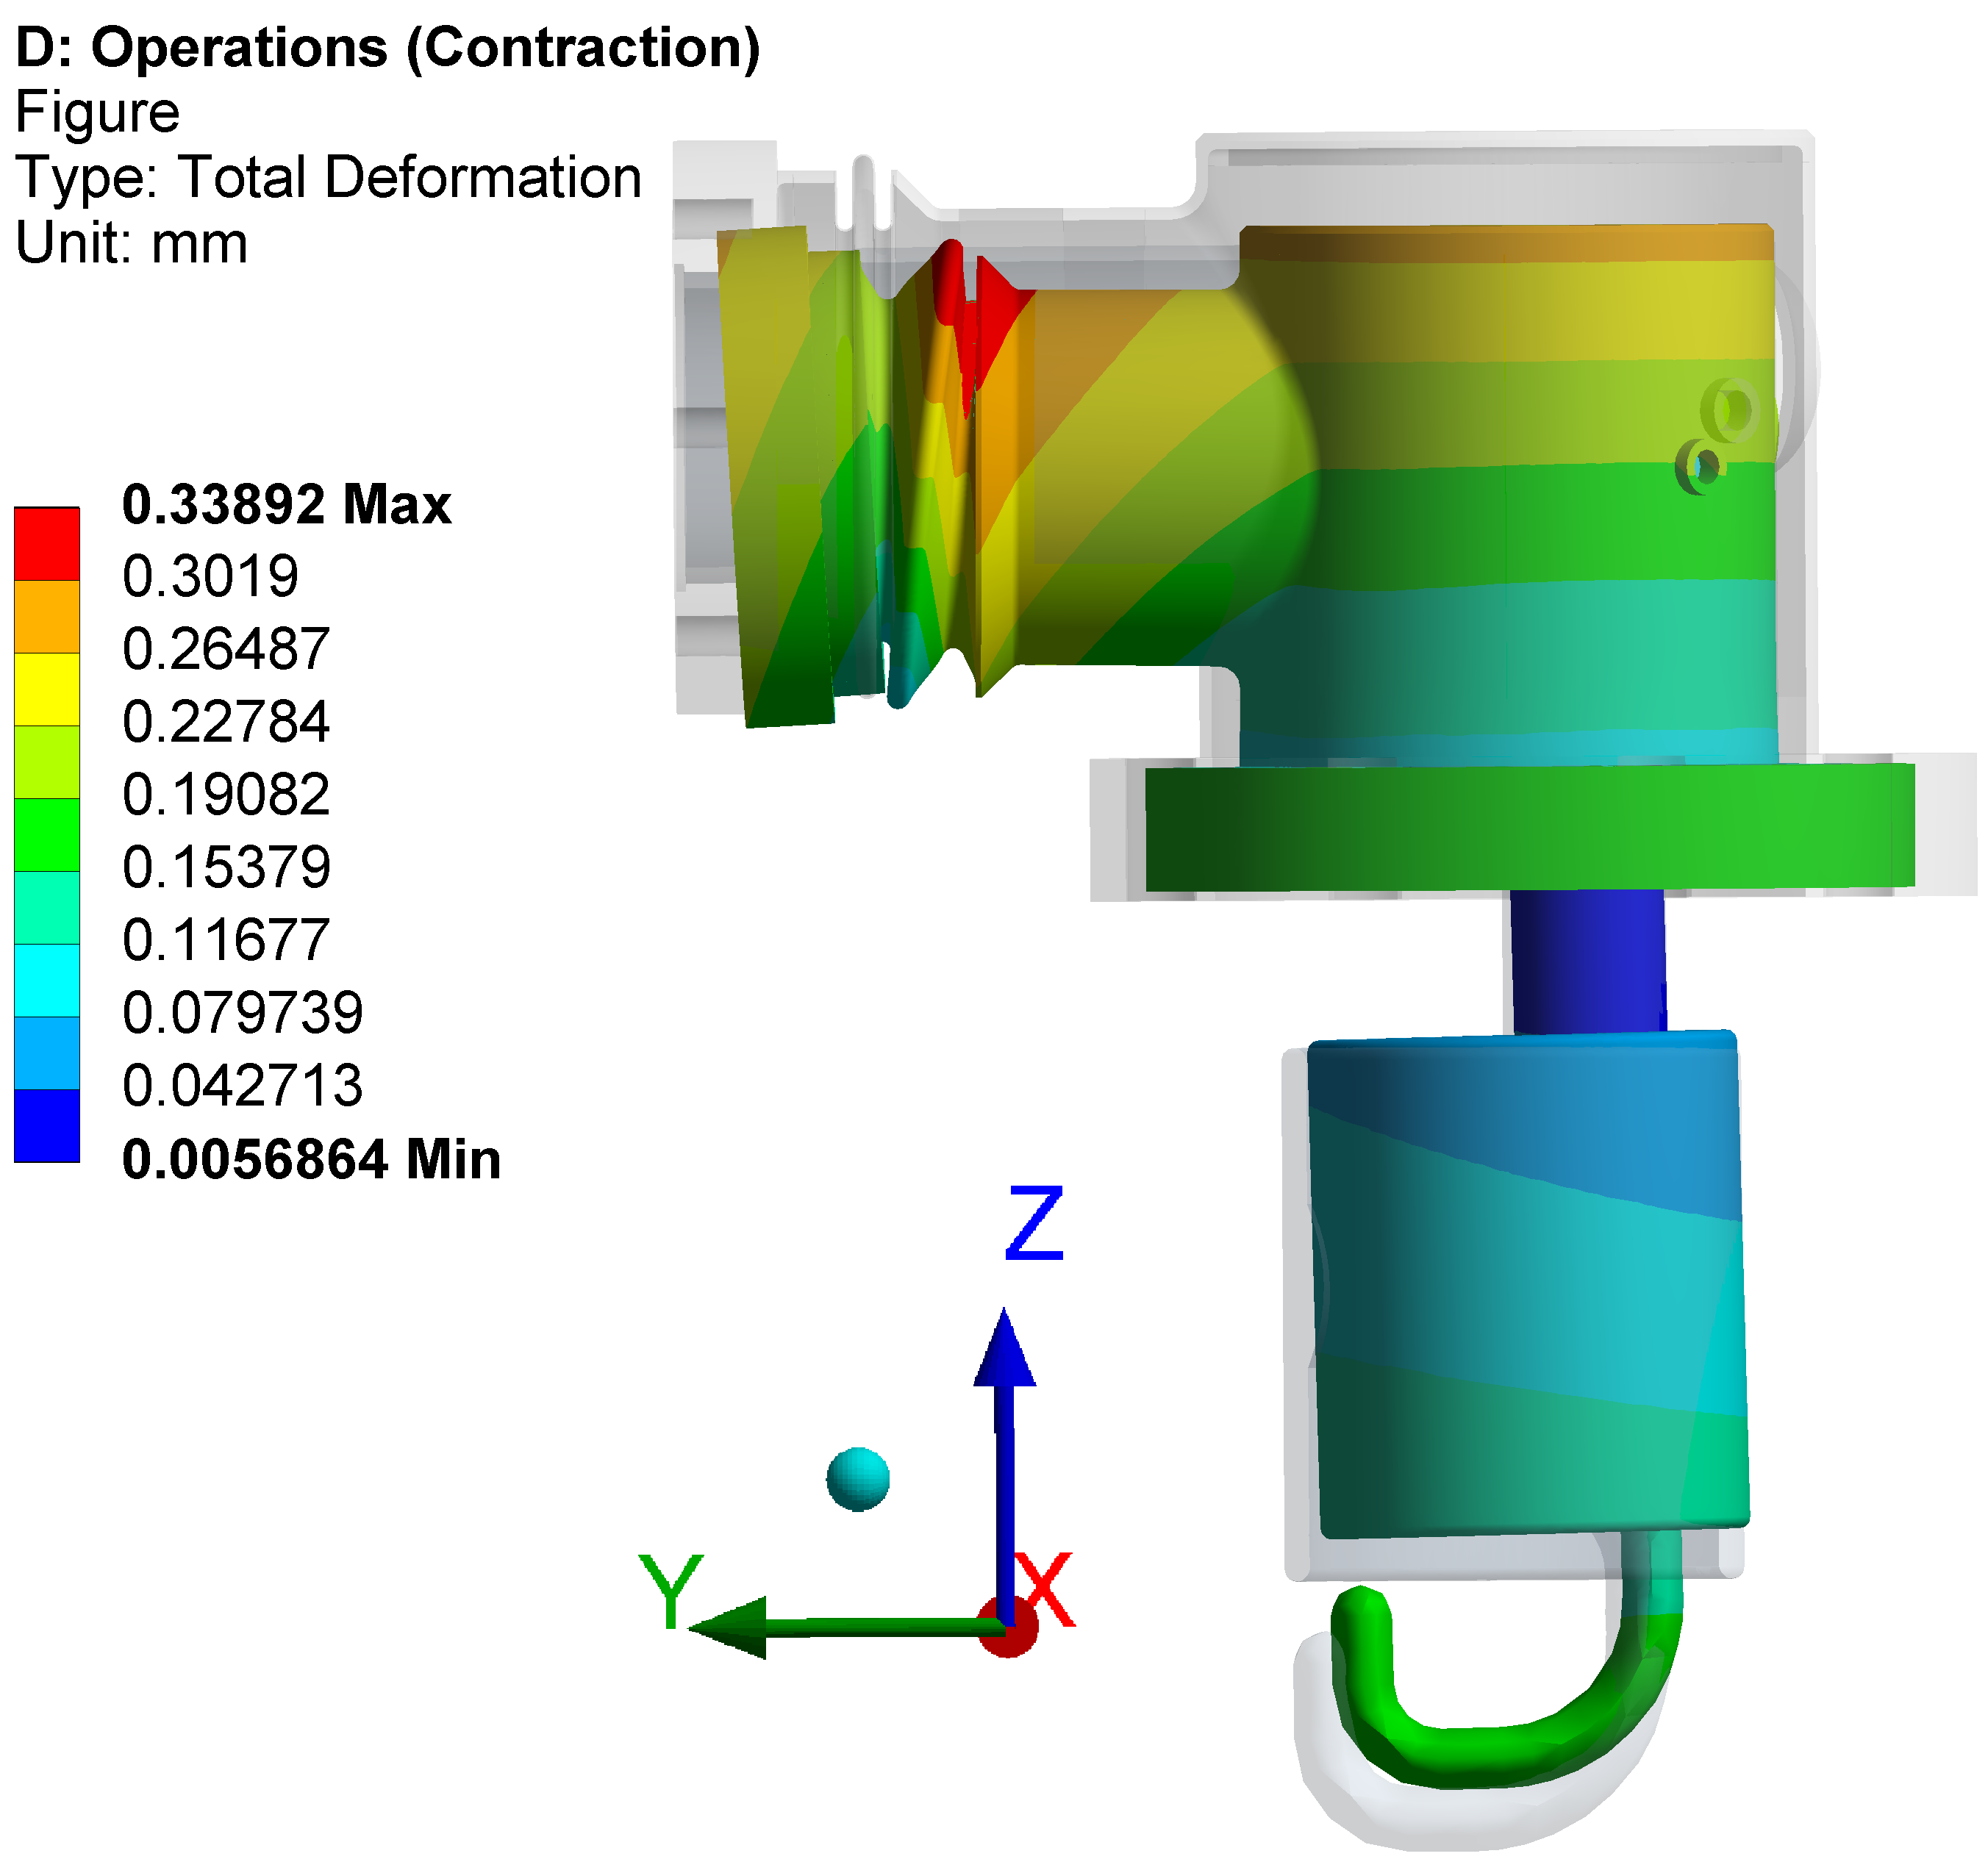
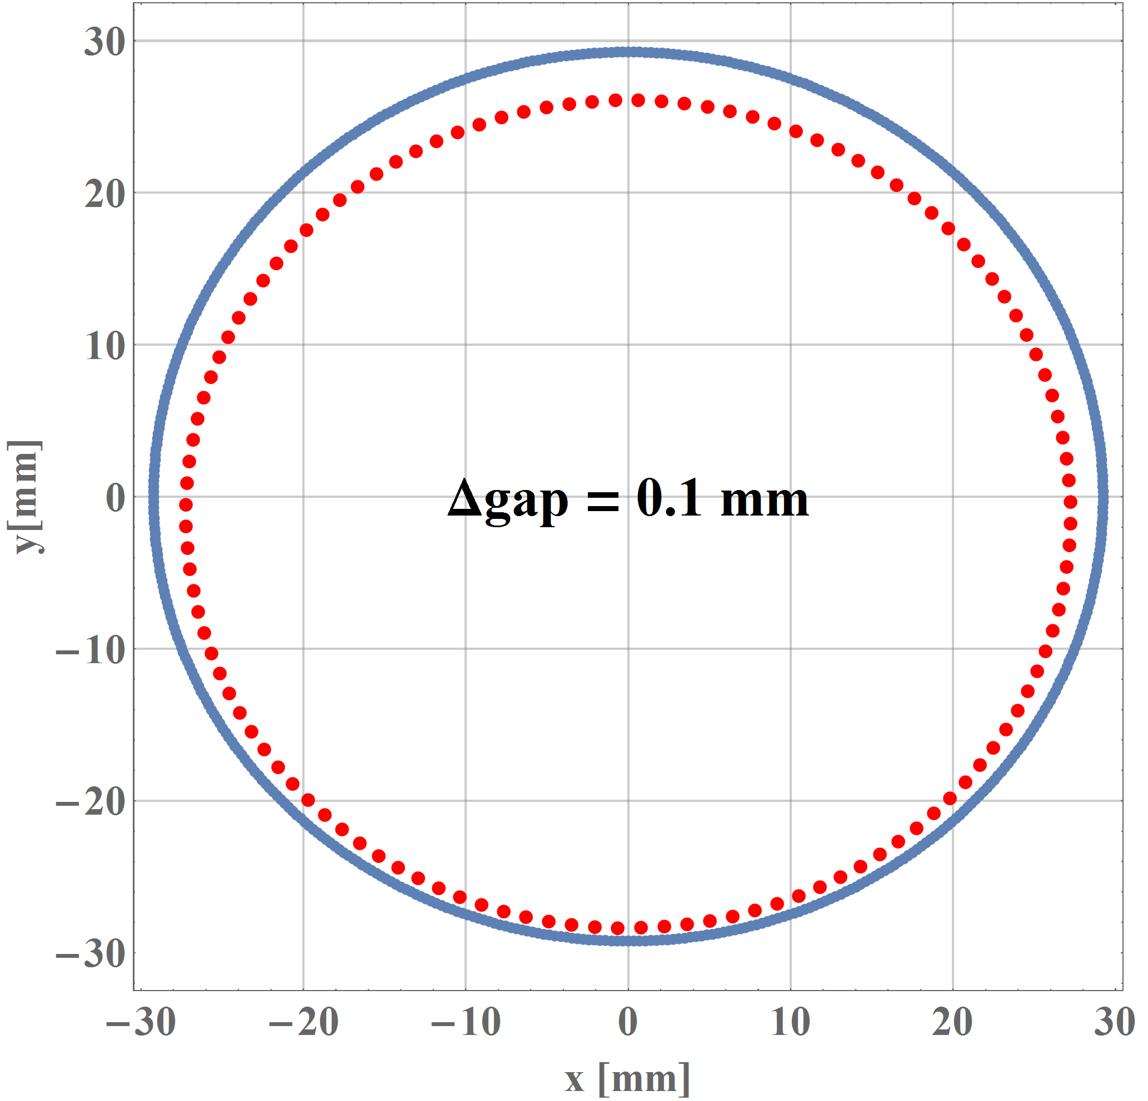
With Bellows - Load Case #1
Nominal gap = 3 mm
Deformed gap = 2.9 mm
0.1 mm

Slide 15
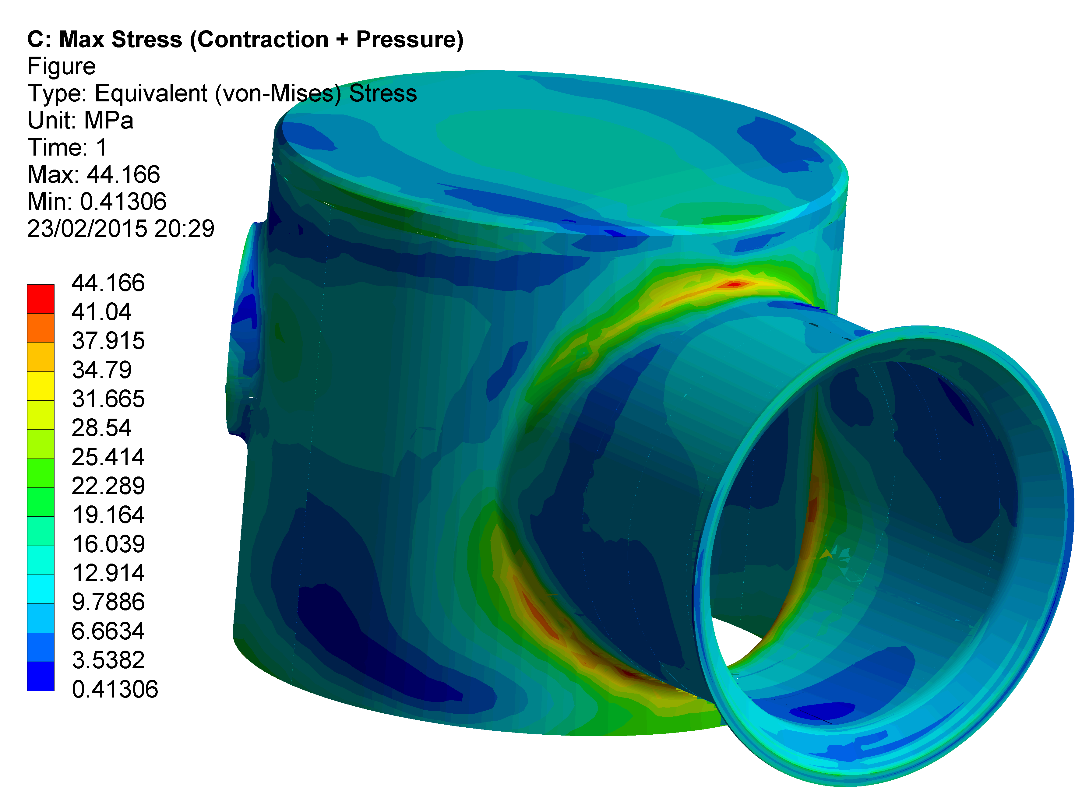
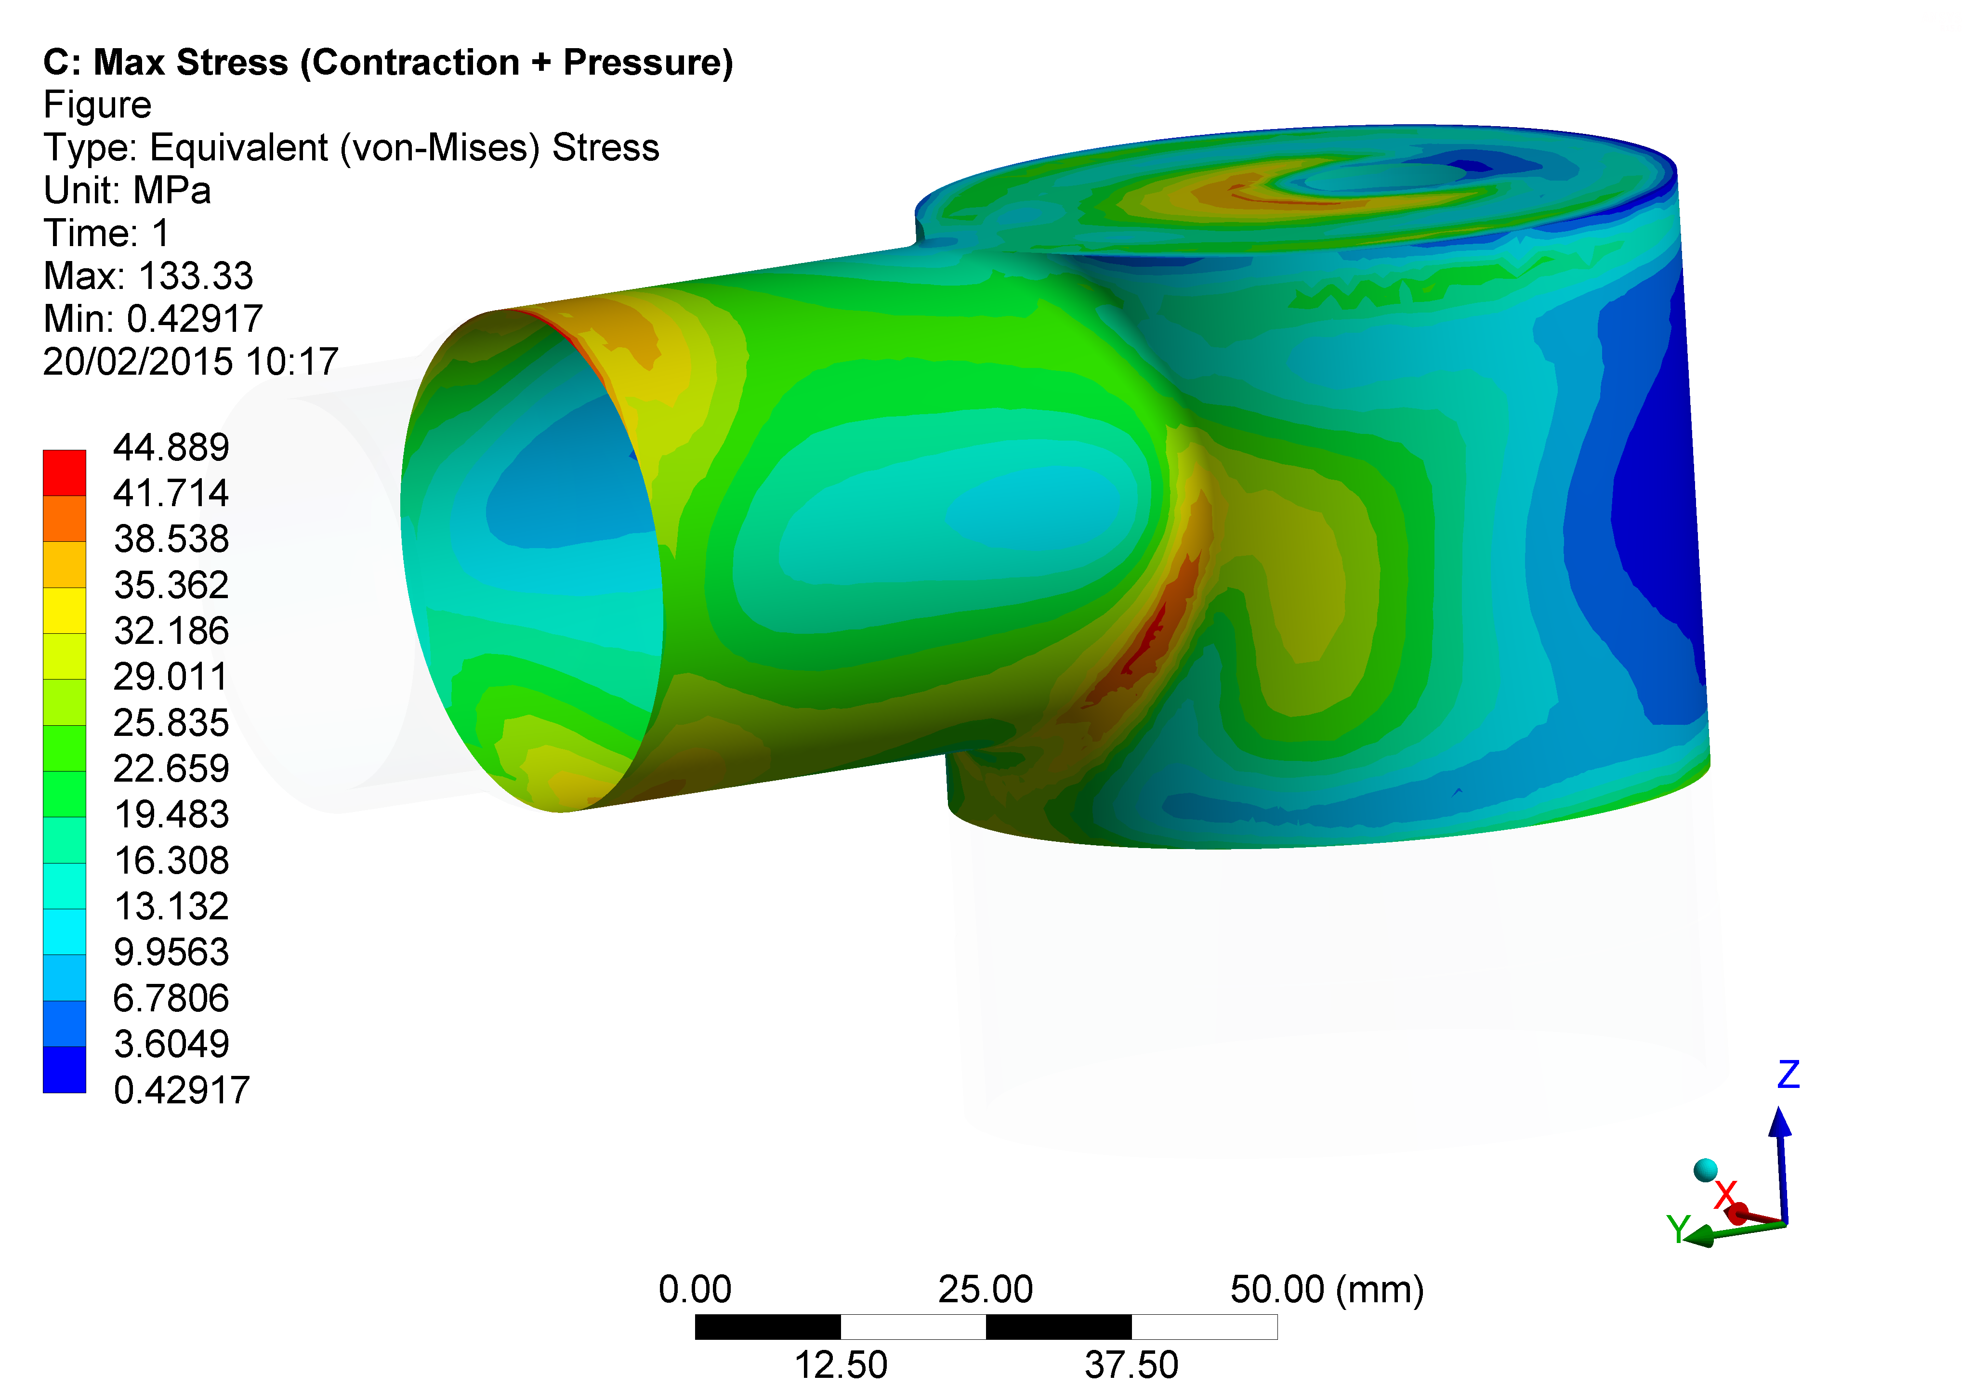
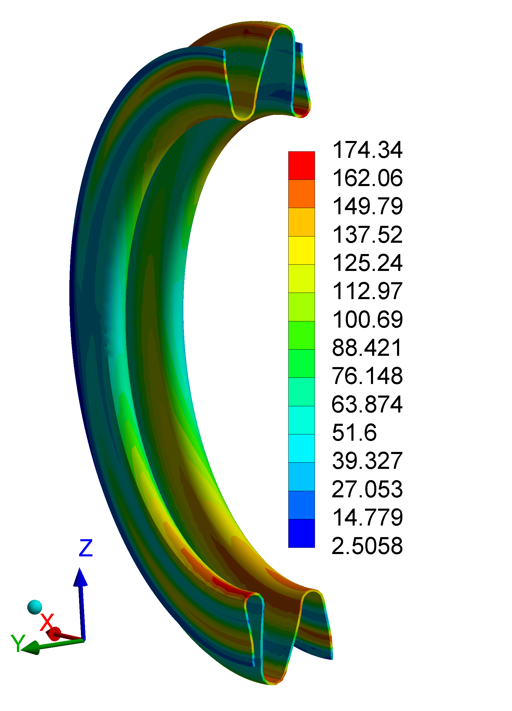
With Bellows - Load Case #2
Component | σ_{EQ_MAX} [MPa] | σ_{Yield}/1.5 [MPa]
SS | 44 | 570^{[5]}
Bellows | 174 | 320 ^{[6]}
Nb | 45 | 320^{[5]}

Slide 16
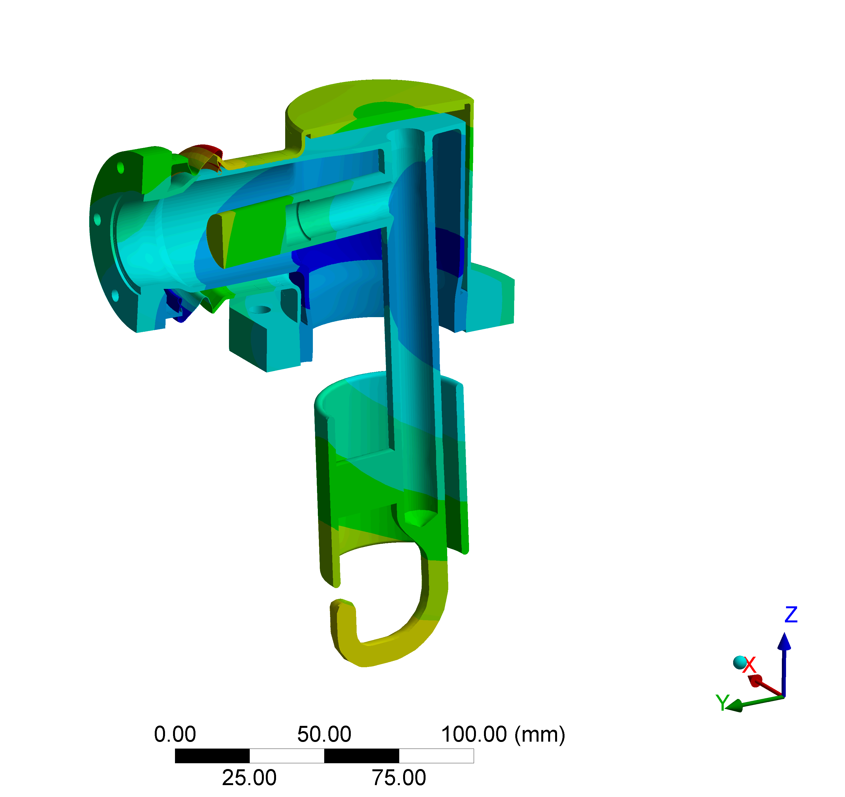
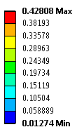
With Bellows - Load Case #2
35x magnification

Slide 17
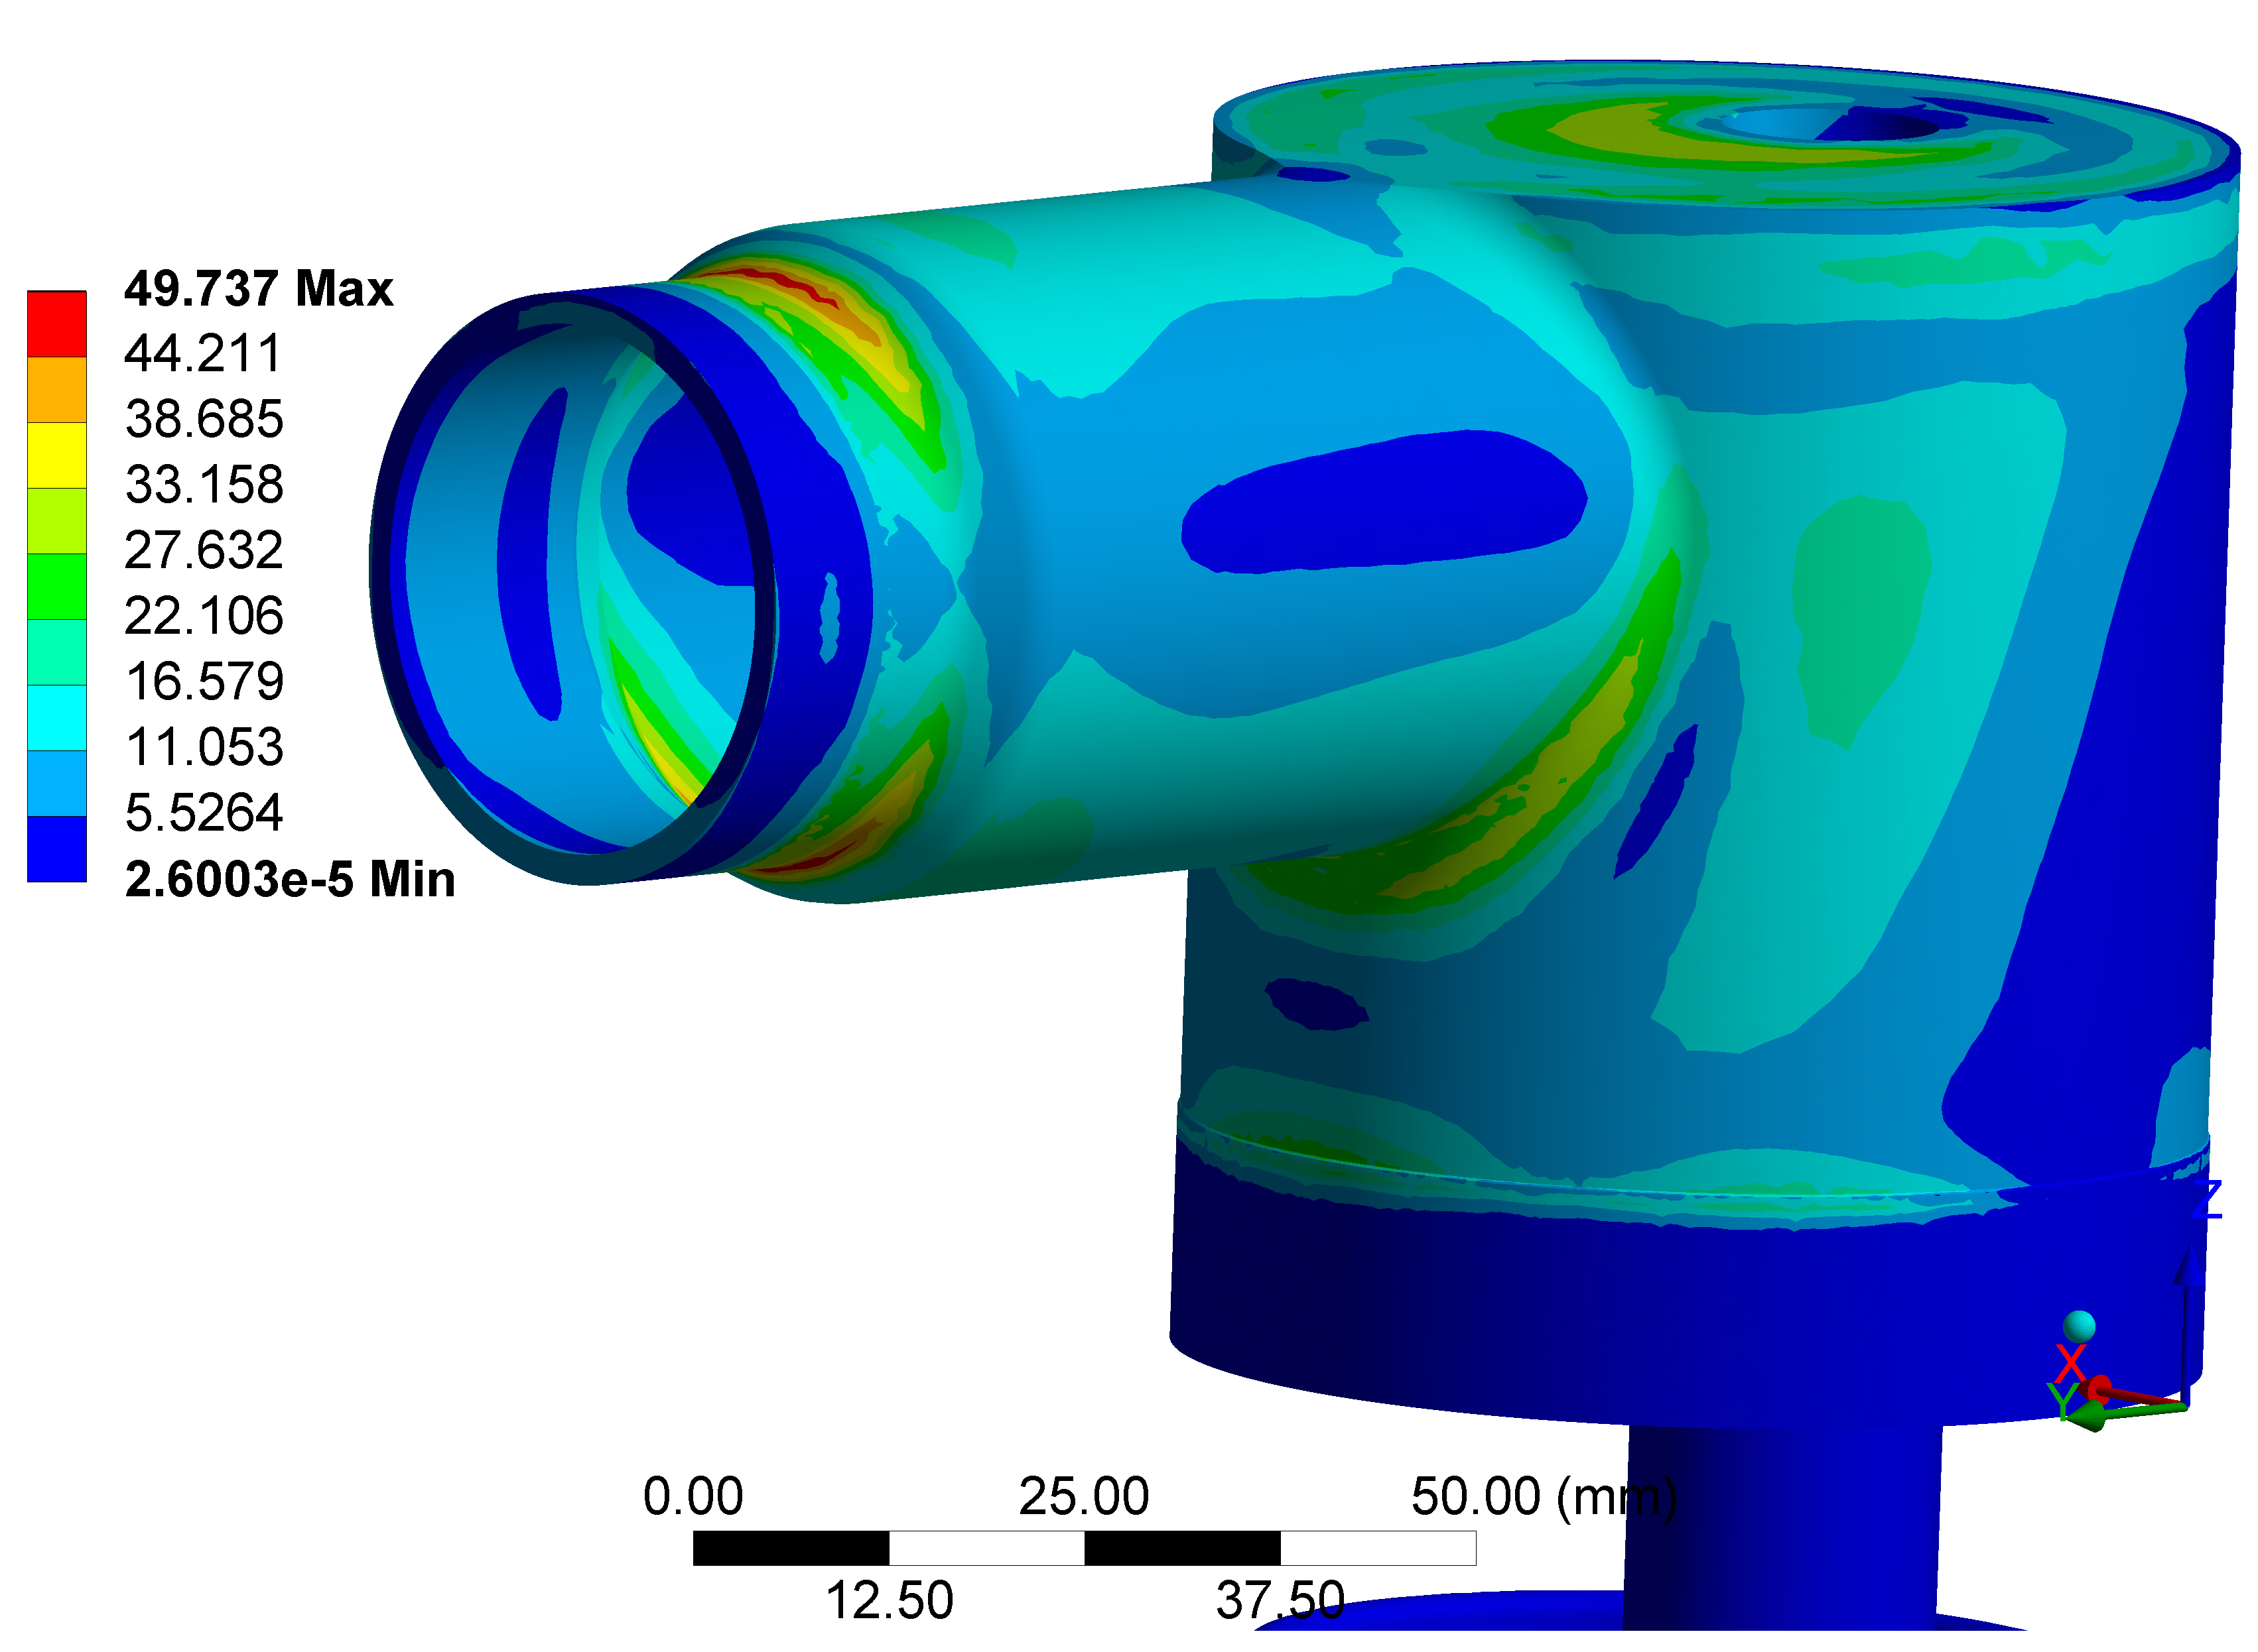
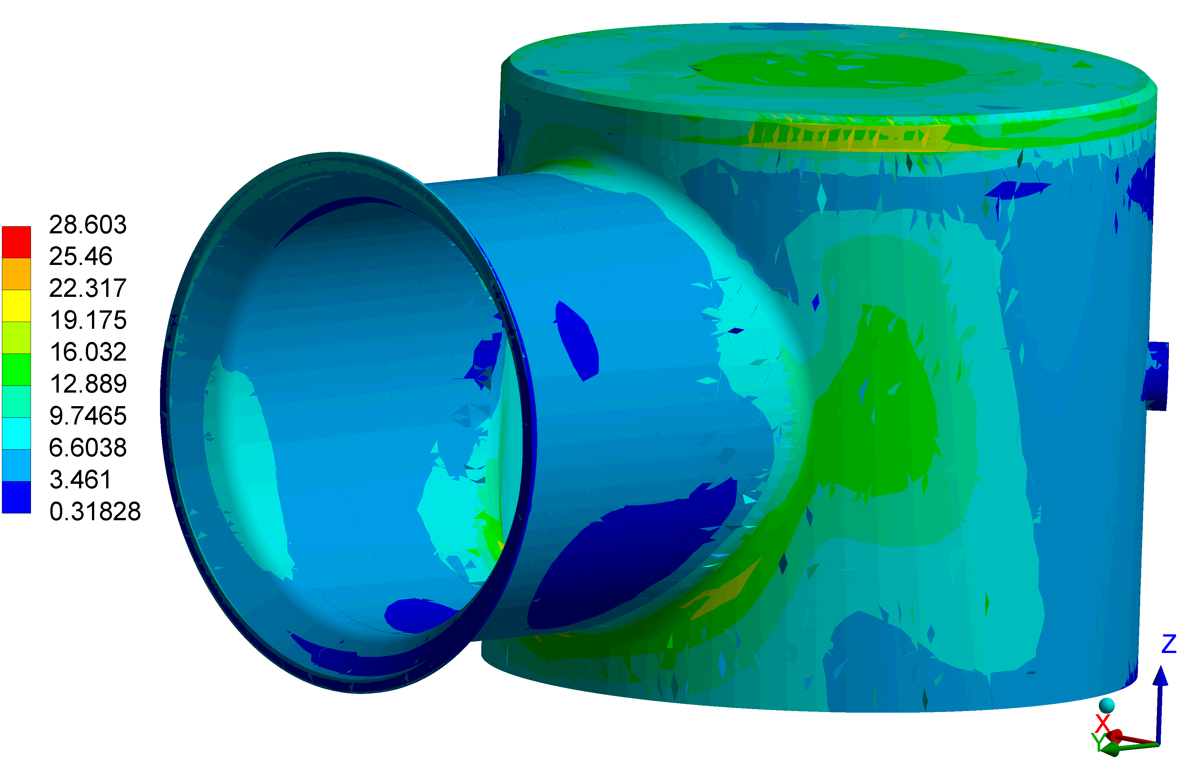
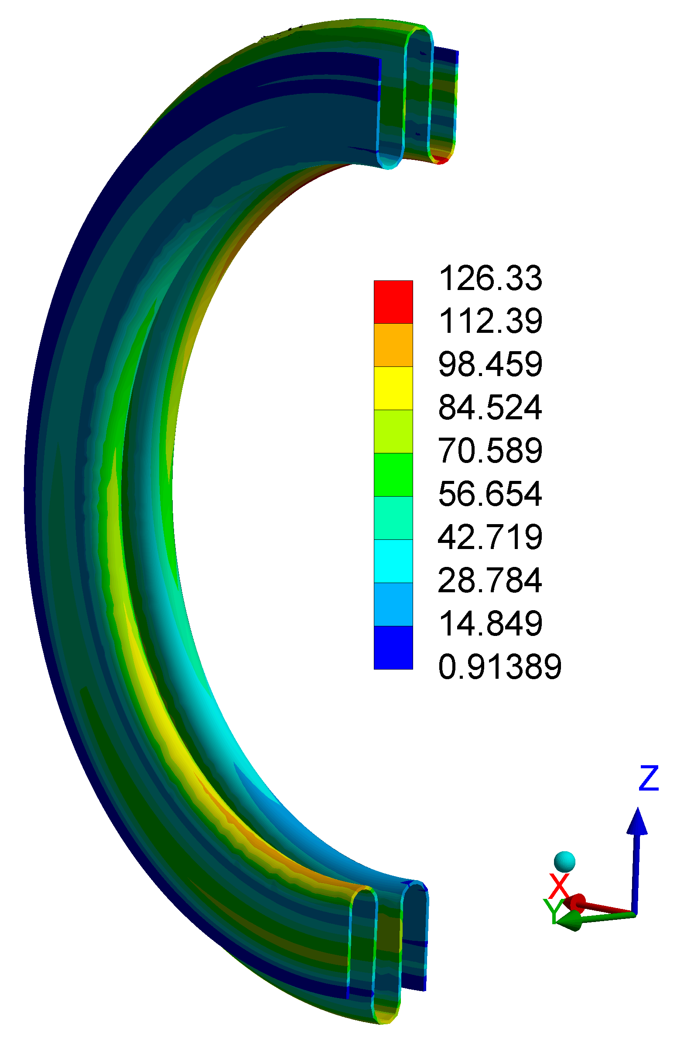
With Bellows - Load Case #3
Component | σ_{EQ_MAX} [MPa] | σ_{Yield}/1.5 [MPa]
SS | 28 | 190^{[5]}
Bellow | 126 | 160^{[6]}
Nb | 49 | 50^{[5]}

Slide 18
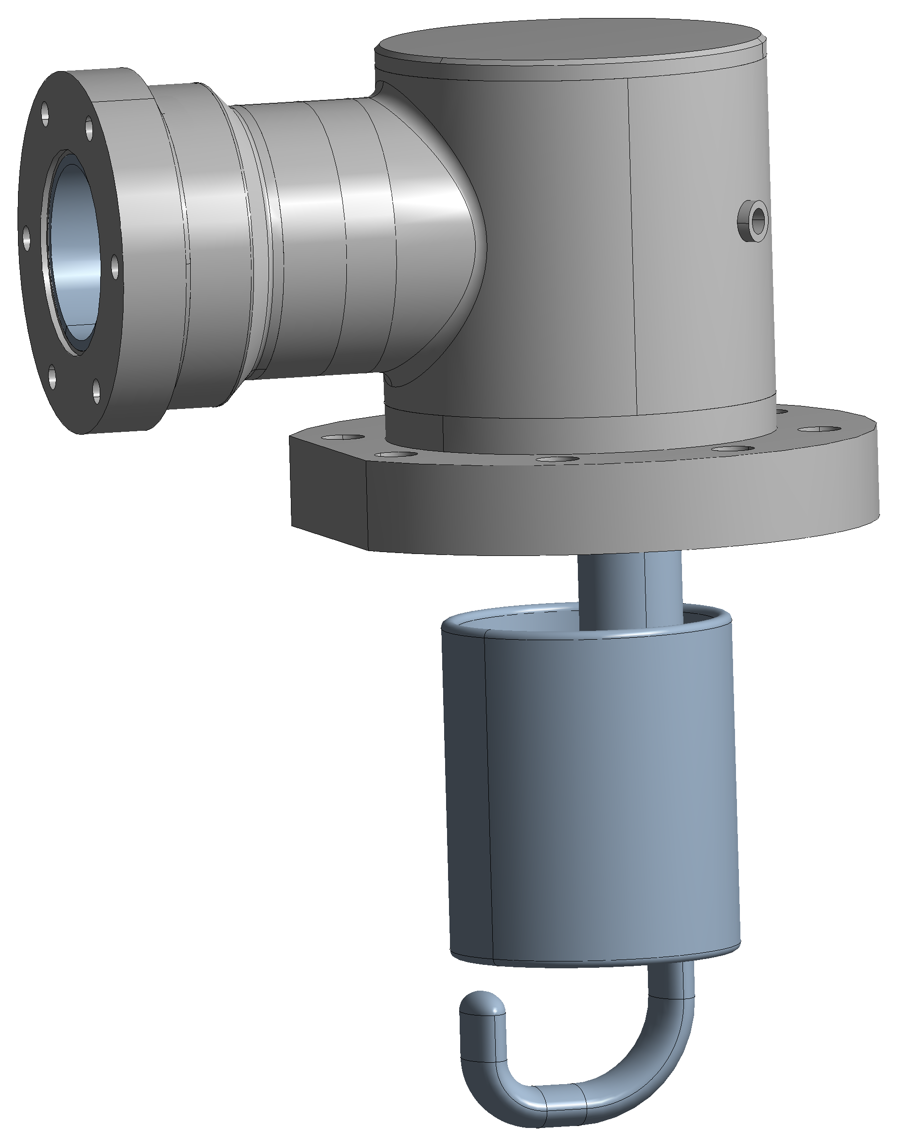
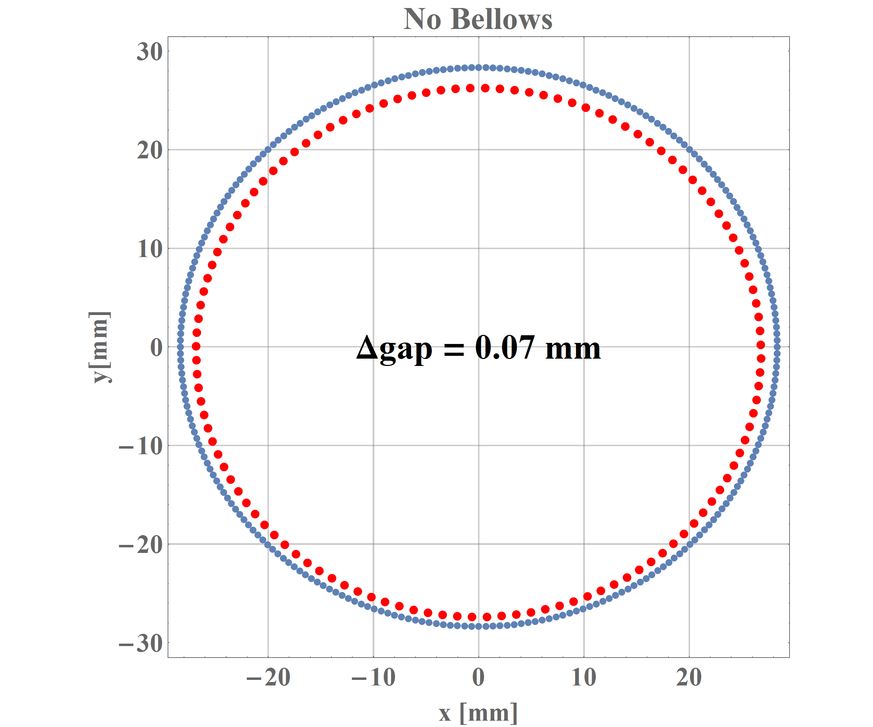
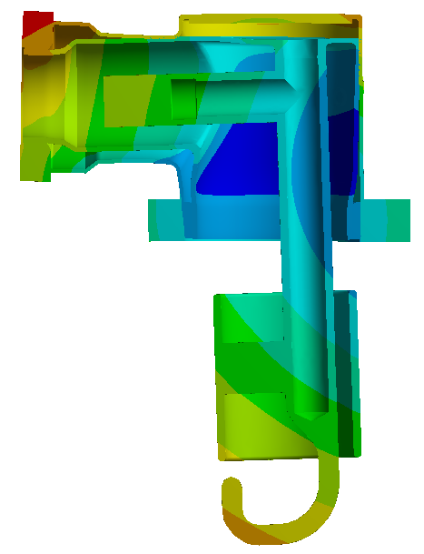
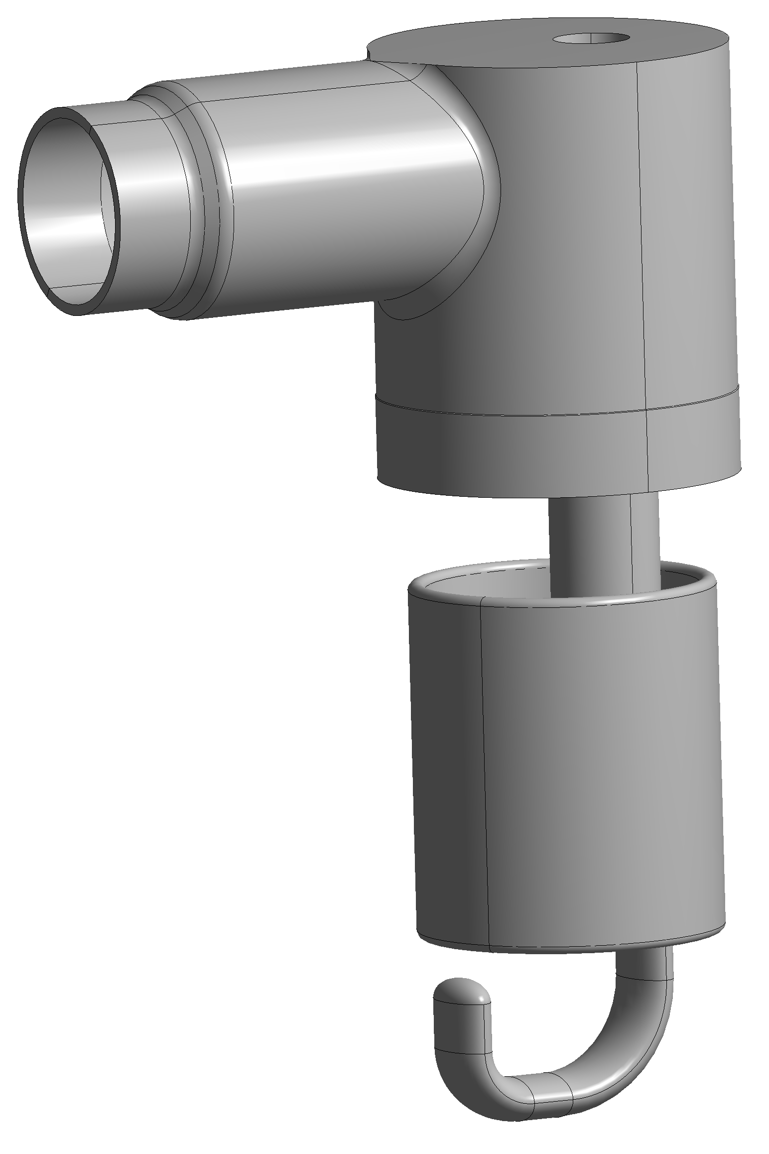
NO Bellows - Load Case #1
0.07mm

Slide 19
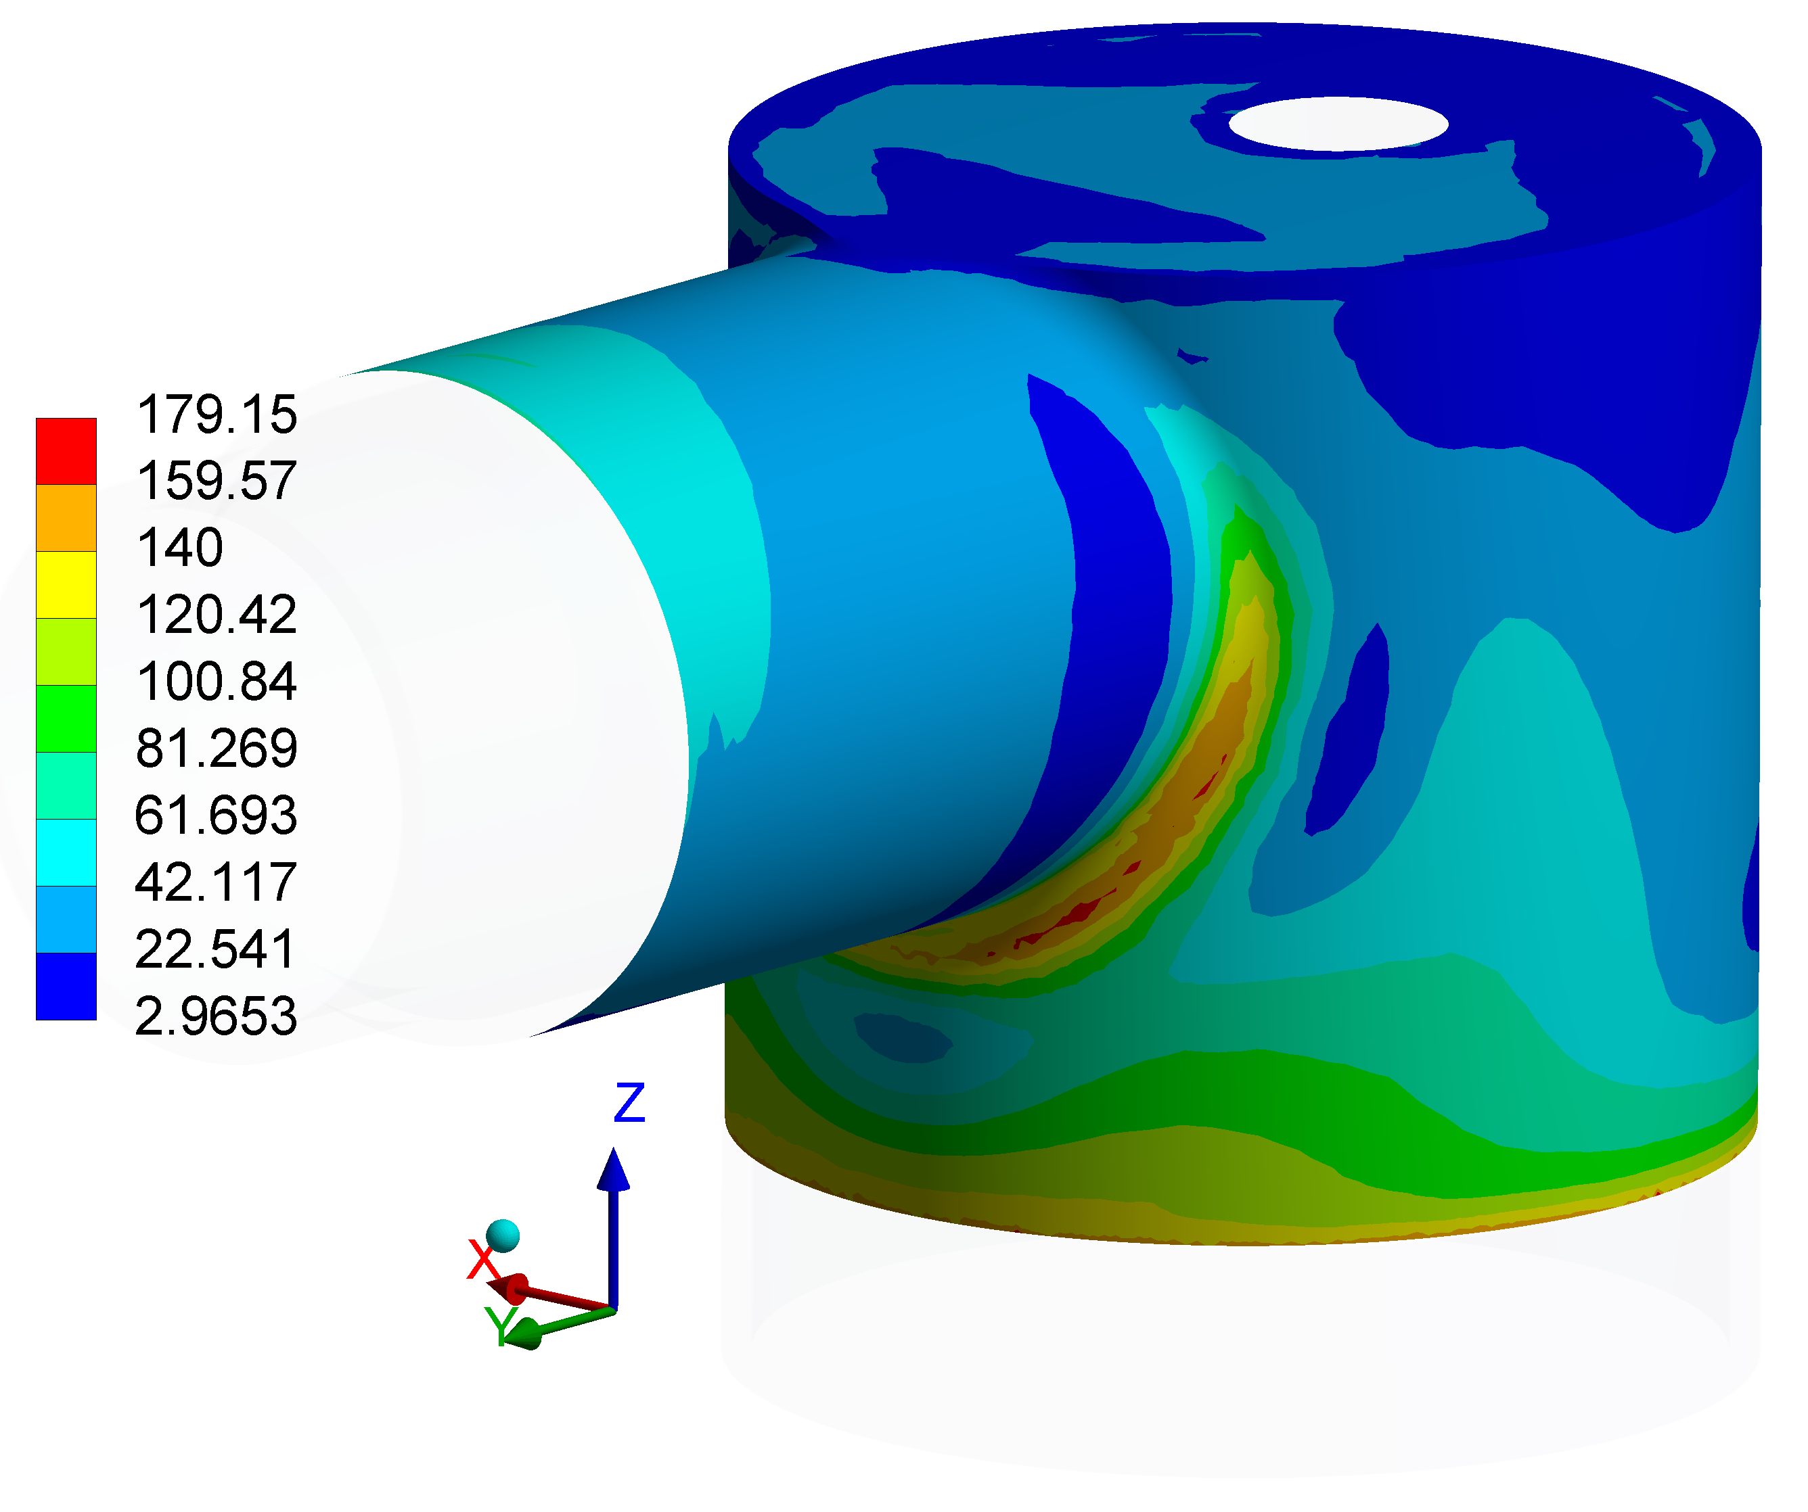
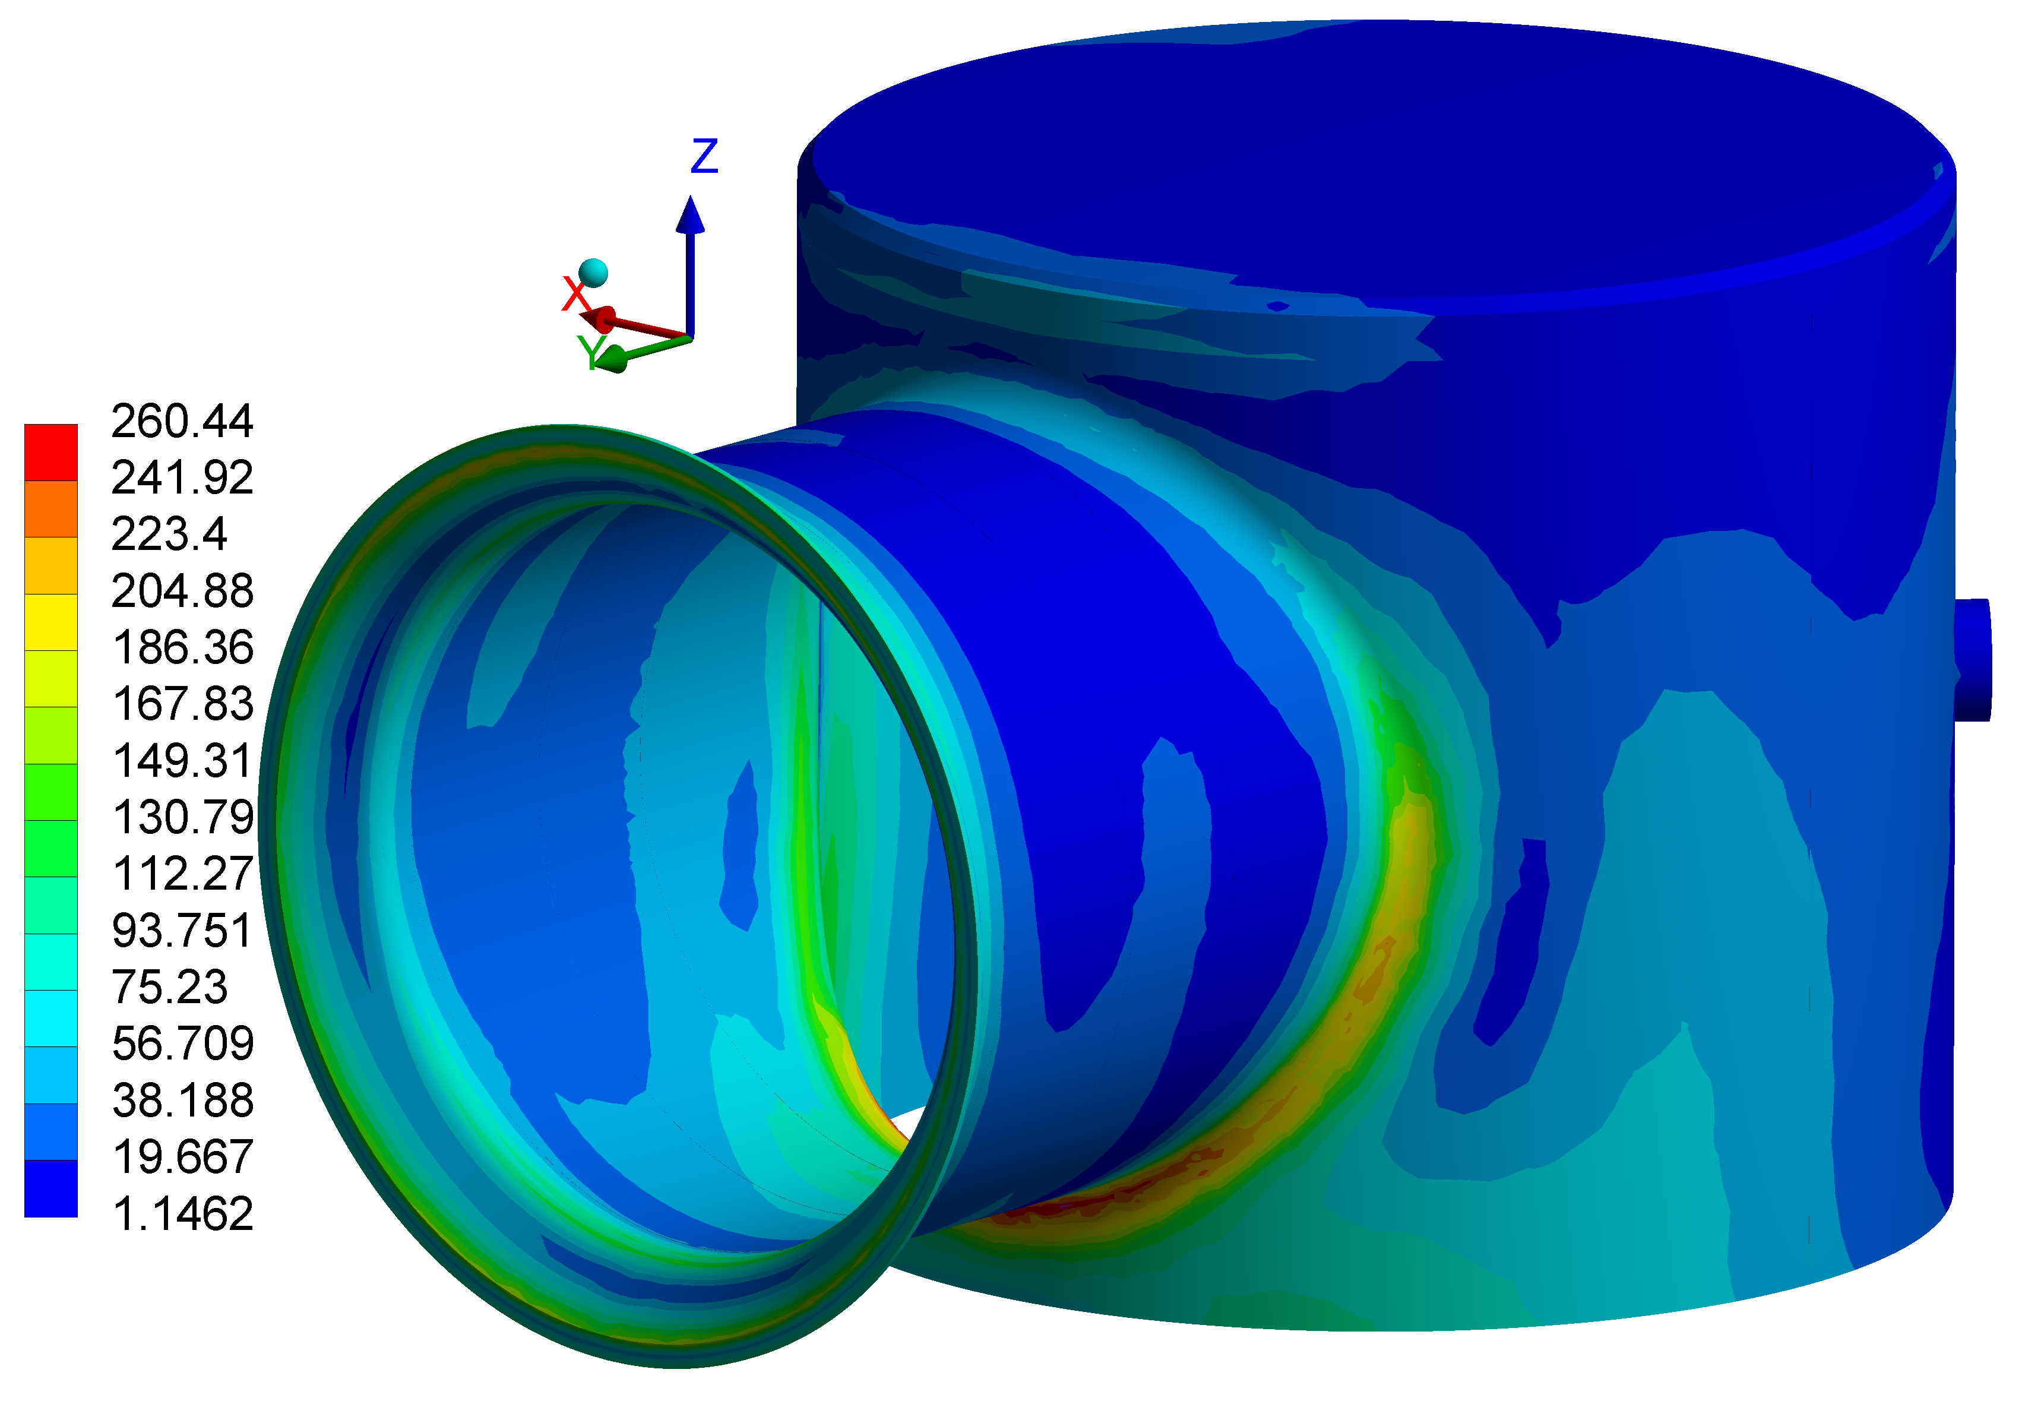
NO Bellows - Load Case #2
Component | σ_{EQ_MAX} [MPa] | σ_{Yield} /1.5 [MPa]
SS | 260 | 570^{[5]}
Nb | 179 | 320^{[5]}

Slide 20
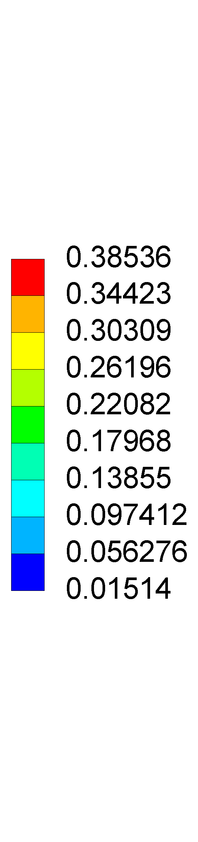
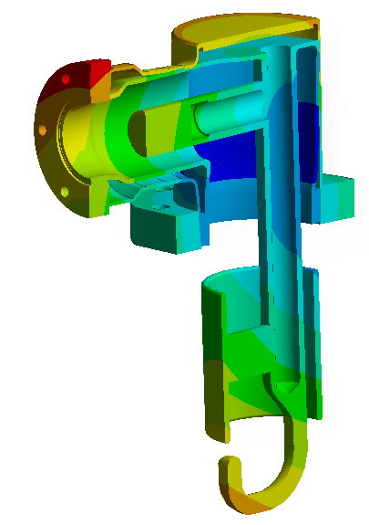
NO Bellows - Load Case #2
35x magnification

Slide 21
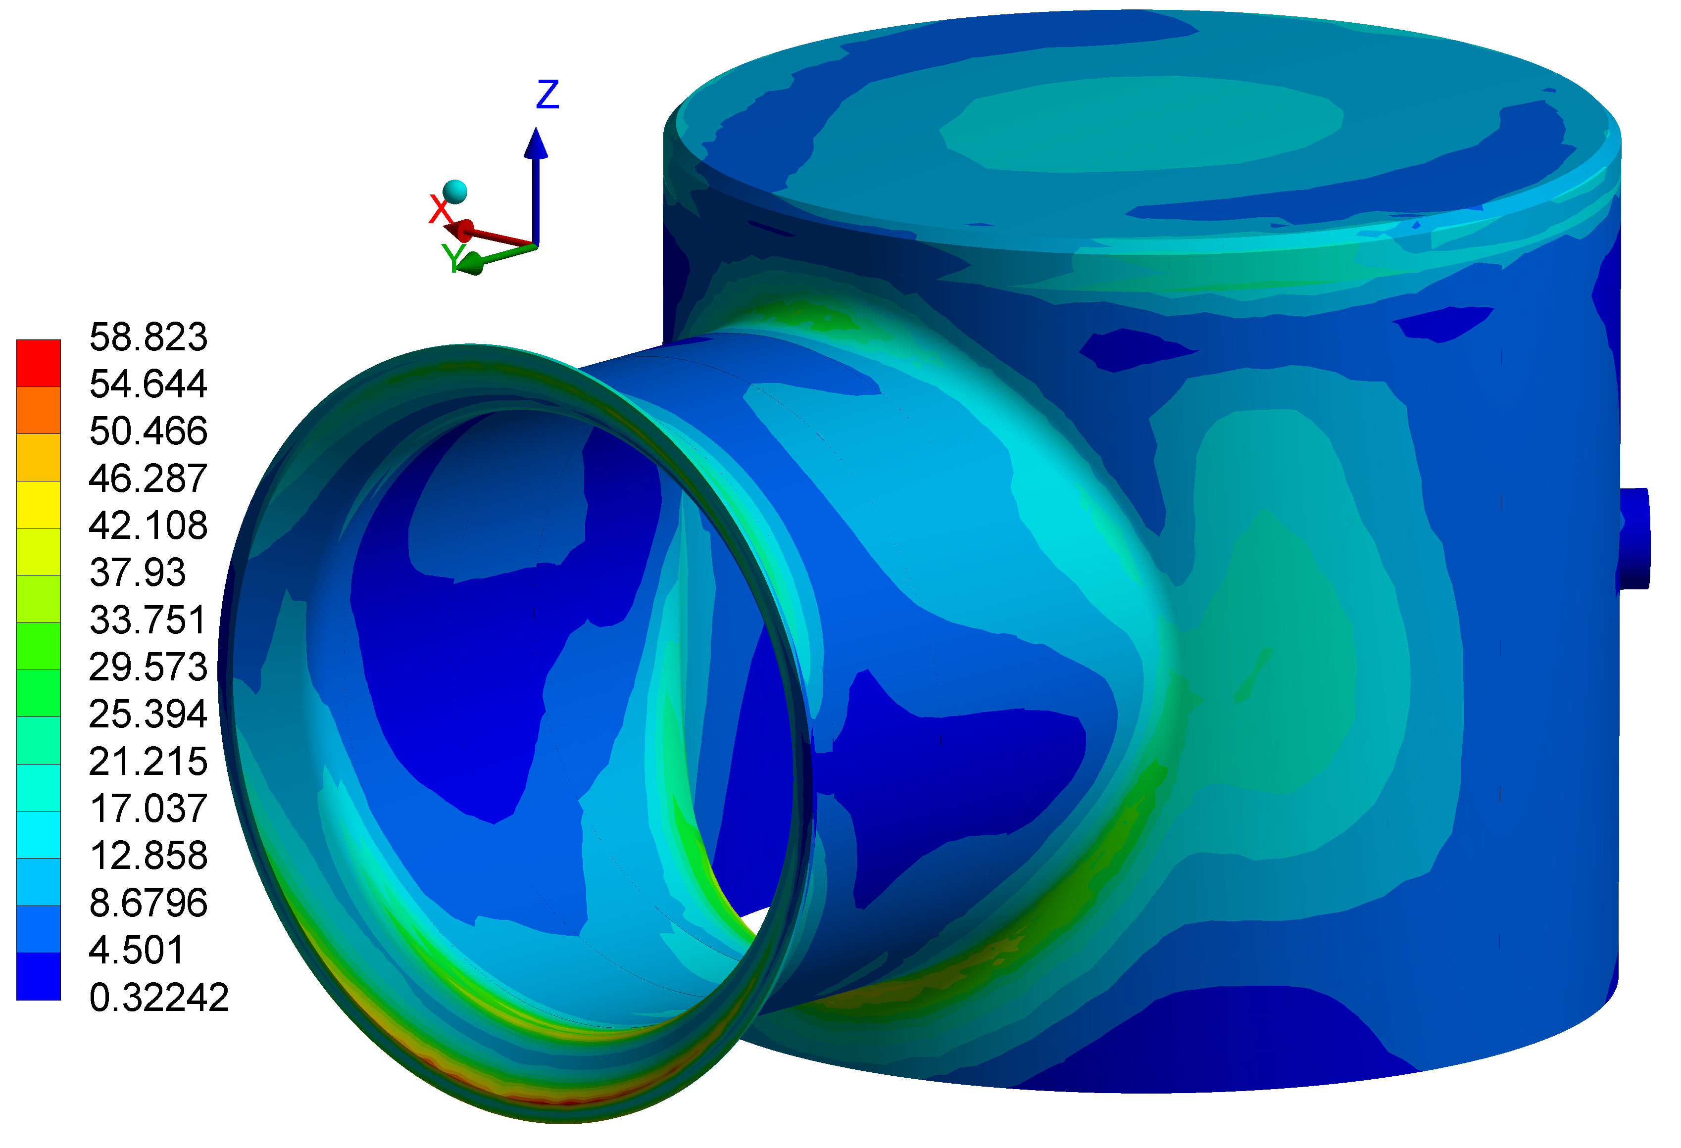
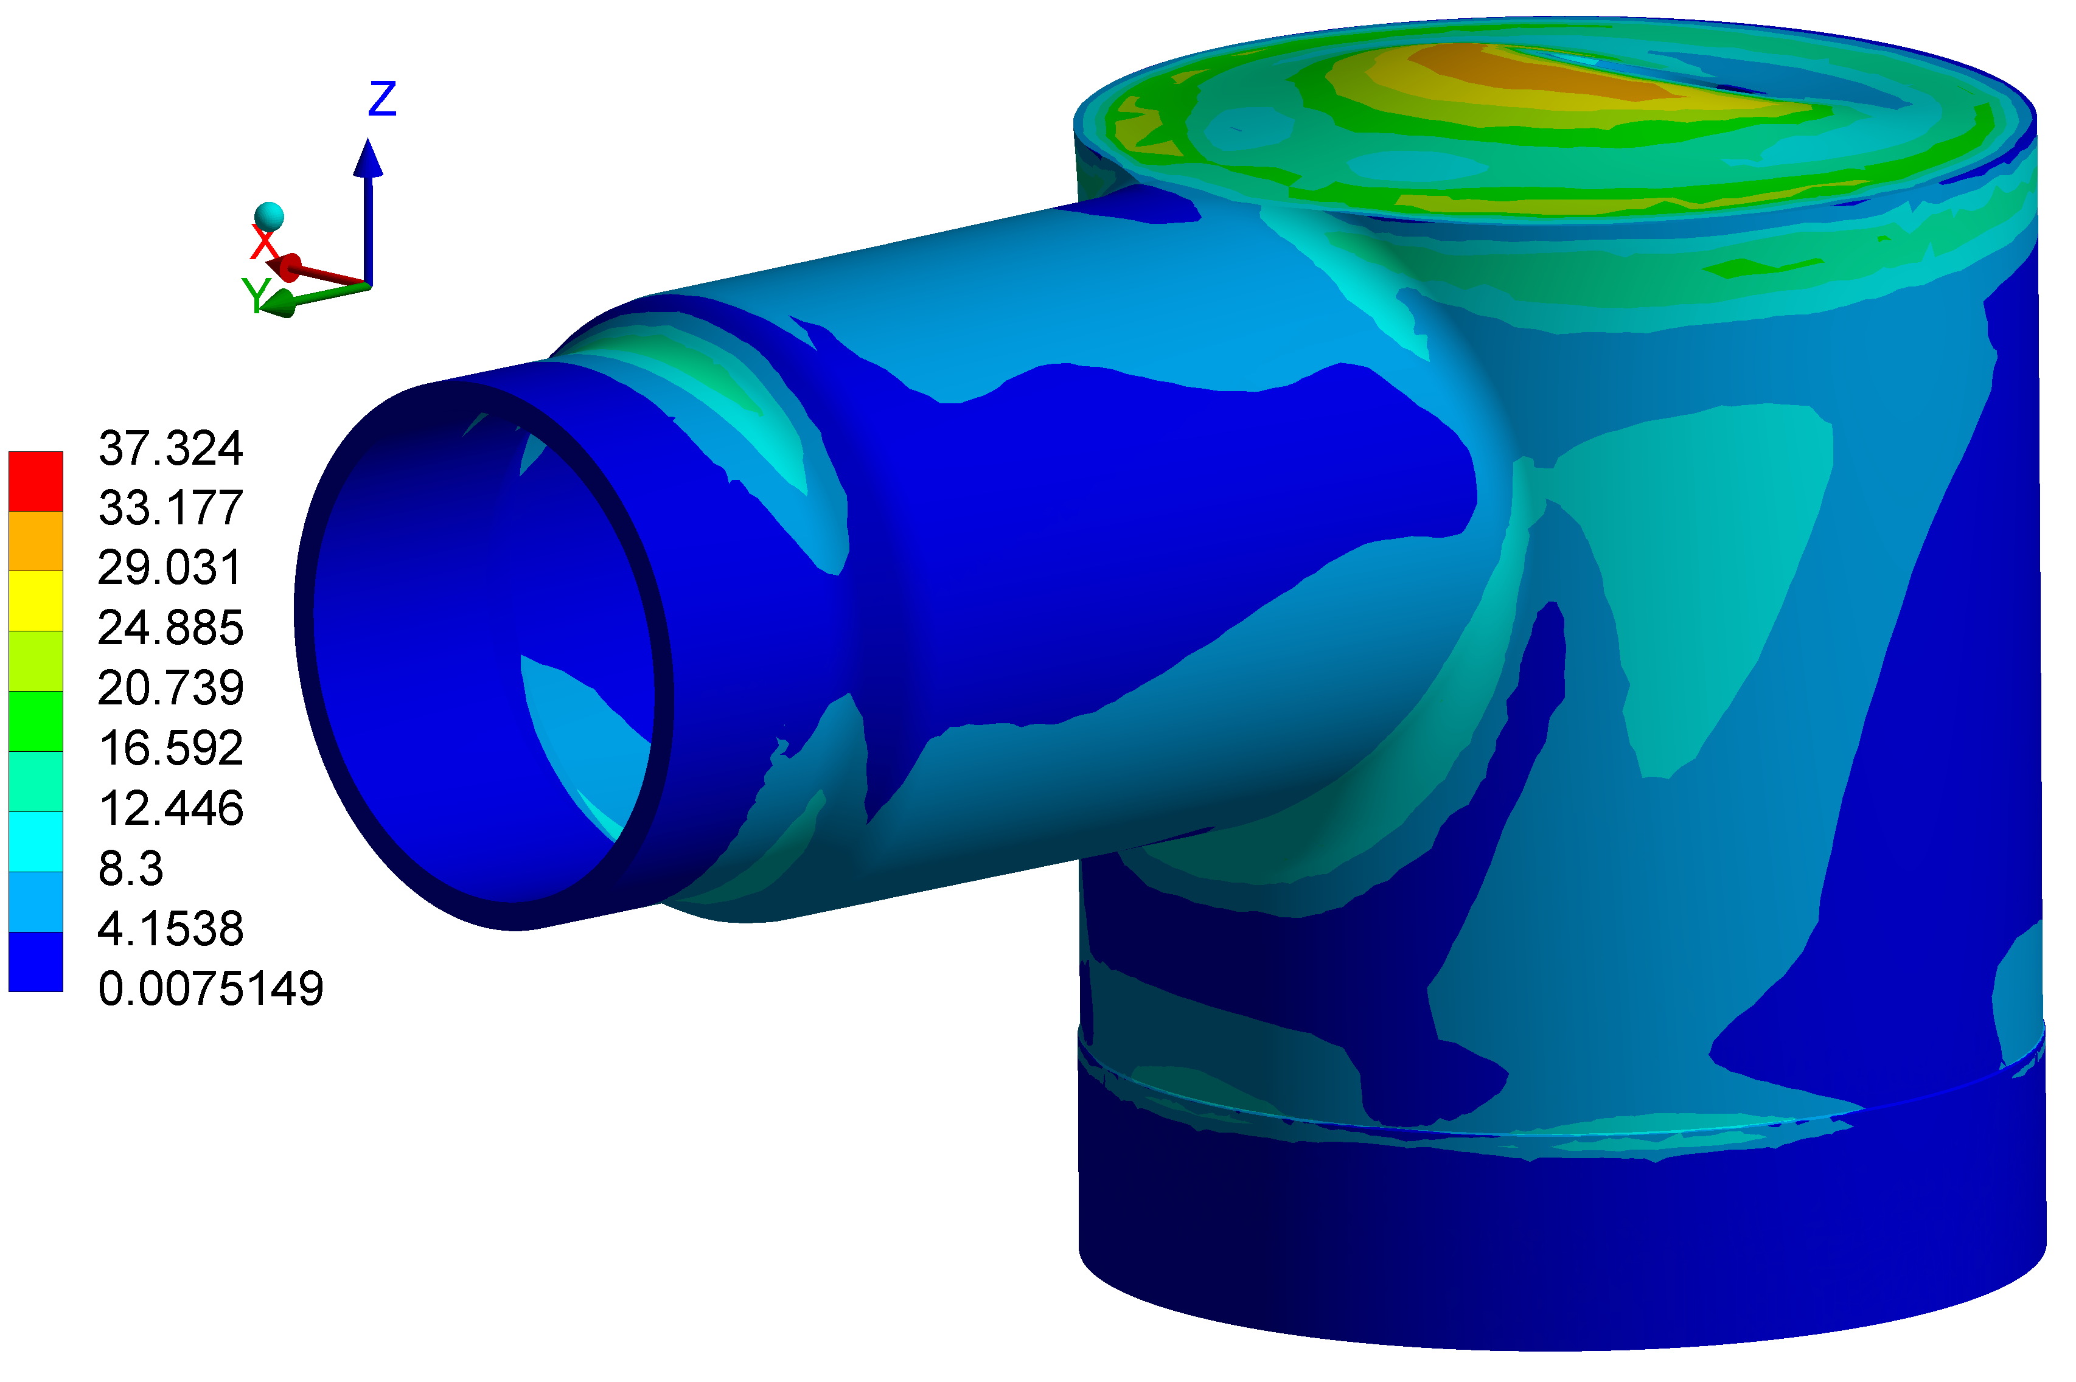
NO Bellows - Load Case #3
Component | σ_{EQ_MAX} [MPa] | σ_{Yield}/1.5 [MPa]
SS | 58 | 190^{[5]}
Nb | 37 | 50^{[5]}

Slide 22
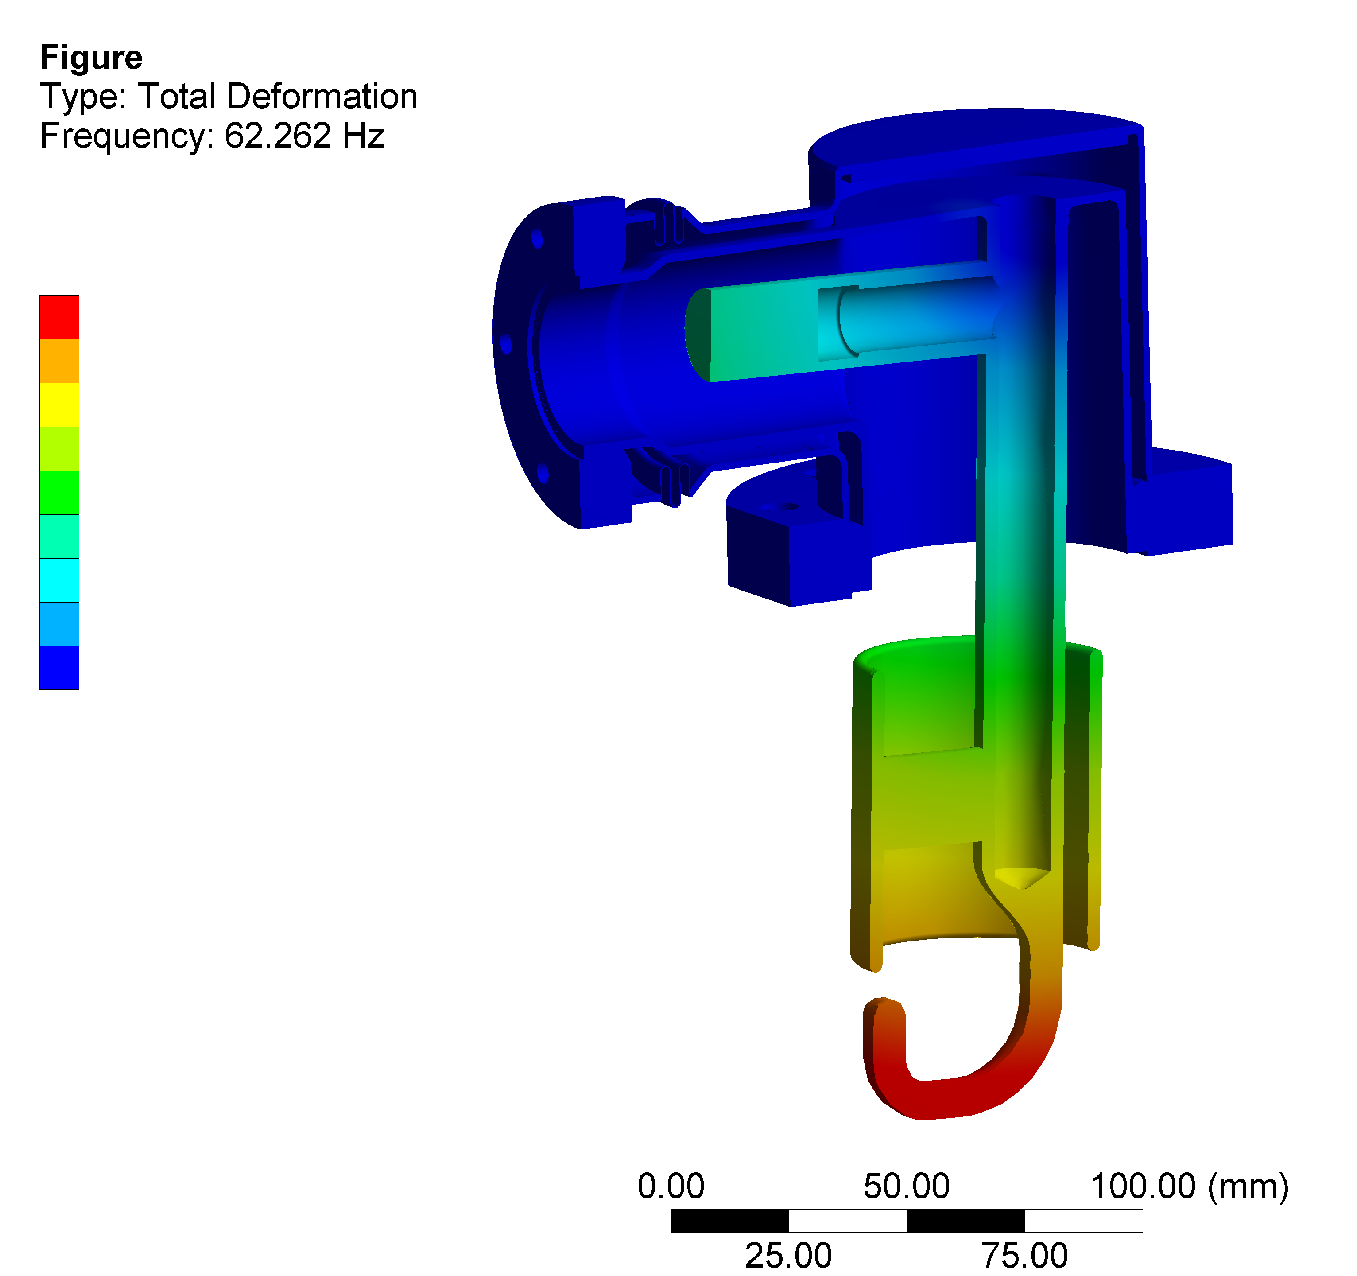
Modal
 | Load Value | Verification criteria
Modal (Load Case #3) | - | > 50 Hz
Displ. Gradient
1st mode: 62 Hz
(both w/ or w/o bellows)

Slide 23
HOM Calculations: Remarks
Thermal
COAX: internal & external cable Intercepts →~2W
Active He Cooling inside stem, able to evacuate P_{COAX}+P_{HOM}
HOM: Thermal calcs to be updated, no criticality expected
RRR_{min}= 250
Thermo-Structural
HOM design is compliant with the specified strength and deformation limits
Max 0.1mm relative displacement in the most critical area @ working condition

Slide 25
References
[1] Cryogenie, B.Hebral et al., pag. 11
[2] D. Vaucoret, Materials and Ansys Library for Design Office, EDMS 1291793.
[3] Tensile tests
[4] H. Kaiser, Ge. Meyer, H.B. Peters, and G. Weichert, “Helium Vessel for the TTF Cavity,” TESLA Collaboration Report 94–26, October 1994.
[5]Information provided by Ignacio Aviles Santillana.
[6] “Fatigue life prediction…bellows at cryogenic temperatures” B. Skoczenet al. , LHC Project Note 012
[7] CERN specification for 1.4435 (316L) for bellows : EDMS 790771
[1]“RF Superconductivity”, H. Padamsee, pag. 53

Slide 26
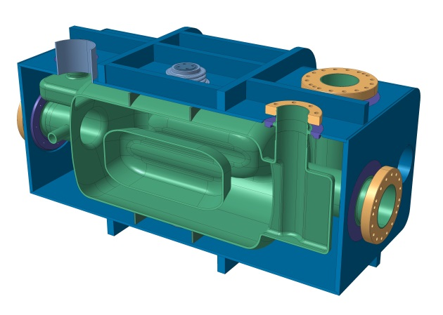
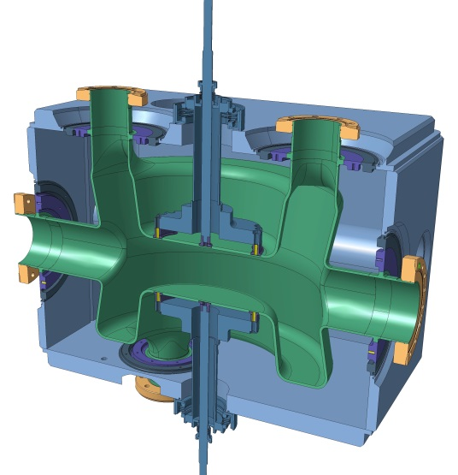

Slide 27
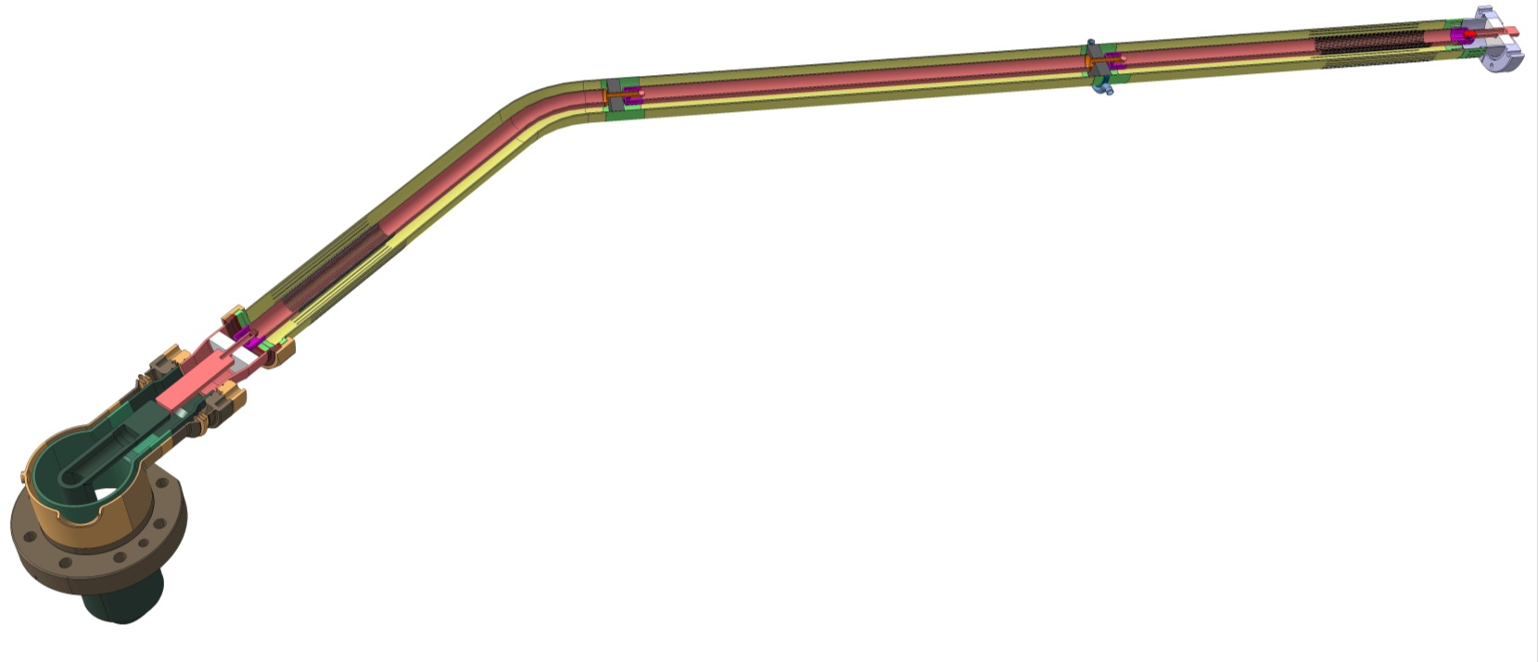
Coaxial Lines

Slide 28
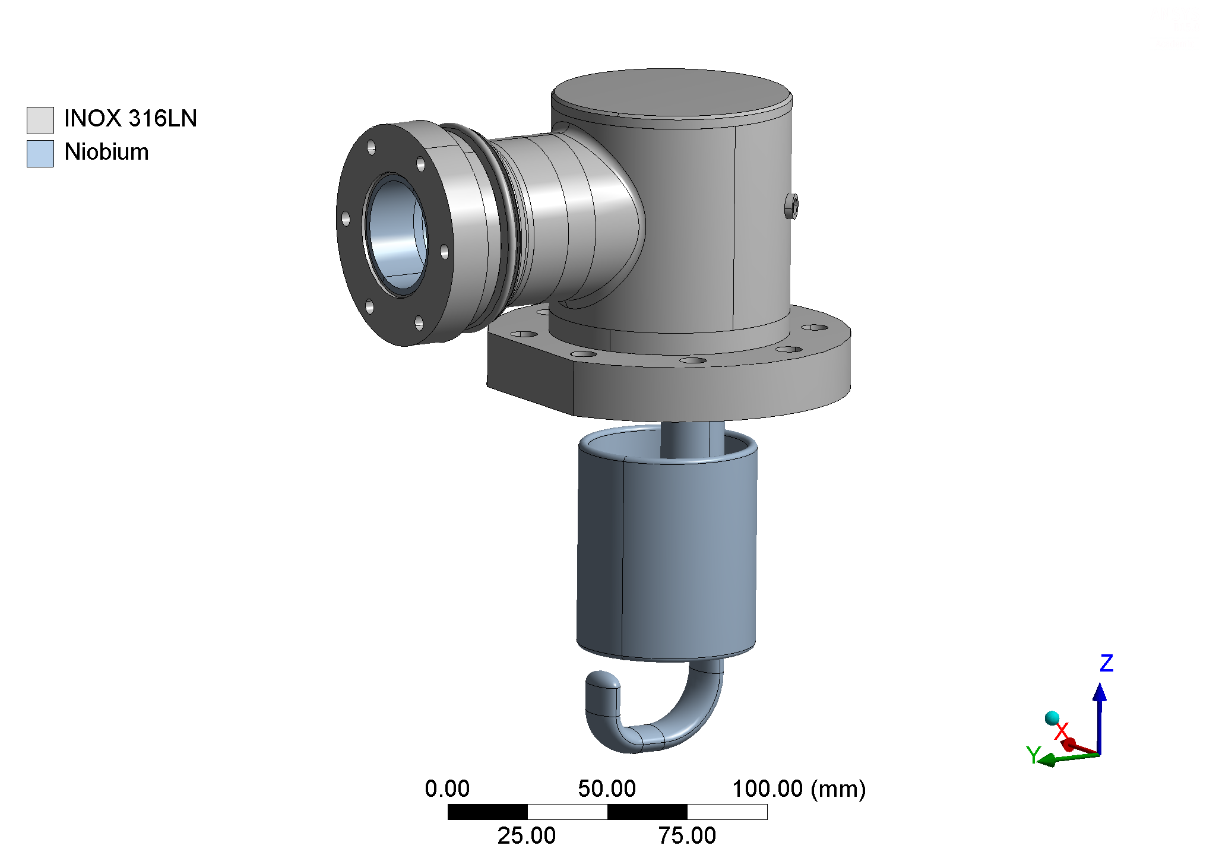
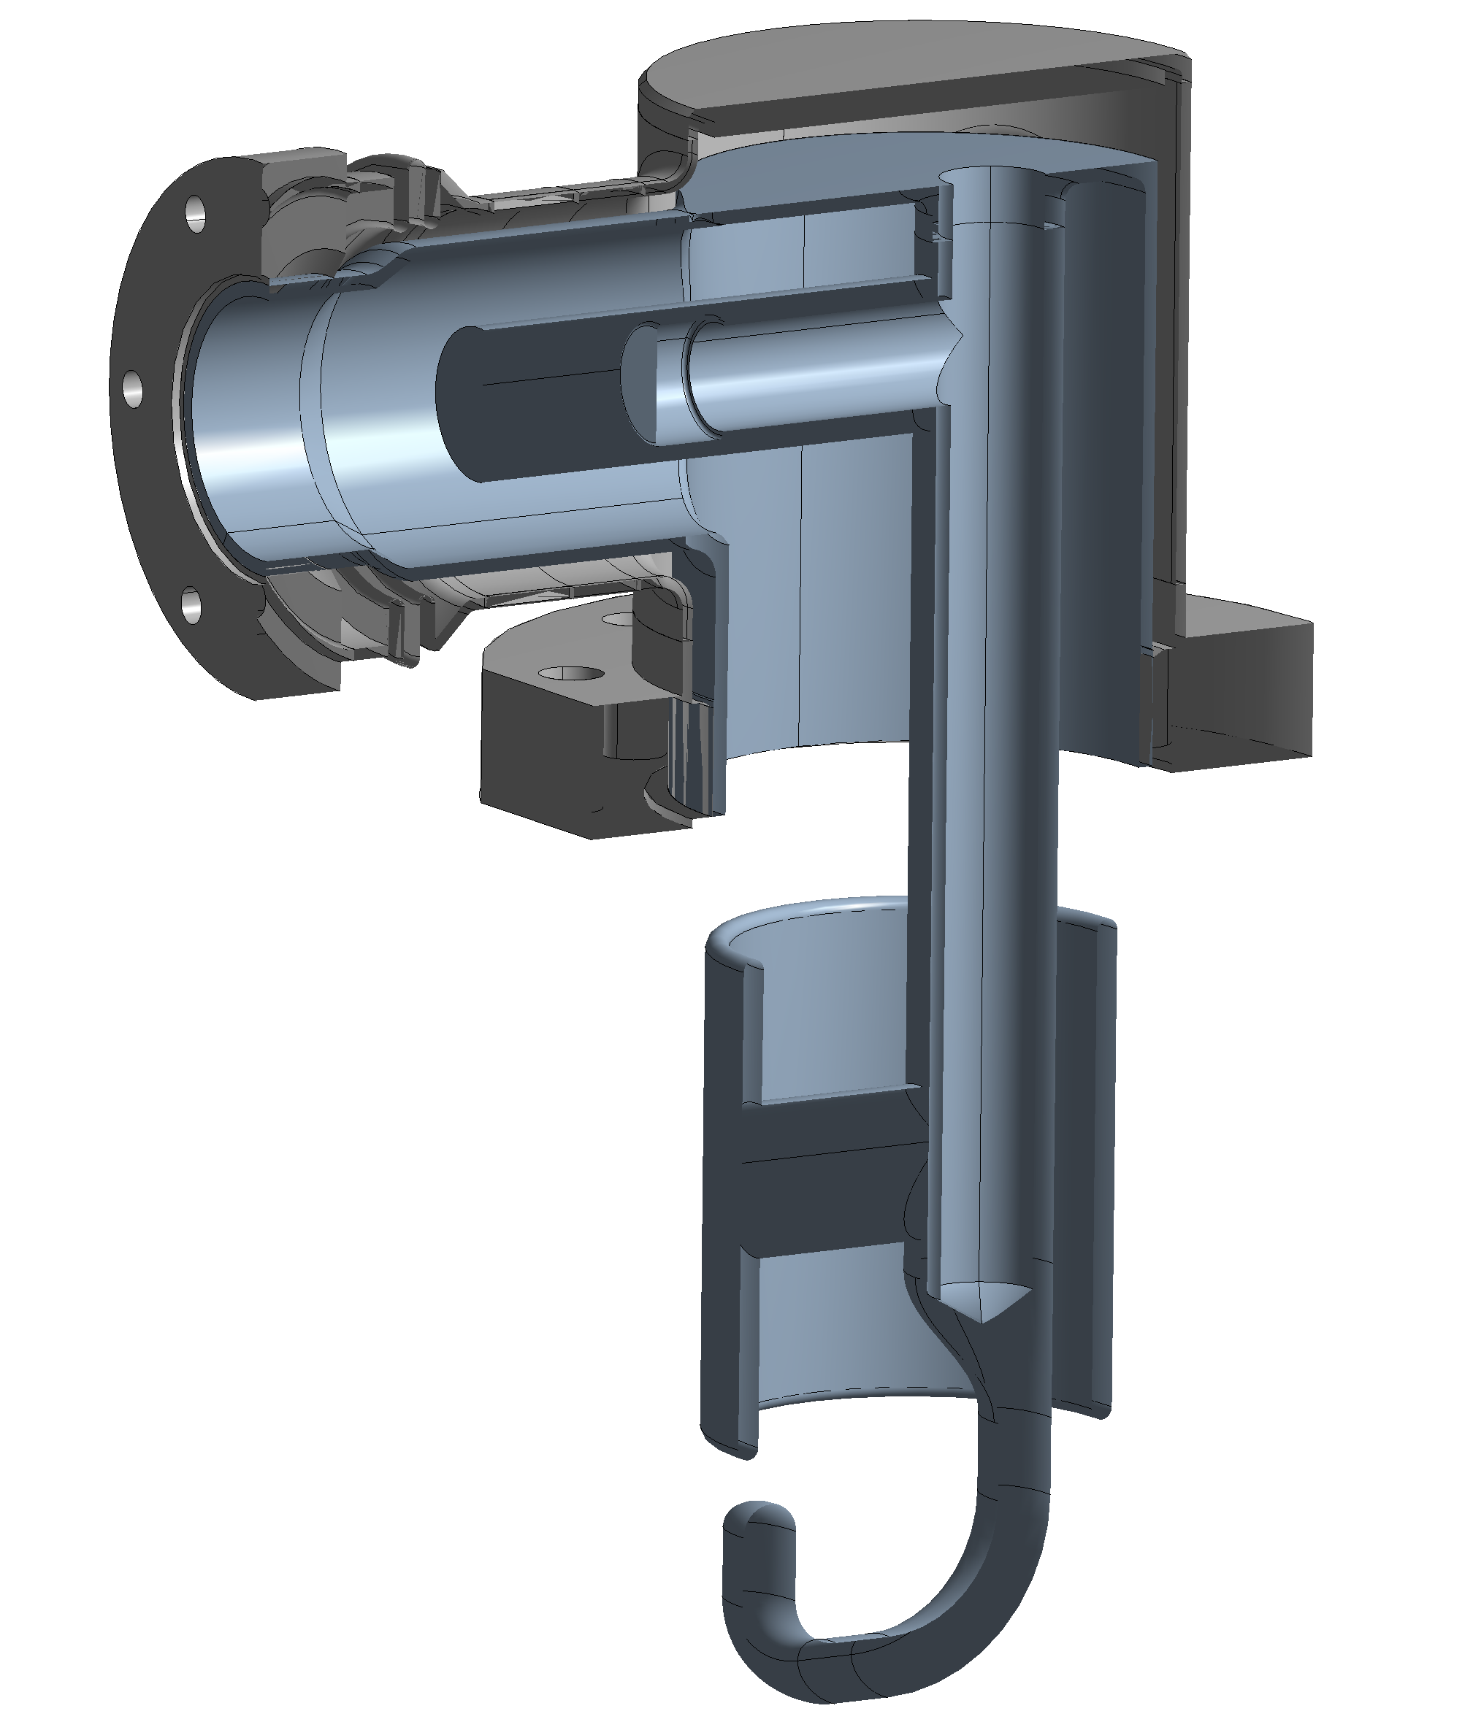
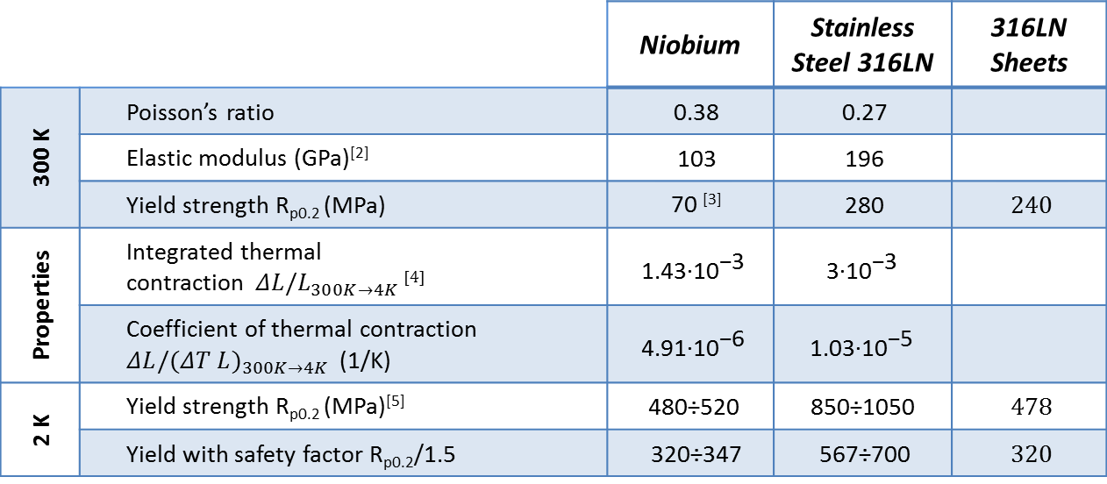
Thermostruct. Calc.
Material Properties
 |  | Niobium | Stainless Steel 316LN | 316LN Sheets
300 K | Poisson’s ratio | 0.38 | 0.27
 | Elastic modulus (GPa)^{[2]} | 103 | 196
 | Yield strength R_{p0.2} (MPa) | 70 ^{[3]} | 280 | 240
Properties | Integrated thermal contraction${ΔL/L}_{300K→4K }$^{[4]} | $$\text{1.43∙}{\text{10}}^{\text{−3}}$$ | $$\text{3∙}{\text{10}}^{\text{−3}}$$
 | Coefficient of thermal contraction ${ΔL/(ΔT L)}_{300K→4K }$ (1/K) | $$\text{4.91∙}{\text{10}}^{\text{−6}}$$ | $$\text{1.03∙}{\text{10}}^{\text{−5}}$$
2 K | Yield strength R_{p0.2} (MPa)^{[5]} | $$\text{480÷520}$$ | $$\text{850÷1050}$$ | 478
 | Yield with safety factor R_{p0.2}/1.5 | 320÷347 | 567÷700 | 320

Slide 29

Thermostruct. Calc: Mesh
Element size minimized in the Nb-316LN interfaces
Shell elements in the bellow
Mapped mesh in regular geometries (e.g. cylinders)
Large elements in the hook (only deformation is critical)
Defeaturing of small details (e.g. flange knife)

Slide 30

Thermostruct. Calc: Mesh

Slide 31

With Bellows - Load Case #2

Slide 32





Current Tests
SPL HOM: OFE Cu prototype
0.2
2.2
+0.05
Nonconformities
16.048
Notes:
HOM metrology EDMS: 1481124

Slide 33


Further Images

