Slide 1
HOM Review: Mechanical design overview
LARP Review of the HOM couplers
Teddy CAPELLI
on behalf of CRAB Collaboration

Slide 2
INTRODUCTION TO CRYOMODULES
HOM inside cryomodules
Design constraints
HOM coax lines overview
HOM review – Feb 2015
CERN – EN-MME

Slide 3
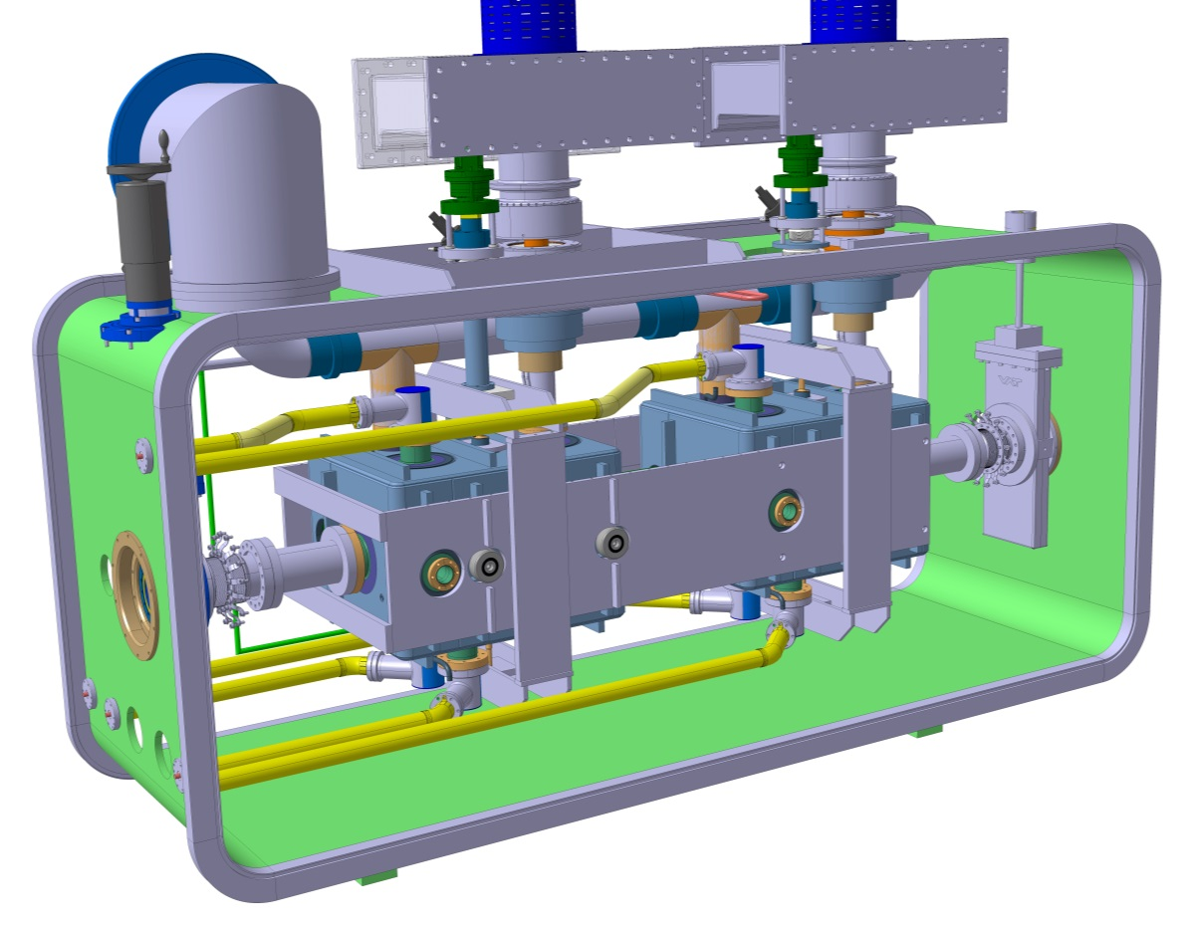
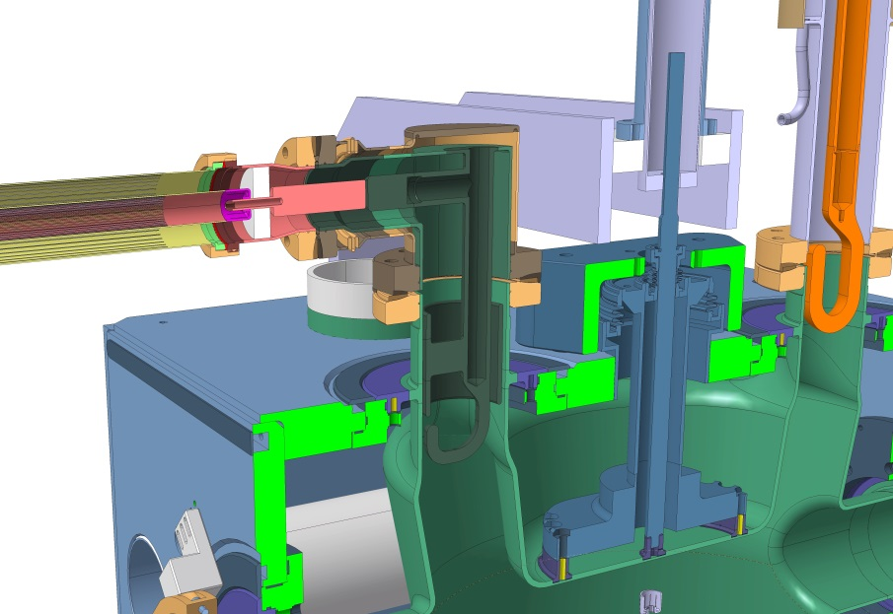
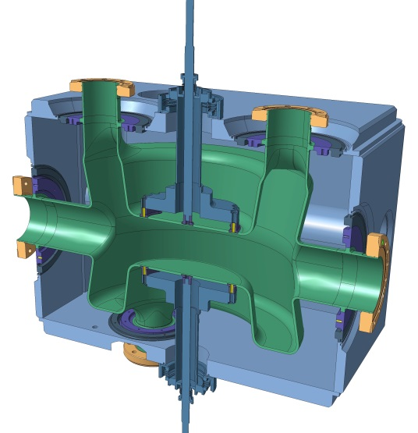
DQW - Cryomodule
HOM (3 HOMs/Cavity)
Helium tank
Cavity

Slide 4
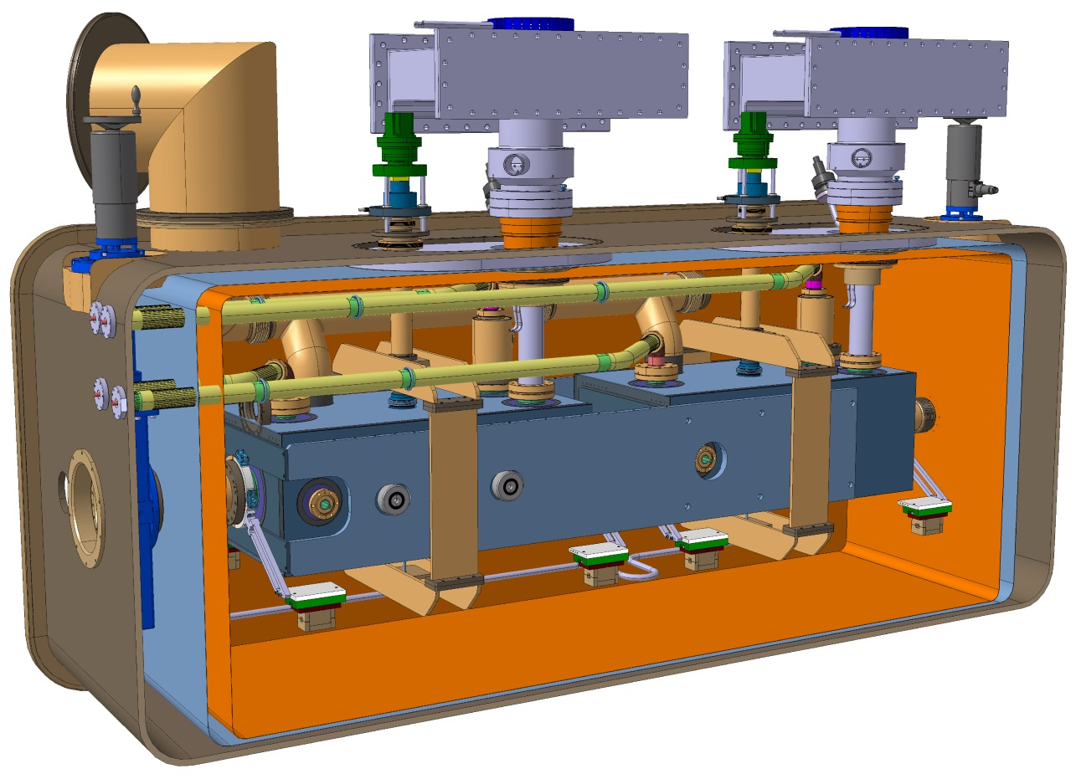
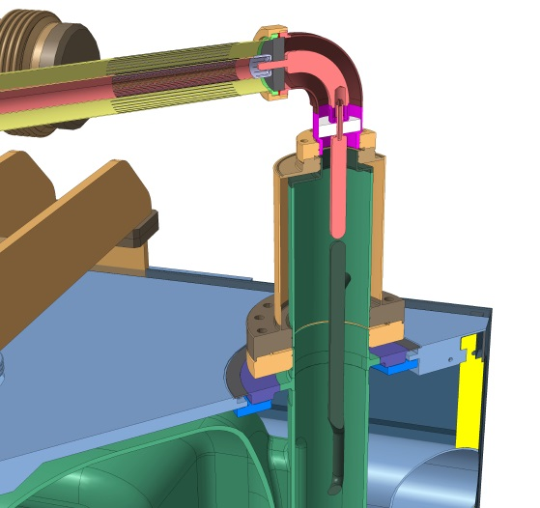
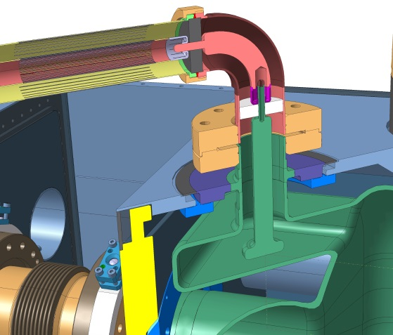
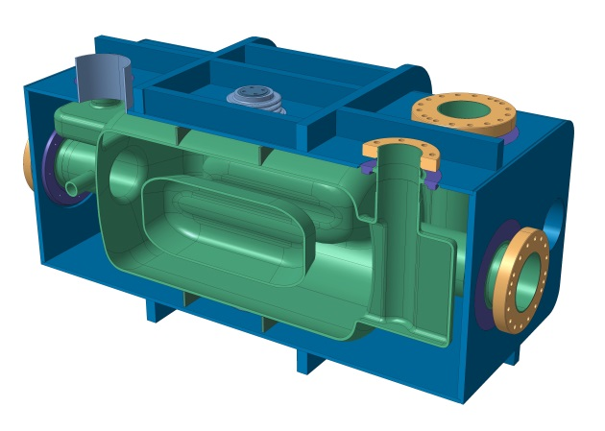
RFD - Cryomodule
H-HOM (1 pce/Cavity)
V-HOM (1 pce/Cavity)
Helium tank
Cavity

Slide 5
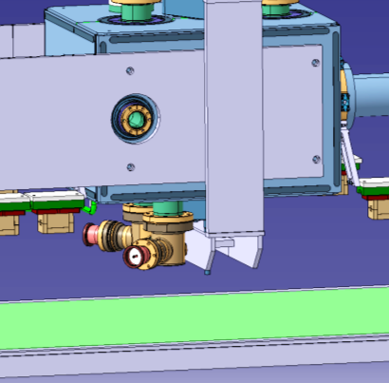
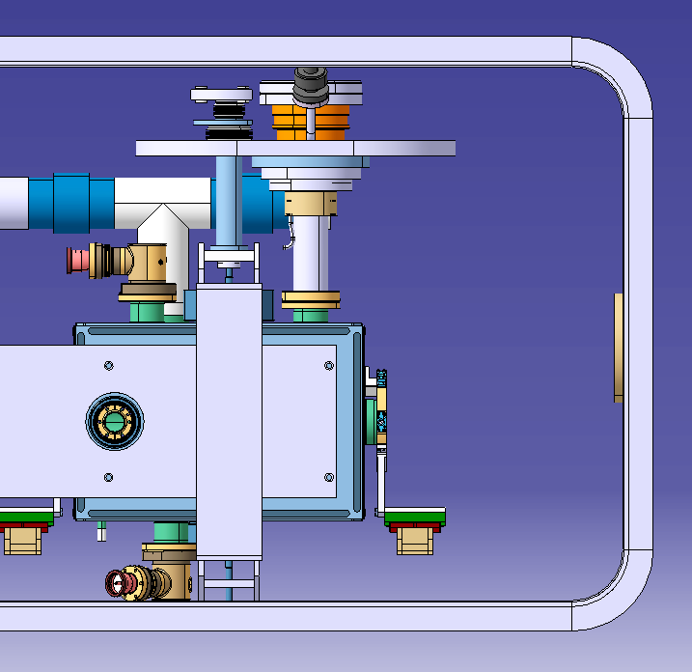
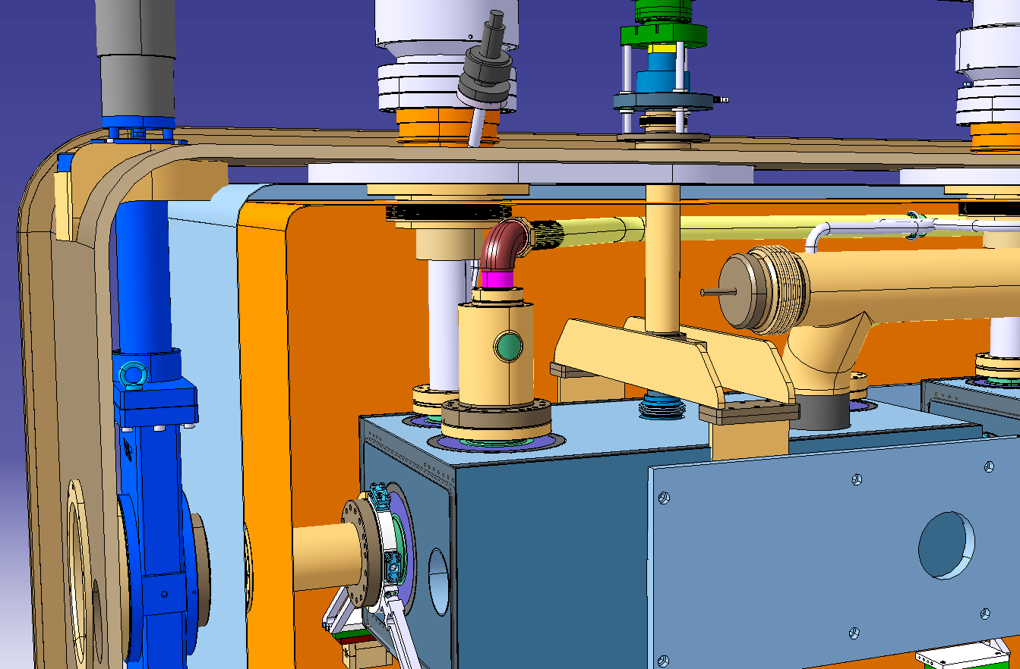
Design constraint
Limited space available inside cryomodules
DQW – Cryomodule – Cavities insertion
DQW – Cryomodule – Cavities after insertion
Space beetween H-HOM feedthrough and thermal shielding < 50 mm
RFD – Cryomodule – H-HOM Limited height
HOM review – Feb 2015
CERN – EN-MME

Slide 6
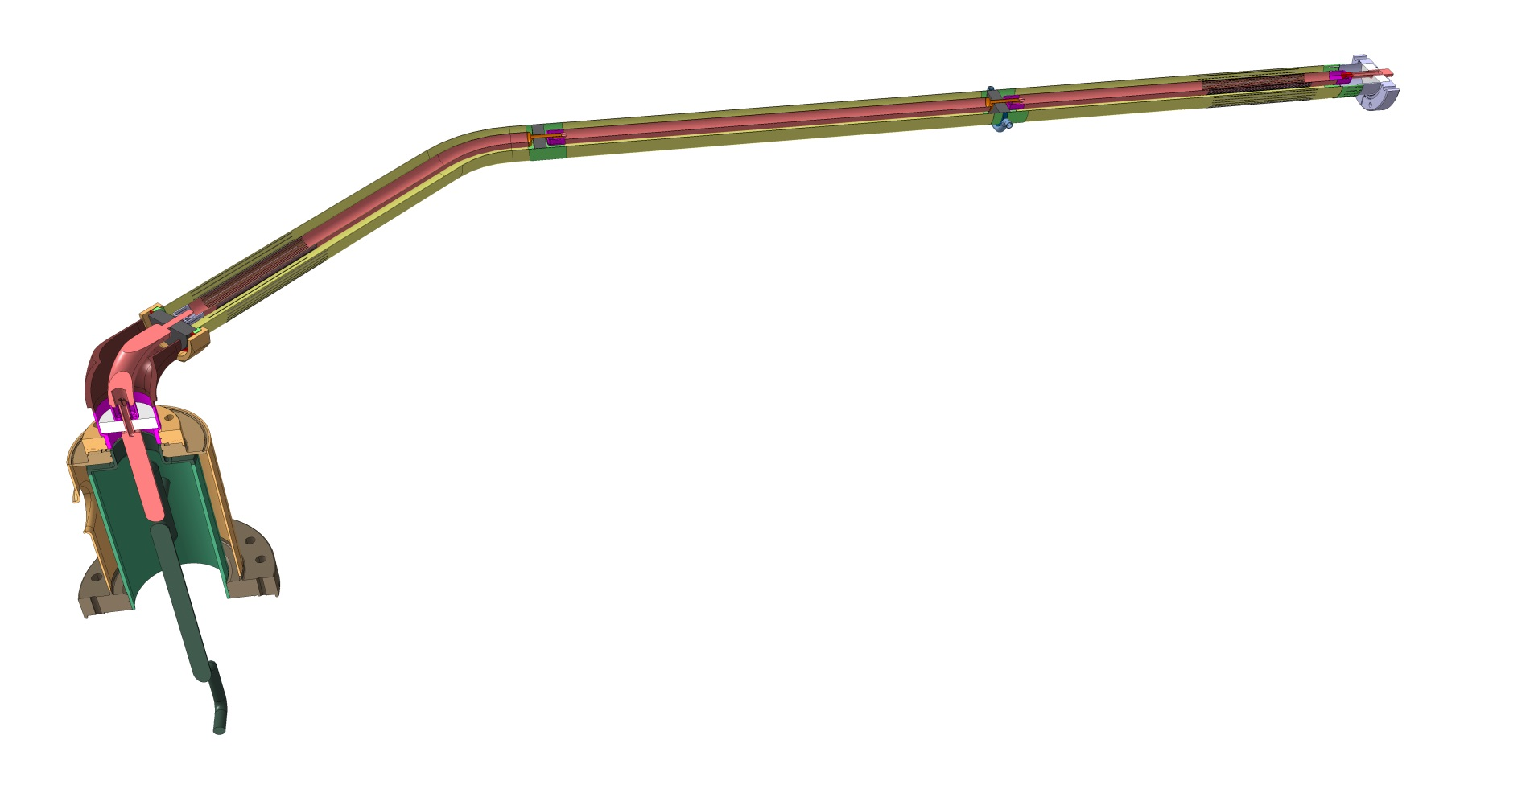
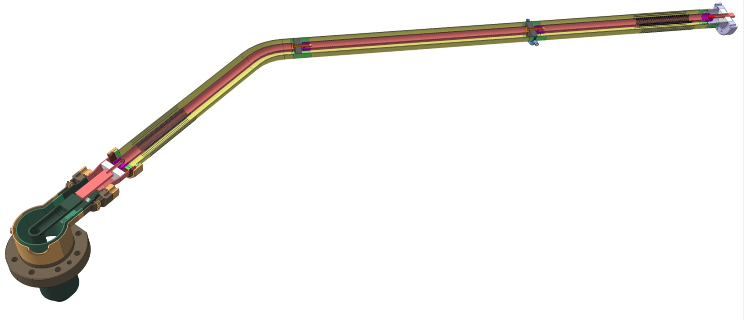
HOMs overview
RFD
Coaxial line
Feed Through
DQW
Filter

Slide 7
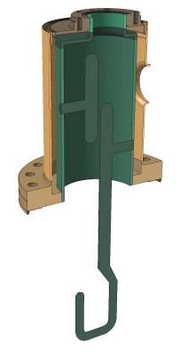
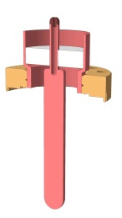
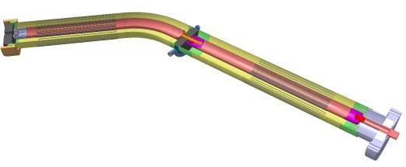
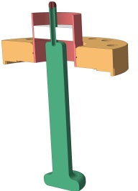

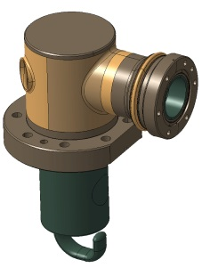
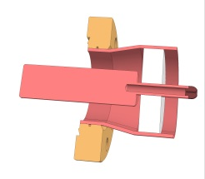

HOMs overview
Filter
Feedthrough
Coaxial line
RFD
H-HOM
V-HOM
Filter
Feedthrough
Coaxial line
DQW

Slide 8
HOM FILTER DETAILS
Geometry
Design details
Cooling circuit
Materials
HOM review – Feb 2015
CERN – EN-MME

Slide 9
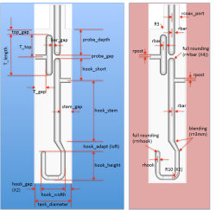
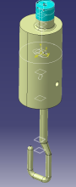
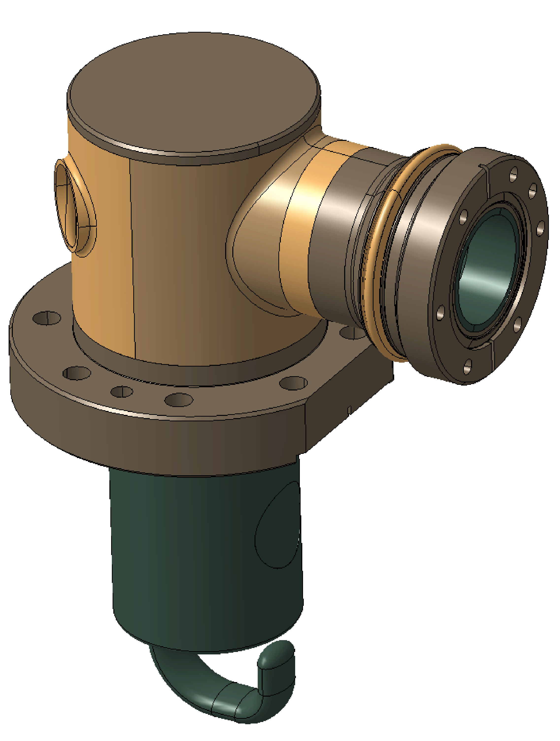
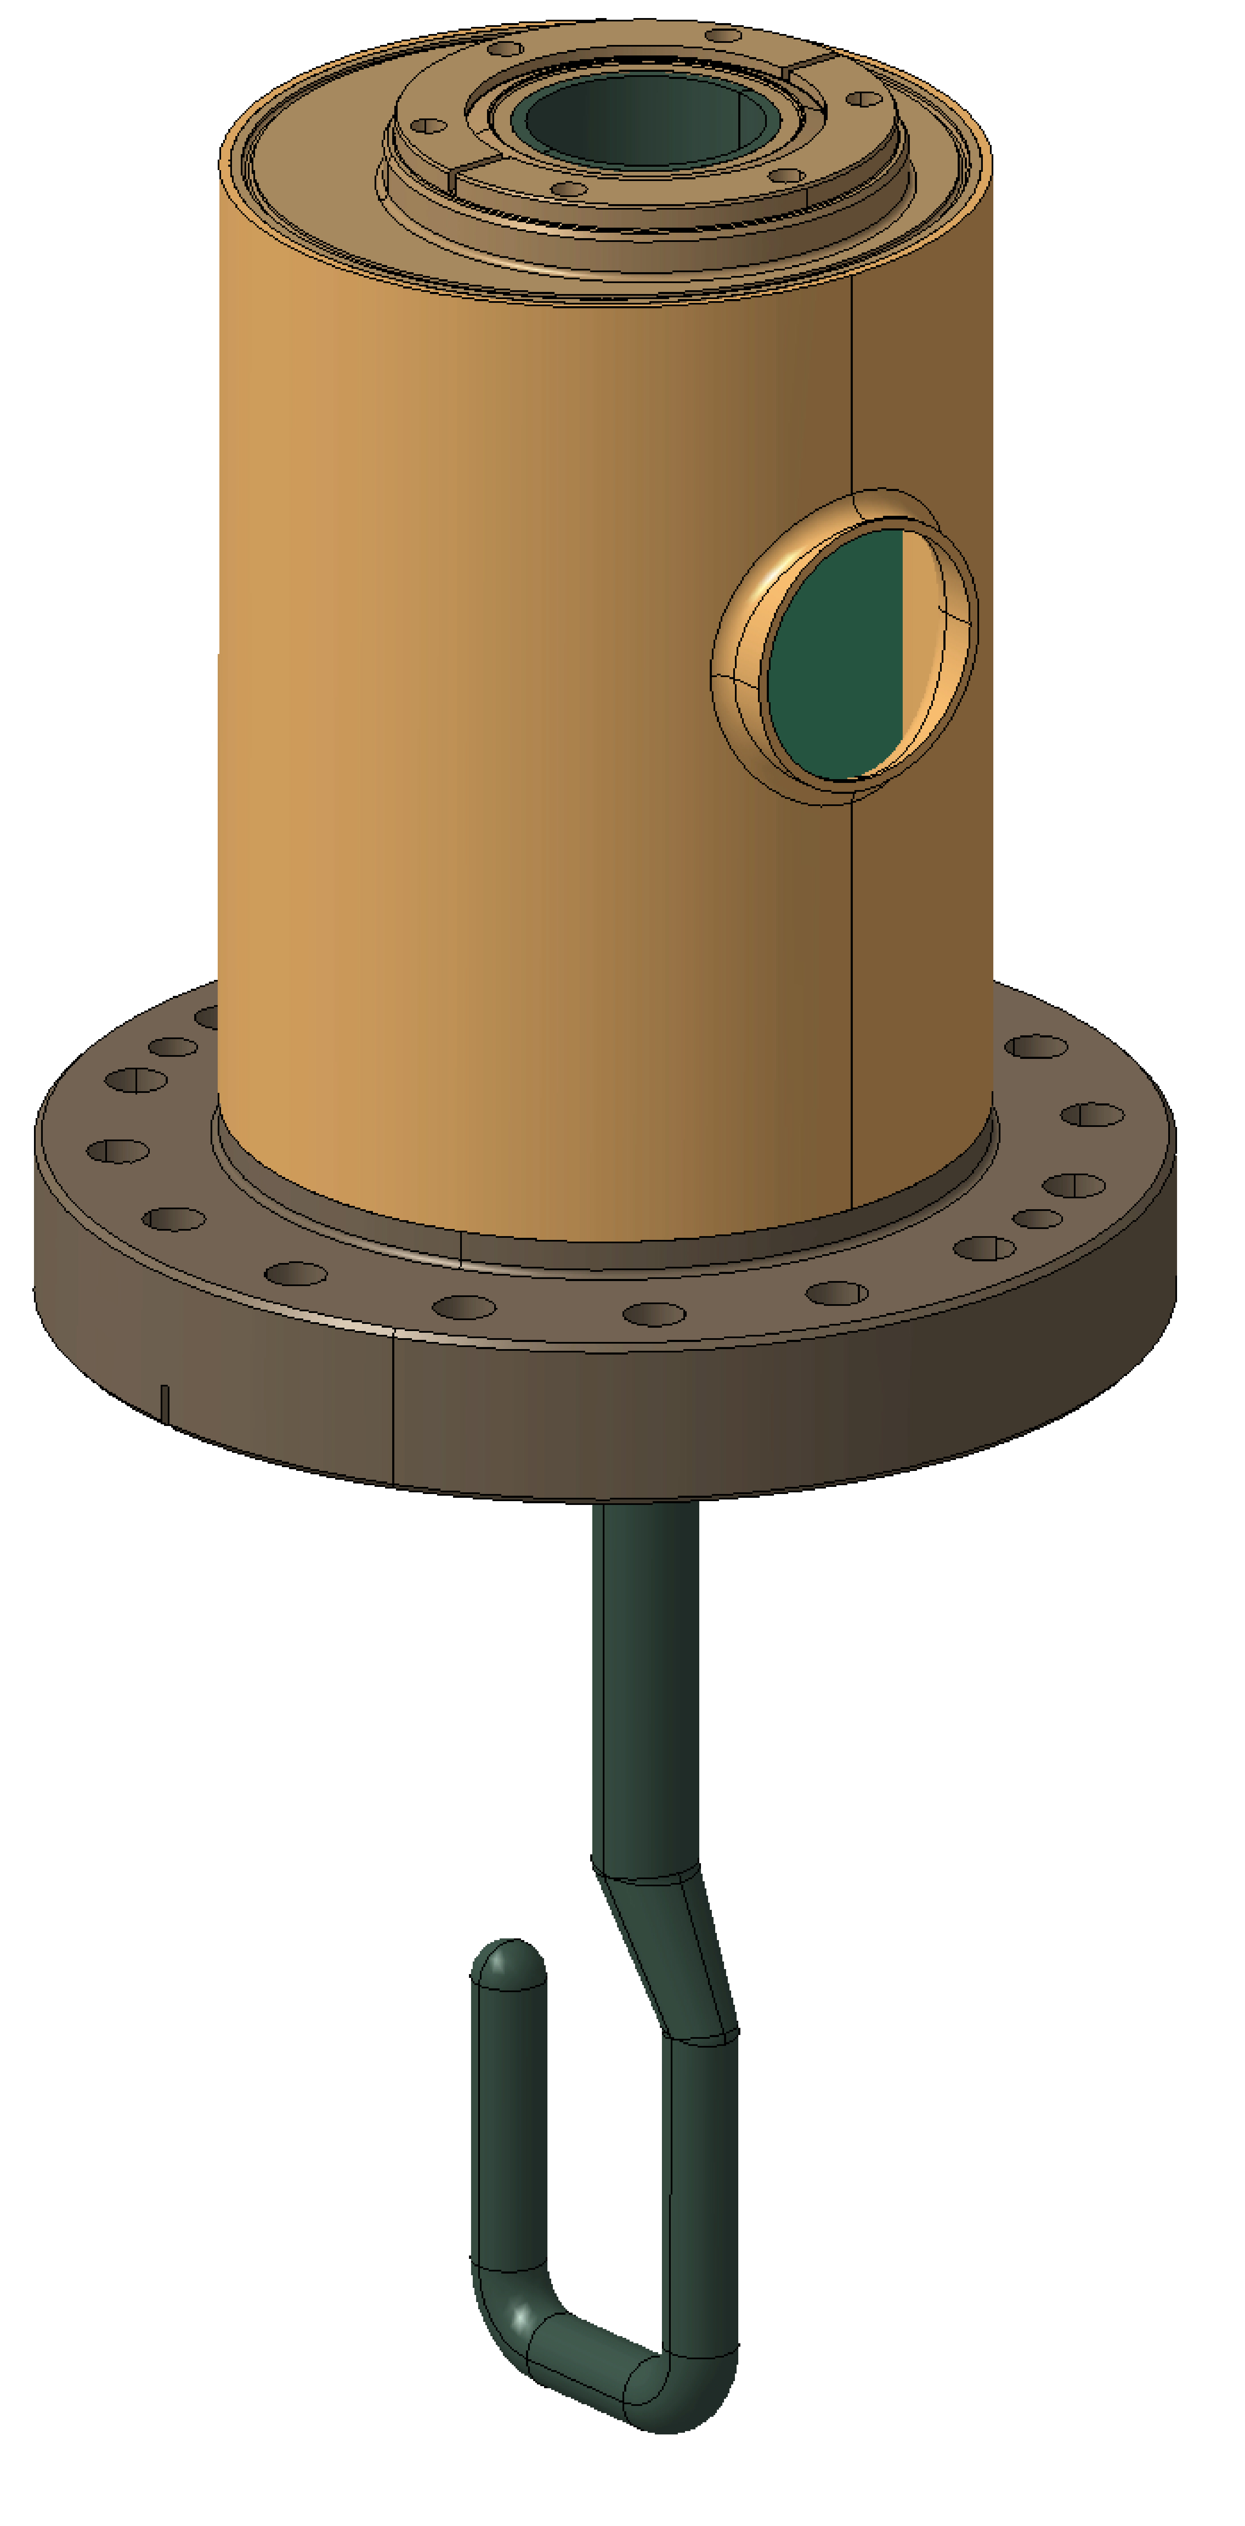
Geometry definition
RF parameters
  2K
  After BCP
Extraction of surfaces from parameters
  2K
  After BCP
Conversion to 300K
  300K
  Before BCP
Definition of parts
  300K
  Before BCP
HOM review – Feb 2015
CERN – EN-MME

Slide 10
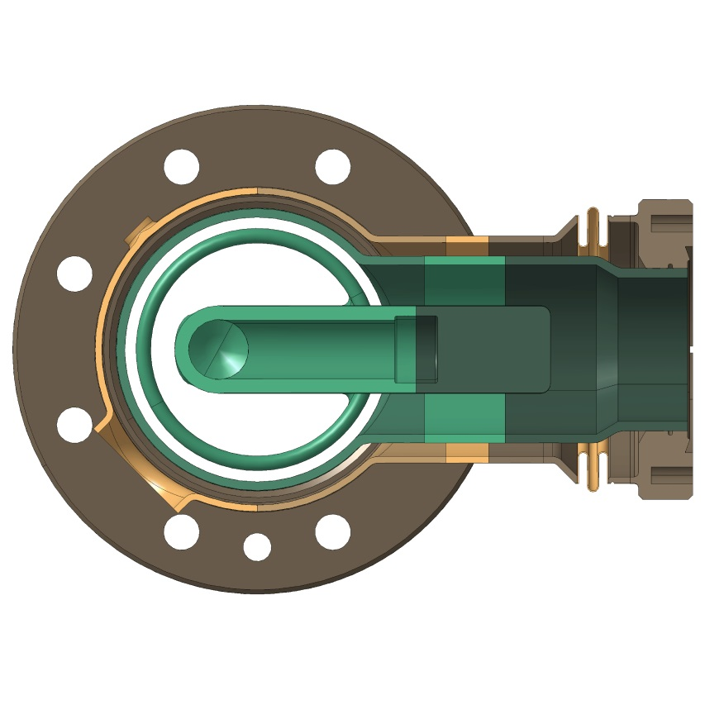
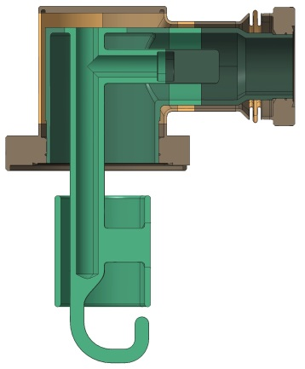
Design details - DQW
UHV Conflat flanges
knife edge flanges with copper seal for UHV applications
Bellows (st. Steel)
(only for CERN prototype)
not mandatory (but used for CERN prototyping)
gives flexibility for the st.steel welding / assembly
St. Steel body
1.5 mm thick plate rolled/welded
Centering step
increases the positioning accuracy (female step on cavity)
maximum gap beetween the two steps: 0.05mm (radial)

Slide 11
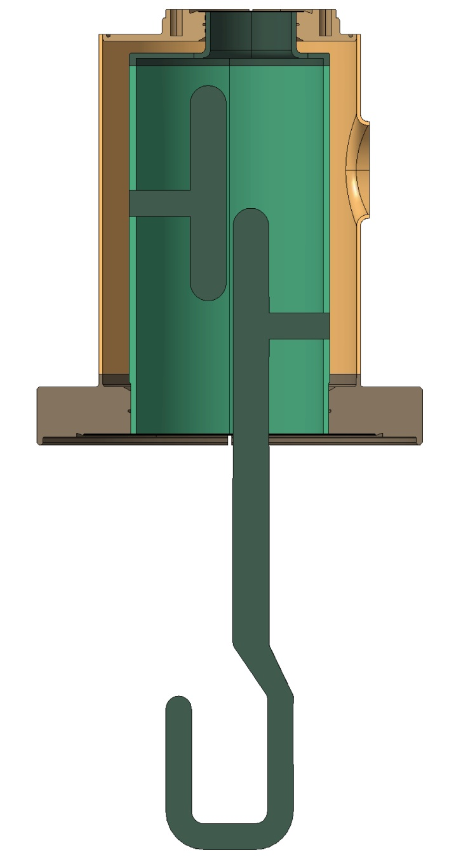
Design details - RFD
UHV Conflat flange
Knife edge flanges with copper seal for UHV applications
1.5 mm thick plate rolled/welded
St. Steel body
Niobium body
3 mm thick
UHV Conflat flanges
increases the positioning accuracy (cavity equipped with female centering step)
maximum gap beetween the two steps: 0.1 mm
Centering step

Slide 12
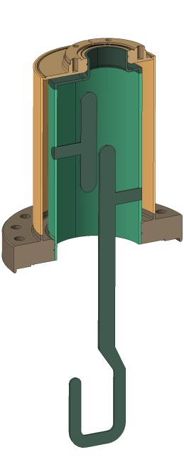
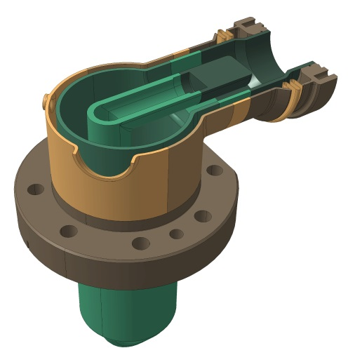
Cooling circuit
Section : ~500mm²
Helium cooling circuit
He Supply
RFD – H-HOM
DQW - HOM
He Supply
Ø20mm

Slide 13
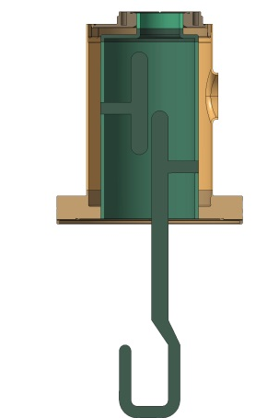
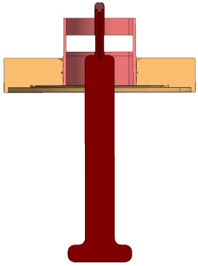
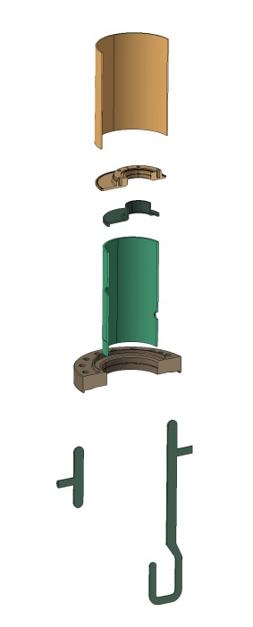
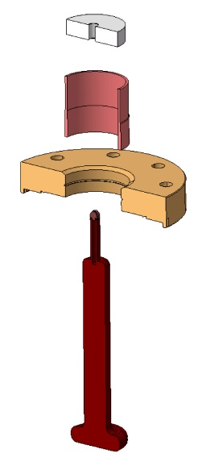
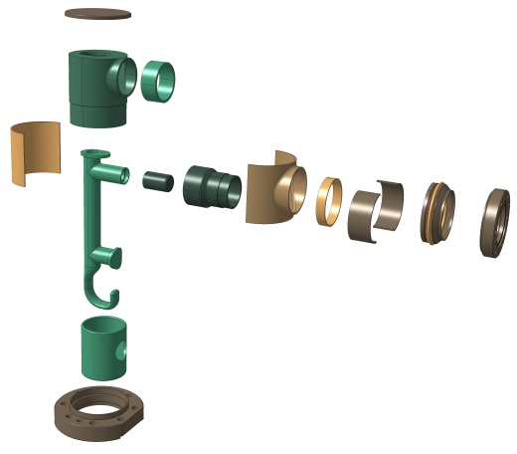
Materials
DQW
H-HOM (RFD)
V-HOM (RFD)
St. steel*
Ceramic*
St. steel*
Niobium*
Copper*
St. steel*
Niobium*
*All materials used to manufacture HOMs
shall be compliant with CERN specification n°1389669

Slide 14
(for CERN prototype)
HOM – DQW: assembly sequence
HOM review – Feb 2015
CERN – EN-MME

Slide 15
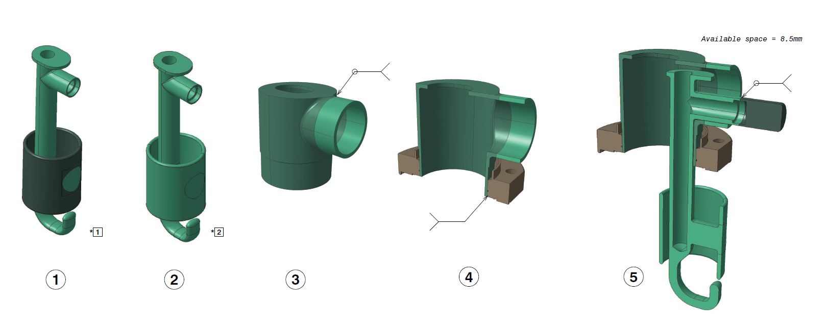
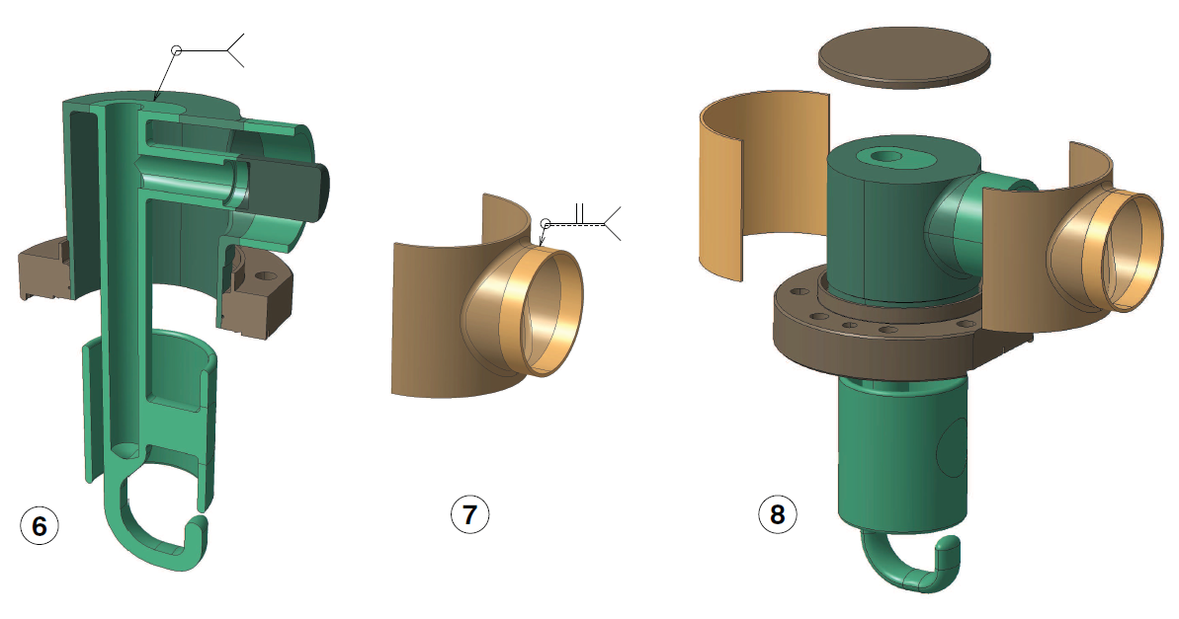
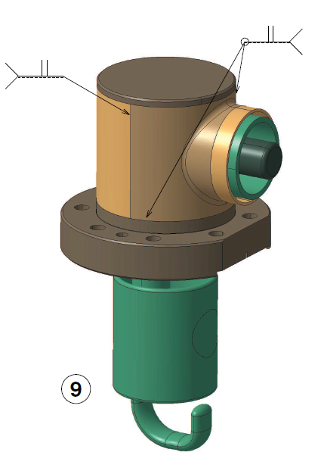
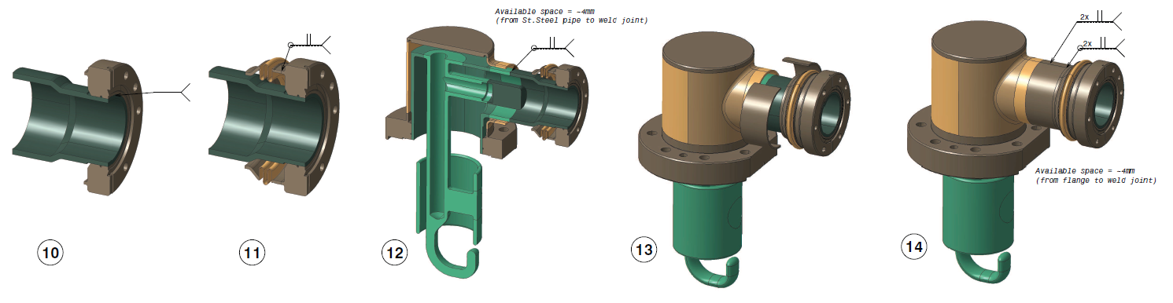
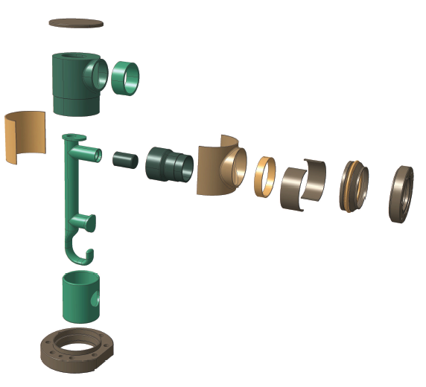
DQW – HOM Assembly sequence (CERN prototype)
All welds shall be compliant with CERN specification n°1389669
HOM review – Feb 2015
CERN – EN-MME

Slide 16
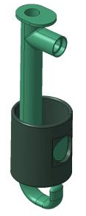
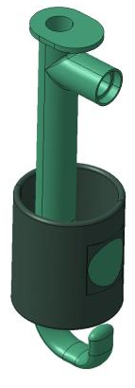
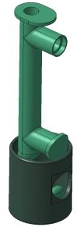
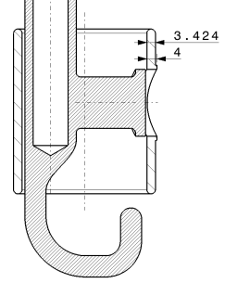
Assembly sequence: step 1
Hook / Cylinder welding (EBW)
*Welding thickness : 4mm
All welds shall be compliant with CERN specification n°1389669
HOM review – Feb 2015
CERN – EN-MME

Slide 17
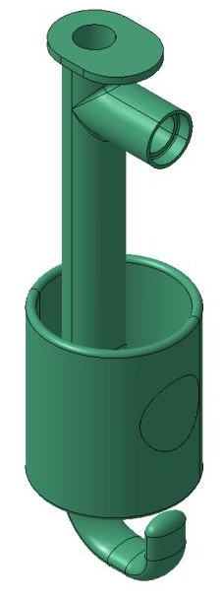
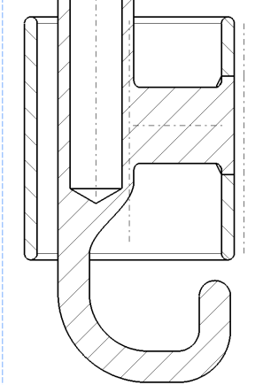
Assembly sequence: step 2
Hook re-machining: removal of welding extra thickness
HOM review – Feb 2015
CERN – EN-MME

Slide 18
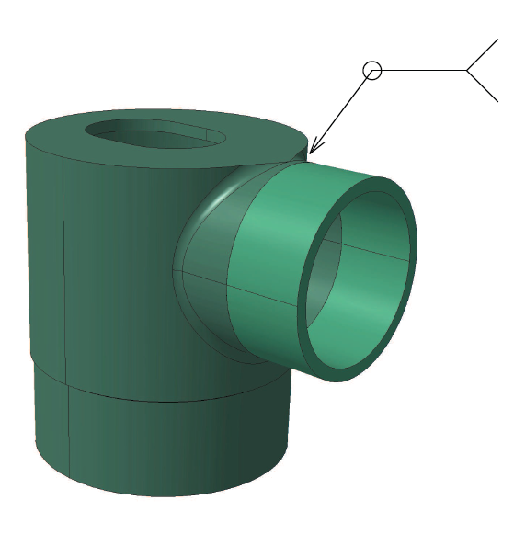
Assembly sequence: step 3
Niobium welding
Welding thickness : 2mm
All welds shall be compliant with CERN specification n°1389669
HOM review – Feb 2015
CERN – EN-MME

Slide 19
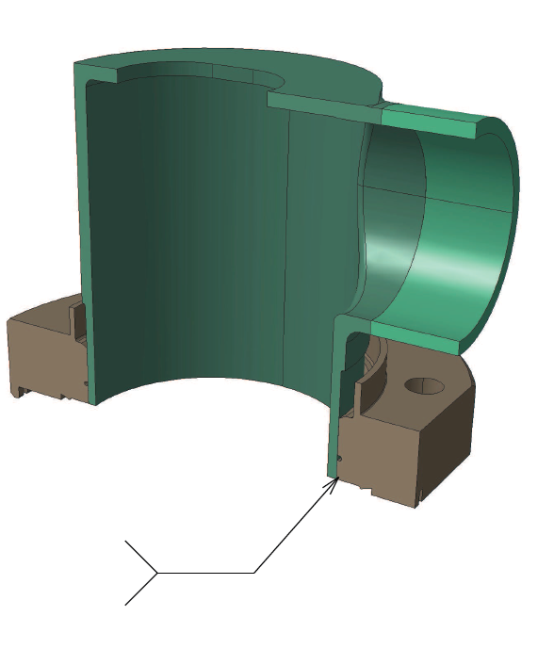
Assembly sequence: step 4
Brazing of DN63 flange with Niobium part
The knife of UHV flange must be machined after brazing
Cu Brazing
All welds shall be compliant with CERN specification n°1389669
HOM review – Feb 2015
CERN – EN-MME

Slide 20
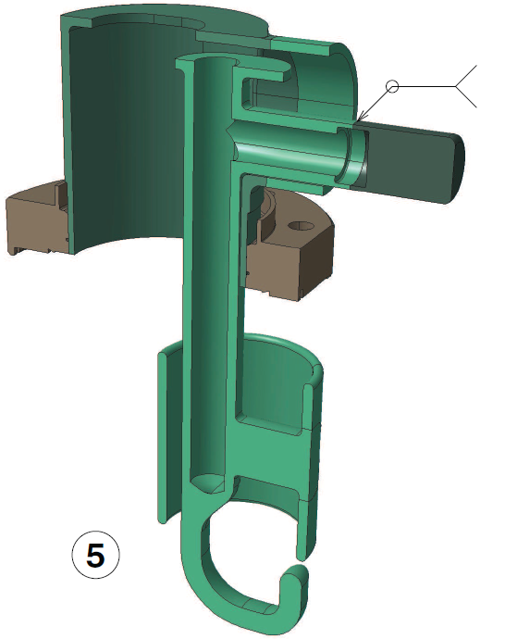
Assembly sequence: step 5
Horizontal rod welding
Welding thickness : 1mm
EBW
All welds shall be compliant with CERN specification n°1389669
HOM review – Feb 2015
CERN – EN-MME

Slide 21
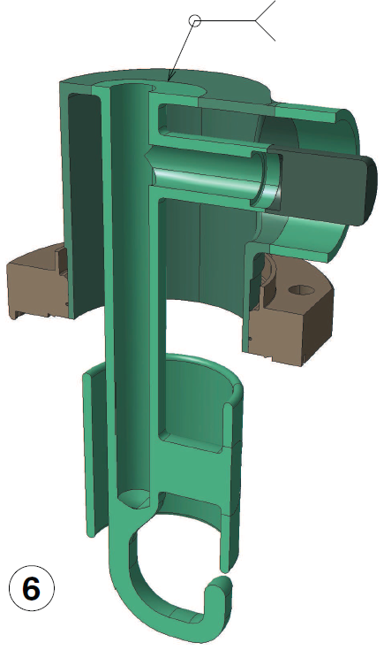
Assembly sequence: step 6
Hook and Niobium cylinder welding
EBW
Welding thickness: 2mm
All welds shall be compliant with CERN specification n°1389669
HOM review – Feb 2015
CERN – EN-MME

Slide 22
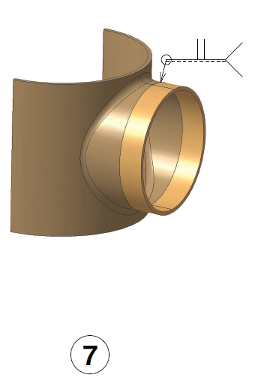
Assembly sequence: step 7
Stainless steel welding
Welding thickness: 1.5mm
TIG or EBW
All welds shall be compliant with CERN specification n°1389669
HOM review – Feb 2015
CERN – EN-MME

Slide 23
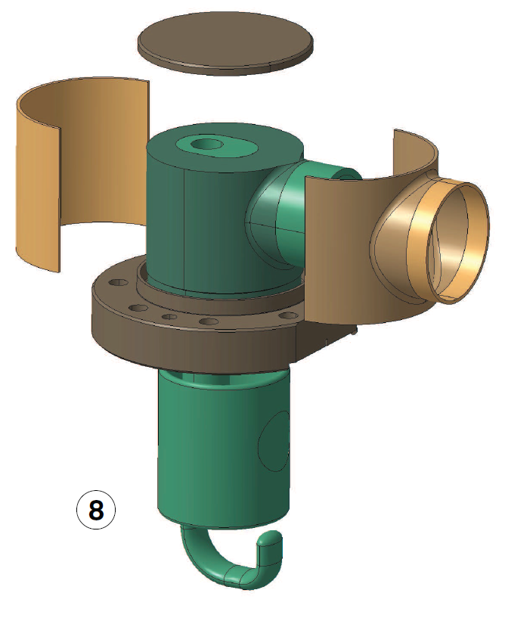
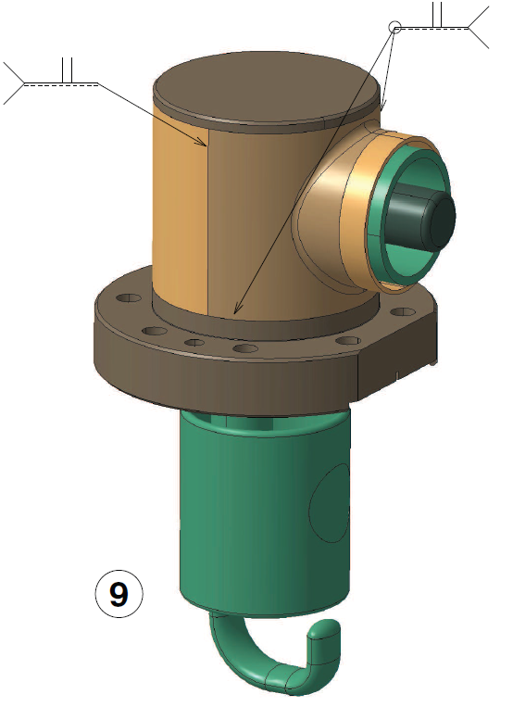
Assembly sequence: step 8 & 9
Stainless steel welding
Welding thickness : 1.5mm
TIG or EBW
TIG or EBW
All welds shall be compliant with CERN specification n°1389669
HOM review – Feb 2015
CERN – EN-MME

Slide 24

Assembly sequence: step 10
Brazing of DN40 flange on Niobium part
Knife of UHV flange must be machined after brazing
Cu Brazing
All welds shall be compliant with CERN specification n°1389669
HOM review – Feb 2015
CERN – EN-MME

Slide 25

Assembly sequence: step 11
Bellows welding
Welding thickness : 1.5mm
TIG or EBW
All welds shall be compliant with CERN specification n°1389669
HOM review – Feb 2015
CERN – EN-MME

Slide 26


Assembly sequence: step 12
Niobium welding
Welding thickness : 2mm
EBW
All welds shall be compliant with CERN specification n°1389669
HOM review – Feb 2015
CERN – EN-MME

Slide 27


Assembly sequence: step 13 & 14
Final stainless steel welding
TIG or EBW
TIG or EBW
All welds shall be compliant with CERN specification n°1389669
HOM review – Feb 2015
CERN – EN-MME

Slide 28





Current Tests
SPL HOM: OFE Cu prototype
0.2
2.2
+0.05
Nonconformities
16.048
Notes:
Mention That Weld Test is ongoing
HOM metrology EDMS: 1481124

Slide 29


Further Images

Slide 30
FEEDTHROUGH § COAXIAL LINE
HOM review – Feb 2015
CERN – EN-MME

Slide 31





FEEDTHROUGH
Shape and RF Calculation under progress.
(E.Montesinos – CERN)
Copper
Ceramic – 10mm thick
RFD - H-HOM
DQW
UHV Conflat flanges
316LN Stainless steel
HOM review – Feb 2015
CERN – EN-MME

Slide 32


COAXIAL LINES (RFD § DQW)
Thermal intercept
Cooling pipe
Cavity side
Flexible connexion to HOM feedthrough
Inner pipe
Sliding/flexible connexion
Outer pipe
Centering ring
§ thermal conductor
Cryomodule side
flexible connexion
Dimensions:
External pipe diameter : 40mm
Internal pipe diameter : 17.4mm
Material:
Stainless steel 0.3mm thick + Copper coating 5 µm
Length:
Minimum 500mm
Maximum 1600mm
Operating conditions : insulation vacuum
HOM review – Feb 2015
CERN – EN-MME
32

