Slide 1
RF Dipole
HOM Electromagnetic Design
Jefferson Lab
February 25, 2015
Zenghai Li
(SLAC)
Subashini De Silva, Jean Delayen, Rocio Olave , HyeKyoung Park
(Center for Accelerator Science, ODU)
2015-02-25 Jefferson Lab

Slide 2
Outline
RFD cavity and couplers
HOM coaxial windows and 90-deg bend
Post-damping spectrum
Error analysis and tolerances
Multipacting
Response to Dec 2014 RF reviewer’s comments
Summary

Slide 3
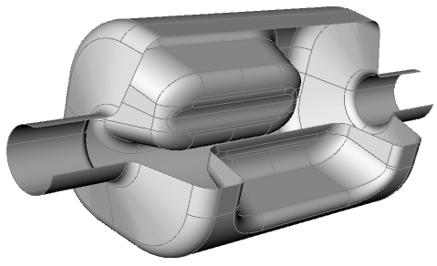
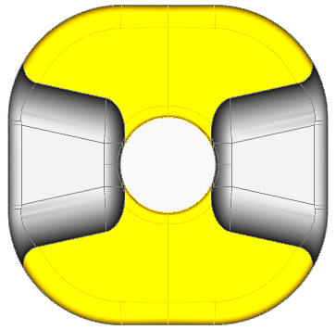
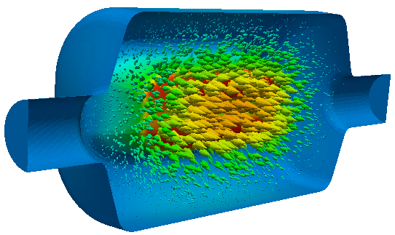
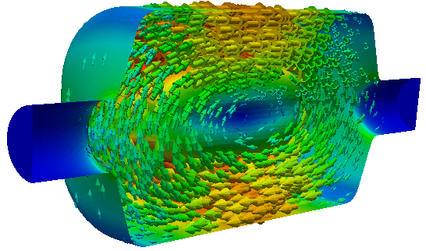
RFD Cavity Parameters
E B
RFD Crab Cavity
Frequency (MHz) | 400
Operating Mode | TE11
Lowest dipole HOM (MHz) | 633
Lowest acc HOM | 715
Iris aperture (diameter) (mm) | 84
Transverse dimension (mm) | 281
Vertical dimension (mm) | 281
Longitudinal dimension (w/o couplers) (mm) | 556
R_{T} (ohm/cavity) | 433
V_{T} (MV/cavity) | 3.34
Bs (mT) | 55.6
Es (MV/m) | 33.4
Deflect mostly by E field
No lower order mode
Compact, clears the second beam pipe
Pole face shaped to minimize higher multipole fields

Slide 4
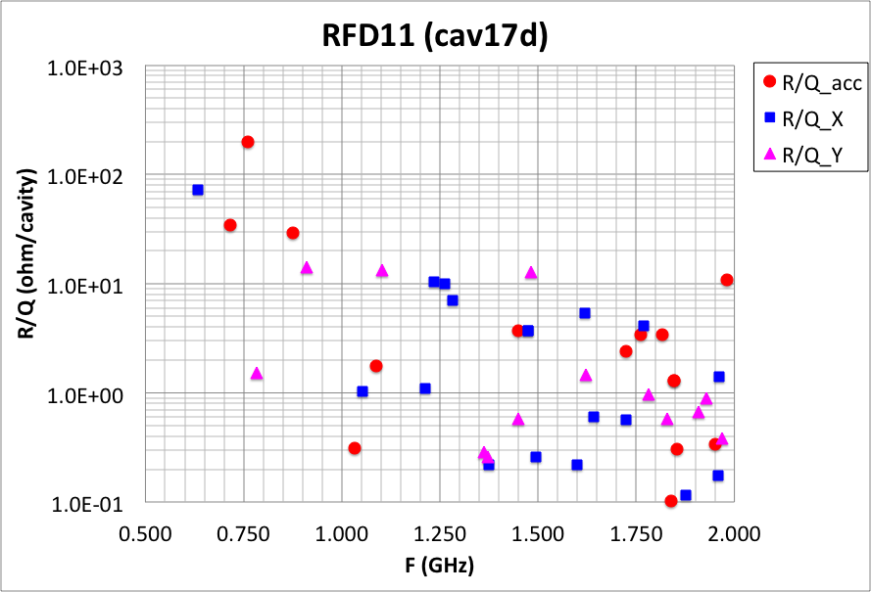
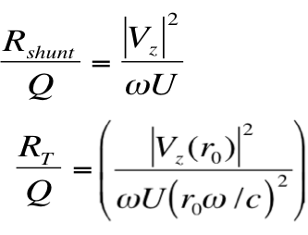
RFD Impedance Spectrum
Lowest HOM is at 630 MHz
Can utilize a high-pass filter HOM damper to damp the HOMs

Slide 5
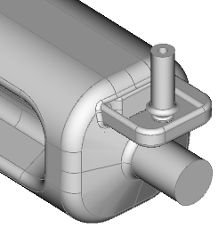
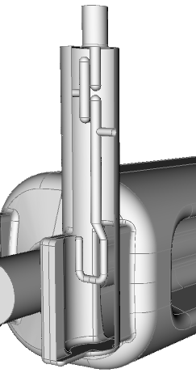
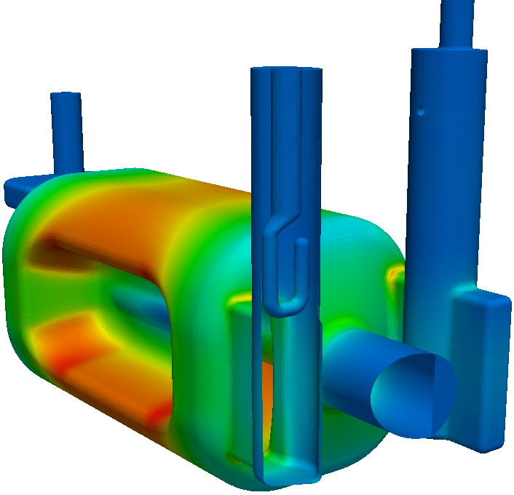
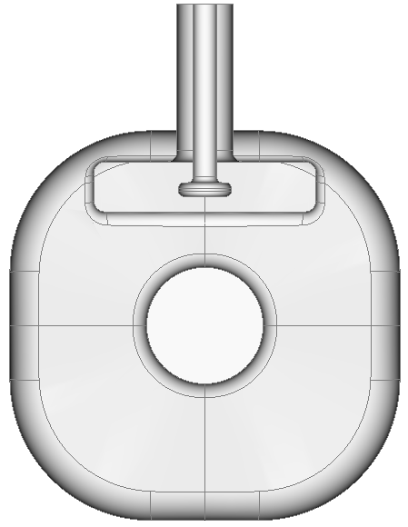
FPC and HOM Couplers
H-HOM
(Hi-pass filter)
V-HOM
(selective coupling)
FPC
Couplers at low field regions
  Minimized RF heating on the coupler
  Minimized effects on the field asymmetry
Selective coupling (V-coupler) to reduce the number of filters
Coupler ports oriented to keep clearance for the second beam pipe

Slide 6
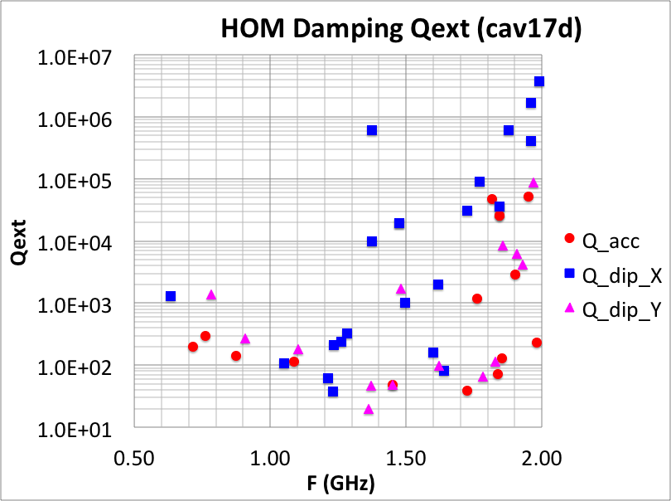
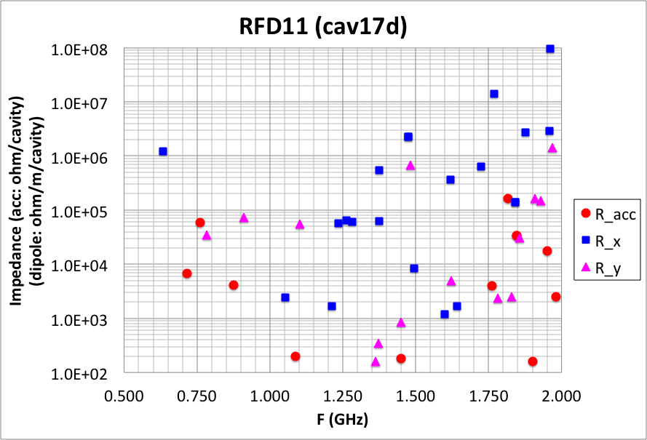
RFD (cav17d) HOM Parameters
Effectively HOM damping achieved
(does not have the (1/2) factor in “Impedance”)

Slide 7
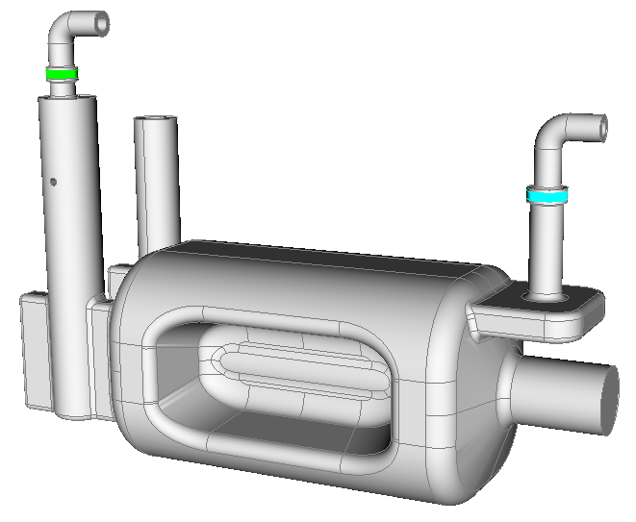
HOM Waveguide to HOM Load
Same interface to load
10-mm coaxial ceramics windows
90 degree coaxial bend to load
Broadband up to 2 GHz

Slide 8
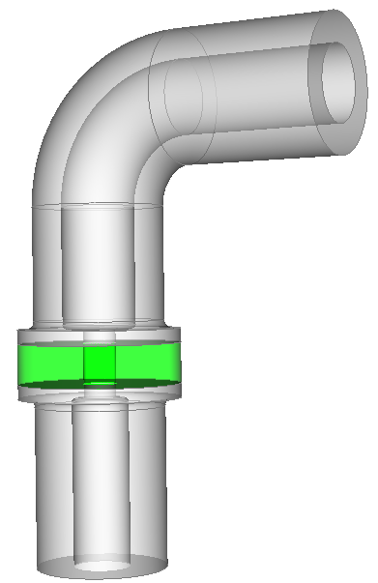
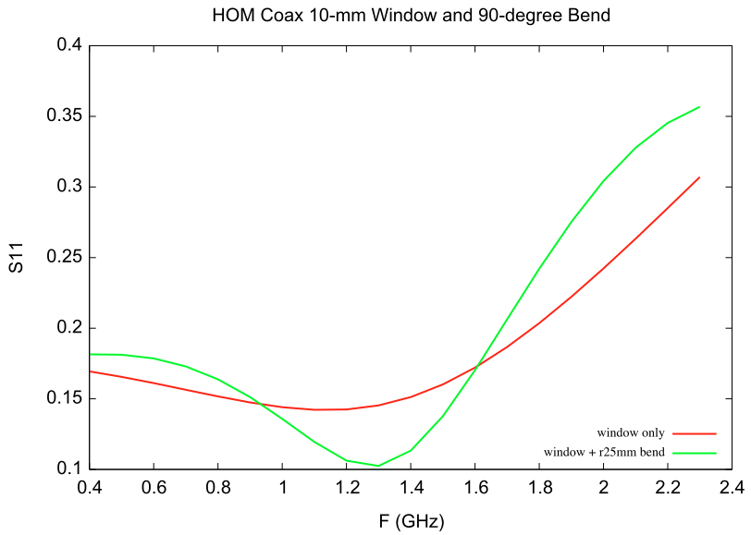
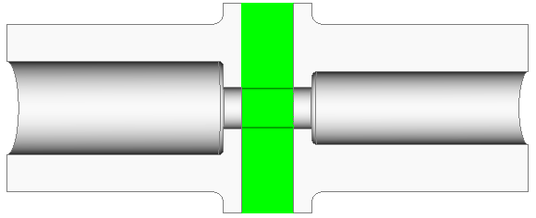
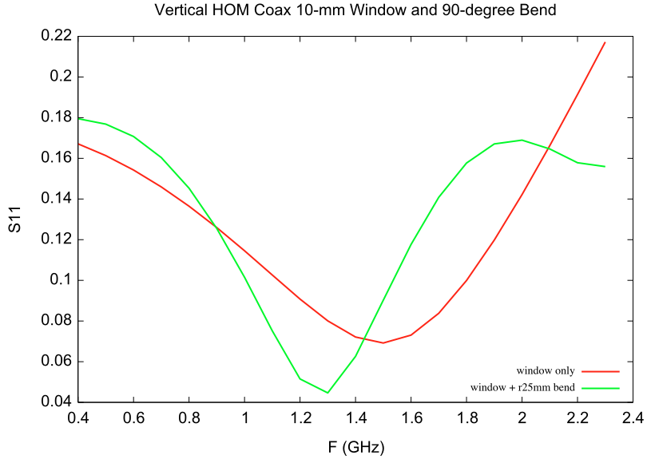
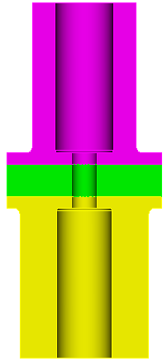
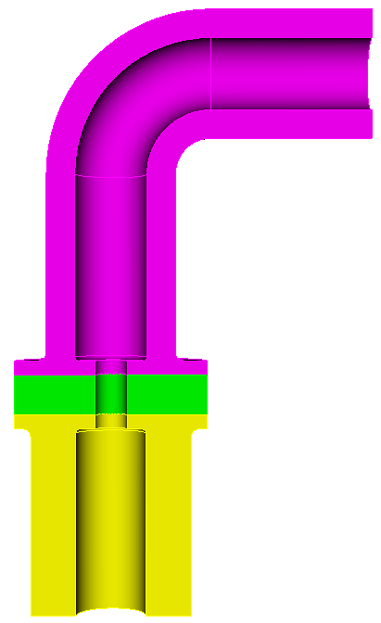
HOM Window and Bend
H-HOM
window and bend
window only
10mm window
window and compact bend
V-HOM
window and bend
window only

Slide 9
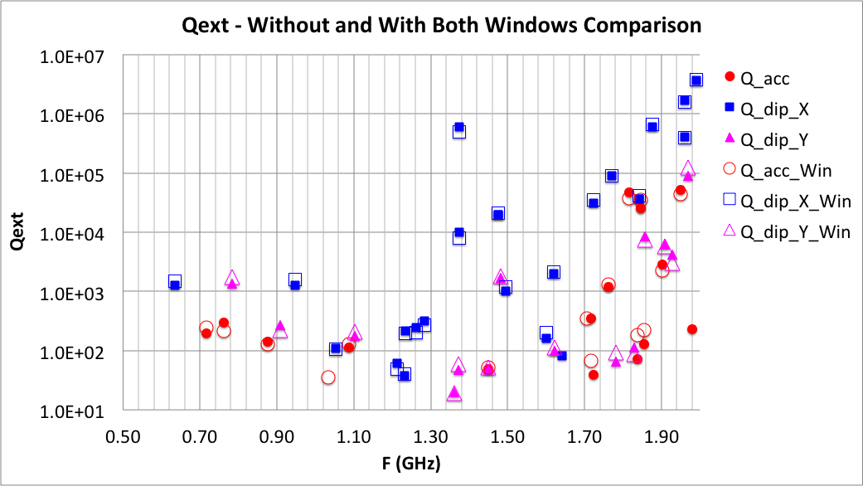
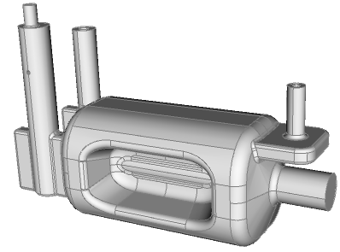
Qext With Coaxial Windows and Bends
All HOM coupler components included in Qext calculation
No significant Qext degradation due to window and bend

Slide 10
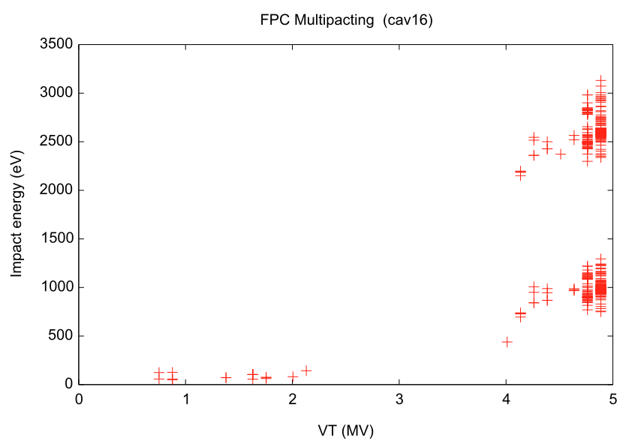
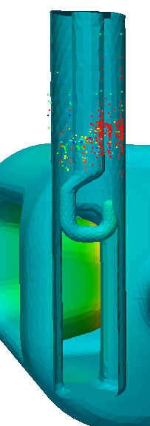
Multipacting in FPC Coupler
No multipacting in the hook region
Has resonant trajectories in the coaxial region at higher deflecting voltages
MP regular coaxial region at high VT
nominal deflecting voltage

Slide 11
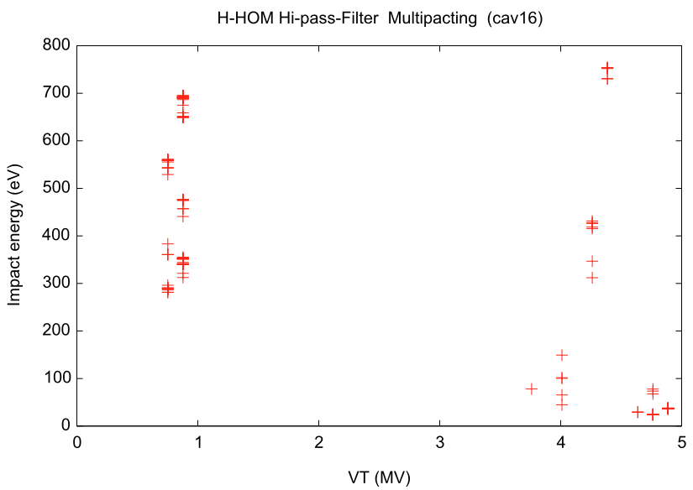
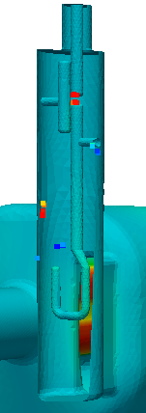
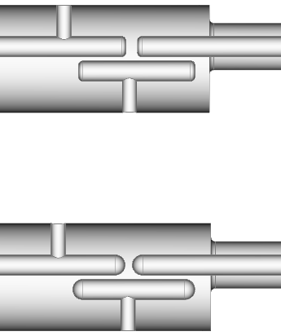
Multipacting in Hi-pass Filter H-HOM Coupler
MP resonances found in the gap if there are flat surfaces
MP eliminated with fully rounded tips
nominal deflecting voltage
MP trajectories in the gap Removed

Slide 12
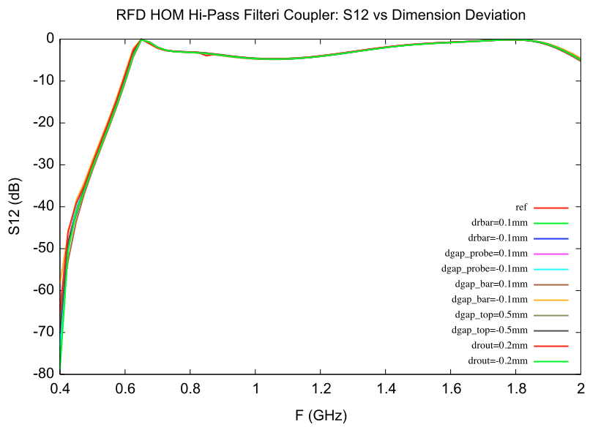
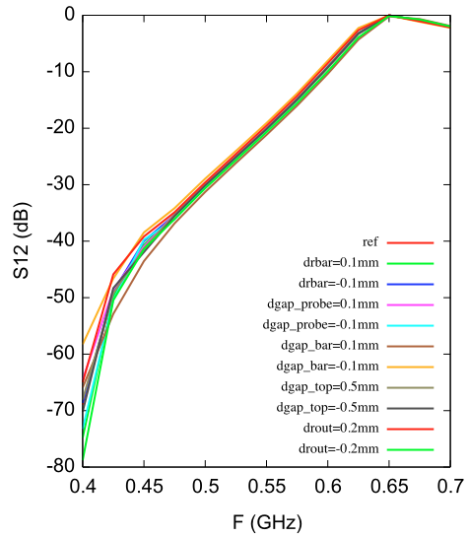
Filter S21 vs dimension deviations
HOM coupler filter dimension sensitivity:
Insensitive at frequencies above 0.65 GHz
Damping of 1st dipole mode at 0.63 GHz and operating mode rejection determine the filter dimension tolerance
Qext_def=9.8E10
Power leakage at 3.4MV: 0.27 W

Slide 13
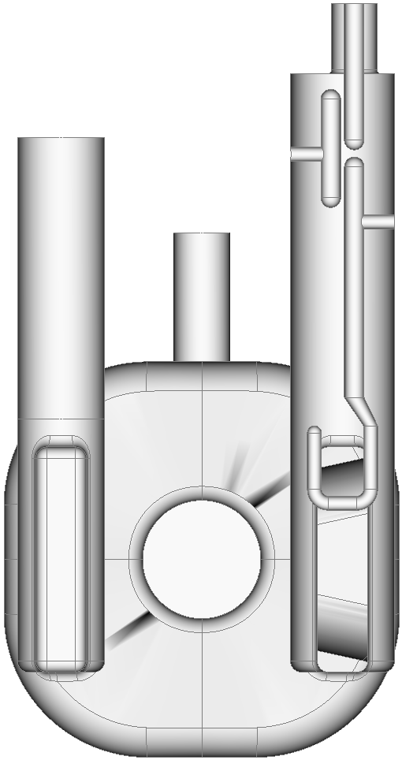
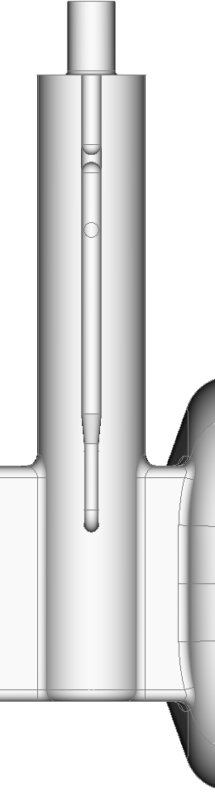
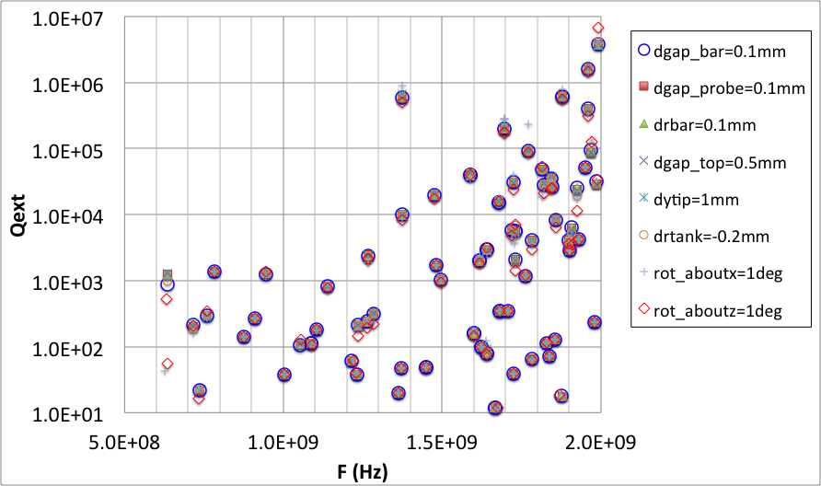
HOM Coupler Tolerance
gap_top
gap_bar
gap_probe
rot_about_x
(+)
rot_about_z
(+)
bar_radius
ytip
tank_radius
HOM damping is quite insensitive
Max power leakage < 0.7W with calculated dimension errors
Loose tolerances on the assembly dimensions

Slide 14
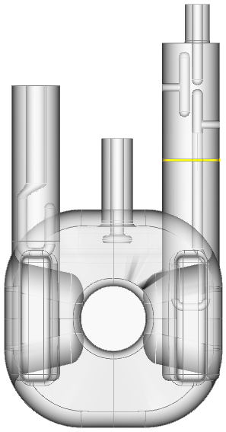
RF Heating on Coupler Surfaces
Deflecting mode: 3.4MV
Copper gasket at 2K (R=1mohm)
H-probe
H-T
Coupler part | RF Heating (W)
fpc-hook | 6.75E+01
HHOM Cu gasket | 1.07E-01 | 2K
H-hook | 5.99E-04 | 2K
H-T | 1.44E-06 | 2K
H probe | 4.90E-02 | 2K
V-probe | 4.66E-01 | RoomT
V-probe
Cu Gasket
FPC hook
H-hook
(Thermal analysis of HOM coupler see HyeKyoung’s talk)

Slide 15
Answer to Dec 2014 Reviewer Comments
GB reported the Q of the 1.4 GHz mode is > 10x bigger in their studies than in Zenghai. These is a discrepancy between Rocio and Zenghai wrt some of the modes, in particular the 1.4 GHz.
Action Item → resolve discrepancy
  Resolved: ACE3P and CST same results
Note: We did not study the V coupler, which does not need a HP filter because it does not couple to the fundamental. Should check power dissipation. Zenghai showed < 0.5W power dissipation. The feedthrough assembly comes from CERN.
  0.47W is for normal conducting Cu
  At 2K, power dissipation would be < 0.1W

Slide 16
Answer to Dec 2014 Reviewer Comments
If indeed the seeding in ACE3P/Track3P is limited to one location in the middle of a surface mesh cell (if not updated recently), the problem could be more pronounced
  ACE3P can emit more than 1 electrons per mesh surface
  So far, benchmark of ACE3P simulations with measurements are in good agreement, measured MPs were observed in ACE3P results

Slide 17
Summary
RFD cavity and coupler RF design complete
Tolerance analyzed – loose machining and assembly tolerances
Multipacting analyzed – no significant MP band found
RF power heating optimized (FPC)
Coaxial window and 90-deg bend designed for HOM couplers
HOM damping spectrum analyzed with windows and bends included - no significant change in Qext due to window and bend.
Comments on HOM calculation from the last RF review resolved. All calculations agree with the (SLAC) results presented in the previous meetings

