Slide 1
HOM filter design for double quarter wave crab cavity
Binping Xiao, BNL
BNL
  Sergey Belomestnykh, Ilan Ben-Zvi, Carlos Marques, John Skaritka, Silvia Verdú-Andrés, Qiong Wu
CERN
  Luis Alberty, Said Atieh, Rama Calaga, Ofelia Capatina, Teddy Capelli, Federico Carra, Norbert Kuder, Raphael Leuxe, Thierry Renaglia
Lancaster University/Cockcroft Institute
  Graeme Burt, Ben Hall, Tom Jones, nik templeton
SLAC
  Zenghai Li

Slide 2
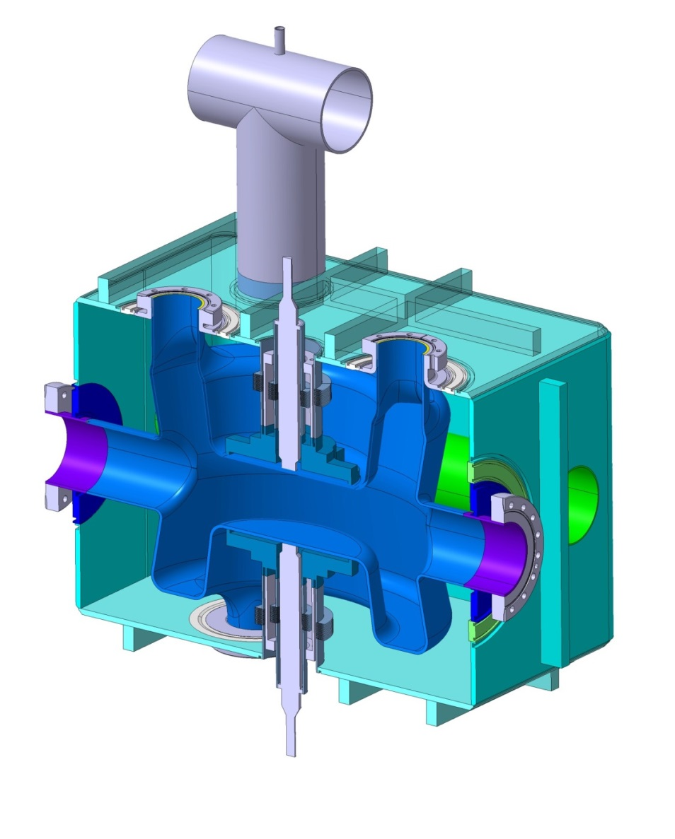
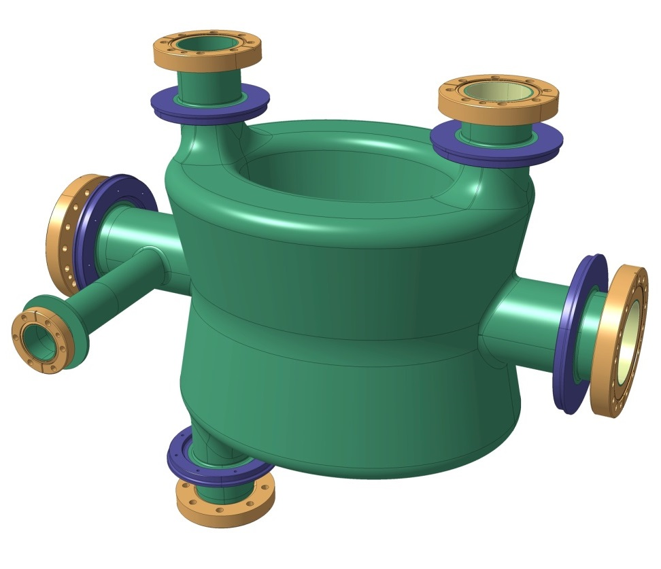
SPS double quarter wave
Cryo
jumper
HOM
HOM
FPC
beam
HOM x2
beam
HOM x2
Adjacent beam pipe through the vessel
© Capatina et, al @CERN
Notes:
Keep the compactness

Slide 3
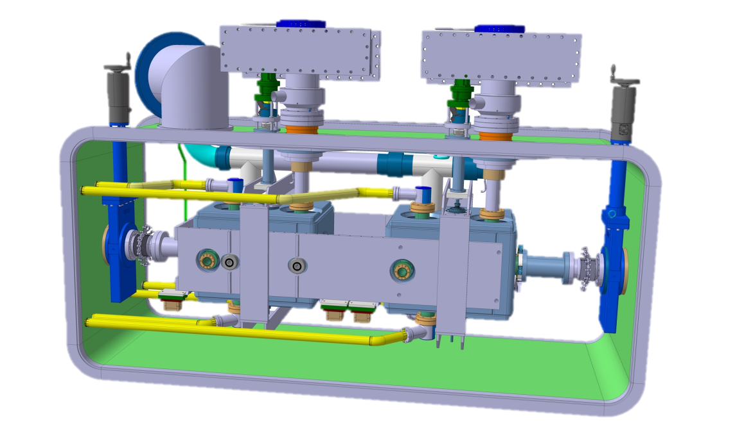
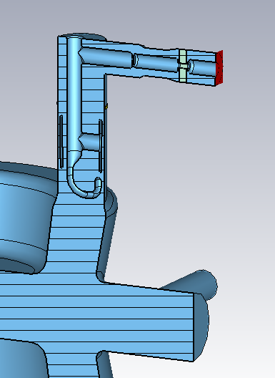
Constraint in the HOM filter design
A liquid helium vessel for the HOM filter was not shown here
© Capatina et, al @CERN
348mm
255mm
143mm
Magnetic & thermal shielding
reference
Notes:
Keep the compactness

Slide 4
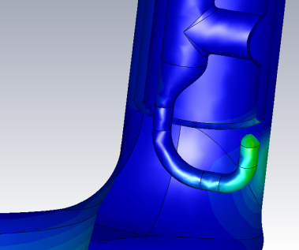
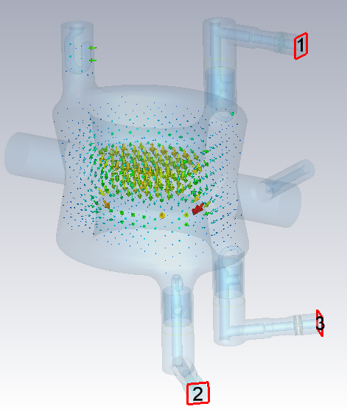
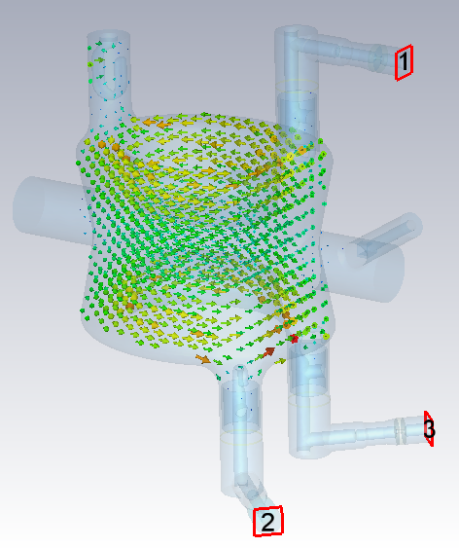
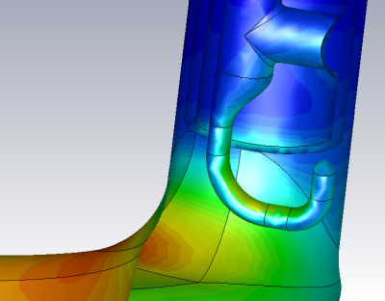
Filter at 400MHz
E field
H field
For 400MHz crabbing mode with Vt = 3.34MV:
Peak E field on the hook: 19.4~29.7MV/m, on the cavity: 37.0~38.8MV/m.
Peak H field on the hook: 46.2~58.7mT, on the cavity: 70.4~70.9mT.
Coupling to 400MHz: >6.3x10⁹, <1.4 W at each port to outside load.

Slide 5
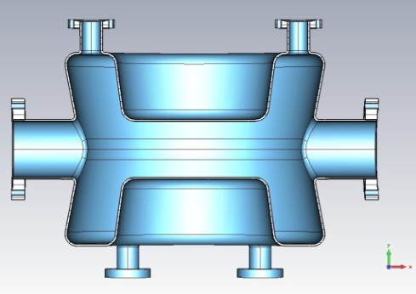
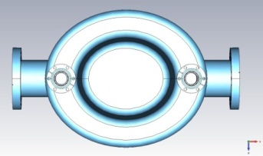
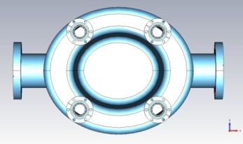
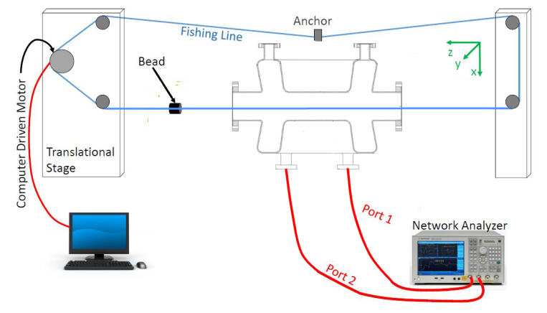
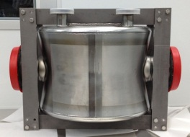
Identify HOMs: Bead Pulling
Proof-of-Principle (PoP)
Double-Quarter Wave Crab Cavity (DQWCC)
Cavity prototype smaller than RF model cause frequencies shifting up.
HOM frequencies deviated from designed values due to unspecified tolerances for PoP cavity.
Bead-pull setup

Slide 6
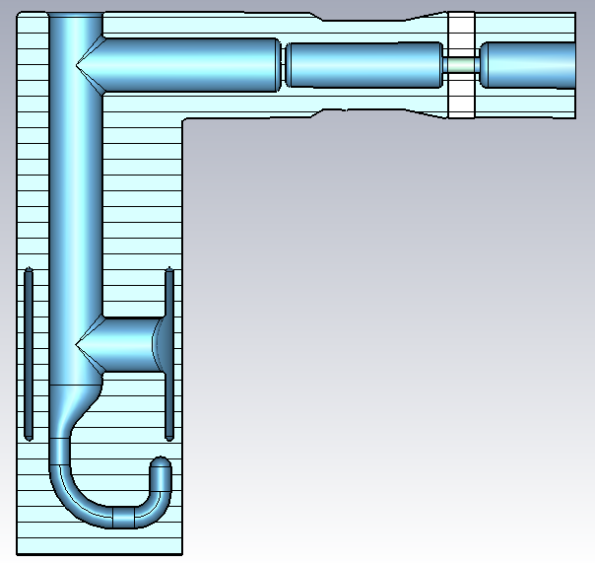
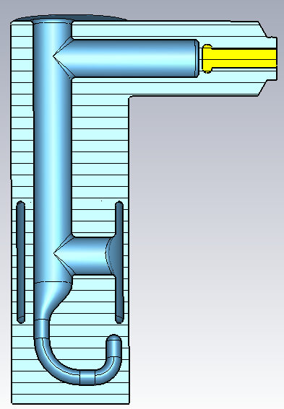
Tolerance study
Gap2 ranges from 1.5 to 2.5 mm.
Gap2
Rod1P at -9 means it is on the left of the center of the 62mm dia. can with a distance at 9mm.
Rod1P
Center of the 62mm dia. can
Center of the 20mm dia. rod with 14mm dia. cooling channel
Rod1L
Rod1L+Rod2P
Rod1L
Rod1L+Rod2P+Tube1P
Tube1P
Rod2P
Please note the parameter Rod2P is negative
Rod2P
This line is at half of the capacitive ring tube

Slide 7
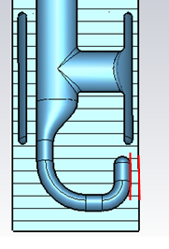
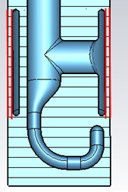
Tolerance study
Unit: mm
Parameter | Nominal | error
Gap0 | 4 | Left 0.4 | Right 0.5
Gap1 | 3 | Left 0.4 | Right 0.5
Gap2 | 2 | Left 0.5 | Right 0.5
Rod1P | -9 | Left 0.4 | Right 0.5
Rod1L+Rod2P | 125 | Down 0.5 | Up 0.5
Rod1L+Rod2P +Tube1P | 128.5 | Down 0.5 | Up 0.5
Insertion | 143 | Down 0.5 | Up 0.5
Rotation |  | Clockwise 1 degree | Counter clockwise 1degree
Gap0
Gap0 ranges from 3.5 to 4.4 mm.
HOM port inner wall
on cavity side
-0.4 means the capacitive ring is shifted left, the gap on the left becomes smaller (to 2.6) and the gap on the right becomes bigger (to 3.4).
+0.5 means the capacitive ring is shifted right, the gap on the left becomes bigger (to 3.5) and the gap on the right becomes smaller (to 2.5).
Gap1

Slide 8
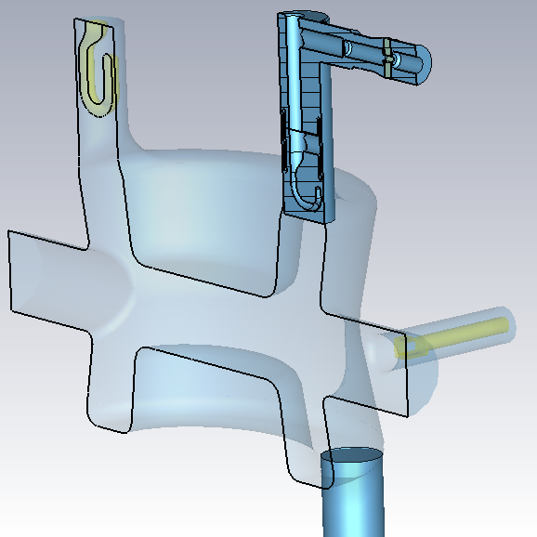
Tolerance study
Qext of each HOM was calculated from cavity+HOM filter model, with 0.2~0.4M meshes.
Qext of each HOM was then calculated from S21 difference of each filter and was compared with the previous results.
Most of the Qexts are consistent (50% to 200%) using two methods, there are a few modes that showed 25%~50%, or 200%~400% difference.
Discrepancy came from the insertion of the HOM filter into the cavity.

Slide 9
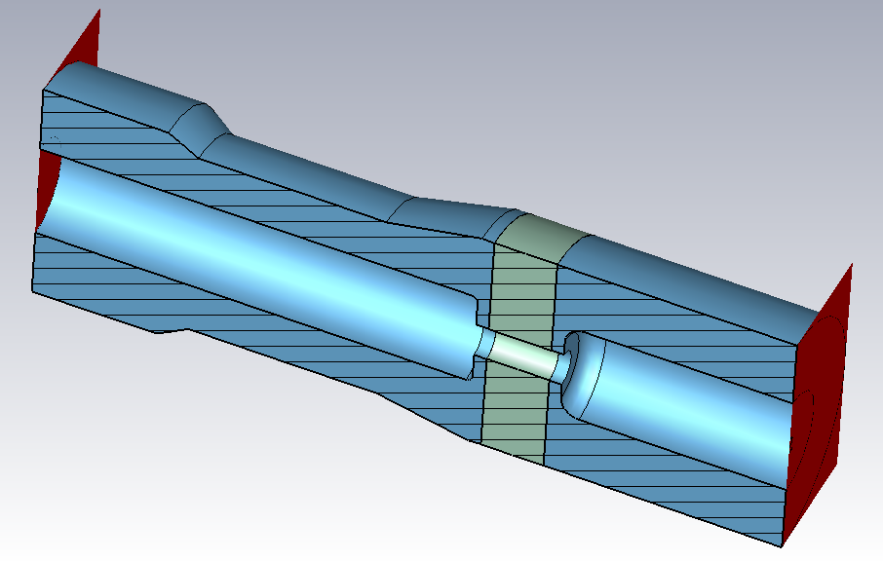
Nb thickness and HOM window
By changing this thickness from 4mm to 3mm, the S21 will basically remain the same.

Slide 10
Thank you!

Slide 13
Outline
SPS double quarter wave crab cavity
Constraint in the HOM filter design
Design of HOM filter
Fundamental mode in HOM filter
Multipacting
HOM window
Identify HOMs (Bead pulling of PoP cavity)
Shunt impedance
HOM power estimation
Thermal analysis
Tolerance study
Summary

Slide 14
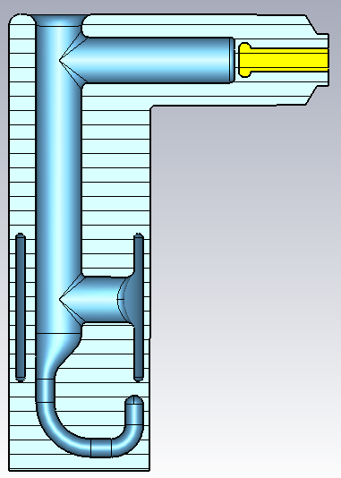
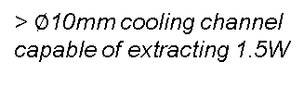
L-shape filter
> $∅$10mm cooling channel
capable of extracting 1.5W
570 MHz (-2 dB)
685 MHz (-20 dB)
400±17 MHz (-128dB)
Cu pin for
RF feedthrough
to outside load
Flanges to separate
HOM filter from cavity,
3 mm RF-seal Cu gasket.
L shape to meet the space constraint.
Band stop structure to reduce loss on Cu gasket.
34MHz rejection band at 400MHz.
Good passing band at freq > 570MHz (1st HOM).
Band stop structure
to reduce loss
on Cu gasket
Bend to lower peak magnetic field
Hook length tuned
to minimize Hpk
on hook surface.

Slide 15
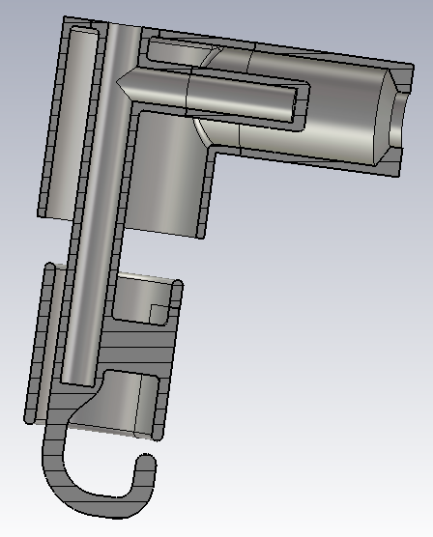
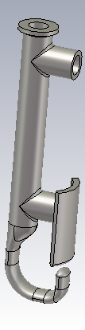
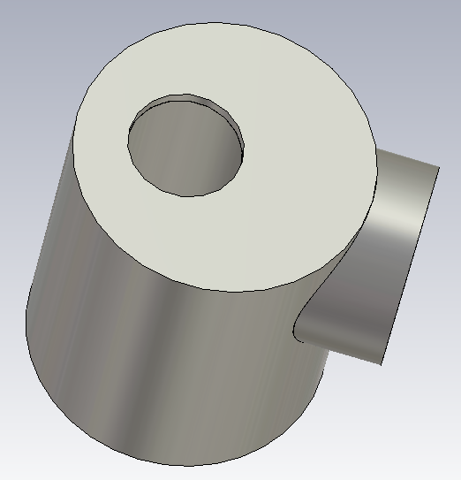
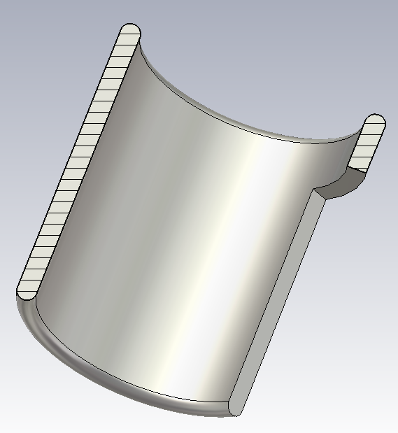
L-shape filter
A
Piece 3
Piece 1
1
B
2
D
5
3
Piece 4
C
4

Slide 16
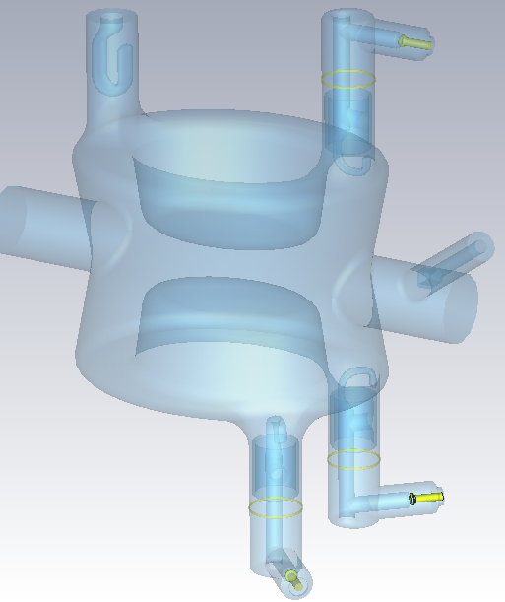
Filter integration
3 HOM filters per cavity, with two 60-degree away from the center to give clearance to the other beam pipe in horizontal kick scheme
Symmetrical design to minimize multipolar components.
60 degree is chosen to provide more coupling to HOMs.
Compact to fit into cryomodule.
Longer RF cables can be easily attached to the L shape filter to reduce static heating.
Notes:
Keep the compactness

Slide 17
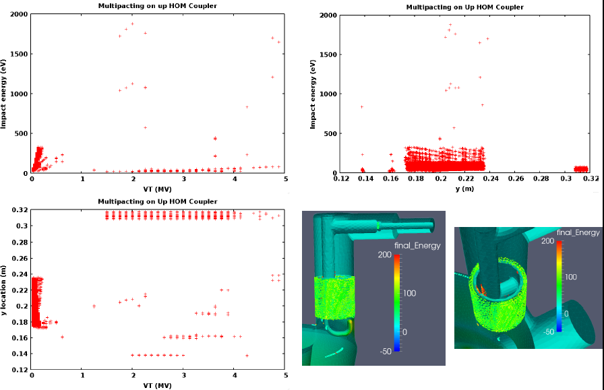
Multipacting: filter on top
© Li @SLAC

Slide 18
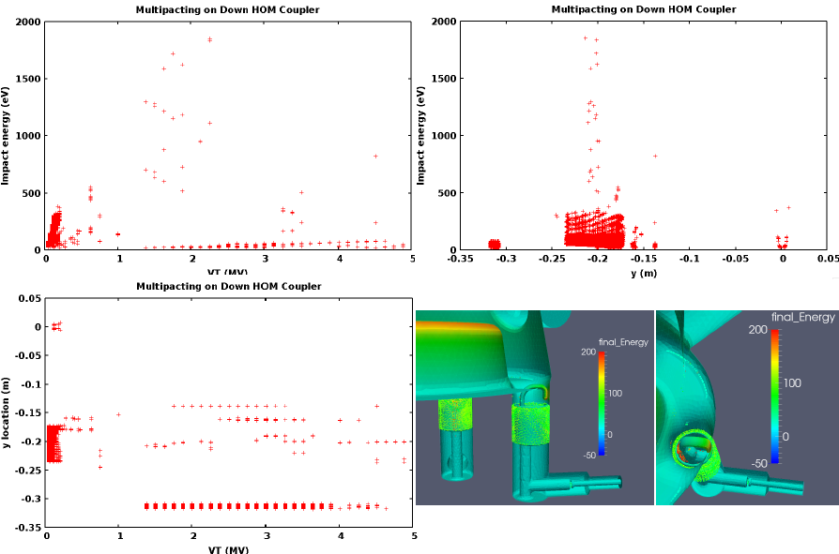
Multipacting: filter on bottom
© Li @SLAC

Slide 19
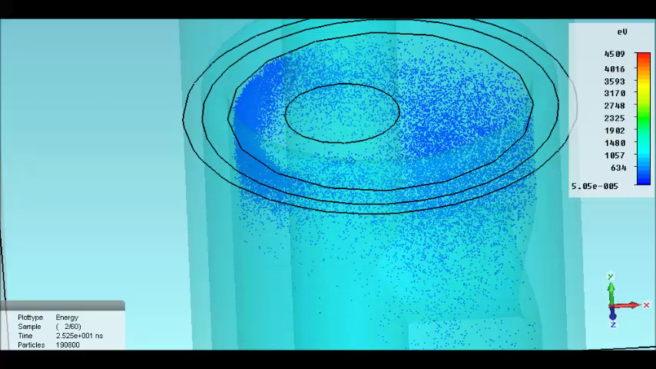
Multipacting
© Hall & Burt @Cockcroft

Slide 20
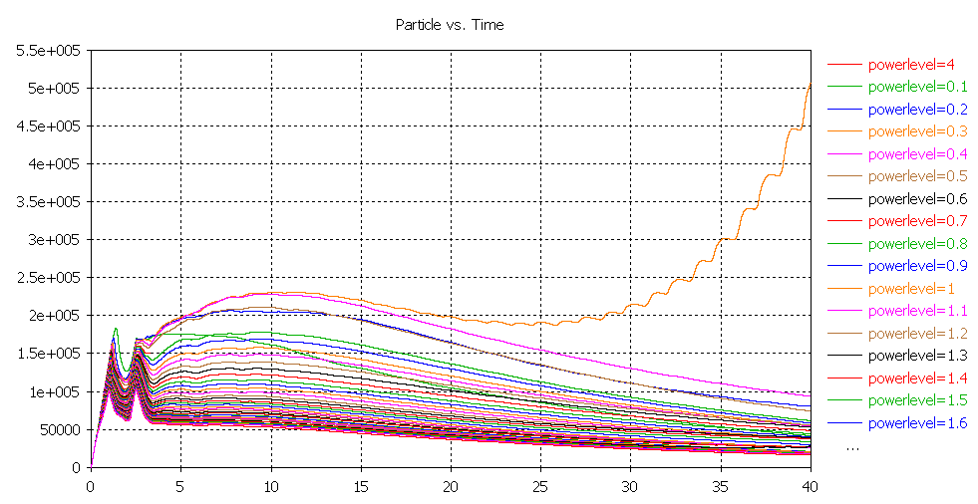
Multipacting
Multipacting with standard treated Nb at 0.3MV
(BCP, EP, baking)
© Hall & Burt @Cockcroft

Slide 21
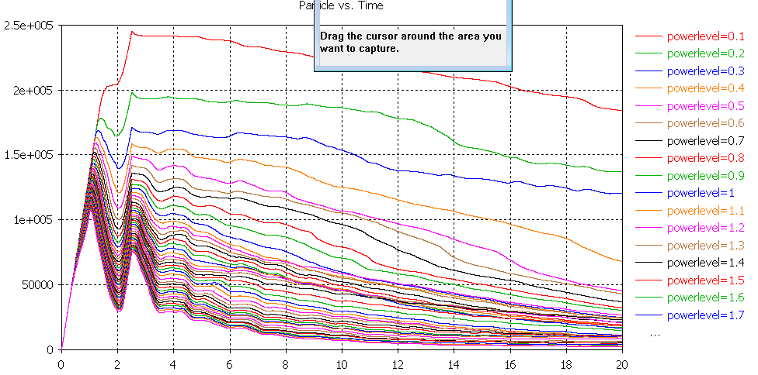
Multipacting
No multipacting for pure/Ar treated Nb (with lower SEY)
© Hall & Burt @Cockcroft
Multipacting is not a critical issue in this design
Continuous study to further suppress it by changing the EM field near the top blending

Slide 22
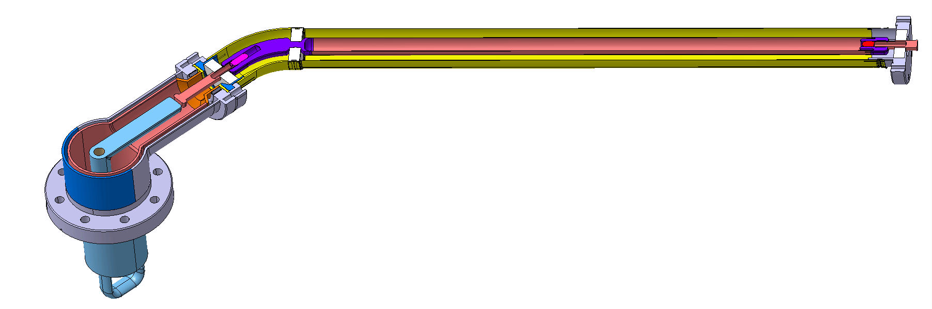
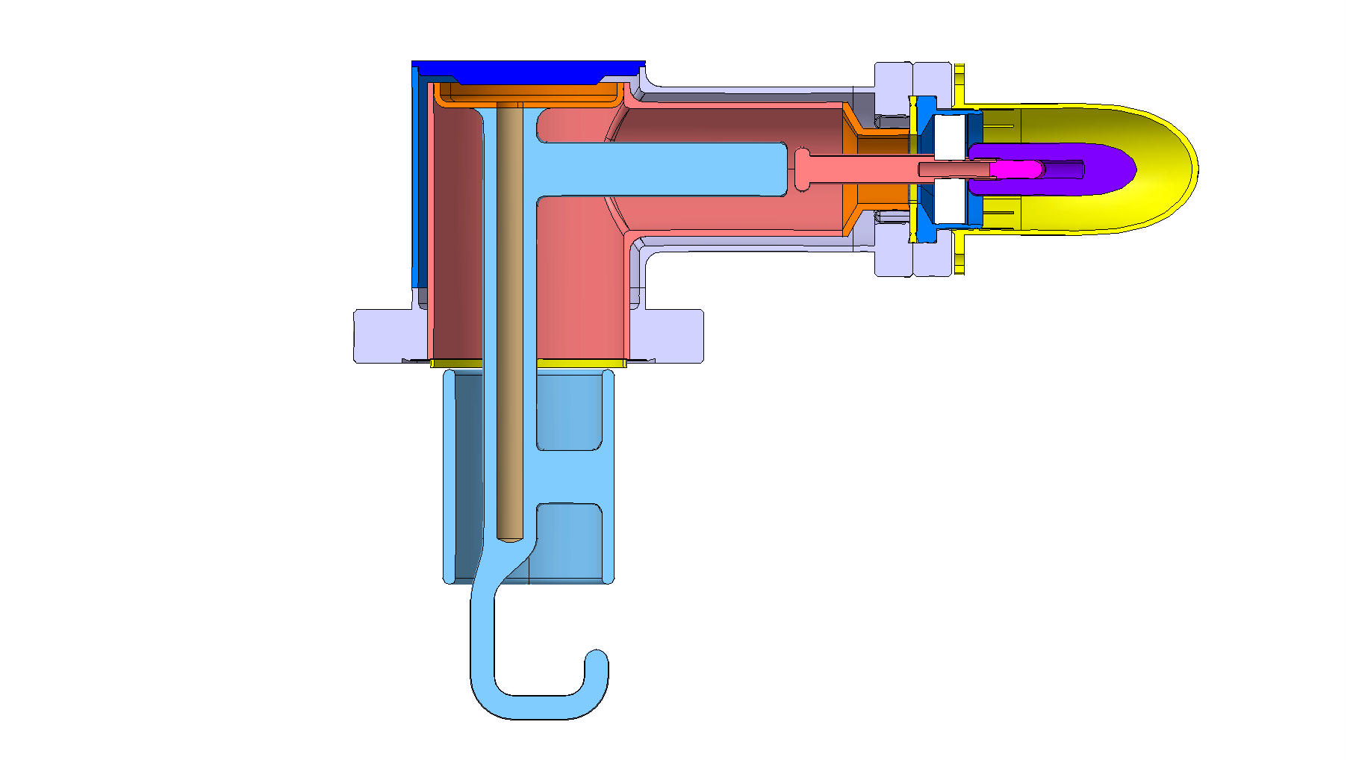
HOM window
© Montesinos, Rama & Capatina @CERN
Preliminary design that fits the space limit.
Thermal study is done.
RF optimization is on-going, preliminary optimization showed less than 0.4dB loss on S₂₁ up to 2 GHz.

Slide 23
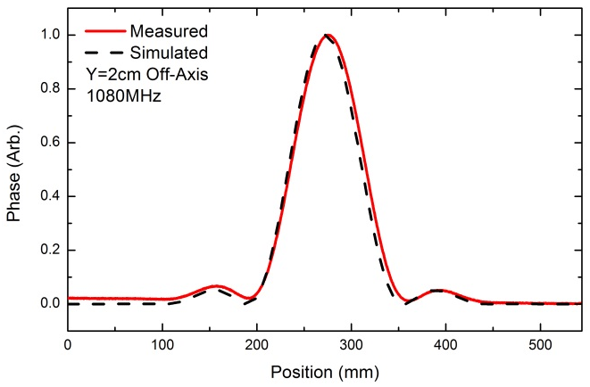
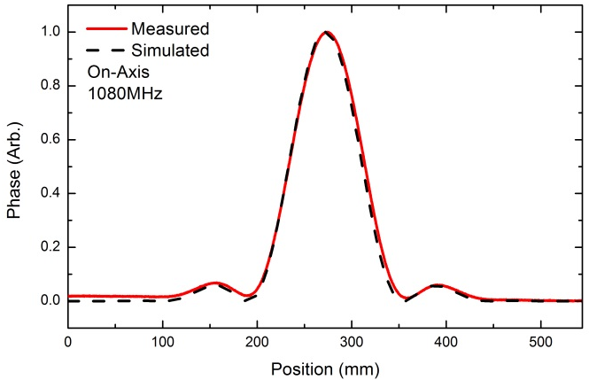
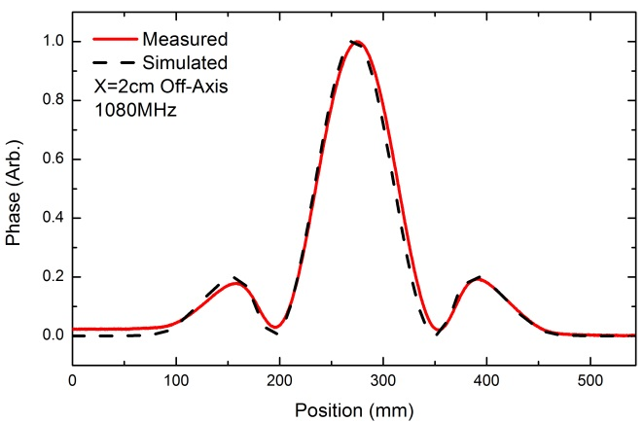
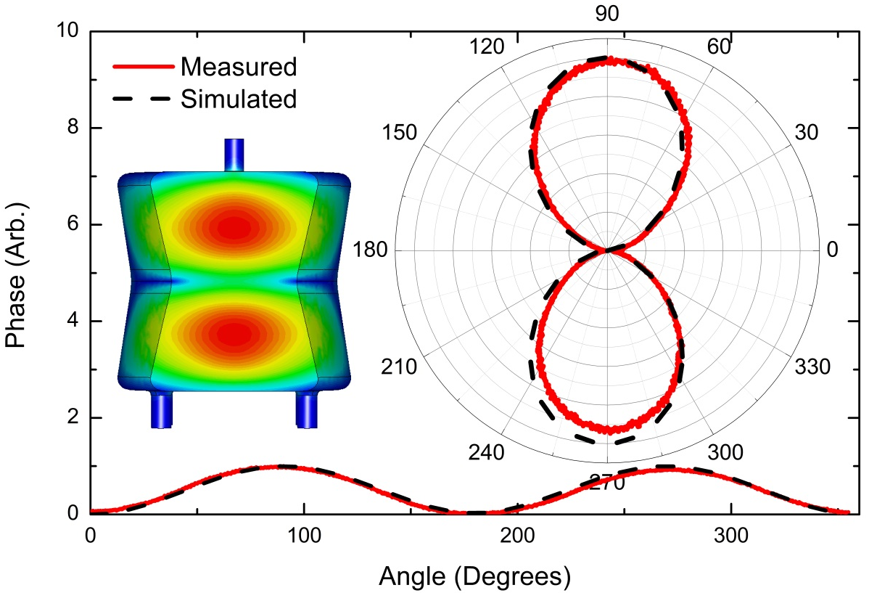
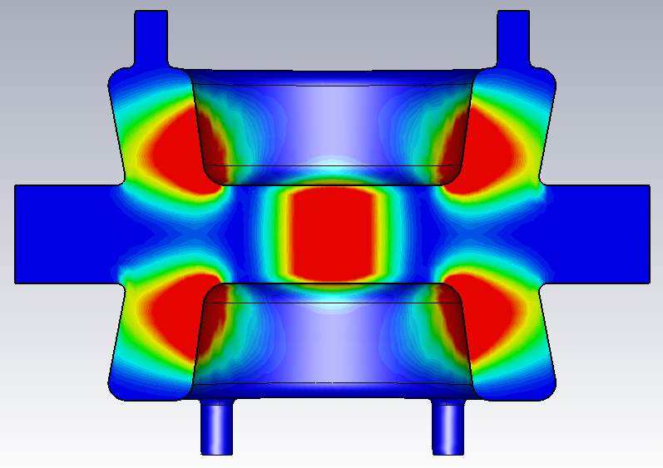
Identify HOMs : Bead Pulling (2)
1080 MHz
© Carlos Marques (Master thesis)

Slide 24
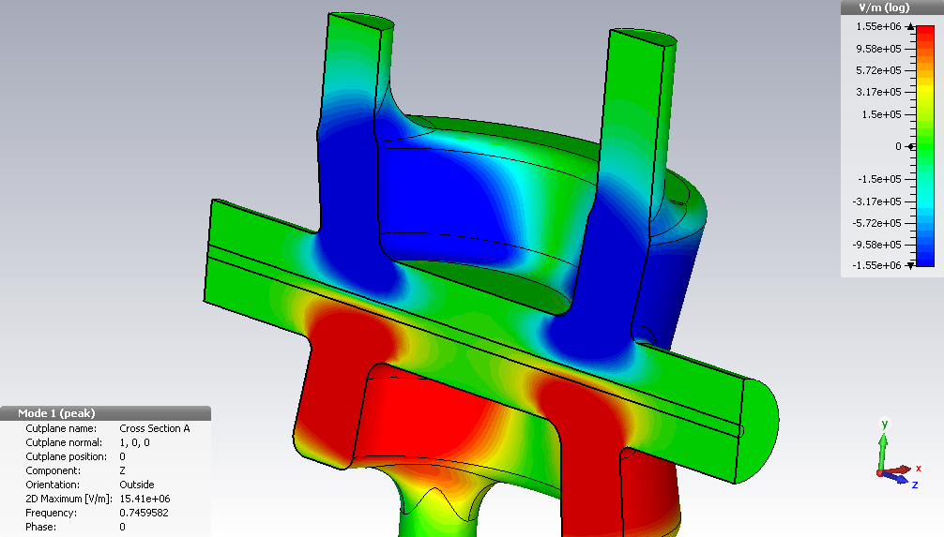
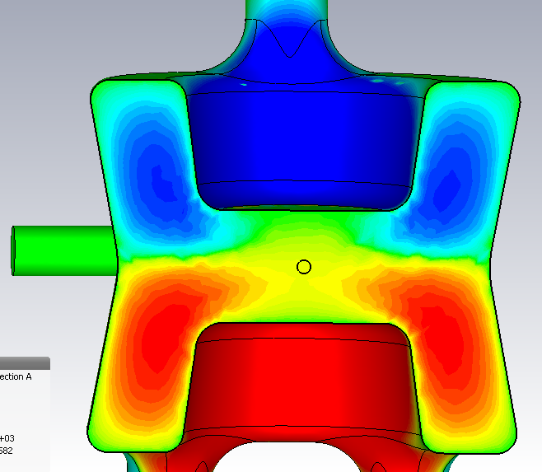
Shunt impedance
© Hall & Burt @Cockcroft
V_{z} both monopole and dipole components.
Out of phase: electrical minimum off centre, and non zero
Components need to be split and recombined to get correct values
V_{z} component

Slide 25
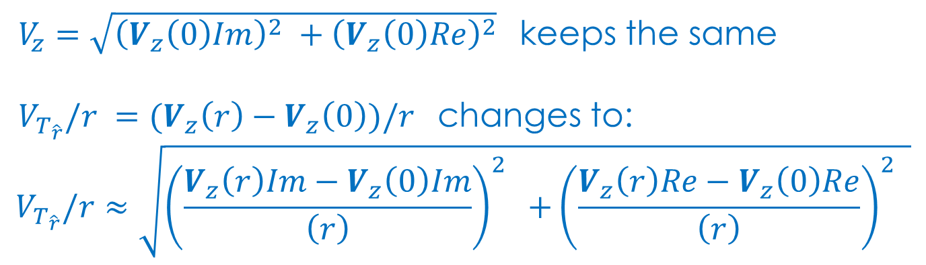
Shunt impedance
© Hall & Burt @Cockcroft
$V_{z}$ $=\sqrt{{\left(V_{z}\left(0\right)Im\right)}^{2} +{\left(V_{z}\left(0\right)Re\right)}^{2}}$ keeps the same
$V_{T_{\hat{r}}}/r =(V_{z}\left(r\right)−V_{z}\left(0\right))/r$ changes to:
$$V_{T_{\hat{r}}}/r≈\sqrt{{\left(\frac{V_{z}\left(r\right)Im−V_{z}\left(0\right)Im}{\left(r\right)}\right)}^{2} {+\left(\frac{V_{z}\left(r\right)Re−V_{z}\left(0\right)Re}{\left(r\right)}\right)}^{2} }$$
Position mm | On axis | -1 to 1 | 1 to 5 | -1 to -5 | 5 to -5
RT/Q | 0.08 | 347.6 | 10.7 | 0.49 | 28.27
@745MHz
Changes to
Positions mm | -5 to 0 | 5 to 0 | 10 to 5 | -1 to 1
RT/Q | 19.86 | 19.54 | 20.2 | 19.9

Slide 26
Shunt impedance
Higher than 10⁵ (Ω for longitudinal, Ω/m for transverse):
0.574, 0.685, 0.927, 1.216, 1.296, 1.500, 1.660, 1.746, 1.750 GHz

Slide 27
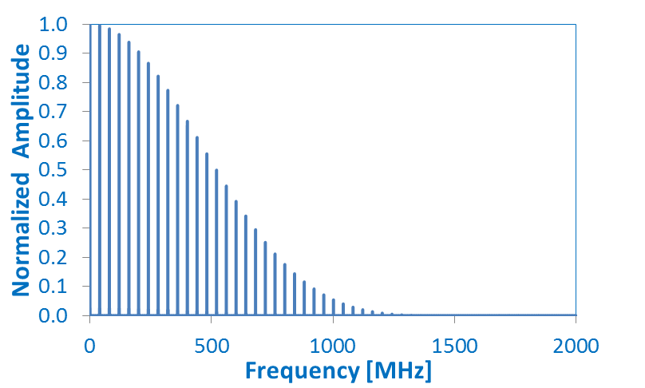
HOM power estimation
 | F (MHz) | 573.8 | 594.9 | 685.1 | 927.0 | 959.1
 | Mode Type | L | L | H | H | L
 | Qext | 4637 | 1270 | 1880 | 8602 | 7200
Impedance | Longitudinal [Ω/cavity] | 170000 | 25800 |  |  | 70100
 | Horizontal [Ω/m/cavity] |  |  | 934000 | 2750000
 | Vertical [Ω/m/cavity]
 | HOM Power [Watt] | 0.7 | 3.8 | <0.1 | <0.1 | 0.13
 | Close to harmonic of 40.08MHz |  | 15th |  |  | 24th
Based on 25nS beam spectrum
Power of transverse modes estimated based on 5mm offsets.
HOM power is about 5.3 Watts per cavity
© Calaga & Salvant @CERN

Slide 28
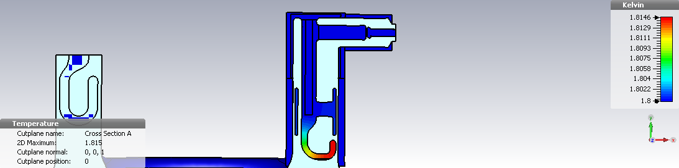
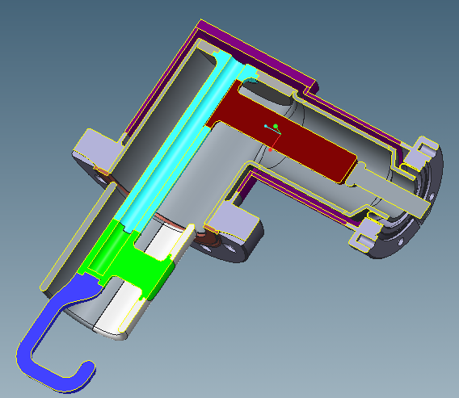
Thermal analysis
CERN and Cockcroft
  Assumes cavity operating at nominal deflecting voltage of 3 MV with 5 nOhm surface resistance.
  Assumes active cooling through the center cooling channel at 1.8 K
5 MV →1.8406K
  Feed-through to a coax cable to an outside load
  Active cooling will be applied in the straight section of the HOM hook, and it is possible to extend it till the end of the tip.
  Static loss from the cable is ~0.5 Watt.

Slide 29
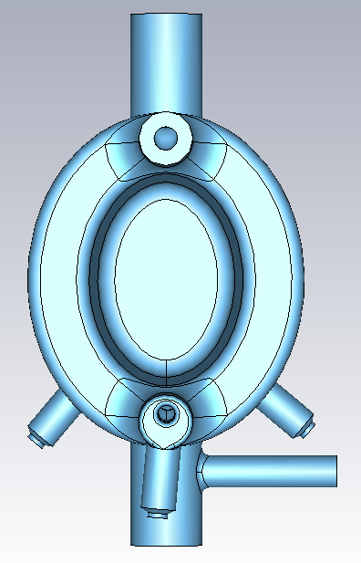
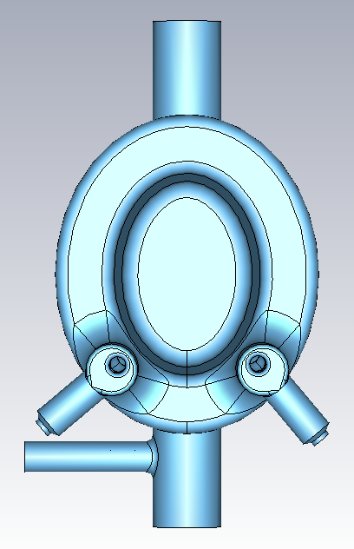
Tolerance and impedance
Evaluate
We use the model with gap0=3.5mm as a start
All filters rotate a certain degree, as shown in the pictures.
CW1: (all filters) rotate 1 degree in clockwise
CCW1: rotate 1 degree in counter clockwise
CW5: rotate 5 degree in clockwise
CCW5: rotate 5 degree in counter clockwise
Center of the HOM port
Clockwise for the top filter
Clockwise for the bottom filters
Impedance table
For modes with impedance higher
than 10⁵ Ω or Ω/m.
L: longitudinal in Ω
H: horizontal in Ω/m
V: vertical in Ω/m
T: transverse (a mix of longitudinal and
vertical, the number showed here is the
higher one of these two) in Ω/m
 | Impedance table (circuit definition)
freq [GHz] | Gap0 3.5 model | CW1 | CCW1 | CW5 | CCW5
0.6851649 | 1.04E+06 | 1.03E+06 | 1.09E+06 | 1.08E+06 | 1.07E+06 | H
0.9269259 | 2.59E+06 | 2.75E+06 | 2.76E+06 | 2.78E+06 | 2.75E+06 | H
1.2162745 | 1.79E+05 | 1.81E+05 | 1.67E+05 | 1.65E+05 | 1.62E+05 | H
1.2955984 | 7.51E+05 | 7.55E+05 | 7.09E+05 | 7.15E+05 | 7.08E+05 | V
1.4998569 | 1.04E+05 | 2.17E+05 | 2.26E+05 | 2.28E+05 | 2.24E+05 | T
1.6598078 | 5.27E+05 | 1.16E+05 | 2.81E+05 | 4.84E+05 | 2.75E+05 | H
1.7460401 | 5.62E+05 | 6.08E+05 | 5.84E+05 | 5.93E+05 | 5.81E+05 | V
1.7497177 | 1.56E+05 | 1.71E+05 | 1.63E+05 | 1.63E+05 | 1.60E+05 | H

Slide 30
Tolerance and impedance
Rod1P
Evaluate the red numbers in ±0.5mm range
Tube1P and Rod2P will not affect RF performance based on S21 calculation and they are not considered in this analysis.
The length of hookP4 is used to tune Gap0
For the ref model, Gap0=4mm, Gap1=3mm, Rod1P=-9mm (minus here means shifting left).
We focus on the modes with impedances higher than 10⁵ (Ω for longitudinal, Ω/m for transverse).
Impedance table were sent to CERN for evaluation.
Tube1P
Insertion,
relative
to the cavity
Rod2P
Gap1
Gap0
hookP4
 |  |  | Impedance (circuit definition)
Freq [GHz] | ref. model | Gap0 3.5 | Gap0 4.5 | Gap1 left0.5 | Gap1 right0.5 | Rod1P -8.5 | Rod1P -9.5 | 0.5inner | 0.5outter | Mode
0.573846 | 1.70E+05 |  | 3.69E+05 | 1.82E+05 |  | 2.89E+05 | 4.67E+05 | 1.17E+05 | 1.19E+05 | L
0.685176 | 9.34E+05 | 1.04E+06 | 8.97E+05 | 7.79E+05 | 6.97E+05 | 1.07E+06 | 8.36E+05 | 7.15E+05 | 7.72E+05 | H
0.926951 | 2.75E+06 | 2.59E+06 | 3.15E+06 | 3.22E+06 | 2.05E+06 | 3.77E+06 | 2.62E+06 | 2.48E+06 | 2.72E+06 | H
1.216278 | 1.69E+05 | 1.79E+05 | 1.53E+05 | 1.45E+05 | 2.00E+05 | 1.47E+05 | 1.78E+05 | 1.65E+05 | 1.75E+05 | H
1.295595 | 7.46E+05 | 7.51E+05 | 7.08E+05 | 6.81E+05 | 7.91E+05 | 7.11E+05 | 7.61E+05 | 6.98E+05 | 7.55E+05 | V
1.499932 | 5.35E+05 | 1.04E+05 | 5.41E+05 | 6.07E+05 |  | 6.41E+05 | 1.20E+05 | 3.75E+05 | 4.27E+05 | T
1.640505 | 1.39E+05 | 2.71E+05 |  |  |  |  |  | 1.57E+05 | 1.30E+05 | T
1.659981 | 6.28E+05 | 5.27E+05 | 4.22E+05 | 2.77E+05 | 7.07E+05 | 2.31E+05 | 8.15E+05 | 6.18E+05 | 5.75E+05 | H
1.746212 | 5.15E+05 | 5.62E+05 | 4.97E+05 | 5.11E+05 | 5.06E+05 | 5.02E+05 | 5.55E+05 | 5.02E+05 | 5.30E+05 | V
1.749750 | 1.41E+05 | 1.56E+05 | 1.35E+05 | 1.42E+05 | 1.39E+05 | 1.41E+05 | 1.57E+05 | 1.36E+05 | 1.47E+05 | H

Slide 31
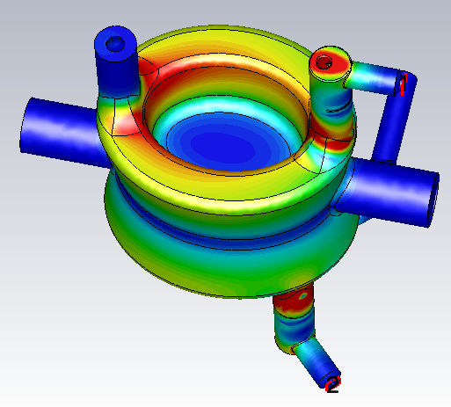
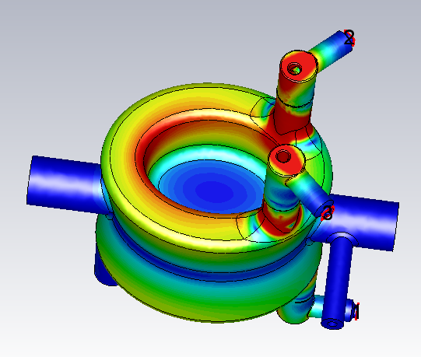
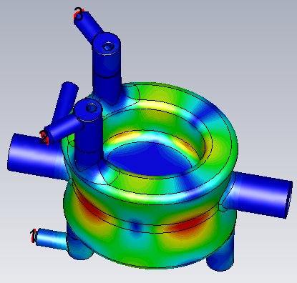
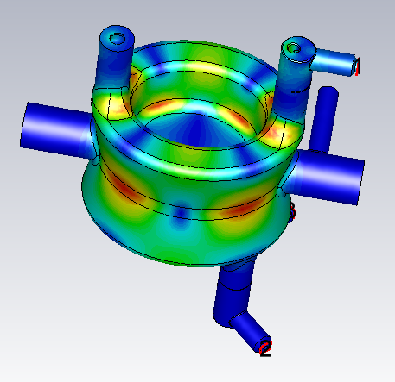
Tolerance and freq shift
 | F (MHz) | 573.8 | 594.9 | 685.1 | 927.0 | 959.1
 | Mode Type | L | L | H | H | L
 | Qext | 4637 | 1270 | 1880 | 8602 | 7200
Impedance | Longitudinal [Ω/cavity] | 170000 | 25800 |  |  | 70100
 | Horizontal [Ω/m/cavity] |  |  | 934000 | 2750000
 | Vertical [Ω/m/cavity]
 | HOM Power [Watt] | 0.7 | 3.8 | <0.1 | <0.1 | 0.13
 | ±6 MHz HOM Power [Watt] | 1.7 | 535.7 | 18.1 | 6.9 | 221.0
 | Harmonic of 40MHz |  | 15th |  |  | 24th
594.9MHz H field
959.1MHz H field

Slide 32
Tolerance and freq shift
Error in the HOM filter
In the study of the tolerances on HOM power, we focus on the two dangerous modes at 594.9MHz and 959.1MHz.
The fabrication tolerances of the HOM filter and the cavity is confined in a reasonable range so that the total HOM power is <100Watt.
However there are several modes at ~600MHz that might be dangerous, an additional constraint on Gap0 (4±0.2mm) is added for risk control.
Qext of the crabbing will not decrease to less than 50%, the coupling to the crabbing mode will extract <2.2Watt power to the outside load for each filter.
 | Qext | Impedance | Power [Watt] | Mode
Gap0 4.5
0.5951258 | 691 | 182.8 | 0.12 | H
0.5997148 | 751 | 9308.1 | 61.90 | L
Rod1P+0.5
0.597517 | 1375 | 21759.7 | 7.63 | L
0.959304 | 10927 | 106660.7 | 0.12 | L
Rod1P-0.5
0.599114 | 705 | 260.9 | 1.48 | H
0.599845 | 748 | 3084.5 | 25.60 | H
0.603770 | 721 | 6188.6 | 15.45 | L
Error in the cavity
Mode | 594.9 MHz | 959.1 MHz
Height change ±0.5mm | ±0.52 MHz | ±0.26 MHz
Waist change ±0.5mm |  | ±0.10 MHz
601.2 MHz
961.9 MHz

Slide 33
Tolerance and RF losses
Freq [MHz] | Power to the load outside [Watt] | Loss on Cu pins [mW] | Loss on Cu gaskets [mW] | Loss on Nb [mW]
573.85 | 1K | 15.01 | 81.27 | 1.36
594.91 | 1K | 11.55 | 35.79 | 0.46
685.18 | 1K | 9.44 | 0.50 | 0.21
926.95 | 1K | 2.18 | 0.90 | 0.07
959.08 | 1K | 28.36 | 9.30 | 0.68
total: |  | 66.53 | 127.76 | 2.79
Results are per cavity, with 3 HOM filters on each cavity.

Slide 34
Summary
An L-shape filter with a band stop structure is designed for DQWCC.
Peak electric/magnetic fields on filter smaller than on cavity.
Multipacting simulations are cross-checked between CST MWS (UK) and ACE3P/TRACK3P (SLAC).
Design of the HOM window is on-going.
HOM modes are characterized using bead pulling system.
Methodology for R/Q calculation has been established by UK team. Values cross checked by UK and BNL using CST MWS.
Q_{ext} calculations of HOMs using two methods: eigenmode Q and S parameter Q.
Thermal simulation of HOM the filter shows only 15 mK temperature increase on the HOM hook.
HOM filter is designed trying to meet the current impedance budget with HOM frequency up to 1.75 GHz. Impedance table were sent to CERN, together with the tolerance study.
Estimated the HOM power and RF losses, together with the tolerance study.

Slide 35
References
B. P. Xiao, et al., “Design, prototyping and testing of a compact superconducting double quarter wave crab cavity” to be submitted
C. Marques. Master's thesis, Stony Brook University, (2014)
Q. Wu, et al., B. P. Xiao, et al., S. Verdú-Andrés, et al., J. Skaritka. et al., “Double Quarter Wave Crab Cavity” Series, LARP review meeting, 2014
B. P. Xiao, S. Verdu-Andres, Q. Wu posters, SRF13, Paris, France, Sep 23-27, 2013
Q. Wu, B. P. Xiao, presentations, Joint LARP CM20/HiLumi Meeting, Napa Valley, CA, 2013
R. Calaga, et al., B. P. Xiao, et. al., in Proceedings of the 4th International Particle Accelerator Conference Shanghai, China (2013)
S. Belomestnykh, Q. Wu, B. P. Xiao, presentations, LHC Crab Cavity Engineering Meeting, Fermi Lab, Dec 13-14, 2012
Q. Wu, R. Calaga & A. Macpherson, K. Brodzinski & L. Tavian, presentations, 2nd Joint HiLumi LHC-LARP Annual Meeting, INFN Frascati, Nov 14-16, 2012
R. Calaga, et. al., A Quarter Wave Design for Crab Crossing in the LHC, Proceedings of IPAC12, New Orleans, LA, May 20-25, 2012
Q. Wu, presentation, LARP CM18/HiLumi LHC Meeting, Fermi Lab, May 7-9, 2012
Q. Wu, S. Belomestnykh, I. Ben-Zvi, Novel deflecting Cavity Design and Fabrication for eRHIC, Proceedings of SRF11, Chicago, IL, July 25-29, 2011
R. Calaga, presentation, LHC-CC11, CERN, Nov 14-15, 2011
I. Ben-Zvi. 4th LHC Crab Cavity Workshop; CERN, Geneva, Switzerland (2010)

