Slide 1

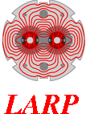





Crab Cavity HOM Coupler Specification Drawings & Tolerances
Nik Templeton
22/02/2015

Slide 2
Overview
Functional drawing scope
HOM model modifications - Rev B
HOM flange locations
Tolerance Analysis
Model checks
FEA design Validation
253-10420-B
Drawing samples
253-10520-B
1

Slide 3
Functional Drawings
Drawing Datums located at fixed flange/cavity interface & inner coupler-body cylinder
All critical dimensions referenced from drawing datums
Dimensional & Geometric drawing tolerances stipulated
Drawing tolerances are after assembly and welding – maximum final error
Tolerances consider stacking/cumulative error
Part breaks shown but not dimensioned - TBD by manufacture
Drawings to be used with models for manufacture
All dimensions at 300K before BCP:
  Assuming 0.143% contraction (300>>2K) for Niobium
  200µm & 150µm BCP removal for DQW & RFD HOMS respectively
Drawing Models have been successfully cross checked with:
  Native coupler models
  CERN HOM models
  Scaled parameter tables
4

Slide 4
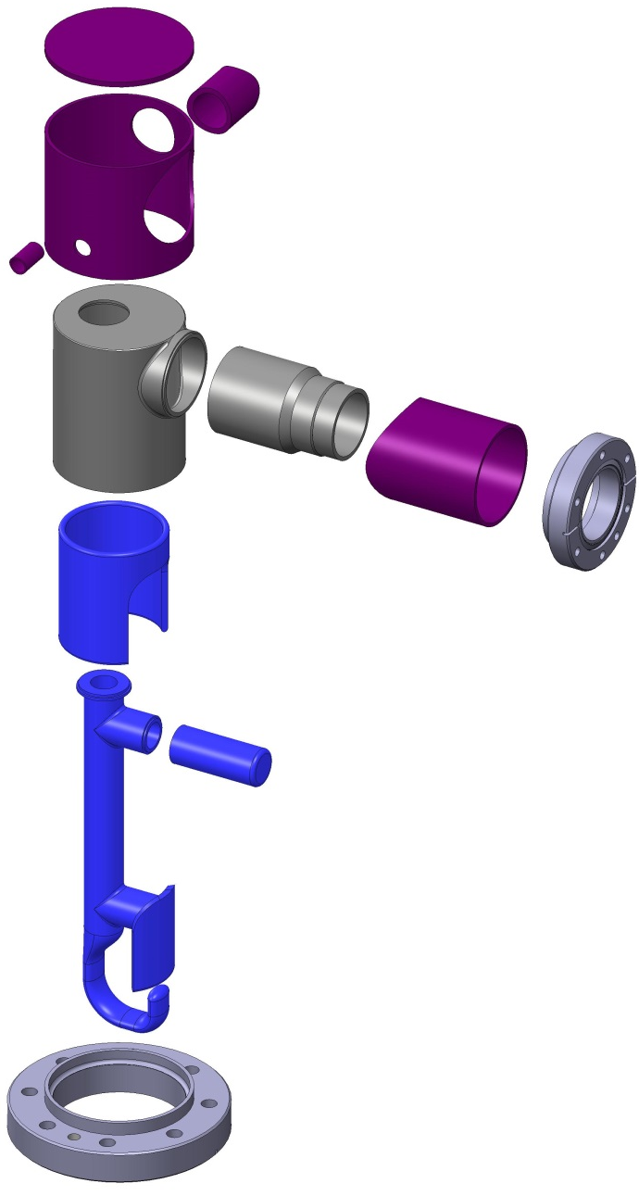
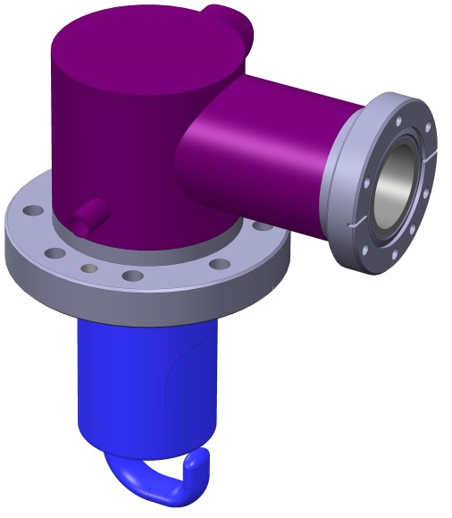
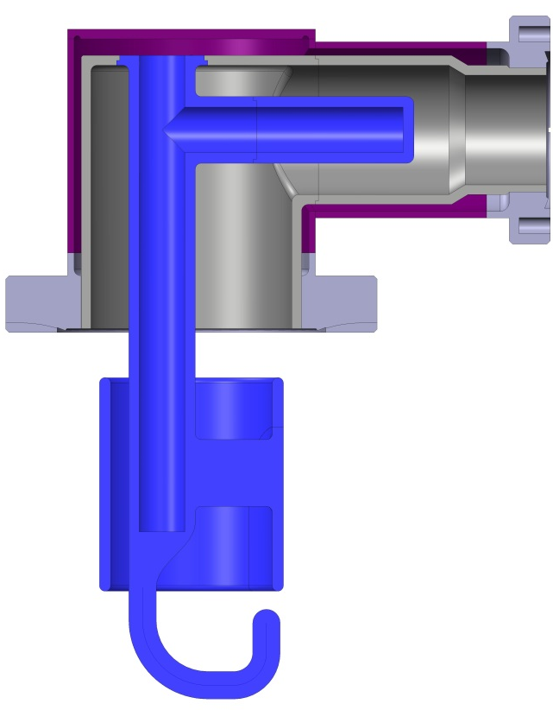
DQW HOM Rev B
Ø26/20mm 2-phase line
Possible assembly method
Rigid coax flange
Ø10/8mm Bottom fill pipe
Iso view
Section view
Ring thickness reduced 4mm>>3mm
2

Slide 5
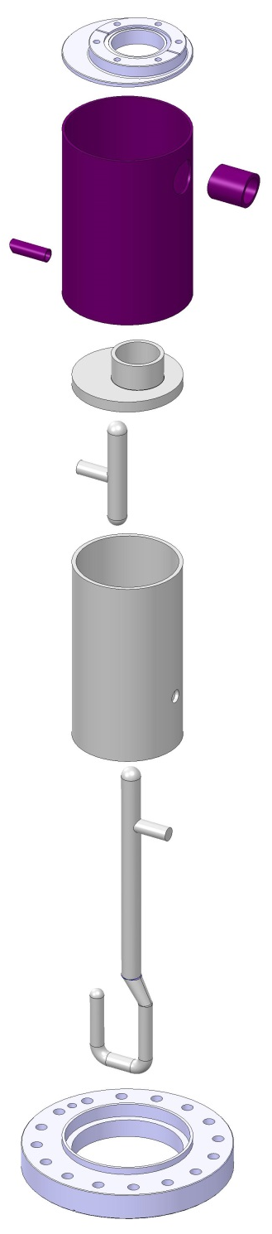
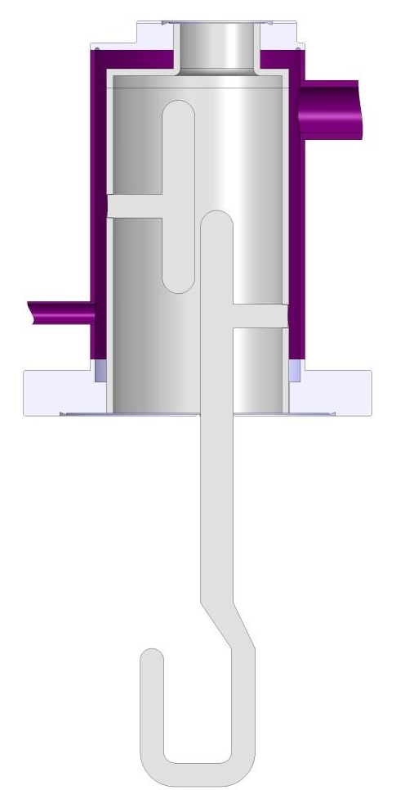
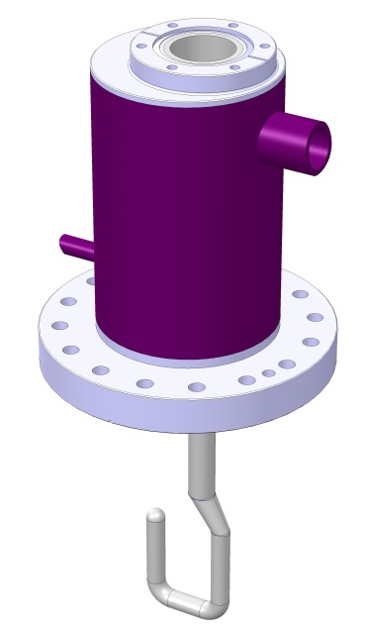
RFD HHOM Revision B
Flange step with weld feature
Ø26/20mm 2-phase line
Ø10/8mm Bottom fill pipe
Rod taper blending
Iso view
Section view
Possible assembly method
3

Slide 6
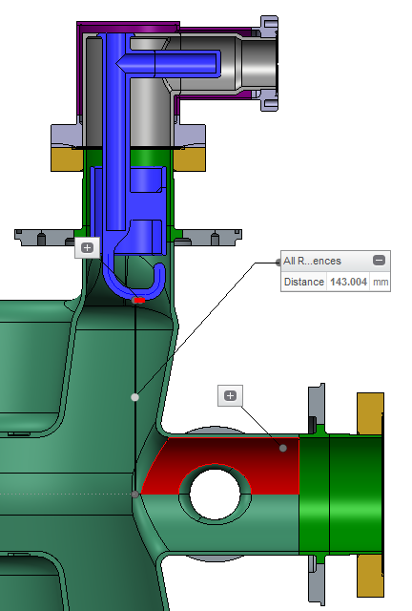
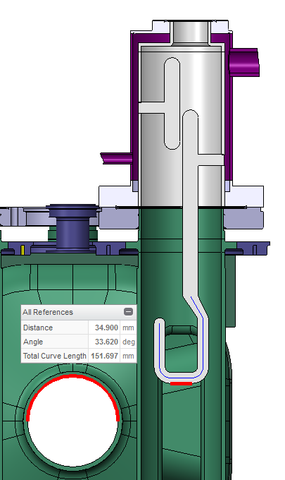
Cavity Interface
 | Beam Centre - Hook Height (mm) |  | Calculation
 | at 2K post-BCP | at 300K pre-BCP
DQW HOM | 143.000 | 143.004 | 143 x 1.00143 -0.2
RFD HHOM | 35.000 | 34.900 | 35 x 1.00143 -0.15
5

Slide 7
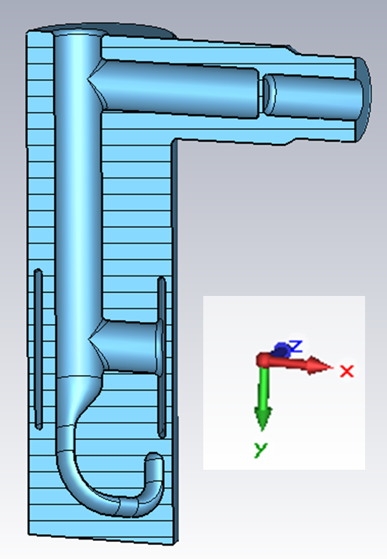
DQW Tolerance Analysis
Tolerance Region | Specification | Dimension Tolerances | Geometric Tolerances
Hook offset X-Z | -0.4/+0.5 mm |  | 0.2 Surface Profile A/B 0.1 Location A 0.1 Parallelism A 0.1 Perpendicularity B
Capacitive ring offset X-Z | -0.4/+0.5 mm |  | 0.4 Concentricity B 0.1 Location A 0.1 Parallelism A 0.1 Perpendicularity B
Rod3 offset X | ± 0.5 mm | ± 0.5 mm
Rod3 location Y |  | ± 0.2 mm | 0.1 Parallelism A 0.1 Perpendicularity B
Rod1 location X-Z | ± 0.5 mm |  | 0.1 Location A
Rod2 offset Y | ± 0.5 mm | ± 0.2 mm | 0.1 Parallelism A 0.1 Perpendicularity B
Hook offset Y | ± 0.5 mm | ± 0.2 mm | 0.2 Surface Profile A/B
Filter (all parts) rotation Y-axis | ± 1˚ | ± 0.5˚
Rod3
Probe
Rod1
Ring
Rod2
Hook
6

Slide 8
RFD Tolerance Analysis
Tolerance Region | Specification | Dimension Tolerances | Geometric Tolerances
Probe bar offset longitudinal | ± 0.3 mm | *coax design | 0.1 Parallelism A
Tee offset longitudinal | ± 0.3 mm | ± 0.1 mm location ± 0.1 mm length | 0.5 Parallelism A 0.5 Perpendicularity B
Hook offset longitudinal | ± 0.2 mm | ± 0.05 mm location ± 0.1 mm height | 0.5 Parallelism A 0.5 Perpendicularity B
Probe bar offset transverse | ± 0.1 mm | *coax design | 0.1 Position B
Tee offset transverse | ± 0.1 mm | ± 0.1 mm | 0.5 Perpendicularity A
Hook offset transverse | ± 0.1 mm | ± 0.1 mm | 0.5 Perpendicularity A
Hook rotation X-axis | ± 0.5˚ | Within general tolerances | 0.2-0.5 Perpendicularity A
Hook rotation Z-axis, Two pivot points | ± 0.5˚ | Within general tolerances | 0.2-0.5 Perpendicularity A
Filter (all parts) rotation Y-axis | ± 0.5˚ | ± 0.5˚ | 0.2-0.5 Perpendicularity A 0.2 Surface Profile A/B
Filter (all parts) offset longitudinal | ± 1 mm | ± 0.1 mm location ± 0.1 mm depth | 0.5 Perpendicularity A 0.2 Surface Profile A/B
Hook and tee (Nb parts) dimensions | ± 0.1 mm | ± 0.1 - 0.2 mm | 0.1 Surface Profile
Filter tank radius | ± 0.5 mm | ± 0.5 mm
7

Slide 9
FEA Design Validation
Material Properties:
Cryogenic material data supplied by FNAL (ES-371110)
  Coupler parts Niobium
  Helium Jacket & Flanges SS 316LN
Loads:
Cool Down: 300-2K temperature all bodies
Pressure Test: 0.18MPa applied to all cooled surfaces
Self-weight and offset coaxial load applied
Boundary Conditions:
Remote displacement at cavity-flange bolt holes – fixed in all 6DOF
8

Slide 10
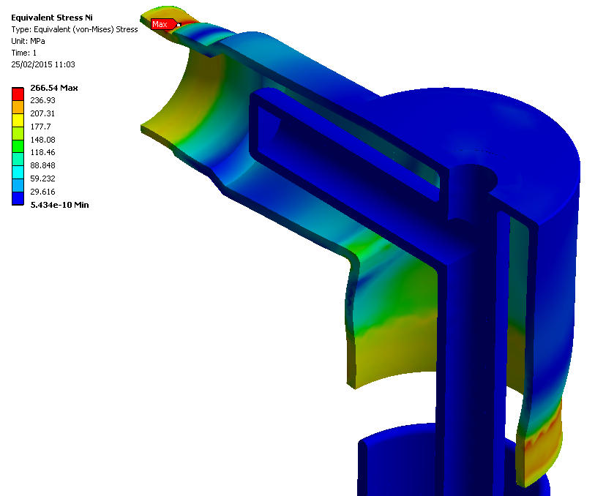
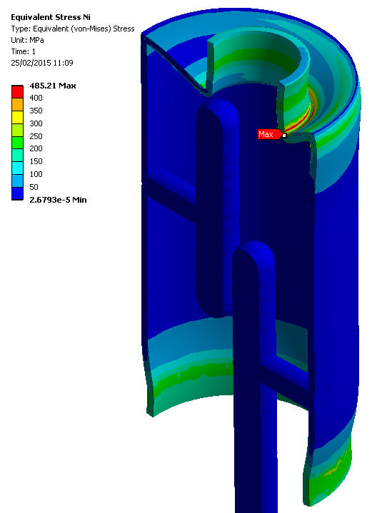
Cool Down Analysis
DQW HOM
RFD HHOM
High localised stress in Niobium parts at flange connections due to difference SS Contraction.
Deemed acceptable after successful fabrication and operation of similar structures at CERN.
Results agree with CERN Thermo Mechanical Analyses Jan15 (Zanoni)
9

Slide 11
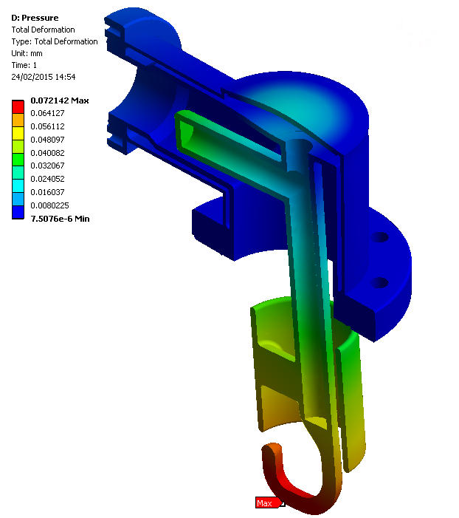
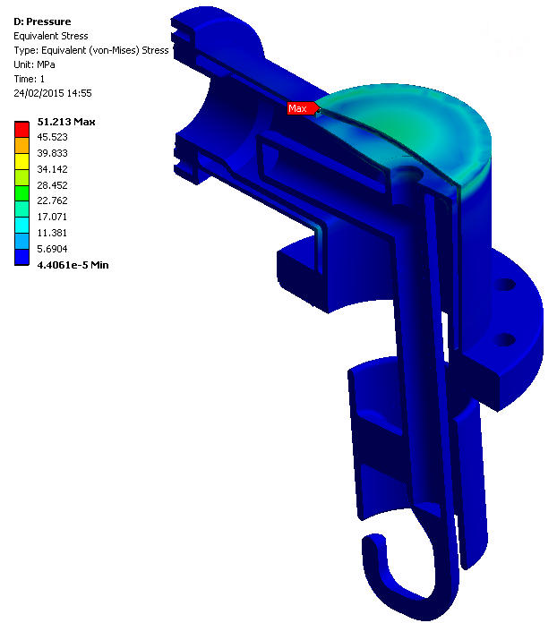
DQW Pressure Test Analysis
Maximum Stress occurs in SS helium jacket and is well within allowable stress limits.
Maximum pressure deflection of hook is elastic and negligible ~0.07mm.
Results agree with CERN Thermo Mechanical Analyses Jan15 (Zanoni)
10

Slide 12
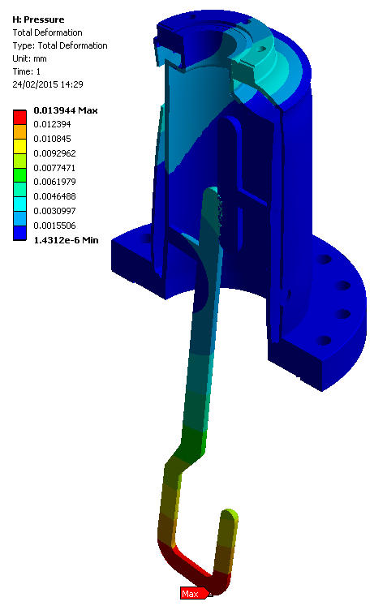
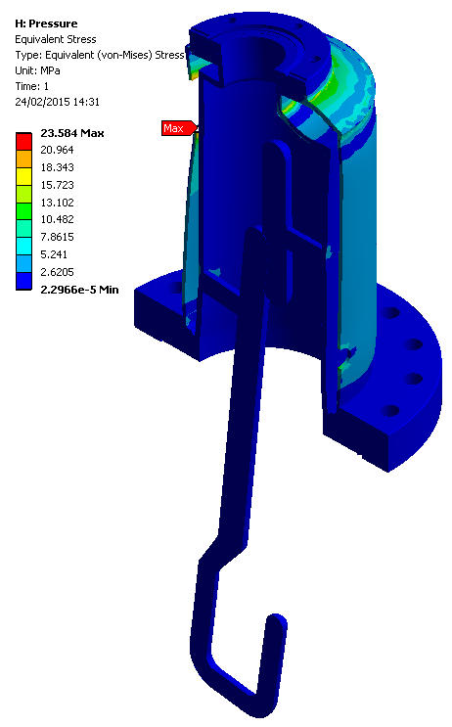
DQW Pressure Test Analysis
Maximum Stress occurs in SS helium jacket and is well within allowable stress limits.
Maximum pressure deflection of hook is elastic and negligible ~0.01mm
11

Slide 13
Thank You!
Questions?

