Slide 1
Review HL-LHC triplet layout
G. Arduini, R. De Maria, M. Giovannozzi
Acknowledgment P. Fessia, T. Lefevre, E. Todesco

Slide 2
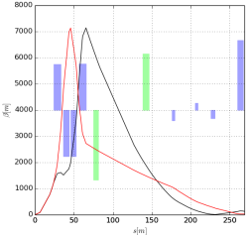
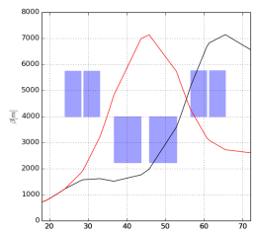
HL-LHC triplet upgrade for IR1 and IR5
Triplets layout and optics defines
beam size in the triplet, i.e. β* reach
crab cavity voltage and optics matching conditions
natural chromaticity, i.e. sextupole strengths
the BPM effectiveness in the presence of LRBB encounters and depends on
gradient and length of the quadrupoles (Q1-3)
drift between the quadrupoles and IP
Recently integration studies and MQXF review envisaged:
increase of L* (to be confirmed),
Change of interconnect lengths
Decrease of the gradient,
At the PLC the option to split the Q2a and Q2b was also mentioned as unlikely backup plan.
Q1-3 D1 D2 Q4-7
Q1 Q2a Q2b Q3
Here we present:
Impact on performance of lower gradients with nominal layout.
Impact on performance of a new layout compatible with the requested changes..

Slide 3
HL-LHC Layout 1.1 ->1.2
From magnet builder (after some iterations):
L_{Q1,3}<=4.2 m; L_{Q2a,b} free.
G_{Q1,2,3} 130T/m with 1-2% tolerance.
From integration studies:
L*=23 m or 24 m.
New distances between quadrupoles.
MCBRD: 105 mm aperture with D2 beam screen (inter-aperture distance = 188 mm).
MCBYY: 105 mm aperture with Q4 beam screen (inter-aperture distance = 194 mm).
New integration TAN - D2 started.
From vacuum studies:
New D2 beam screen.
L* [m] | d_{1a-1b} d_{3a-3b} [m] | d_{1b-2a} d_{2b-3a} [m] | d_{2a-2b} [m]
23 | 0.5 | 3.7 | 2
24 | 0.65 | 3.627 | 2.094

Slide 4
Triplet gradient lower margin without layout changes
Triplet integrated strength is only approximately constant when changing drift spaces and gradient.
Optics boundary conditions have very limited range due to:
internal phase advance constraints for the ATS optics;
need to maximize the β function at the crab cavity;
need to minimize β* without ATS to limit the β-blowup in the arcs (preserve DA and cold losses).
Grad [T/m] | β*_{presqueeze} [m] | Q7 [%]
139.86 | 0.44 | 99% | Nominal β* to be recovered by the arc β blow-up
139.6 | 0.44 | 100%
139.24 | 0.50 | 100%
138.9 | 0.60 | 100%
139 | 0.44 | 110% | Increase Q7 strength beyond limits
138 | 0.44 | 120%
137 | 0.44 | 130%
Not considered as options: upgrade Q7, drop ATS constraints, mismatch optics.
Therefore no layout changes implies:
only ~0.2T/m to 1T/m margin with 30% additional arc β increase or
reduction of beam energy ➔ potential issues for dynamic aperture more an more depending on the main magnet field quality at high energy

Slide 5
Triplet layout optimization criteria
Optimization strategies:
In the past, for optimal performance, we fixed the maximum gradient for Q2 and Q3 (or Q1) and vary Q3 (or Q1) strengths and Q2, Q1/3 length until matched optics found with desired β_{x,y} in Q4 and minimal max(β_{x,y}) in Q2,3. Lengths were then rounded and Q1/Q2/Q3 re-matched.
Now, for imposed constraints, we fix Q1/3 lengths and vary Q1, Q2, Q3 strengths and Q2 length (in rounded steps) until matched optics found with desired β_{x,y} in Q4, minimal max(β_{x,y}) in Q2,3 and Q2 strength in between of Q1/Q3.
Comments:
β_{x,y} upstream of Q4 (MCBYY used as reference position) defines 1) crab cavity kick (the larger the better, smaller triplet int. strength, 2)aperture margins in D2/Q4 (the smaller the better, larger triplet int. strength). The conditions have very limited range due to optics matching condition (e.g. Q7 at 99%, Q4, Q5, Q6 at low current for small β*)
Minimal max(β_{x,y}) in Q2,3 is optimal for aperture and reduction of MCBX1, 2 strengths.
The exercise have been carried out for two values of L*, the unlikely splitting of Q2 and β_{x,y} in Q4 in the range allowed by the matching quadrupole strengths and for a pre-squeeze β* compatible with MS at 600A. Fringe fields effects are also evaluated for few case to assess the impact on the strength changes after re-matching (>0.1 T/m differences with respect to an hard-edge model).

Slide 6
Layout variants and β* reach
Case | L* [m] | G_{Q1} [T/m] | G_{Q2} [T/m] | G_{Q3} [T/m] | l_{Q1/3} [m] | l_{Q2a/b} [m] | β*_{pre} [cm] | β*_{max} at β*_{15cm}
HL1.1 | 23 | 139.8 | 139.8 | 139.3 | 4.0 | 6.8 | 44 | +0%
L* 24 | 24 | 128.9 | 130.2 | 130.4 | 4.2 | 7.15 | 48 | +8.2%
L* 23 | 23 | 132.1 | 130.5 | 130.6 | 4.2 | 7.15 | 48 | +4.3%
Ls 24 split¹ | 24 | 132.2 | 129.4 | 129.6 | 4.2 | 7.15/2 | 49 | +12%
Ls 23 split¹ | 23 | 132.3 | 129.3 | 129.6 | 4.2 | 7.15/2 | 48 | +7.8%
¹ Backup plan for Q2a and Q2b for which 65cm inter-distance is assumed. Not considered to be likely.
The gradient values will be still fine tuned in the range of ±0.3 T/m for the final layout to optimize crab cavities voltage and D2-Q4 aperture.
If needed l_{Q2} can be chosen to 7.2m to approach the old target of 130 T/m at cost <1% in β*_{max} .

Slide 7
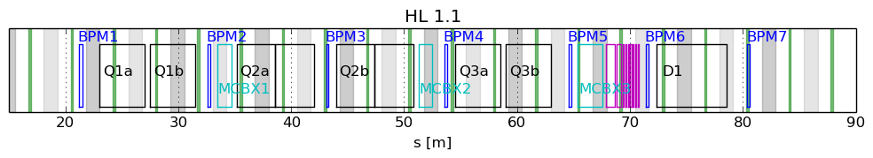
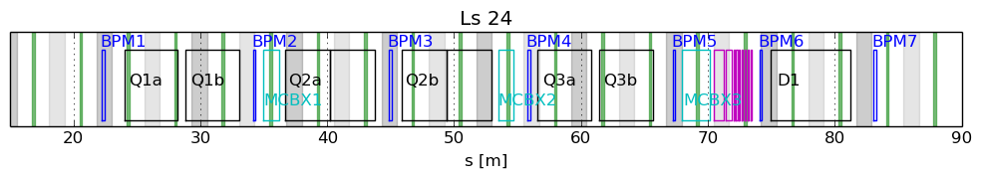
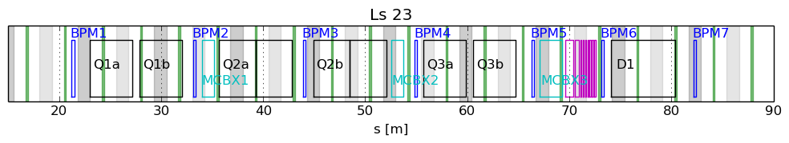
Layouts sketches
Forbidden areas, assuming better than today electronics.
Ideal bpm positions
Options not optimal for BPM positions for which we need in multi bunch mode:
- 1.5 μm precision (while bunches are changing intensity) for BPM1, BPM2,… in descending priority to keep beam in collision (see WP2 TL 23/5/2014)
- 30 μm accuracy to find collision with 1% of luminosity signal.
Mitigation strategies:
Improve BPM technology.
Possibility of inserting the first BPM in the Q1 cold mass.
Possibility of swapping BPM/MCBX.
Possibility of installing one or two BPMs between IP and TAS at about 20.57 m, 16.8 m, 13.9 m, 9.35 m.
If nothing else works, artificially increase inter-connect lengths.

Slide 8
Conclusion
Optics solutions for layouts with l_{Q1,3}=4.2 m and l_{Q2a/b}=7.15 m exists with gradients of 130±2% T/m and L*=23 or 24 m.
In the new layouts the positions of the triplet BPMs end up in non-optimal positions.
The extent of the deterioration of the BPM performance depends on:
  Characteristics of the BPMs,
  Final definition of L*,
  Possible integration options (some proposal have been listed).
A BPM solution compatible with operations with high availability and high reliability is mandatory for approved layouts.
The triplet layout can be finalized only once the assessment of the TAS to Q1 region and BPM solutions is completed.

Slide 9
Backup

Slide 10
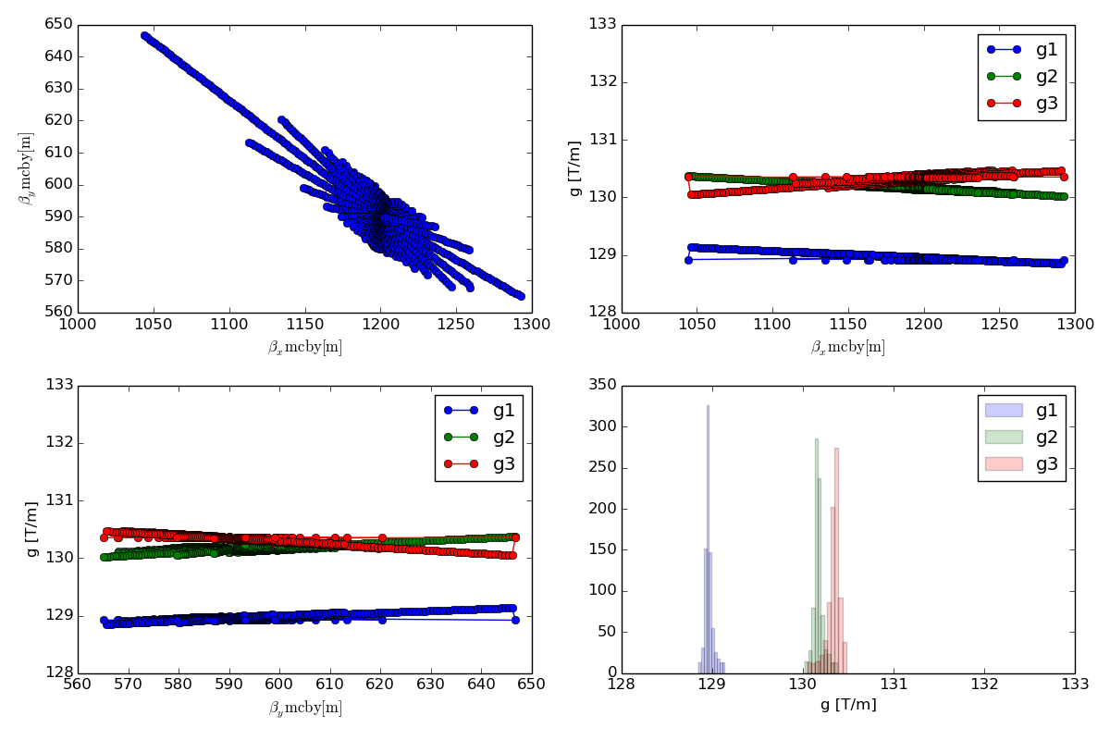
Tunability in Q4: L*=24m option

Slide 11
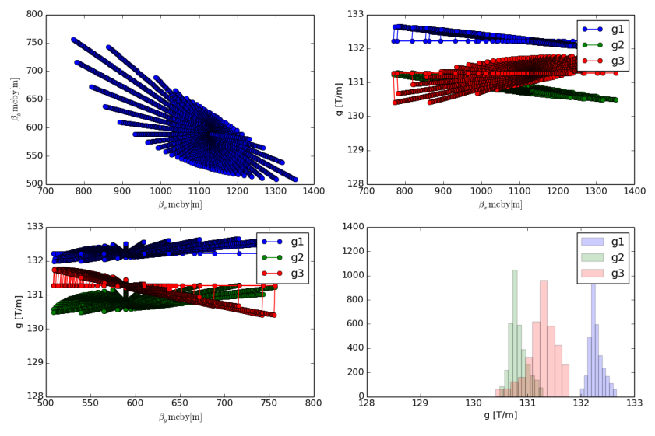
Tunability in Q4: L*=23m option

Slide 12
Integrate Luminosity vs β*
β* acts on virtual luminosity and HL-LHC scenarios are most sensitive to levelled luminosity and beam currents (burn-off and levelling times dominates).
E [TeV] | N [10¹¹] | L_{lev} [10³⁴ cm⁻²s⁻¹] | L_{virt β*=15cm} [10³⁴ cm⁻²s⁻¹] | L_{int}/day _{β*=15cm} [fb⁻¹] | L_{virt β*=18cm} (-13.3%) [10³⁴cm⁻²s⁻¹] | L_{int}/day β*=18cm
7 | 2.2 | 5 | 20.1 | 3.17 | 17.4 | -1.73%
7 | 2.2 | 7.5 | 20.1 | 4.07 | 17.4 | -2.88%
7 | 1.9 | 5 | 15.0 | 2.93 | 13.0 | -2.55%
7 | 1.9 | 7.5 | 15.0 | 3.63 | 13.0 | -4.3%
β* not very sensitive for L_{int} with nominal parameters, at the same time:
relatively risk free and
relative impact of β* on L_{int} increases for lower beam current.

Slide 13
BPM precision
assuming +/-100 μm max. orbit deviation from arc, +/-1 μm BPM precision as reference value (note: linear scaling with BPM precision), no model errors, all BPMs.
orbit at IP5 z=max(x,y) | max(|z-z0|) [μm] | rms(z-z0) [μm]
x(b1)-x₀(b1) | 0.809 | 0.230
x(b2)-x₀(b2) | 0.814 | 0.234
y(b1)-y₀(b1) | 0.872 | 0.233
y(b2)-y₀(b2) | 0.740 | 0.232
x(b1)-x(b2) | 1.139 | 0.326
y(b1)-y(b2) | 1.119 | 0.332
Luminosity loss assuming:
β*=0.15 m, E_{b}=7.00 TeV, ε_{n}=2.50 μm,
σ_{s}=7.50 cm, x-angle=295.0 μrad
=> σ(IP5)=7.09 μm
BPM precision needed during one fill (e.g. 1% luminosity loss = 0.14 σ, 2 rms(z_{b1}-z_{b2})):
precision _{one} _{fill} = +/-1.5 μm
BPM accuracy for finding collision (e.g. 99% luminosity loss = 3.0 σ, 2 rms(z_{b1}-z_{b2})):
precision _{one} _{fill} = +/-30 μm

Slide 14
Selecting the efficient BPMs
Monte Carlo simulations to determine the most efficient BPMs for orbit correction.
adding random noise errors in µm assuming an ideal transverse position. As reference value +/-1 μm BPM precision has been used, but the results scale linearly with the BPM precision
assuming +/-100 μm max. orbit deviation from arc
no magnet imperfections errors
disable one BPM at a time:
-> larger decrease of (z-z₀) in comparison to the case with all BPMs => high efficiency of the BPM
BPMs closest to the IP (BPM1/2/3) are essential for the orbit control at the IP
orbit at IP5 (x/y) | max(|z-z₀|) [μm] | rms(z-z₀) [μm] | 2rms(z-z₀)/σ_{z}
all BPMs | 1.14/1.12 | 0.33/0.33 | 0.092/0.094
no BPM1 | 1.41/1.44 | 0.40/0.41 | 0.113/0.115
no BPM2 | 1.55/1.38 | 0.38/0.39 | 0.108/0.111
no BPM3 | 1.48/1.48 | 0.37/0.38 | 0.106/0.106
no BPM4 | 1.43/1.25 | 0.35/ 0.35 | 0.100/0.100
no BPM5 | 1.14/1.19 | 0.33/0.34 | 0.093/0.095
efficiency decreases
Courtesy M. Fitterer
Notes:
1e-04Q6Q7_1e-06bpm/MC567wbpmd1lbpmd1rnobpm[12345]

Slide 15
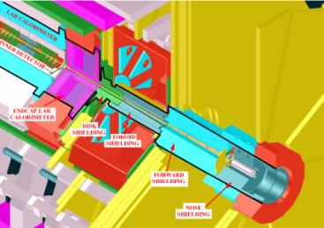
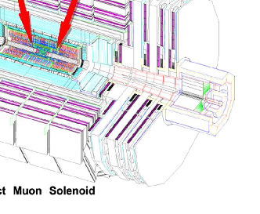
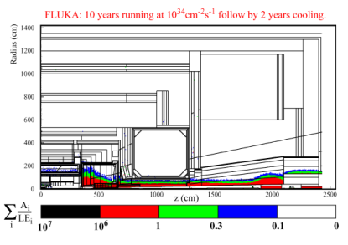
ATLAS
CMS

