Slide 1

Impact on LHC operations for civil engineering work around IR1/IR5
G. Arduini, K. Artoos, R. Bruce, P. Fessia, M. Fitterer, W. Höfle M. Guinchard, J. Osborne, Y. Papaphilippou, D. Valuch, J. Wenninger (CERN), D. Hiller (ARUP)
Acknowledgements: W. Bialowons, B. Holzer, S. Fartoukh, R. De Maria, M. Giovannozzi, S. Redaelli

Slide 2
Outline
mainly summary of the two vibration studies meetings:
http://indico.cern.ch/event/367450/ (26.01.2015)
https://indico.cern.ch/event/374263/ (18.02.2015)
Motivation for vibration studies
HL-LHC civil engineering works in IR1/5
Historical movement of equipment
Effect of vibrations on the beam – theoretical estimates
Proposed measurements
Summary and next steps

Slide 3


Motivation for vibration studies
J. Osborne, Vibration studies for HL-LHC Civil Engineering, 26.01.2015
This study is needed for two projects (and eventually others like FCC, SPS External Beam Dump, SHIP etc) :
HL-LHC : How much underground civil engineering can we do around CMS and ATLAS during LHC operations?
Geneva Program “Géothermie 2020”, to be able to evaluate the sensitivity of CERN’s installation from potential drilling or jetting?
For both studies we need to better understand :
Tolerable vibration for CERN – if known : type of waves, acceleration, moving, speed, …
Historical movement of equipment in the past 30-40 years : dates and eventual consequences for CERN installation
General Infrastructures Services Department

Slide 4
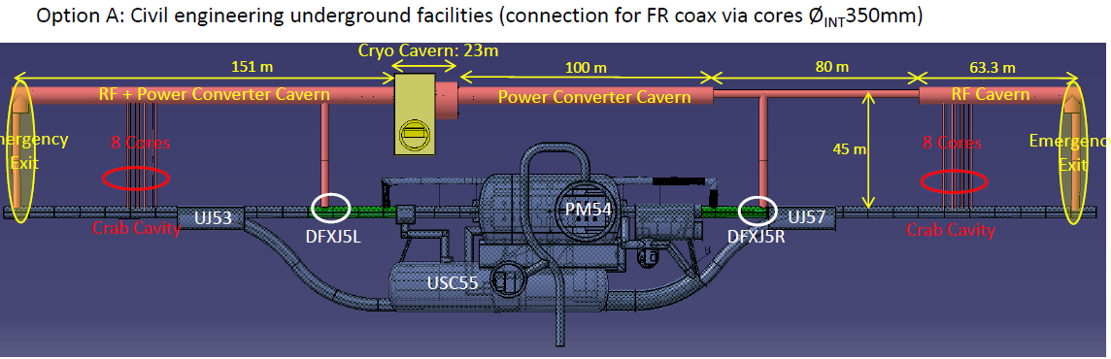
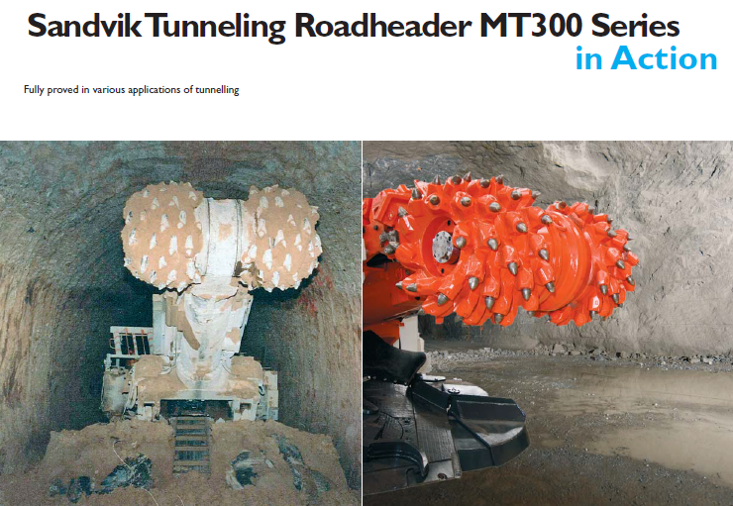
HL-LHC civil engineering works around CMS Point 5
J. Osborne, Vibration studies for HL-LHC Civil Engineering, 26.01.2015
different options considered, see
https://edms.cern.ch/document/1471656/1/TAB3
https://edms.cern.ch/document/1471037/1/TAB3
General Infrastructures Services Department

Slide 5
Courtesy J. Osborne
needed input
for us to define

Slide 6
Tunnel excavations at CERN
  two interesting events (D. Missiaen, Vibration studies for HL-LHC Civil Engineering, 26.01.2015 + 18.02.2015 and many thanks to the colleagues who searched their memories – Karel Cornelis, Lyn Evans, Werner Herr, Kurt Hubner, Horst Schönauer, Rende Steerenberg, F. Tecker, J. Wenninger):
  construction of LEP/LHC tunnel during SppbarS operation:
      only effect: more frequent alignment campaigns needed (several mm displacement during one year)
  construction of LEP klystron galleries (about 12 m away) in early 90s and LHC transfer lines and ATLAS/CMS cavern during LEP operation:
      no effect
      note: LEP max. beta function was about 400 m compared to 6 km during LHC runIII (β*=40 cm), the IT quadrupoles moved during one fill by about 10 μm due to temperature effects (CERN-SL/96-40) and all oscillations were damped by synchrotron radiation.

Slide 7
Tunnel excavations close to DESY
  several construction works close to HERA and PETRA:
  excavation of the XFEL tunnel (about 500 m? distance) with a “Schildvortriebmaschine” (road heading machine with shield tunneling) during operation of PETRA-III -> no effect
  but: during construction of the injector Hall, the operation of PETRA-III was disturbed
  whenever the “Schlitzwandbagger” (bagger shovel for making slits for reinforced
  concrete walls) encountered some hard obstacles
  construction of the football stadium right above the HERA tunnel (50 m)
  -> considerable disturbances of HERA, e.g. increase of tail population, correction of orbit
  to compensate the raise of the ground of the HERA tunnel (kink), …
  excavation of the “Elbtunnel” (about 2 km distance) -> no effect
  Note:
  PETRA is in general less sensitive than the LHC due to its higher revolution frequency, the strong synchrotron radiation damping, its smaller tune spread and smaller beta functions
Courtesy to B. Holzer, W. Bialowons

Slide 8
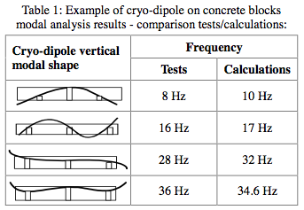
Expected spectrum
  work in progress …
  previous measurements from ARUP (D. Hiller, Vibration studies for HL-LHC Civil Engineering, 26.01.2015 and 18.02.2015)
  measurements at SM18 around March/June (K. Artoos, E. Perez-Duenas, Vibration studies for HL-LHC Civil Engineering, 26.01.2015 and 18.02.2015) with the aim of:
      determine the transfer function (ground – cold mass) of the IT magnets
      dependence of the spectrum on the distance from the excitation source
      determine also maximum amplitude of excitation in time domain, not only rms values as done for usual PSDs
      wavelength? coherence?
[*]
[*] K. Artoos et al., “Mechanical Dynamic Analysis of
the LHC Arc Cryo-magnets”, PAC2003

Slide 9
Expected spectrum (1)
Y. K. Loo, ARUP, Vibration studies for HL-LHC Civil Engineering, 18.02.2015

Slide 10
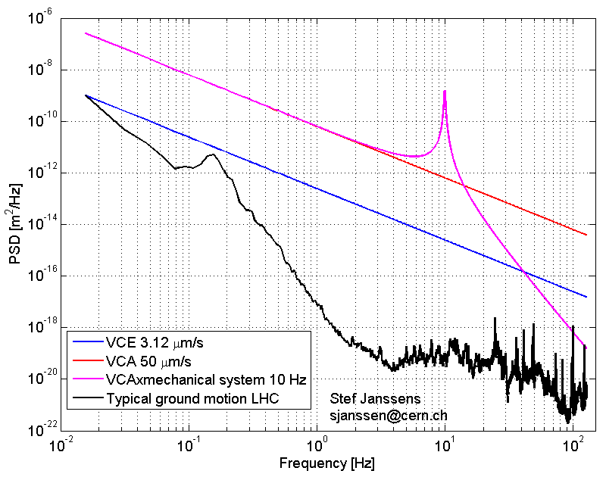
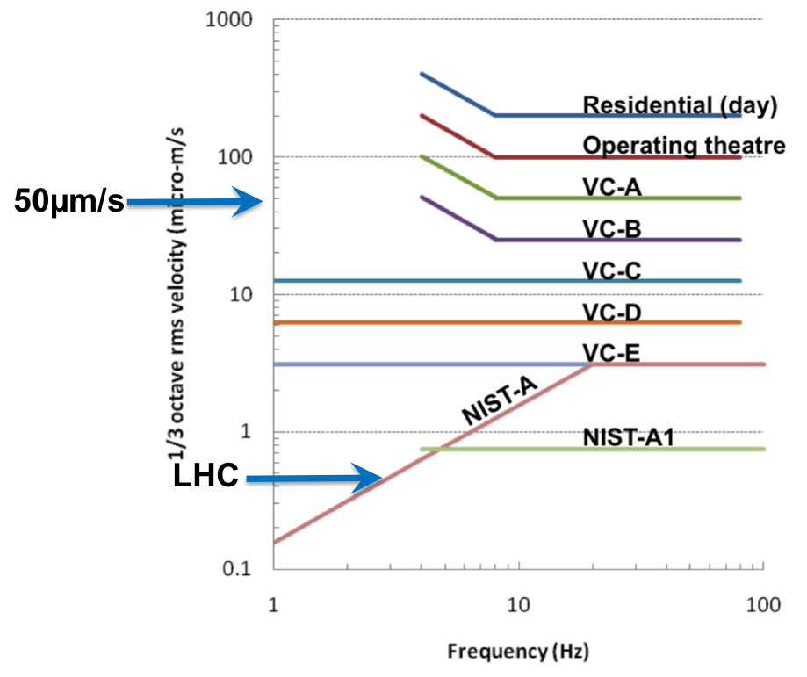
Expected spectrum (2)
Courtesy to K. Artoos, S. Janssens
D. Hiller (ARUP), Vibration studies for HL-LHC Civil Engineering, 26.01.2015
x10⁶
x10⁹

Slide 11
Effect of vibrations on the beam (1)
    Run III parameters:
    N_{bunch}=1.25x10¹¹, ε_{N}=2.0 μm, bunch length= 7.55 cm, N_{tot}=2740, β*(IP1/5)=0.4 m (option med RunII), E=6.5 TeV, σ_{IP}=10.7 μm
  For tunneling work in Point 1/5 we assume that:
    only the elements in the straight section at Point 1/5 are effected
    main effect is displacement of magnets
      - neglect effect from dipoles D1/D2
      - distortion of the beam by quadrupole displacement
      - no sextupoles in this area
      => consider only effects due to quadrupole misalignment in Point 1/5
      => main effect is closed orbit distortion due to quadrupole misalignment:
  => stronger effect from quadrupoles with high k*l and high beta-function
  => main effect expected from inner triplet during collision (closest to tunneling works!!!)
Notes:
Q=tune, not the fractional tune!

Slide 12
Effect of vibrations on the beam (2)
  closed orbit distortion can result in:
  slow movement of the ground (week/months) during and after the construction (detector and magnets)
  -> correction of orbit necessary, so that beam is guided through the center of the magnets
  -> more frequent alignment campaigns to avoid reaching the corrector strength limit
  orbit deviations (several hours = 1 fill), which are particularly critical at the IP and at the collimators.
  Note: at the moment the orbit feedback is off when in stable beams and only possible at a
  maximum frequency of 0.1 Hz
  effects of vibrations on the beam (< 1 hour):
    emittance growth (see later estimates):
    in general two regimes are distinguished:
    - “high frequency” [1], f > 3 kHz : overlap with betatron sidebands at (ν_{x/y}-n)∙f_{rev,LHC}
    - “low frequency” [2], 0<f< 3 kHz : ν_{x/y} ∙f_{0,LHC} = 3485 Hz, less harmful
    stronger population of tails due to interplay of orbit jitter and beam-beam (non-linearities)
    -> tail generation, higher losses (difficult to estimate, would require more thorough/long term study)
    reduction of lifetime
    [1] K.Y. Ng, “Emittance Growth due to a Small Low-frequency Perturbations”, FERMILAB-FN-575
    [2] V. Lebedev, V. Parkhomchuk, V. Shiltsev, G. Stupakov, “Emittance Growth due to Noise and its Suppression with the Feedback System in Large Hadron Colliders”, SSCL-Preprint-188

Slide 13
Correlation IT movement <-> orbit movement
  assume reference displacement of +/-1 μm in horizontal plane:
  same displacement for all IT magnets in IR5:
  - IP: x(IP5,b1) = x(IP5,b2) = 1.17 μm -> no separation of the beams
  - MBRC: x_{max}(MBRC.LR5,b1) = 3-5 μm -> small residual orbit outside of IR
  - collimators: x_{max}(TCP,b1) = 3 μm -> small residual orbit at collimators
  alternated displacement of IT magnets in IR5:
  - IP: x(IP5,b1)= - x(IP5,b2) = -7.2 μm -> maximum = 14 μm separation at IP
  - MBRC: x_{max}(MBRC.LR5,b1) = 53-139 μm -> residual orbit outside of IR
  - collimators: x_{max}(TCP,b1) = 138 μm -> residual orbit at collimators
  “side-alternated” displacement of IT magnets in IR5:
  - IP: x(IP5,b1)= - x(IP5,b2) = -0.81 μm -> small = 1.6 μm separation at IP
  - MBRC: x_{max}(MBRC4.LR5,b1) = 111-296 μm -> maximum residual orbit outside of IR
  - collimators: x_{max}(TCP,b1) = 170 μm -> maximum residual orbit at collimators
Notes:
all max values at TCP.D6L7.B1 -> x(TCP, b1) stands for x(TCP.D6L7.B1,b1)

Slide 14
Correction of week/months orbit drifts
  worst case scenario = scenario with largest separation at IP
  => in the most unfortunate case, already misalignment larger than 0.8 mm could be right at the limit of the corrector strength (-> more frequent alignment campaigns?). That all IT magnets experience the same misaligment is though more likely and would require a considerably smaller corrector strength as the orbit deviation stays minimal in this case. (corrector strength could be reduced by a more intelligent matching strategy – to be studied if needed)
IR5, corrector strength [T], 7 TeV, maximum over b1/b2 and *.L5/*.R5
 | MCBXH1 | MCBXH2 | MCBXH3 | MCBYH4 | MCBCH6
max. strength | 1.51 |  |  | 2.25 | 2.10
crossing | 0.19 |  |  | 0.64 | 0.27
separation | 0.10 |  |  | 0.34 | 0.17
misalignment correction | 1.58 | 1.71 | 1.39 | 0.20 | 0.26
Notes:
Q=tune, not the fractional tune!

Slide 15
Correction during one fill (hours)
  Observables are orbit at collimators and separation of beams at IP (orbit feedback is usually off during stable beams and has a maximum frequency of 0.1 Hz):
    assume worst case of alternated displacement of IT magnets: 1 μm displacement => 14 μm at the IP (1.31 σ or 47% luminosity loss) 0.18 μm displacement => 2.52 μm at the IP (0.24 σ or 2% luminosity loss)
        => keep luminosity loss below 2%/hour => need to have movements below 0.18 μm/hour
    assume worst case of “side-alternated” displacement of IT magnets: 1 μm displacement => 170 μm at the primary collimators Note: in Run I already about 40 μm orbit deviation at TCP caused high losses. For Run III this will be even more critical due to the higher energy (see G. Arduini, M. Lamont, LHC Commissioning 2012, Summary of week 19)
    case 1: continuous orbit movement (low frequency = 1-200 Hz coherent oscillation) constantly
    depletes the tails -> higher overall loss but no high loss spikes -> less harmful?
    case 2: sudden large orbit movement-> populated tails are scraped off -> high loss spikes as
    seen in RunI
        => maximum displacement of IT in case of sudden orbit movement should stay below
        0.24 μm resulting in 40 μm maximum orbit displacement at TCP
Notes:
https://lhc-commissioning.web.cern.ch/lhc-commissioning/news-2012/presentations/week19/Beam_commissioning_20120514-Week19.pptx

Slide 16
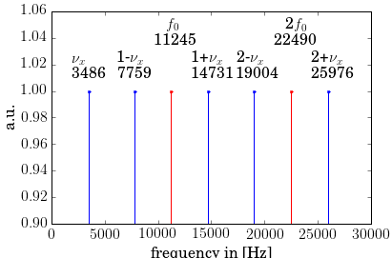
Emittance growth (high frequencies, <1hour)
  emittance growth from misalignment of one quadrupole is given by [1]:
  only components equal to the betatron sidebands contribute to emittance growth. The betatron sidebands are given by
  with and
  lowest frequency for LHC= ν_{x/y} f₀ = 3485 Hz
  random dipole kicks drive coherent oscillations
  -> phase mixing of beam particles due to
  beam-beam tune spread
  a) decoherence time:
  b) resonance width:
  LHC Run III: τ_{decoh} = 0.0044 s ≙ 50 turns
  Δf_{res} = 36 Hz => narrow sidebands
Notes:
nu=tune, not the fractional tune!
xi_runIII(IP1)=8.06e-3
xi_runIII(IP1+IP5)_rms=0.2*2*8.06e-3=3.2e-3

Slide 17
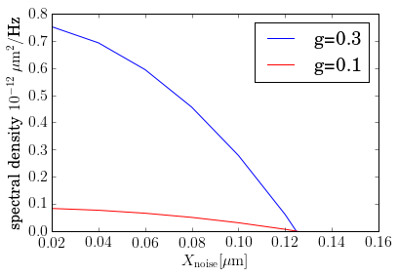
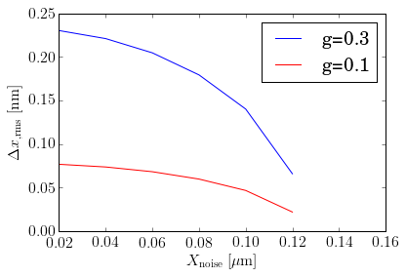
Emittance growth (high frequencies, <1hour)
  emittance growth with feedback system [1]:
  g= feedback gain (g>>Δν), X_{noise}=precision of feedback pickup, β₁=β at location of pickup
  feedback parameters LHC: X_{noise}=1 μm, β₁= 180 m, g=0.01
  Run III bb tune shift:
  assume 1% emittance growth per hour:
emittance growth dominated by noise from feedback pickup for x_{noise}> 0.12 μm
high feedback gain desired
Notes:
<deltap_n deltap_m>=0

Slide 18
Emittance growth (High frequencies, <1hour)
  => more ambitious feedback parameters necessary:
  assumed feedback parameters: X_{noise}=0.02 μm, β₁= 180 m, g=0.3
  Run III optics: option med, β*(IP1/5)=0.4 m, β*(IP2)= 10 m, β*(IP8)= 3 m
  assume 1% emittance growth per hour:
  =>
  =>
  Note:
  models always assume a contribution from the high frequency part of the spectrum, in particular the betatron sidebands. The emittance growth due to a low frequency excitations should be studied further but information about the expected spectrum is required (amplitude and frequency distribution).

Slide 19
Proposed beam measurements (MDs)
  in general two regimes are distinguished:
    - “high frequency” [1], f > 3 kHz : overlap with betatron sidebands at (ν_{x/y}-n)∙f_{rev,LHC}
    - “low frequency” [2], 0<f< 3 kHz : ν_{x/y} ∙f_{0,LHC} = 3485 Hz, less harmful
  what we know:
  from construction works the displacement in the kHz range is expected to be “very small”. An excitation close to the betatron sidebands could in general result in emittance growth
  -> MD proposed by X. Buffat, J. Barranco, T. Pieloni to study in general the effect of noise on the emittance
  effect of a low frequency excitation (0-200 Hz) can result in stronger population of tails and emittance growth (see [2]), but presently no theoretical models or experimental observations are known which could give an reliable answer.
  -> best test-bed is the machine itself!
  -> MD proposal to study specifically the effect of a low frequency excitation on the tail
  population and emittance
    [1] K.Y. Ng, “Emittance Growth due to a Small Low-frequency Perturbations”, FERMILAB-FN-575
    [2] V. Lebedev, V. Parkhomchuk, V. Shiltsev, G. Stupakov, “Emittance Growth due to Noise and its Suppression with the Feedback System in Large Hadron Colliders”, SSCL-Preprint-188

Slide 20
MD proposal: effect of low frequency excitation (1)
  tail population and emittance growth depend on:
  tune spread: roughly speaking the larger the tune spread, the larger the expected emittance growth
  -> full head-on collisions in all IPs needed
  head-on collissions in IR1/5: low frequency excitation creates a coherent oscillations of the beams => (small) offset (head-on) collisions in all IPs from two low frequency noise sources (IR1 + IR5 construction works). Effect of orbit deviation on long range should be negligible.
  -> full head-on collisions in all IPs needed
  non-linearities: emittance growth and halo population depend on non-linearities, which come mainly from machine errors + beam-beam.
  -> ideally: flat top + squeezed and full head-on collisions in all IPs + LR interactions
  possibilities to create low frequency dipole noise:
  ADT: seems feasible (see next slide)
  AC dipole: under discussion
  tail and emittance measurements:
  tail measurements: collimators, wire scanners, diamond monitors (2ns acquisition time)
  emittance: BSRT, wire scanner and luminosity monitors
  excitation spectrum: the better the knowledge of the spectrum seen by the beam the better we can shape the MD specifically for the construction works -> input needed!!!!
  -> MD later in the year to wait for results from SM18 measurements?

Slide 21
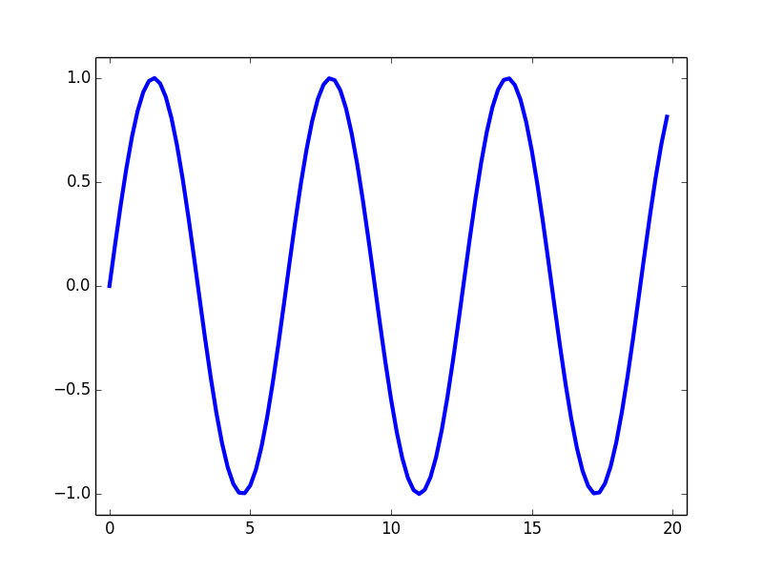
MD proposal: effect of low frequency excitation (2)
  possibilities for low frequency dipole noise with ADT:
  continuous spectrum (still has to be provided – SM18?) could in principle be implemented,
  but would require major modifications
  modulation with single frequency is already implemented and windowing function would allow for modification of the amplitudes. Achievable amplitude corresponds approx. to 1 μm misalignment of 1 IT magnet (50 μm orbit at TCP) => test sensitivity to specific frequencies e.g. eigenfrequencies of Q1/Q2 from SM18 measurements
  case a): emittance of each individual bunch can be measured with BSRT, wire scanner,
  luminosity monitors -> different amplitudes on different bunches
  => dependence of emittance blow-up on frequency and excitation amplitude
  case b): in case of halo measurements with the collimators, only the complete beam can be
  measured -> excitation on single bunch (=> visible losses = losses due to excitation),
  increase amplitude of excitation until an effect is visible
windowing
function
bunches
excitation
turn-number
1
2
3
windowing
function
bunches
excitation
turn-number
1
2
3

Slide 22
Summary: historical events and spectrum
Historical events:
at LEP and SppbarS no effects of the construction works for the LHC were observed
at DESY the construction of the injector hall effected the operation of PETRA-III and the construction of the footballstadium 50 m above the HERA tunnel lead to orbit effects and stronger population of the HERA p-beam
Spectrum:
information from ARUP measurements: 30-80 Hz region dominates, tails off to 200Hz, zero-to-peak displacement of 0.6 μm
converting the VCA standard velocity to a PSD, the construction works would result in an up to x10⁶ higher PSD and taking a simple model of a mechanical system an up to x10⁹ higher PSD
more information is needed on frequency spectrum, wavelength, attenuation with distance

Slide 23
Summary: first estimates
according to the time scale tunneling work can lead to different effects.
some estimates have been provided based on simplified models and extrapolations from existing experience
Acceptable amplitude will vary according to the time scale:
  Long time scale (weeks/months):
          few 10th of mm
          determined by available corrector strength
  Time scale < hours (no orbit feedback):
  a) continuous drift:
          below 1 μm/hour (at the triplet)
          in order to avoid visible effects on luminosity and losses
          b) “sudden shock”:
          well below 1 μm (at the triplet)
in order to avoid sudden loss spikes at the collimators
  one up to a few hundred Hz (no orbit feedback):
          well below 1 μm (at the triplet)
          in order to avoid visible effects on luminosity and losses (emittance blow-up effect to be studied)
  kHz range:
          <1 nm (at the triplet)
          likely pessimistic, but dependent on exact frequency range and spectrum (frequency spectrum could overlap with betatron sidebands) => emittance growth

Slide 24
Next steps: historical events and spectrum
Historical events:
analysis of earthquake events during stable beams (more relevant for Géothermie 2020 project)
Spectrum:
the eigenfunctions of the Q1 and Q2 could be measured at SM18 (for the real spectrum the construction works at SM18 are not so suited as a different construction machine is used and also transfer of vibrations through equipment stored in SM18 is likely. In general, measurements of the vibrations due to this construction work in the SPS/LHC would be possible – see backup slide)
measurements in the CNGS tunnel: a core is drilled in the Molasse in a couple of weeks. Measurements on the existing magnets would be possible.
vibration monitoring during excavation works for the CENF project (extension of the North Hall, Bld 887) in the TT85 tunnel
in general: can we find a construction site in molasse ground using the Sandvik roadheader and with concrete floor in the same distance to measure the spectrum and the propagation through the ground?
more information is needed on frequency spectrum, wavelength, attenuation with distance

Slide 25
Next steps
Needed input:
  expected long term (week/months) movement of the ground (detector/inner triplet)
  amplitude of movements and extension of the area where the movements occur. Are they coherent/what is their wavelength?
  Spectrum of the vibrations (amplitude vs frequency) up to several kHz with resolutions compatible with the above limits
  transfer functions floor to cold masses
  Further studies – input very welcome!
  more detailed studies of effect on collimation performance (impact of stronger population of tails, continuous orbit oscillation at collimators, impact of sudden orbit movements ???)
  beam-beam simulations to study the effect of only low frequency noise
  some first ideas:
  - test eigen-frequencies of dipoles -> sensitivity to different frequencies
  - impact of one compared to two noise sources (construction in IR1/5 = two noise sources)
  - comparison of single frequency excitation with continuous (low frequency) spectrum
  proposed MD to study the effect of a low frequency excitation on halo population and emittance
  mitigation methods? E.g. orbit feedback up to 200 Hz using new DOROS BPMs to keep beams in collisions (would assume installation of BPMs in all IPs + critical collimation region)?

Slide 26
Thank you for your attention!

Slide 27
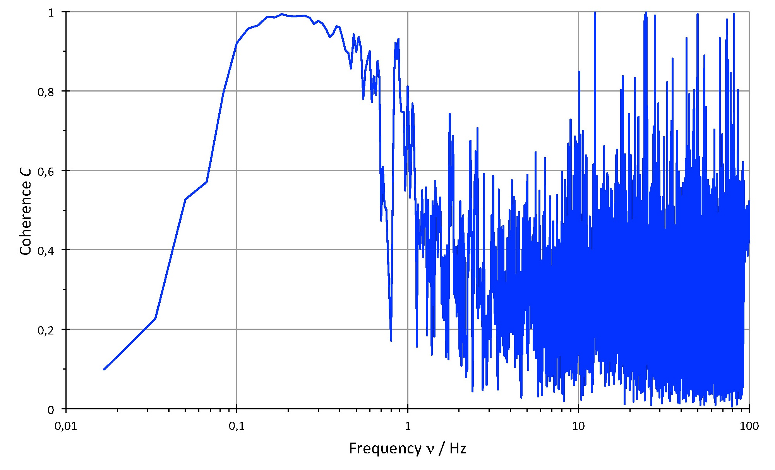
Crosscorrelation K und Coherence C
Wilhelm Bialowons (DESY), Konstruktionsbesprechung, 02.10.2013
Vertikale Kohärenz zwischen HERA WL350 und 745
(3. Juli 2013 2:00 h).
correlation only for low frequencies

Slide 28
Theoretical Background - Literature
  Ground motion LEP/LHC: in general not much available (measurements in view of a linear collider study and in ATLAS/CMS experimental hall)
  [1] L. Vos, “Ground motion in LEP and LHC”, CERN-LHC-NOTE-299
  [2] M.P. Zorzano, T. Sen, “Emittance Growth for the LHC Beams Due to Head-On Beam-Beam Interaction and Ground Motion”, FERMILAB-TM-2106
  [3] V.E. Balakin, W. Coosemans et al., “Measurments of Seismic Vibrations in the CERN TT2A Tunnel for Linear Collider Studies”, CLIC-Note 191
  Ground motion HERA:
  all publications can be found at http://vibration.desy.de/documents/papers/
  Detailed studies for SSC (theoretical background):
  low frequency (f < f_{rev}ν):
    [4] K.Y. Ng, “Emittance Growth due to a Small Low-frequency Perturbations”, FERMILAB-FN-575
  high frequency (f ≥ f_{rev}ν):
    [5] V. Lebedev, V. Parkhomchuk, V. Shiltsev, G. Stupakov, “Emittance Growth due to Noise and its Suppression with the Feedback System in Large Hadron Colliders”, SSCL-Preprint-188
    [6] Y.I. Alexahin, “On the emittance growth due to noise in hadron colliders and methods of its suppresion”, NIM A 391, p. 73-76, 1996
  Ground motion CLIC: http://clic-stability.web.cern.ch/clic-stability/Ground_motion.htm

Slide 29
High frequencies (no feedback)
  estimate of emittance growth for Run III (spectral density):
  emittance growth from misalignment of quadrupoles in IR1/5 is given by [5]:
  Spectral density S_{Δx}:
  where K_{Δx} is the correlation function given by:
  Run III optics: option med, β*(IP1/5)=0.4 m, β*(IP2)= 10 m, β*(IP8)= 3 m
  note: β(kl)²(triplet IR1+IR5) = 130-140 1/m, β(kl)²(Q4-Q7 IR1+IR5) = 1.7 1/m
  => triplet clearly dominates and is the closest element to the tunneling works!!!
  assume 1% emittance growth per hour:
  =>
IR1+IR5
Notes:
nu=tune, not the fractional tune!

Slide 30
High frequencies (no feedback)
  estimate of emittance growth for Run III (“white noise”):
  - assume white noise = correlation time is much less than one revolution period
  - all frequencies contribute
  => emittance growth from misalignment of quadrupoles in IR1/5 is given by [5]:
  assume 1% emittance growth per hour
  =>
IR1+IR5
Notes:
<deltap_n deltap_m>=0

Slide 31
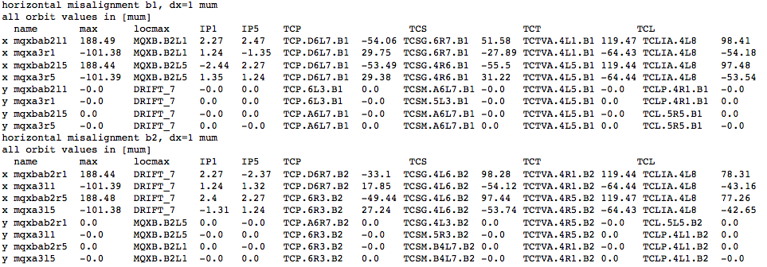
Orbit deviation at collimators (TCP, TCS, TCT, TCL) and IP

Slide 32
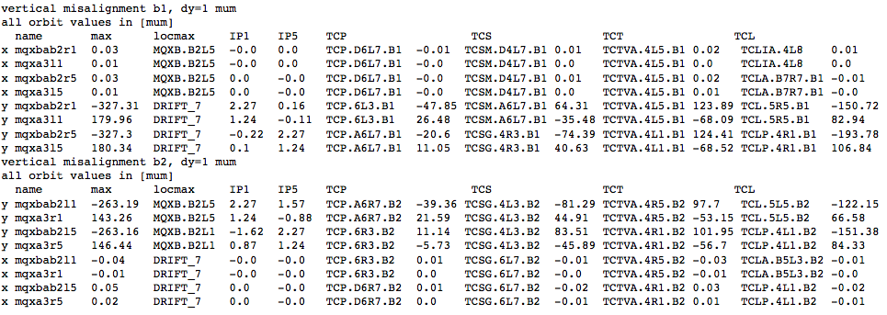
Orbit deviation at collimators (TCP, TCS, TCT, TCL) and IP

Slide 33
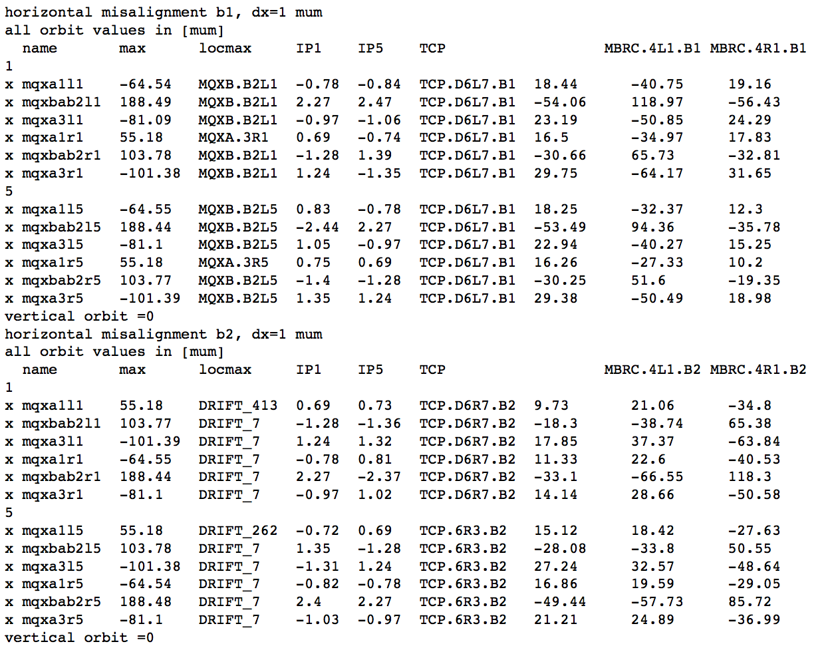
Orbit deviation at primary collimators, IP and entry/exit of IR

Slide 34
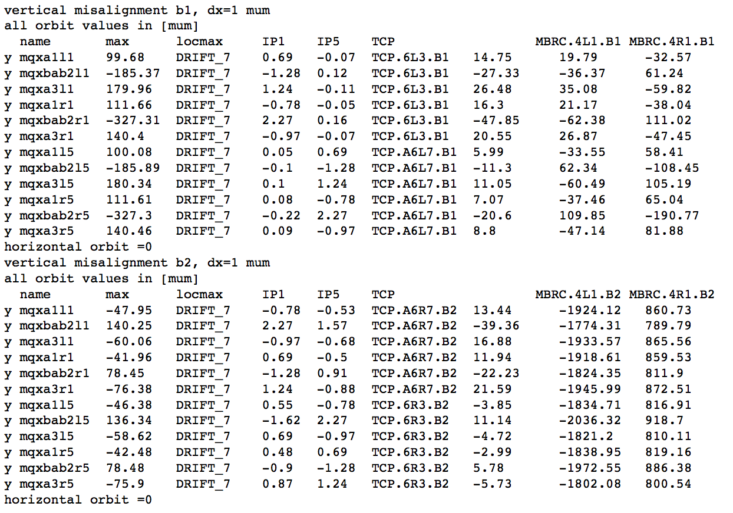
Orbit deviation at primary collimators, IP and entry/exit of IR

Slide 35
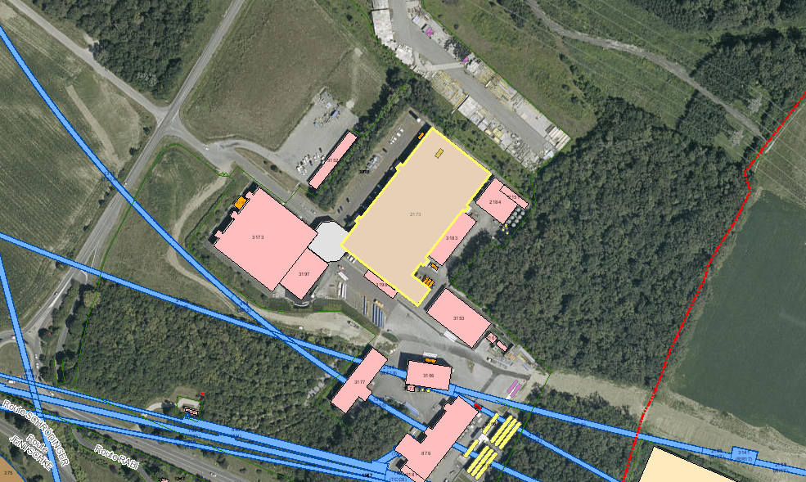
Measurements SM18
SM18
2173
A
Cluster D
A

Slide 36
Measurements at SMS18

