Slide 1
Weak-strong beam-beam simulations
Minimum crossing angle round/flat SixTrack/Lifetrac
Emittance blow-up and luminosity lifetime
A.Valishev (Fermilab/US LARP)
Thanks to: D.Banfi, J.Barranco, S.Fartoukh, T.Pieloni, D.Shatilov
March 6, 2015

Slide 2
HL-LHC baseline parameters
 | LHC nominal | HL-LHC 25 ns
# Bunches | 2808 | 2808
p/bunch [10¹¹] | 1.15 (0.58A) | 2.2 (1.11 A)
Energy in one beam [MJ] | 360 | 690
γε_{x,y} [μm] | 3.75 | 2.5
σ_{z} [cm], σ_{δp/p} [10⁻³] | 7.5, 0.1 | 7.5, 0.1
β∗ [cm] | 55 | 15
X-angle [μrad], separation | 300, (10.0 σ) | 590, (12.5 σ)
Geometrical luminosity loss factor | 0.83 | 0.31
Peak lumi [10³⁴] (with full Piwinsky angle) | 1.0 | 7.4
Virtual lumi [10³⁴] (w/o Piwinsky angle) | 1.2 | 21.9
T_{leveling} [h] @ 5E34 | n/a | 9.0
#Pile up @5E34 | 25 | 140

Slide 3
Simulation parameters
HLLHCV1.0 optics (SLHCV3.1b for flat case)
DA tracking – 10⁶ turns
FMA – 2¹³ turns
Multiparticle tracking – 5,000 particles/bunch, weighted distribution, up to 2.5×10⁶ turns
    No IBS, gas scattering or other diffusion mechanisms. From experience, these usually mitigate (!) beam-beam resonances. However, they would enhance the rate of tail population

Slide 4
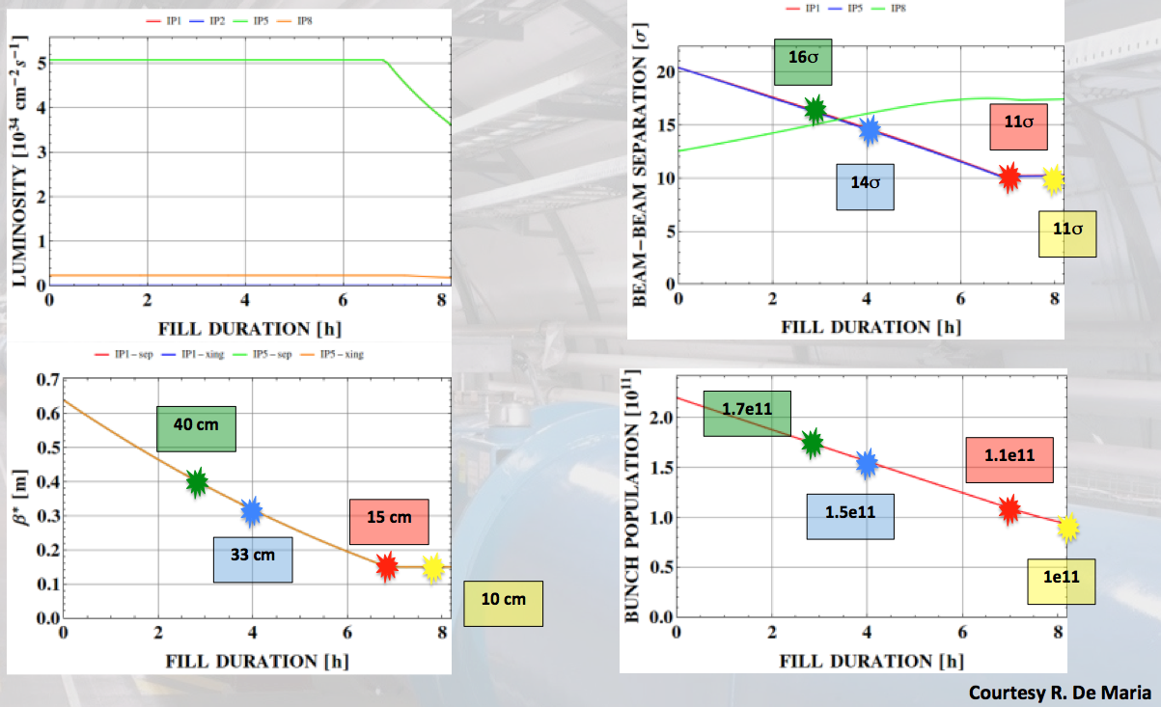
Luminosity Leveling at 5×10³⁴

Slide 5
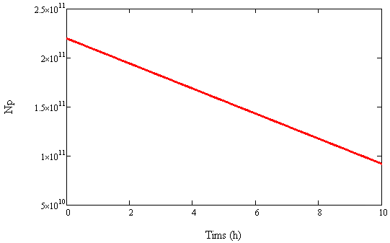
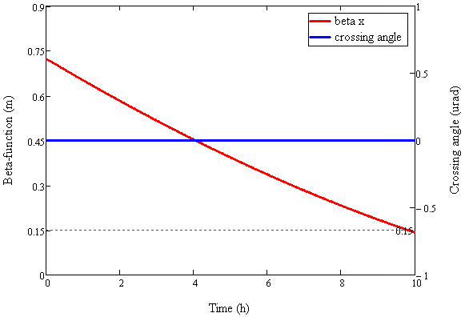
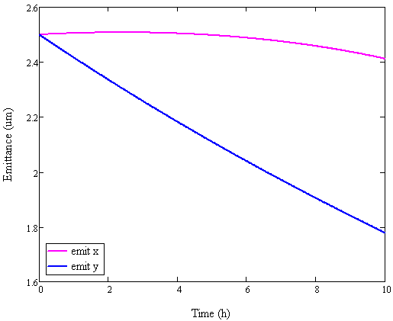
Luminosity Leveling at 5×10³⁴

Slide 6
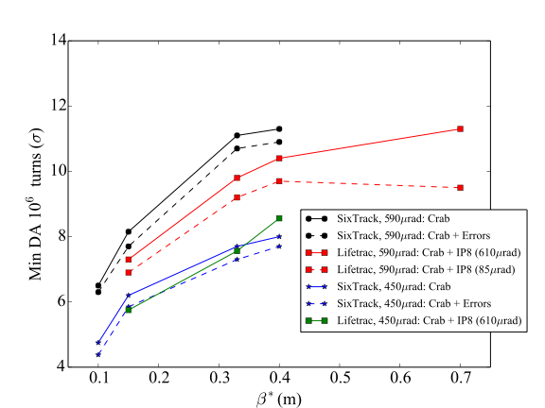
Minimum DA During Luminosity Leveling at 5×10³⁴
courtesy D.Banfi

Slide 7
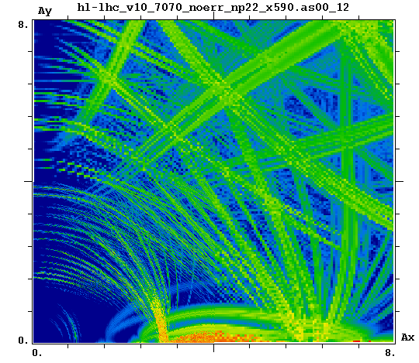
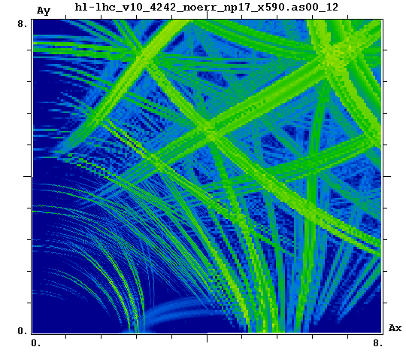
FMA During Luminosity Leveling at 5×10³⁴
β* = 70cm
No errors
β* = 42cm

Slide 8
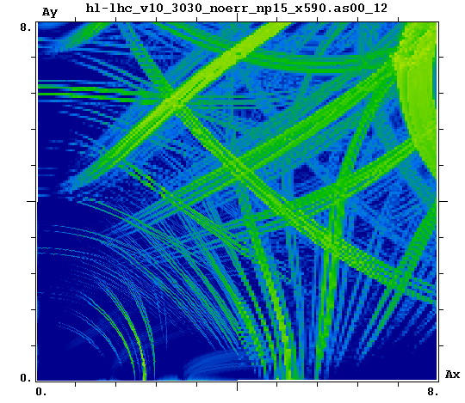
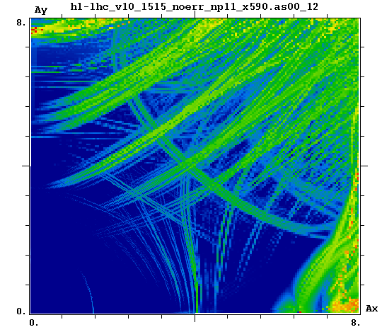
FMA During Luminosity Leveling at 5×10³⁴
β* = 30cm
No errors
β* = 15cm

Slide 9
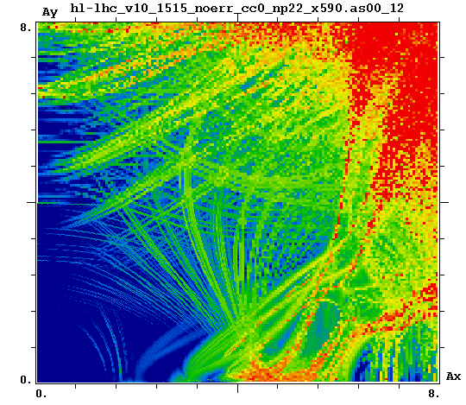
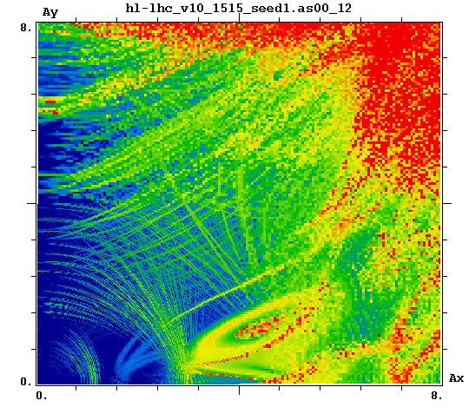
FMA For Ultimate Case β*=15cm, Np=2.2×10¹¹
No errors
Errors – Seed1

Slide 10
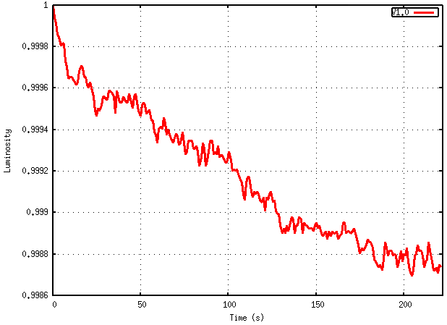
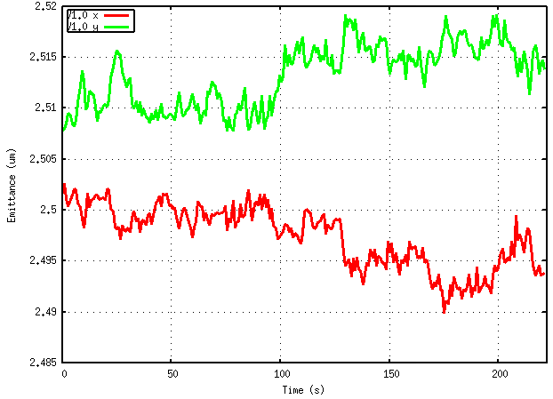
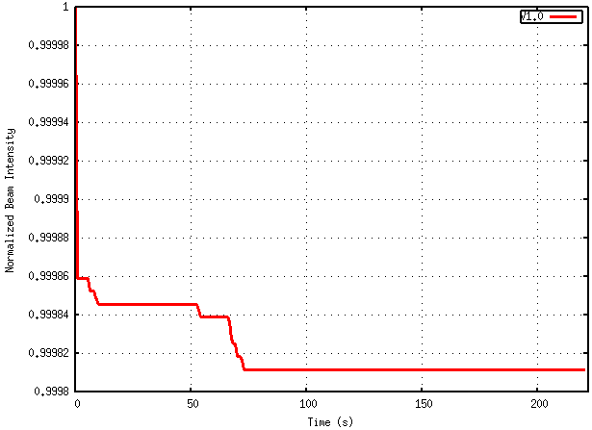
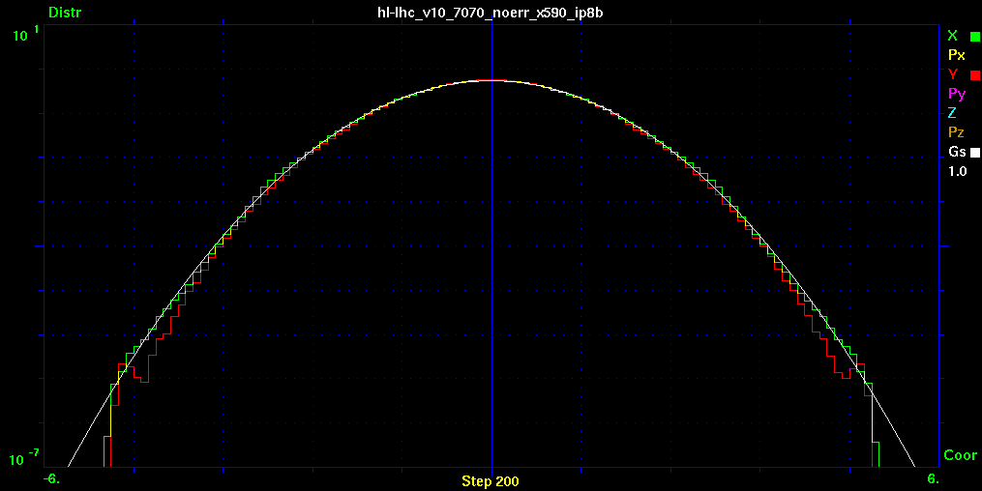
Macroscopic Beam Parameters
During Luminosity Leveling at 5×10³⁴
β* = 70cm, x=590 urad
IP8=on, CC=on
τ_{L}=50 h

Slide 11
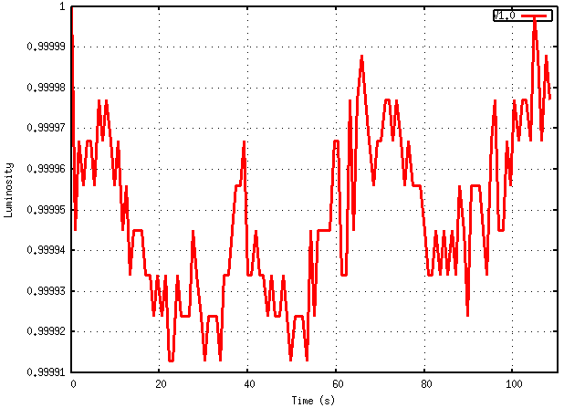
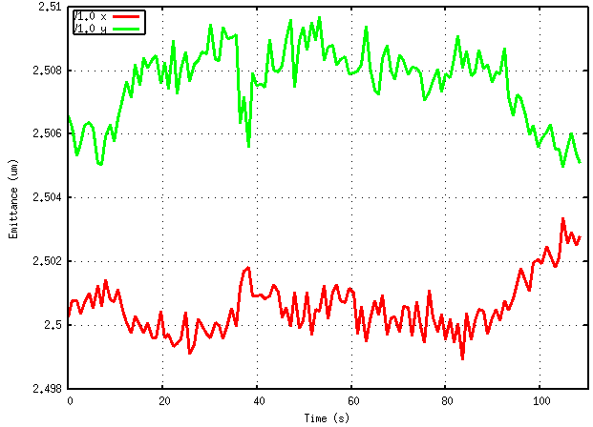
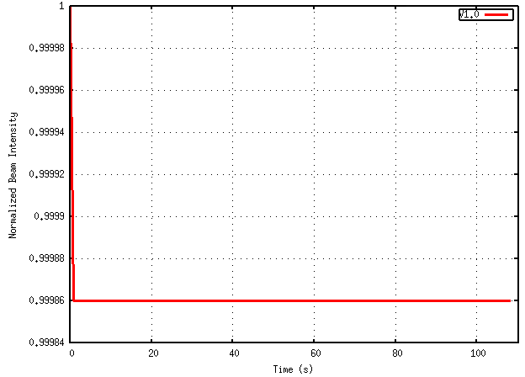
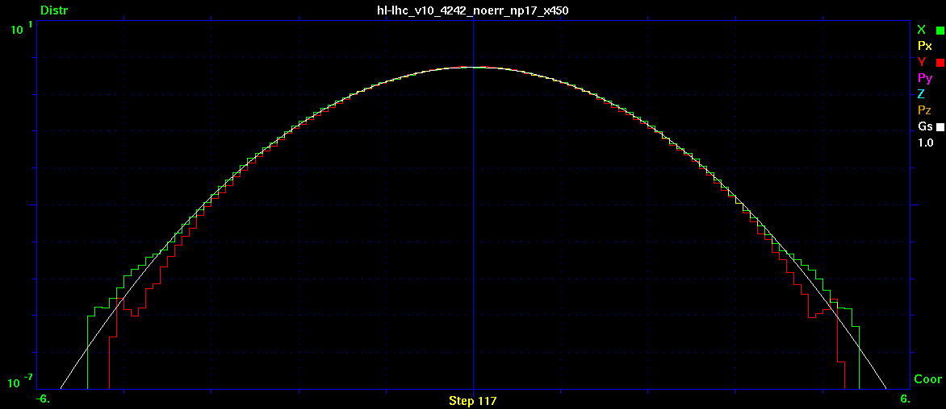
Macroscopic Beam Parameters
During Luminosity Leveling at 5×10³⁴
β* = 42cm, x=450 urad
IP8=on, CC=on

Slide 12
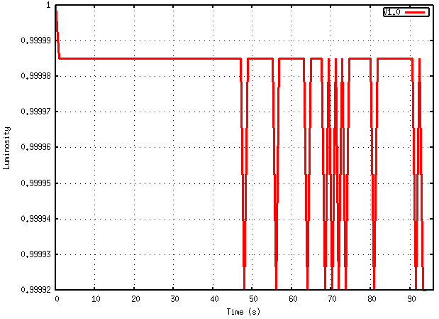
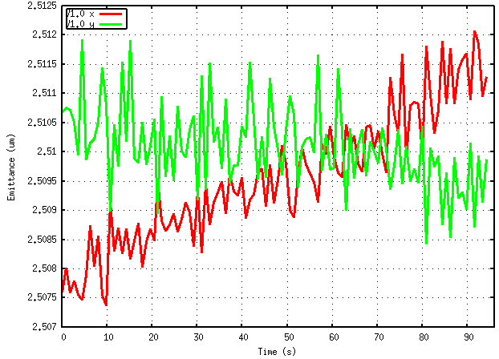
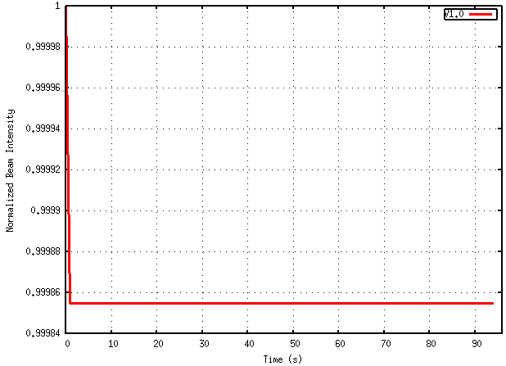
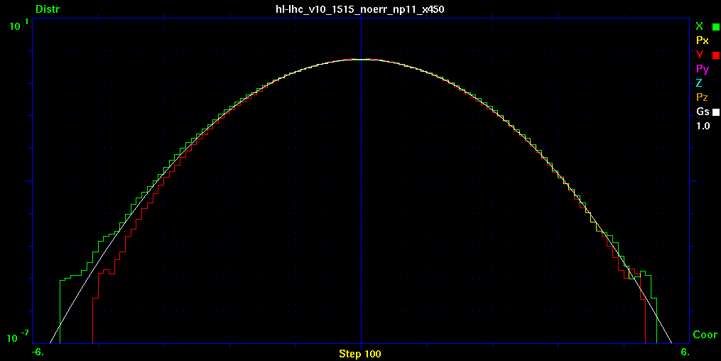
Macroscopic Beam Parameters
During Luminosity Leveling at 5×10³⁴
β* = 15cm, x=450 urad
IP8=on, CC=on

Slide 13
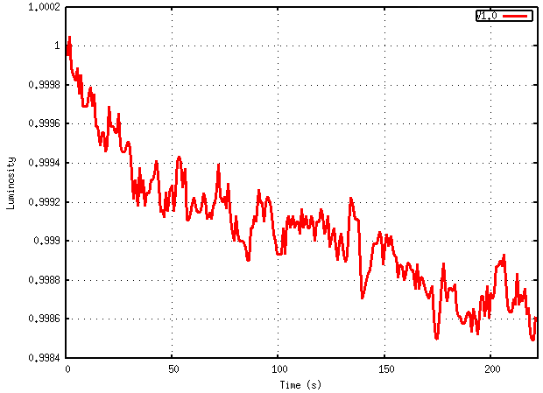
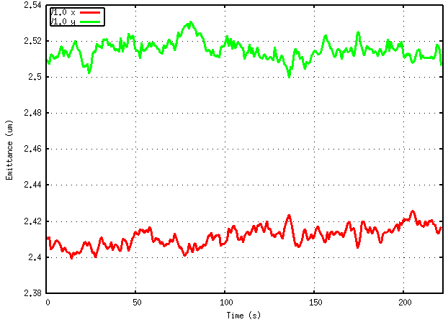
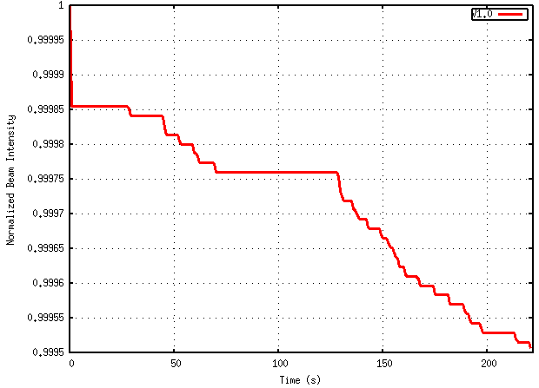
Macroscopic Beam Parameters
Ultimate Case Np=2.2×10¹¹
β* = 15cm, x=590 urad
No errors, IP8=on, CC=on

Slide 14
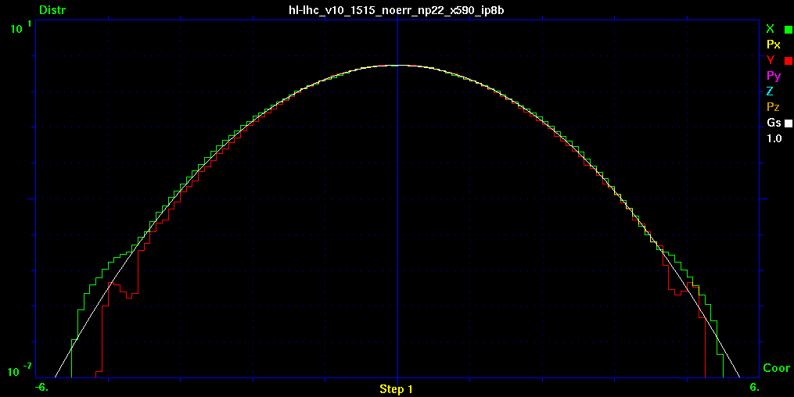
Evolution of Tails
Ultimate Case Np=2.2×10¹¹
β* = 15cm, x=590 urad
No errors, IP8=on, CC=on

Slide 15
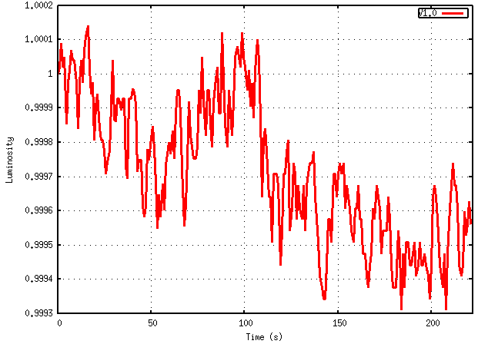
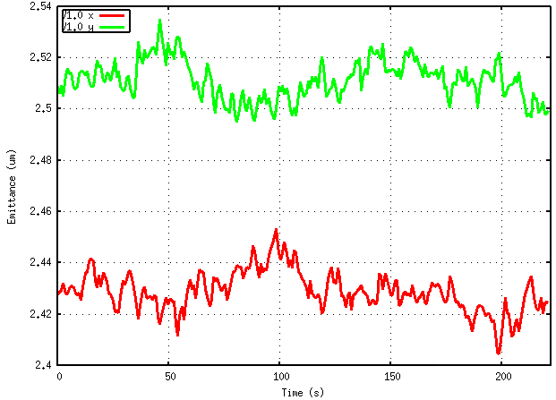
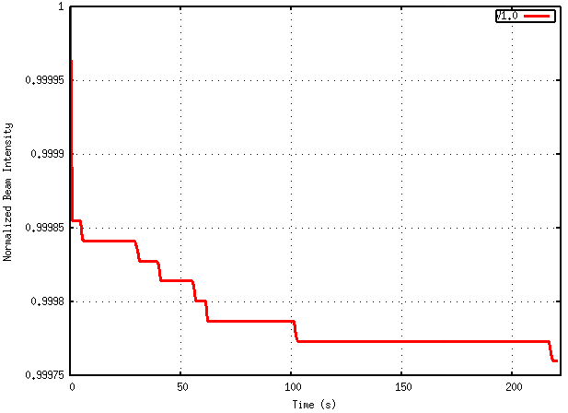
Macroscopic Beam Parameters
Ultimate Case Np=2.2×10¹¹
β* = 15cm, x=590 urad
Error seed1, IP8=on, CC=on

Slide 16
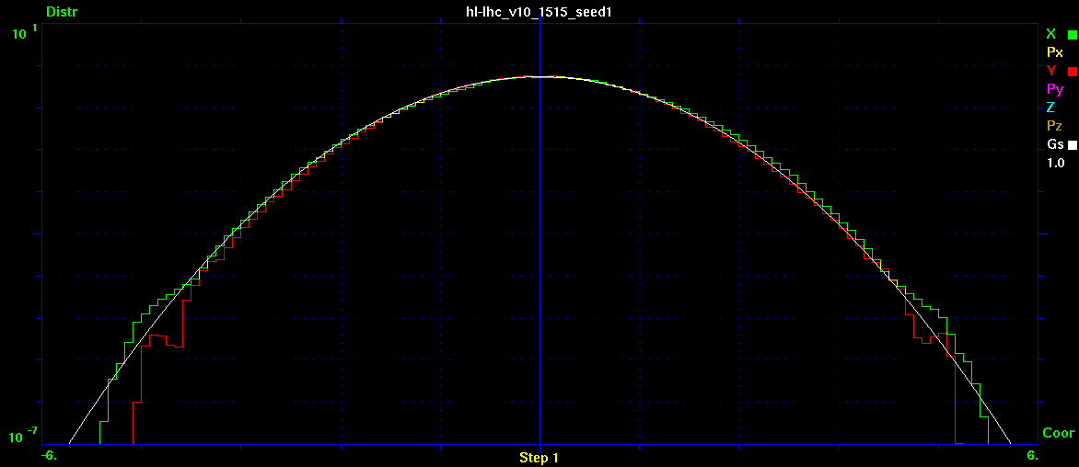
Evolution of Tails
Ultimate Case Np=2.2×10¹¹
β* = 15cm, x=590 urad
Error seed1, IP8=on, CC=on

Slide 17
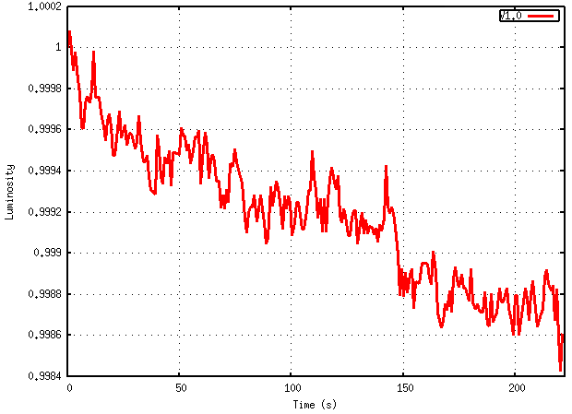
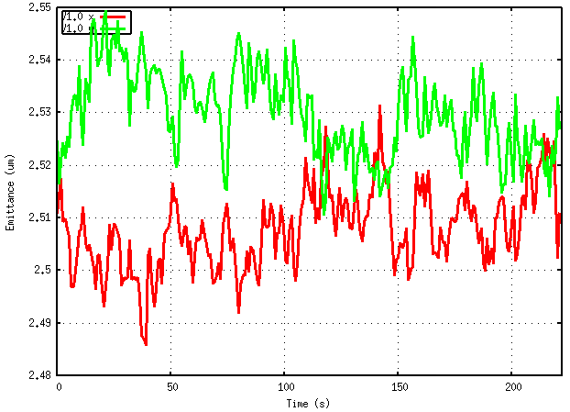
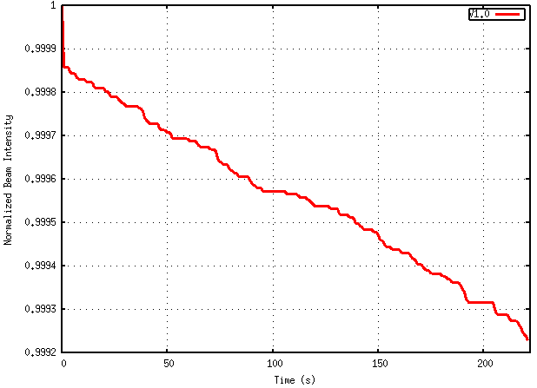
Macroscopic Beam Parameters
Ultimate Case Np=2.2×10¹¹
β* = 15cm, x=450 urad
No errors, IP8=on, CC=on

Slide 18
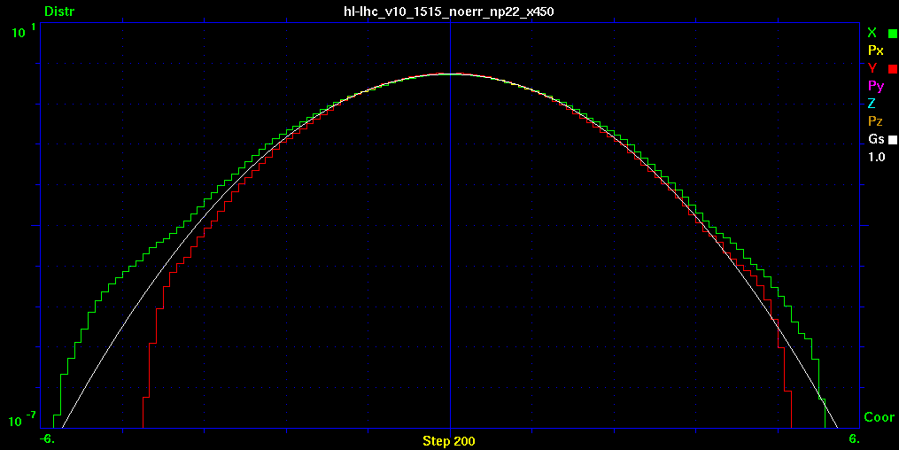
Evolution of Tails
Ultimate Case Np=2.2×10¹¹
β* = 15cm, x=450 urad
No errors, IP8=on, CC=on

Slide 19
Conclusions for round optics
Multiparticle tracking for HLLHCV1.0 shows:
No degradation of parameters in Nominal scenario (lumi leveled at 5E34 and constant x-angle 590 urad)
No degradation of parameters with reduced x-angle 450 urad at leveled lumi 5E34
Slight degradation of luminosity lifetime (τ~40 hr) at full virtual lumi 2E35 at β*=15 and x-angle 590 urad due to tail growth and particle losses

Slide 20
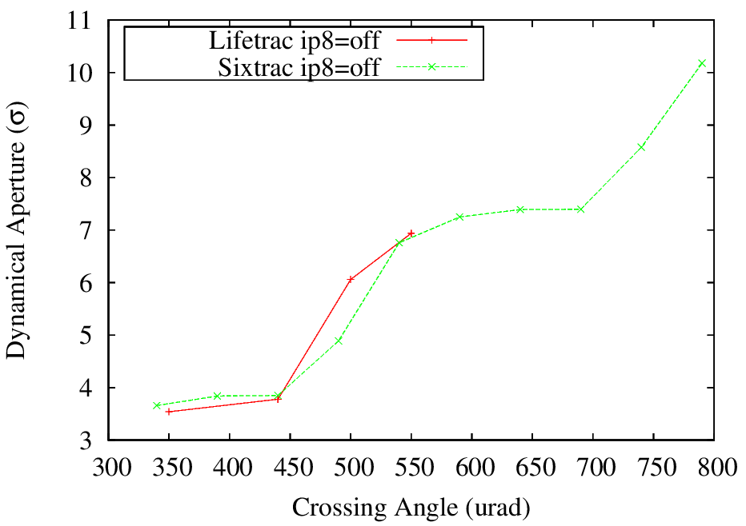
Flat Optics 30/7.5 cm
DA benchmarking with Sixtrack and Lifetrac:

Slide 21
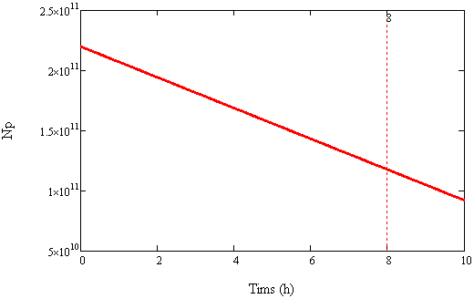
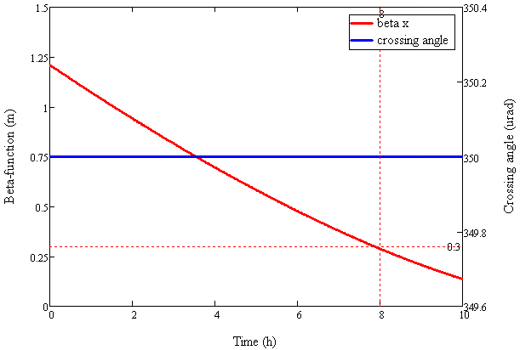
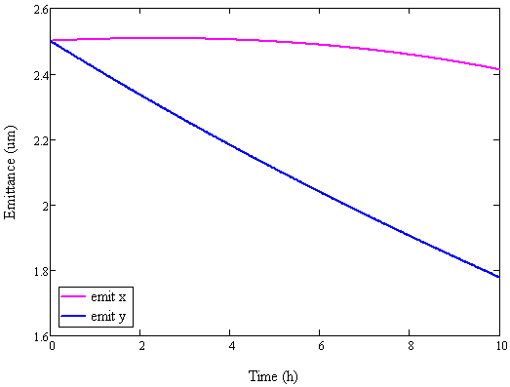
Luminosity Leveling at 5×10³⁴ with Flat Optics βx/βy=4, CC=off, x-angle=350 urad

Slide 22
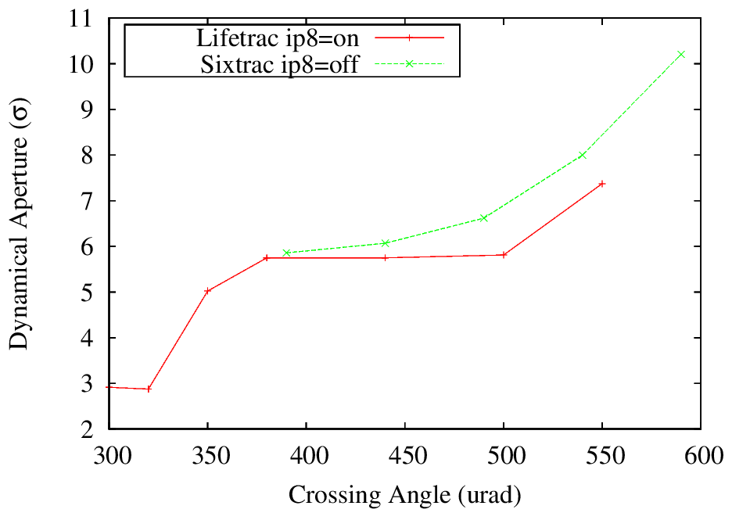
Flat Optics 30/7.5 cm
DA at minimum β-function (min separation):
1
2

Slide 23
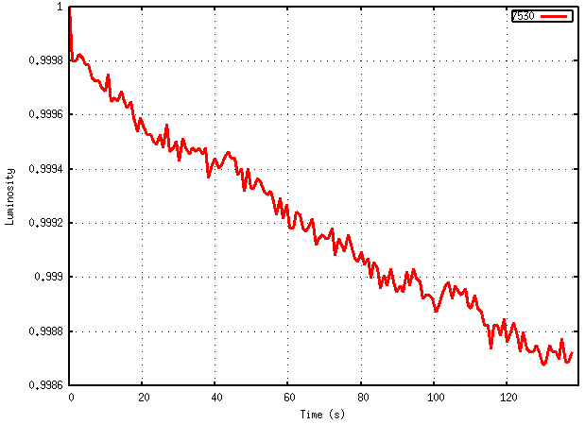
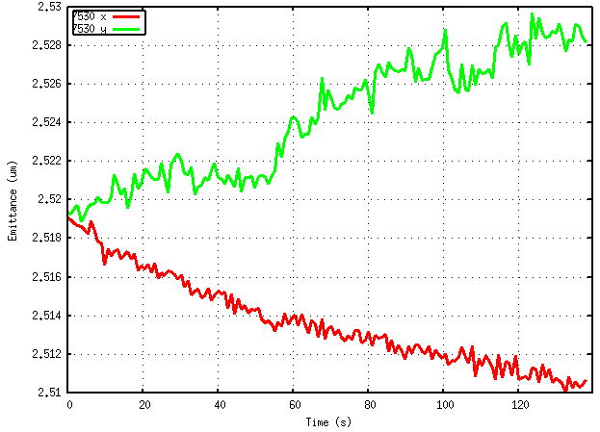
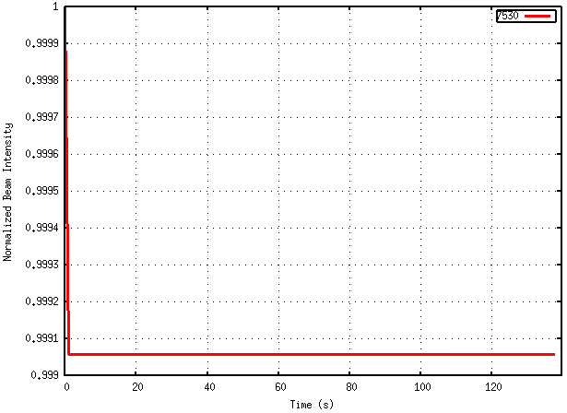
Macroscopic Beam Parameters
During Luminosity Leveling at 5×10³⁴
β* = 30/7.5cm, x=350 urad
IP8=on, CC=off
τ_{L} ~35 hr

Slide 24
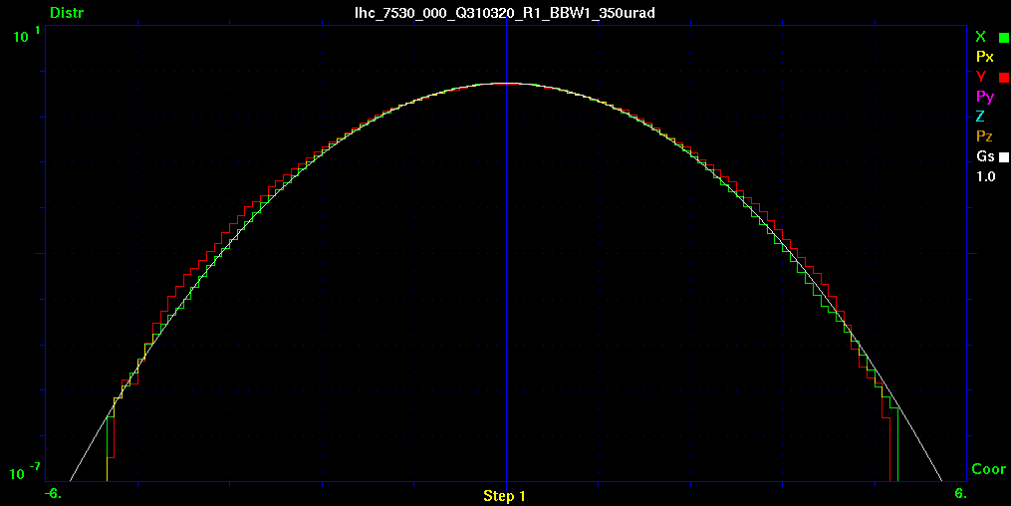
Evolution of Tails
β* = 30/7.5cm, x=350 urad
IP8=on, CC=off

Slide 25
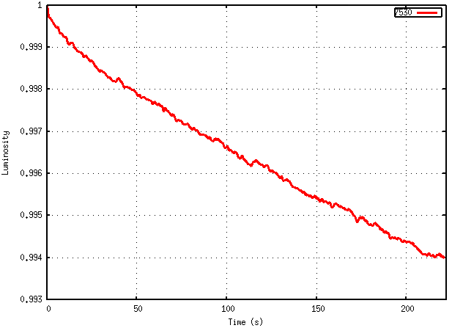
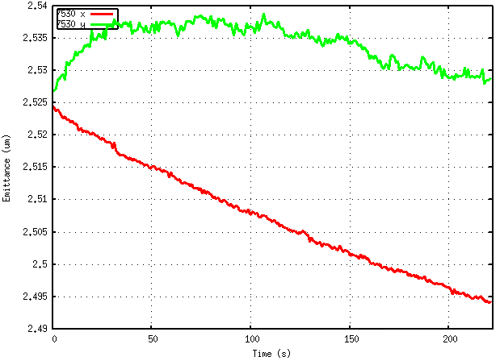
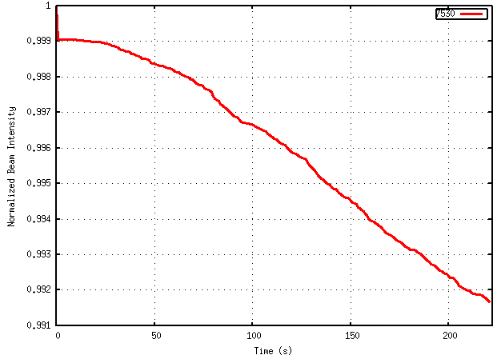
Macroscopic Beam Parameters
During Luminosity Leveling at 5×10³⁴
β* = 30/7.5cm, x=320 urad
IP8=on, CC=off
τ_{L} ~10 hr
τ_{L} ~7 hr

Slide 26
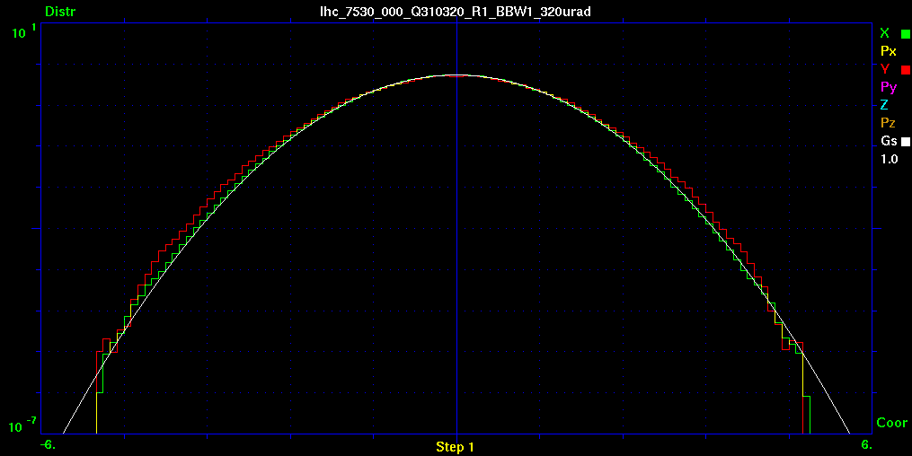
Evolution of Tails
β* = 30/7.5cm, x=320 urad
IP8=on, CC=off

Slide 27
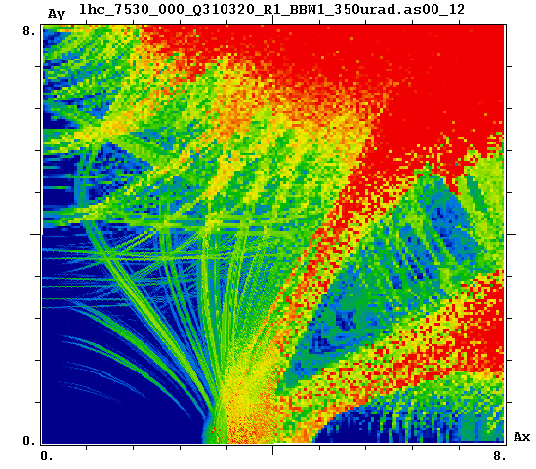
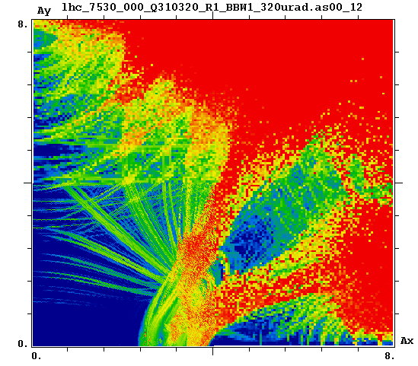
FMA Flat Optics β*=30/7.5cm, Np=1.2×10¹¹
350 urad
320 urad

Slide 28
Conclusions for flat optics
Minimum DA>5-6σ at β=30/7.5 is achieved at crossing angle > 350-380 urad
Slight reduction of luminosity lifetime (τ~35 hr) at x-angle 350 urad (DA=5σ)
Significant degradation of luminosity lifetime (τ~10 hr) at x-angle 320 urad (DA=3σ), significant tail growth (1-2 orders of magnitude)
    Potentially can be used for BBC studies

Slide 29
Outlook
Although quantitative conclusions were shown to be robust by previous experience, quantitative results may be slightly affected by low statistics
    5,000 macro-particles averaged over 10,000 turns
    3×10⁶ turns ~ 4 minutes
    Work is being done to launch more massive studies at FermiGrid
It is essential to include other diffusion mechanisms
    Noise smears resonances, but enhances population of tails

Slide 30
Appendix: error tables used
/afs/cern.ch/eng/lhc/optics/HLLHCV1.0/errors/IT_errortable_v65
/afs/cern.ch/eng/lhc/optics/HLLHCV1.0/errors/D1_errortable_v1
/afs/cern.ch/eng/lhc/optics/HLLHCV1.0/errors/D2_errortable_v4
/afs/cern.ch/eng/lhc/optics/HLLHCV1.0/errors/Q4_errortable_v1
/afs/cern.ch/eng/lhc/optics/HLLHCV1.0/errors/Q5_errortable_v1

