Slide 1

Target and ion source development report
Tânia Melo Mendonça
EN-STI-RBS

Slide 2
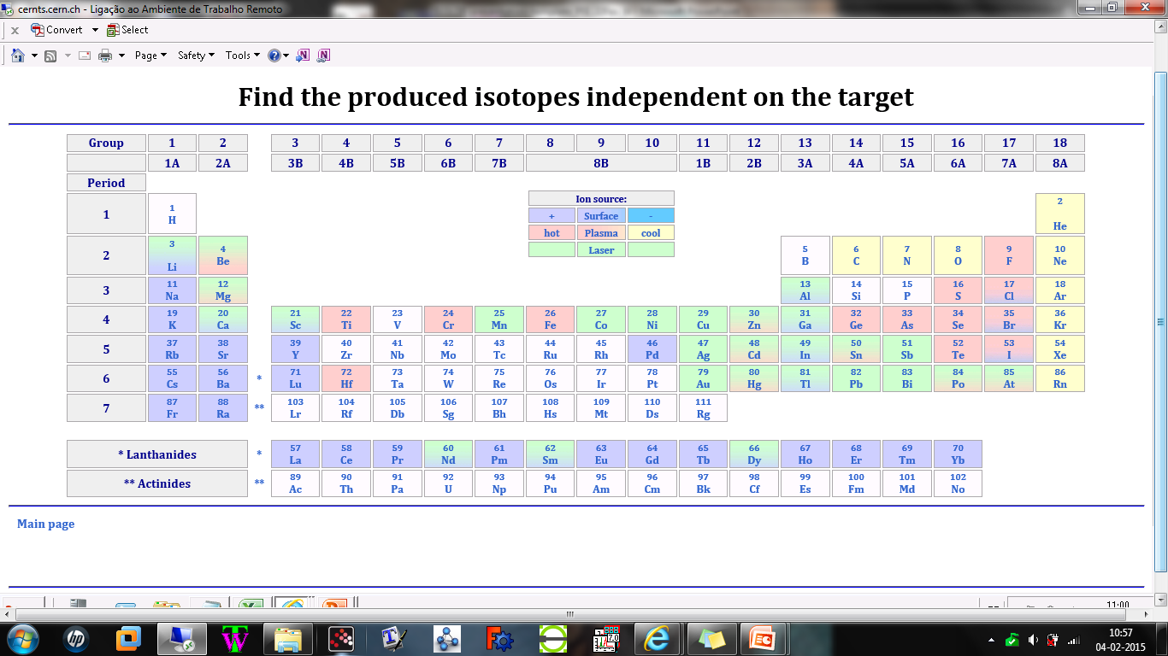
Beam and target developments 2014
NaF:LiF
Nano-TiC
MWCNT
Nano-LaC
Nano-UC
PbBi loop (2016)

Slide 3
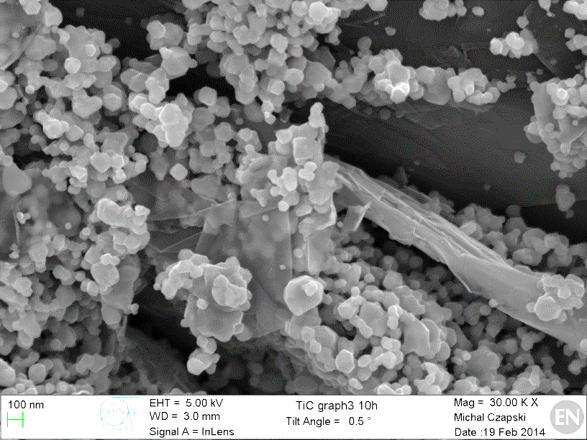
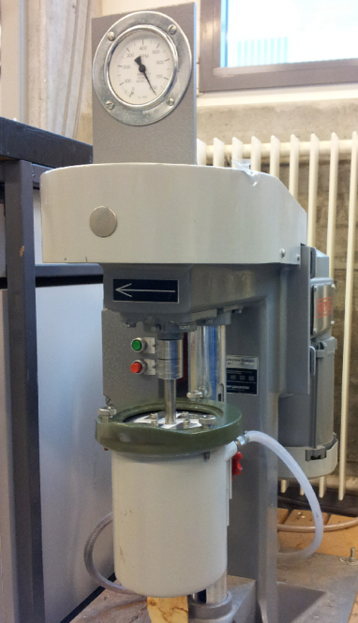
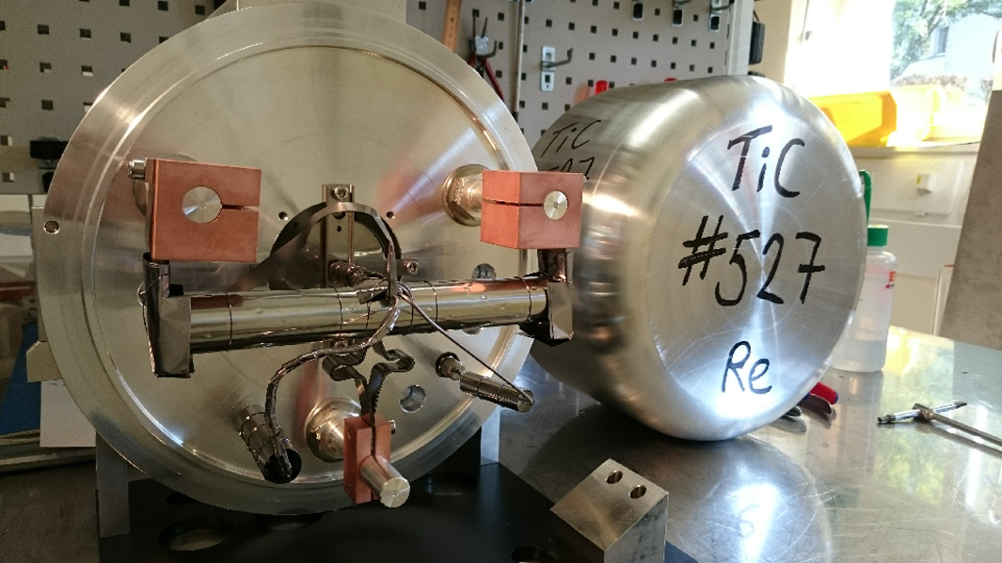
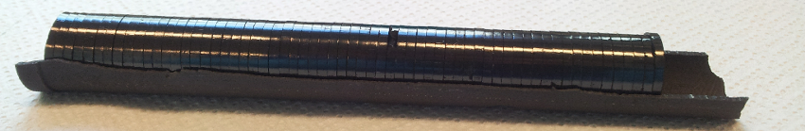
TiC-Carbon Black nanocomposite
Mixing TiC and Carbon (different vol. ratios)
Test for nanostructure stability at 1500, 1650 and 1800ºC
TiC +Graphite
TiC + MWC nanotubes
TiC + Carbon black
TiC + Carbon Black - Milling and mixing
TiC + Carbon black (50 vol.%) nanostructure, which was stable up to 1800ºC, was selected to produce a full target prototype.
João Pedro Ramos

Slide 4
TiC-Carbon Black nanocomposite
Target #527 operated successfully online (November 2014) with a surface ion source
Successfully extracted isotopes of Li, Na, Al, K
Very stable yields
Release curves taken at different temperatures: 1650, 1800 and 2000ºC
Preliminary data!!
Isotope | Temp. | Yield (/μC) | Yield Ti foils (/μC)
⁹Li (178 ms) | 2000ºC | 7.8E5 | 3.2E5 (SC)
²⁶Na (1.07 s) | 2000ºC | 8.1E6 | 1.5E6 (SC)
³⁷K (1.2 s) | 2000ºC | 1.2E6 | 7.1E6
³⁹Ca (860 ms) | 2000ºC (CF₄) | 1.4E2 | 2.0E4
³⁹Ca extracted with CF₄
Target not suitable for ³⁵Ca (25 ms) – probable reaction of Ca with carbon black?
nanoTiC-C - ½ Production rate
(lower density of Ti atoms)
João Pedro Ramos

Slide 5
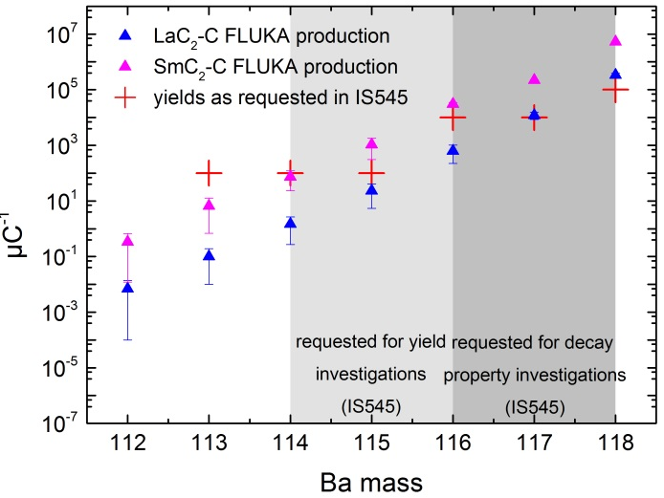
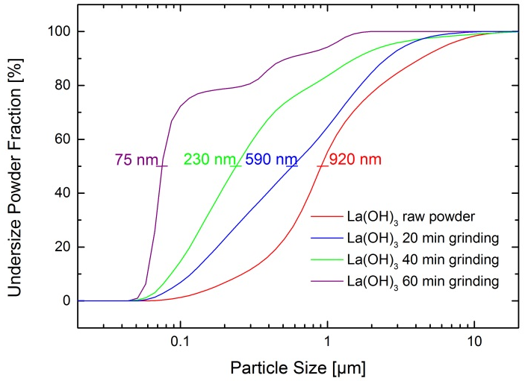
LaC₂–MWCNT Spallation Target Material Development
Theoretical Production Yields
after comparing all possible spallation target nuclei
La(OH)₃ particle size reduction by suspension grinding
LaC₂-MWCNT Nano Composite (After Carbo-Thermal Reduction)
2 µm
200 nm
After 10 days at 1900°C
After 10 days at 1900°C
Julien Guillot, Wonjoo Hwang
Alexander Gottberg

Slide 6
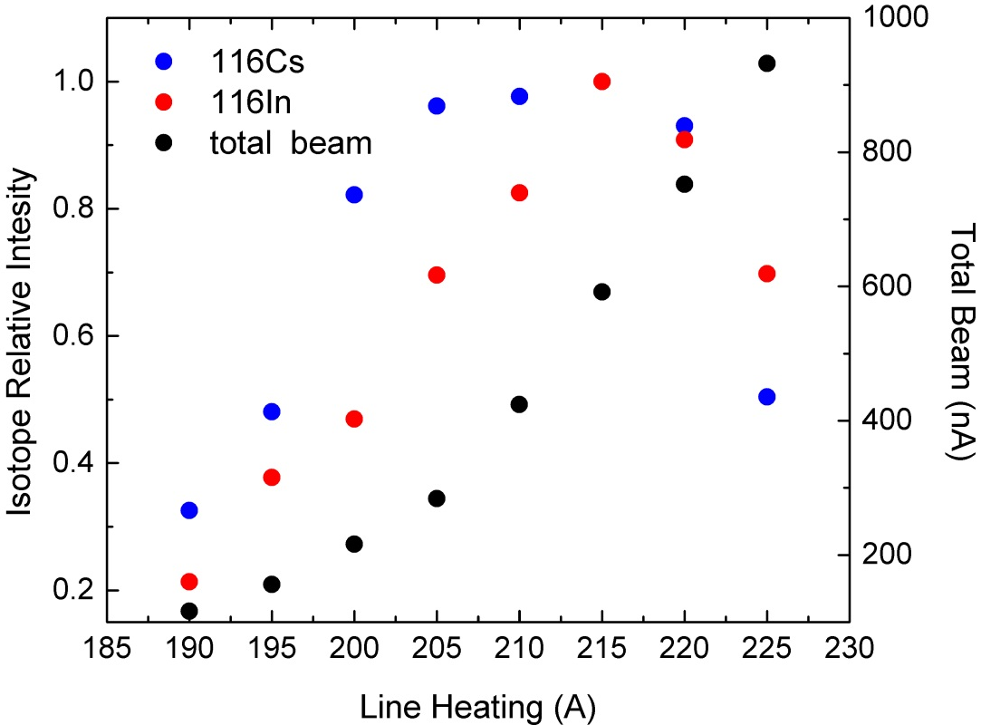
#526 nano LaC₂ – Re Online Tests
The target material could be tested with and without fluorination by CF₄ injection at 2 different temperatures (1700°C and 1900°C)
Isotopes of Li, Na, In, Cs, Ba could be assessed.
The material was found to sublimate LaC2 significantly at 1900°C and above, and the total beam intensity starts limiting the ion source efficiency
The release of Cs is limited presumably because of effusion limits at <1900°C (nano-UC2 results)
Isotope | #526 [µC⁻¹] | Reference
115Cs (1.4 s) | 2 | delayed p
116Cs (3.5 s) | 110 | delayed p
118Cs (14 s) | 2×10⁶ | Gamma
120Cs (57 s) | 5×10⁷ | Gamma
124Cs (30.8 s) | 6×10⁸ | Gamma
126Cs (1.6 min) | 2×10⁹ | Gamma
128Cs (3.8 min) | 9×10⁹ | Gamma
114Ba (0.42 s) | 0.2 | delayed p
117Ba (1.6 s) | 3 | delayed p
119Ba (5.4 s) | 6×10² | delayed p
120Ba (24 s) | >1×10⁴ | Gamma
124Ba (11.9 min) | 1×10⁷ | Gamma
126Ba (100 min) | 2×10⁸ | Gamma
Figure: Systematic control and optimization of Cs vs. In vs. total ionization efficiency
Julien Guillot
Alexander Gottberg, Wonjoo Hwang

Slide 7
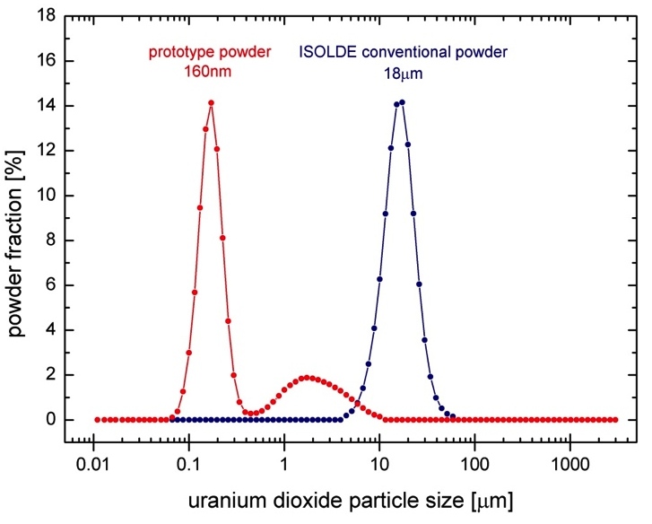
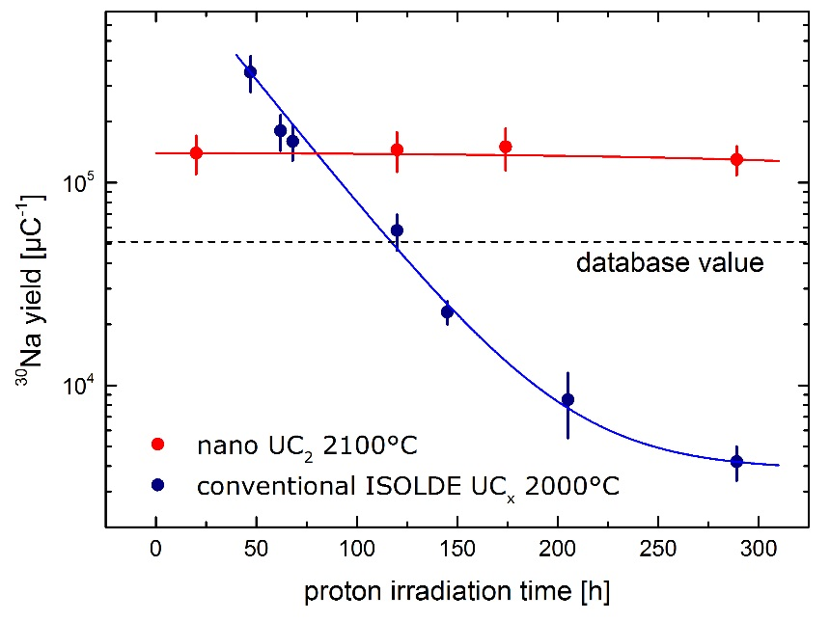
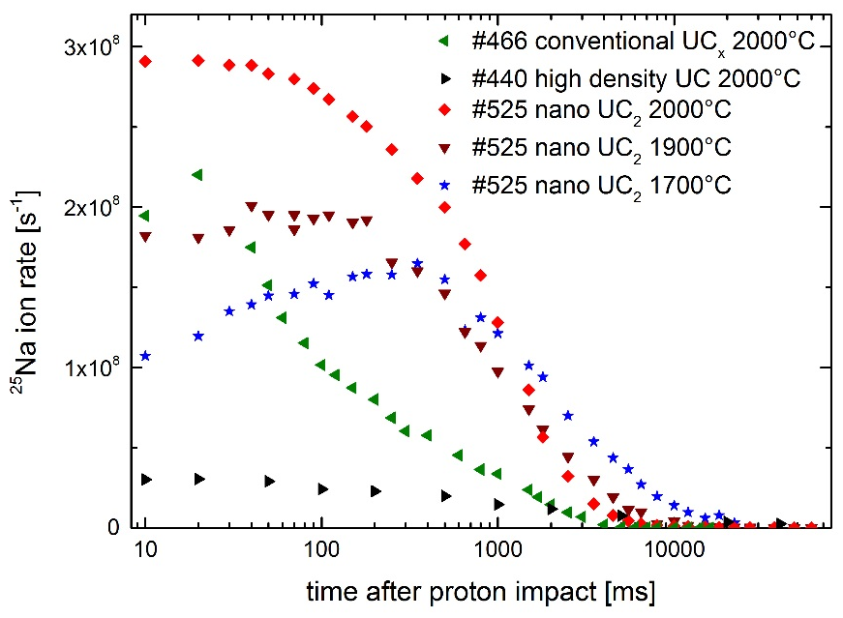
ENSAR-ActILab: Nano Uranium Carbide at ISOLDE
Within ENSAR FP7 – ActILab a new material was developed
New material (Target#525 tested in December 2014):
  consists of nanometric uranium carbide particles immerged in a MWCNT fiber matrix
  increases isotope yield of most investigated elements
  (Li, Na, K, Ca, Cu, Ga, Rb, In, Ra, Fr)
  reduced ageing effects (reduction of yield over time)
  reduces actinide waste by 60%
two orders
of magnitude
Ageing of nano UC_{x} (red) vs. ISOLDE reference (blue) for ³⁰Na
Alexander Gottberg

Slide 8
ENSAR-ActILab: Nano Uranium Carbide at ISOLDE
Alexander Gottberg

Slide 9
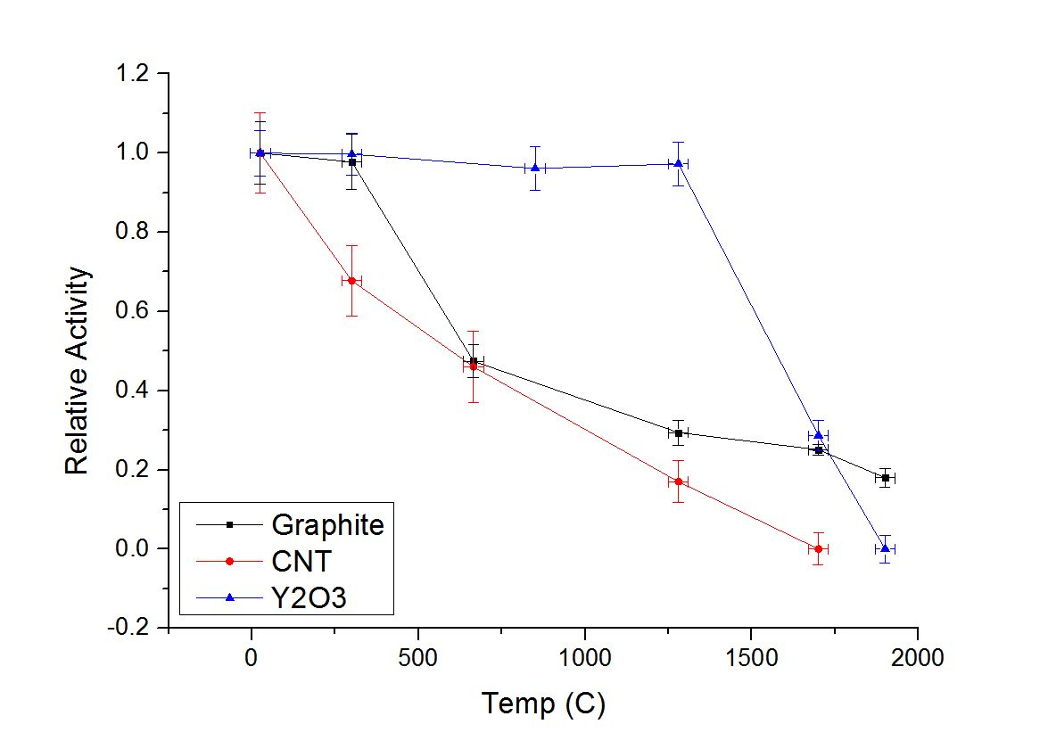
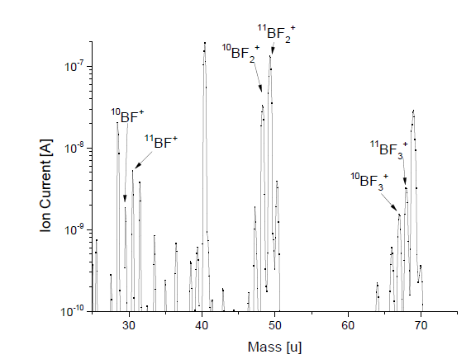
Boron beams - Multi walled carbon nano tubes target
Investigate extraction of boron and identify suited materials & target unit (Extraction of ⁸B desired)
  Diffusion studies of Boron in different target materials (Graphite, MWCNT, Y2O3) – implantation of ¹⁰BF₂⁺
    ¹⁰B(n,α)⁷Li: highest mobility in MWCNT
Formation of molecules
B+3F->BF₃
Christoph Seiffert

Slide 10
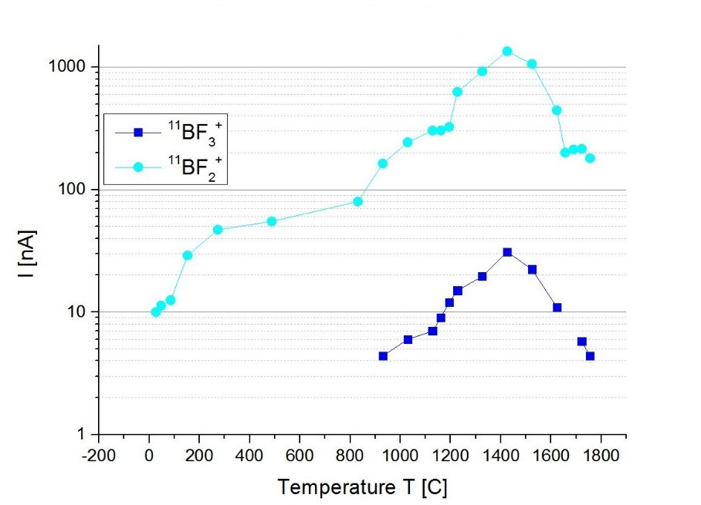

Boron beams - Multi walled carbon nano tubes target
Release of boron fluorides
3B+SF₆→ 3BF₂ +S
BF₂⁺: $ε_{formation}∗ε_{trans}∗ε_{ion}=1,5\%$
Target unit #499 (online September 2014)
Target material MWCNT, ρ=0.43 g/cm³
Cold transfer line, VADIS ion source with gas leak (SF₆, leak rate: 0.37 x10⁻⁴ mbar∙l/s)
Activity on mass A=8 originating from ⁸Li and positron emitter
Positron activity corresponds to 300 /µC - extraction of ⁸B to be validated
Activity below detection limit of Boron in fluoride (⁸BF_{n} ) and oxofluoride (BOF ) form
Christoph Seiffert

Slide 11
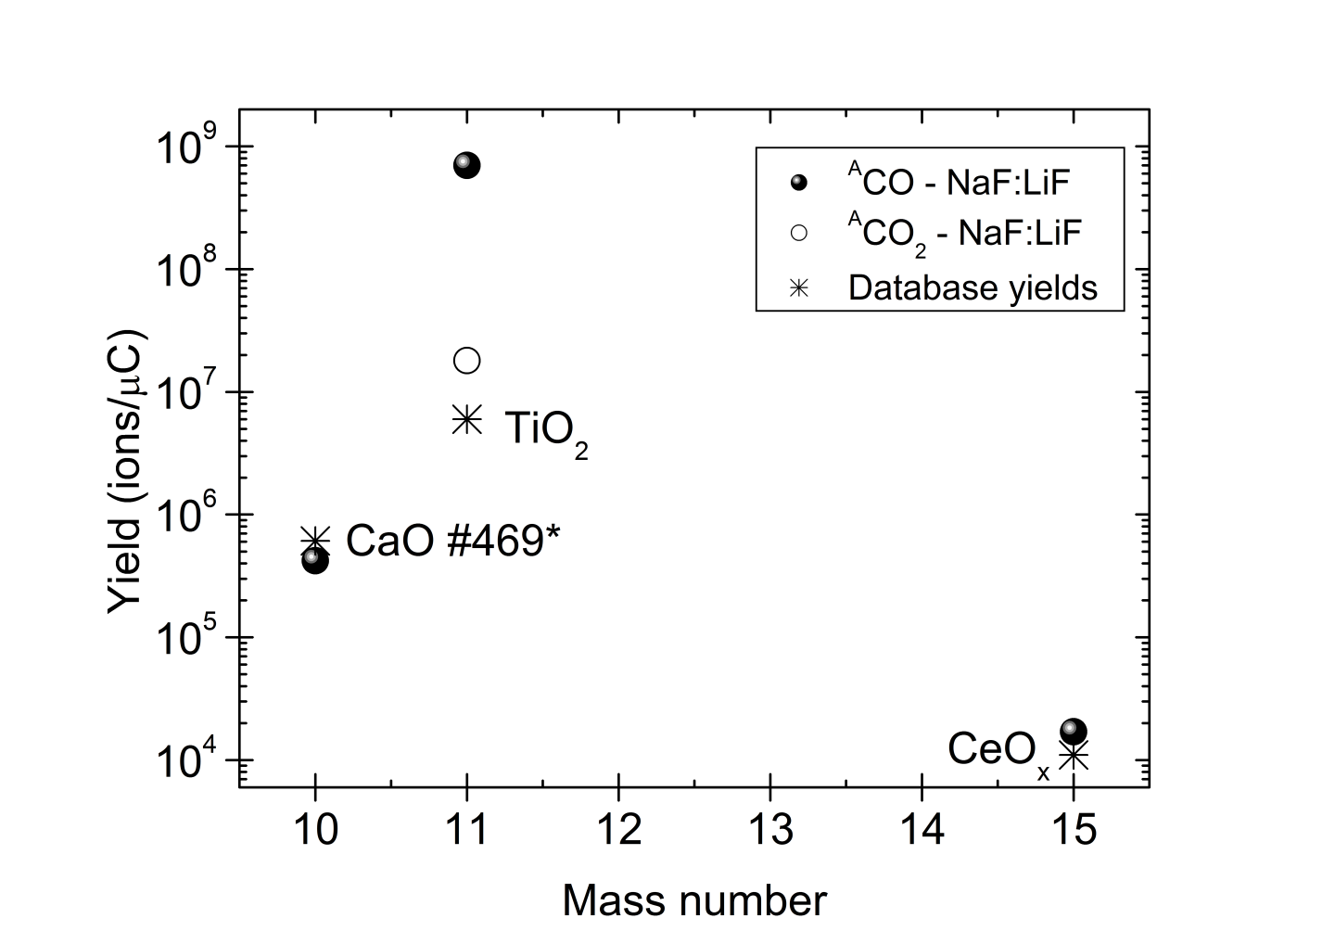
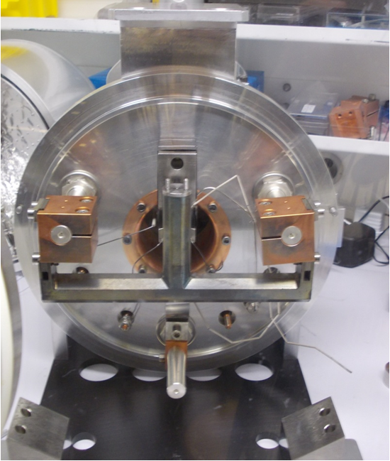
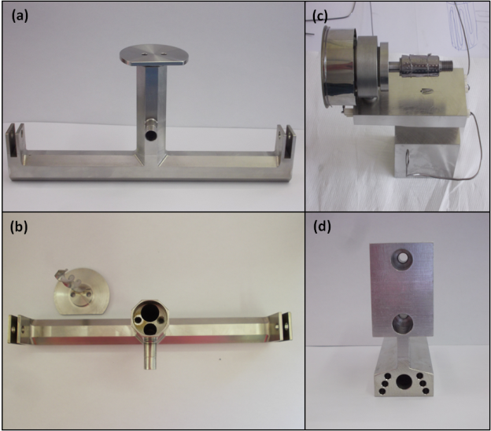
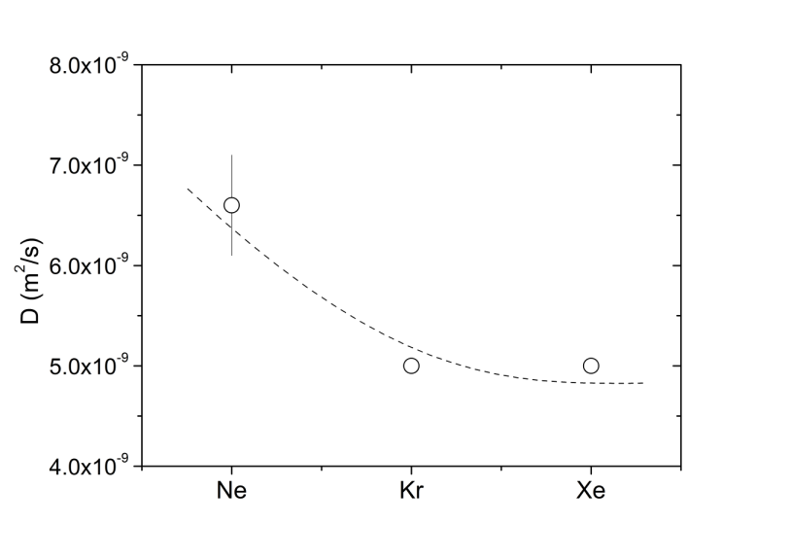
Molten NaF:LiF salt
Validation of results obtained in 2012 (1st prototype #478):
Reproducibility of 8x10⁸ ¹¹CO/µC
Diffusion coefficient of neon in molten salts
21.6 cm
- Material: Haynes 242
(corrosion resistant alloy)
- VADIS ion source
ε_{Ne}~1.8%
(via cold transfer line)
- Three thermocouples
(container, chimney, cold line)
- Salt fills up ¾ of the container volume
D(Ne) in NaF:LiF is 8 orders of magnitude higher than oxide targets (CaO, Al₂O₃ with D~10⁻¹⁷ m²/s)
D(Ne) in NaF:LiF ~10⁻⁹ m²/s
Tânia Melo Mendonça

Slide 12
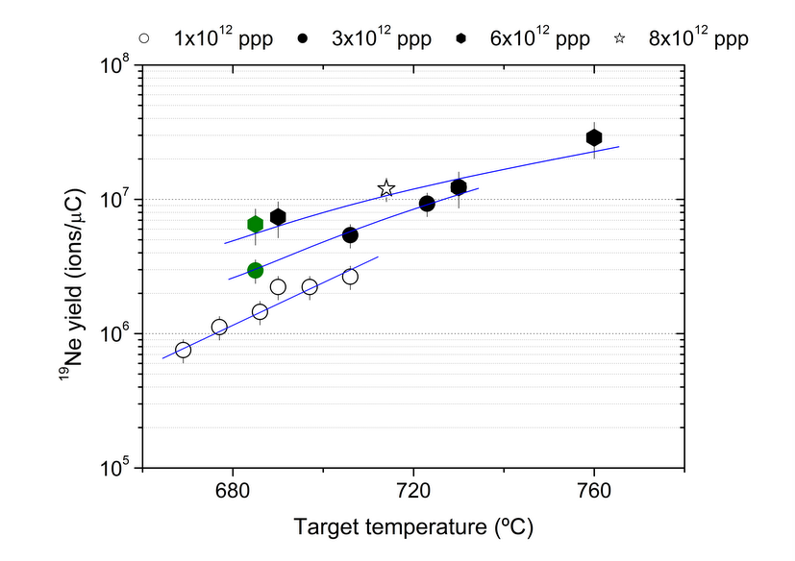
Molten NaF:LiF salt
Target #520 (online 27th October to 2nd November 2014)
Despite several problems at the start of the run (no thermocouples, HV trippings…) we could successfully validate the results obtained in 2012.
Systematic measurement of release curves for Ne diffusion coefficient in fluoride salts. Data analysis ongoing.
Isotope | Temp. | Yield (/μC)
⁶He (807 ms) | 760ºC (6x10¹² ppp) | 2E5
¹⁸Ne (1.67 s) | 720ºC (6x10¹² ppp) | 6.4E4
¹⁹Ne (17.22 s) | 760ºC (6x10¹² ppp) | 2.9E7
¹¹CO (20.38 min) | 715ºC (8x10¹² ppp) | 6.6E8
Tânia Melo Mendonça

Slide 13
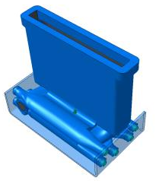
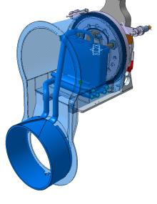
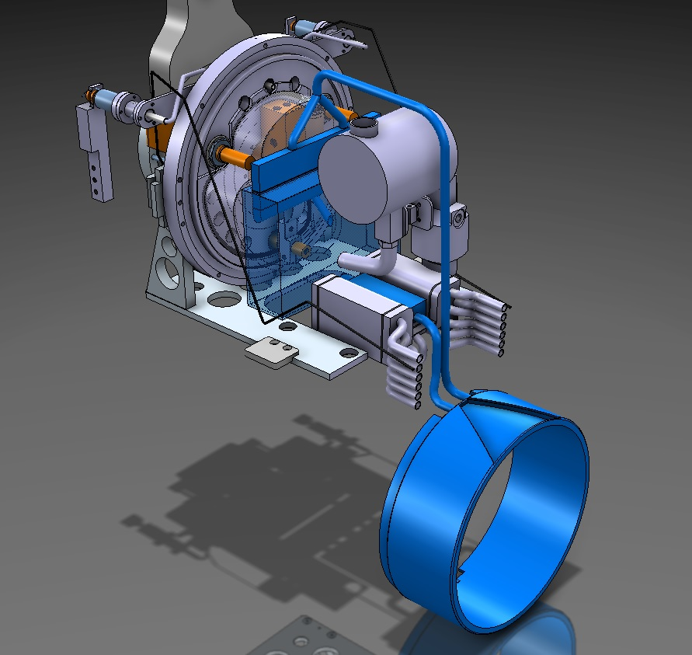
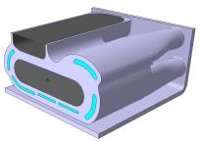
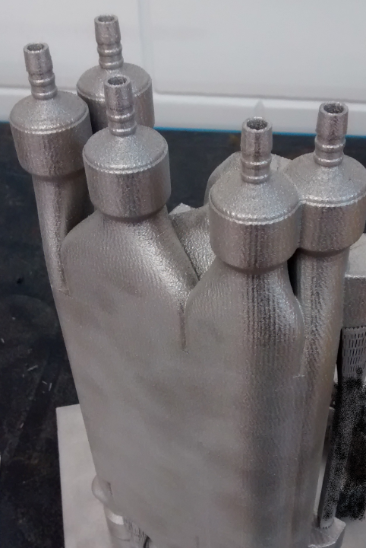
Liquid eutectic Pb/Bi loop for EURISOL
LIEBE project
Target design review – June 2014
Complex unit and many challenges to overcome – online tests postponed to 2016
LIEBE target proposed design
(LIEBE Design Study Report –June 2014)
Fill and drain reservoir
Irradiation chamber
Modifications
Diffusion chamber
Electromagnetic pump
Heat exchanger
Melanie Delonca
Tânia Melo Mendonça

Slide 14
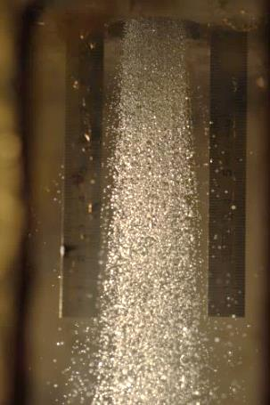
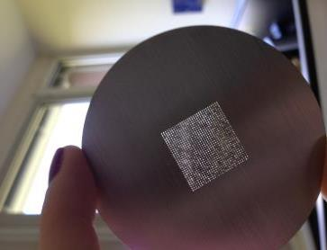
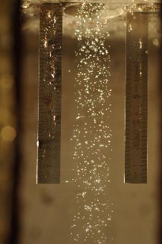
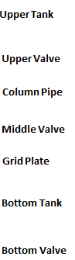
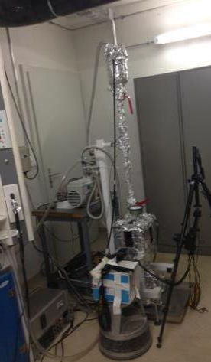
Liquid eutectic Pb/Bi loop for EURISOL
LIEBE project
Shower formation feasibility tests
Shower at start.
Shower at the end.
Vacuum pump
  Shower feasibility proven: smallest spacing between holes of 0,5 mm for 0,1 mm holes
  Oxidation prevent a proper operation of the grid (analysis of the grid foreseen)
  Size of droplets vary between the start and the end of the shower – from 0.3 to 0.5 mm
Vacuum pump
Camera
Melanie Delonca
Tânia de Melo Mendonça

Slide 15
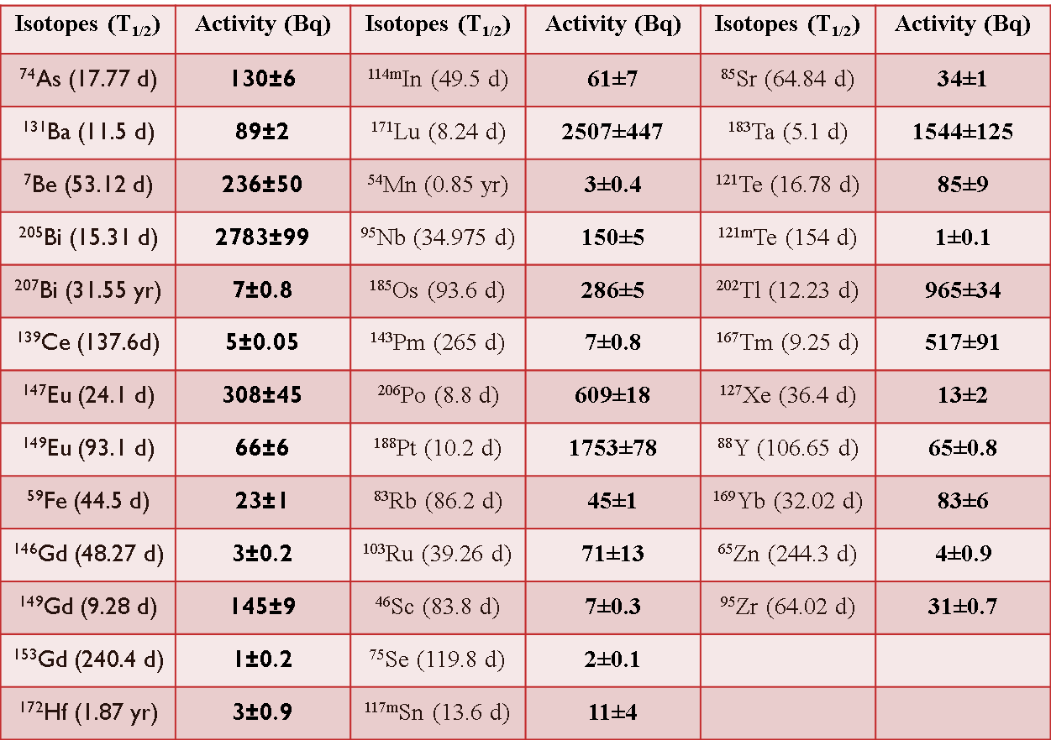
Liquid eutectic Pb/Bi loop for EURISOL
LIEBE project
Radioisotope inventory ( collaboration with SINP-India)
- Irradiation of Pb/Bi samples using RaBBIT setup (2012)
- Measurements performed in different campaigns (2012/2013)
M. Maiti et al., J Radioanal Nucl Chem 302 (2014) 1003
- Comparison with simulations (FLUKA, MCNPX) to be published
Prof. Susanta Lahiri et al.

Slide 16
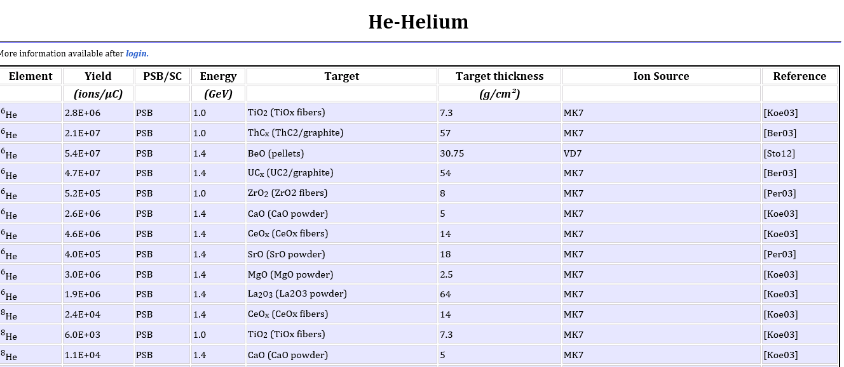
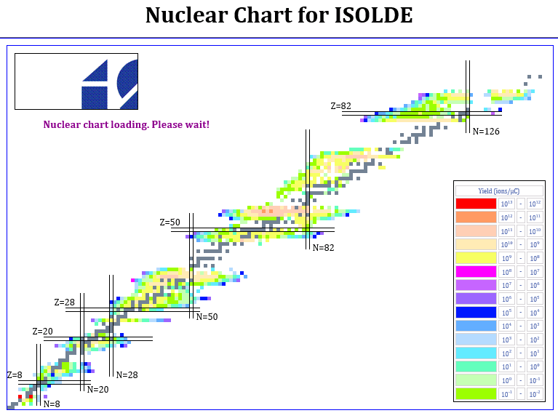
ISOLDE Yield database
User yield database updated with new values in December 2014
Graphical restoration ongoing
Hayley Osman
Tânia Melo Mendonça

Slide 17
The TISD team:
Thierry Stora
Tania M. Mendonça
Alexander Gottberg
João Pedro Ramos
Melanie Delonca
Jochen Ballof
Basil Gonsalves
Thank you for the attention!

