Slide 1


ISOLDE
Operational constrains in 2015
Light at the end of the tunnel!

Slide 2
OUTLINE
1-New ISOLDE equipment .Installation and commissioning
2-Restart of LINAC (warm part)
3-HIE commissioning
4-New control room. Design , installation and move
5-New people at ISOLDE (Operation team)
6-Safety. New risks at ISOLDE
7- Other challenges for this year

Slide 3
New ISOLDE equipment and controls. Installation and commissioning
-New FESA classes for moving parts.
SLITS /Clamping and unclamping targets /extraction electrodes. Deflectors
-New gas injection system for the HRS RFQ
-New RF system for the HRS RFQ
-New patch panel for target connections
-New magnet FESA3 controller for GPS separator. From GM to FGC3
-Minor changes to the HRS separator magnets cycling algorithm

Slide 4
Restart of LINAC (warm part) and REX
-Restart of the LINAC after being down for more than a year
-9GAP RF amplifier upgrade
-New RF controls for the REXTRAP and multiple connections for different
buffer gases
-Improvements on the REXTRAP HT stabilization. Increased REX low energy
efficiency

Slide 5
HIE commissioning
-End of installation simultaneous with the warm part recommissioning .
-New superconducting cavities installation .
-Cryo system for superconducting cavities. New installation at ISOLDE.
-New software and operation procedures to be defined.
-New Beam diagnostic system. To be tested.

Slide 6
HIE commissioning

Slide 7
HIE commissioning
Planning by Y. Kadi

Slide 8
New control room (508). Design , installation and move
-Time to say goodbye to the old ISOLDE control room and hello to a brand new control room at 508.
-Coexistence of the new and old control room. To decide what
equipment to move.
-New visit tours with a better global view of the hall and more visit
friendly layout.
-Better life for operators and users with a proper control room where
silence, eating , drinking are possible.
-New labs and meeting rooms for different groups.

Slide 9

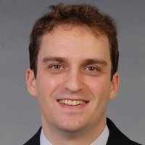
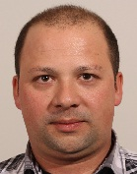

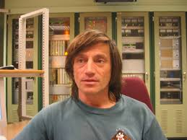
New people at ISOLDE (Operation team)
Eleftherios Fadakis
Jose Alberto Rodriguez Rodriguez
Arriving in June/July
Miguel Lozano Benito
Emanuele Matli
Erwin Siesling
Pascal Fernier. No more shifts!

Slide 10
Safety. New risks at ISOLDE
-New equipment ,new risks analysis and safety requirements.
-Cryo systems. First time at ISOLDE.
-Longer and more complex LINAC tunnel. New interlocks and more complex
setup of the machine.
-New evacuation plans due to new layout and new risks. More evacuation
exercises will take place during the year.

Slide 11
Other challenges for this year
-Negative ions at ISOLDE. At ,Po , Cl.
-New Molten metal target based on Pb-Bi.
-MEDICIS.

Slide 12

MANY THANKS FOR YOUR ATTENTION
QUESTIONS ?

