Slide 1

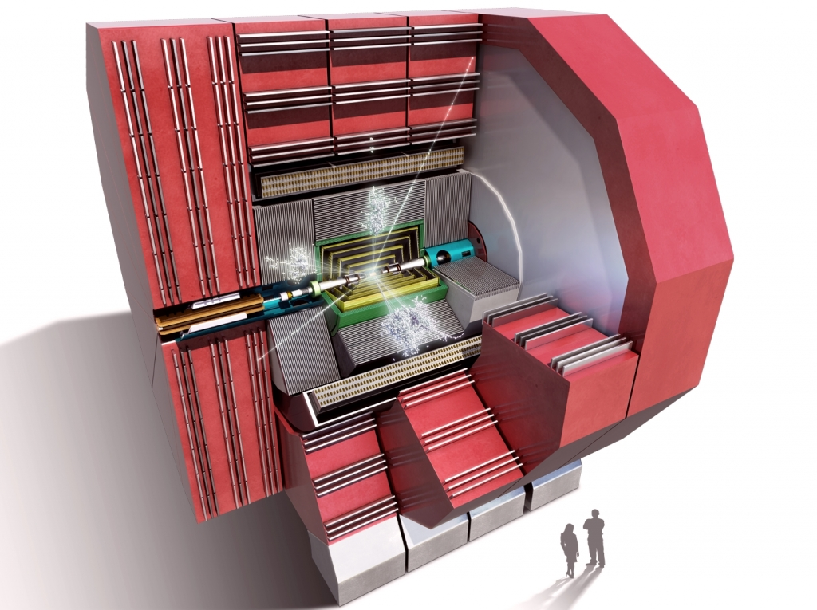
Detectors for Future Linear Colliders
Lucie Linssen, CERN
Intro to Boston students, February 5th 2015

Slide 2
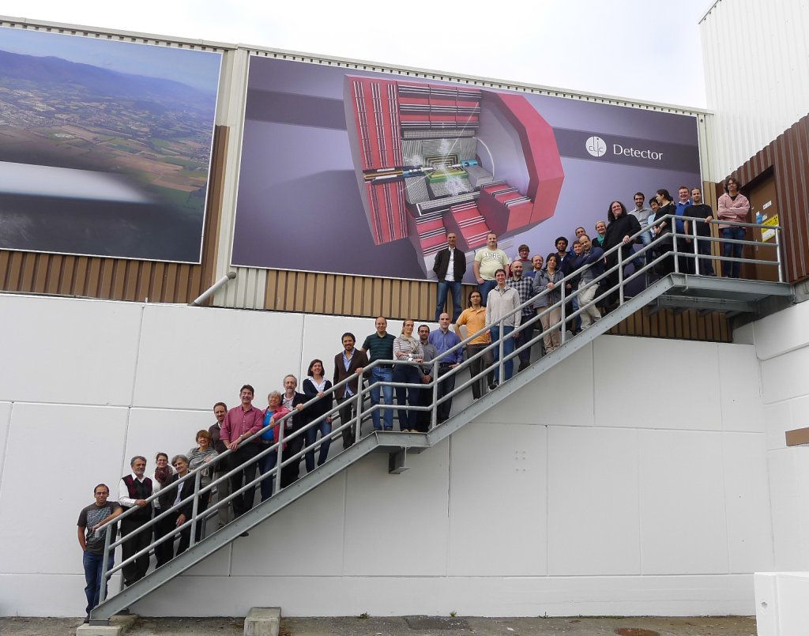
Introduction

Slide 3
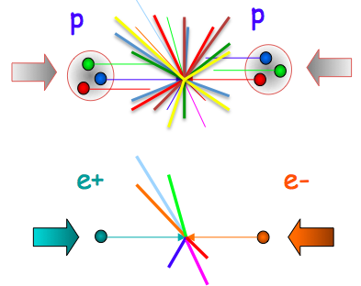
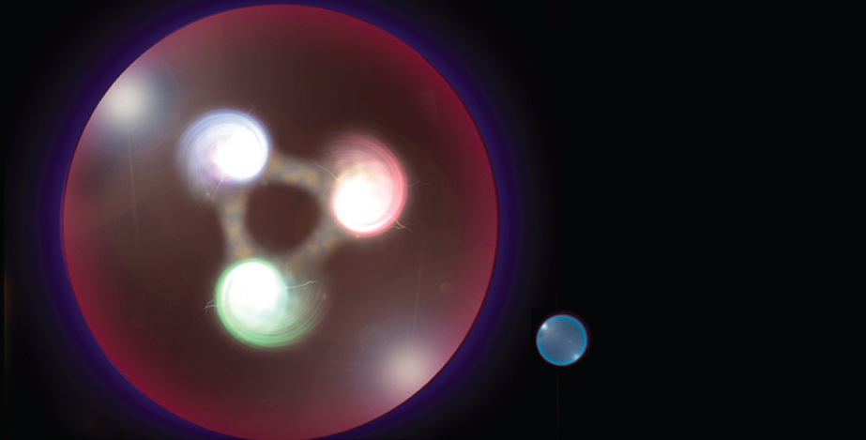

from discovery to precision
LHC
proton
electron
positron
CLIC
p-p collisions | e⁺e⁻ collisions
Proton is compound object Initial state not known event-by-event Limits achievable precision | e⁺/e⁻ are point-like Initial state well defined (√s / polarisation) High-precision measurements
High rates of QCD backgrounds Complex triggering schemes High levels of radiation | Cleaner experimental environment trigger-less readout Low radiation levels
High cross-sections for colored-states | Superior sensitivity for electro-weak states
Notes:
While the LHC is a perfect discovery machine, and reaches already a remarkable precision for the studies, a different type of accelerator can even do better.
This is because the LHC collides protons, which are composite particles. When you collide electrons with their antimatter twins positrons, this opens the door for much higher precision in the physics analysis.

Slide 4
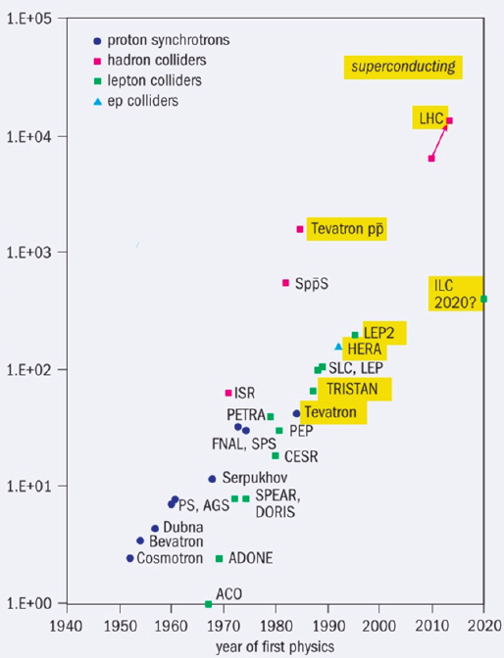
history of proton and electron colliders
100 TeV
pp and e⁺e⁻ provide
complementary
information
⬇
particle physics needs both !
10 TeV
proton collider
electron collider
energy
1 TeV
100 GeV
historically,
electron colliders
lag behind in energy
(see later in this talk)
10 GeV
starting
year
1 GeV
1940 1960 1980 2000 2020

Slide 5
circular or linear collider ?
accelerating cavities
proton mass
electron mass
≈ 2000
N
N
Circular Collider
S
S
Synchrotron radiation
Energy⁴/Mass⁴Radius
many magnets, few accelerating cavities
beam circulates for a long time (at 11000 turns/sec in LHC)
high energy → strong magnets needed more synchrotron radiation loss
Linear Collider
source
main linac
few magnets, many accelerating cavities
beam passes only once
high energy → high accelerating gradient needed
high luminosity → high beam power (high bunch repetition)

Slide 6
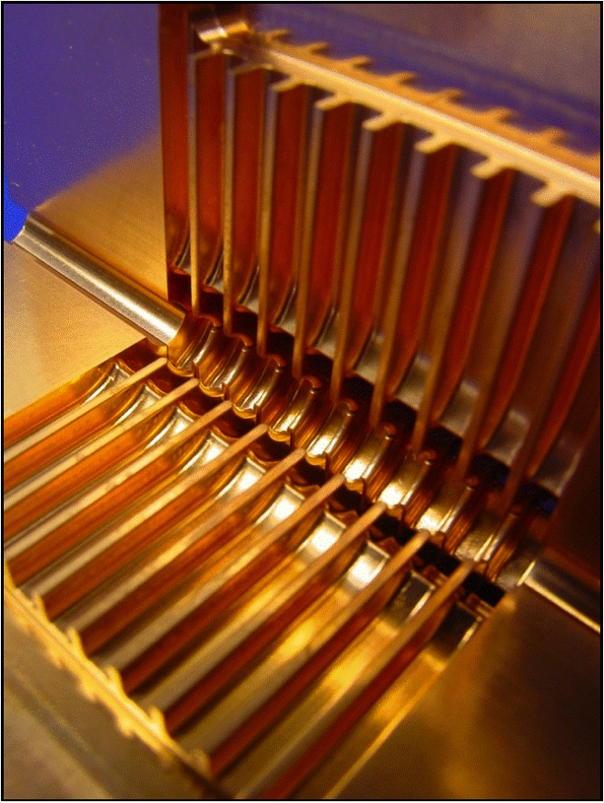
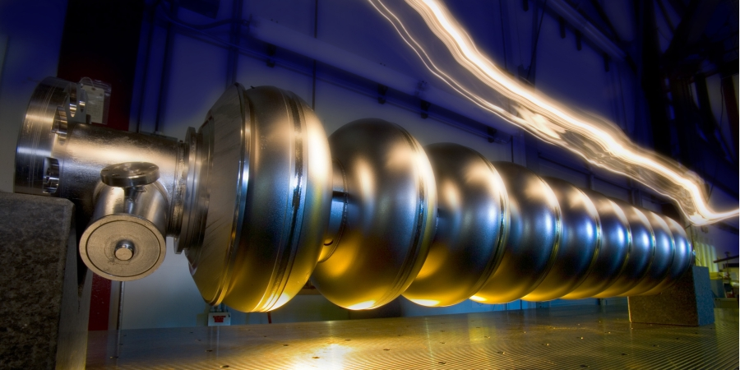
ILC and CLIC in just a few words
CLIC
Linear e⁺e⁻ colliders
Luminosities: few 10³⁴ cm⁻²s⁻¹
ILC
2-beam acceleration scheme,
at room temperature
Gradient 100 MV/m
√s up to 3 TeV
Physics + Detector studies
for 350 GeV - 3 TeV
Superconducting RF cavities
Gradient 32 MV/m
√s ≤ 500 GeV (1 TeV upgrade option)
Focus on ≤ 500 GeV, physics studies also for 1 TeV

Slide 7
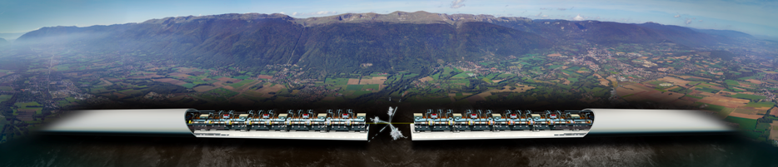
the CLIC accelerator

Slide 8
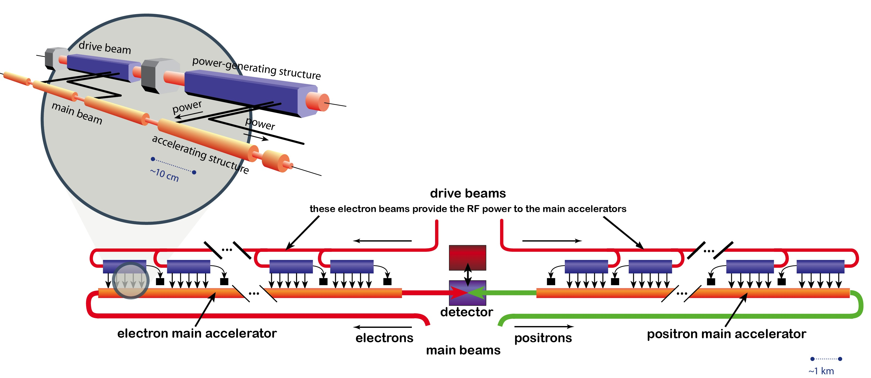
CLIC two-beam acceleration scheme
Two Beam Scheme:
Drive Beam supplies RF power
12 GHz bunch structure
low energy (2.4 GeV - 240 MeV)
high current (100A)
Main beam for physics
high energy (9 GeV – 1.5 TeV)
current 1.2 A
Accelerating gradient: 100 MV/m

Slide 9
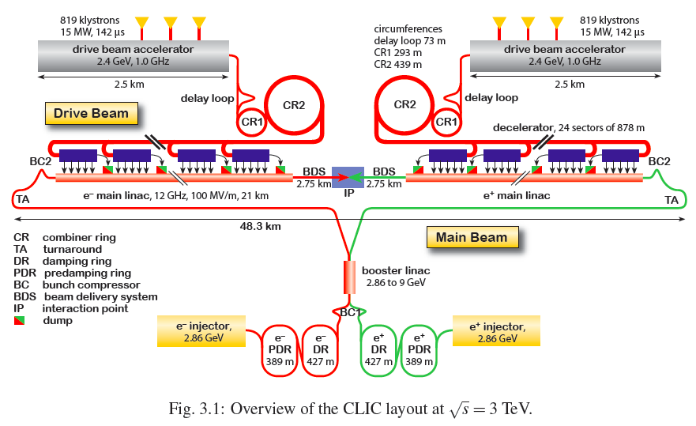
CLIC layout at 3 TeV

Slide 10
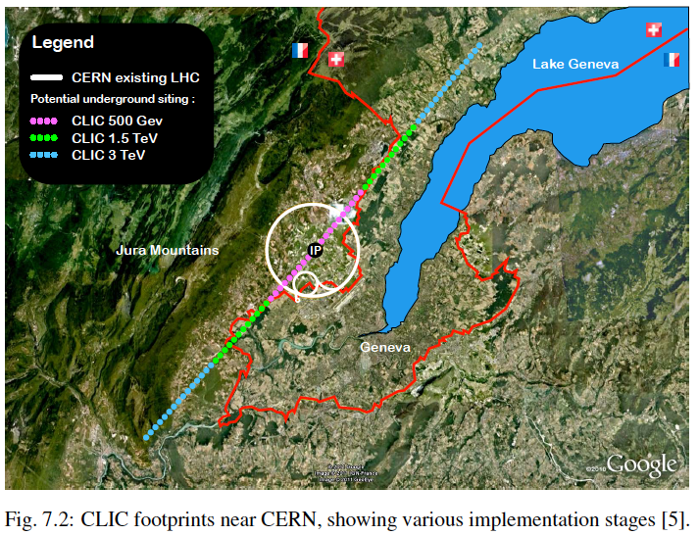
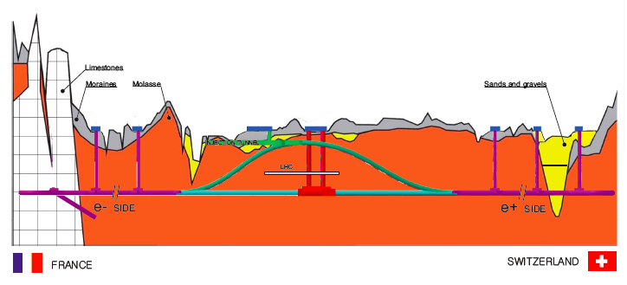
CLIC staged implementation
Collision energy (GeV) | Site length (km) | Luminosity (cm⁻²s⁻¹) | # Higgs events in ~4 yrs
350 | 11 | 1.5×10³⁴ | 90000
1500 | 27 | 3.5×10³⁴ | 430000
3000 | 48 | 6×10³⁴ | 920000
staged operation
⬇
optimal for physics
Note: #Higgs is without enhancement from polarisation
~100 m depth near collision point

Slide 11
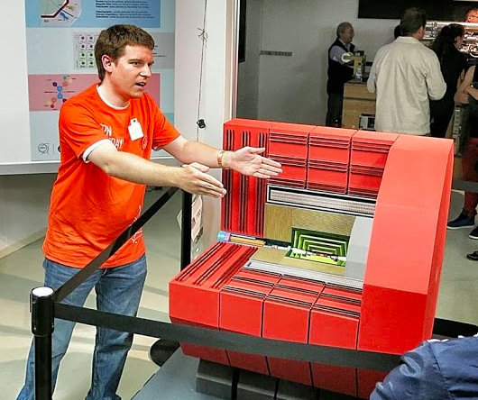
a detector for CLIC

Slide 12
particle detection (1)
Particles make small changes in the material they traverse
  ionisation, atomic effects, nuclear effect <= all very small !
Particles differ in the way they interact with material
  We can use it to identify particle types !
calorimeters
tracker
EM
hadronic
muon detector
photon γ
electron e±
muon μ±
proton p± / pion π±
neutron n
magnetic
field
neutrino ν
passive/active sandwich structures
very light !
very heavy !

Slide 13
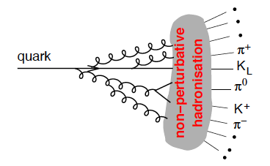
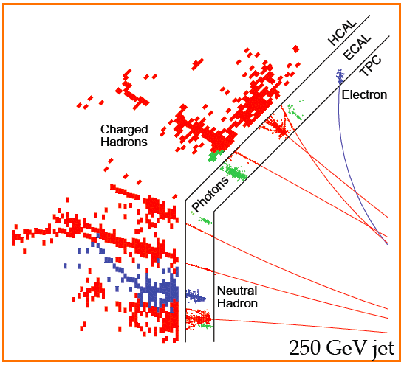
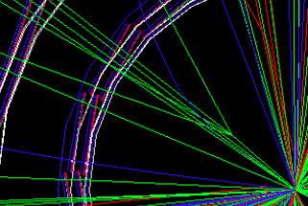
particle detection (2)
Many of the elementary particles we know have very short life times
W, Z, Higgs (!) and many more
We only see the products of their decay
quarks cannot be observed, as they hadronise in to “jets” of particles
jet
Secondary vertex, sign of b-quark
~5
mm
reconstructing the original particles
from the visible decay products
=> key ingredient of particle detection
~1.5 m

Slide 14
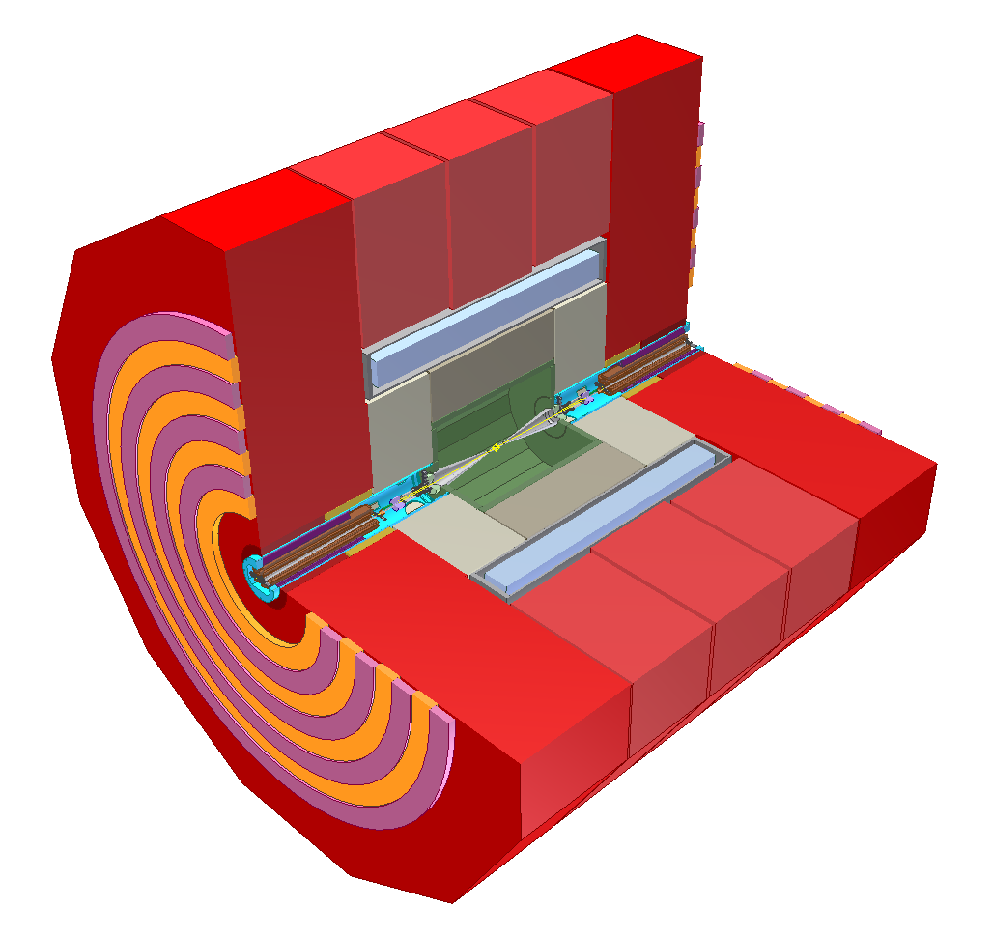
CLIC detector concept (2014)
Combining high precision + beam conditions at CLIC
return yoke (Fe) with detectors
for muon identification
complex forward region with final beam focusing
e⁻
strong solenoid
magnet, 4 Tesla
fine grained (PFA) calorimetry, 1 + 7.5 Λ_{i},
e⁺
6.5 m
main tracker, silicon-based (large pixels and strips)
ultra low-mass
vertex detector
with ~25 μm pixels

Slide 15
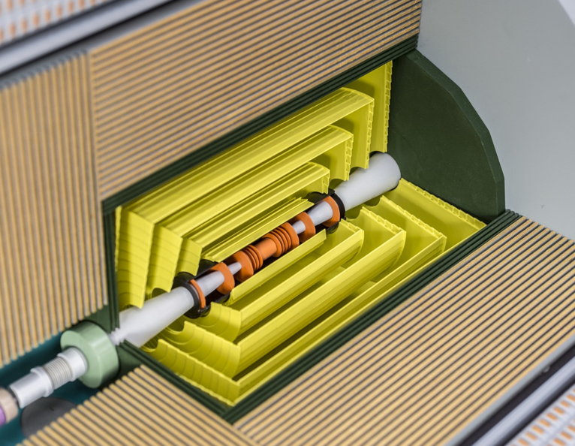
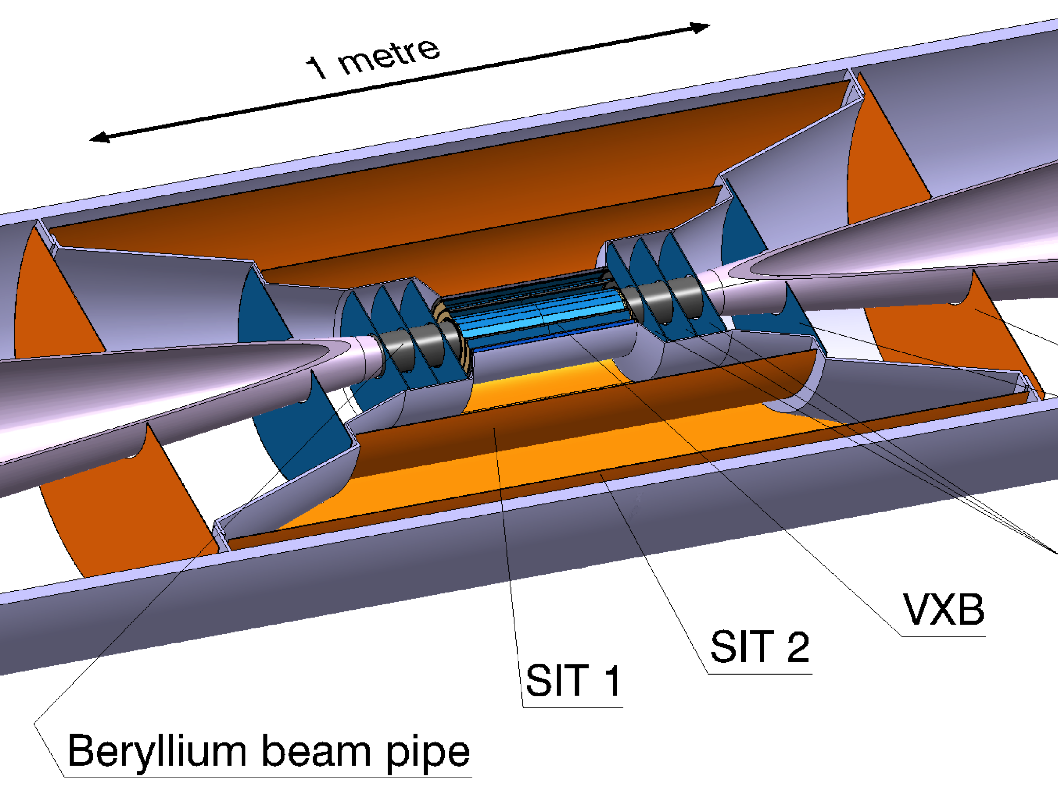
Pixel detector
pixel
detector
Flavour tagging capabilities drive the design of the pixel detector
has to be extremely accurate and light !
(calorimeter)
tracker
2 billion pixels
3 μm single point accuracy
25*25 μm² pixels (25 times smaller pixel area than at LHC)
  Pulse height measurement
  Time measurement to 10 ns
Ultra-light => 0.2%X₀ per layer
  Very thin materials/sensors
  Low-power design, power pulsing, air cooling
  Aim: 50 mW/cm²
  Radiation level 10⁴ lower than LHC
1 m
high-tech R&D
covering several disciplines

Slide 16
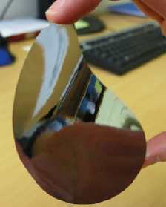
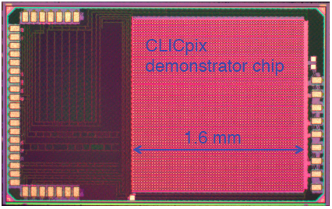
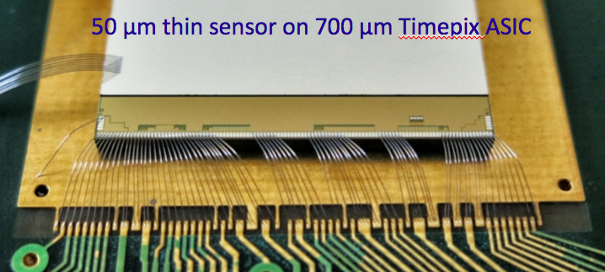
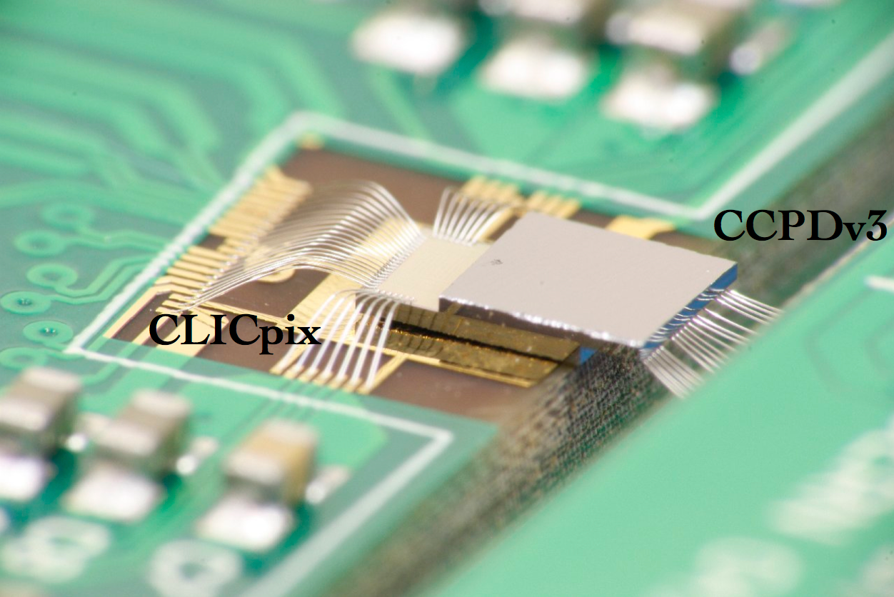
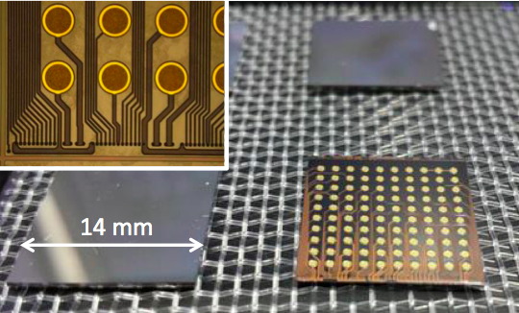
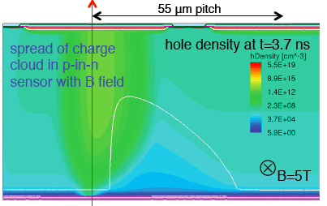
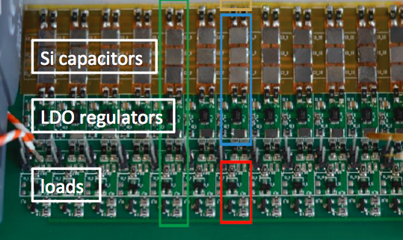
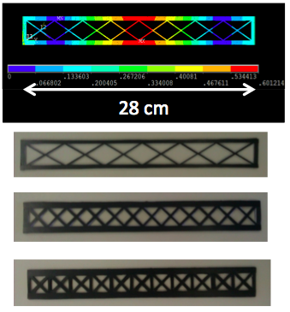
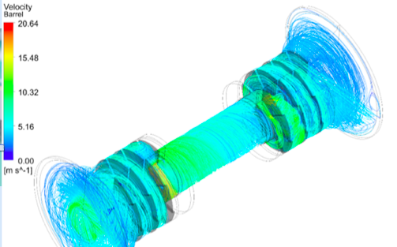
pixel detector R&D
thin silicon sensor
electronics chip (65 nm)
thin electronics + sensor assembly
HV-CMOS sensor + CLICpix
interconnect technology
signal simulations
power delivery + pulsing
thin supports
air cooling simulations/tests

Slide 17
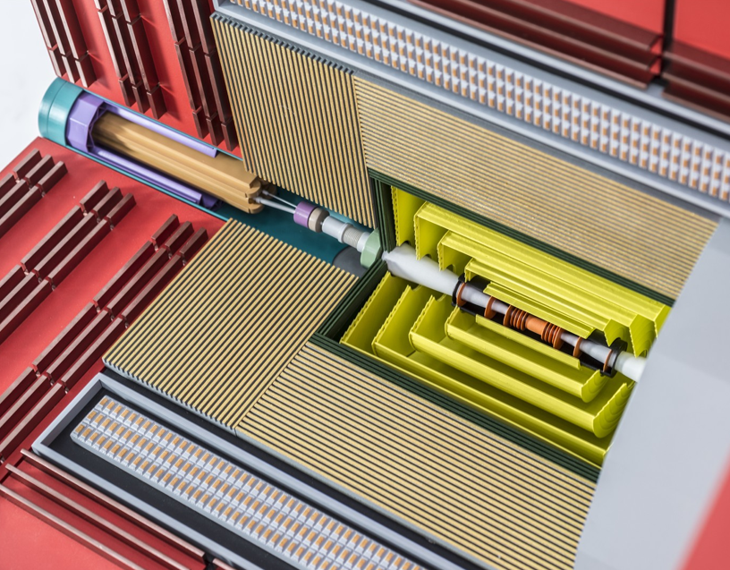
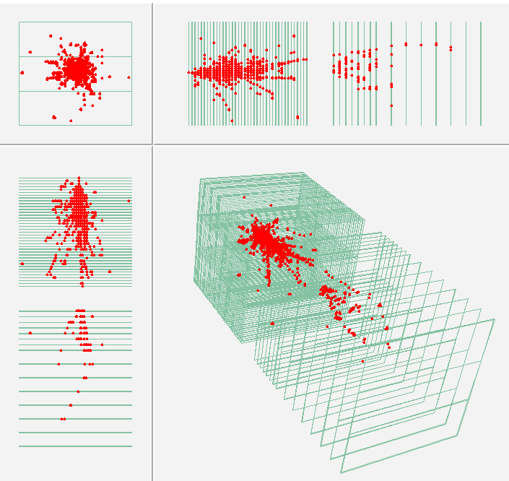
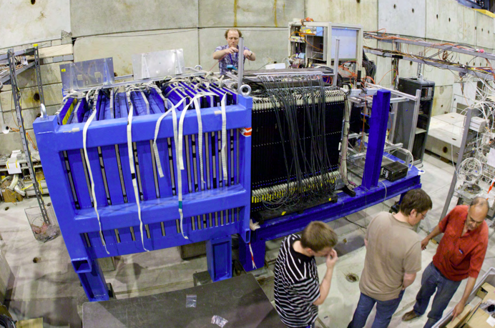
detector technology => “very heavy”
magnet coil
muon
detector
calorimeters
“electromagnetic + hadronic”
particles interact with heavy material => showers
make a sandwich ~60 layers
heavy absorbers + fine-grained detectors
extremely heavy and compact
80 million readout channels (400* larger than LHC)
calorimeter
1.5 m
tungsten analog HCAL
π⁻ at 210 GeV in tungsten-DHCAL

Slide 18
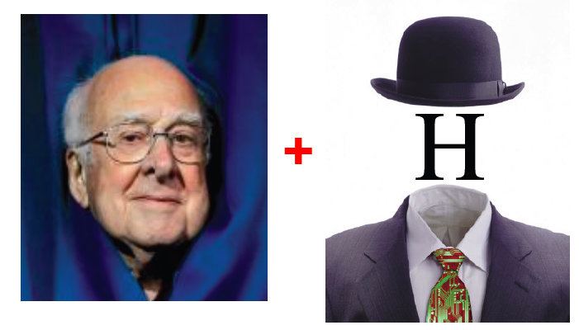

Snapshot of physics at CLIC

Slide 19
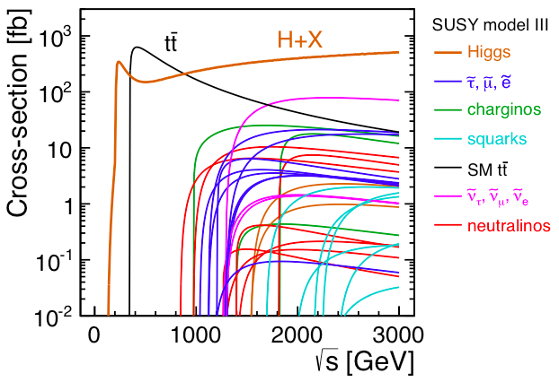
CLIC physics programme…
CLIC: e⁺e⁻ collider, staged approach
350 – 375 GeV, 500 fb⁻¹ : precision Higgs and top physics
~1.4 TeV, 1.5 ab⁻¹ : targeted at BSM physics, precision Higgs
~ 3 TeV, 2 ab⁻¹ : targeted at BSM physics, precision Higgs
Exact energies of TeV stages will depend on LHC results
Example of energy staging
(with an example SUSY model)
sparticles in SUSY example scenario
(not excluded by LHC results)

Slide 20
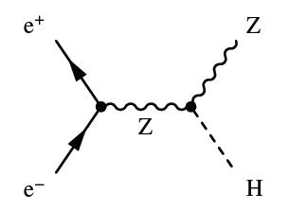
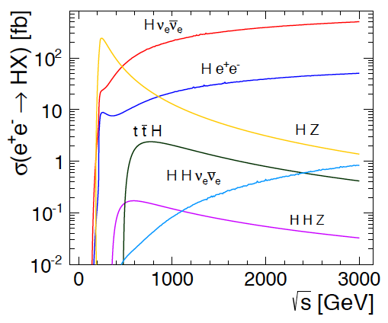
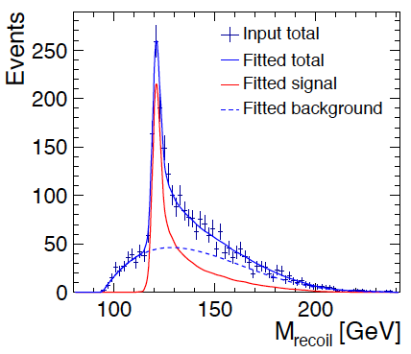
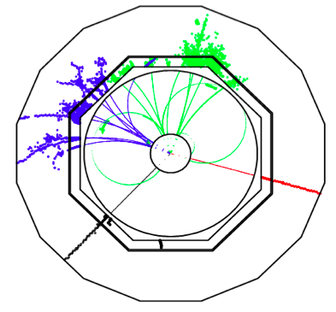
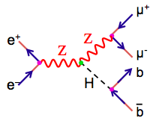
Higgs physics (1)
Higgs production at CLIC
Very clean process
Can “see” Higgs by
looking at Z only !
probability
Model-independent Higgs measurement !
can also “see” invisible Higgs decays: <1% accuracy
energy
b
b
Z => μμ recoil
350 GeV
500 fb⁻¹
μ⁺
μ⁻

Slide 21
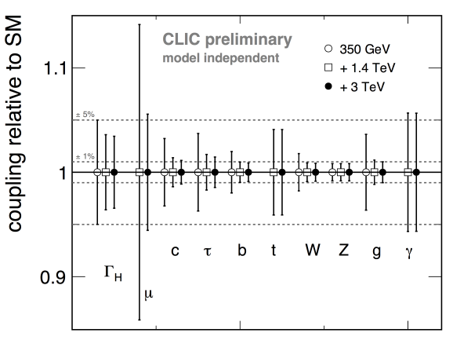
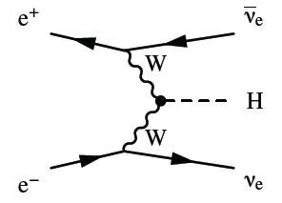
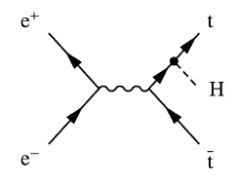
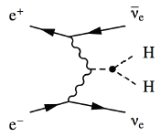
Higgs coupling to mass
combining all
Higgs information
production
+
decay
model independent
much more accurate than HL-LHC
Note: contrary to (HL-)LHC, CLIC results are model-independent
similar accuracy as HL-LHC
Higgs self-coupling H=> HH
Gives access to understanding the Higgs field
Requires high energies => coupling g_{HHH} to 24% at 1.4 TeV, 10% at +3 TeV

Slide 22
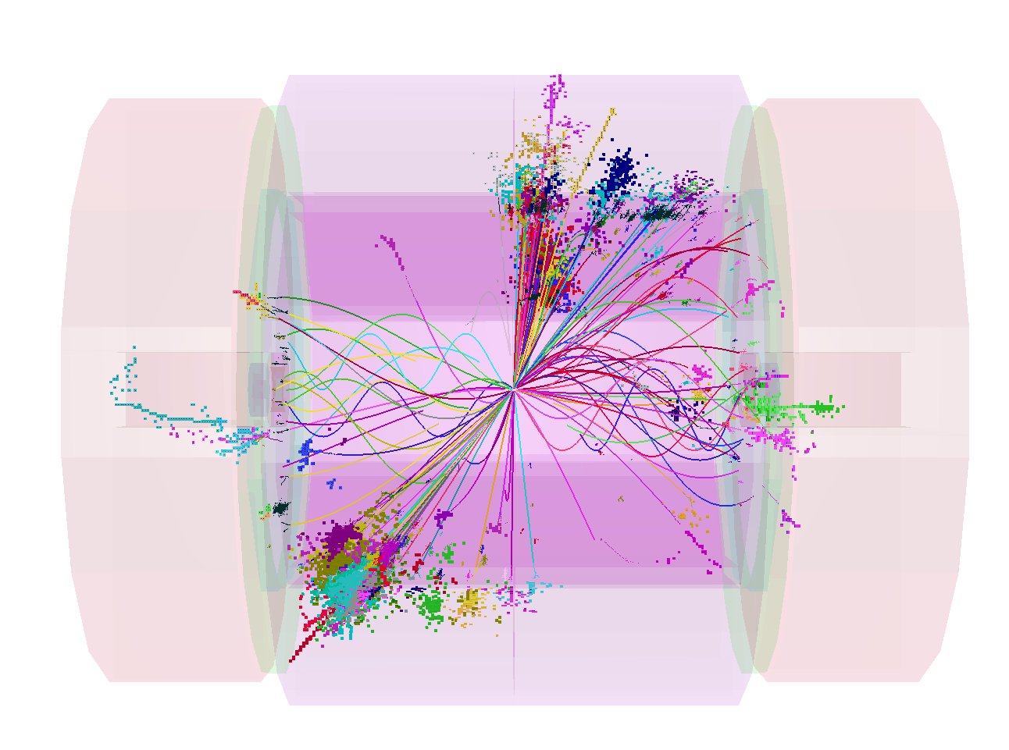
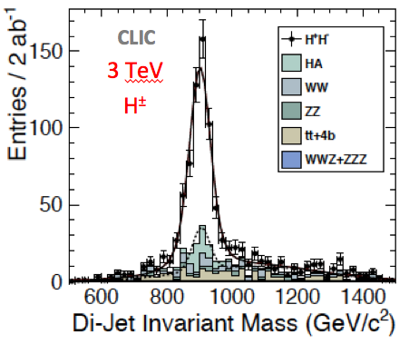
snapshot of other physics at CLIC
CLIC physics potential:
Accurate measurement of known physics:
  Higgs
  Top quark
Searching for New Physics:
  Direct searches
  Indirect searches
top mass
threshold scan
near 350 GeV
Δm < 100 MeV
Δm/m = 0.3%
Additional
heavy Higgs

Slide 23
  How to contribute

Slide 24
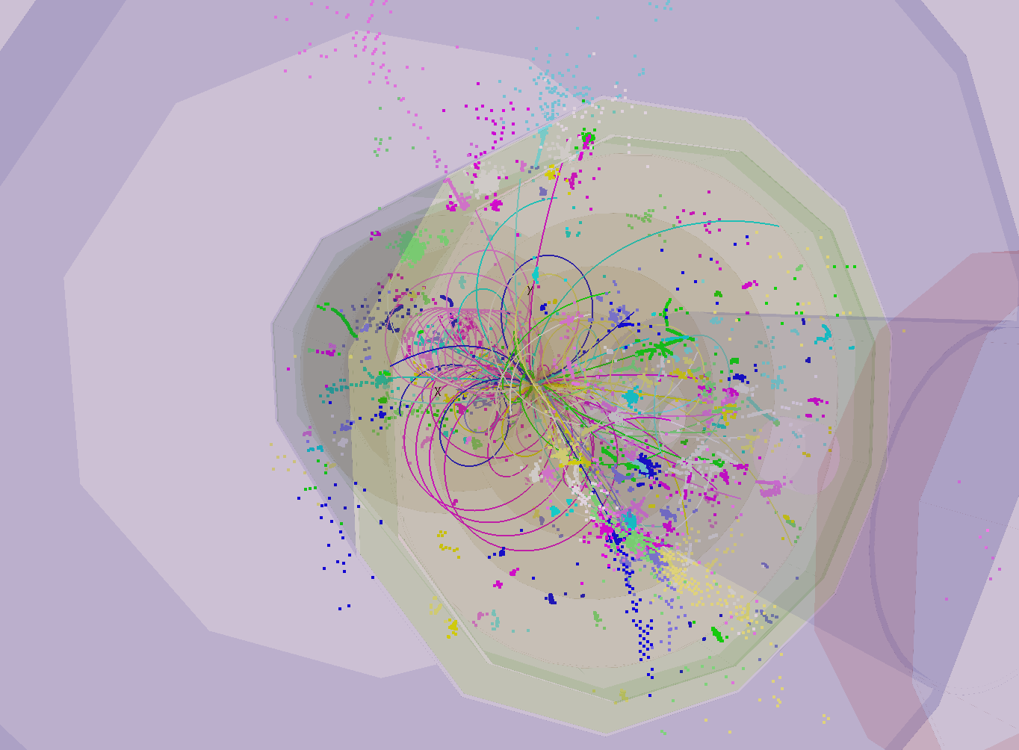
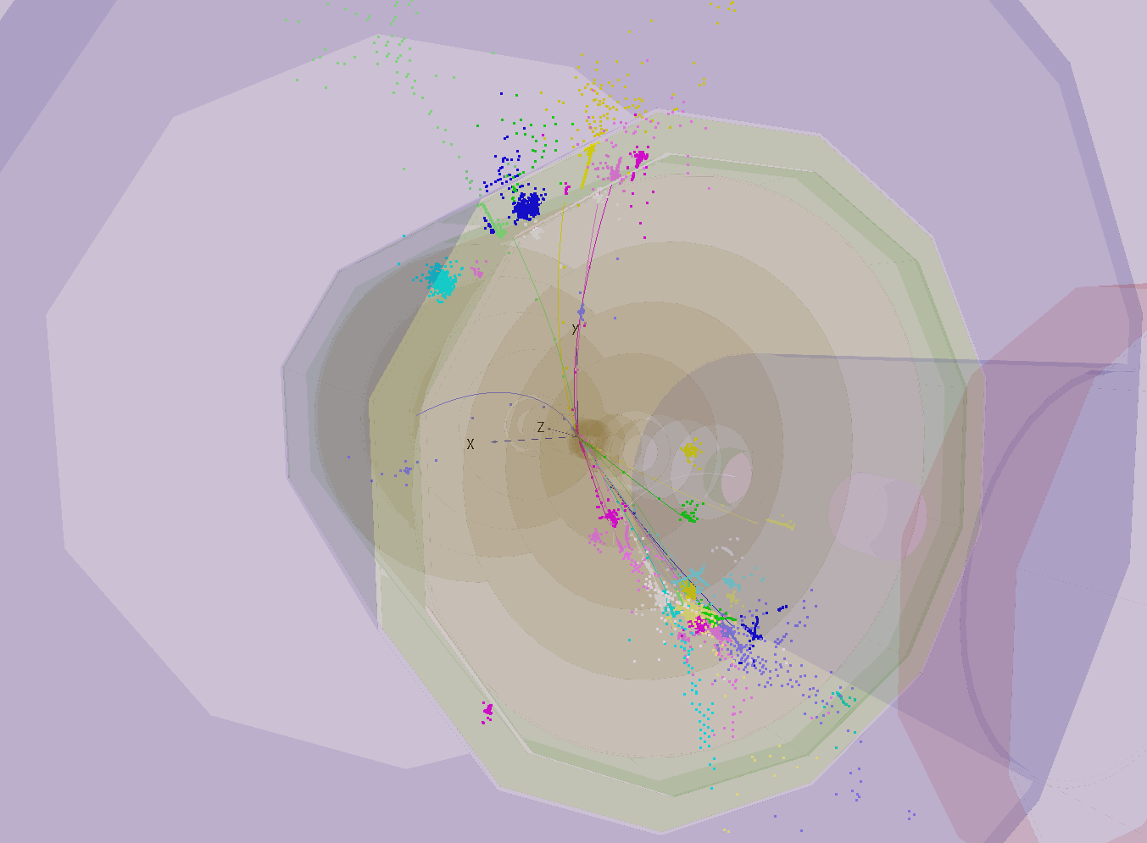
Possible participation in Linear Collider Detector project
Physics
Mechanical engineering
Electronics engineering
Projects:
Vertex (pixel) detector R&D
test beam analysis, laboratory tests, engineering
Calorimeter R&D
laboratory tests (optical)
Detector optimisation
simulation of detector layout variants
Physics benchmarking
simulation and analysis
Welcome to join!
  http://clicdp.web.cern.ch/
-
-
-
e⁺e⁻ ➔ Hνν ➔ Zγνν

Slide 25
SPARE
SLIDES

Slide 26
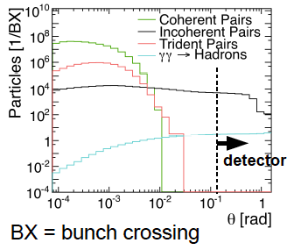
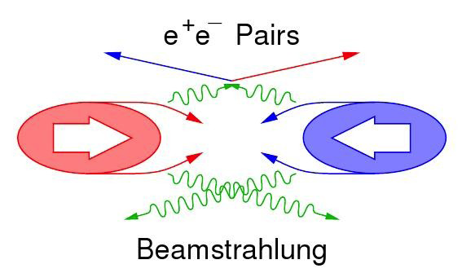
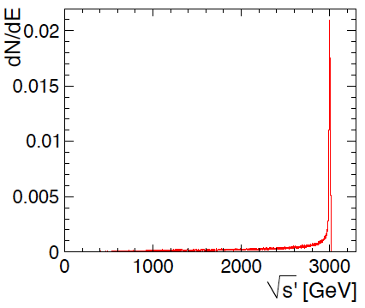
CLIC machine environment
CLIC machine environment
Beam-beam background at IP:
Small beams => very high E-fields
  Beamstrahlung
    Pair-background
      High occupancies
    γγ to hadrons
      Energy deposits
    (19TeV/train @ √s 3TeV)
Beamstrahlung ➔ important energy losses
right at the interaction point
E.g. full luminosity at 3 TeV:
5.9 × 10³⁴ cm⁻²s⁻¹
Of which in the 1% most energetic part:
2.0 × 10³⁴ cm⁻²s⁻¹
Most physics processes are studied well above production threshold => profit from full luminosity
3 TeV
√s
energy spectrum

Slide 27
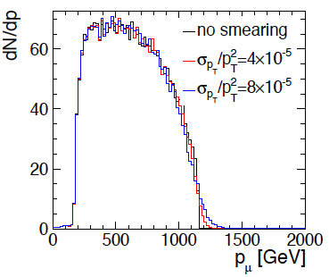




CLIC physics aims => detector needs
momentum resolution:
e.g. Smuon endpoint
Higgs recoil mass, Higgs coupling to muons
smuon
end point
jet energy resolution:
e.g. W/Z/h di-jet mass separation
(for high-E jets)
impact parameter resolution:
e.g. c/b-tagging, Higgs BR
W-Z
jet reco
angular coverage, very forward electron tagging
+ requirements from CLIC beam structure and beam-induced background

Slide 28
CLIC experimental conditions
 | CLIC at 3 TeV
L (cm⁻²s⁻¹) | 5.9×10³⁴
BX separation | 0.5 ns
#BX / train | 312
Train duration (ns) | 156
Rep. rate | 50 Hz
Duty cycle | 0.00078%
σ_{x} / σ_{y} (nm) | ≈ 45 / 1
σ_{z} (μm) | 44
Drives timing
requirements
for CLIC detector
very small beam size
156 ns
20 ms
CLIC
1 train = 312 bunches, 0.5 ns apart
- not to scale -

Slide 29

CLIC conditions => impact on detector
CLIC conditions => impact on detector technologies:
High tracker occupancies => need small cell sizes
(beyond what is needed for resolution)
    Small vertex pixels
    Large pixels / short strips in the tracker
Bkg suppression => need high-granularity calorimetry
Bkg suppression => overall need for precise hit timing
    ~10 ns hit time-stamping in tracking
    1 ns accuracy for calorimeter hits
Low duty cycle
    Triggerless readout
    Allows for power pulsing
      => less mass and high precision in tracking
      => high density for calorimetry

Slide 30
comparison CLIC ⬄ LHC detector
In a nutshell:
CLIC detector:
High precision:
  Jet energy resolution
    => fine-grained calorimetry
  Momentum resolution
  Impact parameter resolution
Overlapping beam-induced background:
  High background rates, medium energies
  High occupancies
  Cannot use vertex separation
  Need very precise timing (1ns, 10ns)
“No” issue of radiation damage (10⁻⁴ LHC)
  Except small forward calorimeters
Beam crossings “sporadic”
No trigger, read-out of full 156 ns train
LHC detector:
Medium-high precision:
  Very precise ECAL (CMS)
  Very precise muon tracking (ATLAS)
Overlapping minimum-bias events:
  High background rates, high energies
  High occupancies
  Can use vertex separation in z
  Need precise time-stamping (25 ns)
Severe challenge of radiation damage
Continuous beam crossings
Trigger has to achieve huge data reduction

Slide 31



-
-
-
e⁺e⁻ ➔ Hνν ➔ bbνν
CLIC 1.4 TeV
same event before cuts on beam-induced background

Slide 32



-
-
-
-
-
e⁺e⁻ ➔ ttH ➔ WbWbH ➔ qqb τνb bb
CLIC 1.4 TeV
same event before cuts on beam-induced background

Slide 33



CLIC vertex detector R&D roadmap
Hybrid approach pursued: (<= other options possible)
Thin (~50 μm) silicon sensors
Thinned high-density readout ASIC (50 μm)
  R&D within Medipix/Timepix effort
Low-mass interconnect
Power pulsing
Air cooling
CLICpix demonstrator ASIC
64×64 pixels, fully functional
65 nm technology
25×25 μm² pixels
4-bit ToA and ToT info
Data compression
Pulsed power: 50 mW/cm²
64×64 pixels
Very thin sensors !
Successfully tested at DESY test beam
(with existing Timepix ASIC)
1.6 mm

Slide 34



Hybrid vertex detector with HV-CMOS
Pursuing an alternative readout option
Hybrid option with HV-CMOS:
Capacitive Coupled Pixel Detector (CCPD)
HV-CMOS chip as integrated sensor + amplifier
Capacitive coupling to CLICpix readout chip
through layer of glue => no bump bonding
Status: successful initial beam tests in 2014
Further beam tests in 2015
HV-CMOS + CLICpix, AC coupled
CCPDV3

Slide 35


Vertex detector optimisation
Work in progress !
Using flavour tagging as a gauge
Test single vs. double layers
More realistic material (0.2% X0/layer)
Vary inner radius (for 4 T or 5 T B-field)
Spiral disks
Single layers
Spiral disks
double layers
Single layers / double layers
0.1% X₀/layer / 0.2%X₀/layer
Inner radius 27 mm / 31 mm
1.
2.
3.
single layer better
double layer better
more material better
larger inner radius better

Slide 36

Main silicon tracker
7 μm single point accuracy
time-stamping 10 ns
~5-6 tracking layers
Radius ~1.5 m, half-length ~2.3 m
High occupancies in certain regions:
Need for large pixels and/or short-strips
Very light => ~1%X₀ per layer
  Requires very thin materials/sensors
  => compatible with charge sharing and 7μm accuracy?
  Power pulsing (?)
  Is air cooling feasible in a large tracker volume?
  Radiation level 10⁴ lower than LHC
all-silicon tracker optimisation ongoing
+
now starting a tracker hardware R&D

Slide 37


calorimetry and PFA
Jet energy resolution and background rejection drive the overall detector design
=> => fine-grained calorimetry + Particle Flow Analysis (PFA)
What is PFA?
Typical jet composition:
60% charged particles
30% photons
10% neutral hadrons
⬇
Always use the best info you have:
60% => tracker
30% => ECAL
10% => HCAL
Hardware + software !

Slide 38



PFA calorimetry at CLIC
Technology (CDR)
simulated jet energy resolution
ECAL
Silicon (active) + Tungsten (absorber)
cell sizes ~25 mm²
30 layers in depth (~23 X₀)
HCAL
Scintillator+SiPM (active)
Tungsten (barrel), steel (endcap)
cell sizes 9 cm² (analog)
75/60 layers in depth
Total depth 7.5 Λ_{i}
(no jet clustering, no background overlay)
CALICE collaboration
http://fcal.desy.de/
many technologies pursued

Slide 39



Forward calorimetry
2 forward calorimeters: Lumical + Beamcal
Electron / photon acceptance to small angles
Luminosity measurement
Beam feedback
Absorbers: tungsten, 40 layers of 1 X₀
Sensors: BeamCal GaAs, LumiCal silicon
Angular coverage:
BeamCal 10 - 40 mrad, LumiCal 38 – 110 mrad
Doses up to 1 Mgy
Neutron fluxes of up to 10¹⁴ per year
BeamCal
LumiCal
Very compact !
FCAL collaboration
http://fcal.desy.de/
LumiCal
30 cm

Slide 40

CLIC detector optimisation
towards one CLIC detector model by mid 2015
include lessons learnt so far
include experience from hardware R&D
Already agreed working hypotheses:
Vertex: double layers
Vertex: spiraling disks
Tracker: all silicon
Tracker: radius 1.5 m, half-length 2.3 m
ECAL: 25 layers, 5×5 mm² cell sizes
HCAL: steel absorbers
Solenoid field: 4 Tesla
Ongoing assessments:
Tracker layout and technology options
HCAL: cells sizes
Enhanced forward calo coverage
QD0 in detector or in tunnel
……..
In parallel:
Major improvements of simulation and reconstruction software
With new geometry description (DD4hep) and new track reconstruction
Some examples in the following slides

Slide 41

CLIC strategy and objectives
2013-18 Development Phase
Develop a Project Plan for a staged implementation in agreement with LHC findings; further technical developments with industry, performance studies for accelerator parts and systems, as well as for detectors.
4-5 year Preparation Phase
Finalise implementation parameters, Drive Beam Facility and other system verifications, site authorisation and preparation for industrial procurement.
Prepare detailed Technical Proposals for the detector-systems.
Construction Phase
Stage 1 construction of CLIC, in parallel with detector construction.
Preparation for implementation of further stages.
2018-19 Decisions
On the basis of LHC data
and Project Plans (for CLIC and other potential projects), take decisions about next project(s) at the Energy Frontier.
2024-25 Construction Start
Ready for full construction
and main tunnel excavation.
Commissioning
Becoming ready for data-taking as the LHC programme reaches completion.

Slide 42



European Strategy statements
=> 2006/2013 CLIC-related statements
2006 statement “4”:
pp or e⁺e⁻
 at high-energy frontier
2013 statement “d”:

Slide 43

timeline: (HL-)LHC and future collider options

