Slide 1
The GridPP DIRAC project
DIRAC for non-LHC communities

Slide 2
Overview
GridPP is a collaboration of particle physicists and computer scientists originally proposed to support the LHC experiments but it now non LHC experiments and researchers from other disciplines.
LHC experiments have moved or are moving away from EMI WMS. DIRAC is being considered as a replacement for EMI WMS
DIRAC also offers a file catalog – possible replacement for the LFC still widely used by small VOs.
We have set up and are maintaining a DIRAC instance at Imperial College London.

Slide 3
Supported VOs
The first installation was done in April 2013. We are currently supporting following VOs:
na62.vo.gridpp.ac.uk
t2k.org
snoplus
cernatschool.org
comet.j-parc.jp
pheno
northgrid
londongrid
gridpp

Slide 4
DIRAC services
Dirac offers many services, some of them are particularly attractive for small VOs:
WMS with pilot jobs
DFC – file and metadata catalogue. LFC is just a file catalogue (+ a comment field…)
Synchronous and asynchronous file transfers integrated with the DFC
Can submit jobs to CREAM and ARC CEs and to cloud and VAC sites

Slide 5
NA62 VO and DIRAC
NA62 use the Grid to run their MC jobs.
Output files are to be moved to central Castor storage at CERN and RAL
We have a custom written job submission and monitoring system which allows shifters to distribute jobs over the Grid and monitor their progress.
The submission can be done either to EMI WMS or GridPP DIRAC service
The output files are copied to CERN and RAL using a File Transfer Controller (a Web Service based FTS client). This decouples the MC simulation task from data movement. We are planning to replace this service by DIRAC asynchronous file transfer service (e.g. use dirac-dms-replicate-and-register-request). Need to upgrade DIRAC to allow this.
Also plan to replace the LFC by the DFC.

Slide 6
Cernatschool VO
http://cernatschool.web.cern.ch/
From the website:
“CERN@school is a programme for school students - and driven by school students - that brings technology from CERN into the classroom to inspire the next generation of scientists and engineers”.
They used the GridPP DIRAC instance to implement an example workflow:
Upload a dataset
  Raw data from the CERN@school detectors;
  Add metadata to the dataset using Python API

Slide 7
Cernatschool VO, contd.
Process the dataset on the Grid
  Select data files of interest using metadata query
  Run CERN@school software (distributed via CVMFS) on selected data
  Write output to a selected Storage Element
  Add metadata to the generated data.
Run an analysis on the processed data
  Select data of interest using a metadata query
  Retrieve output from the grid based on the selection
  Work coordinated by Tom Whyntie from QMUL.

Slide 8
DIRAC instance maintenance
Conservative DIRAC version updates to maintain balance between new features and stability
DIRAC registry updated manually:
  defining new users and groups
  Adding new VOs
  adding new sites and activating/deactivating them
  adding site resources (CE, SEs)
We are working on automating this at Imperial (some details later)
We use a mailing list to give support to our users.
Wiki: https://www.gridpp.ac.uk/wiki/Dirac

Slide 9
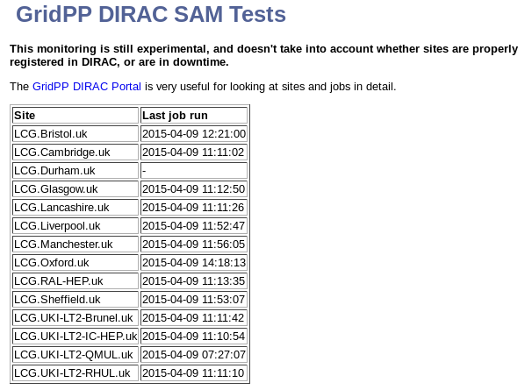
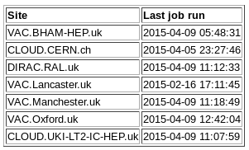
Site Availability Monitoring
We periodically run SAM tests to check if sites are accepting jobs:
Thanks to Andrew McNab
University of Manchester

Slide 10

GridPP DIRAC

Slide 11
Users & Groups Agent
The Users and Groups agent fetches user lists from the VOMS server and adds them to the DIRAC authentication DB.
Multi-VO modifications:
Multiple VOMS Servers (one per VO)
Extended for multiple VOMS Roles -> Group Mappings

Slide 12
AutoBDII2CS Agent
DIRAC base agent searches the BDII for all CE and SE resources and e-mails the admin with any of these that are not yet configured.
Fully Automated Adding of Resources.
Deals with multiple SEs and creates a path mapping section for each one.
Ignores resources matching a set of regular expressions (currently work in progress).

Slide 13
Some problems …
DIRAC can't submit to ARC CEs when gridengine is used because the endpoint contains an extra "/" that the CS can't cope with.
https://github.com/DIRACGrid/DIRAC/issues/2063 [Opened Aug 2014]
A security alert was sent out requesting sites to upgrade to v6r13, however there are no released versions of this available. When will this [Today's production version is: v6r12p35]
Asynchronous file transfers not operational in v6r11p24, v6r12p30? Upgrade broke the WMS (no pilots)

