Slide 1
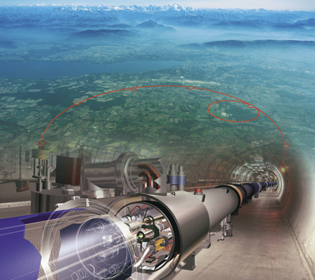

LHC (and ATLAS) Status and Plans
Chicagoland LHC Workshop
University of Illinois (UIUC)
Feb 11, 2015
Mark Neubauer
University of Illinois at Urbana-Champaign

Slide 2




From Dusk Till Dawn…
Run 1 Dusk
Run 2 Dawn
…
Present state
Notes:
Latin for “Make haste slowly”. Proper balance of urgency and diligence

Slide 3
LHC Status / Plans

Slide 4
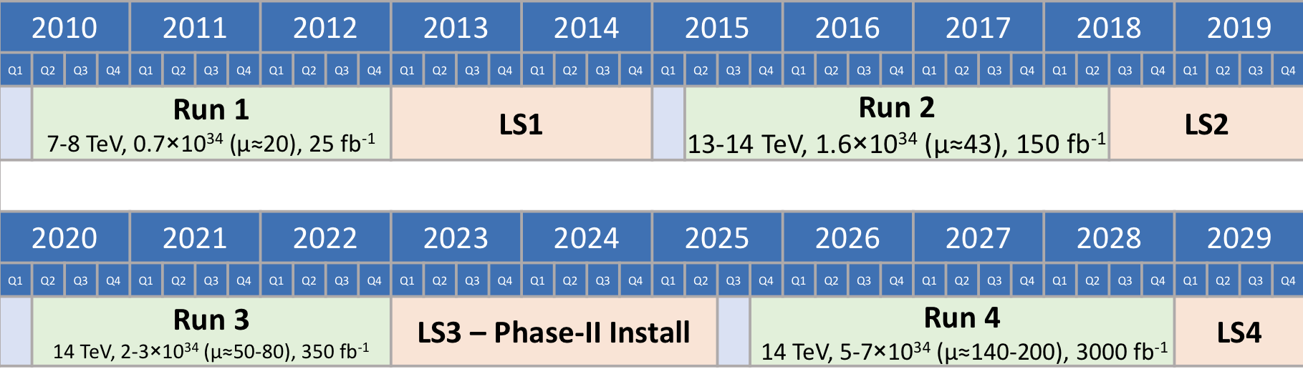
LHC Schedule: The Big Picture
LS = Long Shutdown
Phase-I Install
The HL-LHC running starts in 2025 and continues beyond LS4 until 2035
Notes:
Latin for “Make haste slowly”. Proper balance of urgency and diligence

Slide 5
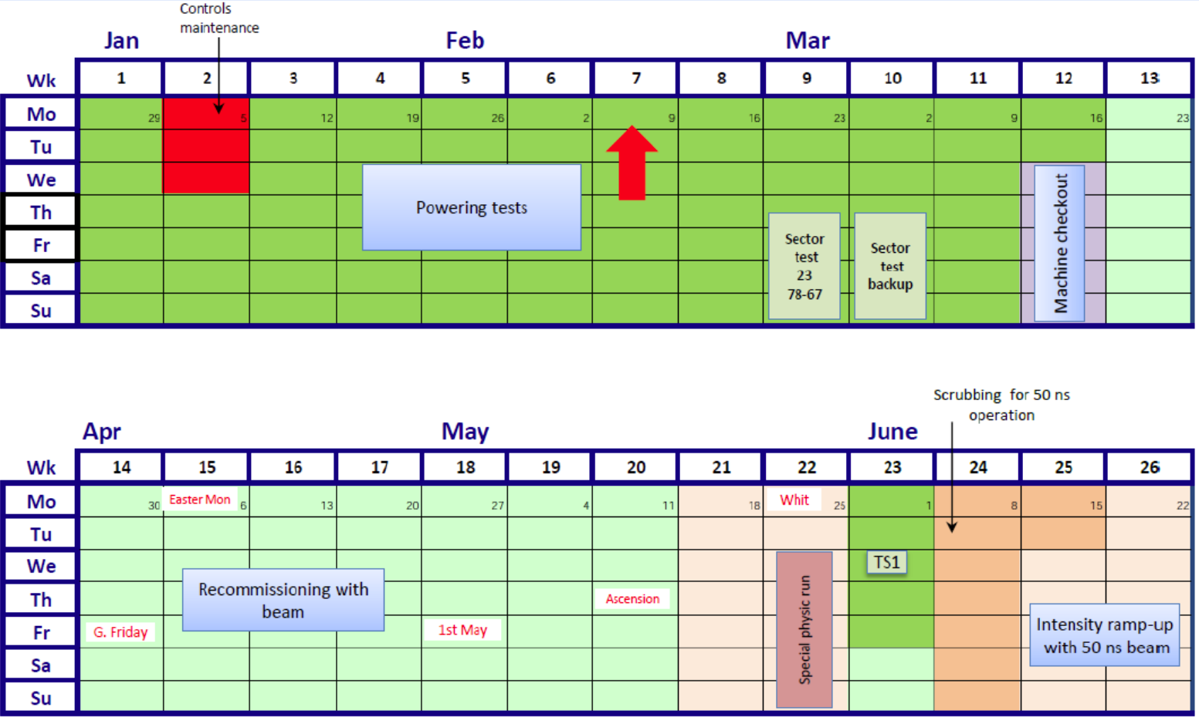
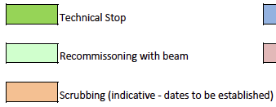

LHC Schedule through 2015
2015 LHC Schedule
2 week slip
Expect 1st beam in the week starting March 23!
Physics
Notes:
Latin for “Make haste slowly”. Proper balance of urgency and diligence

Slide 6
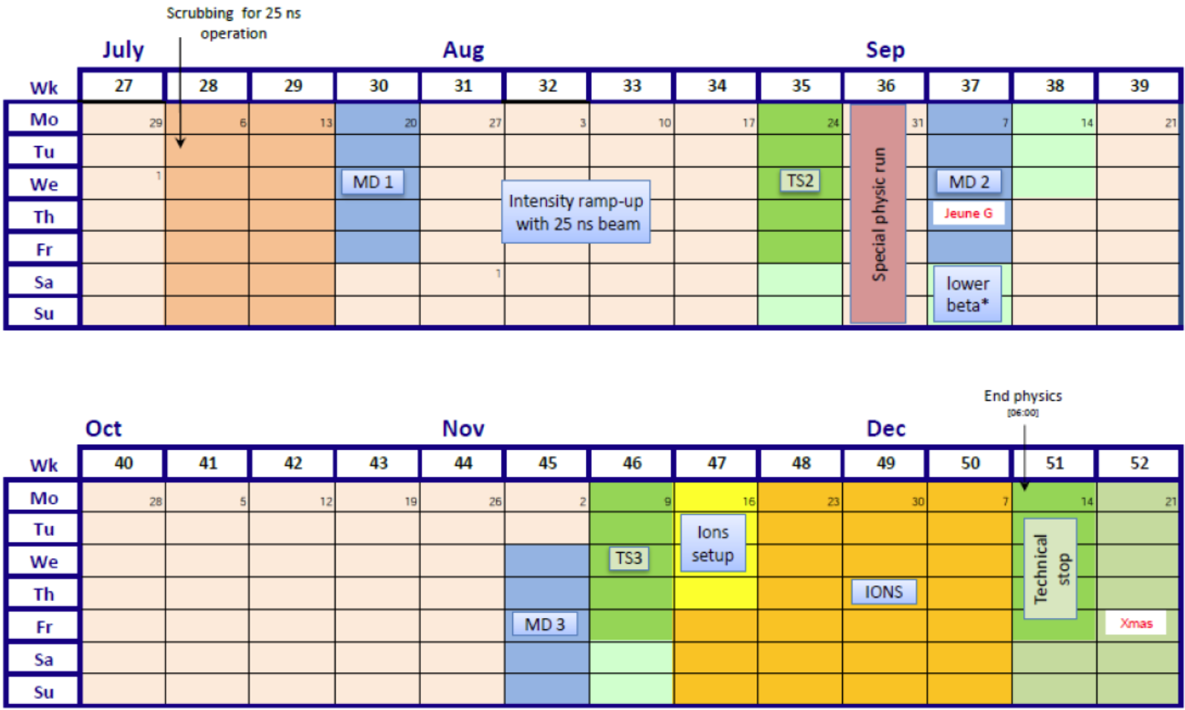
LHC Schedule through 2015
2015 LHC Schedule (cont.)
Physics
Notes:
Latin for “Make haste slowly”. Proper balance of urgency and diligence

Slide 7
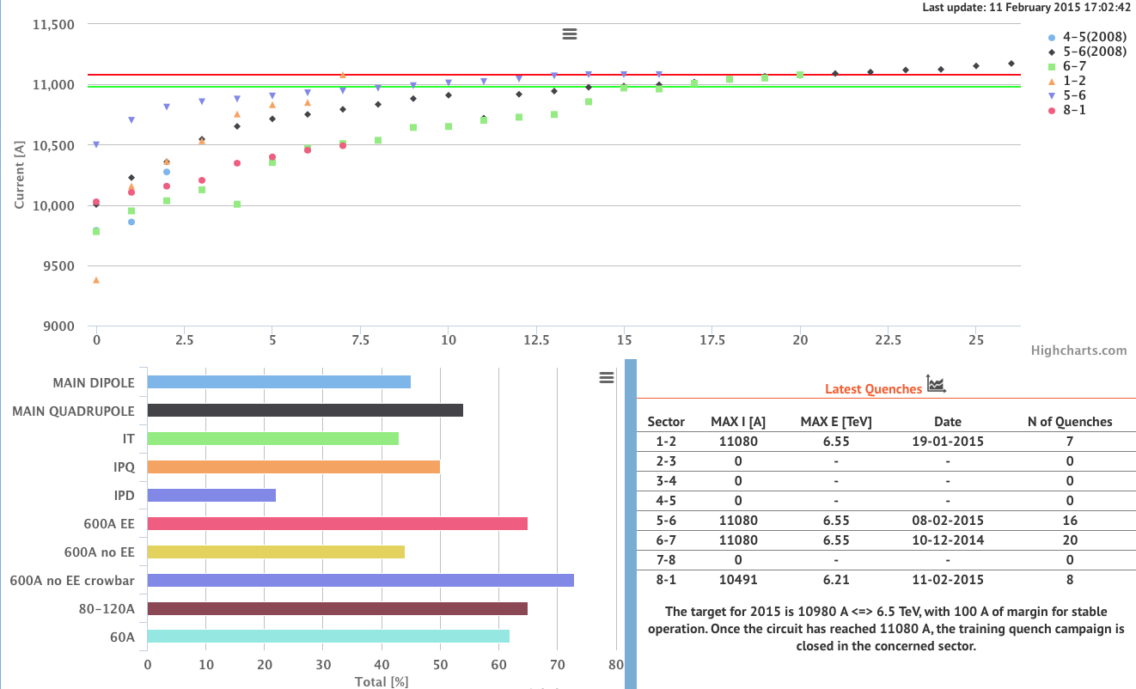
LHC Magnet Powering Tests
NOT STARTED
NOT STARTED
NOT STARTED
NOT STARTED
Notes:
Latin for “Make haste slowly”. Proper balance of urgency and diligence

Slide 8
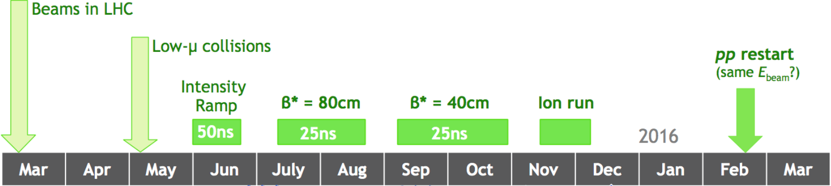
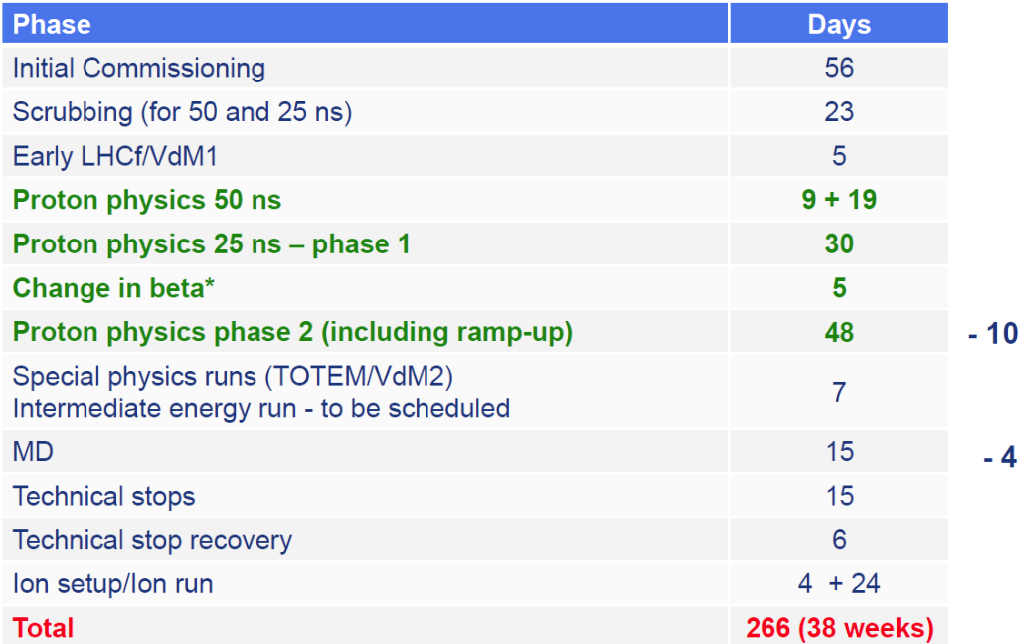
Q: How much and when?
EPS
LP, LHCP
Council
Moriond
2015 Summary (@13 TeV):
≤ 1 fb⁻¹ with 50 ns by July 5
~3 fb⁻¹ with 25 ns by Sept 6
~12 fb⁻¹ with 25 ns by Nov 3
Notes:
Latin for “Make haste slowly”. Proper balance of urgency and diligence

Slide 9
ATLAS Status / Plans

Slide 10
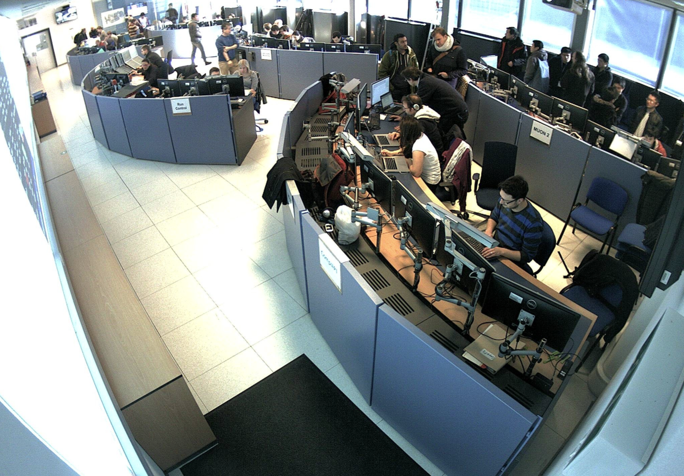
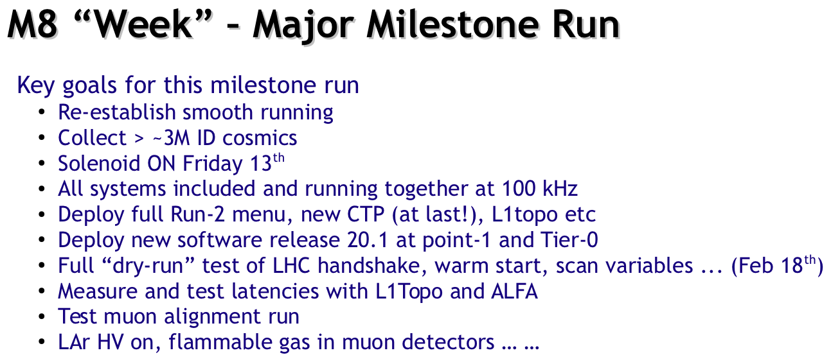

Slide 11
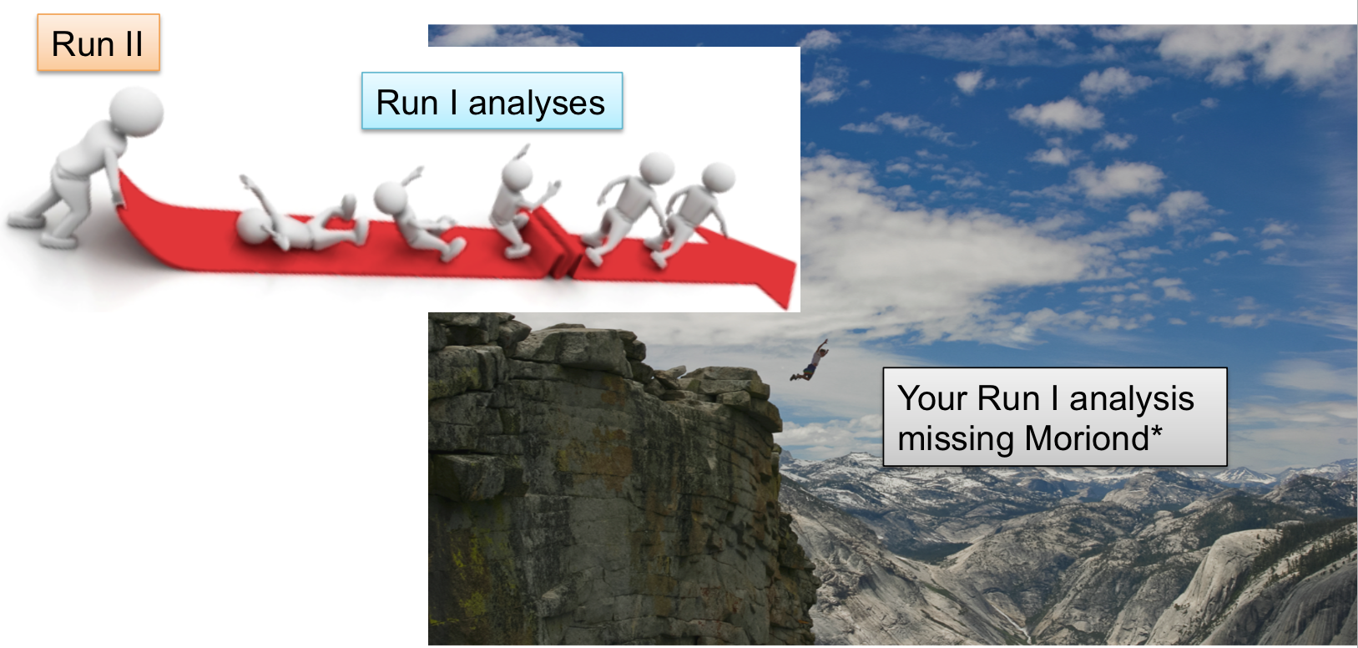
ATLAS Run I Analyses & Publications…
Run II preparations
  Trigger menu development
  New analysis framework, MC generation, etc..
  FTK ;)
*PC: parachute provided only in exceptional cases

Slide 12
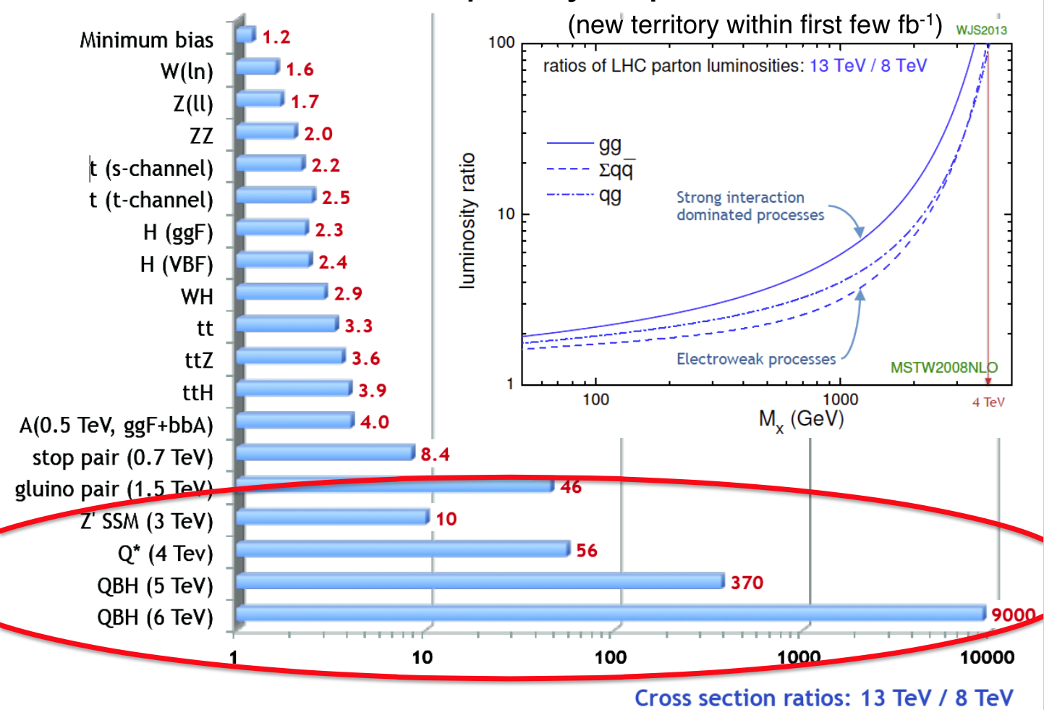
Many Run I results quickly superseded
Notes:
Latin for “Make haste slowly”. Proper balance of urgency and diligence

Slide 13
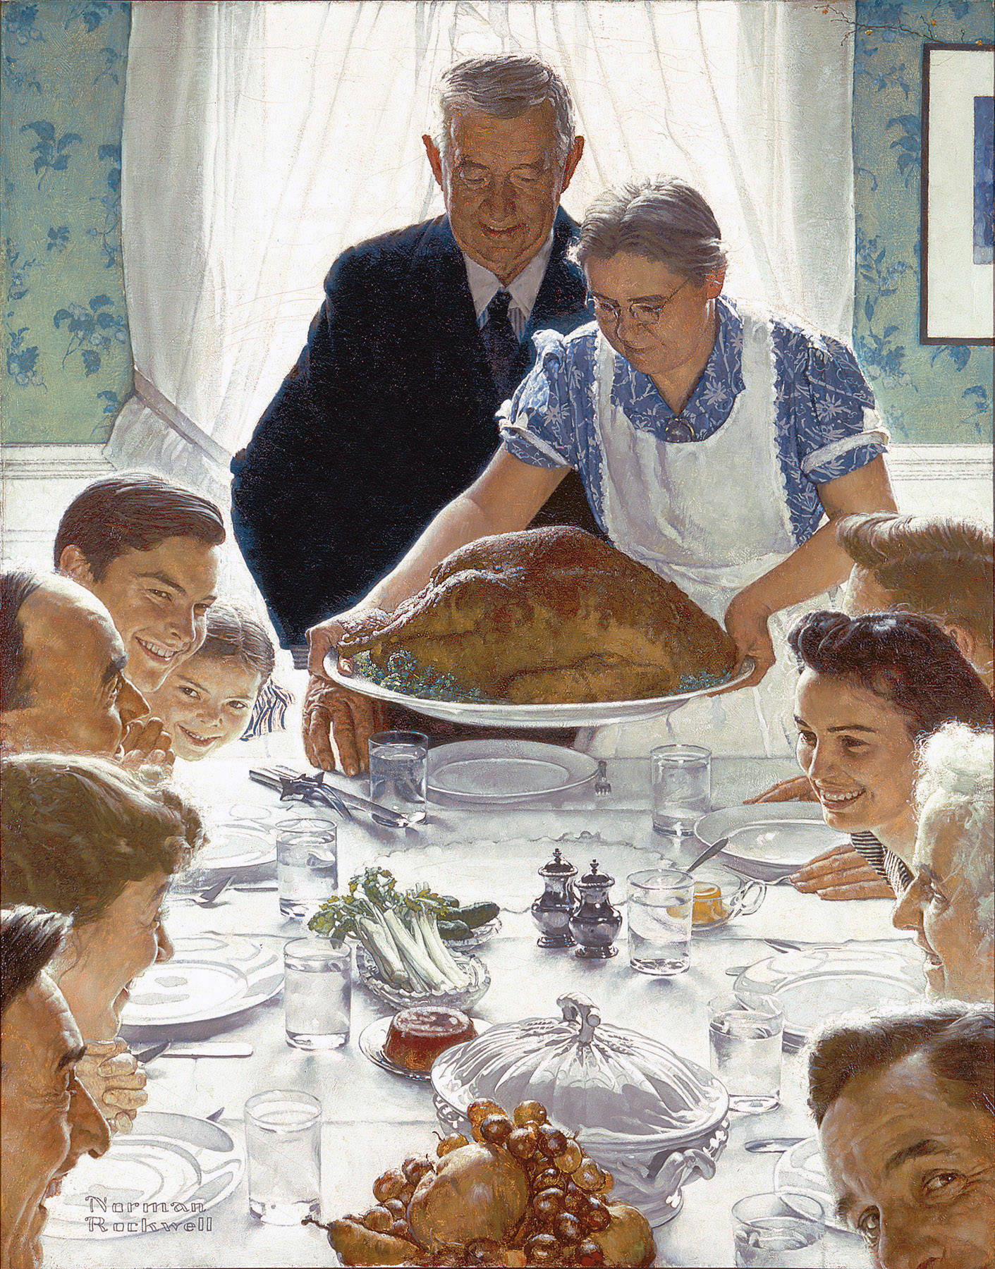
Summary
A feast is coming…
LHC is in the midst of magnet conditioning for 13 TeV
  Expect 1st beam at on 23 March (previously 9 March)
  “Success-driven schedule”, with ~no contingency in final powering tests
ATLAS now in 24/7 shift mode
  In midst of M8 commissioning work
  Run I pub → Run 2 prep
Expect ~3 (15) fb⁻¹ early Sep (Nov)
  Many analyses exceed Run 1 sensitivity with a few fb⁻¹ (or less)
0101001011110…
Festina Lente!
Notes:
Latin for “Make haste slowly”. Proper balance of urgency and diligence

