Slide 1
Warm Magnets - LS1 Feedback
J. Bauche, on behalf of the TE-MSC-MNC Team

Slide 2
Outline
Magnet maintenance program in LS
TE/MSC/MNC activities in LS1
  Baseline program
  Additional requests
Feedback
  Organization, coordination, and planning
  Support from/to other groups
  Electrical and radiation safety
  Infrastructure (incl. access)
Resources
Summary

Slide 3
Magnet maintenance program in LS
MNC magnet maintenance program in IEF
  Beam operation: intervention 24h/24 (piquet + experts)
  Short TS: systematic visual inspections; corrective maintenance
  End of Year TS: previous + audio-visual inspection in pulsed mode; electrical tests; preventive maintenance; small consolidations
  Long Shutdowns: previous + thermal inspections; large consolidations; major activities in highly radioactive areas
Associated with suitable spare policy
  Continuous refurbishment of large magnet families with few spares
  Certification program to prepare spares “ready to install”
➔ Ultimate goal: mitigate MTTR and MTBF
  Feedback: operation mode with TS, YETS, and LS is
  convenient to magnet maintenance rhythm!

Slide 4
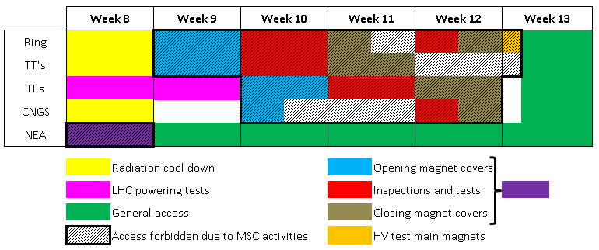
Magnet activity program during LS1
Inspections and tests campaign at LS start require:
  All technical services, infrastructure, power converters available
  Support from BE/OP and other equipment groups
  Safety: access restricted to magnet experts; consignations; EIS out of chains
Planning
  E.g.: SPS
  Coordination: several non-MNC activities could be organized during inspections campaign

Slide 5
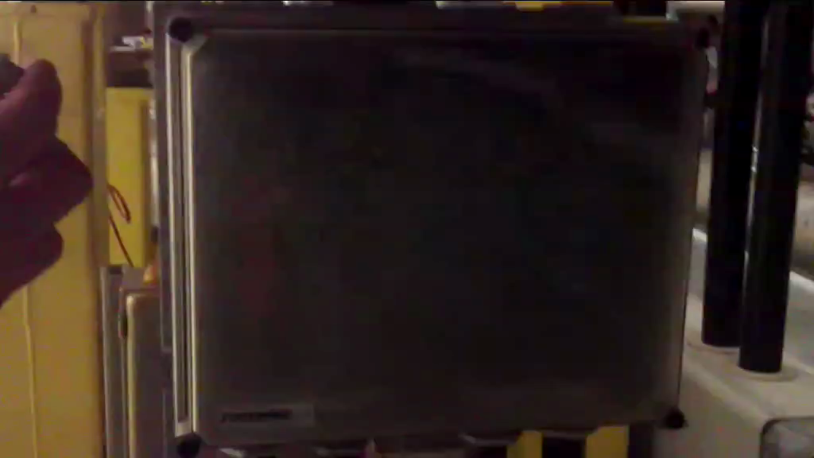
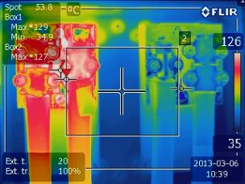
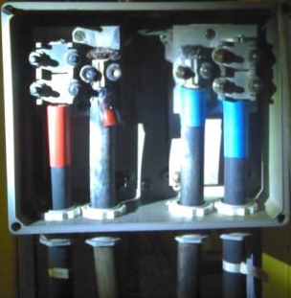
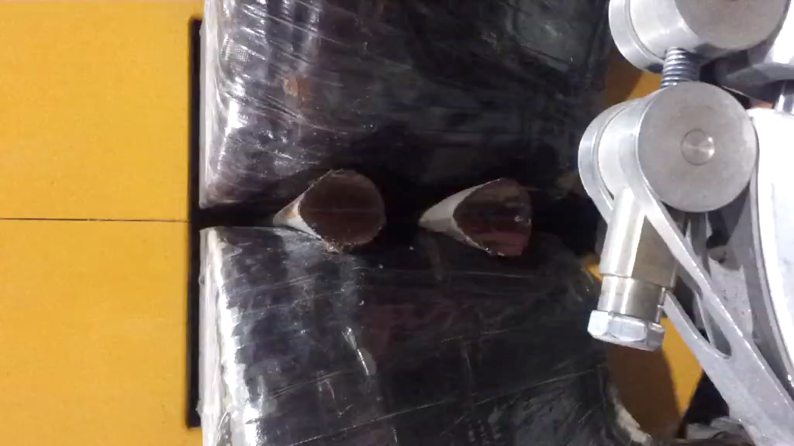
Magnet activity program during LS1
The inspections and tests performed during LS allow detecting critical issues:
→ shall be kept systematic for LS!

Slide 6
MNC activities during LS1(planned) (1/3)
Machine | Activity | Status | Remark
All CERN accelerator complex
All machines | Global inspection and test campaign, including thermal inspections | Done | > 3000 magnets
All machines | Routine maintenance/Filters cleaning | Done
PSB complex
PSB | Refurbishment of critical ancillary magnets cooling circuits | Done
AD transfer lines | Dismantling of TL 7000 and 8000 for ELENA | Done
ISOLDE | Refurbishment of GPS and HRS | Inspected | Found OK
PS complex
PS | Replacement of PFW on main units #55 and #75 | Done | Collaboration BINP, Russia
TT2 | Refurbishment of critical ancillary magnets cooling circuits | Done | Collaboration BINP, Russia
East Area | Refurb. 2 magnets + replace SMH01 | Done

Slide 7

MNC activities during LS1(planned) (2/3)
Machine | Activity | Status | Remark
SPS complex
SPS | Special inspection of main magnet circuits (busbars, capacitive discharge) | Done | Collaboration NCBJ, Poland
SPS + TL | Replacement of all magnet cooling water supply hoses | Done | Collaboration NCBJ, Poland
SPS | Replacement 20 main magnet for corrective/preventive maintenance | Done | Defined after inspections
SPS | Removal/reinstallation of 30 magnets for LSS1+ irradiated cabling campaign | Done
North Area | Shunting of defective redundant interlock signals of magnet water supply | Done
North Area | Upgrade of magnet electrical and cooling water supply circuits | Partial | Prepared for LS2
North Area | Removal/reinstallation of 3 splitter magnets for TDC2/TCC2 consolidation | Done

Slide 8
MNC activities during LS1(planned) (3/3)
Machine | Activity |  | Status | Remark
Activities for LIU projects
PSB | Upgrade of the main magnets cooling circuits | Done |  | Collaboration BINP, Russia
PSB | Installation of new PSB injection magnet | Postponed |  | Production delay
SPS | Installation of 20 main magnets with a-C coated chambers | Done
SPS | Modification of the MDHD 11832 for injection dogleg compensation (Q20) | Done
LHC warm magnets
LHC | Tungsten shielding of MBW and MQW coils in IP7 for HL-LHC | Done

Slide 9
MNC activities added during LS1
Support requested to TE-MSC-MNC after LS1 start
Machine | Activity | Status | Remark
AD | Installation of beam transfer line magnets for the BASE experiment | Done | 9 magnets
TT10 | Removal/reinstallation of magnet and ancillaries for tunnel CE consolidation | Done | 8 magnets
SPS | Modification of MD-H/V-W magnet circuits for IPM – BGI set-up upgrade | Done
SPS | Support for vacuum chamber insulation check and repair campaign | Done | All ring magnets
SPS | Production/installation of shims for sextants 5 and 6 realignment campaign | Done

Slide 10
Feedback
Organization, coordination and planning
  LS1 has been well prepared. Preparation started in appropriate time for main activities (e.g. IEFC WS 03/12)
  Technical coordination very efficient in most cases
  Prioritization of activities between machines not always obvious
  Activities impacting access for others to be announced early enough
  For MNC, final workload is known after inspection/test campaigns results
  Time margin to be added for issues found during restart phase (e.g. magnet replacement impacting EPC tests)

Slide 11
Feedback
Support from/to other groups
  We have been fully supported by all groups during the whole LS1, including when we blocked the access with our inspections ➔ MANY THANKS!
  We provided full support to all activities when we were requested ☺
  Interactions with EN/EL during cabling campaigns were well organized

Slide 12
Feedback
Safety
  For LSS1+ cabling campaign and TDC2 consolidation, the radiation safety has been well managed thanks to well prepared WDPs and support from DGS/RP. Interventions documented for future
  For a few activities in the PS complex and LHC, the requested granularity of some WDP for low dose activities was sometimes too high for the dose benefit → homogenize granularity w.r.t. ALARA
  level of intervention
  Flexibility of RP rules helped treating non-radioactive material in radioactive workshops for specific cases (“dérogation”), e.g. for magnetic measurements
  Sometimes, magnet covers found open without informing us
  Safety rules changing too often in general
  Accelerated procedures for safety courses for external collaborations

Slide 13
Feedback
Infrastructure
  Lack of space in radioactive storage not easy to manage in LS1. To be improved!
  IMPACT system sometimes heavy (e.g. LHC: one IMPACT/point; validity of IMPACT in case of activity delays), and not always reactive (signature delay)
  MADs have driven us mad! → too high sensitivity. Access to an area has often required more time than the intervention itself!

Slide 14
Resources
TE-MSC-MNC staff and FSU
  Large contribution to LHC SMACC: 5 staff + 4 FSU
  Activities in IEF and on all other projects (LIUs, HIE-ISOLDE, ELENA, BASE, AWAKE, PS magnetic model, CLIC, SESAME, MedAustron) continued in parallel!
Collaborations with external institutes
  National Centre for Nuclear Research, POLAND
  → 5 pers. x 6 months for SPS hoses replacement
  Budker Institute for Nuclear Physics, RUSSIA
  6 pers. x 3 months for PSB, PS, and TT2 magnet refurbishment
  ➔ These resources helped recover our SMACC contribution
BE-OP staff
  Operators integrated in our team during shutdown
  → Inspection and maintenance: 1 staff FT + 1 staff part time

Slide 15
Summary
What | Keep | Improve | Change
Organization, coordination & planning | -Dedicated MNC inspection and test period at LS start -Early preparation | -Late announcement of some activities impacting access for others -Margin for restart issues -Coordination between machines
Collaboration with other groups | Strong and collaborative support from all groups! | Closing magnet water valves without informing MNC
Electrical safety | General respect of rules | Intervention on magnets without informing MNC
Radiation safety | Documenting work campaigns in highly radioactive areas | Inhomogeneous WDP granularity requested
Radioactive workshops/storage | Specific RP authorization to treat non-radioactive material in radioactive areas |  | Lack of radioactive storage place
Access / IMPACT | Simple and efficient access system like the one of SPS | -Keep constantly EDH special permit for experts -IMPACT signature delay | MAD systems sensitivity
Resources | -Budget for external collaborations in advance -Integration of BE-OP staff in equipment group activities | Personnel margin for additional requests

Slide 16
Many thanks for your support to MNC activities!

