Slide 1
Safety in LS1
Thomas Otto, TE DSO

Slide 2
Contents
Safety Performance in LS1
Technical Preparation
Safety Training
Coordination and Follow-Up
Management and Communication
Clean-up and Waste
Summary

Slide 3
Safety Performance: Accidents
Approximately 3.4 million hours of LS1 work
64 minor accidents (no absence)
31 accidents with 273 days of absence

Slide 4
LS1 Accidents
Facility | Total | Minor | With absence | Total days
PS | 2 | 1 | 1 | 6
SPS | 7 | 6 | 1 | 3
LHC | 30 | 20 | 10 | 93
Surface | 50 | 34 | 16 | 151
Exp. Areas* | 6 | 3 | 3 | 20
Total | 95 | 64 | 31 | 273
* (Only A&T personnel)
 | ENTC | STAFF | COAS/ USAS | FELL/ TRNE | Total
Minor | 49 | 10 | 4 | 1 | 64
With absence | 24 | 5 | 1 | 1 | 31
Total | 73 | 15 | 5 | 2 | 95
Near misses included:
Electrical lock-out
Unauthorised crossing of safety barriers

Slide 5
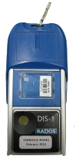
Safety Performance: Personal Dose
From D. Forkel-Wirth, HSE
DIS:
13345 assignments
58 %
42 %

Slide 6
Technical Preparation
Procedures incl. Safety measures
EC / EU-conformity of mechanical equipment
Pre-LS1 Training on the job
ALARA approach for radiation protection

Slide 7
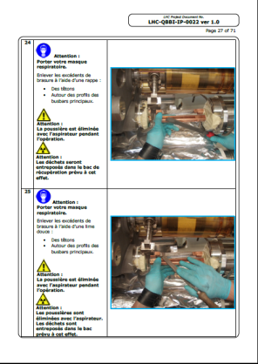
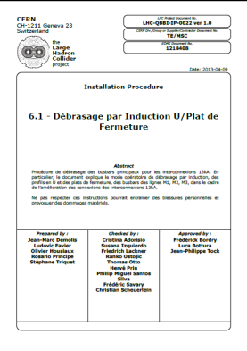
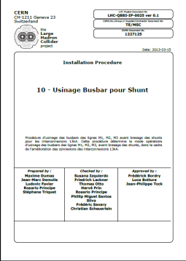
Technical procedures
Several 1000 pages of procedures for SMACC
Pictorial guide
Safety requirements for every process step

Slide 8
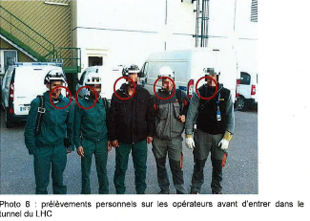
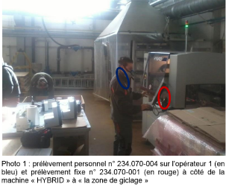
Chemical Safety Highlights during LS1
Exposure monitoring
Chemical exposure monitoring campaigns were organized with external laboratories, to determine the degree of exposure to various Hazardous Chemical Agents
fibreglass in building 927;
welding fume in building 100 and the LHC Tunnel;
organic vapours in building 101
From J. Gulley, HSE

Slide 9
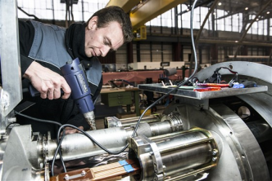
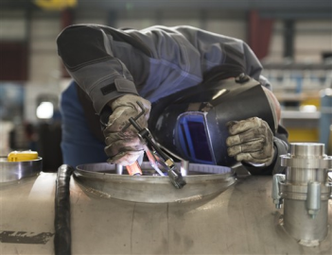
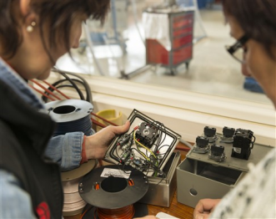
Job-related training
Thorough training of all workers on mock-ups in Bld. 180

Slide 10
LS1 – ALARA Committees
11 jobs for approval
TCC2/TDC2 Cabling
before optimization
after optimization
Collective dose [mSv]
TCC2/TDC2 works
SPS –LSS1 phase 2
SPS –LSS1 phase 3
PS Magnets
ISOLDE
SPS –LSS1 phase 1
PS CV
Cabling LHC IR 3-7
PS Beam Dump
From T. Wijnands & A. Pardons, EN
ISOLDE
Total estimated collective dose for ALARA 3 interventions in LS1:
before optimization : 840 mSv - after optimization : 423mSv
Effectively taken: 240 mSv

Slide 11
Lessons for Technical Preparation
Most accidents suffered during activities on the surface
Technical + Safety documentation and on-the-job training instrumental for accident prevention
Extend the model to LS2 subprojects
ALARA process will be key to radiation protection performance in LS2 (Injectors !)

Slide 12
Safety Training
LS1 sensibilisation on SIR
Classroom training
2-level RP training
Training infrastructure

Slide 13
LS1 Safety Training Matrix
Work Area | Safety Introduction / Safety during LS1 | Accelerator Safety 4 | Electrical Safety Awareness | Self-Rescue Mask | Radiation Protection
LHC | X |  | X | X | X
SPS | X |  | X | X | X
PS and other injectors | X | X | X |  | X
Experimental areas | X | Where existing |  |  | X
Workshops | X
Work with radioactive objects | X |  |  |  | X
As a professional electrician, an “electrical habilitation” from the group leader is required

Slide 14
Classroom Safety Training
persons
trained
8750 “very urgent” training requests
Training not targeted to CERN
Language barrier
6000
5000
4000
3000
2000
1000
From C. Balle, HSE
2009
2010
2011
2012
2013
2014
2015
2016
Repair
Run 1
LS 1 Long Shutdown

Slide 15
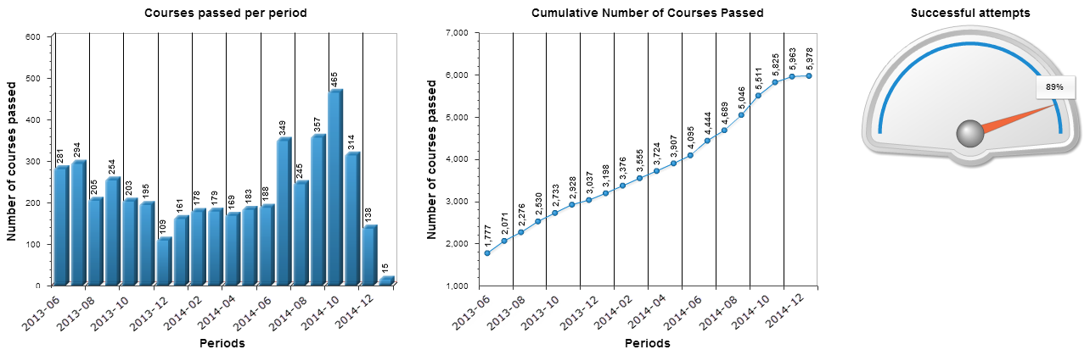
RP Training
Radiation Protection Training for Controlled Rad. Area (Face2Face):
SOFRANEXT | 1401 (FR)
CERN | 241 FR + 582 EN
2224 persons
(1884 during LS1)
(2nd October 2014)
Radiation Protection Training for Supervised Radiation Areas (e-learning)
From D. Forkel-Wirth, HSE
5978 persons
(5th January 2015)

Slide 16
Safety Training: Lessons
CERN is a World-Laboratory
Safety Training shall be targeted to CERN
Content
Language
HSE freezes requirements and course types
Departments evaluate training needs
Number of arrivals during LS
Technical Documentation → Risk Assessment → Safety training requirement

Slide 17
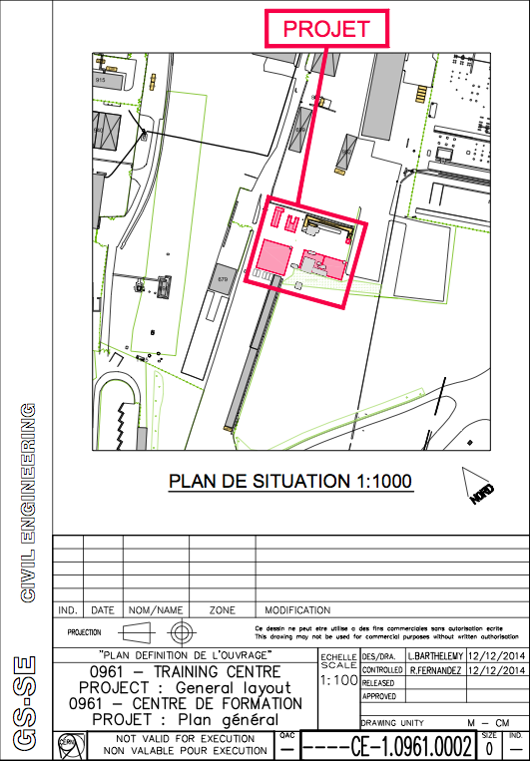
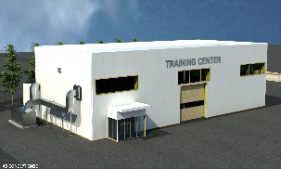
Safety Training Infrastructure
To deliver, Safety training needs
Trainers and technical personnel
Infrastructure (Safety Training Centre)
The present solutions must be consolidated until the “rush” during LS2
From C. Balle, HSE

Slide 18
Safe solutions for unforeseen issues
Safety Bulletin October 2013
HSE Formalisation of the “bump-cap” policy of A&T DSOs at workplaces without the hazard of falling objects.
Others:
Self-Rescue Mask and Helmet not on the persons, but in reach
Recognition of electrical safety training under different legislations from France (e.g. Poland)
Ventilation speed for geometers
Work-around to failing LHC lifts (means of evacuation)
Co-activities during equipment check-out

Slide 19
Safety Rules and Regulations
Last-minute Safety measures, after budgets have been allocated
e.g. Special vacuum cleaners
Electrical “habilitation” instead of electrical safety awareness
Recommendation:
Freeze all Safety measures well before LS
Allows consideration in budget allocation
and inclusion in contractual documents

Slide 20
Coordination and Follow-Up
Team of coordinators
Sufficient number
Sufficient authority
Cooperation of Safety Officers in A&T sector, GS and PH
Technical tools
IMPACT for activity planning
Automatisation of operational dosimetry
TREC for equipment from accelerator areas

Slide 21
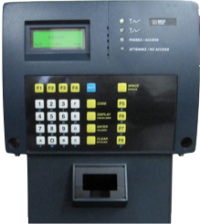
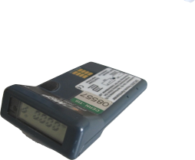
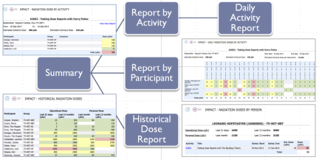
Operational Dosimetry and IMPACT
+ IMPACT
+
Radiation dose reports in IMPACT
Extensive use of IMPACT in 2014
From D. Forkel-Wirth, HSE
8686 reports generated in 2014

Slide 22
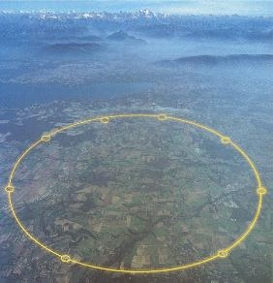
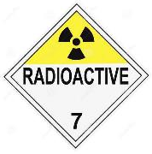
TREC & Transport of radioactive goods
TREC
RP checks of components | 39395
components measured | 3373 t
radioactive components | 2618 t
of which radioactive waste | 722 t
Departure | Radioactive Transports
Meyrin | 1248 (part on-site)
Prévessin | 683 (part on site)
SPS and LHC | 875 (public roads)
TOTAL | 2806

Slide 23
Coordination and Follow-Up: Lessons
Preserve force and authority of coordinators
Too many last minute activities:
Improve planning in the last months before start-up
IMPACT tool integrates most Safety aspects related to the activity
IMPACT does not replace Supervisor responsibility
IMPACT not suitable to grant conditional access
Electrical Lock-Outs: reproduce good LHC example in injectors

Slide 24
Management and Communication
“Safety First” was one motto for the LS1
Safety officer representation in all LS1-related management- and coordination meetings
Close collaboration with coordination
Regular contributions on Safety matters in LSC and Subproject-Committees
Safety coordinators and officers present on-site

Slide 25
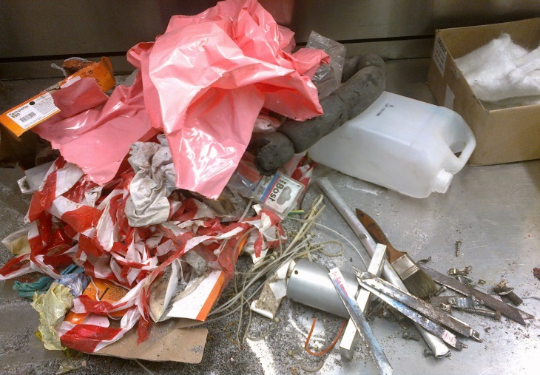
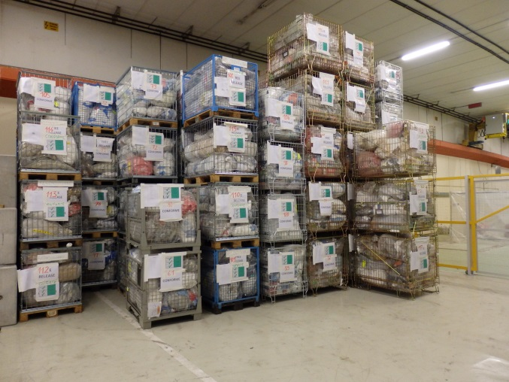
Clean-Up and Waste
Better discipline during pre-sorting
Temporary waste storage
Waste elimination to host state repositories
Conventional waste is also an issue !
Incinerable waste,
Before sorting
After sorting and measurement,
ready for clearance
From D. Forkel-Wirth, HSE

Slide 26
Safety Summary
what | I - keep | II - improve | III – change
List the different aspects in the management of the work carried out during the LS1 | Define what should be kept and was an added value during the LS1 | Define what you propose to improve in order to better manage the LS2 | Define what was a bottleneck to carry out the work during the LS1 and needs to be changed for LS2
Safety Training | LS specific safety training Training targeted to risk profile of person | Freeze access and training req’s early Assess training needs | Electrical training for electricians Safety training centre
Safety Rules |  | Freeze well before LS
Procedures & Accident prevention |  | Extend to all subprojects
Inspections |  | Announce and plan early
ALARA approach | Worked well |  | Take preparatory work into account
(radioactive) waste & material |  | Better discipline | Storage space (in progress)
Radioactive work areas |  |  | Need to be identified and (temporarily) classified (in progress)
Coordination | Keep at similar level
Last minute jobs |  | Only with serious justification

