Slide 1
TE-EPC Activities during LS1
V. Montabonnet [TE-EPC]

Slide 2
Scope
LS1 & TE-EPC Activities
TE-EPC Organisation
TE-EPC Feedbacks

Slide 3
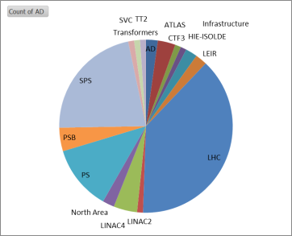
LS1 TE-EPC Activities
LS1 = 94x group activities as defined in PLAN
LS1 was mainly LHC and SPS in term of activity volume.
LS2 will have more activities and more scattered around the different machines

Slide 4
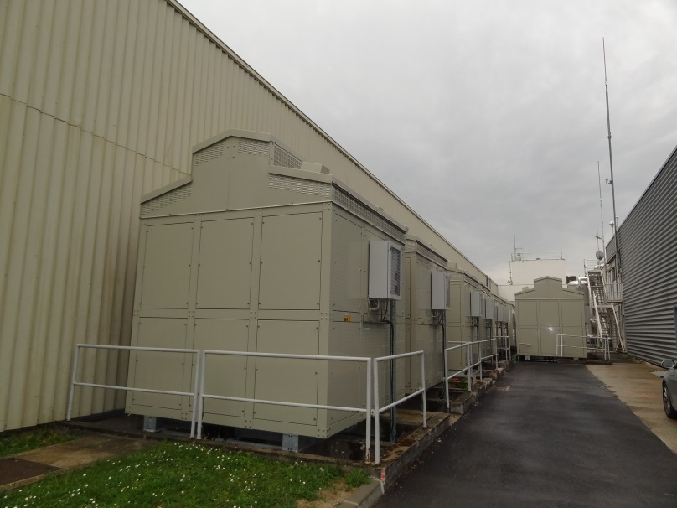
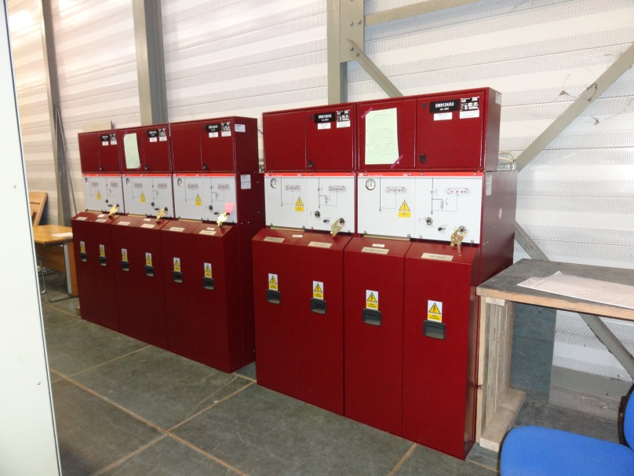
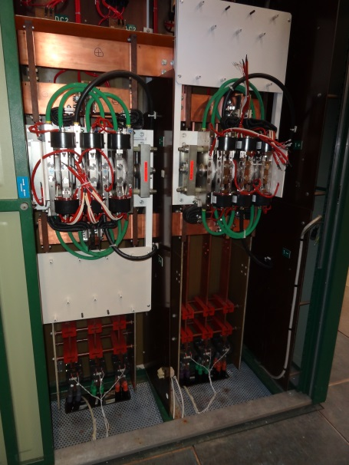
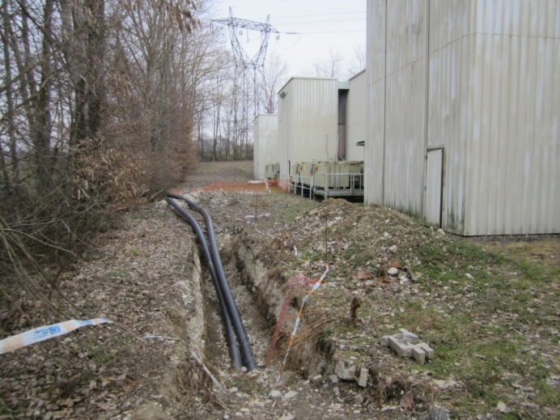
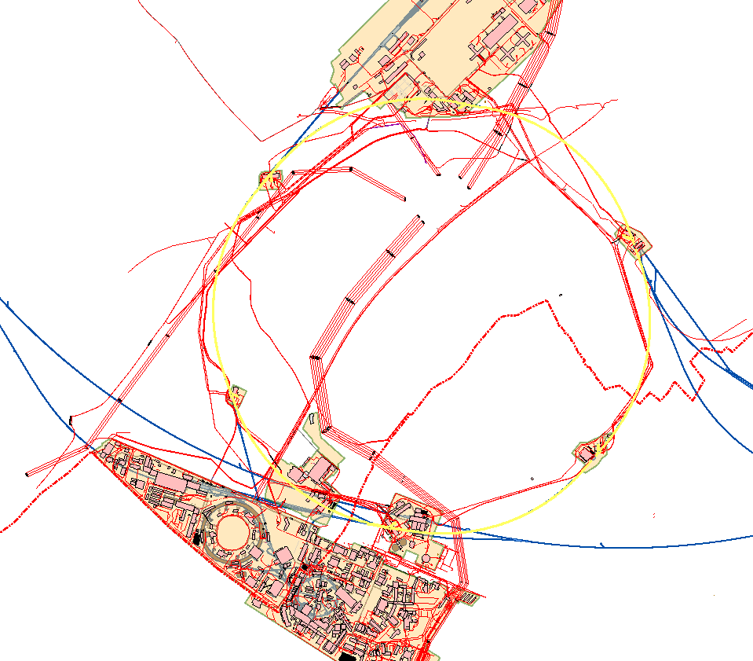
LS1 & SPS Consolidation
Transformers
Earth switches
SPS
Thyristor stacks
18kV cables

Slide 5
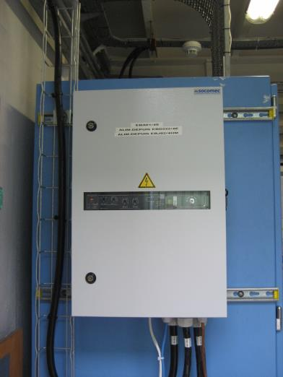
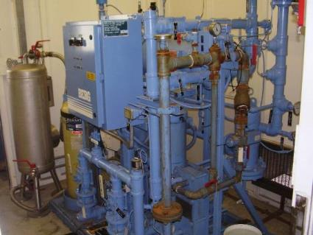
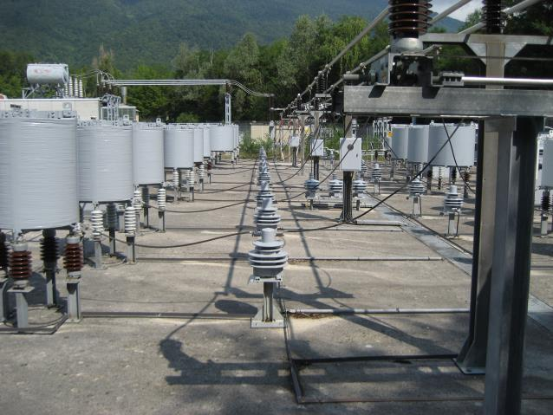
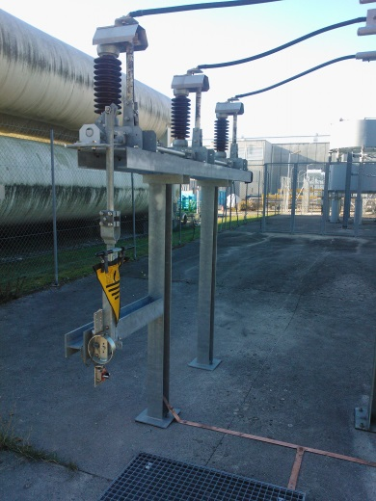
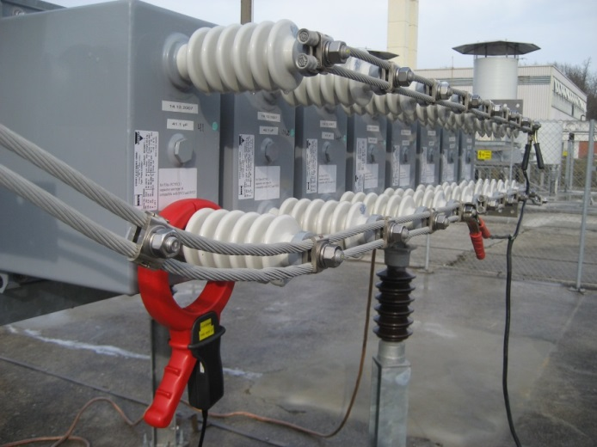
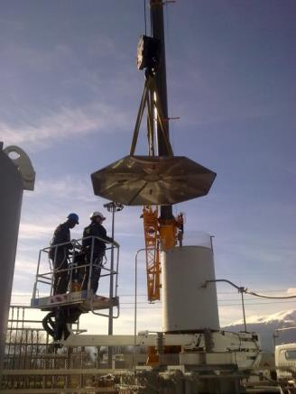
LS1 & Static Var Compensators
New 400V double-source Cooling plant consolidation New Coils
New earthing switches New Capacitors Maintenance of resistors

Slide 6
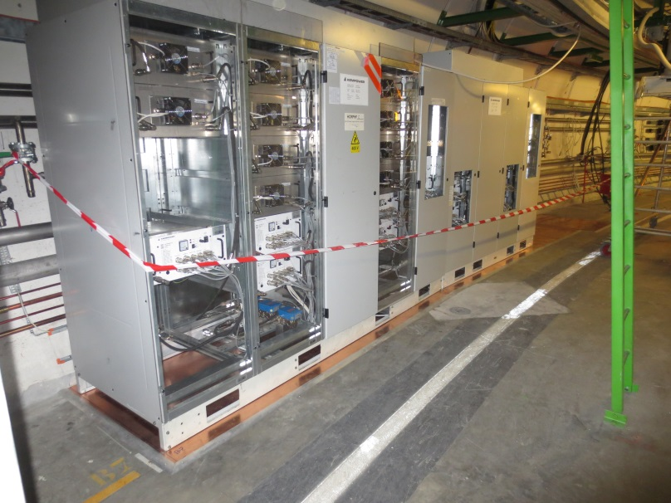
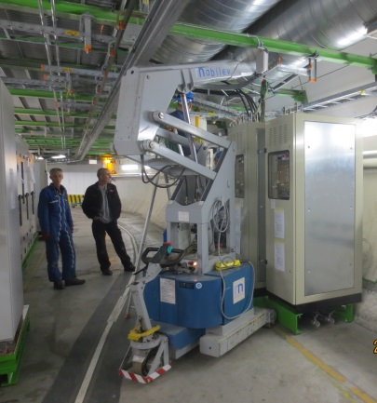
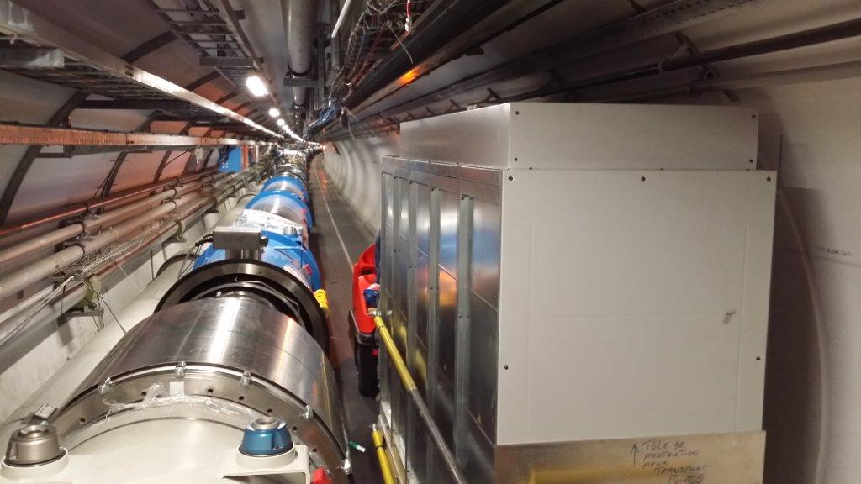
LS1 & LHC
Some Figures
61 converters relocated [R2E Project]
2600 DC cable disconnection for ELQA tests
1892 Lock-outs

Slide 7
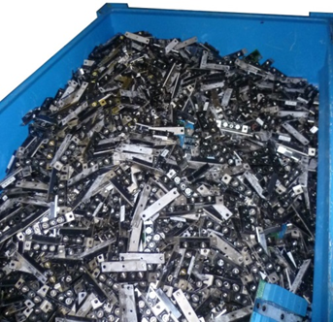
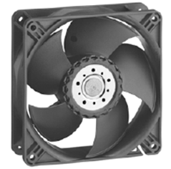
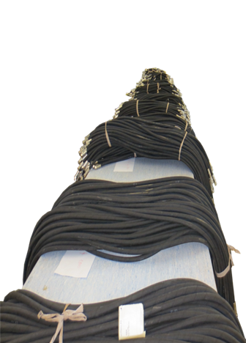
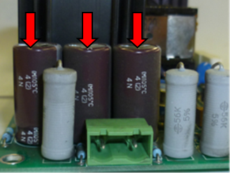
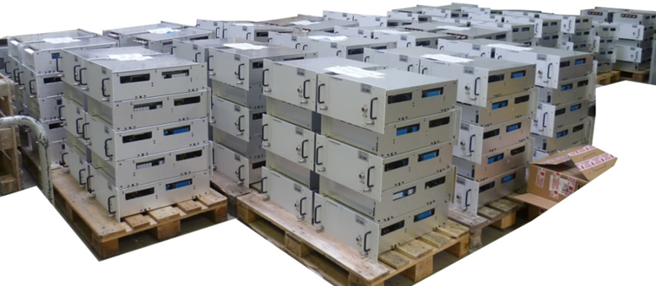
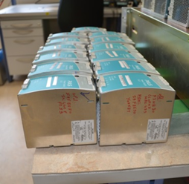
LS1 & LHC
14500 Output Module diodes replaced
4725 crimped hoses replaced (4.3km)
2500 fans installed
750 PSU upgraded (60A)
460 PSU upgraded for R2E (600A)

Slide 8
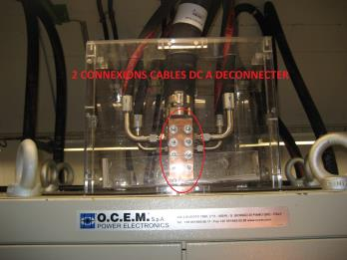
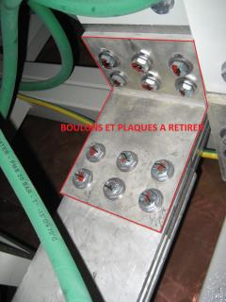
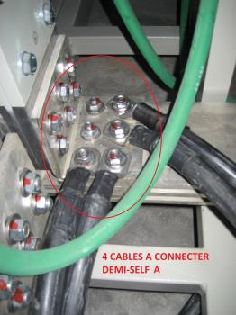
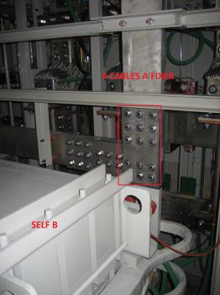
LHC & CSCM Tests
Heavy modifications of the RB converters for the tests
6 months of preparation and tests
1 Engineer [Part Time], 1 Technician and 2 electromechanical technicians at full time

Slide 9
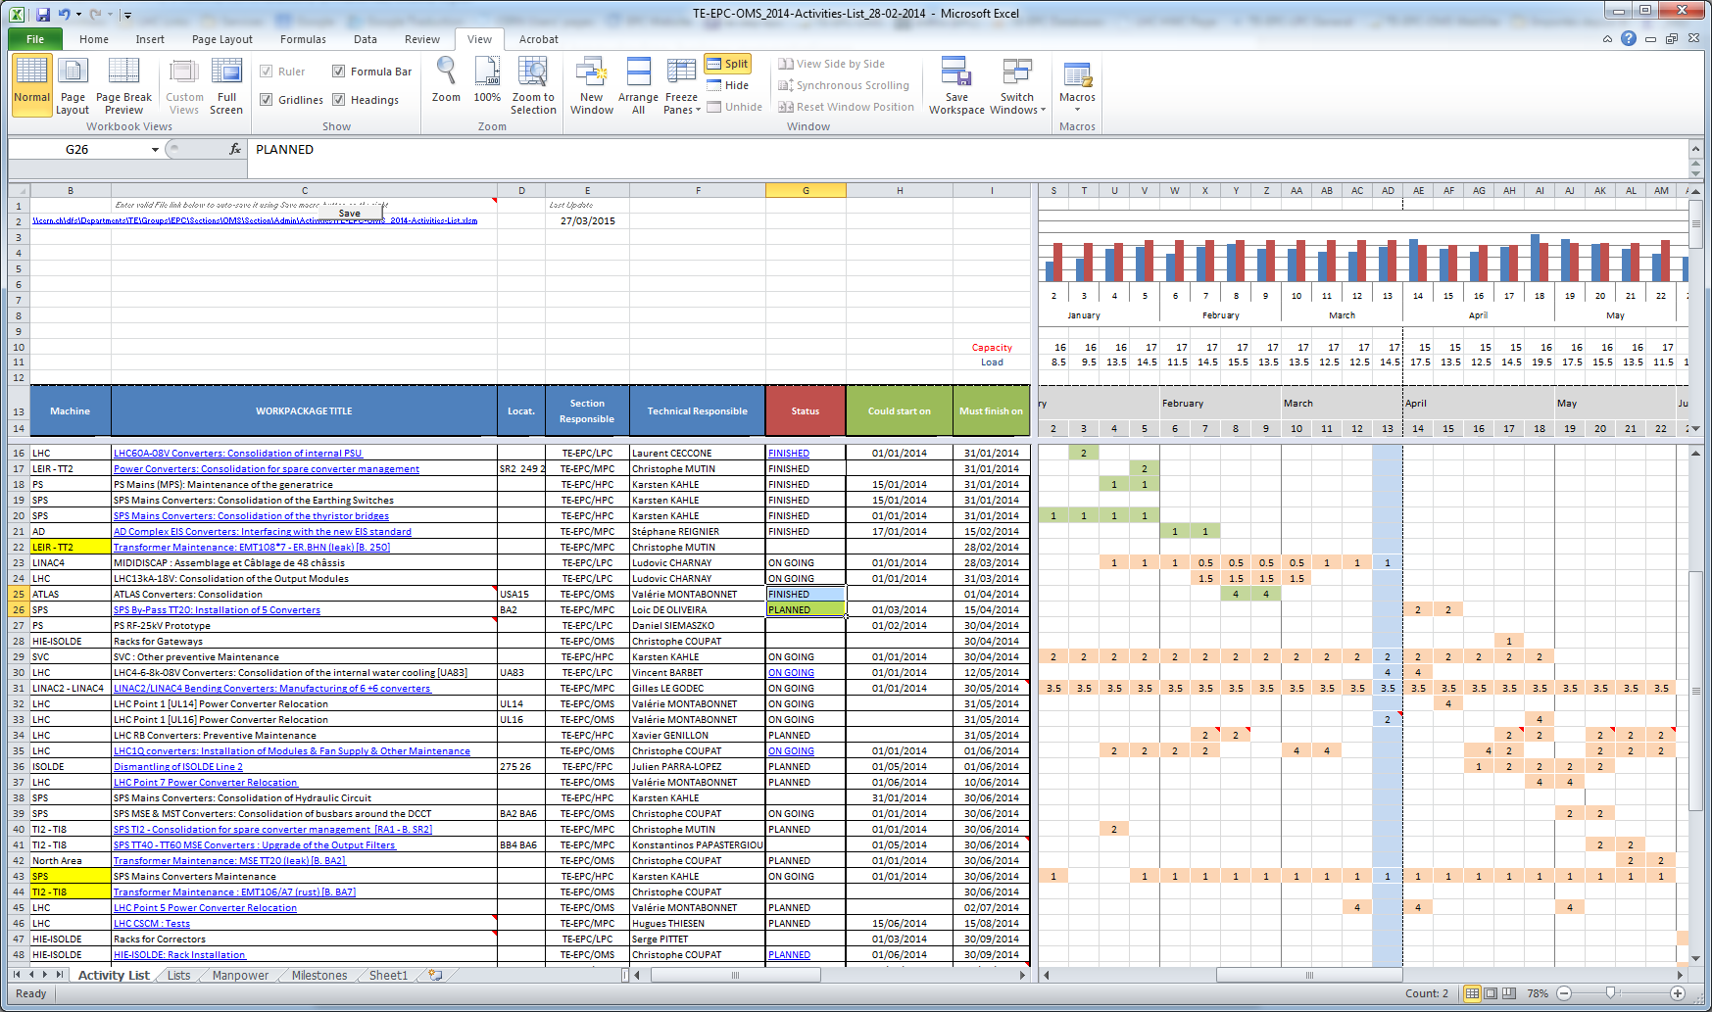
TE-EPC Organisation
What worked well
Preparation
Work breakdown structure
Work package analysis (scope, person responsible, resource requirements, procedures, time and cost estimation, status/reporting, dead line)
Workload & planning for internal support resources

Slide 10
TE-EPC Organisation
What worked well
Organisation
New FSUs resource allocation (x2 for BE-09 and TE-05)
Setting of internal group priorities
Mobilisation of TE-EPC different teams with a dynamic allocation (FSUs, staff …)
Accountability & engagement of the teams
Lessons learned
Keep points
Anticipation & Preparation
Limitation
Manpower during installation/maintenance & tests phases
V. Montabonnet TE-EPC

Slide 11
TE-EPC & LS1 Coordination
What worked well
Work package Analysis - Useful for co-activity, constraints and service support identification
Flexibility given by the Coordination Team - Useful to manage priority all around CERN complex and access constraints
Trust and very good communication with the Coordination Team
V. Montabonnet TE-EPC

Slide 12
TE-EPC & LS1 Coordination
What could be improved
Don’t forget to plan
Infrastructure Maintenance for TE-EPC Test Beds
Maintenance of SVC’s related to the ‘Réseau Stable’
Cleaning Activities at the end of LS1
Access constraints to be reported in the Access Conditions Web Page and/or ADAMS’s database (Access to Accelerators)

Slide 13
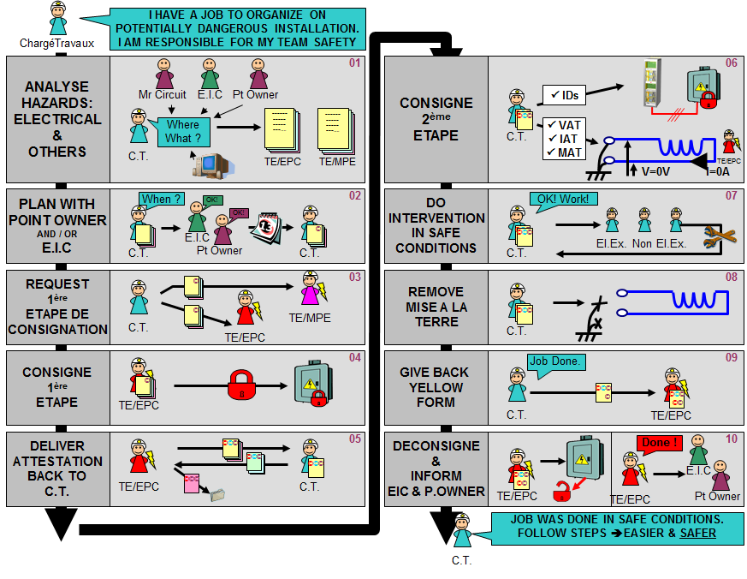
Electrical Safety
What worked well
Centralisation of the Demande de Travaux on LHC circuit DC side
Identification of the different types of hazards and risk assessment (procedure, VIC …)
Central planification
Role appointment clearly identified for LHC circuit consignation
V. Montabonnet TE-EPC

Slide 14
Electrical Safety
What could be improved
LHC Electrical Safety Organisation not well known by everybody at the beginning of LS1.
Could be part of a SIR training module
In Injector complex, role appointment for Circuit Consignation not clearly identified
Need a same organisation as for the LHC ?
V. Montabonnet TE-EPC

Slide 15
Tests & Organisation
What could be improved
Some tests requesting power converters arrived very late (LHC Energy Extraction System Test, Access & EIS validation …)
Need a clear list of tests
Need for each test:
Testpackage Analysis to identify safety issue, the contribution of the different groups/services, the time needed
Procedures in advance
Assignment of Coordination Work
V. Montabonnet TE-EPC

Slide 16
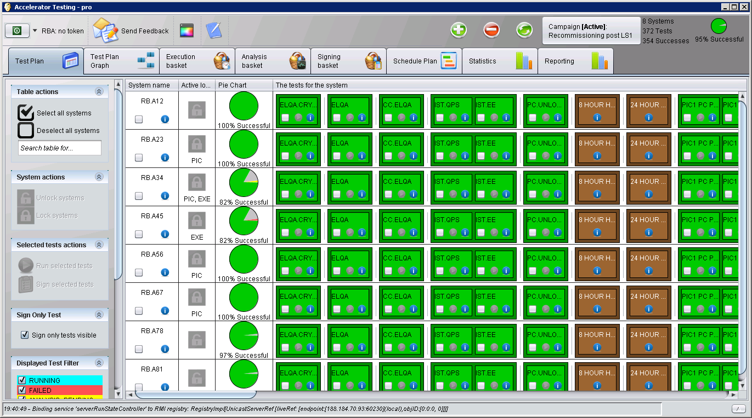
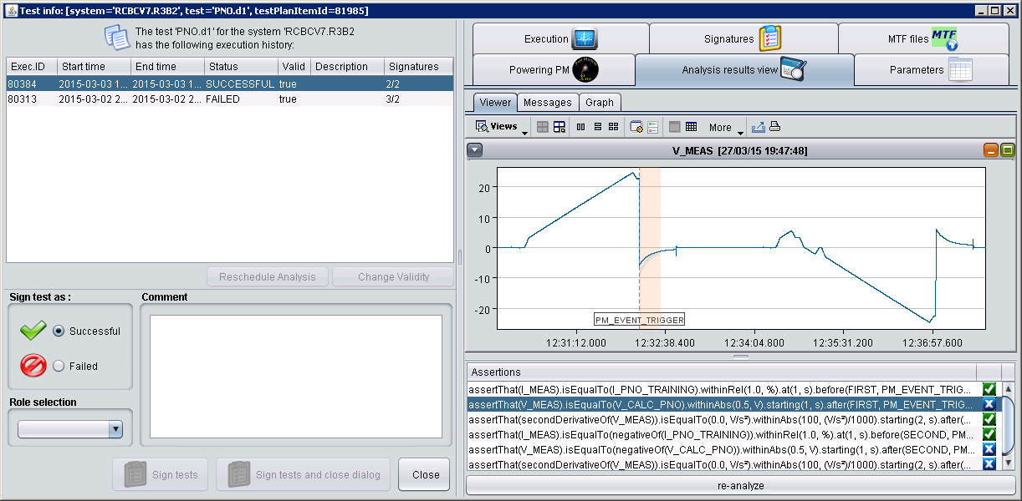
Test & Quality Assurance
What could be improved
For LHC Normal Conducting Magnet Circuit & Injector Circuit, develop Automatic Test Sequences as for the LHC Cold Circuits for Quality Assurance
Same tests every year
Better traceability of the tests and their results
Better detection of performance deviation
V. Montabonnet TE-EPC

Slide 17
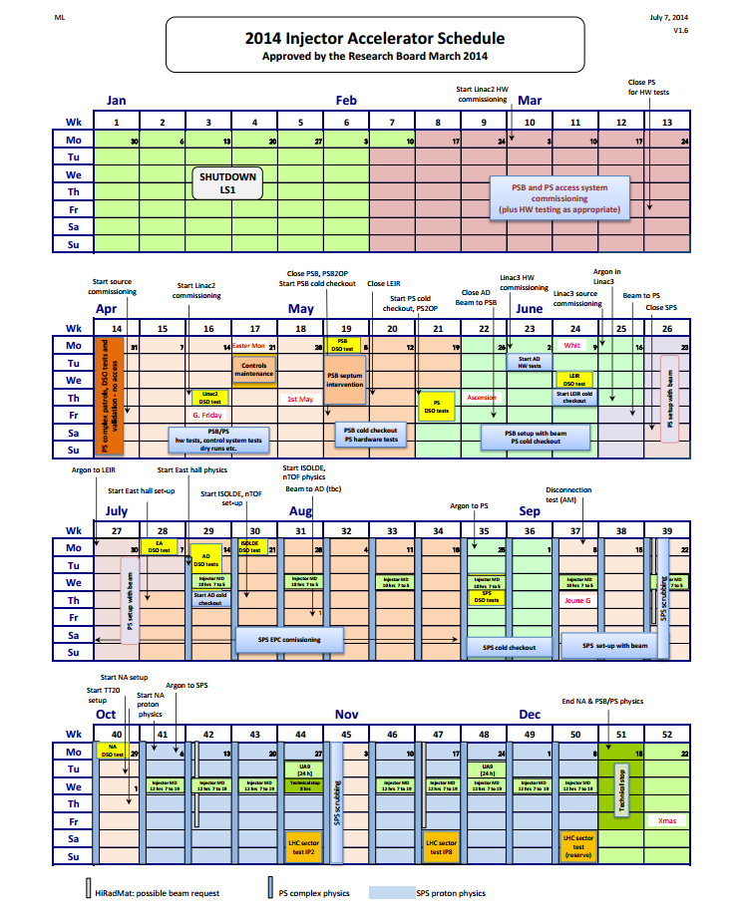
Tests & Planification
What worked well
Test Levelling (machine by machine) - very useful for manpower issue
Time for tests. Their duration cannot be shrunk.
V. Montabonnet TE-EPC

Slide 18
Conclusions
LS1 was successful with 100% of the baseline completed
Good and effective organisation
Positive feedback and very good collaboration with coordination team & services
Safety and tests issues could be improved
V. Montabonnet TE-EPC

