Slide 1
LHC Experiments in LS1
the Technical Coordinators of:
ALICE (Werner Riegler),
ATLAS (Beniamino Di Girolamo)
CMS (Austin Ball –presenter))
LHCb (Rolf Lindner)

Slide 2
Overview
Scope of LS1 programmes in the 4 experiments
-scale and type of LS1 activities
-overview from each experiment
Technical Sector (GS,TE,EN,IT, BE depts) activities for experiments
- specialist support
- projects
with some comments on issues for discussion
Main themes arising from LS1 experience
Conclusions

Slide 3
LHC expts: scale & type of LS1 activity
Typically >1000 distinct (underground) work-packages for each experiment
(note: could be 1hr to few days, definitions not identical)
-this will likely be the case in LS2 and LS3 also
Main workstreams:
Preparation of detector assembly & maintenance areas (from 2009!!)
Refurbishment/improvement of surface facilities & control rooms
Maintenance/re-fit of detectors after attrition/experience in Run 1
all experiments went through major opening/closing sequences
Completion of nominal configurations
First stages of detector upgrade
Provision for future detector upgrades
“10-year maintenance” of service infrastructure
Consolidation of magnets and infrastructure based on Run 1 experience
New service infrastructure for detector upgrades in LS1 or LS2.
Coordinated work by teams from Collaboration, PH, contractors, FSU and
very importantly, the Technical Departments.
– heavy reliance on them for maintenance, consolidation & upgrade work.

Slide 4
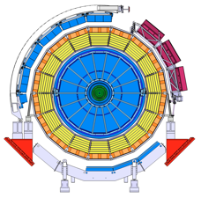
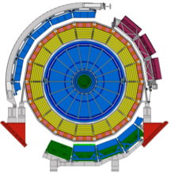
ALICE LS1:detector upgrade
Before LS1
After LS1
Key activities:
The final 5/18 TRD modules were installed
A fourth PHOS module was installed
The Dijet Calorimeter (DCAL) consisting of 6+2x1/3 modules was installed
Shower counters (AD) were installed in the LHC tunnel

Slide 5
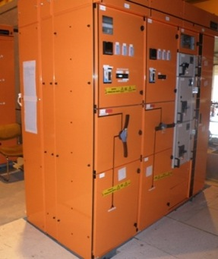
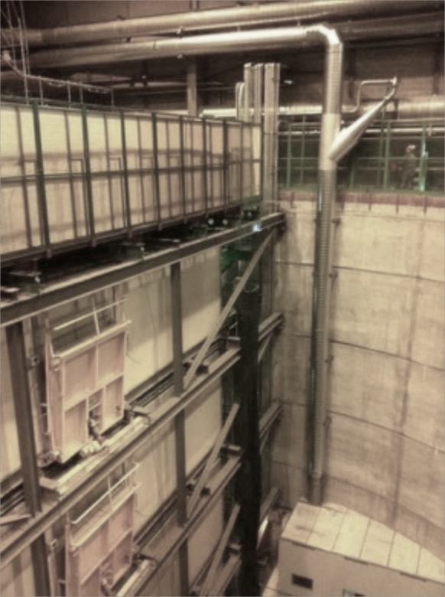
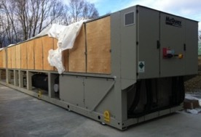
ALICE LS1: infrastructure
UPS upgrade
(EN-EL-BT):
Replacement of old units (from LEP times)
Consolidation of electrical network
UPS power increased (X5) from 160kVA to 800kVA
Existing switchboards (Hazemeyers)
New switchboards and distribution lines in each CR
Normal power
New UPS1
(500kVA)
New UPS2
(200kVA)
New UPS3
(100kVA)
CR1
DAQ
CR2
HLT
CR3
DCS
CR4
HV+other
CR5
UX25
CV
CRs
Safety
L3 ventilation upgrade
(EN-CV-PJ):
Replacement of the (LEP time) ventilation infrastructure for the L3 magnet that allow 10’000m³/h into the L3 magnet.
Increase air flow inside the L3 magnet by 60%
Chilled water upgrade
(EN-CV):
Installation of 5 chillers, new pumps and heat exchangers
Increase P2 primary cooling power by 60%
New pipe

Slide 6
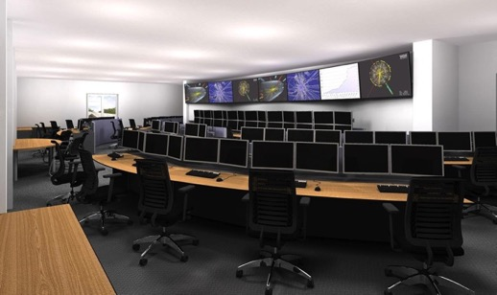
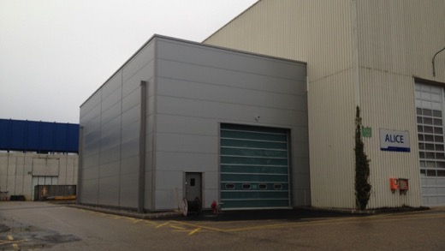
ALICE LS1:surface facilities
New ALICE run control center:
Complete reshape of the room, including new cabling and ventilation.
Groups involved: GS-SE-CEB, EN-EL-BT, EN-CV-DOW, IT-CS-CD, GS-ASE-AS and EN-MEF-SI
New storage hall (b.3297) :
New storage area for small/delicate equipment needed to service the Experiment.
Groups involved: GS-SE-CEB, EN-EL-BT, EN-CV-DOW and EN-MEF-SI

Slide 7
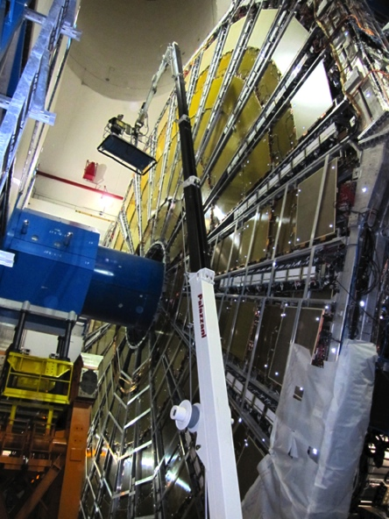
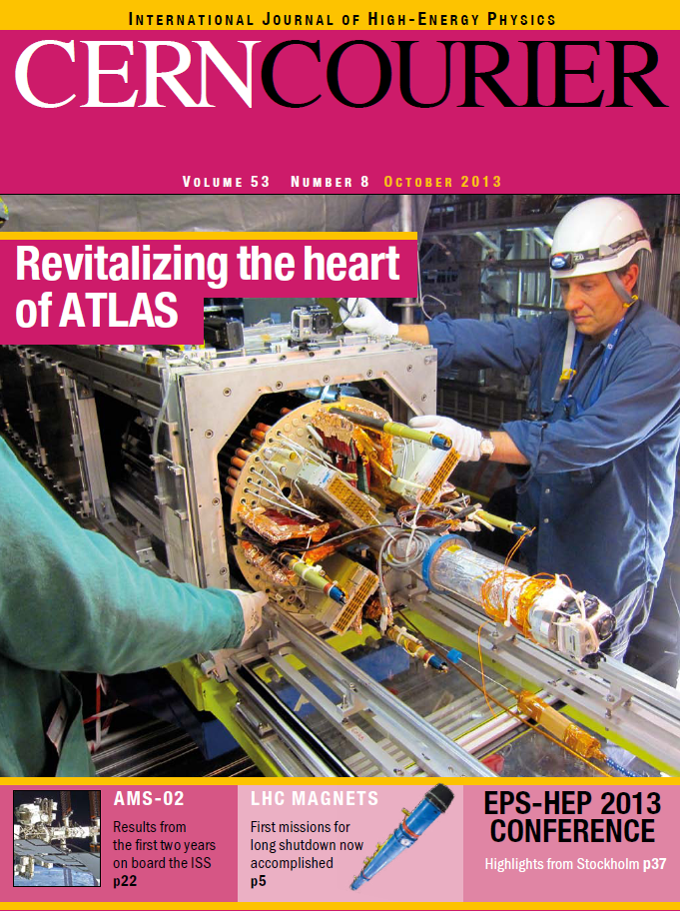
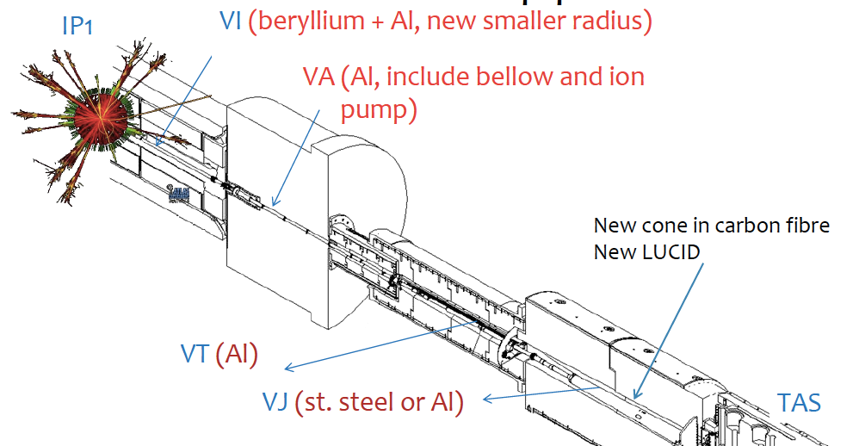
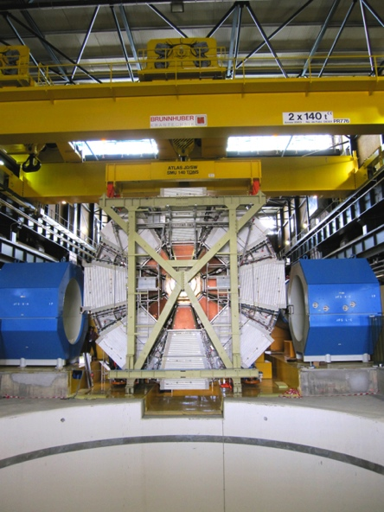
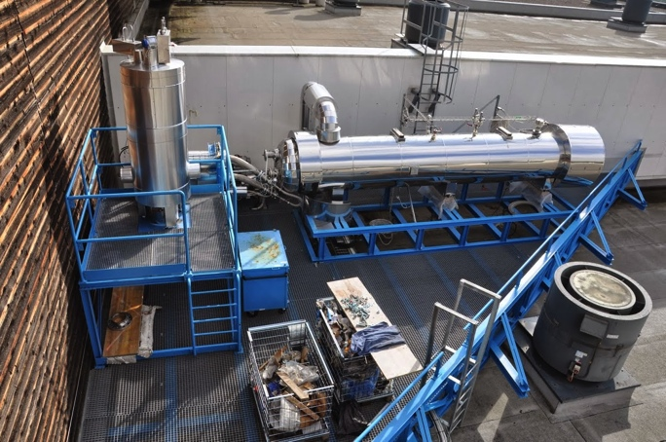
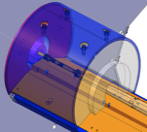
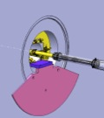
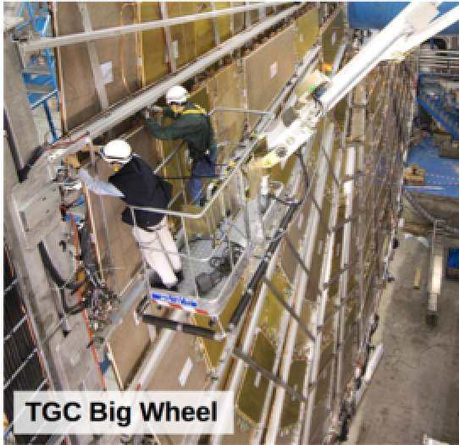
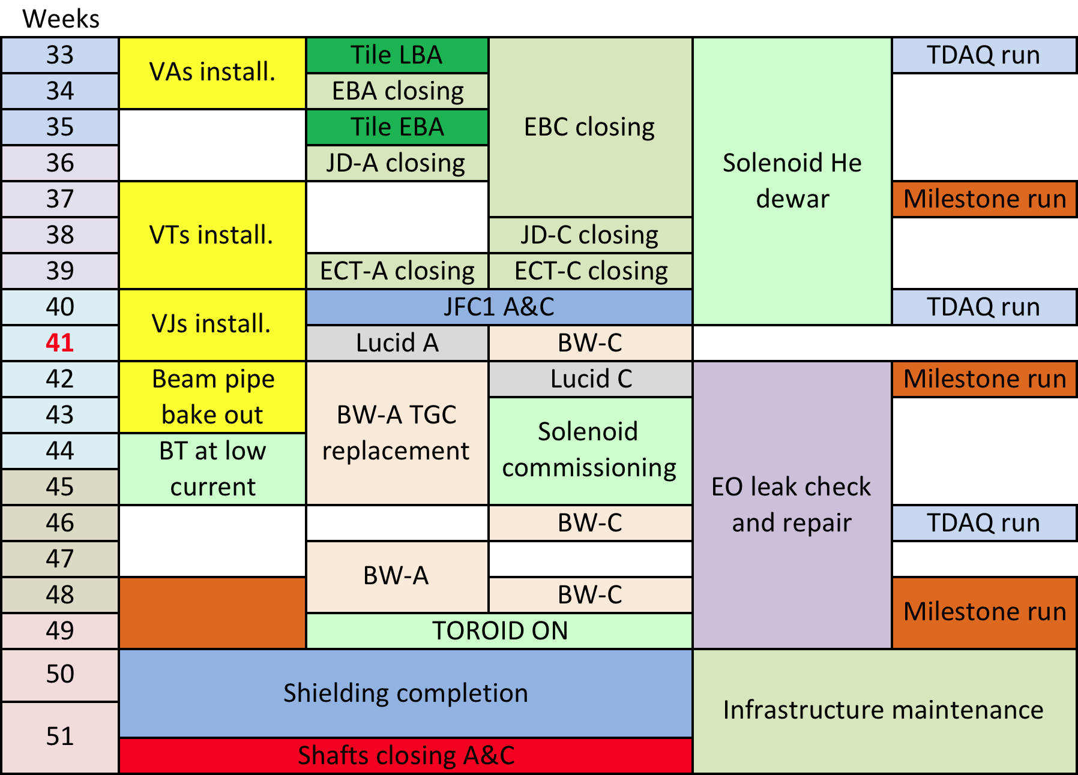
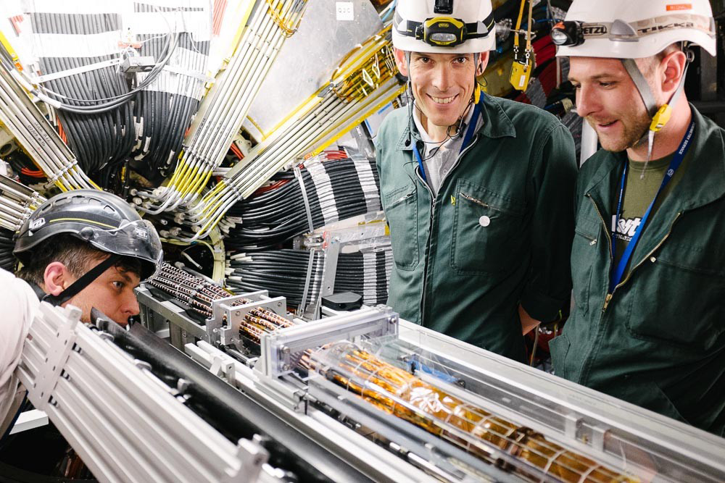
ATLAS LS1 overview
Beampipes
Pixel revision
Muon wheels
More shielding against fast neutrons from IP
7
Cooling plants
Insertable B-layer

Slide 8
ATLAS LS1 overview
Installed 12 million more Pixels (now 92M) and 25k Muon channel; repaired Pixel services
Expanded back-end DAQ for Pixel and Strips to reach higher luminosities
Some LS2-like electronics deployed; improvements in trigger electronics
Leak-fixing campaign for Muon and TRT detectors
Multiple Muon chambers installed and repaired
Access scenario for LS2 exercised; detailed scheduling for easy reactions

Slide 9
ATLAS LS1 infrastructure/surface facilities
Thermosiphon and CO₂ cooling projects for pixel + SCT
All Aluminum beam pipes and extensive use of carbon fibre replacing metal, to minimize exposure to activated materials
Solenoid and Toroid independence. He dryer,
Entire experiment on UPS (10 minutes for graceful shutdown if needed); extensive consolidation of electrical installations
Cooling tower backup created
Extensive consolidation for ageing h/w components and software
New satellite control rooms and general consolidation and improvements of surface installations (thrown away many barracks and containers!); improved logistic

Slide 10
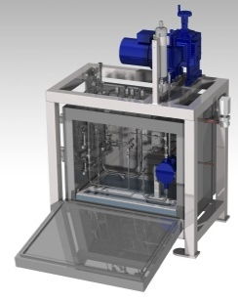
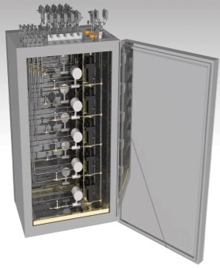
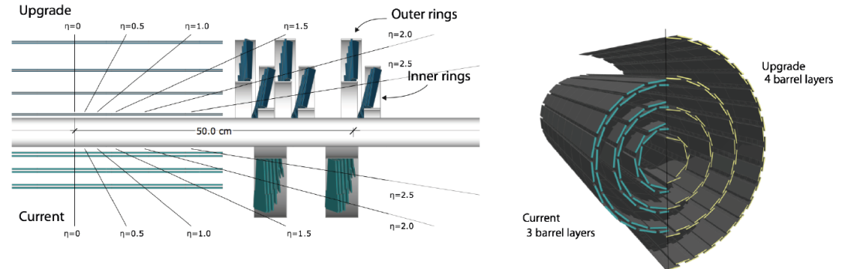
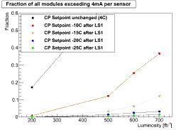
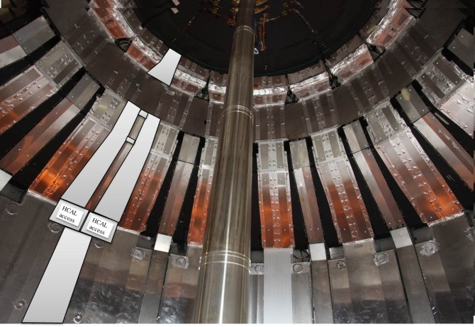
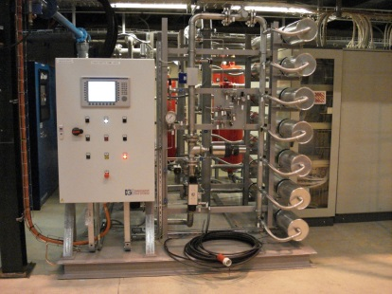
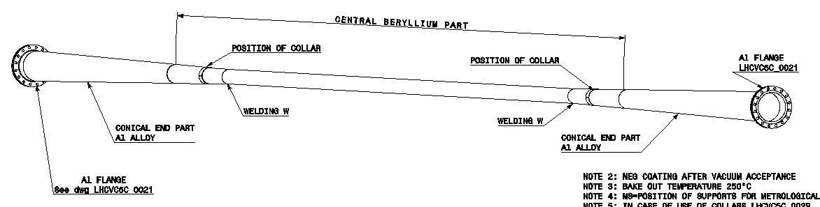
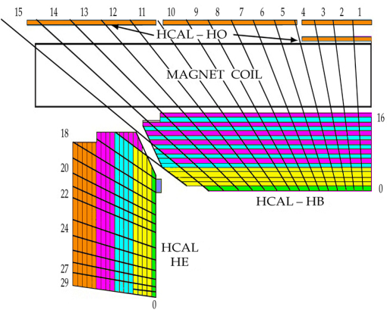
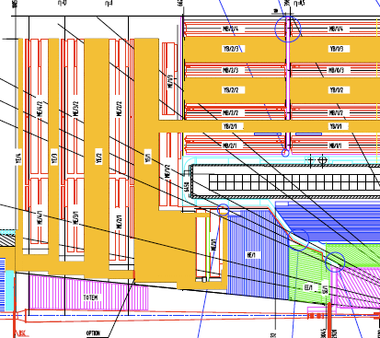
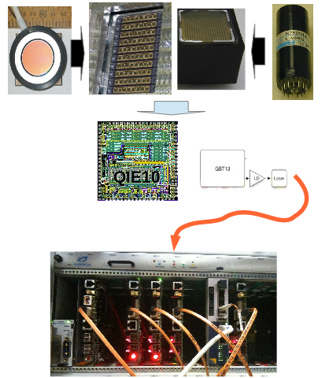
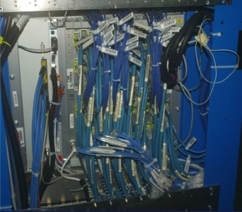
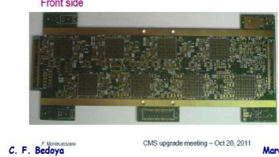
CMS LS1: overview (1)
For Pixel upgrade in YETS16-17
CO2 cooling
TK colder
New central beampipe
Dry gas
4th muon station & disk YE4, CSC4/RE 4
HCAL Phototransducers, cabling, CCMs
HCAL HF
HB,HE.HF
Ist muon station (ME1/1) refit
Muon DT: TRB, sector collectors to USC

Slide 11
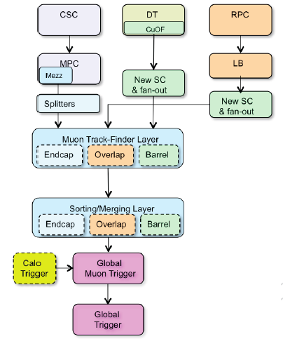
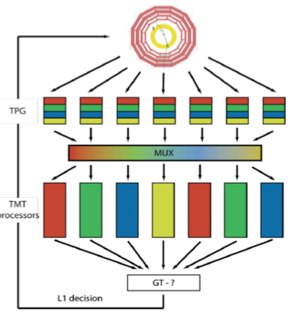
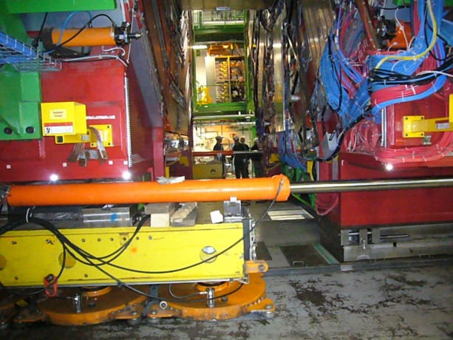
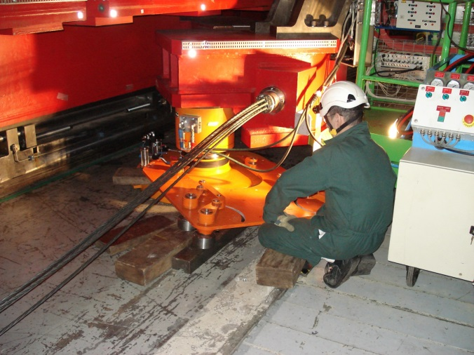
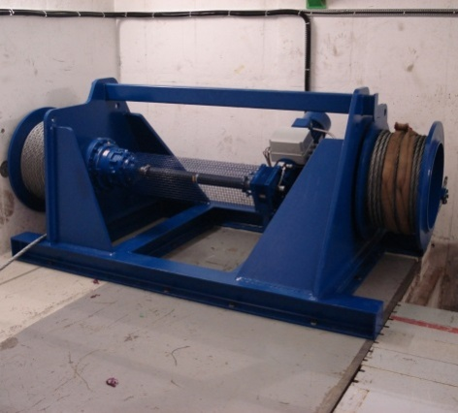
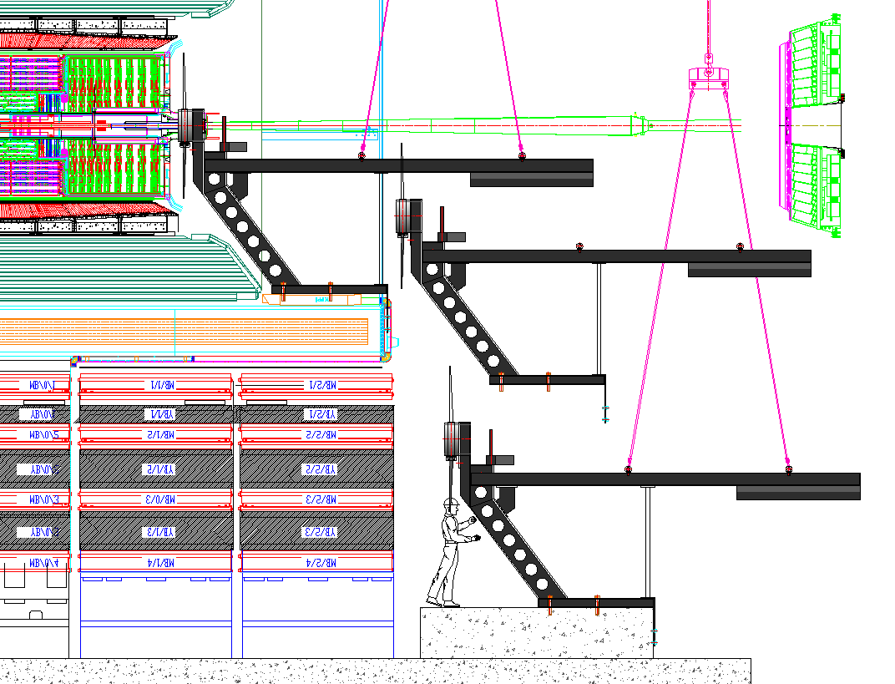
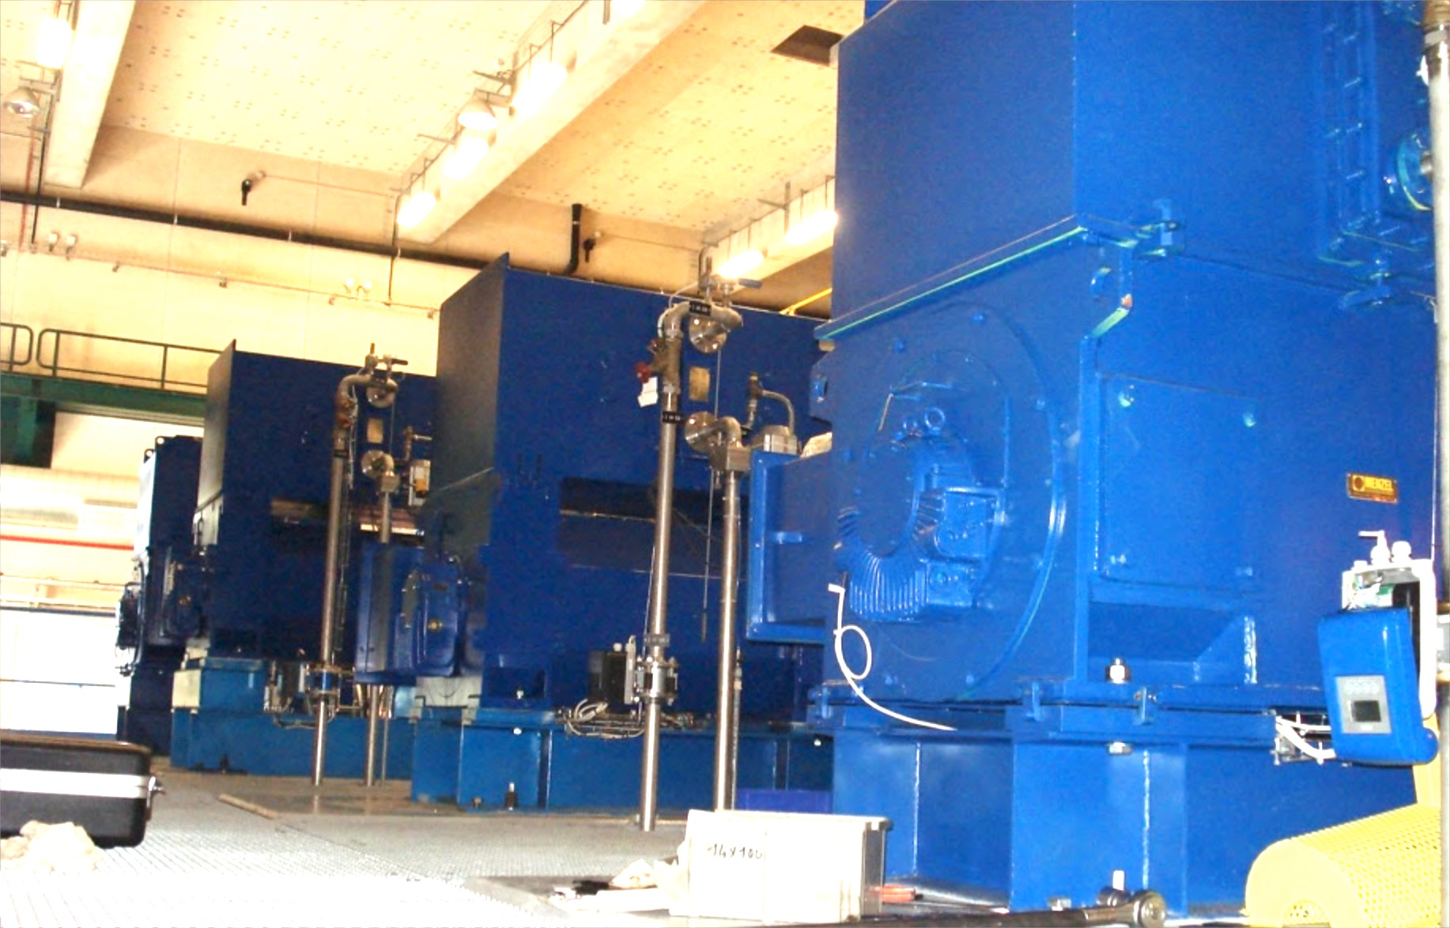
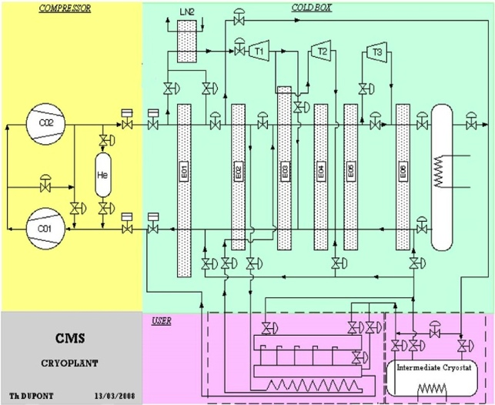
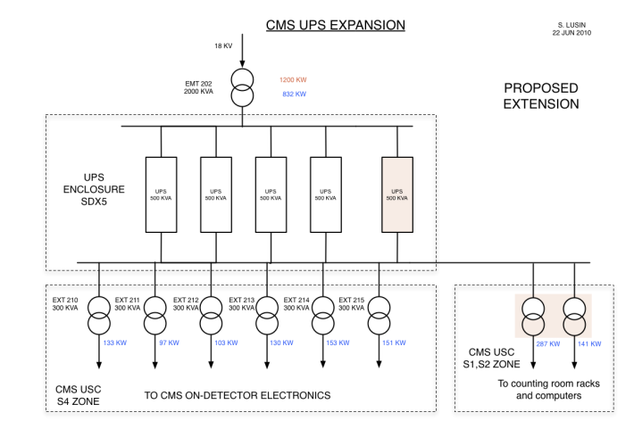
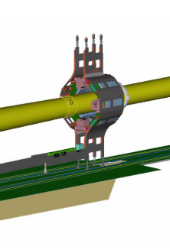
CMS LS1: overview (2)
TRG
Layer 1
Layer 2
Moving system
Demux
Trigger : L1 upgrade cabling & splitters
Mag/cryo (power, compressors, He dryers)
Future RP Shielding tests
Power distr/UPS
Beam/
Lumi
Mon
BCM/PLT

Slide 12
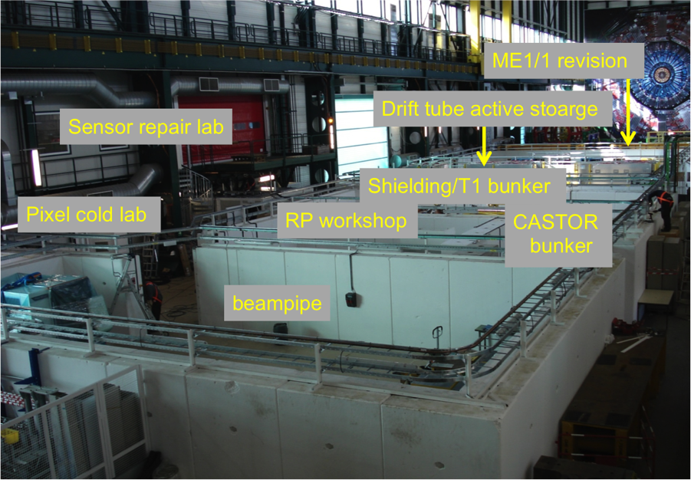
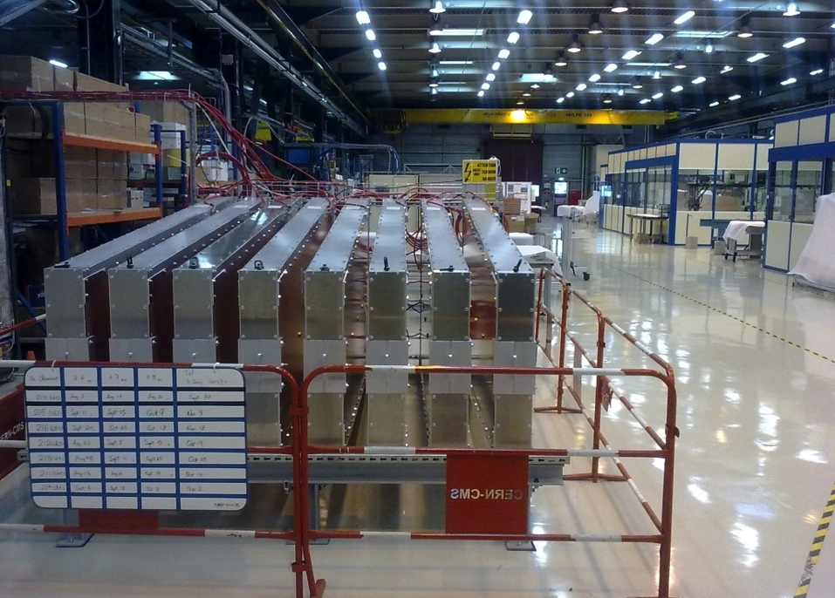
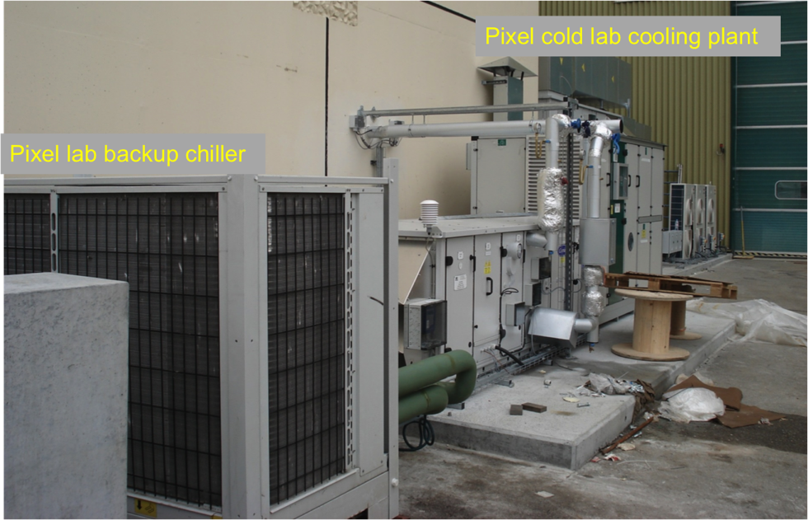
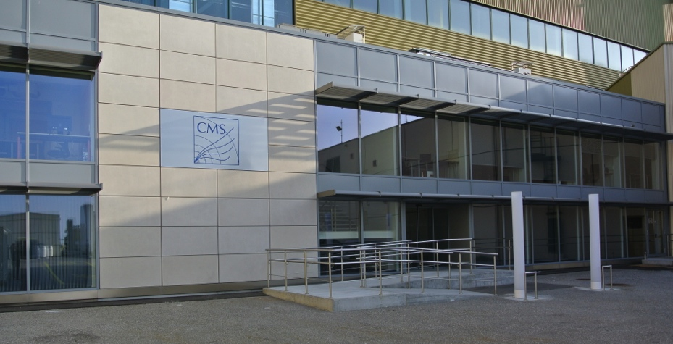
CMS LS1: surface facilities
SX5 Operational support centre (labs)
Bldg 904 assembly labs
Pixel cold lab
SL53 : visitor reception, meeting rooms and offices

Slide 13
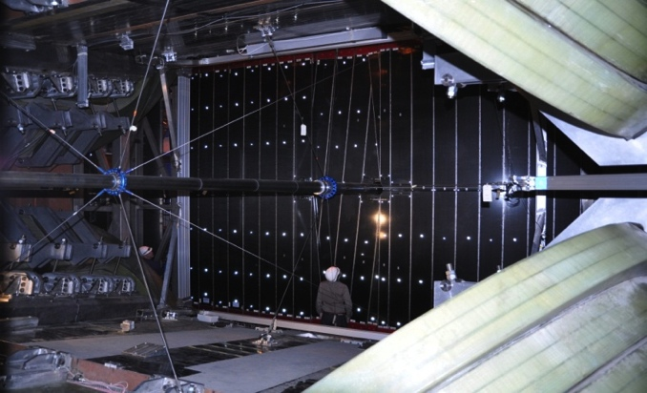
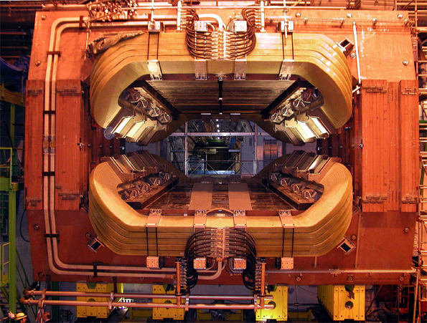
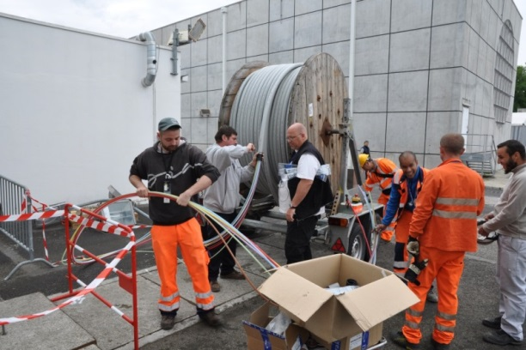
LHCb LS1: main projects
Beam pipe
Exchange of the LHCb beam pipe section UX85/3.
New and much lighter support structure of the beam pipe section UX85/2 and /3.
Required the dismounting of section 2,3 and 4 (16.5 m)
UX85/2
UX85/3
Groups involved TE/VSC, EN/MEF/SU
Support structure
LHCb Dipole:
Replacing of mechanical protection between magnet coils and support structure.
Upper Coil
Support
Required displacing of both coils, each 25tons.
Lower Coil
Groups involved PH/DT, EN/MEF/SU
Upgrade (Full LHCb upgrade installation
scheduled for 2018/19)
First preparation of infrastructure, cable trays for optical fibers and their support structure from the underground to the surface, 330m.
Groups involved EN/EL, EN/MEF, GS

Slide 14
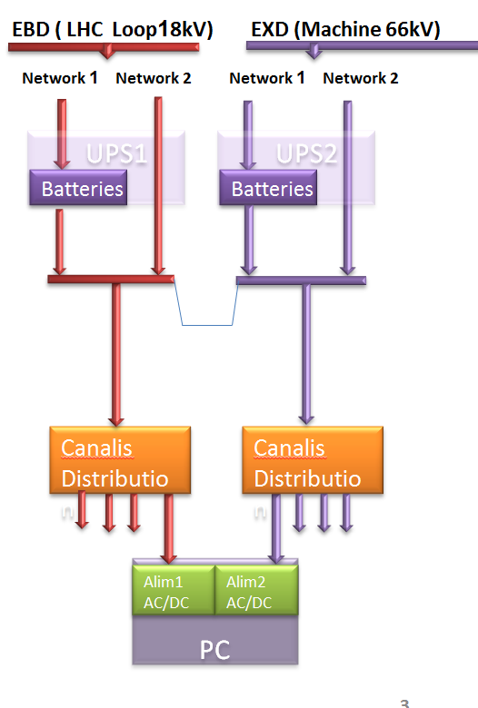
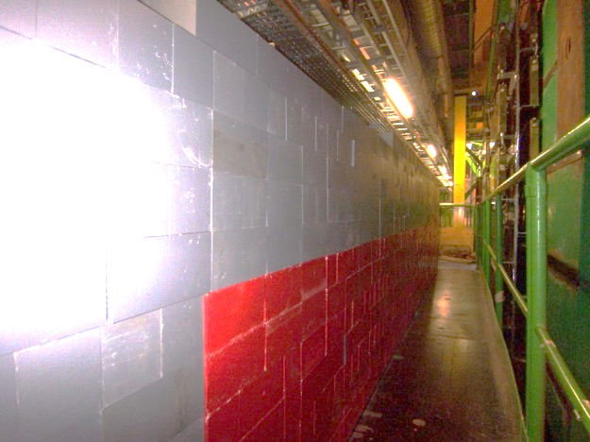
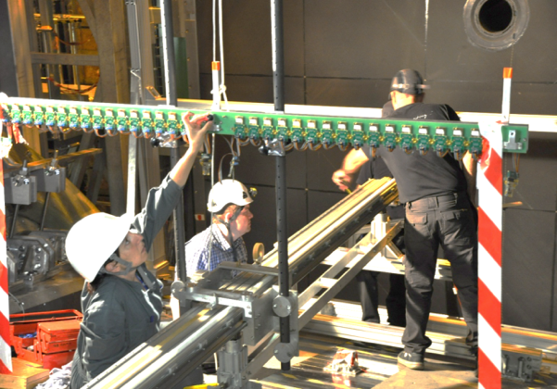
LHCb LS1: infrastructure
Consolidation of electrical power network: UPS
INTRODUCE REDUNDANCY AT ALL LEVELS
At the surface for online
UX85-D2 Control PCs
UX85-PZ MSS and DSS
13,5 T of hardware installed (+new metallic structures and lifting tools)
Groups involved: EN/EL, EN/HE, EN/MEF
Additional shielding
downstream of the expt
2100 iron bricks, ~30 Tons
installed in a confined and
difficult accessible area.
Groups involved: EN/HE
Extensive magnetic field measurement
Installation of measurement bench.
Surveying all position, before, during & after magnet on.
4680 measurement points inside dipole volume.
Groups involved: EN/MEF/SU, PH/DT

Slide 15
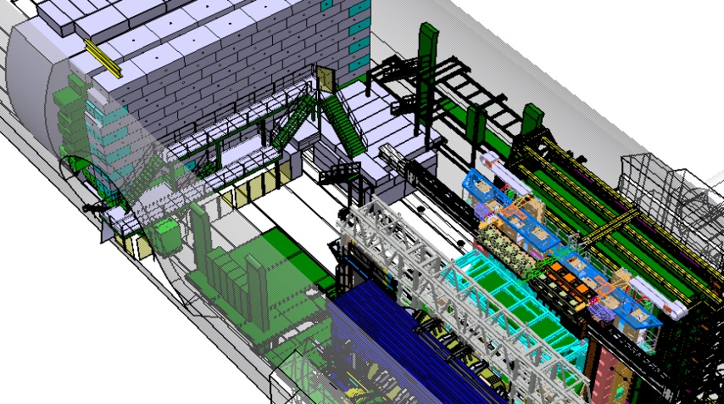

LHCb: LS1 infrastructure
Visitor Platform
New gangway for increased number of visitors and improved safety with easy access.
New building for
Control rooms for LHCb and LHC cryogenics
Conference room and office space.
Groups involved: EN/CV, EN/EL, GS, HSE, IT
All sub detectors had been opened for service repair, maintenance and consolidation!

Slide 16
Technical departments: specialist support
Transport – movement between sites, specialist rigging on sites
crane & lift maintenance & improvement OK
Safety – safety coordinators (with field exp) -present at every VIC OK
(also DG units for RP OK ; depends on expt RPE/RPA)
HSE certification – lacking pragmatism)
Survey – at times almost half critical path task are survey OK
status quo at opening & alignment when closing
geometry of existing/new elements
reference to beamline & cavern movements
Asst surveyors from expts vital: but M & O paying for a host lab function?
- is likely to become harder in future.
Access and general safety/alarm systems OK
issues of costs & “host-lab” responsibility boundaries
Beampipe & Vacuum - removal/ re-installation of vacuum chambers OK
bakeout/inert gas fill/pumpdown
concerns about fragmentation/contact person/expertise continuity
DSS – consolidation/update : concerns: s/w support accessibility/backup OK

Slide 17
Technical departments: specialist support
Electrical supply – maintenance of power converters OK
transformers, switchboards etc OK
IT infrastructure: Maintenance and update (eg starpoints). New items costs? OK
Cooling systems - maintenance of cooling towers, chillers, pumps, filters etc
- provision of temporary cooling was well handled OK
procedures/communications to improve
Compressed air systems - maintenance of compressors & pneumatic control OK
within current limits of supply
Cryogenics - shutdown, routine maintenance and startup OK
under-resourced
Gas supply - maintenance/revision of delivery points, bottle status indicators etc
improve procedures EN/expts/PH-DT OK
FSU – important source of manpower for electrical, mechanical techs
some prompt hires for LS1 not of highest quality OK

Slide 18
Projects (1)
Beampipe & vacuum OK
new chambers: joint design
procurement
reception, flanges, supports
testing, coating
consolidation of gas injection & evacuation
concerns about engineering continuity.
Electrical systems consolidation to prepare for new subsystems (extra load) OK reduce vulnerability to glitches
protect sensitive, unique equipment
Expts had to step in: to fill gaps in proj definition and supervision
to coordinate across sections & groups
missing host lab proj engineer function
Cooling systems consolidation to prepare colder operation of Si systems OK
make provision for new detectors
improve diagnostics & robustness
room to improve procedures/ communications

Slide 19
Projects (2)
Dry gas systems upgrade improved control of detector environment OK
Expt equipment in LSS issues during transition LTEX to TREX
-- uncertainty in scope of support
Surface facilities OK
detector assembly labs
new meeting/reception/office/control bldgs
storage buildings
needed expts to coordinate between EN/GS/IT etc
different tech specs between EN/GS/IT – source of friction
machine/tertiary definition/confusion not helpful
limited cost control scrutiny unless by expts.
Special shielding preparation OK

Slide 20
Planning & workflow management
PLAN worked – though not transparent how and why? OK
- service groups filled in the request on expts behalf.
- but tracing how they appeared was a mystery (to us!)
- other documents agredd with depts/groups were the reference for us
flexibility to accommodate new requests throughout LS1 was maintained
IMPACT: common use satisfactory OK
- simplify user interface?
Experimental Area management
- vital function for expt- tech sector liaison & interface
disengaged from technical sector over last few years
→ must be fully & formally taken over by PH.
- all experiments found short-term ways to cope satisfactorily in LS1
as the situation was clear from the outset.
- clear shortfall in host lab function
expt budgets cannot be expected to compensate this in future

Slide 21
Main themes arising from LS1 experience
project engineering/supervision resources insufficient
from tech spec to completion on site
shortfall in provision for “host lab” responsibilities
will not work to expect expt collaborations to compensate
re-examine definitions/provision with Tech sector & PH
“limits of supply” of tech depts to be re-discussed/re-optimised.
(tech sector + expts + PH)
[More resources must be found within CERN
option → increase in PH dept technical reponsibilities/resources?]
cost control scrutiny and oversight could/must be improved
experiment budgets (from outside CERN) keenly scrutinised
frame contract system & internal (monopoly) market flawed
(award of contracts still under-weights technical advice)

Slide 22
Conclusion
Technical Depts delivered on all tasks requested
& collaborative atmosphere was very generally very good
a very big THANK YOU from all the experiments!!
but
expt collaborations will not be able to provide a similar level of engineering & supervisory resources in future shutdowns

