Slide 1
From flipchart to glossy visualization through collaboration and d3.js
D. Mazur

Slide 2





Slide 3
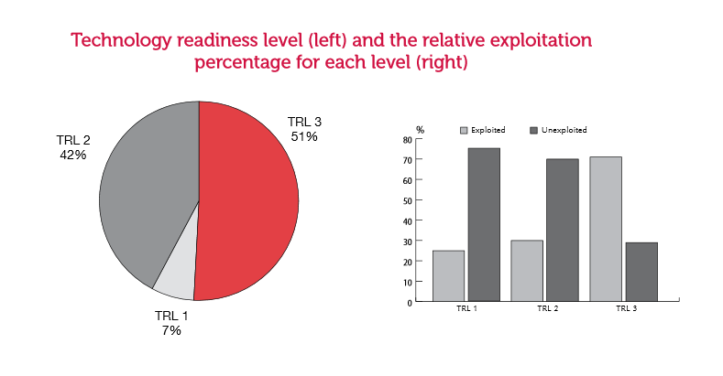
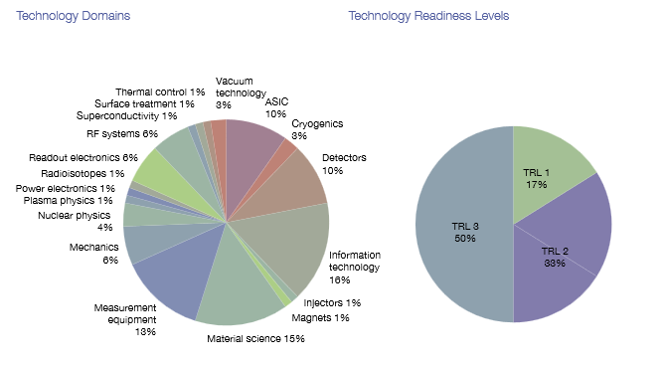
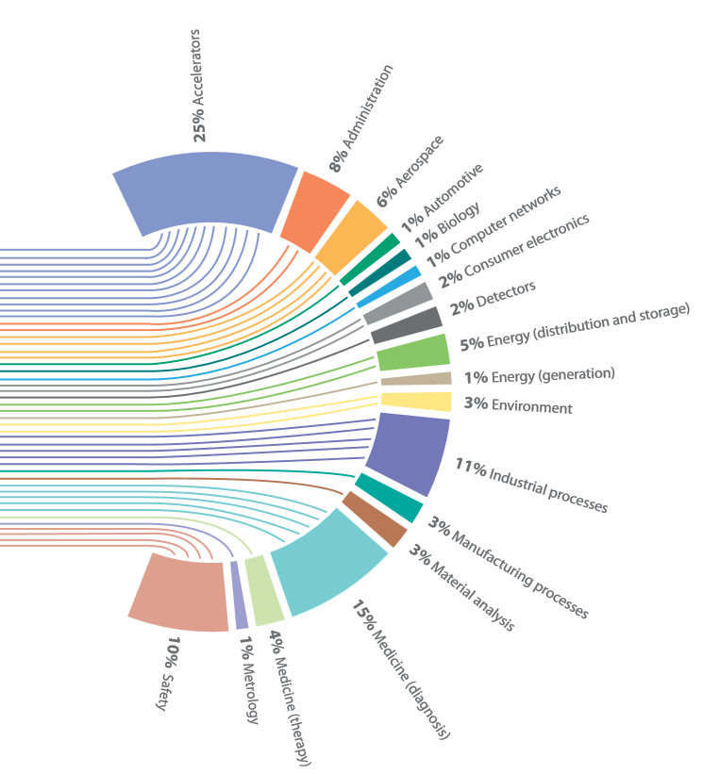
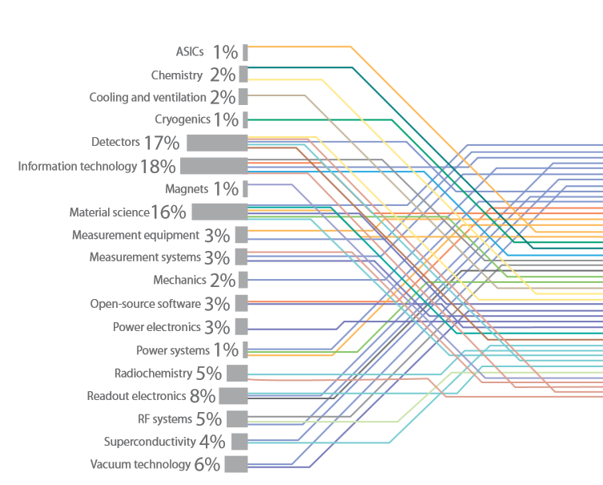
Data Visualization
2012
2011
2013

Slide 4
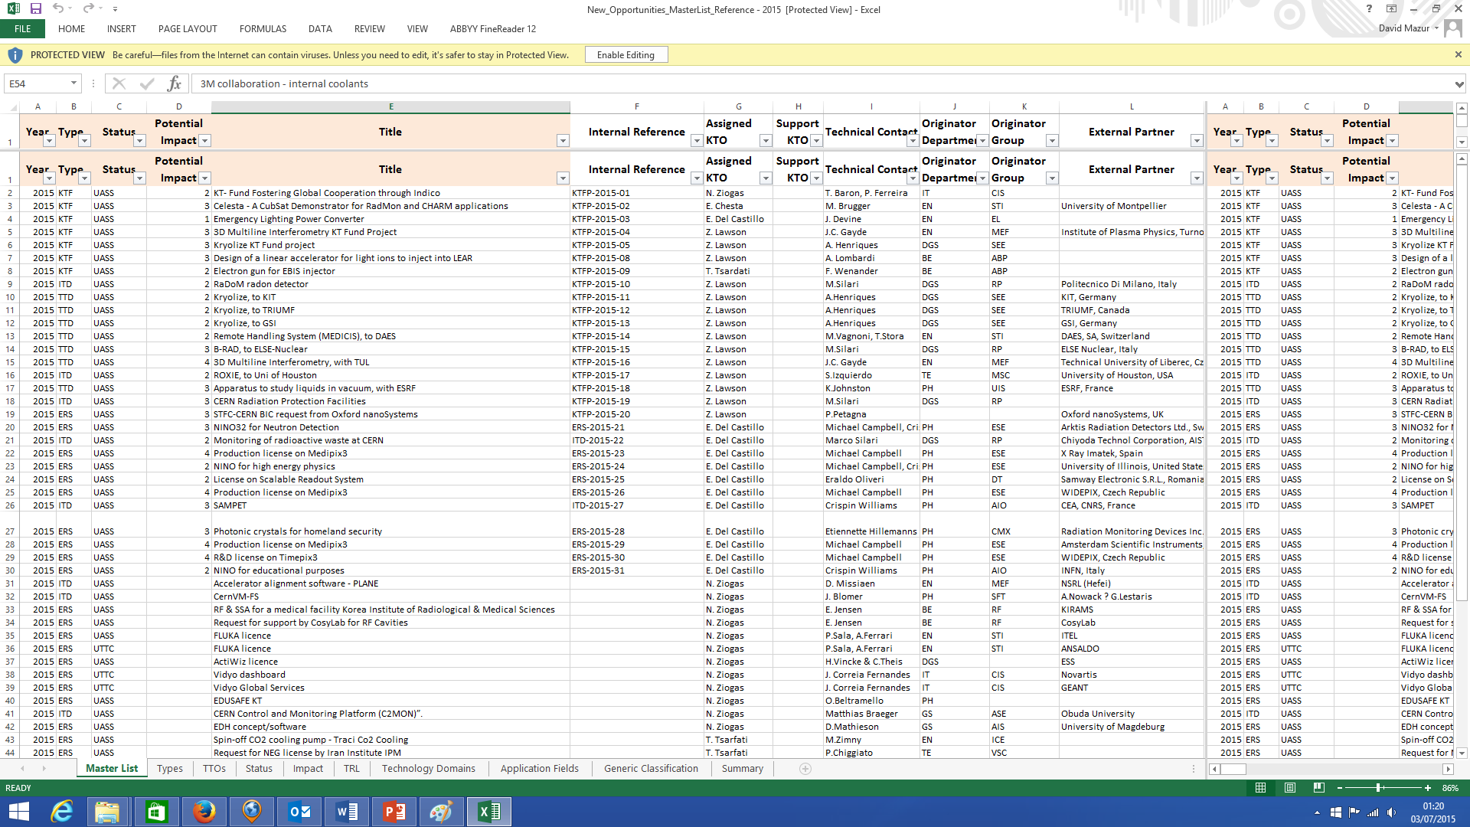

Slide 5
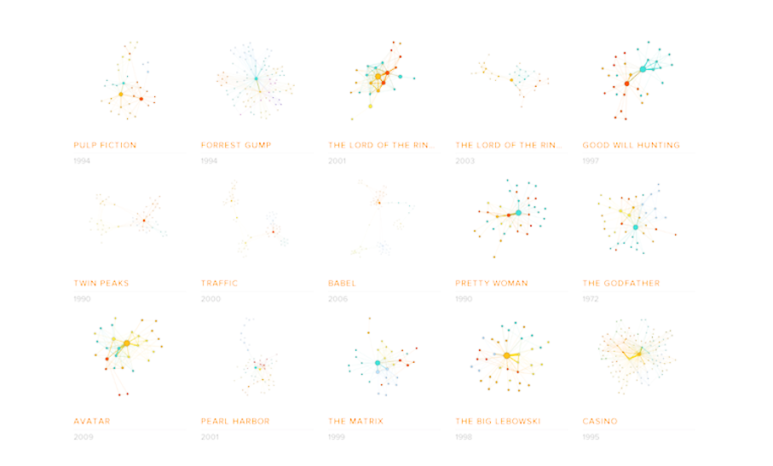
Data visualization course
For all the people involved in preparing visualizations for the KT annual report
Focused on method, not tools
1 day course
+ 0.5 day working in teams on a visualization

Slide 6
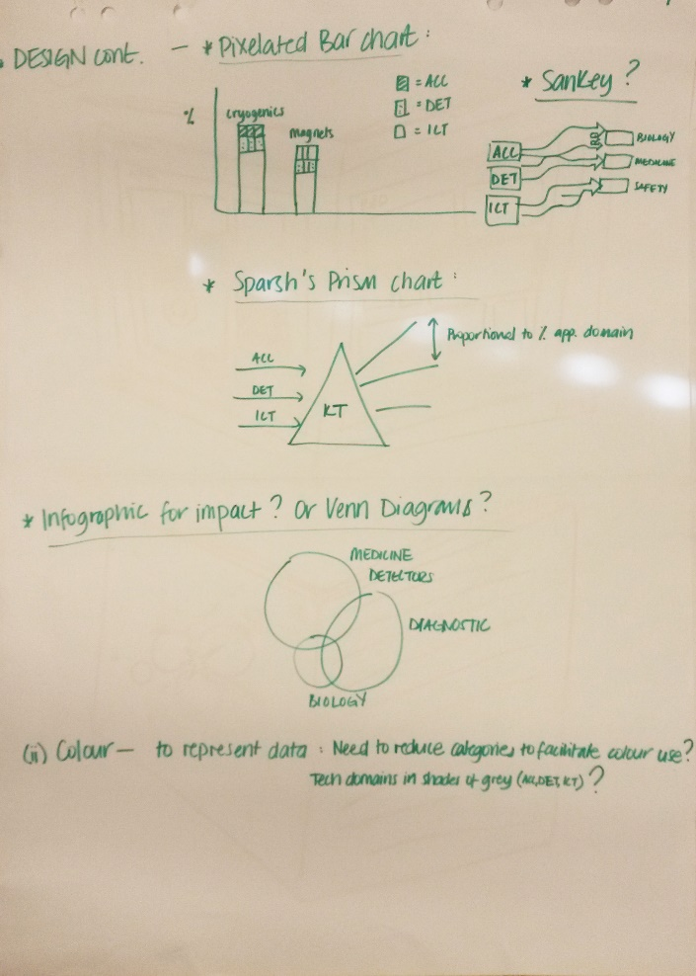
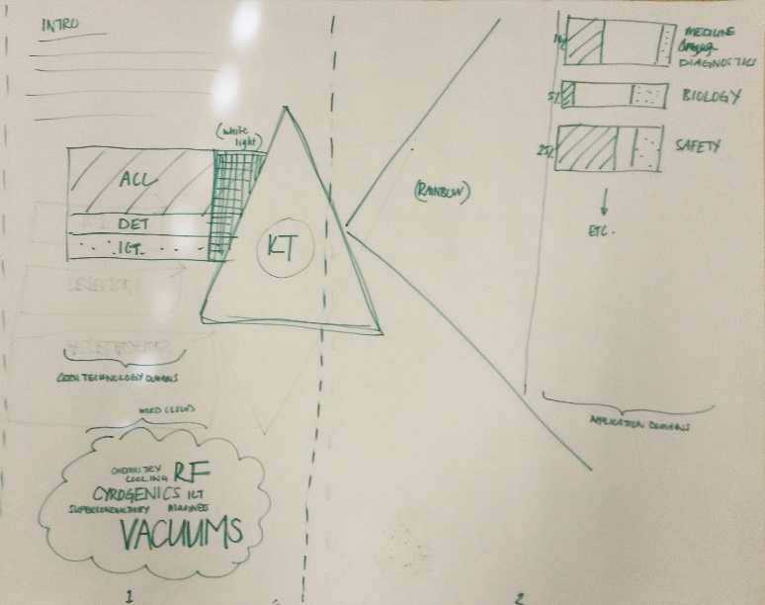
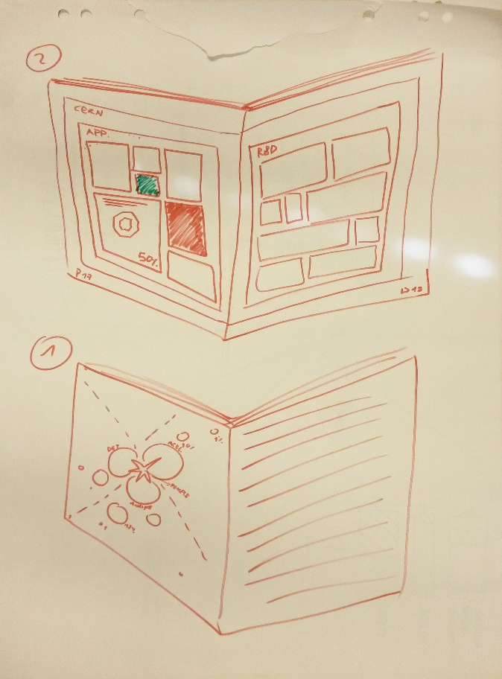
Step 1: Sketches

Slide 7
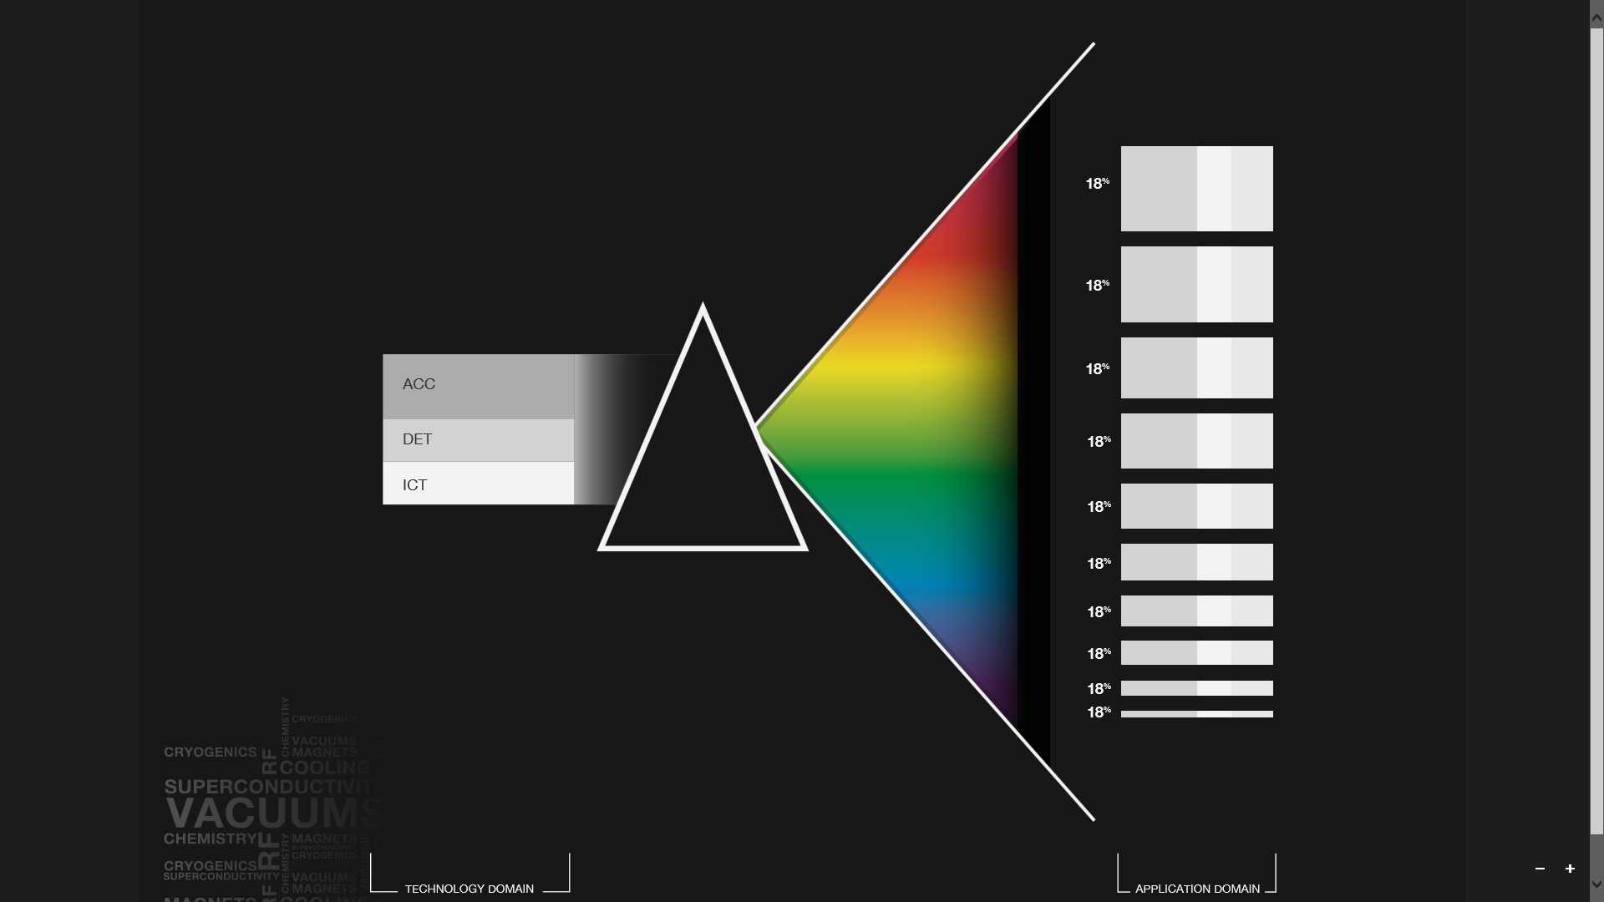
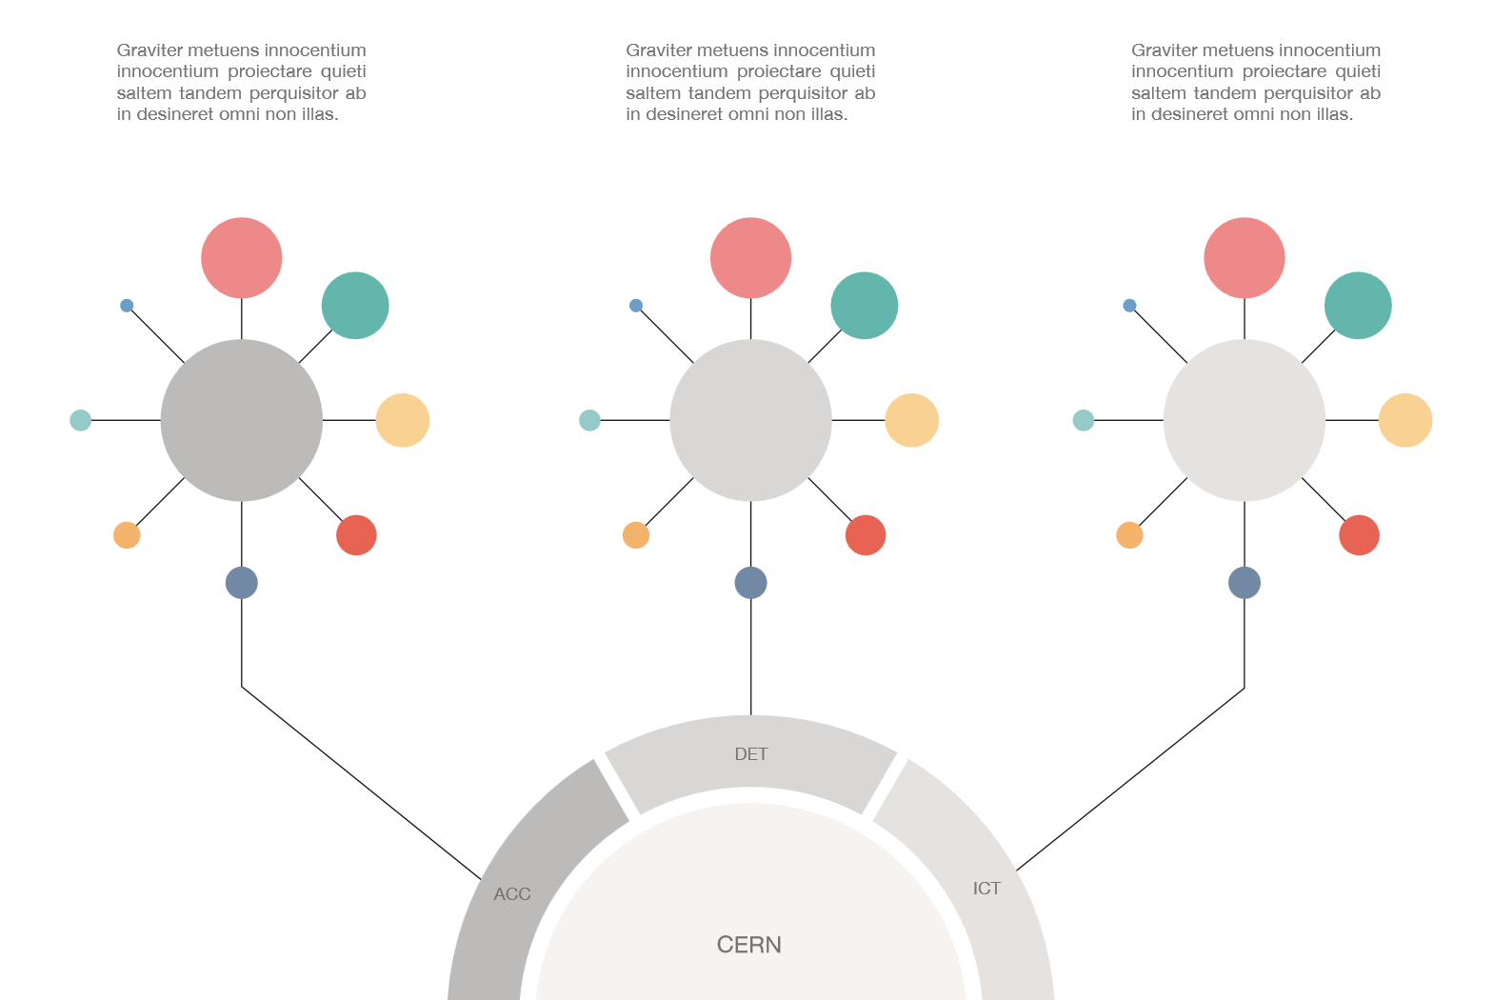
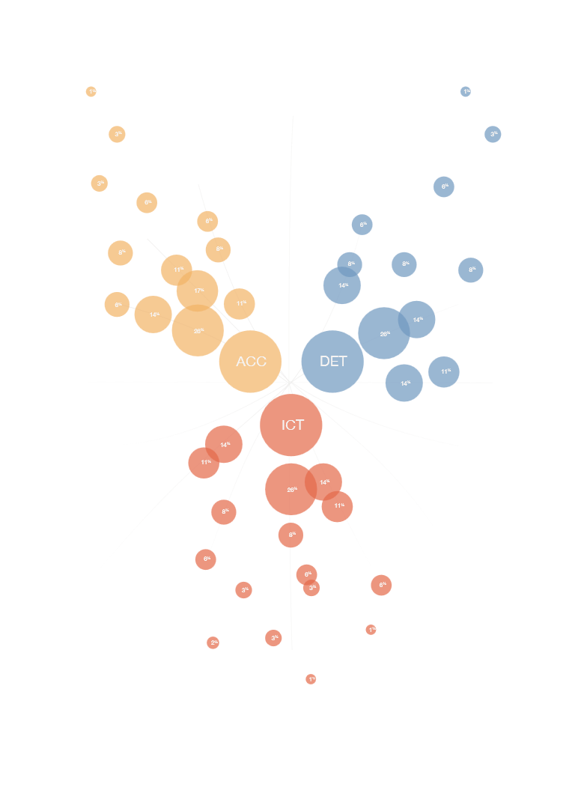
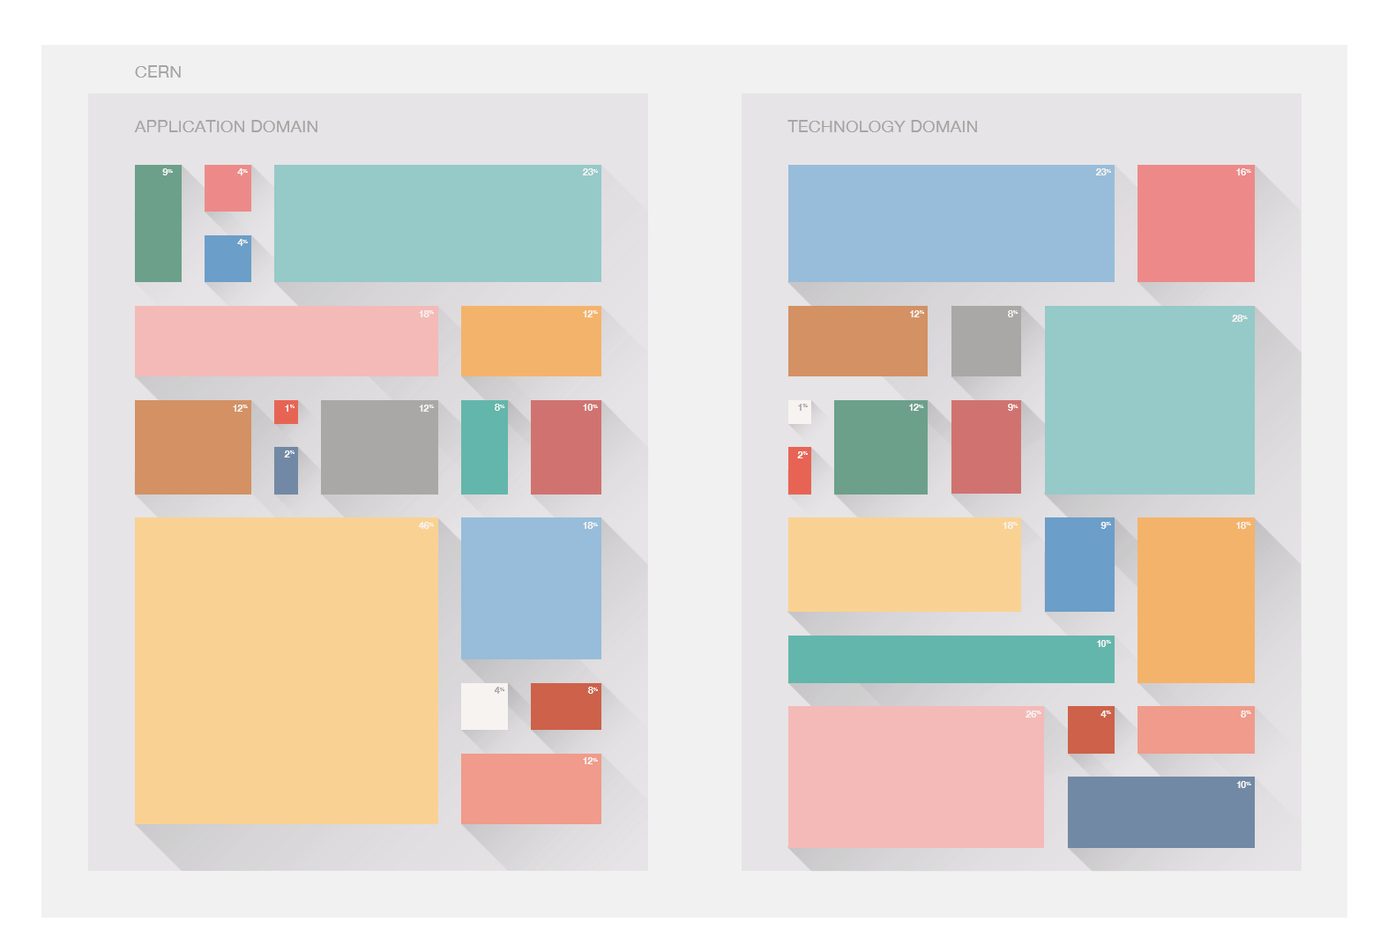
Step 2: Mockups

Slide 8
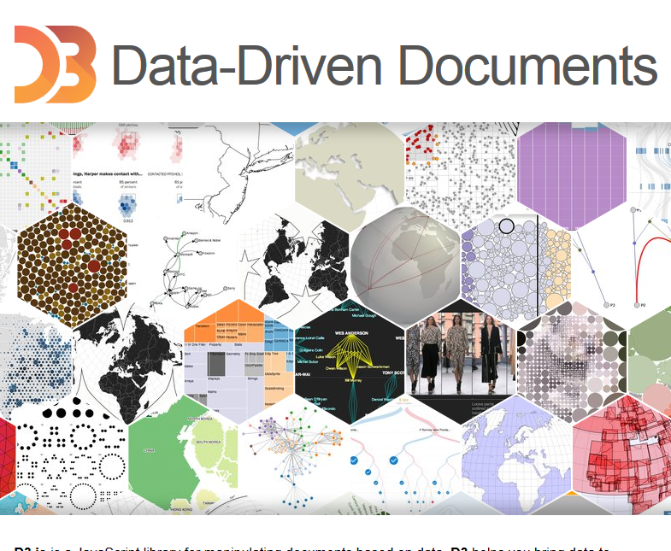


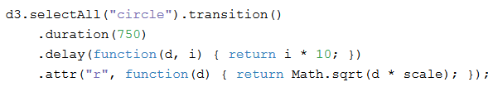
D3 JS
Javascript Data Visualization
library
  Selections
  Dynamic properties
  Transitions – Interactions and animations
http://d3js.org
+ loading of CSV files !

Slide 9
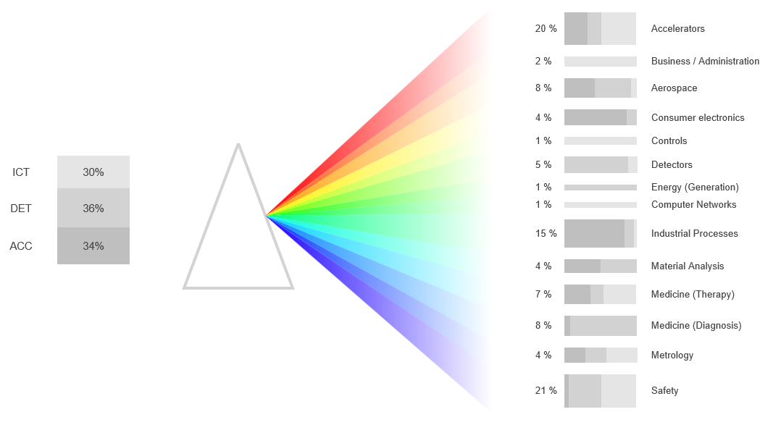
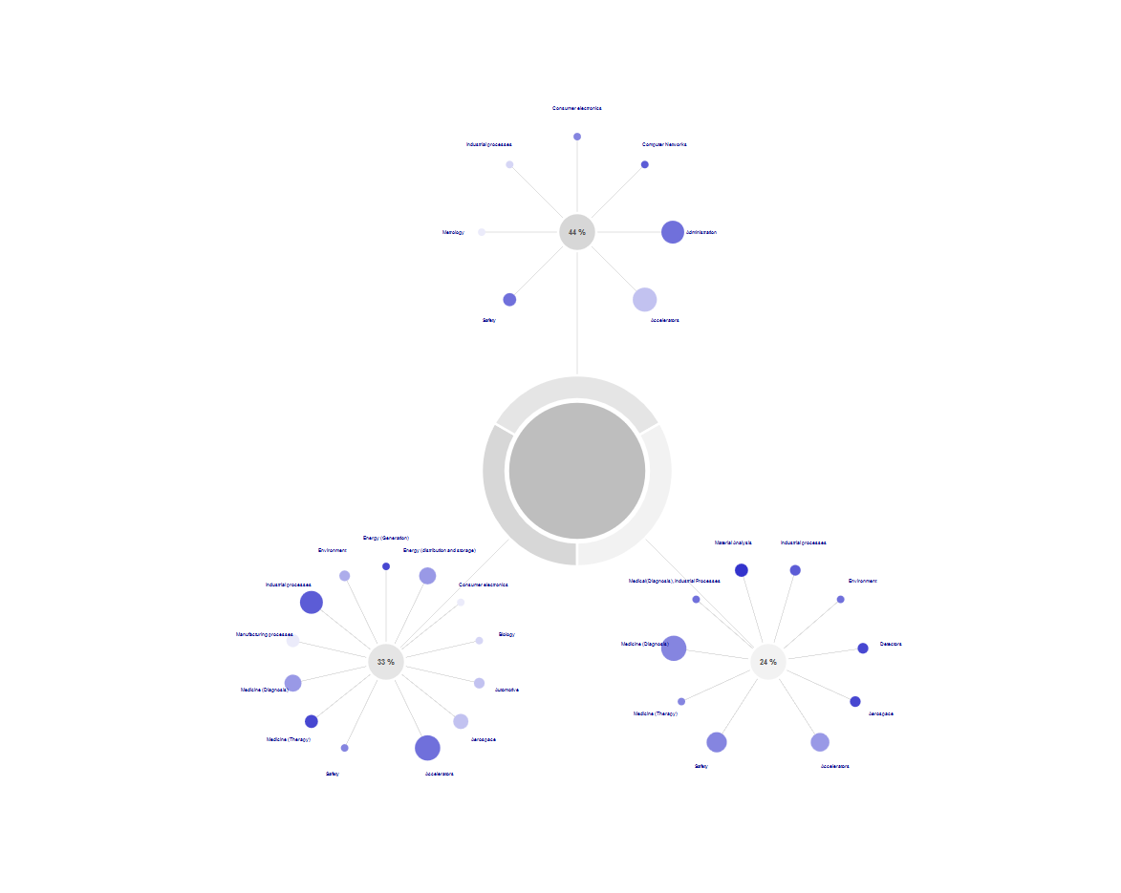
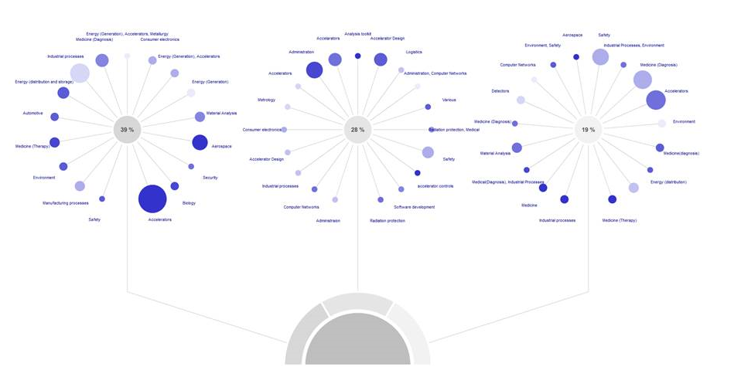
Step 3:
D3 JS models

Slide 10
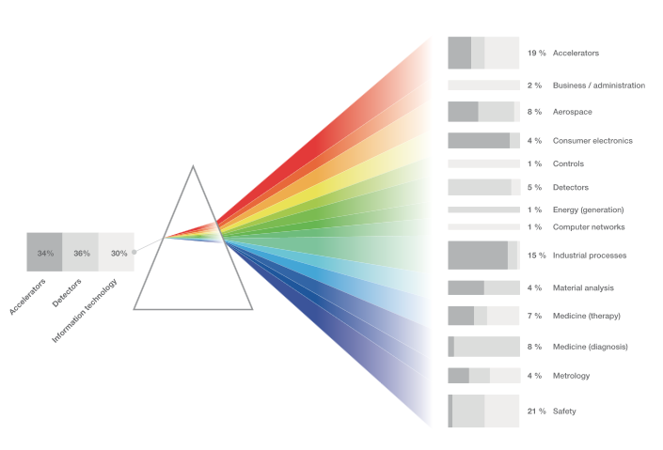
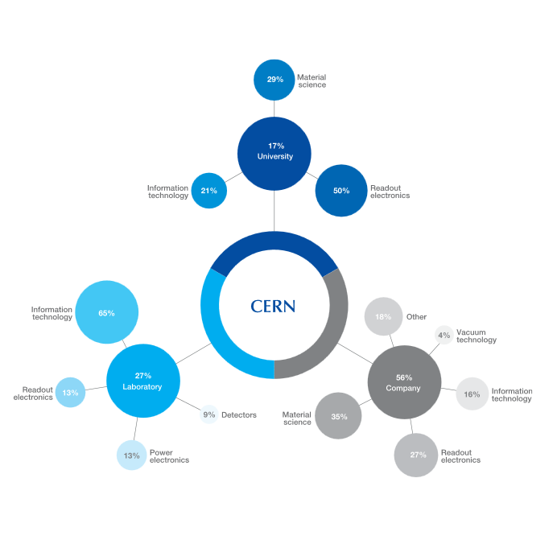
Step 4: Graphical design

Slide 11
Lessons and question
Data visualization is a multidisciplinary team sport
Tools like D3 JS help to see how the final visualization looks like
Important to play around
Question: data visualization community at CERN ?

