Slide 1
Layout update in IR1/5
G. Arduini, R. De Maria, M. Fitterer, M. Giovannozzi
Thanks to S. Fartoukh, P. Fessia, C. Garion, C. Magnier, H. Prin, E. Todesco, B. Vasquez De Prada

Slide 2
Introduction and outline
Layout changes
Optics changes
Aperture
Next activities
Summary

Slide 3
Layout: V1.1 -> V1.2 in IR1 and IR5
Changes | by
Triplet gradient reduction. New length, position; D1 position changed by 2.35 m towards the arc. | WP3, WP15
TAXS moved towards the IP by 0.33 m (better integration) | WP2, WP8, WP15
D1/D2 integrated strength from 33.4 Tm to 35 Tm (reduced CC voltage) resulting in TAXN-D2-CRAB rigid shift (0.18 m towards the arc) | WP2
no D2/Q4 mask, more space between TCTs/TCLs | WP10, WP15
MCBRD – MCBYY length (1.5 m -> 1.8 m) for larger integrated strength | WP3, WP2, WP15
D2, Q4 and Q5 orbit corrector orientations | WP2, WP15
Q4-Q5 position re-optimized (reduced CC voltage) | WP2
Minor changes of all interconnection lengths | WP15
Changes implemented in optics files. TODO:
  BPM position to be iterated with Blanca
  TCL.6 (maybe even the TCTs) to be iterated with Collimation team
  Renamed TCT.5 in TCT.6 (S. Chemli)
  Wire space reservation (WP2)

Slide 4
Optics V1.1 -> V1.2
Increase pre-squeeze β* 44 cm -> 48 cm (due to lower triplet gradient)
Increased peak β at constant β* by 5% (due to lower triplet gradient)
Typical ATS squeeze, injection, VDM updated
Provided alignment optics for BPM calibration
Offset knobs ± 2mm introduced due to recent requests from Experiments
Lumi scan knobs in the shadow of this knob with ~100 μm range
TODO:
  β_{x,y} in Q4 tunability range
  IR8 ATS with β*< 3 m and IP longitudinal shift for LHCb new requests
  IR4 optics optimization for instrumentation and e-lens (received only generic optics specifications)
  IR6 optics optimization (no feedback yet LBDS constraints)
  Include D1/D2 transfer function correction if powered in series (not likely to happen)
  Exotic optics: no ATS (no IP phase constraint), ATS2 (suboptimal arc matching) to increase Q4 β_{x,y} tunability range at the cost of chromatic correction and/or arc aperture.

Slide 5
Squeezed optics
β* pre-squeeze: 44 cm -> 48 cm
Crab cavity: 12 MV needed for 590 μrad
New squeeze transitions needed for flat optics to have β*= 40 cm in the crossing plane.
Optics provided:
β* | 15 cm | 7.5 cm/30 cm | 20 cm | 10 cm/40 cm
Crossing angle | ± 295 μrad | ± 245 μrad | ± 255 μrad | ± 210 μrad
 | 12.5 σ | 14.5 σ | 12.5 σ | 14.5 σ
Separation | ± 2 mm | ± 0.75 mm | ± 2 mm | ± 0.75 mm

Slide 6
Aperture margins
Layout and optics define nominal orbit and beam sizes.
Geometry of the vacuum system (e.g. beam screens inner dimensions with tolerances).
Operational tolerances on beam size are added to the actual beam size.
Alignment and fiducialization tolerances are subtracted from available aperture.
The difference in units of beam sigma is calculated and compared with the aperture protected by the collimation systems

Slide 7
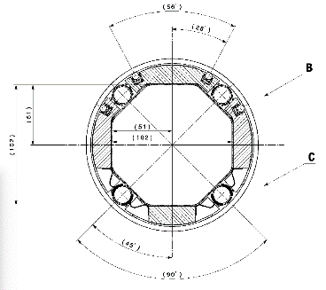
Aperture triplet region
Triplet beam screens, C. Garion
Octagonal beam screens for triplets/D1 with tungsten shielding have been designed.
Expected straightness: 0.5 mm
Shape tolerance: ± 1 mm (C. Garion 12/06/2015 ), to be confirmed by the prototype.
The possibility of reducing the tungsten layer thanks to alternating crossing planes (F. Cerutti, S. Fartoukh) should be checked.
cooling
shielding
Element | H or V gap [mm] | 45° gap [mm]
Q1 | 102-1.5 | 102-1.5
Q2-Q3-CP | 122-1.5 | 114-1.5
D1 | 122-1.5 | 114-1.5

Slide 8
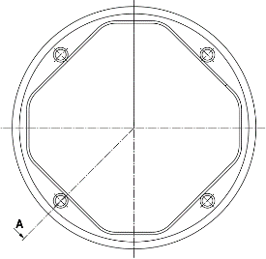
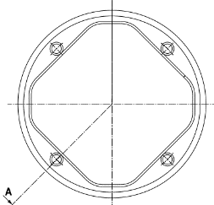
Aperture D2-Q4-Q5
New D2-Q4 octagonal beam screens have been designed, no tolerances given, yet.
Q5 beam screens (RectEllipse) oriented for collision optics aperture optimizations.
Same triplet tolerances removed from the mechanical dimensions.
D2
C. Garion, no tolerances included
Element | H or V gap [mm] | 45° gap [mm]
MBRD | 87.0-1.5 | 78.0-1.5
MQYY | 78.5-1.5 | 63.8-1.5
Q5 | 57.8, 48.0
Q4

Slide 9
Orbit corrector knobs
IP crossing, separation, offset (x: ±295 μrad, , s: ±0.75 mm, o: ±2.0 mm)
beam based alignment of crab cavities: ccp, ccm (shift): ±0.5 mm, ccs (slope): ±0.25 mm
IT alignment and transfer function errors (err): ±0.5 mm transverse, ±10 mm longitudinal, ±2x10⁻³ relative gradient error, ±2x10⁻³ D2 relative field error.
orbit correction from the arc (to confirmed): arc 0.7 Tm;
lumi scan knobs (single beam IP shift for 100μm)
 | x-scheme [Tm] |  |  | cc alignment [Tm] |  |  | err [Tm] | arc [Tm] | lumi [Tm] | summary [Tm]
name | x | s | o | ccp | ccm | ccs | err | arc | lumi | tot | max | margin [%]
MCBX1 | 0.14 | 0.11 | 1.16 | 0.19 | 0 | 0 | 0.92 | 0 | 0 | 2.42 | 2.5 | 3.30
MCBX2 | 0.07 | 0.05 | 0.79 | 0.19 | 0 | 0 | 1.40 | 0 | 0 | 2.17 | 2.5 | 1.53
MCBX3 | 2.11 | 0.2 | 0.94 | 0.45 | 0.15 | 0 | 0.78 | 0 | 0 | 4.43 | 4.5 | 1.45
MCBRD4 | 2.97 | 0.09 | 0 | 0.28 | 0.15 | 0.52 | 0.11 | 0.35 | 0.27 | 4.60 | 4.5 | -2.89
MCBYY4 | 1.49 | 0.04 | 0.12 | 0.42 | 0.42 | 0.92 | 0 | 0.35 | 0.20 | 4.74 | 4.5 | -5.39
MCBY5 | 0 | 0 | 1.35 | 0.40 | 0.40 | 0.35 | 0 | 0 | 0 | 2.46 | 2.7 | 8.9
MCBY5 | 0 | 0 | 0 | 0 | 0 | 0 | 0 | 0.7 | 0 | 0.7 | 2.7 | 26
MCBC6 | 0 | 0 | 0.46 | 0 | 0 | 0 | 0 | 0.7 | 0 | 0.46 | 2.8 | 83.4
MCBC7 | 0 | 0 | 1.40 | 0 | 0 | 0 | 0 | 0.7 | 0 | 1.40 | 2.8 | 50
Studying re-sharing forces with new crossing and separation scenarios
  MCBRD/YY length increase 1.6 m -> 1.8 m needed

Slide 10
Beam tolerances and collimation protection
Beam tolerances have been re-defined by:
Taking into account LHC Run I successful experience
Adding safety margins based on possible unknowns.
For collimation:
magnet protected by TCT: ≥ 12 σ
magnet not protect by TCT: 18 σ⁽²⁾ or possibly less, pending dedicated studies (R. Bruce) .
Beam Tolerance | LHC DR Inj./Coll. | HL-LHC Inj./Coll.
Emittance [µm] (normalization only) | 3.75/3.75 | 3.5/3.5
β-beating [%] | 20/20 | 10/20
Orbit error [mm] | 4/3 | 4/2
Spurious Disp. [%] | 27.3/27.3 | 14/10
Δp/p [10⁻⁴] | 15/8.6 | 6/2
Target aperture [σ] | 8.4/8.4 | 9⁽¹⁾/12 (18⁽²⁾)
R. Bruce et al., CERN-ACC-2014-0044
Minimum aperture not protected by TCT in collision and aperture targets at injection should be confirmed by WP5⁽²⁾ and WP14⁽¹⁾.

Slide 11
Aperture vs optics for baseline
 | Round 15 cm | Round 20 cm | Flat 7.5 cm | Flat 10 cm
 | [σ] | [σ] | [σ] | [σ]
TAXS | 9.9 | 12.1 | 9.6 | 11.3
MQXFA.[AB]1 | 13.2 | 16 | 12.3 | 14.2
MQXFB.[AB]2 | 9.4 | 11.7 | 9.7 | 11.2
MQXFA.[AB]3 | 9.5 | 11.8 | 10 | 11.6
MBXF | 10.7 | 13.1 | 10.6 | 12.3
TAXN | 11.6 | 13.8 | 9.5 | 11.0
MBRD | 13.1 | 15.3 | 11.1 | 12.8
MCBRD | 16 | 18.7 | 13.7 | 15.4
MCBYY | 15.4 | 17.9 | 13.4 | 15.5
MQYY | 16.3 | 18.9 | 13.9 | 16.1
TCLMB.5 | 20.3 | 23.5 | 14.5 | 16.8
MCBY[HV].5 | 20.6 | 23.9 | 15 | 17.3
MQY.5 | 21.4 | 24.7 | 15.3 | 17.7
TCLMC.6 | 21.2 | 24.6 | 15 | 17.4
MCBC[HV].6 | 24.7 | 28.5 | 17.4 | 20.1
MQML.6 | 21.8 | 25.2 | 15.7 | 18.1
Aperture includes worst case scenarios for all knobs (IP crossing, separation, offset, crab cavity offset) assuming linear addition
Aperture in the triplets can be recovered by:
reducing crossing angle (round optics) and separation (flat optics) if one assumes that β* levelling is feasible
reducing beam screen/cold bore tolerances, shielding thickness (see US-LARP presentation)
This allows:
more aperture in the triplet at constant β* or
more performance if matching section keeps present margins.

Slide 12
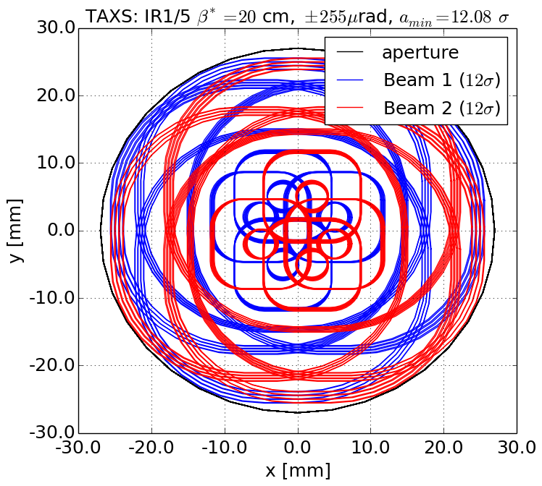
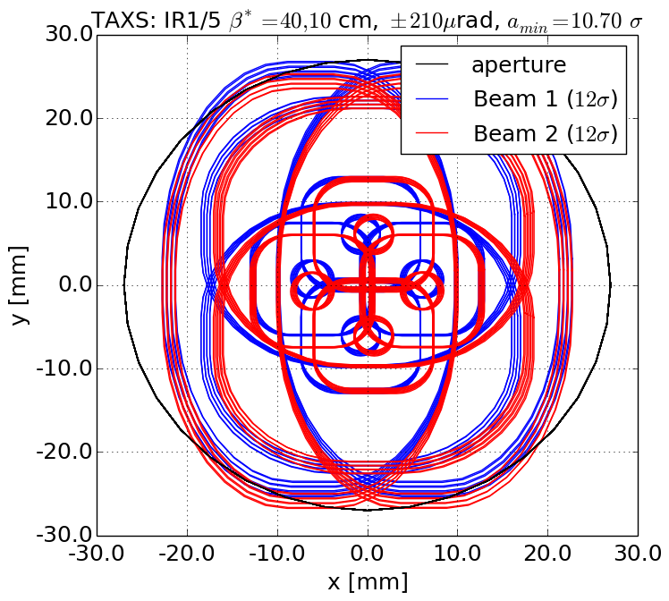
TAXS
Round
Flat
TAXS aperture needs to be increased to 60 mm

Slide 13
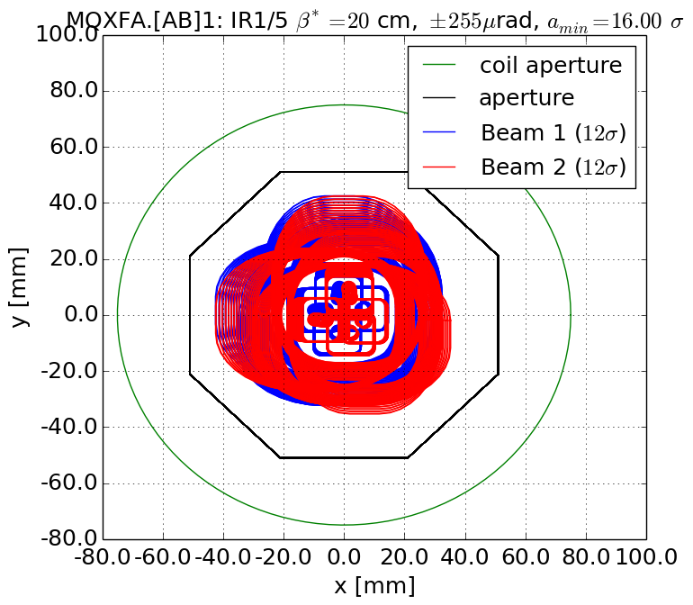
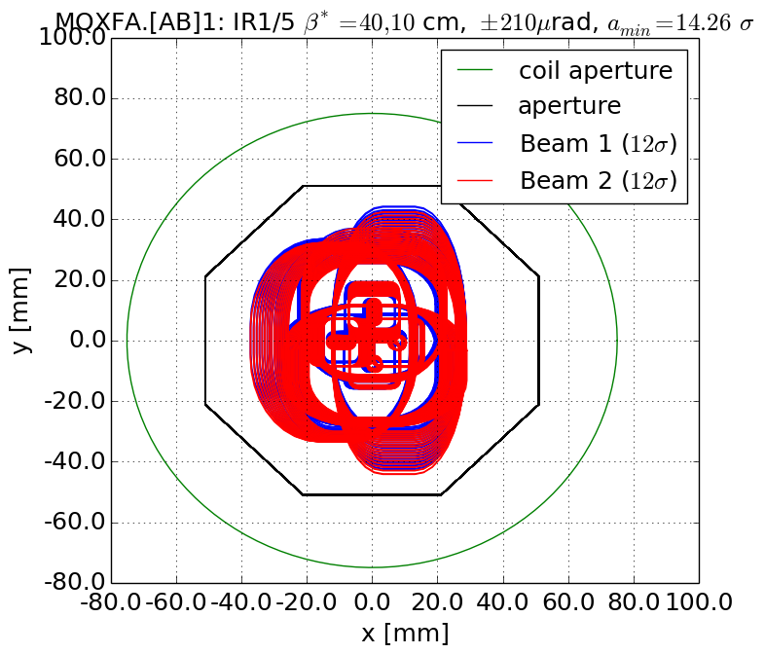
Q1
Round
Flat
Q1 OK

Slide 14
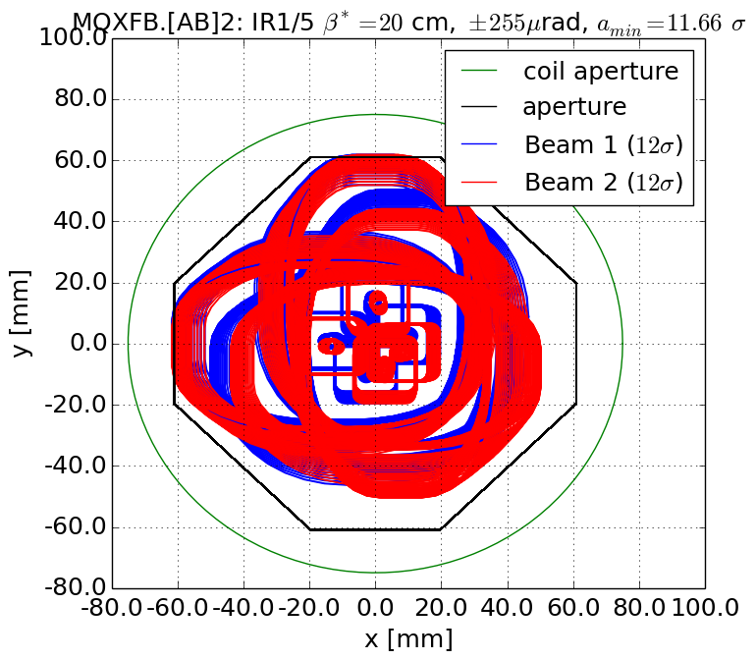
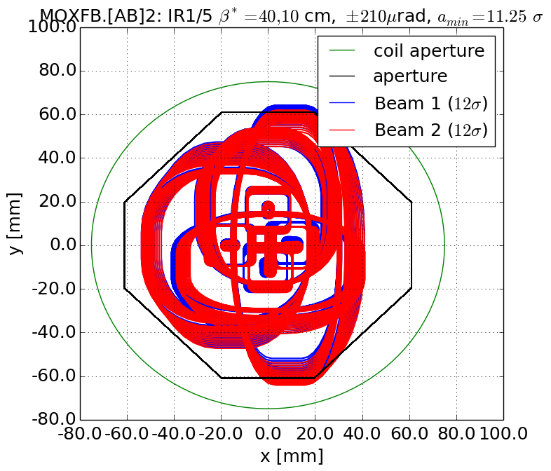
Q2
Round
Flat
Q2 not OK, but options to improve it available

Slide 15
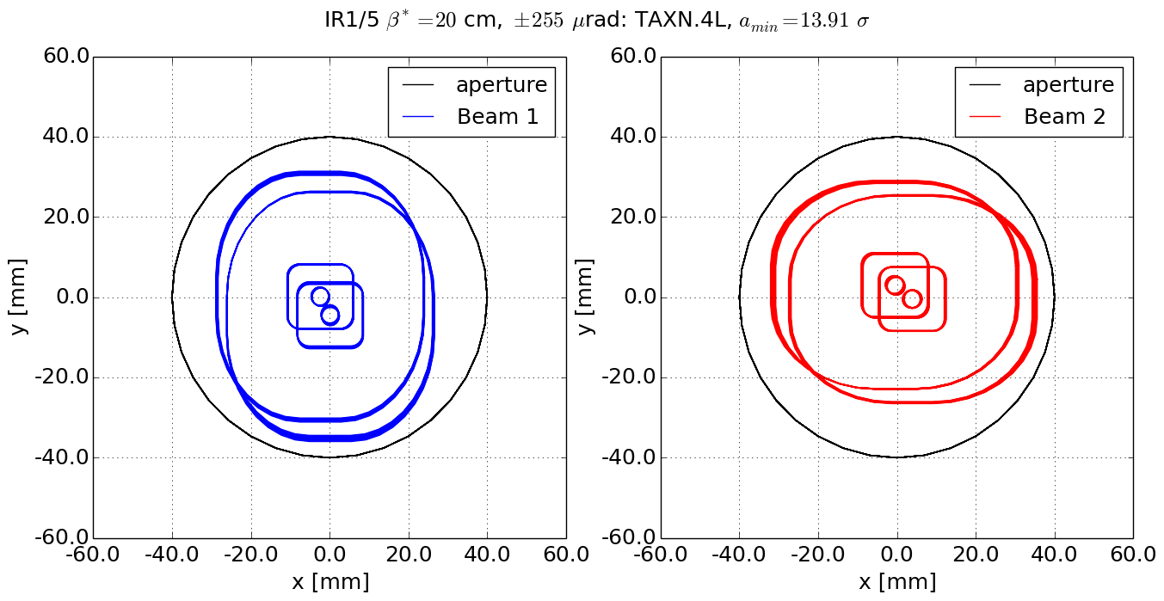
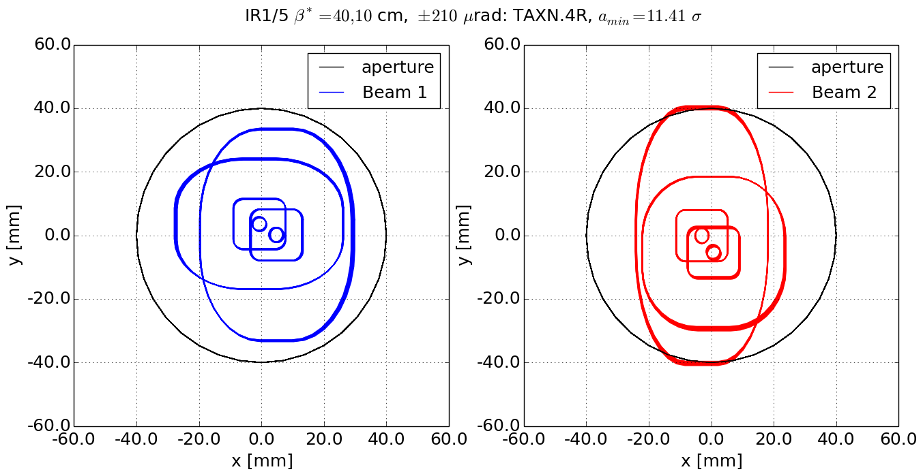
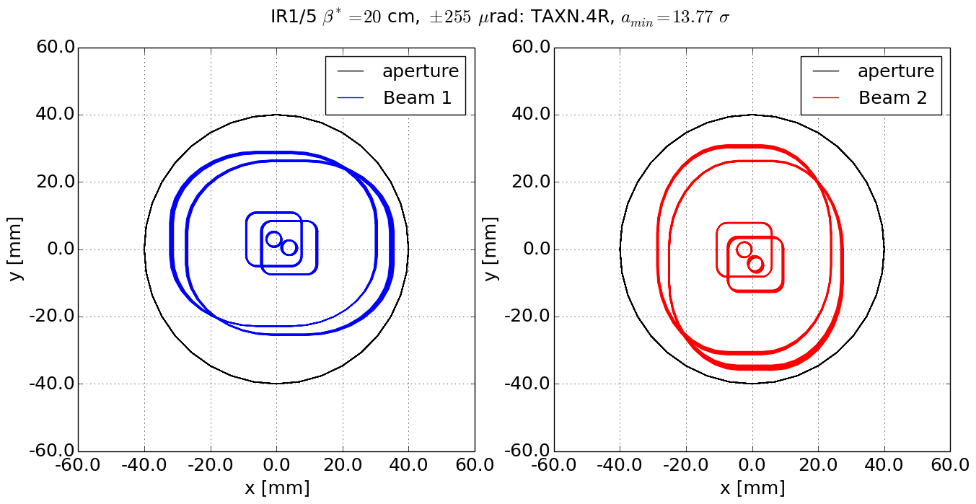
TAXN
Round
Flat
Left
Right
Aperture to be increased: 80mm to 85mm

Slide 16
Q4 options
Aperture includes worst case scenarios for all knobs: IP crossing, separation, offset, crab cavity offset (assuming linear addition).
 | Coil aperture | Beam¹ aperture | H,V² full gaps | Round 15 cm | Round 20 cm | Flat 7.5 cm | Flat 10 cm
 | [mm] |  | [mm] | [σ] | [σ] | [σ] | [σ]
MCBYY | 90 | Octagon | 73.8,73.8 | 15.4 | 17.9 | 13.4 | 15.5
MQYY | 90 | Octagon | 73.8,73.8 | 16.3 | 18.9 | 13.9 | 16.1
MCBYY | 80 | Octagon | 63.8,63.8 | 11.6 | 13.5 | 10.1 | 11.7
MQYY | 80 | Octagon | 63.8,63.8 | 12.3 | 14.2 | 10.5 | 12.1
MCBY | 70 | RectEllipse | 57.8,48 | 11.8 | 13.7 | 8.4 | 9.8
MQY | 70 | RectEllipse | 57.8,48 | 13 | 15.1 | 9.2 | 10.6
We exclude the option MQY for robust flat optics operations.
MQYY at 80 mm is not sufficient to provide enough flexibility:
  Any improvement in triplet aperture would be useless if Q4 aperture is degraded.
  If Q4 needs to be pushed towards D2 more aperture is needed (about 0.7 σ).
  In case of operation at 6.5 TeV.
  The use of a Rectellipse beam screen can help recovering aperture, but only in specific cases: freezing optics constraints or crossing plane.
Impact of energy deposition needs to be re-evaluated in case of reduction of coil aperture

Slide 17
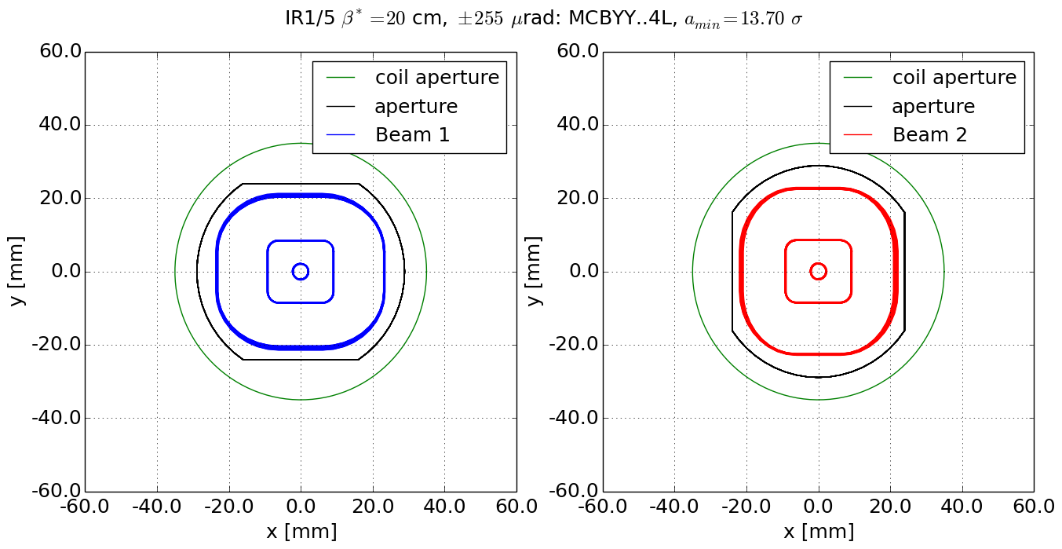
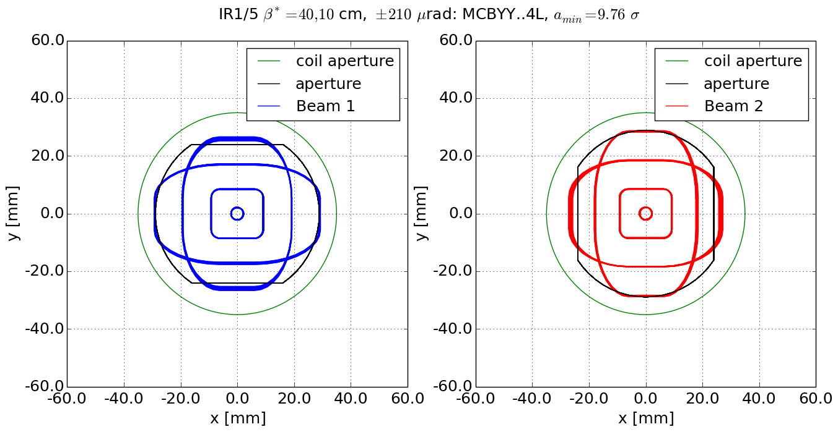
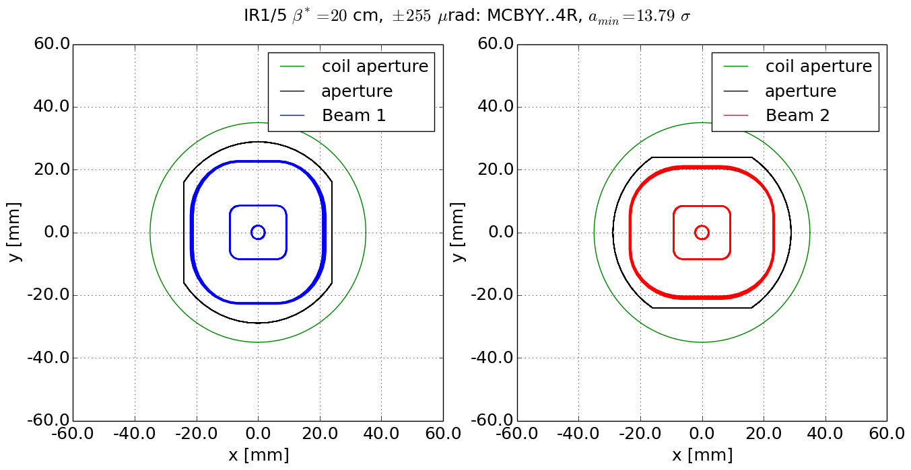
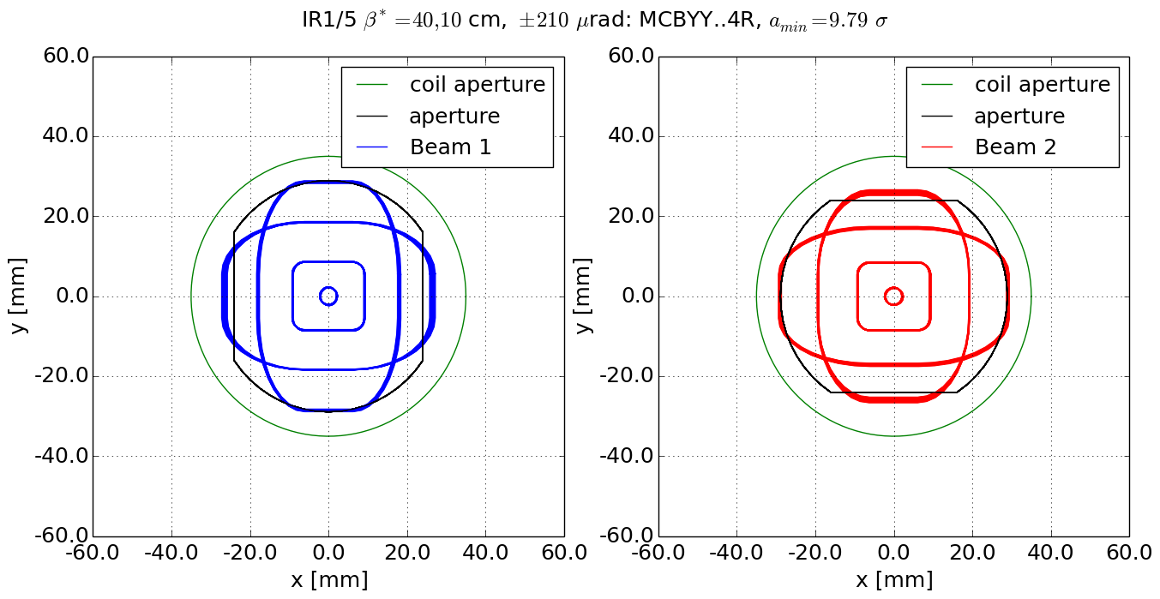
Q4: MQY with 70 mm coils
Round
Flat
Left
Right
Q4 with MQY not ok

Slide 18
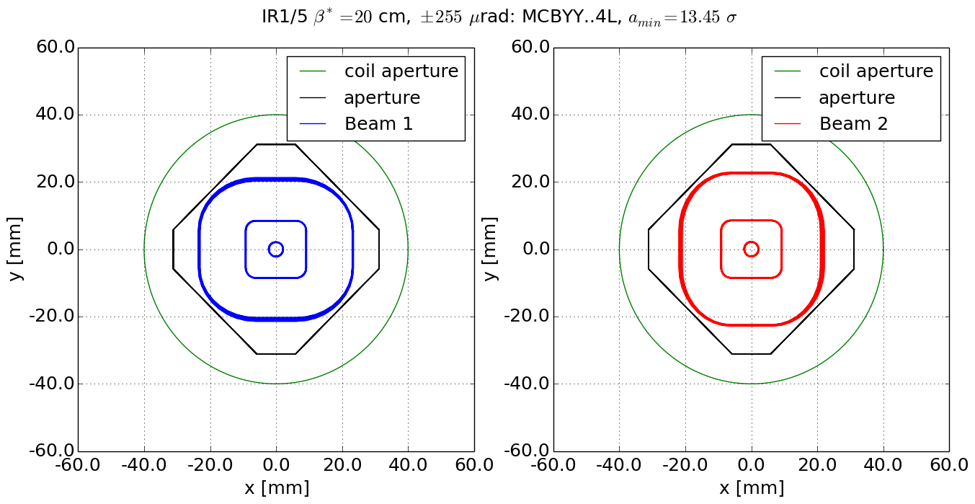
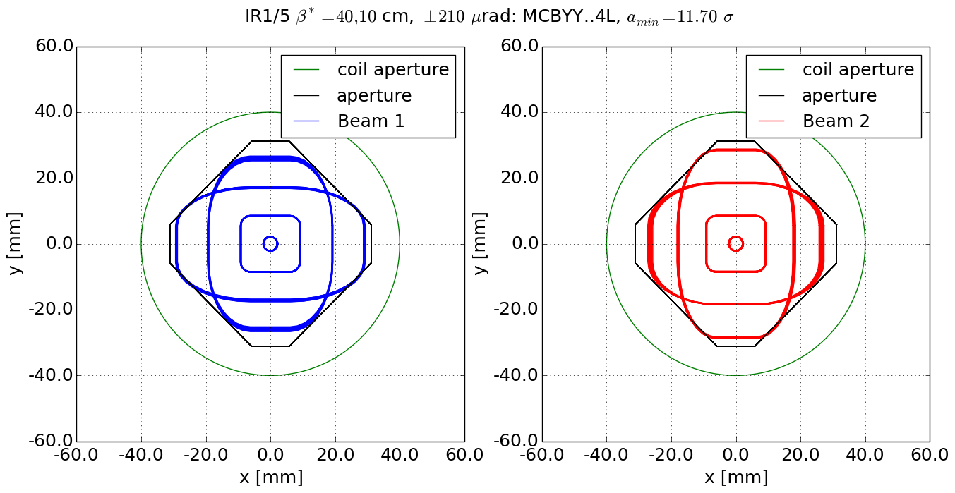
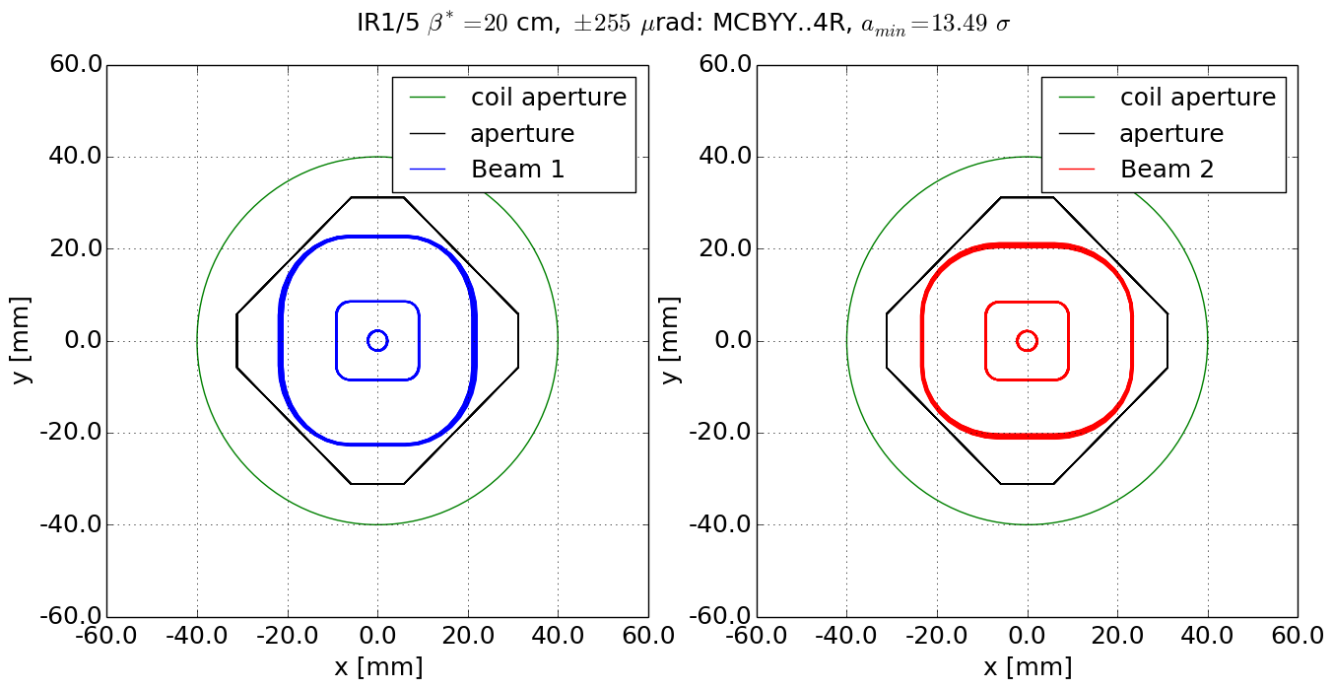

Q4: MQYY with 80 mm coils
Round
Flat
Left
Right
MQYY with 80mm coil not OK. RectEllipse option can help only for special cases.

Slide 19
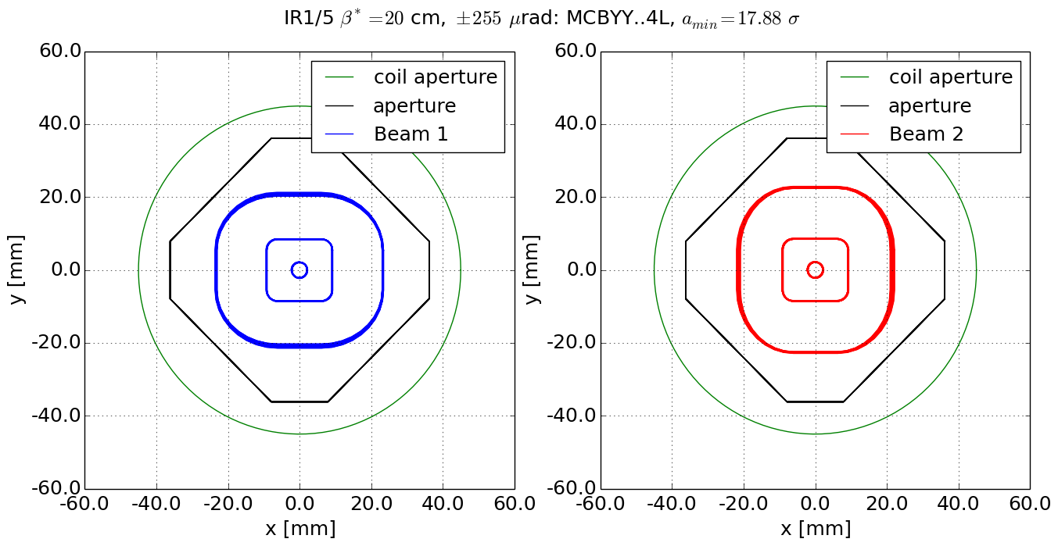
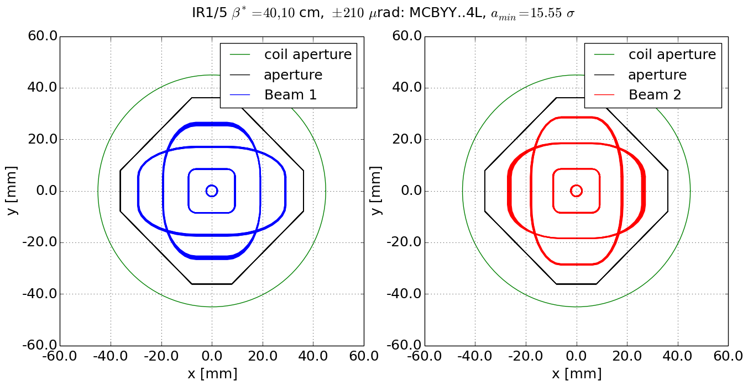
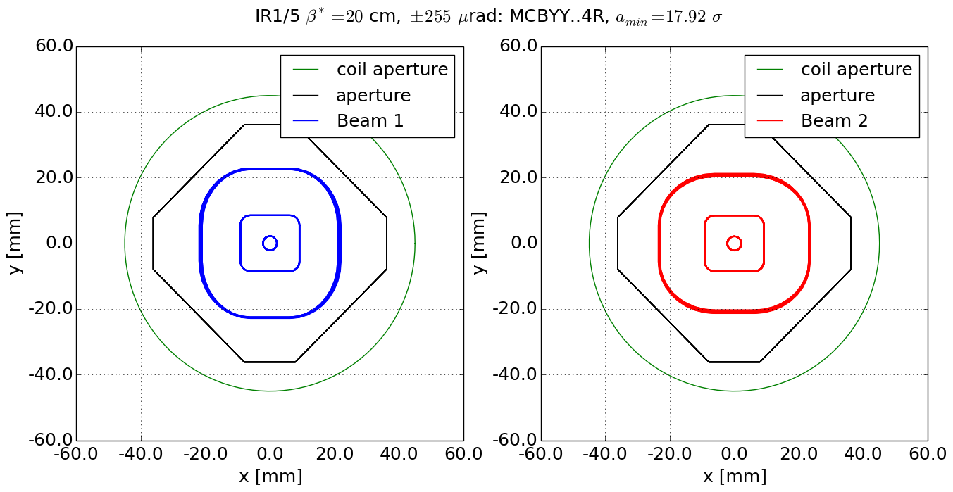
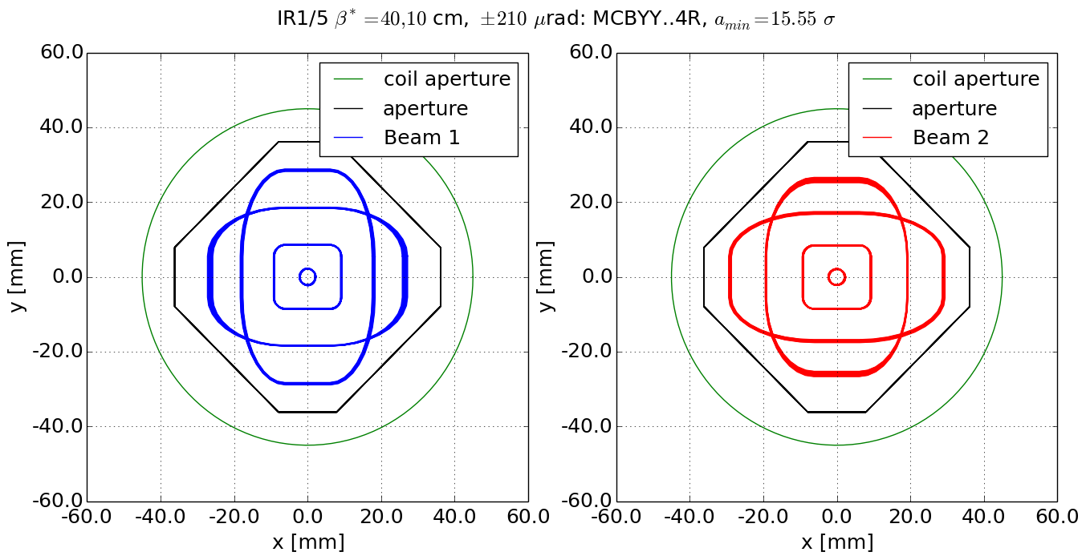
Q4: MQYY with 90 mm coils
Round
Flat
Left
Right
Q4 with MQYY: OK

Slide 20
Q5 options
Aperture includes worst case scenarios for all knobs: IP crossing, separation, offset, crab cavity offset (assuming linear addition).
 | Coil aperture | Beam¹ aperture | H,V²full gaps | Round 15 cm | Round 20 cm | Flat 7.5 cm | Flat 10 cm
 | [mm] |  | [mm] | [σ] | [σ] | [σ] | [σ]
TCLMB.5 | 70 | RectEllipse | 57.8,48 | 20.6 | 23.9 | 15.0 | 17.8
MCBY[HV].5 | 70 | RectEllipse | 57.8,48 | 21.4 | 24.7 | 15.3 | 18.4
MQY.5 | 70 | RectEllipse | 57.8,48 | 21.2 | 24.6 | 15.0 | 17.6
TCLMB.5 | 56 | RectEllipse | 45.1,35.3 | 14.0 | 16.2 | 10.0 | 11.6
MCBC[HV].5 | 56 | RectEllipse | 45.1,35.3 | 13.8 | 16.0 | 10.1 | 11.7
MQML.5 | 56 | RectEllipse | 45.1,35.3 | 14.4 | 16.6 | 10.3 | 11.9
The RectEllipse shapes are oriented in opposite way w.r.t the LHC for both MQY and MQML options.
The choice of a new MQYY option for Q4 allows to re-use the MQY for Q5 including, which provides the two additional orbit correctors that are needed in Q5.
The MQY aperture is also needed for the present alignment optics at injection (not shown in the table).
The MQY aperture may avoid the need of a TCT protecting Q5.

Slide 21
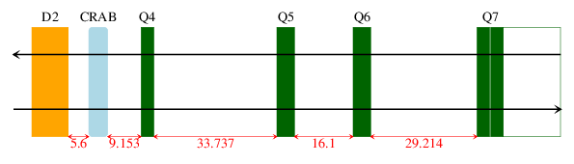
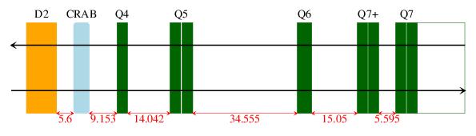
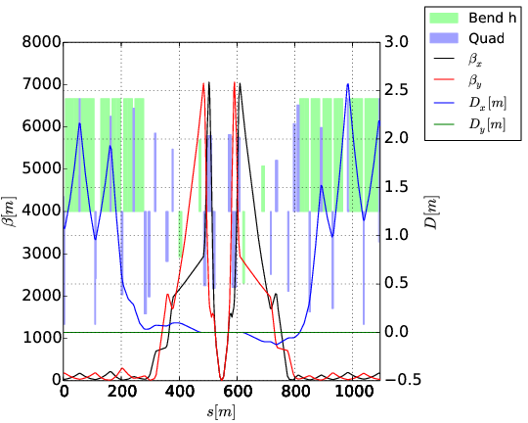
MQYY for Q5 in Q7+ optics
An additional Q7 and 2xMQYY in Q5 per side allow a substantial reduction of crab cavity voltage.
D2
Crabs
Q4
Q5
Q6
Q7
V1.1
MQYY
MQY
MQML
2xMQM
Q7+
MQYY
2xMQYY
MQML
2xMQM
2xMQM
 | V1.1 | Q7+
Crab voltage for 295 µrad | 12 MV | 8.8 MV
Voltage reach based on 90 mm aperture
without offset at the IP.
Ref: B. Dalena et al., Task 2.2, 24/10/2014
Without the additional Q7, it is difficult to make use of the large aperture margin provided by a MQYY in Q5. This option is therefore dropped.

Slide 22
Next activities
Layout re-validation (Q4-Q5 position) | WP15, WP2
Wire space reservation | WP2
Review energy deposition | WP10
Confirm ground motion and fiducialization assumptions | Survey, WP3, WP8
Validation minimum protected aperture (collimation, injection, dump) | WP5, WP14
Validation aperture TAXS and TAXN with Experiments | WP8
Beam screen tolerances | WP12
Validation of dump (IR6), injection (IR2, IR8) optics constraints | WP14
Specification of optics constraints for IR4 | All requestors
Validation requirements orbit correction from the arc | WP2/OP

Slide 23
Summary
New layout and optics increased β* value for the squeeze and pre-squeeze optics.
Critical revision of aperture, taking into account all constraints learnt from Run I experience.
Orbit correctors margins re-evaluated taking into account all known requests: additional strength needed (increased magnetic length). In addition, revision of the strength sharing on-going.
Q4 aperture: option of re-using MQY excluded. The current baseline is kept (90 mm), pending evaluation of benefits (magnet side) of slight aperture reduction (e.g., down to 85 mm).
Q5 aperture: critical review of aperture indicates the benefits of re-using the MQY (present Q4). This choice provides naturally also the needed two additional orbit correctors.

Slide 24
Back-up

Slide 25
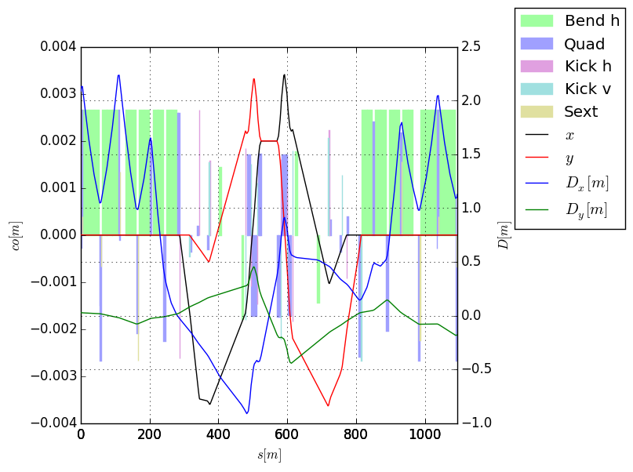
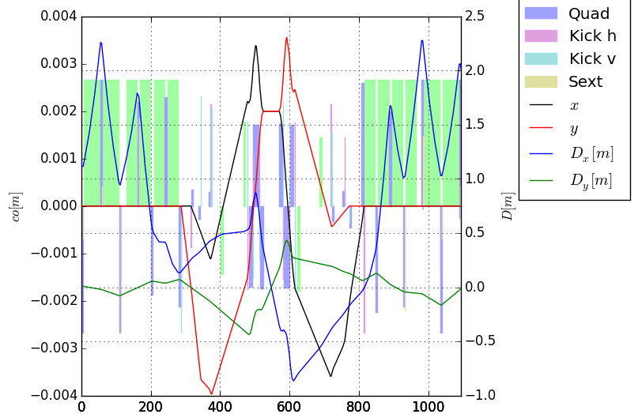
Offset knob – 2mm

Slide 26
Orbit corrector knobs - 1.5 m, 3T
IP crossing, separation, offset (x: ±295 μrad, , s: ±2.0 mm, o: ±2.0 mm)
beam based alignment of crab cavities: ccp, ccm (shift): ±0.5 mm, ccs (slope): ±0.25 mm
IT alignment and transfer function errors (err): ±0.5 mm transverse, ±10 mm longitudinal, ±2x10⁻³ relative gradient error, ±2x10⁻³ D2 relative field error.
orbit correction from the arc (to confirmed): arc 0.7 Tm;
lumi scan knobs (single beam IP shift for 100μm)
 | x-scheme [Tm] |  |  | cc alignment [Tm] |  |  | err [Tm] | arc [Tm] | lumi [Tm] | summary [Tm]
name | x | s | o | ccp | ccm | ccs | err | arc | lumi | tot | max | margin [%]
MCBX1 | 0.14 | 0.29 | 1.22 | 0.19 | 0 | 0 | 0.92 | 0 | 0 | 2.63 | 2.5 | -5.2
MCBX2 | 0.07 | 0.14 | 0.55 | 0.19 | 0 | 0 | 1.4 | 0 | 0 | 2.54 | 2.5 | -1.42
MCBX3 | 2.11 | 0.54 | 0.94 | 0.45 | 0.15 | 0 | 0.78 | 0 | 0 | 4.43 | 4.5 | 1.45
MCBRD4 | 2.97 | 0.24 | 0 | 0.28 | 0.15 | 0.52 | 0.08 | 0.35 | 0.27 | 4.53 | 4.5 | -0.63
MCBYY4 | 1.49 | 0.12 | 1.12 | 0.42 | 0.42 | 0.92 | 0 | 0.35 | 0.2 | 4.81 | 4.5 | -6.98
MCBYS5 | 0 | 0 | 1.35 | 0.4 | 0.4 | 0.44 | 0 | 0 | 0 | 2.46 | 2.7 | 8.9
MCBY5 | 0 | 0 | 0.47 | 0 | 0 | 0 | 0 | 0 | 0 | 0.47 | 2.8 | 83.31
MCBC6 | 0 | 0 | 1.4 | 0 | 0 | 0 | 0 | 0 | 0 | 1.4 | 2.8 | 50
MCBC7 | 0.14 | 0.29 | 1.22 | 0.19 | 0 | 0 | 0.92 | 0 | 0 | 2.63 | 2.5 | -5.2
Notes:
Q4_8m/opt_presqueeze.madx

Slide 27
Orbit corrector knobs – 1.8 m
IP crossing, separation, offset (x: ±295 μrad, , s: ±0.75 mm, o: ±2.0 mm)
beam based alignment of crab cavities: ccp, ccm (shift): ±0.5 mm, ccs (slope): ±0.25 mm
IT alignment and transfer function errors (err): ±0.5 mm transverse, ±10 mm longitudinal, ±2x10⁻³ relative gradient error, ±2x10⁻³ D2 relative field error.
orbit correction from the arc (to confirmed): arc 0.7 Tm;
lumi scan knobs (single beam IP shift for 100μm)
 | x-scheme [Tm] |  |  | cc alignment [Tm] |  |  | err [Tm] | arc [Tm] | lumi [Tm] | summary [Tm]
name | x | s | o | ccp | ccm | ccs | err | arc | lumi | tot | max | margin [%]
MCBX1 | 0.19 | 0.28 | 0.88 | 0.19 | 0 | 0 | 0.92 | 0 | 0 | 2.27 | 2.5 | 9.04
MCBX2 | 0.09 | 0.14 | 0.14 | 0.19 | 0 | 0 | 1.4 | 0 | 0 | 1.9 | 2.5 | 24.06
MCBX3 | 2.29 | 0.54 | 0.41 | 0.45 | 0.15 | 0 | 0.78 | 0 | 0 | 4.08 | 4.5 | 9.37
MCBRD4 | 3.55 | 0.28 | 0 | 0.28 | 0.15 | 0.52 | 0.08 | 0 | 0.27 | 4.76 | 5.4 | 11.91
MCBYY4 | 1.07 | 0.08 | 2.1 | 0.42 | 0.42 | 0.92 | 0 | 0.7 | 0.2 | 4.96 | 5.4 | 8.24
MCBYS5 | 0 | 0 | 1.23 | 0.4 | 0.4 | 0.44 | 0 | 0 | 0 | 2.34 | 2.7 | 13.51
MCBY5 | 0 | 0 | 0.0 | 0 | 0 | 0 | 0 | 0.7 | 0 | 1.26 | 2.8 | 83.31
MCBC6 | 0 | 0 | 1.26 | 0 | 0 | 0 | 0 | 0 | 0 | 1.26 | 2.8 | 55.17
MCBC7 | 0 | 0 | 1.4 | 0 | 0 | 0 | 0 | 0 | 0 | 1.4 | 2.8 | 50
Notes:
Q4_8m/opt_presqueeze_1_8m_mcbrd_mcbyy.madx with cd2q4=0.3

Slide 28
Effect of the knobs
 | Coil aperture | Beam¹ aperture | H,V²full gaps | Sep. knob | Crossing Knob | Crab shift knob | Crab slope knob | Offset knob
 | [mm] |  | [mm] | [mm] | [mm] | [mm] | [mm] | [mm]
TAXS | 54 | Circle | 54, 54 | 0.8 | 6.1 | 0.0 | 0.0 | 2.0
MQXFA.[AB]1 | 150 | Octagon | 102, 102 | 0.8 | 11.2 | 0.0 | 0.0 | 2.4
MQXFB.[AB]2 | 150 | Octagon | 122, 122 | 1.2 | 16.7 | 0.2 | 0.0 | 3.6
MQXFA.[AB]3 | 150 | Octagon | 122, 122 | 0.8 | 16.6 | 0.4 | 0.0 | 2.8
MBXF | 150 | Octagon | 122, 122 | 0.5 | 15.5 | 0.5 | 0.0 | 2.4
TAXN | n/a | Circle | 80, 80 | 0.2 | 5.5 | 0.9 | 0.0 | 3.0
MBRD | 105 | Octagon | 87, 87 | 0.1 | 3.3 | 1.0 | 0.0 | 3.3
MCBRD | 105 | Octagon | 87, 87 | 0.1 | 1.7 | 1.0 | 0.1 | 3.4
MCBYY | 90 | Octagon | 73.8,73.8 | 0.0 | 0.1 | 1.0 | 0.5 | 4.0
MQYY | 90 | Octagon | 73.8,73.8 | 0.0 | 0.0 | 1.0 | 0.5 | 3.9
TCLMB.5 |  | RectEllipse | 57.8, 48 | 0.0 | 0.0 | 0.4 | 0.2 | 3.7
MCBY[HV].5 | 70 | RectEllipse | 57.8, 48 | 0.0 | 0.0 | 0.0 | 0.0 | 3.6
MQY.5 | 70 | RectEllipse | 57.8, 48 | 0.0 | 0.0 | 0.2 | 0.1 | 3.5
TCLMC.6 | 56 | RectEllipse | 45.1,35.3 | 0.0 | 0.0 | 0.0 | 0.0 | 2.3
MCBC[HV].6 | 56 | RectEllipse | 45.1,35.3 | 0.0 | 0.0 | 0.0 | 0.0 | 2.1
MQML.6 | 56 | RectEllipse | 45.1,35.3 | 0.0 | 0.0 | 0.0 | 0.0 | 2.1
¹Either Beam screen or beam pipe;
² Rectellipse types are exchanges the H,V orientation depending on the polarity

Slide 29
Effect of the knobs – 1.8 m
 | Coil aperture | Beam¹ aperture | H,V²full gaps | Sep. knob | Crossing Knob | Crab shift knob | Crab slope knob | Offset knob
 | [mm] |  | [mm] | [mm] | [mm] | [mm] | [mm] | [mm]
TAXS | 54 | Circle | 54, 54 | 0.8 | 6.1 | 0.0 | 0.0 | 2.0
MQXFA.[AB]1 | 150 | Octagon | 102, 102 | 0.8 | 11.2 | 0.0 | 0.0 | 2.5
MQXFB.[AB]2 | 150 | Octagon | 122, 122 | 1.2 | 16.7 | 0.2 | 0.0 | 3.4
MQXFA.[AB]3 | 150 | Octagon | 122, 122 | 0.8 | 16.6 | 0.4 | 0.0 | 2.6
MBXF | 150 | Octagon | 122, 122 | 0.5 | 15.5 | 0.5 | 0.0 | 1.7
TAXN | n/a | Circle | 80, 80 | 0.2 | 5.5 | 0.9 | 0.0 | 3.1
MBRD | 105 | Octagon | 87, 87 | 0.1 | 3.3 | 1.0 | 0.0 | 3.4
MCBRD | 105 | Octagon | 87, 87 | 0.1 | 1.7 | 1.0 | 0.1 | 3.7
MCBYY | 90 | Octagon | 73.8,73.8 | 0.0 | 0.1 | 1.0 | 0.5 | 4.3
MQYY | 90 | Octagon | 73.8,73.8 | 0.0 | 0.0 | 1.0 | 0.5 | 4.2
TCLMB.5 |  | RectEllipse | 57.8, 48 | 0.0 | 0.0 | 0.3 | 0.1 | 3.7
MCBY[HV].5 | 70 | RectEllipse | 57.8, 48 | 0.0 | 0.0 | 0.0 | 0.0 | 3.6
MQY.5 | 70 | RectEllipse | 57.8, 48 | 0.0 | 0.0 | 0.1 | 0.1 | 3.5
TCLMC.6 | 56 | RectEllipse | 45.1,35.3 | 0.0 | 0.0 | 0.0 | 0.0 | 2.3
MCBC[HV].6 | 56 | RectEllipse | 45.1,35.3 | 0.0 | 0.0 | 0.0 | 0.0 | 2.1
MQML.6 | 56 | RectEllipse | 45.1,35.3 | 0.0 | 0.0 | 0.0 | 0.0 | 2.1
¹Either Beam screen or beam pipe;
² Rectellipse types are exchanges the H,V orientation depending on the polarity
Notes:
Q4_8m/opt_presqueeze.madx

Slide 30
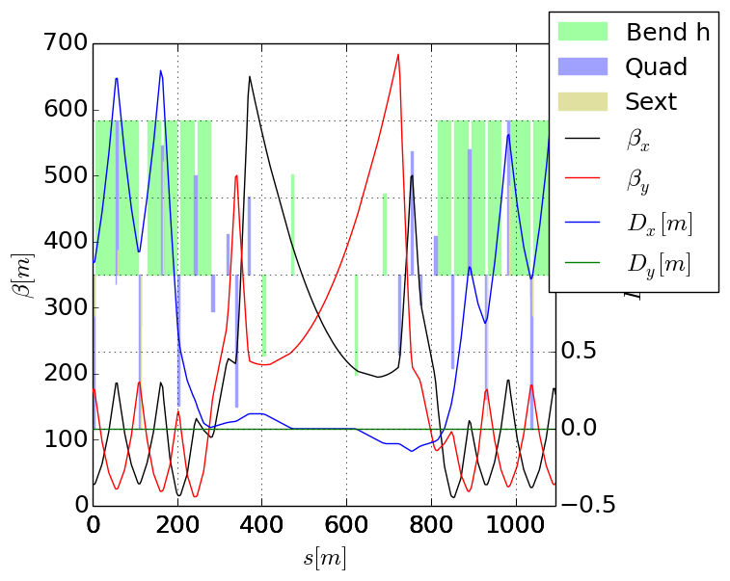
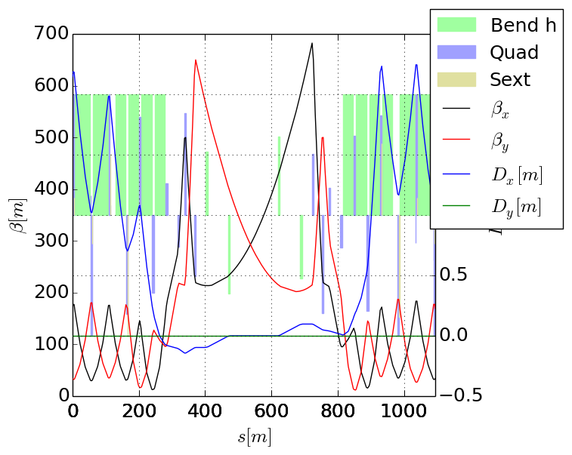
Alignment optics
Optics to align BPMs in the triplet at injection.
Compatible with injection strength, but aperture not exceptional in the arcs.

