Slide 1
Участие в международных конференциях 2015
семинар Лаборатории Технологии Больших Данных
проектов в области мегасайнс
А. Климентов, Р. Машинистов, М. Григорьева
13 февраля 2015 г.

Slide 2
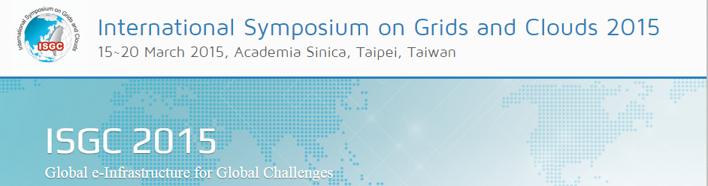
1. “Scaling up ATLAS production system for Big Data: development, commissioning and operational experience”
Authors: M. Borodin, K. De, J. Garcia Navarro, D. Golubkov, A. Klimentov, T. Maeno and A. Vaniachine
2. “PanDA Portal for HENP Experiments and Beyond” (постер)
Authors: A. Klimentov; R. Mashinistov; A. Poyda; E. Ryabinkin; A. Teslyuk, D. Drizhuk; A. Novikov; D. Oleynik; A. Polyakov
3. “FTS3 – a file transfer service for Grids and Clouds” (устный)
Authors: A. Kyrianov, Andres Abad Rodriguez, A.A. Ayllon, M. Hellmich, O. Keeble, A. Manzi, M. Salichos, M. Schulz, M. Simon, C. Skarpathiotaki

Slide 3

1. Integration of PanDA workload management system with Titan supercomputer at OLCF (устный)
Authors: K. De, S. Panitkin, D. Oleynik, A. Petrosyan, A. Klimentov, A. Vaniachine, T. Wenaus, J. Schovancova
2. Studies of Big Data meta-data segmentation between relational and non-relational databases (устный)
Authors: M. Golosova, M. Grigorieva, E. Ryabinkin, G. Dimitrov, M. Potekhin, A. Klimentov
3. The Future of PanDA in ATLAS Distributed Computing (устный)
Authors: A. Klimentov, K. De, J. Schovancova, P. Nilsson, A. Vaniachine, D. Oleynik, T. Wenaus, S. Panitkin, A. Petrosyan, T. Maeno
4. Integrating Network Awareness in ATLAS Distributed Computing Using the ANSE Project (устный)
Authors: J.Batista, K.De, A.Klimentov, S.McKee, A.Petrosyan
5. Scaling up ATLAS production system for the LHC Run 2 and beyond: project ProdSys2 (постер)
Authors: M .Borodin, A. Vaniachine, K. De, T. Maeno, N. Garcia Navarro, E. Jose, A. Klimentov
6. Overview of High Performance Computing in the ATLAS Experiment at the LHC (постер)
Authors: D.Benjamin, J.T.Childers, A. Klimentov, D. Oleynik, E. Lancon, K. De, R. Walker, P. Nilsson, A. Filipcic
7. Integration of Russian Tier-1 Grid Center with High Performance Computers at NRC-KI for LHC experiments and beyond HENP (постер)
Authors: R. Mashinistov, E. Ryabinkin , A. Teslyuk, A. Poyda, P. Buncic, I. Tkachenko, A. Novikov, K. De, A. Klimentov, L. Yasnopolskiy, D. Oleynik, D. Drizhuk, A. Polyakov, etc.

Slide 4
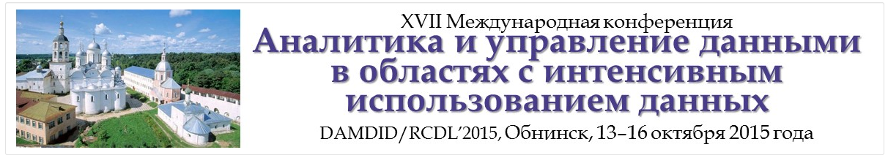

1. Next Generation Workload Management System on Heterogeneous Distributed Computing For Data-Intensive Science
Authors: A.Klimentov, K.De, S.Jha, T.Maeno, S.Panitkin, D.Oleynik, P.Nilsson, R.Mashinistov, E.Ryabinkin, A.Teslyuk, D.Krasnopevtsev and T.Wenaus
Call for papers:
Nuclear Electronics & Computing, NEC-2015 | 28 September- 3 October Budva Montenegro

