Slide 1
CMS Detector and its Physics
CMS e-Masterclass at Riyadh

Slide 2
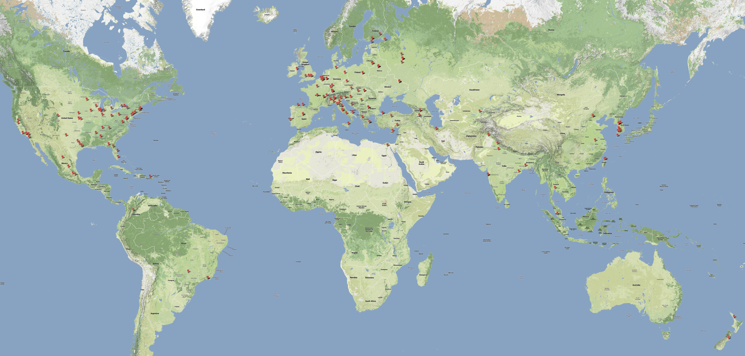
About 10,000 of its inhabitants came together to build…

Slide 3
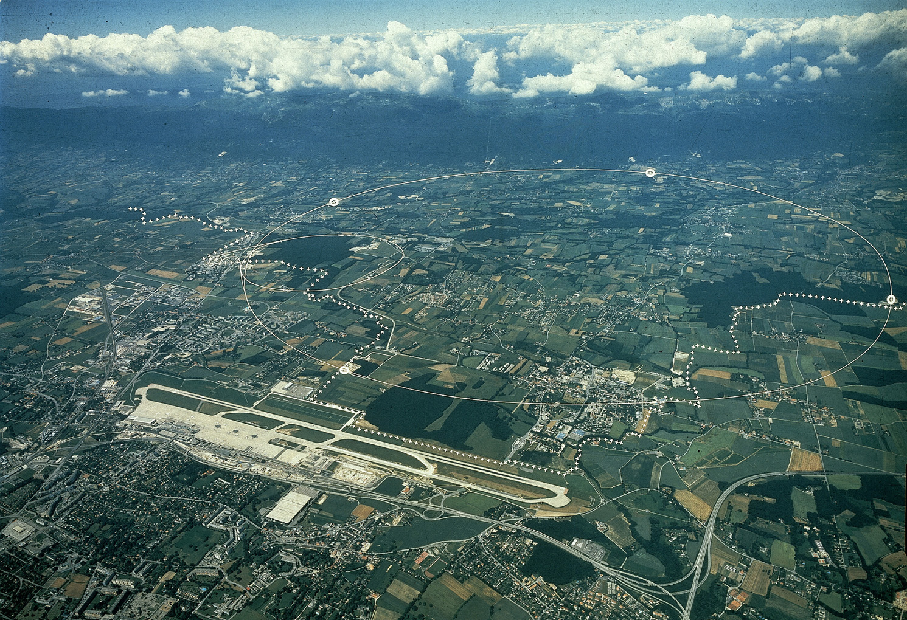
The Large Hadron Collider at CERN, Geneva, Switzerland
And in July 2012…

Slide 4
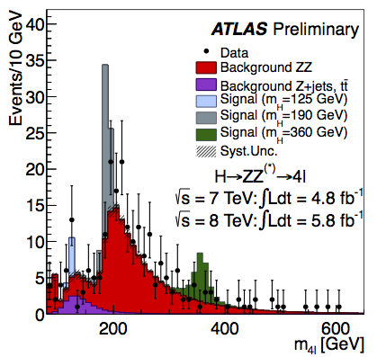
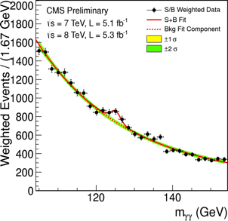
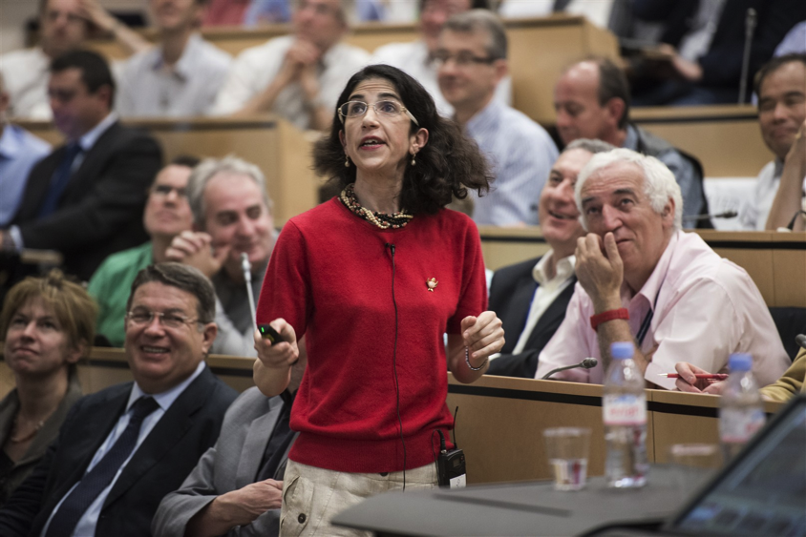

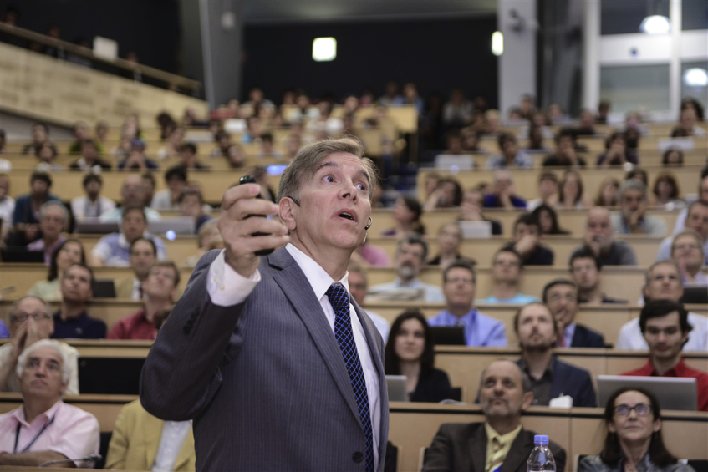
Two of these 10,000 people presented results…
Fabiola Gianotti
ATLAS Spokesperson 2010-2012
And in July 2012…
Joe Incandela
CMS Spokesperson 2012-2013

Slide 5
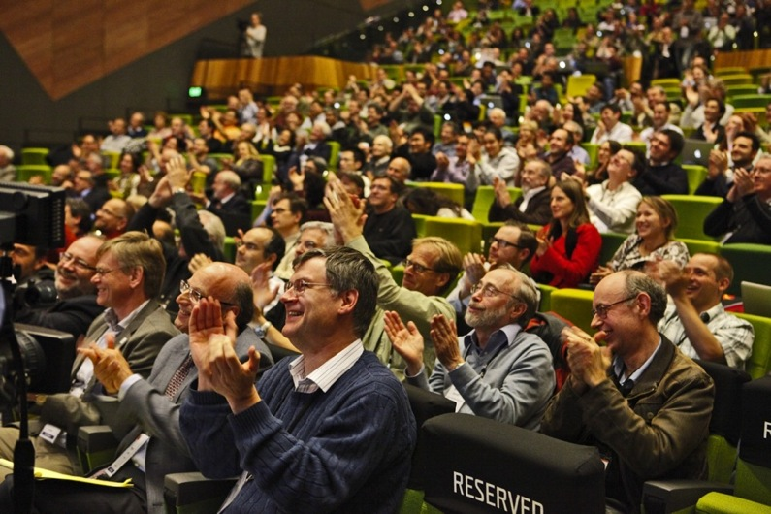
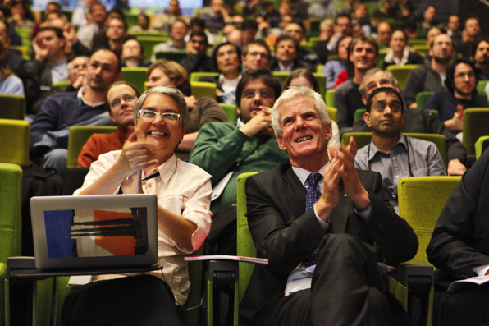
…that made a lot of physicists VERY happy…

Slide 6
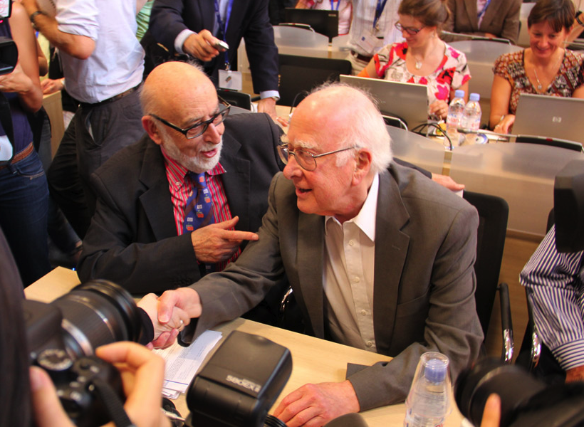
… including these two guys!
Prof. Francois Englert
Prof. Peter Higgs

Slide 7
So what is all the fuss about?

Slide 8
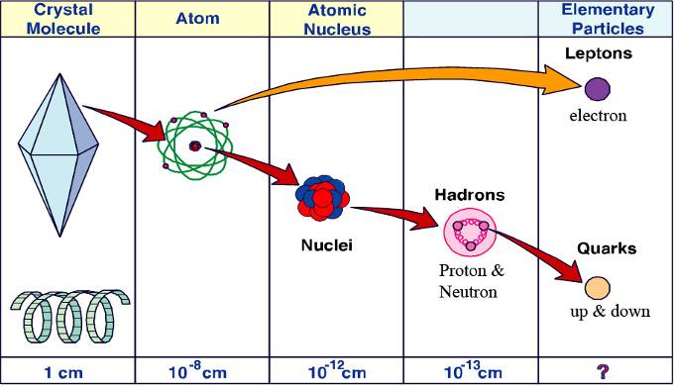
Our current understanding of the constituents of matter

Slide 9
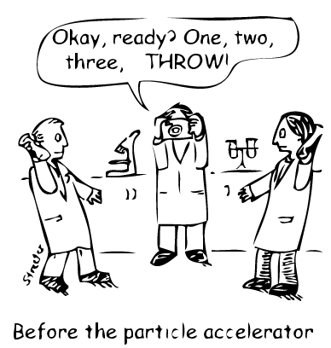
How do we know this?
Smash things together and see what happens!

Slide 10
Accelerator Energy
Notes:
An illustration to show the effect of colliding objects that are “composite”. The “accelerator energy” bar shows that the collision speed is rather low. The resulting fragments are big.
Suggest to ask the audience what they think will happen. For a younger audience it is very good to point out that this is the “scientific method” at work – that they are being scientists:
They think of what might happen, do an experiment and then try to understand what really did happen.

Slide 11
Accelerator Energy
Notes:
Point-out the higher accelerator energy. Again ask the audience what they think will happen. Most guess correctly. Point out that the resulting fragments are the “basic building blocks”.

Slide 12



Universal building blocks
Quarks
Lepton
Up (u)
electron
Down (d)
Chemistry!
Groups of 3 quarks
form Nucleons
uud = proton
udd = neutron

Slide 13
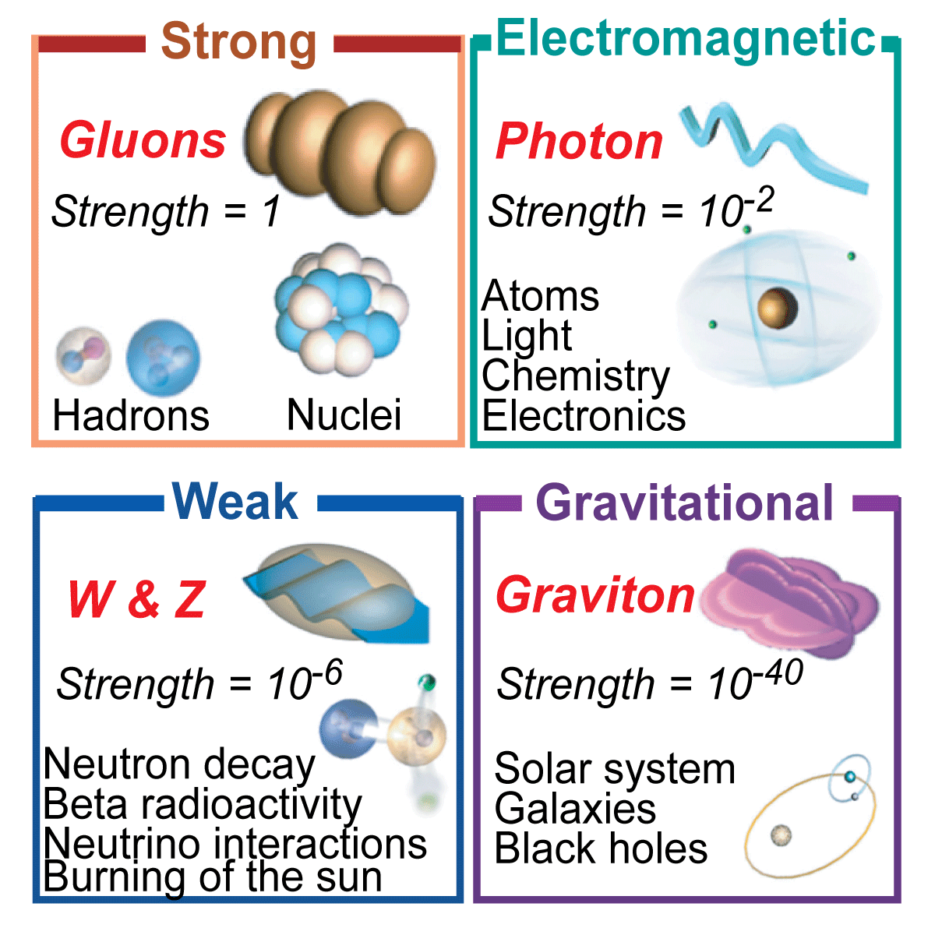
Universal forces

Slide 14



Building atoms
electrons
Helium Atom
protons
neutrons
Multiply by billions and billions…

Slide 15
But that is not the end of the story…

Slide 16


E=mc2
The collision energy was used
to create something new, that
*did* exist but does not any more!
Accelerator Energy
Notes:
Now it gets really interesting! Ask again what they think will happen with even higher collision energy/speed. Most will say “even smaller pieces” but some may be more cautious.
But they never expect the dinosaurs! Emphasize that this is just an illustration – we don’t really make dinosaurs (sounds obvious but 10-11 year olds can take things literally!).
Can ask if they recognise the equation and ask them what it means – even a lot of the 10-11 year olds do know!
Another reason why dinosaurs are appropriate: CERN is at the foot of the Jura mountains – the origin of the “Jurassic” period due to the number of dinosaur bones found in the mountains. And what CERN is doing goes WAY back further in time than the dinosaurs.

Slide 17
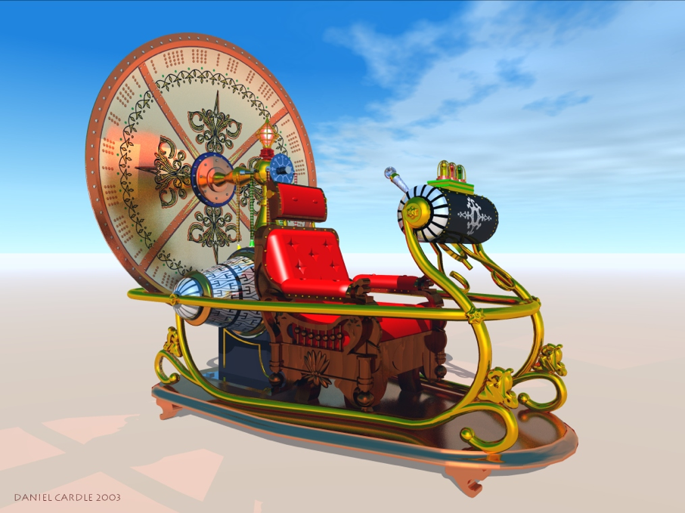
13,700,000,000 years ago there were other things in the Universe – that we can “create” in the laboratory
So we have built a Time Machine!

Slide 18











Fundamental Particles at the time of the Big Bang
Quarks
Leptons
up
charm
electron
muon
tau
top
down
strange
bottom
electron neutrino
muon neutrino
tau neutrino
Le Zoo des particules

Slide 19
X
It looks like we
know everything!
In fact we know very little!

Slide 20
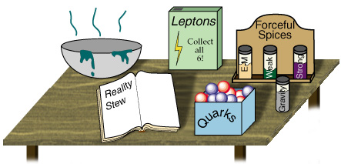
Answers to simple questions
Since the early 70s, particle physicists have synthesized all their knowledge in a single model: the «Standard Model»
We know and we understand a lot but we do not know everything …
Mysteries remain unexplained
There are things to discover ...

Slide 21

The massive mystery
.
.
.
Why do some fundamental particles have mass while others don’t?

Slide 22
Do you remember these guys?
Prof. Francois Englert
Prof. Peter Higgs

Slide 23
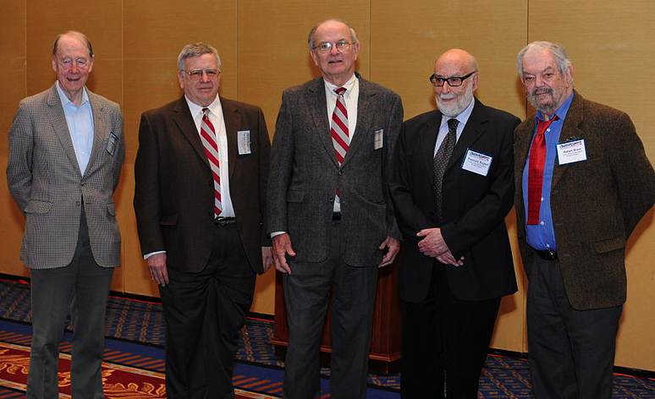
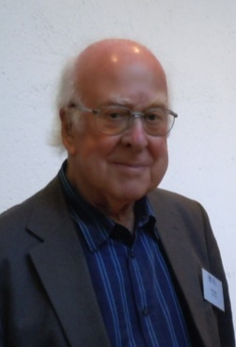
Nearly 50 years ago six physicists proposed an explanation of how particles get mass…
Higgs
Guralnik
Englert
Brout
Kibble
Hagen

Slide 24
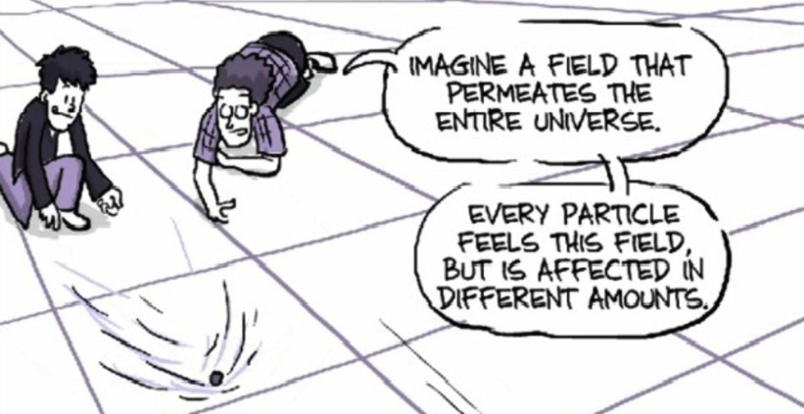
THEORY: The Brout-Englert-Higgs Field
The more a particle interacts with this invisible field, the more mass it gets.

Slide 25
But if this field is invisible, how can we PROVE it exists?

Slide 26

The theory predicts that the field has an associated particle:
The Higgs Boson!
We can try to create the Higgs
boson in our experiment!

Slide 27

It is predicted to be VERY rare
Assume ~7’000 grains of rice in a serving of Kabsa…
…then the chances of creating and finding a Higgs boson is…
Like finding 1 grain if everyone in Riyadh eats Kabsa once a day for a whole month!!
1 in 1,000,000,000,000

Slide 28

And just to make things even more complicated…
The Higgs boson would “decay” instantly to lighter particles. We only detect these resulting particles – so we have to be like detectives – look at the evidence to see what happened!

Slide 29
But despite all these difficulties
Fabiola Gianotti
ATLAS Spokesperson 2010-2012
Joe Incandela
CMS Spokesperson 2012-2013
We found it!

Slide 30
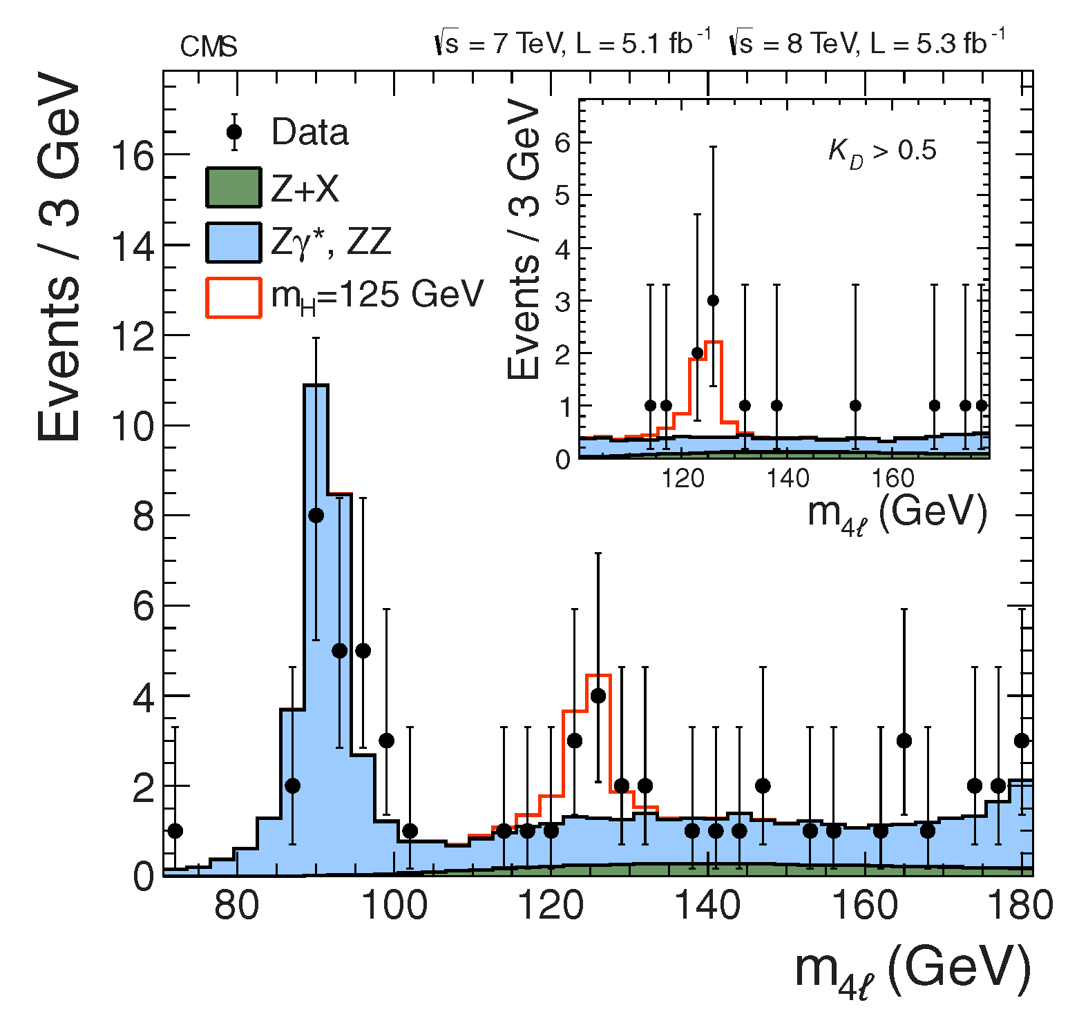
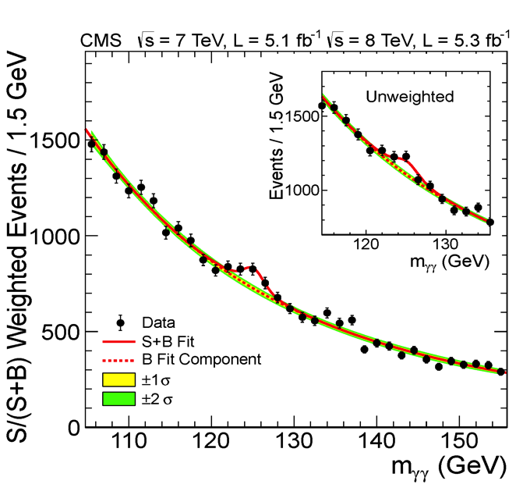
We Found Some Higgs Bosons!!
These bumps in the data signify a new particle, found in two different ways, at the same mass – about 125 GeV/c2

Slide 31
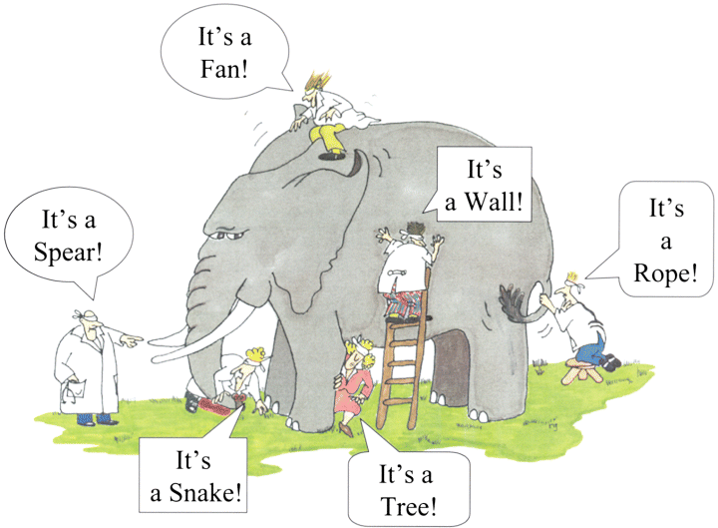
But we have only just started to understand the Higgs boson…and we need to look from every angle

Slide 32
So how do we “create” particles in reality?

Slide 33
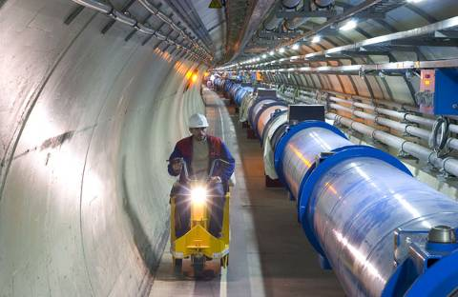
One of the fastest racetracks on earth:
The Large Hadron Collider
Several thousand billion protons travelling at 99.9999991% of the speed of light travel round the 27km ring, 100m underground, over 11000 times a second!

Slide 34
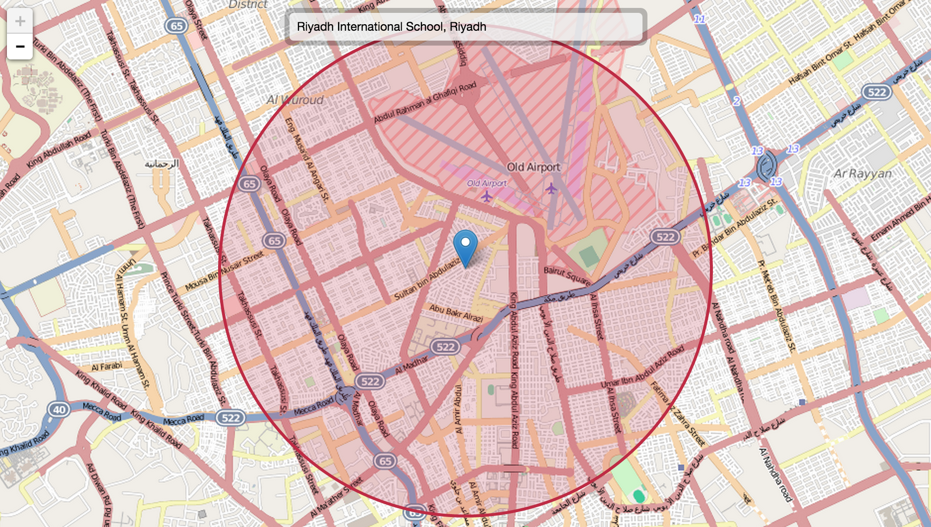
The Lord of the Rings
Try it out yourself: http://natronics.github.io/science-hack-day-2014/lhc-map/

Slide 35
And then what?
After the collisions, we have detectors that “reveal” the presence of different particles.
You will learn today about the CMS detector and how to use it to identify the decays of W and Z bosons.
Enjoy!

