Slide 1
TPC R&D status

Slide 2
Outline
Data analysis
Tracking resolution studies

Slide 3
Data analysis
We took a few hundred of events
No zero suppression
Very long time frames : 511 clock cycles
Sampling frequency : 100 MHz
Shaper peaking time : 200 ns
Use Fabrice’s .acq to root converter (based on ILC monitoring code
  To be developed further…
Analysis done on resulting root files
Using root compresses data by factor of ~10
Zero suppression plus shorter time frames will compress even further

Slide 4
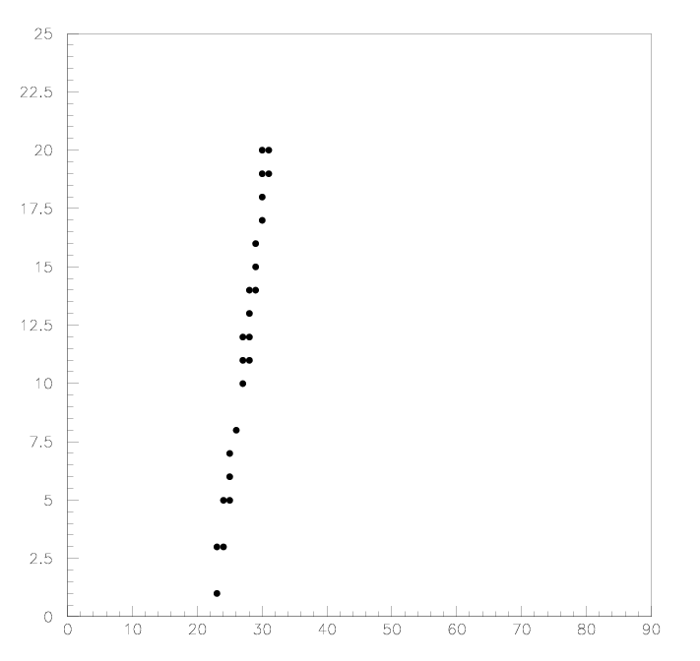
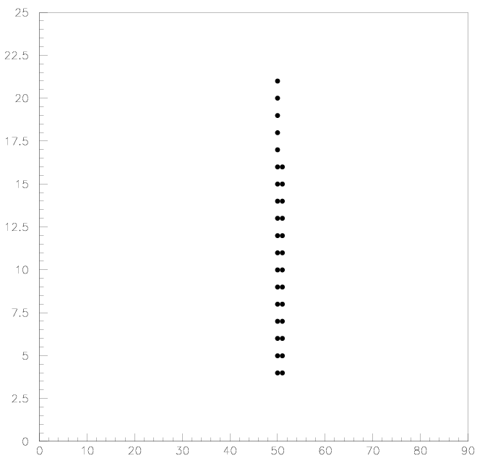
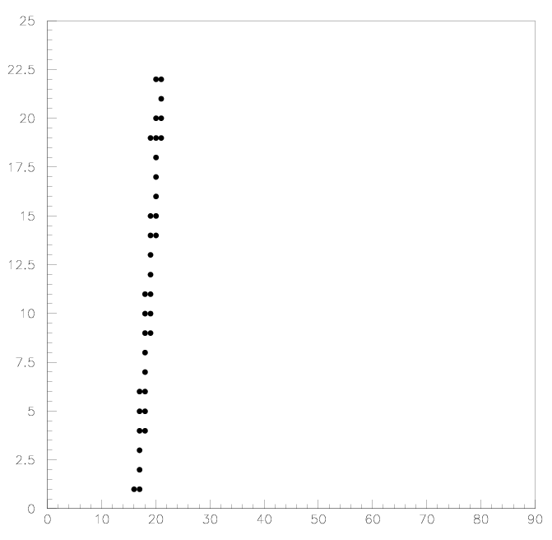
Some tracks
Plot row vs col for frames with max sample > 500 adc counts
Column
Column
Column
Row
Row
Row
Straight tracks clearly seen !

Slide 5
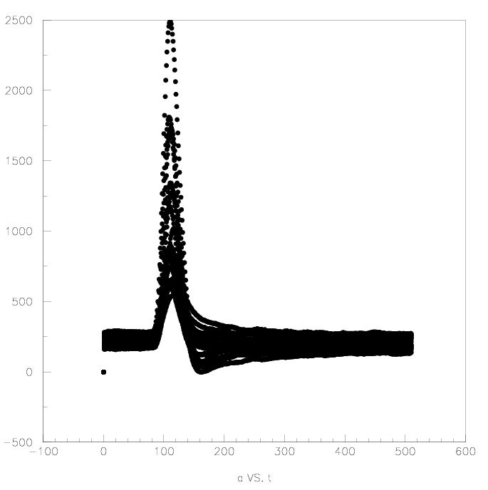
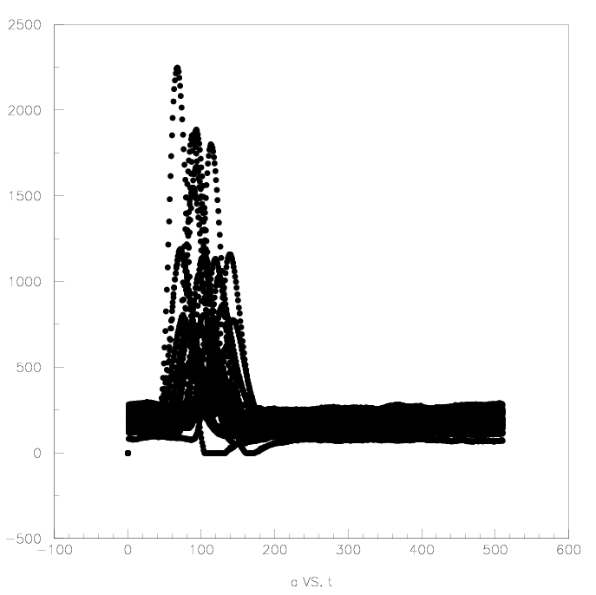
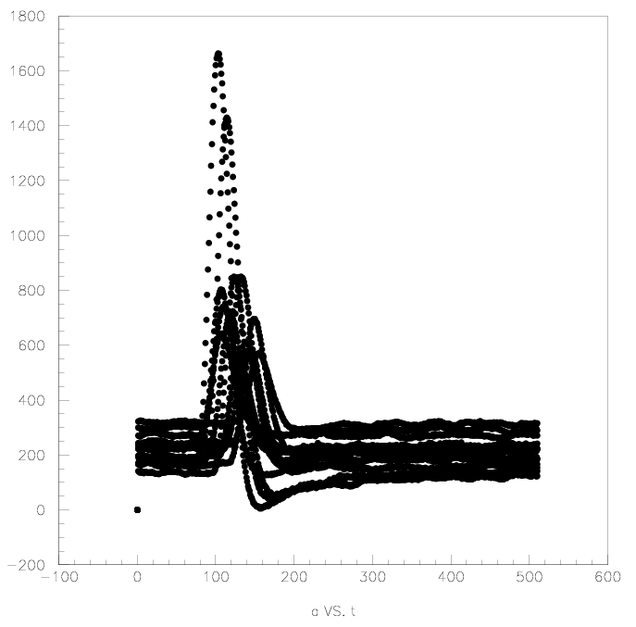
Pulseshapes
ADC counts
Time (samples, 1 sample=10 ns)
Timing differences clearly visible
Pulse shapes differences also visible

Slide 6
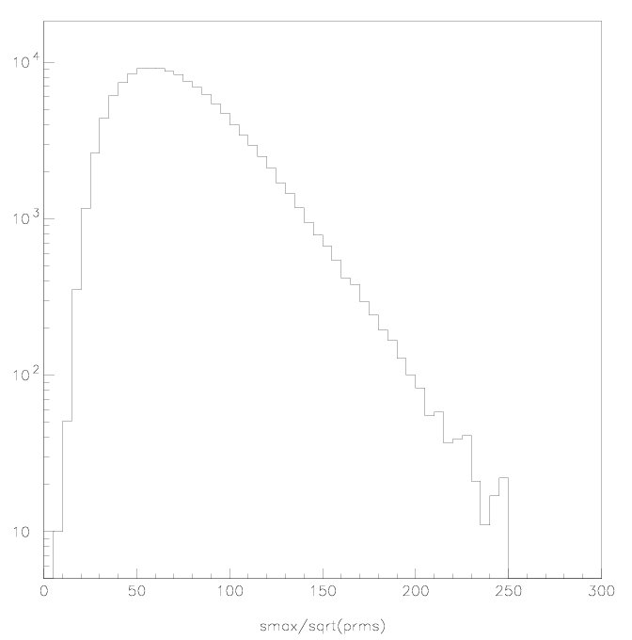
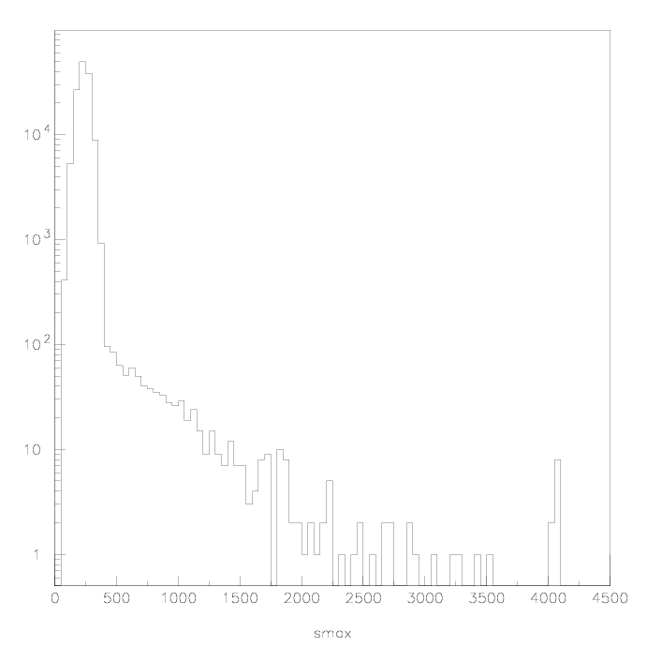
Amplitude distribution
Max sample/rms of pedestal
Max sample
ADC
saturation
ADC count
HT/readout electronics settings make good use of ADC dynamic range

Slide 7
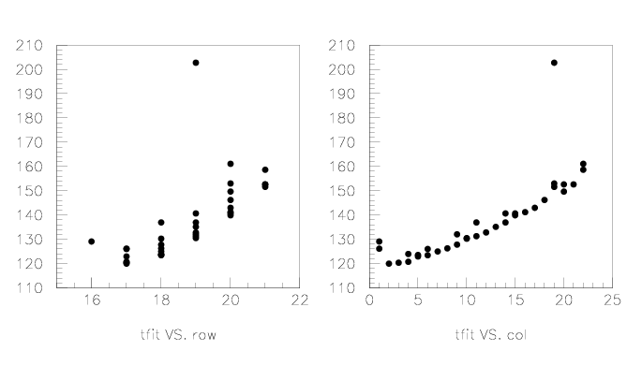
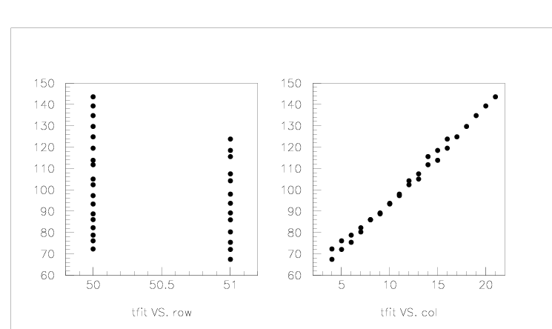
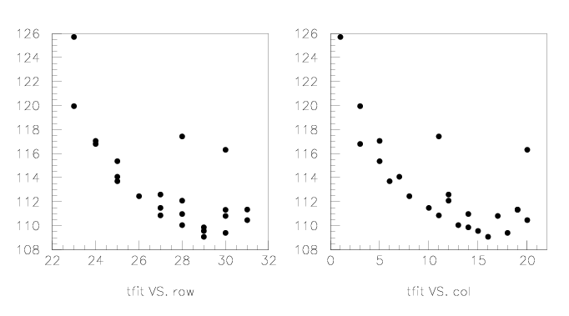
Timing
Time (1=10 ns)
Row
Column

Slide 8
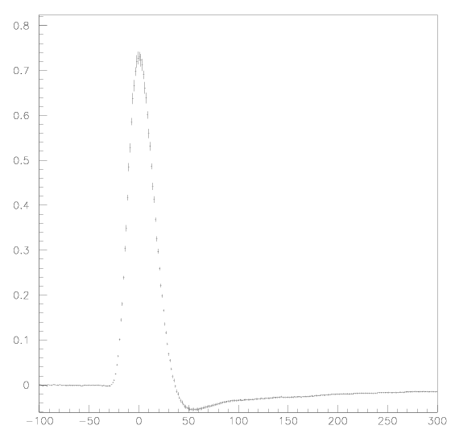
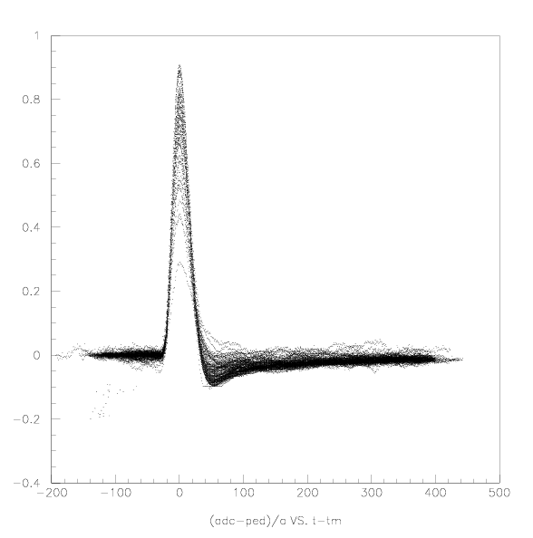
Shapes as a funtion to track distance maximal pad
(ADC-pedestal)/ADCMax
Time (1=10 ns)

Slide 9
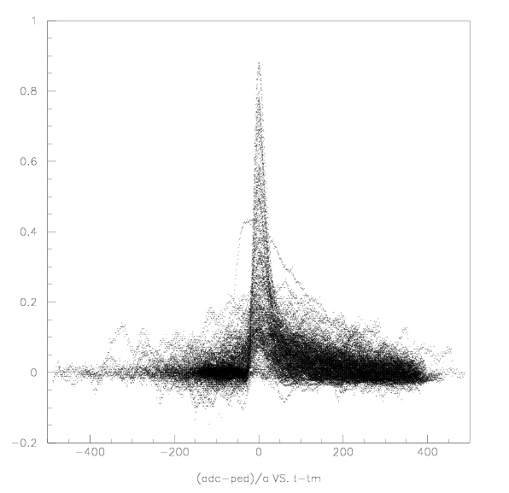
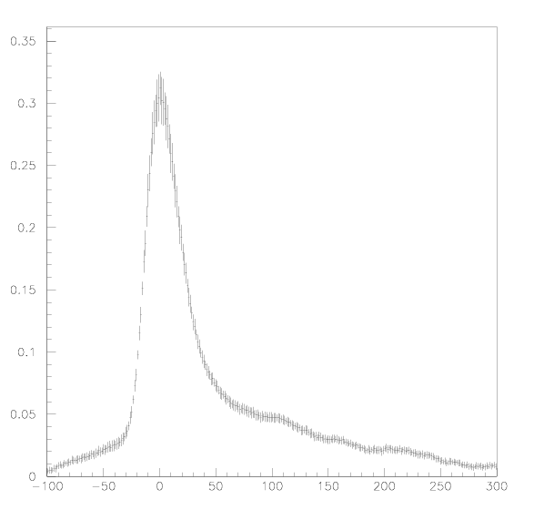
Shapes as a funtion to track distance max+/-1 pad

Slide 10
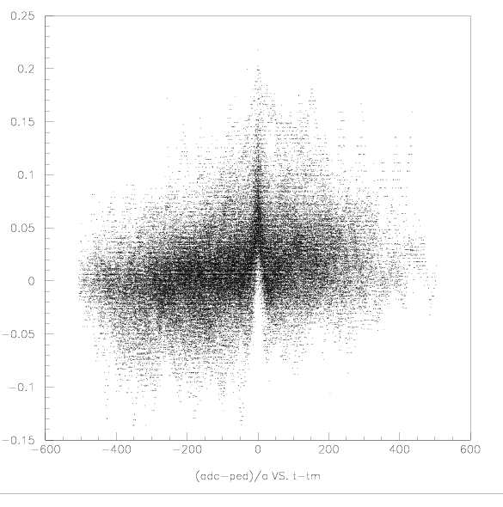
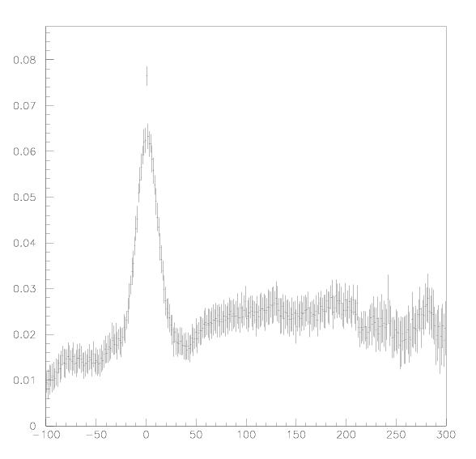
Shapes as a funtion to track distance max+/-2 pad

Slide 11
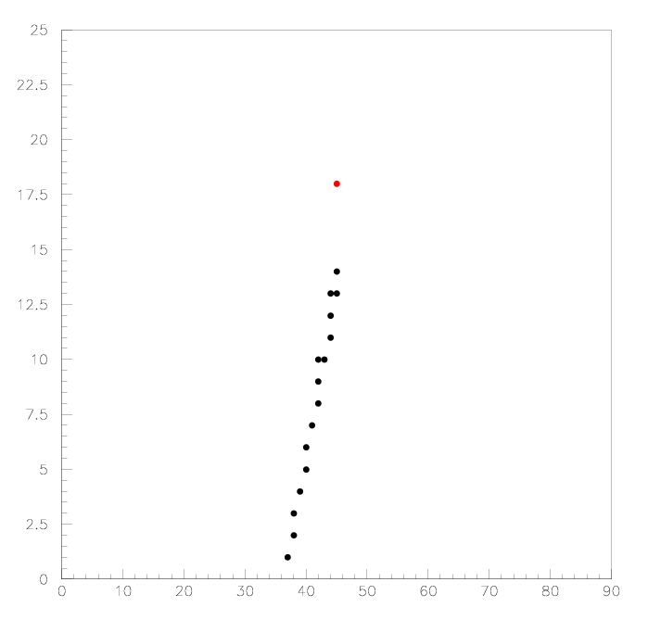
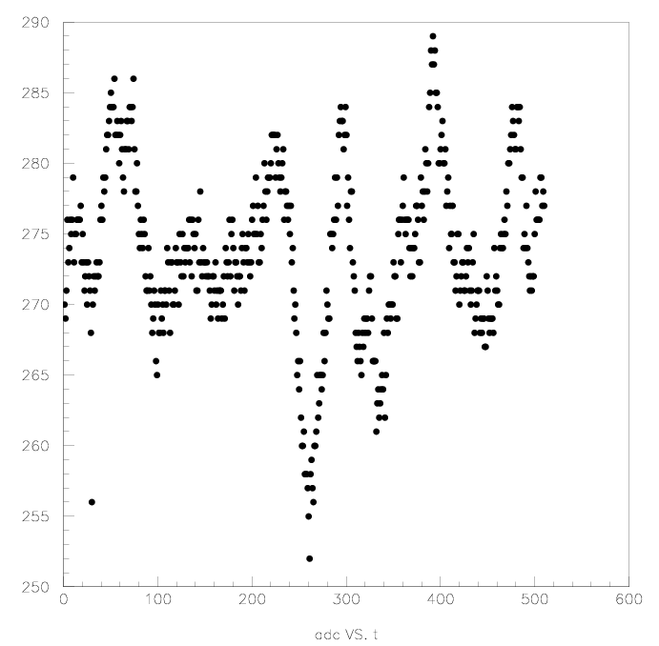
Abnormal pad signal

Slide 12
What comes next ?
Define ESD format :
  Local pedestal, noise amplitude, timing, signal quality
  Correspondance with geometry and readout topology
Build cleaning algorithm
  Reject abnormal pads/signals
Take long runs

Slide 13
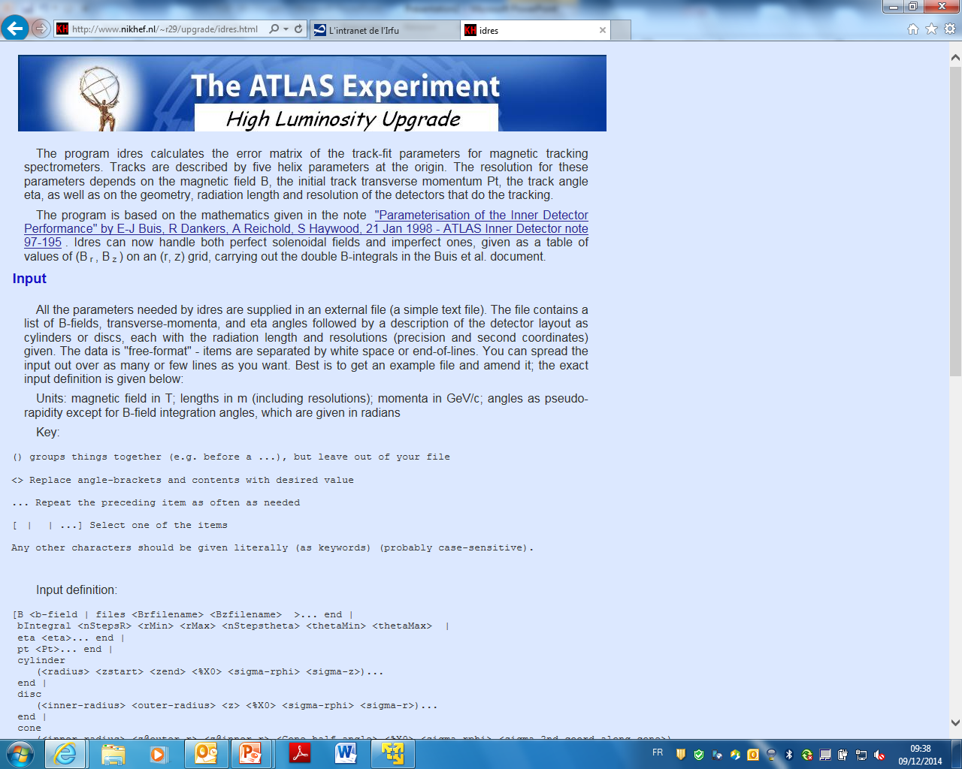
Idres (pointed to me by Sergei)

Slide 14
Idres advantages
Code is easier to use than Trackerr
Encoding of geometry much simpler
Can be used also for fcc-hh
Can work with complicated B topology : accepts B-maps

Slide 15
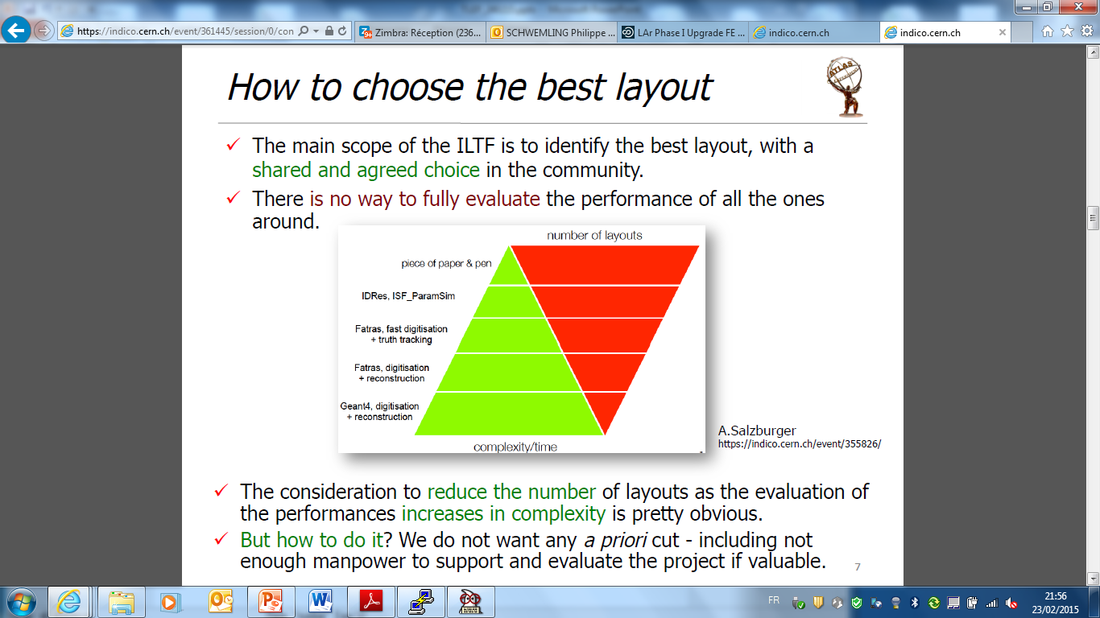
ITK week, 23/02/2015

Slide 16
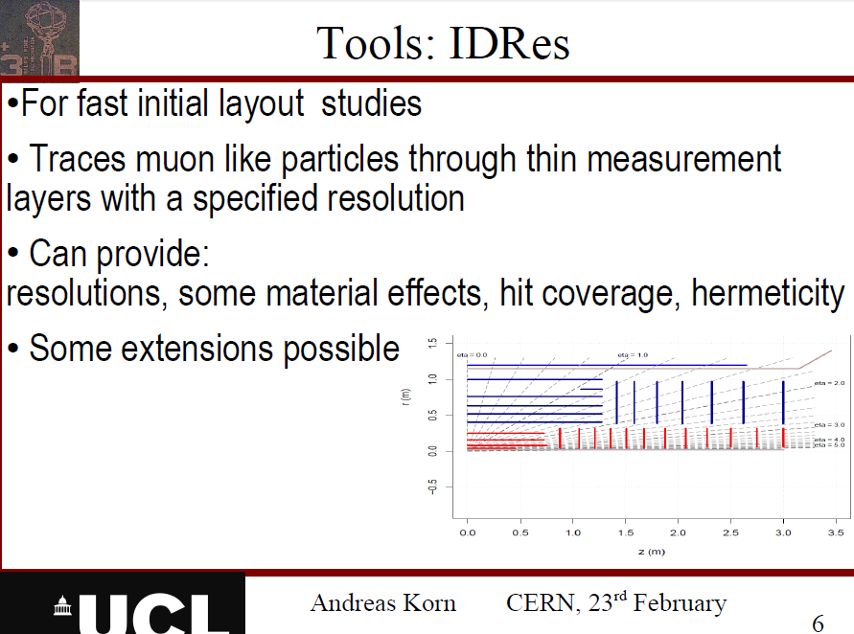

Slide 17
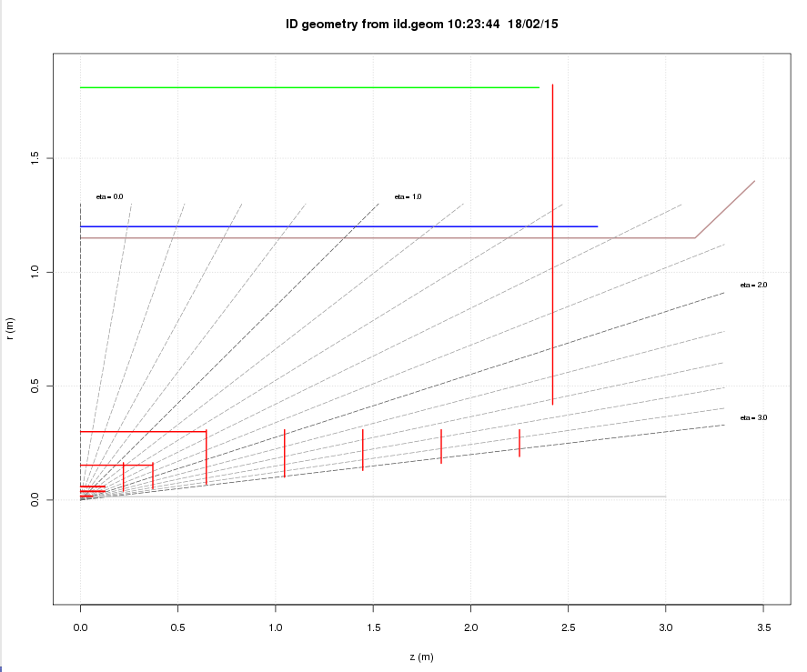
Status
ILD geometry fully encoded

Slide 18
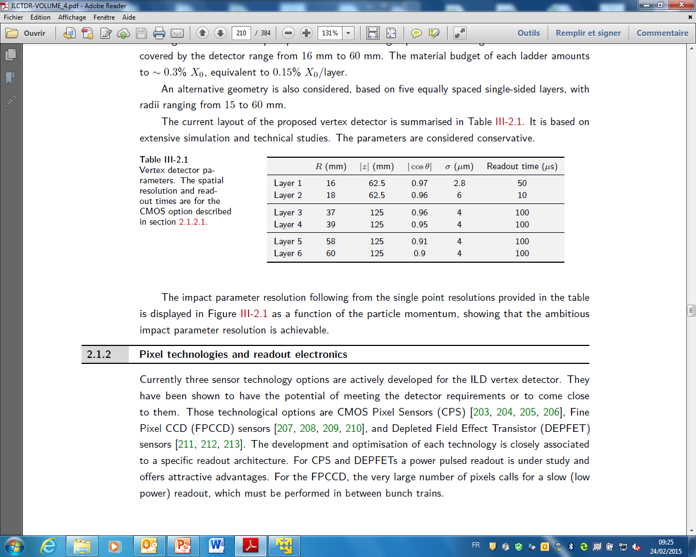
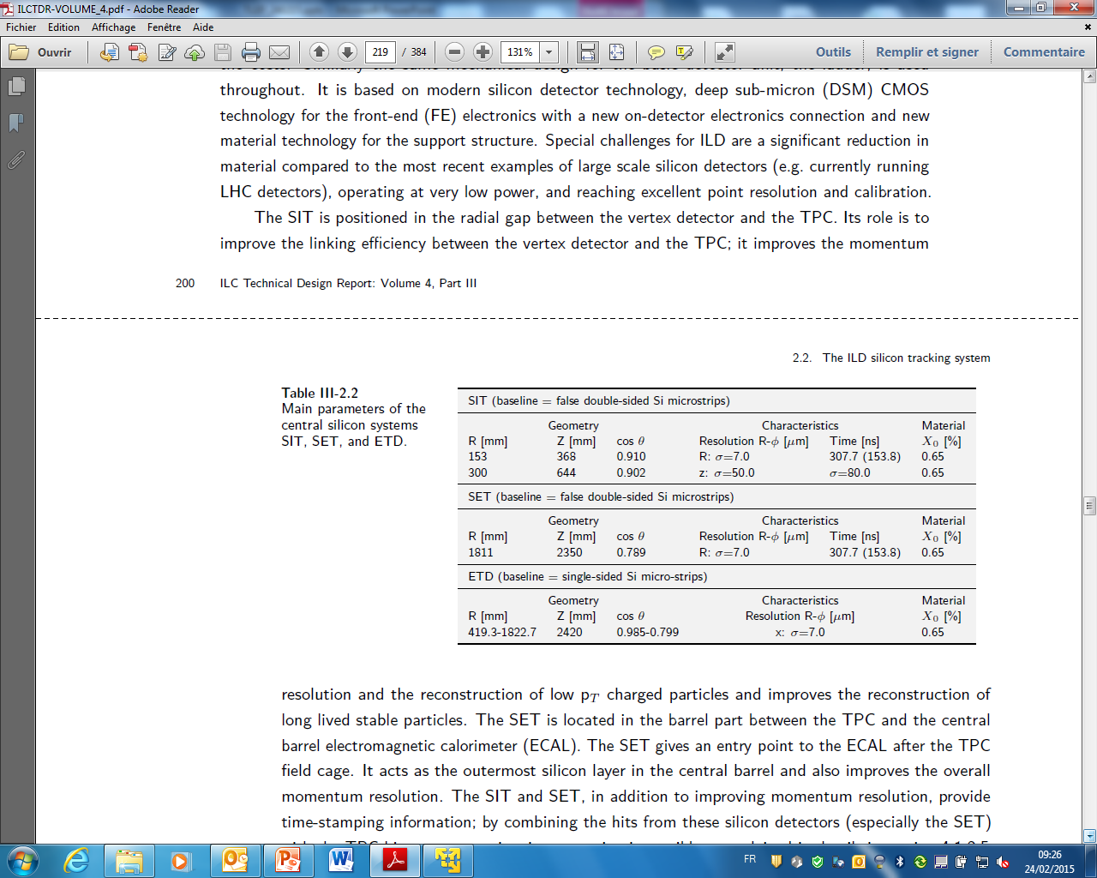
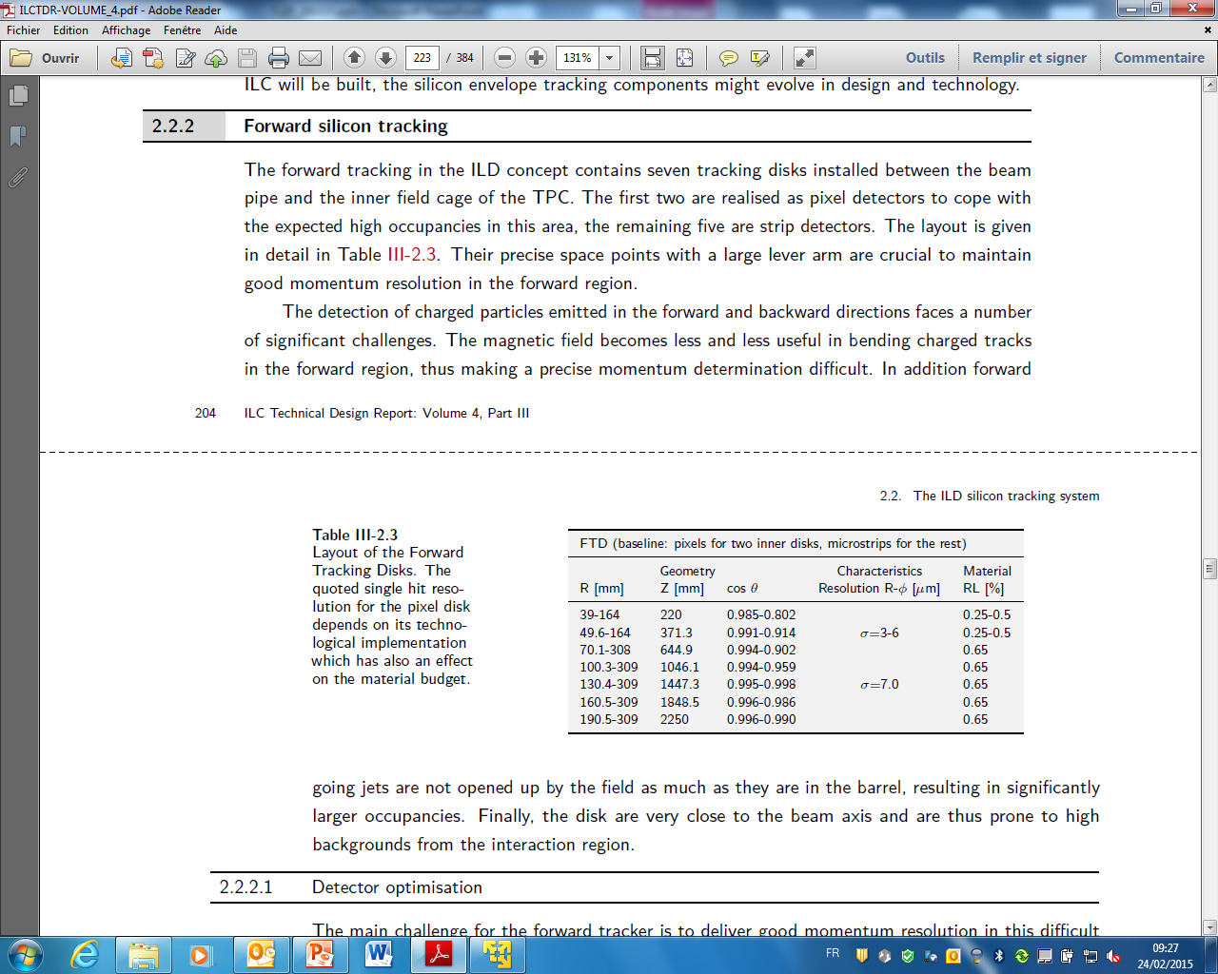
ILD layout as encoded

Slide 19
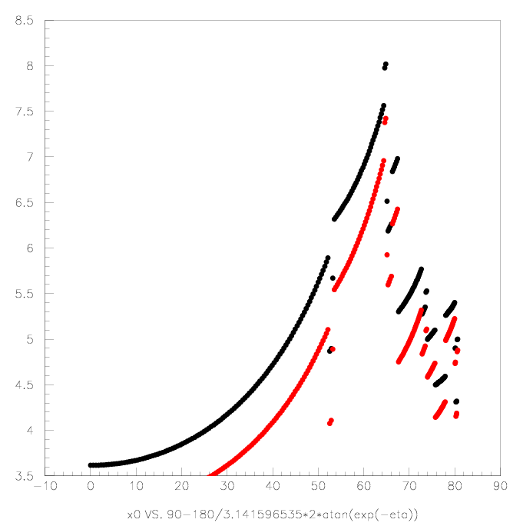
Material budget estimates
X/X0 (%)
Si+TPC
Si only
θ (degree)

Slide 20
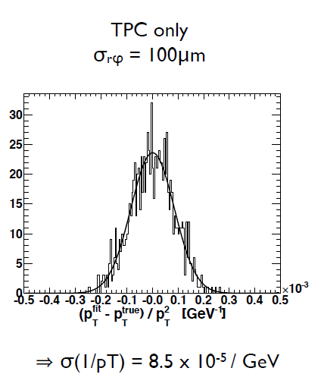
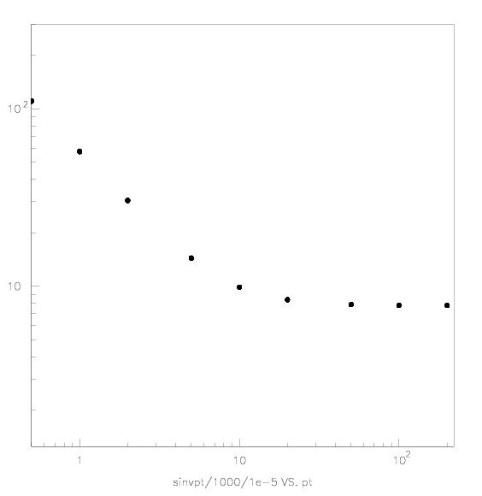
Validation plots
Plot F. Couderc
σ(1/Pt)×10⁻⁵
idRes
Pt

Slide 21
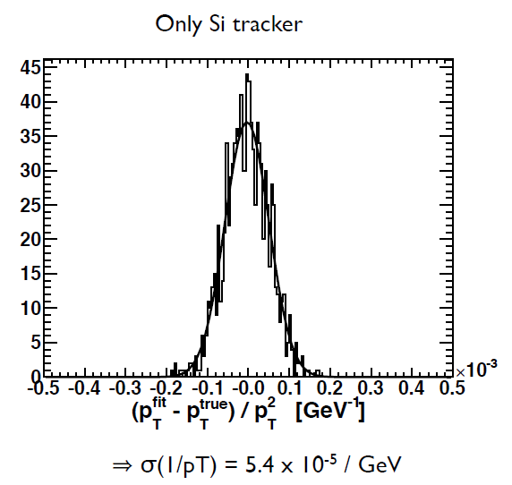
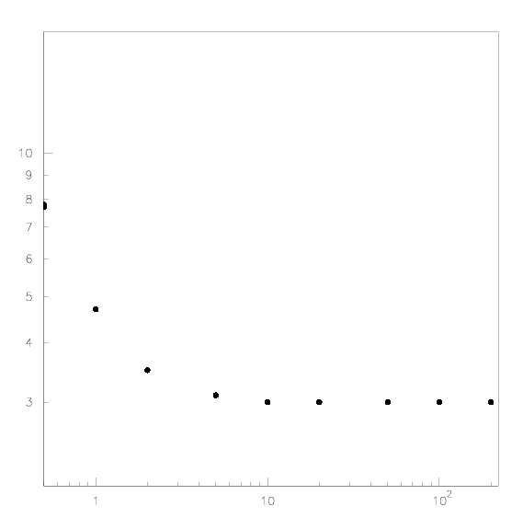
Validation plots
Plot F. Couderc
σ(1/Pt)×10⁻⁵
idRes
Pt

Slide 22
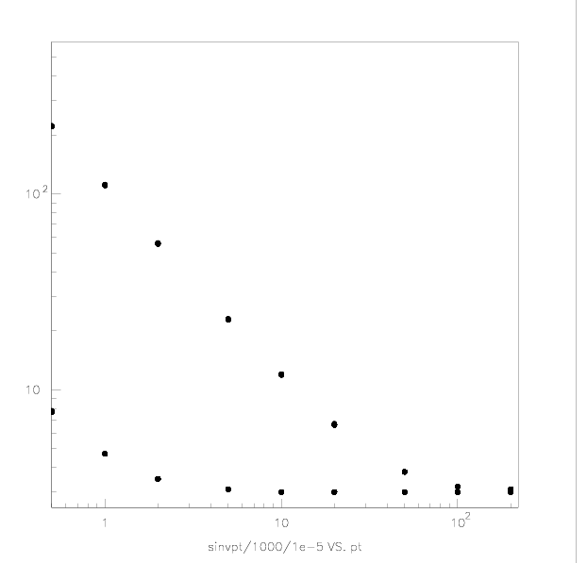
Material effects, Si only
σ(1/Pt)×10⁻⁵
Material effects included
≈no material
Pt

Slide 23
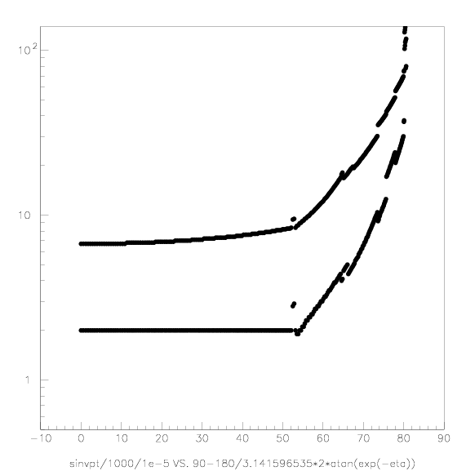
Angular dependance (Si+TPC)
σ(1/Pt)×10⁻⁵
Pt=10 GeV
Pt=200 GeV
θ (degree)

