Slide 1
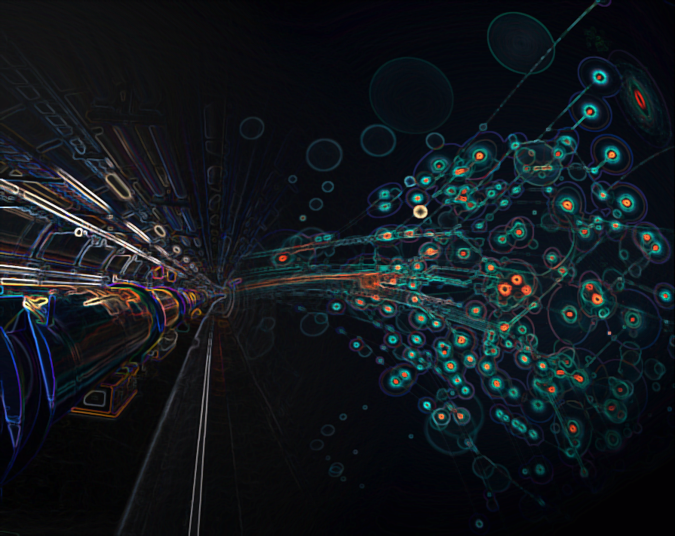

FCC Design Study
R. Aleksan
Saclay
Fevrier 24, 2015
General News
Informations générales
CECP
Prochain RV

Slide 2
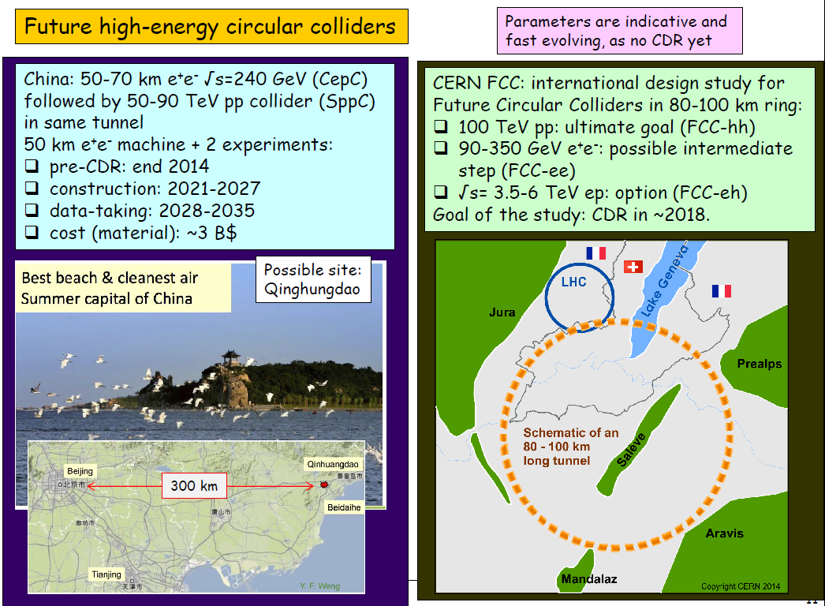
ON THE MAP!
2014 F. Gianotti, LHCP2014
NB (AB): time scale for FCC-ee similar to CLIC (2030++)

Slide 3
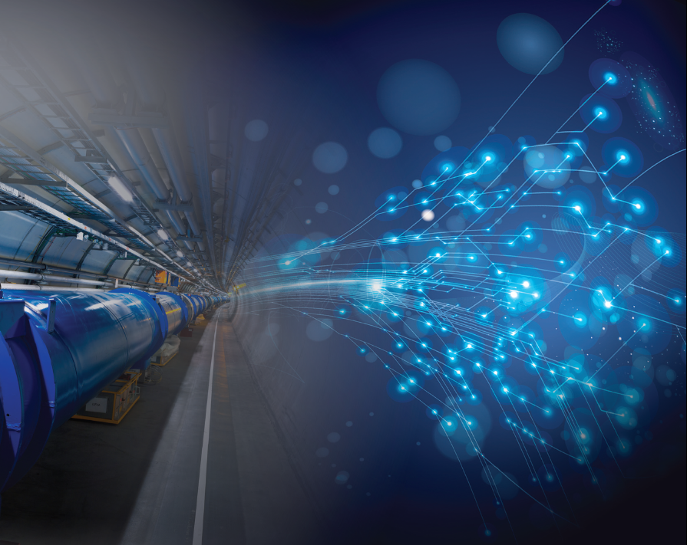
H2020: Past calls
3 DS (INFRADEV-1) projects submitted
Calls | 2014 (M€) | «Max.» EC co. (M€) | Deadline
INFRADEV-1 (DS) | 15 | « 3 » | 2 Sept. 2014
EuroCIRCOL: FCC-hh 100km Circular collider (Core part of FCC)
EuPRAXIA: European Plasma Accelerator with High Beam Quality and Pilot Applications
ESSnuSB : neutrino Super-Beam based on ESS linac
39 projects submitted (expected success rate ~13%)
Notification from the EC received in January 2015

Slide 4
DS Results
Outcome very good in general (all project in top 25%) but in practice only one funded for the moment
FCC approved with a score of 15/15 (ranked #1)
Full requested budget accepted (3M€)
EuPRAXIA in the reserve list with a score of 14/15 (ranked #8)
ESSnuSB rejected with a score of 13.5/15
(ranked #9)

Slide 5
Contract and MoU
Contract with the EC for EuroCIRCOL
MoU with CERN for FCC
2 parts:
  General framework
  Addendum with specific activities
    Study of TPC for FCC-ee
    Study of magnetic configuration for FCC-hh detectors
    Design and arcs layouts for FCC-hh
    Study and design of dipole magnets fon FCC-hh

Slide 6
Objective CepC:
End 2014: First Draft pre-CDR collection of existing information
  from ILC, FCC on physics and accelerator
  for detector (ILD)
On-going internal review of the document with external reviewer also
  Accelerator part done
  Physics : this week
  Detector (?)
Spring 2015: Submission for funding CDR during next 5 years
Request in the range 500-800MYuan (70-100M€)
Summer/fall 2015: Decision from Government for R&D support

Slide 7
Etudes conjointes IHEP/Tsinghua - Saclay
Fort souhait des physiciens IHEP et Tsinghua (CEPC) de collaborer avec Saclay
Il est aussi de notre intérêt de collaborer avec eux pour suivre les développements de CEPC et éventuellement de faire des études conjointes
Après discussions lors de la réunion FCPPL, nous avons convenu
  R&D communes sur la TPC
  accueil de thésard chinois vers 2nd semestre 2015
Mais peu d’action jusqu’à présent :
Manque de temps du coté Chine à cause du pre-CDR
Pas vraiment près de notre coté
Discussion récente avec GAO Yuanning
Difficulté de trouver un étudiant de niveau suffisant
Si bon candidat, pourrait l’envoyer pour quelque mois cette année
Financement ne semble pas poser de pb.
Si OK pourrait rester plus longtemps en 2016
On pourrait finaliser cela lors du meeting FCPPL à Hefei du 8 au 10 Avril 2015: https://indico.cern.ch/event/348717/

Slide 8
FCC-ee (TLEP) VIDYO meetings & Workshops
FCC-ee vidyo meetings:
http://tlep.web.cern.ch/node/1553/indico-events
Last FCC-ee workshop Feb. 3-5 see
https://agenda.infn.it/conferenceDisplay.py?ovw=True&confId=8830
Next Physics meeting March 2nd
Next accelerator meeting March 2nd
https://indico.cern.ch/event/375193/
https://indico.cern.ch/event/373936/
FCC-hh (VHELHC) VIDYO meetings
https://indico.cern.ch/categoryDisplay.py?categId=5258
Many vidyo meeting done:
Next workshop scheduled: https://indico.cern.ch/event/352868/
March 11-13 (Higgs and BSM at 100 TeV)

Slide 9

First FCC Week
Conference
Washington DC
23-27 March 2015
http://cern.ch/fccw2015
++...
draft poster

