Slide 1

Plans for delivery and commission the RF system
K Ronald, University of Strathclyde
For the MICE RF team

Slide 2
Content
The RF System has several Key subsystems to be addressed in different talks
  RF Cavities and Cavity Modules
    Progress on the tests at the MTA discussed in the first paper
    Cavity modules to be addressed in penultimate paper
  Muon-RF phase determination
    Discussed in preceding talk
  RF drive and distribution system
    Plans for test, delivery and installation of amplifiers will be addressed here
      Encompasses development of remote control (2nd talk) and LLRF control (final talk)
  Cavity tests at RAL
    Opportunity for a full system test
    Commission all major components before assembly in beam line

Slide 3
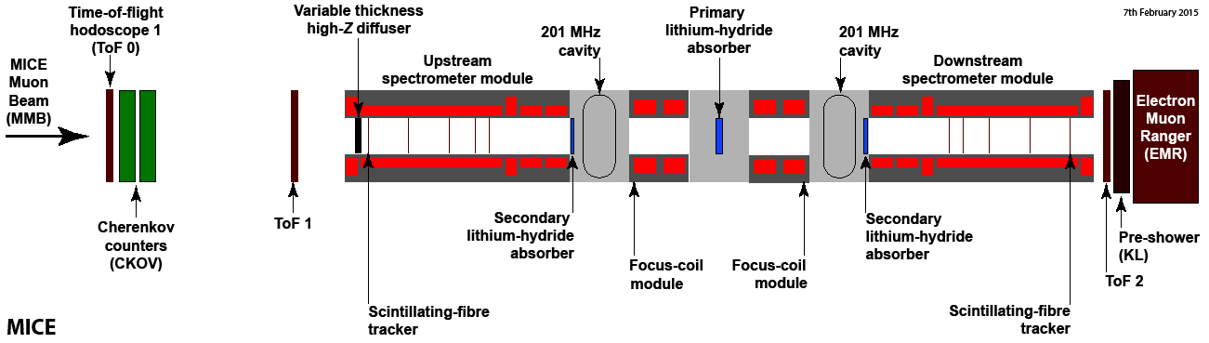
MICE High Power RF systems
MICE HPRF system requirements have changed
  Fewer cavities, no coupling coil
  Required operational date on the beamline is Summer 2017
    Requires early commissioning of the hardware: Starting Aug 2016
  Enables demonstration of ionisation cooling with re-acceleration
  First results complete before end US fiscal year 2017
It is relevant to review the timeframe and resources required to deliver this system

Slide 4
MICE High Power RF drive systems: Commissioning
2MW peak output from RF drive amplifiers, are unchanged
  First triode amplifier proven and installed at RAL
  First tetrode amplifier also proven with pulsed power modulators
    These are now back at Daresbury
Commissioning System No. 2
  Recommissioning of tetrode amplifier no. 1 underway at DL
  This will be used to commission triode No. 2 with first modulators
  Tetrode No. 1 will be replaced by tetrode no 2 by end of year
  Remote control system no. 1 will be implemented in control rack by end of year
  2nd Triode and Tetrode amplifiers operating with 1st control rack and modulators by end 2015
  2nd Triode and Tetrode Amplifiers operating with 2nd modulators and control rack by end Summer 2016
Effort requirement
  6-8 months of RF test (two people),
  1.5 Months defining controls philosophy (two people)
  PLUS electrical engineering effort drawn from the 6.6 FTE allocated 2015-2017

Slide 5
MICE High Power RF drive systems: Installation and Test
Amplifier System No. 1
  First triode remains installed at RAL
  Reinstall Tetrode No.1 with Modulators No.1 and control racks No. 1 Spring- Aug ’16
    Build on previous installation for TIARA tests
    Note there may be some conflict with key people required for installation at RAL and commissioning at DL
    Will require mechanical modification to the Mezzanine
  Prove with 1 Month of test operation into resistive loads
Amplifier System No. 2
  Completion of Daresbury proving trials in Aug’ 2016
  Installation can commence from July ‘16 to Jan ‘17 (preliminaries need not await July ‘16)
    Build on experience from installation of system No. 1
    Will require new wiring ‘loom’ installation, additional cooling water panel and mechanical modification to the Mezzanine
  Prove with 1 Month of test operation into resistive loads
Effort requirement
  6 months of RF installation (one RF engineer), 2 months RF testing (2 staff), ~8-12 Months technicians (split between electrical and mechanical)
  2 Months Hall manager (Service Engineering Support), 1 Month Drawing Office
  PLUS electrical engineering effort drawn from the 6.6 FTE allocated 2015-2017

Slide 6
Cavities: Pre-Installation
Cavity Module No. 1: Arrival and Installation
  Assumed to arrive under purge and fully assembled May ‘16
    Assume cavity has been baked prior to arrival
  In advance auxiliary systems will be prepared in MICE hall
    Clean room: Essential in case any intervention is required
    Independent cooling loop for each cavity with tight thermal regulation
  LLRF tests to verify safe transport and arrival
  Install cavity next to shield wall opposite U/S SS
  Install vacuum pumps and pump cavity ready for operation late Jun 2016 (1-2 months)
Cavity Module No. 2: Arrival and Installation
  Assumed to follow same pattern as Cavity module No. 1 with object of completion at Oct 2016
Effort requirement
  Primarily a mechanical and vacuum engineering problem, so should be defined by others
  Rough estimates,
    2 man months on clean room?
    2-3 man months on cavity cooling system?
    3 man months on vacuum system installation per cavity?

Slide 7
Cavities: Pre-Commissioning
Pre-requisities
  As described above RF system No.1 with full remote controls is expected to be available in July 2016
  Cavity No 1 expected available by June 2016
  LLRF tuner control and RF closed loop control system expected by Summer 2016
  Installation of RF power feeds to the test point (shield wall opp. U/S SS)
HPRF Tests of Cavity No. 1
  Initial tests on a single cavity, using drive system No. 1
  Aug ‘16- Oct ‘16, est 2 months for complete tests
HPRF Tests of Cavity No. 2
  Oct ‘16- Dec ’16 using drive system No. 1
  Leave in situ until last possible moment
  Opportunistically test with drive system no. 2 if timing is good
Effort requirement
  Rough estimates,
    1 man months to build and install pre-comissioning distribution system
    6 (minimum) man months RF staff on cavity tests

Slide 8
Cavities: Installation
Pre-requisities
  Completion of tests as defined in previous page on two cavities with RF amplifier No. 1
    Ideally also pre-commissioning tests with Amplifier No. 2 and Cavity No. 2
  After tests cavities left either under vacuum or purge N₂ gas
  Removal of the STEP IV yoke and completion of the absorber, spool vacuum pieces
  Build of floor plates, mechanical integration components
  Installation of final RF distribution network (planned for Aug ‘16- Feb ‘17)
Procedure
  Cavities should be left under purge until the last possible moment.
  Absorber and spool sections ‘beam line vessel’ should be pumped separately and left under purge
  When final installation is imminent, the ‘beam line vessel’ cavity gap be opened and the apertures blocked with thin plates
  When ready, the end plates of the cavity modules should be removed, replaced with this plates for installation
    Cavities immediately installed in the beam line vessel
    Immediately ‘rough pumped’, then HV pumped
  Shown as starting early Feb and could complete early March 2017, validate with LLRF measurements
Effort requirement
  Primarily a mechanical and vacuum engineering problem, so should be defined by others
  2 man months to build and install distribution system

Slide 9
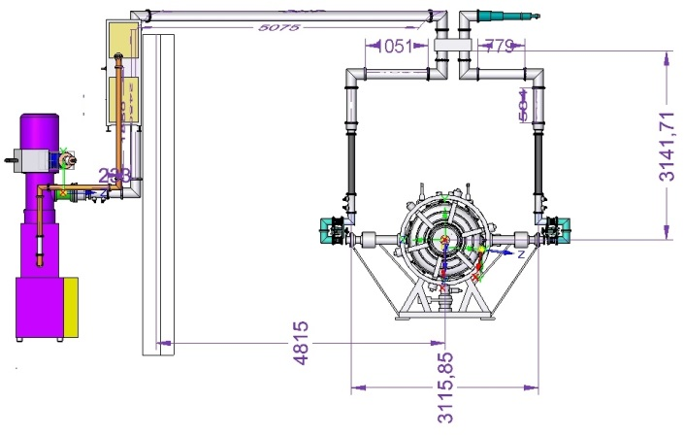
RF network
Simplified distribution network- feasible to route overhead
Off-centre mounting of hybrid takes up phase shift
Orientation of load arbitrary- align with the 6” distribution line and share mountings
Minimised length of 4” line- minimises losses
500kW Load
4616 Pre Amplifier
Hybrid Splitter
Directional
Coupler in
each line
Flexible coax
Directional
Coupler 6 inch
Line Trimmers
TH116
Amplifier

Slide 10
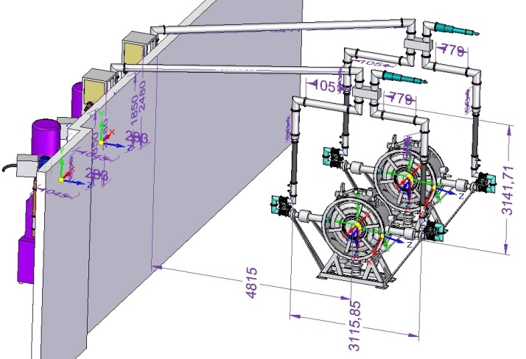
RF network

Slide 11
Cavities: Commissioning
Commissioning without B field
  Cavities should be HPRF tested on beam line before yoke is complete
    In case any intervention is required
  Estimate <1 month operation of both cavities together, so completion by April 2017
Commissioning with B field
  Requires completion of Yoke and recommissioning of all magnets
    Note ONE magnet only will be added to the STEP IV set
    Yoke plate final installation est ~ 1 wk
    Commissioning of magnets will benefit from the STEP IV plan- presently assumed to be the same process, planned for April 2017
    Tests of the cavities with magnetic field and all systems April 2017, say 2wks- 1mnth
      In parallel with magnet commissioning if possible
Effort requirement
  Requires effort to integrate magnets- will be similar to STEP IV
  2 months of RF effort (2 people)

Slide 12
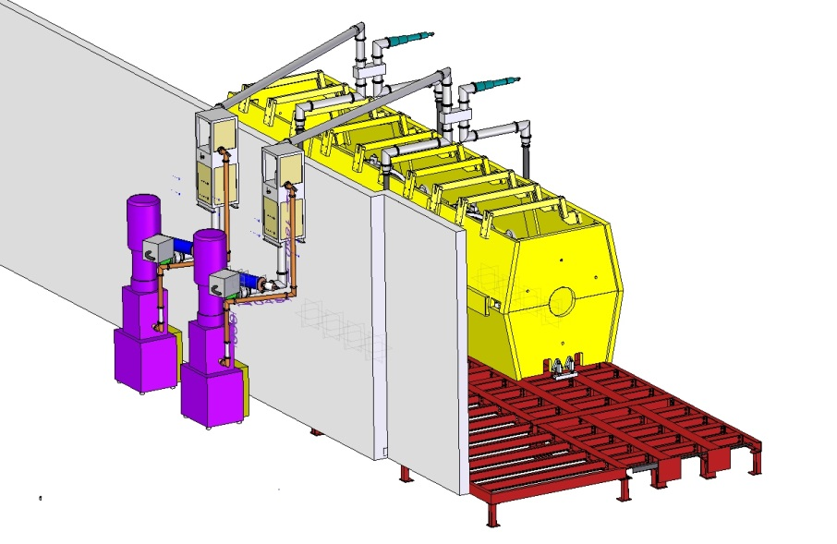
RF network
Load on each splitter to absorb unbalanced reflections
Retracted crane hook clears coax over the wall.
Support from present ‘shield wall’ and yoke
2nd amplifier moved to 3rd position behind wall to ease installation in congested area
With 2 RF amplifiers now relatively straightforward to place auxiliary systems (cooling)
Water cooling for load will need to route over the air gap on the transmission lines

Slide 13
Summary
Drive Commissioning Timetable
  Amplifier No. 1 with automation installed and operational by Aug 2016
  Amplifier No. 2 with automation installed and operational by Feb 2017
  LLRF and cavity control systems operational by Aug 2016
Cavities
  Arrival May 2016
  Cavity no. 1 ready for standalone tests by end June 2016 : Compete by Oct 2016
  Cavity No. 2 ready for standalone test by Oct 2016 : Complete by Dec 2016
  Cavity installation to beamline Mar ’17
  Installation of distribution network by Feb ‘17
  Tests of the cavities without B-field late march /early April
  Tests of Cavities with B-field, May 2017
Timetable to be integrated into Gannt Chart

