Slide 1
MICE RF Module Update
MICE CM42 at RAL, UK
June 22, 2015
Allan DeMello, Dr. Derun Li
Lawrence Berkeley National Laboratory

Slide 2
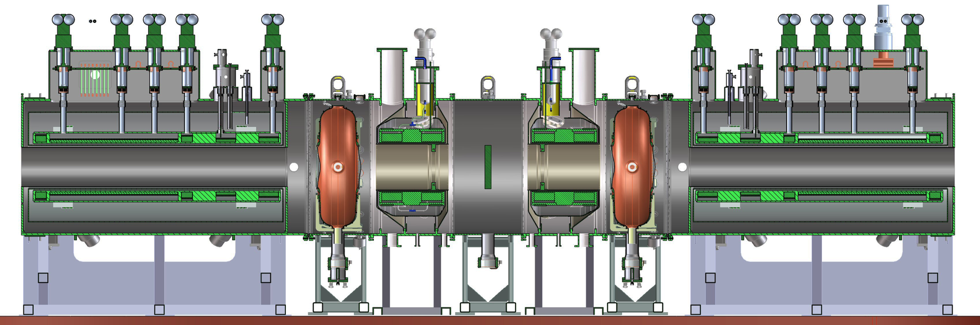
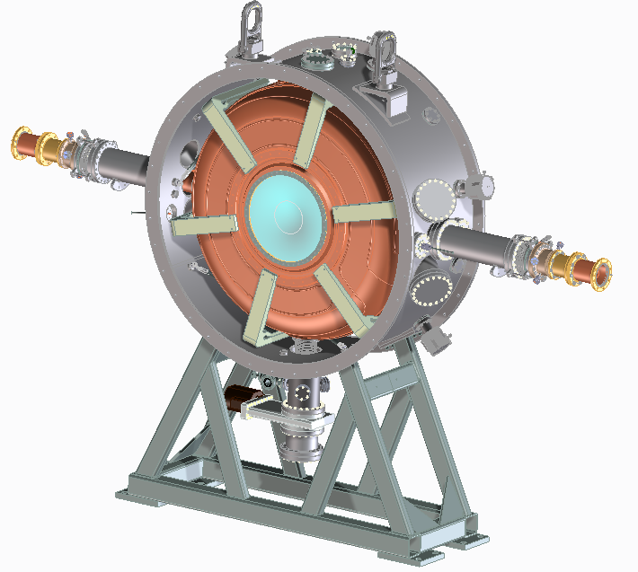
Re-baseline MICE Cooling Channel
New MICE cooling channel needs two RF modules
Each MICE RF module has
  One 201 MHz RF cavity
  Two Beryllium windows
  Two RF power couplers
  One vacuum vessel hosting the 201 MHz RF cavity
  Six tuner arms and six actuators
  Cavity support struts
  Vacuum pump system and water cooling
  Diagnostics and bypass lines

Slide 3
Current Status of MICE RF Module
Recent MICE 201 MHz RF cavity testing at MTA exceeded/reached required RF gradient
  1.8 MW power in the cavity
  3M pulses, no sparks observed
  Testing with Be windows and external magnetic field
  High power testing with tuners
Vacuum vessel nearly ready for fabrication
  Two design reviews held in the end of January and April 30 & May 1, 2015, respectively
  Update design and drawing package done
  RFQ of the RFM vacuum vessel ( ~ 3 weeks)
201 MHz RF cavities ready
  Four cavities (two spares) EPed completed at LBNL

Slide 4
Current Status of MICE RF Module
RF power coupler fabrication started
  Updated design to address issues identified at MTA assembly
  Ceramic RF windows ready and materials ordered
  Fabrication schedule developed: estimated delivery of the RF couplers ~ end of September 2015
New tuner actuator design and prototype
  Functional testing complete
  Lifetime testing complete
  Production of the actuators will begin soon
25 tuner arms being shipped from University of Miss. to LBNL: will show up at LBNL anytime
Be windows ready (we have 10 windows!)
  Will explore the possibility for a destruction test at Materion in Fremont
Vacuum system design (protection of Be windows) evolving
  Close collaboration with MICE team at RAL, coordinated by Mr. Terry Anderson at Fermilab

Slide 5
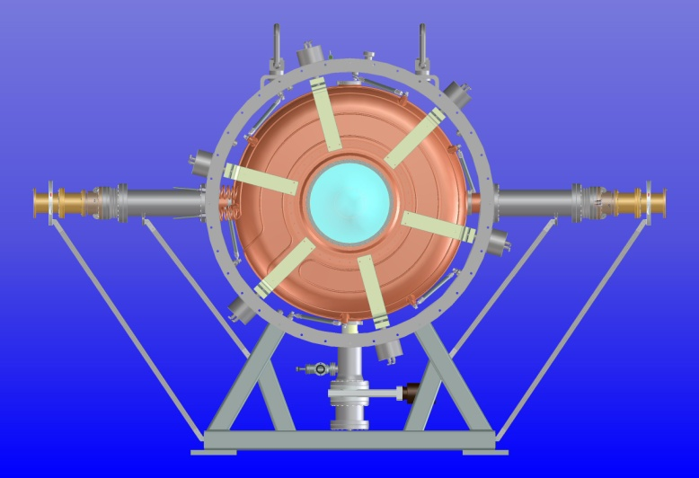
The RF Module
MICE RF module (RFM) is very similar to the single cavity test module (SCTM) that has been tested under high power RF at MTA, FNAL
  Integration into MICE cooling channel, including vacuum system, still remains
Necessary improvement and modification to the RFM & components design made to address issues and experience learned from SCTM at MTA
  Vacuum issues
    Modification to the vessel design
    RF coupler
    Actuator design
    Vacuum port and bypass lines
    Water cooling lines
Original SCTM

Slide 6
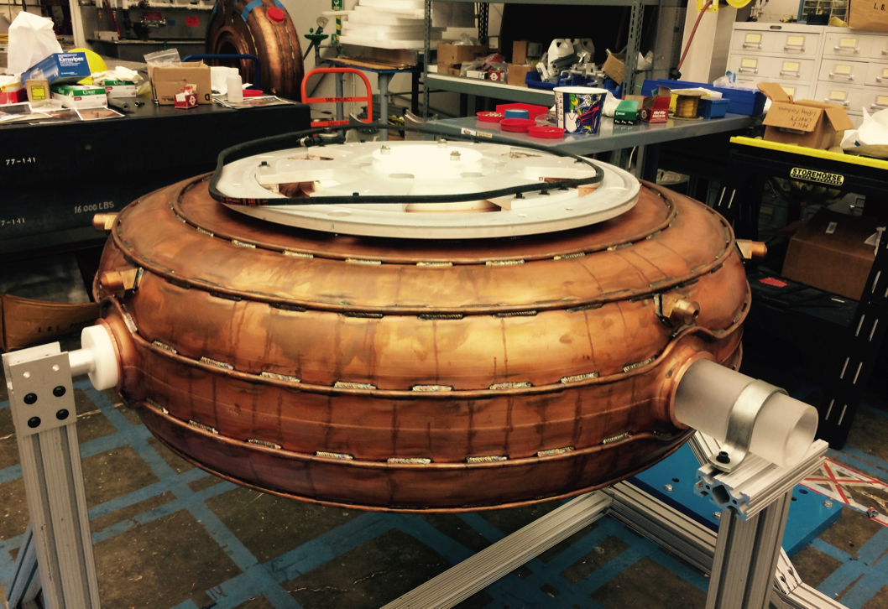
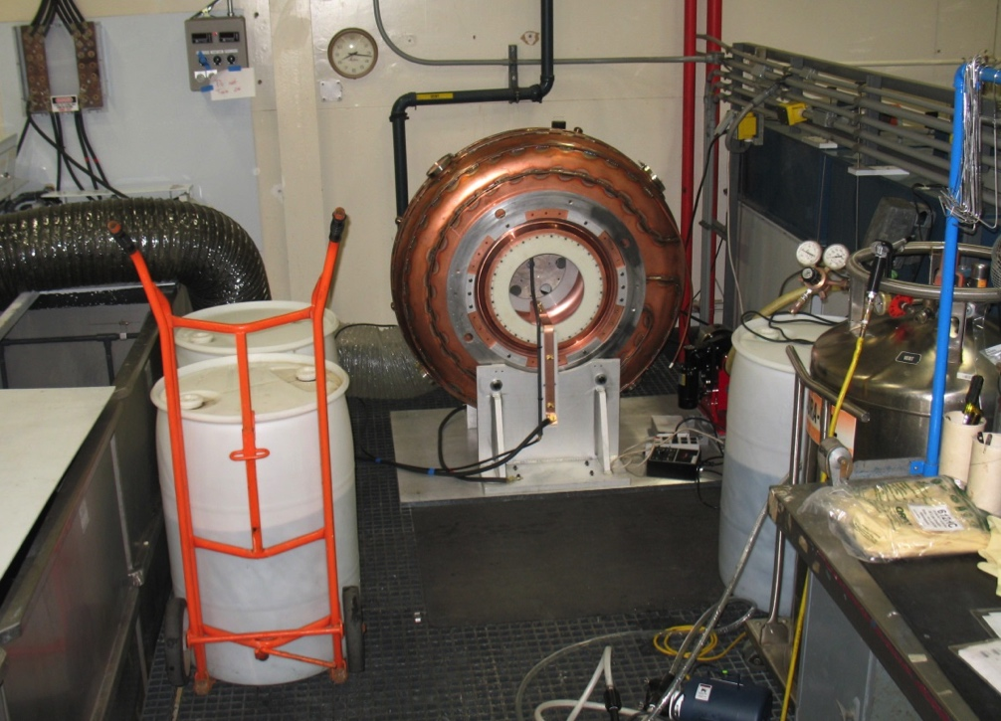
MICE RF Cavity
Selected four best cavities (two spares) from nine cavity bodies based on inner surface finish & frequency measurements of the cavity bodies with Be windows
Four cavities have been selected for electro-polished (EP) and completed
Ten beryllium windows available
Cavity assembly & measurement
EP setup at LBNL

Slide 7
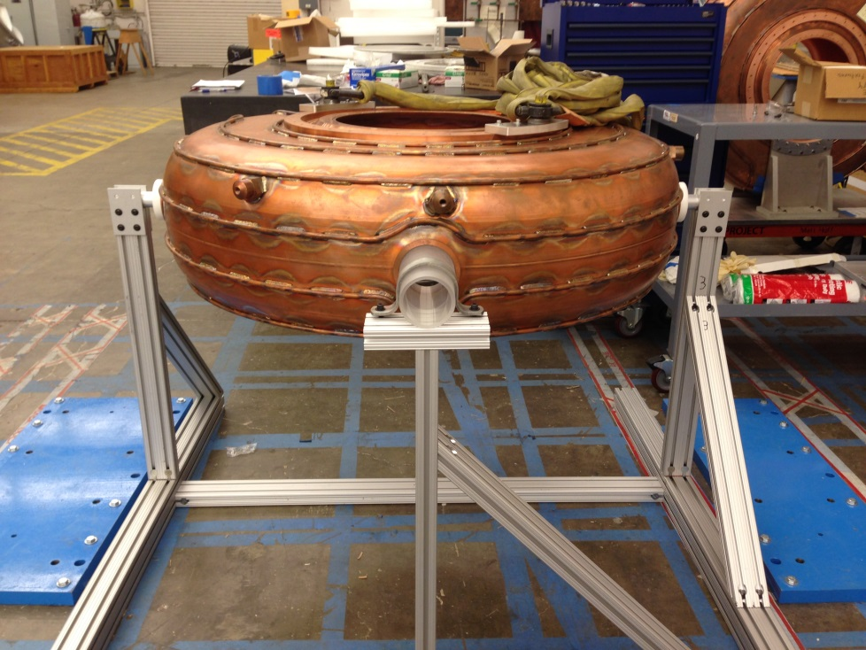
RF Cavity Fixtures
Cavity assembly fixtures developed at FNAL,
shipped to LBNL and was used for MICE RFM

Slide 8
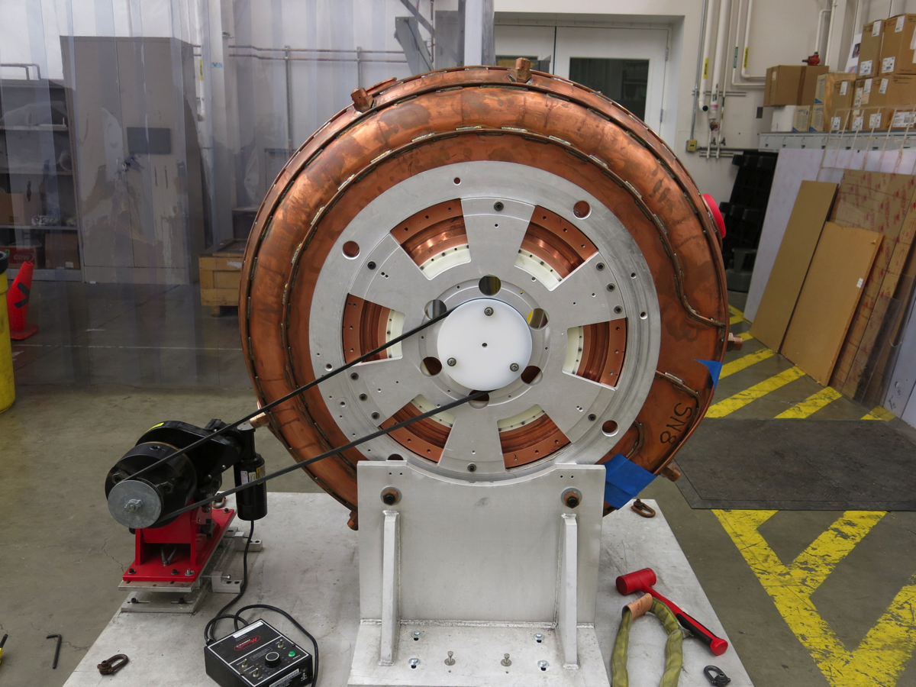
EP Setup at LBNL
Improved stand
and grounding
EP setup at LBNL

Slide 9
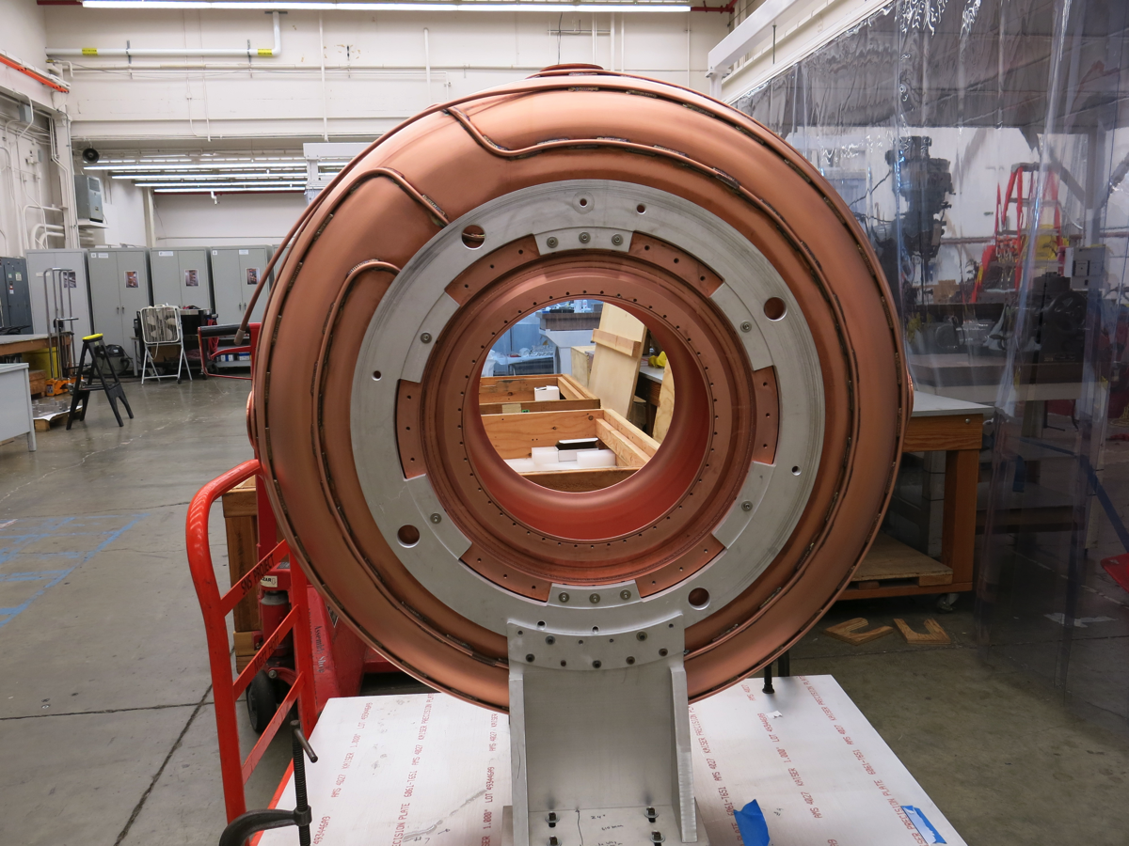
The First EPed MICE Production Cavity

Slide 10
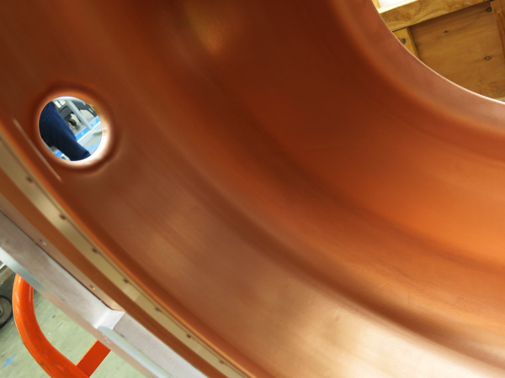
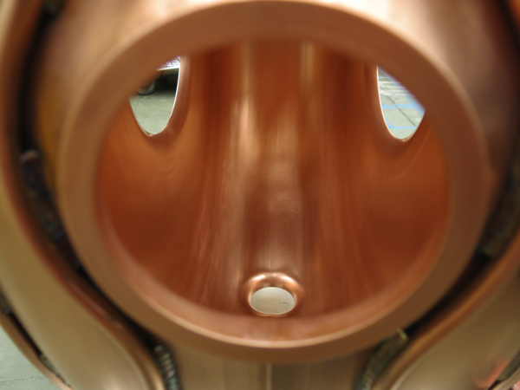
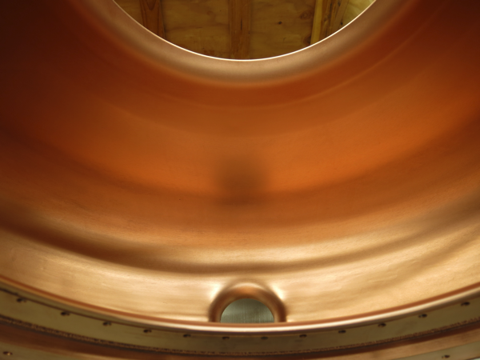
Images of Cavity Inner Surface
Inner surface finish of the
first EPed MICE production
cavity at LBNL
(photo taken on 2/21/2015)

Slide 11
Summary of MICE RF Cavities
  Cavity (with beryllium windows) selection complete
    Four cavities selected (two spares)
    In combination with different Be windows, additional
    ~ 100 kHz frequency tuning range
  EP of the four cavities complete and are ready for assembly in early FY16
  RF power coupler design updated
    Interface with cavity re-designed for easier assembly/tuning
    Cooling tube slot cover plate to be silver soldered for isolate the cavity vacuum
    Materials and parts received/ordered
    Fabrication schedule developed: ~ end of September 2015
    TiN coating work has begun on the inner surface of the outer coax tube
  Production of actuators
    Prototype lifetime testing is complete
    Fabrication starts soon

Slide 12
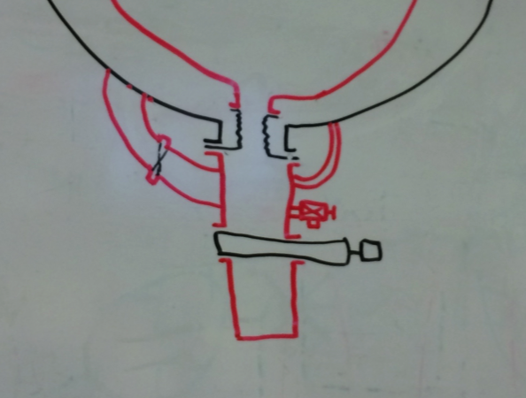
Brief Summary Of Vacuum Vessel Design
First RFM Vacuum Vessel conceptual design review held at LBNL on Jan. 27-28, 2015
Second RFM Vacuum Vessel Fabrication Readiness Review held at LBNL on April 30 and May 2015
Design requirements/goals
  Good vacuum inside RF cavity ~ 10⁻⁸ Torr
  Minimal differential force on the beryllium windows
  Exterior vacuum connecting to the rest of MICE cooling channel with base pressure of ~ 1-3 x 10⁻⁶ Torr
Summary of the new vacuum vessel design
  Update of vacuum system calculations
  Isolate cavity vacuum from the external channel
  Direct cavity port-pump connection with bellows
  By pass lines or burst disc/pressure valve to
  protect Be windows still needs work (cross spool piece in the model – vacuum vessel unaffected)
  Design complete and ready to produce fabrication drawings

Slide 13
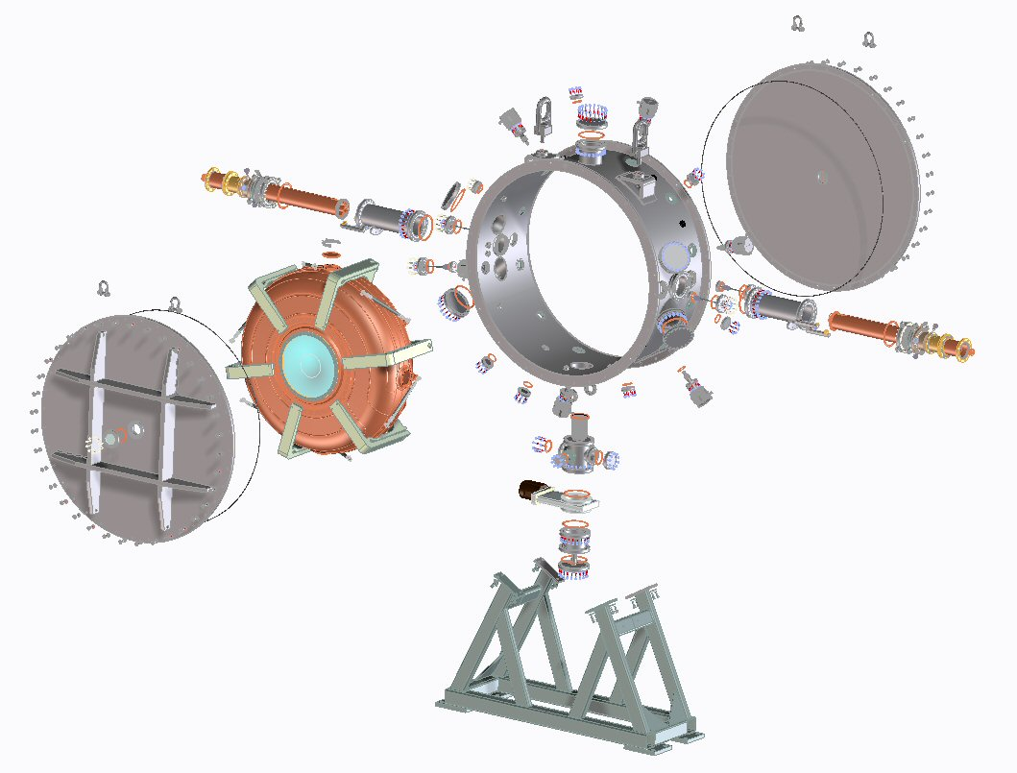
New Vacuum Vessel Design
Exploded view of the new MICE RFM
View ports added to end-plates
for inspection of Be windows
Preliminary stand design

Slide 14
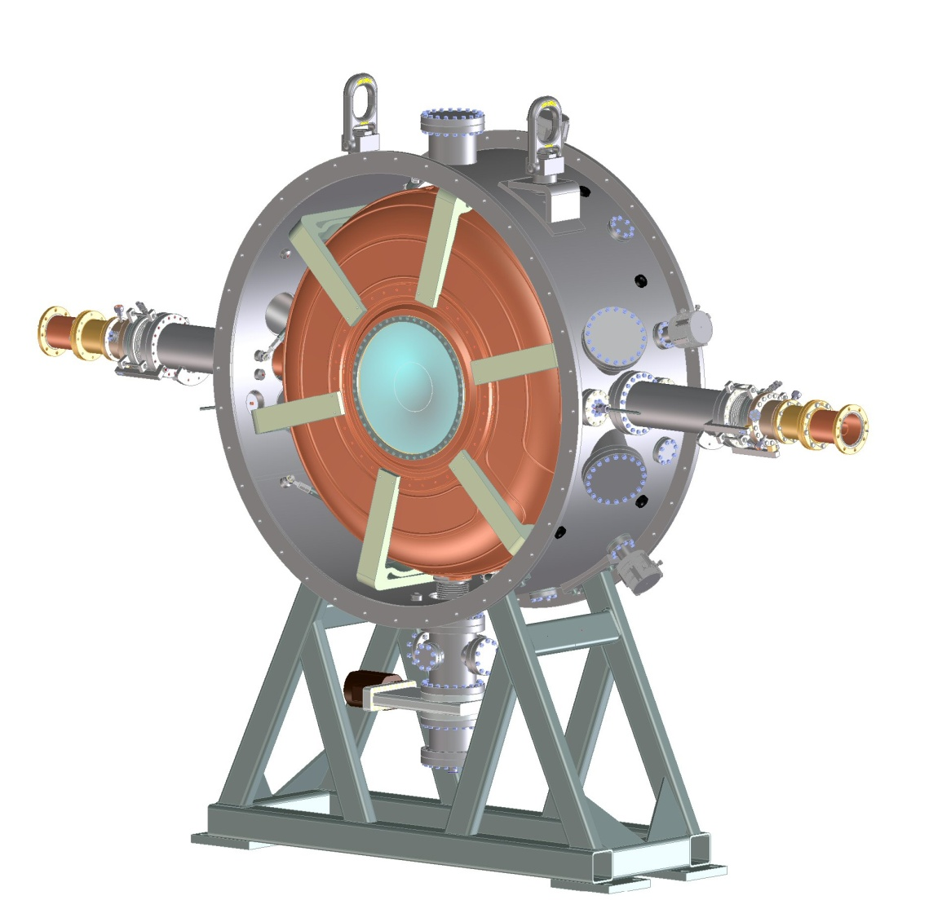
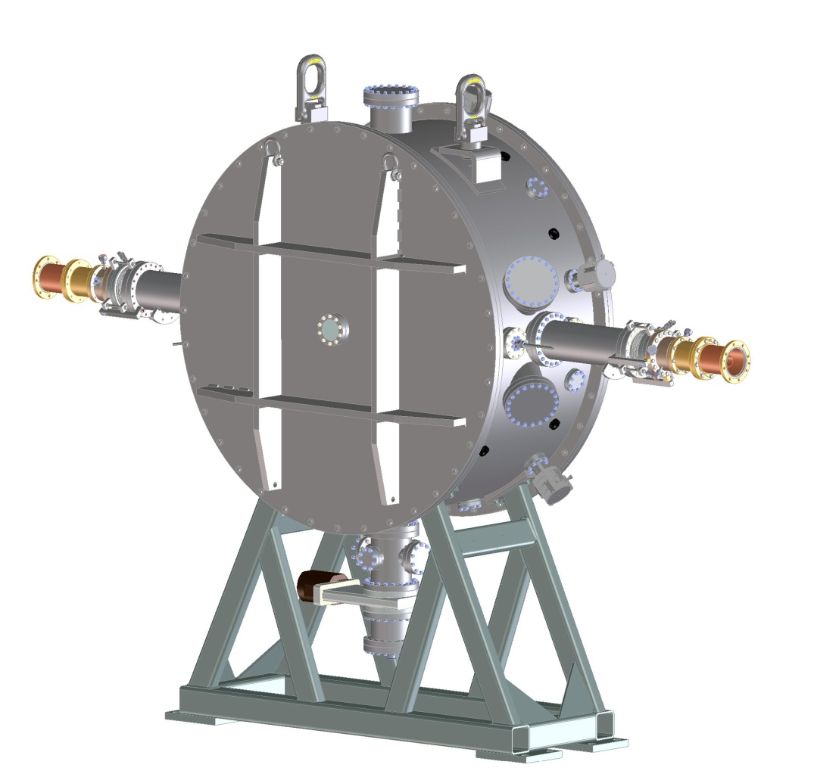
The Vacuum Vessel Design

Slide 15
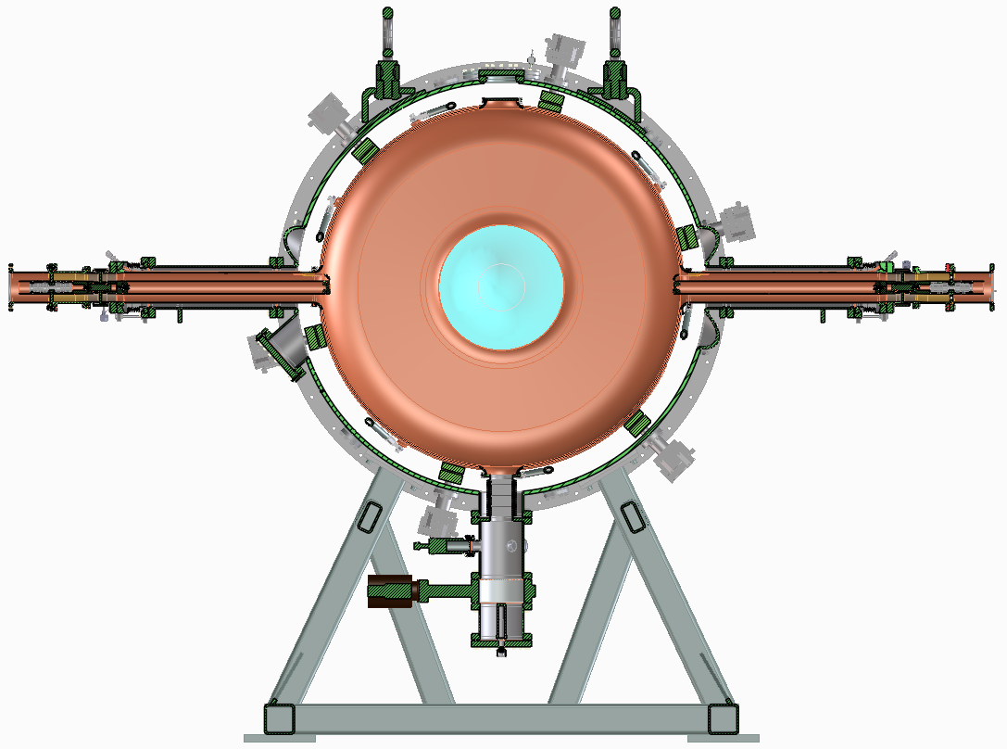
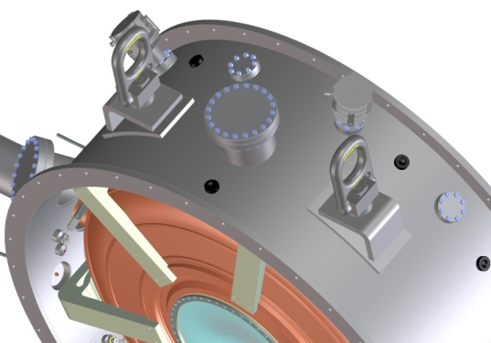
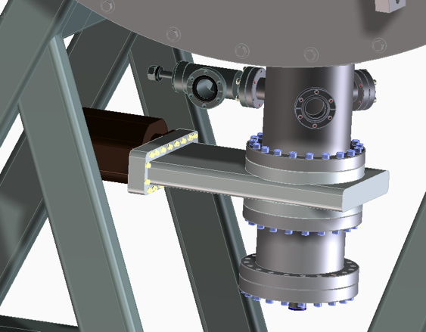
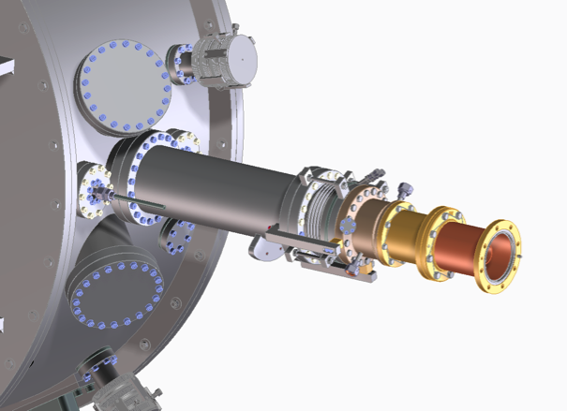
Sectional View of the Vessel
Top port for diagnostics,
possibly extra pumping if
needed; it will be an 8”
bore port

Slide 16
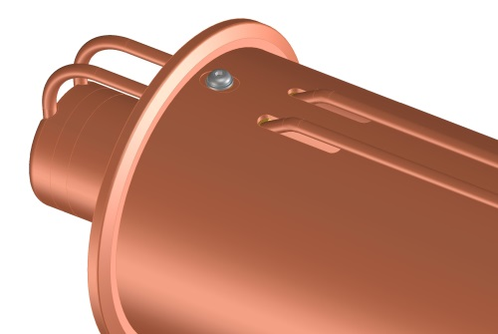
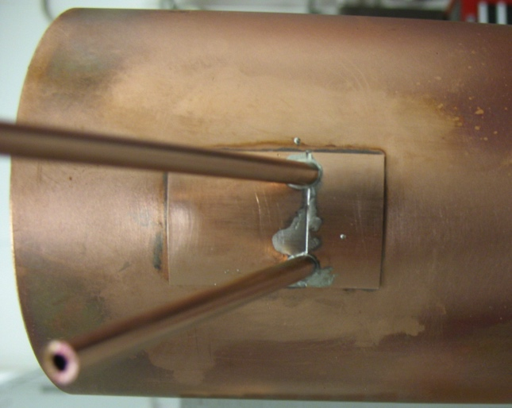
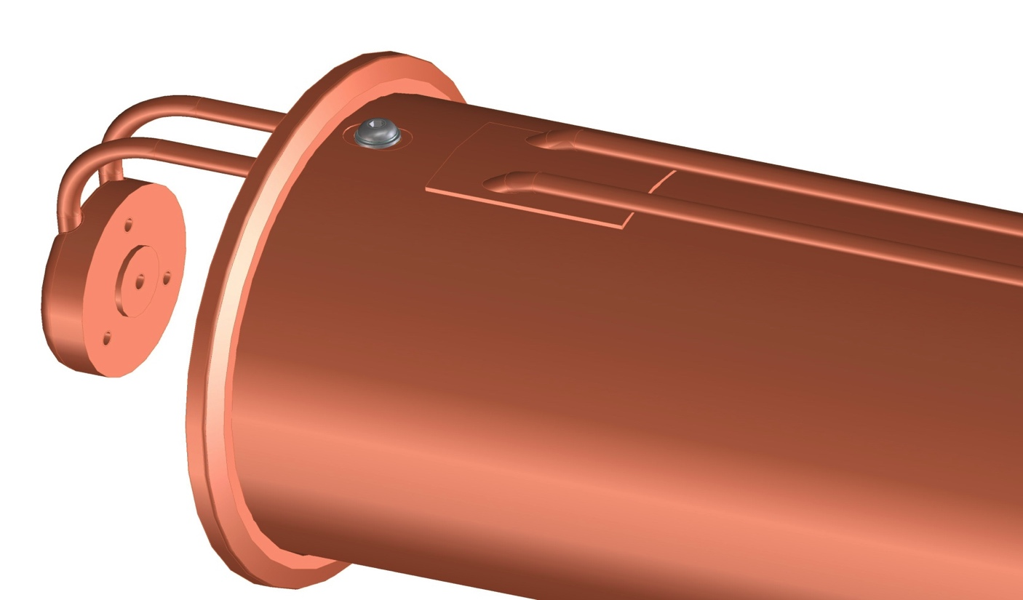
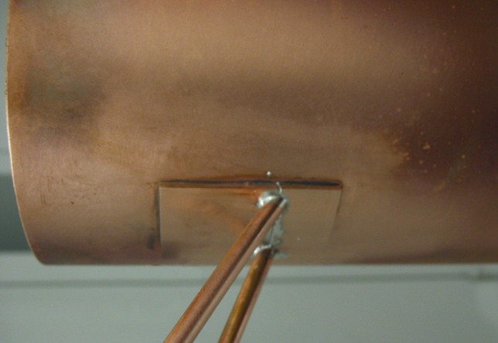
RF Coupler Modification (cont’d)
Once the cooling tubes are in their final position the slot cover plates are pushed into their final position
The coax tube is preheated and the plates are silver soldered to the coax tube with a reflow process
Test assembly complete ➔ vacuum leak tight

Slide 17
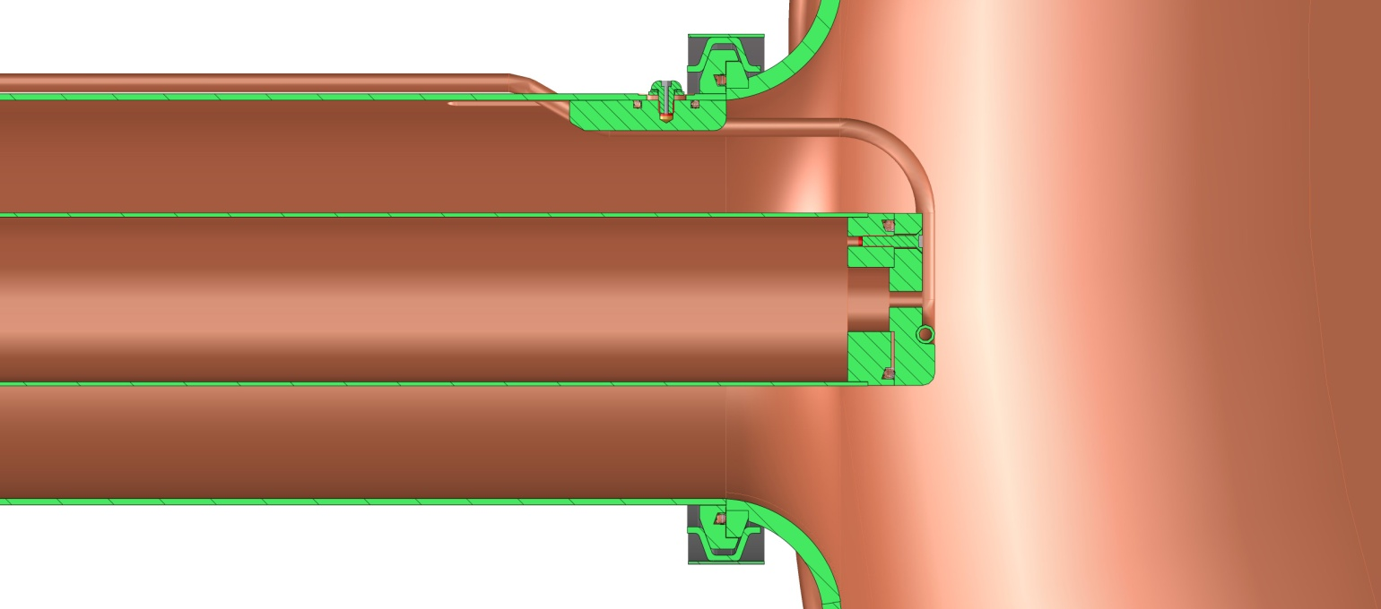
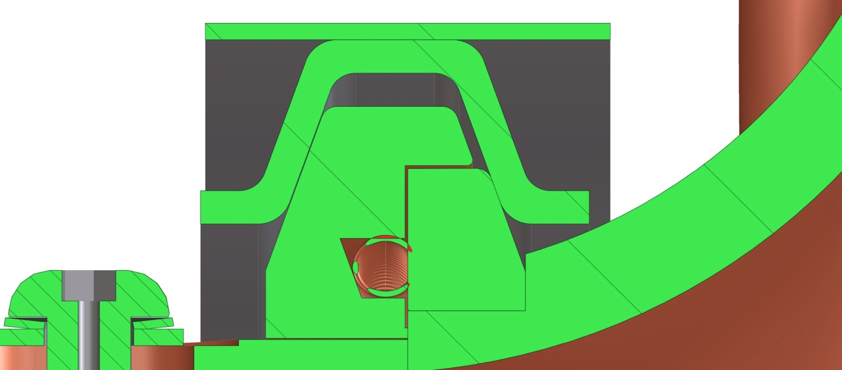
RF Coupler Modification (cont’d)
The coupler flange will have a lip to capture the cavity flange
This flange lip will fit over the cavity flange O.D. to provide a connection for rotating the coupler
(modification to the vacuum vessel)
The cavity flange remains un-modified

Slide 18
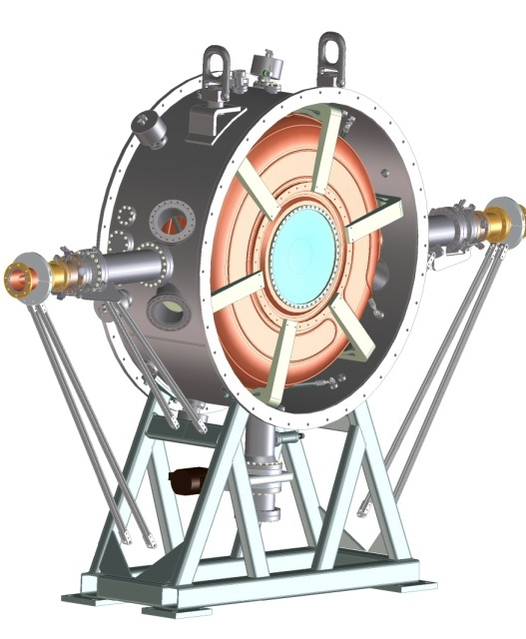
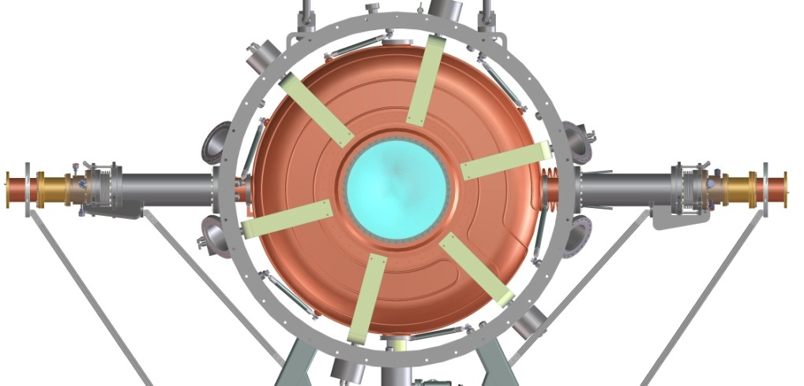
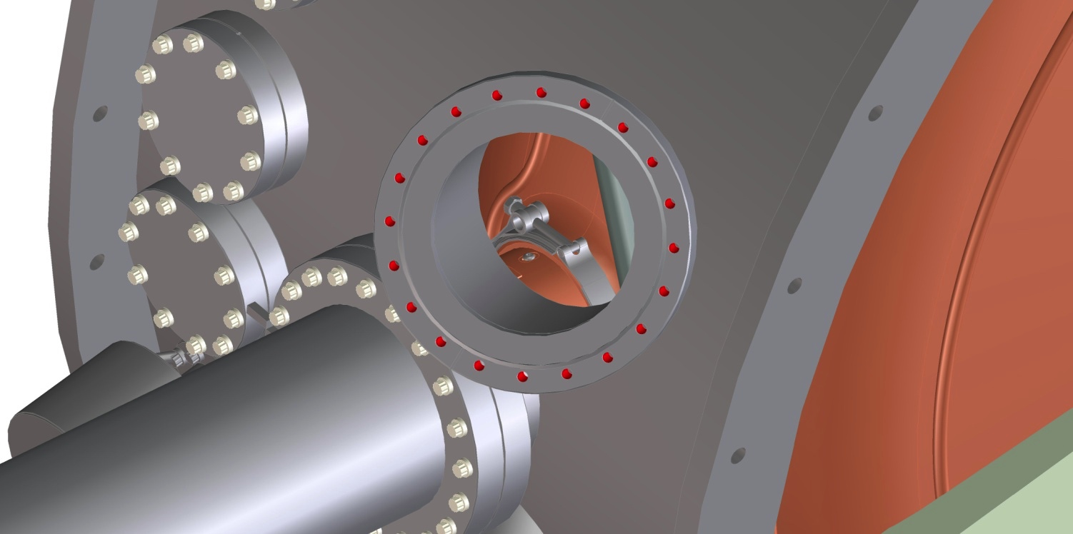
Extra Ports for RF Coupler in Beamline
Extra ports to access the coupler/cavity interface
Port will look in from above and below on the coupler to cavity joint

Slide 19
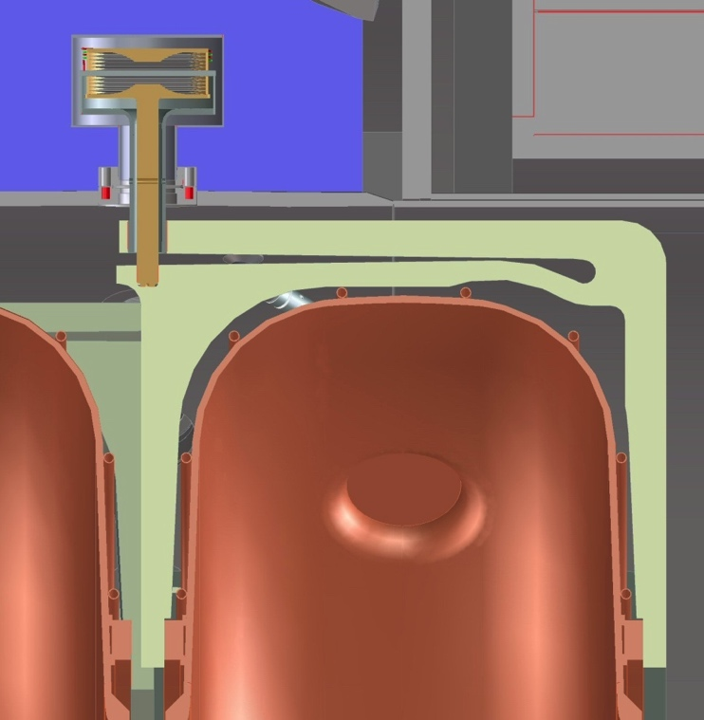
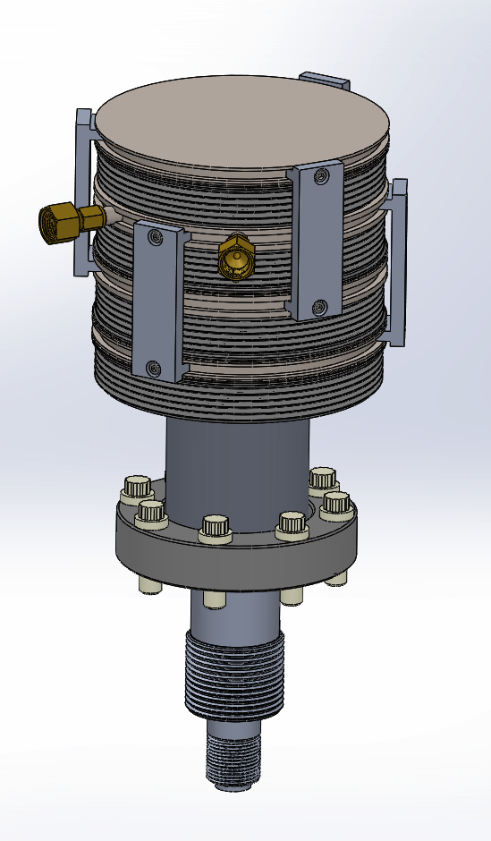
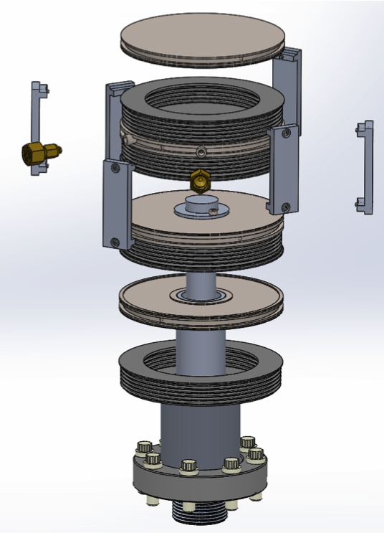
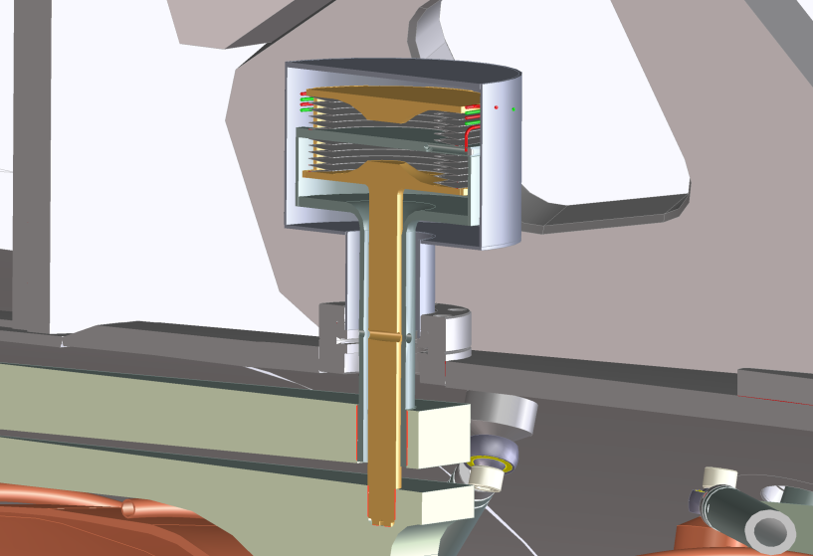
New Actuator Design
The new design:
  Re-use bellows we already have
  Simpler parts to make
  Easier assembly
  More reliable operation
Functional test complete, lifetime test complete
Old design

Slide 20
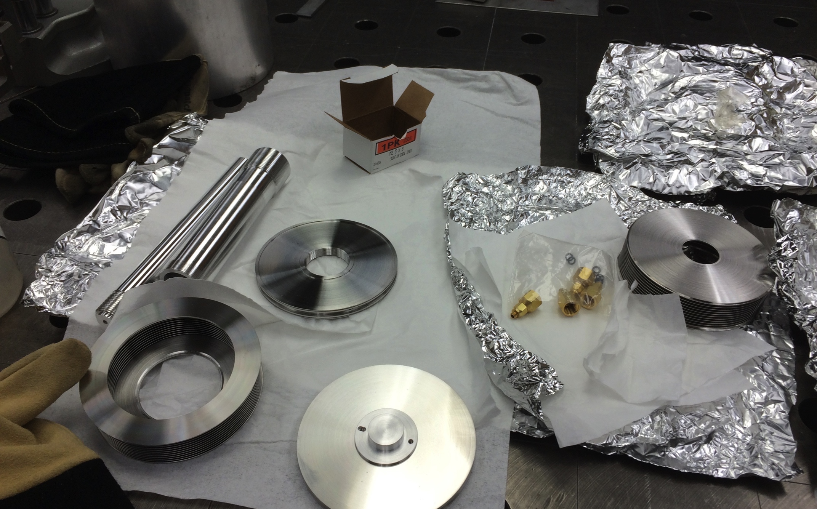
Actuator Parts Before Assembly

Slide 21
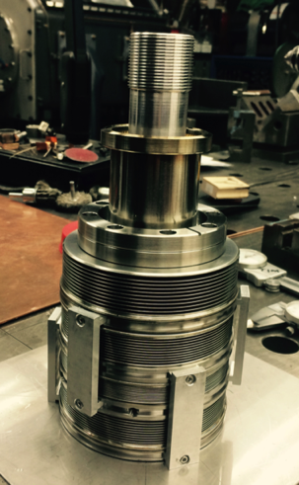
Functional Test of the Actuator
Agree well with the previous tests, lifetime testing started early May, but a leak developed at one of the bellows after 1200 cycles at ± 80 psi (± ~ 200 kHz). A more meaningful and realistic testing plan has been developed/defined and the testing is complete.
The actuator has
been repaired:
broken bellows
has been replaced
and welded.

Slide 22
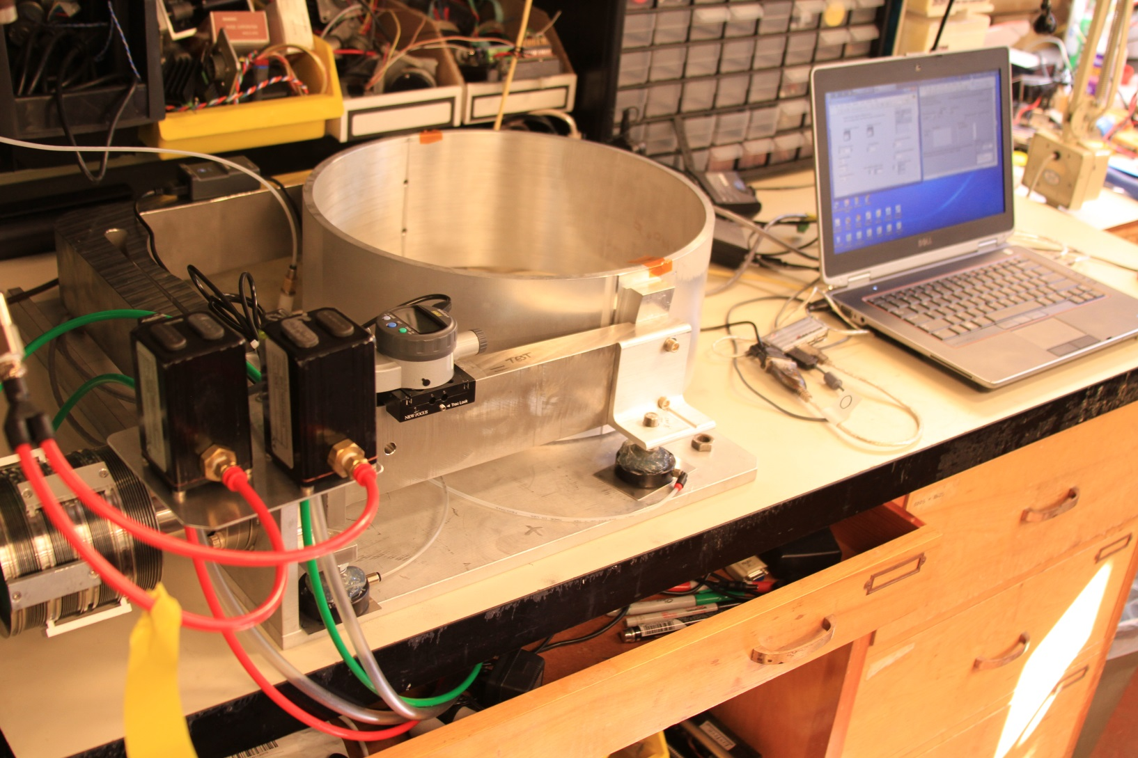
Lifetime Testing Complete

Slide 23
Lifetime Testing of the Actuator
First round of the actuator testing failed
  1,200 cycles at ± 80 psi (~ ± 200 kHz)
  Vacuum leak developed in one of the bellows
  Replaced broken bellows with new ones and testing resumed
2nd round of testing
  Plan: ± 20 psi (± 50 kHz) at base pressure of 0, 15 and 30 psi for 10,000 cycles + 40 hours operation
    Base pressure equivalent to a frequency offset
    Pressure variation ➔ dynamic tuning
  All 3 sets of the testing complete
    Very smooth operation
    No hysteresis observed
  The 40 hours lifetime test is complete

Slide 24
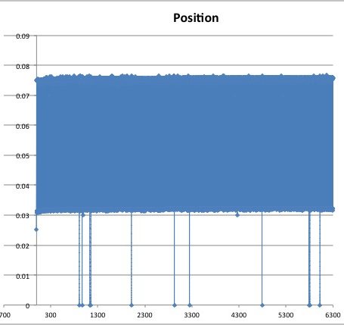
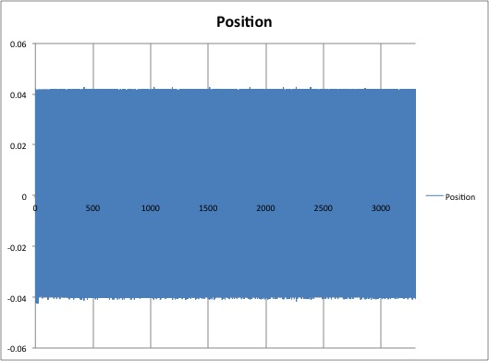
Lifetime Testing Results
Base pressure = 0 psi
Dynamic range = ± 20 psi
Base pressure = 15 psi
Dynamic range = ± 20 psi

Slide 25
Summary
MICE RF module design is complete
RFM fabrication starts soon after the RFQ process
Delivery date of two RF modules to RAL:
  1st in May and 2nd in June 2016 (details in MICE WBS)
RF module assembly starts at LBNL in the fall of 2015
  First two RF power couplers testing at MTA
  All hardware components must be ready by Oct. 2015
  Full characterization tests of tuners, low power RF measurement and coupler tuning to be conducted after final assembly
  Vacuum system testing

