Slide 1
Vacuum system in R5.2 for the cryostats SSU, SSD, and FC
Presentation to CM42
22/06/2015

Slide 2
The Vacuum Group
Hardware: Tom Weston (DL), Roy Preece (RAL), Mike Courthold (RAL), Mark Tucker (RAL)
Controls: Ian Mullacrane (DL), John Webb (DL), Peter Owens (DL), Phil Warburton (DL)
Integration into local EPICS: Pierrick Hanlet (LTV from FNAL)
Integration with Hall services: Andy Nichols (RAL), Andy Gallagher (DL), John Govans (RAL) and others (drawings by Jason Tarrant and Paul Barclay, both RAL)

Slide 3
Overall description
The turbomolecular pumps (TMPs) are as close as possible to each cryostat.
The TMPs are outside the PRY, protected from magnetic fields.
The TMPs can be backed by a shared backing manifold system.
DN100 (CF) pipework connect them with the cryostats.
The backing line pipework is DN100 (LF).
There are two backing pumps, one of which will be running whilst the other is spare. Each pump contains a 500m³/hr ROOTS backed by a dry scroll pump.
The vacuum system is fully automated with in-built safety via interlocks.

Slide 4
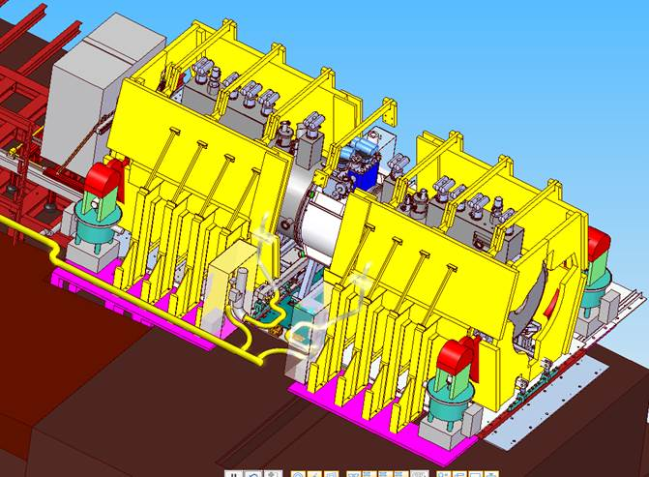
Model view of South side of cryostats
Jason Tarrant

Slide 5
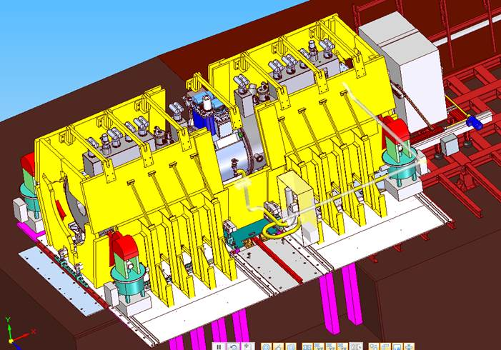
Model view of North side of cryostats
Jason Tarrant

Slide 6
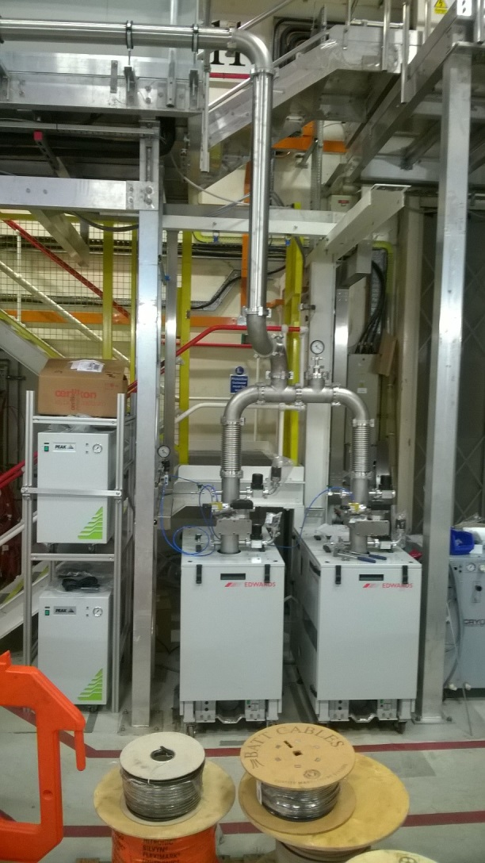
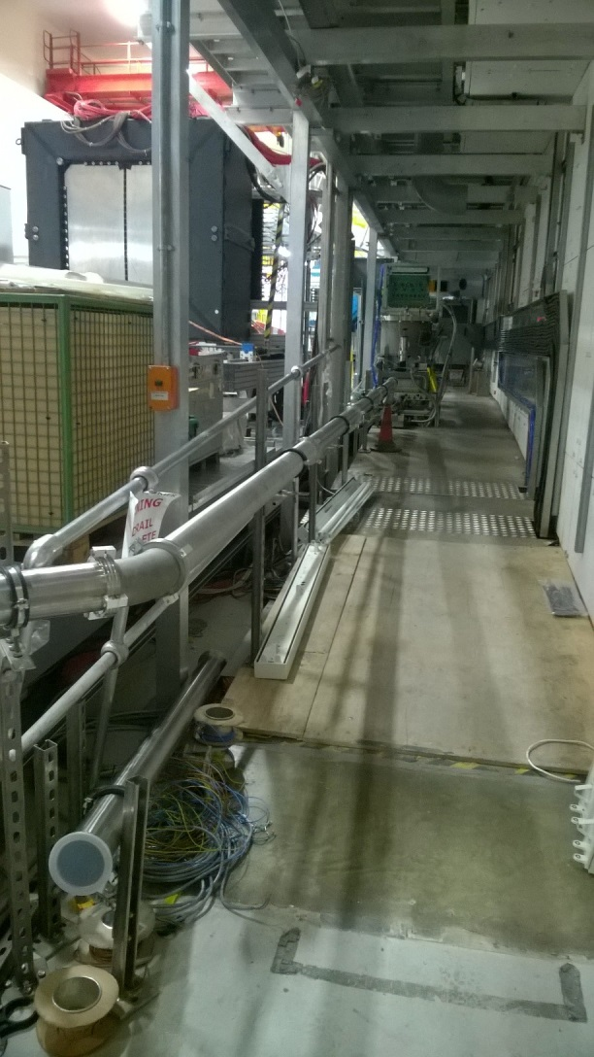
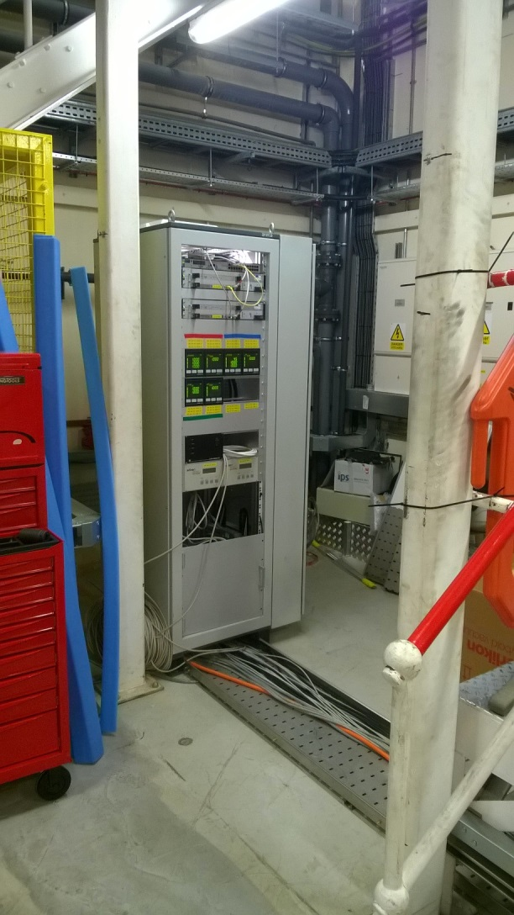
Edwards iQ backing pumps, pipework towards cryostats, and the controls rack in the North-West corner of R5.2

Slide 7
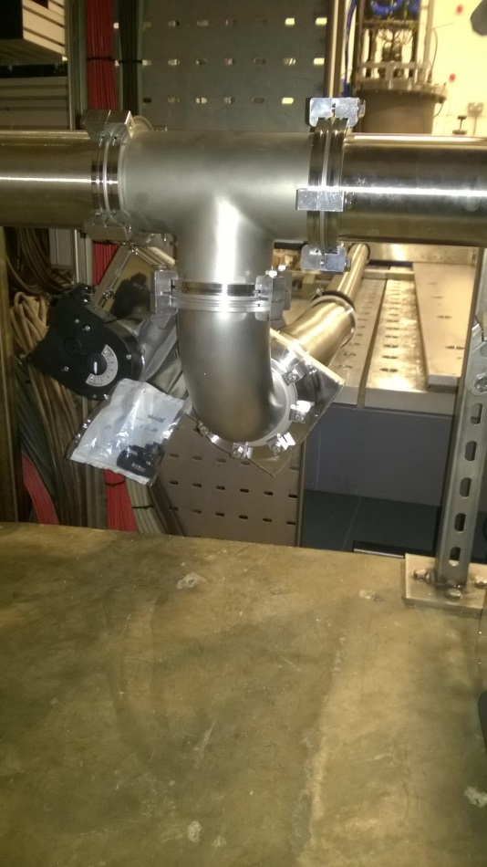
Along the South side of the cryostats
The branch with gate-valve to the North side at the EMR/KL position.

Slide 8
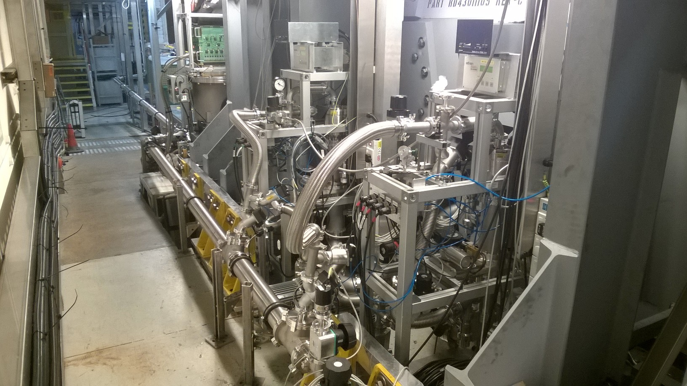
Pumping stations on the South-side for the two Spectrometer Solenoids

Slide 9
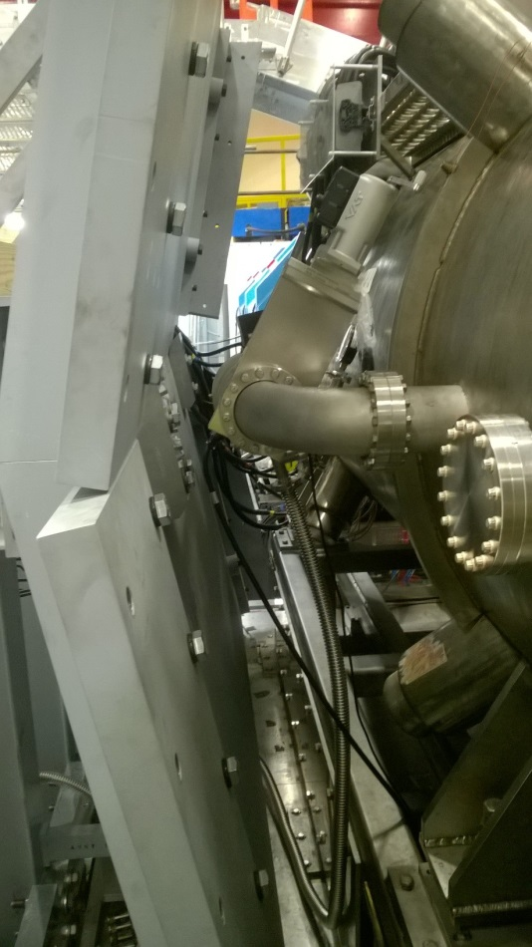
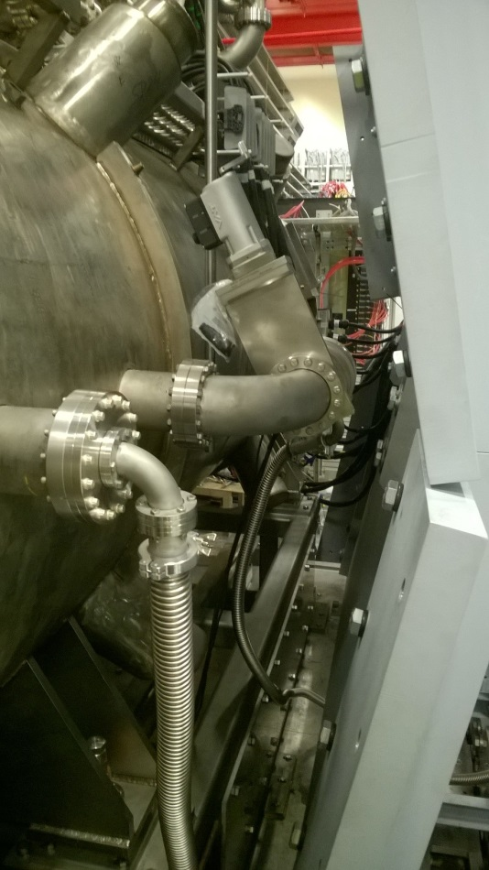
Additional turbopumps on the North-side for the Spectrometer Solenoids
On SSU
On SSD

Slide 10
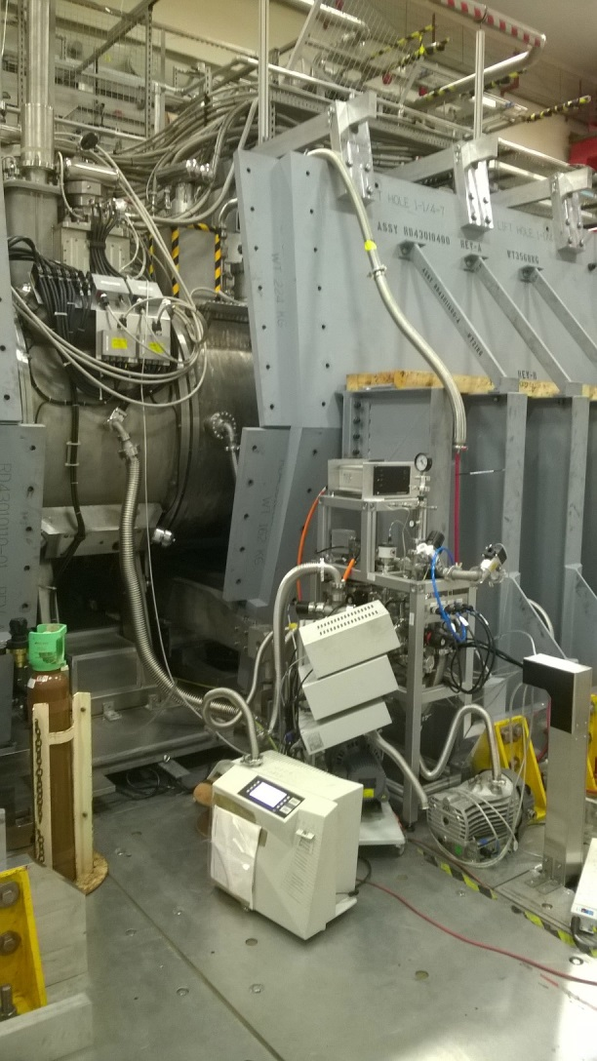
Turbopump station for the Focus Coil

Slide 11
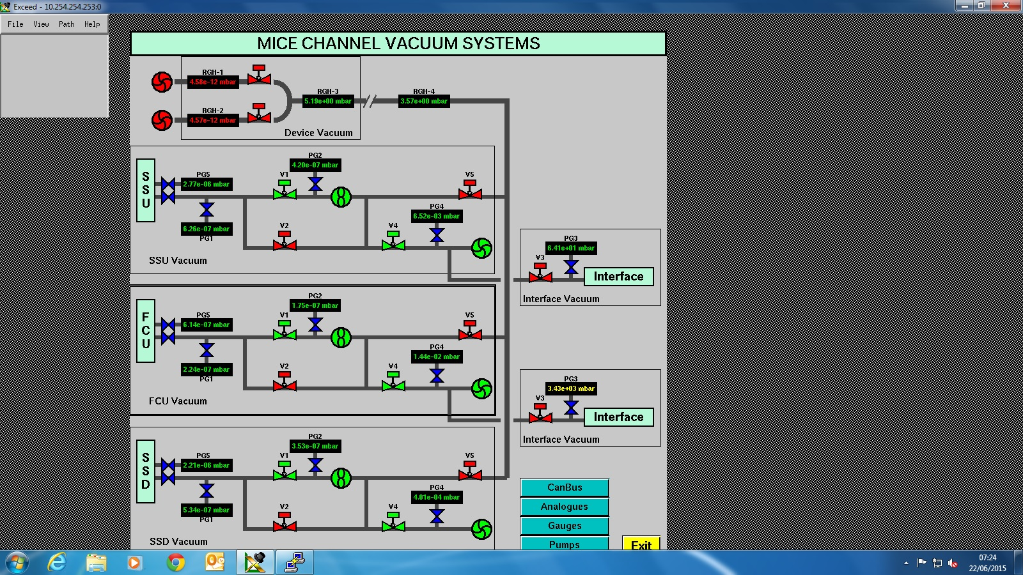
GUI

Slide 12
Summary of latest changes
Two 300 l/s TMPs have been installed on SSU and SSD (North-side) isolated by manual gate-valves with position read-out.
Pipework of the pumping stations has been slightly modified to enable them to operate as stand-alone systems, or to be backed by the manifold.
The dry pumps backing the ROOTS on the manifold are being changed from iQDP80 to XDS46 scroll. This will negate the need for high volume nitrogen flushing of the seals and bearings of the iQDP80s.

