Slide 1
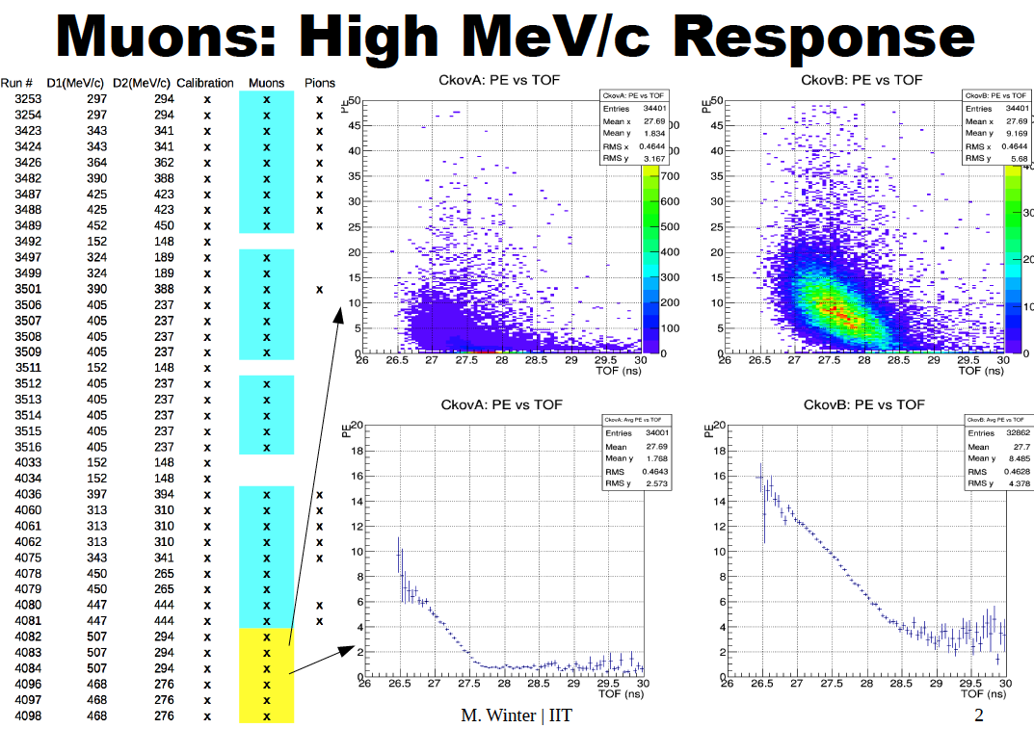
MICE CKOVs - Brief Update
Miles Winter, Michael Drews, Dan Kaplan (IIT), Lucien Cremaldi (UM) +others
Hardware update.
Thresholds and calibration.
Detection of high momemtum muons and pions.
Below are files processed by Michael and Miles for our studies.
L. Cremaldi, CM42 RAL, June 22-24 UK

Slide 2
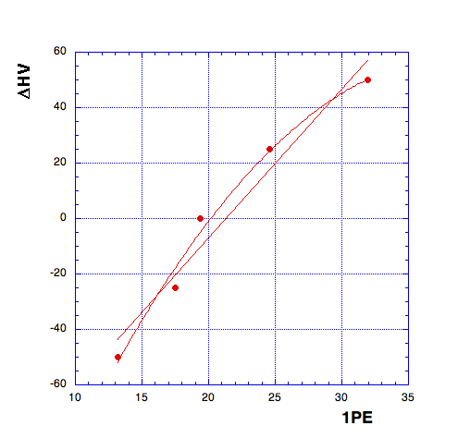
HARDWARE UPDATE
HV scan was performed summer 2014 with CAEN ST1527 HV.
Nominal default HV settings were determined to the pmt balance gains.
A new CAEN SY4527 +HV module is being installed and we should verify
that gains have not changed.
With a quadratic fit and adjusting 1PE=25, the results are given below.
The other channels are similar.
PMT0 | HV0 | delta_HV | HV_NEW
PMT1 | 1610 | 25.8 | 1635.8
PMT2 | 1520 | 6.8 | 1526.8
PMT3 | 1570 | 28.7 | 1598.7
PMT4 | 1620 | 3.0 | 1623.0
PMT5 | 1540 | -10.5 | 1529.5
PMT6 | 1715 | 16.9 | 1731.9
PMT7 | 1550 | -15.3 | 1534.7
PMT8 | 1500 | -27.2 | 1472.8
L. Cremaldi, CM42 RAL, June 22-24 UK

Slide 3
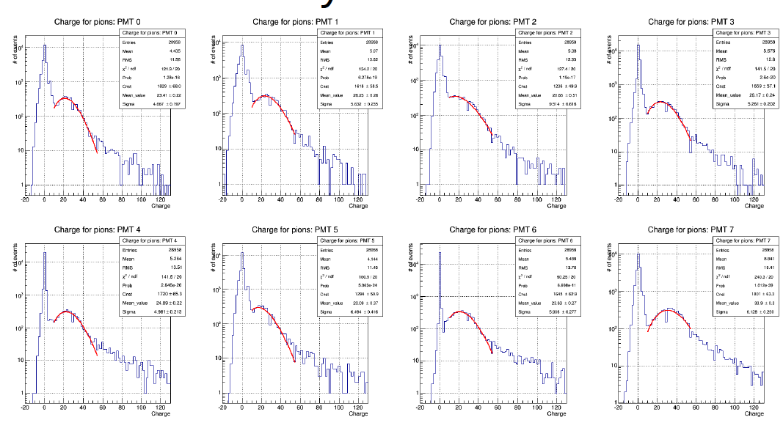
HARDWARE UPDATE (cont)
These are examples of muon/pion data from which 1PE signals are easily extracted.
A simple gaussian fit is used to find the estimate 1pe peak.
This calibration/fit could be performed run-by-run and automated.
L. Cremaldi, CM42 RAL, June 22-24 UK

Slide 4
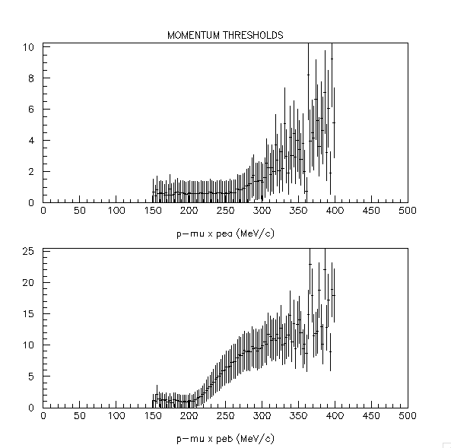
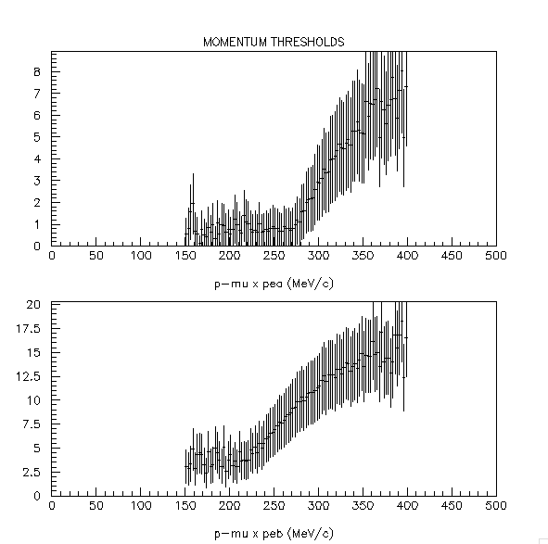
MOMENTUM THRESHOLDS (pre-2014 data)
In pre -2014 data thresholds we plot the pe vs p, where (p taken from tof.
We do a histogram of p weighted by pea(b) and divide by histogram of p.
The aerogel n112 and n107 thresholds are at 210 MeV/c and 270 MeV/c.
These thresholds correspond to n107 = 1.07 and n112=1.11, close to the expected values.
237 Mev/c data
290 Mev/c data
L. Cremaldi, CM42 RAL, June 22-24 UK

Slide 5
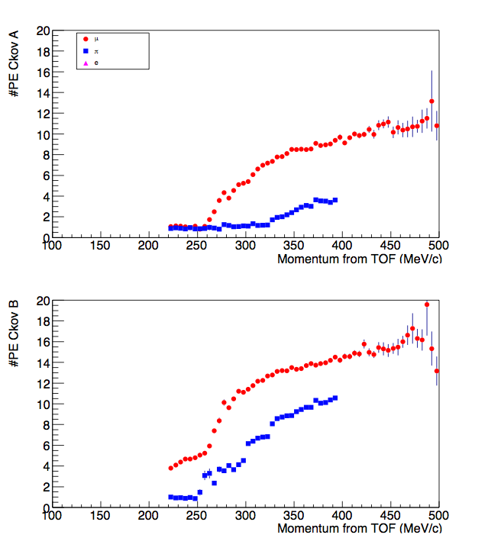
MOMENTUM THRESHOLDS (2015 data)
From 2015 P–scan data Ryan B performed
an analysis of thresholds. The results show a
shift in threshold to lower momenta.
muon pion
Pth_a = 260 MeV/c, 325 MeV/c
Pth_b = 190 MeV/c, 260 MeV/c
This corresponds to a change in index
n107 = 1.09 n112 = 1.14
The original densities are measured
ρ =0.261 g/cc ρ= 0.371g/cc
Aerogel panels sizes are 1.15x1.15x1. cm³
The aerogel density could have changed?
n = 1. + 0.27 ρ(g/cc)
Δn = 0.27 Δρ
Δρ = 0.02/0.27 = +0.07g/cc
This Increase in aerogel density is puzzling.
A p scaling problem might also explain the shift.
http://micewww.pp.rl.ac.uk/issues/1667
*
*
*
*
L. Cremaldi, CM42 RAL, June 22-24 UK

Slide 6
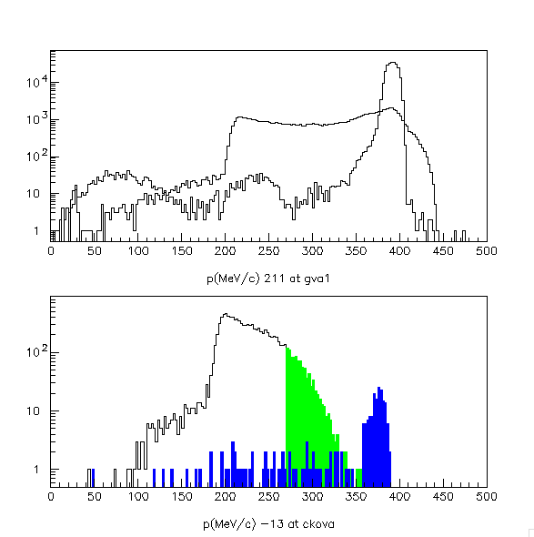
HIGH MOMENTUM PIONS AND MUONS
G4BL suggests our pion contamination from high momentum π’s leaking through D2.
The high momentum muons and pions will trigger in CKOVa.
We expect 1-2pe signals at thresholds p_{μ}>270 MeV/c and pions p_{π}>355 MeV/c.
This signal should be prominent in 237 MeV/c data.
Pions
at D2
Muons
at CKOVa
Muons
Pions
L. Cremaldi, CM42 RAL, June 22-24 UK

Slide 7
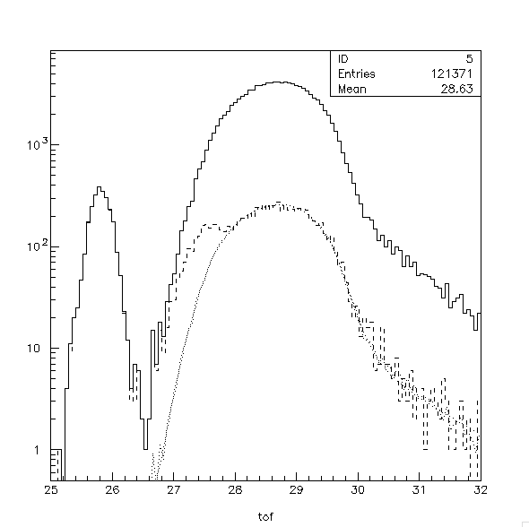
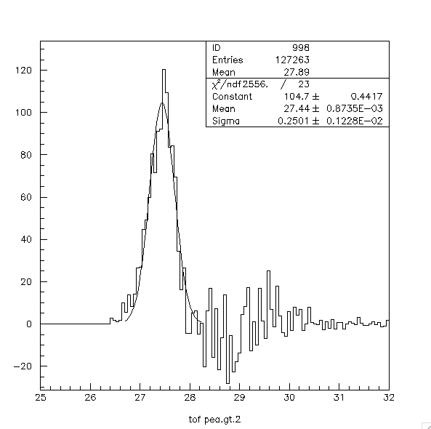
HIGH MOMENTUM PIONS AND MUONS - DATA
We look in a sample of 237 MeV/c Muon Data, and required a pea> 2 cut.
A shoulder at 25.5 ns in the tof spectra indicates about 1125 ± 55 fast μ/π’s.
pea>2 is highly efficient for electrons are highly efficient.
On the right is a gaussian fit to the residual S(pea>2)-B. (B scaled from pea>0 shape).
The separation of fast μ/π’scan only be made at the MC level.
pea>0
electrons
S = (104) σ√(2π) / ΔW= 1125±55
B = 25 x 75 = 1875
Err = √(S+B) = 55
pea>2
μ/π
background
curve
L. Cremaldi, CM42 RAL, June 22-24 UK

Slide 8
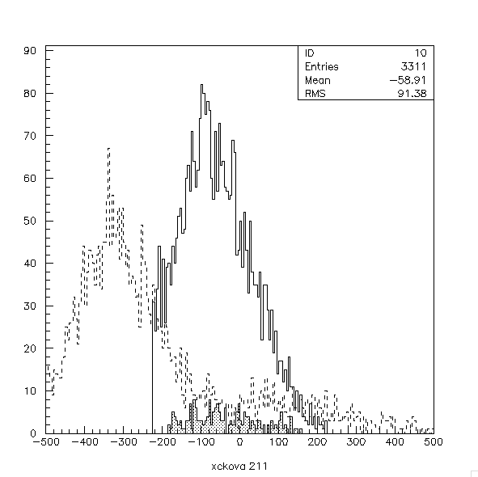
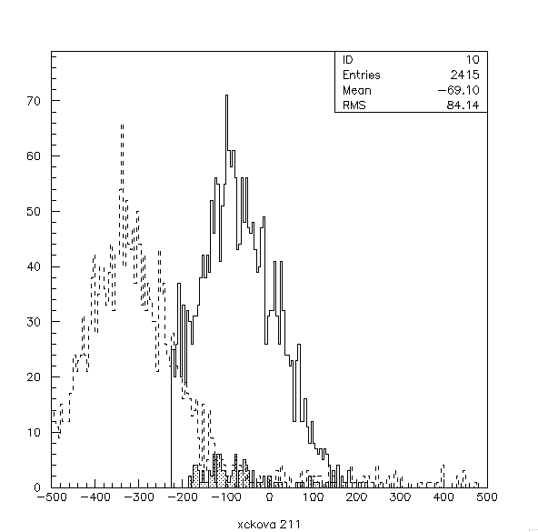
HIGH MOMENTUM PIONS AND MUONS – G4BL
We (Dan) performed a series of G4BL runs at 237 MeV/c with John N deck.
The position and # of pions are displayed at CKOVa and TOF1 (hatched).
Pions
Pions (3311) at CKOVa
Pions (196) at TOF1
Pions w p > 355 MeV/c
Pions (2415) at CKOVa
Pions (107) at TOF1
P>355 MeV/c
Extraplation
From Ckova
Extraplation
From Ckova
L. Cremaldi, CM42 RAL, June 22-24 UK

Slide 9
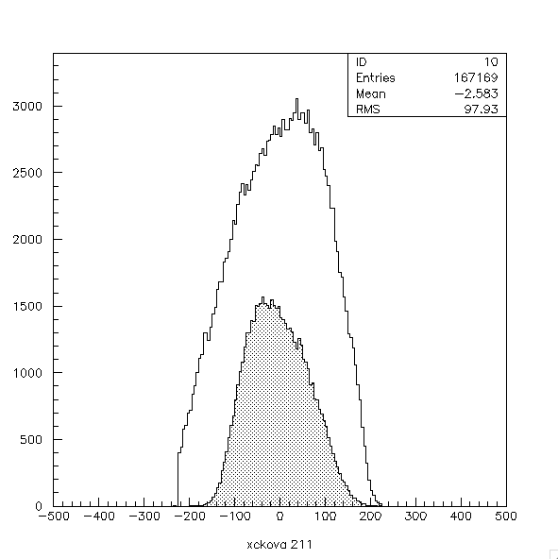
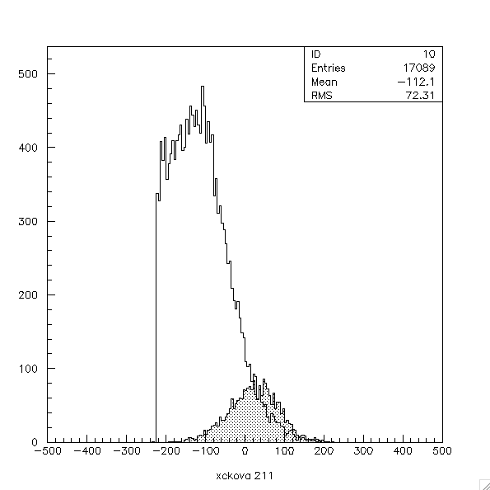
HIGH MOMENTUM PIONS AND MUONS – G4BL
.The position and # of muons are displayed at CKOVa and TOF1 (hatched).
Muons
Muons (167169) at CKOVa
Muons (55924) at TOF1
Muons w p > 270 MeV/c
Muons (17089) at CKOVa
Muons (2341) at TOF1
P>355 MeV/c
ckova
ckova
tof1
tof1
L. Cremaldi, CM42 RAL, June 22-24 UK

Slide 10
HIGH MOMENTUM PIONS AND MUONS – G4BL SUMMARY
CKOVa | D2 | CKOVa | TOF1
All
MUONS |  | 167169 | 55924
MUONS P>270 |  | 17089 | 2341
PIONS |  | 3511 | 196
PIONS P>355 |  | 2415 | 107
HIghP μ/π Data All beam w/o e+- | 118793 | 1125±48 1411±56 eff corr
π/μ ratio | =107/2341=0.046±0.004
f_{π+μ} ratio | =1411/118793 =0.012
L. Cremaldi, CM42 RAL, June 22-24 UK

Slide 11
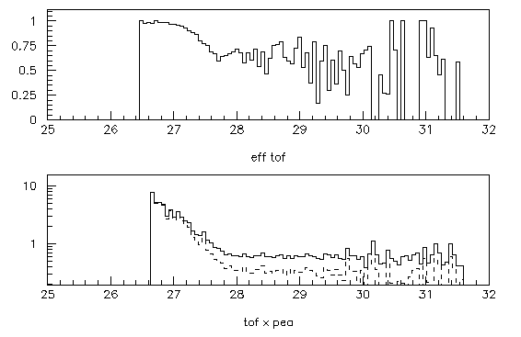
HIGH MOMENTUM PIONS AND MUONS – EFFICIENCY
Take an independent sample of muons and evaluate the tof with and w/o the pea>2 cut.
The ratio is a fair approximation of the cut efficiency vs tof.
Eff ratio
pea>0
pea>2
L. Cremaldi, CM42 RAL, June 22-24 UK

Slide 12
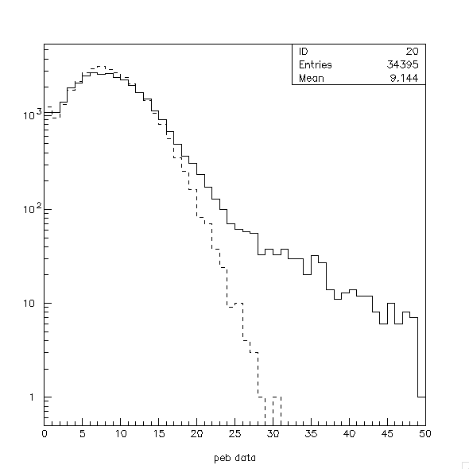
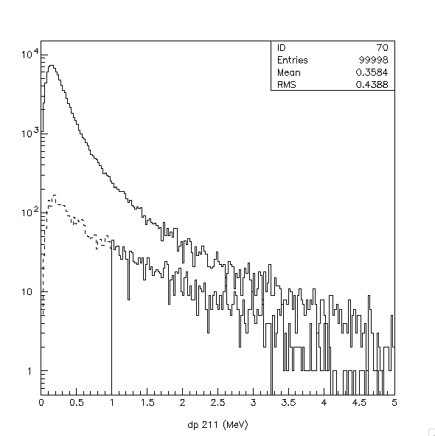
Photoelectron Modeling for MAUS
A full ckov photoelectrons model should include cherenkov, δ-rays, and pedestal noise.
Delta rays production is significant at the 3-5% level. Pe≥1MeV/c radiate-čerenkov light.
Photoelectron data can be reproduced by a poisson light distribution using mean pe-yield
and directly adding additional light from δ-rays as a tail; avoiding optical photons in G4!
Pedestal (pe=0,1) not Poisson-like and must be studied (most challenging).
Photoelectron data
-dE/dx and Delta ray Spectrum
-dE/dx
δ-ray tail
ΔΕ-δrays
Poisson-like
1 Mev
L. Cremaldi, CM42 RAL, June 22-24 UK

Slide 13
COMMISSIONING
We should perform a mini-HV Scan with new CAEN SY4527 +HV module in place.
We should check aerogel thesholds and/or density with 2015 data.
- Standard 237, 290 MeV/c muon runs are adequate.
- Or a dedicated p scans ccan be performed.
L. Cremaldi, CM42 RAL, June 22-24 UK

Slide 14
SUMMARY
We performed some CKOV analysis of high momentum μ/π.
We are working on some methods of characterizing the CKOV efficiency.
We are working on MAUS simulation of photoelectron yields. These are working
at some level and need to be implemented in to MAUS.
L. Cremaldi, CM42 RAL, June 22-24 UK

