Slide 1
Closing remarks

Slide 2
Progress

Slide 3
Progress
Spectrometer solenoid cool-down for purification has started
  FC is warming to allow pump/purge cycle
Reconstruction of tracks … and now the track fit:
Hunt

Slide 4
Commissioning and operation

Slide 5
Bones of the roadmap
Blackmore
Post simplified version on WWW
as operations “dashboard”.

Slide 6
Next VCs and CMs

Slide 7
CMs and VCs:
CMs:
  RAL: CM43 29th to 31st October 2015
  2016 (all TBC; need to check ISIS schedule):
    CM44 15th to 19th February 2016
    CM45 20th to 24th June 2016
    CM46 03rd to 07th October 2016
VCs (to be defined b M. Uchida):
  …

Slide 8
The event and the wall

Slide 10
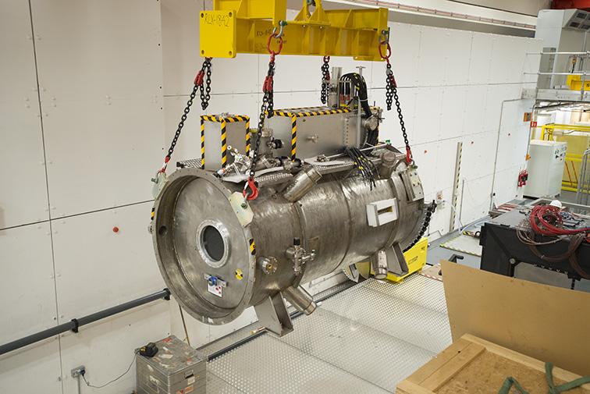
Painting the wall
Competition for 6th formers:
  Design a mural inspired by MICE and the science our R&D is designed to facilitate
Prize to be presented by J. Womersley at Neutrino 2016; London July 2016

Slide 11
An early entry?

Slide 12
And finally …

Slide 13
And finally …
Thanks to the local organisers:
  Debbie Loader
  Rose Hayes
Thanks for coming and contributing;
  “Safe travels” … and …
    We’re poised to discuss Step IV results at CM43!

