Slide 1
Final Cooling For a High-Luminosity High-Energy Lepton Collider
Super wedgies!
David Neuffer FNAL
Don Summers, T. Hart, … U. Miss.

Slide 2
Outline
Motivation-IPAC15
Final Cooling for a Collider & Simulation
  – R. Palmer & H. Sayed
Final scenario variations
  w /D. Summers & T. Hart
  emittance exchange

Slide 3
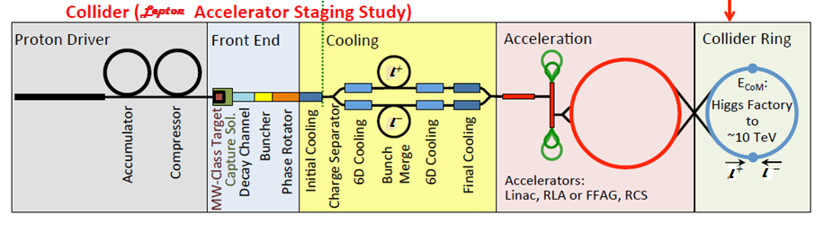
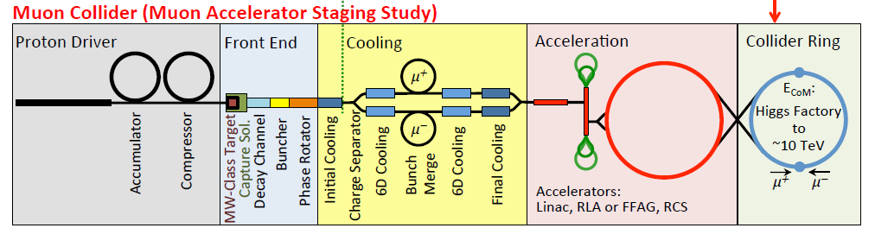
Towards multi-TeV lepton colliders
M. Palmer, FRXC3
Parameter | Unit | Higgs factory | 3 TeV design | 6 TeV design
Beam energy | TeV | 0.063 | 1.5 | 3.0
Number of IPs |  | 1 | 2 | 2
Circumference | m | 300 | 2767 | 6302
β* | cm | 2.5 | 1 | 1
Tune x/y |  | 5.16/4.56 | 20.13/22.22 | 38.23/40.14
Compaction |  | 0.08 | -2.88E-4 | -1.22E-3
Emittance (Norm.) | mm·mrad | 300 | 25 | 25
Momentum spread | % | 0.003 | 0.1 | 0.1
Bunch length | cm | 5 | 1 | 1
H. electrons/bunch | 10¹² | 2 | 2 | 2
Repetition rate | Hz | 30 | 15 | 15
Average luminosity | 10³⁴ cm⁻²s⁻¹ | 0.005 | 4.5 | 7.1

Slide 4
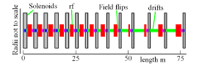
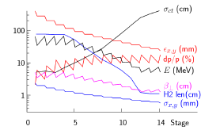
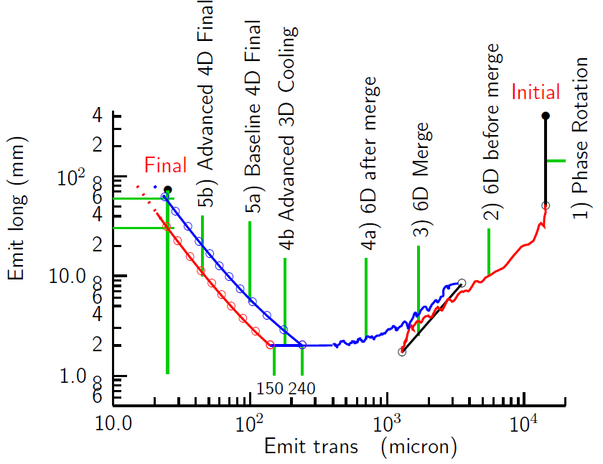
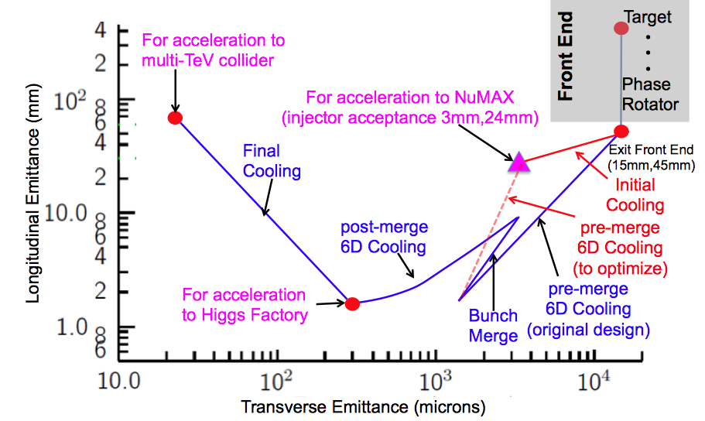
Final cooling baseline
(R. Palmer et al. IPAC12)
Baseline Final Cooling
  solenoids, B → 30--50T
  H₂ absorbers,
  Low momentum
  ε_{t,N} : 3.0 →0.3 ×10⁻⁴ m
  ε_{L} : 1.0→70mm
    expensive emittance exchange

Slide 5
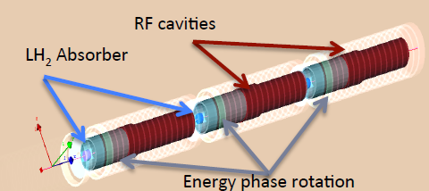
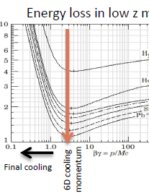
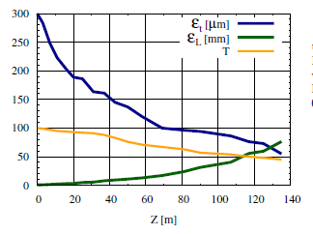
Detailed simulation of final cooling
(H. Sayed et al. IPAC14)
G4Beamline simulation of final cooling scenario
  System is ~135m long
  ε_{t,N} : 3.0 →0.5 10⁻⁴ m
  ε_{L} : 1.0→75mm
    P_{l} :135 → 70 MeV/c
    B: 25 →32 T; 325➔ 20MHz
    not quite specs
  Transmission ~ 50%
Predominantly ε_{t,N} / ε_{L}
emittance exchange

Slide 6
Variant Approaches
Keep P_{l}, B, E’, f_{rf} within ~current technology
  P > 100MeV/c; B~8➔15T; f_{rf} > ~100MHz
  round to flat transformation
  beam slicing and recombination
Explicitly use emittance exchange in final cooling
  thick wedge energy loss

Slide 7
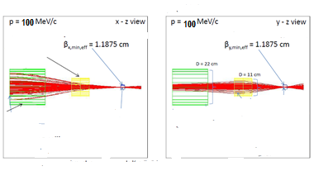
Variant: “thick” wedge transform
Use wedge to increase δp/p
  increase ε_{L}, decrease ε_{x}
If δp/p introduced by wedge >> δp/p_{beam};
  can get large emittance exchange
    exchanges x with δp (Mucool 003)
      also in CERN 99-13, p.30
Example:
  100 MeV/c; δp=0.5MeV/c
    ε⊥= 10⁻⁴m, β₀=1.2cm
    Be wedge 0.6cm, 140° wedge
  obtain factor of ~5 exchange
  ε_{x} →0.2 ×10⁻⁴m; δp=2.5 MeV/c
Much simpler than equivalent final cooling section

Slide 8
Wedge theory (MuCool-003)
Dispersion + wedge is product of two matrices
δ′ = dp/ds 2 tan[θ /2]/p
variables are [x, δ] , where δ =dp/p
transport through wedge is transport of [x, δ] phase space ellipse, initially
becoming

Slide 9
Results of wedge
new coefficients
new energy width (ε_{L,1} = ε_{L,0} (δ₁/δ₀))
new transverse emittance (ε_{x,1} = ε_{x,0} (δ₀/δ₁))
new β_{x}, η

Slide 10
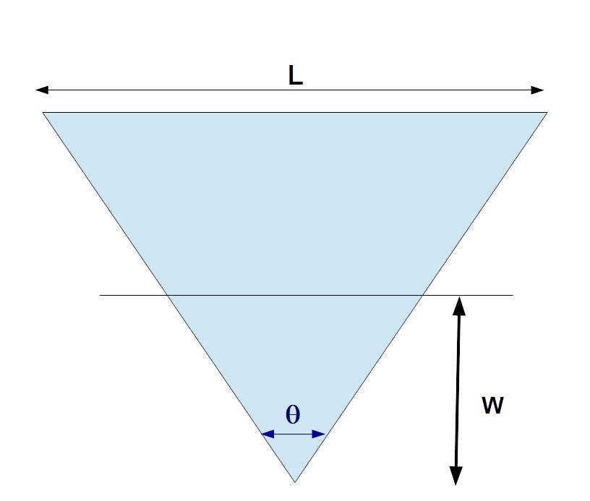
Evaluation of Super-wedge examples
Set reference momentum at 100 MeV/c
  ε_{x} , ε_{y} → 10⁻⁴ m
  β_{x}= β_{y} = ~1cm
    ~1mm beam
      round numbers …
Need small δp/p
  δp ~0.5 MeV/c
    obtain by lengthening and flattening bunch (ε_{L} = ~0.001m)
Need dense low-Z wedge
  Be (ρ=1.86) → Diamond
    (ρ=3.6 C)
    dp/ds =15.1 MeV/c /cm
Evaluate in ICOOL
  wedge and beam definition, match
  emitcalc evaluates eigen emittances before/after
  a few cm transport

Slide 11
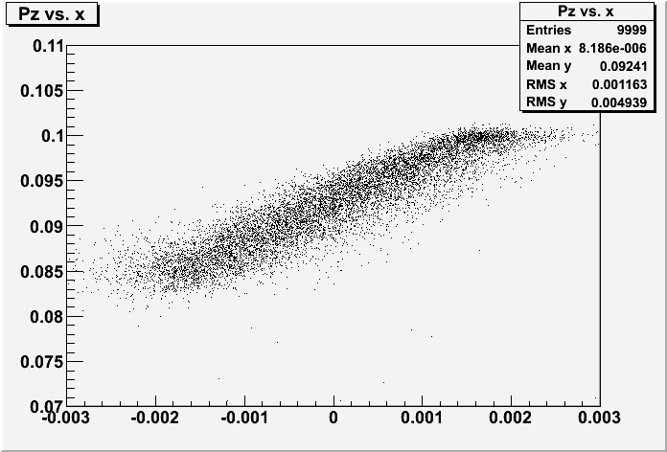
Numerical examples
Wedge parameters
  Diamond, w=1.75mm, θ = 100°(4.17mm thick at center)
  reduces ε_{x} by factor of 4.3, ε_{L} increases by factor of 7.0
    first half of wedge more efficient than second half …
Second wedge ?
  if matched to same optics (P_{z} → 100 MeV/c, σ_{E}→0.46 MeV)
    ε_{x} : 23 →27μ; ε_{y} :97 → 23 μ
z(cm) | P_{z} | ε_{x}(μ) | ε_{y} | ε_{L}(mm | σ_{E} MeV | 6-D ε increase
0 | 100 | 97 | 95.5 | 1.27 | 0.46 | 1.0
0.4 | 96.4 | 33.4 | 96.3 | 4.55 | 1.64 | 1.24
0.8 | 92.4 | 22.7 | 96.5 | 8.94 | 3.22 | 1.65
Pz – x plot

Slide 12
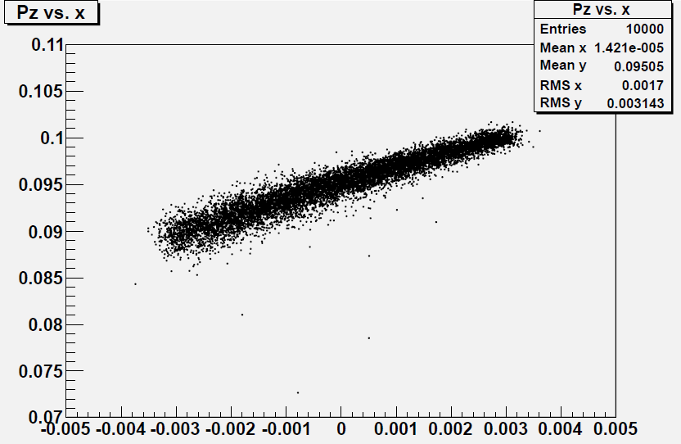
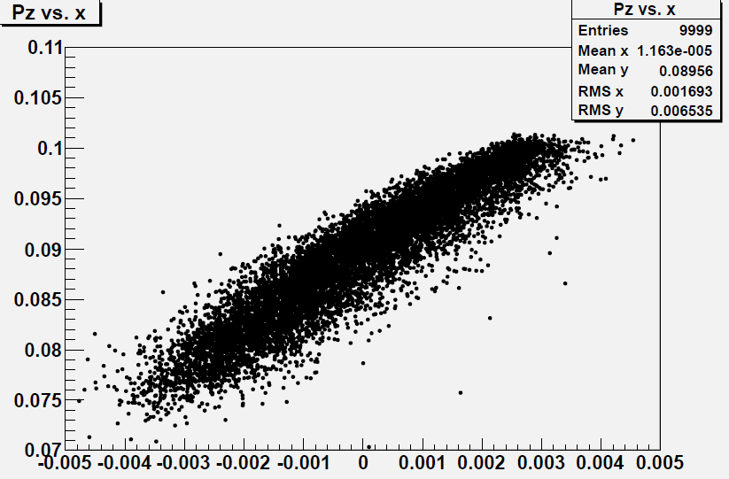
Parameter variations…
Go to larger initial beams, larger wedge
  β_{t}=2.6cm, ε_{t} =130μ
  Diamond, w=3.0mm, θ = 85°(5.6mm thick at center)
z(cm) | P_{z} | ε_{x}(μ) | ε_{y} | ε_{L} (mm) | σ_{E} MeV | 6-D ε increase
0 | 100 | 129 | 127 | 0.91 | 0.44 | 1.0
0.55 | 95 | 36.6 | 131 | 4.33 | 2.08 | 1.34
1.1 | 89.6 | 25.0 | 132 | 8.66 | 4.17 | 1.845
Pz – x plots

Slide 13
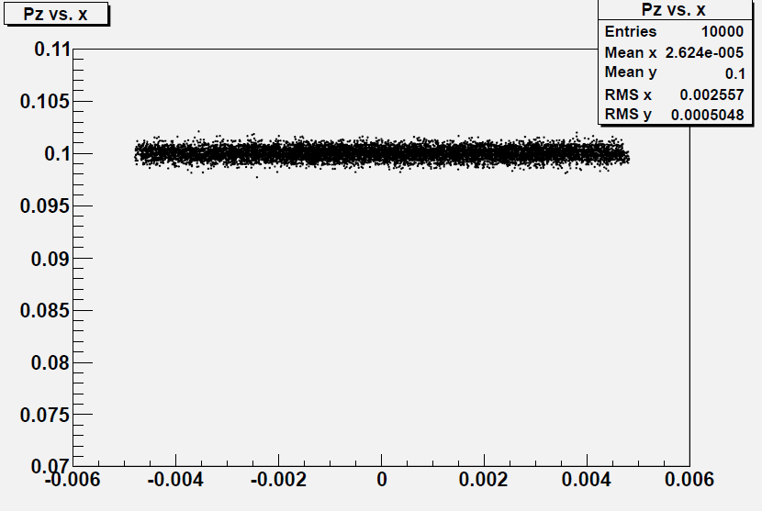
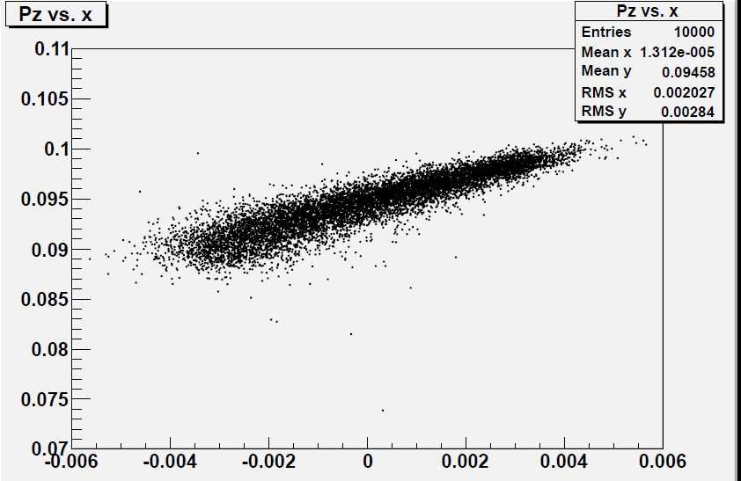
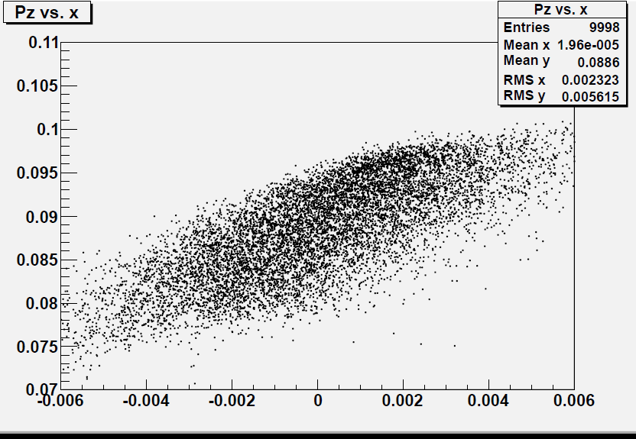
Parameter variations…
Go to larger initial beams, larger wedge
  β_{t}=3.2cm, ε_{t} =200μ
  Graphite, w=4.5mm, θ = 100°(9.6mm thick at center)
z(cm) | P_{z} | ε_{x}(μ) | ε_{y} | ε_{L} (mm) | σ_{E} MeV | 6-D ε increase
0 | 100 | 194 | 191 | 1.09 | 0.53 | 1.0
1.4 | 94.6 | 67.3 | 193 | 3.9 | 1.88 | 1.245
2.8 | 88.5 | 47.3 | 192 | 7.7 | 3.7 | 1.72
Pz – x plots

Slide 14
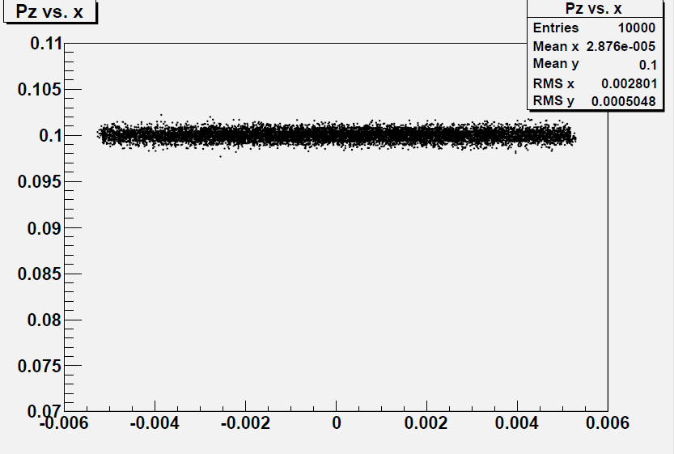
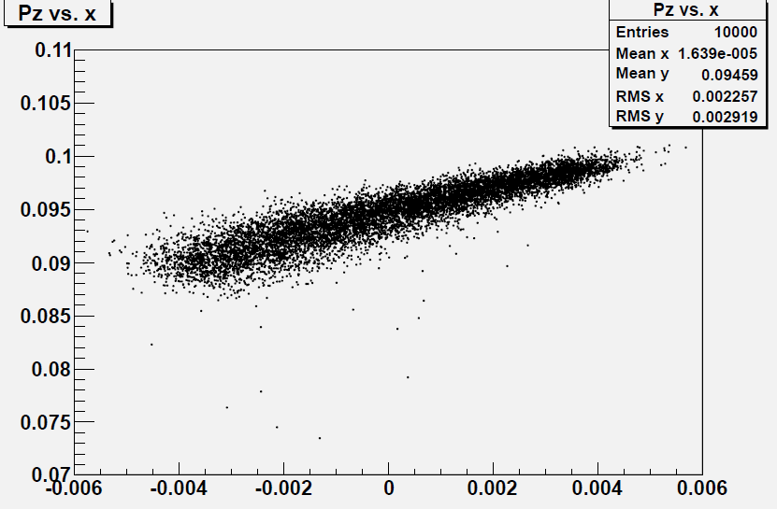
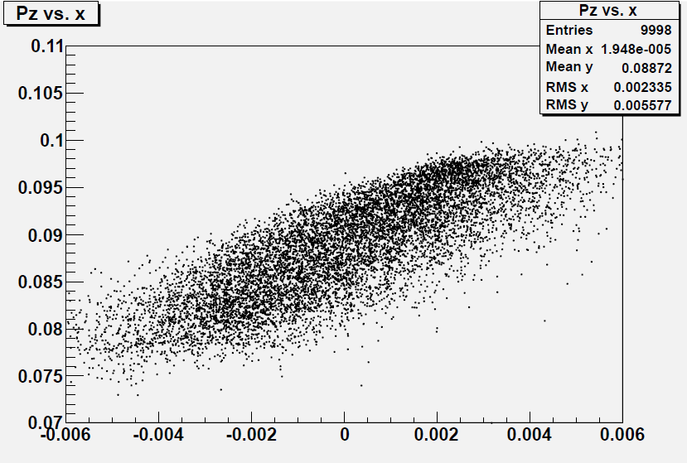
Parameter variations…
Go to larger initial beams, larger wedge
  β_{t}=3.6cm, ε_{t} =200μ
  Be, w=5mm, θ = 110°(14.3 mm thick at center)
z(cm) | P_{z} | ε_{x}(μ) | ε_{y} | ε_{L} (mm) | σ_{E} MeV | 6-D ε increase
0 | 100 | 194 | 191 | 0.99 | 0.53 | 1.0
1.4 | 94.6 | 60.2 | 191 | 4.0 | 1.88 | 1.24
2.8 | 88.7 | 43.8 | 189 | 7.5 | 3.7 | 1.69

Slide 15
Compare with current final scenario
last 120 m
    14 30 T SOLENOIDS
    ~1GeV rf
  ε_{t,N} : 180 →55 10⁻⁶ m
  ε_{L} : 2.0→75mm
    B: 25 →32 T; 325➔ 20MHz
    not quite specs
  Transmission ~ 50%
Two Be wedges ~ 3cm
  ε_{t,N} : 200 →40 10⁻⁶ m
  ε_{L} : 1→50mm
  Transmission ~ 95+%
    ~30 MeV rf

Slide 16
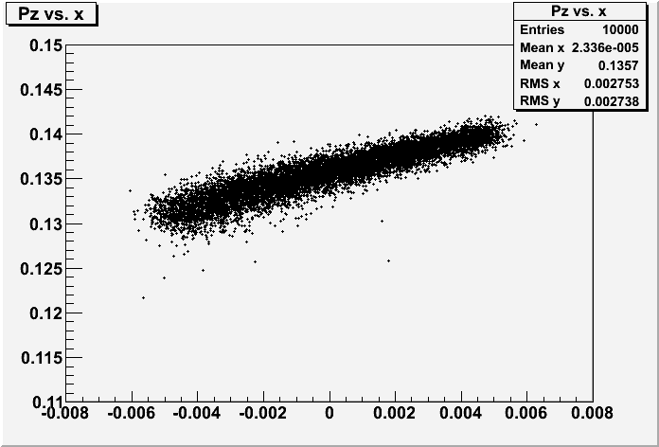
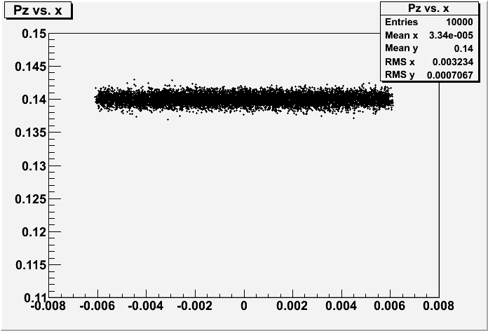
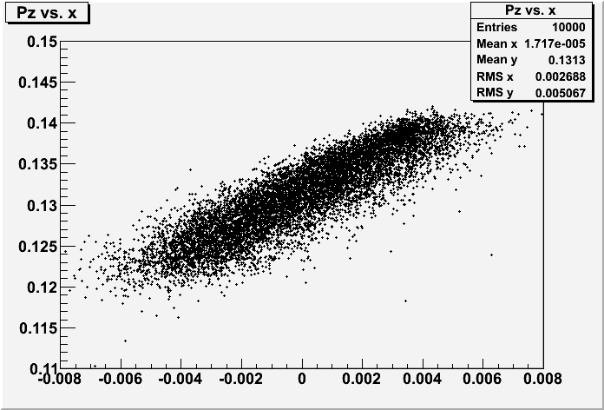
Parameters closer to MICE
Go to larger initial beams, larger wedge, higher P
  β_{t}=5cm, ε_{t} =272μ
  C, w=5mm, θ = 105°(14.3 mm thick at center)
z(cm) | P_{z MeV/c} | ε_{x}(μ) | ε_{y} | ε_{L} (mm) | σ_{E} MeV | 6-D ε increase
0 | 140 | 272 | 268 | 1.22 | 0.68 | 1.0
1.4 | 135.7 | 102 | 273 | 4.0 | 2.15 | 1.2
2.8 | 131.3 | 67.8 | 275 | 7.5 | 3.92 | 1.44

Slide 17
Need to complete scenario
Match into first wedge
  long ~0.15m, δp = 0.5MeV/c
  β_{t} ~ 3cm ε_{t} ~ 200μ
    beam out has dispersion η~4cm, δp ~3 MeV/c, β_{x} ~0.5cm
Match into second wedge
  Accelerate centroid to 100(?) MeV/c
  long ~1m, δp = 0.5MeV/c
  β_{t} ~ 3cm ε₁ ~ 200μ, ε₂ ~ 40μ
  Dispersion match to ~0
Biggest problem could be optical match out of wedge
  Beam has small x-emittance
  dispersion + smaller β_{x}
  larger δp
Similar to PIC match?

Slide 18
Disadvantages
exchange per wedge limited to ~4-6 x (?)
Does not cool
  beam heating by >~25%; more for larger exchange
Optics matching is nontrivial

Slide 19
Summary
Thick Wedge parameters are so attractive it has to be part of final cooling scenario
  Details depend on actual implementation values and matching solutions
  how many passes possible 2→3→4 ?
  how much longitudinal emittance increase is tolerable?
Not optimized (100MeV/c → ???)
Could we do an experiment at MICE ??
  cm-scale dense large-angle wedge, small δE initial beam

Slide 20


Telewedgie…

