Slide 1

TOF commisioning
M. Bonesini
Sezione INFN Milano Bicocca

Slide 2
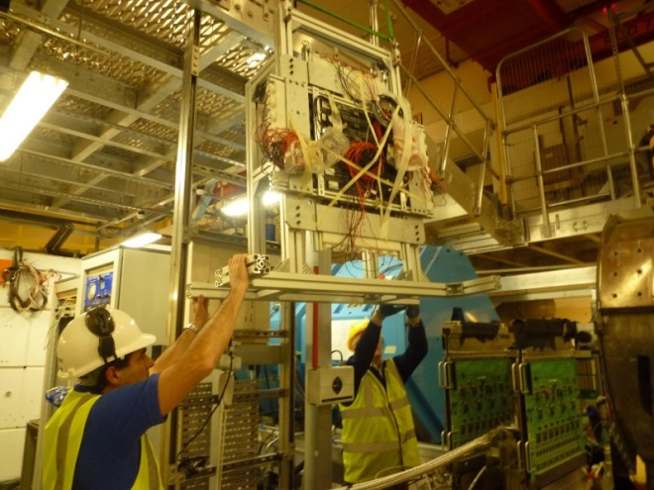
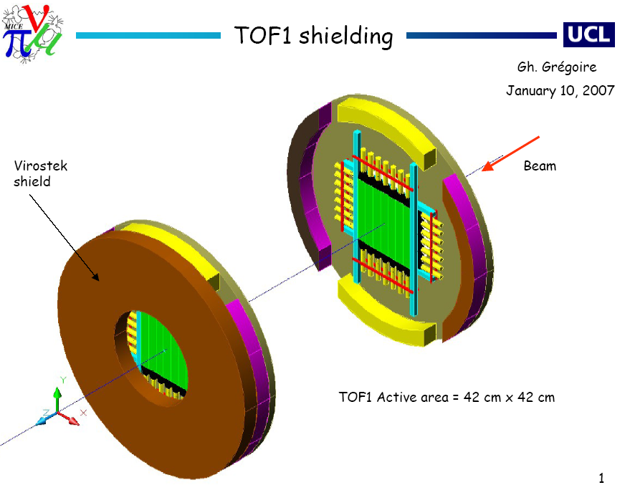
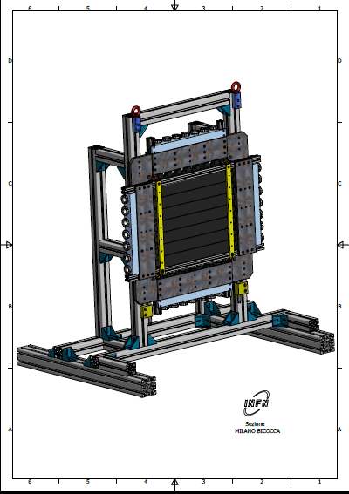
TOF1 local shielding (Nov 2014)
Local shielding for TOF1 (as TOF2) instead of cage, to fit PRY
Intervention done in Nov 2014

Slide 3
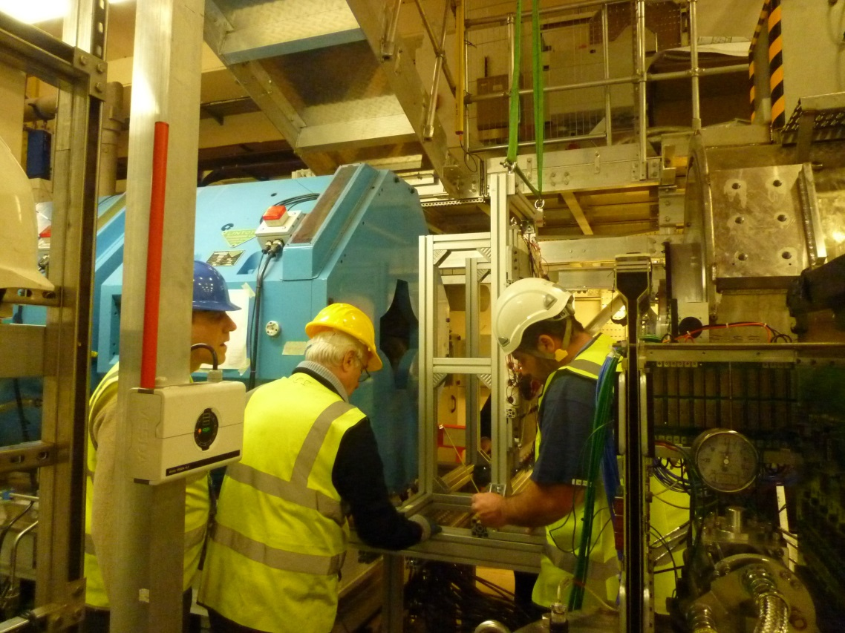
In its final place …

Slide 4
Readiness of TOF system for STEP IV
The TOF system (TOF0,TOF1,TOF2) is working
smoothly since 2009 and we do not foresee problems
for STEP IV operations
The only difference is the presence of fringe fields from solenoids (but shielding must work is simulations were correct)
After shielding operations on TOF1 only 1 PMT was
found broken and replaced

Slide 5

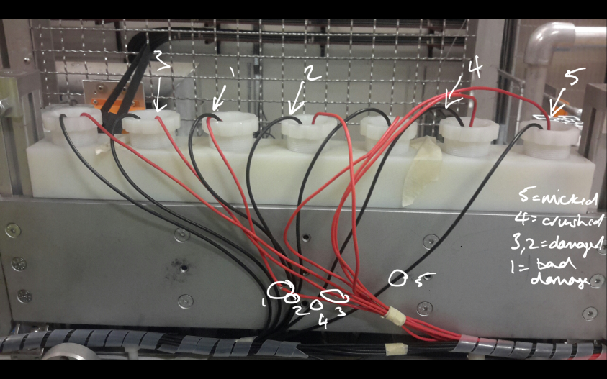
Houston we had a problem
during maintenance operations
for tracker some TOF1 cables
were damaged
luckily no major problem: all solved by MICE-OM (Victoria) + Pierrick
I and Roberto will re-check all stuff this week

