Slide 1



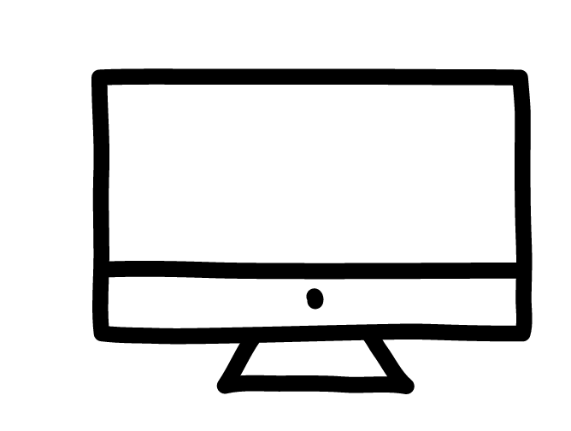
Share it, tweet it, read it!
THE Port (page)
#THEPort15
@theportatcern
Subscribe to THE Port E-newsletter

