Slide 1
Based on a true story !

Slide 2
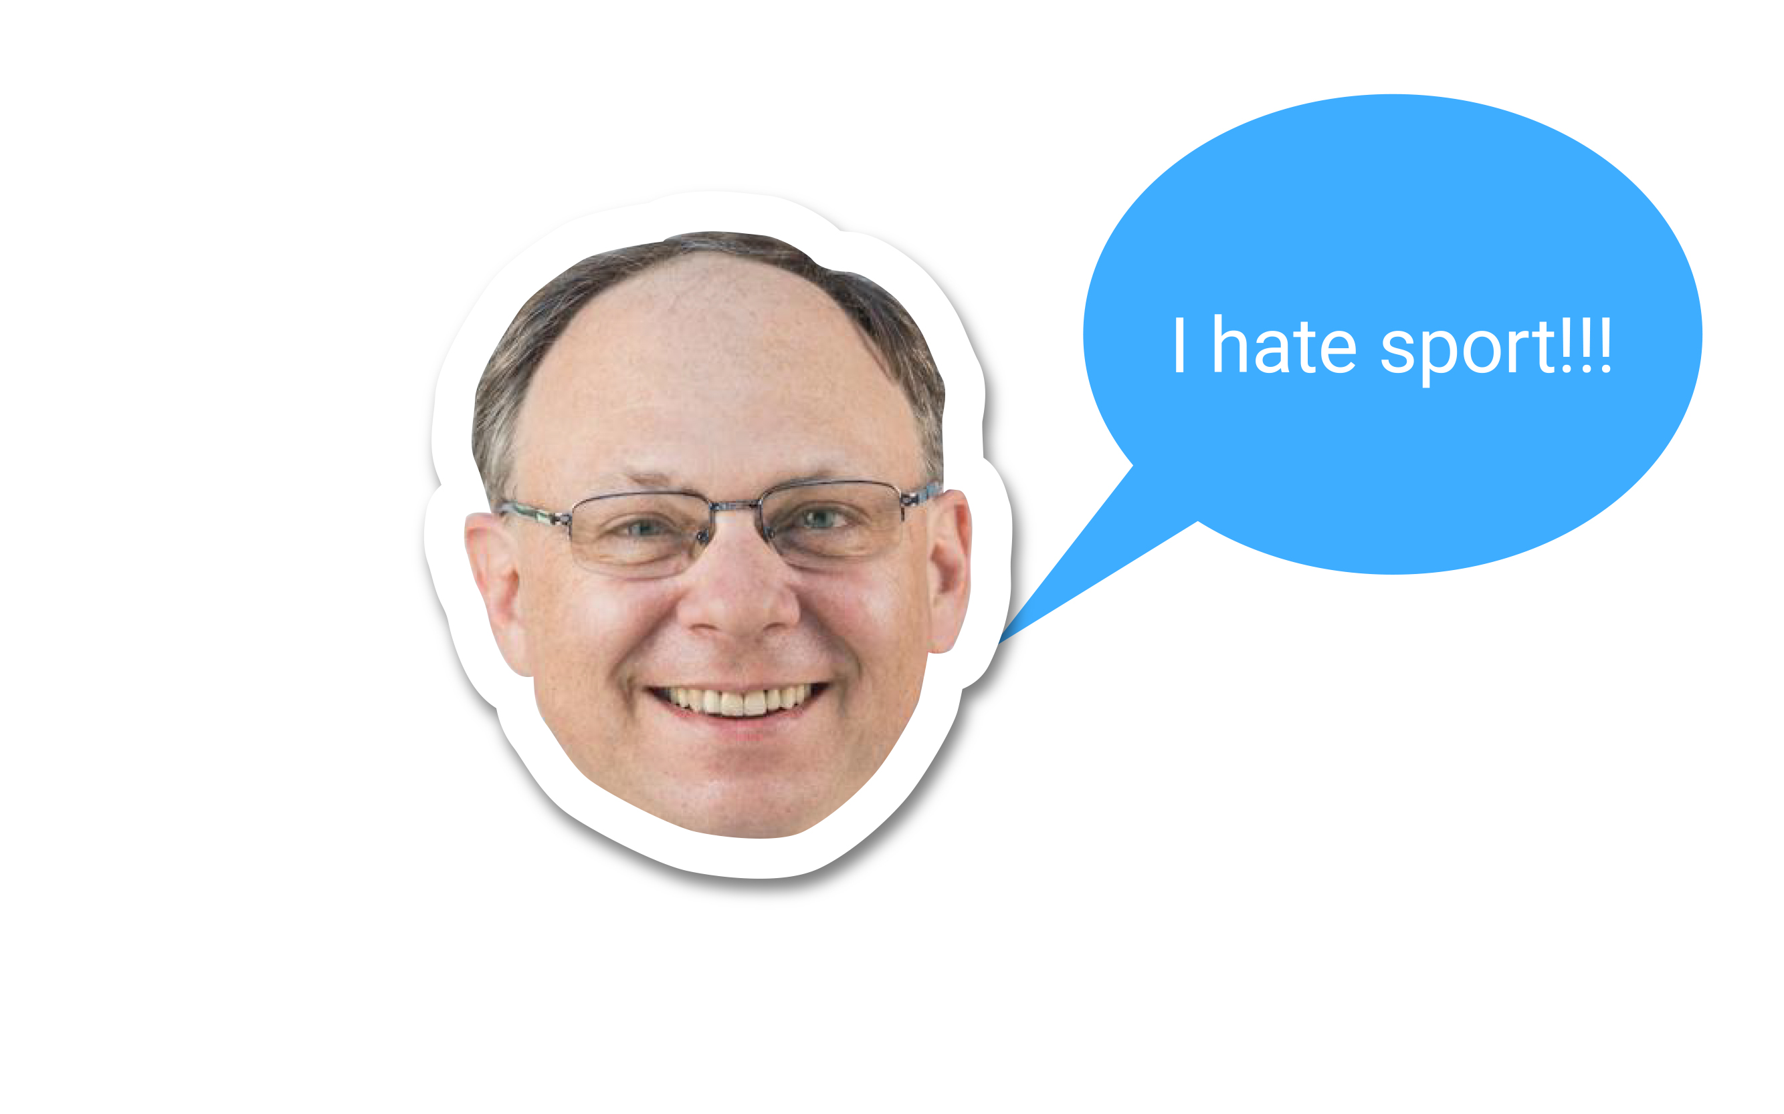


Slide 4
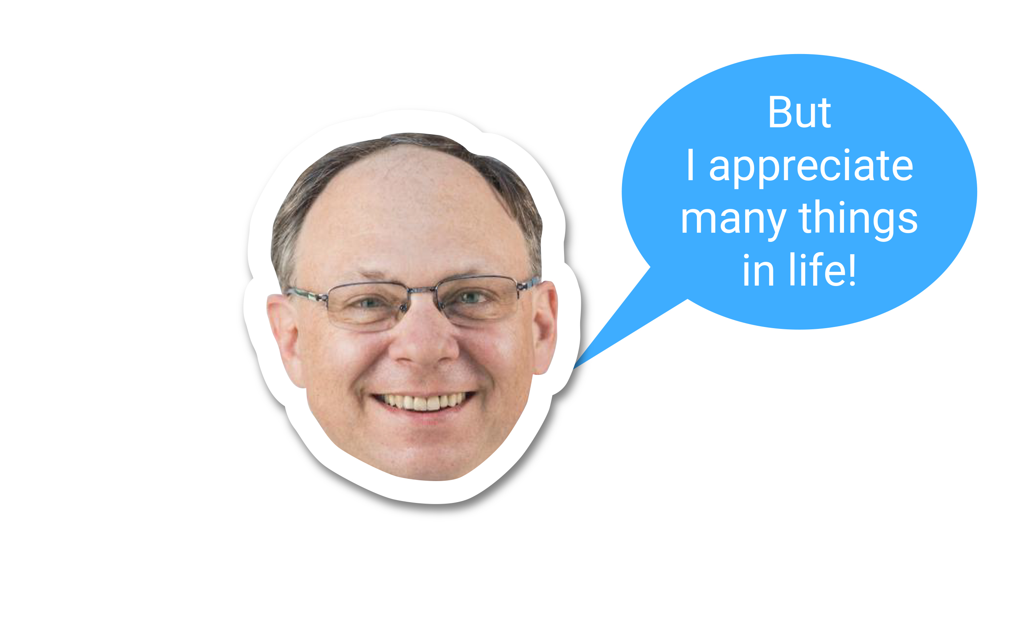

Slide 5
Things that I do for myself or for others

Slide 6
Things that represent my inerself and define my QoL

Slide 7
I’m no fool… I know taking care of my health would help me enjoy these things much longer and therefore contribute to my QoL

Slide 8
Since I LOVE my QoL, I wonder …
« can I leverage things I enjoy to ‘’trick my brain’’ and incidently do things for my health and contribute to my QoL ? »

Slide 9
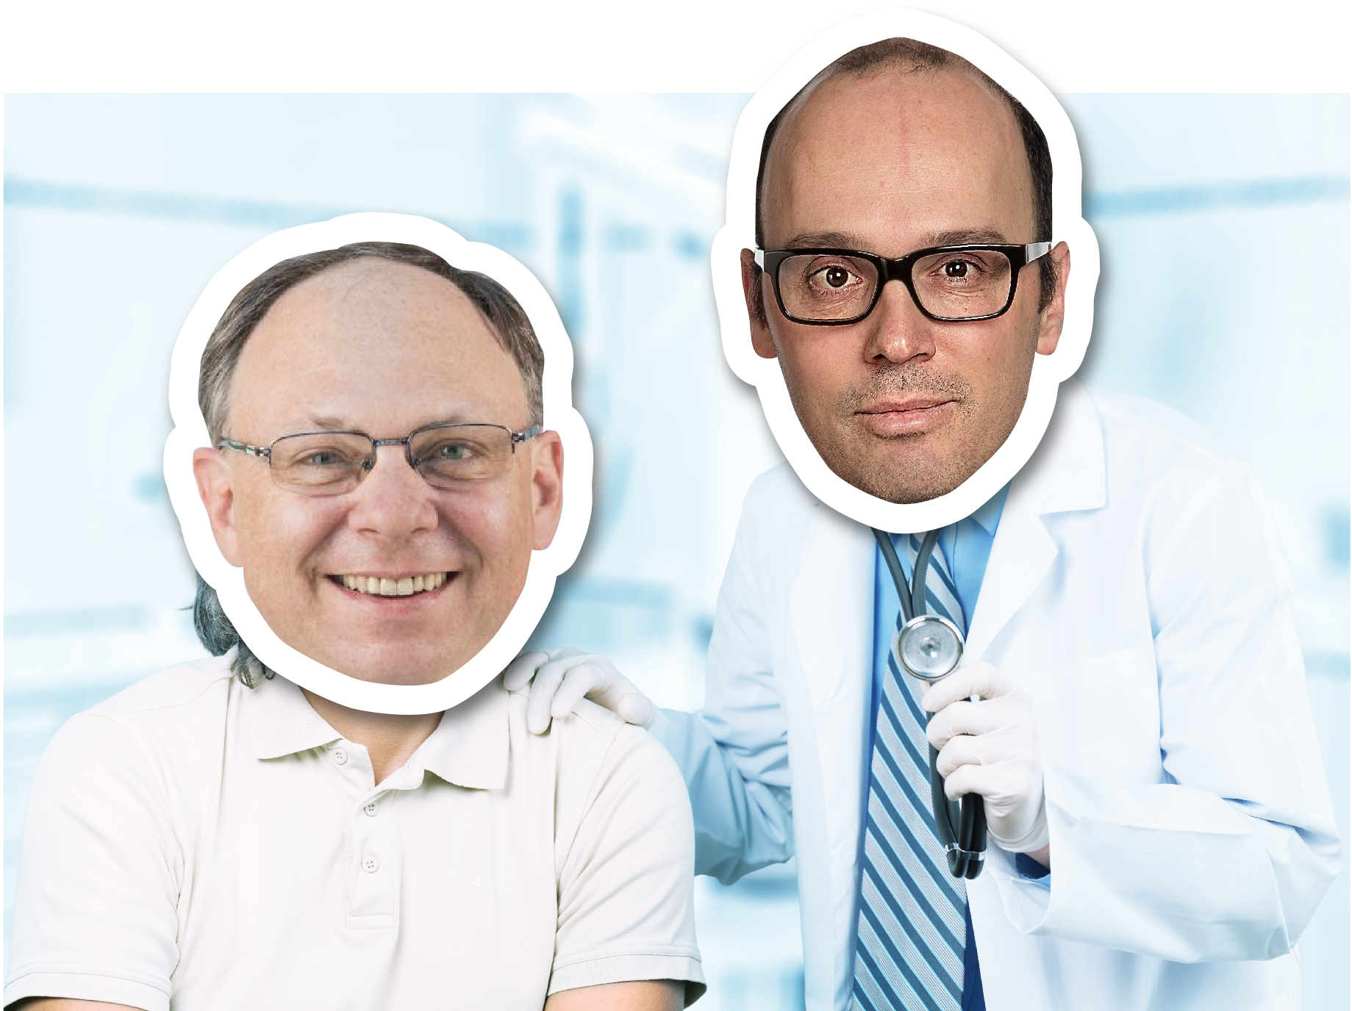

Slide 10
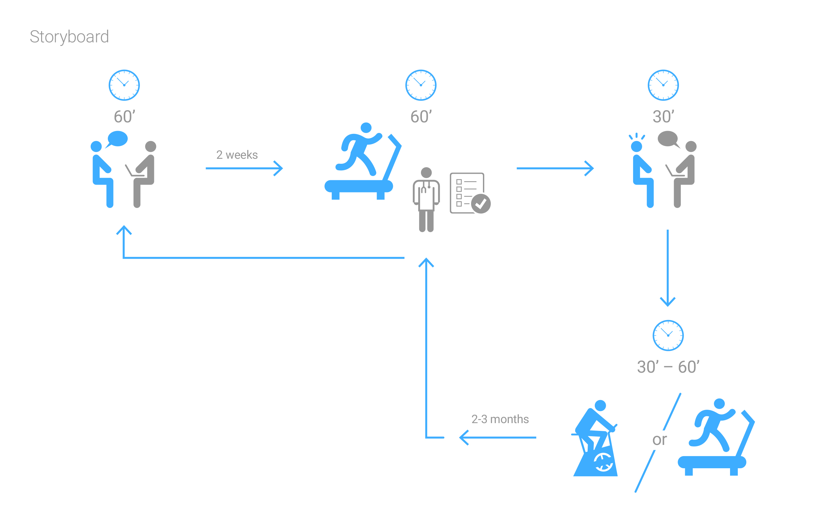

Slide 11
With Boris, we tried to be more efficient …

Slide 12
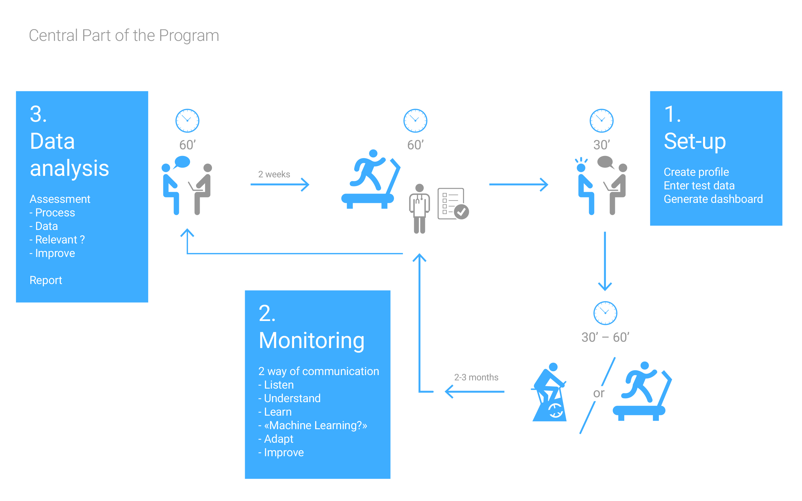

Slide 13
Now… l believe I’m not the only person thinking this way :
Tricking the brain to do yourself Good!

Slide 14
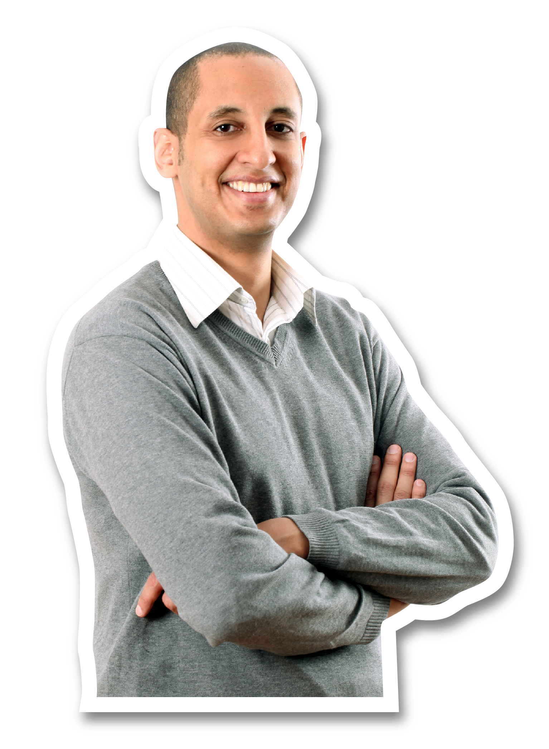

Slide 15
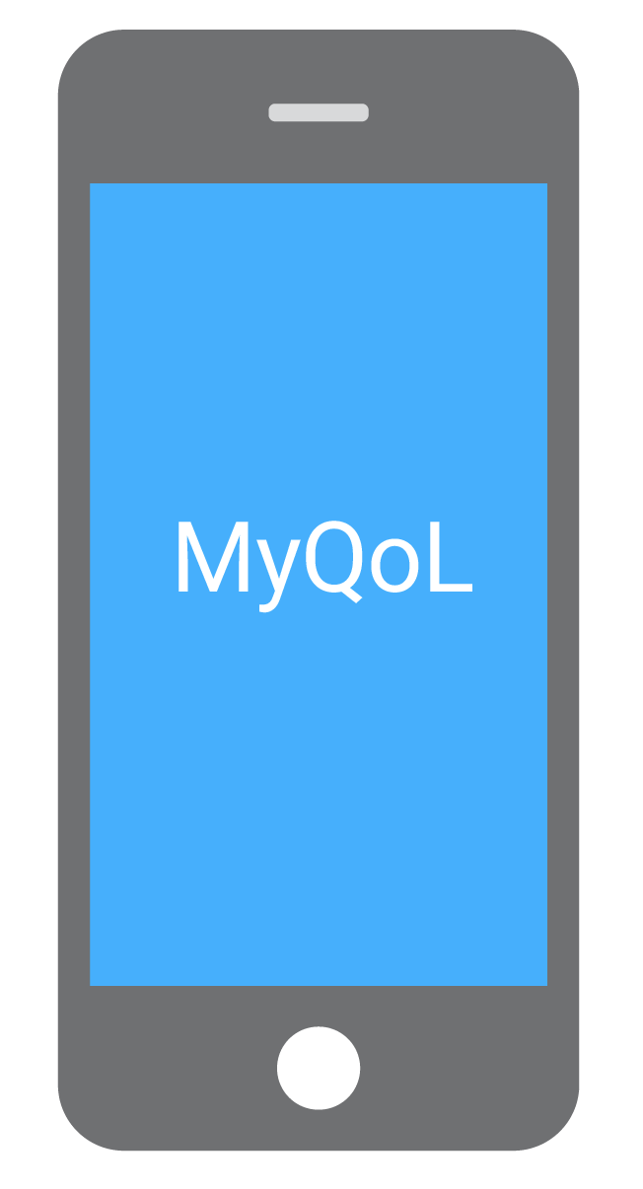

Slide 16
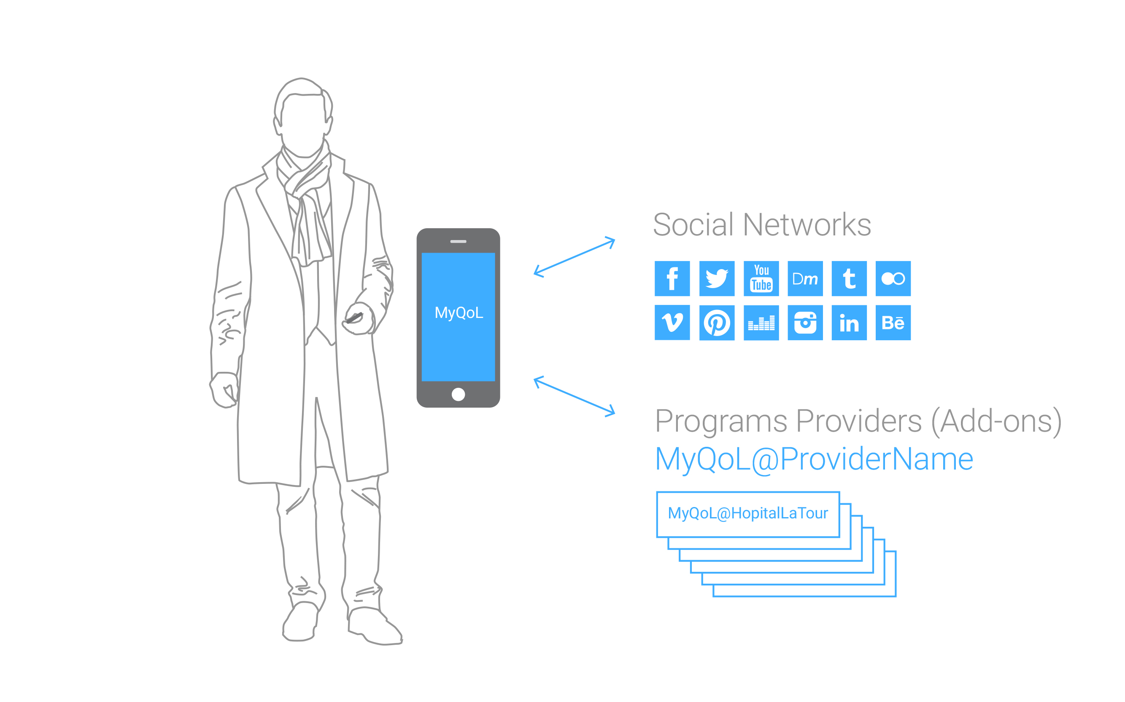

Slide 17
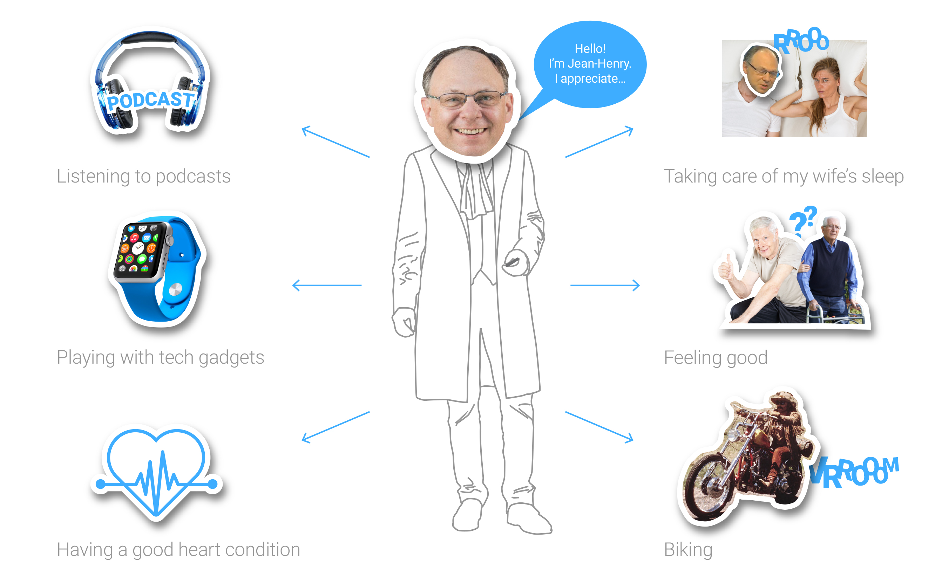

Slide 18
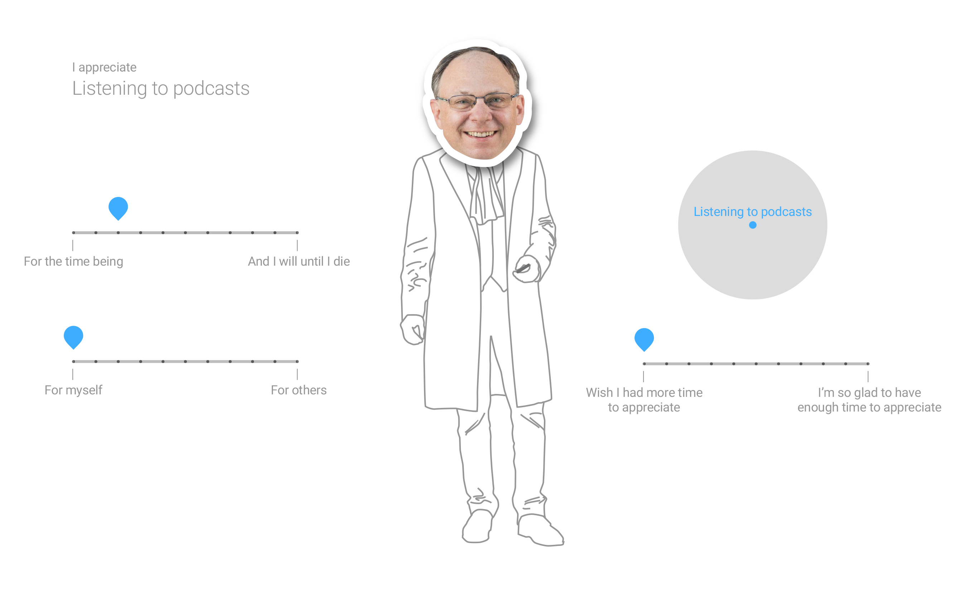

Slide 19
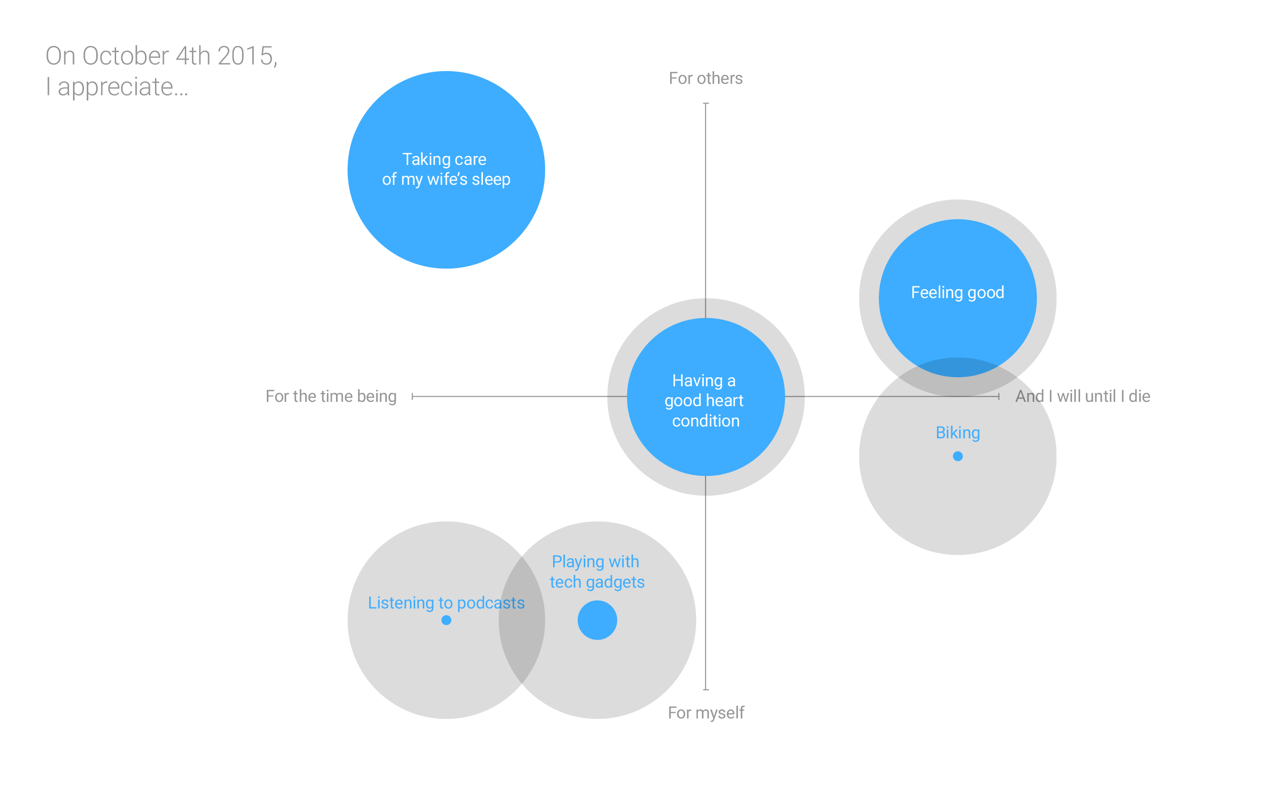

Slide 20


Slide 21
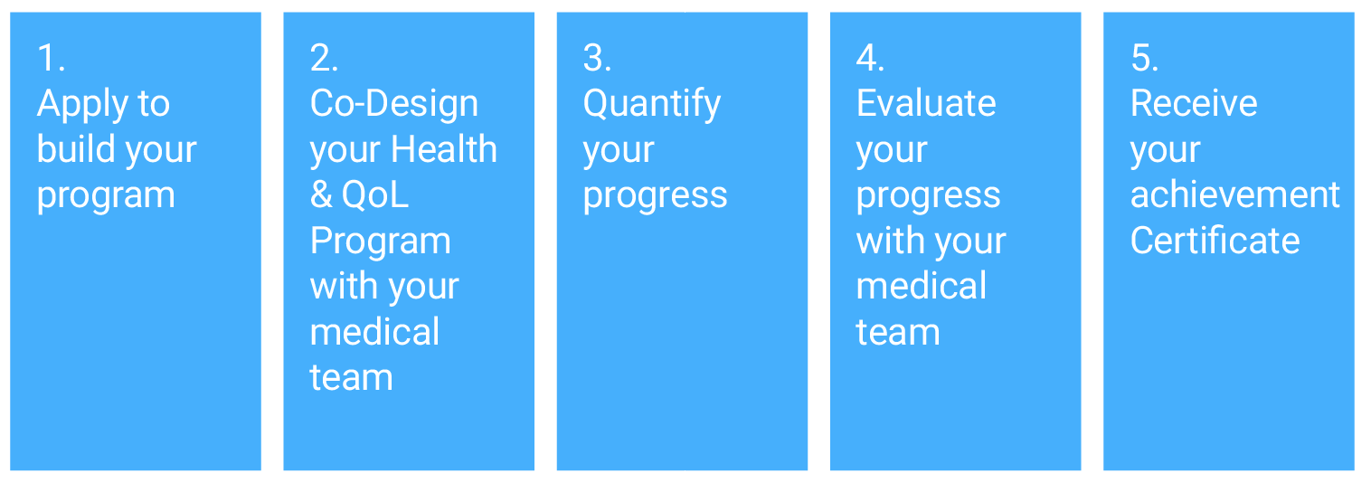

Slide 22
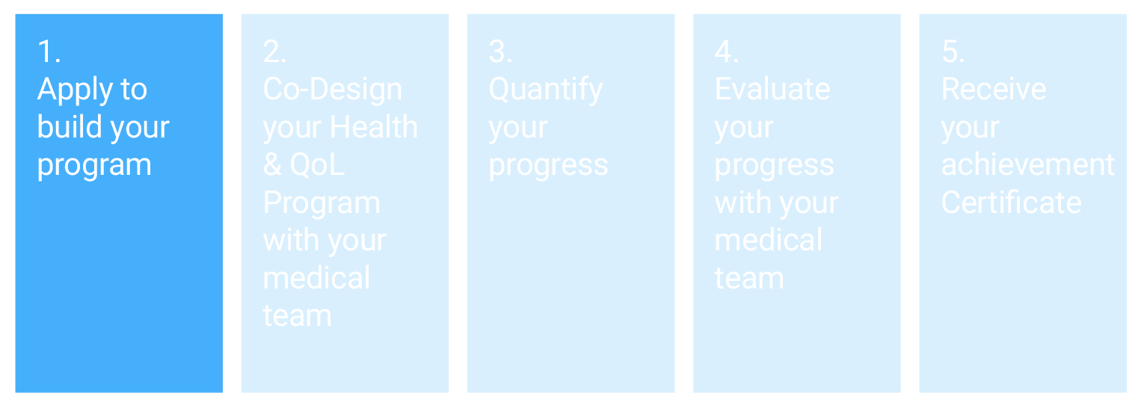
Notes:
Accès form
Percieved importance of « Boris’ Cloud » self assessment
Upload information + Name referal
Calendar: Meeting 1
Assessment report given to doctor
External information gathering

Slide 23
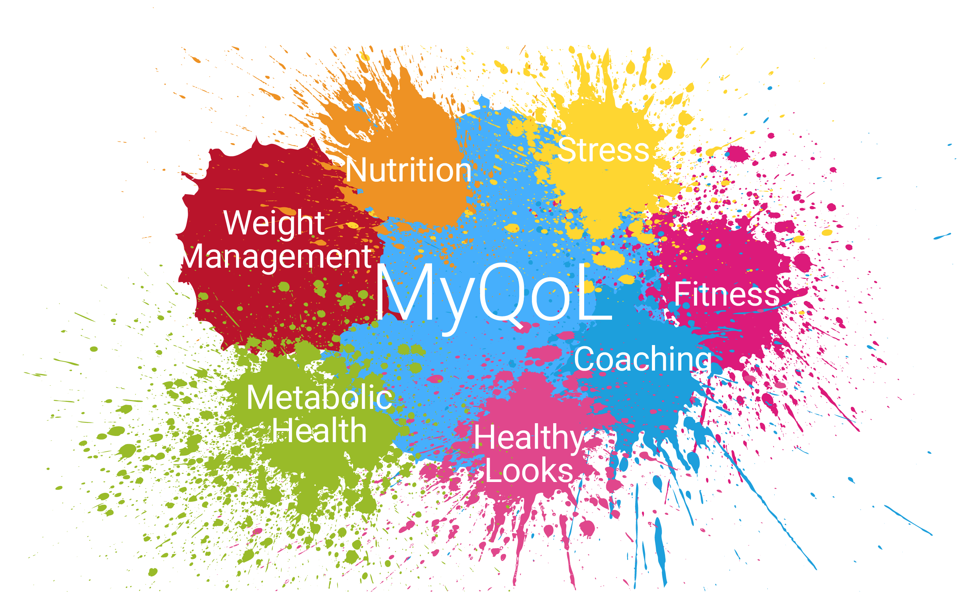

Slide 24
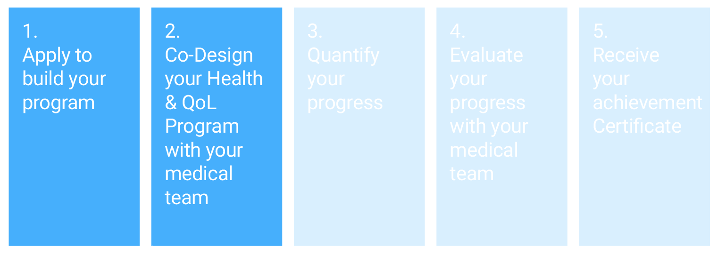
Notes:
Meeting 1
Percieved state on « Boris’ Cloud » self assessment with doctor
Discussion on delta of perception
Discussion with doctor on Leveraging patient’s QoL (with for example MyQoL)
Discussion with doctor on the necessary tests (during Meeting 2)
Calendar: Meeting 2 -> Tests with Medical Team
Meeting 2
Presentation of Medical team
Tests & Test results
Setting of parameters of you personal program / secured access (using an app) (link witn MyQoL for example)
Launch of personal program

Slide 25
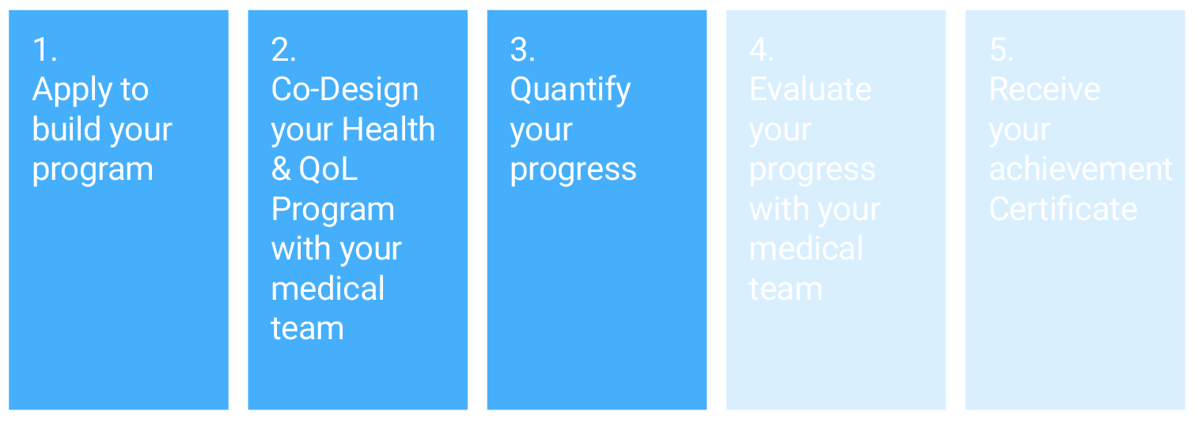
Notes:
Program execution
Follow-up & Alerts Self on App (link witn MyQoL for example)
Follow-up & Alerts Medical Team on App (link witn MyQoL for example)
Follow-up & Alerts with doctor: Remote or Face to Face
Calendar: Meeting 3 -> Personal Program assessment with Doctor & Medical Team

Slide 26
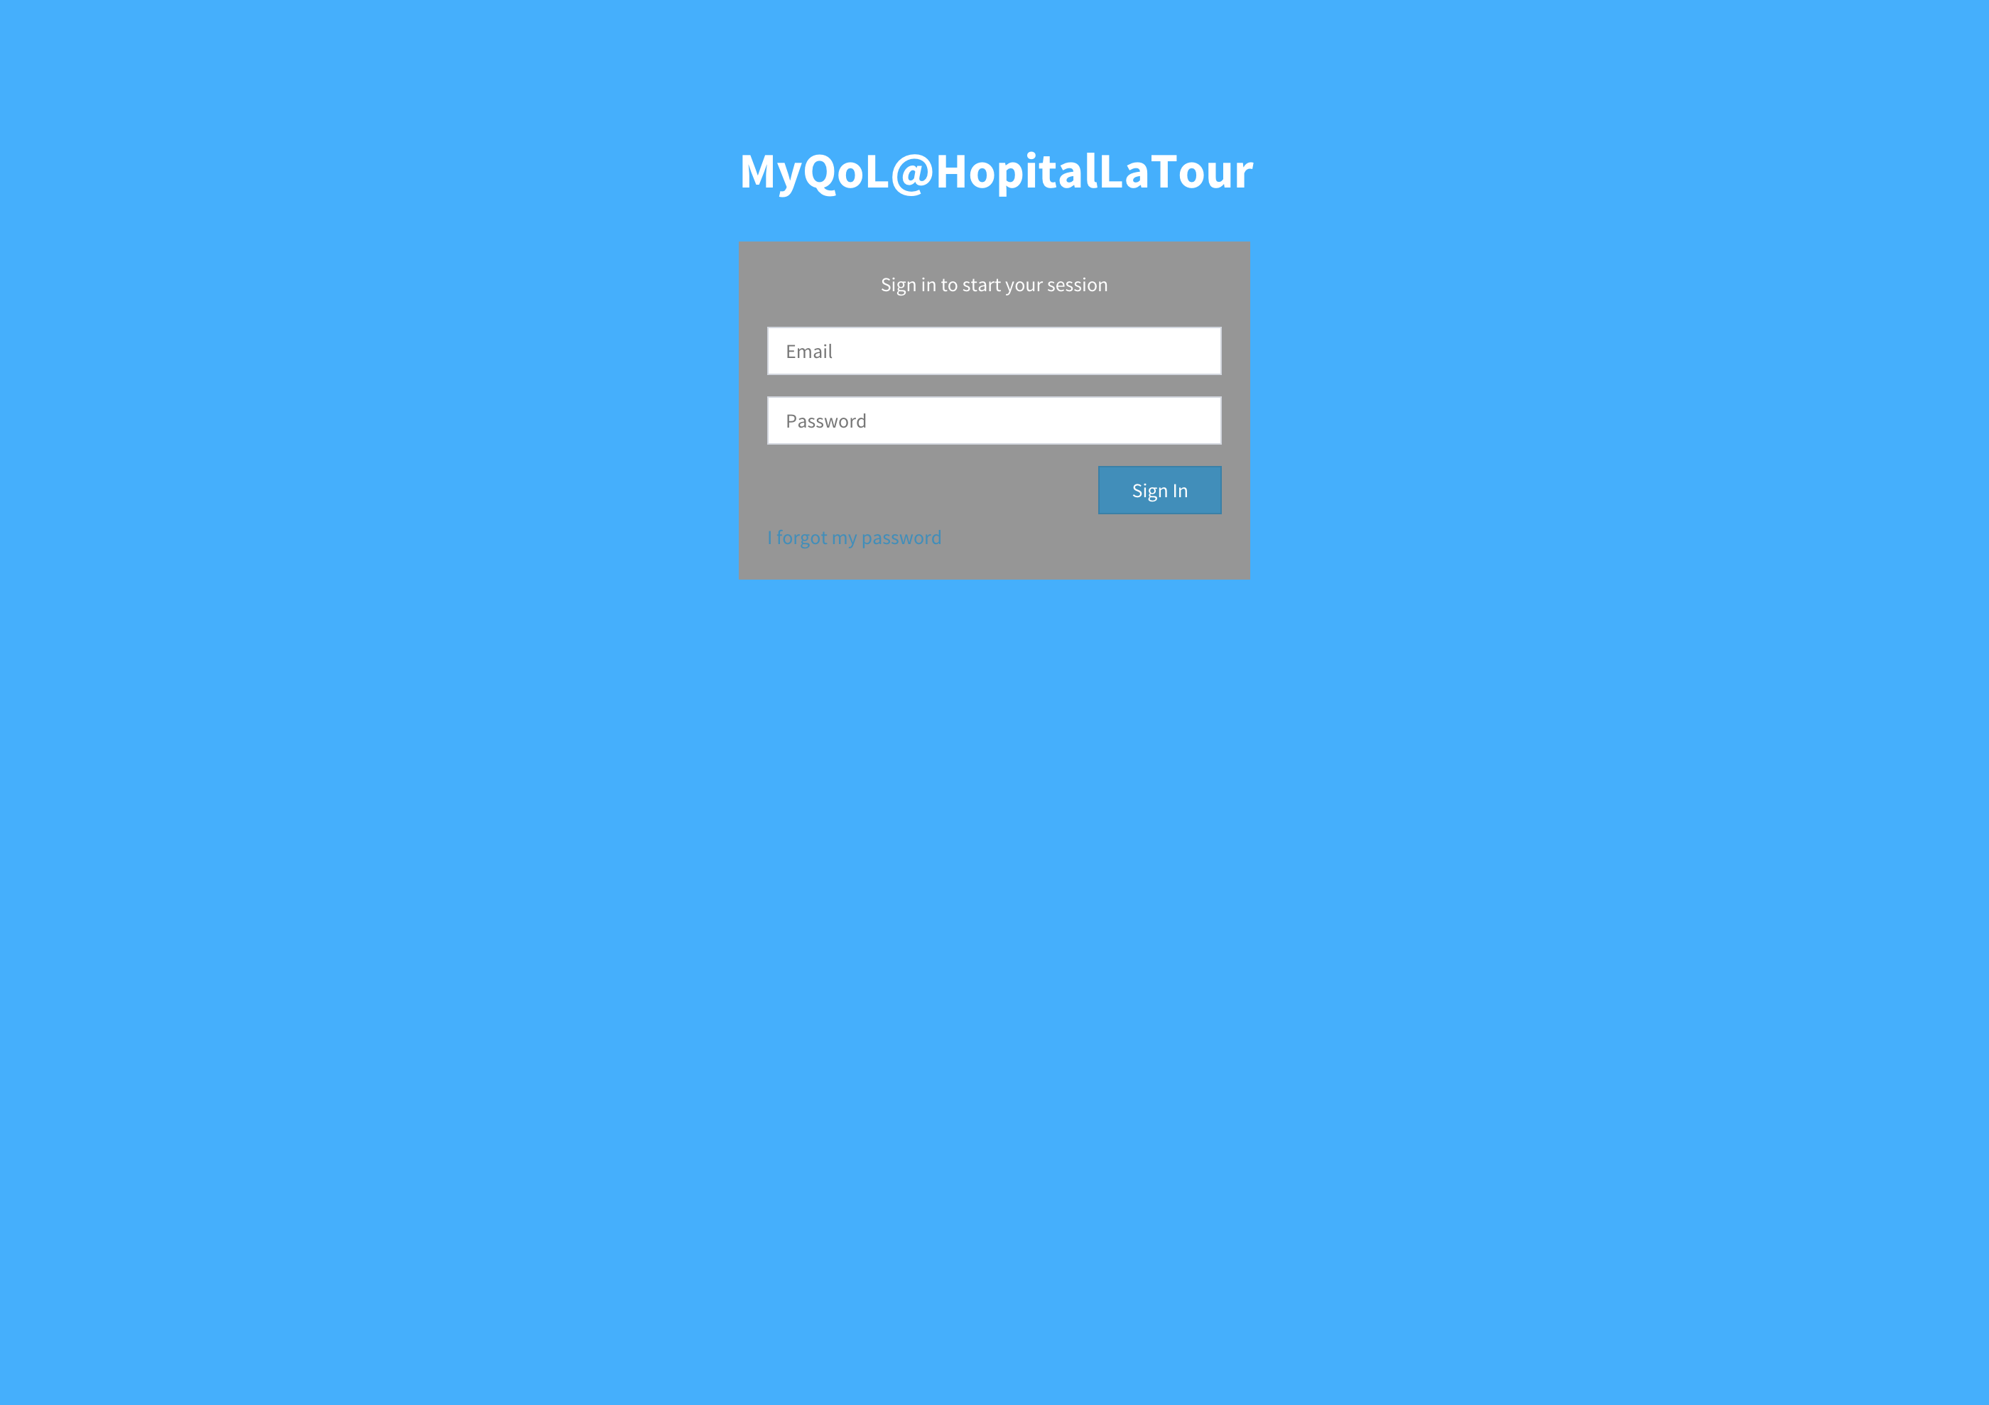

Slide 27
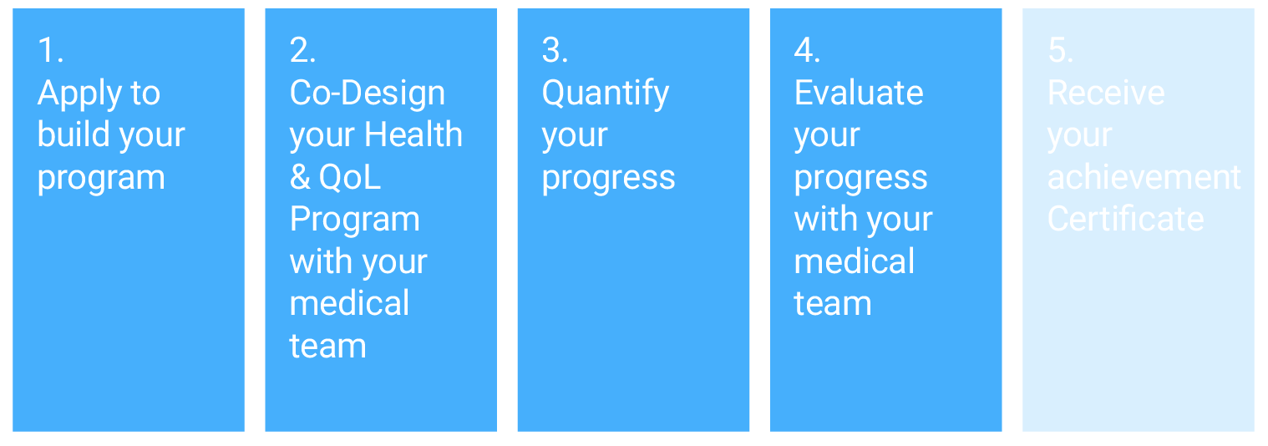
Notes:
Meeting 3 (+ 3.1 /3.2)
Personal Program assessment with Doctor & Medical Team
Review of parameters of you personal program / secured access (using an app) (link witn MyQoL for example)
If needed + Calendar: Meeting 3.1 -> Personal Program assessment with Doctor & Medical Team
If needed + Calendar: Meeting 3.2 -> Personal Program assessment with Doctor & Medical Team
Calendar: Meeting 4 -> Achievment Certificate

Slide 28
Notes:
Meeting 4
Achievment & Level Certificate on MyQoL
Mention: Empowerment, Autonomy, Rehabilitation, Preventive Health

Slide 29
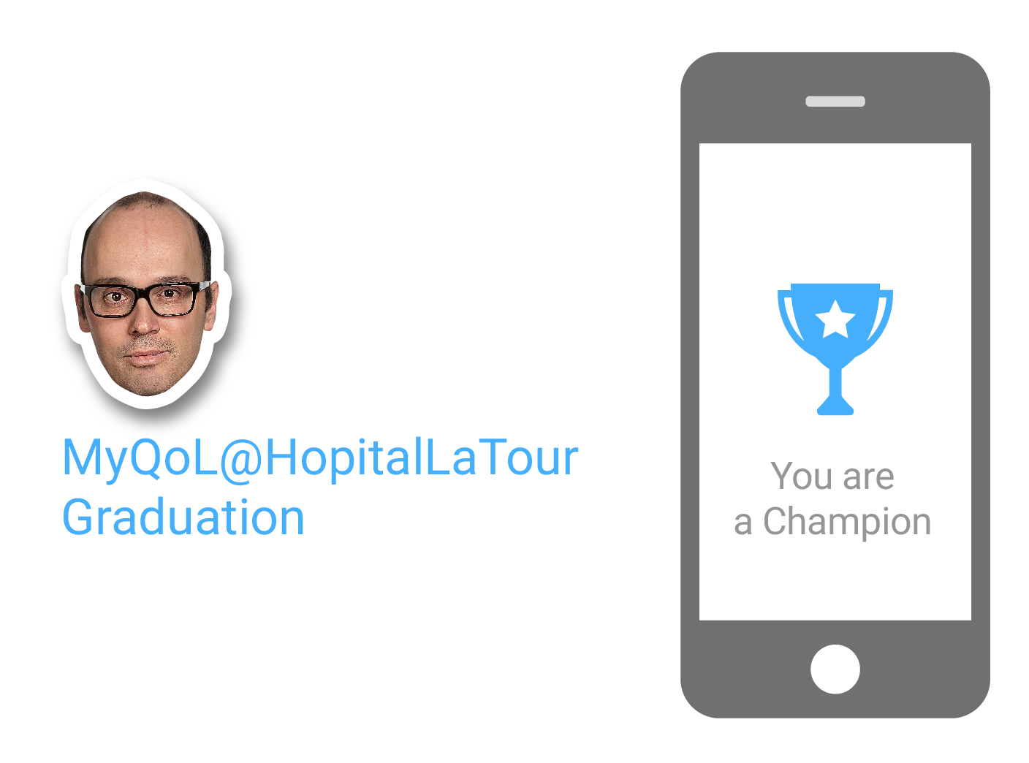

Slide 30
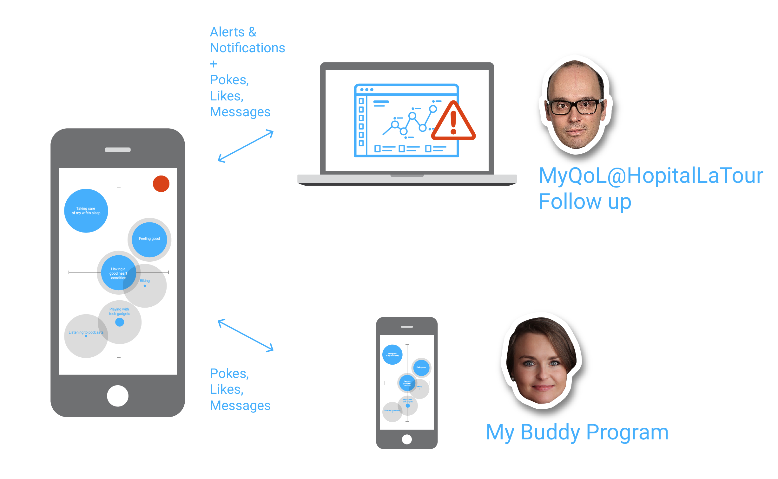

Slide 31
Basicaly…
Narrator
Motivational Health Framework
Audience
Individuals who look for QoL driven healthcare solutions
Heros
QoL-Motivated Healthcare Applicants
Quest
Autonomous and QoL-driven health monitoring systems
Magics
MyQoL (My App) MyQoL@HopitalLaTour (Provider’s Add-On)
Evils
Not enough health programs that contribute directly to MyQoL… Where to go ? Which medical partners ? How self-monitor ? How to interpret my performance ? How to be autonomous ?

Slide 32
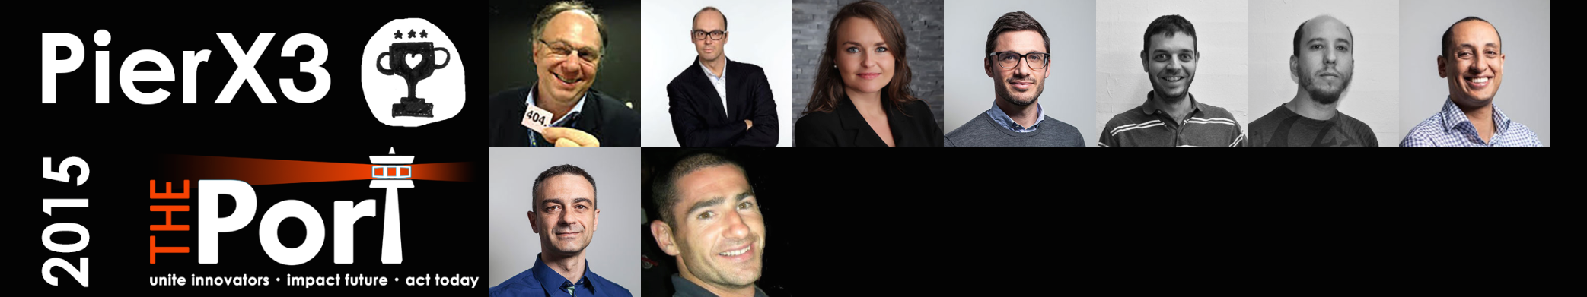






“One more thing” ;-)
As of TODAY :
  The work done @ The Port Hackathon 2015 is transferred to a ThinkServices Think Group : TG-MyQoL pulling in all PierX3 participants
  Everyone interested in furthering this initiative (we’re open, join us ;-)
As of Tomorrow :
  The MyQoL App will be used from 7:30 AM
  We’re open for beta testers
  Hôpital La Tour will be furthering the development of the program in it’s own context

