Slide 1

WLCG Service Report
4 weeks, March 17 – April 14
WLCG Management Board, 14th April 2015
Maarten Litmaath
CERN v1.1

Slide 2
Operations Coordination highlights (1) https://twiki.cern.ch/twiki/bin/view/LCG/WLCGOpsCoordination
Please refer to the 2015 WLCG Collaboration Workshop presentations
  http://indico.cern.ch/event/345619/
In particular:
  WLCG Status and Readiness for Run2
  Optimisation of operational costs
  Update on OSG/WLCG Network Services

Slide 3
Operations Coordination highlights (2) https://twiki.cern.ch/twiki/bin/view/LCG/WLCGOpsCoordination
VOMRS to VOMS-Admin migration finale
  Not all is perfect yet, but no need to go back
    Various tickets open, mostly RFE
  The old alias lcg-voms.cern.ch can be removed
    Highly desirable, viz. to avoid potential operational issues due to stale VOMS client configurations
    CERN CC routers currently have a special ad-hoc configuration to mitigate such issues
  The old aliases (lcg-)voms.cern.ch are foreseen to be removed on Apr 29

Slide 4
Selected items from Operations (1) https://twiki.cern.ch/twiki/bin/view/LCG/WLCGOperationsMeetings
Run-2 preparations alongside usual activities
  Scale tests of various components
  Cosmics data taking and processing
  MC, analysis, (re-)reco
  High grid activity
CERN: various CASTOR instabilities affected ALICE, ATLAS and CMS
  Good support from the CASTOR team
FTS-3 shares working since late March
  Case-sensitivity issue was discovered and fixed

Slide 5
Selected items from Operations (2) https://twiki.cern.ch/twiki/bin/view/LCG/WLCGOperationsMeetings
CRL URLs of 2 CAs firewalled on IPv6 while accessible on IPv4
  More such issues were seen and can be expected
ATLAS central service operations affected by “White Hat” challenge not announced to ATLAS
  https://security.web.cern.ch/security/services/en/whitehats.shtml
PIC: UPS upgrade led to major electrical fault affecting the cooling equipment
  During 2 weeks up to 70% of the CPU was available
  By Apr 16 the full capacity was restored

Slide 6
Service Incident Reports https://twiki.cern.ch/twiki/bin/view/LCG/WLCGServiceIncidents
None

Slide 7
GGUS summary (4 weeks 16/2/15 -15/03/15) by Pablo Saiz
VO | User | Team | Alarm | Total
ALICE | 4 | 0 | 0 | 4
ATLAS | 16 | 67 | 0 | 83
CMS | 156 | 1 | 1 | 158
LHCb | 1 | 11 | 0 | 12
Totals | 177 | 79 | 1 | 257

Slide 8
Significant events
GGUS release on the 25th of March
  Site list for CMS supporters using CMS naming convention
  Several fixes in the GGUS/SNOW interface
  Bug fix on the ‘Last Modifier’
  Next release scheduled for 29th April
1 real alarm during this period

Slide 9
CMS ALARM GGUS:112971
ARGUS is failing all CMS analysis jobs
What time UTC | What happened
2015/4/10 10:20 | Initial submission. Type of Issue: Other Site: CERN-PROD Ticket created since there was no response to GGUS:112942
2015/4/10 10:38 | CC operator creates a new SNOW ticket *THIS SHOULD NOT HAVE HAPPENED! Ended up with two SNOW tickets for the same GGUS incident The alarm ticket procedure for the operators has since been updated and reiterated
2015/4/10 12:20 | Service manager acknowledges the ticket
2015/4/10 13:57 | Ticket closed by submitter, and marked as UNRESOLVED. Submitter announces that having between 12% and 35% of failing ARGUS connections does not warrant an alarm ticket

Slide 10
Availability Reports
The following pages show the Availability of T0 and the T1 during the last calendar month
  As shown by SAM-3 at the time of this report
  Recomputations might still change some results
The official Availability and Reliability archive is maintained by the WLCG Project Office
  https://espace2013.cern.ch/WLCG-document-repository/ReliabilityAvailability

Slide 11
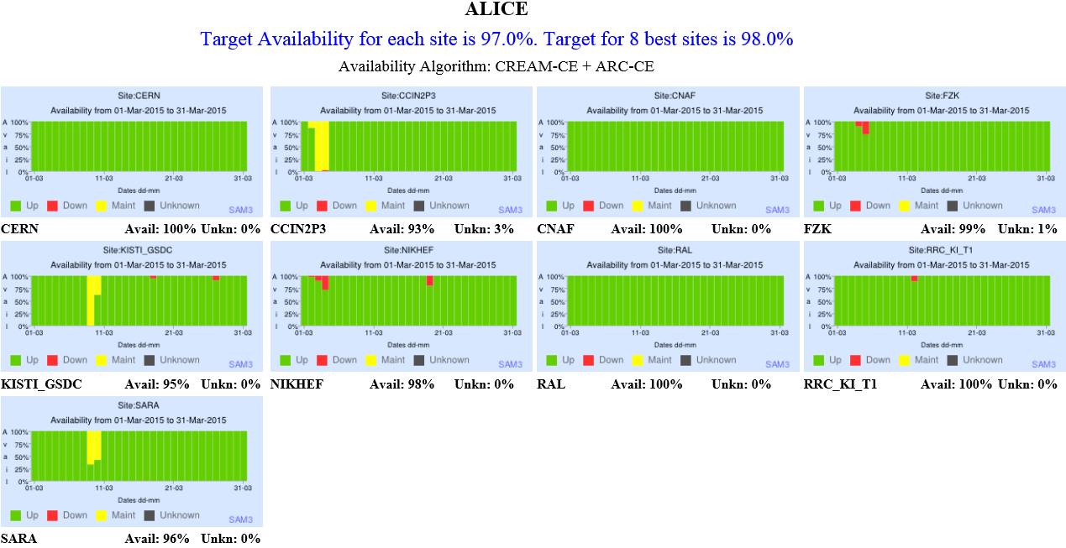
March 2015

Slide 12
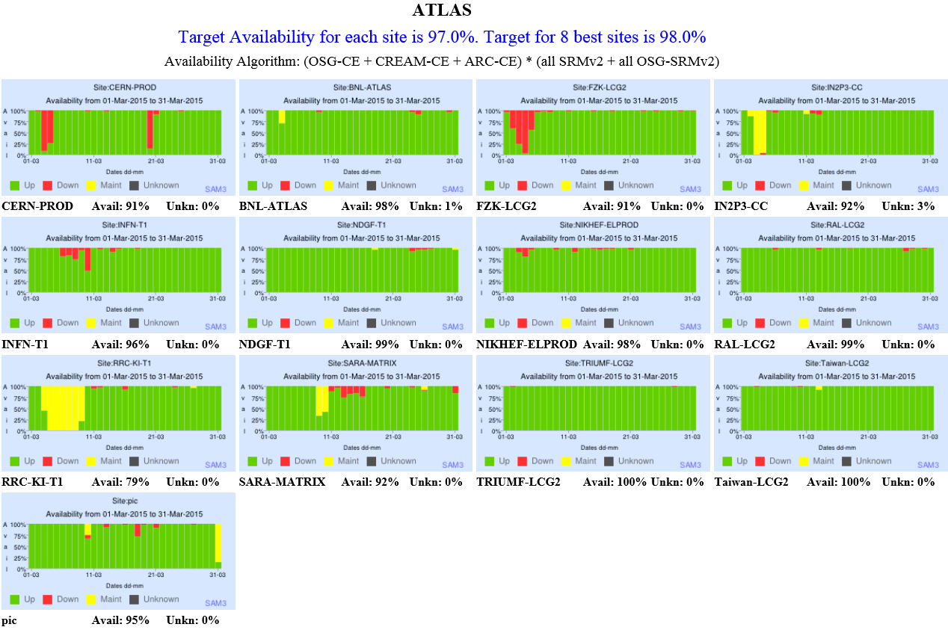
March 2015

Slide 13
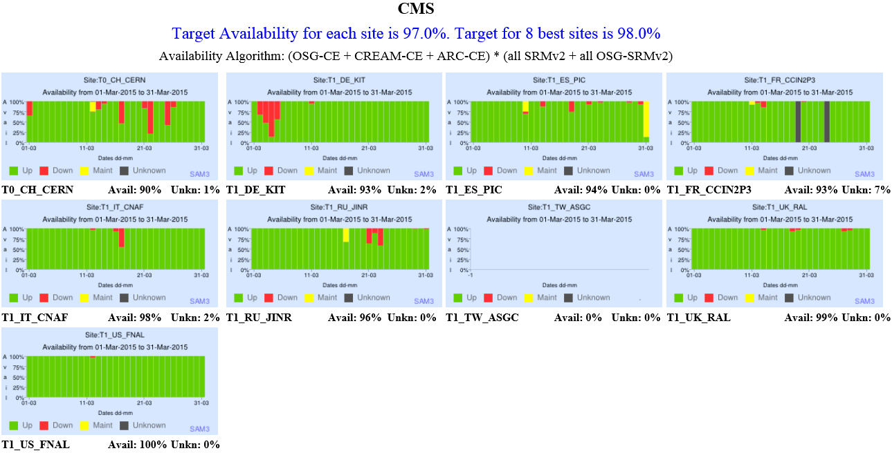
March 2015

Slide 14
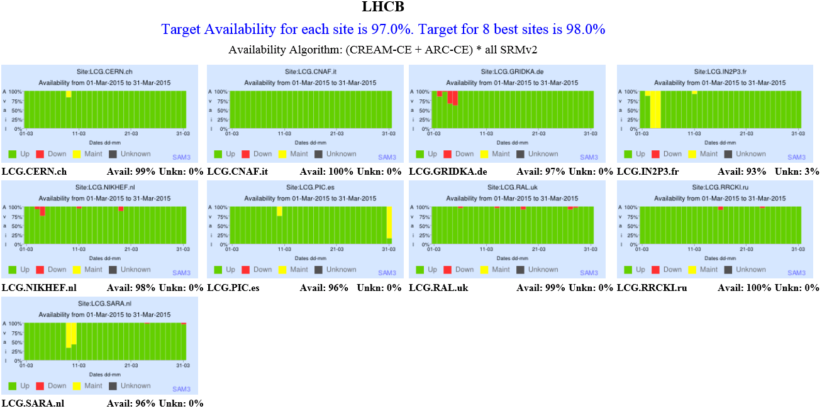
March 2015

