Slide 1
Cosmology and Fundamental Physics
Subodh P. Patil, Theory division, CERN
February 25, 2015
A warm welcome to students from Israel

Slide 2

Physics is a frontier science.
As every explanation raises a new set of questions, the buck stops with the physicist.
Material phenomenon → molecules/ atoms → particle physics → ?
Where does the chain of explanation end?

Slide 3
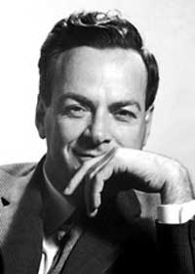
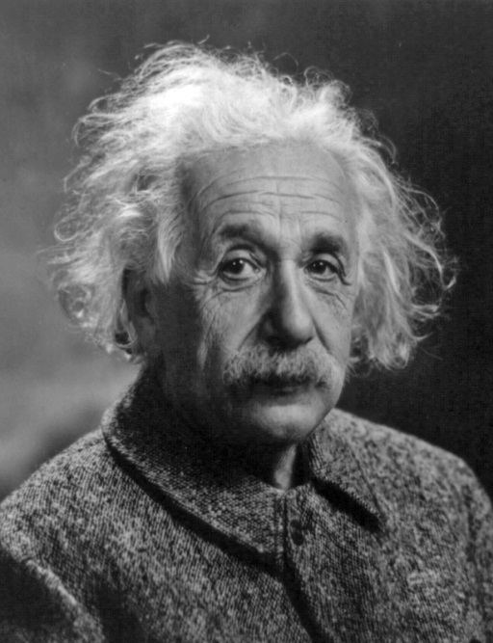
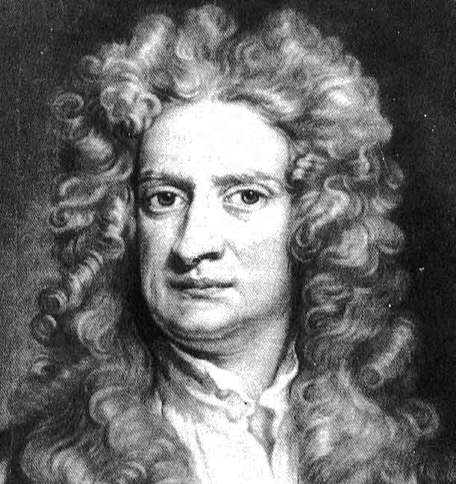
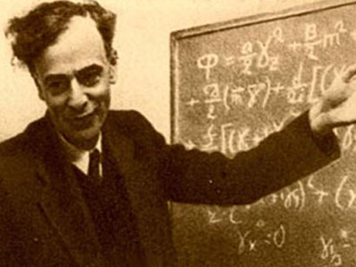
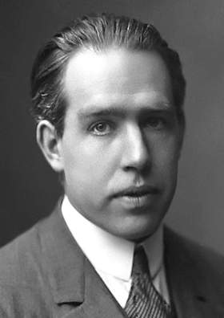
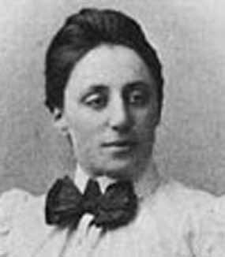
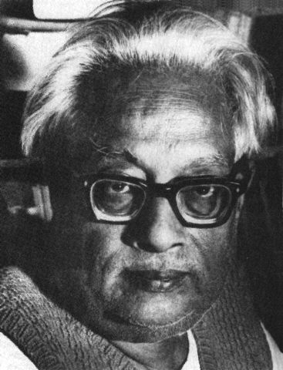
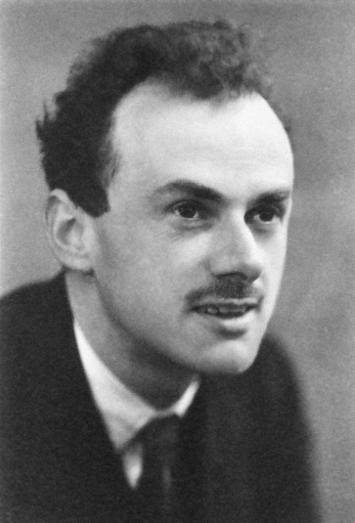
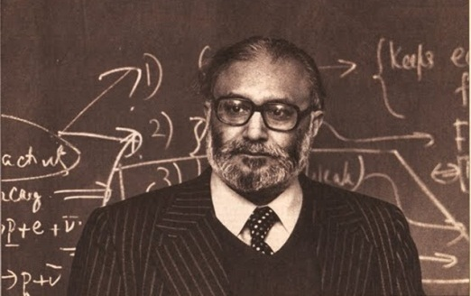
Theoretical Physics is the study of how and why the laws of nature are the way they are. It is the meta language through which we understand not just this, but all possible universes.

Slide 4
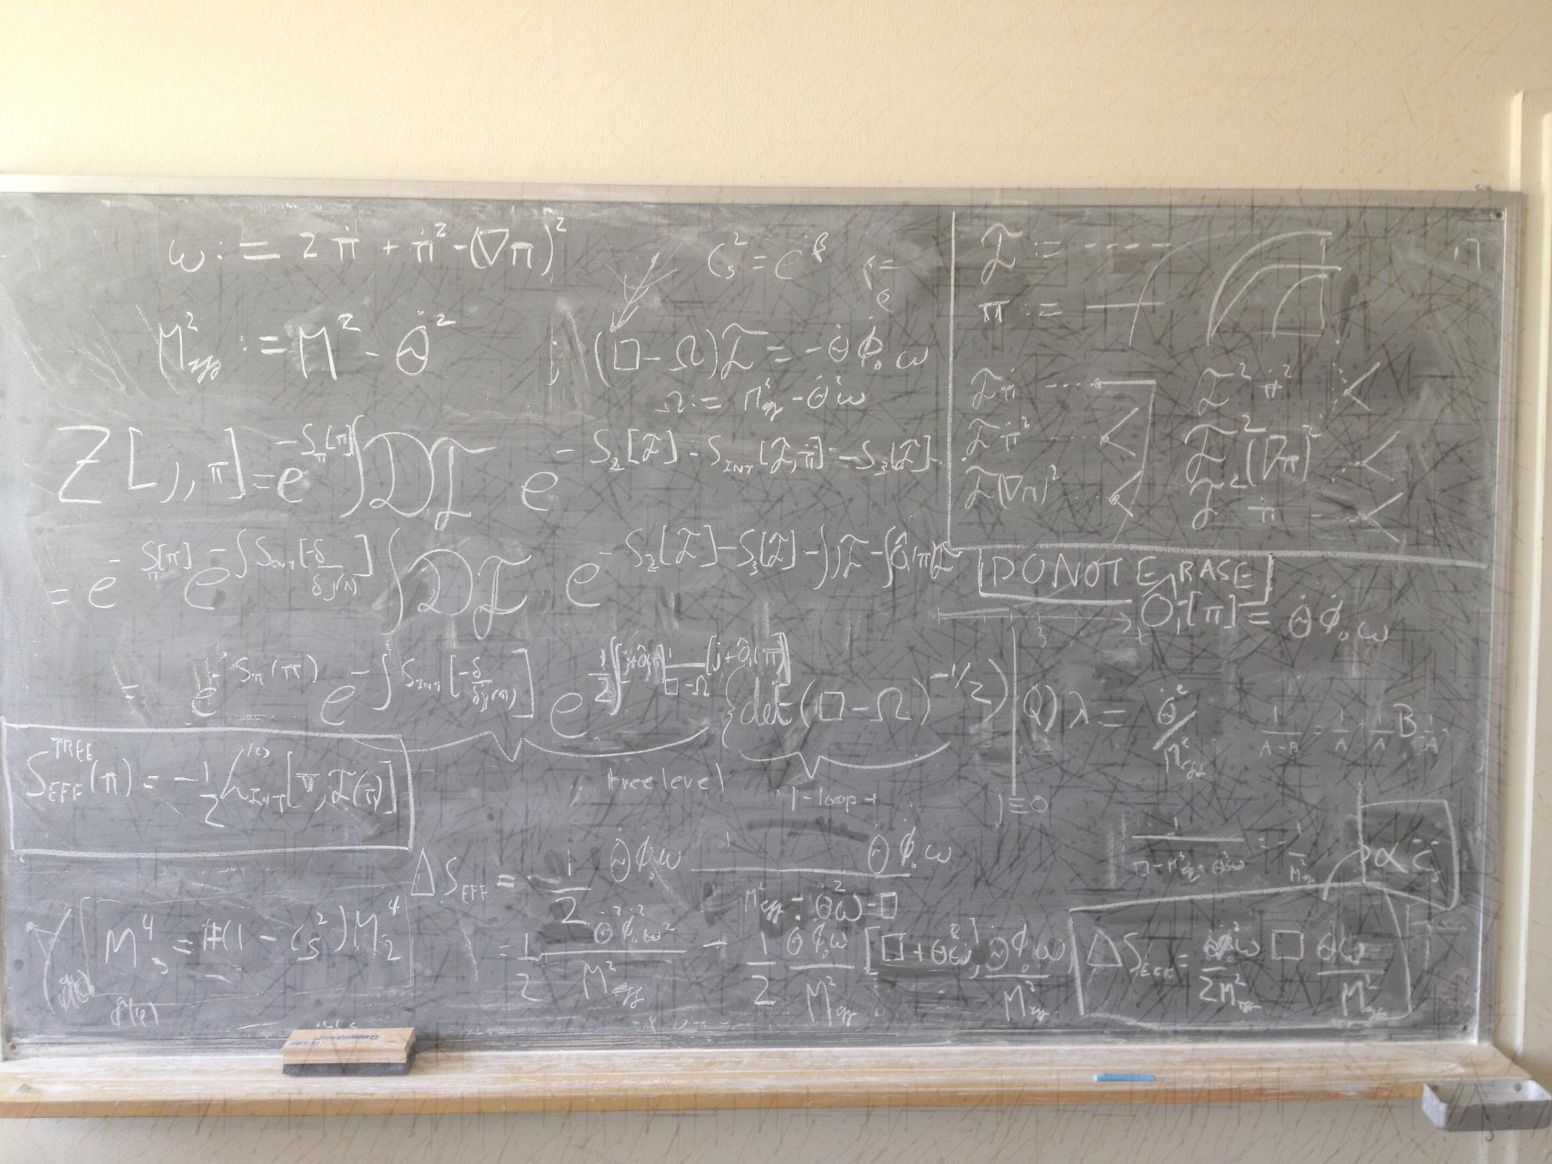
A Theoretical Cosmologist is someone who seeks to understand the fundamental questions at the very end of that chain…
Understand the origins of our universe and the structures that we see in it.
To see if we can explain the `Big Bang’ itself– was it really the beginning of the universe? Was there anything before it?
To test theories of fundamental physics at energy scales up to a Trillion times higher than what we can reach at the LHC.
Are there any extra dimensions?
Any new particles `beyond the standard model’?
Is spacetime itself geometric or `atomic’?
Does the universe have a non-trivial `topology’?
Is there only one universe, or are there others just like ours?
As scientists, we will always have more questions than answers…
How can we even hope to answer such questions?

Slide 5
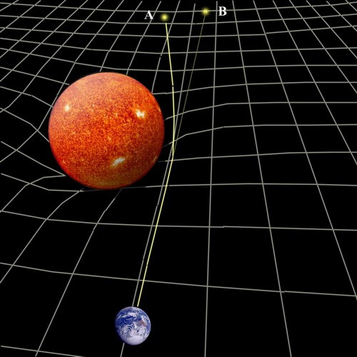
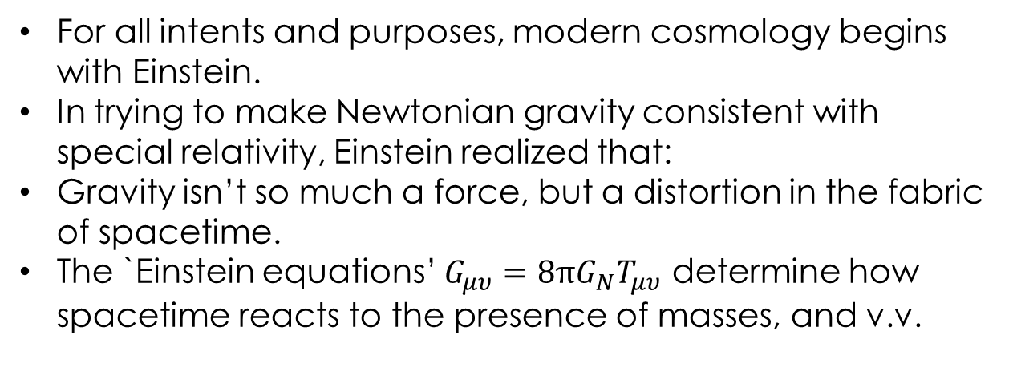
Cosmology– a brief historical overview.
For all intents and purposes, modern cosmology begins with Einstein.
In trying to make Newtonian gravity consistent with special relativity, Einstein realized that:
Gravity isn’t so much a force, but a distortion in the fabric of spacetime.
The `Einstein equations’ $G_{μυ}=8πG_{N}T_{μυ}$ determine how spacetime reacts to the presence of masses, and v.v.
The orbits of planets around stars is simply the consequence of masses moving along straight lines `geodesics’ in a `curved’ geometry.
Geodesics-- c.f. airplanes on the surface of the earth.
Spacetime is dynamical!
The same must be true of the universe on the largest scales.
But this cannot be, right?

Slide 6
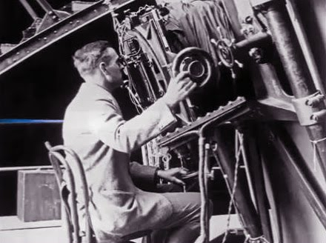
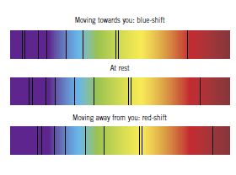
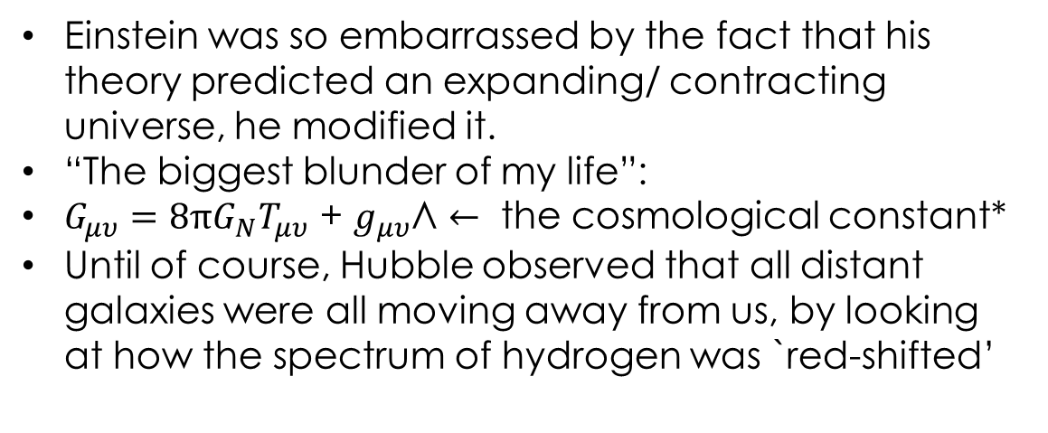
Cosmology– a brief historical overview.
Einstein was so embarrassed by the fact that his theory predicted an expanding/ contracting universe, he modified it.
“The biggest blunder of my life”:
$G_{μυ}=8πG_{N}T_{μυ}$ + $g_{μυ}$Л $←$ the cosmological constant*
Until of course, Hubble observed that all distant galaxies were all moving away from us, by looking at how the spectrum of hydrogen was `red-shifted’

Slide 7
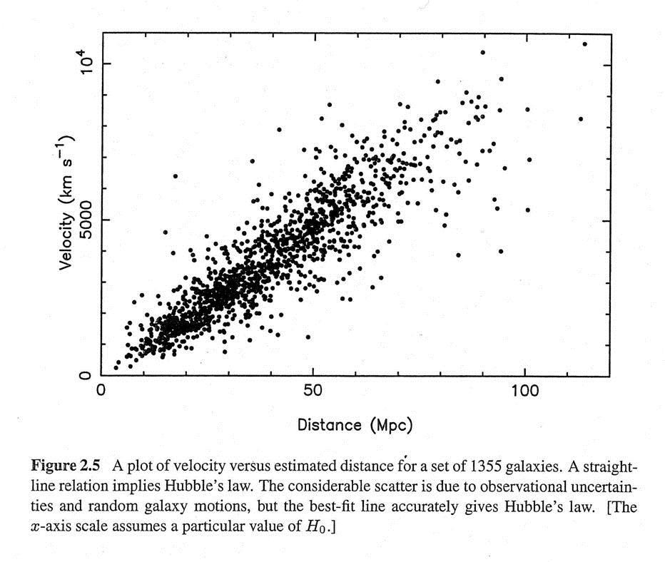

Cosmology– a brief historical overview.
So stars appear to be moving away from us at a rate given by Hubble’s law-- $v=H r$
This implies that the universe is expanding.
Rewind the film far back enough, then all matter must have been squeezed into some very hot, dense initial state.
Friedmann, Lemaitre, Robertson and Walker wrote down solutions to Einstein’s equations that reproduced Hubble’s law.
Implies that the universe began in some sort of a `big bang’.
Lemaitre referred to the initial state as the `primeval atom’.

Slide 8
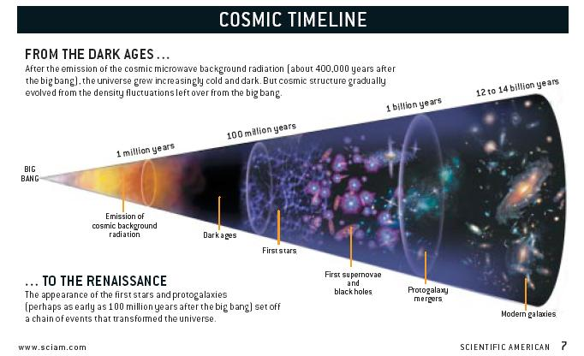
The Big Bang model is the simple result of Einstein’s equations, with added simplifying assumptions of symmetry (homogeneity, isotropy) and the properties of matter (thermal equilibrium)… and It makes predictions!

Slide 9
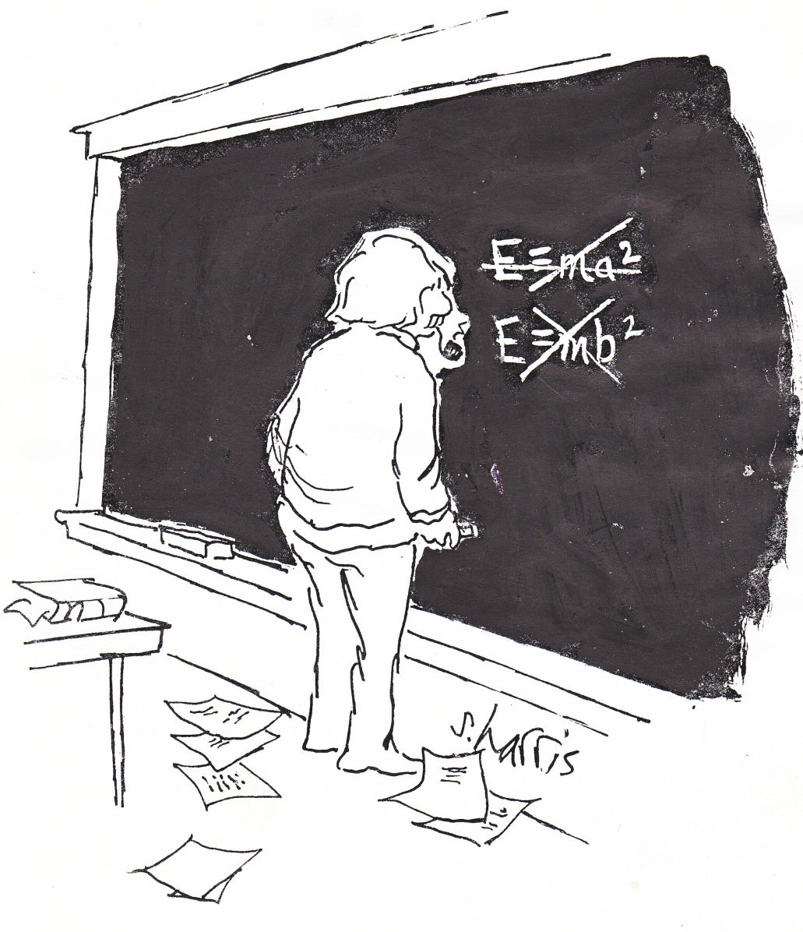
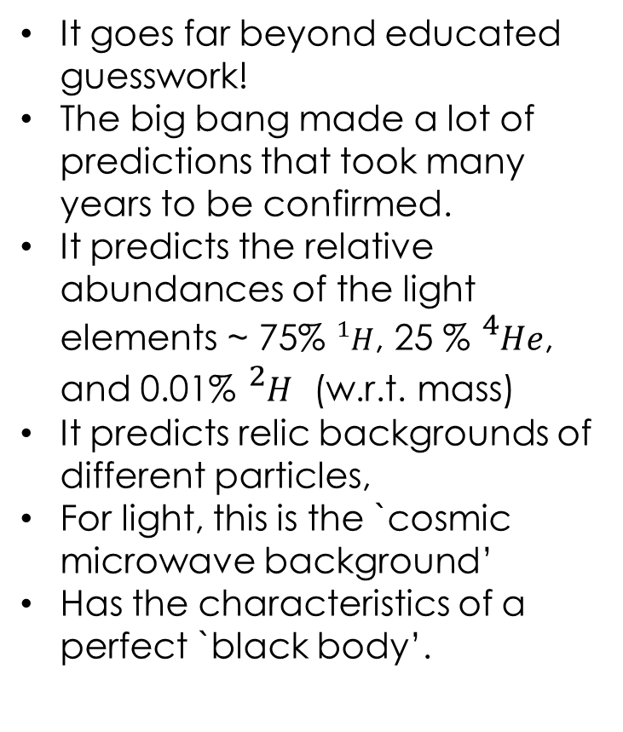
The history of big bang cosmology typifies progress in theoretical physics– guided by notions of simplicity and symmetry (`invariances’), we posit models of the universe that we then go out and test.
It goes far beyond educated guesswork!
The big bang made a lot of predictions that took many years to be confirmed.
It predicts the relative abundances of the light elements ~ 75% ${}_{}^{1}H$, 25 % ${}_{}^{4}{He}$, and 0.01% ${}_{}^{2}H$ (w.r.t. mass)
It predicts relic backgrounds of different particles,
For light, this is the `cosmic microwave background’
Has the characteristics of a perfect `black body’.

Slide 10
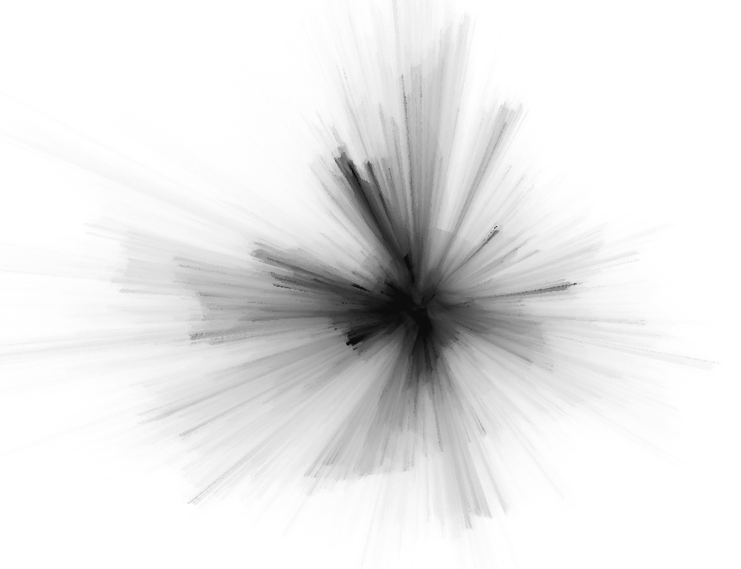
But what is this `primeval atom’?
Does the `initial singularity’ get resolved by new physics at the `Planck scale’?
Is the big bang really the beginning of the universe?
How did the ordered initial conditions of the big bang come to be arranged so?
….

Slide 11
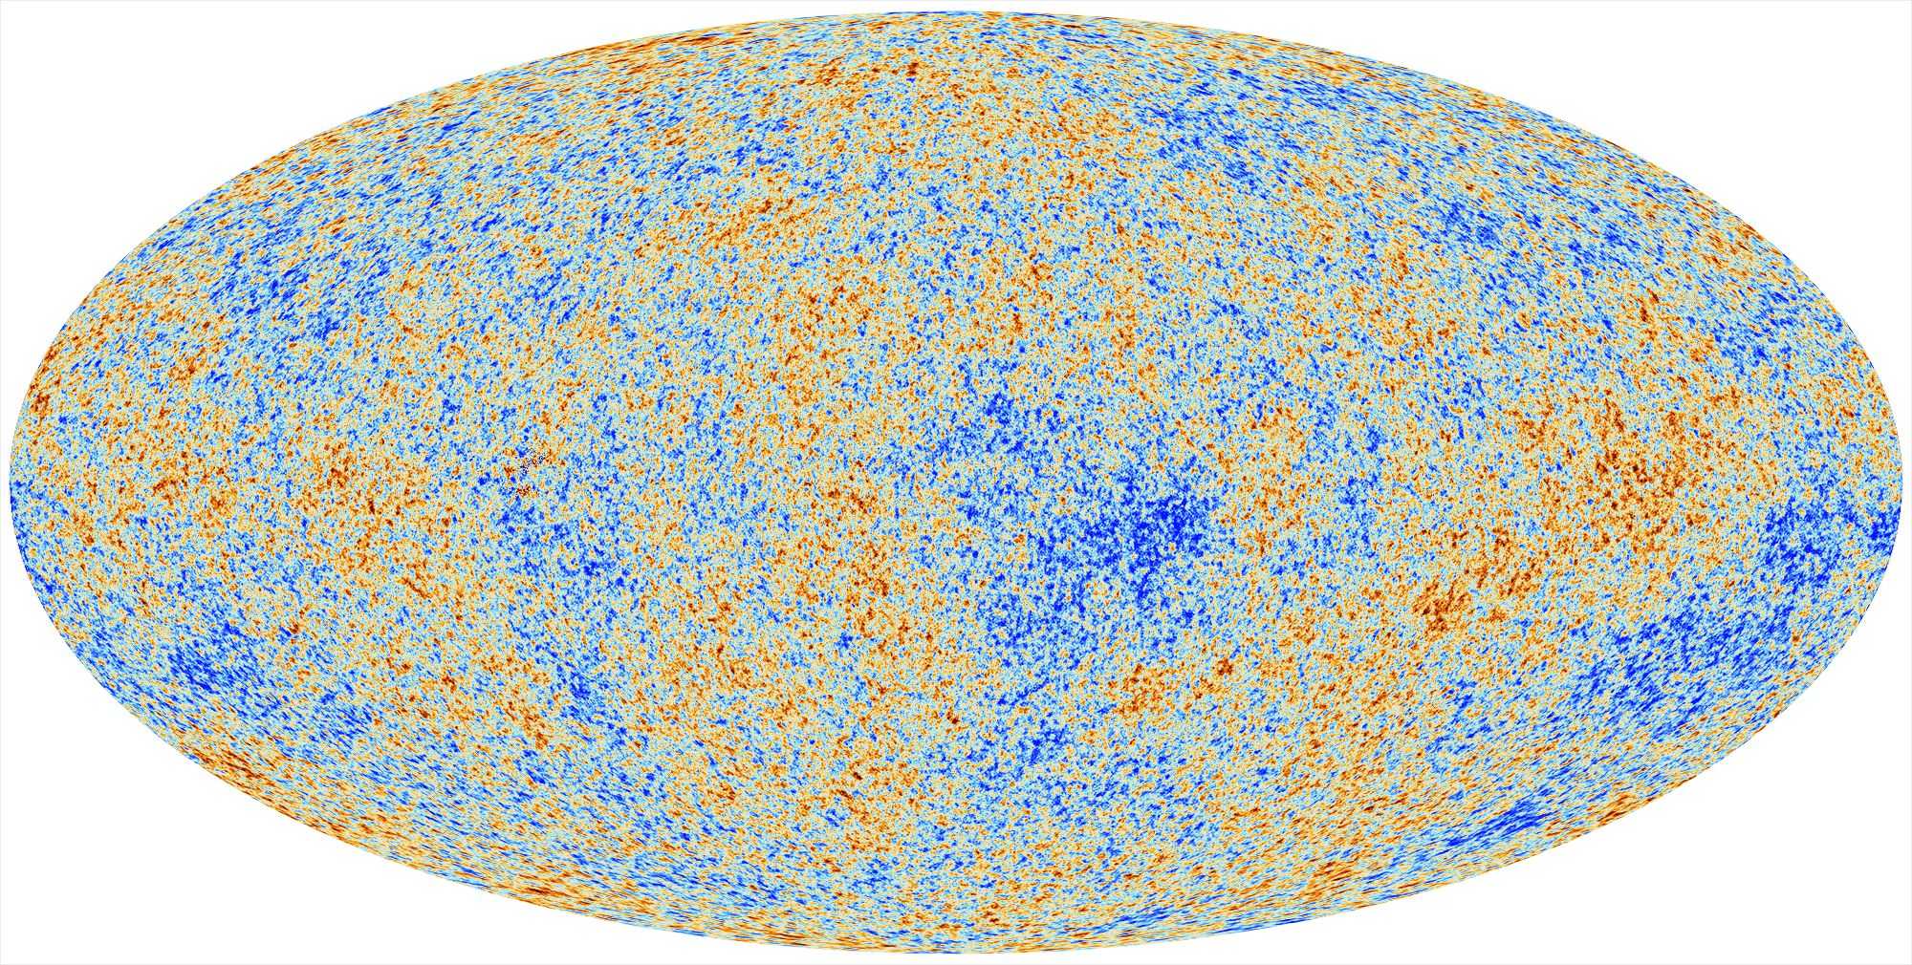

Our biggest trove of clues: the Cosmic Microwave Background (CMB) can be thought of as an “echo” of the Big Bang.
Literally, an ultrasound of the universe when it was a baby!
In the form of a background of microwave radiation.
400 CMB “photons”/${cm}^{3}$ permeate all of space.
Approximately 1% of the static on your TV set is from this echo!
The CMB is the same temperature in every direction you look, but for tiny fluctuations of 1 part in 100,000.
Snapshot of when the universe cooled enough so that light broke free from matter at t = 378,000 y.
Courtesy PLANCK Collaboration 2013

Slide 12
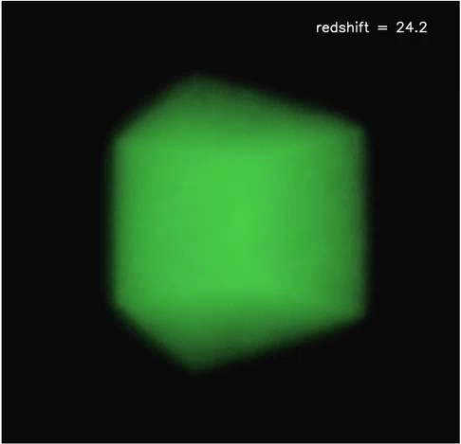
In the CMB, we’re seeing the initial seeds around which structures at the largest scales eventually coalesced.
Courtesy of Dr. Matthias Hoeft ,
Thüringer Landessternwarte, Tautenburg

Slide 13
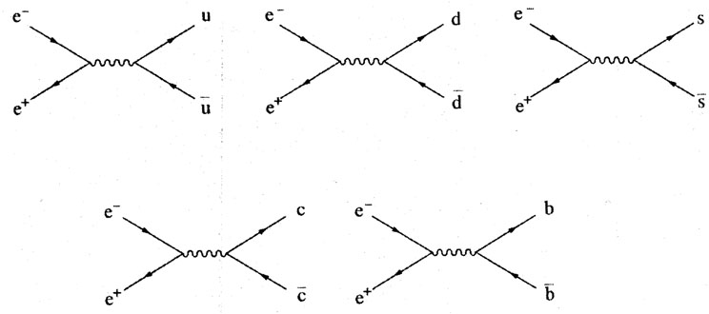
What caused these primordial fluctuations? Where did all the stuff that makes up everything come from? How did the universe even begin?
The Big Bang is premised to have been preceded by a phase of primordial inflation--
a phase of rapid (exponential) expansion of space time.
Once inflation ends, it violently dumps all of its energy into all the particles it can, resulting in what we observe today the Big Bang.
The quantum mechanical fluctuations of the inflaton field caused the primordial plasma into which it dumped its energy to be hotter in some places, and colder in others.

Slide 14
The inhomogeneities of the CMB are a snapshot of the acoustic excitations of the primordial plasma at t = 378,000 y.
By studying the harmonics of these acoustic excitations, we learn (though their amplitude and phases):
What the universe is made up of: 73% dark energy, 23% dark matter, 4% visible matter.
Its geometry (almost “flat”)
Its seed perturbations almost “scale free”, just as predicted by the simplest models of inflation.
How does one even accomplish this?
Is this all we can know? Is there anything else lurking in the data?
Courtesy PLANCK Collaboration 2013

Slide 15
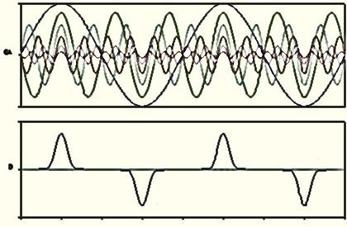

“Can One Hear the Shape of a Drum?”
-- Mark Kac
Every sound you hear can be decomposed into
a series of constituent harmonics.
Musicians know this as “Additive Synthesis”, scientists, as “Fourier Decomposition”, your ears, as “Hearing”.
By analyzing these harmonics, you can learn about the material properties of whatever is making the sound.
Can hear the shape of the bell and its material properties!
In reality, any sound is made up of a continuum of harmonics (and phases).

Slide 16
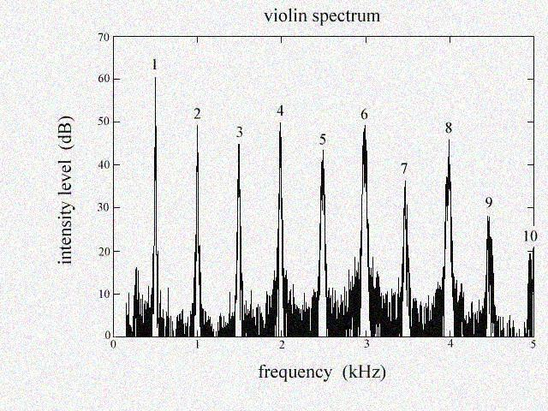
Middle A ~ 440 Hz
Courtesy H.T. Stokes
Brigham Young University

Slide 17
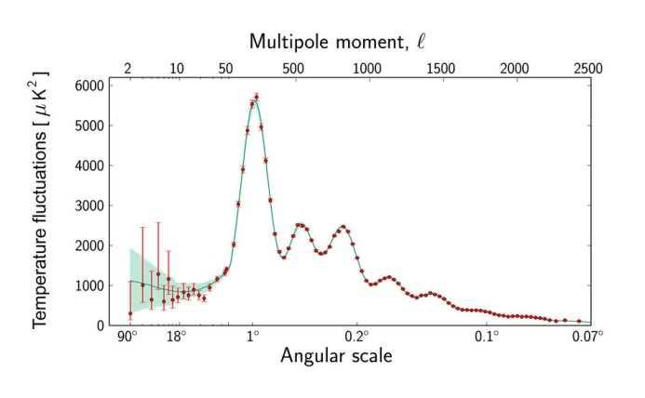
We can generalize this “Fourier analysis” to the sphere, and decompose the acoustic excitations of the CMB last scattering surface into its “spherical harmonics”:
Courtesy PLANCK Collaboration 2013

Slide 18
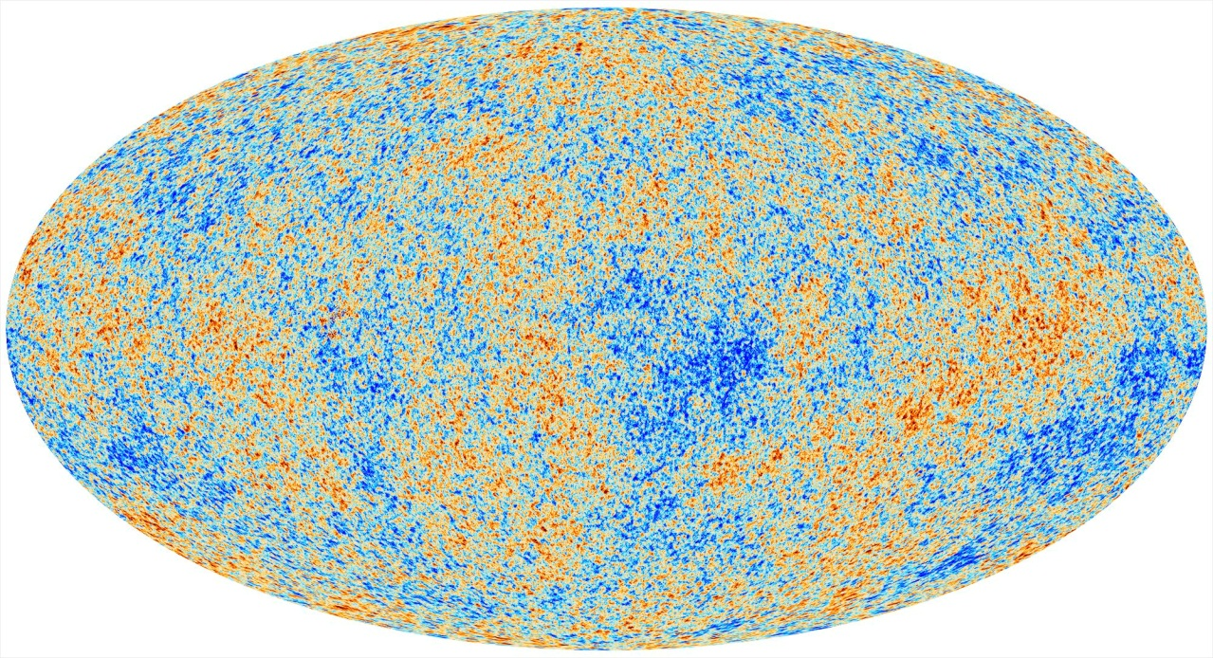
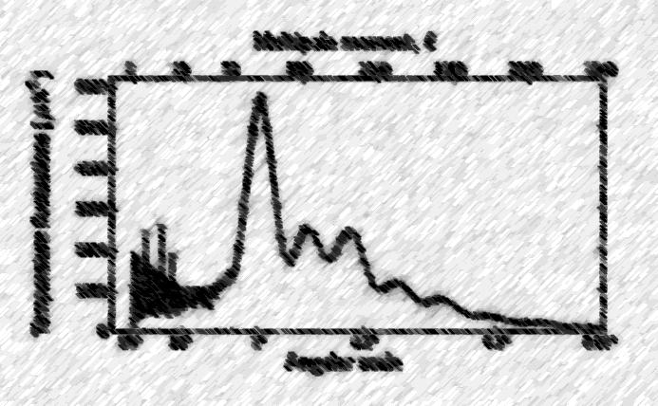
We disentangle the relative amplitudes of the constituent harmonics and their relative phases.
From these, we infer the speed of sound of the primordial plasma.
Can deduce what the universe is made up of and what its initial conditions were.
Courtesy PLANCK Collaboration 2013

Slide 19
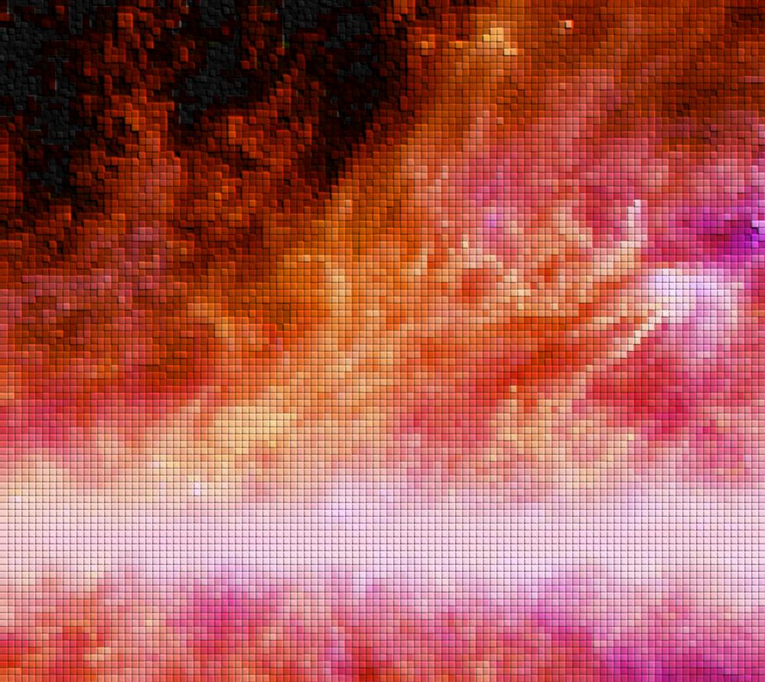

We find spectacular confirmation of the so-called standard model of cosmology– the six parameter Λ-CDM model.
The universe is 73% Dark energy, 23% Dark matter and only 4 % visible matter.
Almost “scale free” in its primordial perturbations.
Generated at energies as high as $10^{15} GeV$.
Widely accepted as confirming the predictions of the simplest models of inflation.
… with absolutely no hints (so far) of the details of the fundamental theory that inflation exists in.
What would these hints, if they were there, even look like?
Might these already be lurking in the data?

Slide 20
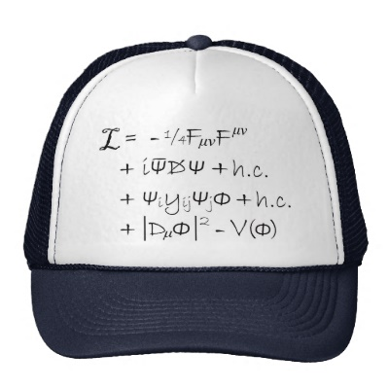
A lot of current research involves adapting a very powerful tool from high energy particle physics to search for “beyond the standard model” physics in the context of cosmology.
Effective Field theory–
the systematization of parameterizing your ignorance…
generalized to time dependent backgrounds.
What works at LHC beyond the standard model searches, also works in cosmology…
With some interesting twists!
And some interesting analogs…

Slide 21
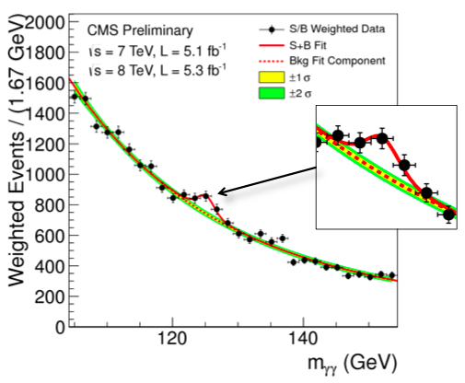
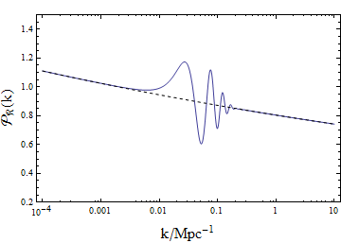
As inflation progresses, very heavy fields can influence the dynamics of its fluctuations, much more than you would normally expect*.
Manifest as transient reductions in the speed of sound during inflation.
Result in “bumps” in the spectral analysis of the CMB.
Can infer properties of the theory in which inflation lives by studying these bumps.
Correlate in a precise way with localized “non-Gaussian” features in the primordial perturbations.
If detected, could allow us to infer properties of the inflaton, possibly even falsify inflation itself.
Courtesy CMS collaboration
*Achucarro et al., ‘10 – ‘12
Burgess, Horbatsch, Patil, ‘12

Slide 22
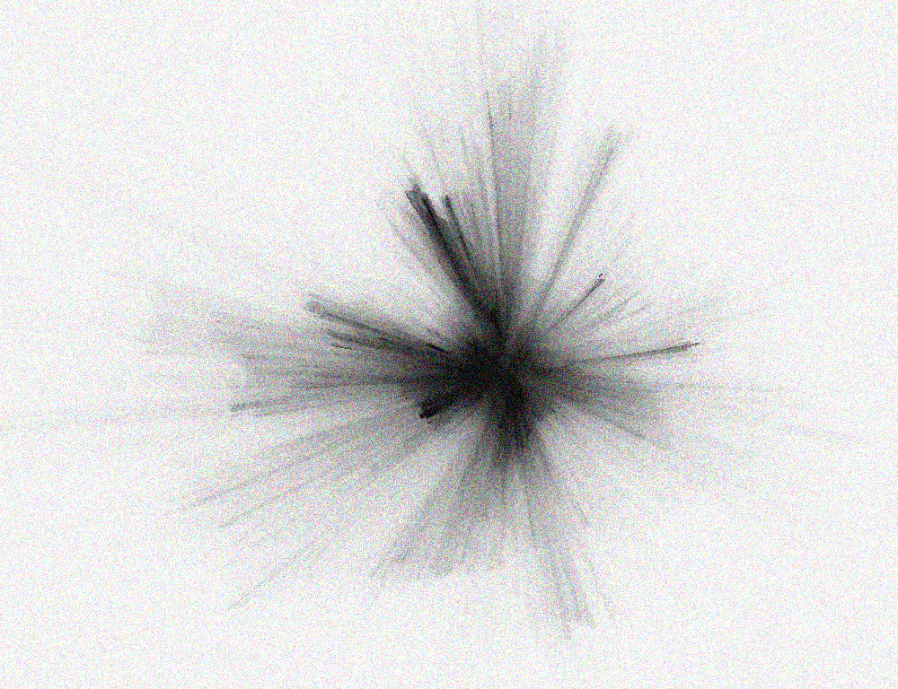
The CMB is but one possible window onto the early universe. Within a generation, we will have extracted all of its information content (polarization, `spectral distortions’, etc.)
We will also eventually map all possible large scale structures.
With `21 cm’ cosmology offering us a view into the universe before the first stars formed, we may be on the verge of an epoch where we have mapped the entire visible universe!
c.f. the early explorers vis a vis the earth.
What might we learn about the origins of the universe? Dark matter? Dark Energy?
Might there be new surprises in store for us?
A life is science is an incredible adventure.
Maybe some of you will be the ones that find the answers to our most vexing questions?

