Slide 1
FETS*-HIPSTER**
* Front End Test Stand
**High Intensity Proton Source for Testing Effects of Radiation
Chris Densham, Tristan Davenne, Alan Letchford (RAL),
Juergen Pozimski (Imperial College/RAL),
Steve Roberts (University of Oxford)

Slide 2
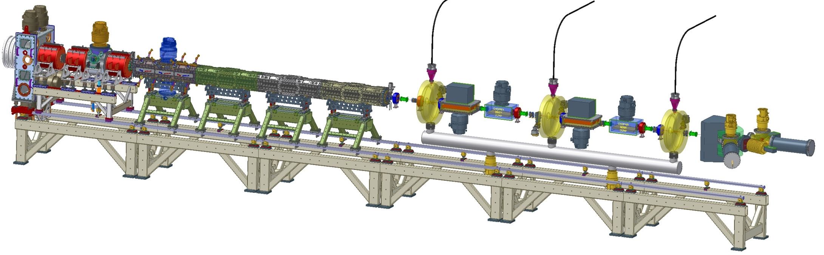











Front End Test Stand (FETS)
High brightness H– ion source
4 kW peak-power arc discharge
60 mA, 0.25 π mm mrad beam
2 ms, 50 Hz pulsed operation
Radio Frequency Quadrupole
Four-vane, 324 MHz, 3 MeV
4 metre bolted construction
High power efficiency
Diagnostics
Non-interceptive
Well distributed
Laser-based
Low Energy Beam Transport
Three-solenoid configuration
Space-charge neutralisation
5600 Ls⁻¹ total pumping speed
Medium Energy Beam Transport
Re-buncher cavities and EM quads
Novel ‘fast-slow’ perfect chopping
Low emittance growth

Slide 3
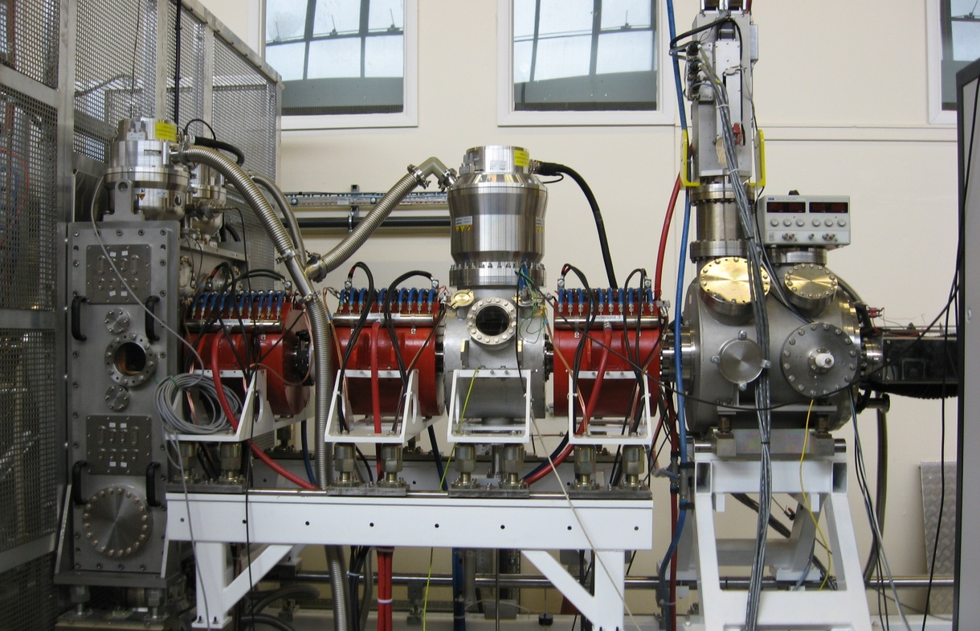
Front End Test Stand (FETS)
FETS is an accelerator test facility at RAL
HIPSTER is a potential application as a materials irradiation facility
FETS
Low Energy Beam Transport (LEBT)

Slide 4
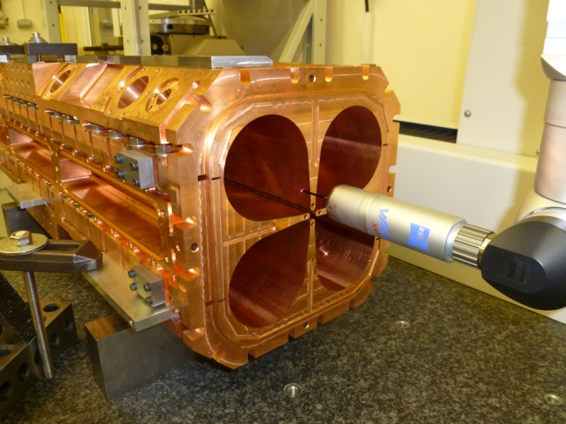
Front End Test Stand (FETS)
FETS is an accelerator test facility at RAL
HIPSTER is a potential application as a materials irradiation facility
FETS
Low Energy Beam Transport (LEBT)
RFQ

Slide 5
FETS-HIPSTER parameters
Proton beam energy = 3 MeV
Beam sigma = 21.2 mm i.e. FWHM = 50mm
Beam Pulse length = 2 ms
Beam Frequency = 50 Hz
Time averaged beam current = 6 mA
Current during beam pulse = 60 mA
Candidate materials for irradiation testing: Be, C, Ti, Steels, W

Slide 6
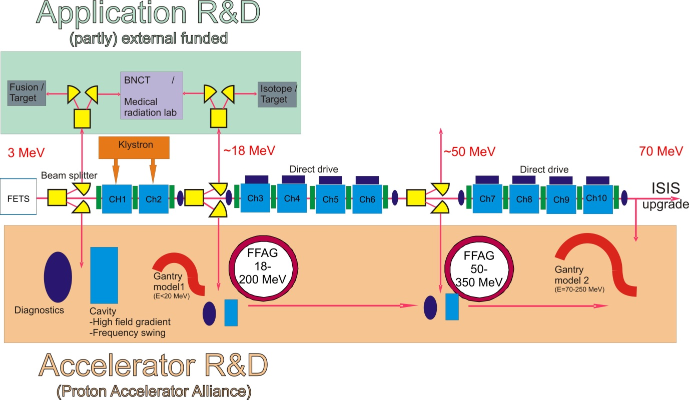
FETS Future and long term plans
It is the aspiration of the FETS team to develop a 5-10 year plan for the future expansion and exploitation of FETS.
Our bid for continuation contains some element of forward look as well as the primary goal of completing the current phase.
FETS continues discussions with the neutron, medical and fusion materials communities as well as active participation in the Proton Accelerator Alliance.

Slide 7
FETS-HIPSTER
Extension of the Front End Test Stand (FETS) would provide a high-intensity (6 mA, 3 MeV) materials irradiation facility
HIPSTER would be capable of studying:
  irradiation induced microstructural changes and mechanical properties
  ‘deep’ (~25 micron), near-uniform radiation damage to moderate levels within reasonable timescales (up to ~100 dpa per annum)
  High heat flux source (ref fusion divertor)
The downside(?): pulsed beam
  Good for accelerator materials testing
  Potential limitation for fusion/fission materials testing

Slide 8
HIPSTER outline
Beamline extension to transport beam from FETS -> HIPSTER
Material samples could be located in prototypic environments within a shielded target station
Remote handling facilities would enable transfer of material samples into shielded containers
Activated samples would be supplied to collaborating institutes for post-irradiation examination, for example the NNUF irradiated materials test facility at CCFE (Culham Centre for Fusion Energy)
Possible beam sharing with other applications

Slide 9
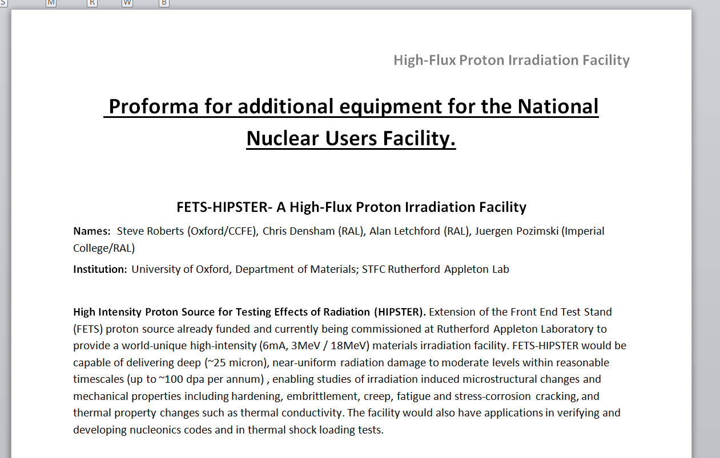
Proposal submitted to
UK National Nuclear Users Facility

Slide 10
HIPSTER c.f. other proton facilities
 | Energy | Proton current | Target area | T-range | Readiness | Notes
FETS-HIPSTER | 3 MeV fixed: upgradable to 15-18 MeV | 6mA average (60mA pulses, 10% duty cycle) | undecided, but up to 300mm diameter | 300 – 1000C likely | Accelerator being commissioned, target area to be designed & commissioned | protons only.
DCF | variable, <1 MeV – 10 MeV | 0.1mA | ~5cm diameter | Under development | Single beam now, dual beam in late 2015 | part of dual –beam facility. Can deliver any ion at micro-Amp current
Birmingham cyclotron | 11-39 MeV | 60 μA | Several cm? |  | Under construction | Max run time 6-10 hours – shared with isotope production.
Birmingham dynamitron | Up to 3MeV | 1 mA | Several cm? |  | Under construction | Long run times?
UK IBC, Surrey | up to 2 MeV | 3 μA (2x10^13 H/s) / 30 μA | Up to ~40cm diameter | Up to 900C | Operational
JaNNUS | up to 4 MeV (typically 2.5MeV on Yvette for H⁺) | 40 μA (2.5×10¹⁴ ions/s) | ~2.5cm diameter | up to 800C | Operational | Part of triple – beam facility.
HZDR | up to 6 MeV | 0.001 - 100 µA | Up to 10cm diameter? | up to 800C | Operational
IMBL, Michigan | 400 kV – 3 MeV | 1 nA – 50 μA | ~5cm diameter |  | late 2014. | Part of triple – beam facility.
MIAMI Huddersfield | 2- 100 kV | 10¹⁰ – 10¹⁴ ions/cm²/s | TEM foil |  | Operational | In-situ irradiation TEM

Slide 11
HIPSTER potential programme
Protons as surrogates for reactor neutrons
  Strong theoretical and experimental underpinning for required temperatures to generate required defect types, densities, hardening, precipitation, segregation…
  3 MeV protons can generate radiation damage at end-of-life dpa levels for fission reactors
  Deep enough penetration (~30 microns) to access ‘bulk’ mechanical behaviour:
  hardening, embrittlement, creep, stress-corrosion cracking, and thermal property changes such as thermal conductivity, Environmentally Assisted Cracking
Nuclear reaction/cross section data
  For secondary protons generated by fusion
  Useful for medical physics
Upgrade to 15-20 MeV attractive to mimic fusion neutrons

Slide 12
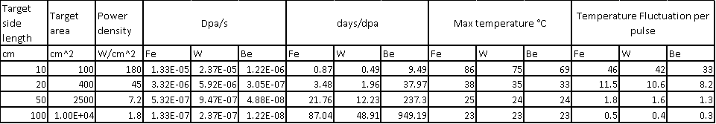
Summary of HIPSTER Simulations
A wide range of target area (beam spot size) have been considered.
SRIM calculations highlight that large dpa values are achievable even with the most blown up beam considered
The larger the beam the easier the thermal management issues are to deal with (but lower damage rate).
With a beam area of 2500 cm² the required cooling heat flux is easily manageable at 0.07MW/m², the predicted sample temperature fluctuation is less than 2K and yet 20 dpa/fpy in Tungsten is still possible.

Slide 13
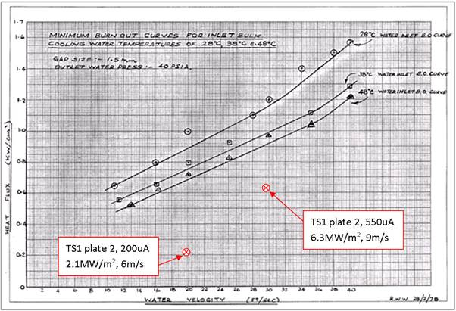
Heat Flux
For the range of beam size considered the required heat flux would be a maximum of 1.8MW/m², this is below the heat flux achieved in the ISIS Neutron target TS1 at RAL

Slide 14
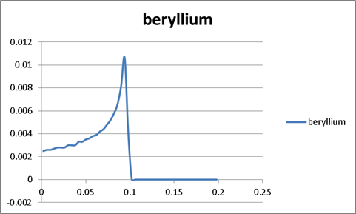
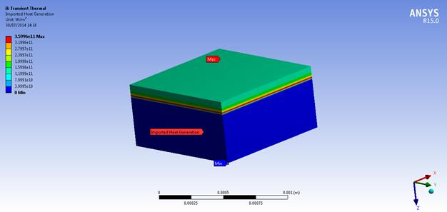
Example of energy deposition
beam stopped within 0.1mm in a beryllium sample

Slide 15
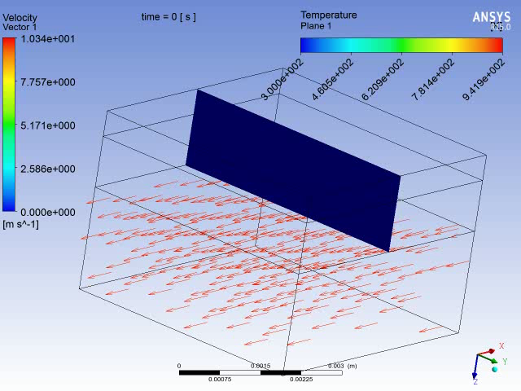
Thermal Management
Consider a 0.5mm thick 1cm x1cm irradiation sample attached to a water cooled aluminium back plate.
Significant pulse power density results in unsteady sample temperature with peak temperature and fluctuation depending on the sample material.
Click on image to see video of simulation

Slide 16
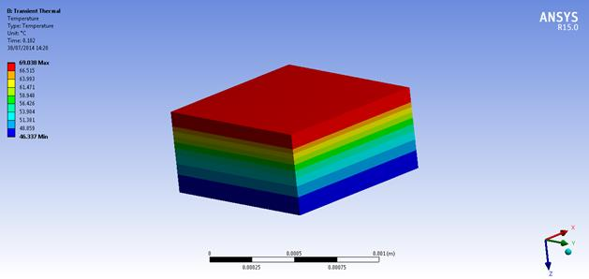
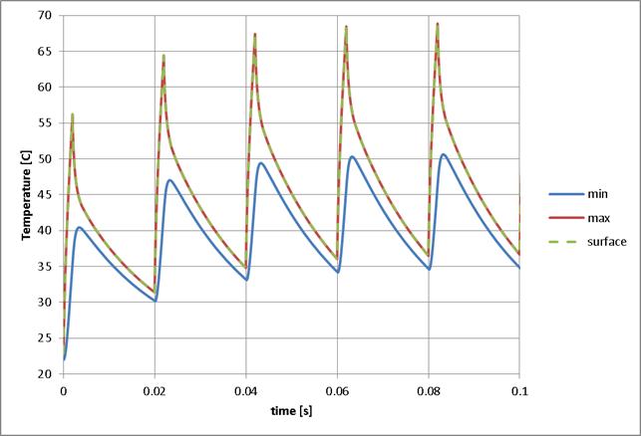
Pulsed thermal power deposition
Temperature immediately after beam pulse
Resultant temperature fluctuation depends on beam size
Conduction in the sample during the 2ms beam pulse affects peak temperature
Surface temperature similar to maximum temperature

Slide 17
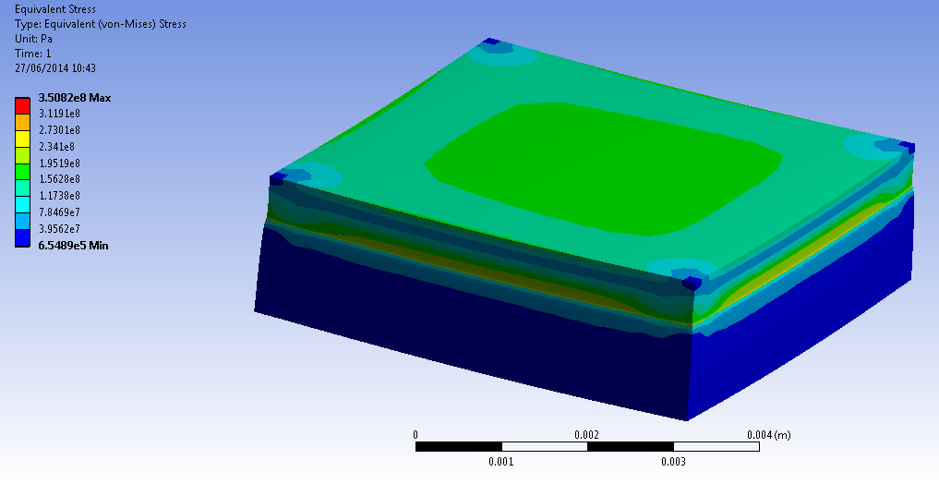
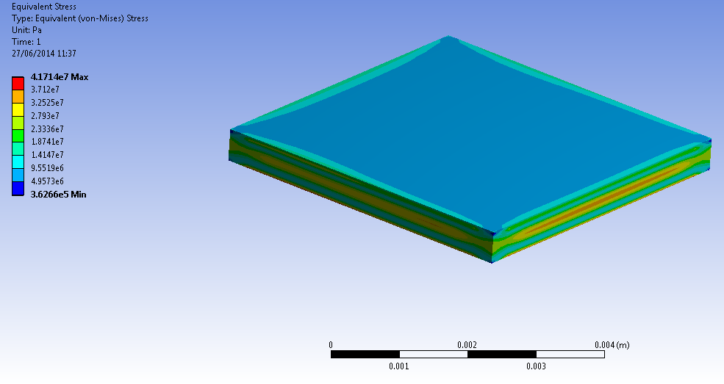
Induced Stress in Sample
High stresses arise with a focused beam on the sample especially if it is perfectly bonded to a cooled back plate
350MPa in 0.5mm thick beryllium sample bonded to aluminium cooled back plate heated by a focused FETS beam
Maximum temperature and stress in samples depends on beam size, sample shape, and attachment to cooled back plate.
42MPa in unbonded beryllium sample with focused beam

Slide 18
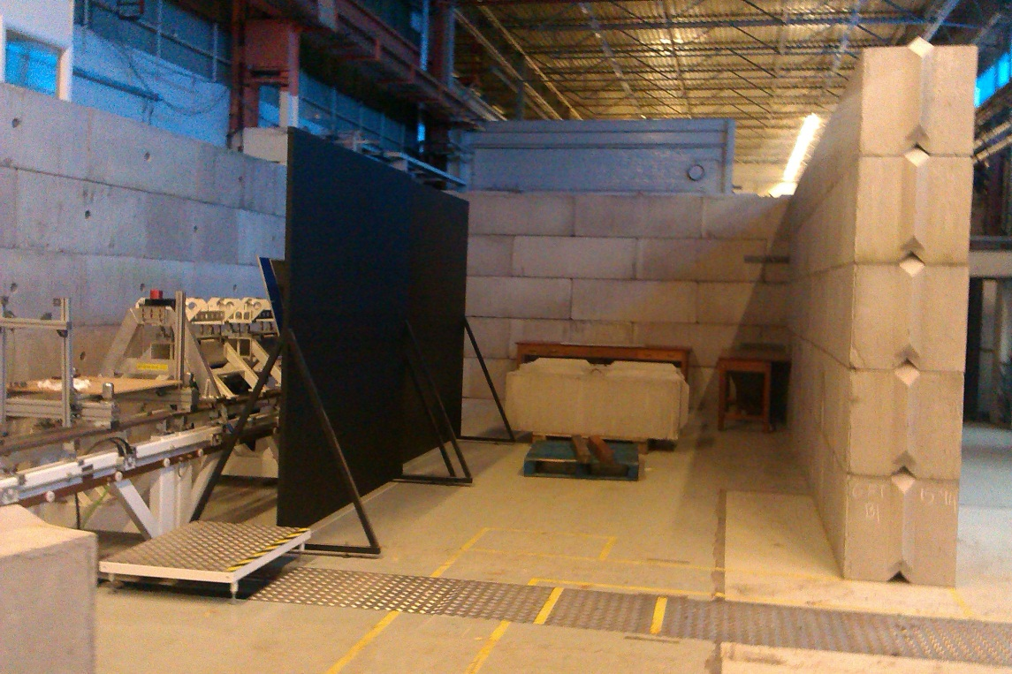
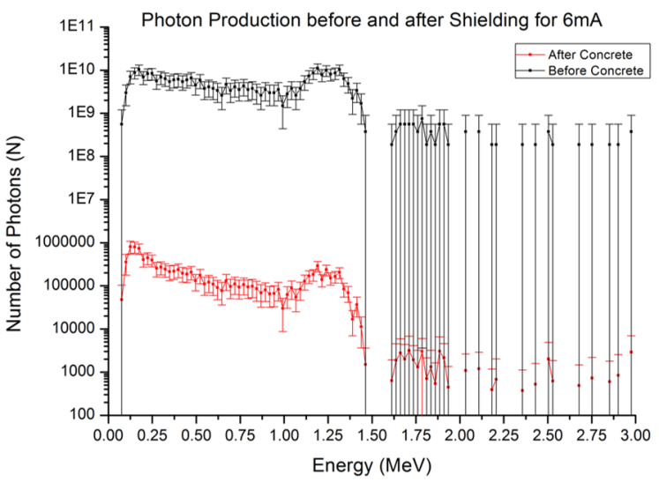
FETS radiation shielding
Shielding required for FETS aluminium beam dump
More shielding required for materials generating more activity

Slide 19
FETS-HIPSTER Summary
Can deliver beam currents in excess of any existing irradiation facilities
High dpa rates with manageable power density
Deep enough irradiation to access bulk material properties
Complementary e.g. to Birmingham Dynamitron
Complementary (and a LOT cheaper) than proposed future facilities (TRITON, DCF, FAFNIR, IFMIF…)
Proposal driven by fission and fusion materials community
Support from senior UK lab management (RAL and Culham)
On table for joint UK Research Council ‘fusion for energy’ strategy
Proposal submitted to NNUF in July 2014

