Slide 1
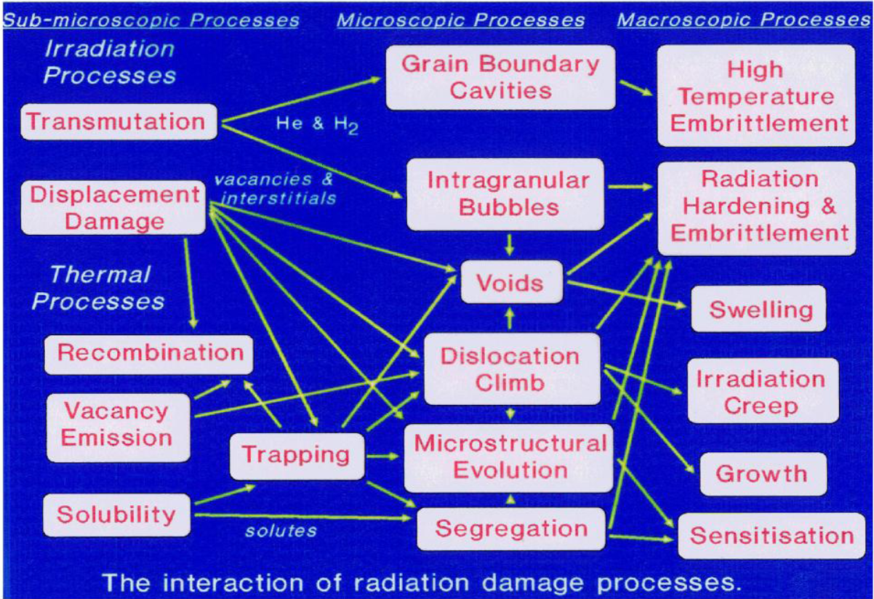
Radiation damage in Materials
C.A. English (2011)

Slide 2
Transmutation

Slide 3
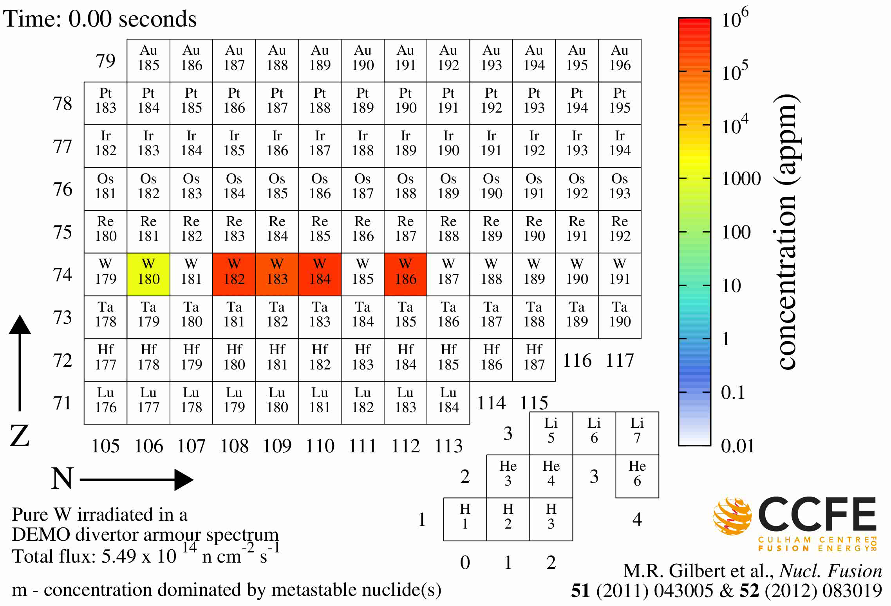
Tungsten Transmutations in Fusion Reactor

Slide 4
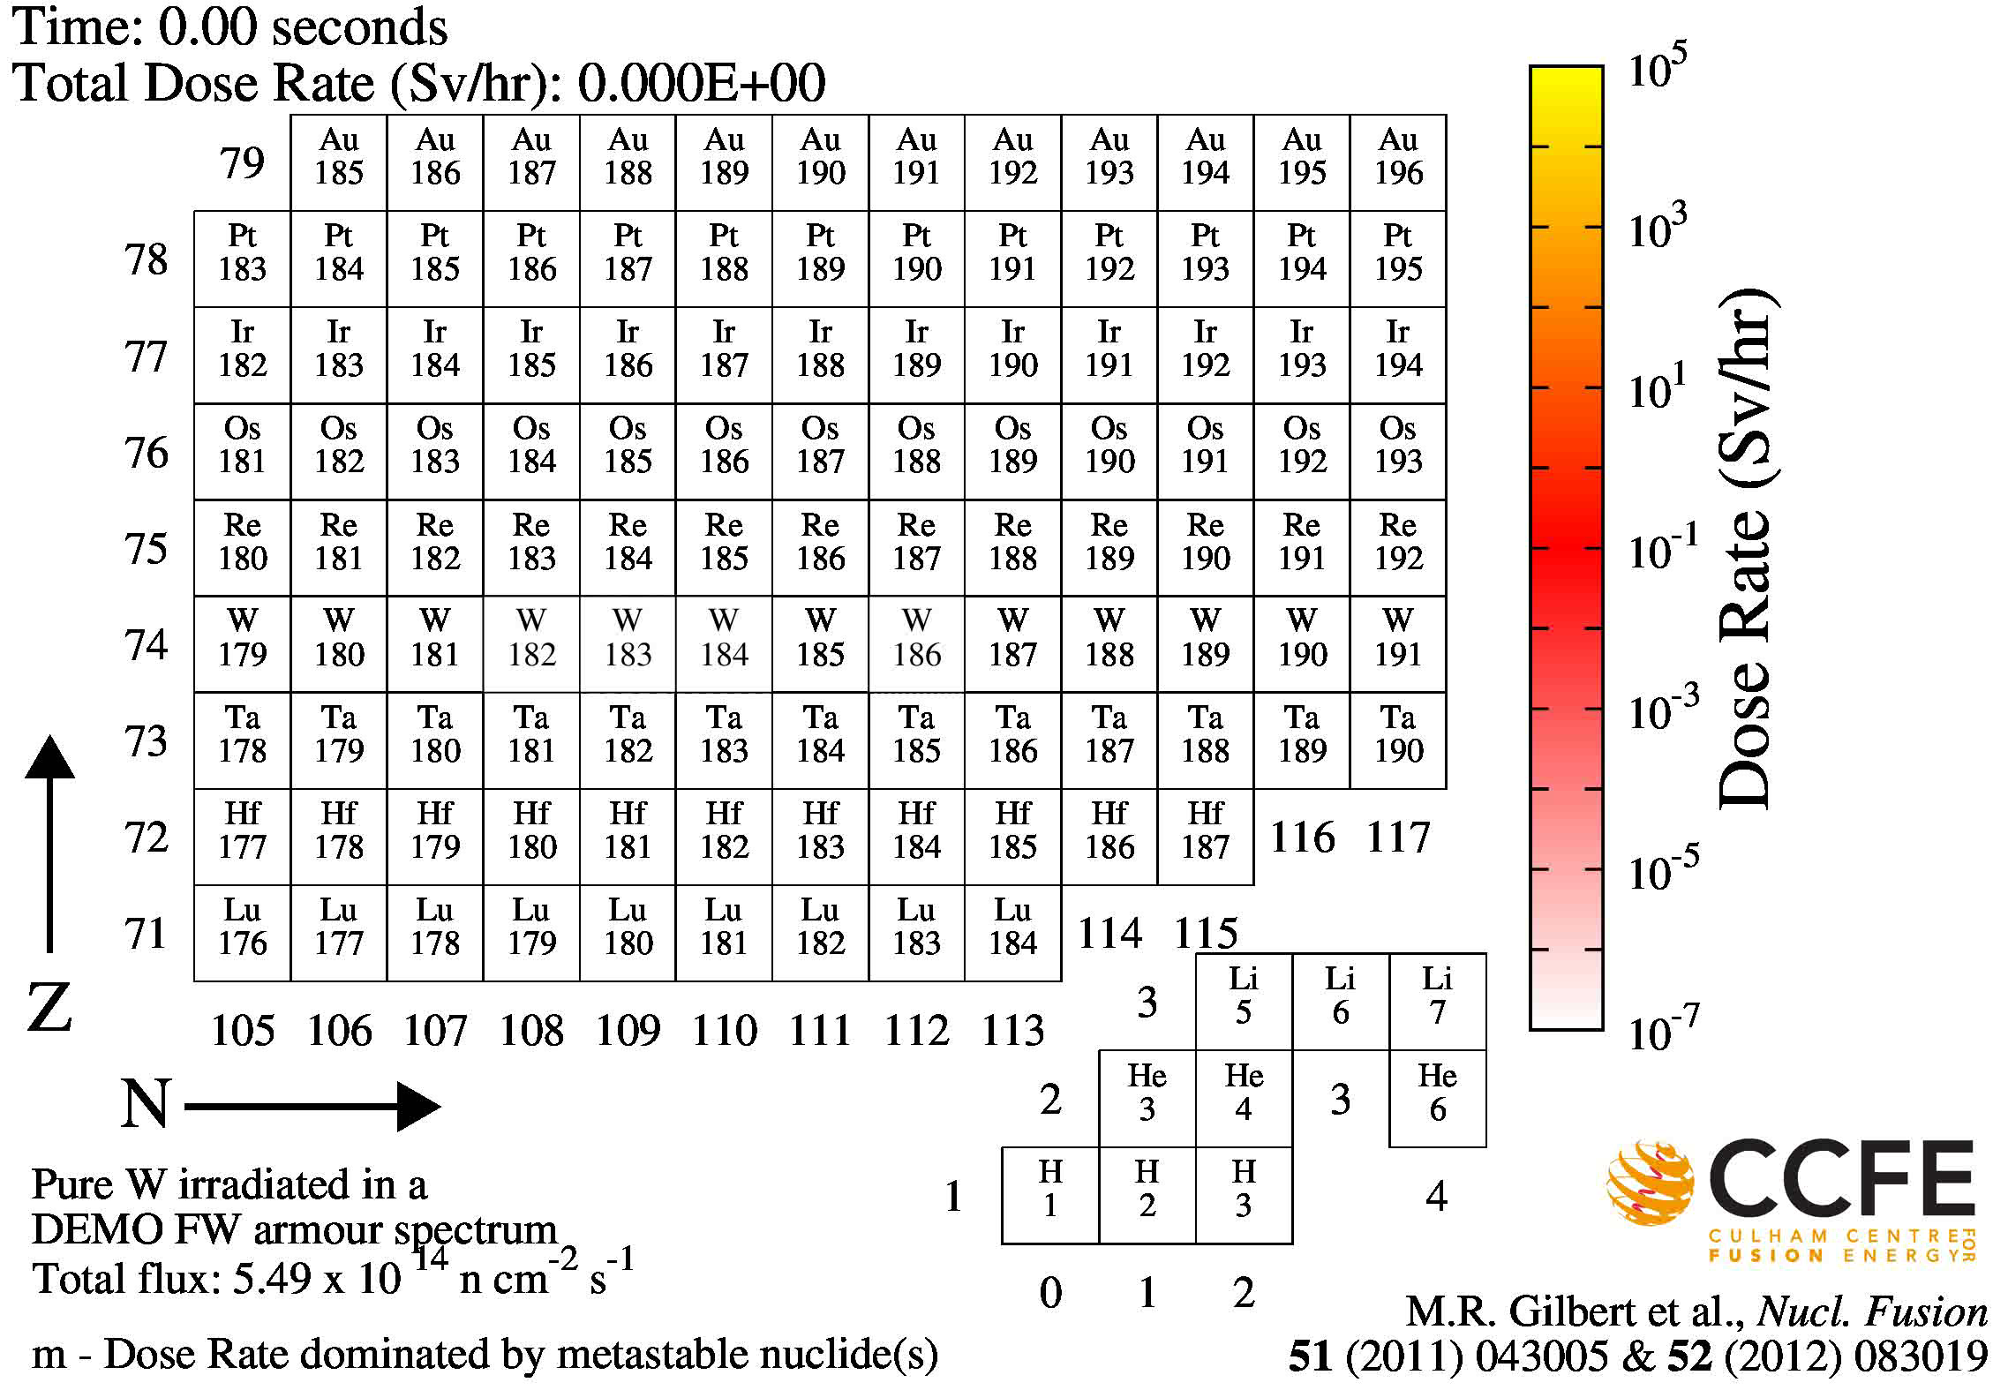
Tungsten Transmutations - activity

Slide 5

Tungsten transmutation in fusion power reactor

Slide 6
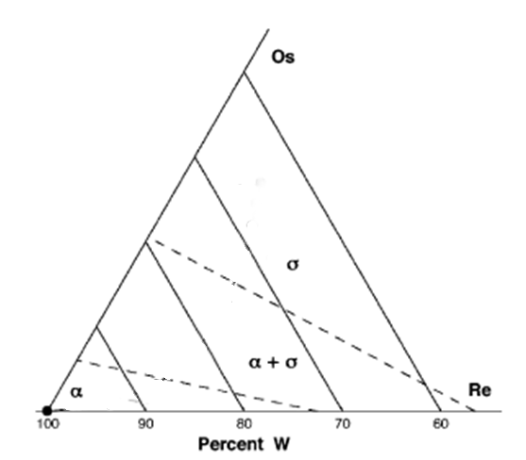
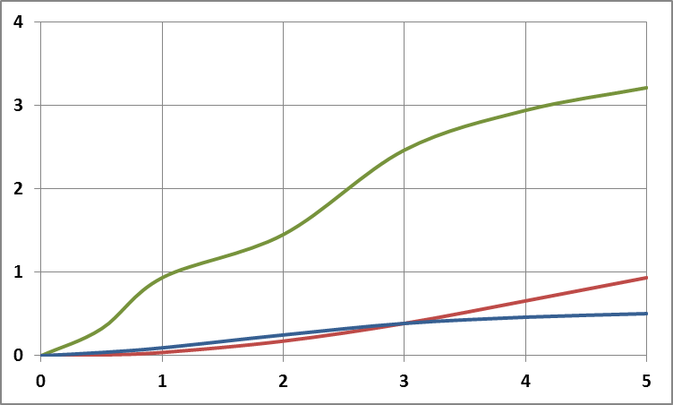
Tungsten transmutation in fusion power reactor
Os
Re
% Transmutant
Os
5yr
Re
Ta
W
Reactor Full Power Years

Slide 7
Tungsten transmutation in fusion power reactor
Ion irradiation can’t mimic transmutation effects
But we can MODEL what transmutations we expect
And can ion-irradiate pre-made W alloys
To see what effect displacement damage -
(and if we like, He, H )
have on microstructures and properties.

Slide 8
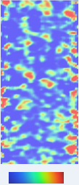
Radiation-induced clustering in alloys
W- 5%Re should be a stable solid solution
… but it’s not when it is irradiated
Under Fusion Power Reactor conditions,
pure W transmutes to give 5%Re in ~ 7 years.
8%
5%
Ion irradiation to 2.64 x 10¹⁵ W⁺/cm² (33dpa) Dose rate: 3.57 x 10⁻⁴ dpa / s
Temperature: 300°C
A. Xu (Oxford) unpublished 2013
Notes:
NB – DEMo - 50-80 dpa per FPY at divertor, ITER, ~1dpa / FPY.

Slide 9
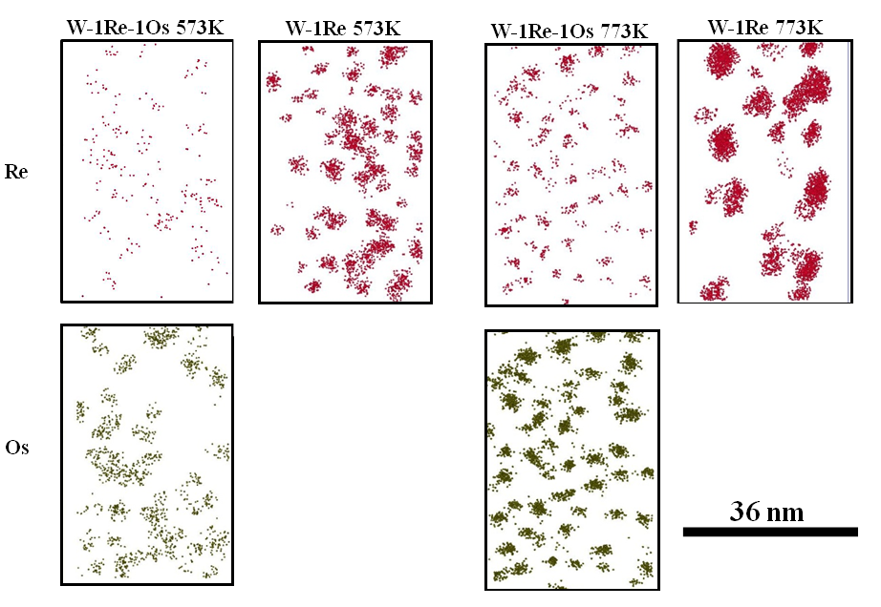
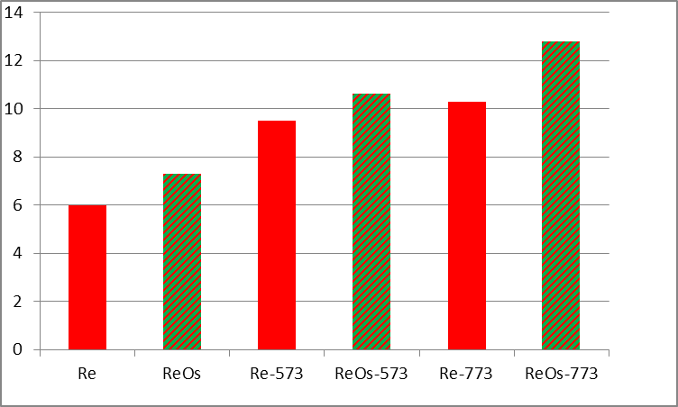
Clustering and Hardening in “Transmuted” W
573 K
773 K
Re
W 1%Re
W 1%Re 1%Os
2MeV W+
33dpa
FIB-lift-out
Nanoindentation hardness (GPa) (100nm depth)
Os
35nm
Preliminary analysis indicates that the clusters are very weak obstacles:
Φ_{c} ≈ 85°
But there are lots of them, very closely spaced
especially in W-Re-Os
Same would apply to neutron irradiation ???
A. Xu, D.E.J. Armstrong (Oxford) K. Rajan (Iowa State) unpublished 2014
Notes:
Thanks to Krishna Rajan,

Slide 10
Transmutation gases

Slide 11
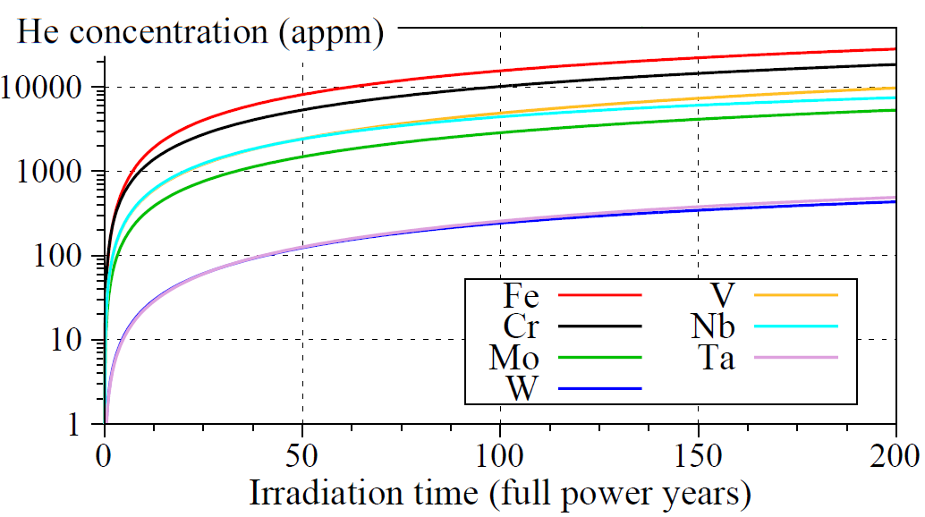
Transmutations producing He in fusion power reactor

Slide 12
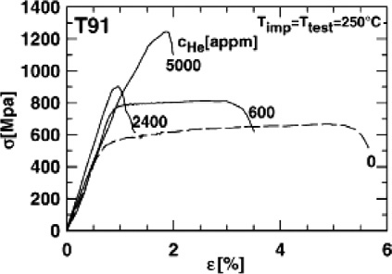
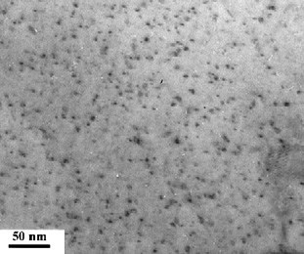
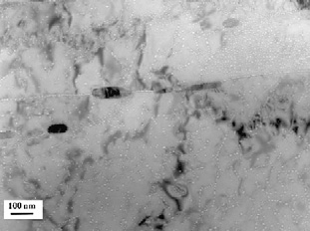
Effects of Implanted He on T91 steel
Fracture surface
He –V nanoclusters
He g.b. bubbles
“Uniform implantation of 23 MeV α-particles up to 5000 appm at 250°C carried out at the compact cyclotron of Forschungszentrum Jülich (FZJ)”
J.-L. Boutard et al. C. R. Physique 9 (2008) 287–302
P. Jung, J. Henry, J. Nucl. Mater. 318 (2003) 241–248 & 249–259.

Slide 13
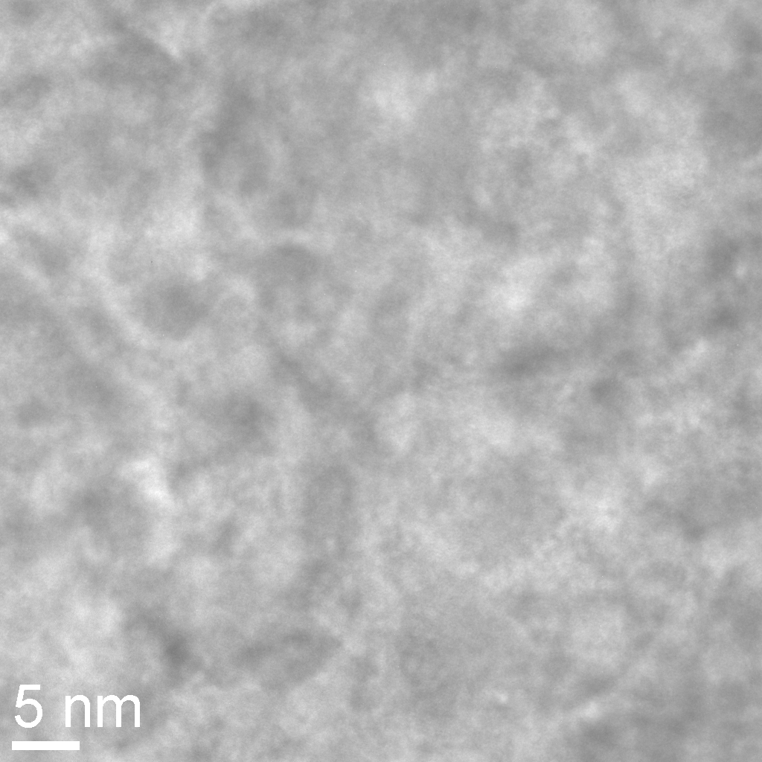
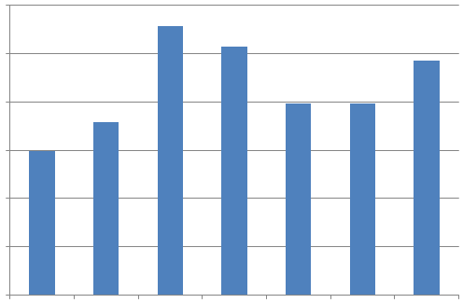
Tungsten – Hardening by Displacement Damage and Helium
12
Hardness
(GPa)
10
8
6
4
2
dpa
0.003
0.03
0.4
13
13
13
dpa
appm He
300
3000
3000
300
3000
appm He
Polycrystalline W 99.99% pure, sequentially ion-implanted with W⁺ and He⁺ at 300°C
W implantation depth 0 - 200nm; He implantation depth range 0 - 2500 nm
Hardness data at 100 nm indenter depth .
C. Beck & D. Armstrong (Oxford) unpublished 2013

Slide 14
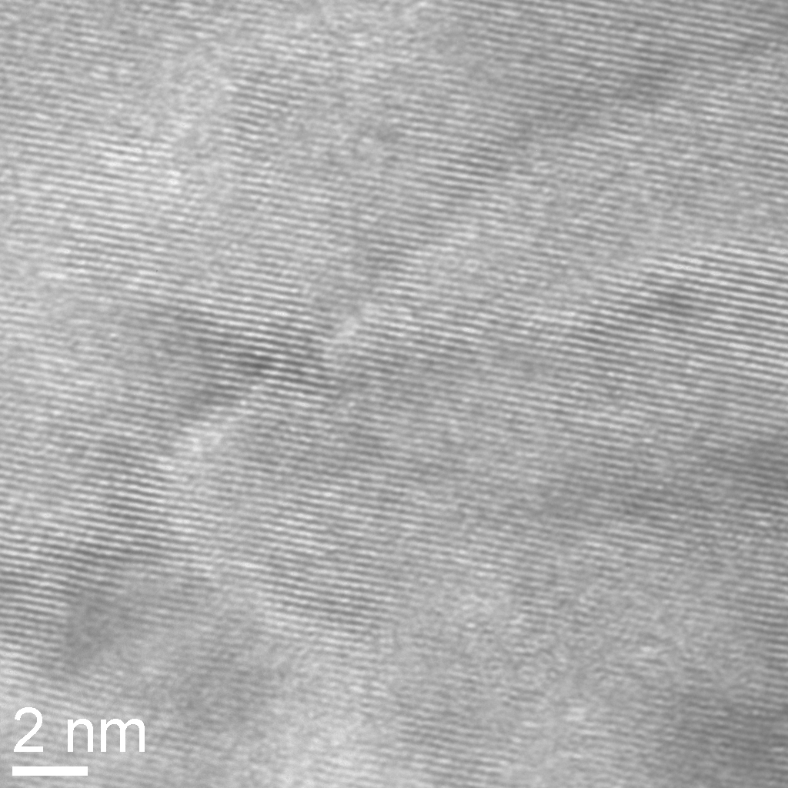
Tungsten – Hardening by Displacement Damage and Helium
12
Hardness
(GPa)
10
8
6
4
2
dpa
0.003
0.03
0.4
13
13
13
dpa
appm He
300
3000
3000
300
3000
Polycrystalline W 99.99% pure, sequentially ion-implanted with W⁺ and He⁺ at 300°C
W implantation depth 0 - 200nm; He implantation depth range 0 - 2500 nm
Hardness data at 100 nm indenter depth .
C. Beck & D. Armstrong (Oxford) unpublished 2013

Slide 15
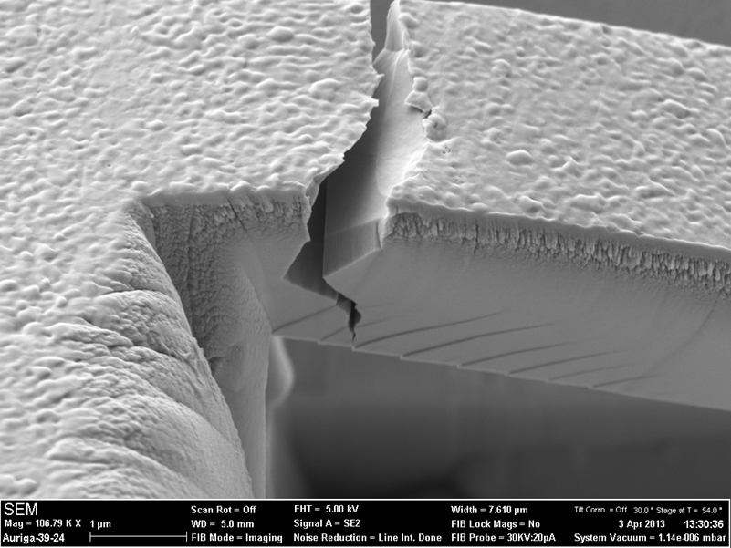
Tungsten – Embrittlement by Displacement Damage and Helium
Irradiation | Fracture ?
none | 0 / 7
1.7 dpa W¹²⁺ | 1 / 16
600 appm He | 0 / 13
1.7 dpa W¹²⁺ + 600 appm He | 7 / 10
Polycrystalline W 99.99% pure, ion-implanted with W¹²⁺ (36MeV) and He⁺ at 800°C
W + He simultaneously implanted
W implantation depth ~2.5 μm; He depth range ~ 2.8 μm
Fracture data from microbeams 3 μm deep .
J. Gibson & D. Armstrong (Oxford) unpublished 2013

Slide 16
“Damage”

Slide 17
Elastic scattering of neutrons
…. What about the “target” atoms?
 | E_{d} |  | E_{d} |  | E_{d}
Al | ~32eV | Fe | ~24eV | Si | ~13eV
Cu | ~25eV | W | ~40eV | C (graphite) | ~25-60eV
Fusion neutrons are ~14MeV !

Slide 18
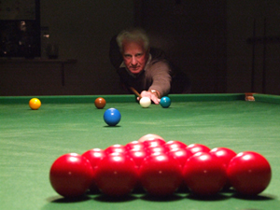
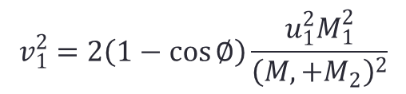

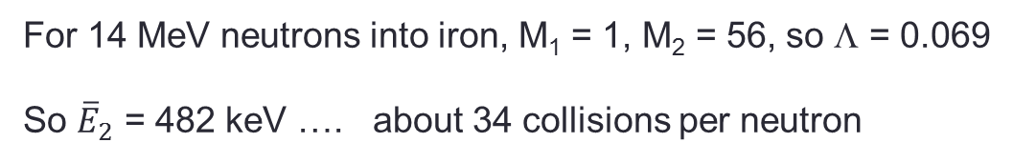
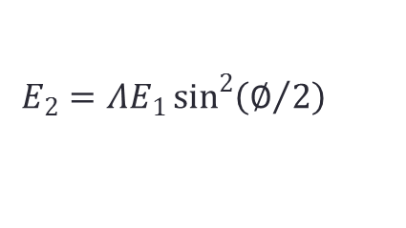
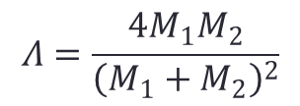
Elastic scattering of neutrons
M₁,v₁
M₁,u₁
φ
M₂
v₂
$$v_{1}^{2}=2\left(1−\cos{∅}\right)\frac{u_{1}^{2}M_{1}^{2}}{{\left(M,+M_{2}\right)}^{2}}$$
$$Λ=\frac{4M_{1}M_{2}}{{\left(M_{1}+M_{2}\right)}^{2}}$$
$$E_{2}={ΛE}_{1}\sin^{2}\left(∅/2\right)$$
$${\overline{E}}_{2}={ΛE}_{1}/2$$
For 14 MeV neutrons into iron, M₁ = 1, M₂ = 56, so Λ = 0.069
So ${\overline{E}}_{2}$ = 482 keV …. about 34 collisions per neutron

Slide 19
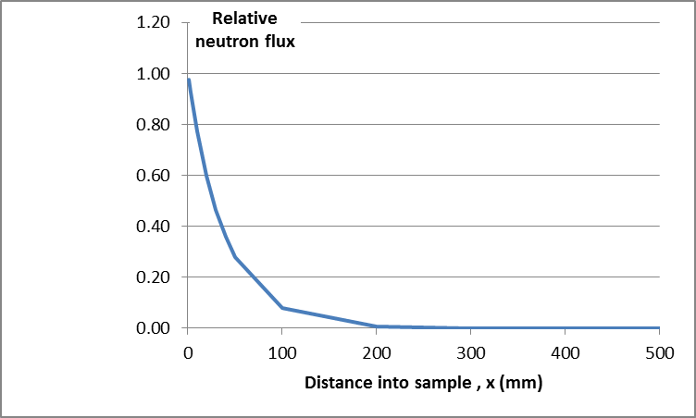

Elastic scattering of neutrons
N nuclei/m³
I₀
I
x
$$I=I_{0}\exp\left(−Nσx\right)$$
For σ = 3.2 barns,
N = 8x10²⁸ m⁻³
Neutrons penetrate in Fe to 100 – 200 mm
If ~ 30 collisions over this depth, and “random walk”,
Spacing between neutron collisions is ~ 10 - 20mm
M₂

Slide 20
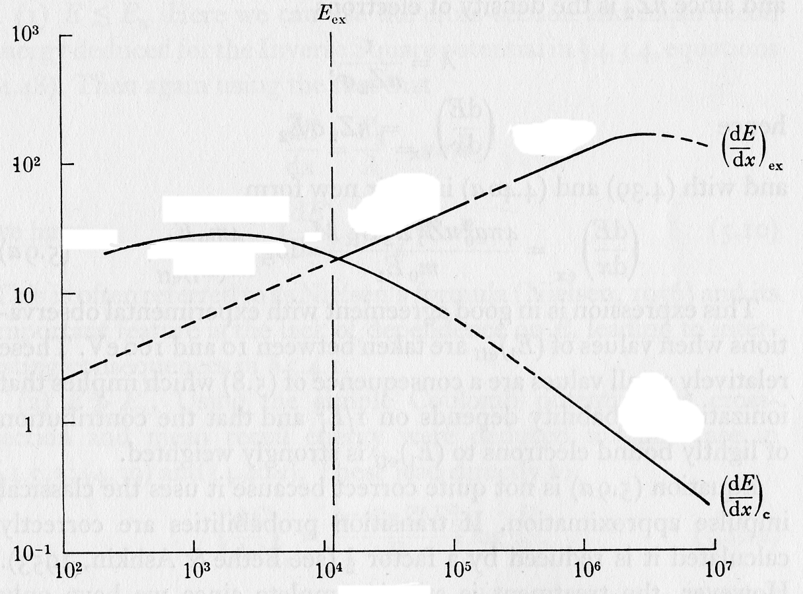
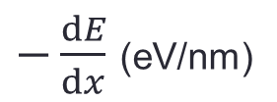
The collision cascade
Energy loss from C ions in graphite
$−\frac{dE}{dx}$ (eV/nm)
E_{ex}
1000
electronic
At high energies, ions lose energy mostly by electronic excitation
At low energies, ions lose energy mostly by collisions
100
collisions
10
E_{ex} (keV) ~ M₂ (a.m.u.)
1
0.1
1
10
100
1000
10000
Ion energy (keV)

Slide 21
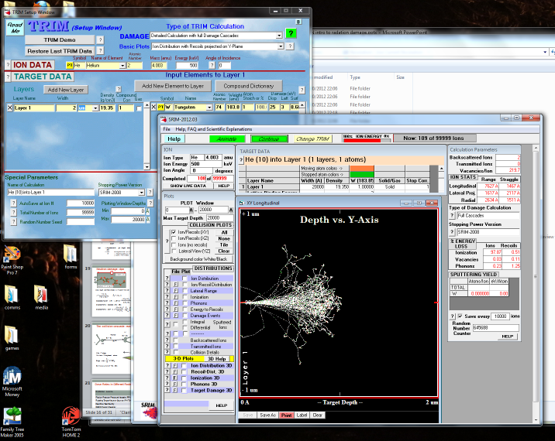
SRIM / TRIM
http://www.srim.org/

Slide 22
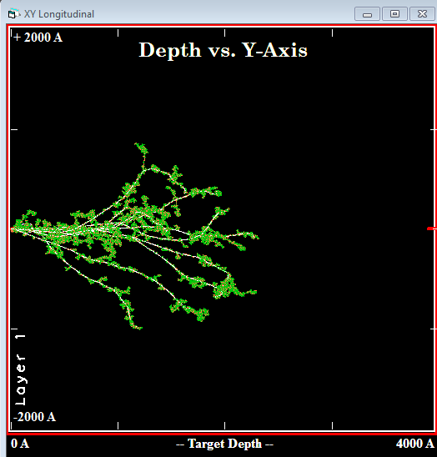

The collision cascade
Tracks of ten 482keV Fe ions in Fe target.
“Consequent events” show in red and green.
Note long gaps between sub-cascades, and randomness of process.

Slide 23
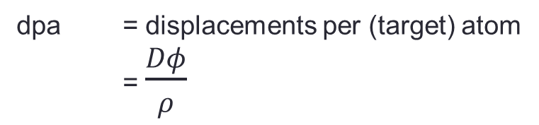
Ion irradiation: dpa
Displaced target atoms vs depth
Unit: Number / (Å – ion) (!)
4
2
0
Depth
400nm
750 ion tracks:
482keV Fe ion in Fe target
0
0
Depth
400nm
Here: Fe ions into Fe
D: ~ 4.5 at peak
ρ: 8x10²⁸m⁻³
φ: typically 10¹⁸ m⁻² (10¹⁴cm⁻²)
= 0.56 dpa
dpa = displacements per (target) atom
= $\frac{Dφ}{ρ}$
D: displacements / (m – ion)
φ: irradiating particles / m^2
ρ: atoms / m^3 in target

Slide 24
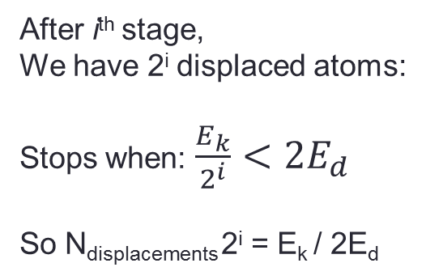
The collision cascade: evolution after initiation
i=3
i=….
i=2
i=1
“Thermal”
E₂ < E_{k}
E₂ > E_{k}
E₂ ⬇
n
pka
“Displacement spike”
After i^{th} stage,
We have 2^{i} displaced atoms:
Stops when: $\frac{E_{k}}{2^{i}}<2E_{d}$
So N_{displacements} 2^{i} = E_{k} / 2E_{d}
A few 100 nm
Interstitial-rich shell
Vacancy-rich core

Slide 25
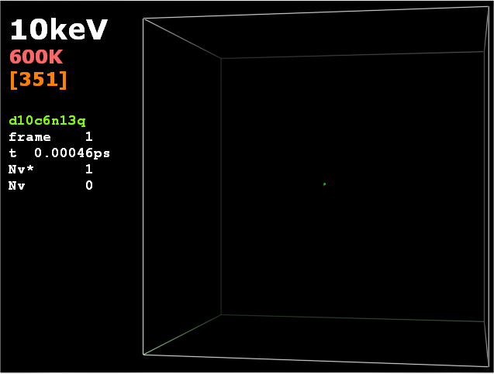
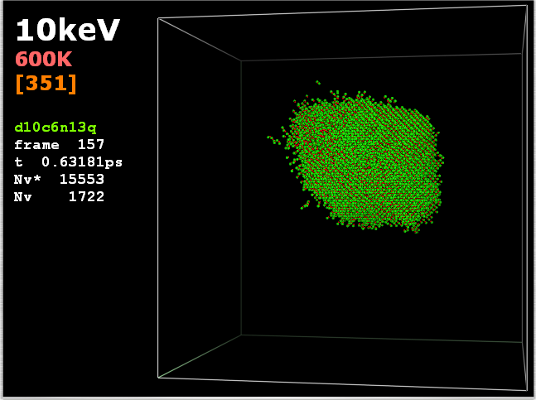
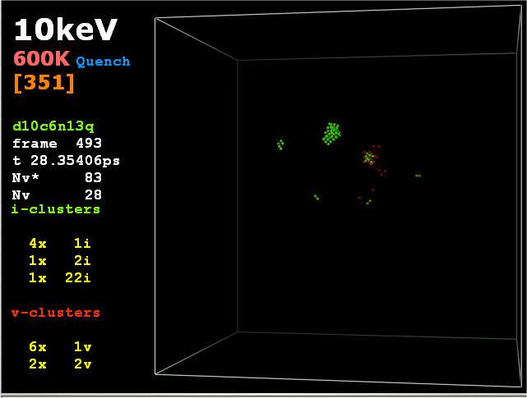
The collision cascade: evolution after initiation
n
“Molecular dynamics” simulation: up to 30 ps.
Only the out-of-place atoms are shown –
vacancies in green; self interstitials in red.
Started by a low-energy collision (10keV ion):
end of cascade branch.
10 keV < E_{ex},
so N_{displacement} ~ 10000/25 = 400
D. Bacon, Y. Osetsky, U. Liverpool

Slide 26
Radiation ➔ dislocation loops
Missing sheet of atoms
Dislocation loop

Slide 27
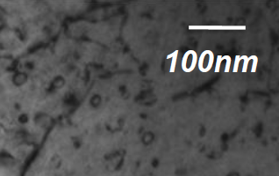
Radiation ➔ dislocation loops
Iron, ion-irradiated to 2.5 dpa at 300°C

Slide 28
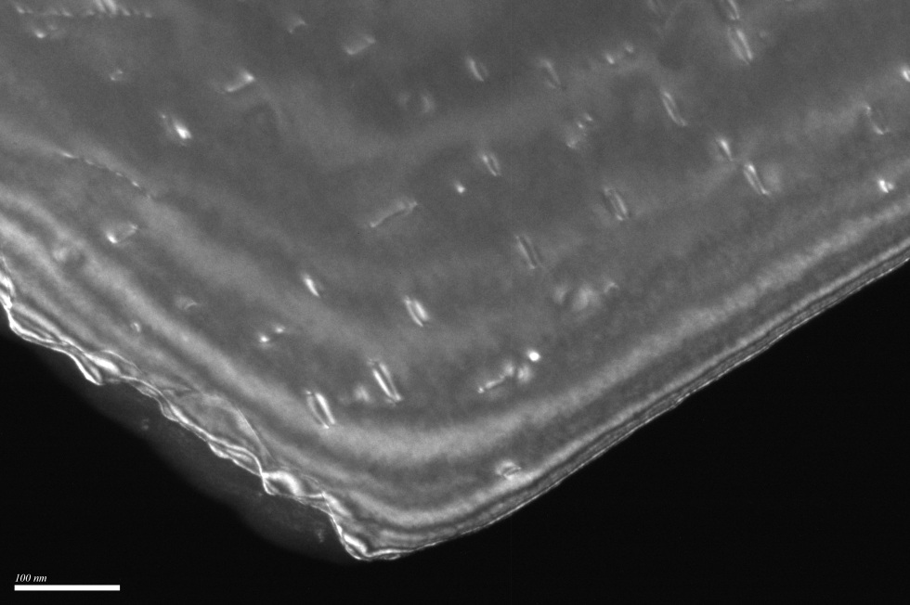
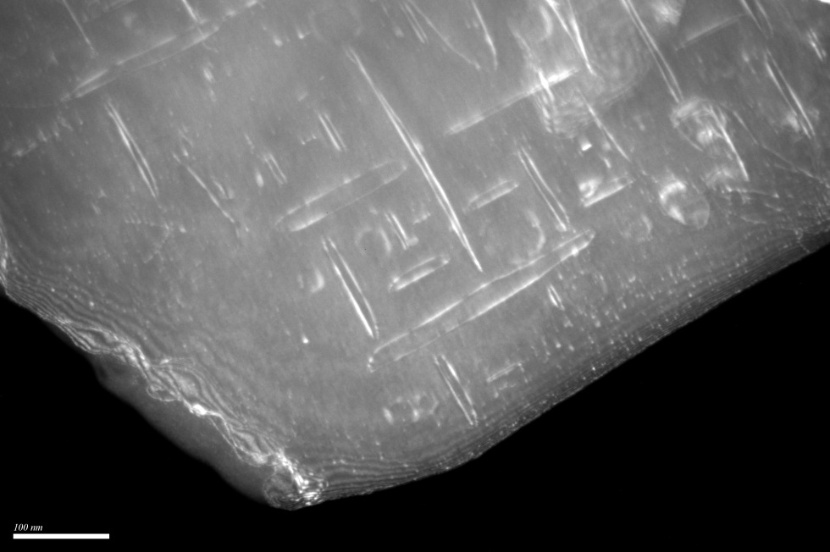
Dislocation loops in Fe irradiated at 500°C
g = 110
200nm
Dose: 3x10¹⁸ ions m⁻², Dose: 1x10¹⁹ ions m⁻²
UHP-Fe irradiated at 500ºC with 150 keV Fe⁺ ions
loops are of <100> type.
loops are of interstitial type

Slide 29
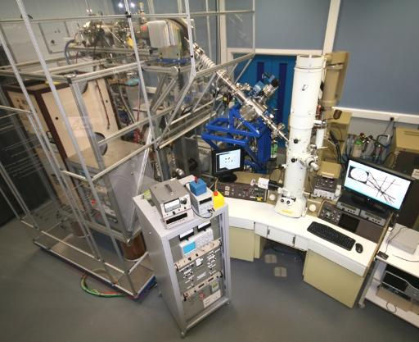
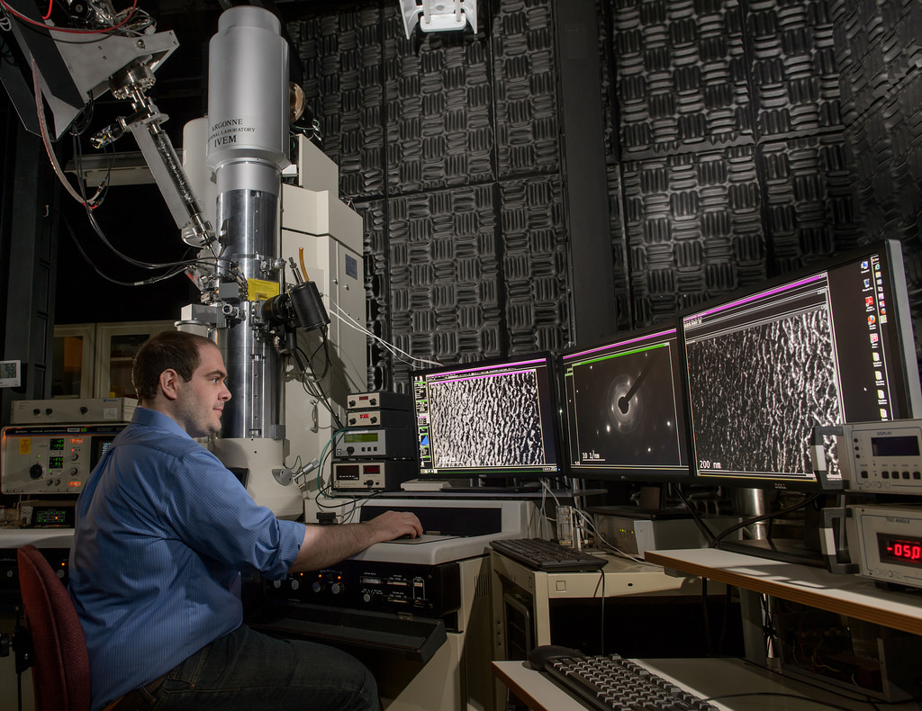
Radiation Damage as it happens…
IVEM – Argonne NL
MIAMI – U. Huddersfield

Slide 30
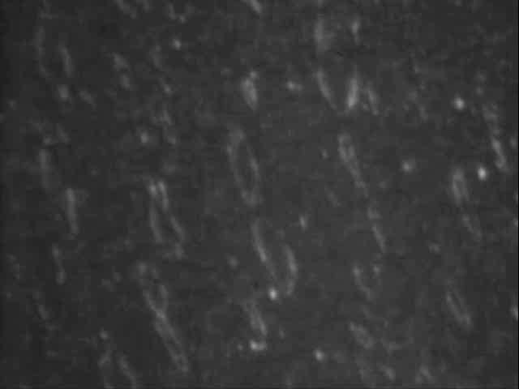
Damage accumulation; Fe, 300°C , high dose

Slide 31
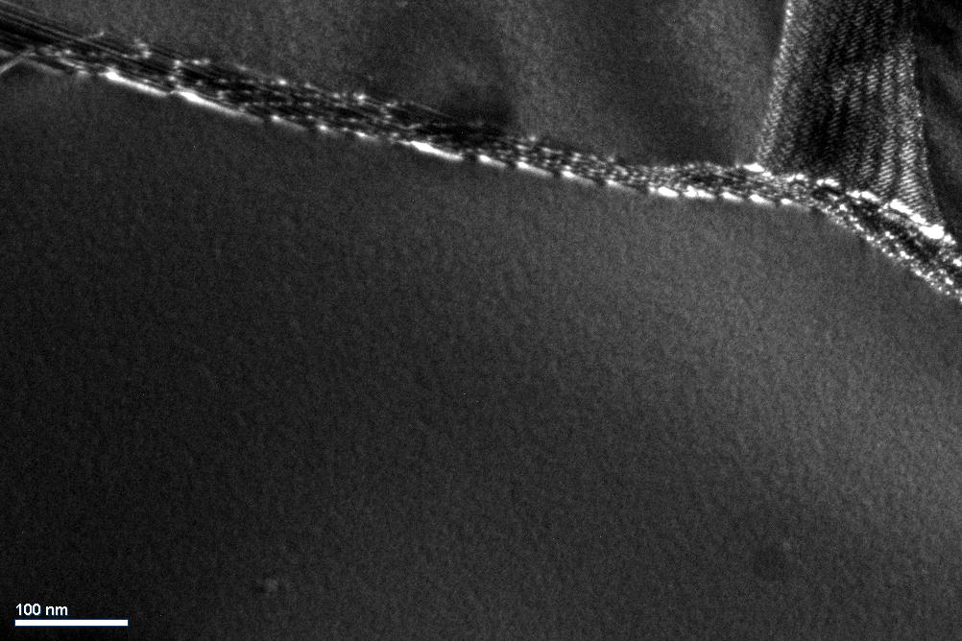
Loop density vs dose: W-5%Re
g=200
0
Unit: 10¹³W⁺/cm²
~10¹⁵ loops/m²

Slide 32
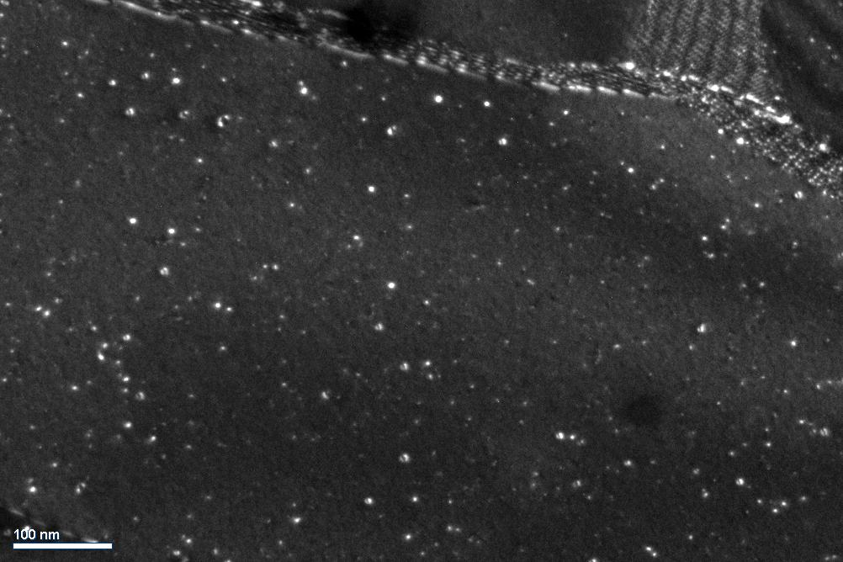
Loop density vs dose: W-5%Re
g=200
0
0.38
Unit: 10¹³W⁺/cm²
~10¹⁵ loops/m²

Slide 33
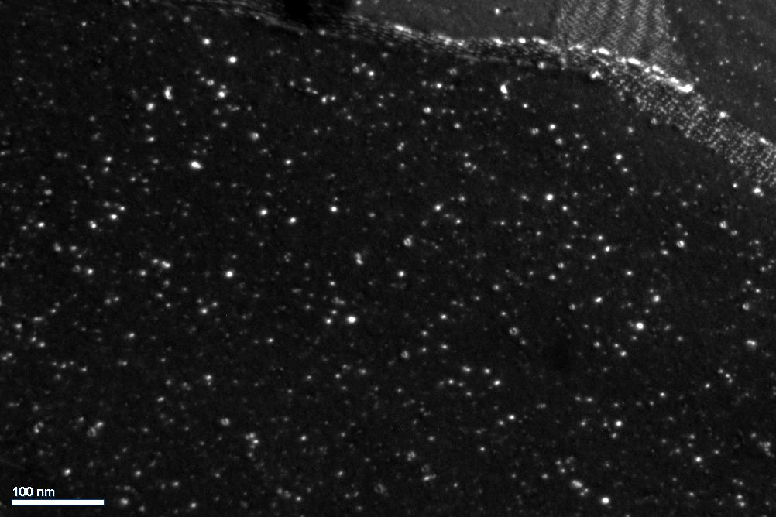
Loop density vs dose: W-5%Re
g=200
0
0.38
1.0
Unit: 10¹³W⁺/cm²
~10¹⁵ loops/m²

Slide 34
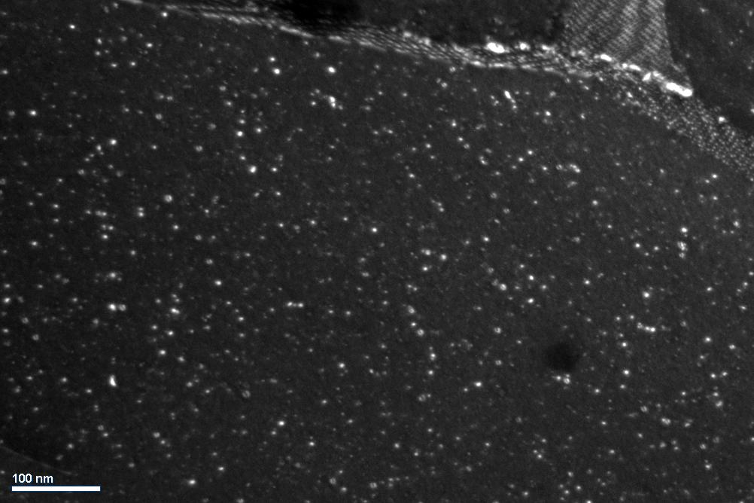
Loop density vs dose: W-5%Re
g=200
0
0.38
1.0
1.75
Unit: 10¹³W⁺/cm²
~10¹⁵ loops/m²

Slide 35
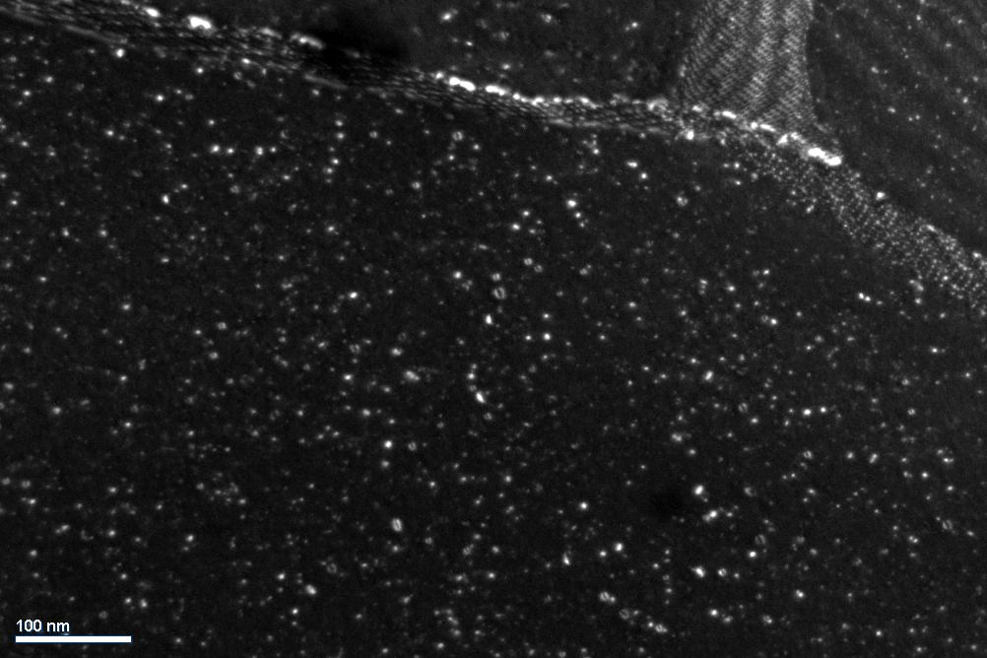
Loop density vs dose: W-5%Re
g=200
0
0.38
1.0
1.75
3.25
Unit: 10¹³W⁺/cm²
~10¹⁵ loops/m²

Slide 36
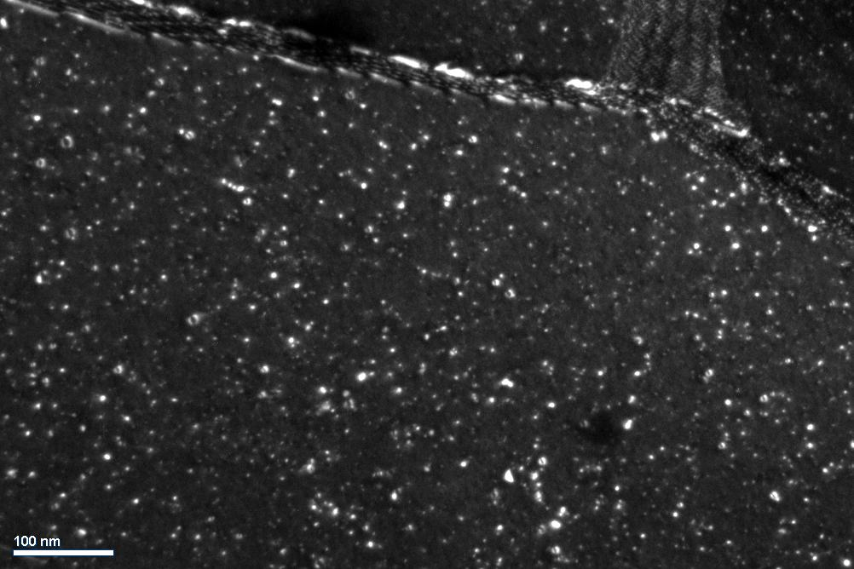
Loop density vs dose: W-5%Re
g=200
0
0.38
1.0
1.75
3.25
6.25
Unit: 10¹³W⁺/cm²
~10¹⁵ loops/m²

Slide 37
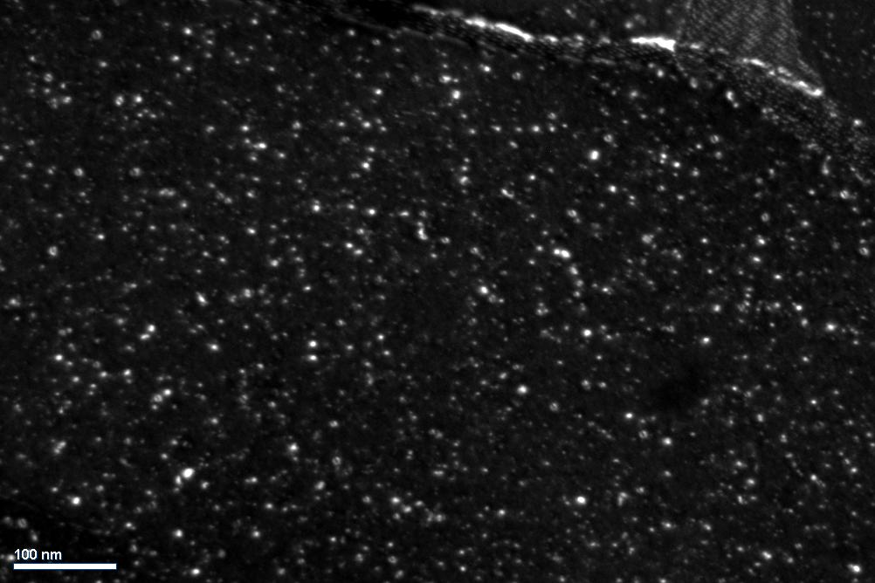
Loop density vs dose: W-5%Re
g=200
0
0.38
1.0
1.75
3.25
6.25
10.0
Unit: 10¹³W⁺/cm²
~10¹⁵ loops/m²

Slide 38
Self-ion irradiations of pure materials and FeCr alloys
- 100keV room temperature irradiations
Defect density (m⁻²)
Iron-based metals (Body centred cubic metals in general?) are more resistant to radiation damage.
Fewer defects
Threshold dose
Cu
1E16
Ni
1E15
1E14
Fe5Cr
Fe
1E13
Fe8Cr
Fe11Cr
1E12
1E15
1E16
1E17
1E18
1E19
Dose of 100 keV self-ions (ions m⁻²)

Slide 39
Effects of radiation damage on materials
Sputtering
Stored energy
  “Wigner energy” release
Point defect accumulation
  Swelling, dislocation loops, nano-voids
  Changes in thermal & electrical conductivity
Enhanced diffusion
  Radiation-enhanced creep
  Faster kinetics of phase transitions
  Radiation-enhanced grain-boundary segregation
Gas from transmutation
  Bubbles, swelling (with 2)
Soluble and insoluble transmutation products
  Hardening, precipitation
Knock-on randomisation of structure
Non-equilibrium microstructures? (related to 3. 6)
Hardening (from 2, 4, 5)
Embrittlement (from 7, 3c, 4)
Radiation-enhanced corrosion (related to 3a, maybe 5)

Slide 40
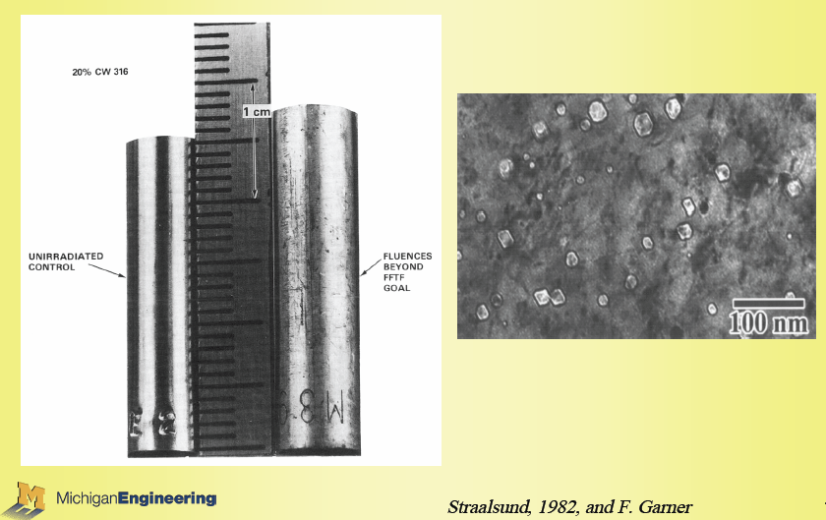
Radiation-induced swelling
Type 316 stainless steel:
Fe 16-18%Cr, 10-14%Ni, 2%Mo, <0.08%C
G. Was, Michigan

Slide 41
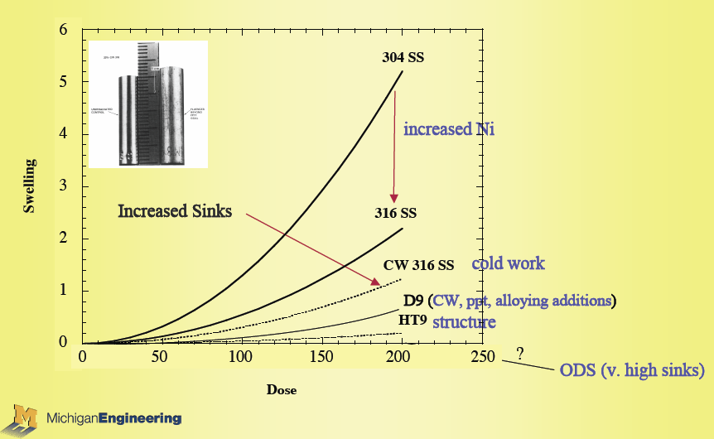
Radiation-induced swelling
(%)
G. Was, Michigan

Slide 42
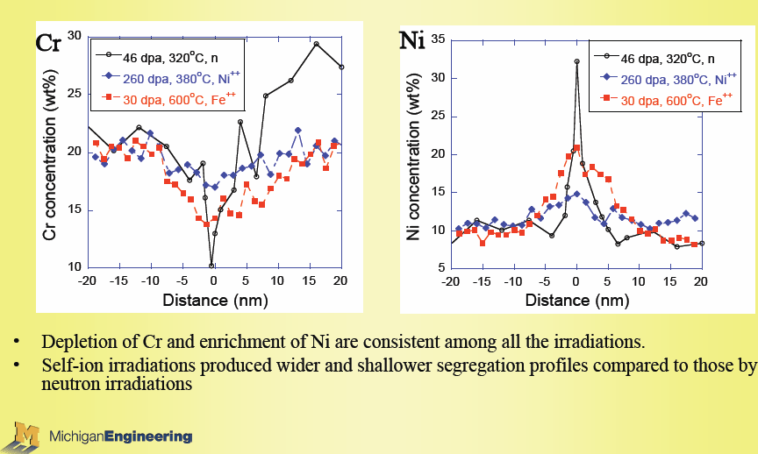
Radiation-induced grain boundary segregation
Type 304L stainless steel: Fe 18-20%Cr, 8-12%Ni, <0.03%C
G. Was, Michigan

Slide 43
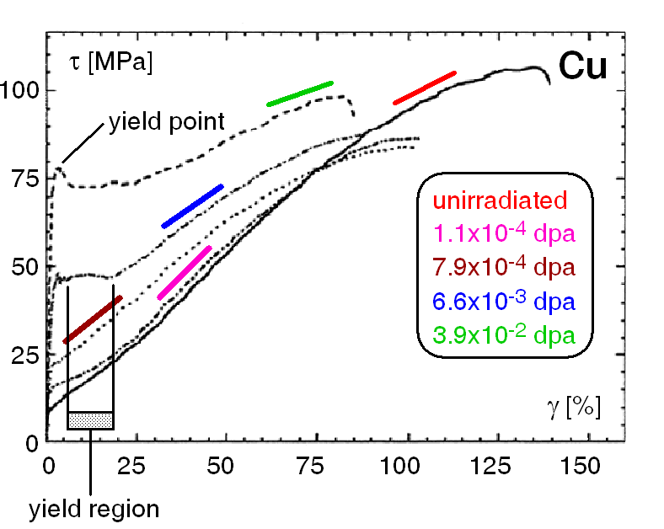
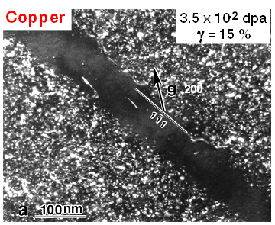
Radiation-induced dislocation loops: effects on mechanical properties
“Strain localisation”

Slide 44
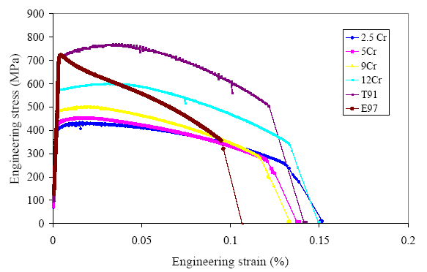
Stress-strain curves: Iron alloys
Stress (MPa)
T91 steel
Eurofer 97
n-irrad up to 1.5 dpa
T_{irr} =300°C, T_{TEST}=27°C
Fe Cr alloys
Strain (%)
Eurofer 97: Fe - 8.9%Cr – 1%W - 0.2%V - 0.14%Ta - 0.12%C
T91: Fe - 8.3%Cr – 0.4%Mn - 1%Mo - 0.2%V - 0.08% Nb - 0.1%C

Slide 45

Stress-strain curves: Iron alloys
Plastic instability after yield
Stress (MPa)
Eurofer 97
n-irrad up to 1.5 dpa
T_{irr} =300°C, T_{TEST}=27°C
Strain (%)

Slide 46
Dose Rates
Radiation Source | Dose Rate (dpa / s) in Iron-based Alloys
Fission Reactor Pressure Vessels (RPV) | ~ 10⁻¹² – 10⁻¹¹
Rotating Target Neutron Source (RNTS-II) | ~ 10⁻¹⁰
Fast Flux Test Facility (FFTF)/DEMO Fusion Reactor | ~ 10⁻⁸ – 10⁻⁶
Ion Implantation – Low Dose Rate | 3 x 10⁻⁵
Ion Implantation – High Dose Rate | 6 x 10⁻⁴
HVEM Irradiation | ~ 10⁻³
C. D..Hardie 2013

Slide 47

Nanoindentation hardness: Fe 5%Cr 0.6dpa
Low Dose Rate
Indenter
High Dose Rate
Un-irradiated

Slide 48
Nanoindentation hardness: Fe 5%Cr 0.6dpa
Low Dose Rate
Indenter
High Dose Rate
Un-irradiated

Slide 49

TEM of ion irradiation damage Fe 5%Cr 300ºC
110
110
100nm
Low dose
rate
High dose
rate
S. Xu 2012

Slide 50


APT of ion irradiation damage Fe 5%Cr 400ºC
Low dose rate
High dose rate
APT data for the Fe 5%Cr alloy irradiated at 400 Cwith the low dose rate (a)and high dose rate.(b)The figureincludes an atom map showing Fe atoms and a0.5 at.%CrN isoconcentration surface (i)and proximity histograms showing the variation in composition from the centre of enrichment outwards into the matrix (ii).Centre of enrichment is definedas the region of highest CrN concentration.
C.D. Hardie et al. J Nuclear Materials 439 (2013) 33–40

Slide 51
Micro-mechanical Testing
6.8 dpa
Fe-12%Cr
Ion – irradiated
Fe⁺
0.5MeV & 2MeV
320°C
0 dpa
Chris Hardie, D.Phil Thesis, Oxford, 2013

Slide 52


Micro-mechanical Testing
6.8 dpa
Fe-12%Cr
Ion – irradiated
Fe⁺
0.5MeV & 2MeV
320°C
0 dpa
1mm
0.1mm
Fe-6%Cr
neutron – irradiated
288°C
1.7 dpa
Chris Hardie, D.Phil Thesis, Oxford, 2013

Slide 53

Micromechanical testing Fe-6%Cr – Size effects
Yield Stress (GPa)
0.1mm
6.0
Ion-
irradiated
4.0
2.0
Neutron-irradiated
Unirradiated
0.0
0.0
2.0
4.0
6.0
8.0
Beam depth (μm)

Slide 54

Micromechanical testing Fe-6%Cr – Size effects
Yield Stress (GPa)
0.1mm
6.0
Ion-
irradiated
4.0
2.0
Neutron-irradiated
Unirradiated
0.0
0.0
2.0
4.0
6.0
8.0
Beam depth (μm)

Slide 55
Micromechanical testing Fe-6%Cr – Size effects
Yield Stress (GPa)
0.1mm
6.0
Ion-
irradiated
4.0
2.0
Neutron-irradiated
Unirradiated
0.0
0.0
2.0
4.0
6.0
8.0
Beam depth (μm)

Slide 56
Micromechanical testing Fe-6%Cr – Size effects
Yield Stress (GPa)
0.1mm
6.0
Ion-
irradiated
4.0
2.0
Neutron-irradiated
Unirradiated
0.0
0.0
2.0
4.0
6.0
8.0
Beam depth (μm)

Slide 57
Protons ?

Slide 58

SRIM : 2 MeV protons into Fe

Slide 59

Proton irradiation for (micro) mechanics?
SRIM : 2 MeV protons into Fe
0μm
25μm
0μm
25μm
Could use specimens 10 – 12 μm thick – well beyond the size-dependent mechanics regime

Slide 60
Proton irradiation for (micro) mechanics?
SRIM : 2 MeV protons into Fe
For 2MeV H⁺ into Fe:
  Total damage:
  ~1 x10⁻⁴ events / (Å - ion)
  ~10²¹ ions cm⁻² for 1 dpa
  Depth ~ 15 μm
0μm
25μm

Slide 61
Proton irradiation for (micro) mechanics?
SRIM : 2 MeV protons into Fe
For 2MeV H⁺ into Fe:
  Total damage:
  ~1 x10⁻⁴ events / (Å - ion)
  ~10²¹ ions cm⁻² for 1 dpa
  Depth ~ 15 μm
For 2MeV Fe⁺ into Fe:
  Total damage:
  ~4 events / (Å - ion)
  ~2 x 10¹⁶ ions cm⁻² for 1 dpa
  Depth ~ 1 μm
0μm
25μm
0μm
5μm

Slide 62
Radiation damage in Materials
C.A. English (2011)

