Slide 1
SNS Target PIE
David McClintock
Bernie Riemer
RaDIATE Collaboration Meeting 2015
May 19-20, 2015
Spallation Neutron Source

Slide 2
Outline
Brief Overview of SNS Target Post Irradiation Examination (PIE) Program and Lessons Learned
Observations from PIE of Jet-flow Target Design
Future PIE of SNS Target Modules
  Sampling of leak locations in Targets 10 and 11
  Analysis Methods for Leak Location Samples
Summary

Slide 3
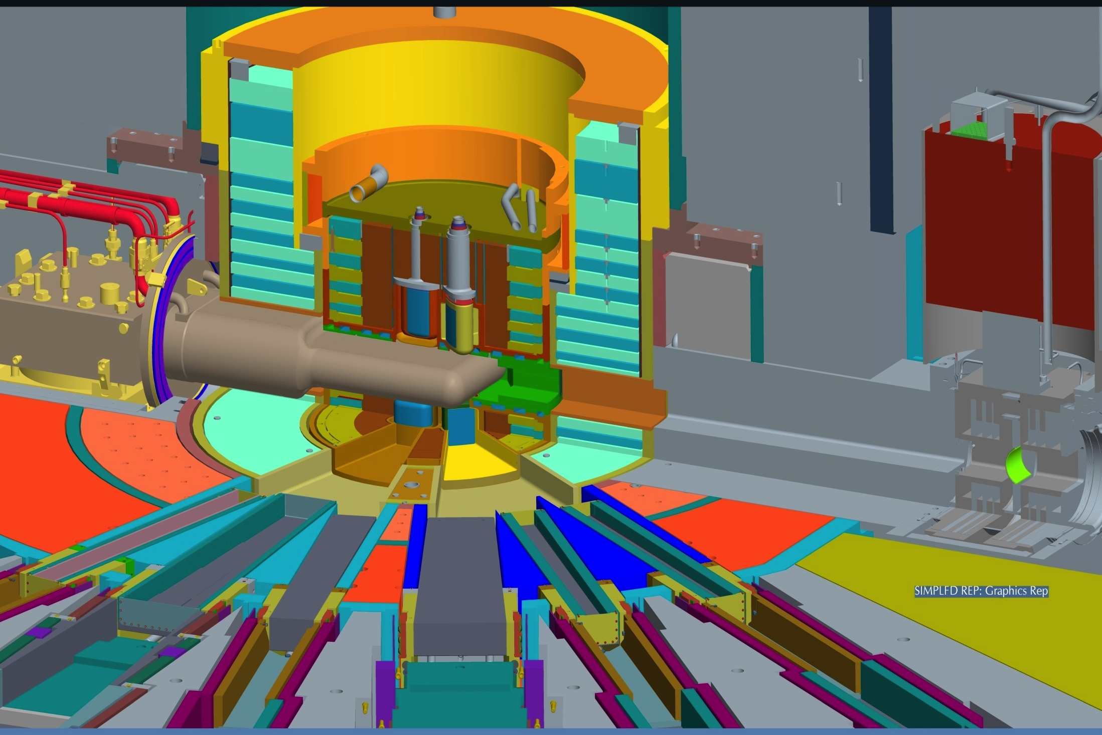
The target provides neutrons to 24 beam lines
Target
Inner Reflector Plug
Outer Reflector Plug
Core Vessel
Core Vessel Insert
Shutter
Proton Beam Window
Figure: D. McClintock
Notes:
The SNS has 4 Moderators:
1. Two downstream and one upstream liquid hydrogen
2. One upstream ambient water
Proton Beam Window:
Currently – Inconel 718 (precipitation hardened nickel alloy)
Next Generation Design – 6061-T651

Slide 4
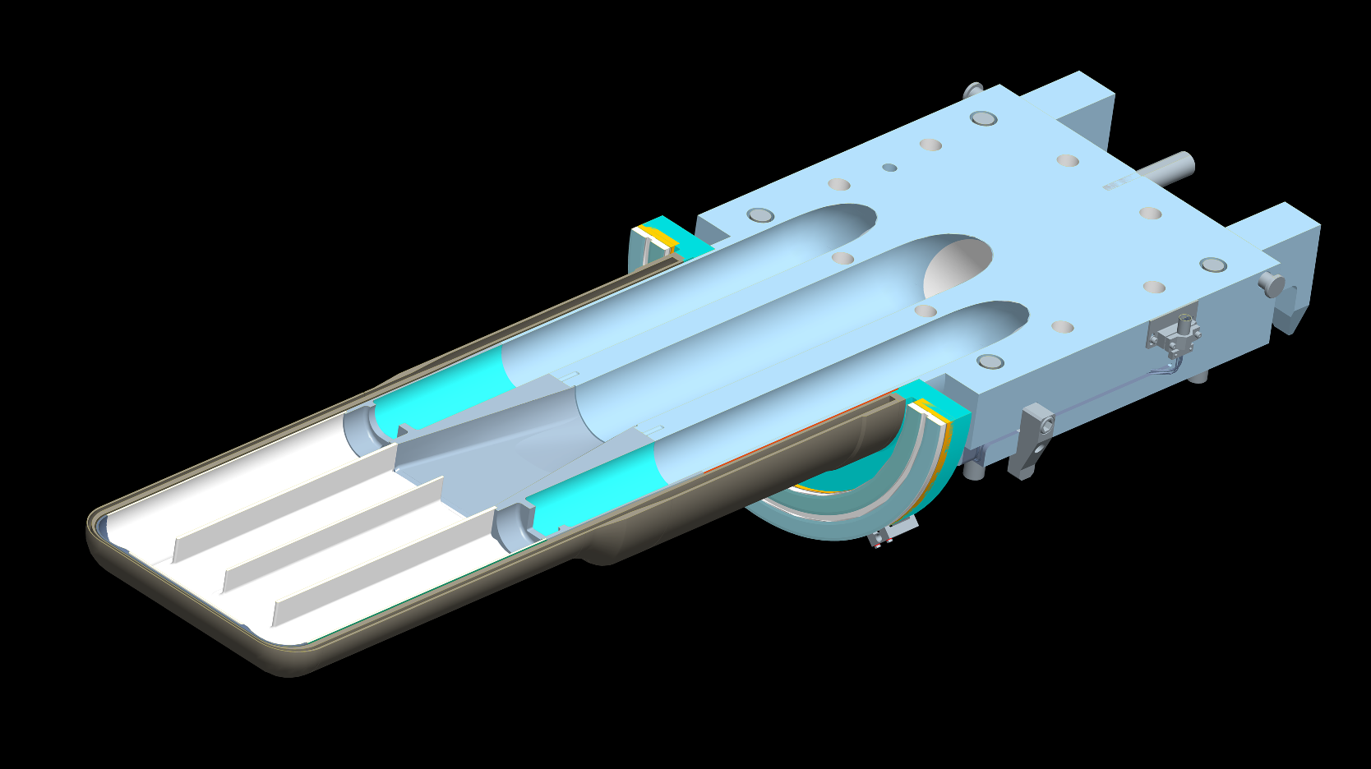
Mercury enters through side supply passages and returns through the center return passage
Figure Credit: D. McClintock
Notes:
Target has two mercury supply passages and one central return passage
Center baffle was added to SNS Target design to suppress a “breathing” modal resonance that was identified during early target design development

Slide 5
PIE program was established to learn about degradative processes occurring in SNS target modules during operation
Early R&D on the SNS Target design indicated cavitation-induced erosion of the vessel surfaces would likely occur during operation
Mechanical properties of the 316L vessel material are altered during operation from displacement damage and transmutation gas production
  There was uncertainty with the rate of change in mechanical properties due to high transmutation gas (H and He) production rate
A PIE program was established to accomplish several goals:
  Diagnose any issues with target operation
  Characterize the extent and nature of cavitation-induced erosion
  Measure mechanical properties of vessel material after irradiation
  Evaluate stability of Kolsterising® treated layer after irradiation

Slide 6
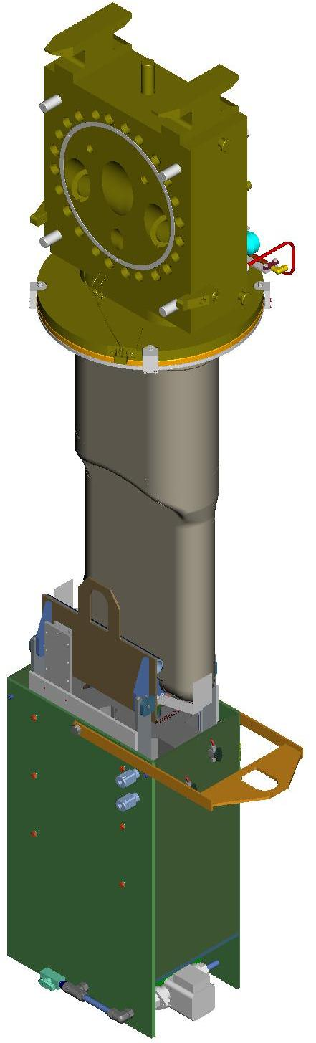
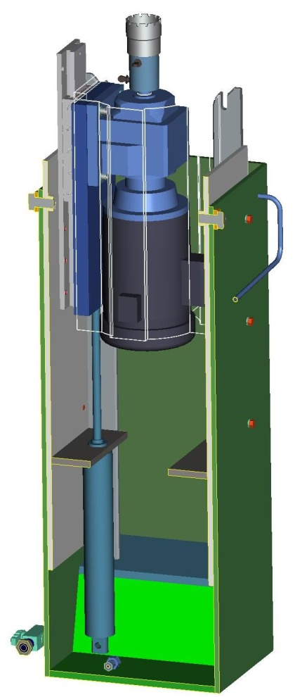
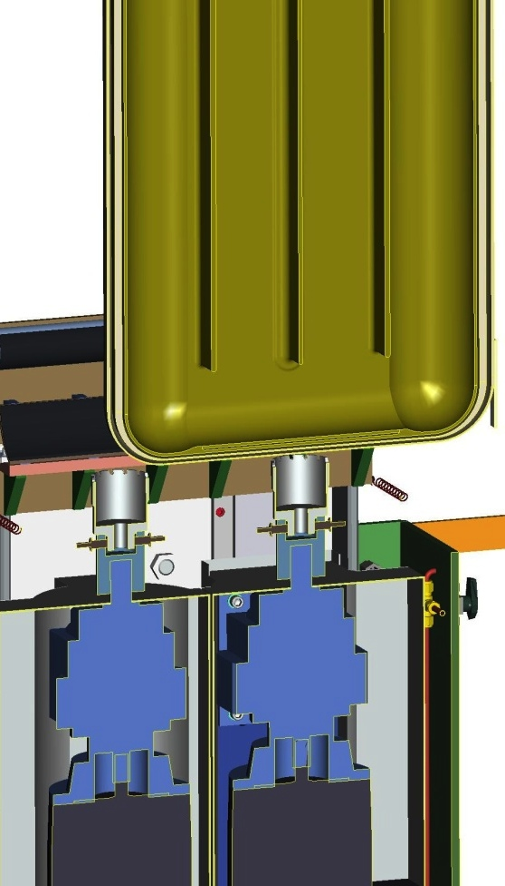
Targets are routinely sampled using carbide-tipped annular cutters
Target in Center-cut Position
Annular Cutter
Low-profile Linear Slide
Electric Drill Motor
Pneumatic Piston
Figure: Adam Carroll

Slide 7
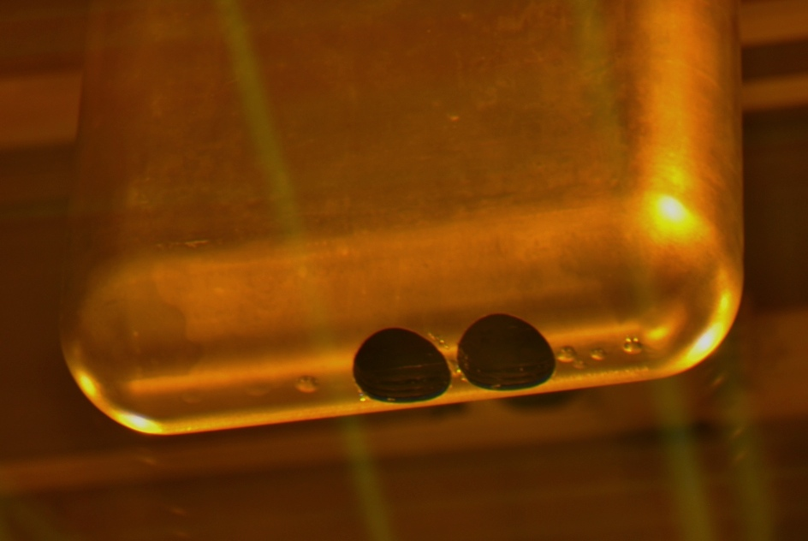
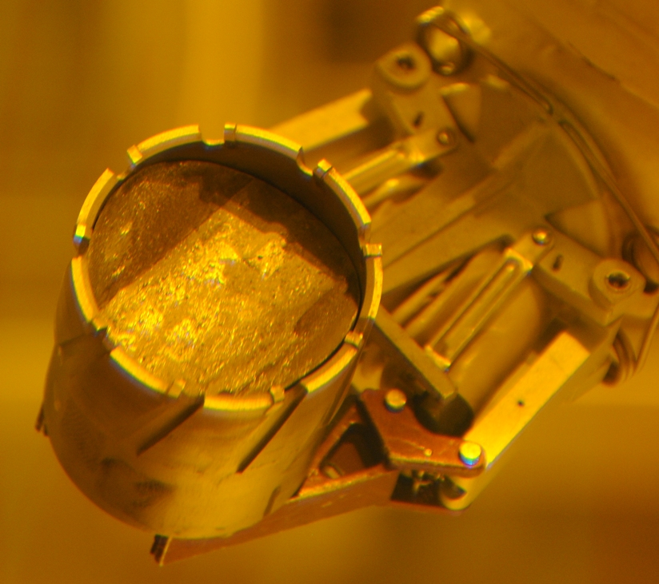
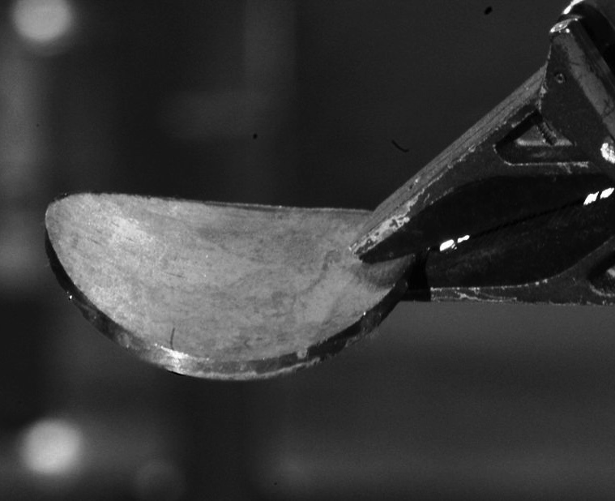
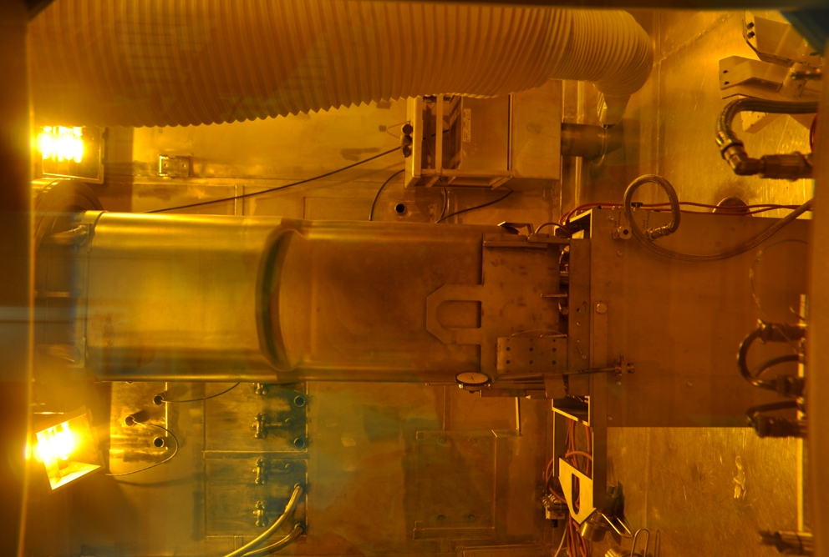
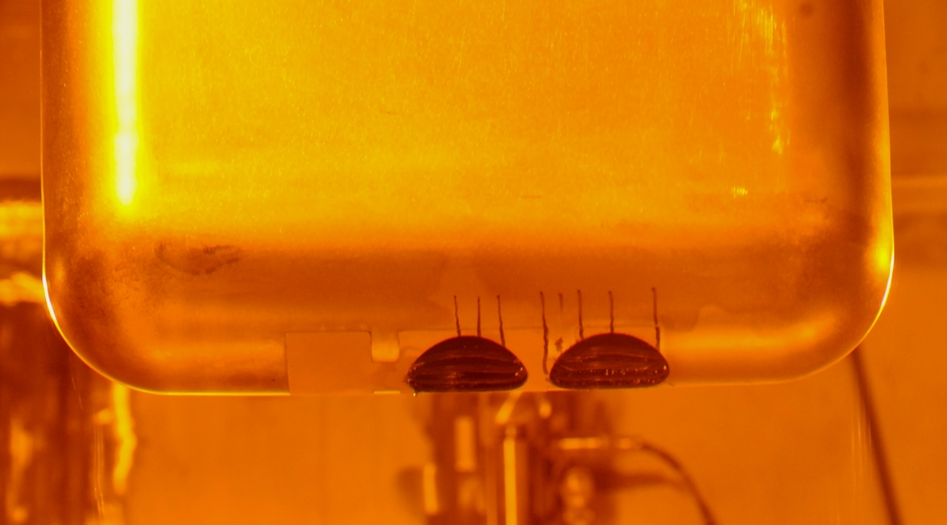
Sampling the target beam entrance region produces curved disk-shaped specimens
Target 1
Target 2

Slide 8
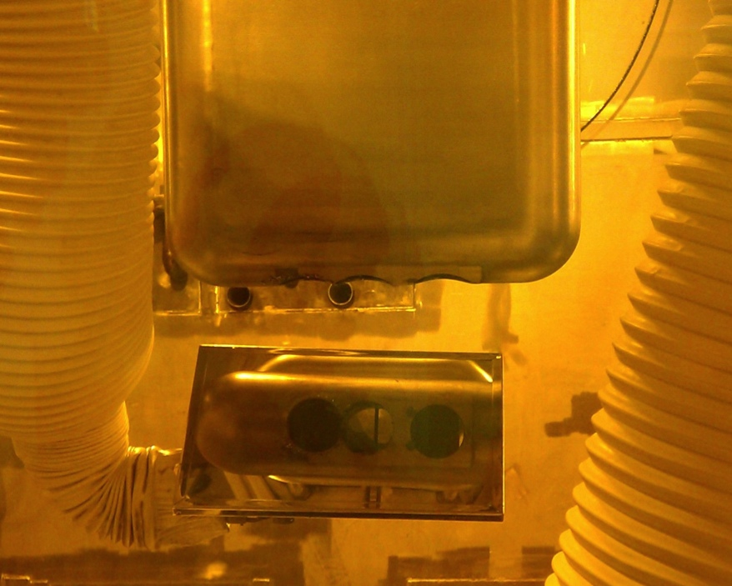
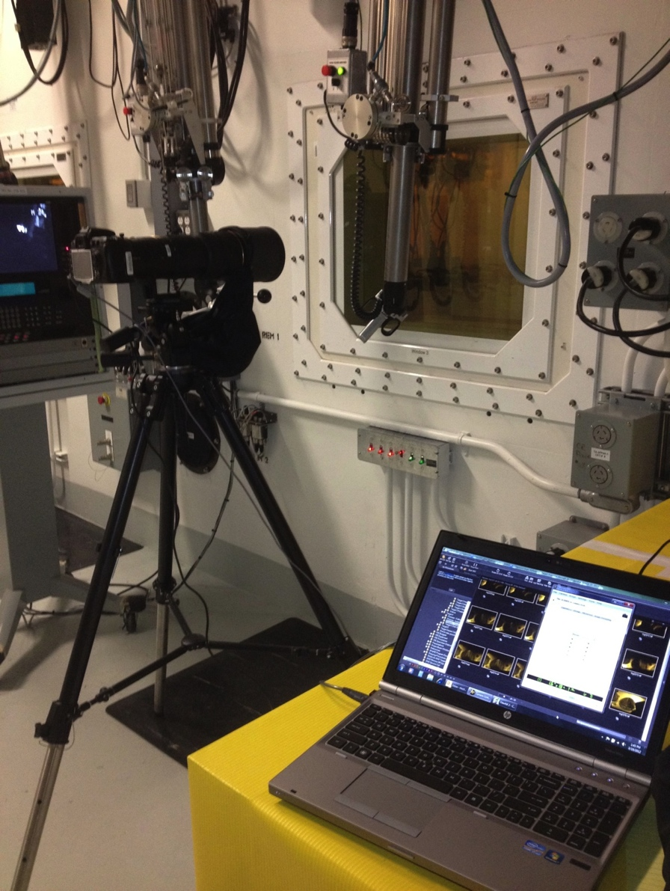
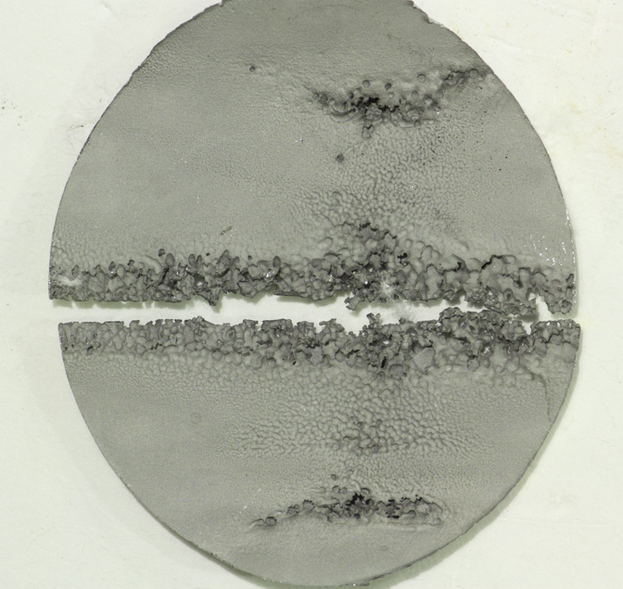
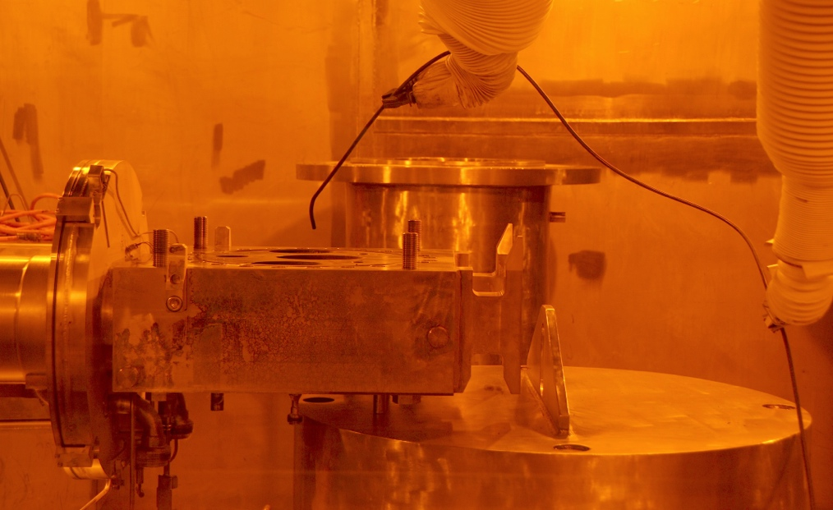
SNS target and specimens are photographically examined using a variety of techniques
Two to five cuts have been made in Targets 1-11
Targets have been inspected using:
  Through shield window high-resolution photography
  Internal examinations using articulating videoprobes
  Direct photography of disk specimens
Through-window Photography
Direct Photography
Articulating Videoprobe

Slide 9
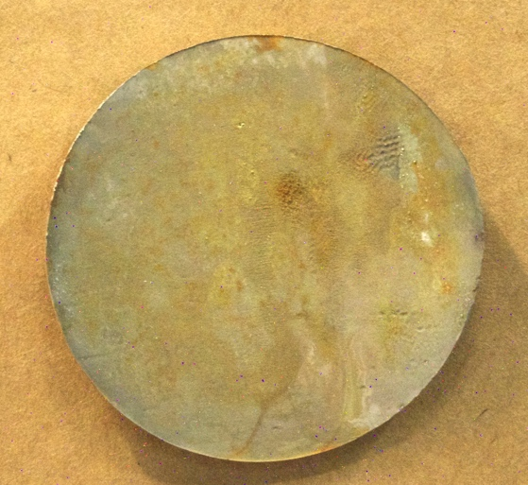
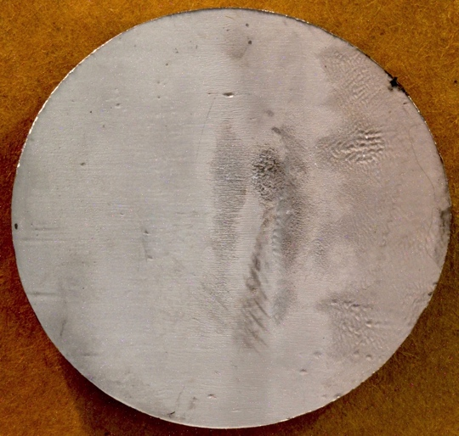
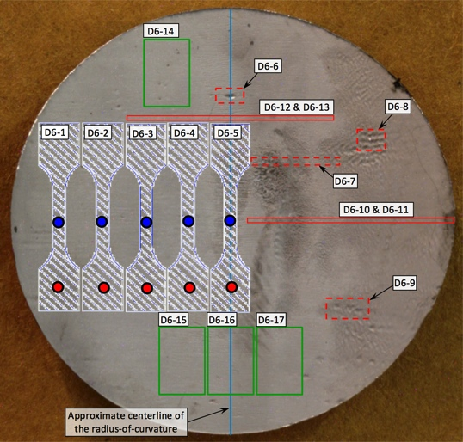
Mechanical properties and microscopy specimens have been tested from disk samples
Specimens were fabricated and tested by Babcock & Wilcox Technical Services Group (Lynchburg, VA, USA)
The disks were cleaned in an ultrasonic bath and photographed; the images were used to produce specimen maps for each disk
Specimen machining maps were produced for each disk and the specimens were machined via electrical-discharge machining (EDM)
Example: Disk 6 from Target 2
Before Cleaning
After Cleaning
Specimen Map
EDM Machining Map
Notes:
Tensile specimens were fabricated by Babcock and Wilcox via four step process:
1. Clean disk and photograph
2. ORNL produces machining map
3. Machining map is digitized into EDM wire path program
4. After final approval and mockup testing specimens are cut with multi-step wire EDM

Slide 10
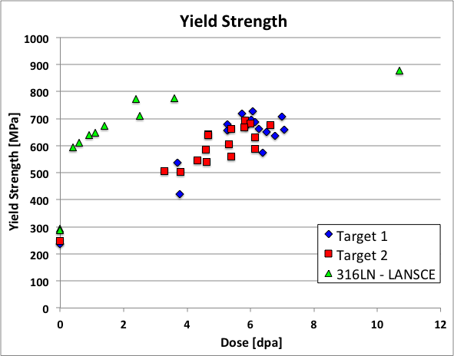
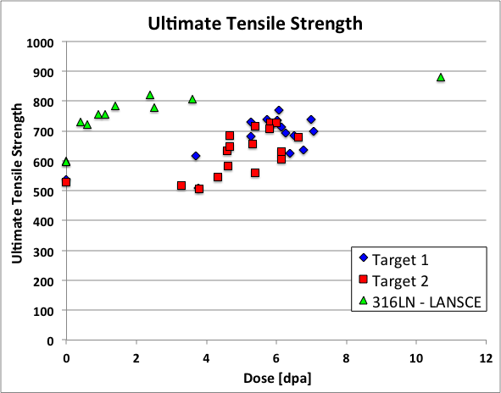
Tensile data show significant strengthening occurred during operation
LANSCE irradiation* was 316LN – slightly higher strength due to nitrogen addition
General hardening trend of SNS tensile data is consistent with data in literature, but appreciable scatter in data was observed
References: D.A. McCintock et al., Journal of Nuclear Materials 450 (2014) 130-140
*K. Farrell and T.S. Byun, Journal of Nuclear Materials, 296 ( 2001) 129-138
Notes:
Doses were calculated using MCMPX with Tom McManamy’s proton beam profile (peaking factor ~1.18)
Irradiation temperature = 50-125°C
Test temperature = room temperature (~22°C)

Slide 11
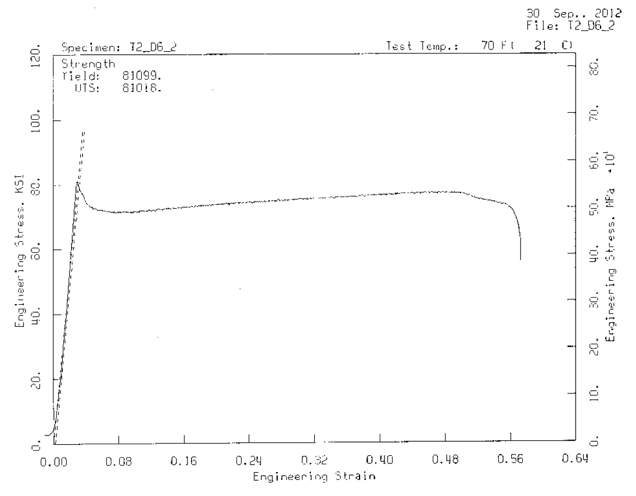
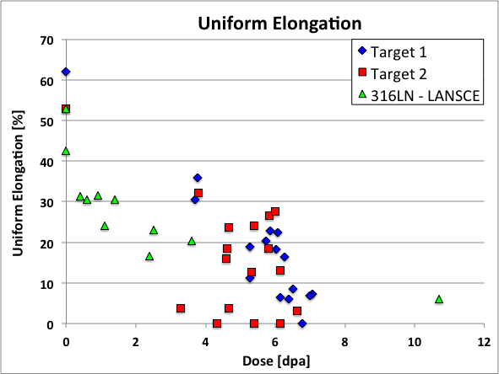
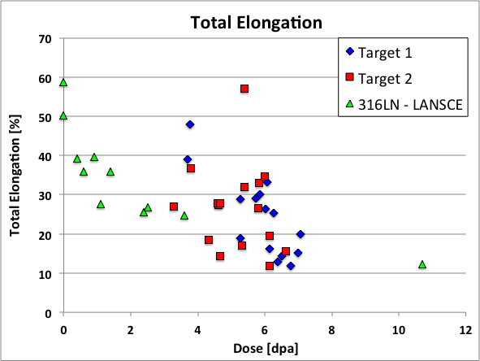
Tensile data show appreciable total elongation remained after ~7 dpa
Reduction in uniform elongation observed in Targets 1 and 2 are generally consistent with previous LANSCE data*
Scatter was attributed to abnormally large grain size and an atypical deformation mechanism based on an austenite to martensite phase transformation
References: D.A. McClintock et al., Journal of Nuclear Materials 450 (2014) 130-140
*K. Farrell and T.S. Byun, Journal of Nuclear Materials, 296 ( 2001) 129-138
From: D.A. McCintock et al., Journal of Nuclear Materials
450 (2014) 130-140
Notes:
Doses were calculated using MCMPX with Tom McManamy’s proton beam profile (peaking factor ~1.18)
Irradiation temperature = 50-125°C
Test temperature = room temperature (~22°C)

Slide 12
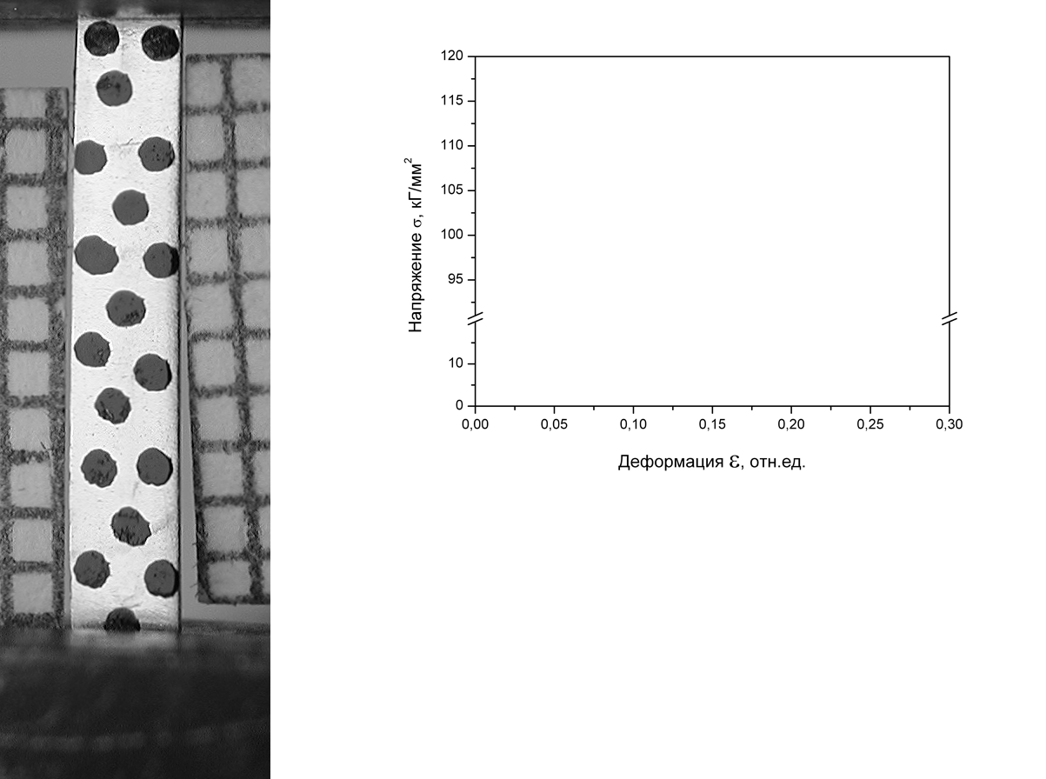
Inability to neck produces a “deformation wave” in highly irradiated stainless steel*
*Slide Courtesy of: Frank Garner and Maxim Gusev
55 dpa, 310°C
in BN-350
Russian analog to 321 stainless steel
room temperature test
Stress, kg/mm²
Deformation, rel.unit.
A “deformation wave” appears on the surface and moves along the specimen gauge section
Gusev et al., J. Nucl. Mater. 386–388 (2009) 273–276
Gusev et al., J. Nucl. Mater. 403 (2010) 121–125
Notes:
12
Plastic deformation behavior after yielding is quite different when a deformation wave is generated. As the specimen begins to yield, usually near the specimen shoulder where the grips are concentrating stress, the material that undergoes plastic deformation begins to transform from austenite (face center cubic, fcc, crystal structure) to a martensitic (body centered cubic, bct, crystal structure) and the deforming material is hardened to the point where the material below the transformed volume begins to yield and transform into martensite. The subsequent yielding causes a “wave of deformation” to propagate down the length of the gauge section, which allows more material in the specimen gauge section to participate in the plastic deformation. The wave continues to propagate until fracture occurs.
By permitting more volume of the gauge section to participate in the test, the elongation values increase relative to specimens that experience localized plastic deformation.

Slide 13
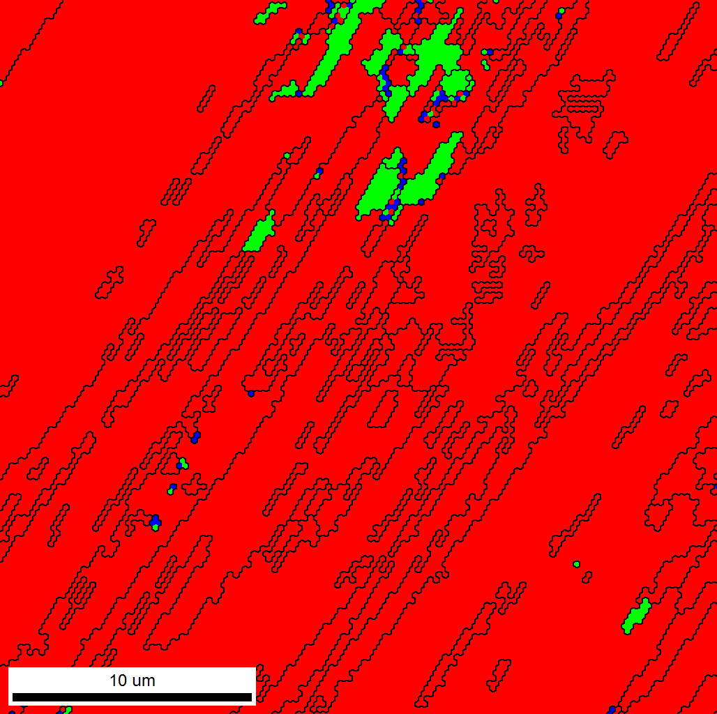
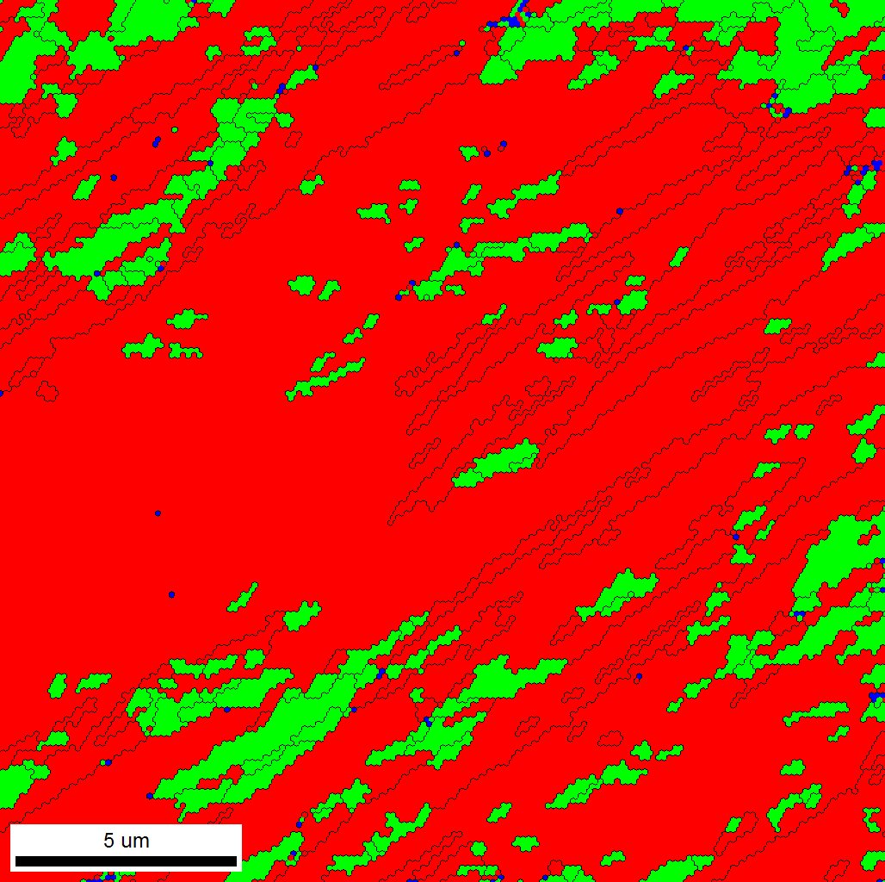
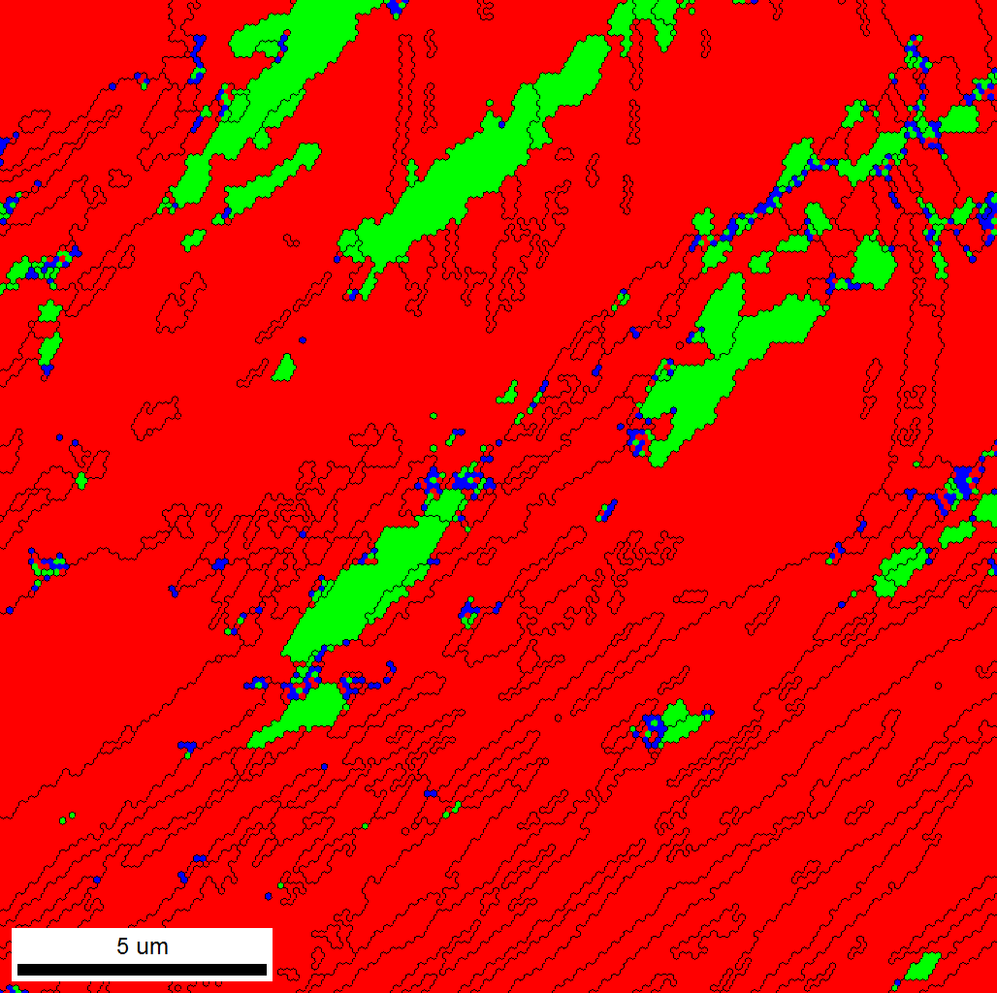
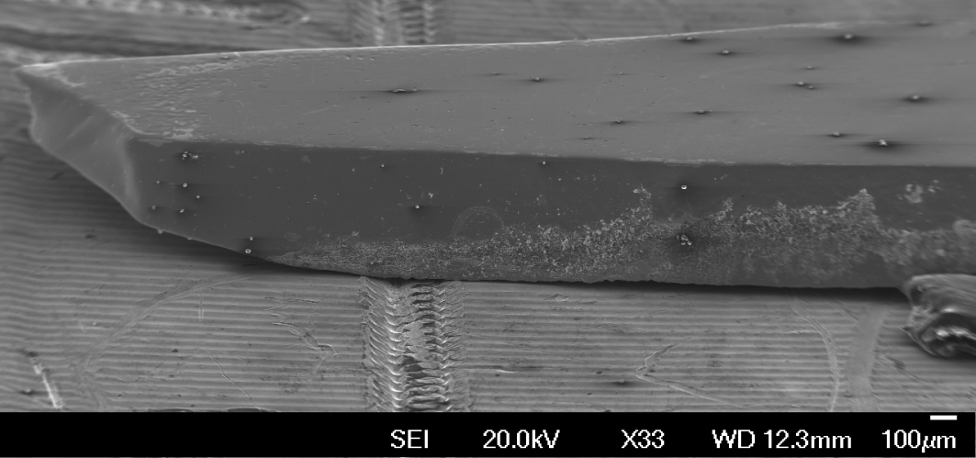
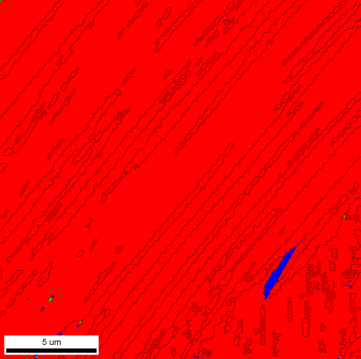
Significant volume fractions of α-martensite were observed in D6-2
Structure contain significant amount of alpha-martensite; its amount varies along the gauge
Neck may contain up to 25-30 % of α-martensite
Epsilon-phase indications are non-convincing
Martensite co-exists with twins
For all maps:
γ: Red;
α: Green;
ε: Blue.
V_{α}~15%
V_{α} ~8%
V_{α} ~2.3%
Scan #7, 2000x
V_{α} ~0%
No successful scans for this area

Slide 14
Additional tensile testing is planned to justify an increase in target administrative dose limit
Currently, there is a 10 dpa (displacements per atom) administrative dose limit for SNS target modules
Planning is underway to test high dose specimens from Target 9 that are slightly under the 10 dpa limit
  Results from the high-dose tensile specimens will be used to justify an increase in the administrative dose limit
We are also planning on measuring H and He content of “high dose” material from the beam entrance region
Concurrent efforts are underway to increase target lifetime by changing the layer of the target vessel the limit is based on
  Will result in a 20-25% increase in target lifetime

Slide 15
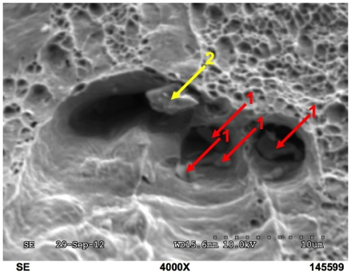
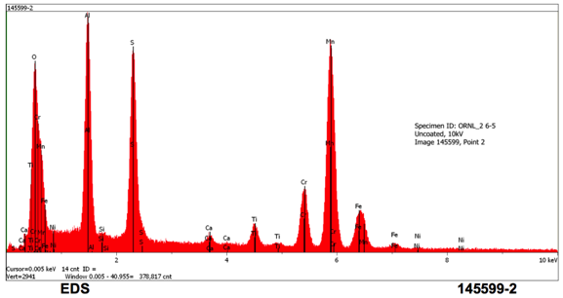
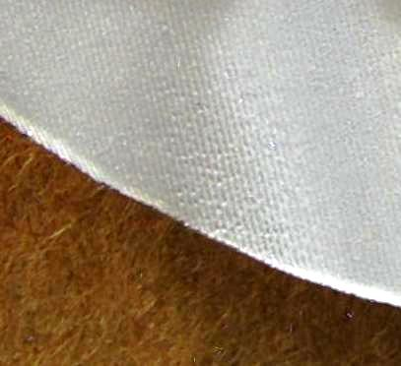
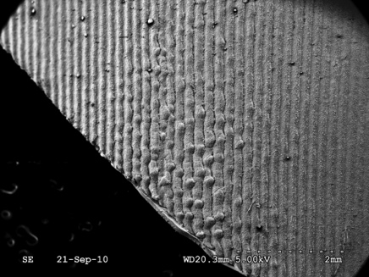
Studies also focused on non-metallic inclusions and surfaces features promoting erosion damage
An appreciable population of non-metallic inclusions were observed in material from Targets 1 and 2
  Inclusions are a bi-product of the steel making process
  Two plates of Electro Slag Remelt (ESR) processed 316L were purchased to reduced inclusions
Microscopy of surface replicas indicated erosion pits initiate at the base of machining features on the vessel surfaces
  Target surfaces facing the bulk mercury flow are now polished via electro-polishing to remove pit-like features and delay onset of erosion
O
Al
S
Point 2

Slide 16
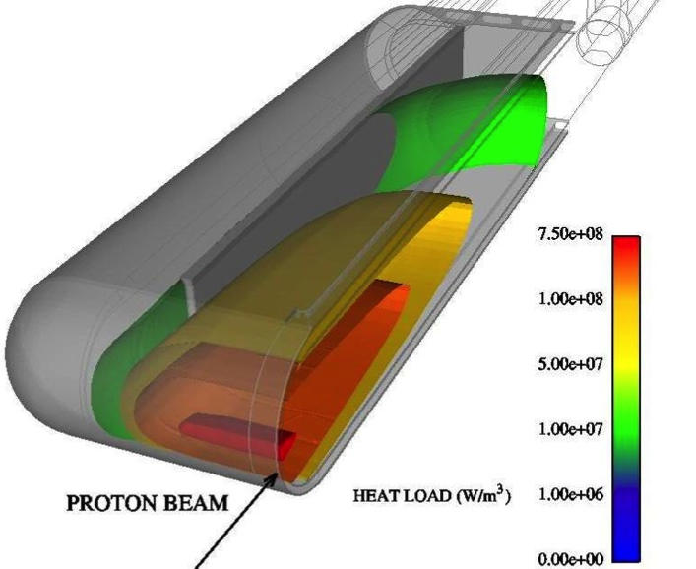
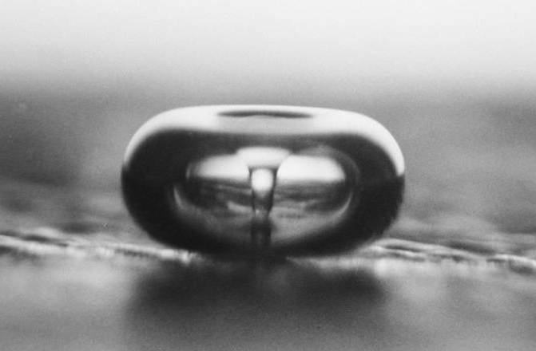
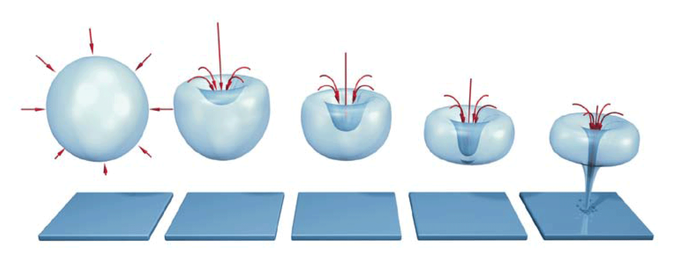
Mercury target vessel surfaces are damaged by cavitation-induced erosion
Temperature rise from a high-power (1.4 MW) proton beam pulse is approximately 10 K
Rate of temperature rise is approximately 10⁷ K/s
The isochoric (constant volume) energy deposition leads to formation of tensile pressure waves that cavitate the mercury
The collapsing bubbles create mercury “jets”, which erode the target vessel surfaces by:
  Direct erosion
  Fatigue “spalling”
Photo Credit: Lawrence Crum (University of Washington)
Figure: http.eswt.net/cavitation

Slide 17
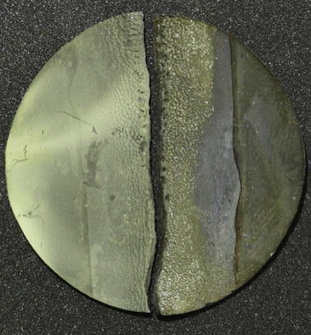
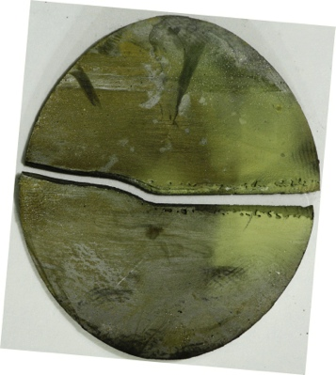
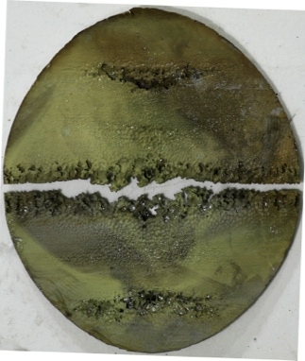
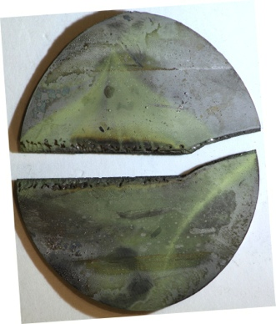
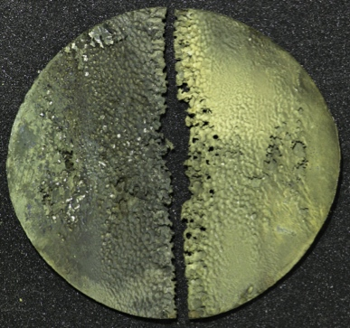
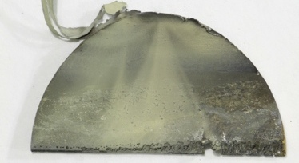
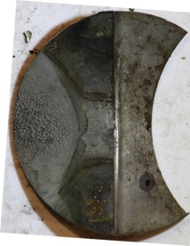
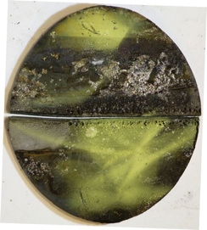
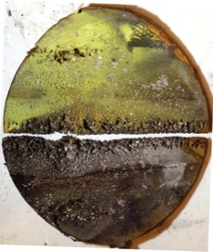
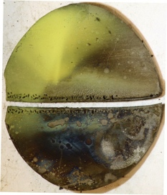
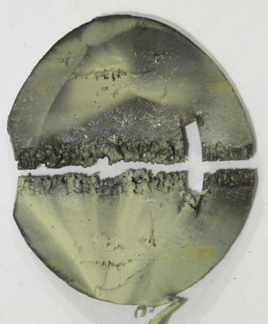
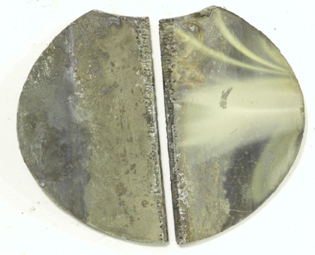

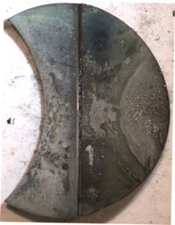
The inner wall of the beam-entrance region of high-use targets were fractured along the vertical centerline
Through-wall erosion damage was observed across the mercury vessel inner-window in all high-use targets
Fracture was arrested at the press-fit edge of the inner wall
Target 2 – Inner Window
Target 4 – Inner Window
Target 5 – Inner Window
Target 3 – Inner Window

Slide 18
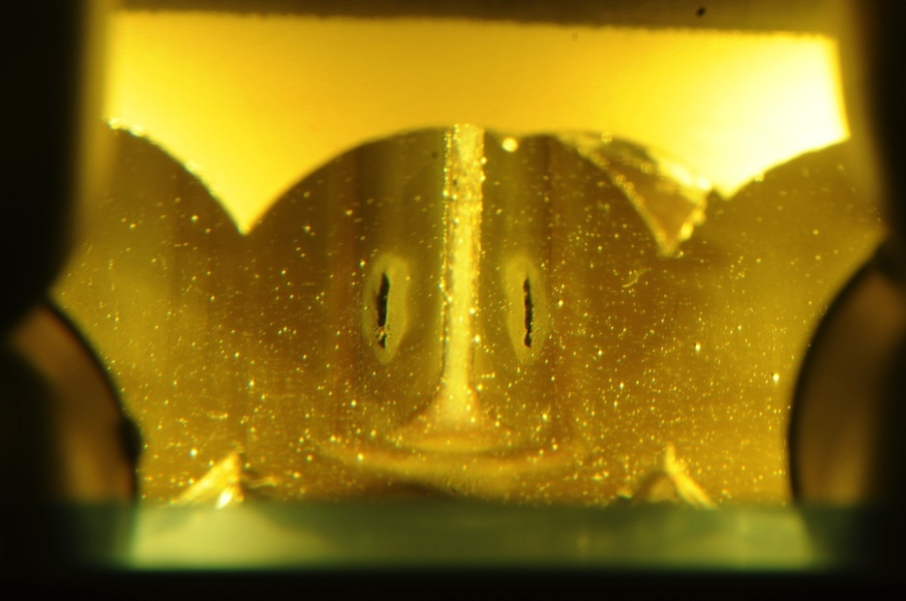
Slit-shaped erosion “Hot Spots” were observed on either side of center baffle
Top Interior Surface of Target 5
Slit-shaped Cavitation-Induced Erosion Patterns
Figure: D. McClintock
Notes:
Slit-shaped cavitation-induced erosion patterns were observed on the (top and bottom) target vessel interior surface on either side of the center baffle.
Deep erosion damage, leads to question: Is the erosion deep enough to cut through inner vessel wall, allowing communication of bulk and window supply mercury flows?

Slide 19
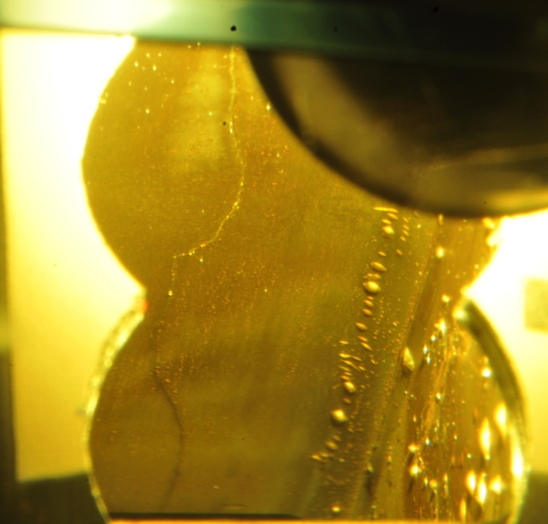

Observations Suggest the Crack-like Feature is a Crack Through the Baffle Thickness
The crack-like feature on the Target 8 center baffle appears to extend the full length of the baffle
Jogs in feature appear to mirror one another – suggesting a connected crack through the baffle thickness
Target 8 Center Baffle “Passenger Side”
Target 8 Center Baffle “Driver Side”

Slide 20

Saturation Time maps correlate with erosion patterns observed on bulk flow-facing surface of Target 1
Top and bottom of “I” clearly illustrated in saturation time map of bulk flow facing surface
Figures: B. Riemer & D. McClintock

Slide 21
Microhardness testing showed the Kolsterising® treated layer was present after irradiation
The mercury facing surfaces of SNS targets are protected by a surface hardening process called Kolsterising®
Microhardness values from Target 1 indicate the high-initial hardness at surface was still present after irradiation
Data suggest Kolsterised layer remains stable after irradiation to ~4-5 dpa, thereby maintaining protection throughout a typical target lifetime
Reference: D.A. McClintock et al., Journal of Nuclear Materials 450 (2014) 176-182

Slide 22


Target 10 was a “Jet-Flow” target, designed to assess the mitigating effect of flow on cavitation-induced erosion
The mercury bulk flow of the original target design created a stagnation zone on the inner wall of the mercury vessel
Early testing showed that less cavitation-induced erosion occurred to specimens in contact with flowing mercury relative to stagnant mercury
A target design with a high-velocity flow of mercury against the inner wall was fabricated to evaluate the mitigating effect of flow on cavitation-induced erosion to the inner wall
Flow Stream Lines for Bulk Flow
Jet Flow Stream Lines on Inner Wall
Quasi-stagnation zone on inner wall
High-velocity mercury flow against target vessel inner wall

Slide 23
Assessment of the damage to Targets 6 and 10 allows a comparison of the original and Jet-flow target designs
Targets 6 and 10 had almost identical operational histories
The operational histories permit an almost direct comparison between the original and Jet-flow designs
 | Target Design | Average Operational Power [kW] | Total Energy [MW-hr]
Target 6 | Original | 916 | 617
Target 10 | Jet-flow | 1052 | 601

Slide 24





Photography of the Jet-flow inner window indicates erosion damage was mitigated
From the pictures below it appears the Jet-flow target design effectively mitigates erosion to the target inner wall
Inner Wall of Beam-entrance Region
Target 6
(original design)
Target 10
(Jet-flow)

Slide 25



Internal volume was pressurized and Snoop was applied to “area-of-interest” in Target 10
Crack Location
Weld
Transition
Front Body

Slide 26




Location of Target 11 leak was identified during Post Irradiation Examination (PIE) using an articulating videoprobe
Mercury Window Flow
•high velocity flow of mercury between target vessel walls
•cools beam-entrance region of target
Trapezoidal Cover Plate
•welded on all four sides to seal window supply plenum area
Mercury Window Flow Supply Passage
View of Window Flow Supply Plenum Area

Slide 27
Analysis of the leak location could reveal the nature of the target vulnerability
Location of leak
  Is leak at a weld or base material?
Morphology of leak pathway
  Crack or pore in base material or weld?
Crack growth mode
  Did crack grow via fast fracture, fatigue growth, tearing…?
Fracture mode
  Was the fracture ductile, brittle, mixed, transgranular, intergranular…?
Are there unforeseen issues with target design/fabrication applicable to all targets?
  Is the K-layer carbon-contamination responsible?
  Are there indications liquid metal embrittlement (LME) and/or high-cycle fatigue cracks at welds?

Slide 28



The Target 10 Leak Location Could be Removed using an Annular Cutter
Annular cutters with carbide teeth have been successfully used to sample SNS targets
Sampling method and equipment are currently being developed to remove the Target 10 leak location
Sample of Target 10 Leak Location
Approximate Leak Location

Slide 29



Sampling Target 11 leak location with an annular cutter is most feasible sampling method
Annular cutters with carbide teeth have been successfully used to sample SNS targets
Sampling method and equipment could be developed to remove the Target 11 leak location
Sample of Target 11 Leak Location
Cutter must cut through thick section of shroud to sample leak location
Figures: Drew Winder

Slide 30




Analysis of sample would include detailed sectioning and microscopy
The leak location sample will be sectioned using guillotine and slow-speed metallurgical saws
Guillotine-type Saw
Slow-speed Metallurgical Saw
Specimen Holder
Reciprocating Saw Blade
Abrasive Metallurgical Saw Blade
Progressive Cuts
Approximate Leak Location
Figures: Drew Winder

Slide 31


Sectioning of samples from Target 10 will be guided by the morphology of the leak
The precise morphology of the leak fractures is not known
Sectioning would be directed by knowledge of the leak geometry as cuts are made
Progressive Cuts
Progressive Cuts

Slide 32
Summary of Major “Lessons Learned” from the SNS Target PIE program
Appreciable ductility was observed in tensile specimens from Targets 1 and 2 irradiated up to 6-7 dpa
  Radiation-induced changes in tensile properties were consistent with results in literature
  Abnormally large ductility observed during tensile testing was attributed to a combination of large grains and an abnormal deformation mechanism
  Results from testing high-dose specimens from Target 9 will be used to justify an increase in the target administrative dose limit – H and He measurements will also be performed
A large population of non-metallic inclusions were observed in material from Targets 1 and 2
  Plates of “clean” ESR processed 316L material are used for target fabrication
Machining features on target surfaces were found to be initiation sites for cavitation-induced erosion
  Surfaces facing bulk mercury flow are electro-polished to remove initiation sites for erosion damage
The protective Kolsterising layer was found to be stable after 4-5 dpa
Leak locations in Targets 10 and 11 were identified and PIE is planned for samples of the leak locations

Slide 33
Backup Slides

Slide 34


Target 3 bulk supply passages had damage outside of beam path and was indicated by saturation time
Figure: B. Riemer & D. McClintock
Notes:
No beam here at all, but some significant saturation time here

Slide 35



Photography of the Target Interior has Provided Detailed Images of Cavitation Erosion Patterns
Photography of the target interior has shown what appears to be a crack in the center baffle and “hotspot” erosion locations
Erosion patterns observed with photography have been used to develop an understanding of the cavitation-induced erosion
Target 3 - Top
Target 3
Target 3 - Bottom
Figure: D. McClintock

Slide 36


Slit-shaped erosion “hot spots” were observed on top and bottom inner surface of Targets 4 and 5
Bottom of Target 5
Top of Target 5
Figure: D. McClintock
Notes:
Slit-shaped erosion patterns observed in Target 5 (and Target 4) were observed on both the top and bottom of the target vessel on either side of the center baffle.

Slide 37


Saturation time was higher in the location of the erosion “hotspots”
Target 5 - Top
Saturation time is higher at the hotspot locations, but severity of damage does not correspond to relative magnitude observed in other areas
Figure: B. Riemer & D. McClintock

Slide 38

Operational History

Slide 39



An articulating videoprobe was used to inspect the Target 11 trapezoidal cover plate plenum area
An articulating videoprobe was inserted into the window flow supply passage to inspect trapezoidal cover plate
The cover plate is adjacent to holes leading to window flow supply passage
View of Window Flow Supply Plenum Area
Window Flow Supply Passages
Viewing Direction of Plenum Area
Trapezoidal Cover Plate

Slide 40



Bubbles created from pressurization clearly identified the Target 11 leak location
The interstitial region between the mercury and shroud vessels was pressurized during the inspection to force air through leak location
The articulating videoprobe was positioned to view the front weld of the trapezoidal cover plate and “Snoop” (soapy liquid) was poured down videoprobe cable
As the Snoop dripped off the videoprobe tip onto the weld the leak location was clearly identified by bubbles escaping the crack in the leak
Approximate location of leak in Target 11
Screen grab from videoprobe inspection of Target 11

Slide 41


Deformation waves are caused by a martensitic transformation in the gauge section during plastic deformation*
*Slide Courtesy of: Frank Garner and Maxim Gusev
Typical amount of martensite in deformed non-irradiated sample:
V_{α} ~ 5-10 %
Distribution of martensite along gage section of Cr18Ni10Ti specimen
Specimen Dose ~26 dpa
Deformed region
α
Area of moving
deformation band
V_{α} ~ 30-35% martensite
Specimen Dose ~55 dpa
Photo Credit: Maksimkin O.P. et al., Institute of Nuclear Physics, Almaty, Kazakhstan.
Notes:
41
Typically, the amount of martensite present in non-irradiated and non-deformed austenitic steels is approximately 5-10% (depending on the relative amounts of alloying elements)
Post testing microscopy has verified the presence of elevated volume fraction of martensite in the deformed regions of the gauge section.
The deformation wave (band) was clearly resolved in the plot of the volume fraction of martensite along the specimen gauge section.

Slide 42





Evidence of a deformation wave was observed in D6-2
Deformation wave front?
A
Misorientation evolution of the central grain A. It rotates towards stable [211] orientation.

Slide 43

Penetration of Kolsterised layer leads to accelerated erosion damage
Disk 5/Target 2 Window-flow Surface
Penetration of Kolsterising® Treated Layer
Figure Credit: D. McClintock, J. Hyres, & B. Vevera
Erosion “Pitting” Damage
Notes:
Optical micrographs of Disk 5 from Target 2 (window flow side) show that once the Kolsterised treated layer is penetrated the soft underlying material is quickly eaten away.

