Slide 1
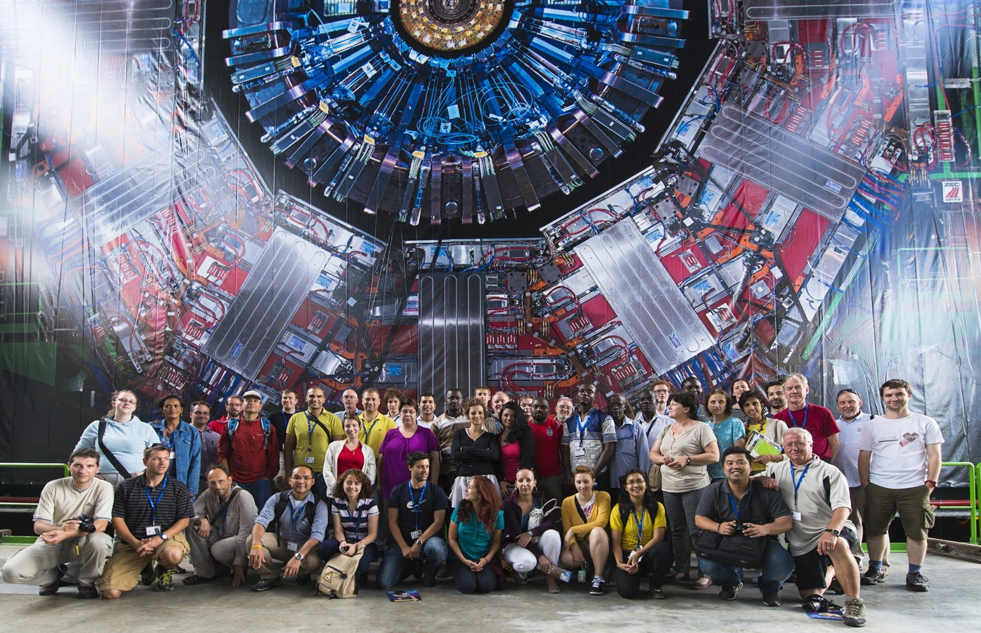
CERN teacher and student programmes
Rolf Landua
CERN
Head of Education and Public Outreach

Slide 2



CERN education programmes for schools and teachers
UNIVERSITY STUDENTS
- Summer Student Programme (8-13 weeks)
- Doctoral, technical, administrative student programmes
- Specialised schools (Particle physics, accelerators, computing)
HIGH SCHOOL TEACHERS
- 3 week international programme in English (55 participants)
- 35+ one-week national language programmes (1200+ participants)
- Teaching resources
SCHOOL STUDENTS
- CERN guided tours (110,000+ visitors per year)
- S’cool Lab
- Virtual visits

Slide 3

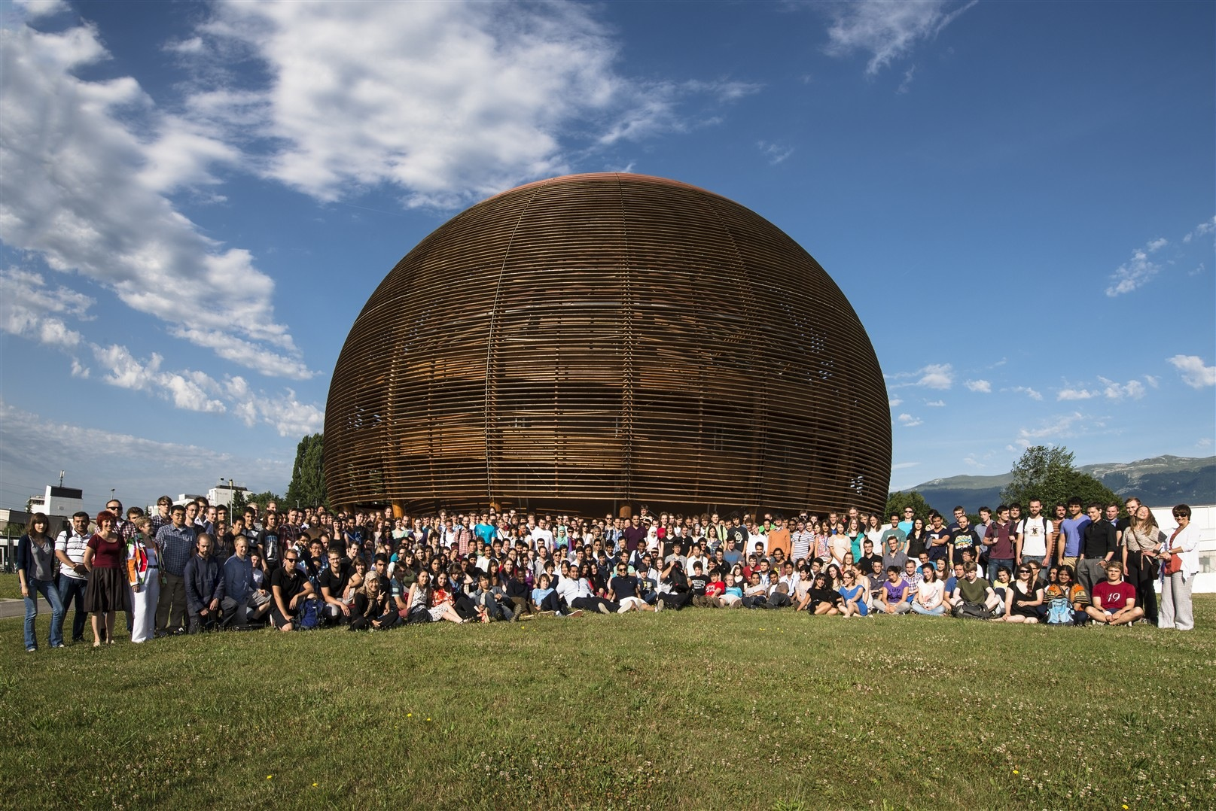
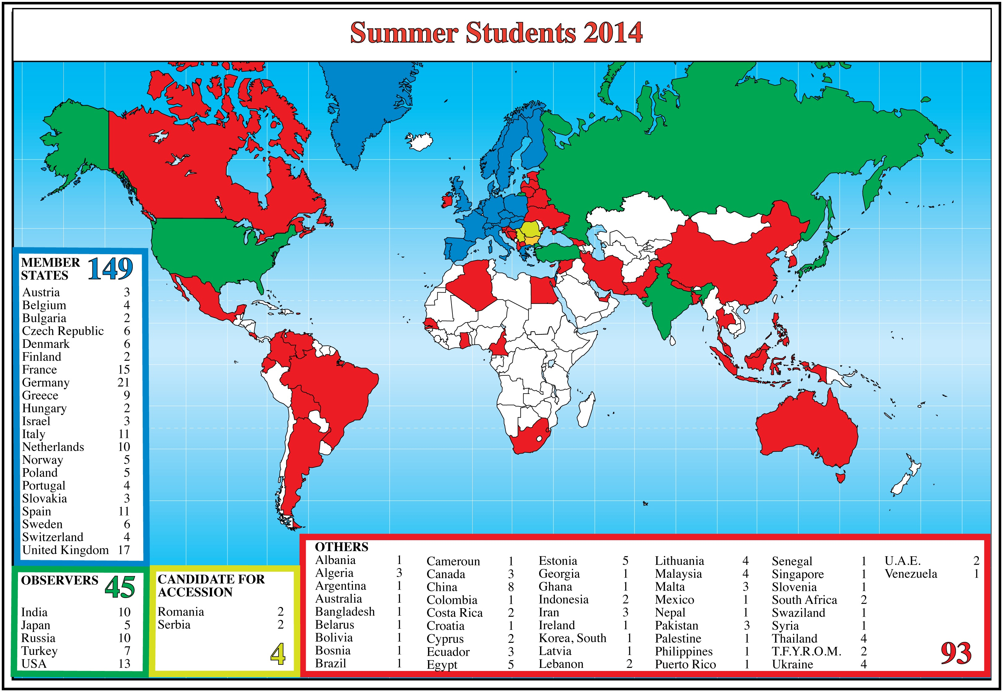
UNIVERSITY STUDENTS
Summer Student Programme (8-13 weeks)
LECTURES (morning)
WORK IN RESEARCH GROUPS (afternoon)
[after 2-3 years of study physics, engineering, computing]
Doctoral students
Technical, administrative students
Specialised conferences
(Accelerators, Computing, High Energy Physics)

Slide 4



HIGH SCHOOL TEACHERS
x 1000
Teacher
CERN = Science in Action
School students
Mysteries of the Universe
Raise interest in science
Superlatives of research
Teachers = mediators
Role models
Multipliers
Bring modern science to schools
Instil feeling of discovery
potential
How science works
Meet real scientists
￼

Slide 5



HIGH SCHOOL TEACHERS
High School Teacher - Summer School (3 weeks, in English, 55 participants)
- Fully funded by CERN for MS participants (programme, travel, accommodation)
- Participants from US, Asia, South America, and other Non-Member states, funded externally
National Language Teacher Schools (1 week, native language)
- Externally funded by home country of teachers
- Lectures by visiting scientists from home country
- 35+ programmes per year
PROGRAMME
Lectures
Workshops
Particle physics and cosmology
Accelerators and detectors
Applications in society
CERN experiments
Magnet test facility
Antimatter factory
CERN Control Centre
Computing Centre
S’cool Lab
Lesson reviews
Education resources

Slide 6
HIGH SCHOOL TEACHERS
CERN teacher schools have become very popular
2014: 1200 teachers in 37 programmes

Slide 7
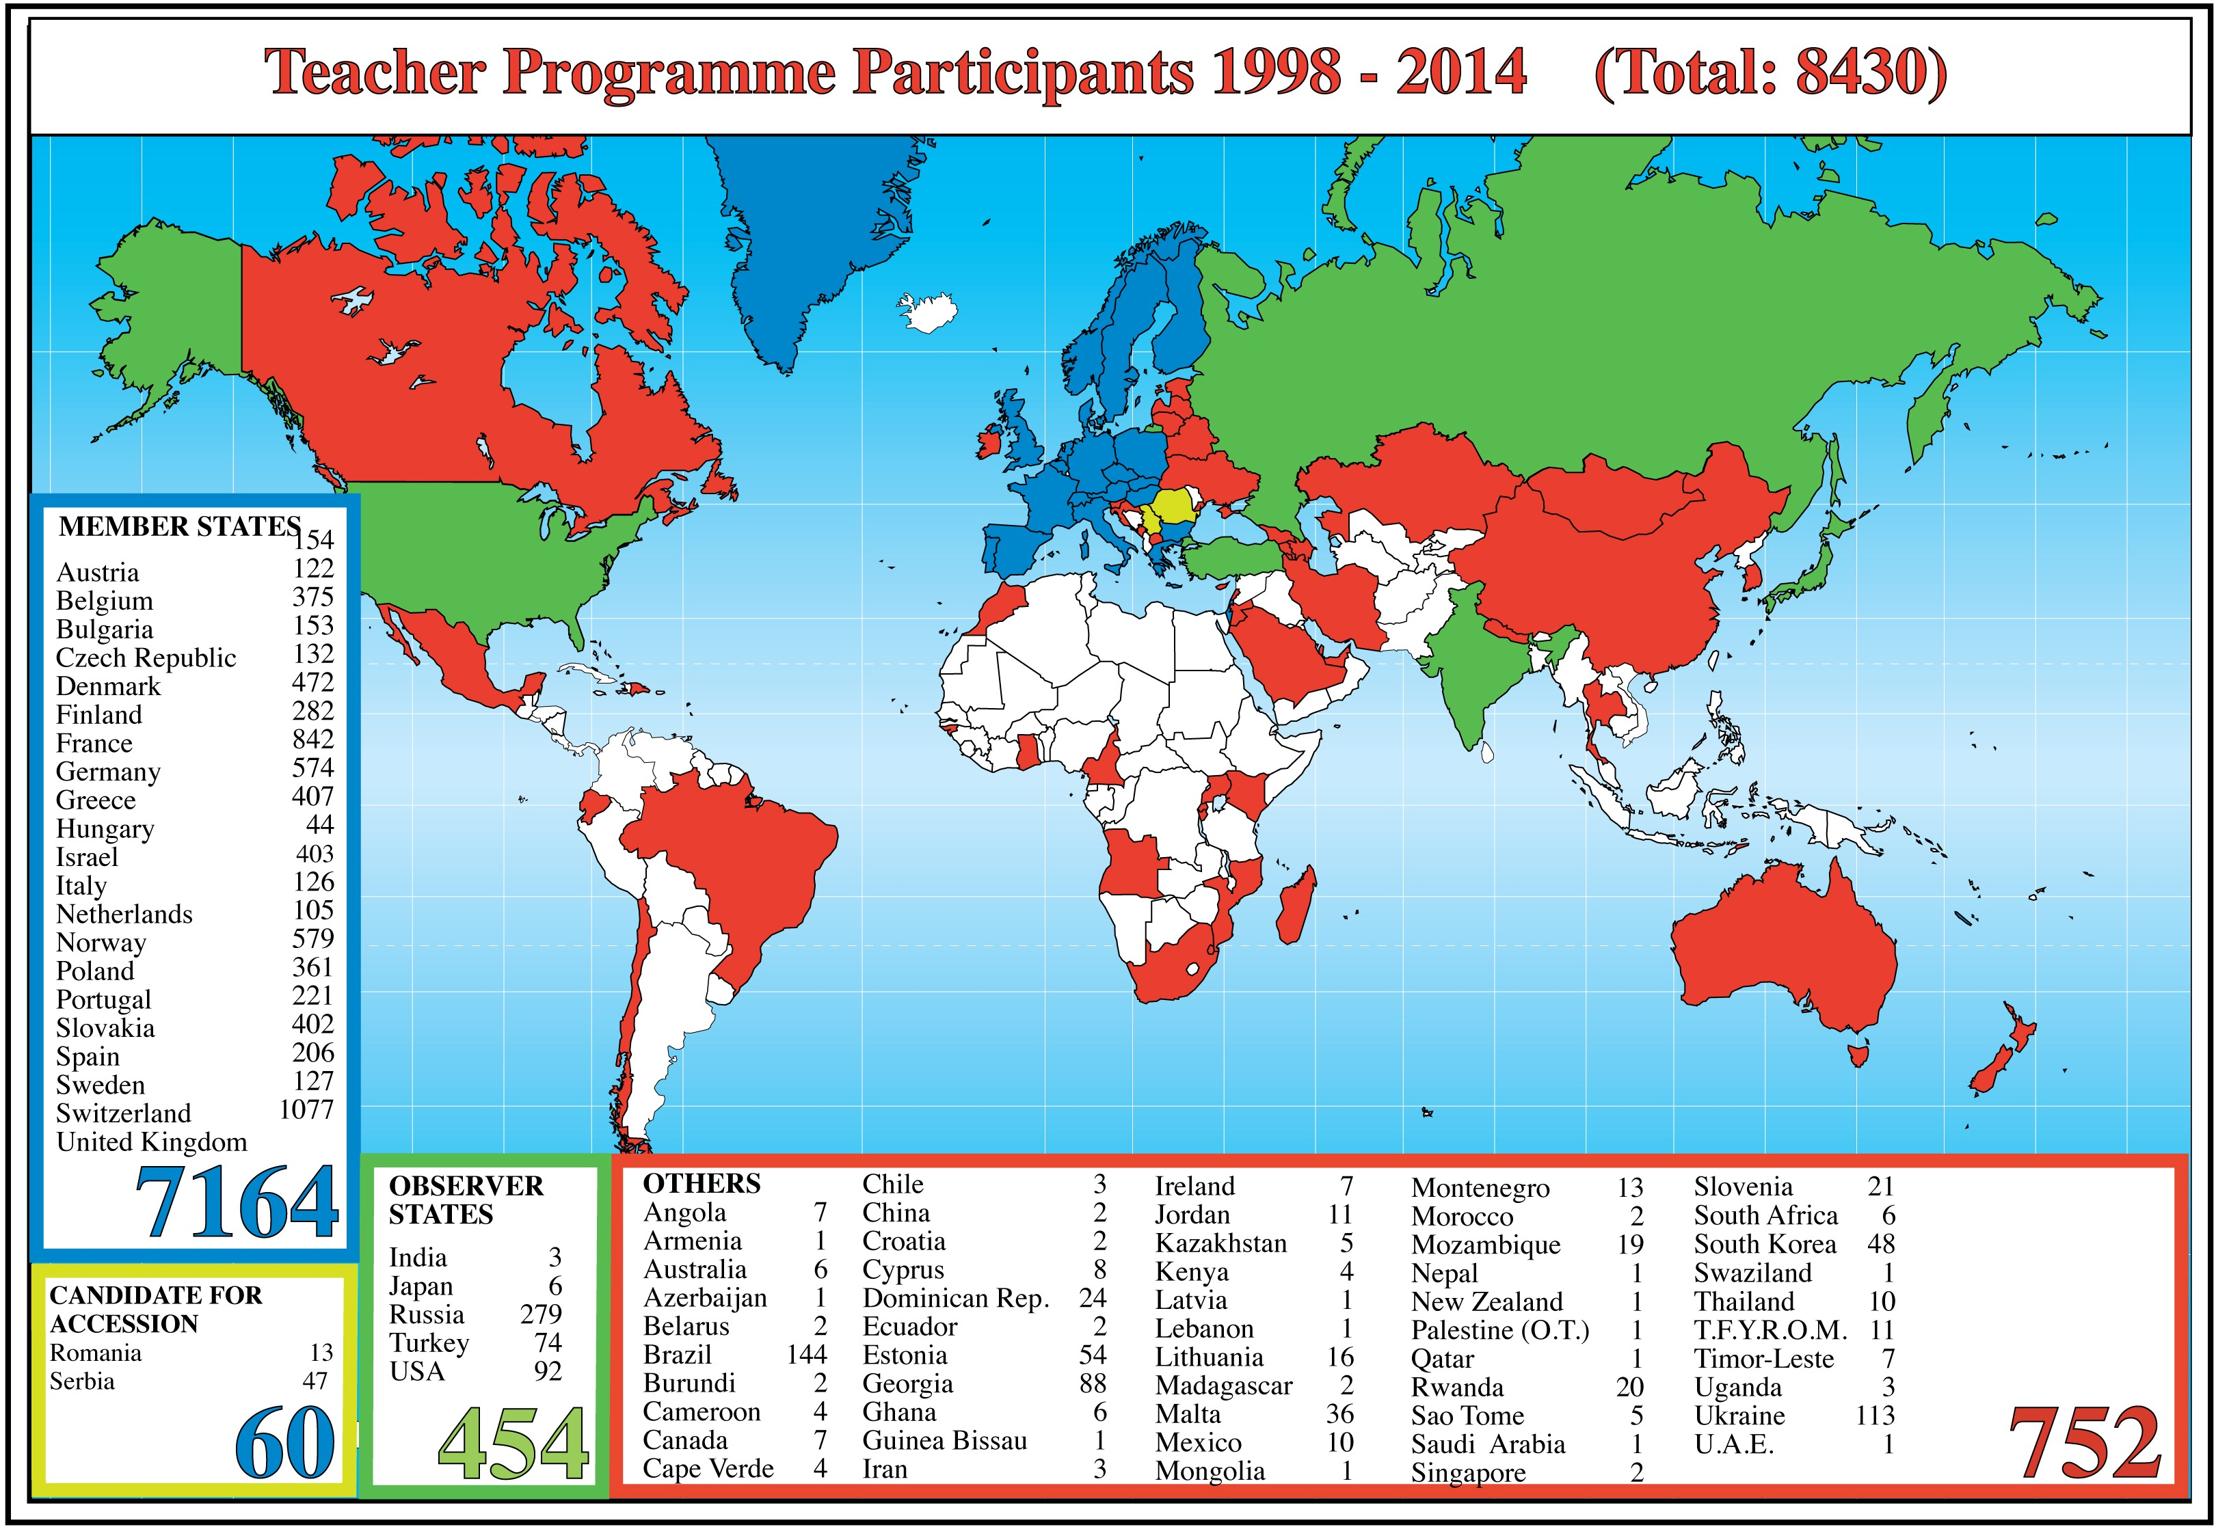
HIGH SCHOOL TEACHERS
8430 teachers from 81 countries
participated in a CERN teacher school

Slide 8
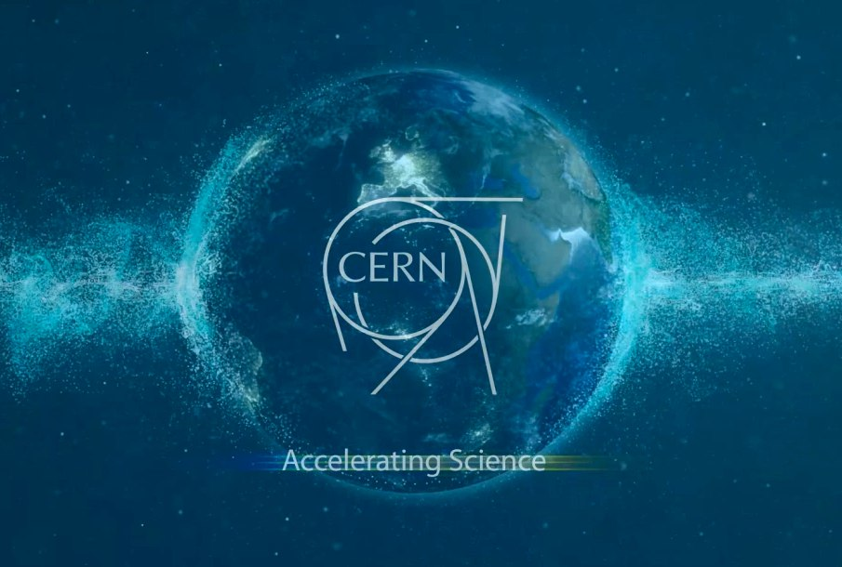
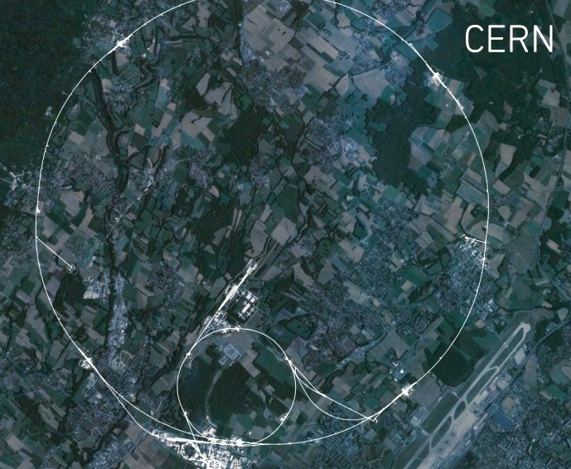
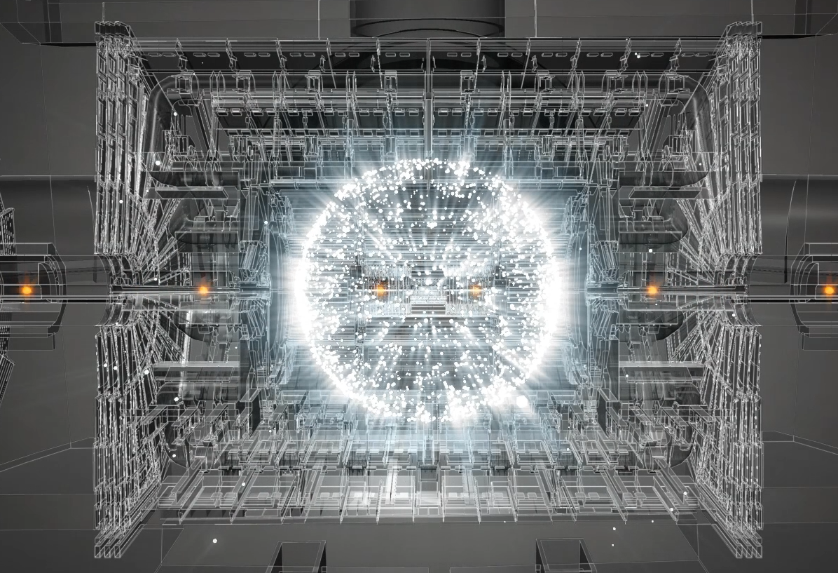
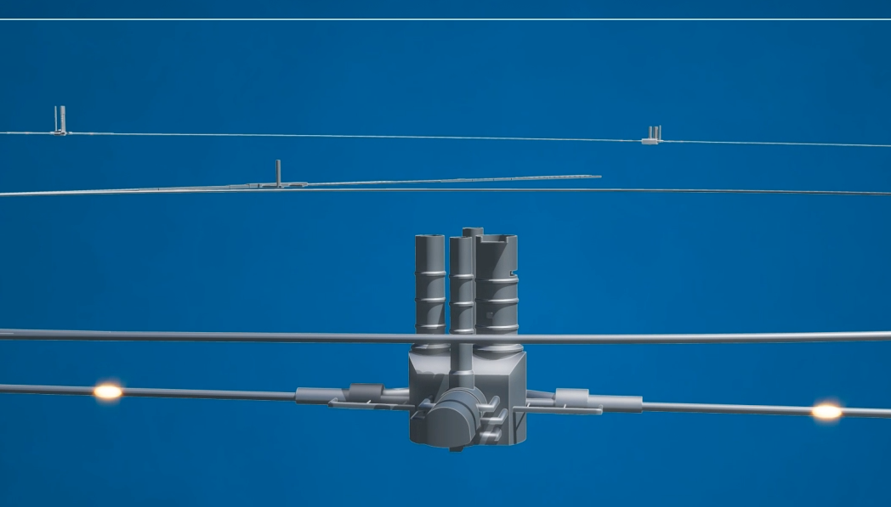
HIGH SCHOOL TEACHERS
Teaching resources: Animations
http://cern60.web.cern.ch/en/exhibitions/animations-1

Slide 9

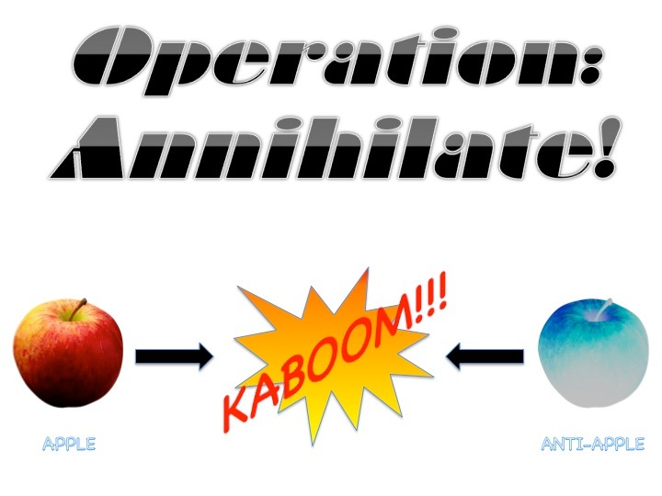

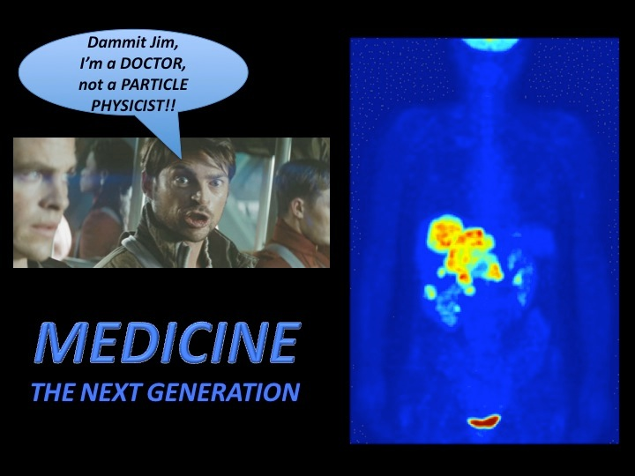
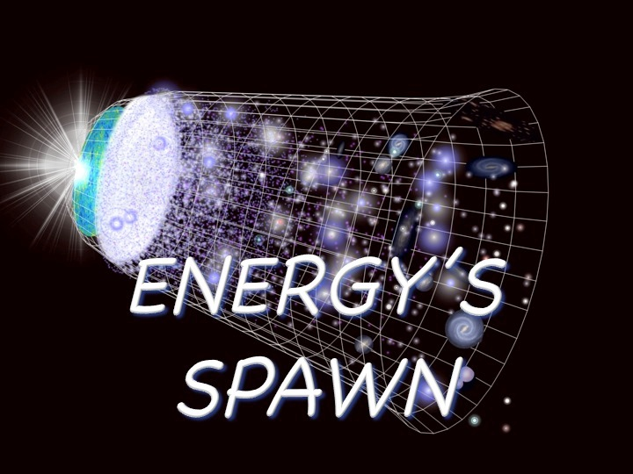
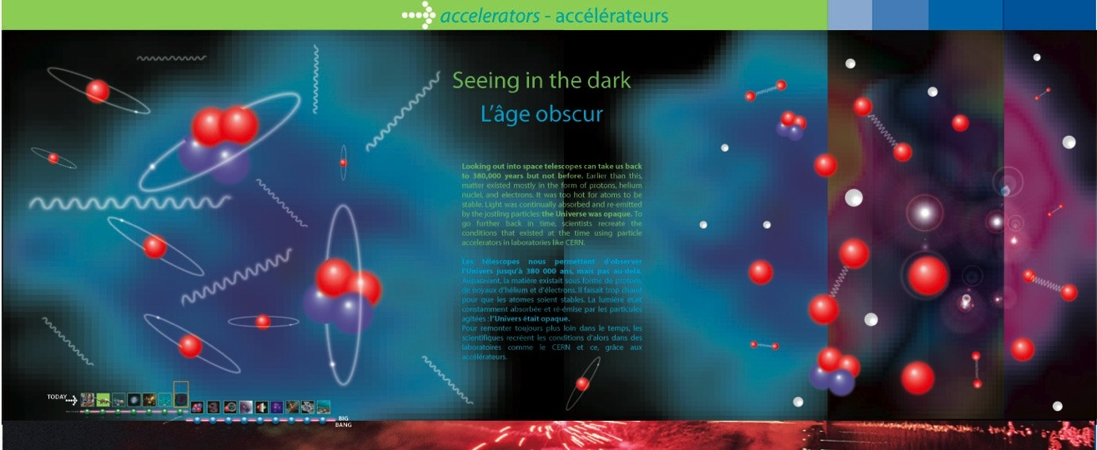

HIGH SCHOOL TEACHERS
Teaching Resources: Lesson plans, posters
ANTIMATTER
EVOLUTION OF THE UNIVERSE (17 POSTERS)
COSMIC RAYS
Target: Teachers

Slide 10

HIGH SCHOOL TEACHERS
What happens afterwards?
Follow up
Home country
CERN
Teach other teachers
Visit CERN - guided tour
Share resources and ideas
Visit CERN - S’cool lab
Form networks
Beam line for Schools
Visit national research centres and universities
Virtual visit to CERN

Slide 11
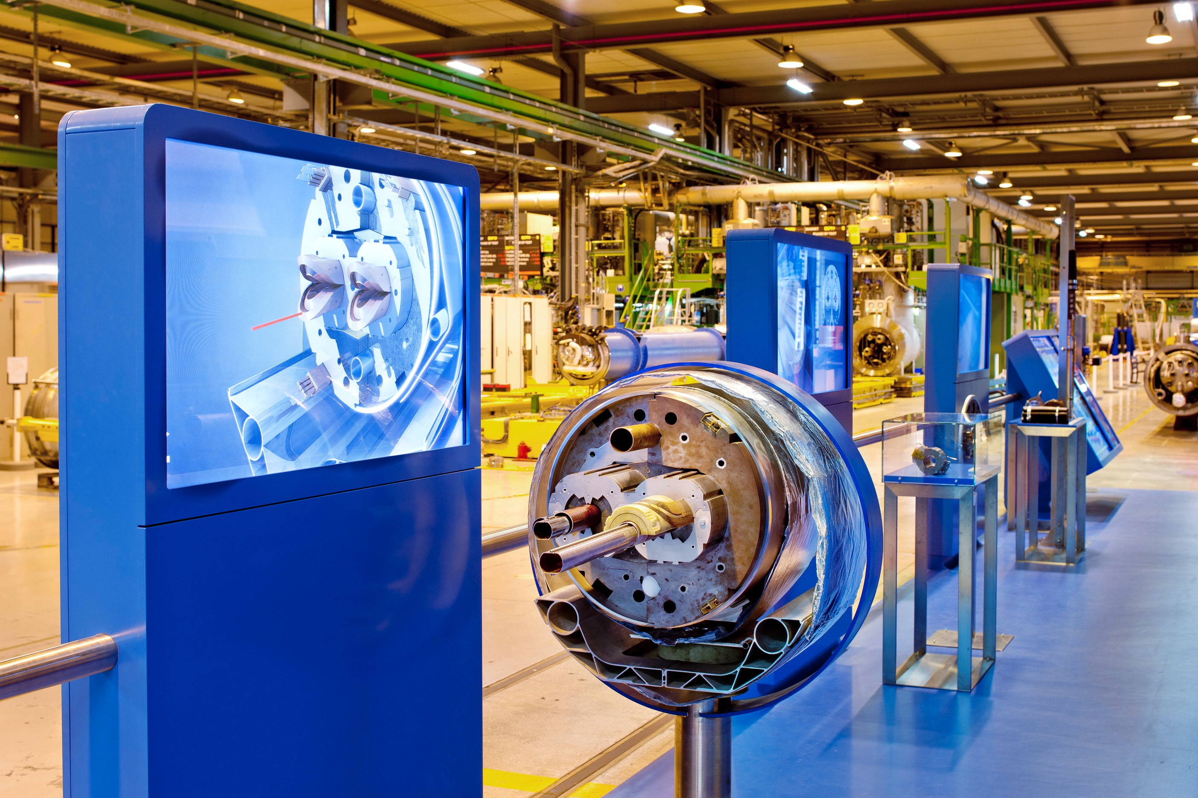
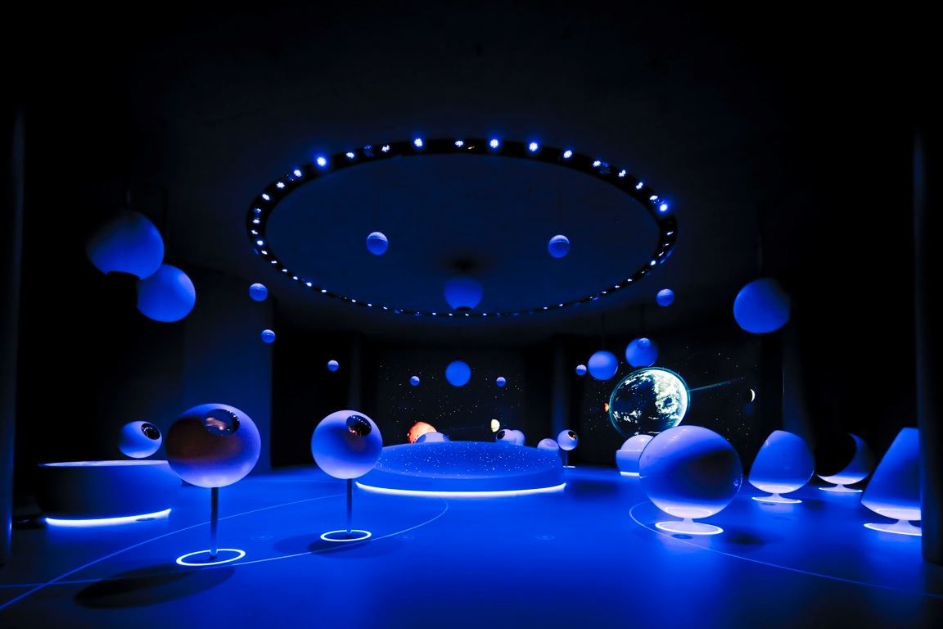
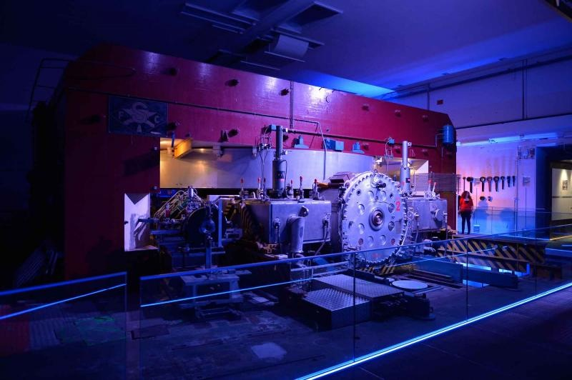
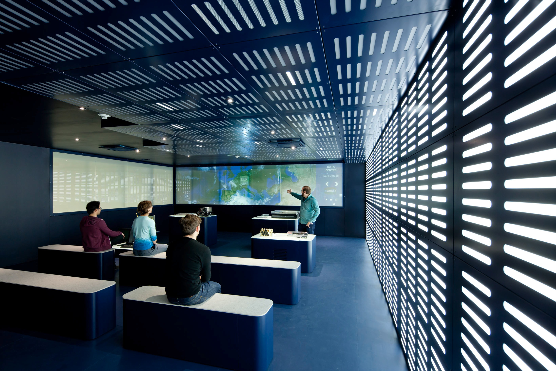
SCHOOL STUDENTS
Guided CERN tours
Experience the CERN atmosphere and see ‘science in action’
CERN visitors per year
Visit points
Magnet test facility
Universe of Particles
2014: 112,000 visitors on guided tours
~ 40 % school classes
~ 70 % travel more than 600 km
Synchrocyclotron
Computing Centre

Slide 12
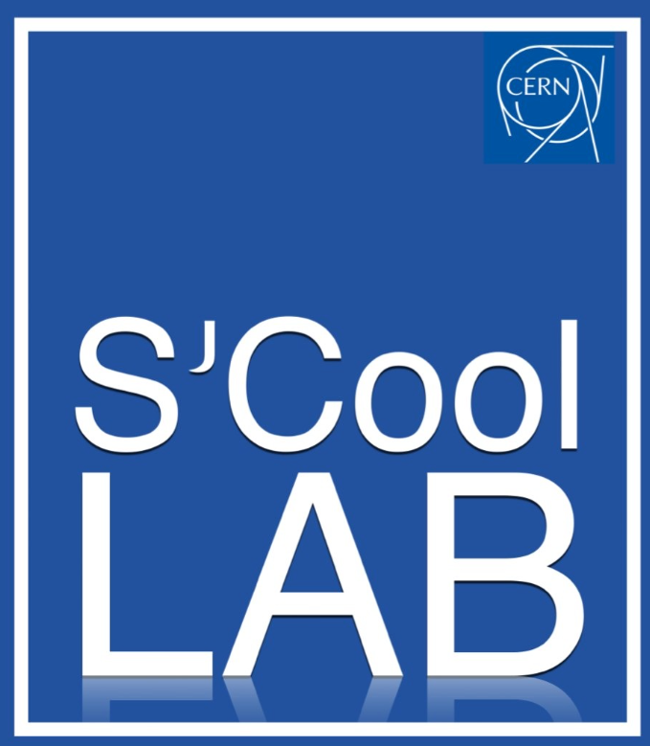
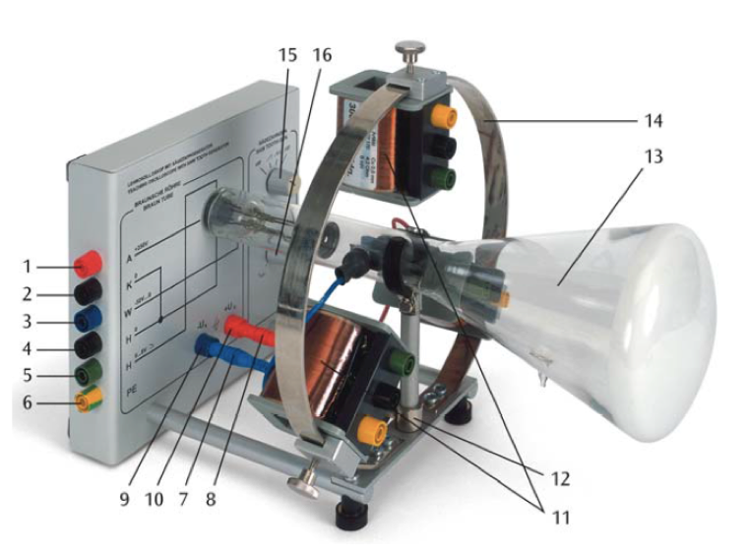
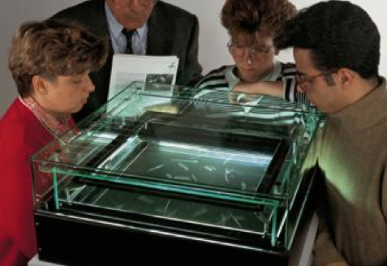
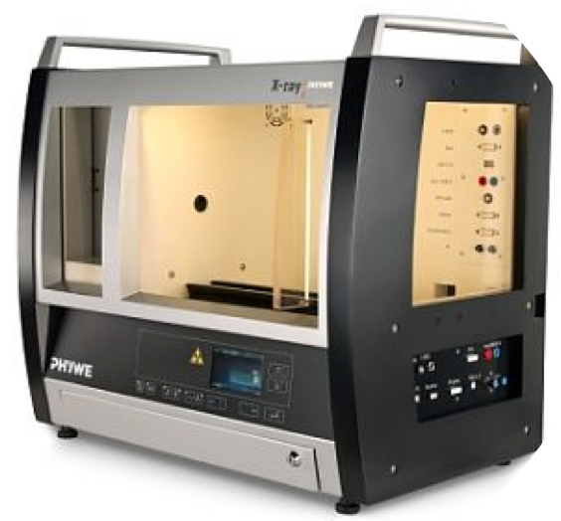
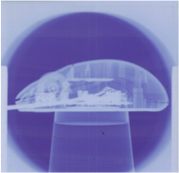
SCHOOL STUDENTS
Hands-on modern physics
Fundamental experiments and modern detector technologies
Classics
Detectors
Technologies
Planck constant
Cloud chamber
Superconductivity
Rutherford
Pixel detector
Particle trap
S’cool lab fact sheet
1/2 day of experiments
30 students
2 supervisors + teacher
Up to 3 different experiments
Franck-Hertz
Scintillators
X-ray unit
Electron tube
Cerenkov counter
PET technology
Hall effect
Radiation detection
Charge-mass ratio

Slide 13
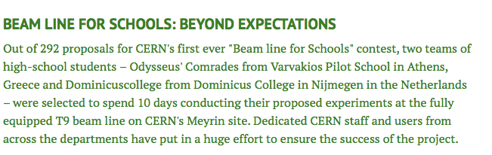
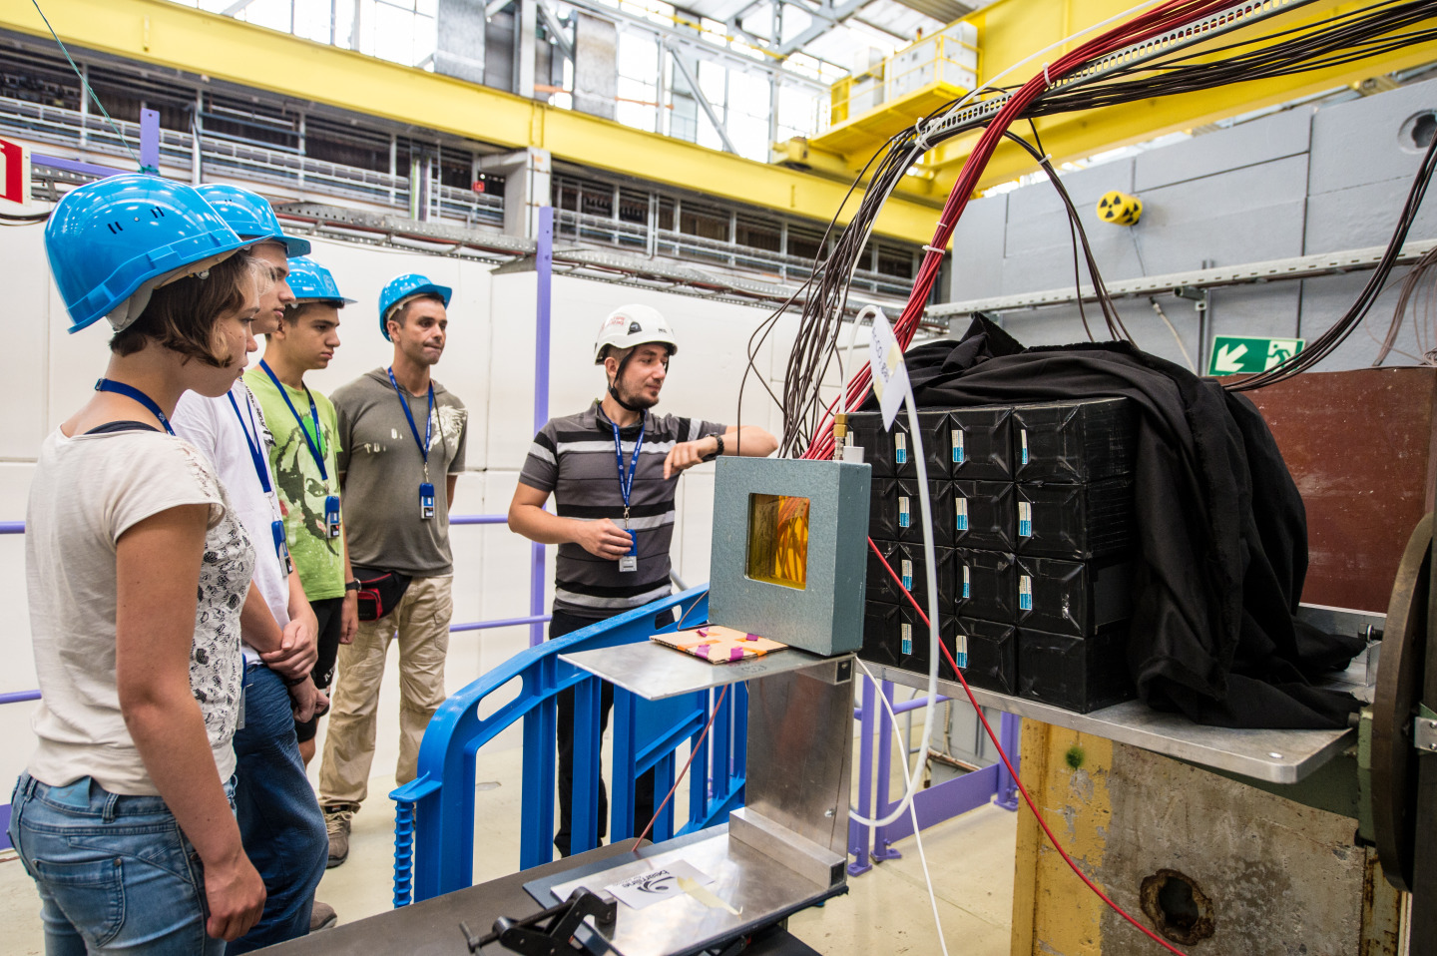
SCHOOL STUDENTS
“Beam Line for Schools”
School student teams propose and conduct a real CERN experiment
“BL4S” facts 2014
410 YouTube video entries
292 full proposals !
2 winning teams (GR, NL)
10 days of experimental work
2015: next edition

Slide 14
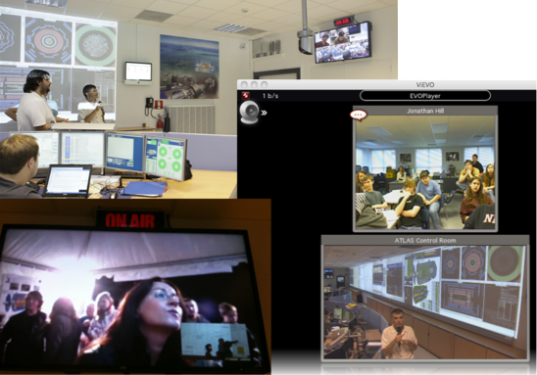

SCHOOL STUDENTS
“Virtual CERN visits” for schools
School classes connect with CERN scientists for one hour of Q + A
Virtual visits fact sheet
Skype, EVO, Vidyo, Google+, Polycom, Tandberg
Possibility of simultaneous transmission to many classes
From ATLAS, CMS, Control Centre, Experiments
2014: about 100 virtual visits

