Slide 1
Status of the charge breeder upgrade
Outline
Revise goals
HEC² path
MedEgun path
Fredrik Wenander, TSR workshop 27/4-2015
Notes:
Programme since 2012
Time to deliver - present status

Slide 2
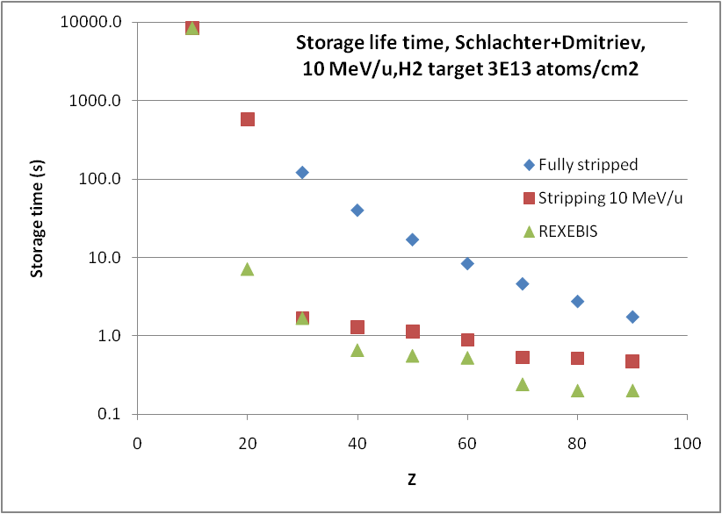
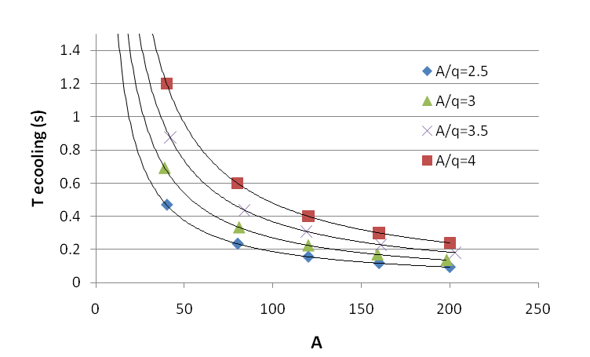
Benefits of high charges states
REXEBIS charge breeding times
Ion | Z | q | A/q | Breeding time (ms)
⁷Be | 4 | 3 | 2.33 | 20
¹⁸F | 9 | 9 | 2 | 100
⁷⁰Ni | 30 | 25 | 2.33 | 350
¹³²Sn | 50 | 39 | 3.38 | 700 *
¹⁸²Pb | 82 | 53 | 3.43 | 1000 *
¹⁸²Pb | 82 | 64 | 2.84 | EBIS upgrade needed
Internal gas target
* to be tested
  Rigidity TSR
  Storage lifetimes
  Cooling times
  Experiments
Light elements easiest to reach low A/q
Some experiments might require:
* Fully stripped to Z~70
* Few-electron system, e.g. for Th/U
T_{cool} – horizontal cooling time for beam with
large diameter
Notes:
REXEBIS charge breeding times for a selection of elements of relevance for TSR@ISOLDE experiments
A/q<3.5 required for 10 MeV/u
☺ REXEBIS charge breeder capable of producing sufficiently low A/q (or beam rigidity for < 10MeV/u) for most elements

Slide 3
TSR@ISOLDE breeder design parameters
Barium charge states
150 keV electron beam
 | TSR breeder | REXEBIS
Electron energy [keV] | 150 | 5
Electron current [A] | 2-5* | 0.2
Electron current density [A/cm²] | 1-2x10⁴ | 100
Trap pressure (mbar) | ~10⁻¹¹ | ~10⁻¹¹
Ion-ion cooling needed | YES | NO
Extraction time (us) | <30 | >50
*
Capacity of 10⁸ primary ions needs current I_{e} >3 A
Transverse acceptance ~ 34 μm (REXEBIS) needs I_{e} ~ 4-5 A

Slide 4
HEC² path
High Energy Current and Compression (HEC²) electron gun project

Slide 5
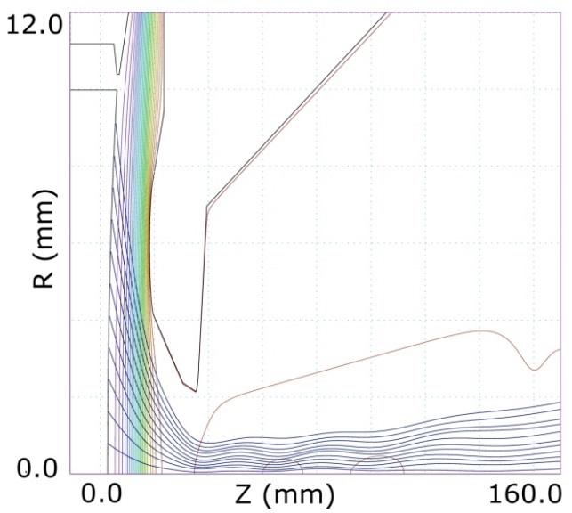
Gun design
Matching two focusing systems
Electrostatic compression (~300)
Magnetic compression (~50)
Very laminar electron flow,
high electrostatic compression
anode
Challenges
Require low B-field at cathode
Non-rippling electron beam
Mechanical tolerances
(Penning) discharges
electron beam
cathode
magnetic field ‘grab’ the beam (~0.25 T)
A. Pikin, E. N. Beebe, and D. Raparia,
Rev. Sci. Instr. 84 033303 (2013)

Slide 6


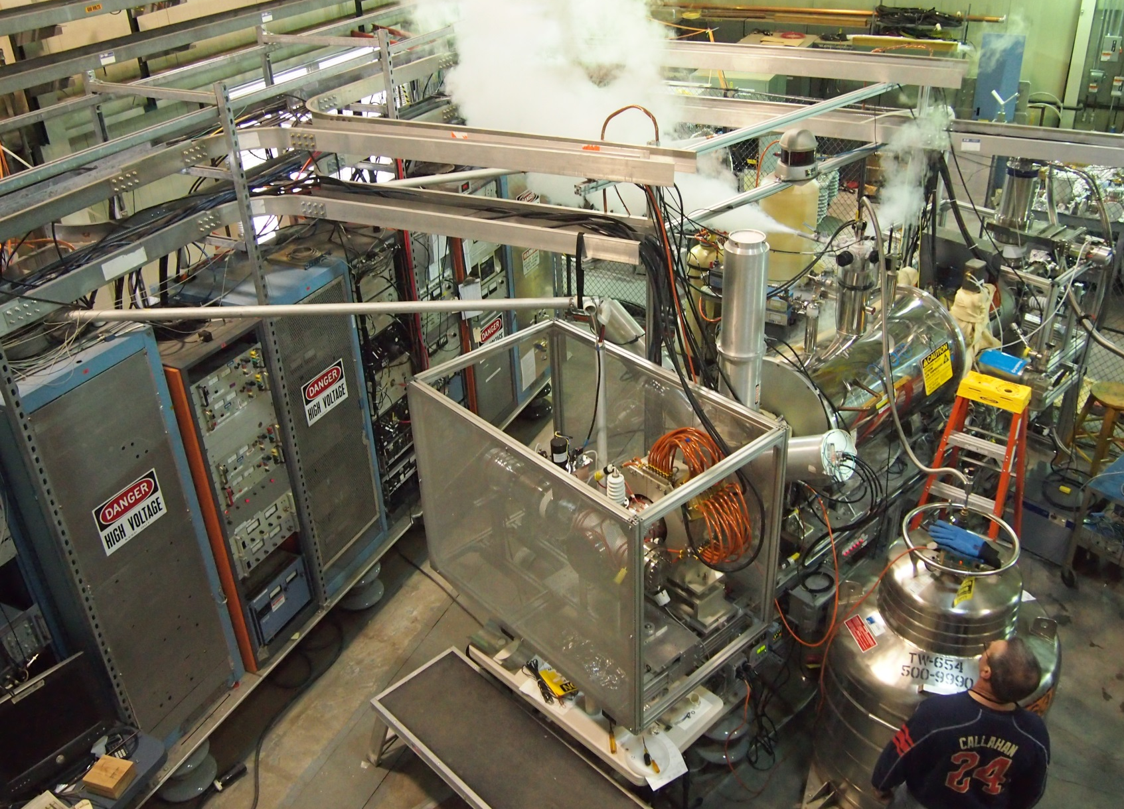
HEC² gun and TestEBIS
Prototype gun design by BNL, built by CERN being tested at BNL by joint team at BNL TEBIS
Notes:
External magnetic coil

Slide 7
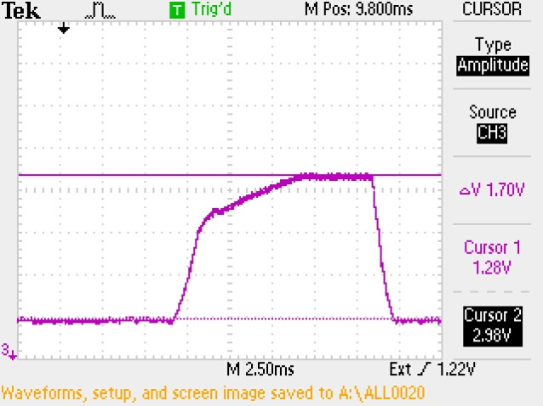
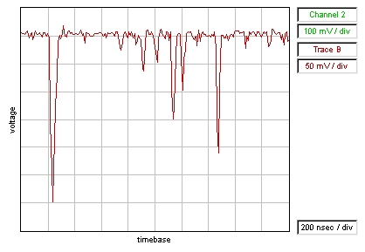
HEC² prototype tests at BNL
1V⬄0.5A
C⁶⁺/O⁸⁺
O⁷⁺
O⁶⁺
O⁵⁺
450 mA,
16.6 ms
C⁵⁺
C⁴⁺
C³⁺/O⁴⁺
Max current ramped to 1.7 A,
still limited by loss current
courtesy E. Beebe
H¹⁺
Ions extracted, O⁶⁺/O⁵⁺ and C⁵⁺/C⁴⁺
give too big error bars to define J_{e}
Scenario | E_{e}, keV | I_{e}, A | J_{e}, kA/cm²
HEC² ultimate spec | 150 | 5 | >10
Test stand limit as is | 40 | 2.2 | 5
Achieved in 2nd run | 30 | 1.7 | tba

Slide 8
Where we are on the map?
Bubble size represents electron current
rep – reported
est – estimated - in commissioning phase
† - discontinued

Slide 9
Limiting factor – loss current
20 mA = 2% losses, too high for an EBIS.
20 mA x 12 kV = 240 W heating on the anode,
too high for high duty factor and good vacuum.
In experiment – 20 mA trips the power supply.
Where 20 mA come from?

Slide 10
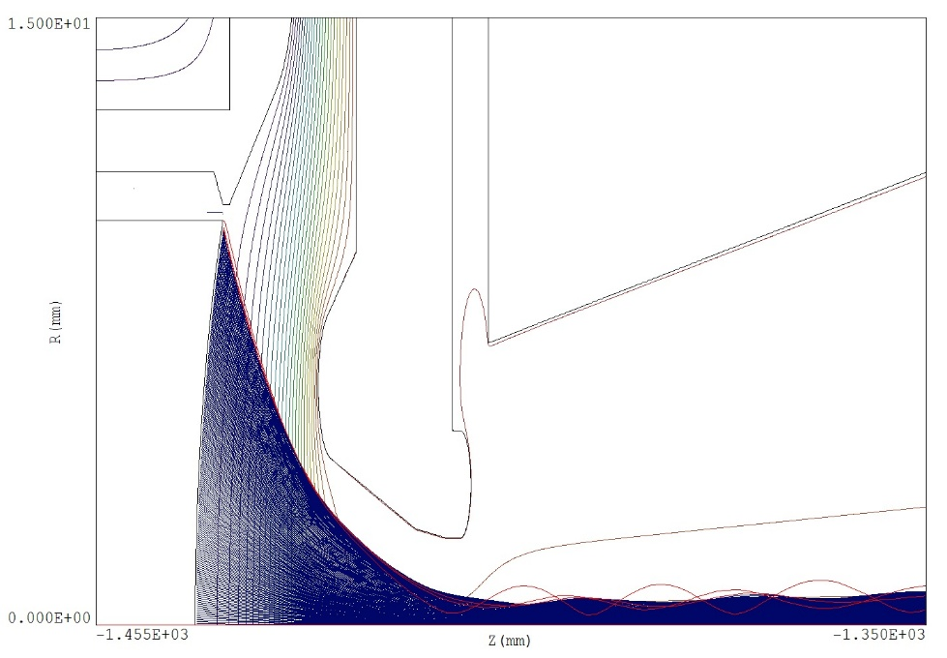
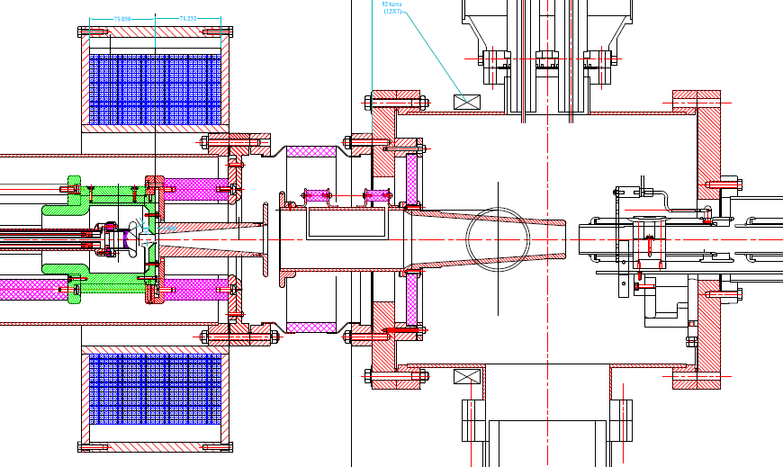
Origin of loss current?
Simplest answer is the wrong one
How do we know that?

Slide 11
Origin of loss current?
Anode current strongly depends on
Drift tune voltages
Phase-coil current

Slide 12
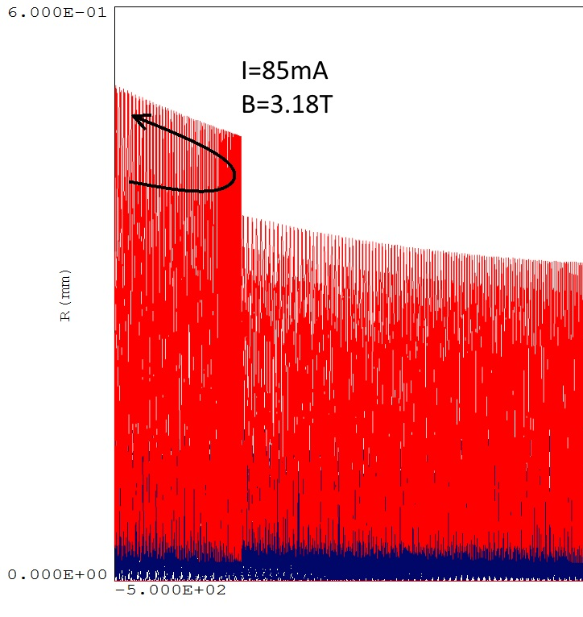
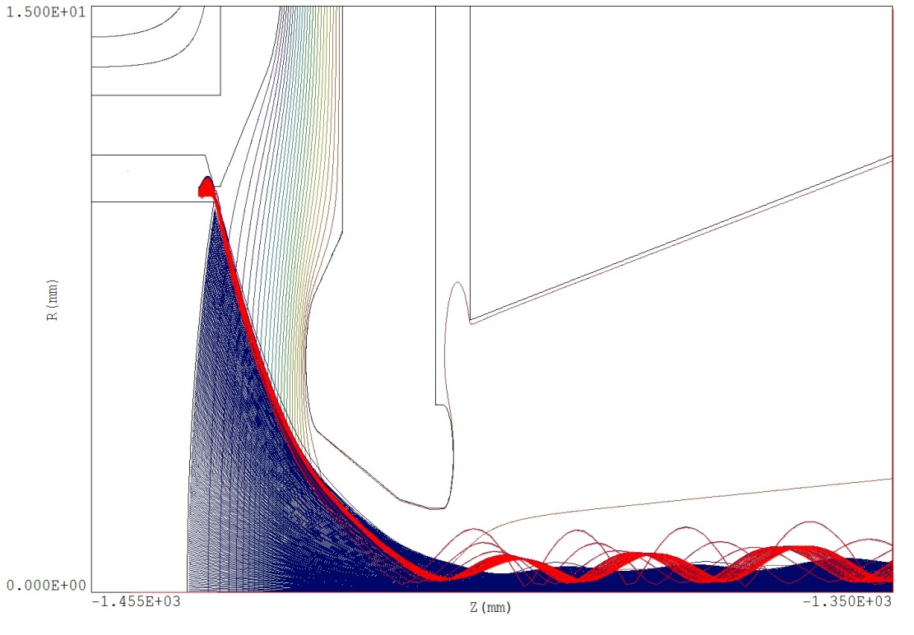
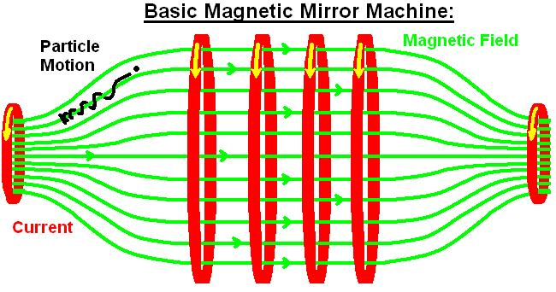
Origin of loss current?
increasing B-field
courtesy R. Mertzig

Slide 13


Next HEC² actions
First two runs without Wehnelt.
At third test Wehnelt was shortcut.
Furthermore
a. Adjustment to compensate for
heat dilatation of cathode
b. Intercept reflected electrons
with a collimating tube
HEC² design presently under revision
to reach specification of 3.5 A
Wehnelt 0 V
Wehnelt 50 V
courtesy R. Mertzig

Slide 14
MedEgun path
Electron gun optimised for production of rapid C⁶⁺

Slide 15
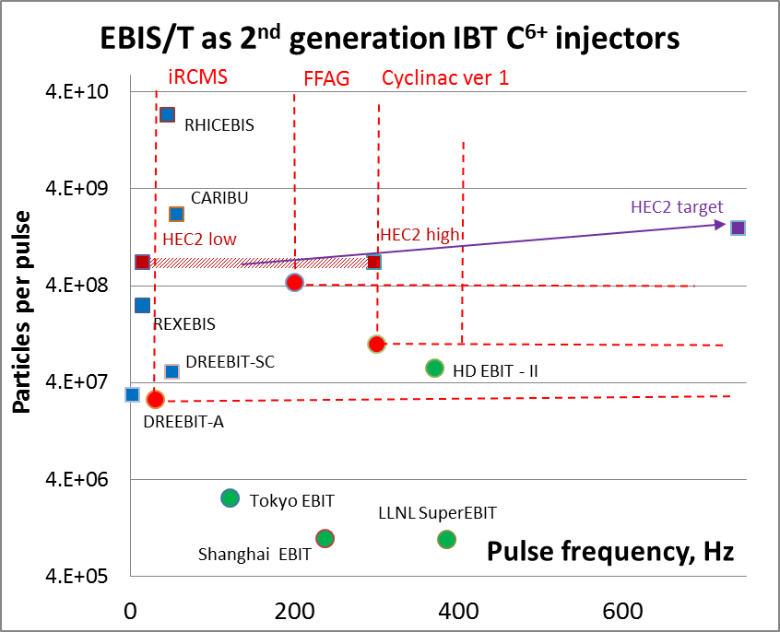
EBIST as 2nd generation IBT injector
Our suggestion:
EBIS with high-compression electron gun
+ Potentially very fast
+ Short ion pulses <5 us attainable for carbon ions
(aim for single-turn inj.)
+ 6⁺ ions out of the source
+ Very low beam contamination
Cyclinac ver. 2
MedEgun
C⁶⁺ per pulse
MedEgun would require less electron current than proven, but a higher current density

Slide 16
How can TSR@ISOLDE benefit?
Downscaling of HEC² ultimate goal leads to IBT application
+ Less dependent on BNL constraints
+ More straightforward to implement
(no need for a new SC magnet)
+ Funding available
? Efficiency unknown
fully stripped to Fe
Z=30 He-like
Z=40 He-like
Z=50 He-like
Z=60 O-like
Z=70 Na-like
Z=80 Na-like
Z=90 P-like
 | TSR breeder | REXEBIS | MedEgun
Electron energy [keV] | 150 | 5 | 10
Electron current [A] | 2-5* | 0.2 | 1
Electron current density [A/cm²] | 1-2x10⁴ | 100 | 1200
Trap pressure (mbar) | ~10⁻¹¹ | ~10⁻¹¹ | ~10⁻¹¹
Ion-ion cooling needed | Yes | No | To be tested
Extraction time (us) | <30 | >50 | >50
No fully stripped heavy ions
10 times faster than REXEBIS

Slide 17
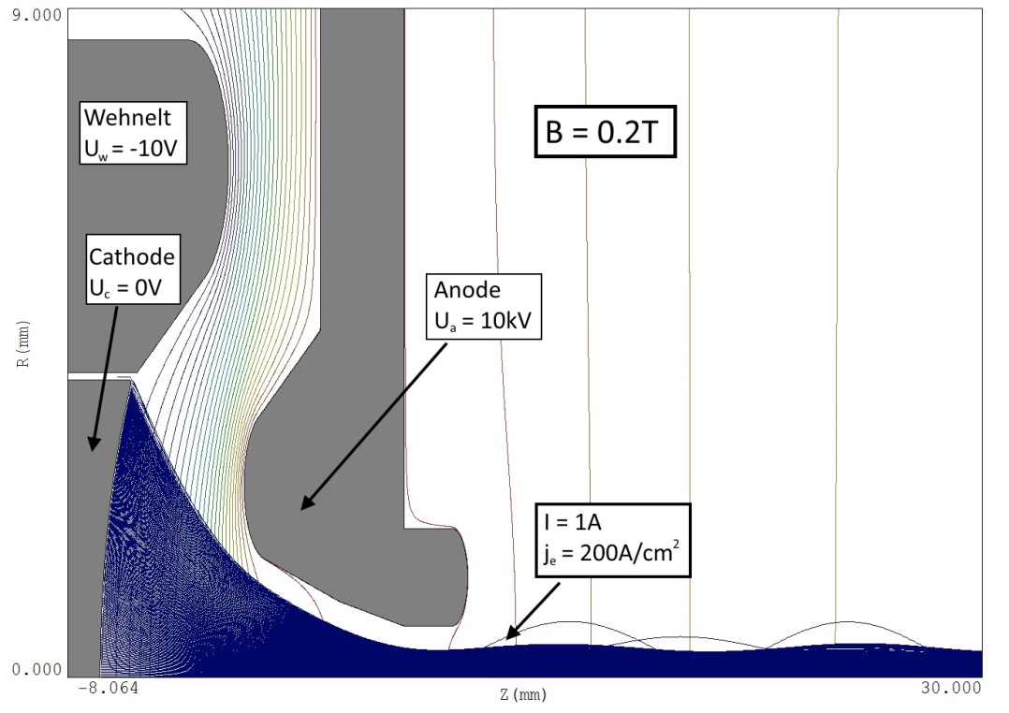
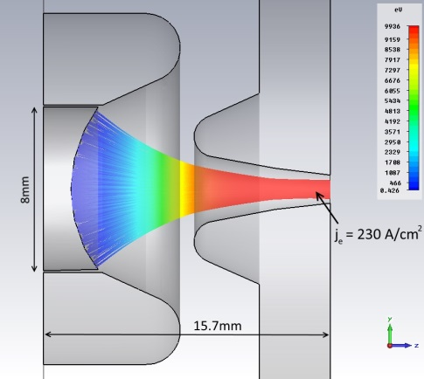
MedEGUN simulations
2D Field Precision
Latest state of the electron gun optimisation
Also use 3D electron beam simulations running on the CERN computing cluster
Investigate:
mechanical tolerances
electron beam back reflection
from gun-to-collector simulation
3D CST

Slide 18
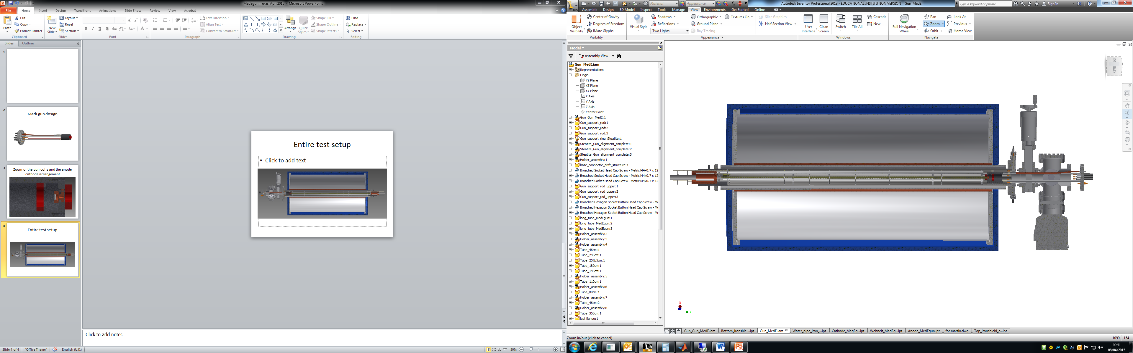
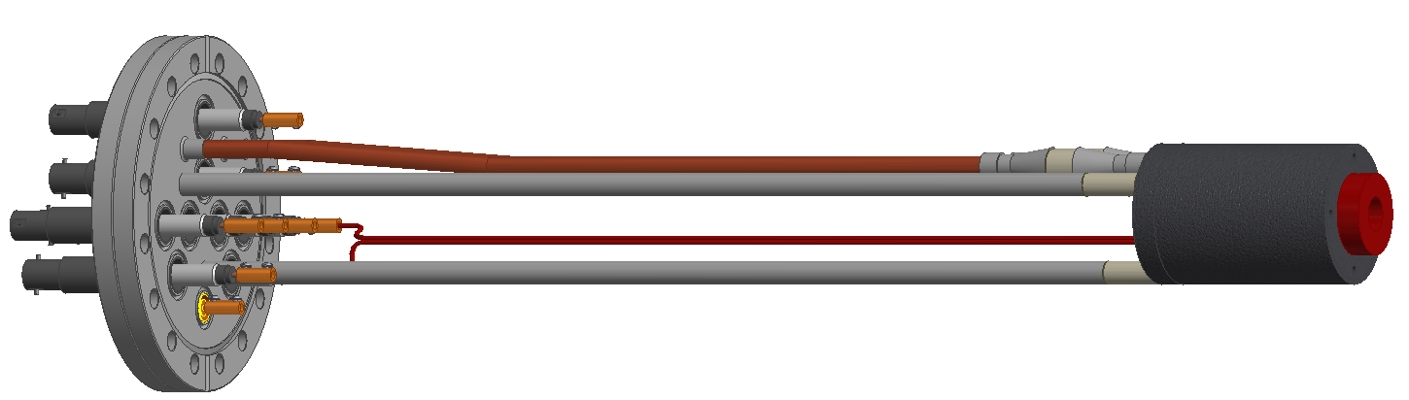
Mechanical design
gate valve
Present stage of the mechanical design
* integration study
* mechanical precision
superconducting magnet
drift tube structure
electron gun
feedthrough flange
Notes:
Two different mechanical implementations of the electron gun
Will start involving specialists from CERN group in June

Slide 19
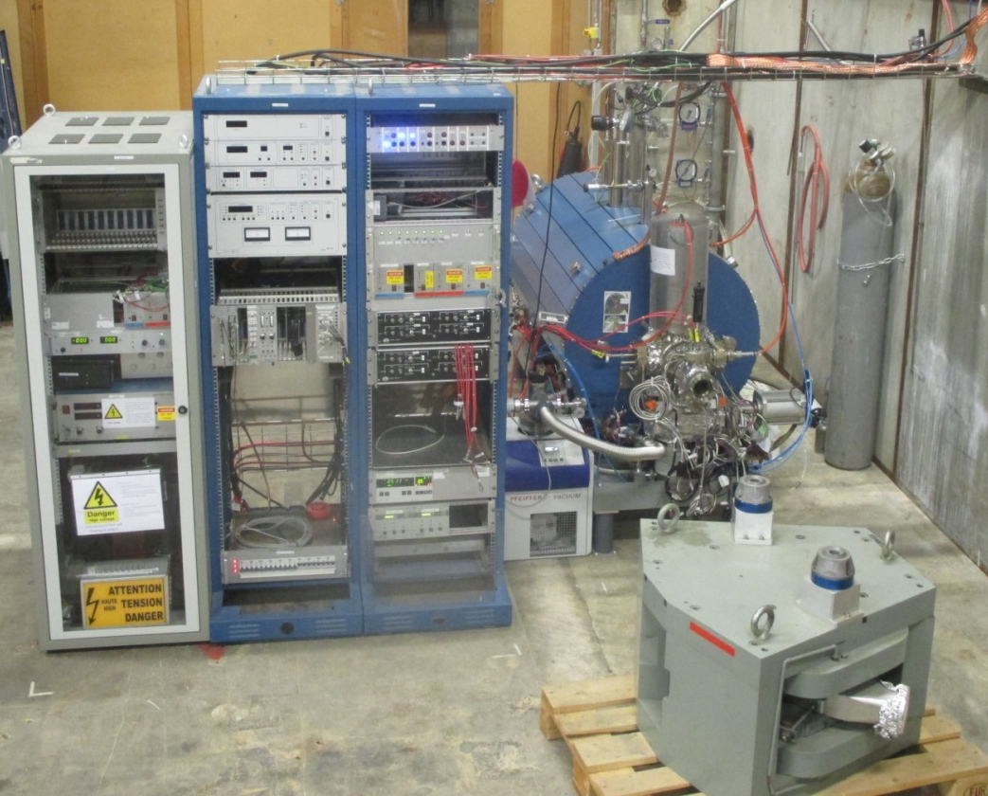
Test bench for electron gun
Functional EBIS available for tests:
magnet and vacuum chamber
electron collector
Focus entirely on the gun side
TwinEBIS setup in building 150
If successful -> could be implemented at REXEBIS
Possibly need to modify :
drift tube structure
collector to handle the larger current and deposited current
Approximate cost 200 kCHF

Slide 20
Timeline and resources
2nd iteration
Manpower and budget request to KT fund (approved)
* Estimated hardware cost for technical support 90 kCHF
* Full-time fellow over 2 years with 50% coverage by the KT fund, remaining part elsewhere
Notes:
Already started the development work, ahead of schedule for the moment
190 kCHF manpower+materials (CERN Knowledge Transfer grant)

Slide 21
Conclusions
* Next HEC² tests foreseen in May 2015
* HEC² development continues
+ with or without CERN
  - fellow A. Shornikov’s continuation depends
on approval of ENSAR2
? HEC² priority for BNL?
* In parallel MedEgun development started at CERN
partly funded by Knowledge Transfer fund at CERN
not aiming for heavy fully stripped ions
potentially very fast breeder
electron gun can be used in REXEBIS solenoid
intermediate stage to ultimate TSR charge breeder
Notes:
HEC2 more difficult than BNL thought – maybe not me

