Slide 1
HCAL Analysis
Samet Lezki
Yalcin Guler
Emine Gurpinar,Serdal Damarseckin,
Shuichi Kunori, Isa Dumanoglu,
Bayram Tali, Merve Ince, Hasan Huseyin Isik
26.02.15
1

Slide 2
Following results were obtained using
/MinimumBias/Run2012D-PromptReco-v1/RECO data set and it was filtred by "HLT_ZeroBias_v7"
26.02.15
2

Slide 3
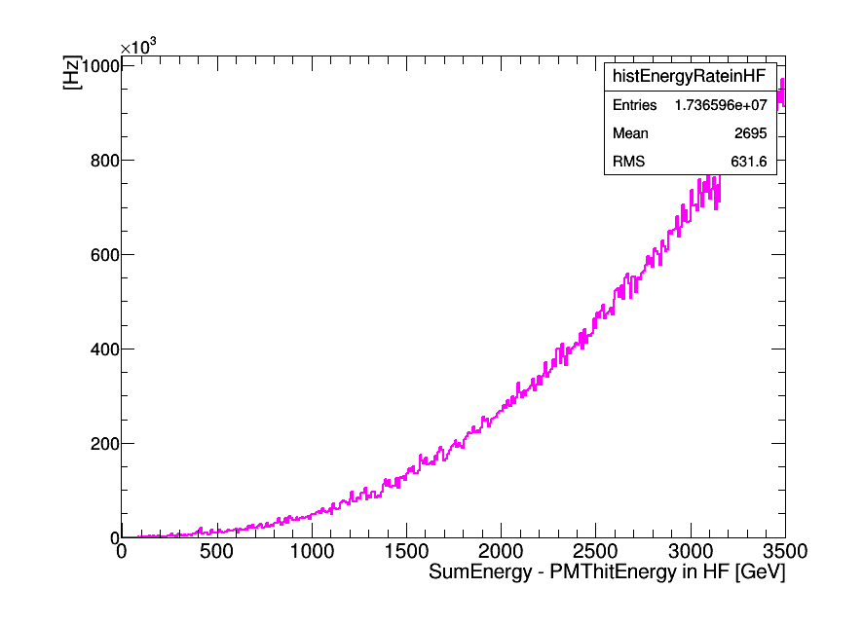
T [sec] =integratedLumi/L(average)
Rate = N/T * 1.5E6 [Hz]
N: PMT hits Events (noise events)
HLT_ZeroBias_v7
The total persecuting factor is
10,000 (L1) * 150 (HLT) = 1.5E6

Slide 4
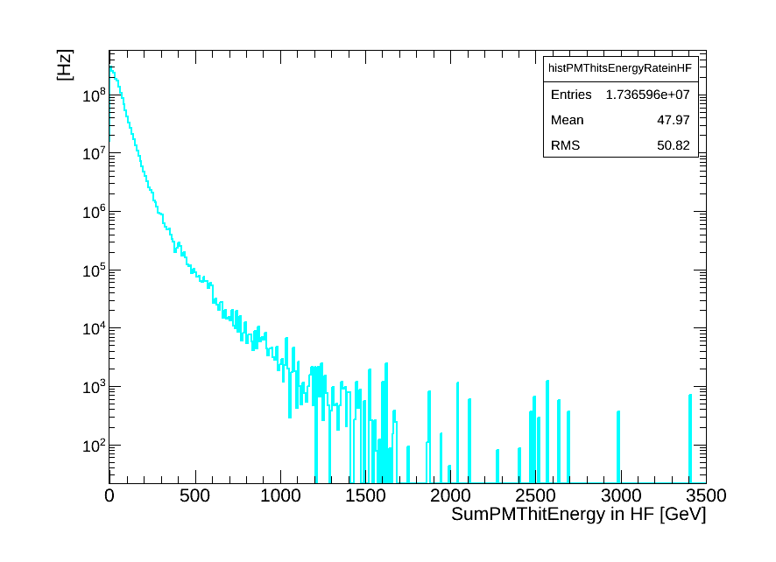
T [sec] =integratedLumi/L(average)
Rate = N/T * 1.5E6 [Hz]
N: PMT hits Events (noise events)
HLT_ZeroBias_v7
The total persecuting factor is
10,000 (L1) * 150 (HLT) = 1.5E6

Slide 5
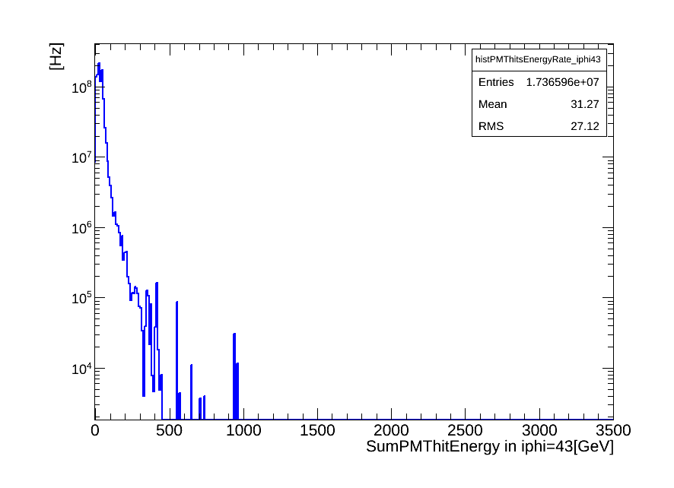
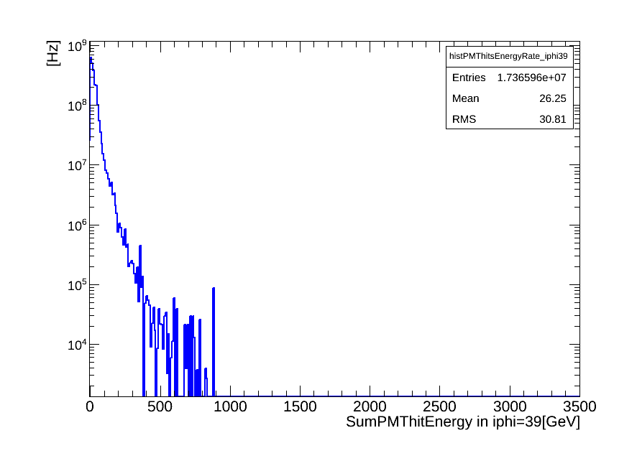
T [sec] =integratedLumi/L(average)
Rate = N/T * 1.5E6 * 72 [Hz]
N: PMT hits Events (noise events)
HLT_ZeroBias_v7
The total persecuting factor is
10,000 (L1) * 150 (HLT) = 1.5E6
72 is number of wedges in the HF.
New PMTs
iφ=43
Old PMTs
iφ=39

Slide 6
Following results were obtained using
/MinimumBias/Run2012D-PromptReco-v1/RECO data set and it was filtred by "HLT_Physics_v5"
17.02.15
26.02.15
6
6

Slide 7
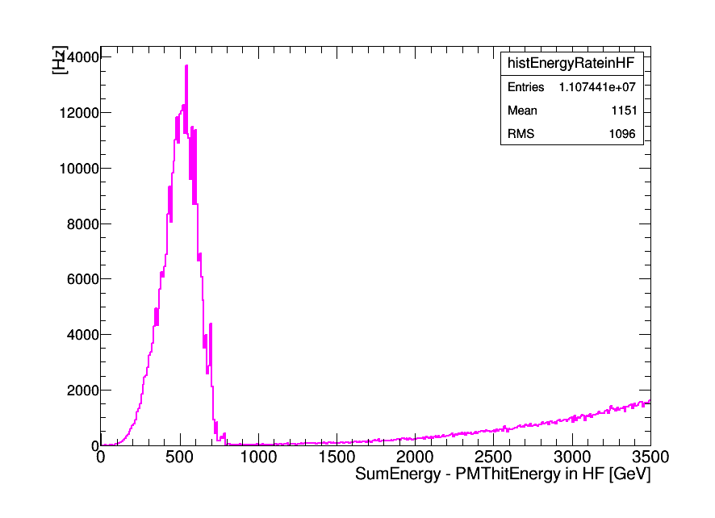
T [sec] =integratedLumi/L(average)
Rate = N/T * 8E3 [Hz]
N: PMT hits Events (noise events)
HLT_Physics_V5 had the perscaling factor of 8e3.

Slide 8
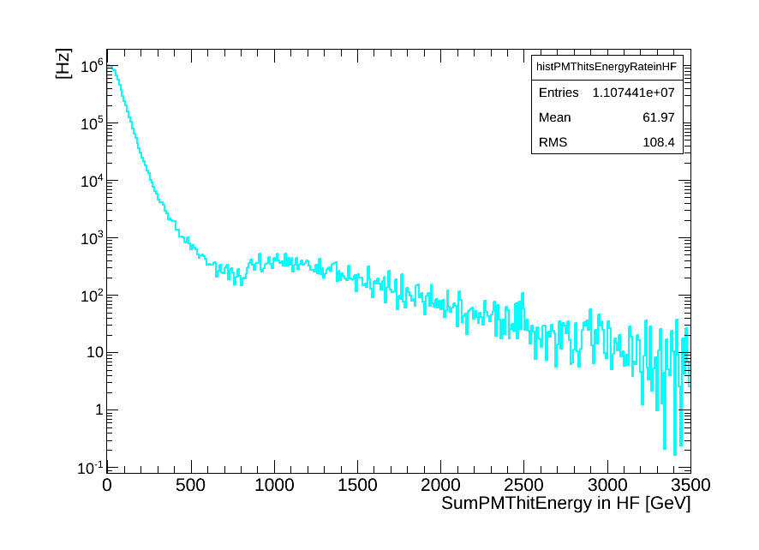
T [sec] =integratedLumi/L(average)
Rate = N/T * 8E3 [Hz]
N: PMT hits Events (noise events)
HLT_Physics_V5 had the perscaling factor of 8e3.

Slide 9
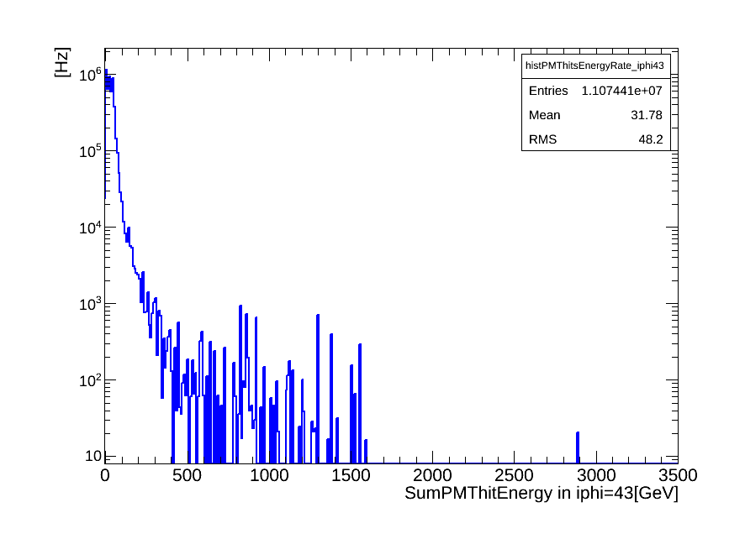
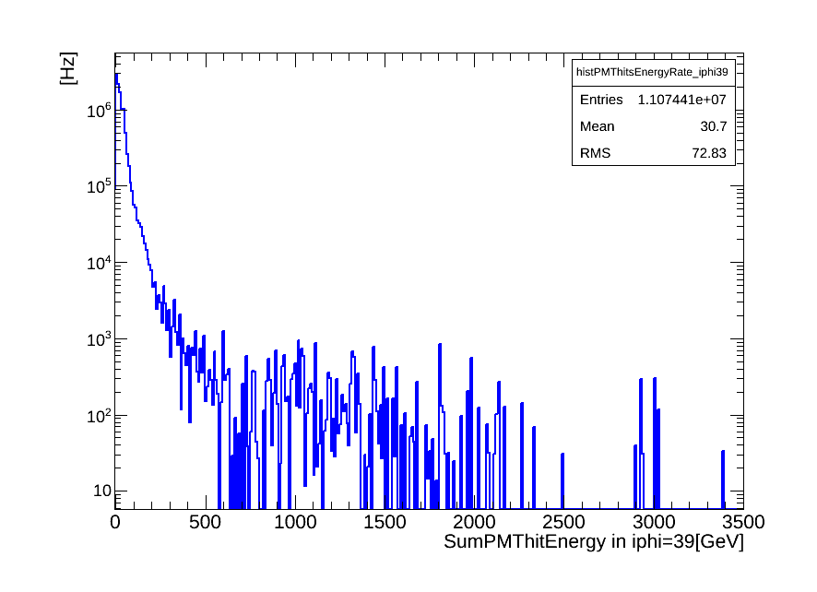
T [sec] =integratedLumi/L(average)
Rate = N/T * 8E3*72 [Hz]
N: PMT hits Events (noise events)
HLT_Physics_V5 had the perscaling factor of 8e3.
72 is number of wedges in the HF.
New PMTs
iφ=43
Old PMTs
iφ=39

Slide 10
Following results were obtained using
/MinimumBias/Run2012D-PromptReco-v1/RECO data set and following HLT filters was excluded while the data was analysing.
HLT_Physics_v5
17.02.15
26.02.15
10
10

Slide 11
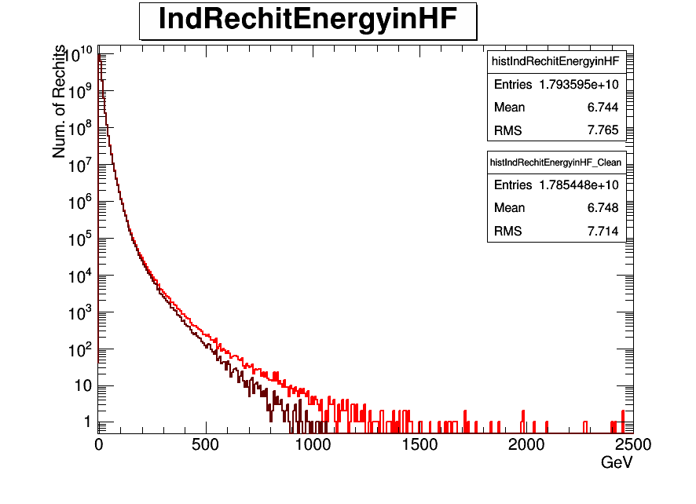

Slide 12
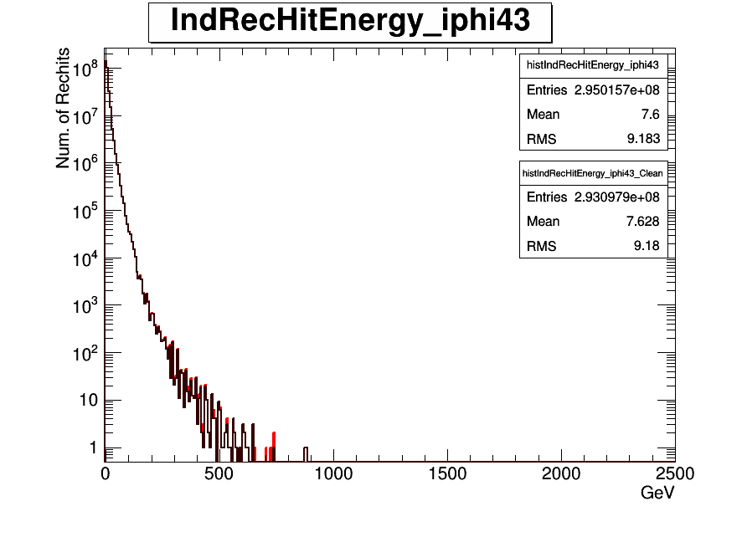
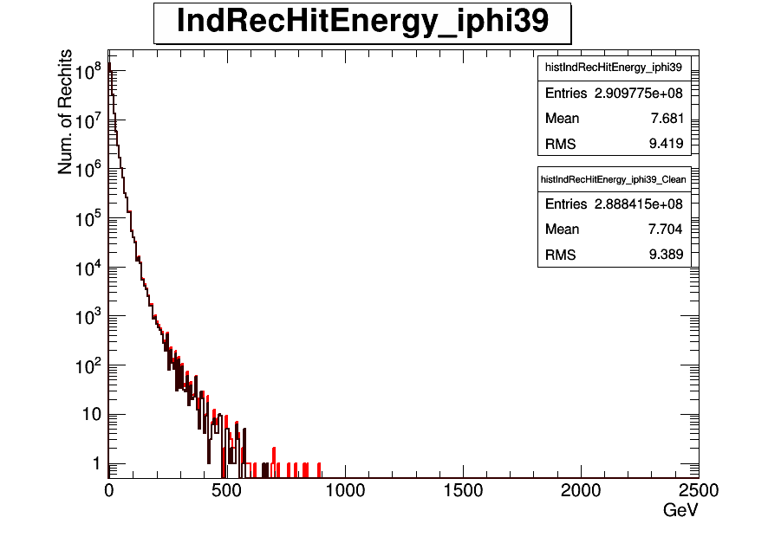
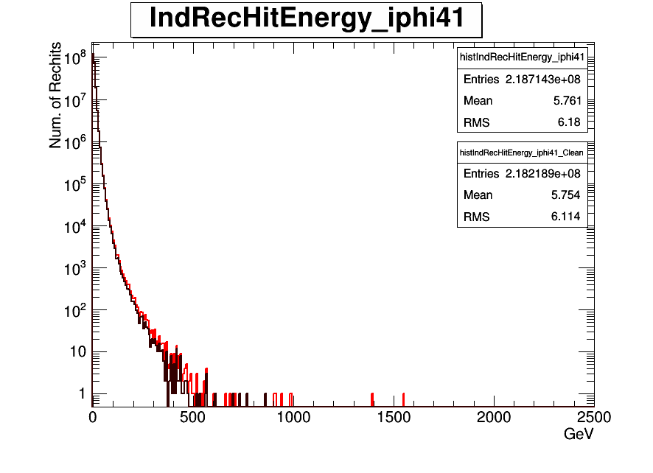

Individual Rechit Energy before and after filter for iφ=43,39,41,45
New PMTs
iφ=43
Old PMTs
iφ=39
Old PMTs
iφ=45
Old PMTs
iφ=41

Slide 13
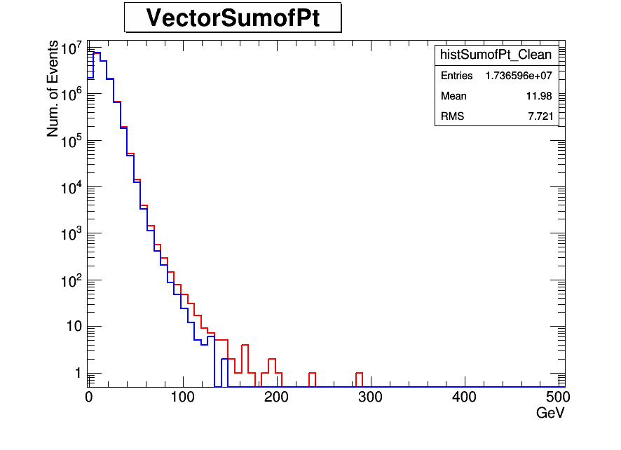

Slide 14
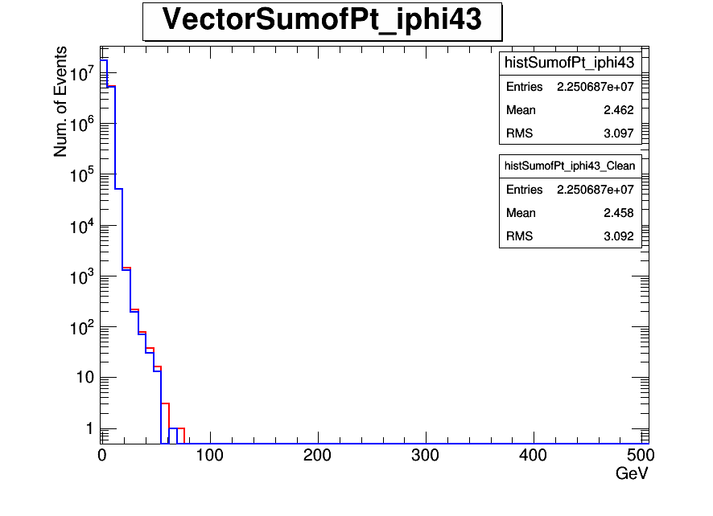
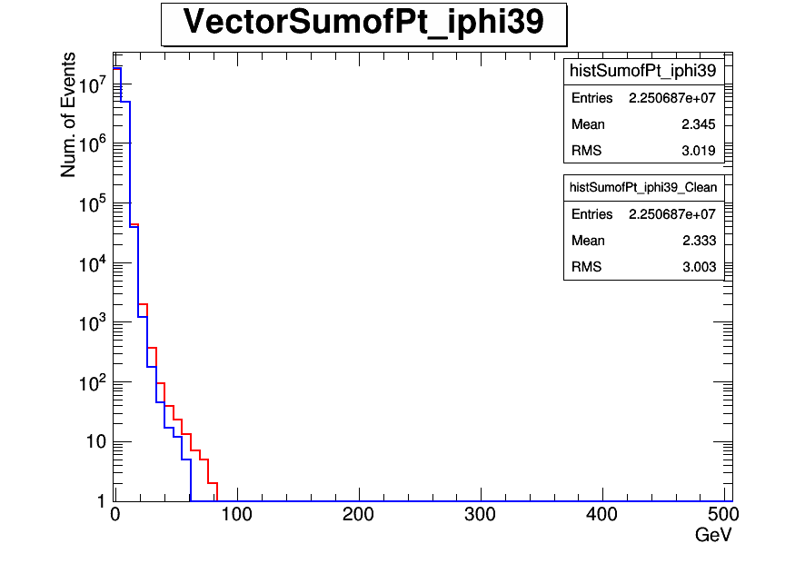
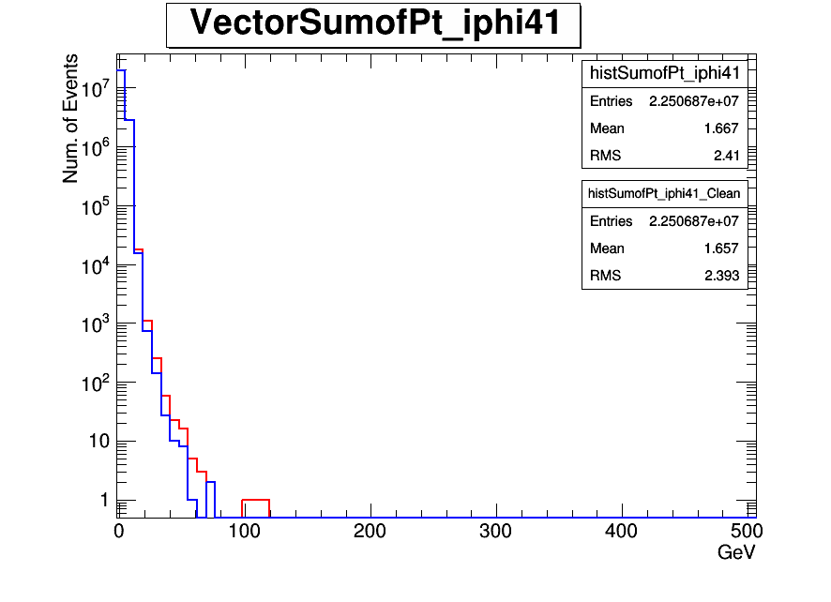
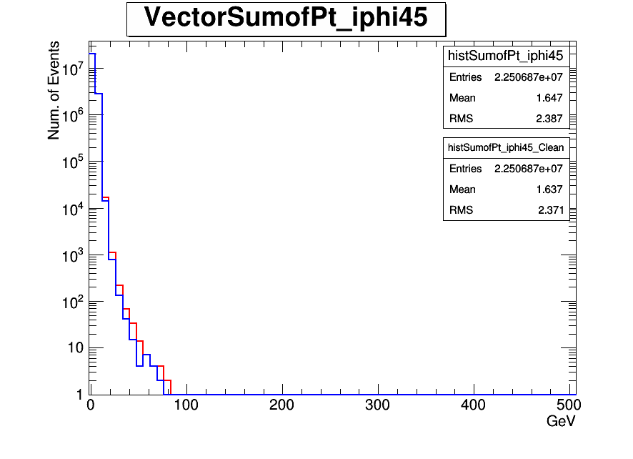
New PMTs
iφ=43
Old PMTs
iφ=39
Old PMTs
iφ=45
Old PMTs
iφ=41

Slide 15
Summary
Analysed data set is /MinimumBias/Run2012D-PromptReco-v1/RECO
When it is filtered by HLT_Physics_v5 trigger, is applyed prescaling factor is 8E3 for noise rate.
When the data set is filtered by HLT_Zerobias_v7 trigger, were applyed prescaling factor was 1.5E6 for noise rate.
When the data set is analysing, HLT_Physics_v5 trigger was excluded.
26.02.15
15

Slide 16
Back up
26.02.15
16

Slide 17
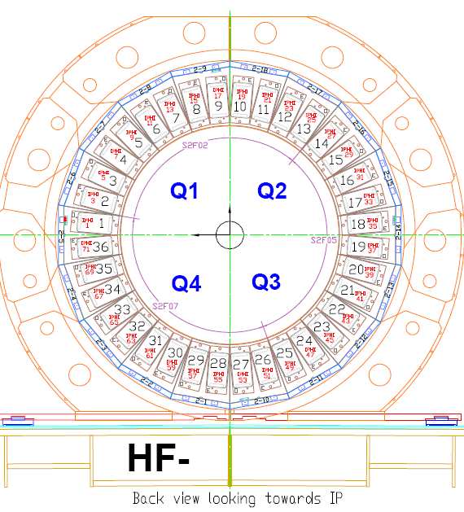
New PMTs location in old data
24 New PMTs are at HF-(iφ =43)
26.02.15
17

Slide 18
Following results were obtained using
/MinimumBias/Run2012D-PromptReco-v1/RECO data set and it was filtred by "HLT_ZeroBias_v7"

Slide 19
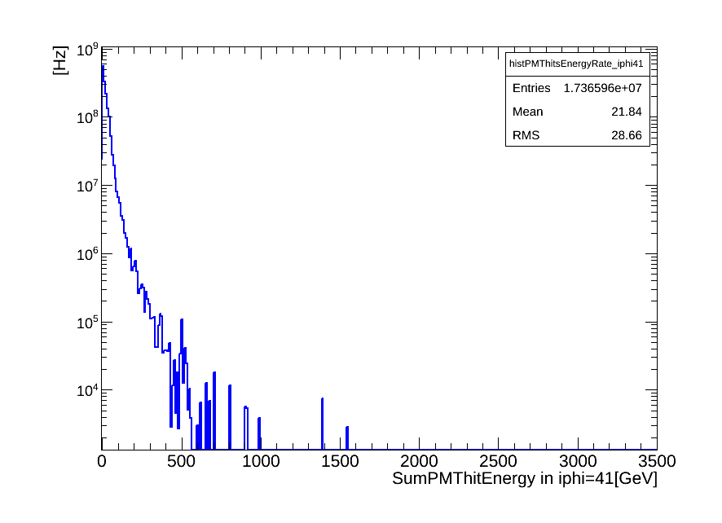
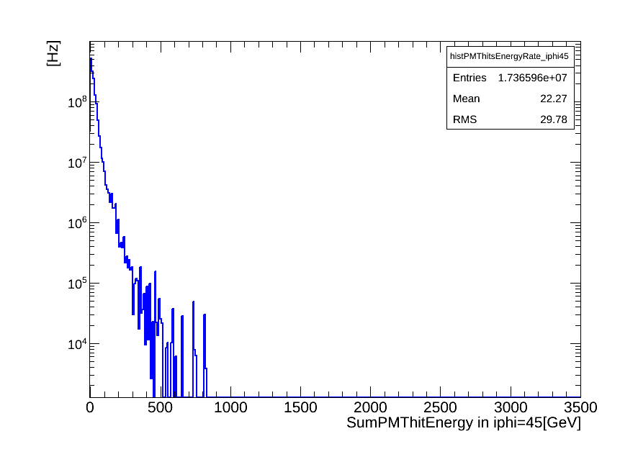
Old PMTs
iφ=41
Old PMTs
iφ=45

Slide 20
Following results were obtained using
/MinimumBias/Run2012D-PromptReco-v1/RECO data set and it was filtred by "HLT_Physics_v5"
17.02.15
20

Slide 21
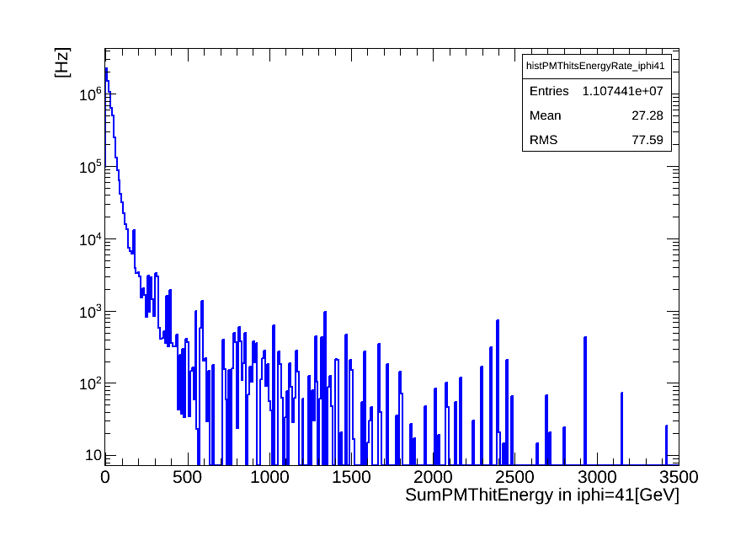
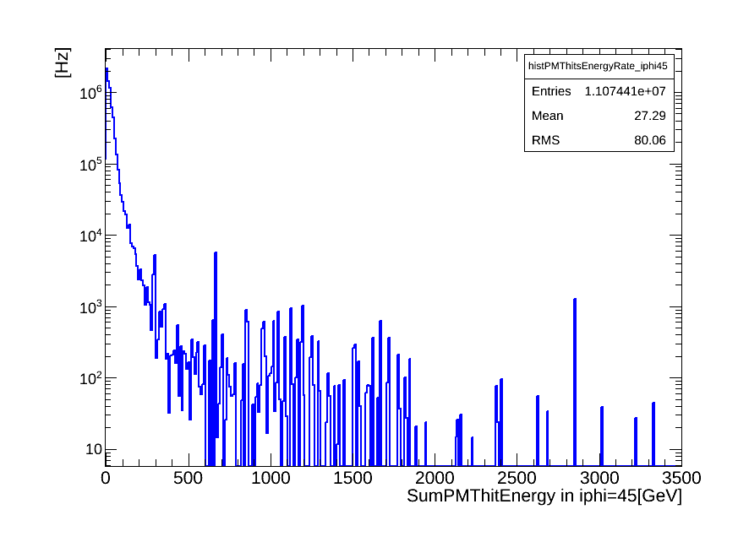
Old PMTs
iφ=41
Old PMTs
iφ=45

