Slide 1
HCAL Analysis
Samet Lezki
Yalcin Guler
Emine Gurpinar,Serdal Damarseckin,
Shuichi Kunori, Isa Dumanoglu,
Bayram Tali, Merve Ince, Hasan Huseyin Isik
26.02.15
<number>

Slide 2
Following results were obtained using
/MinimumBias/Run2012D-PromptReco-v1/RECO data set and it was filtred by "HLT_ZeroBias_v7"
26.02.15
<number>

Slide 3
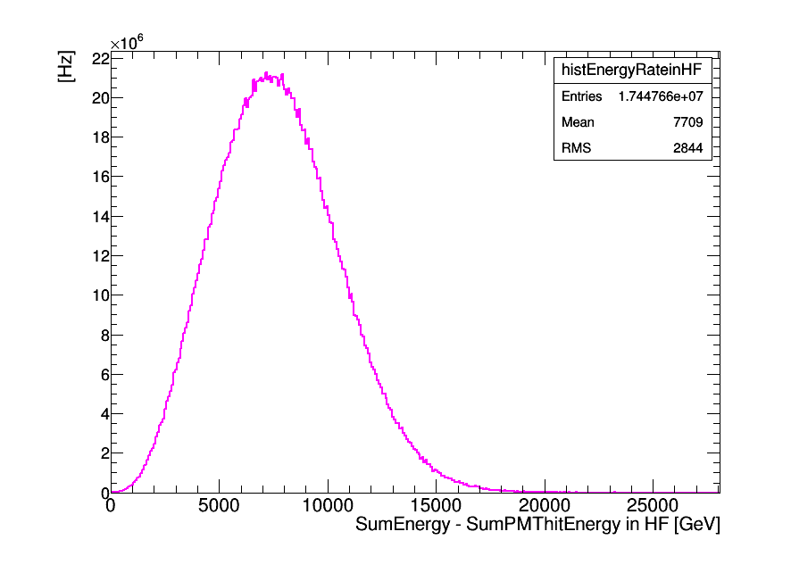
T [sec] =integratedLumi/L(average)
Rate = N/T * 1.5E6 [Hz]
N: PMT hits Events (noise events)
HLT_ZeroBias_v7
The total persecuting factor is
10,000 (L1) * 150 (HLT) = 1.5E6

Slide 4
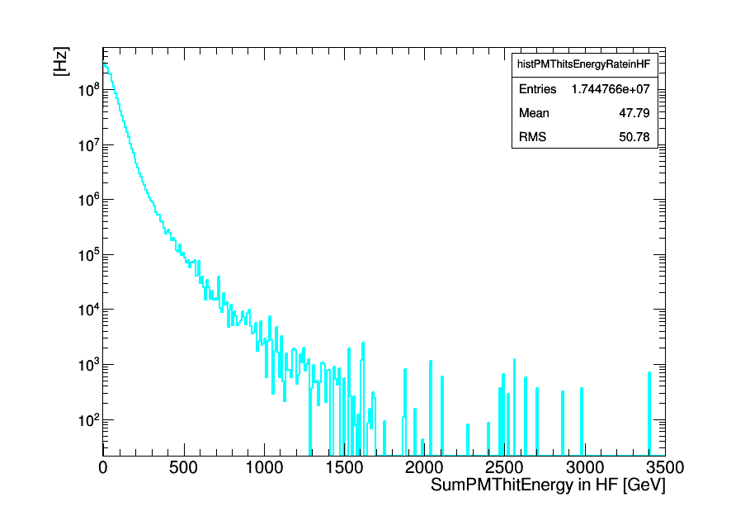
T [sec] =integratedLumi/L(average)
Rate = N/T * 1.5E6 [Hz]
N: PMT hits Events (noise events)
HLT_ZeroBias_v7
The total persecuting factor is
10,000 (L1) * 150 (HLT) = 1.5E6

Slide 5
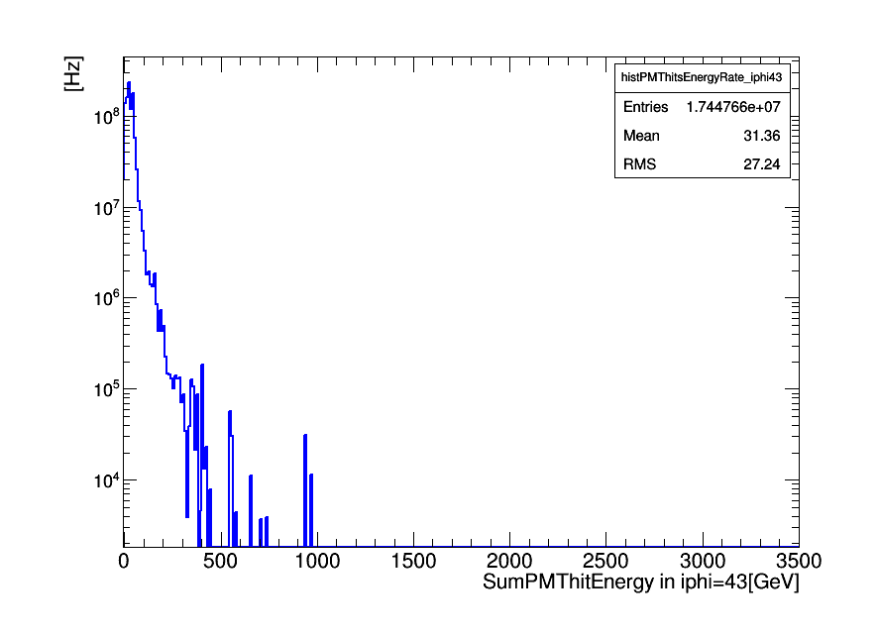
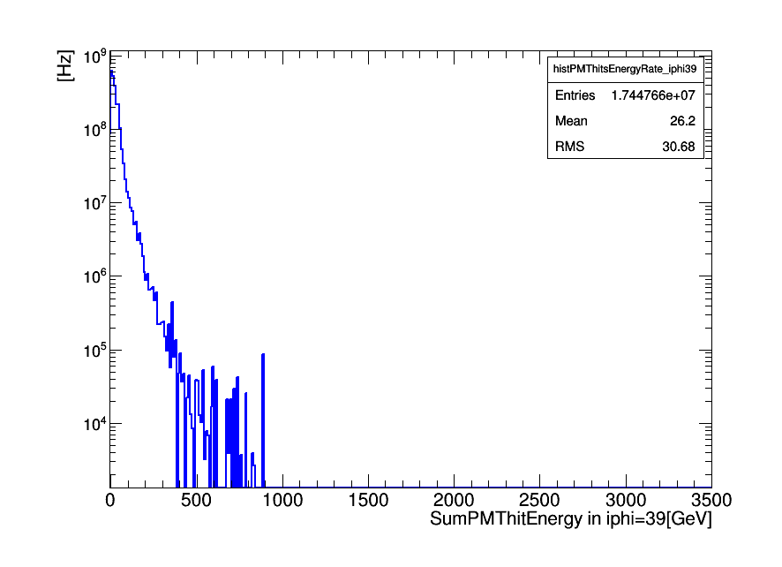
T [sec] =integratedLumi/L(average)
Rate = N/T * 1.5E6 * 72 [Hz]
N: PMT hits Events (noise events)
HLT_ZeroBias_v7
The total persecuting factor is
10,000 (L1) * 150 (HLT) = 1.5E6
72 is number of wedges in the HF.
New PMTs
iφ=43
Old PMTs
iφ=39

Slide 6
Following results were obtained using
/MinimumBias/Run2012D-PromptReco-v1/RECO data set and it was filtred by "HLT_Physics_v5"
17.02.15
26.02.15
<number>
<number>

Slide 7
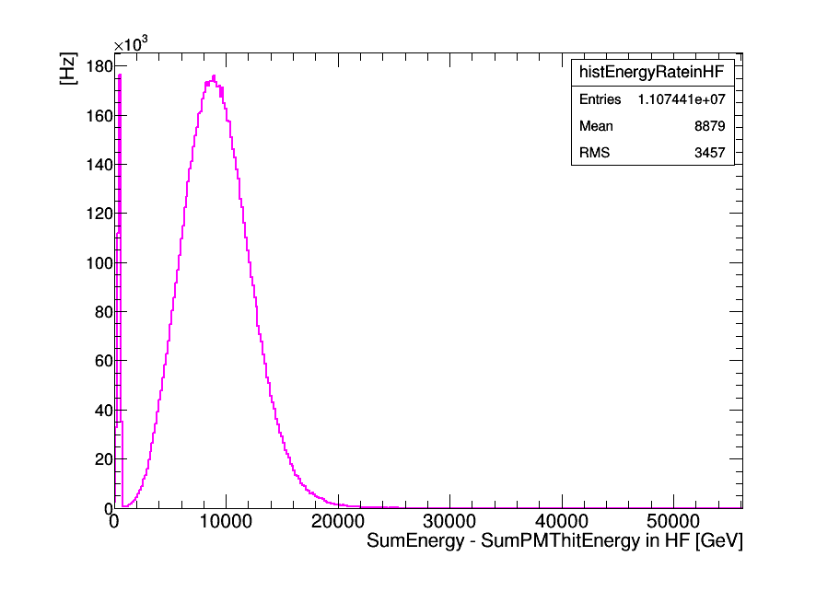
T [sec] =integratedLumi/L(average)
Rate = N/T * 8E3 [Hz]
N: PMT hits Events (noise events)
HLT_Physics_V5 had the perscaling factor of 8e3.

Slide 8
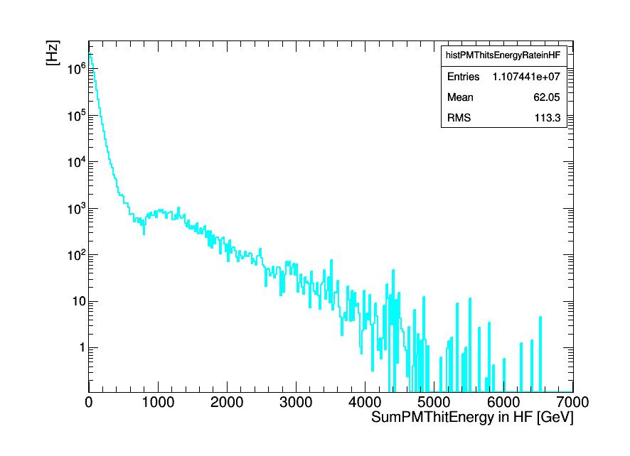
T [sec] =integratedLumi/L(average)
Rate = N/T * 8E3 [Hz]
N: PMT hits Events (noise events)
HLT_Physics_V5 had the perscaling factor of 8e3.

Slide 9
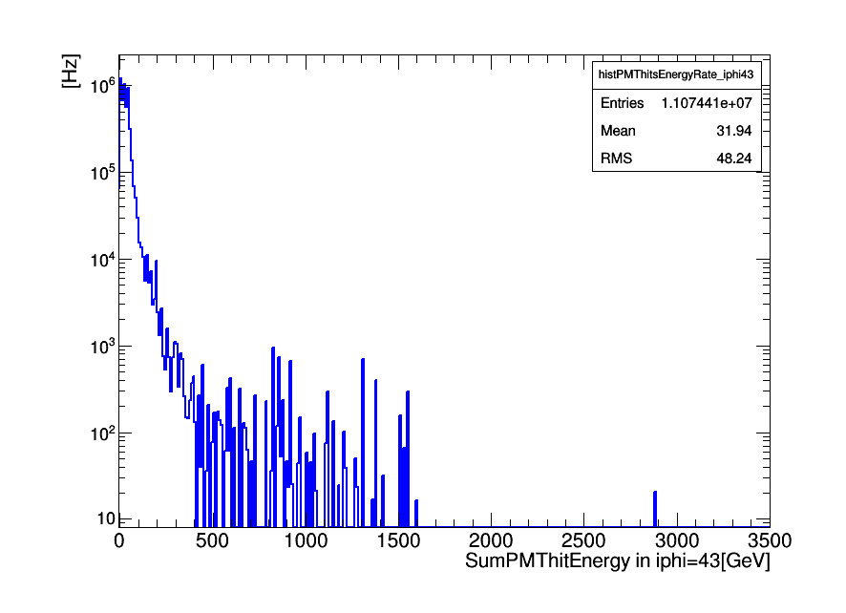
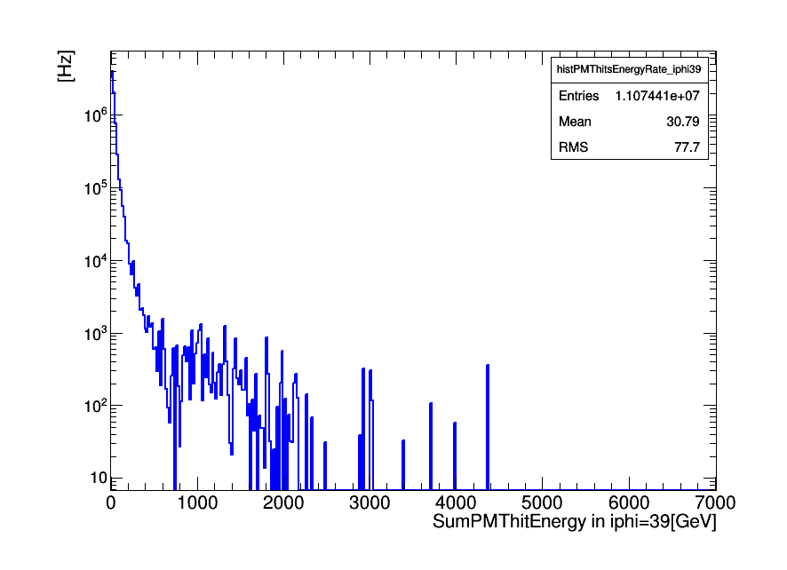
New PMTs
iφ=43
T [sec] =integratedLumi/L(average)
Rate = N/T * 8E3*72 [Hz]
N: PMT hits Events (noise events)
HLT_Physics_V5 had the perscaling factor of 8e3.
72 is number of wedges in the HF.
Old PMTs
iφ=39

Slide 10
Following results were obtained using
/MinimumBias/Run2012D-PromptReco-v1/RECO data set and following DST filters was excluded while the data was analysing.
DST_HT250_v4
DST_Mu5_HT250_v4
DST_L1HTT_Or_L1MultiJet_v4
DST_Ele8_CaloIdL_CaloIsoVL_TrkIdVL_TrkIsoVL_HT250_v4
17.02.15
26.02.15
<number>
<number>

Slide 11
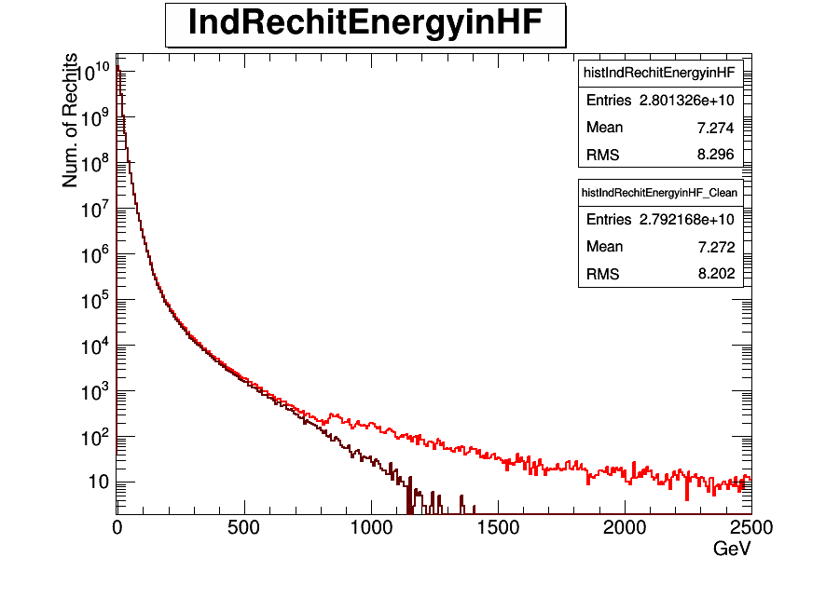

Slide 12
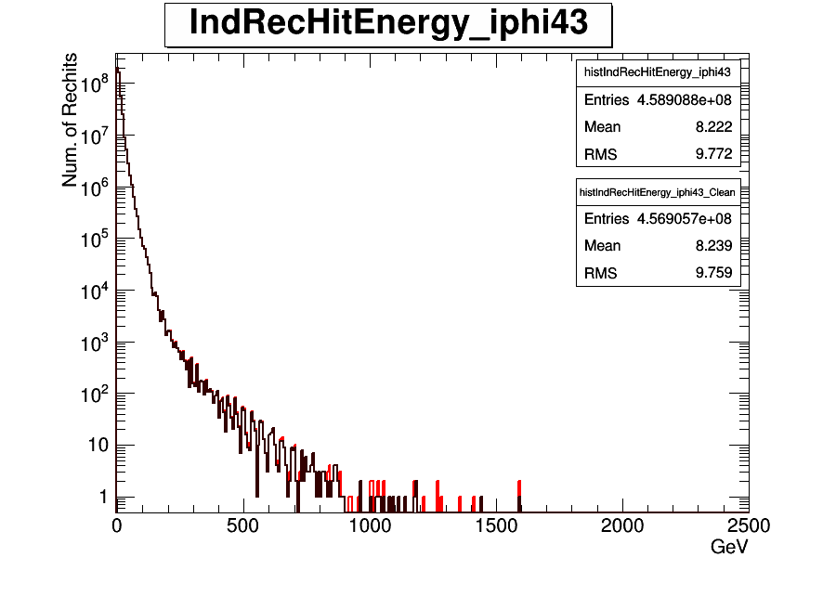
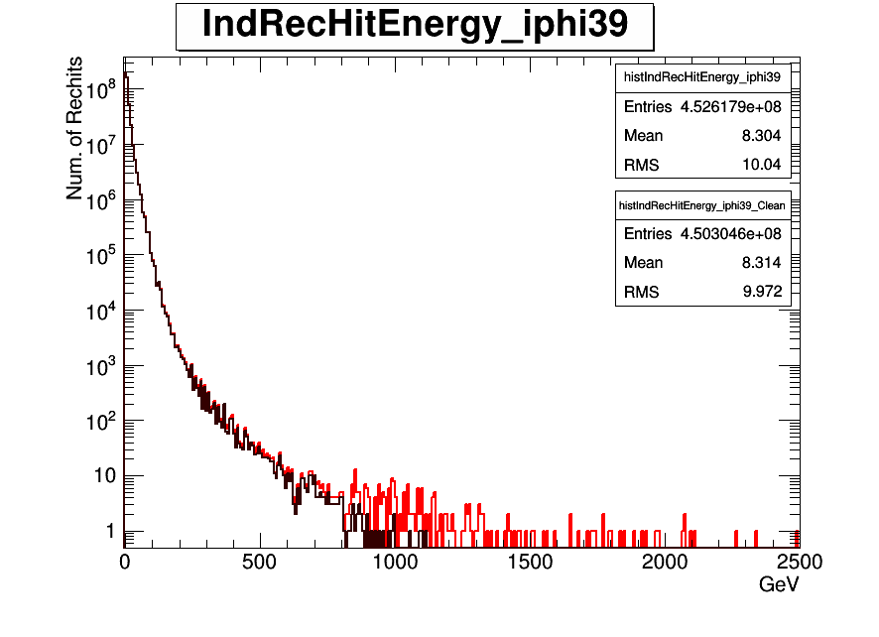
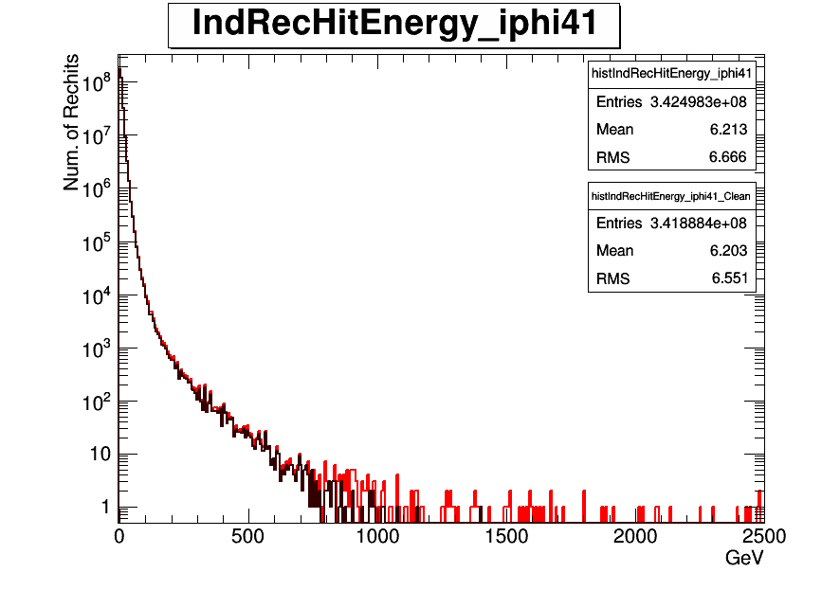
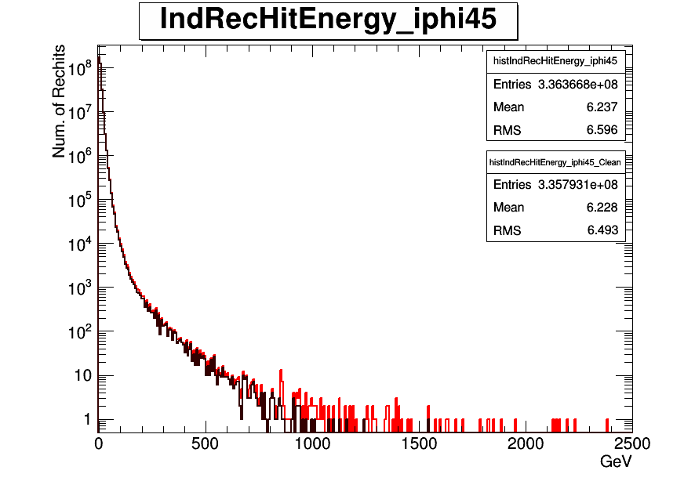
Individual Rechit Energy before and after filter for iφ=43,39,41,45
New PMTs
iφ=43
Old PMTs
iφ=39
Old PMTs
iφ=41
Old PMTs
iφ=45

Slide 13
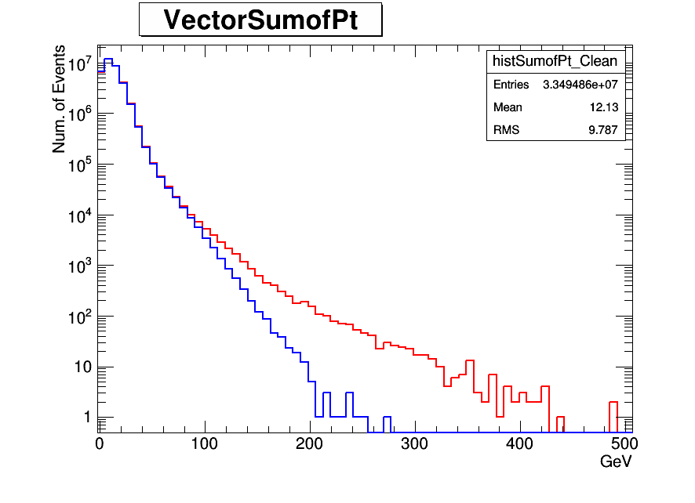

Slide 14
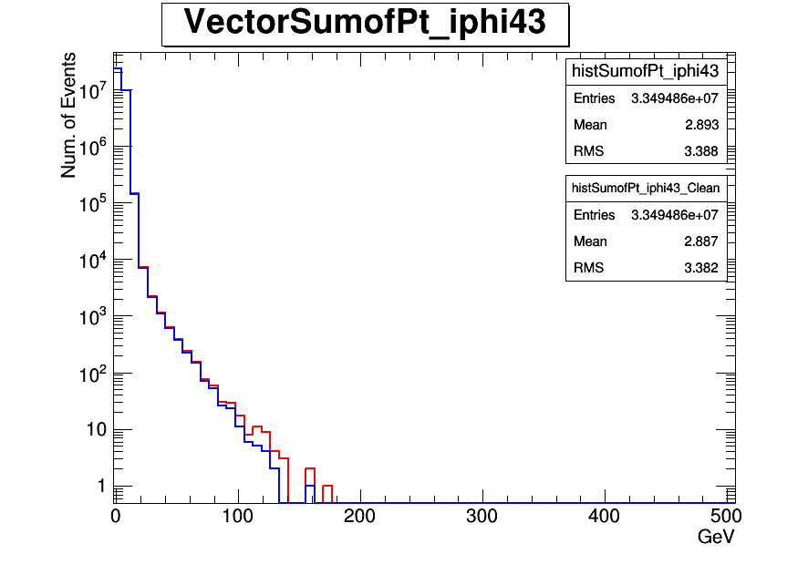
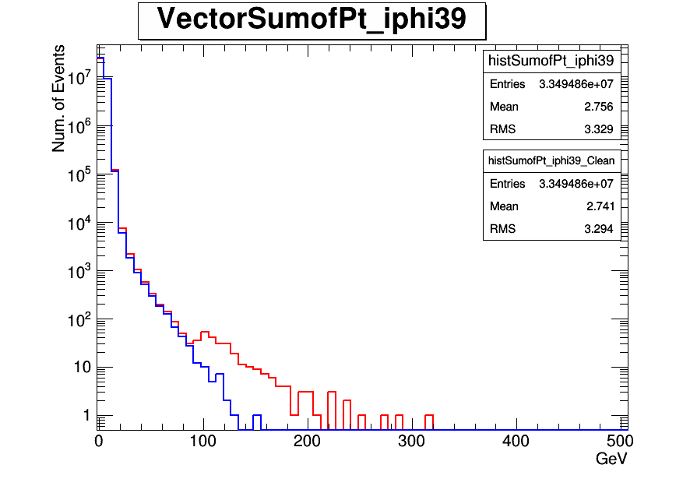
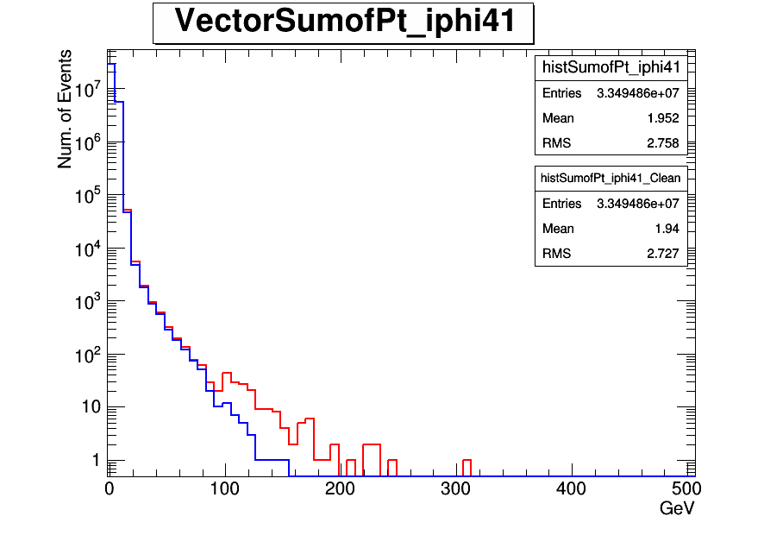
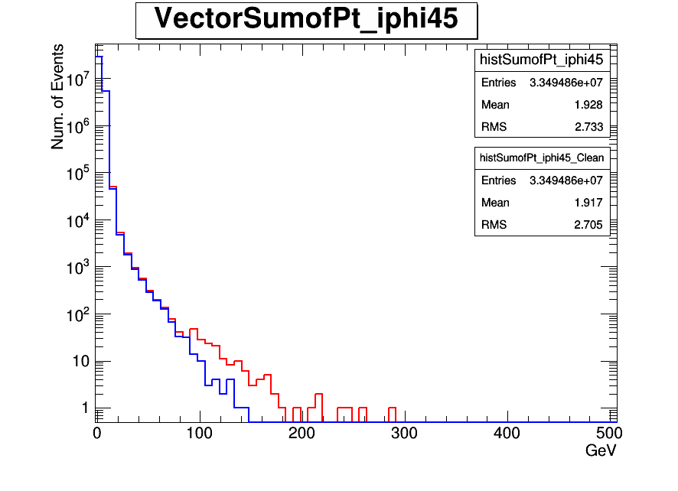
New PMTs
iφ=43
Old PMTs
iφ=39
Old PMTs
iφ=41
Old PMTs
iφ=45

Slide 15
Following results were obtained using
/MinimumBias/Run2012D-PromptReco-v1/RECO data set and following HLT filters was excluded while the data was analysing.
HLT_HT200_v6
HLT_HT250_v7
HLT_HT300_v7
HLT_HT350_v7
HLT_HT400_v7
HLT_HT450_v7
HLT_HT500_v7
HLT_HT550_v7
HLT_HT650_v7
HLT_HT750_v7
17.02.15
26.02.15
<number>
<number>

Slide 16
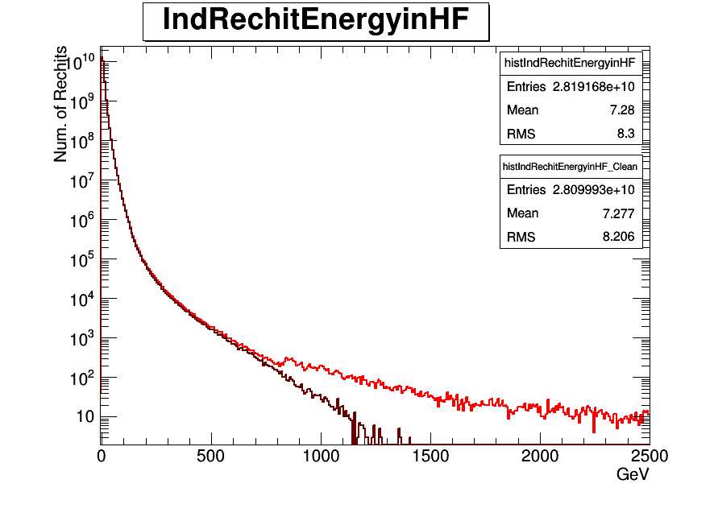

Slide 17
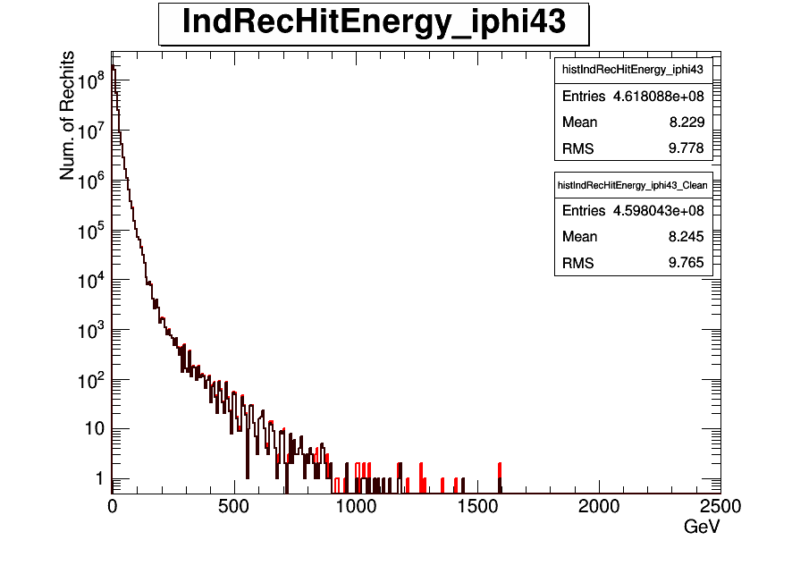

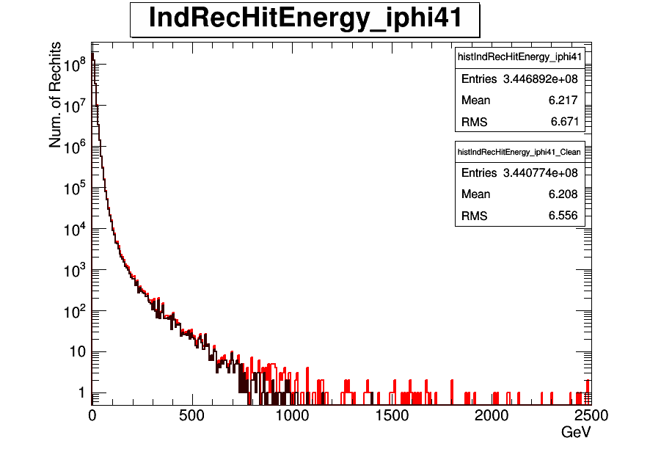

Individual Rechit Energy before and after filter for iφ=43,39,41,45
New PMTs
iφ=43
Old PMTs
iφ=39
Old PMTs
iφ=41
Old PMTs
iφ=45

Slide 18


Slide 19
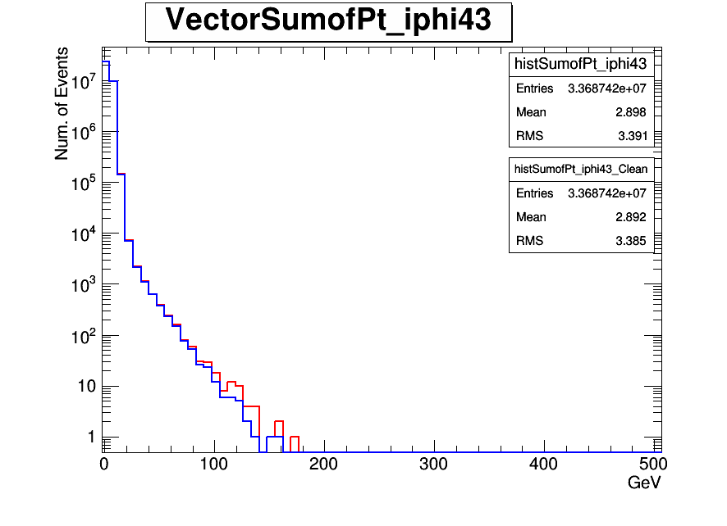



New PMTs
iφ=43
Old PMTs
iφ=39
Old PMTs
iφ=41
Old PMTs
iφ=45

Slide 20
Following results were obtained using
/MinimumBias/Run2012D-PromptReco-v1/RECO data set and following HLT filters was excluded while the data was analysing.
HLT_CleanPFNoPUHT350_Ele5_CaloIdT_CaloIsoVL_TrkIdT_TrkIsoVL_PFMET45_v3
HLT_CleanPFNoPUHT350_Ele5_CaloIdT_CaloIsoVL_TrkIdT_TrkIsoVL_PFMET50_v3
HLT_CleanPFNoPUHT300_Ele15_CaloIdT_CaloIsoVL_TrkIdT_TrkIsoVL_PFMET45_v3
HLT_CleanPFNoPUHT300_Ele15_CaloIdT_CaloIsoVL_TrkIdT_TrkIsoVL_PFMET50_v3
HLT_CleanPFNoPUHT300_Ele40_CaloIdVT_TrkIdT_v3
HLT_CleanPFNoPUHT300_Ele60_CaloIdVT_TrkIdT_v3
17.02.15
26.02.15
<number>
<number>

Slide 21


Slide 22




Individual Rechit Energy before and after filter for iφ=43,39,41,45
New PMTs
iφ=43
Old PMTs
iφ=39
Old PMTs
iφ=41
Old PMTs
iφ=45

Slide 23


Slide 24




New PMTs
iφ=43
Old PMTs
iφ=39
Old PMTs
iφ=41
Old PMTs
iφ=45

Slide 25
Following results were obtained using
/MinimumBias/Run2012D-PromptReco-v1/RECO data set and following HLT filters was excluded while the data was analysing.
HLT_HT200_AlphaT0p57_v8'
HLT_HT250_AlphaT0p55_v8'
HLT_HT250_AlphaT0p57_v8'
HLT_HT300_AlphaT0p53_v8
HLT_HT300_AlphaT0p54_v14
HLT_HT350_AlphaT0p52_v8'
HLT_HT350_AlphaT0p53_v19
HLT_HT400_AlphaT0p51_v19
HLT_HT400_AlphaT0p52_v14
HLT_HT450_AlphaT0p51_v14
17.02.15
26.02.15
<number>
<number>

Slide 26


Slide 27


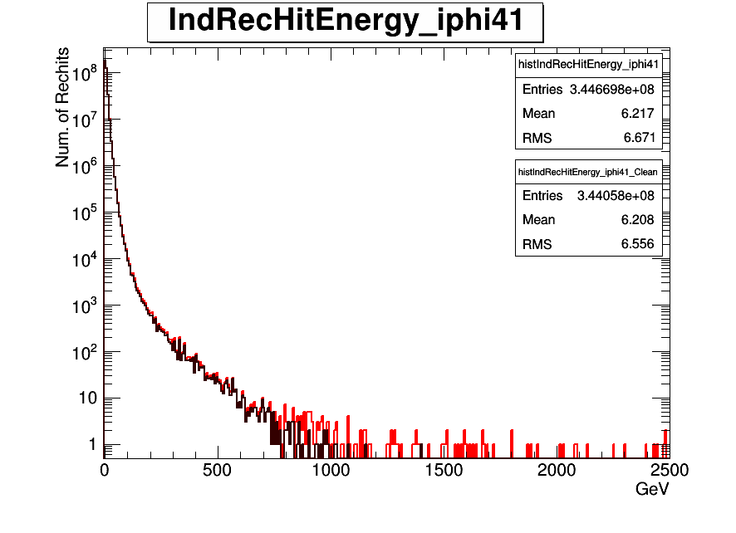

Individual Rechit Energy before and after filter for iφ=43,39,41,45
New PMTs
iφ=43
Old PMTs
iφ=39
Old PMTs
iφ=41
Old PMTs
iφ=45

Slide 28


Slide 29
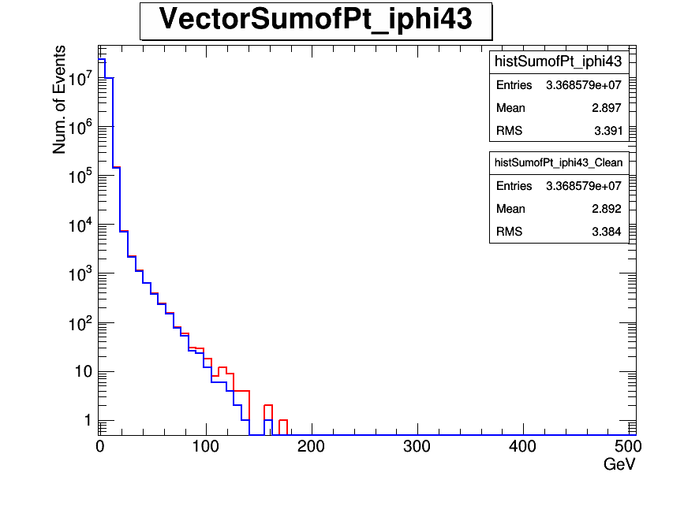



New PMTs
iφ=43
Old PMTs
iφ=39
Old PMTs
iφ=41
Old PMTs
iφ=45

Slide 30
Back up
26.02.15
<number>

Slide 31
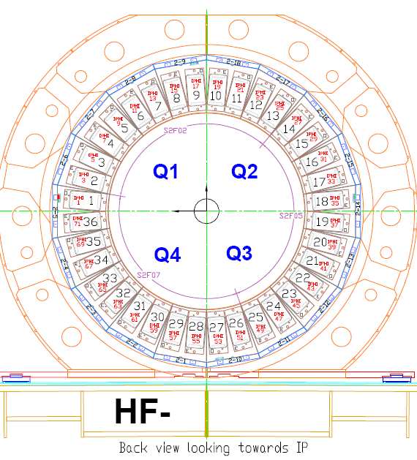
New PMTs location in old data
24 New PMTs are at HF-(iφ =43)
26.02.15
<number>

Slide 32
Following results were obtained using
/MinimumBias/Run2012D-PromptReco-v1/RECO data set and it was filtred by "HLT_ZeroBias_v7"
05.03.15
<number>

Slide 33
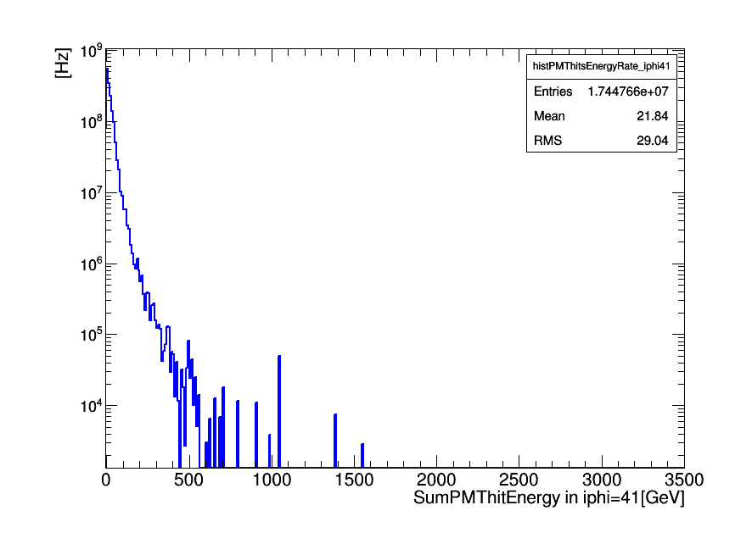
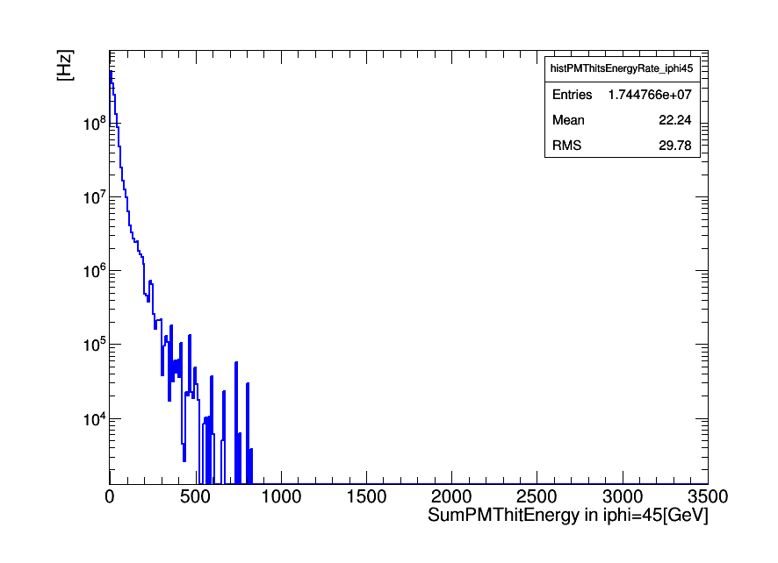
Old PMTs
iφ=41
Old PMTs
iφ=45

Slide 34
Following results were obtained using
/MinimumBias/Run2012D-PromptReco-v1/RECO data set and it was filtred by "HLT_Physics_v5"
17.02.15
05.03.15
<number>
<number>

Slide 35
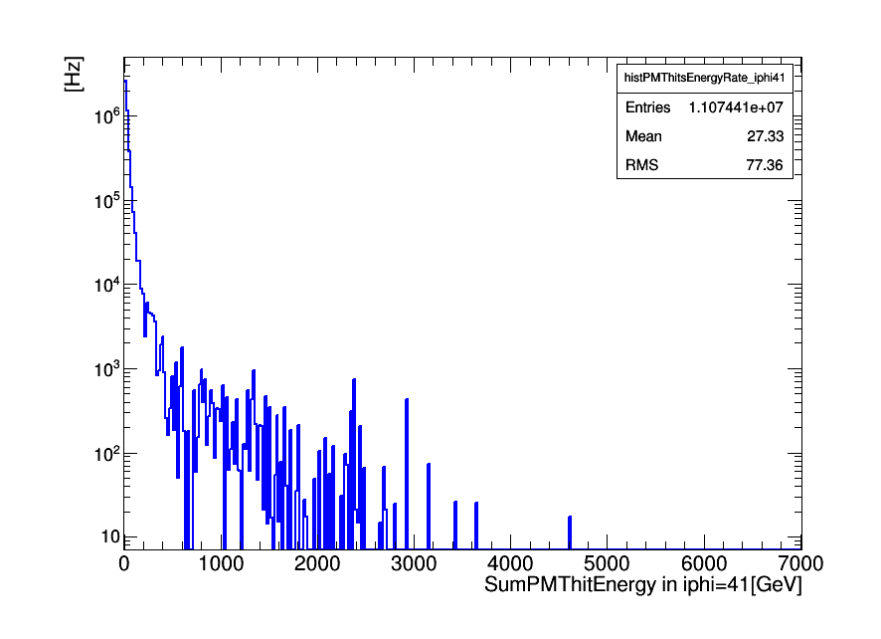
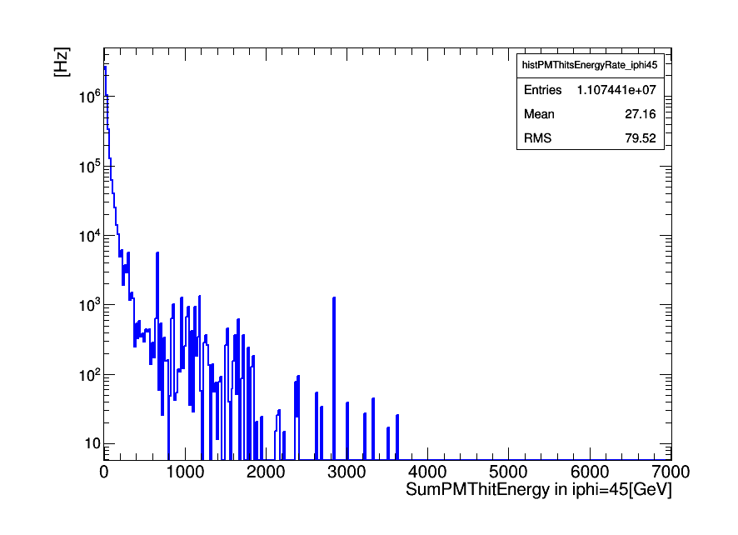
Old PMTs
iφ=41
Old PMTs
iφ=45

