Slide 1
CRUZET Data Analysis
Hasan Huseyin Isik
Shuichi Kunori, Isa Dumanoglu
Bayram Tali, Yalcin Guler, Serdal Damarseckin,Merve Ince, Samet Lezki, Emine Gurpinar

Slide 2
We analyzed all runs for Cruzet ( 23 Feb2015-01 Mar2015)

Slide 3
Introduction
We checked the plots of CaloMETPt, CaloJetPhi, CaloJetEta, CaloJetEnergy,CaloJetPt, CaloJetMultiplicity with Minbias and Cosmic Datasets.
We have analyzed Cruzet Data for some plots of HB,HE,HO and HBHE.

Slide 4
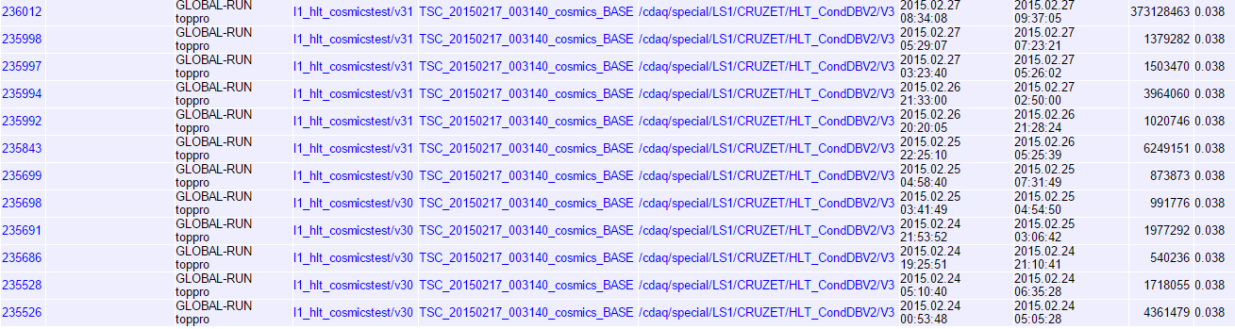
Run Info
  We have analyzed CRUZET Data for 60 minutes taking in different period.

Slide 5
MinBias dataset for CRUZET Runs

Slide 6
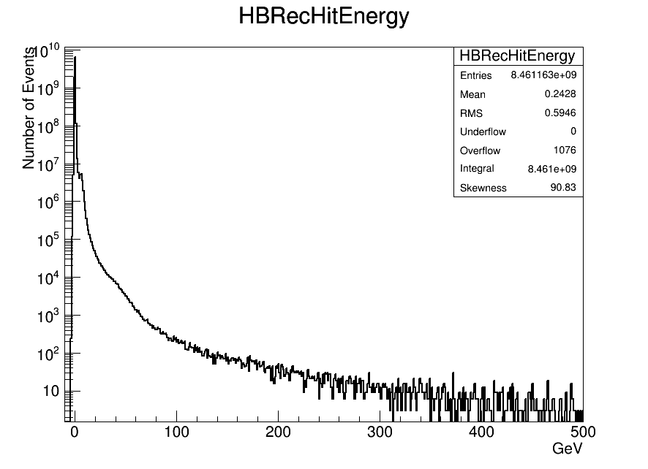
RecHit Energy (HB)

Slide 7
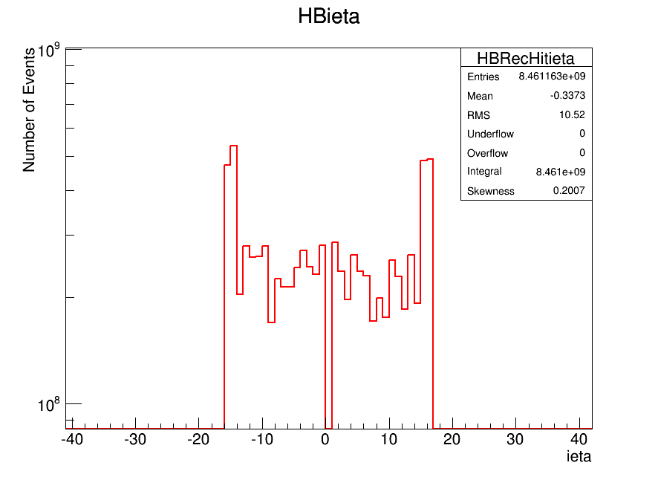
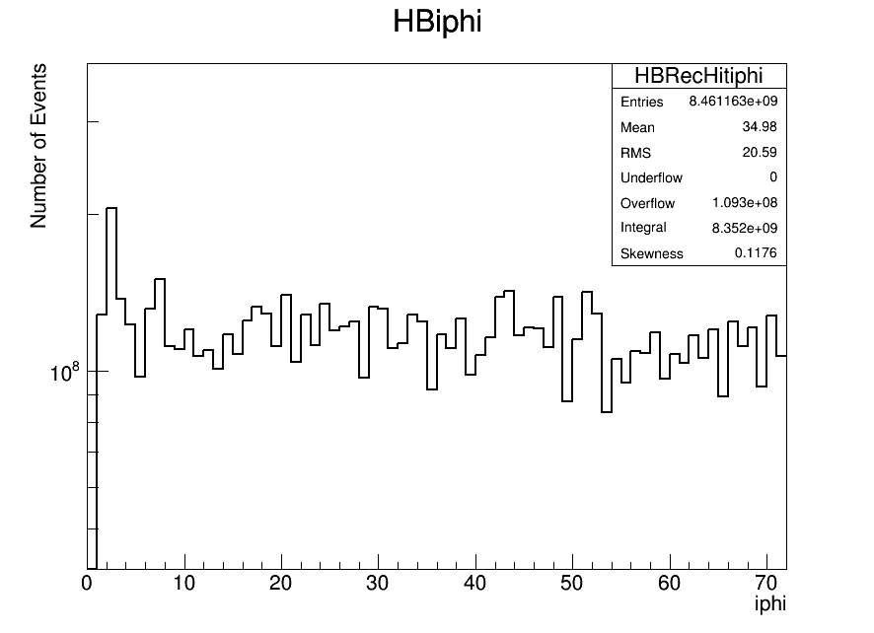
ieta and iphi distrubution

Slide 8
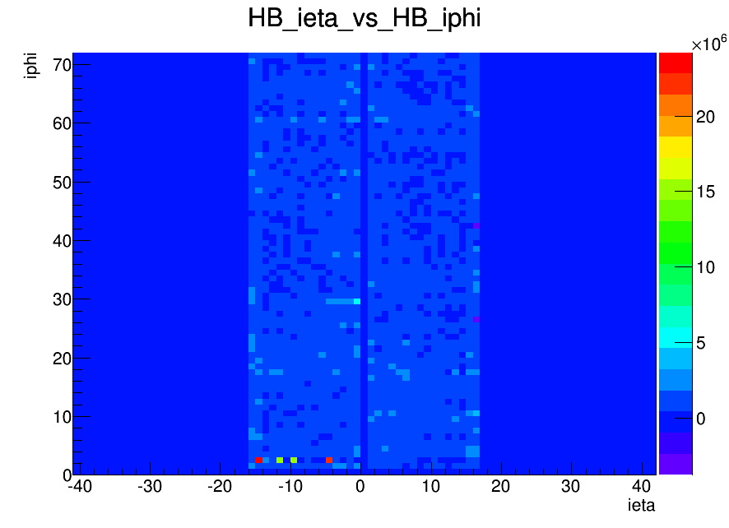
ieta vs iphi (HB)

Slide 9
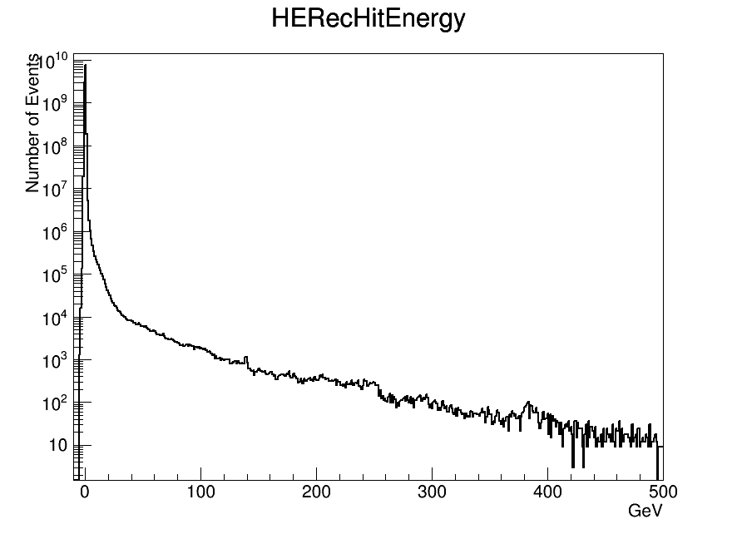
RecHitEnergy (HE)

Slide 10
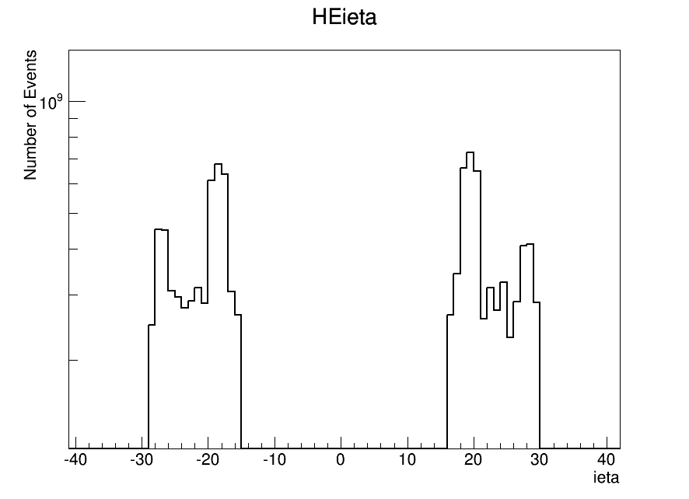
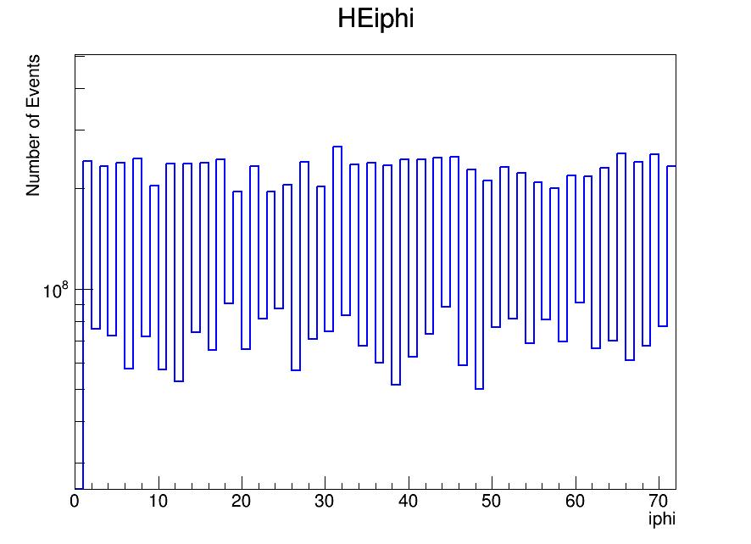
ieta and iphi (HE)

Slide 11
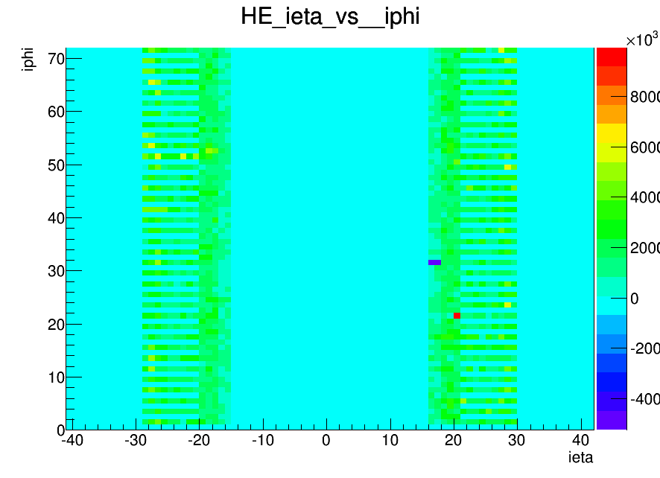
ieta vs iphi (HE)

Slide 12
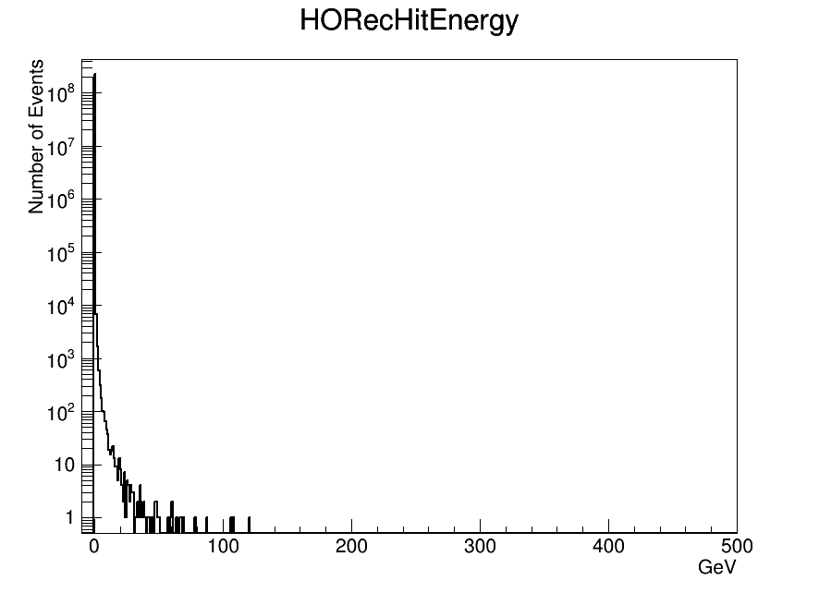
RecHit Energy (HO)

Slide 13
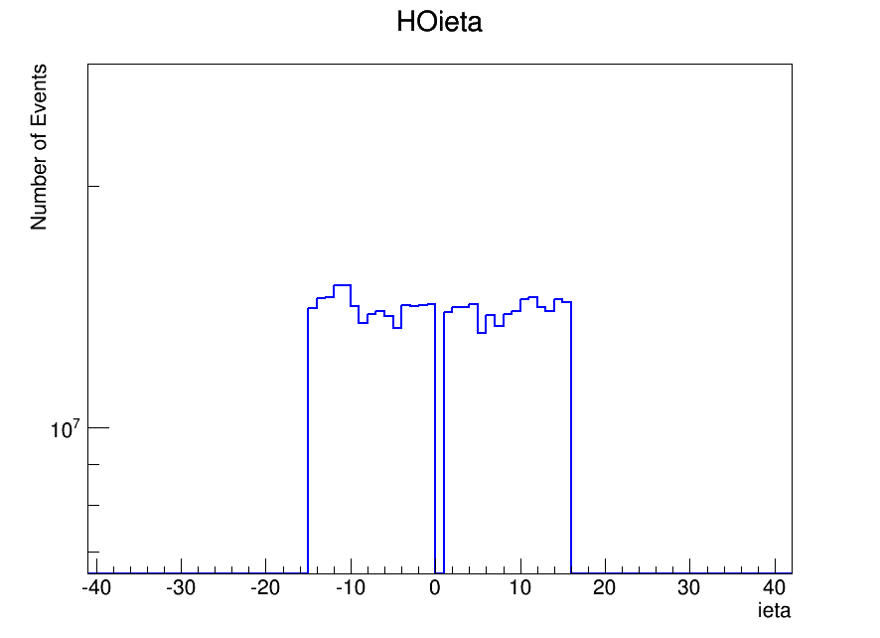
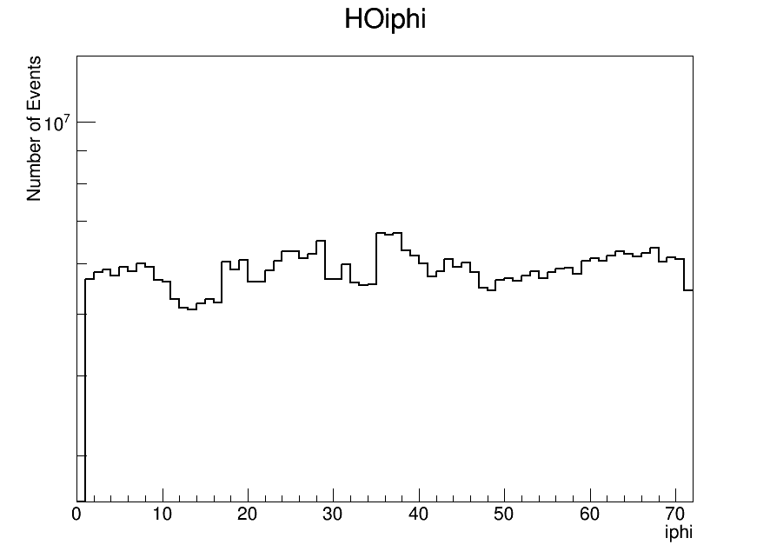
ieta and iphi (HO)

Slide 14
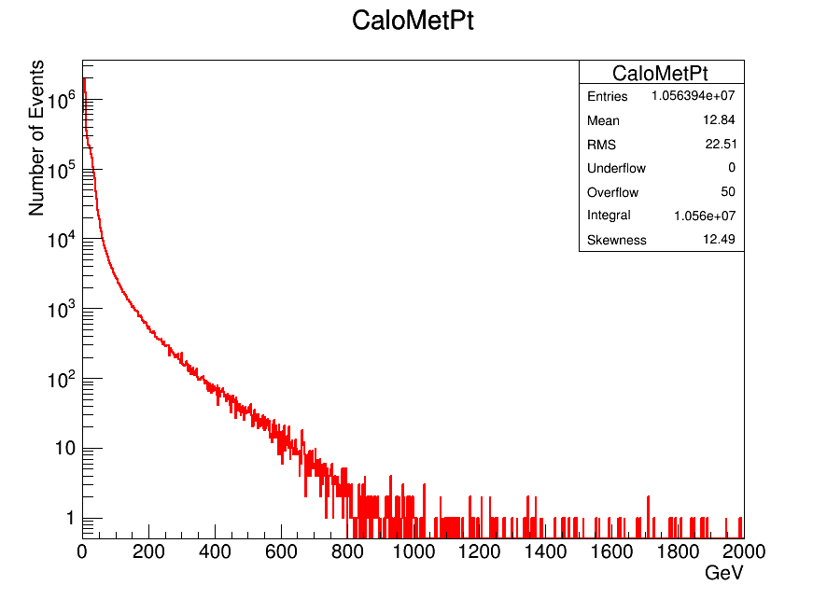
MET distrubition

Slide 15
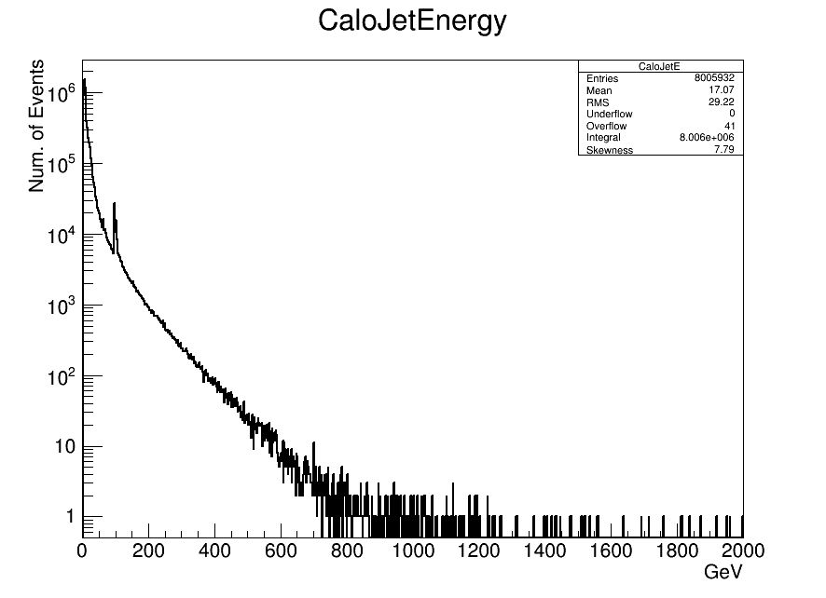
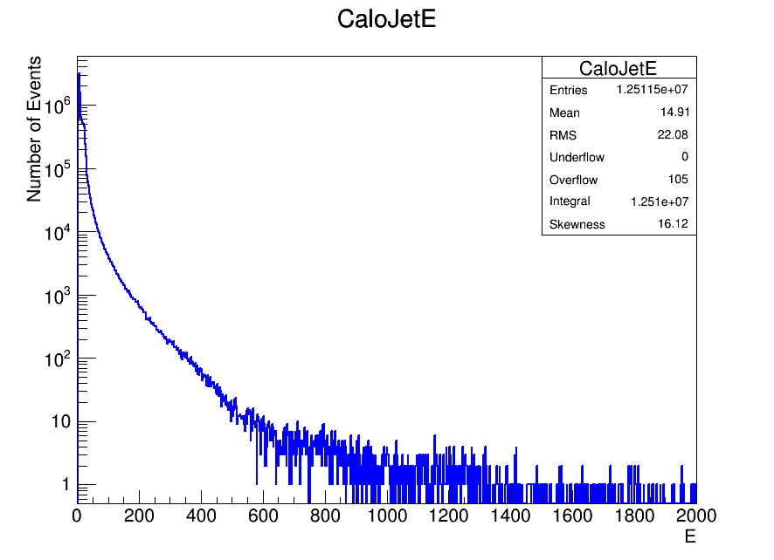
Energy distributions
  MWGR10 Minbias dataset CRUZET Minbias dataset

Slide 16
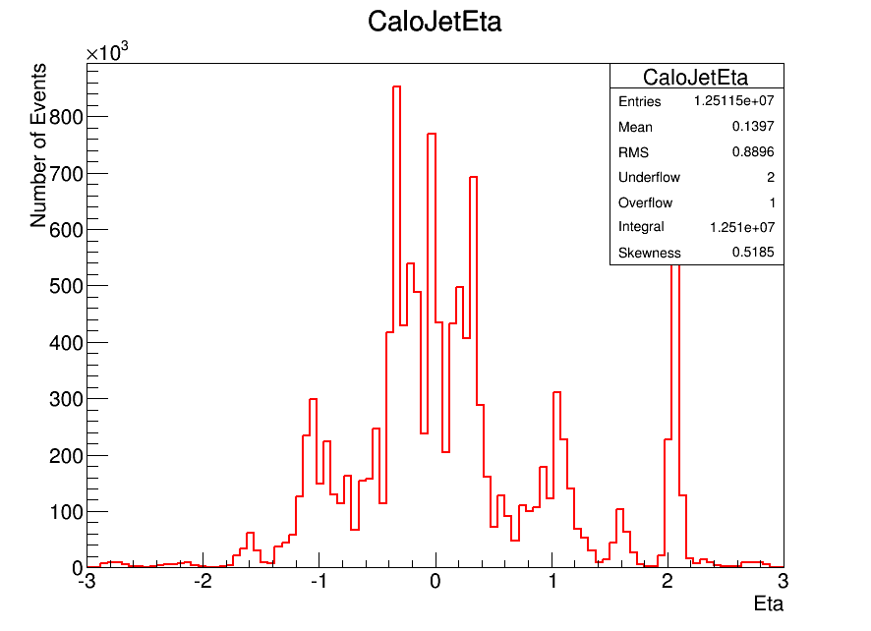
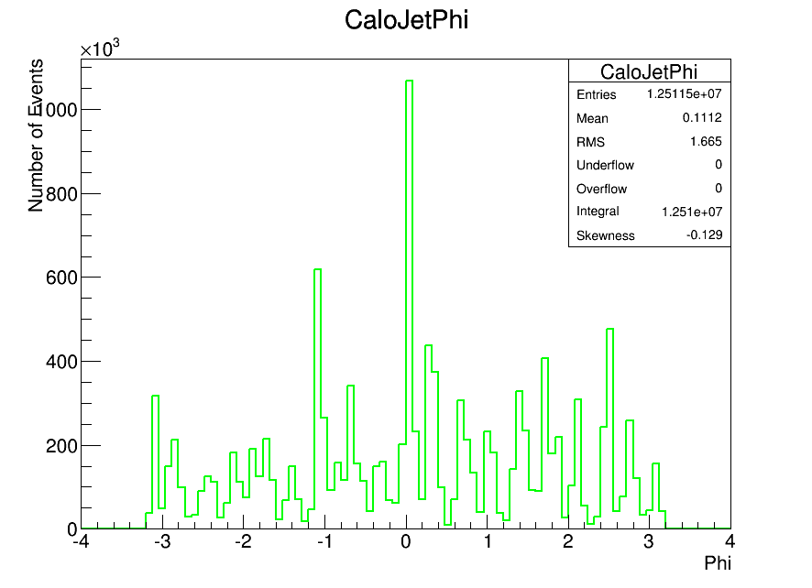
Eta and Phi distributions

Slide 17
CosmicRuns

Slide 18
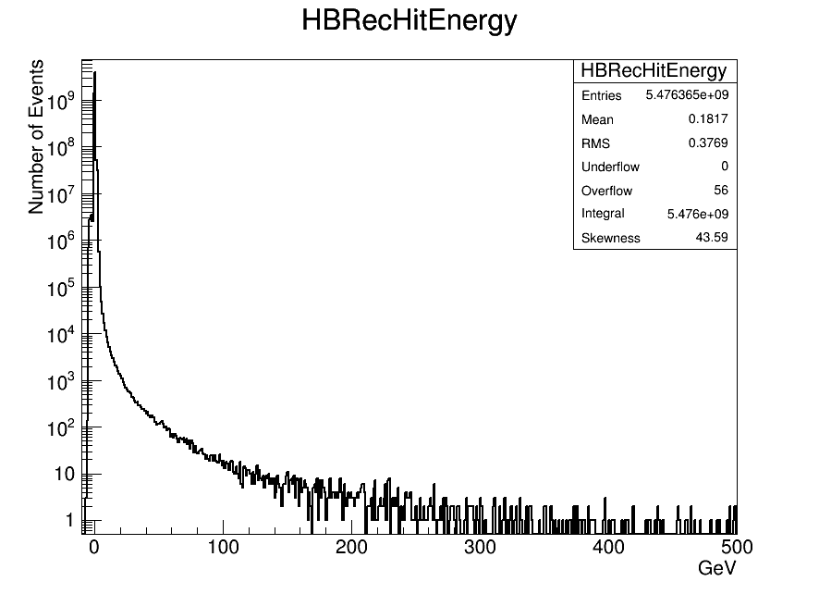
RecHit Energy (HB)

Slide 19
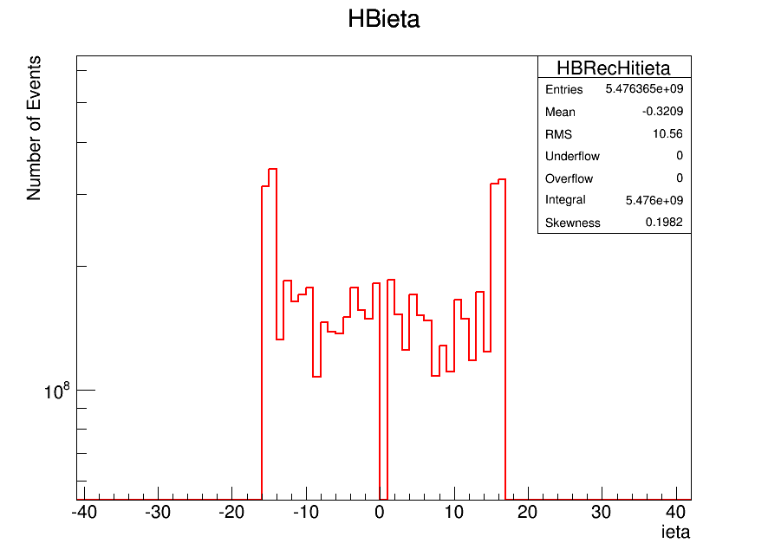
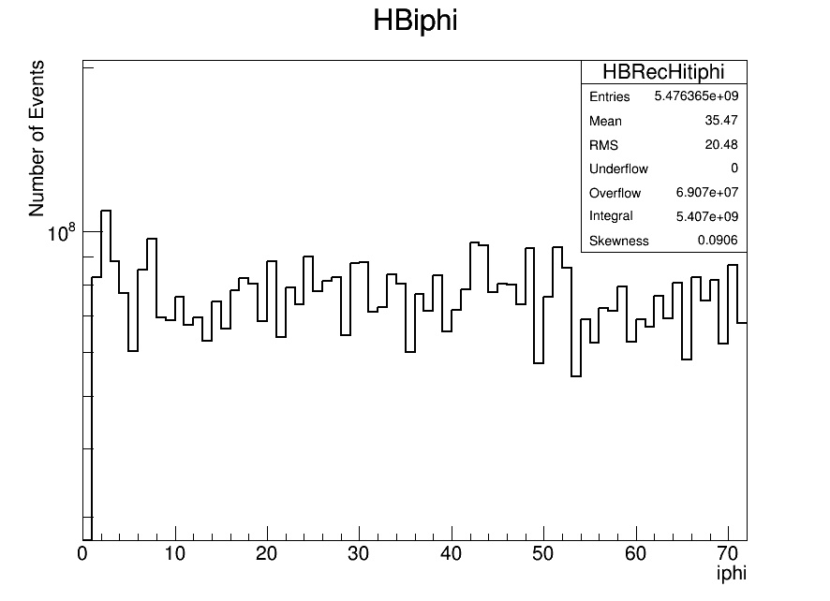
ieta and iphi (HB)

Slide 20
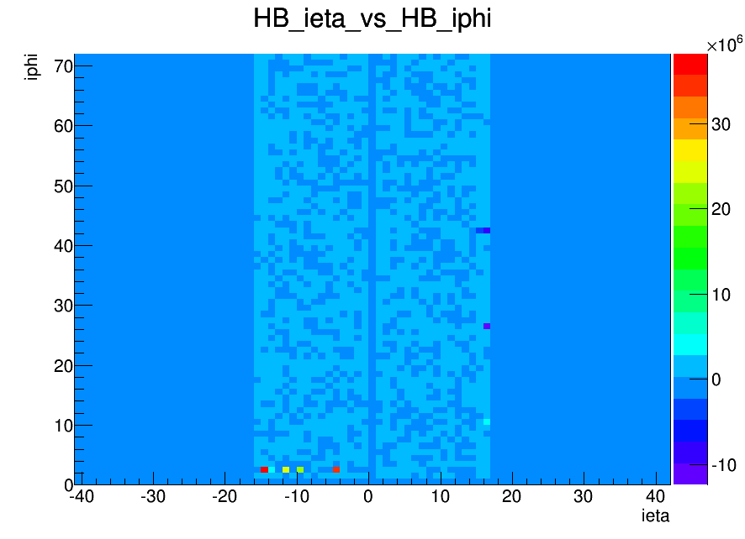
İeta vs iphi (HB)

Slide 21
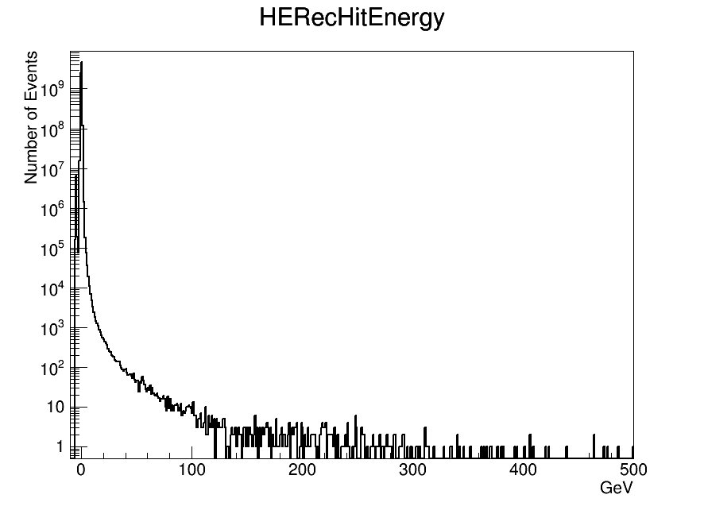
RecHit Energy (HE)

Slide 22

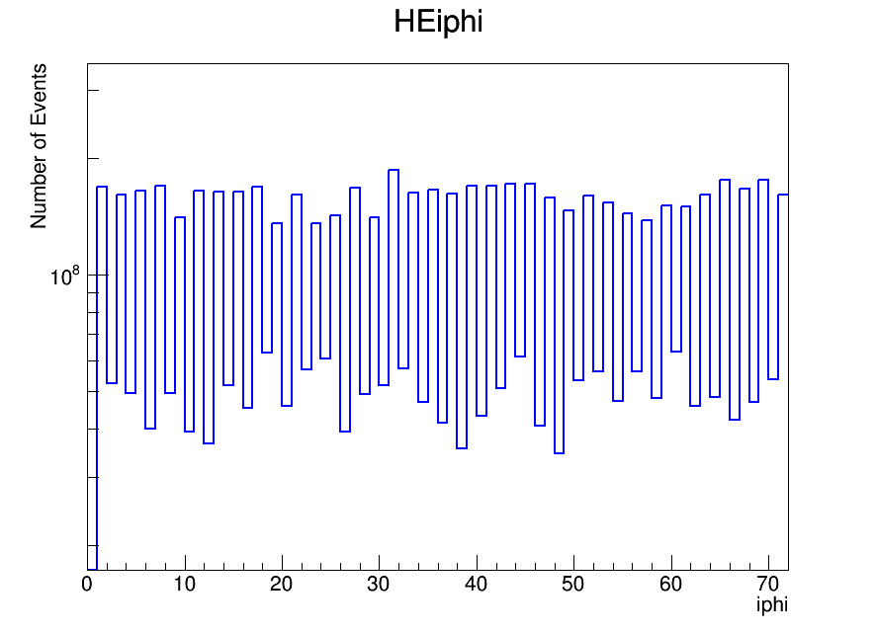
ieta and iphi(HE)

Slide 23
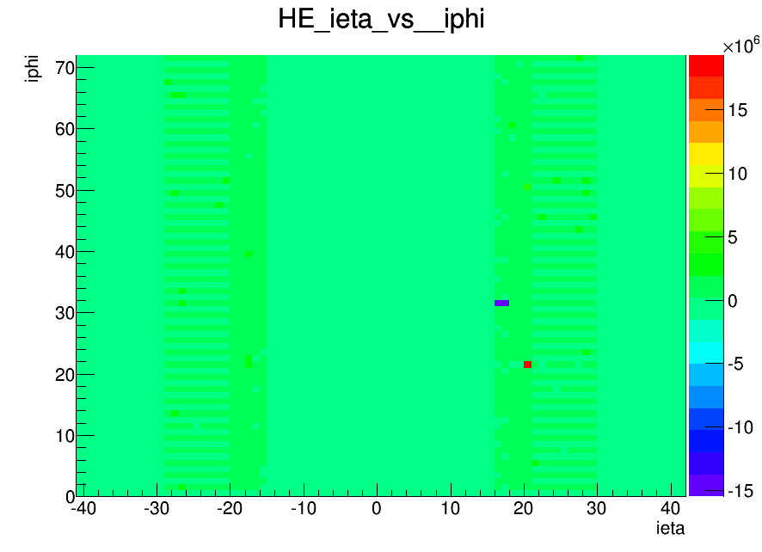
ieta vs iphi(HE)

Slide 24
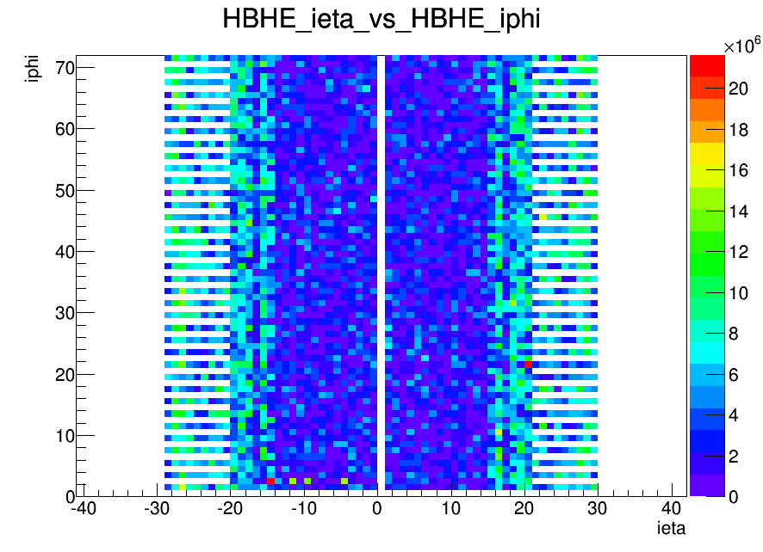
RecHit Energy (HBHE)

Slide 25
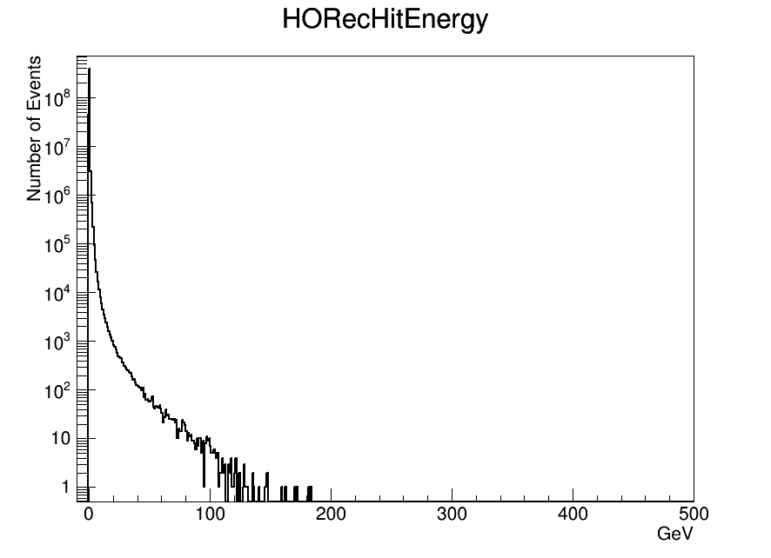
RecHit Energy (HO)

Slide 26
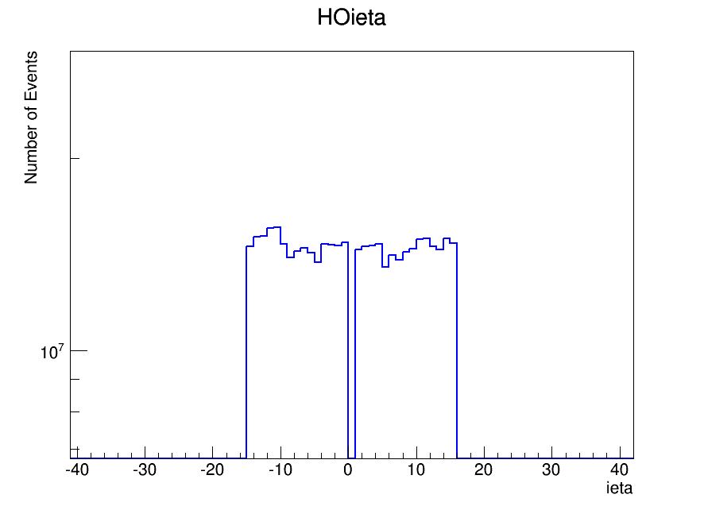
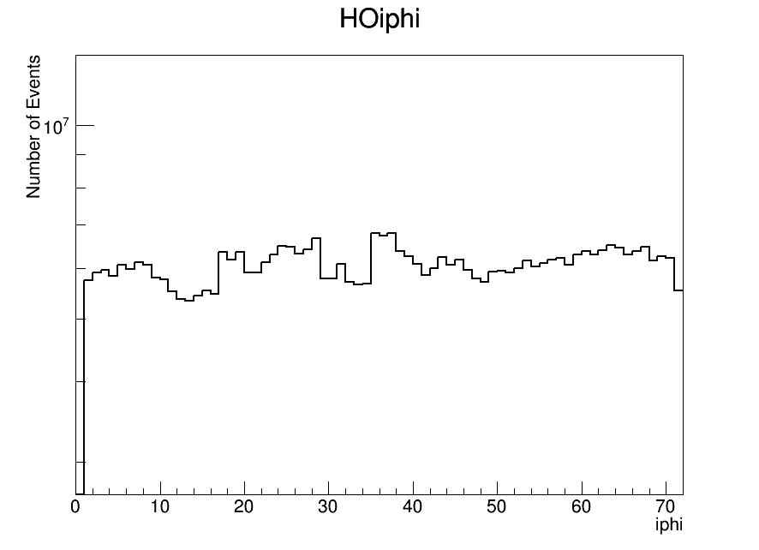
İeta and iphi (HO)

Slide 27
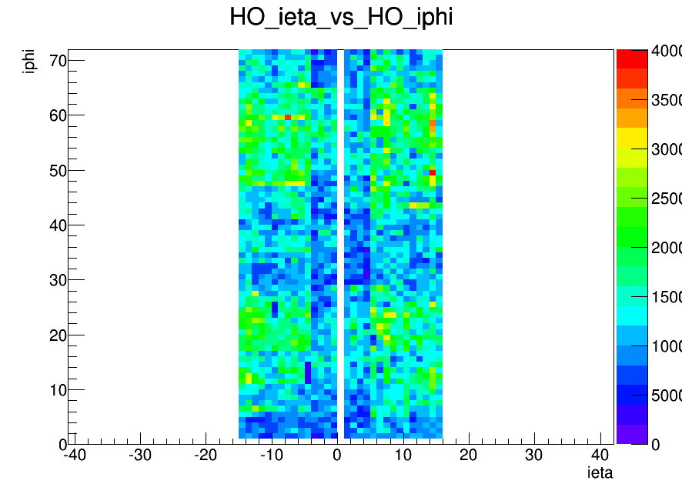
İeta vs iphi

Slide 28
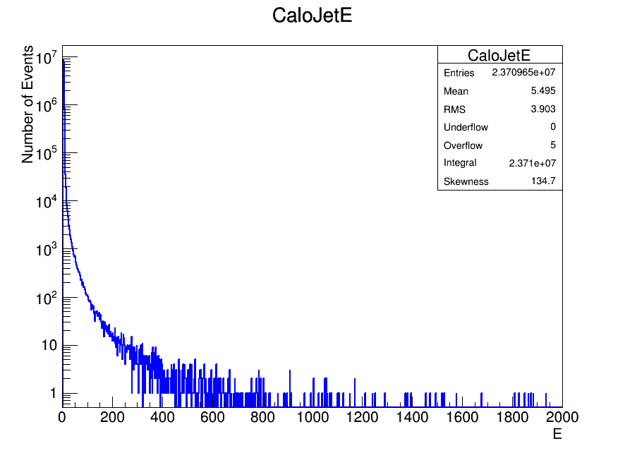
Energy Distrubution
MWGR10
CRUZET

Slide 29
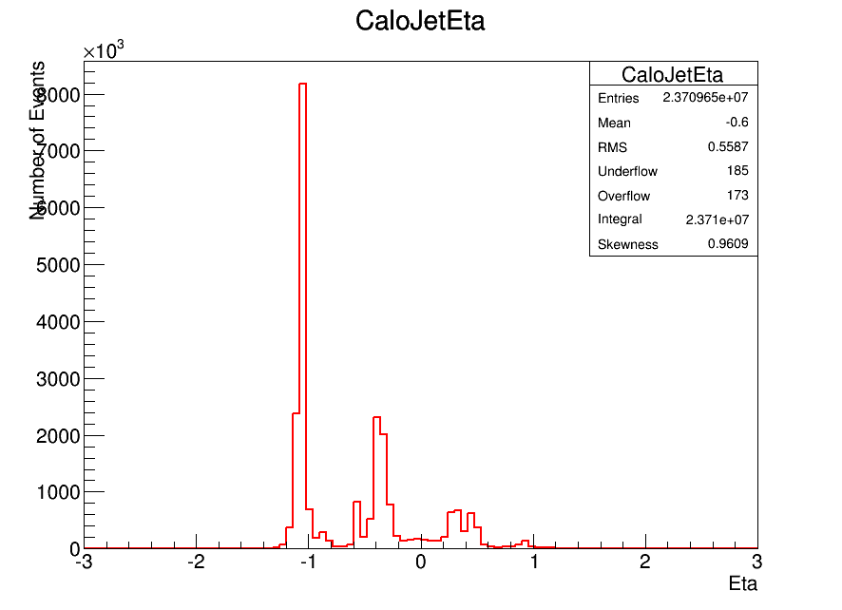
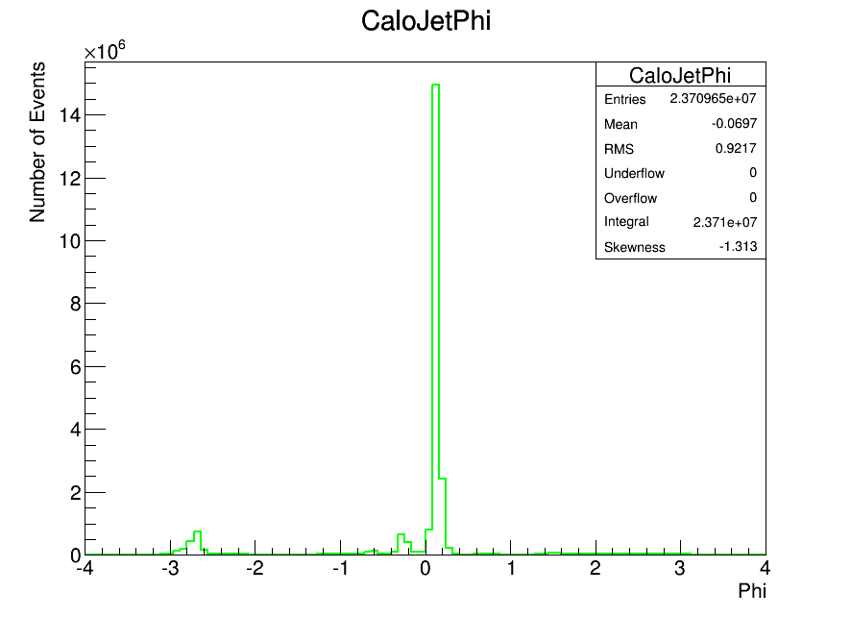
Eta and Phi Distrubution (CaloJet)

Slide 30
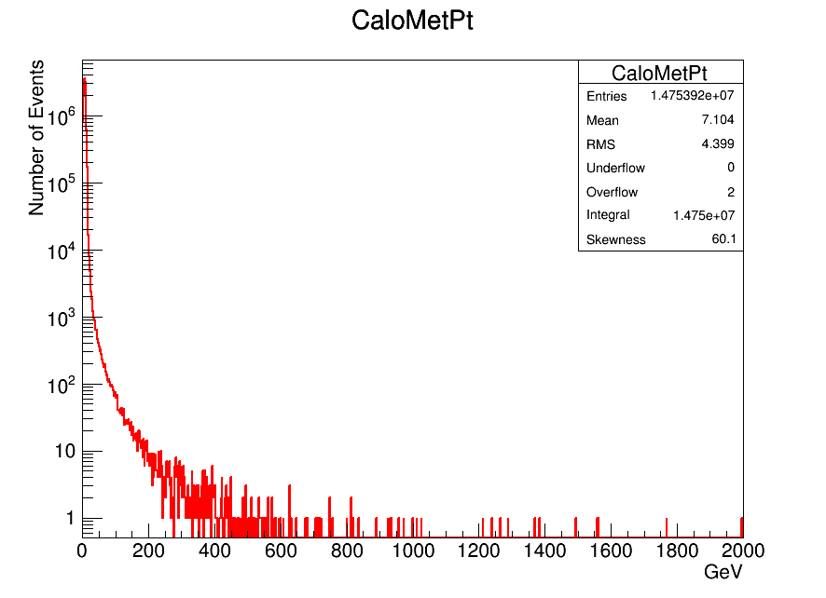
Met Distrubution

Slide 31
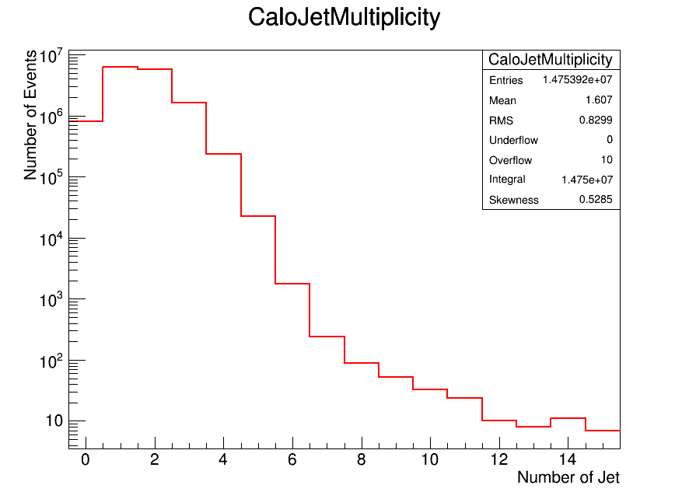
Multiplicity

Slide 32
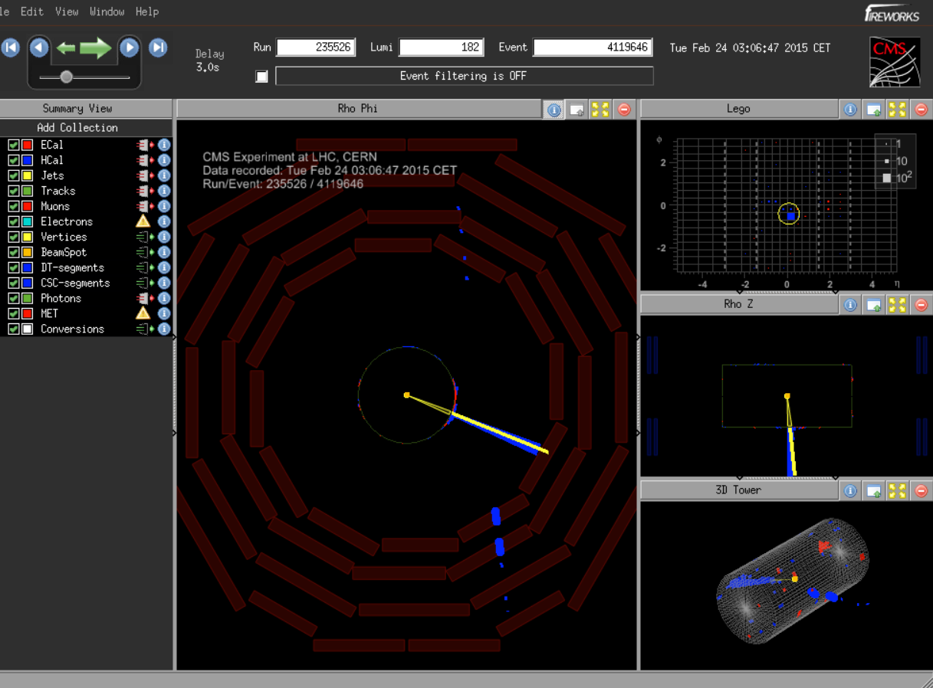
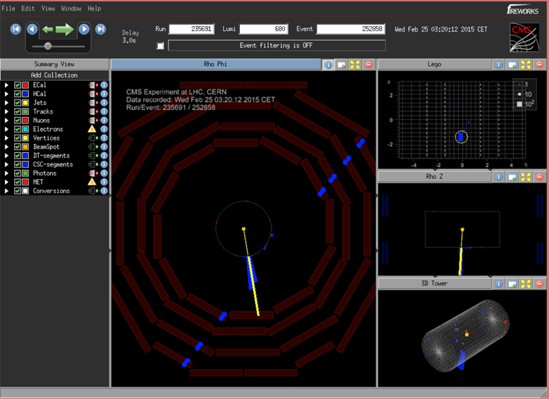
Event=4119646
Pt=101.518 GeV
Event=252858
Pt=109.02 GeV

Slide 33
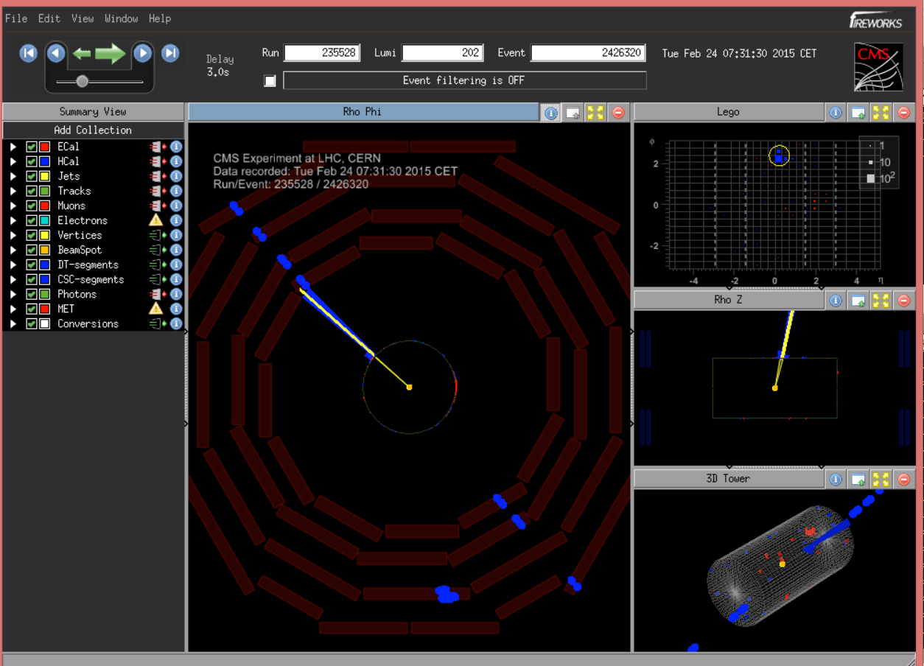
Event =2426320
Pt=107.403 GeV

Slide 34
Conclusion
  We checked different runs for CRUZET and put new plots.
  We analyzed CRUZET Runs for HB,HE,HO
  We obtain some cmsShow pictures for high Pt evets .

