Slide 1
HCAL Analysis
Samet Lezki
Yalcin Guler
Emine Gurpinar,Serdal Damarseckin,
Shuichi Kunori, Isa Dumanoglu,
Bayram Tali, Merve Ince, Hasan Huseyin Isik
26.02.15
1

Slide 2
Following results were obtained using
/MinimumBias/Run2012D-PromptReco-v1/RECO data set and following HLT filters was excluded while the data was analysing.
HLT_QuadJet45_v1
HLT_QuadJet50_v5
HLT_QuadJet75_55_35_20_BTagIP_VBF_v6
HLT_QuadJet75_55_38_20_BTagIP_VBF_v6
HLT_QuadJet70_v6
HLT_QuadJet80_v6
HLT_QuadJet90_v6
HLT_QuadJet60_DiJet20_v6
HLT_QuadJet75_55_38_20_BTagIP_VBF_v7
HLT_QuadJet75_55_35_20_VBF_v1
HLT_QuadJet75_55_35_20_BTagIP_VBF_v7
HLT_Mu8_QuadJet30_v7
HLT_SixJet45_v6
HLT_SixJet50_v6
HLT_SixJet35_v6
HLT_EightJet30_eta3p0_v5
HLT_EightJet35_eta3p0_v5
17.02.15
26.02.15
2
2

Slide 3
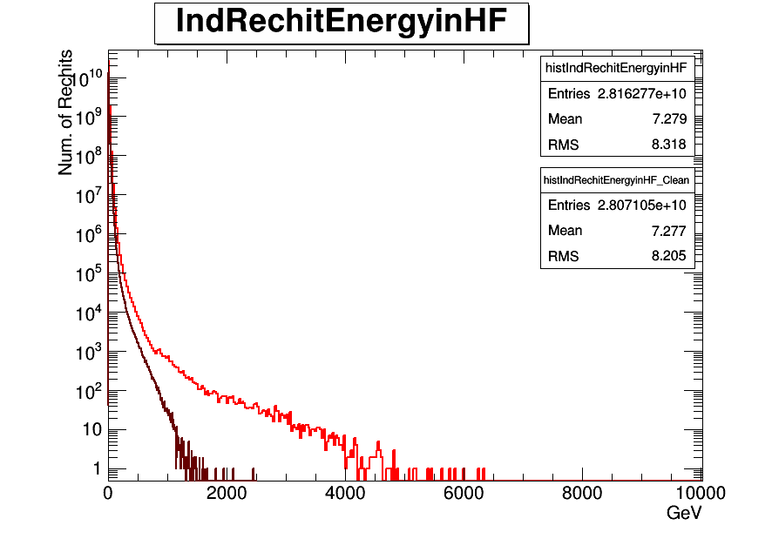
Individual Rechit Energy before and after noise filter for all HF

Slide 4
Following results were obtained using
/MinimumBias/Run2012D-PromptReco-v1/RECO data set and following HLT filters was excluded while the data was analysing.
HLT_Physics_Parked_v1
HLT_Physics_Part1_v5
HLT_Physics_Part2_v5
17.02.15
26.02.15
4
4

Slide 5

Individual Rechit Energy before and after noise filter for all HF

Slide 6
Following results were obtained using
/MinimumBias/Run2012D-PromptReco-v1/RECO data set and following HLT filters was excluded while the data was analysing.
HLT_PFMET150_v7,
HLT_PFMET180_v7,
HLT_MET80_Parked_v5,
HLT_MET80_HBHENoiseCleaned_v1,
HLT_LooseIsoPFTau35_Trk20_Prong1_MET70_v10,
HLT_LooseIsoPFTau35_Trk20_Prong1_MET75_v10,
HLT_MET100_HBHENoiseCleaned_v1,
HLT_MET120_HBHENoiseCleaned_v5,
HLT_Photon30_R9Id90_CaloId_HE10_Iso40_EBOnly_Met25_HBHENoiseCleaned_v1
HLT_Ele27_WP80_PFMET_MT50_v7
HLT_DiPFJet40_PFMETnoMu65_MJJ600VBF_LeadingJets_v9
:HLT_IsoMu18_CentralPFJet30_CentralPFJet25_PFMET20_v1,
HLT_MonoCentralPFJet80_PFMETnoMu105_NHEF0p95_v4
HLT_DiPFJet40_PFMETnoMu65_MJJ800VBF_AllJets_v9
HLT_PFMET150_v7
HLT_PFMET180_v7
HLT_MET200_v12
HLT_MET200_HBHENoiseCleaned_v5
HLT_Mu14_Ele14_CaloIdT_TrkIdVL_Mass8_PFMET40_v8
HLT_Ele24_WP80_CentralPFJet35_CentralPFJet25_PFMET20_v1
HLT_DiCentralPFJet30_PFMET80_BTagCSV07_v5
HLT_DisplacedPhoton65_CaloIdVL_IsoL_PFMET25_v4
HLT_PFNoPUHT400_Mu5_PFMET45_v4
HLT_CleanPFNoPUHT350_Ele5_CaloIdT_CaloIsoVL_TrkIdT_TrkIsoVL_PFMET45_v3,
HLT_CleanPFNoPUHT350_Ele5_CaloIdT_CaloIsoVL_TrkIdT_TrkIsoVL_PFMET50_v3,
HLT_CleanPFNoPUHT300_Ele15_CaloIdT_CaloIsoVL_TrkIdT_TrkIsoVL_PFMET45_v3,
HLT_CleanPFNoPUHT300_Ele15_CaloIdT_CaloIsoVL_TrkIdT_TrkIsoVL_PFMET50_v3,
HLT_DiCentralPFNoPUJet50_PFMETORPFMETNoMu80_v4
HLT_DoubleMu14_Mass8_PFMET40_v8
HLT_DoubleMu14_Mass8_PFMET50_v8
HLT_DiCentralPFJet30_PFMET80_v6
HLT_L2Mu70_2Cha_eta2p1_PFMET55_v2
HLT_PFNoPUHT400_Mu5_PFMET50_v4
HLT_MET120_v13
HLT_MET120_HBHENoiseCleaned_v6
HLT_DoubleEle14_CaloIdT_TrkIdVL_Mass8_PFMET40_v8
HLT_DoubleEle14_CaloIdT_TrkIdVL_Mass8_PFMET50_v8
HLT_DiCentralJetSumpT100_dPhi05_DiCentralPFJet60_25_PFMET100_HBHENoiseCleaned_v5
HLT_DisplacedPhoton65EBOnly_CaloIdVL_IsoL_PFMET30_v4
HLT_MET80_Track50_dEdx3p6_v6
HLT_PFNoPUHT350_Mu15_PFMET45_v4
HLT_PFNoPUHT350_Mu15_PFMET50_v4
HLT_Mu14_Ele14_CaloIdT_TrkIdVL_Mass8_PFMET50_v8
HLT_PFNoPUHT350_PFMET100_v4
HLT_PFNoPUHT400_PFMET100_v4
HLT_MET300_v4
HLT_MET400_v7
HLT_L2Mu70_2Cha_eta2p1_PFMET60_v2
HLT_MET80_v5
HLT_MET120_v12
HLT_MET80_Track60_dEdx3p7_v6
HLT_Photon70_CaloIdXL_PFMET100_v7
HLT_MET300_HBHENoiseCleaned_v5
HLT_MET400_HBHENoiseCleaned_v5
17.02.15
26.02.15
6
6

Slide 7

Individual Rechit Energy before and after noise filter for all HF
17.02.15
26.02.15
7
7

Slide 8
Following results were obtained using
/MinimumBias/Run2012D-PromptReco-v1/RECO data set and following HLT filters was excluded while the data was analysing.
AlCa_RPCMuonNoTriggers_v9
AlCa_RPCMuonNoHits_v9
AlCa_RPCMuonNormalisation_v9
HLT_Mu17_Ele8_CaloIdT_CaloIsoVL_TrkIdVL_TrkIsoVL_v9
HLT_Mu8_Ele17_CaloIdT_CaloIsoVL_TrkIdVL_TrkIsoVL_v9
HLT_IsoMu12_RsqMR30_Rsq0p04_MR200_v4
HLT_IsoMu12_RsqMR40_Rsq0p04_MR200_v4
DST_Mu5_HT250_v4
DST_L1HTT_Or_L1MultiJet_v4
HLT_L1SingleMuOpen_v7
HLT_L1SingleMu12_v2
HLT_DoubleMu3p5_LowMass_Displaced_v6
HLT_DoubleMu3p5_LowMassNonResonant_Displaced_v6
HLT_IsoMu24_v17
HLT_IsoMu24_eta2p1_v15
HLT_IsoMu30_v11
HLT_IsoMu30_eta2p1_v15
HLT_DiPFJet40_PFMETnoMu65_MJJ600VBF_LeadingJets_v9
HLT_Mu40_v14
HLT_Mu40_eta2p1_v11
HLT_Mu50_eta2p1_v8
HLT_Mu30_Ele30_CaloIdL_v8
HLT_Mu22_Photon22_CaloIdL_v7
HLT_IsoMu15_eta2p1_L1ETM20_v7
HLT_IsoMu34_eta2p1_v13
HLT_IsoMu40_eta2p1_v10
HLT_IsoMu15_eta2p1_LooseIsoPFTau35_Trk20_Prong1_L1ETM20_v10
HLT_IsoMu18_eta2p1_MediumIsoPFTau25_Trk1_eta2p1_v4
HLT_IsoMu18_CentralPFJet30_CentralPFJet25_v1
HLT_IsoMu18_CentralPFJet30_CentralPFJet25_PFMET20_v1
HLT_IsoMu17_eta2p1_LooseIsoPFTau20_v7
HLT_MonoCentralPFJet80_PFMETnoMu105_NHEF0p95_v4
HLT_DiPFJet40_PFMETnoMu65_MJJ800VBF_AllJets_v9
HLT_Mu15_eta2p1_L1ETM20_v5
HLT_L1SingleMuOpen_AntiBPTX_v7
HLT_Mu13_Mu8_v21
HLT_Mu17_Mu8_v21
HLT_Mu17_TkMu8_v13
HLT_Mu22_TkMu8_v8
HLT_Mu22_TkMu22_v8
HLT_IsoMu8_eta2p1_LooseIsoPFTau20_L1ETM26_v1
HLT_IsoMu17_eta2p1_CentralPFNoPUJet30_BTagIPIter_v4
HLT_Mu12_eta2p1_DiCentral_40_20_DiBTagIP3D1stTrack_v8
HLT_Mu15_eta2p1_TriCentral_40_20_20_DiBTagIP3D1stTrack_v8
HLT_L2Mu20_NoVertex_2Cha_NoBPTX3BX_NoHalo_v1
HLT_L2Mu30_NoVertex_2Cha_NoBPTX3BX_NoHalo_v1
HLT_Mu40_eta2p1_Track50_dEdx3p6_v5
HLT_Mu40_eta2p1_Track60_dEdx3p7_v5
HLT_BTagMu_Jet60_Mu4_v2
HLT_Mu14_Ele14_CaloIdT_TrkIdVL_Mass8_PFMET40_v8
HLT_IsoMu17_eta2p1_CentralPFNoPUJet30_v4
HLT_IsoMu20_WCandPt80_v4
HLT_Tau2Mu_ItTrack_v7
HLT_Mu8_eta2p1_LooseIsoPFTau20_L1ETM26_v1
HLT_DoubleMu3_4_Dimuon5_Bs_Central_v5
HLT_DoubleMu3p5_4_Dimuon5_Bs_Central_v5
HLT_DoubleMu4_Dimuon7_Bs_Forward_v5
HLT_DoubleMu4_Jpsi_Displaced_v12
HLT_DoubleMu8_Mass8_PFNoPUHT175_v4
HLT_Mu15_TkMu5_Onia_v1
HLT_Dimuon0_Jpsi_Muon_v18
HLT_Mu15_eta2p1_TriCentral_40_20_20_BTagIP3D1stTrack_v8
HLT_PFNoPUHT400_Mu5_PFMET45_v4
HLT_Mu8_Ele8_CaloIdT_TrkIdVL_Ele8_CaloIdL_TrkIdVL_v7
HLT_BTagMu_Jet20_Mu4_v2
HLT_BTagMu_DiJet70_Mu5_v6
HLT_Mu12_eta2p1_DiCentral_40_20_v8
HLT_Mu12_eta2p1_DiCentral_20_v8
HLT_Mu15_eta2p1_DiCentral_40_20_v1
HLT_Mu15_eta2p1_DiCentral_20_v1
HLT_IsoMu18_PFJet30_PFJet25_Deta3_v1
HLT_Mu24_v16
HLT_Mu30_v16
HLT_Mu18_PFJet30_PFJet25_Deta3_CentralPFJet25_v1
HLT_Dimuon0_Upsilon_Muon_v18
HLT_L2TripleMu10_0_0_NoVertex_PFJet40Neutral_v8
HLT_DoubleMu11_Acoplanarity03_v5
HLT_TripleMu5_v19
HLT_IsoMu18_PFJet30_PFJet25_Deta3_CentralPFJet25_v1
HLT_IsoMu17_eta2p1_TriCentralPFNoPUJet45_35_25_v2
HLT_IsoMu17_eta2p1_TriCentralPFNoPUJet30_v4
HLT_BTagMu_DiJet40_Mu5_v6
HLT_DiCentralPFNoPUJet50_PFMETORPFMETNoMu80_v4
HLT_BTagMu_DiJet110_Mu5_v6
HLT_Mu12_eta2p1_L1Mu10erJetC12WdEtaPhi1DiJetsC_v7
HLT_Mu5_L2Mu3_Jpsi_v8
HLT_L2Mu20_eta2p1_NoVertex_v2
HLT_Mu17_v5
HLT_DoubleMu4_JpsiTk_Displaced_v6
HLT_BTagMu_Jet300_Mu5_v6
HLT_DoubleMu5_IsoMu5_v20
HLT_Mu13_Mu8_v22
HLT_Mu17_Mu8_v22
HLT_IsoMu12_DoubleCentralJet65_v4
HLT_Mu17_TkMu8_v14
HLT_DoubleMu14_Mass8_PFMET40_v8
HLT_DoubleMu14_Mass8_PFMET50_v8
HLT_RelIso1p0Mu5_v6
HLT_L2DoubleMu23_NoVertex_2Cha_Angle2p5_v3
HLT_Mu22_TkMu8_v9
HLT_Mu22_TkMu22_v9
HLT_L2Mu70_2Cha_eta2p1_PFMET55_v2
HLT_IsoMu17_eta2p1_DiCentralPFNoPUJet30_PFNoPUHT350_PFMHT40_v3
HLT_DoubleRelIso1p0Mu5_Mass8_PFNoPUHT175_v4
HLT_DoubleRelIso1p0Mu5_Mass8_PFNoPUHT225_v4
HLT_DoubleMu8_Mass8_PFNoPUHT225_v4
HLT_Mu40_PFNoPUHT350_v4
HLT_Mu60_PFNoPUHT350_v4
HLT_PFNoPUHT400_Mu5_PFMET50_v4
HLT_Mu12_eta2p1_DiCentral_40_20_BTagIP3D1stTrack_v8
HLT_L2DoubleMu38_NoVertex_2Cha_Angle2p5_v3
HLT_Mu17_eta2p1_LooseIsoPFTau20_v7
HLT_L2DoubleMu23_NoVertex_v11
HLT_Mu8_v18
HLT_BTagMu_DiJet20_Mu5_v6
HLT_Mu8_TriJet30_v7
HLT_RelIso1p0Mu20_v3
HLT_L2Mu10_NoVertex_NoBPTX3BX_NoHalo_v4
HLT_Mu24_eta2p1_v5
HLT_IsoMu20_eta2p1_v71
HLT_IsoMu20_eta2p1_CentralPFJet80_v9
HLT_RelIso1p0Mu5_Ele8_CaloIdT_TrkIdVL_Mass8_PFNoPUHT175_v4
HLT_RelIso1p0Mu5_Ele8_CaloIdT_TrkIdVL_Mass8_PFNoPUHT225_v4
HLT_Mu8_Ele8_CaloIdT_TrkIdVL_Mass8_PFNoPUHT175_v4
HLT_Mu8_Ele8_CaloIdT_TrkIdVL_Mass8_PFNoPUHT225_v4
HLT_PFNoPUHT350_Mu15_PFMET45_v4
HLT_PFNoPUHT350_Mu15_PFMET50_v4
HLT_Mu14_Ele14_CaloIdT_TrkIdVL_Mass8_PFMET50_v8
HLT_Mu8_DoubleEle8_CaloIdT_TrkIdVL_v7
HLT_Mu17_eta2p1_TriCentralPFNoPUJet45_35_25_v2
HLT_Mu17_eta2p1_CentralPFNoPUJet30_BTagIPIter_v4
HLT_Mu18_CentralPFJet30_CentralPFJet25_v1
HLT_Mu15_eta2p1_TriCentral_40_20_20_v8
HLT_DoubleMu8_Ele8_CaloIdT_TrkIdVL_v5
HLT_Mu15_eta2p1_L1Mu10erJetC12WdEtaPhi1DiJetsC_v3
HLT_Mu5_Track2_Jpsi_v21
HLT_Mu5_Track3p5_Jpsi_v7
HLT_Mu8_DiJet30_v7
HLT_DoubleDisplacedMu4_DiPFJet40Neutral_v8
HLT_L2Mu70_2Cha_eta2p1_PFMET60_v2
HLT_Mu12_v18
HLT_Mu8_QuadJet30_v7
HLT_Mu30_eta2p1_v5
HLT_IsoMu17_eta2p1_DiCentralPFNoPUJet30_v4
HLT_IsoMu8_eta2p1_LooseIsoPFTau20_v1
HLT_Mu17_TkMu8_NoDZ_v1
HLT_Mu13_Mu8_NoDZ_v1HLT_Mu5_v20
HLT_Mu7_Track7_Jpsi_v20
17.02.15
26.02.15
8
8

Slide 9

Individual Rechit Energy before and after noise filter for all HF

Slide 10
Following results were obtained using
/MinimumBias/Run2012D-PromptReco-v1/RECO data set and following HLT filters was excluded while the data was analysing.
HLT_Photon36_R9Id85_OR_CaloId10_Iso50_Photon10_R9Id85_OR_CaloId10_Iso50_Mass80_v1
HLT_Photon22_R9Id90_HE10_Iso40_EBOnly_v5
HLT_Photon26_R9Id85_OR_CaloId10_Iso50_Photon18_R9Id85_OR_CaloId10_Iso50_Mass70_v2
HLT_Photon30_R9Id90_CaloId_HE10_Iso40_EBOnly_Met25_HBHENoiseCleaned_v1
HLT_Photon70_CaloIdXL_PFNoPUHT400_v4
HLT_Photon135_v7
HLT_Photon150_v4
HLT_Photon160_v4
HLT_DoublePhoton48_HEVT_v8
HLT_DoublePhoton53_HEVT_v2
HLT_Photon40_CaloIdL_RsqMR45_Rsq0p09_MR150_v6
HLT_Photon40_CaloIdL_RsqMR50_Rsq0p09_MR150_v6
HLT_Photon36_R9Id85_Photon22_R9Id85_v4
HLT_Photon36_R9Id85_Photon22_CaloId10_Iso50_v6
HLT_Photon36_CaloId10_Iso50_Photon22_R9Id85_v6
HLT_Photon36_CaloId10_Iso50_Photon22_CaloId10_Iso50_v6
HLT_Photon36_R9Id85_OR_CaloId10_Iso50_Photon22_R9Id85_OR_CaloId10_Iso50_v6
HLT_Photon26_Photon18_v12
HLT_Photon30_v1
HLT_Photon50_CaloIdVL_v10
HLT_Photon75_CaloIdVL_v13
HLT_Photon90_CaloIdVL_v10
HLT_DoublePhoton40_CaloIdL_Rsq0p035_v6
HLT_DoublePhoton40_CaloIdL_Rsq0p06_v6
HLT_Photon30_R9Id90_CaloId_HE10_Iso40_EBOnly_v1
HLT_Photon70_CaloIdXL_PFNoPUHT500_v4
HLT_Photon50_CaloIdVL_IsoL_v17
HLT_Photon36_R9Id90_HE10_Iso40_EBOnly_v5
HLT_Photon300_NoHE_v5
HLT_Photon26_R9Id85_OR_CaloId10_Iso50_Photon18_v5
HLT_Photon40_CaloIdL_RsqMR40_Rsq0p09_MR150_v6
HLT_Photon30_CaloIdVL_v14
HLT_DoublePhoton70_v6
HLT_DoublePhoton80_v7
HLT_Photon60_CaloIdL_MHT70_v11
HLT_Photon50_R9Id90_HE10_Iso40_EBOnly_v5
HLT_Photon60_CaloIdL_HT300_v4
HLT_Photon90_R9Id90_HE10_Iso40_EBOnly_v5
HLT_Photon75_R9Id90_HE10_Iso40_EBOnly_v5
HLT_Photon20_CaloIdVL_IsoL_v16
HLT_Photon36_Photon22_v6
HLT_Photon36_R9Id85_OR_CaloId10_Iso50_Photon22_v5
17.02.15
26.02.15
10
10

Slide 11

Individual Rechit Energy before and after noise filter for all HF

Slide 12
Following results were obtained using
/MinimumBias/Run2012D-PromptReco-v1/RECO data set and following HLT filters was excluded while the data was analysing.
HLT_Ele25_CaloIdVT_CaloIsoVL_TrkIdVL_TrkIsoT_TriCentralPFNoPUJet45_35_25_v2
HLT_Ele25_CaloIdVT_CaloIsoT_TrkIdT_TrkIsoT_CentralPFNoPUJet30_BTagIPIter_v9
HLT_Ele27_WP80_v11
HLT_Ele80_CaloIdVT_GsfTrkIdT_v2
HLT_Ele90_CaloIdVT_GsfTrkIdT_v2
HLT_Ele30_CaloIdVT_TrkIdT_PFNoPUJet100_PFNoPUJet25_v8
HLT_Ele30_CaloIdVT_TrkIdT_PFNoPUJet150_PFNoPUJet25_v8
HLT_Ele27_CaloIdT_CaloIsoVL_TrkIdVL_TrkIsoVL_HFT15_v8
HLT_Ele23_CaloIdT_CaloIsoVL_TrkIdVL_TrkIsoVL_HFT30_v8
HLT_Ele8_CaloIdT_TrkIdVL_Jet30_v7
HLT_Ele22_eta2p1_WP90Rho_LooseIsoPFTau20_v7
HLT_Ele8_CaloIdT_CaloIsoVL_TrkIdVL_TrkIsoVL_v15
HLT_Ele17_CaloIdT_CaloIsoVL_TrkIdVL_TrkIsoVL_Ele8_CaloIdT_CaloIsoVL_TrkIdVL_TrkIsoVL_v18
HLT_Ele20_CaloIdVT_CaloIsoVT_TrkIdT_TrkIsoVT_SC4_Mass50_v7
HLT_Ele24_WP80_CentralPFJet35_CentralPFJet25_v1
HLT_Ele27_WP80_WCandPt80_v9
HLT_Ele27_WP80_CentralPFJet80_v9
HLT_Ele17_CaloIdVT_CaloIsoVT_TrkIdT_TrkIsoVT_Ele8_Mass50_v6
HLT_Ele8_CaloIdT_TrkIdVL_EG7_v2
HLT_Ele25_CaloIdVT_CaloIsoVL_TrkIdVL_TrkIsoT_DiCentralPFNoPUJet30_v2
HLT_Ele17_CaloIdT_CaloIsoVL_TrkIdVL_TrkIsoVL_v6
HLT_Ele17_CaloIdT_CaloIsoVL_TrkIdVL_TrkIsoVL_Jet30_v7
HLT_Ele30_CaloIdVT_TrkIdT_v6
HLT_Ele25_CaloIdVT_CaloIsoVL_TrkIdVL_TrkIsoT_TriCentralPFNoPUJet30_v4
HLT_Ele25_CaloIdVT_CaloIsoVL_TrkIdVL_TrkIsoT_TriCentralPFNoPUJet50_40_30_v4
HLT_Ele24_WP80_PFJet30_PFJet25_Deta3_v1
HLT_Ele24_WP80_PFJet30_PFJet25_Deta3_CentralPFJet30_v1
HLT_Ele15_Ele8_Ele5_CaloIdL_TrkIdVL_v6
HLT_Ele27_CaloIdT_CaloIsoVL_TrkIdVL_TrkIsoVL_Ele15_CaloIdT_CaloIsoVL_trackless_v8
HLT_Ele27_CaloIdL_CaloIsoVL_TrkIdVL_TrkIsoVL_v11
HLT_Ele22_eta2p1_WP90NoIso_LooseIsoPFTau20_v7
HLT_Ele25_CaloIdVT_CaloIsoT_TrkIdT_TrkIsoT_CentralPFNoPUJet30_v8
HLT_Ele12_CaloIdT_CaloIsoVL_TrkIdVL_TrkIsoVL_RsqMR30_Rsq0p04_MR200_v4
HLT_Ele17_CaloIdT_CaloIsoVL_TrkIdVL_TrkIsoVL_Ele8_CaloIdT_CaloIsoVL_TrkIdVL_TrkIsoVL_v19
HLT_Ele8_CaloIdT_CaloIsoVL_TrkIdVL_TrkIsoVL_Jet30_v7
HLT_Ele32_CaloIdT_CaloIsoT_TrkIdT_TrkIsoT_SC17_Mass50_v6
HLT_Ele12_CaloIdT_CaloIsoVL_TrkIdVL_TrkIsoVL_DoubleCentralJet65_v4
HLT_Ele12_CaloIdT_CaloIsoVL_TrkIdVL_TrkIsoVL_RsqMR40_Rsq0p04_MR200_v4
HLT_Ele8_CaloIdT_TrkIdT_TriJet30_v18
HLT_Ele8_CaloIdT_TrkIdT_QuadJet30_v18
HLT_Ele13_eta2p1_WP90Rho_LooseIsoPFTau20_v1
HLT_Ele8_CaloIdL_CaloIsoVL_v17
HLT_Ele17_CaloIdL_CaloIsoVL_v17
HLT_Ele8_CaloIdT_TrkIdVL_v5
17.02.15
26.02.15
12
12

Slide 13

Individual Rechit Energy before and after noise filter for all HF

Slide 14
Following results were obtained using
/MinimumBias/Run2012D-PromptReco-v1/RECO data set and following HLT filters was excluded while the data was analysing.
HLT_L1ETM40_v2
HLT_L1ETM70_v2
HLT_L1TrackerCosmics_v7
HLT_L1SingleEG5_v6
HLT_L1ETM100_v2
HLT_L1SingleEG12_v6
HLT_L1ETM30_v2
HLT_L1SingleJet36_v7
HLT_Ele13_eta2p1_WP90NoIso_LooseIsoPFTau20_L1ETM36_v1
HLT_Ele13_eta2p1_WP90Rho_LooseIsoPFTau20_L1ETM36_v1
HLT_L1DoubleJet36Central_v7
HLT_L1SingleJet16_v7
17.02.15
26.02.15
14
14

Slide 15

Individual Rechit Energy before and after noise filter for all HF

Slide 16
Back up
26.02.15
16

Slide 17
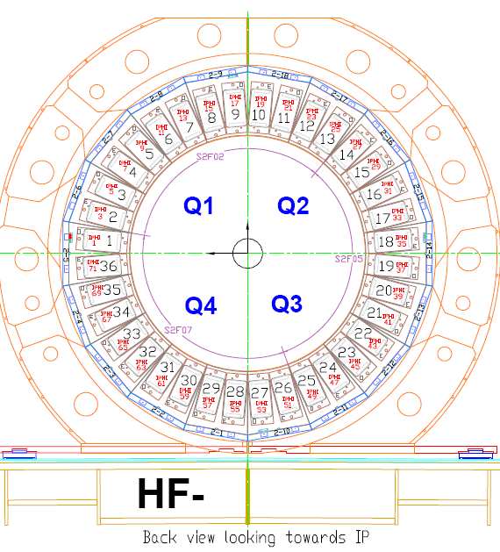
New PMTs location in old data
24 New PMTs are at HF-(iφ =43)
26.02.15
17

