Slide 1
MWGRs & CRUZET Analysis
Merve Ince
Emine Gurpinar
Shuichi Kunori, Isa Dumanoglu
Bayram Tali, Yalcin Guler, Serdal Damarseckin
HCAL analysis Meeting
19.03.2015

Slide 2
Introduction
We have analyzed all CRUZET (23 February – 8 March, 2015) runs longer than 60 minutes.
We have used two different set of samples.
  “/eos/cms/store/data/Commissioning2015/Cosmics/RECO/PromptReco-v1” applying “L1_SingleMuOpen” trigger
  “/eos/cms/store/data/Commissioning2015/MinimumBias/RECO/PromptReco-v1/” applying “L1_SingleJet16” and “L1_SingleEG5” .
We will show
  RecHitEnergy, ieta-iphi distributions and CaloJetEnergy for HB,HE,HO.

Slide 3
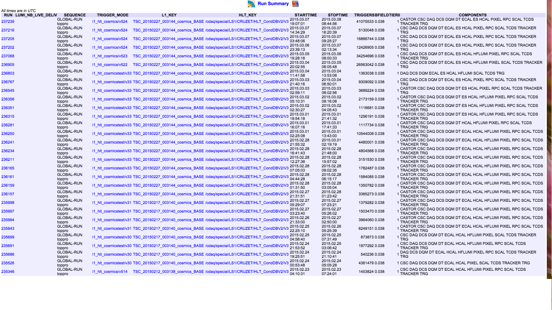
Run Information for CRUZET

Slide 4
MinBias dataset with ‘’L1_SingleJet16’’ for CRUZET Runs

Slide 5
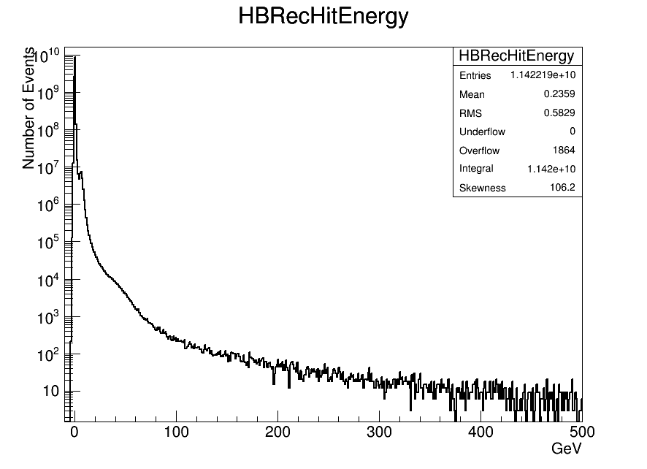
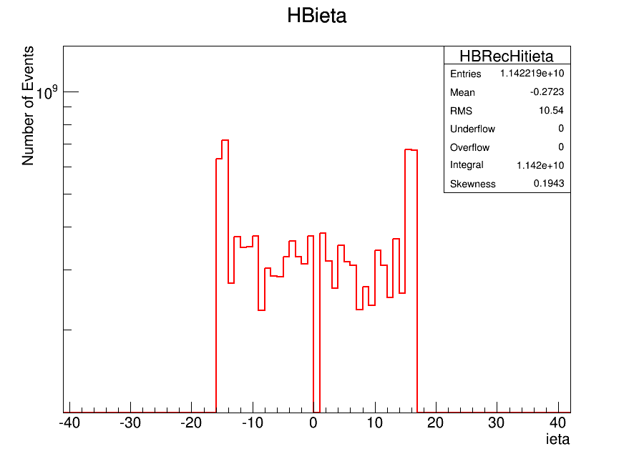
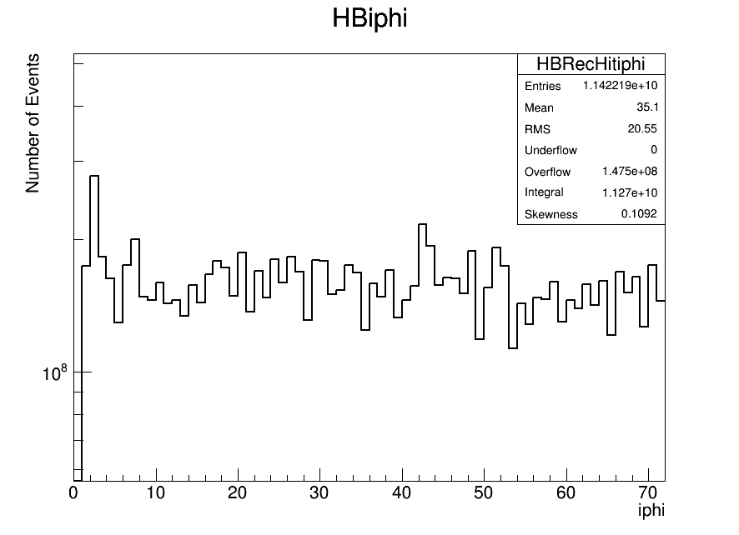
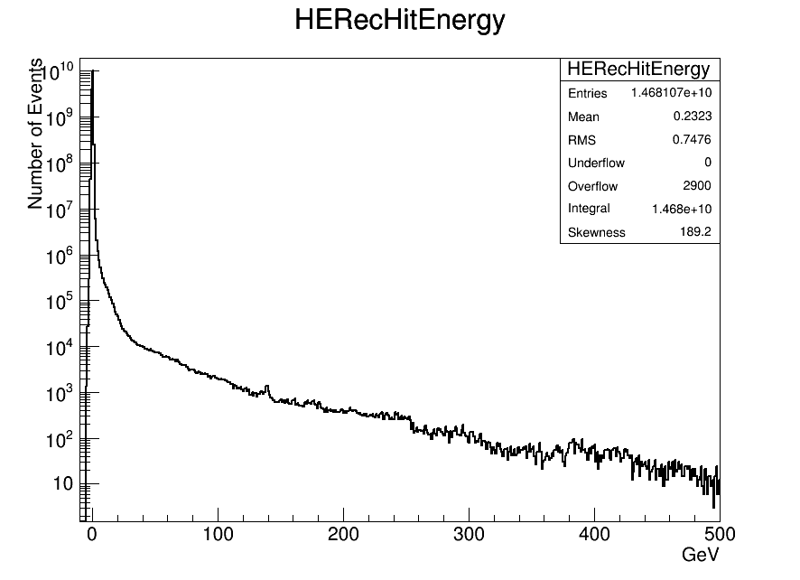
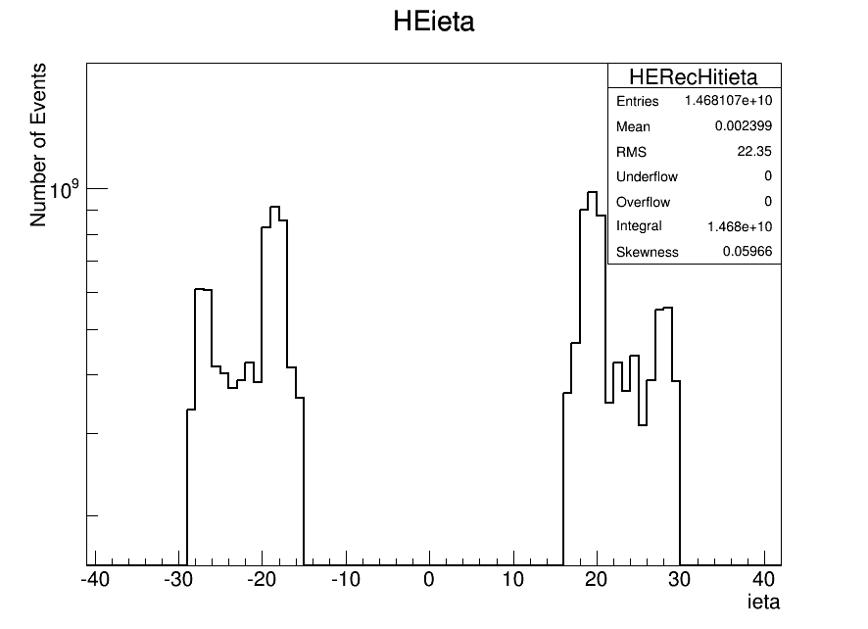
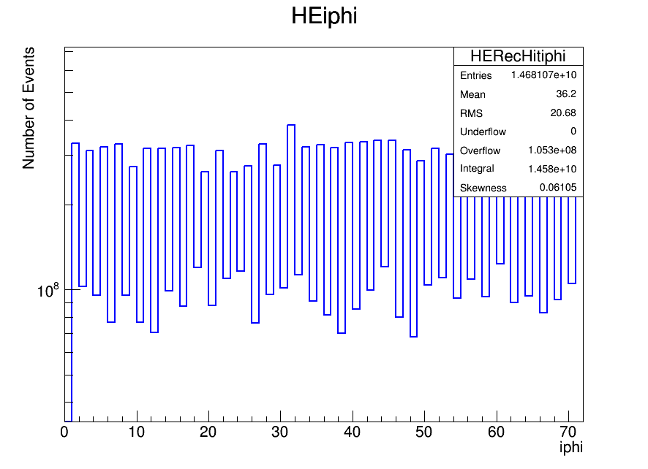
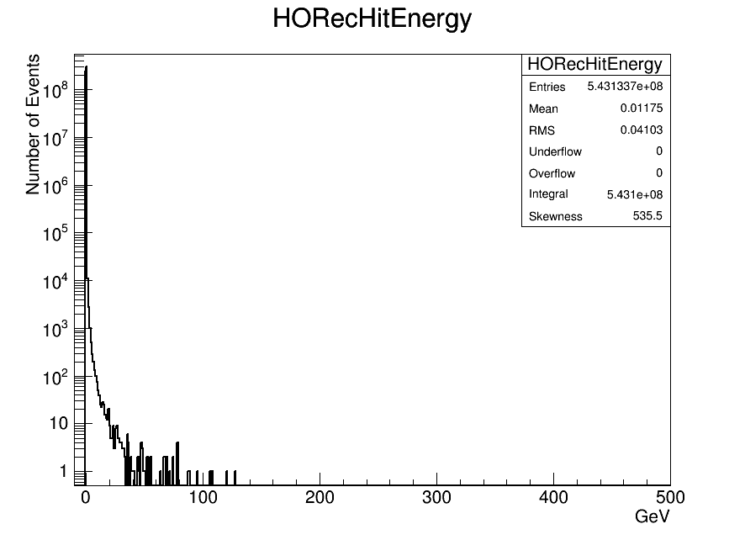
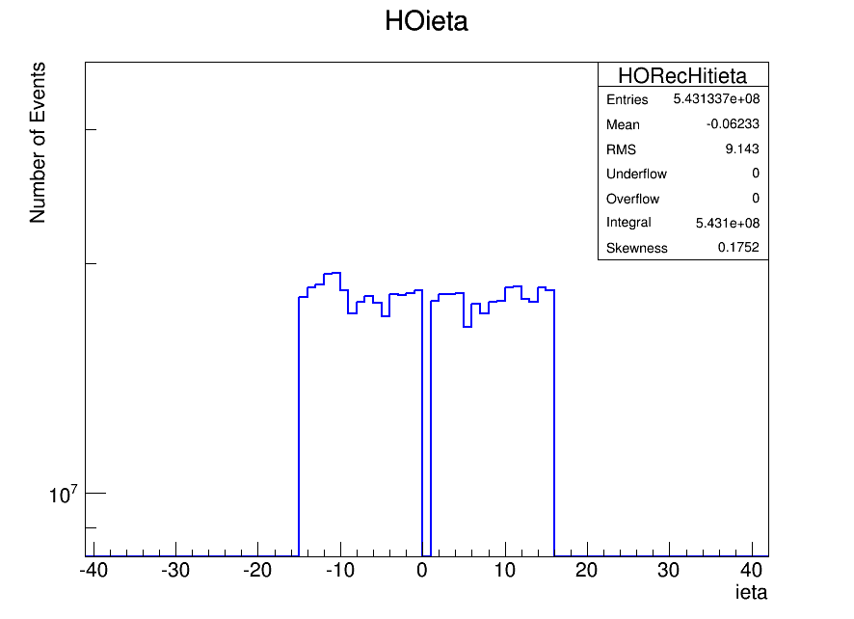
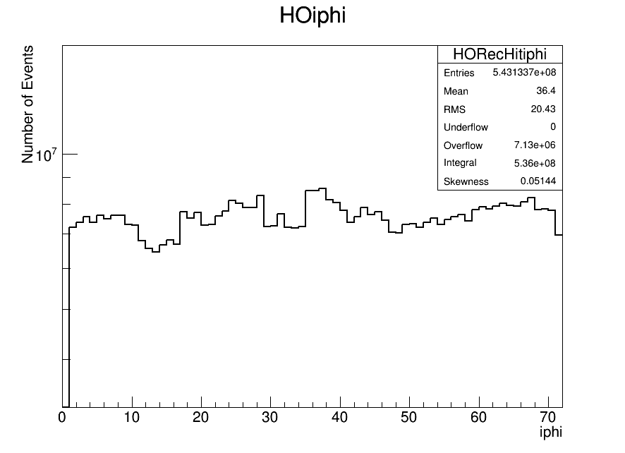
Individual RecHit Energy, ieta and iphi Distributions for HB, HE and HO
HB
HB
HB
HE
HE
HE
HO
HO
HO

Slide 6
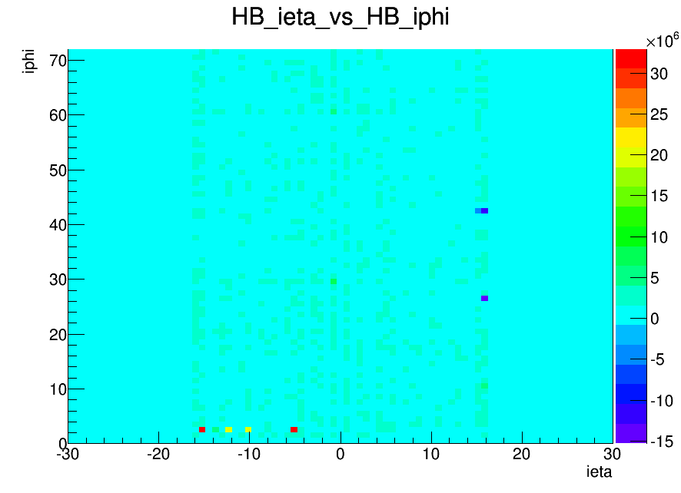
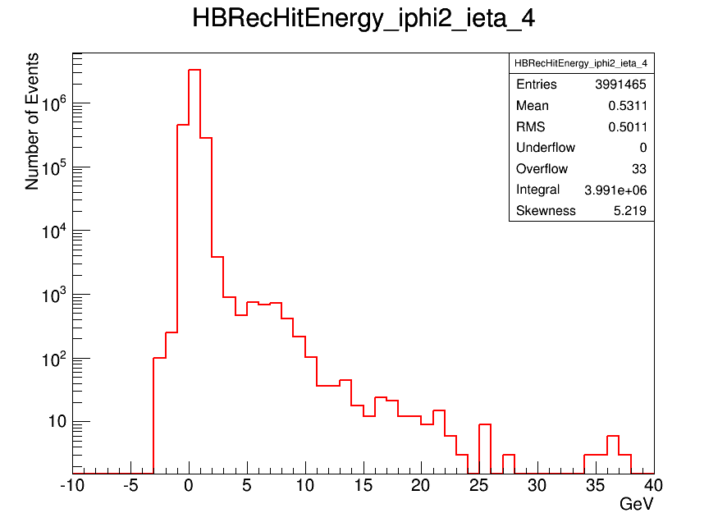
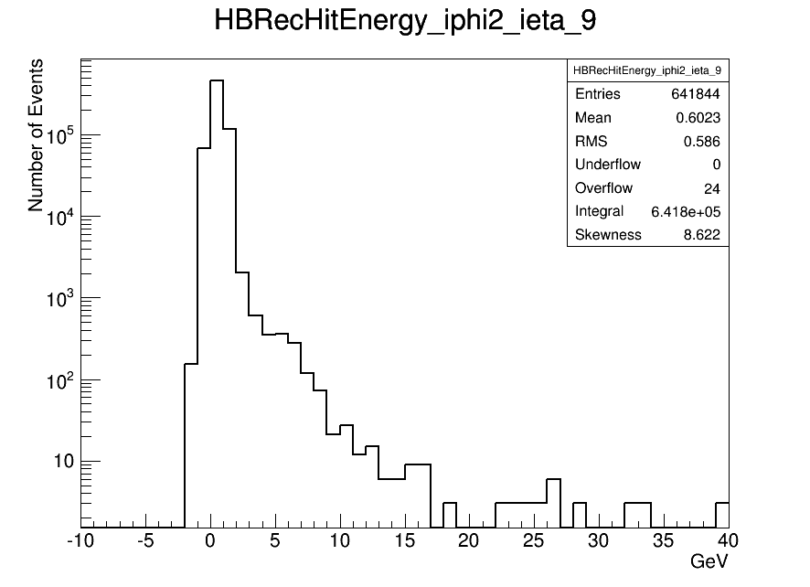
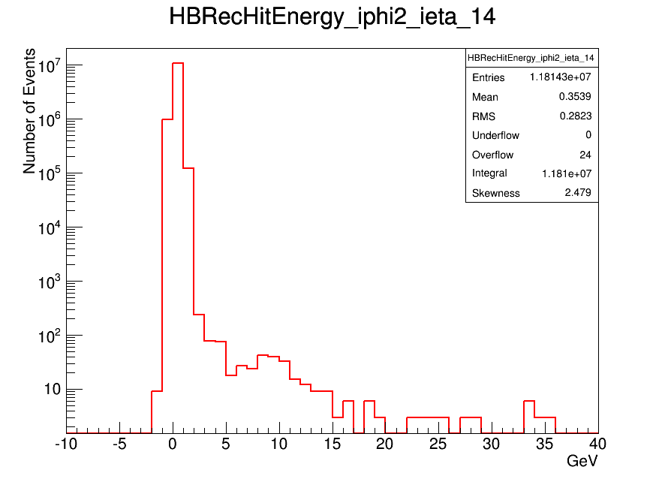
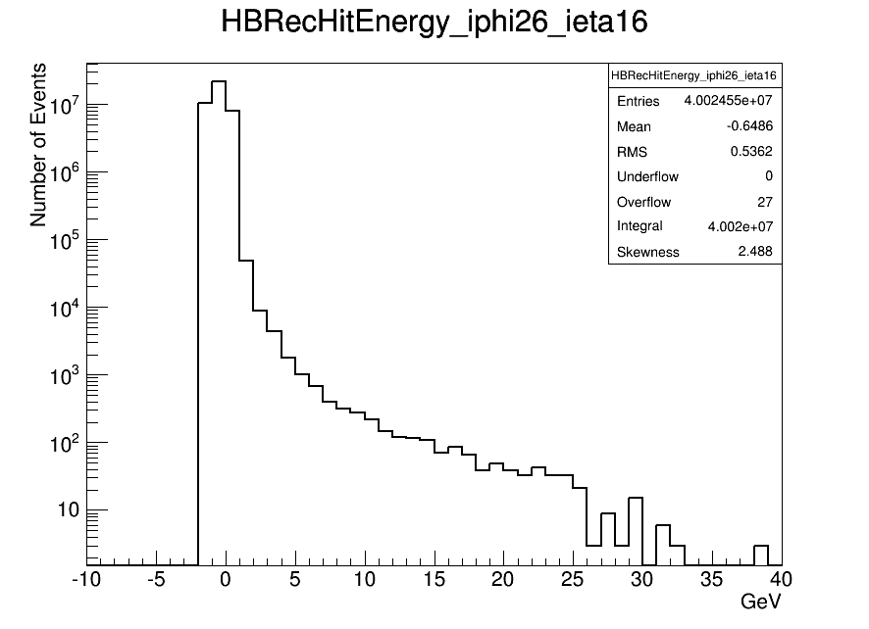
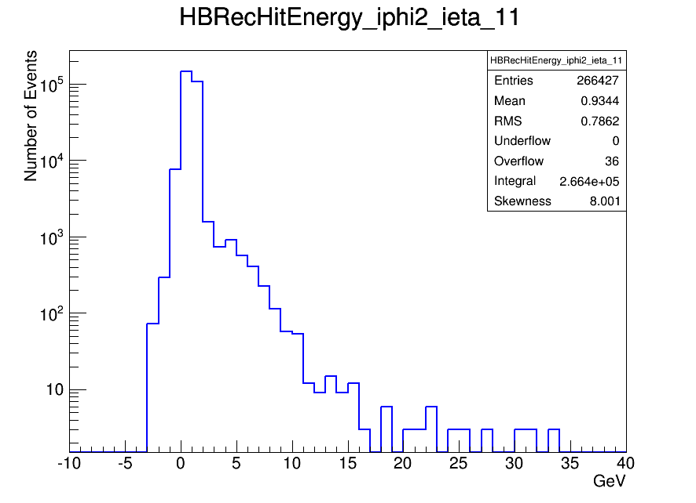
ieta vs iphi in GeV for HB
HB (42, 16)
HB(26, 16)
HB(2, -9)
HB(2, -4)
HB(2, -4), HB(2, -9), HB(2, -11), HB(2, -14)
HB(2, -14)
HB(26, 16)
HB(2,-11)

Slide 7
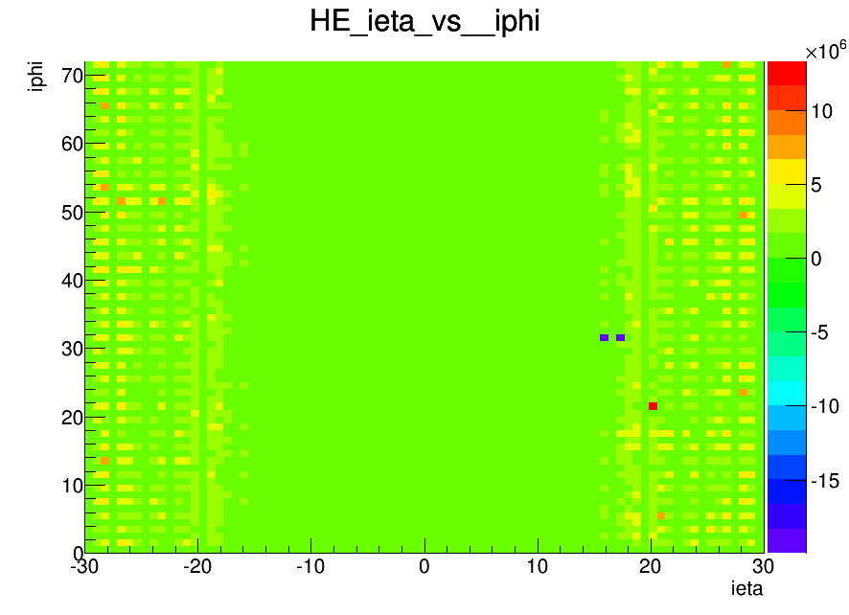
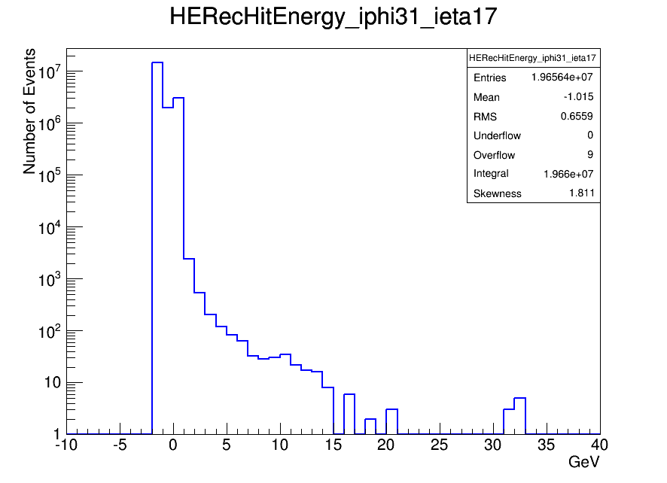
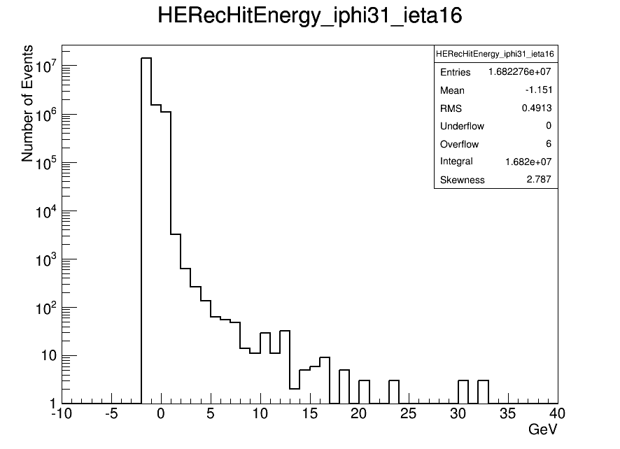
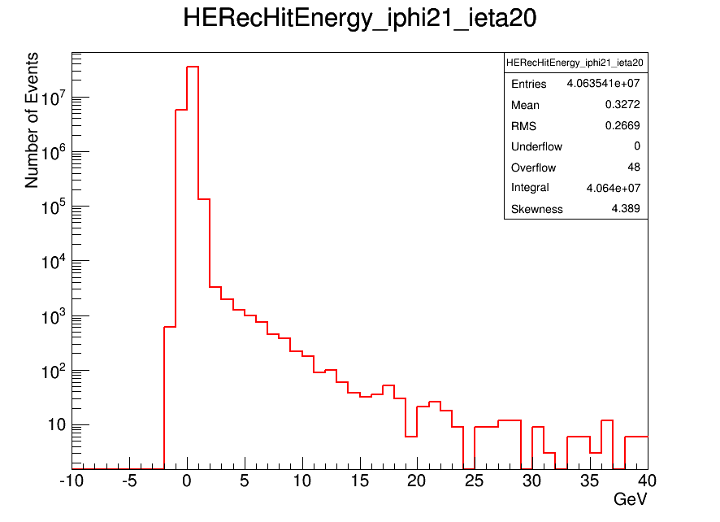
ieta vs iphi in GeV for HE
HE(31, 16&17)
HE(21,20)
HE(31, 17)
HE(31, 16)
HE(21, 20)

Slide 8
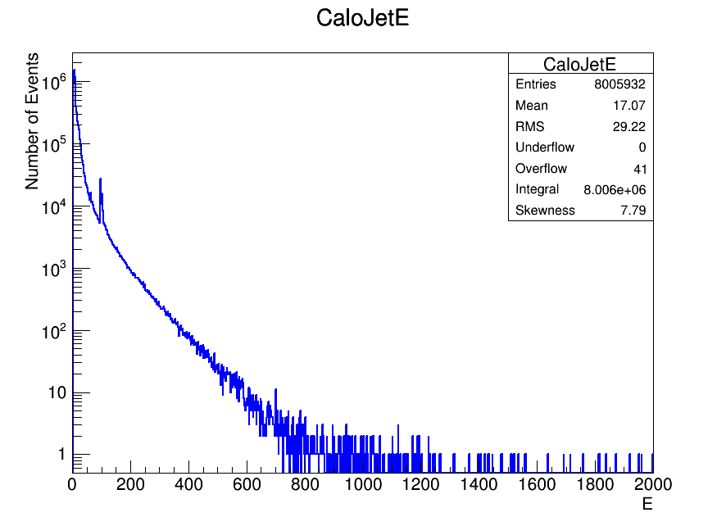
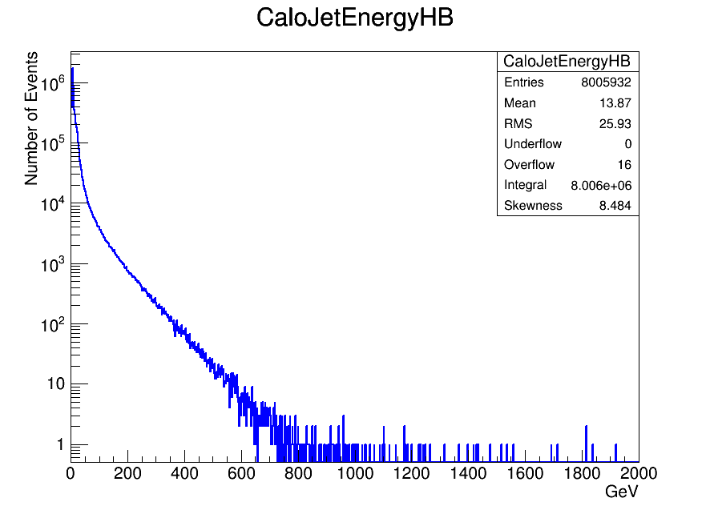
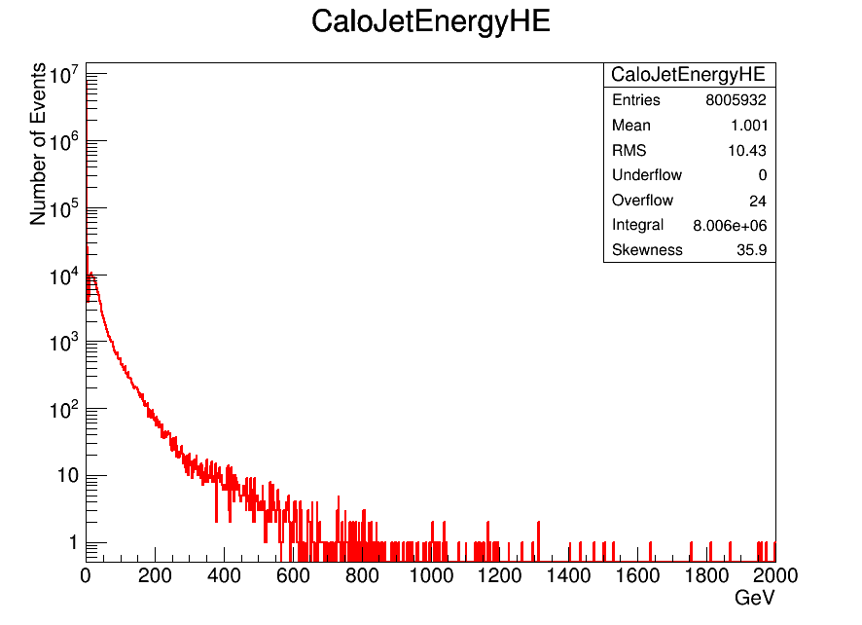
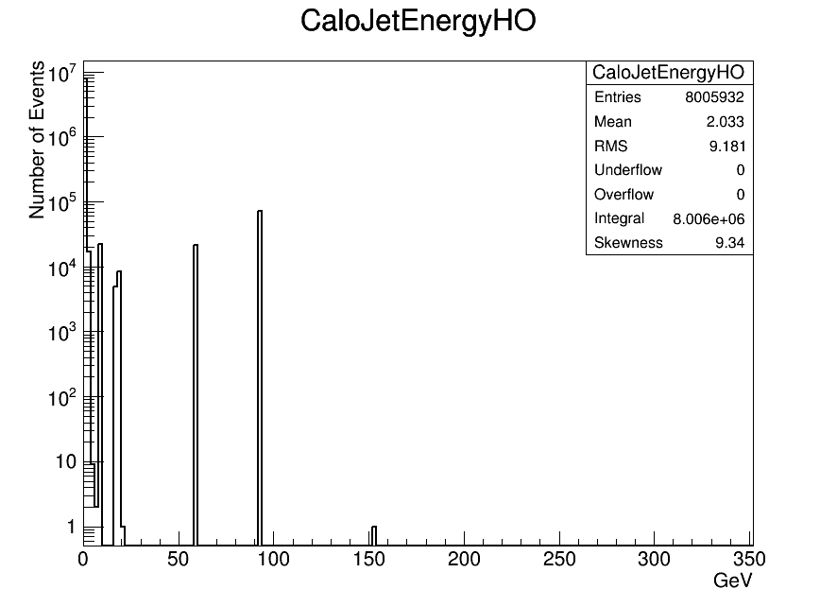
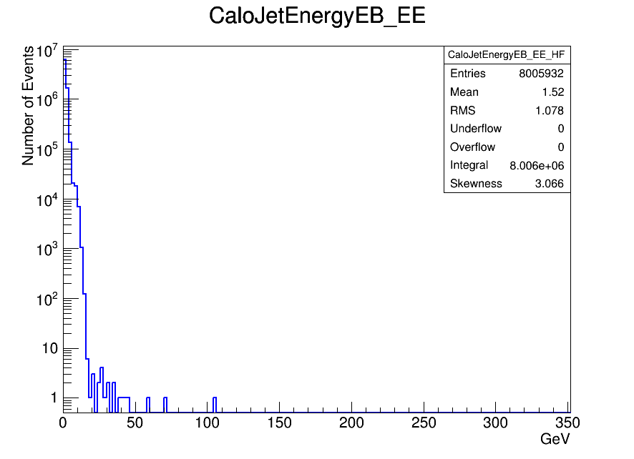
CaloJetEnergy Distributions for MWGR10
Sum CaloJet enerji distribution
hadEnergy In HB hadEnergy In HE
hadEnergy In HO
emEnergy In EB + emEnergy In EE

Slide 9
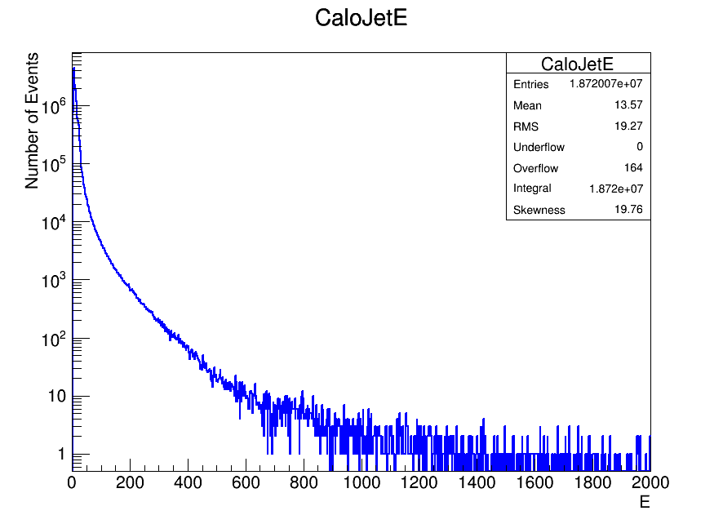
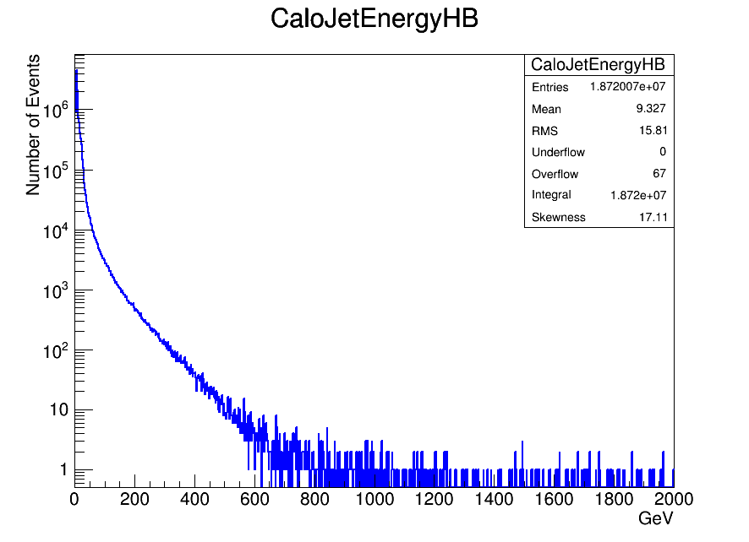
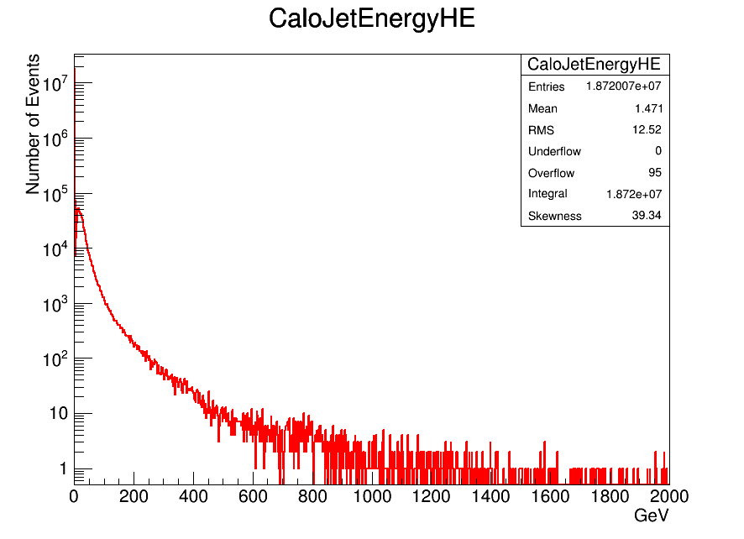
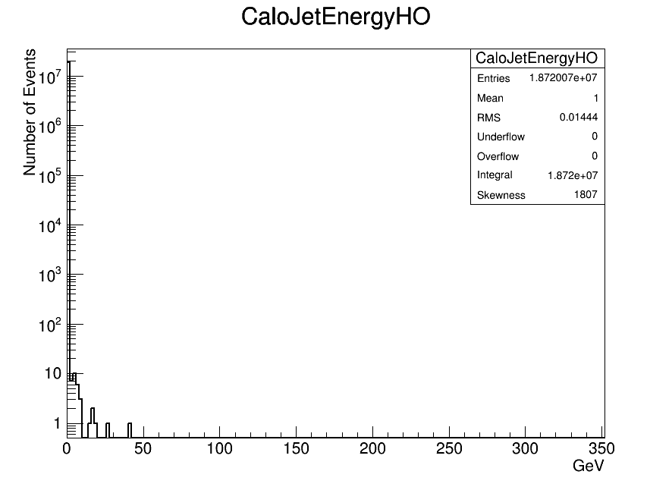
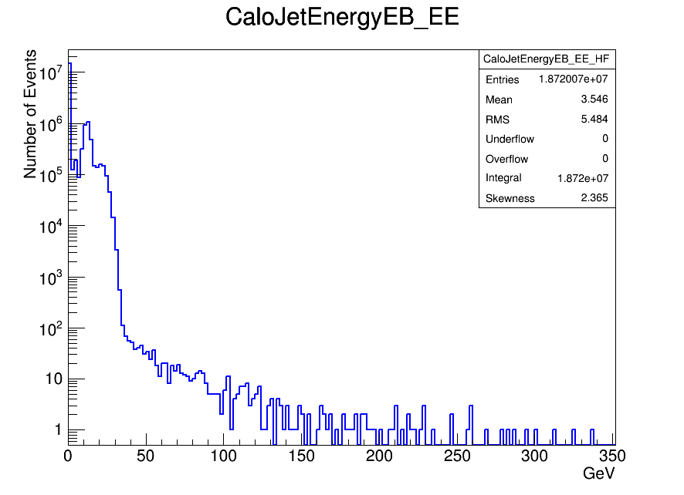
CaloJetEnergy Distributions for CRUZET
Sum CaloJet enerji distribution
hadEnergy In HB hadEnergy In HE
hadEnergy In HO
emEnergy In EB + emEnergy In EE

Slide 10
Cosmic dataset with ‘’L1_Muon Trigger’’ for CRUZET Runs

Slide 11
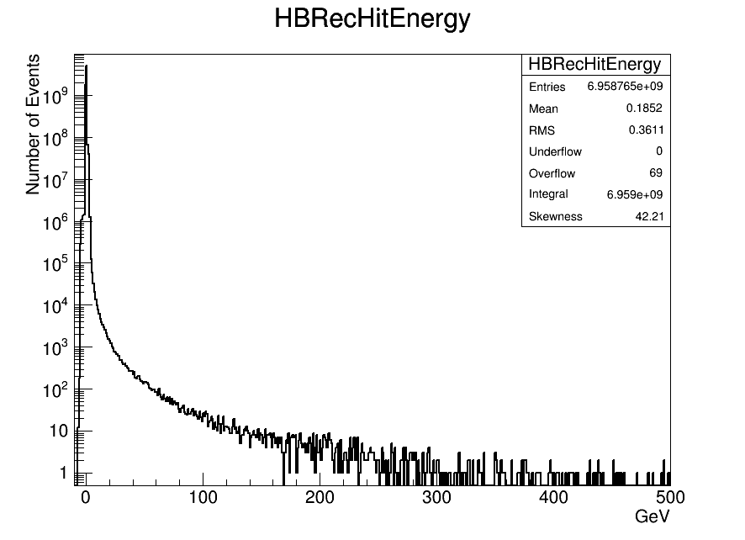
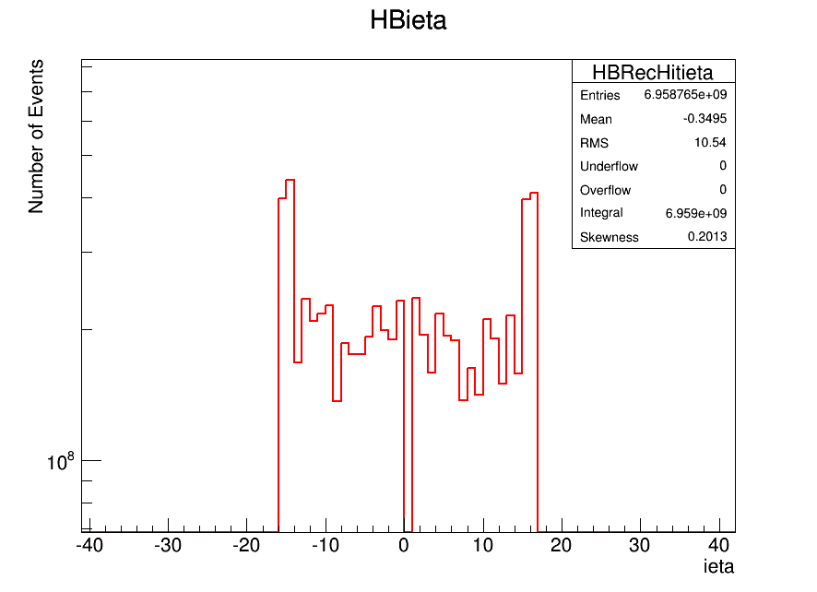
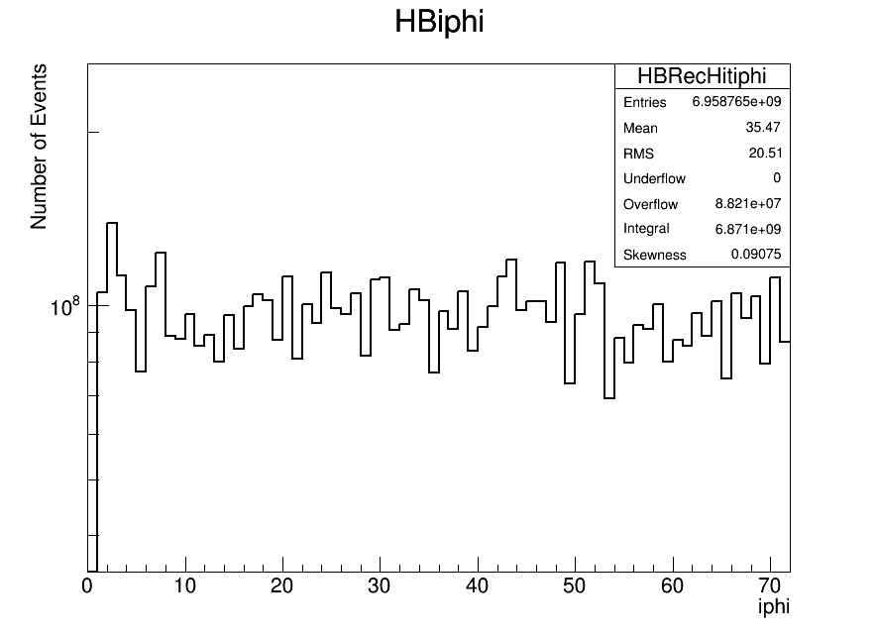
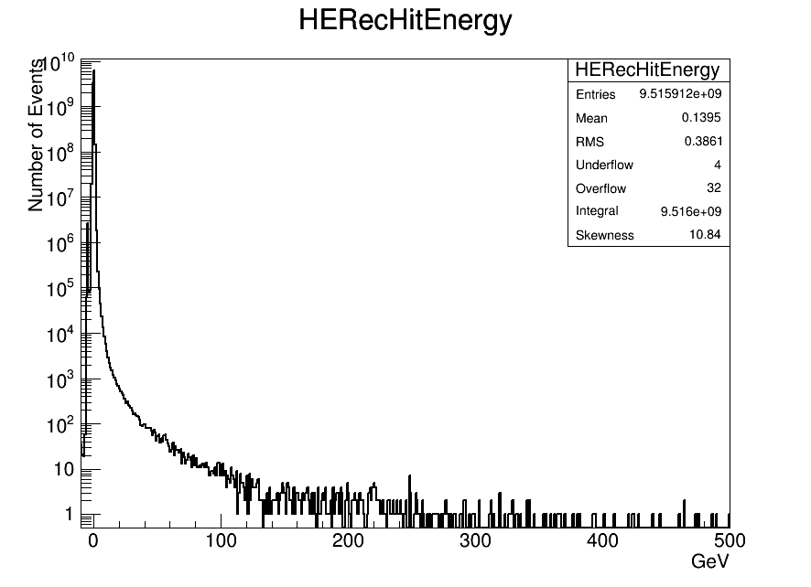
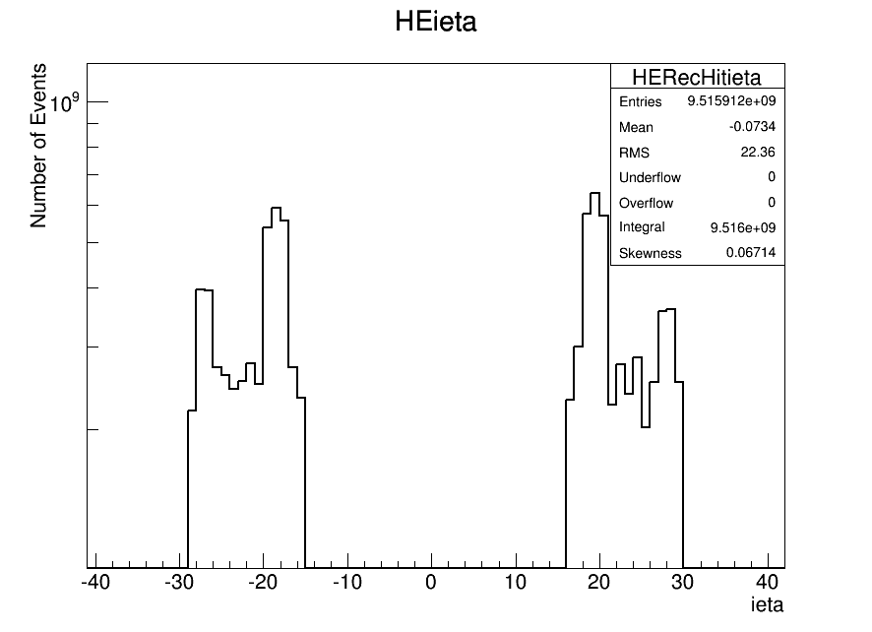
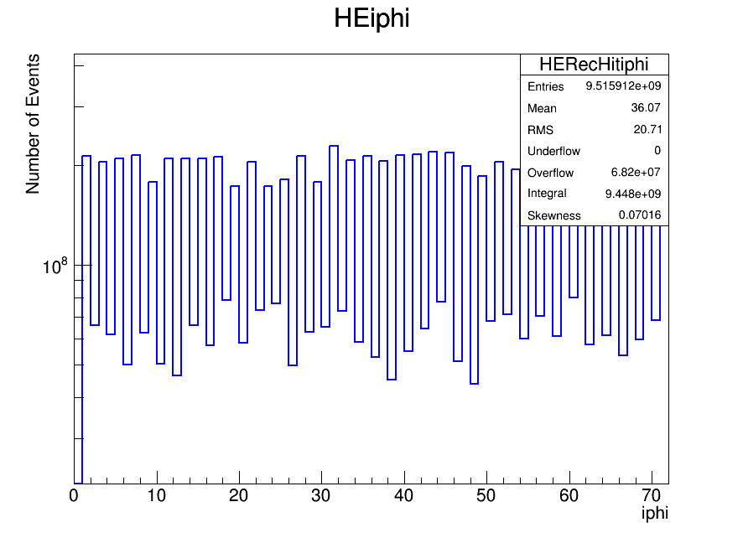
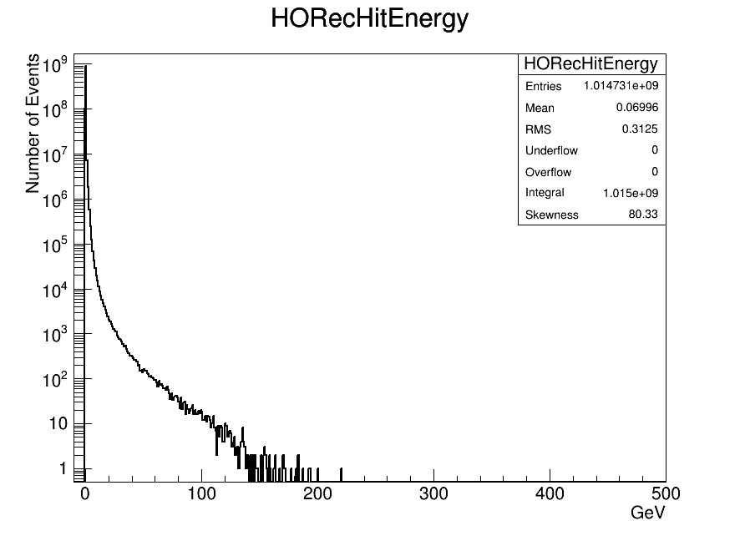
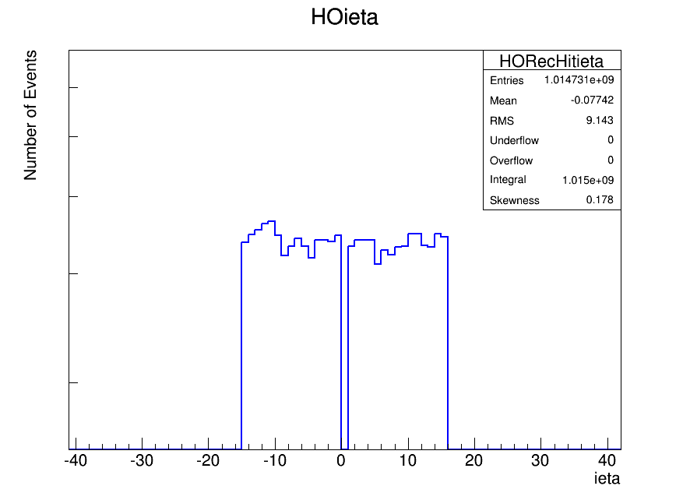
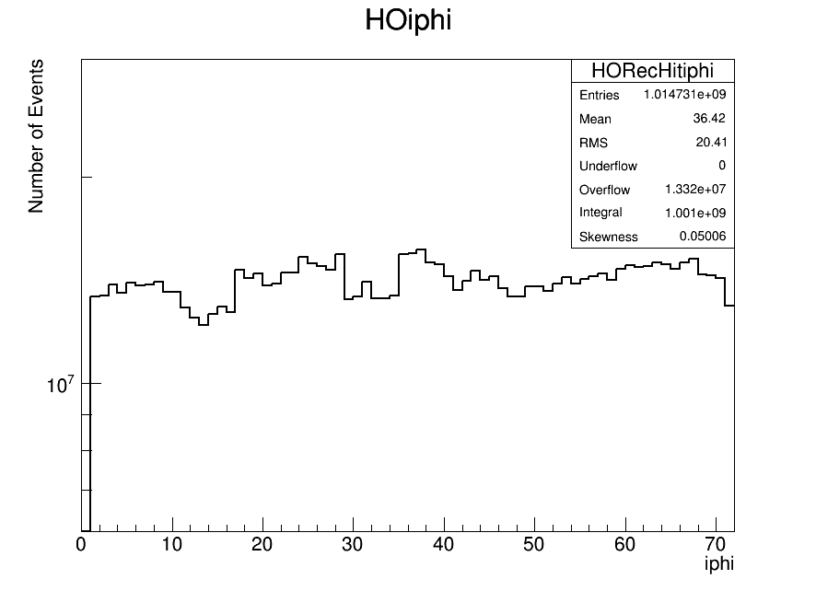
Individual RecHit Energy, ieta and iphi Distributions for HB, HE and HO
HB
HB
HB
HE
HE
HE
HO
HO
HO

Slide 12
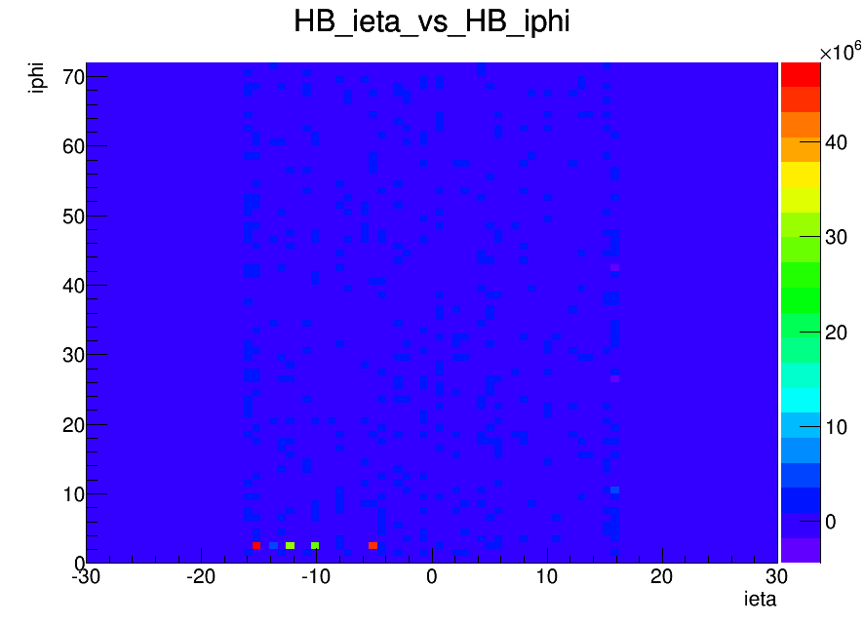
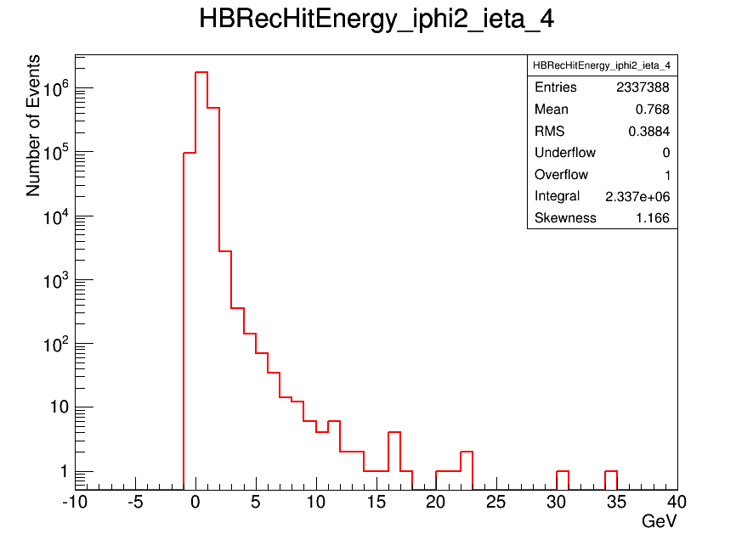
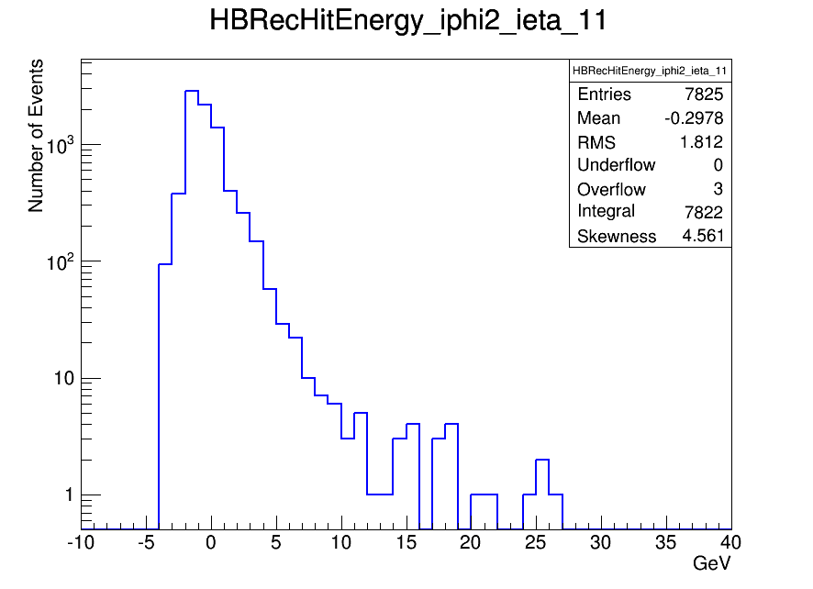
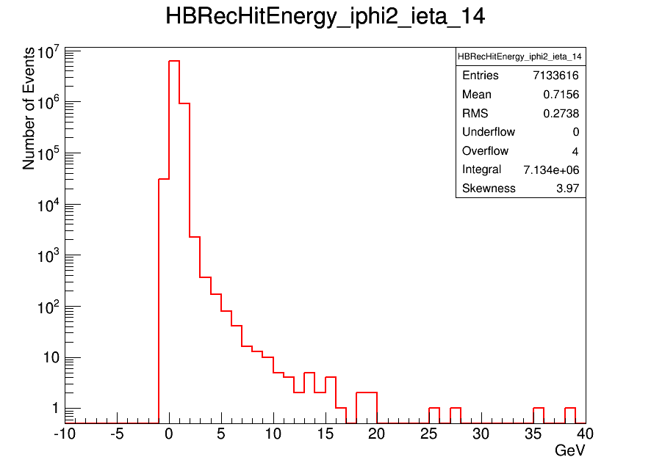
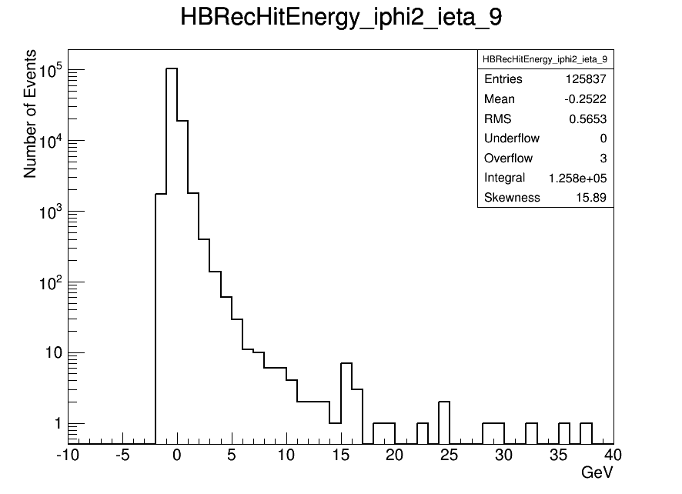
ieta vs iphi in GeV for HB
HB(2, -4), HB(2, -9), HB(2, -11), HB(2, -14)
HB(2, -4)
HB(2, -11)
HB(2, -14)
HB(2, -9)

Slide 13
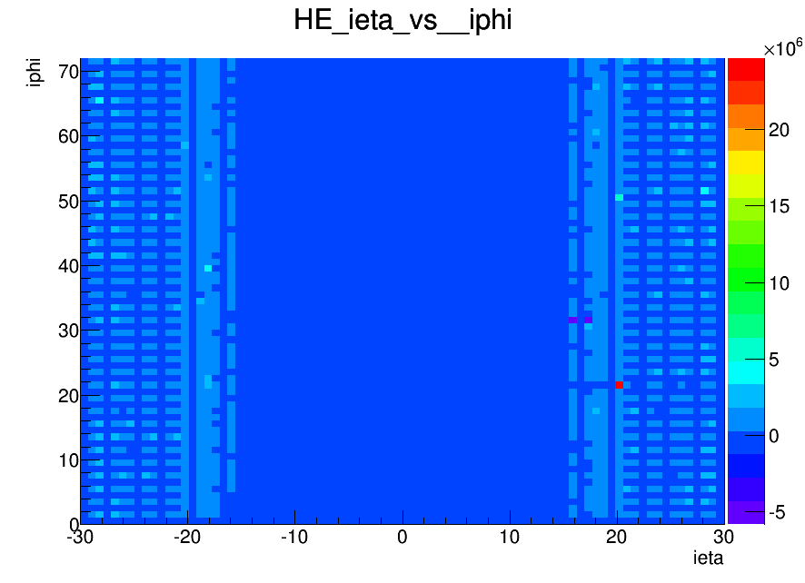
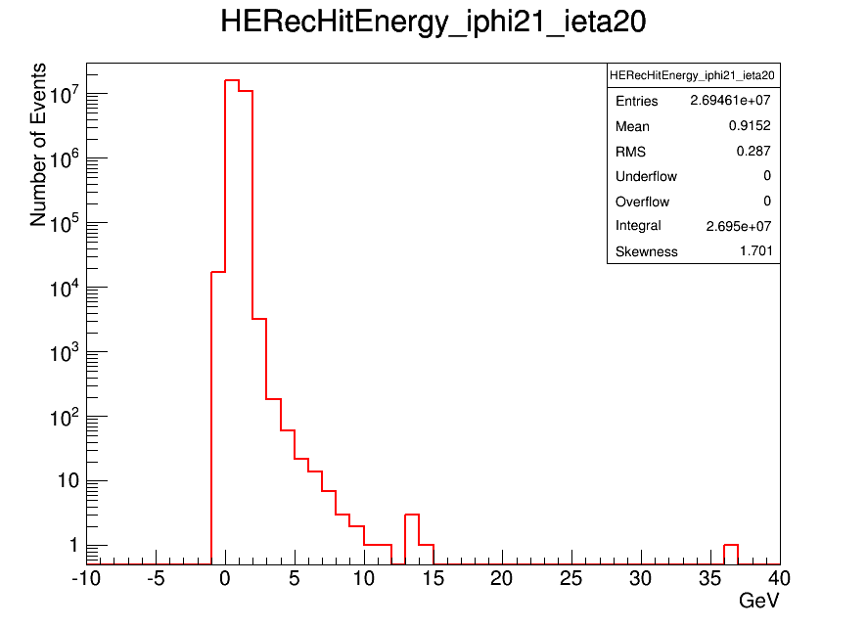
ieta vs iphi in GeV for HE
HE(21,20)
HE(21, 20)

Slide 14
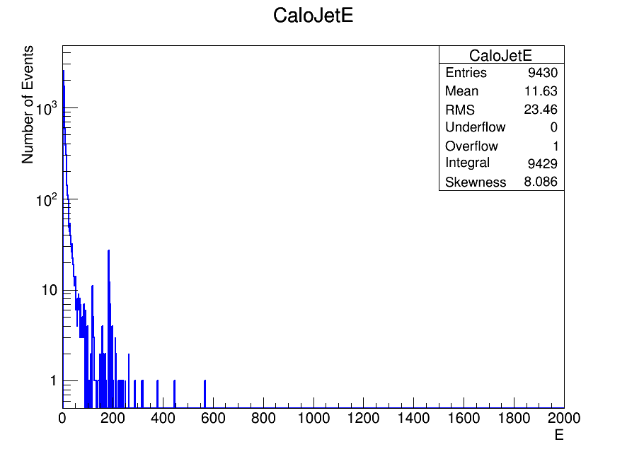
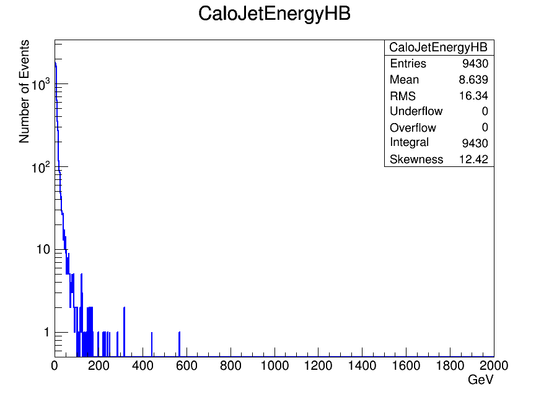
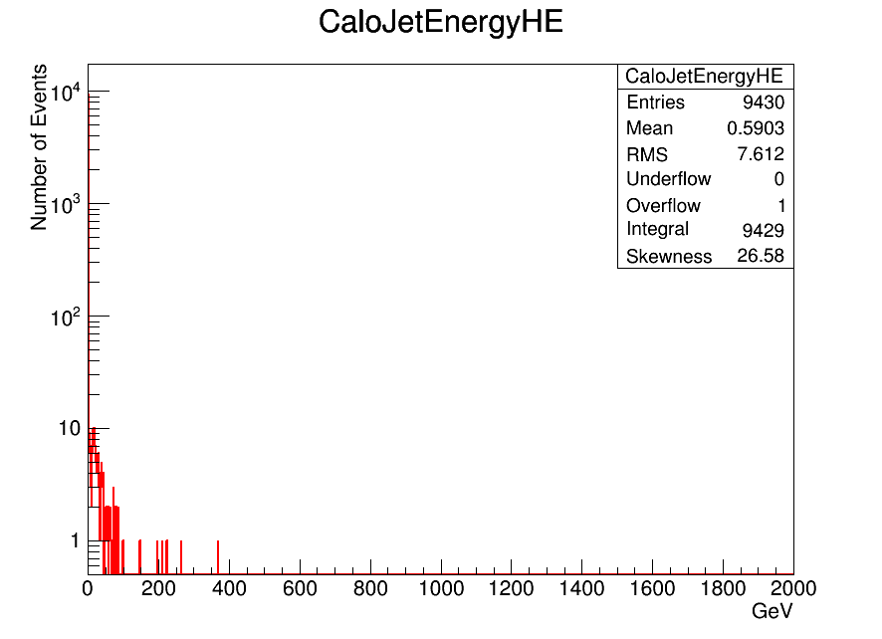
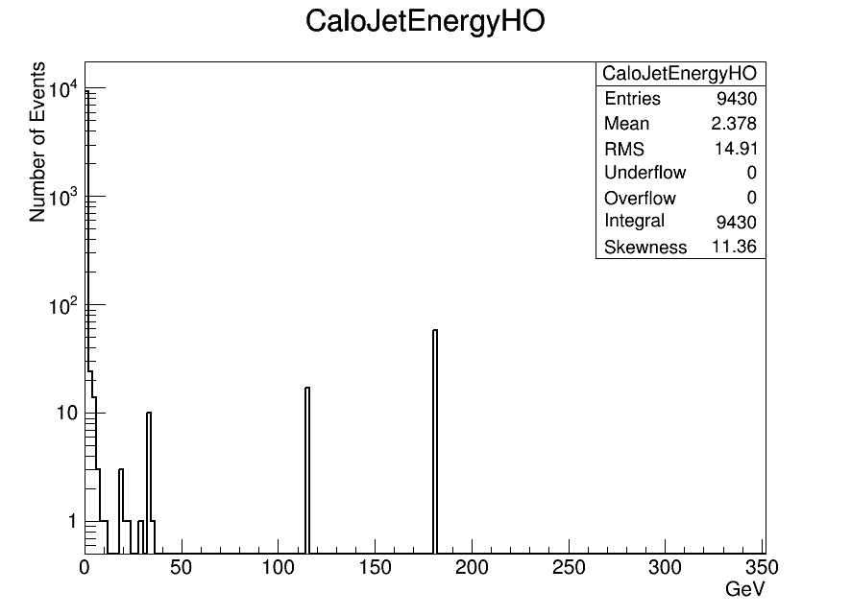

CaloJetEnergy Distributions for MWGR10
Sum CaloJet enerji distribution
hadEnergy In HB hadEnergy In HE
hadEnergy In HO
emEnergy In EB + emEnergy In EE

Slide 15





CaloJetEnergy Distributions for CRUZET
Sum CaloJet enerji distribution
hadEnergy In HB hadEnergy In HE
hadEnergy In HO
emEnergy In EB + emEnergy In EE

Slide 16
MinBias dataset with ‘’L1_SingleEG5’’ Trigger for CRUZET Runs

Slide 17









Individual RecHit Energy, ieta and iphi Distributions for HB, HE and HO
HB
HB
HB
HE
HE
HE
HO
HO
HO

Slide 18





ieta vs iphi in GeV for HB
HB(2, -4), HB(2, -9), HB(2, -11), HB(2, -14)
HB(2, -4)
HB(2, -11)
HB(2, -14)
HB(2, -9)

Slide 19


ieta vs iphi in GeV for HE
HE(21,20)
HE(21, 20)

Slide 20





CaloJetEnergy Distributions for MWGR10
Sum CaloJet enerji distribution
hadEnergy In HB hadEnergy In HE
hadEnergy In HO
emEnergy In EB + emEnergy In EE

Slide 21



CaloJetEnergy Distributions for CRUZET
Sum CaloJet enerji distribution
hadEnergy In HB hadEnergy In HE
hadEnergy In HO
emEnergy In EB + emEnergy In EE

Slide 22
Conclusion
We have checked the control plots (enerji, eta, phi vs.) using the CRUZET runs (23 February – 8 March, 2015) .
We compared MWGR10 and CRUZET looking by Calojet enerji plots including HAD enerji, EM enerji distrubitions. We will add franction of them.
We report about some bad HBHE channels in MWGRs and CRUZET at Operation Meeting (16.03.2015)
  https://indico.cern.ch/event/370930/contribution/3/material/slides/0.pdf
  Most of individual channels in HB and HE are stable with rms ~ 0.2 GeV and mean ~ 0.15 GeV .
  Some channels misbehave in ieta versus iphi plots for HBHE because of wrong pedestal used in the offline reconstruction ?? (Ted’s comment)

Slide 23
BACK UP

Slide 24
CMS HCAL
~Hadron Calorimeter~

Slide 25


Slide 26




HB Detector
The HCAL barrel consist of two halves, HB + and HB – each weighing approximately 465 metric tonnes. The hadronic barrel calorimeter covers a rapidity region │ƞ│<1.3 ranges. Each plane in the ƞ segmentation is divided into a ring of 36 segments covering the complete ɸ region. HB has a single depth. HB energy resolution value is ~ %90 . A lateral granularity ( ƞ×ɸ ) was chosen ~ 0.087 × 0.087 . HB depth is 5.8 $λ_{int}$ and π resolution 90% / $\sqrt{E}$

Slide 27



HE Detector
HE is consist of two halves HE + and HE - . The endcap hadron calorimeter (HE) covers a rapidity region between 1.3 and 3.0 ranges. HE has good transverse granularity, moderate energy resolution and sufficient depth. A lateral granularity (ƞ ×ɸ )was chosen ~0.087 × 0.087 .
The total depth of HE calorimeter is about 10 absorption lengths (19 active layers). The absorber sampling thickness is 8 cm. HE depth is 10 $λ_{int}$ and π resolution 100% / $\sqrt{E}$ . HE has 3 depths.

Slide 28



HO Detector
The hadronic outer calorimeter consist of two halves HO + and HO - . HO calorimeter is located inside the barrel muon system . HO are divided into the same granularity of ~ 0.087 × 0.087 as the barrel and envelop the entire first layer of te CMS muon iron absorber. The hadronic outer calorimeter covers a rapidity region between 0<│ƞ│<1.3 ranges. HO π resolution value is 120% / $\sqrt{E}$ and depth is 10 $λ_{int}$ . HO has a single depth.

Slide 29


HF Detector
The very forward calormeter (HF) covers the pseudorapidity range 3.0 ≤│ƞ│≤ 5.0 . The front face of HF is located at ± 11.1 m from the interactiom point (IP). HF is consist of two halves HF + and HF - .About 1000 km of quartz fiber have been used for the two HF modules, which weight about 250 tons each. HF calorimeter depth is 10 $λ_{int}$ .

Slide 30

Depth Segmentation

Slide 31

Why does the CMS take Cosmic Runs??
  Cosmic rays from outer space routinely bombard the Earth and its atmosphere with energies up to ${10}^{20}$ eV. These cosmic rays create a pedestal at the CMS detector. So, we must seperate from collision data to cosmic pedestal in order to take good data and good event.
  Prepare for the LHC collisions with a better understood detector performance and better-trained collaboration.
  While waiting for LHC collision data CMS detector take CRUZET and CRAFT data therefore the detector is ready for real collision.

Slide 32

Detecting cosmic rays need different techniques (synchronization, reconstruction,…)
Cosmic rays arrive at the detector at random time random direction.

