Slide 1
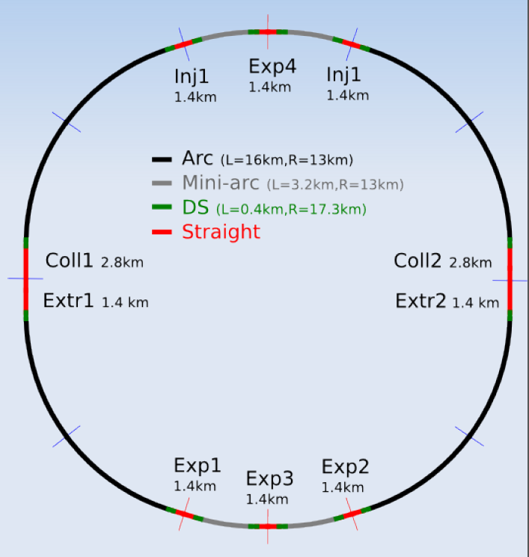
FCC layout
D. Schulte et al.

Slide 2
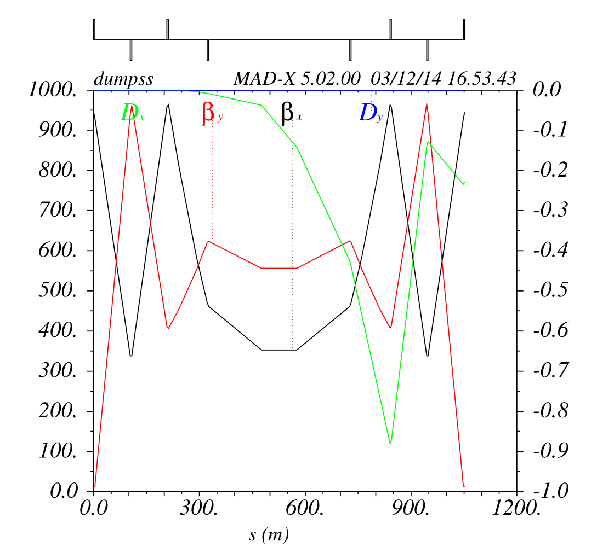
Conventional dump design
110 m
440 m
Rms sigma ~ 1 mm
Assume otherwise max of 0.5 mm
100 m
Quads of 4m length
500 T/m
Extract the two beams from different straight sections
Requires enlarged quadrupole downstream of dump kicker

Slide 3
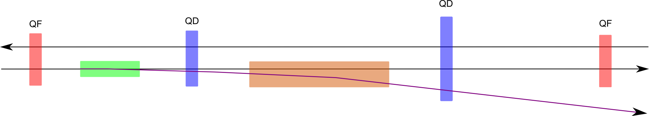
Required insertion magnets
Enlarged quadrupole
Triple chamber quadrupole?

Slide 4
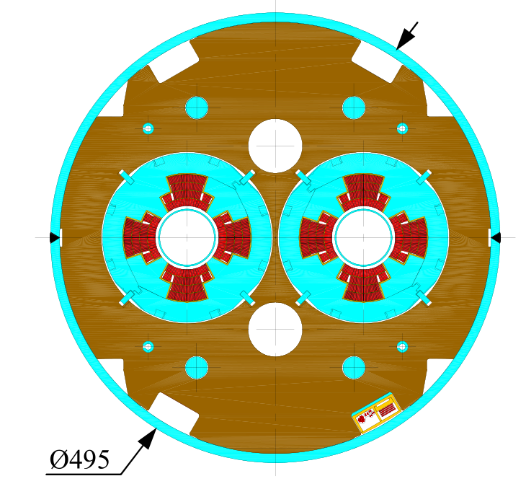
MQY like enlarged aperture quadrupole
Offset of extracted beam ~6 - 9 mm
Good field region: beam radius + offset

Slide 5
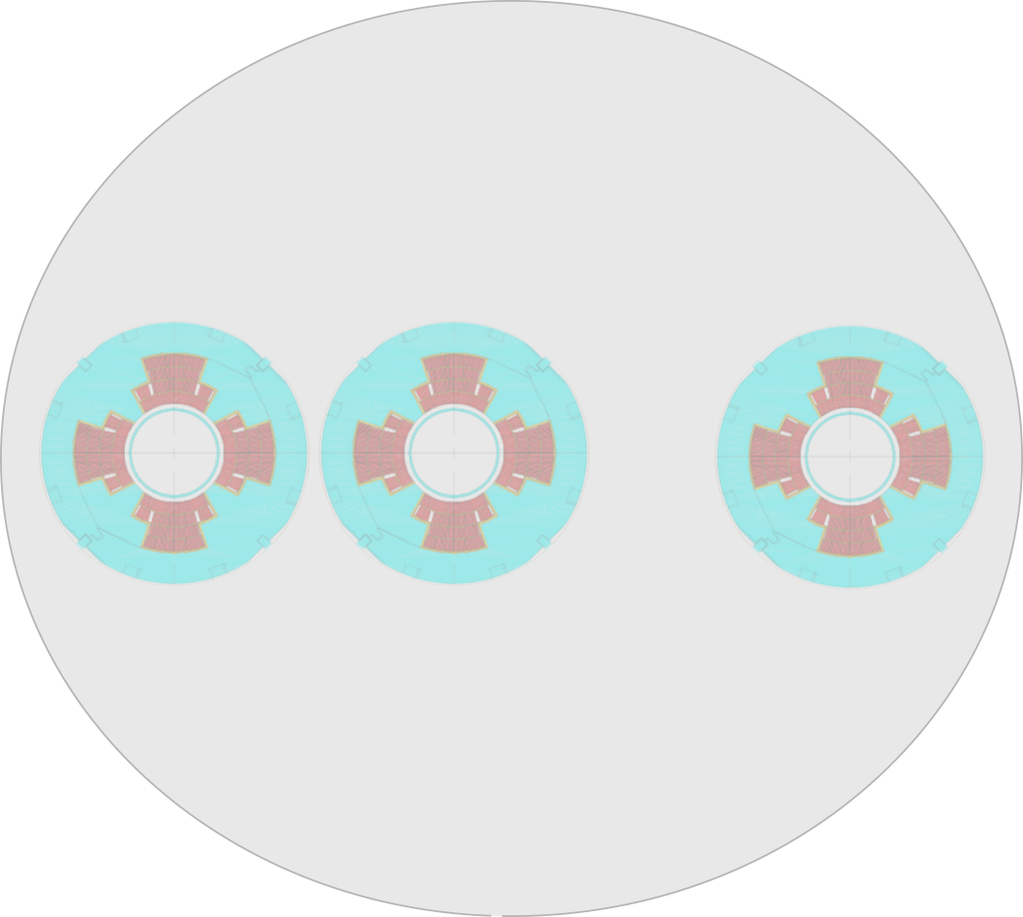
Triple chamber quadrupole?
Quadrupoles: 4 m, <500 T/m
MKD: 0.15 mrad, 25 T.m
MSE: 0.95 mrad, 160 T.m
With a 5.5 T dipole field in the third chamber gain ~5% for the septum strength
200 mm
280 mm

Slide 6
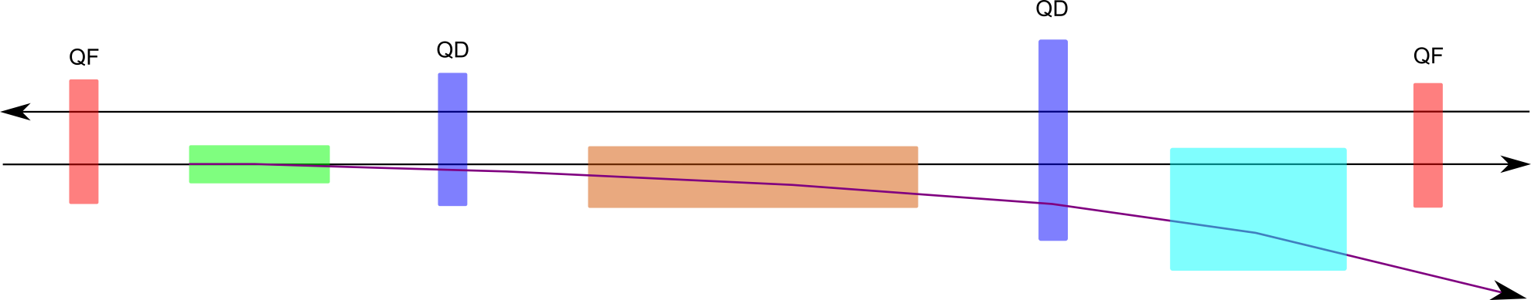
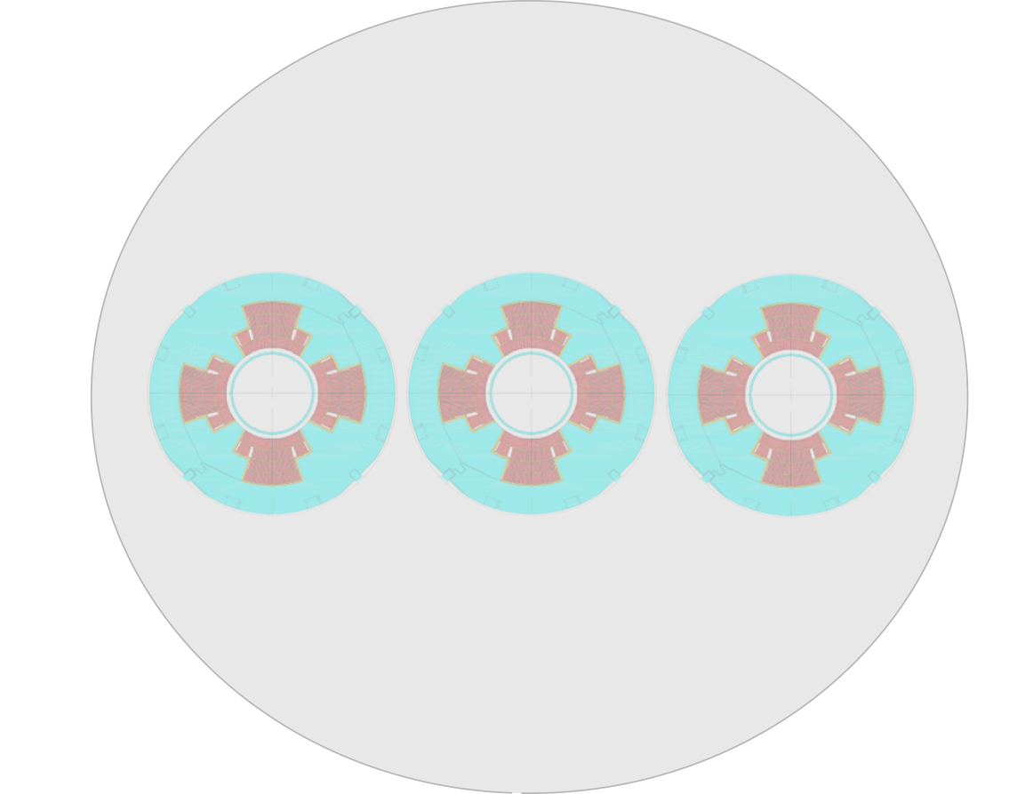
Triple chamber quad + SC septum
With a sequence of NC (thin) and SC (thick) septum around a triple chamber quad can reach a symmetric 200 mm chamber spacing
Quadrupoles: 4 m, <500 T/m
MKD: 0.10 mrad, 17 T.m
→(6 mm offset in quad)
MSE: 0.65 mrad, 110 T.m
MSESC: 2.43 mrad, 406 T.m
With dipole field of 6.6 T in third chamber → MSESC: 2.1 mrad, 350 T.m
200 mm
200 mm

Slide 7
Triple chamber – 250 mm
MKD: 0.10 mrad, 17 T.m
→(6 mm offset in quad)
MSE: 0.90 mrad, 150 T.m
MSESC: 1.3 mrad, 220 T.m
250 mm
250 mm

Slide 8
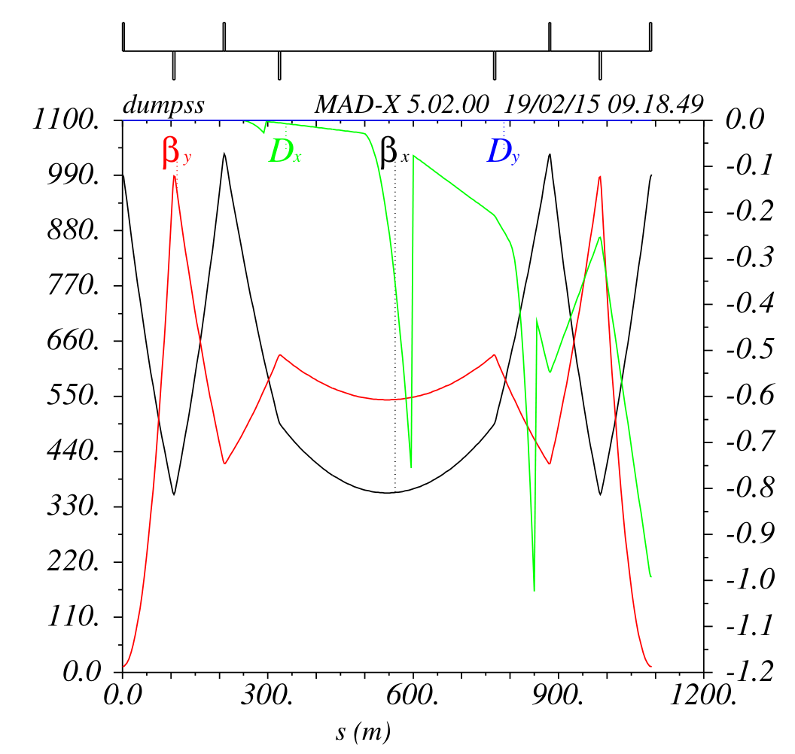
Optics with SC septum
Quadrupole strength
(from left to right)
  668 T/m (foresee two units)
  534 T/m (foresee two units)
  285 T/m
  105 T/m (enlarged aperture)

Slide 9
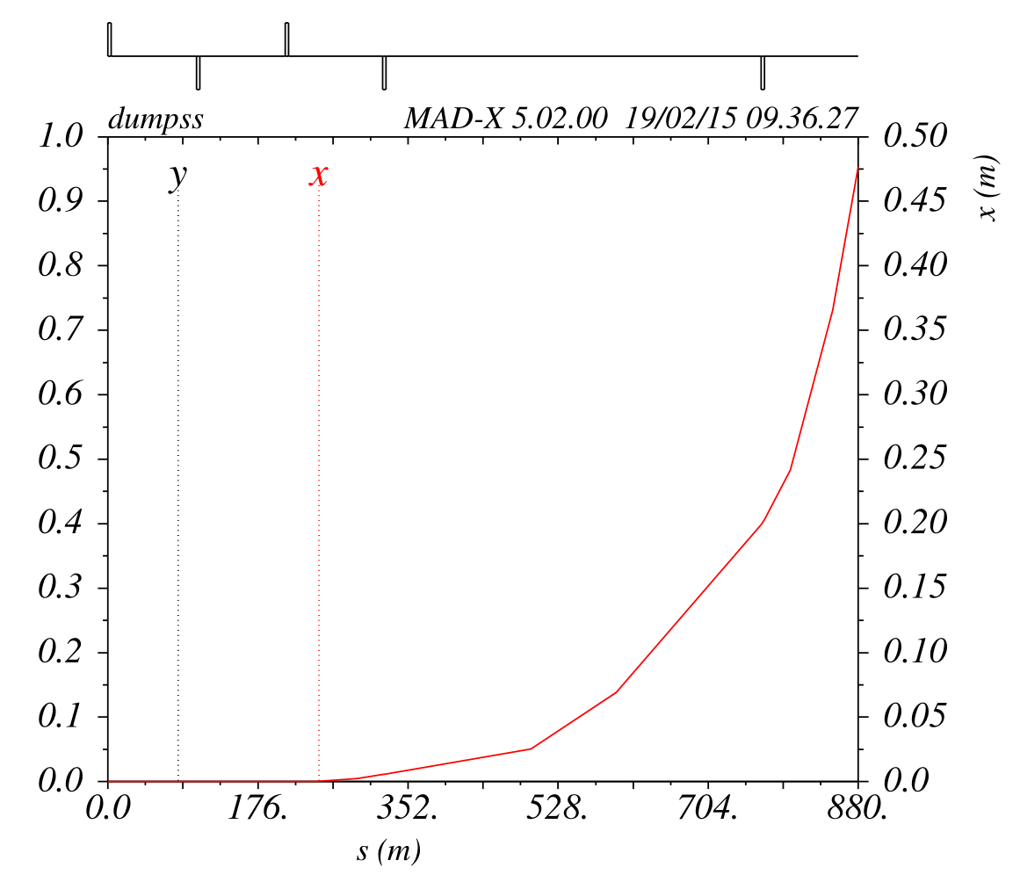
Extraction trajectory for SC septum option
270 mm
400 mm

