Slide 1
ESnet Update: with a focus on R&D
Inder Monga
Deputy of Technology, SND
CTO, ESnet
LHCONE Meeting, Berkeley
June 1, 2015

Slide 2
ESnet Background
ESnet is a special-purpose mission network, funded by the US Congress to support scientific goals of the Department of Energy.
We see networking as a means to an end: scientific productivity.
We aim to create a world in which discovery is unconstrained by geography.

Slide 3
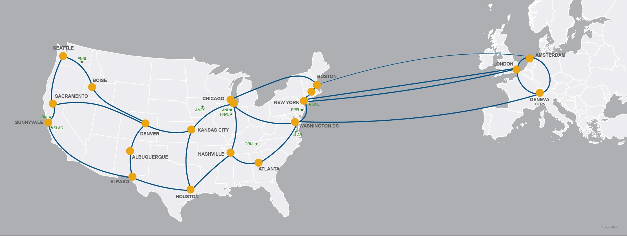
This is not an ISP.

Slide 4
It’s a DOE user facility designed to overcome the constraints of geography.
We do this by offering unique capabilities, and optimizing the facility for data acquisition, data placement, data sharing, data mobility.

Slide 5
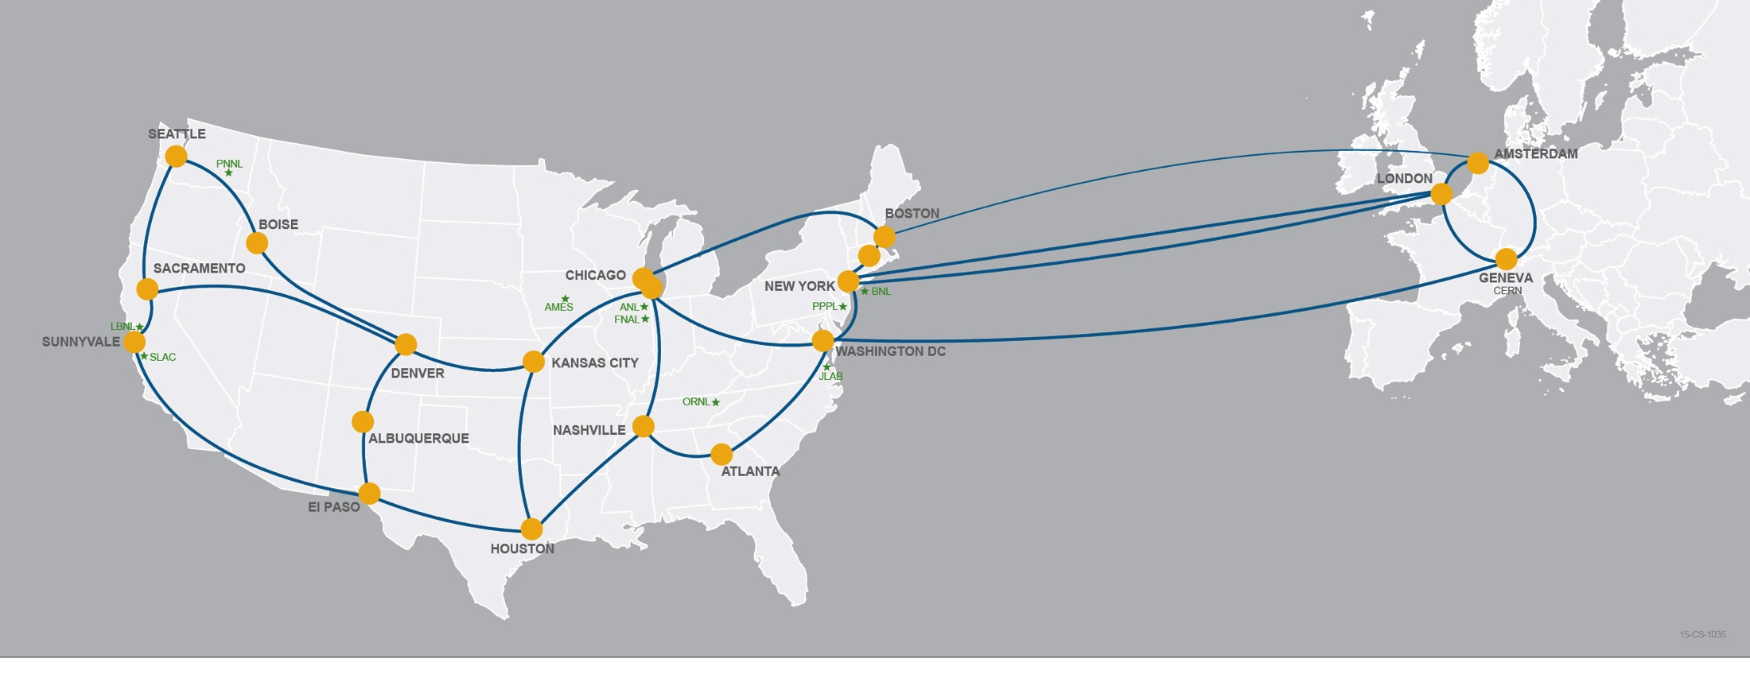
80% of ESnet traffic originates or terminates outside the DOE complex.
ESnet’s success is necessary but not sufficient for DOE, because networks share fate. SC invests nearly $1B/year in university research: campus networks matter.

Slide 6
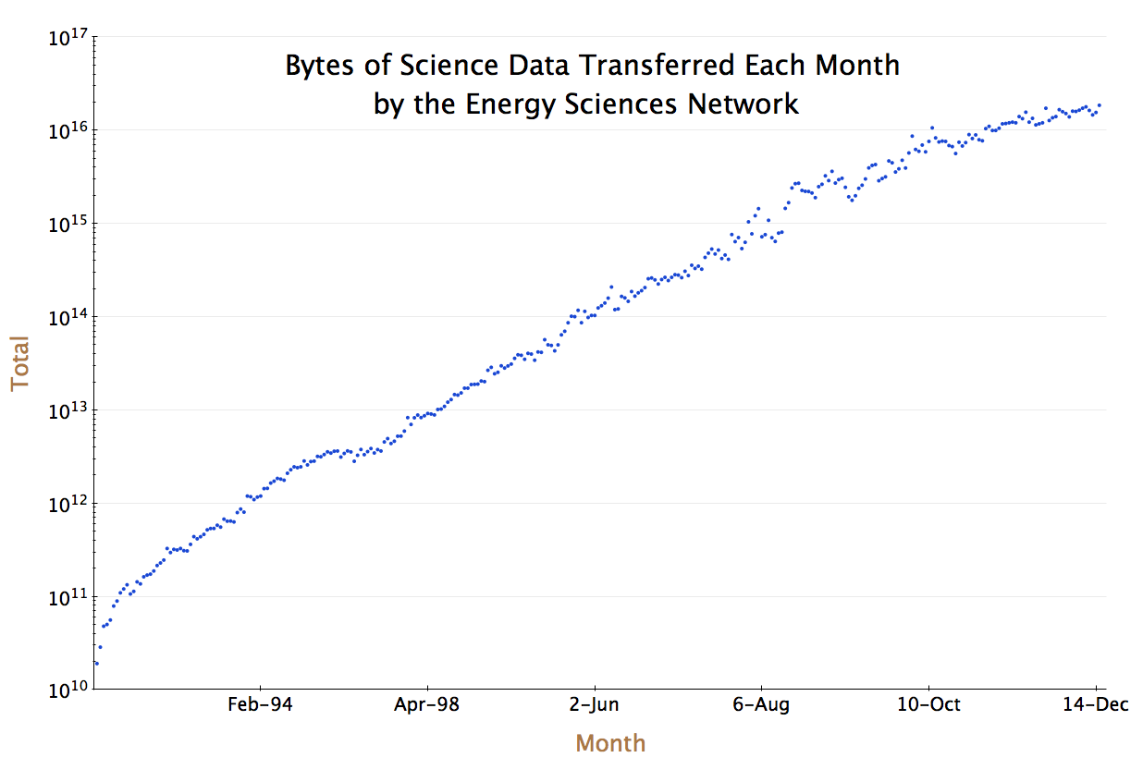
Exponential growth rate slowing, but still double that of commercial Internet.
March 2015:
18.5 PB
~10x every 48 months

Slide 7
ESnet Vision and Goals
(in addition to world-class operations…)
Discovery is unconstrained by geography.
2. Provide information and tools for optimal network use.
vision:
goals:
3. Pioneer architectures, protocols, applications.
1. Improve networking practices globally.

Slide 8
ESnet Research and Software Development Portfolio
Funded Research
Next-Generation Architectures
Network Software
Tools Development

Slide 9
ESnet adopts Github
Commitment to make it easy for the community to discover and collaborate on software
All ESnet public repositories are on Github
  https://github.com/esnet
Documentation for the projects
  http://software.es.net/

Slide 10
Network Software

Slide 11
perfSONAR
Re-invigorated collaboration with Internet2, Indiana University and GEANT is resulting in consistent and operational software package
perfSONAR 3.4 release full of great feature enhancements, notably, REST interface, security enhancements and new graphs
perfSONAR 3.5 planned for June 2015
  Highlights include:
    GUI modernization
    Central Management and Node Auto-configuration
    Support for 1 inexpensive node platform (~$100 – $200)
    perfSONAR Security Audit Completion
1300+ public perfSONAR hosts in 30 countries as adoption continues to rise
New perfsonar.net website and user-manual both written from scratch

Slide 12
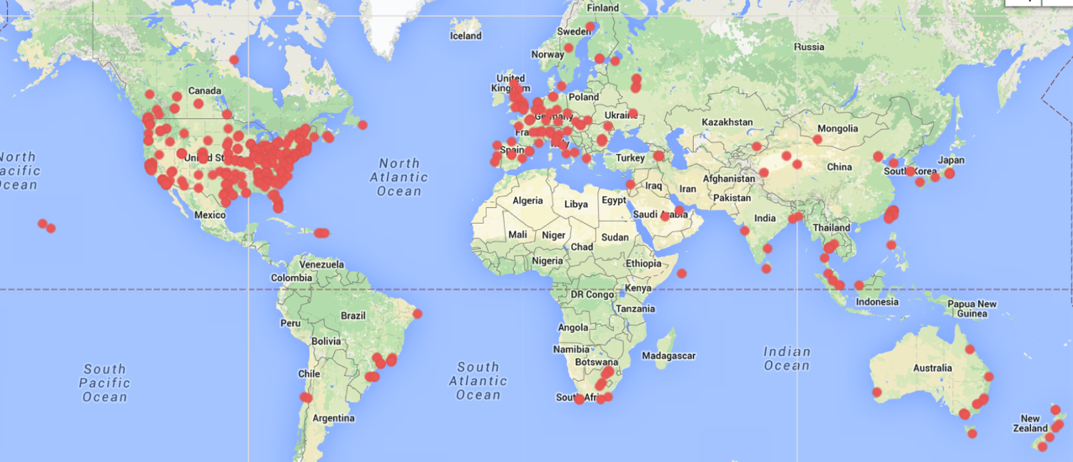
Who is running perfSONAR?
Currently over 1300 deployments world-wide
http://stats.es.net/ServicesDirectory/

Slide 13
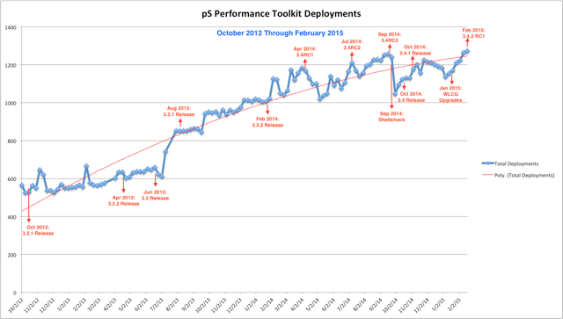
perfSONAR Growth

Slide 14
ESnet Public DTNs and perfSONAR hosts
Upgraded public test DTNs at LBL, ANL, and BNL, and with a new DTN at CERN
  Anonymous GridFTP hosts, Globus Online Endpoints
  Capable of > 9Gbps from disk, single file read performance
  http://fasterdata.es.net/performance-testing/DTNs/
40G perfSONAR host deployed in Boston
  First 40G perfSONAR node on an R&E backbone network
Beginning hardware refresh of the > 85 perfSONAR hosts we have deployed
  Many of the current perfSONAR hosts are > 5 years old
  New design combines bandwidth and latency testing into a single host, each on a separate NIC
    Will reduce the number of hosts to manage by 50%

Slide 15
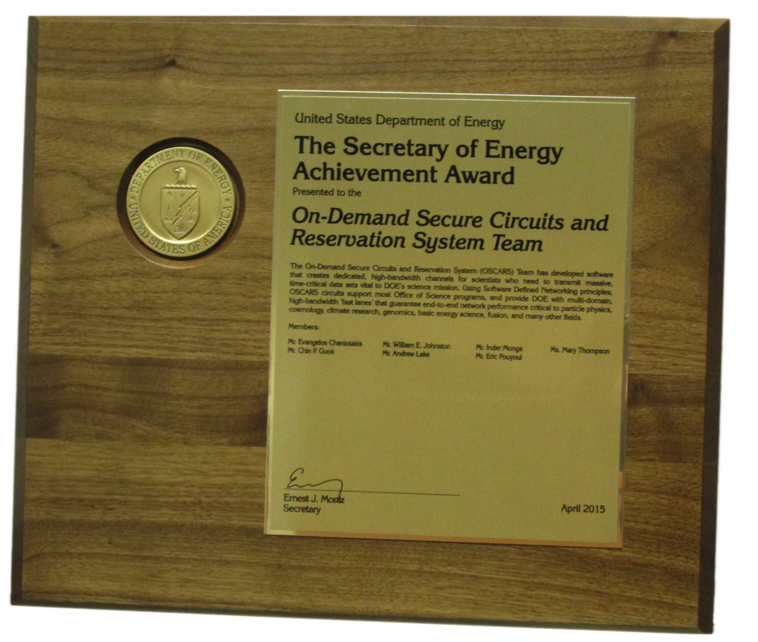
OSCARS
OSCARS contributions to networking technology and science continue to get recognized
  2014 Secretary’s Honor Award from US Department of Energy
Focus of OSCARS software development is to support LHCONE’s multi-domain virtual circuit experimentation
  by implementing NSI
  building community consensus
  and helping with NSI deployments/ interoperability testing.

Slide 16
OSCARS/NSI Latest Updates
NSI Bridge
  Running in ESnet, WIX, MANLAN, RNP, UMich, CalTech
  In process of being deployed at Internet2 AL2S
NSI – Document Distribution Service
  Topology translator from NM to NML up and running
  Being used by ESnet’s OSCARS
  WIX, MANLAN, UMich and CalTech also using this software
SURFnet/ESnet NSI Aggregator
  Running in ESnet, SURFnet, iCAIR and RNP
-

Slide 17
Focus on Operational use of OSCARS
New capabilities include:
  New QoS profile to handle best-effort circuits
    User can now specify guaranteed bandwidth or best-effort circuit
  Policing enhancements for hard or soft QoS
    Over-subscribed traffic dropped (Hard QoS), or marked for discard and allowed to burst (Soft QoS)
  Circuit Protection
    Enhanced for EEX, protection circuits are best-effort circuits

Slide 18
iPerf3
Maintained actively by ESnet, and helping answer community questions
  https://fasterdata.es.net/performance-testing/network-troubleshooting-tools/iperf-and-iperf3/
  https://github.com/esnet/iperf
Good uptake by the community
  Docker build for iperf3
    https://github.com/nerdalert/iperf3

Slide 19
Tools Development

Slide 20
myESnet Portal - https://my.es.net/
Vision: Transform the way we visualize network information
Lots of software work being developed, not all of it visible in the portal
Based on ‘state of the art’ in industry
  Twitter Bootstrap
  Node.js
  React and Flux
Open-Source requests
  Code re-organized to make it modular and open-source
  Separating ESnet specific data from the portal code
  Plan to open-source modules by end of August

Slide 21
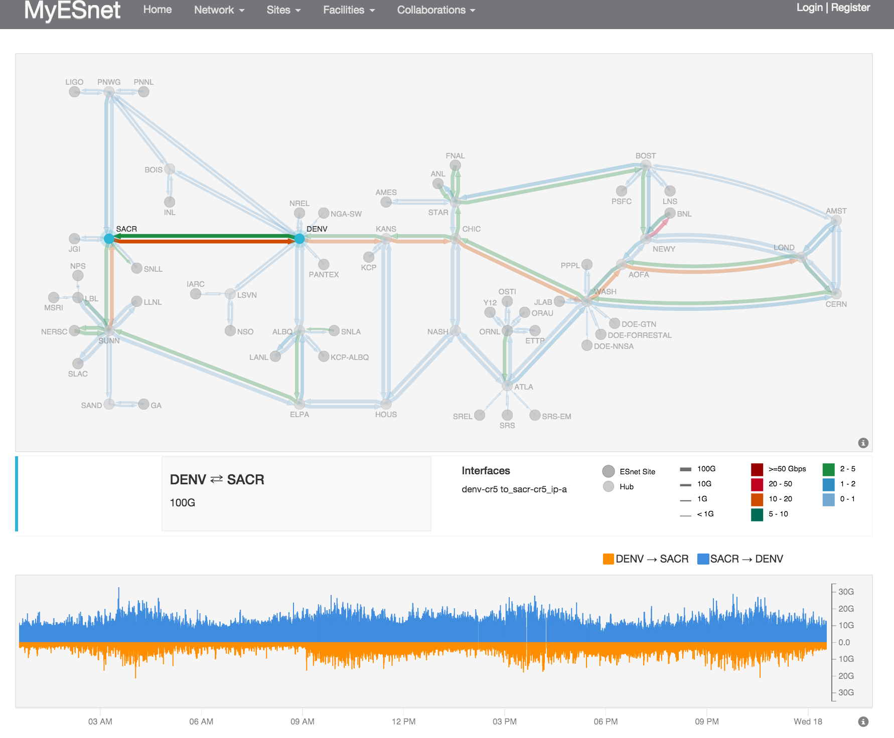
New Visualization and improvements to the front page map software
  New way to showcase charts on clicking a link
  Improved response, layout and backend technologies
  Expanded to showcase trans-atlantic network including presence in Europe

Slide 22
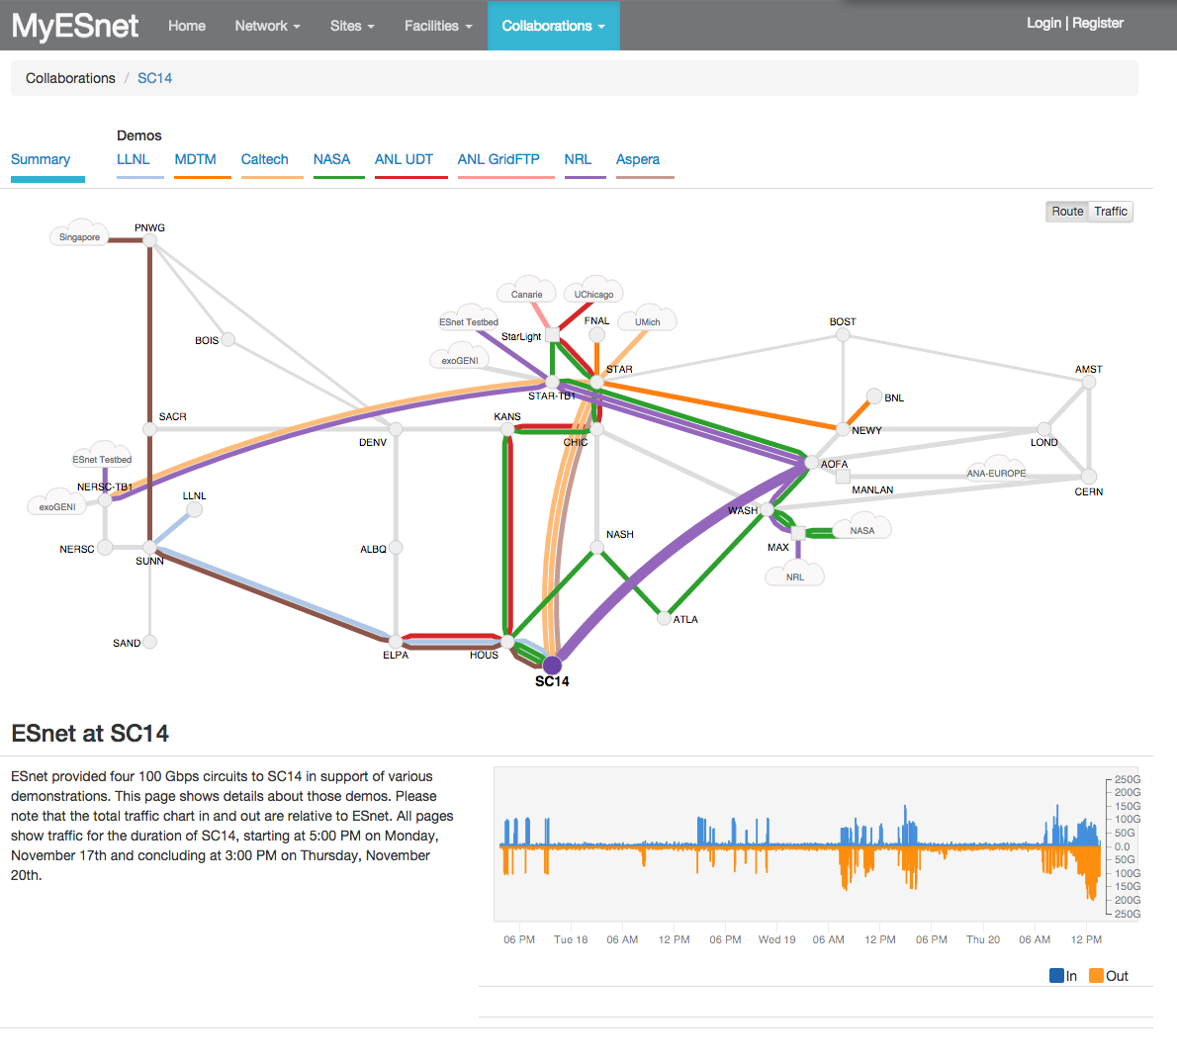
Visualization of Demos at SC14

Slide 23
esmond - ESnet Monitoring Daemon
system for collecting, storing, visualizing and analyzing large sets of time-series data
RESTful API which allows easy access to the data which is collected
perfSONAR project has begun using esmond to store time-series of network measurements
Documentation
  http://software.es.net/esmond/
Software
  https://github.com/esnet/esmond

Slide 24
ESnet Database (ESDB)
ESnet wide effort to build a common source of truth for core data sets:
  Organizations
  Contacts
  Locations
  Circuits
Provides a strong foundation for many internal and external processes.
Web based and REST API access – enables further automation with programmatic access to ESDB data
Internal Software only – no open-source planned

Slide 25
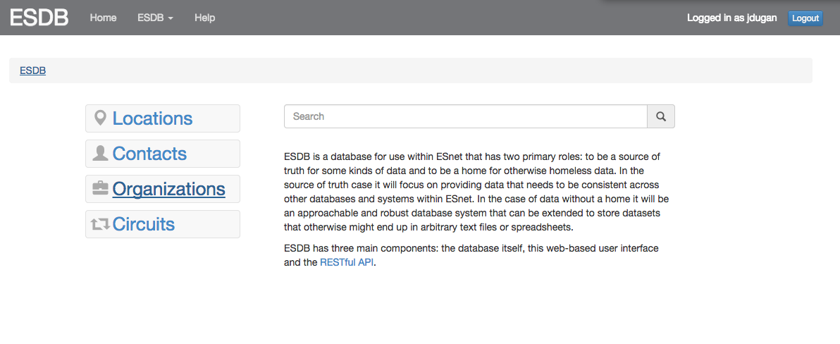
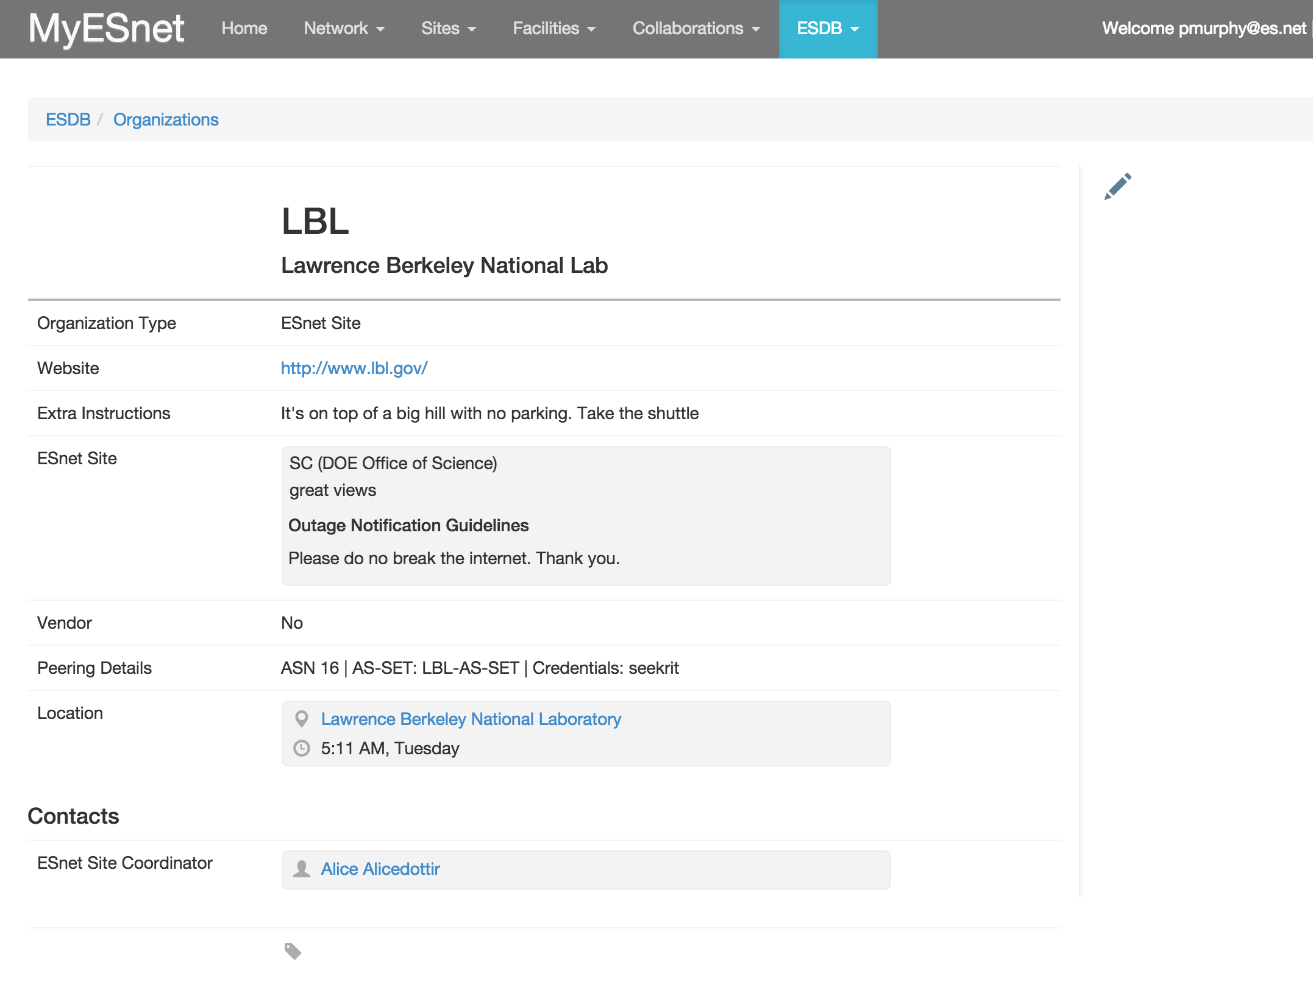
ESDB Contacts
Not real-data, but shows
the fields and possibilities

Slide 26
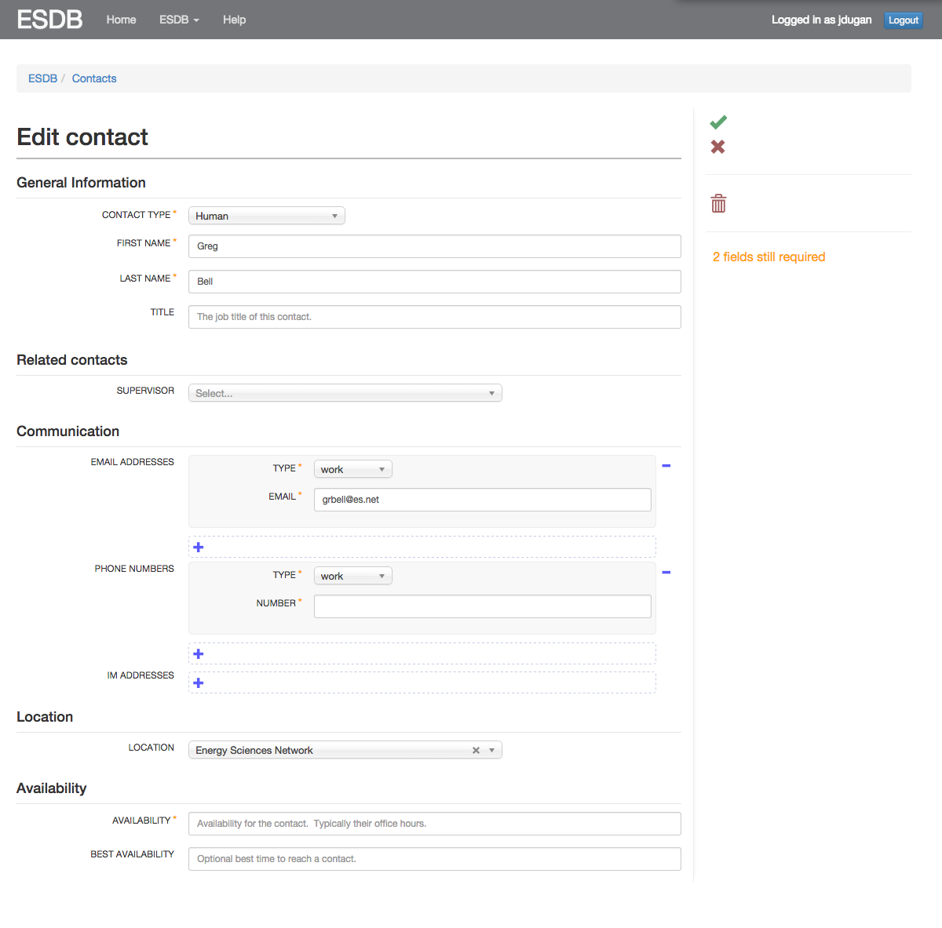
Modular Forms software creates flexible information gathering interface

Slide 27
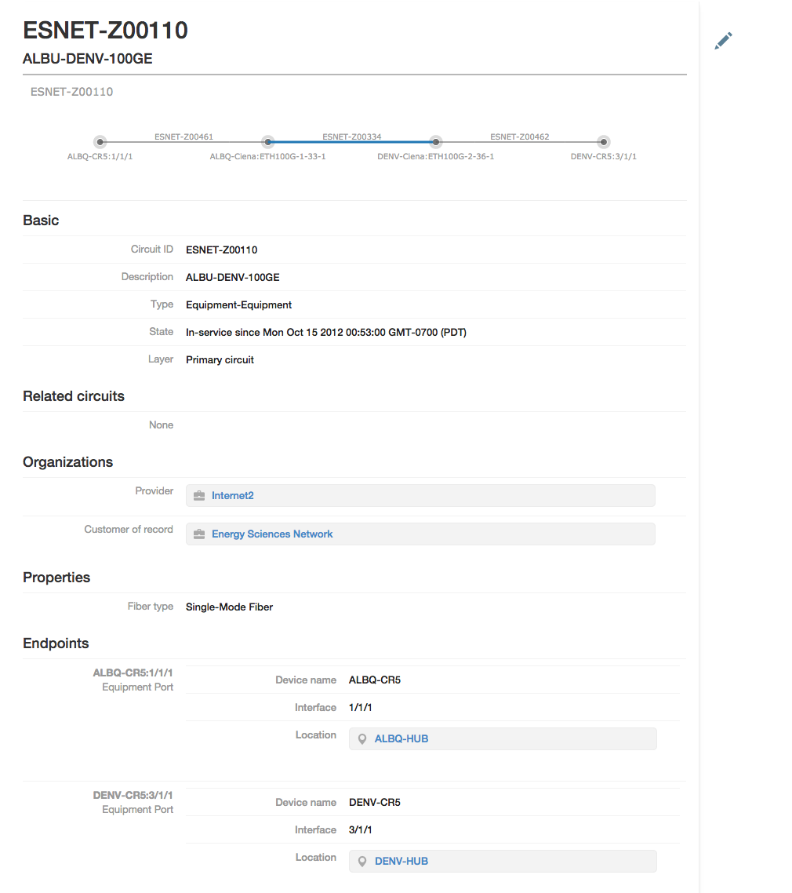
Inline circuit editing and visualization increases data accuracy and operational efficiency

Slide 28
Next-Generation Architectures investigations only

Slide 29
a flexible platform
a flexible white-box hardware platform to support existing ESnet services and new abstractions

Slide 30

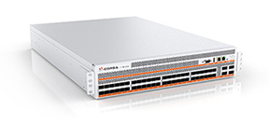

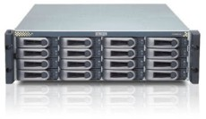
ESnet SDN Testbed
ESnet PE Router
(2+)x10GE
(n)x10GE
Planned SDN Testbed node locations
Planned SDN Testbed connectivity overlay (using OSCARS circuits)
Testbed Host
STAR
AMST
DENV
AOFA
LBL
WASH
CERN
ATLA
Notes:
We plan to deploy these switches in eight locations within ESnet: LBL, DENV, STAR, ATLA, AOFA, WASH, AMST, CERN.
Each location gets a “testbed node”. It consists of a Corsa switch connected directly to an ESnet core router, as well as a testbed host.
The testbed host is a whitebox rack-mounted Linux server. It is not a part of the dataplane, but is used for providing control plane network services. More about that shortly.
The testbed nodes are connected via a set of OSCARS circuits, in an overlay on the ESnet production network. Similar to ESnet’s existing OpenFlow testbed.

Slide 31
a flexible, programmable platform
a flexible hardware platform to support existing ESnet services and new abstractions
an environment to support ‘the right’ abstractions for science applications

Slide 32
ESnet SDN investigations, in a nutshell:
2006
2012
OSCARS;
R&D100 Award 2013
RDMA over Ethernet with OF and NEC, 2011
Zero Configuration Circuits, 2011
Network Virtualization ‘One Switch’, Nov 2012
2012
2013
World’s first Transport SDN,
Dec 2012
Software-Defined Exchange @ REANNZ/ESnet, April 2013
Multi-domain Circuits with NSI,
Oct 2013
2013
2014
Multilayer Transport SDN Demonstration,
Oct 2013
Dynamic L3 and L2, SDN router + NSI,
Sept 2014
Scalable BGP ‘white-box’ Router, w/ Corsa, Aug 2014
Notes:
All this activity is somewhat difficult to summarize, and a couple of highlights already captured.

Slide 33
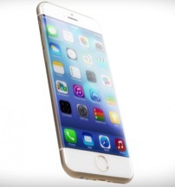
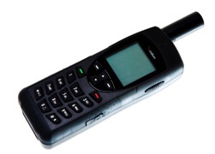
ESnet Operating System
Software platform with capabilities to run multiple science applications
Integrating the capabilities from above point-demonstrations, into a working platform running on flexible hardware infrastructure
Concept still under development, presentations and paper by the end of the year
Single App
Multiple Apps

Slide 34
a flexible, programmable, content platform
a flexible hardware platform to support existing ESnet services and new abstractions
an environment to support ‘the right’ abstractions for science applications
a content platform to abstract the placement and retrieval of content

Slide 35
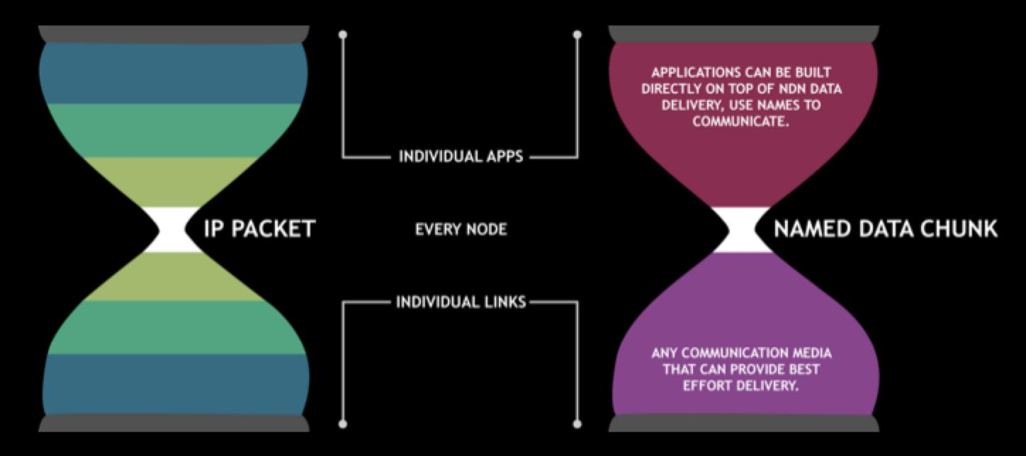
Named-Data Networking (NDN)
The new idea: Name the data, not the hosts!
..so you can ask the network directly for the data!
New abstractions for science applications looking for data

Slide 36
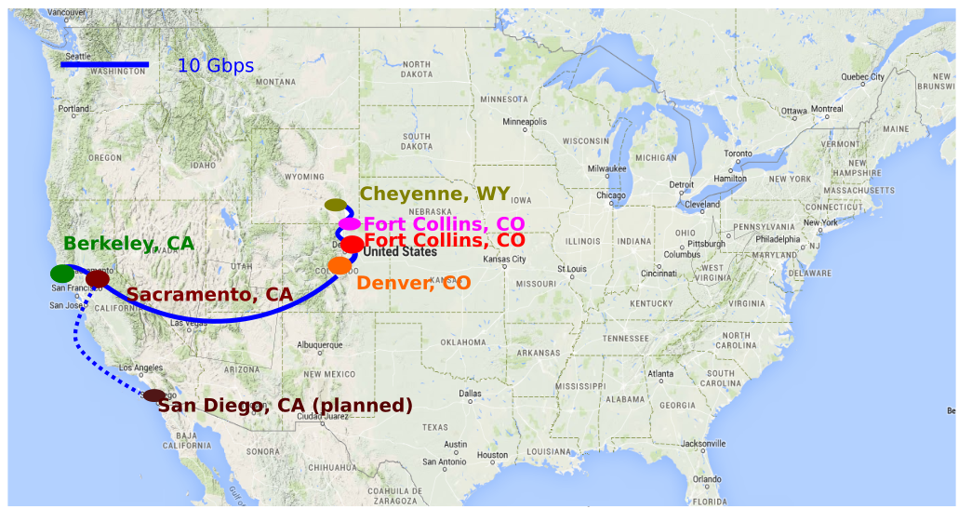


NDN for Climate Testbed with Colorado State University

Slide 37
a converged, flexible, programmable, content platform
a flexible hardware platform to support existing ESnet services and new abstractions
an environment to support ‘the right’ abstractions for science applications
a content platform to abstract the placement and retrieval of content
a converged platform to optimize the cost of the moving bits end-to-end

Slide 38

Packet-Optical convergence
From Chris Tracy’s OFC presentation

Slide 39
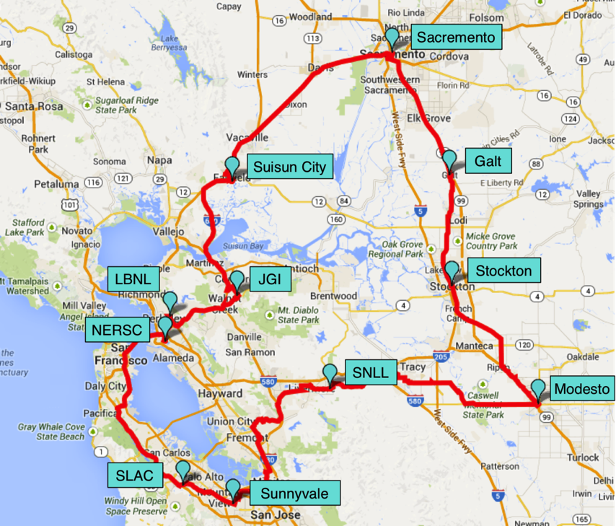

Field Trial of ONT4 Router Interfaces

Slide 40





Testing on live, 1400 km Bay Area Loop
83 km/ 18.6 dB
85 km/ 19.1 dB
68 km/ 13.5 dB
57. km/ 11.65 dB
BER
Measurement
Suisun City
Galt
Stockton
JGI
Sacramento
100G
Colored
36 km/ 7.9 dB
56 km/ 11.09 dB
100GE
LBNL
Modesto
IXIA
PTX
72 km/ 15.15 dB
12 km/ 2.6 dB
NERSC
SLAC
Sunnyvale
SNLL
Tracy
Loop
Back
ROADM
ILA
31` km/ 8.14 dB
97 km/ 21.49 dB
32 km/ 6.55 dB
93 km/ 20.59 dB

Slide 41
Field Test Results
Demonstrated:
  Error-free transmission of integrated DWDM optics in the router over entire distance
  over mix of fiber types (1400km was LEAF + SMF-28), and - in a multi-vendor environment
Bit-error Rates (BER) of production wavelengths were not affected
Operational integration of integrated DWDM router optics with third-party DWDM system
  Optically, the transport system treated like any other wavelength
  Fully automated provisioning/teardown via optical control plane
  Fully automated power balancing/equalization, gain adjustments, etc.
More work to be done to incorporate this architecture into the programmable, content, platform envisioned

Slide 42
a operationally supportable, converged, flexible, programmable, content platform
a flexible hardware platform to support existing ESnet services and new abstractions
an environment to support ‘the right’ abstractions for science applications
a content platform to abstract the placement and retrieval of content
a converged platform to optimize the cost of the moving bits end-to-end
an operationally supportable platform with abstractions suitable for automation and analytics

Slide 43
Operationalizing SDN: Calling attention to Manageability, Implementation and Security
https://www.orau.gov/sdnpr2013/default.htm
Notes:
Strong recommendation to deploy and develop SDXs

Slide 44
Roadmap to Operational SDN
July 14 – 16th @ Berkeley

Slide 45

Thank you!
Notes:
When developing the next generation network, we all look for innovation, or adopting innovation, but it is important to understand how we can help our end user. For us network innovation is only important if applied and helps science
Our vision: Scientific progress will be completely unconstrained by the physical location of instruments, people, computational resources, or data. Does not have the name network in there.

Slide 46
Backup

Slide 47
ESnet Vision and Goals
(in addition to world-class operations…)
Discovery is unconstrained by geography.
2. Provide information and tools for optimal network use.
vision:
goals:
3. Pioneer architectures, protocols, applications.
1. Improve networking practices globally.

Slide 48
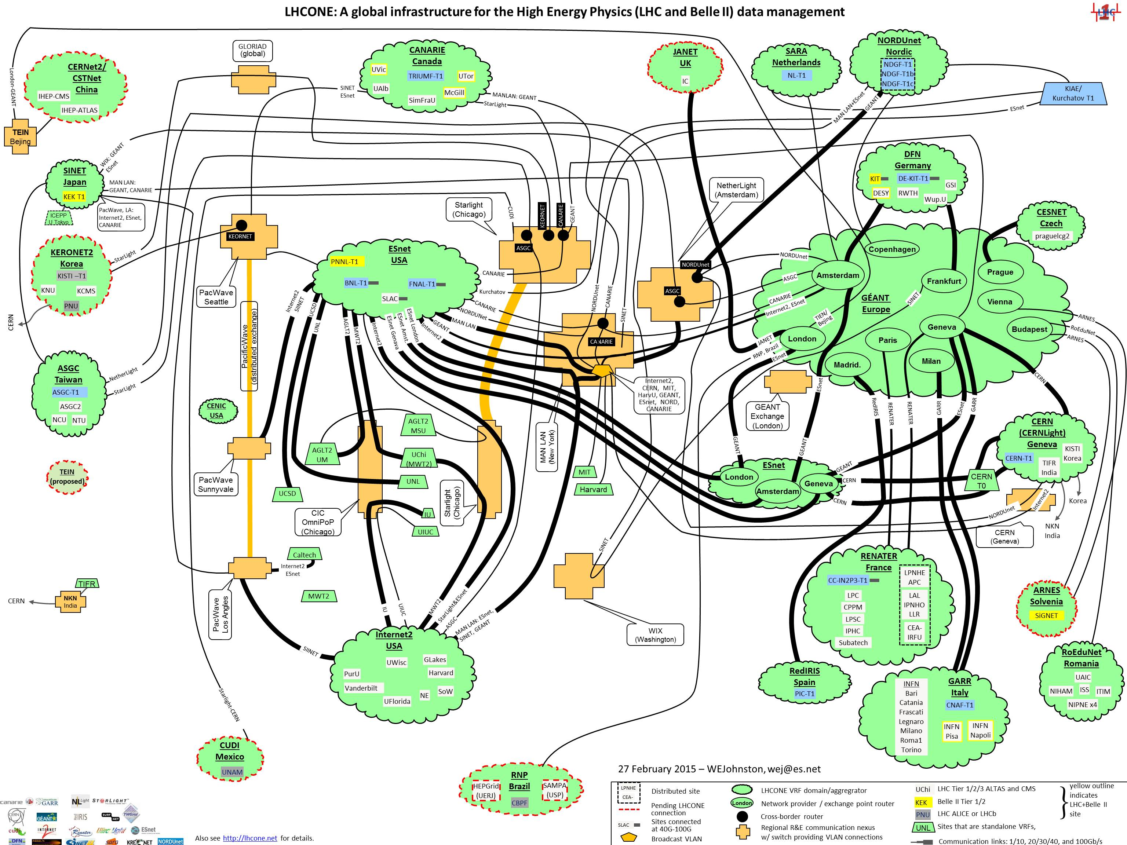

Slide 49
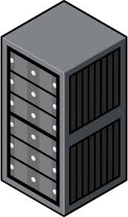

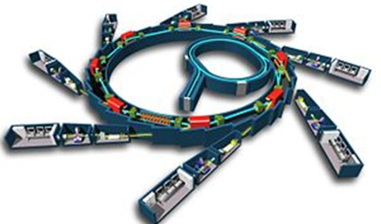
This architecture (instruments and computational resources coupled by networks) now spreading outside HEP: ‘super-facilities.’
Experimental facilities are being transformed by new detectors, advanced mathematics, robotics, automation, advanced networks.

Slide 50
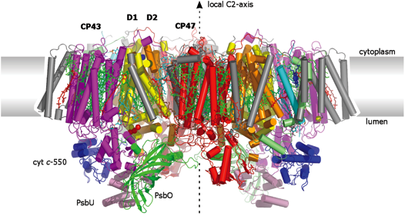


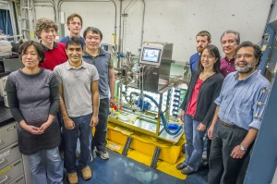
Super-facility example #1:
Researchers from Berkeley Lab and SLAC conducted protein crystallography experiments at LCLS to investigate photoexcited states of PSII, with near-real-time computational analysis at NERSC.
“Taking snapshots of photosynthetic water oxidation using femtosecond X-ray diffraction and spectroscopy,” Nature Communications 5, 4371 (9 July 2014)

Slide 51
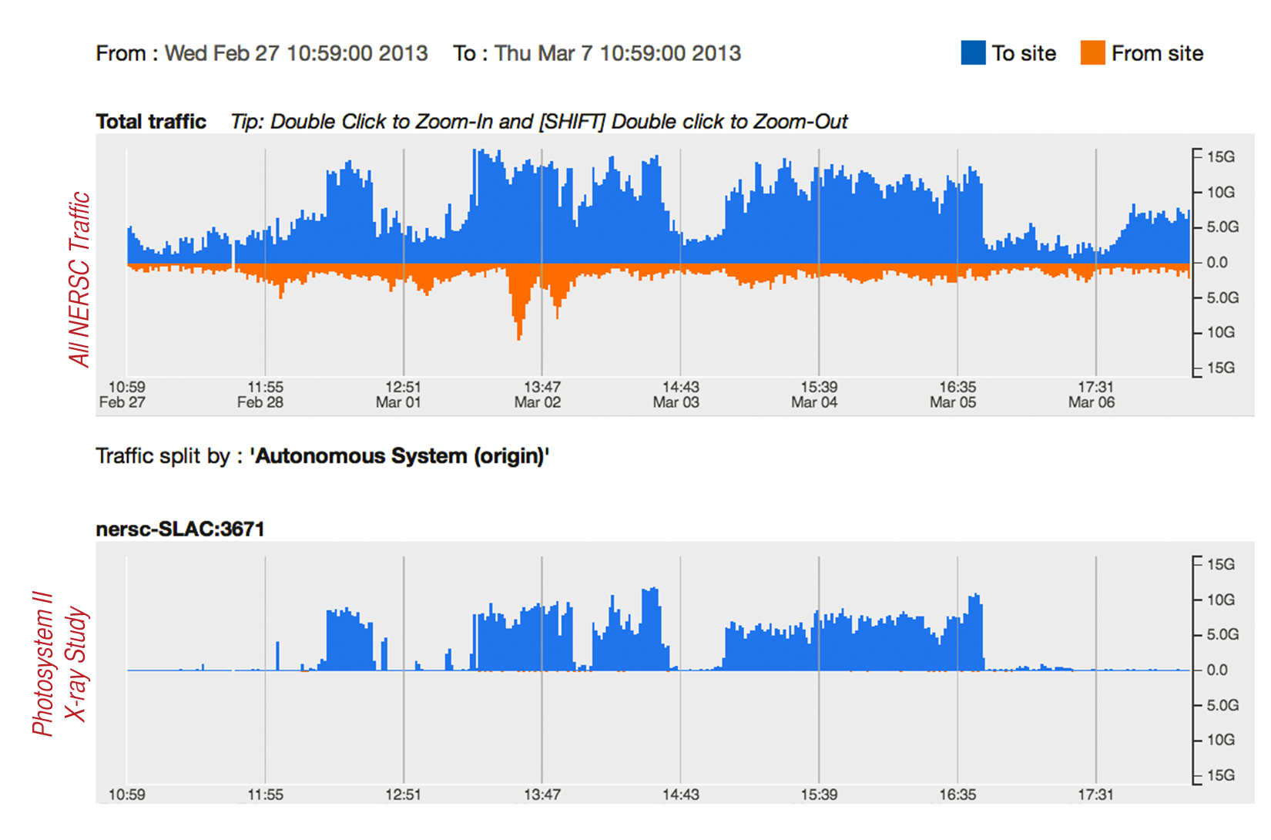
Data flow from single LCLS detector tripled network utilization for major HPC center.

Slide 52



Super-facility example #2:
Real-time analysis of ‘slot-die’ technique for printing organic photovoltaics, using ALS + NERSC (SPOT Suite for reduction, remeshing, analysis) + OLCF (HipGISAXS running on Titan w/ 8000 GPUs).
1
2
http://www.es.net/news-and-publications/esnet-news/2015/esnet-paves-way-for-hpc-superfacility-real-time-beamline-experiments/
Results presented at March 2015 meeting of American Physical Society by Alex Hexemer.
Additional DOE contributions: GLOBUS (ANL), CAMERA (Berkeley Lab)

Slide 53
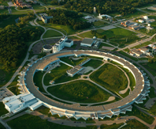
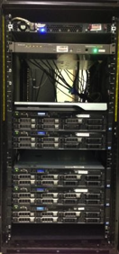
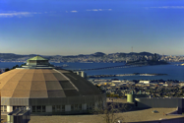
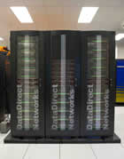
Super-facility-on-demand demo at NSF GENI conference
ESnet, Internet2
ESnet
SPADE instance -
server at Argonne
ExoGENI SPADE VM @
Starlight, Chicago
ExoGENI SPADE VM @
Oakland, California
fictional - but realistic - workflow
dedicated systems for data transfer and network circuits created programmatically
future vision: application declares intention for super-facility, network responds
“Science DMZ as a service”
Data from ALS
beamline
Compute Cluster
NERSC, LBL
In collaboration with Ilya Baldine and his team from RENCI and Craig Tull and his team from CRD. http://portal.nersc.gov/project/als/sc14/

