Slide 1


  LHCONE Point2Point Service ‘BGP solution’
From the Netherlands: Freek Dijkstra, Sander Boele,
Hans Trompert and Gerben van Malenstein
LHCOPN - LHCONE meeting at LBL - June 2, 2015 – Berkeley, CA, USA

Slide 2
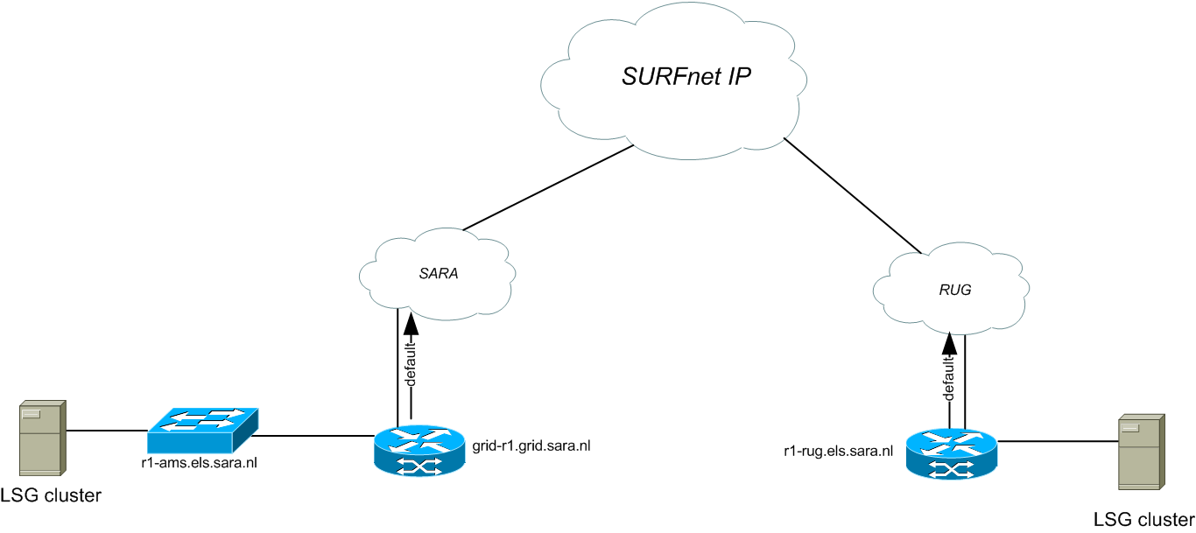
Earlier experience by SURFsara
Life Science Grid (NL, 2011)
Regular IP connectivity between two sites

Slide 3
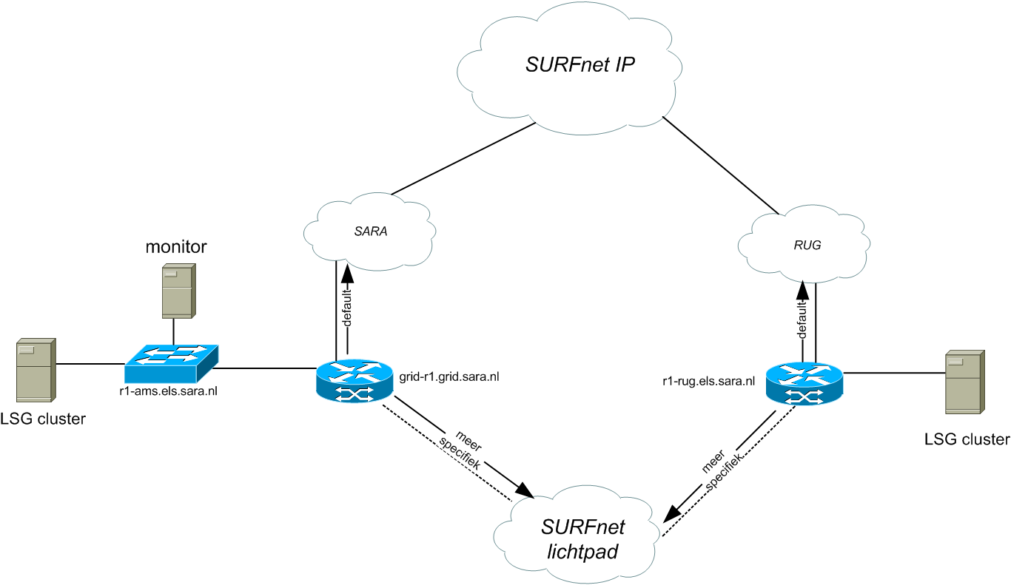
Earlier experience by SURFsara
Life Science Grid (NL, 2011)
Automatically (scripted) routing traffic into dynamic circuit

Slide 4
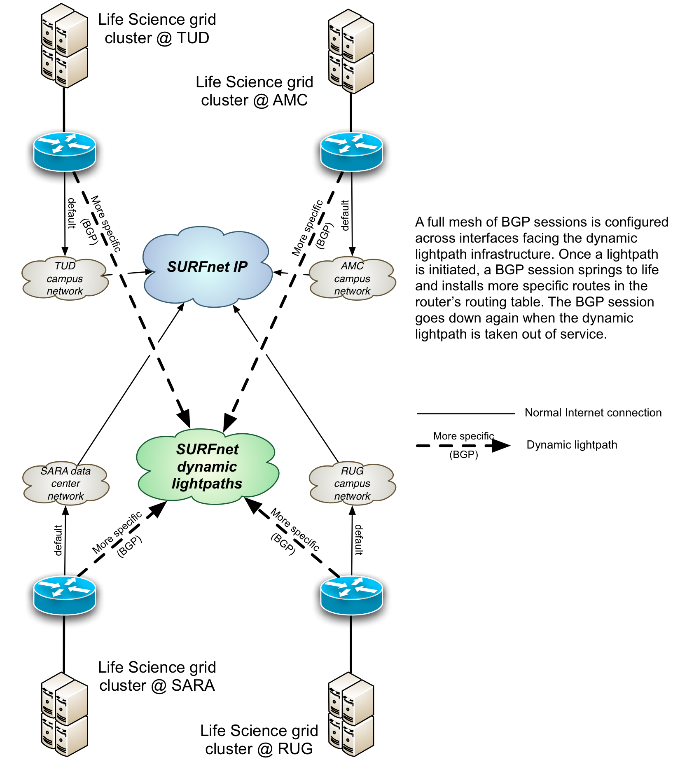
NL, 2011

Slide 5
Scenario and result 2015
LHCONE Point2Point Service
Exchanging production traffic between Brookhaven National Laboratory (US) and SURFsara (NL) via a dynamic layer 2 path while using BGP to put traffic into the path.
Test was executed last week of May 2015, successfully, since production traffic was routed over the created dynamic path.

Slide 6
LHCONE P2P Experiment (BNL – SURFSara)
(Test Setup May 2015)
BNL (AS43)
SURFSara (AS1162)
BGP (AS43) Route
Announcements:
130.199.48.0/23
130.199.185.0/24
192.12.15.0/24
BGP (AS1162) Route
Announcements:
145.100.17.0/28
145.100.32.0/22
194.171.96.128/25
145.100.0.126/30
[VLAN 3901]
145.100.0.125/30
[VLAN 3901]
10Gbps Guaranteed Ethernet VLAN tagged multi-domain circuit between BNL and SURFSara
100G
10G
VLAN 3901
urn:ogf:network:surfnet.nl:1990:production7:96292?vlan=3901
VLAN 3901
ESnet
SURFnet
4/2/1
NSI STPID:
urn:ogf:network:es.net:2013::aofa-cr5:4_2_1:+
aofa-cr5
Asd001A_5410_03 9/10
urn:ogf:network:netherlight.net:2013:production7:esnet-1?vlan=1000-1019
Asd001A_5410_01 5/8
urn:ogf:network:surfnet.nl:1990:production7:netherlight-1?vlan=2-4094
NetherLight
NSI STPID:
urn:ogf:network:es.net:2013::amst-cr5:3_1_1:+
Asd001A_5410_03 3/6
urn:ogf:network:netherlight.net:2013:production7:surfnet-1?vlan=2-4094
VLAN 1000-1019
VLAN 1000-1019
amst-cr5
100G
10G
10G
Physical Connection:
AMST-HUB:AMST-FDP:A7/8:FRONT
Asd001A_8700_07 5/12
Physical Connection:
SURFNET:S145-ODF18/38:Asd001A_8700_07:10/2

Slide 7
BNL–SURFsara: SURFsara L2 details
NetherLight
SURFsara
Grid
storage
Asd001A
5410_03 intf 3/4
rt-core-2
grid-r1
ODF 18 port 41 S145/N17
perfSONAR
VLAN 3901
(4 Gb/s dedicated)
in 10 Gb/s MSP
VLAN 3901 is forwarded on layer 2
VLAN 3901
in 30 Gb/s trunk
NL-T1 (routing VRF)
Grid
storage
NIKHEF

Slide 8
BNL–SURFsara: Layer 3 details
BNL
(AS 43)
SURFsara
(AS 1162)
Grid
storage
145.100.0.126/30
145.100.0.125/30
perfSONAR
130.199.48.0/23
130.199.185.0/24
192.12.15.0/24
145.100.32.0/22 = grid-storage-cluster
145.100.17.0/28 = perfSONAR-lhcopn-lan
194.171.96.128/25 = NIKHEF-NL-T1-grid
NIKHEF
Grid
storage
IPv6 for some inexplicable reason ignored... again

Slide 9
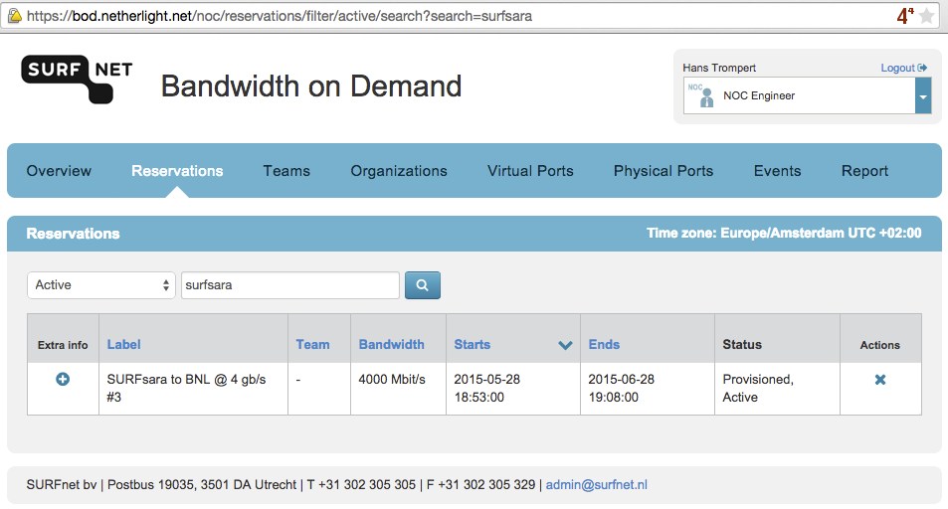
Dynamic circuit created

Slide 10
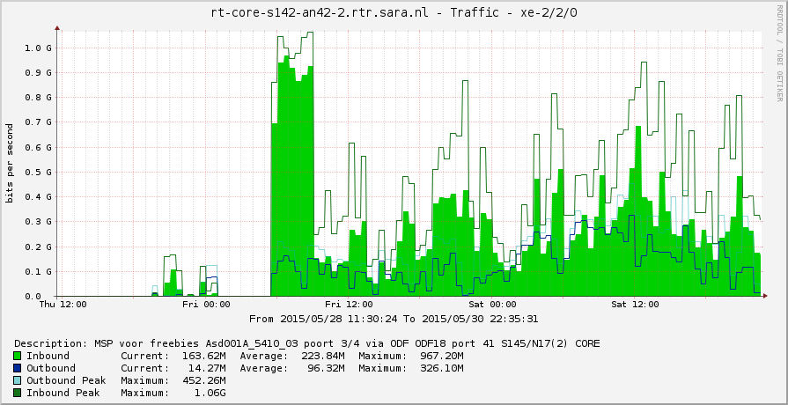
Traffic
~ 200M steady over dynamic circuit
Most traffic from BNL to SURFsara, while expected opposite

Slide 11
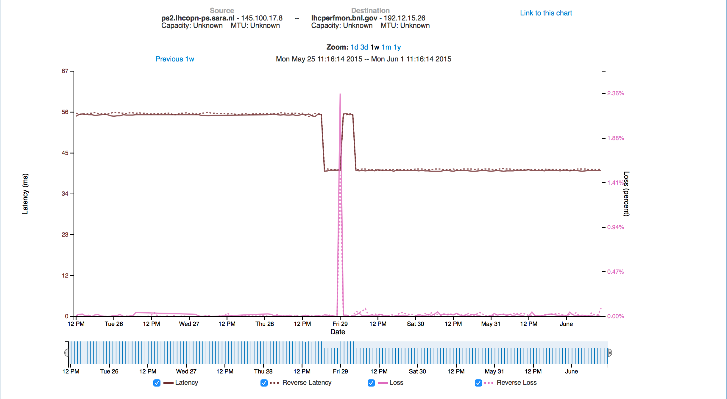
perfSONAR

Slide 12
How does BGP scale?
The BNL-SURFsara BGP session in this scenario is essentially just a direct BGP peering over a circuit.
  A regular IP peering has larger latency between the two peers.
  The dynamic circuit (and thus its BGP session) may be down for prolonged periods of time for dynamic circuits.
Technically, BGP scales for hundreds of peers
Manual maintenance only scales for up to 10-20 peers
  After that, it becomes tedious, and one likes to make preset-agreements on e.g. BGP peering IP addresses.

Slide 13
How does BGP scale?
Internet Exchanges have faced the same scaling issues, and found solutions like route servers. This can't be used without any changes in this scenario, since route servers assume that all routers are in the same VLAN.
The big advantages of circuits is that there is no fixed central infrastructure (like LHCONE), and traffic engineering (e.g. avoiding TCP congestion control to kick in) is easier.
Scalability falls between:
  LHCONE: does not need configuration templates, config once
  (Dynamic) Circuits: needs configuration templates after >10-20 sites connected (BGP sessions)
  OpenFlow: always needs automated scripts to configure, even for a few flows

Slide 14
Discussion
To what extend does BGP scale when using dynamic circuits?
How to scale this scenario to partial mesh (including route server)?

