Slide 1
Parameters and tolerances for aperture margin evaluation at injection
R. Bruce, M. Giovannozzi, V. Kain, S. Redaelli,
R. Tomas, F. Velotti, J. Wenninger
Acknowledgement: P. Baudrenghien, R. de Maria, M. Fiascaris
R. Bruce, 2015.03.03
Notes:
1
1
21:02

Slide 2
Outline
Introduction
Updated tolerances
Updated criterion for allowed aperture
Summary

Slide 3
Introduction
Available aperture in experimental insertions defines reach in β*
Aperture calculations traditionally carried out with n1 model, including different tolerances
Aperture measurements and beam measurements (orbit, optics,...) in running machine allows to refine tolerances
  Done last year for collision (CERN-ACC-2014-0044)

Slide 4
Injection calculation
Injection aperture also to be evaluated for LHC and HL-LHC
Applications:
  Global aperture: Calculation to be used to determine whether an optics (globally) gives enough aperture margin
  Injection at smaller β*: Updated aperture calculations to be used to determine triplet aperture and β* for injection – similar calculation as in collision
To update calculation parameters, need
  Updated error tolerances
  Updated criterion of allowed aperture

Slide 5
Previous parameters
During design, used same parameters at injection and collision except closed orbit and momentum offset
Criterion: n1≥7
Parameter | Unit | Design value @ injection | Design value @ collision
Primary halo | σ | 6.0 | 6.0
Sec. halo, H/V | σ | 7.3 | 7.3
Sec. halo, R | σ | 8.4 | 8.4
Normalized emittance | μm | 3.75 | 3.75
Closed orbit | mm | 4.0 | 3.0
Momentum offset | - | 1.5e-3 | 8.6e-4
β-beat (beam size) | - | 1.1 | 1.1
Parasitic dispersion | - | 0.27 | 0.27

Slide 6
Outline
Introduction: need for update of parameters
Updated tolerances
Updated criterion for allowed aperture
Summary

Slide 7
Updated error tolerances
Discussions with various experts based on Run 1 experience and expectations for HL-LHC
Concerned parameters:
  Halo shape
  Emittance : only overall scaling factor as long as other constraints (impedance, machine protection margins) limit the collimator settings
  Optics (β-beat, parasitic dispersion)
  Orbit
  Momentum offset

Slide 8
Halo and emittance
Old halo definition: Very rough assumption of secondary halo without tail, not accounting for tertiary halo - not adequate for the modeling of the real cleaning bottlenecks in the DS
Proposal: use round halo={6,6,6} so that the calculation gives the aperture and not n1
  As done for collision
Emittance: overall scaling factor in aperture calculation. Either
  keep present design emittance of 3.5 µm => Easy comparison with present machine (done so far for HL-LHC collimation), or
  Use the HL-LHC design emittance of 2.5 µm => Consistency within HL-LHC
  (all collimator settings in sigma would then need to be rescaled)

Slide 9
Optics
Philosophy to base parameters for future machines on what has been achieved so far in the LHC. Include any expected worsening on top
Run 1: achieved about 10% beta-beat and 14% spurious dispersion at injection.
  Reduced to half of the design parameters!
Similar philosophy used at collision: better beta-beat than nominal achieved, but correction expected to be worse for HL due to high β-functions in the arcs
    Kept design parameter of 20%
  Proposal: 10% beta-beat (bbeat=1.05) and 14% spurious dispersion

Slide 10
Orbit
So far used 4 mm closed orbit tolerance
Could be decreased to 2 mm, but need to add 1.75 mm for injection oscillations
  Closed orbit tolerance could be decreased to 1 mm but at the expense of availability
  (need of immediate corrector repair if not all available)
  transfer line re-steering needed above 1.75 mm
  Proposal: Keep 4 mm orbit tolerance

Slide 11
Dp/p
Dp at collision decreased from 8.6e-4 to 2e-4 : no chromaticity measurements with full beam
  Using 3 twiss evaluations for +δ, -δ, 0 and taking the minimum
For injection (previously: dp was set to 1.5e-3):
  Also no chromaticity measurements – do not need full bucket height
  Take 1 σ momentum spread ≈ 4e-4
  Add 2e-4 for energy oscillations
Proposal: Decrease dp/p to 6e-4

Slide 12
Summary of parameters
Parameter | Unit | New value @ injection
Primary halo | σ | 6.0
Sec. halo, H/V | σ | 6.0
Sec. halo, R | σ | 6.0
Normalized emittance | μm | 3.5 (2.5?)
Closed orbit | mm | 4.0
Momentum offset | - | 6e-4
β-beat (beam size) | - | 1.05
Parasitic dispersion | - | 0.14

Slide 13
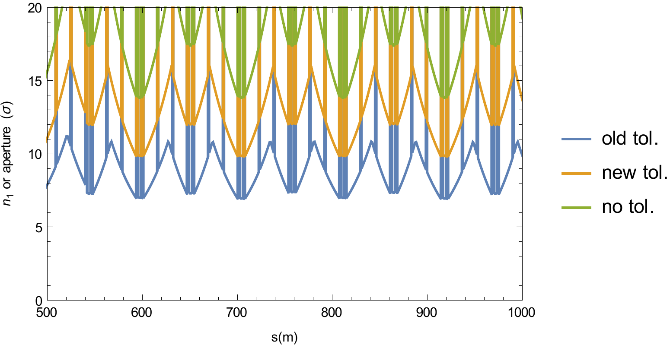
Example comparison of obtained apertures
Example: 500m of the arc

Slide 14
Outline
Introduction: need for update of parameters
Updated tolerances
Updated criterion for allowed aperture
Summary

Slide 15
Estimating allowed aperture
Aperture must be protected by collimation system during all relevant loss scenarios
In the past, considered only halo cleaning in n1 model
At top energy, potential damage during asynchronous dumps was driving the allowed aperture
At injection: evaluate minimum allowed aperture for different loss scenarios, and take the maximum
  Asynchronous beam dumps
  Injection failure (talk F. Velotti)
  Halo cleaning

Slide 16
Asynchronous beam dump
Single-module pre-fire simulated with SixTrack at injection with full collimation system in place
25 ns bunch structure, each bunch in train simulated
Assuming 3.5 um emittance, 7 TeV: worse case than 2.5 um
Standard nominal collimator settings for injection
Studying several different cases: HL-LHC B1 &B2, nominal LHC, using a perfect Gaussian and measured tails, error on TCDQ retraction
Example illustration on next slide
  bunch-by-bunch distribution of normalized betatron amplitude of particles escaping dump protection in IR6 for HL B1 with perfect Gaussian

Slide 17
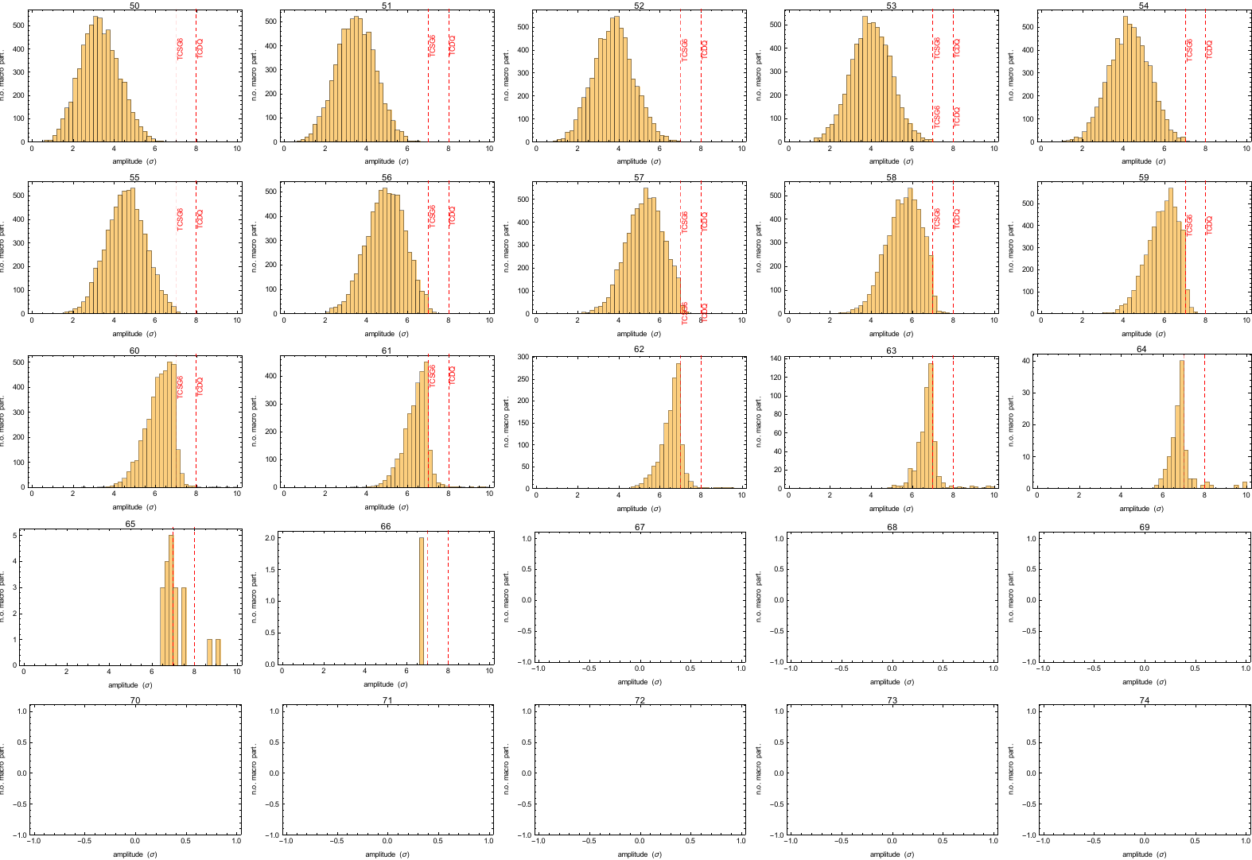
Escaping population bunch by bunch

Slide 18
Quantifying allowed aperture
Idea:
  Study distribution of escaping betatron amplitudes out of IR6, summed over all bunches
  Study as survival function: Integrate escaping population from N σ to infinity. This is the maximum number of impacting protons that is possible at an aperture at level N
    This is a pessimistic estimate – most likely the losses will be distributed
  Normalize to HL bunch population of 2.2e11 p/bunch
  Compare with damage level used for setup beam flag
  If integrated population is below, the aperture is allowed

Slide 19
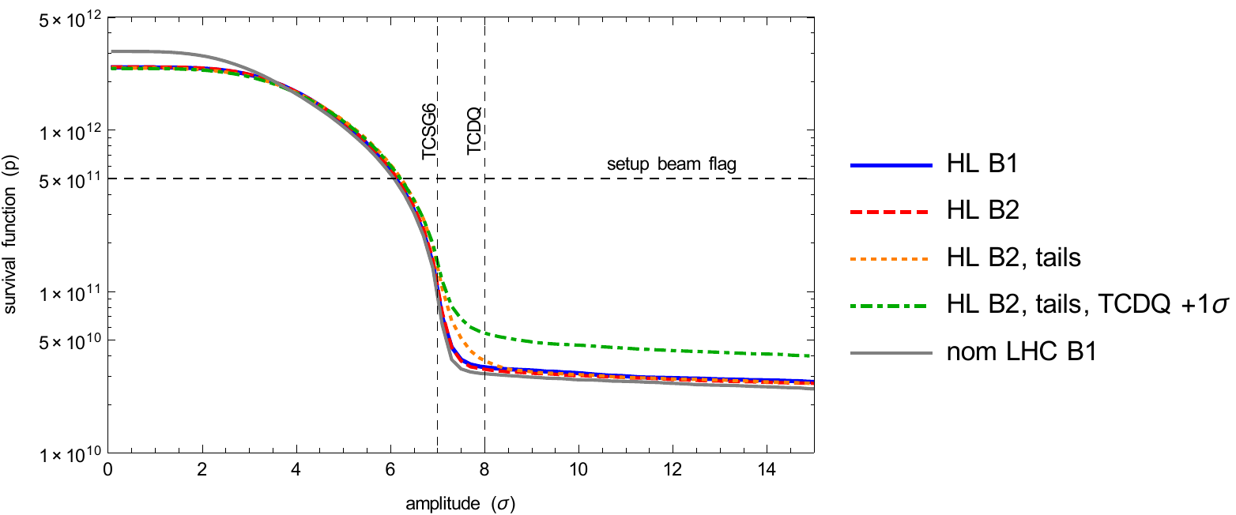
Integrated population above given aperture cut
Survival function equals setup beam flag at ≤6.5σ for all studied cases
Differences between cases seen mainly in the tail

Slide 20
Adding errors
Could thus allow ~6.5 σ aperture with perfect IR6. Should on top account for imperfections
Orbit drifts at the dump protection=> TCSG/TCDQ could be at a larger effective setting than simulated:
  Use 3.5 mm as worst case: it is the allowed excursion by the BPMS interlock. Translates to about 1.8 σ for all studies optics
Account for additional errors:
  10% β-beat => 0.4 σ
  Setup and positioning errors negligible at injection (<0.03σ)
Conclusion: accounting for imperfections, allowed aperture for asynch. dump goes to ~8.7 σ. Round to 9 σ => additional safety

Slide 21
Calculation principle to qualify aperture
Calculate worst-case aperture from imperfections (locally) with updated parameters in MAD from previous slides
Compare with max amplitude of dangerous beam escaping IR6, including local imperfections there to say if OK or not
Aperture (σ)
Cold aperture (perfect)
(local imperfect.)
TCDQ
Escaping beam (imperf.)
Mis-kicked Beam
TCSG
Escaping beam (perf. IR6)
Dangerous beam
can extend to 9 σ
In worst case

Slide 22
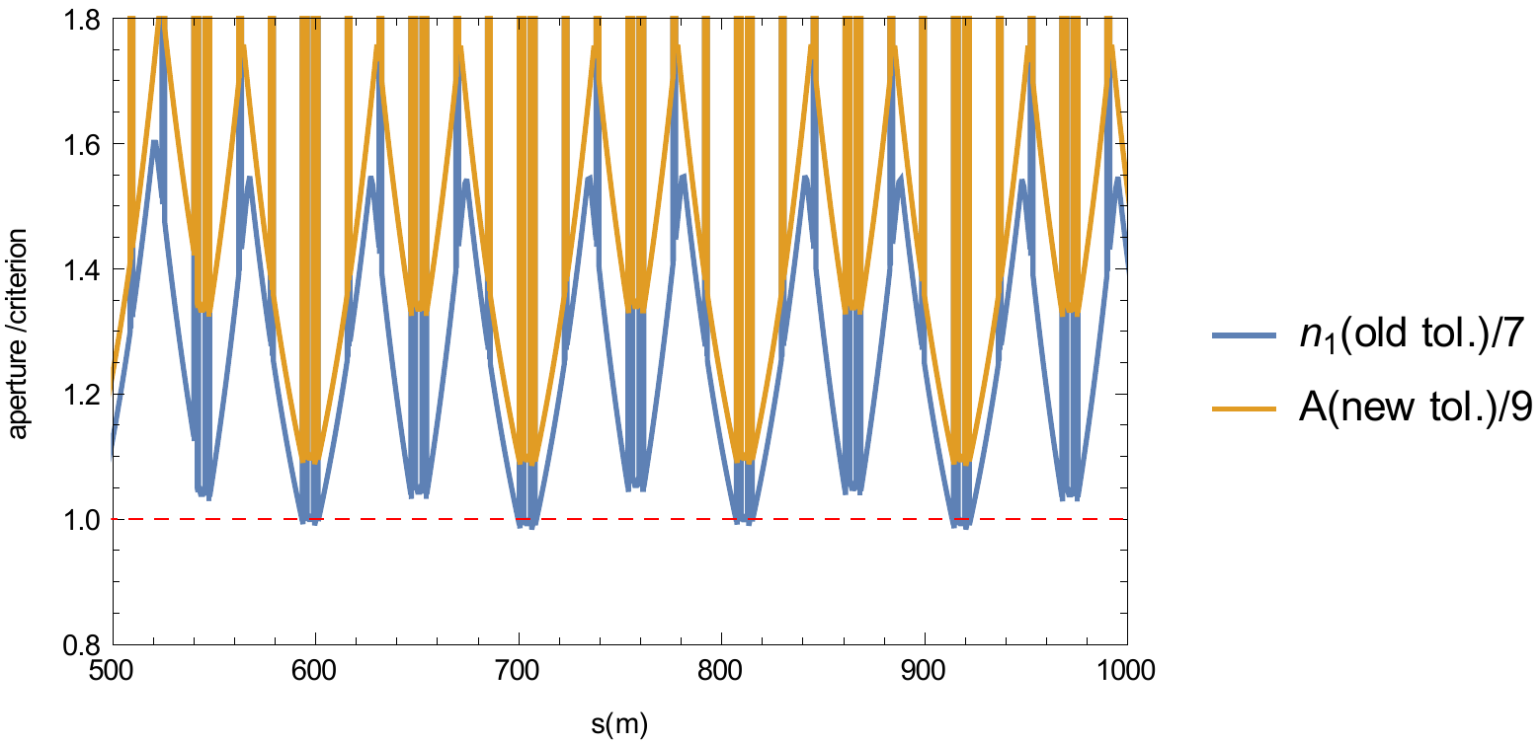
Comparison: old n1 vs new aperture calculation
Comparing ratio of obtained aperture (or n1) to the criterion

Slide 23
Cleaning
Pessimistic estimate : Look at outgoing halo population downstream of IR7 simulated with SixTrack without aperture
  Sum halo over 200 turns: Assuming a constant loss rate, this is the convolution of the losses from previous turns. Gives the instantaneous halo population at any given moment. Assume this can be lost per turn – very pessimistic!
  Re-normalize to loss rate during lifetime drop to 12 minutes (collimation design criterion)
Integrate halo population from any given aperture cut X to infinity: an aperture at X σ cannot intercept a higher loss rate
  In reality, losses are distributed: not all lost on one bottleneck
  Compare with pessimistic design quench limit – real quench limit is higher!

Slide 24
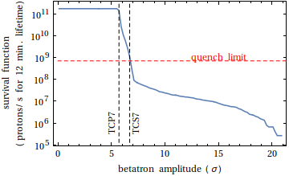
Survival function for cleaning
Similar to cleaning inefficiency curves studied in the past
IR7 secondary collimators give limit around 6.7 σ

Slide 25
Cleaning constraints
Extremely pessimistic assumptions: losing on every turn the whole integrated instantaneous halo at given bottleneck
Not straightforward to include imperfections
  almost impossible that all TCSGs are simultaneously misaligned
  Could nevertheless increase a bit the halo population by order of factor ~2 (peak DS losses in previous SixTrack studies with imperfections)
However, very steep curve => almost impossible that limit goes as high as 9 σ
  Cleaning is less critical than asynch. dumps
In the future: look at 2D halo distribution in betatron amplitude and energy offset
Similar studies ongoing for FCC (M. Fiascaris)

Slide 26
Summary
New tolerances for aperture calculations at injection estimated based on Run 1 experience and expectations for the future
Criterion for allowed aperture: studying several loss scenarios, and taking the most critical one
  Asynch. dumps more critical than cleaning: allowed aperture of 9 σ
  Still to be compared with injection failure: see talk F. Velotti
  As for the case of the top-energy triplet aperture, the allowed value depends on the collimator settings
The presented criterion is valid for all apertures in the ring but pessimistic.
  If the injection aperture limits performance, could consider local collimation studies to qualify smaller apertures at specific locations
  (as done for triplets with squeezed optics)

Slide 27
Summary of parameters
Parameter | Unit | Design value @ injection | Design value @ collision | New value @ injection | New value @ collision
Primary halo | σ | 6.0 | 6.0 | 6.0 | 6.0
Sec. halo, H/V | σ | 7.3 | 7.3 | 6.0 | 6.0
Sec. halo, R | σ | 8.4 | 8.4 | 6.0 | 6.0
Normalized emittance | μm | 3.75 | 3.75 | 3.5 (2.5?) | 3.5 (2.5?)
Closed orbit | mm | 4.0 | 3.0 | 4.0 | 2.0
Momentum offset | - | 1.5e-3 | 8.6e-4 | 6e-4 | 2e-4
β-beat (beam size) | - | 1.1 | 1.1 | 1.05 | 1.1
Parasitic dispersion | - | 0.27 | 0.27 | 0.14 | 0.1
Criterion: obtained aperture should be > 9 σ
(possibly to be updated based on requirements for injection failure)

Slide 28
Backup

Slide 29
